Slide 1
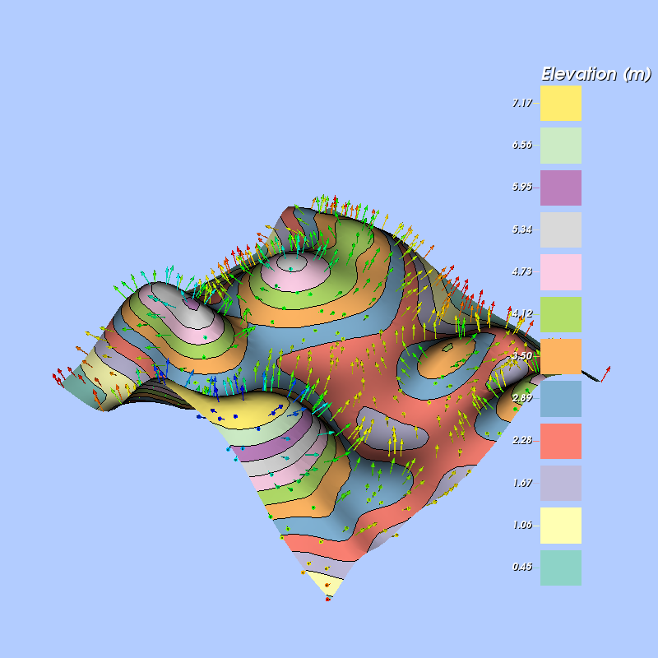
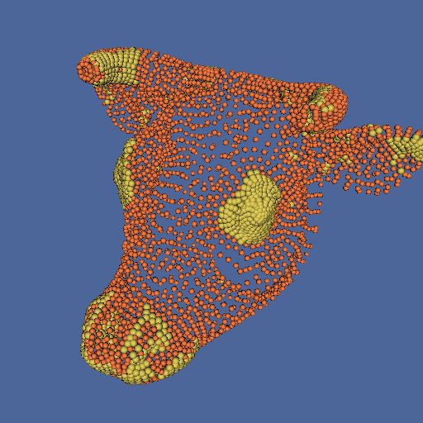
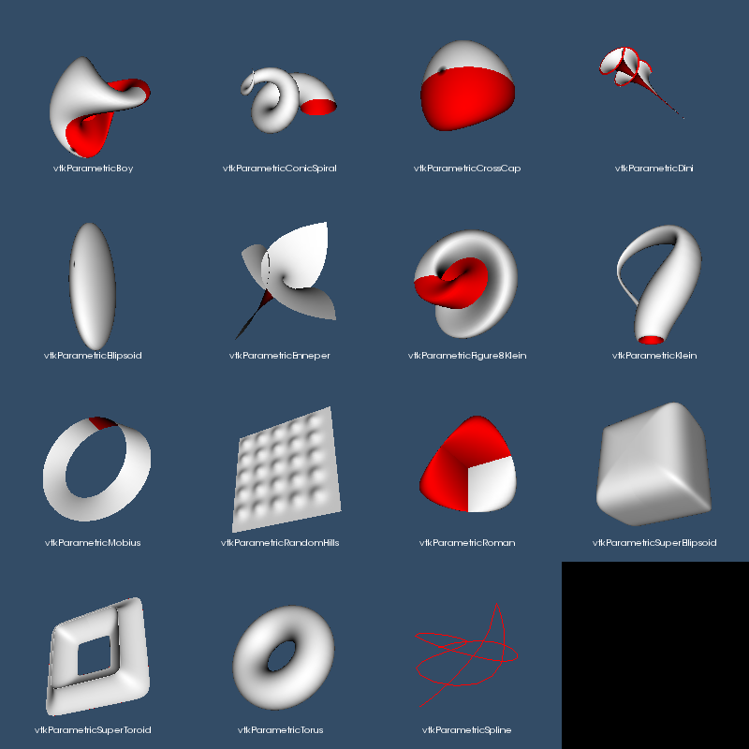
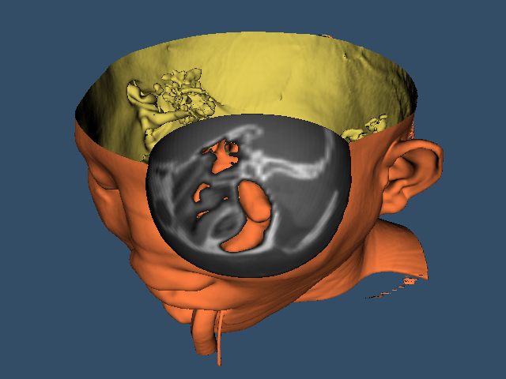
Learning Toolkits by Example
The VTK and ITK Wiki Examples
Bill Lorensen
Noware

Slide 2
Background
David Doria, a grad student at RPI, wanted to use VTK and ITK for his graduate work
David found it difficult to find examples of the toolkit classes
Most of the classes were demonstrated in toolkit tests that were meant to TEST classes not meant to show HOW to use classes.
In July 2009, David started creating VTK wiki pages that contained small self-contained examples.

Slide 3
Examples
The wiki contains the example code and a CMakeLists.txt file
The wiki is the holder of the master copy of each example
As examples are added to the wiki by the VTK community, they are automatically placed in the git repository each night, compiled and tested

Slide 4
Ways to use the examples
One example at a time
  Each C++ example page has a tar file that contains the example and CMakelists.txt file
All examples
  Download tar file of git master
  git clone
  VTK Remote module

Slide 5
Under the hood
SyncWikiToRepo.sh
A shell script that runs nightly performing the following:
Pulls updates from the example and tarball repositories
Scrapes the wiki to download each example
Adds and commits any new examples
Adds and commits any modified examples
Removes and commits any deleted examples
Commits any new or modified tarballs
Pushes the examples and tarballs to their respective git repositories

Slide 6
ScrapeWiki
The bulk of the interesting work is done by the wiki scraping program, written in python, using mwclient
Log on to the wiki
Download the wiki templates for the CmakeLists.txt files and compares them to the existing templates in the repository. If they change, the tarballs that reference them must be modified.
Get a list of all of the pages on the wiki and select those that have a prefix corresponding to an example. For instance, all VTK wiki examples have the page prefix VTK/Examples
Extract the code for the example. All wiki example code must be contained in a level 2 wiki heading: ==exampleName.cxx== and within <source></source> tags.
Create local tarballs for each example.

Slide 7
VTK Wiki Examples Today
C++ 792 files
Python 136 files
Java 12 files
C# 121 files
Tcl 3 files
Since 2009, 1852 emails on the VTK Users mailing list reference the Wiki examples.

Slide 8
Tests
A cmake script automatically creates a test in the build tree for each example.
The tests use the vtk testing object factory and the vtk test harness.
The created test looks like this:
TestBackgroundColor.cxx contains
#define main TestBackgroundColor
#include "BackgroundColor.cxx"

Slide 9
Testing
One nightly submission to the VTK dashboard
  “Expected Nightly Remote Modules”
Uses standard VTK dashboard script
set(MODULE "WikiExamples")
set(CTEST_DASHBOARD_ROOT "/home/lorensen")
set(CTEST_SITE "BillsUbuntu")
set(CTEST_BUILD_NAME "Ubuntu14-gcc-4.8.4-Release-${MODULE}")
set(CTEST_BUILD_CONFIGURATION Release)
set(CTEST_CMAKE_GENERATOR "Unix Makefiles")
set(CTEST_TEST_TIMEOUT 4000)
set(CTEST_TEST_ARGS INCLUDE_LABEL ${MODULE})
set(dashboard_model "Nightly")
set(dashboard_source_name "ProjectsGIT/Dashboards/VTK")
set(dashboard_binary_name "ProjectsGIT/Dashboards/VTK-${MODULE}")
set(dashboard_no_clean True)
set(dashboard_data_name "VTKExternalData")
set(dashboard_cache "
BUILD_SHARED_LIBS:BOOL=TRUE
BUILD_EXAMPLES:BOOL=OFF
BUILD_TESTING:BOOL=ON
VTK_DEBUG_LEAKS:BOOL=FALSE
VTK_OPENGL_HAS_OSMESA:BOOL=ON
VTK_USE_OFFSCREEN:BOOL=ON
VTK_USE_X:BOOL=OFF
VTK_RENDERING_BACKEND:STRING=OpenGL
RUN_ADMIN_TESTS:BOOL=TRUE
Module_SplineDrivenImageSlicer:BOOL=ON
Module_${MODULE}:BOOL=ON
")
include(${CTEST_SCRIPT_DIRECTORY}/vtk_common.cmake)
NOTE: set(CTEST_TEST_ARGS INCLUDE_LABEL ${MODULE}) will run only the WikiExamples tests.

Slide 10
Other Details
Examples that produce images link to the testing baseline image for the example.
<div class="floatright">[[File:VTK_Examples_Baseline_Visualization_TestBillboardTextActor3D.png]]
</div>
Nightly, any new or changed baseline images are uploaded to the Wiki
ExampleCodeToWikiPage.html updated each night. Contains a hyperlink to each example. Useful for manual maintenance

Slide 11
What's Next?
Keep the status quo
  Populate with VTK/Examples
Take a more “modern” approach?

