Slide 1
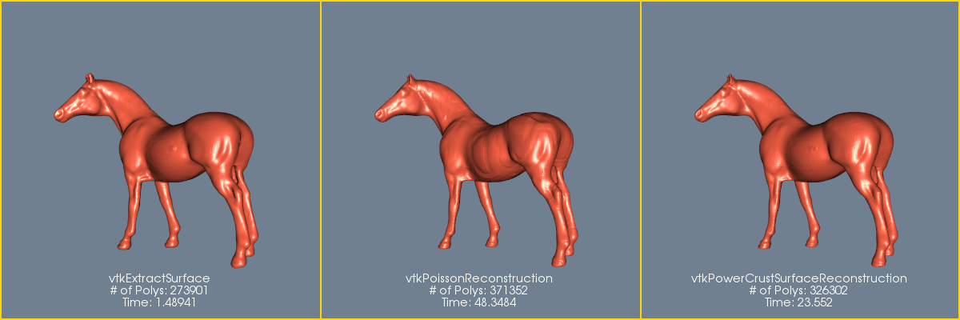
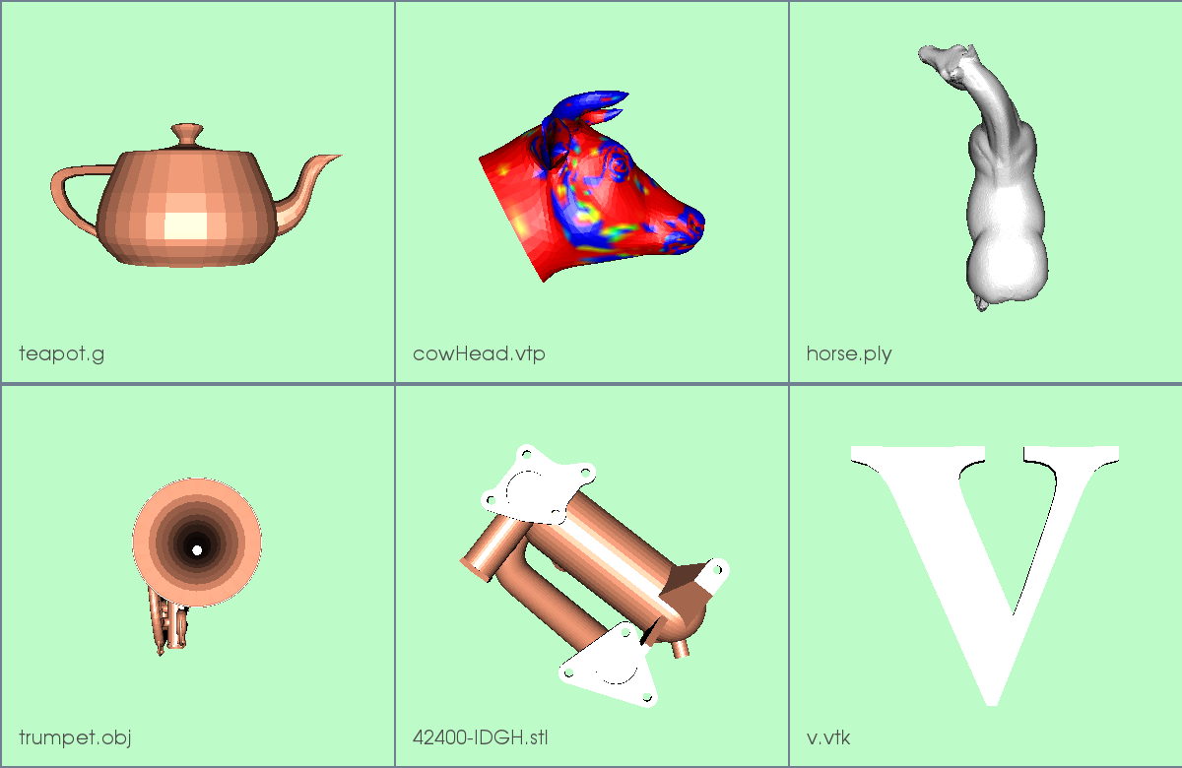
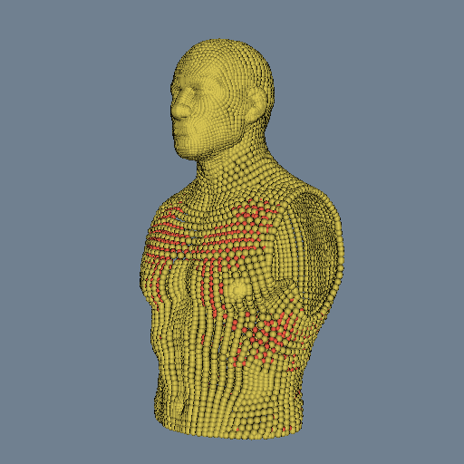
VTK Examples
Moving Forward
Bill Lorensen
Noware
"It is a bad plan that admits of no modification."
— Publilius Syrus

Slide 2
April 27 Hack-a-thon
The current WikiExamples have served us well for 8 years
But...
  Adding examples requires creating a wiki page in an archaic language
  No mechanism to push changes to the wiki
  Dated look and feel
  Not mobile friendly
But

Slide 3
The Old Guy Hates Change
"Change is the law of life and those who look only to the past or present are certain to miss the future."
— John F. Kennedy
"In times of rapid change, experience could be your worst enemy."
— J. Paul Getty

Slide 4
A Lot of Change
1966 - Machine language
1967 - IBM Assembler
1968 - Fortran
Fortran II
1978 - Fortran 4
1980 - C
1994 - C++
1996 - Java
1966 – IBM
1967 - IBM
1968 – Univac SS80
1970 – IBM MFT
1974 - PDP 11 DOS
1980 - GECOS
1994 – Vax VMS
1996 - Unix

Slide 5
There's an old saying about those who forget history. I don't remember it, but it's good.”
Stephen Colbert, The Colbert Report
March 10, 2008

Slide 6
Reuse Some Old Technology
Nightly testing
Three ways to build
  Individual example
  Git clone the repository
  VTK Remote Module
Auto tarball per example

Slide 7
VTK Examples New Technologies
Github pages replaces Media Wiki
Markdown replaces wiki language
MkDocs
  Google's Material Design look and feel
  Code hilite extension
  Admonition extension
  TOC extension
Class coverage
  Contributed by Andrew Maclean
Google custom search engine
Google Analytics

Slide 8
Old versus New
Old Way
  The wiki contains the example code and description
  The wiki holds the master copy of each example
  As examples are added to the wiki, they are automatically placed in the git repo each night, compiled and tested (no review)
New Way
  The git repo contains the example code and description
  The repo holds the master copy
  Examples are added using git merge

Slide 9
Make it easier to write examples
Developer
  Write code for example and description and push to github
  Generate a merge request
ScrapeRepo
  Auto insert example images into descriptions
  Auto insert thumbnails into language summary pages
  Auto link any vtk class references to doxygen
  Auto highlight code lines with vtk classes
Reusable snippets

Slide 10
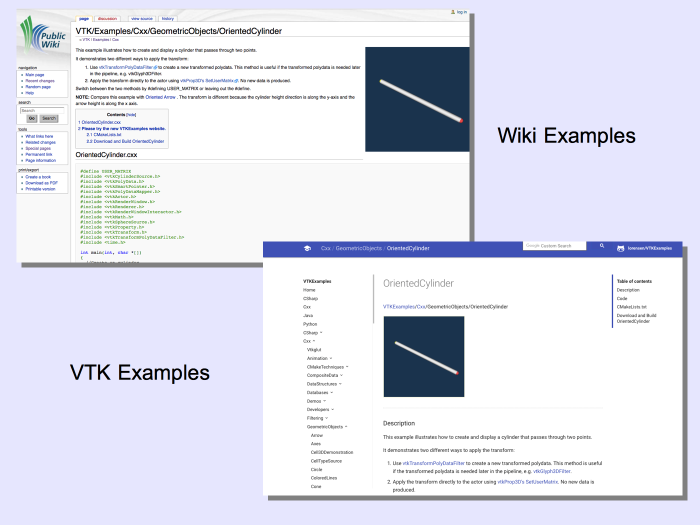

Slide 11

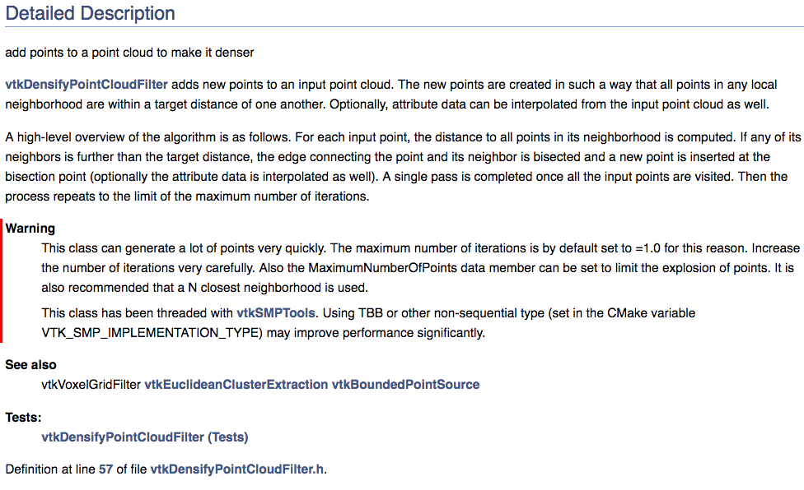
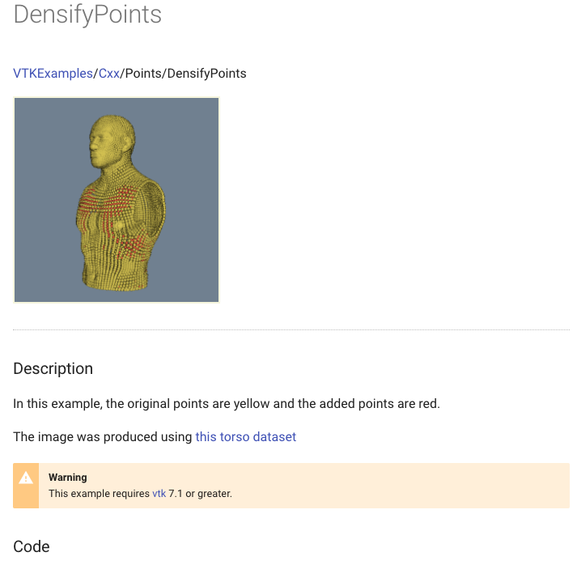
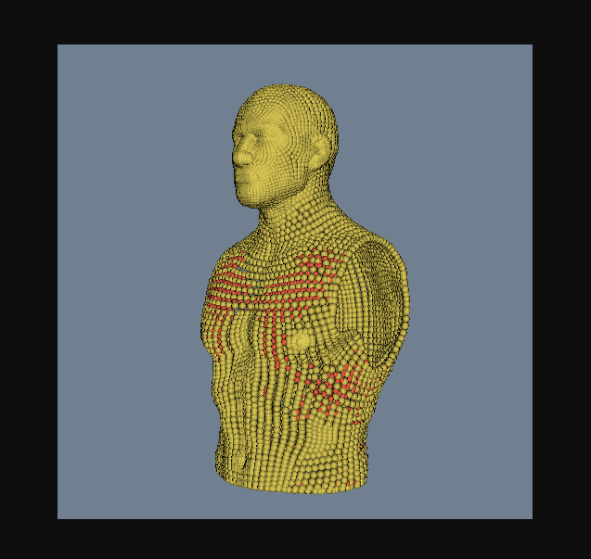
Lots of Hyperlinks

Slide 12

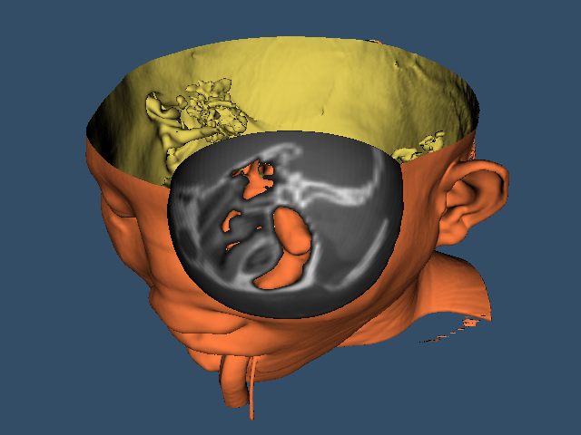

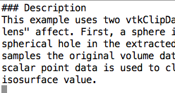
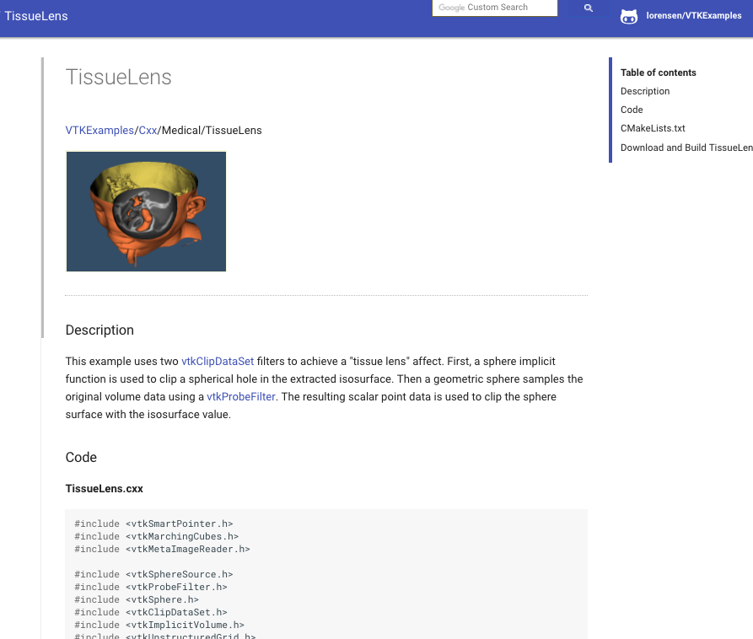
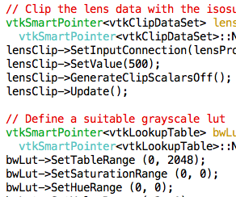
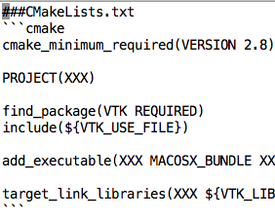
src/
.tar
.md
.png
Tarballs/
docs/
ScrapeRepo
.md
MkDocs
.html
site/
.cxx
.txt

Slide 13
Performance Improvements
Lazy image loading via javascript
  Initial implementation loaded all summary images and hit github limits
Use tiny url's for summary pages
Htmlmin reduces page sizes by ~30%

Slide 14
Adding a Summary Line
Old
|-
| [[VTK/Examples/Cxx/Medical/TissueLens|TissueLens]] || {{VTKDoxygenURL|vtkMarchingCubes}} {{VTKDoxygenURL|vtkClipDataSet}} {{VTKDoxygenURL|vtkProbeFilter}} ||Cut a volume with a sphere
New
[TissueLens](/Cxx/Medical/TissueLens) | vtkMarchingCubes vtkClipDataSet vtkProbeFilter | Cut a volume with a sphere
And... If the example has an image, you get a thumbnail for free

Slide 15
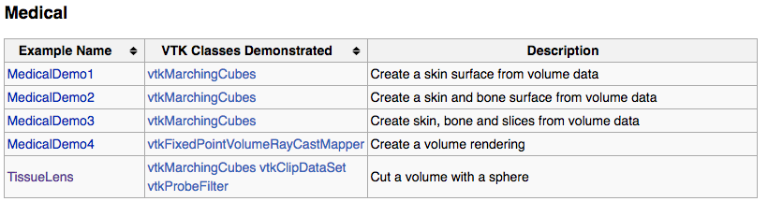
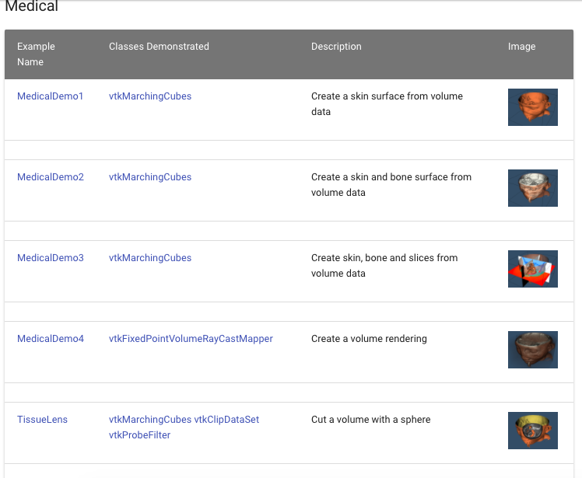
Old
New

Slide 16
VTK Examples
By the Numbers
ScrapeRepo Summary
C++ examples: 835
CSharp examples: 121
Python examples: 139
Java examples: 18
Total examples: 1113
Doxygen links added: 1229
Thumbnails added: 1075
Nightly Tests: 750

Slide 17
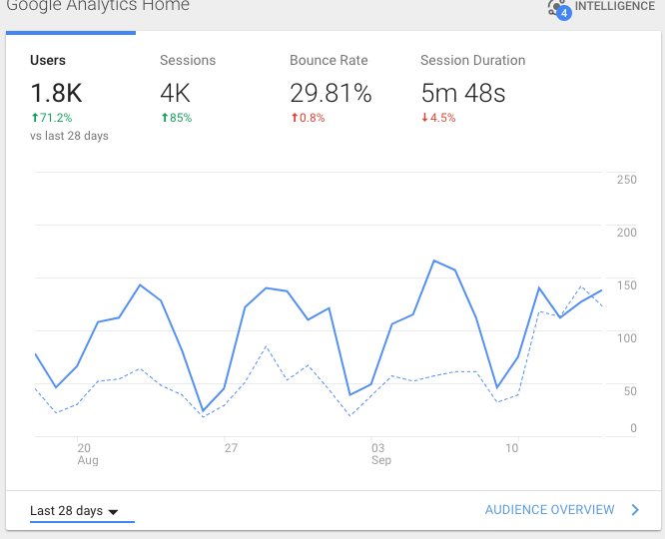
Usage

Slide 18
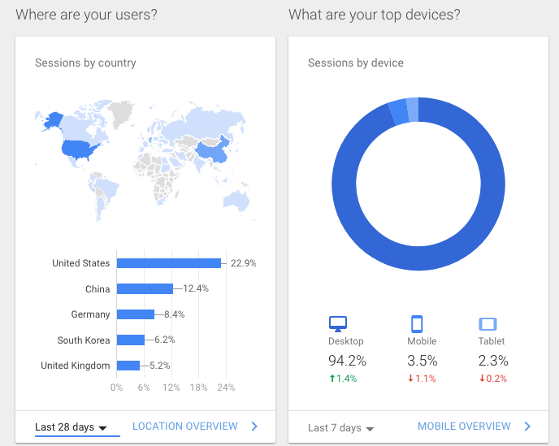

Slide 19
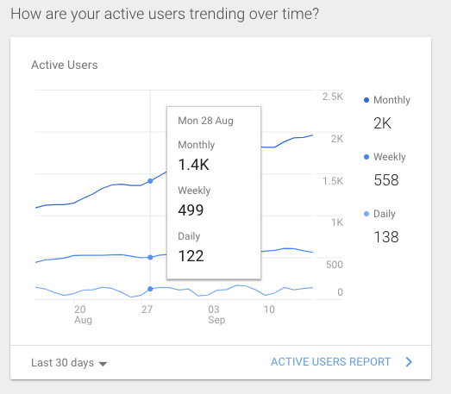

Slide 20
Issues
Google needs to discover the VTK Examples
  There are some links from the old Wiki Examples to the VTK Examples
Deprecate VTK Wiki Examples
  Redirect sto VTK Examples
Convert or retire remaining VTK/Examples
Cannot get Google Search to generate image results
Need more Administrators
  Instructions are being prepared

Slide 21
Quick Demo

