Slide 1
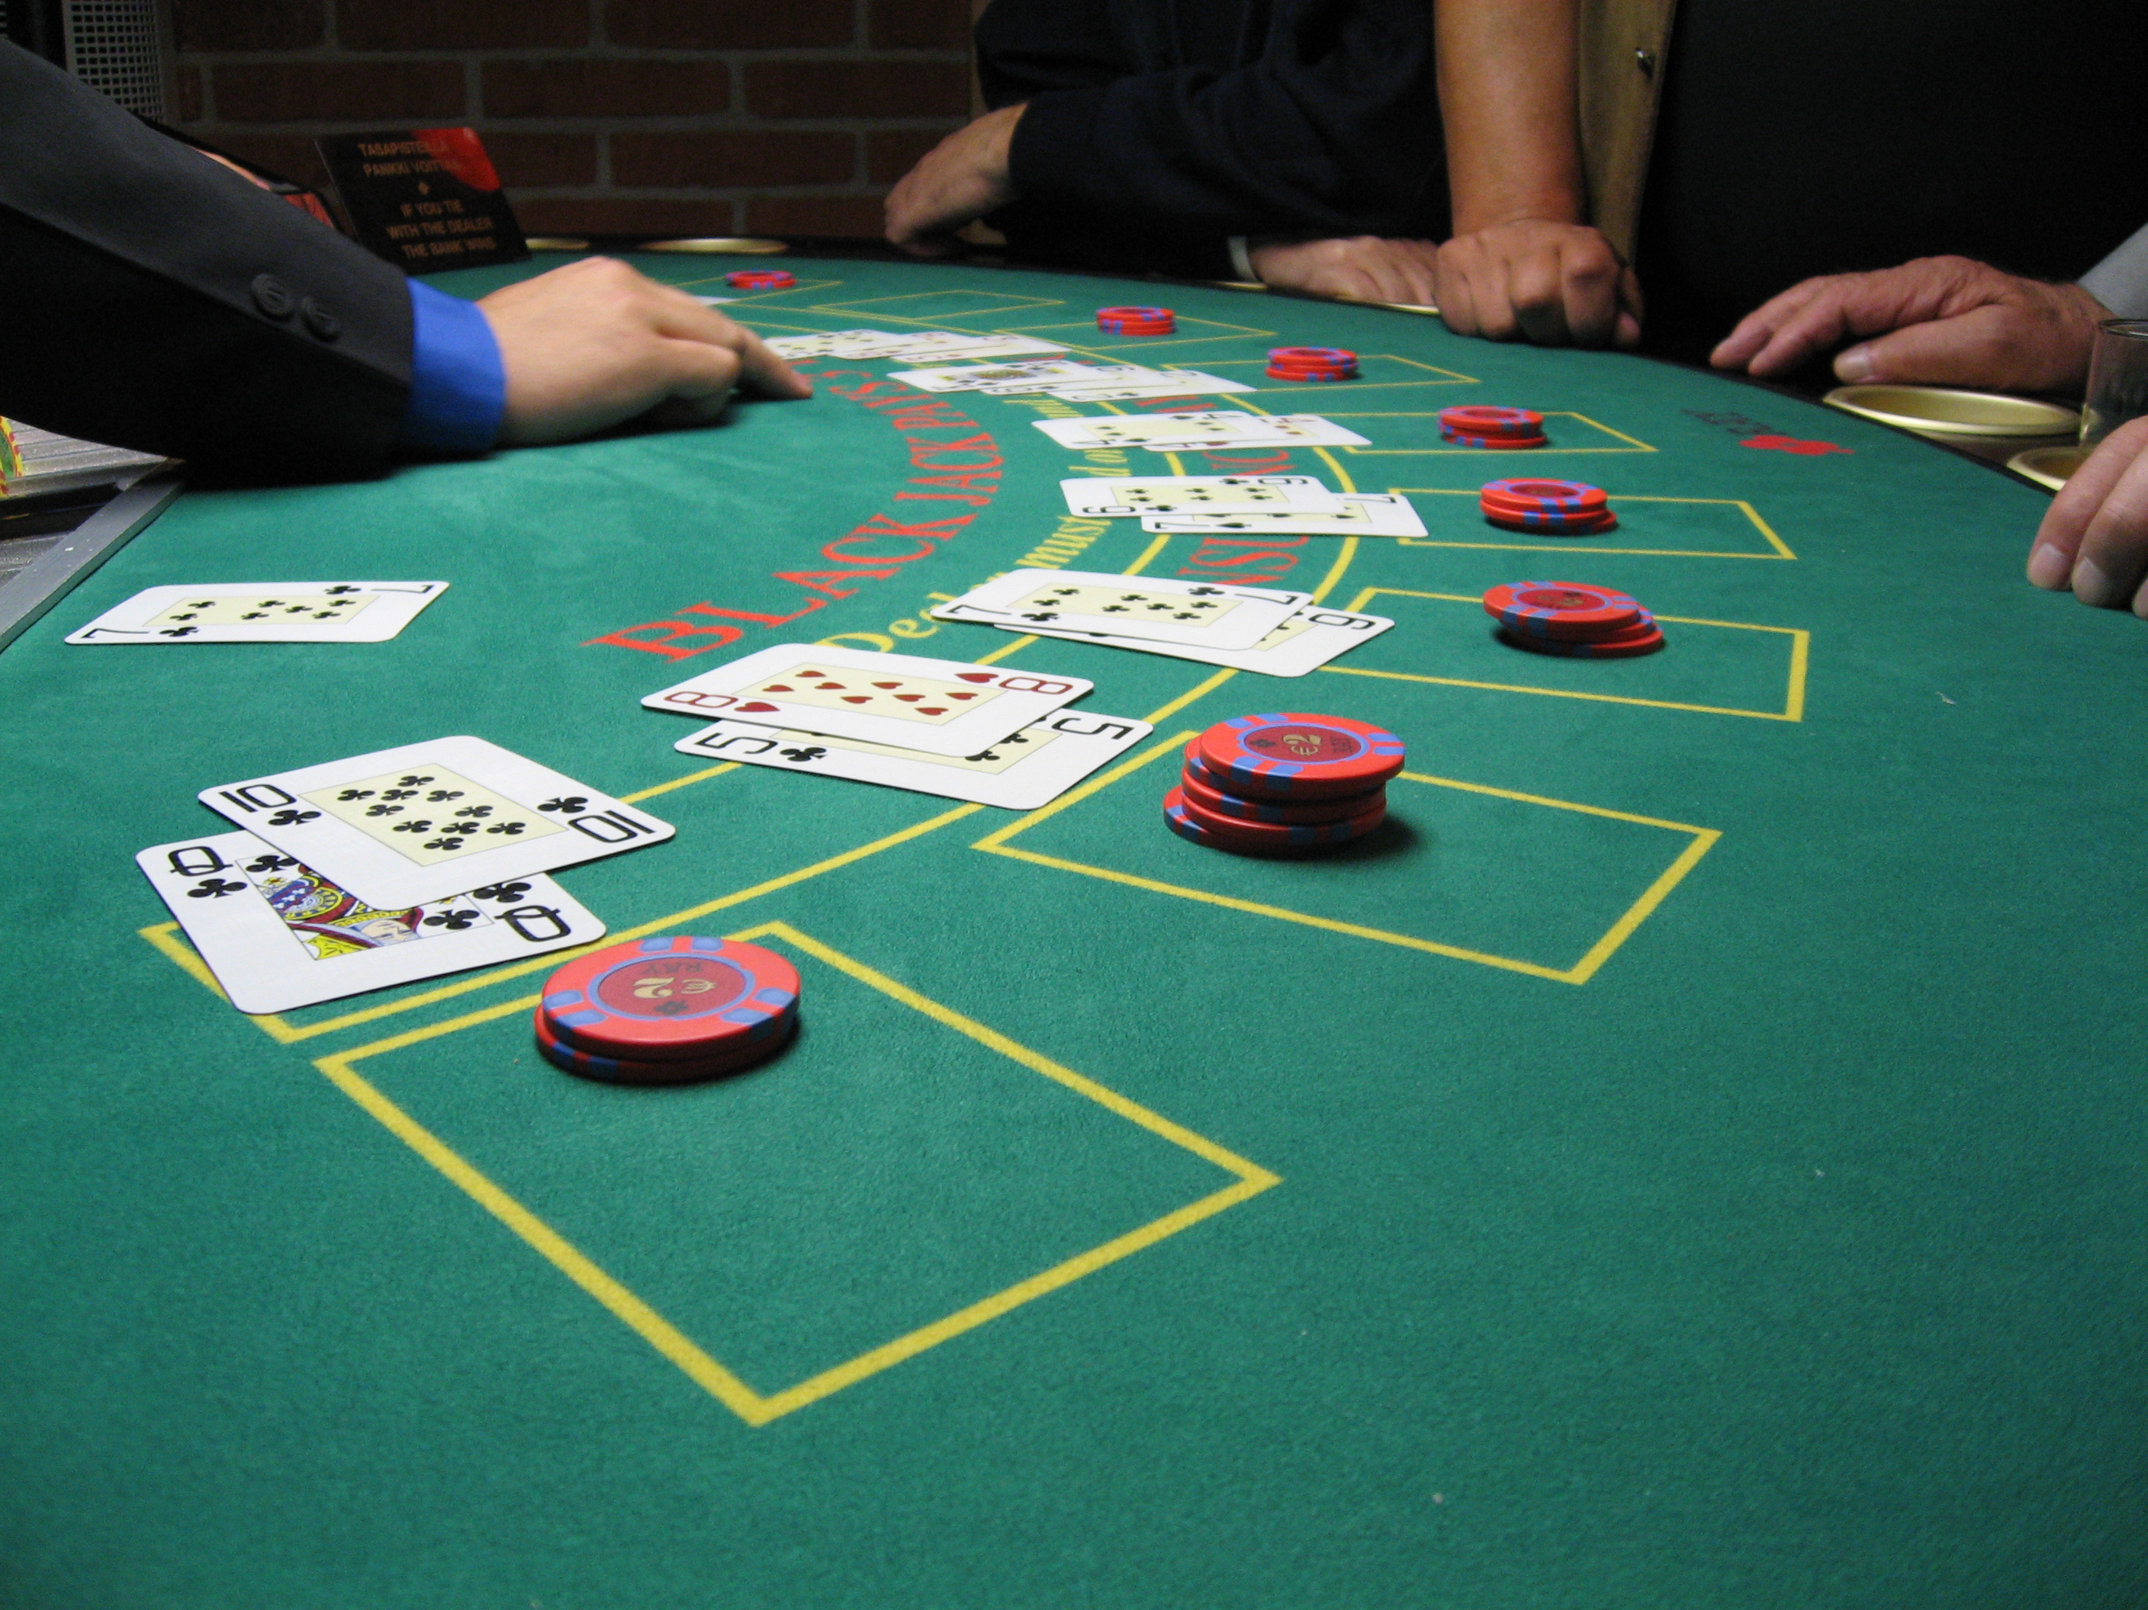
BLACKJACK
Game Starts
Game end.
Display final wallet for all players
Also known as twenty-one.
Second most popular gambling game, after Poker.
Players, by drawing cards try to score as close to 21 as they can, without surpassing it. If they do, they lose the bet. If they don’t, their final score is checked against the Dealer’s.
Each card is worth the following:
Face cards: 10.
Aces: 1 or 11 at the Player’s election.
Other cards: pip value.
The Dealer’s play is automatic, when it reaches 17 or more, it must stand.
Players win if they beat the Dealer’s score, and lose if they don’t. Ties are possible.
The most valuable hand is Blackjack: an Ace/Face pair. It beats anything except another Blackjack.
https://bicyclecards.com/how-to-play/blackjack/
Define deck and deck population
Introduce players: number, names and money of each (list and dictionary)
Yes
A new round: Players place their bets.
No
End game?
Dealer places 2 cards face up to each player. The dealer receives one faceup and one face down.
Round End. Players with no money are eliminated. Ask for a new round.
Check for Blackjacks.
Yes
Dealer Blackjack?
. Final score and payments
No
Players’ turn. Hit or stand for each.
Dealer reveals his second hand.
Turn of Dealer.

Slide 2
BLACKJACK
Incorporate side features:
Double Down: Possibility to double your bet if your initial score is 9, 10 or 11.
Splits: If your initial hand is a Pair you could Split your hand into two different hands, treating them as if they were from different players.
Insurances: If the initial card of the Dealer is a face card or an Ace, you can make a side bet to guess if it has a Blackjack. If it finally has one, you recover your bets (as an Insurance, you do not lose money).
Incorporate the Reshuffling feature (when the remaining deck has less than 70 cards, a new deck pack is shuffled and used in the following rounds.
Feature that allow players to “leave individually the table” at the end of each round.
To use functions more effectively, not just chunks of stored code. Maybe use .py files.
https://bicyclecards.com/how-to-play/blackjack/

