Slide 1
Lecture 12: Ray-tracing based rendering
DHBW, Computer Graphics
Lovro Bosnar
8.3.2023.

Slide 2
Syllabus
3D scene
  Object
  Camera
  Light
Rendering
  Ray-tracing based rendering
  Rasterization-based rendering
Image and display
Ray-tracing based rendering
  Overview
  Camera rays
  Intersections (visibility)
  Shading
  Light transport

Slide 3
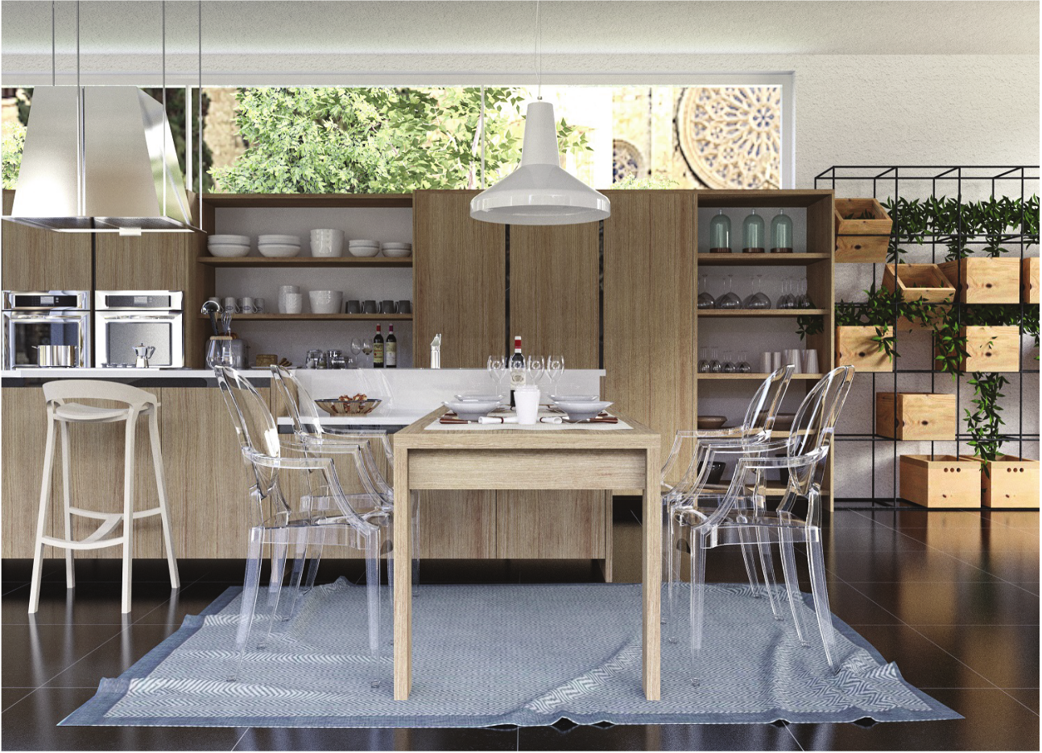
Inter-reflections
Glossy reflections
Soft shadows
Transmission
Ray-tracing-based rendering: https://www.realtimerendering.com/Real-Time_Rendering_4th-Real-Time_Ray_Tracing.pdf

Slide 4
Ray-tracing based rendering overview

Slide 5
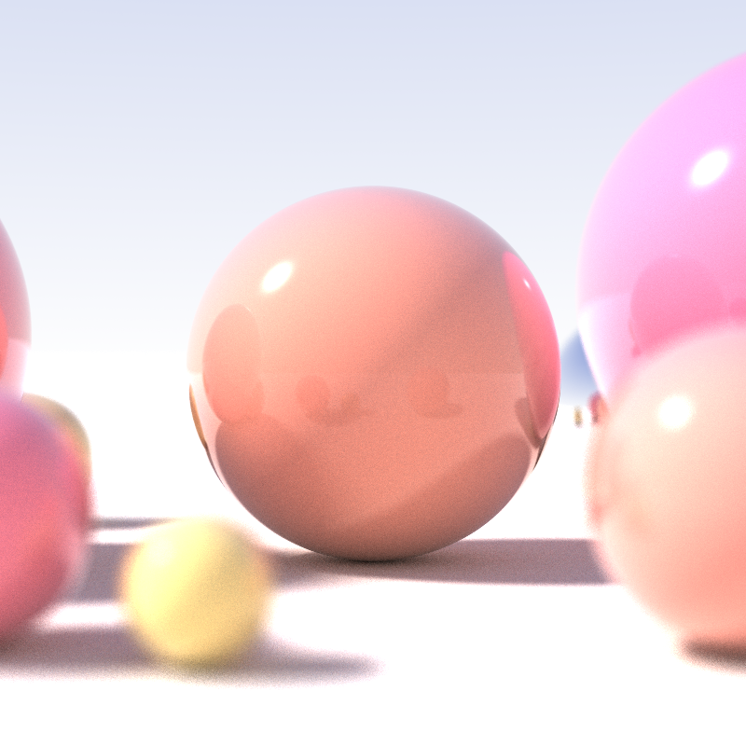

Introduction
Ray-tracing is a method inspired by physics of light → realistic image synthesis
Ray-tracing is considered one of the most elegant techniques in computer graphics
Many phenomena such as shadows, reflections and refracted light are intuitive and straightforward to implement
Robert L. Cook Thomas Porter Loren Carpenter. "Distributed Ray-Tracing" (1984).
https://en.wikipedia.org/wiki/Ray_tracing_(graphics)

Slide 6
Rendering recap
Rendering: generating 2D image from 3D scene
  Calculating a color of each pixel of the virtual image plane
Rendering process: visibility and shading
  Visibility: find objects that are visible from camera
    Find which surfaces are visible, ignore participating media
  Shading: what is the color of visible objects
    Use incoming light, view, object shape and material information

Slide 7
Ray-tracing for visibility
Visibility problem: two points are visible to each other if line segment that joins them does not intersect any obstacle.
Ray-tracing fundamentally solves visibility problem using ray-casting
  Finding objects visible from camera: generate ray from camera and test intersections with objects in 3D scene
  Shading, light transport: generate additional rays from intersected objects into 3D scene to find amount and direction of incoming light

Slide 8
Ray-tracing-based rendering
Generate ray for each pixel of virtual image plane → camera ray
  Perspective camera: generate rays from aperture to each pixel
  Orthographic camera: generate parallel rays for each pixel
Ray-object intersection: testing intersection of generated ray and 3D scene objects to find closest intersection → objects visible from camera
Shading: calculating the color and intensity of intersected points
  Light-matter calculation: light absorption and reflection
  Light transport for computing incoming light: tracing rays to potential sources of light

Slide 9
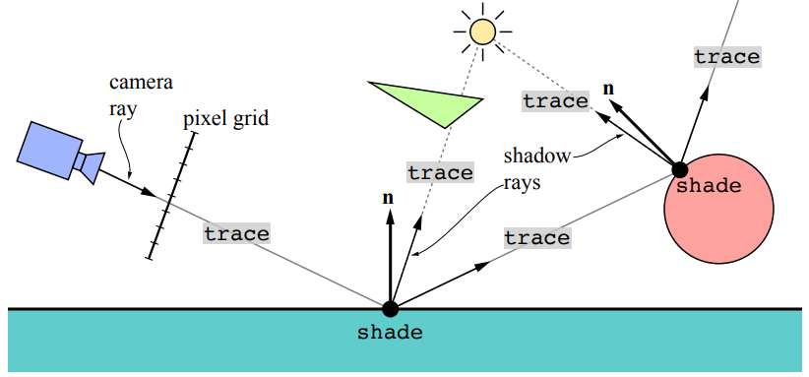
Ray-tracing-based rendering: trace() & shade()
Raytracing can be described with two functions trace()and shade()
trace() is geometrical part of algorithm responsible for finding closest intersection between ray and the objects in 3D scene → solving visibility problem
Shade() returns color of the ray intersecting object found by trace()
Ray-tracing-based rendering: https://www.realtimerendering.com/Real-Time_Rendering_4th-Real-Time_Ray_Tracing.pdf

Slide 10
trace() for camera rays
Rendering starts by generating camera rays for each pixel in the image
trace() function is used on generated camera rays
  Find closest intersection of camera ray with 3D scene objects
  Naive trace() function: loop through all n objects in the scene and returns closest intersection
    O(n) performance. Spatial acceleration structure (BVH or k-d tree) → O(log(n)) performance

Slide 11
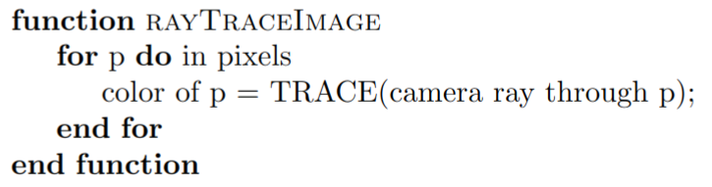
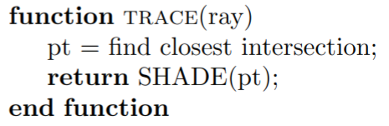
trace() for camera rays
Ray-casting is often used in trace() function for determining visibility between two points.

Slide 12
shade() for intersections
shade() calculates color in intersection.
shade() can be arbitrarily complex:
  It can just return the color of object
  It can use material information in intersected point with incoming light information
    Use trace() for closest light sources
    Use trace() to gather incoming light from all directions (e.g., other surfaces)

Slide 13
trace() for light transport
Light transport: obtaining incident light on shading point using trace()
  Calculate visibility between shaded point and light source (direct illumination)
  Compute light from specular surfaces (Whitted ray-tracing)
  Compute indirect light reflected from other surfaces (e.g., path-tracing)

Slide 14
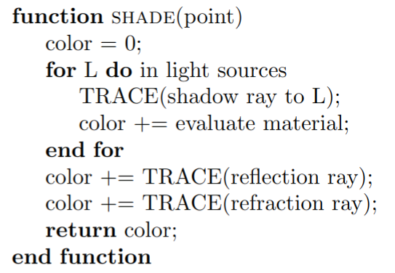
shade() for intersections
Each shade() can call trace() and each trace() can call shade()
Ray depth is term with indicates number of rays that have been shot recursively along a ray path

Slide 15
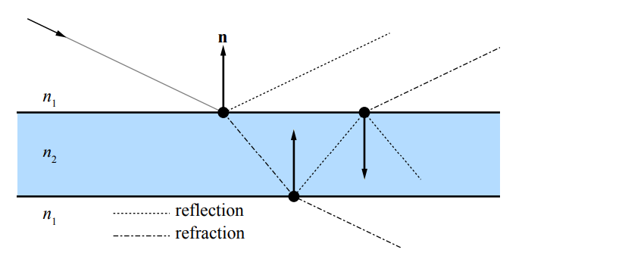
shade() and trace()
shade() function is implemented by user as a shader program
  Material (scattering functions and textures) are used to define light-surface interaction – amount of absorption and reflection, that is, color
Traversal and intersection testing which takes place in trace() function is often implemented on CPU
  GPU rendering uses compute or ray-tracing shaders in Vulkan or DXR
shade() defines interaction of light with surface, its color.

Slide 16
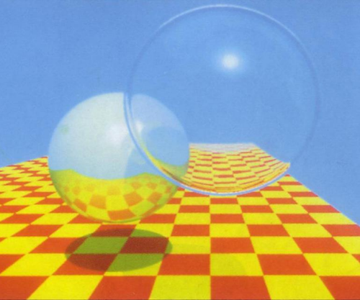
Ray-tracing structure
Ray-tracing structure consisting of shade() and trace() is basis for Whitted ray-tracer.
  Assumptions: surface are perfectly sharp (specular) reflections and refractions or diffuse.
  Computes indirect light coming from specular surface
Whitted ray-tracing is foundation of many other rendering variants such as path-tracing which are solving rendering equation and global illumination.

Slide 17

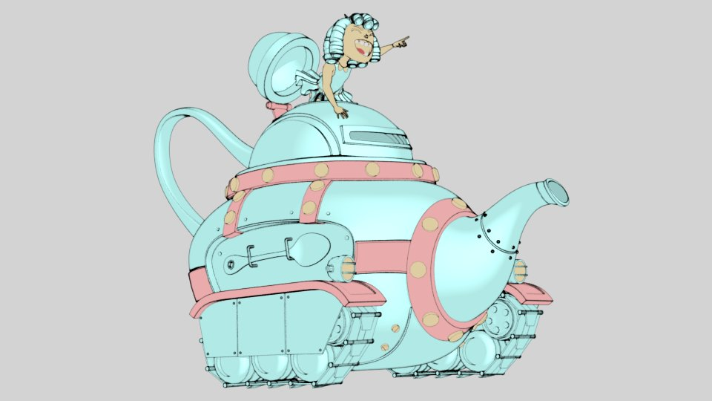
(Non-)Photo-realistic rendering
Level of photo-realism depends on reproducing the color and intensity of objects - appearance
Shading plays crucial role for object appearance:
  Photo-realistic rendering
  Expressive or artistic rendering → non-photo-realistic rendering
Photo-realistic rendering is useful for understanding physically-based shading from which non-photo realistic rendering can be derived with means of exaggeration
“Rolling Teapot” - Model by Brice Laville, concept by Tom Robinson, render by Esteban Tovagliari - RenderMan ‘Rolling Teapot’ Art Challenge: https://appleseedhq.net/gallery.html#https%3A%2F%2Fappleseedhq.net%2Fimg%2Frenders%2Frolling-teapot.jpg
https://www.artstation.com/artwork/rANRe5

Slide 18
Digression: ray-casting
Ray-casting is often used in trace() function for determining visibility between two points
<image: raycasting>
It is also very useful operation in different applications
  Ambient occlusion
  modeling

Slide 19
Generating camera rays

Slide 20
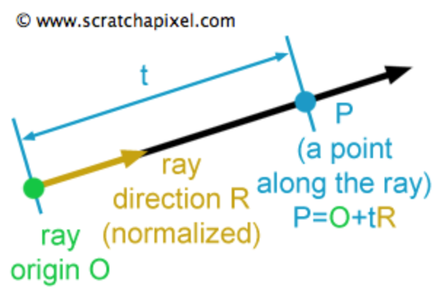
Ray
Ray is fundamental element of ray-tracing used for solving visibility
Ray is defined as:
  vector3f origin;
  vector3f direction;
Any point on ray is is defined with parametric equation:
  P(t) = origin + t * direction;
    t – distance from origin to P(t)
    t > 0 → P(t) is in front of ray’s origin
    t < 0 → P(t) is behind the ray’s origin

Slide 21
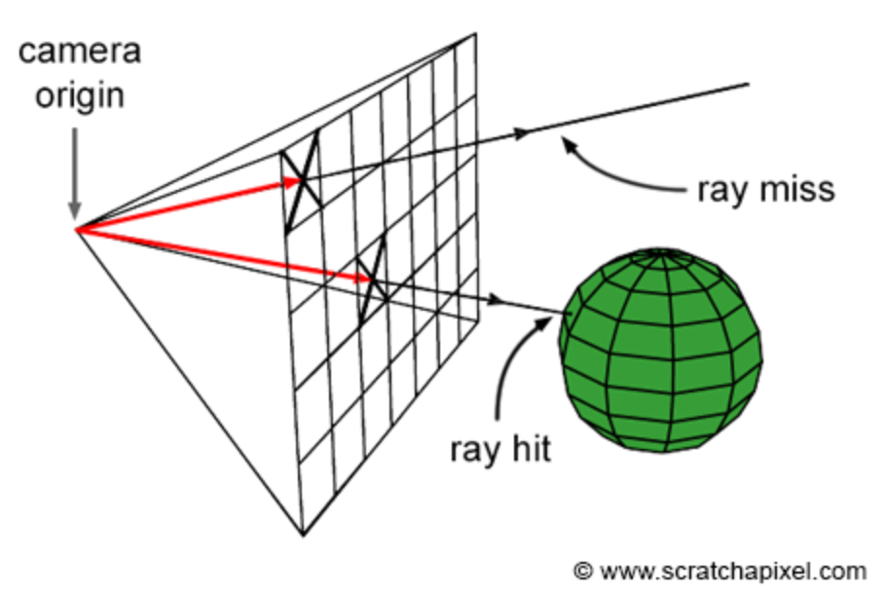
Generating camera rays
Camera:
  Aperture (eye) position
  Orientation of camera line of sight
  Field of view: how much of the scene we see
  Frame (image): array of pixels where image is formed
Camera rays are generated starting from camera aperture and passing through each pixel in the image plane into 3D scene → backward/eye-tracing
  Used to compute the visible objects → ray-casting
Camera rays are also known as: primary ray, view ray
Aperture/eye
Frame
Camera-ray

Slide 22
Generating camera rays
Vector3f ImageBuffer[imageWidth, imageHeight];
For (int j = 0; j < imageHeight; ++j)
{
For (int i = 0; i < imageWidth; ++i)
{
Ray ray = buildCameraRay(i, j);
For (int k = 0; k < nObjectsInScene; ++k)
{
if (intersect(ray, object[k], intersectionContext)
{
// Object hit. Compute shading using intersectionContext.
ImageBuffer[j * imageWidth + i] = shadingResult;
}
else
{
// Background hit. Compute background color...
ImageBuffer[j * imageWidth + i] = backgroundColor;
}
}
}
}

Slide 23
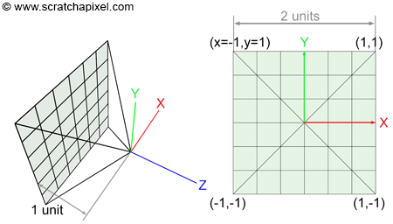
Generating camera rays: basic setup
Basic setup:
  Camera origin (aperture, eye) is in (0,0,0)
  Camera is looking in negative Z axis
  Film (image) plane is placed 1 unit from from camera’s origin
  Film dimensions are 2x2 units
  Film is centered around Z axis
  Image is square (image_width == image_height)
https://www.scratchapixel.com/lessons/3d-basic-rendering/ray-tracing-generating-camera-rays/generating-camera-rays.html

Slide 24
Generating camera rays: basic setup
World-space ray is created by connecting world-space points:
  Camera origin – already aligned with world coordinate system origin (0,0,0)
  Pixel center – requires transformation from raster space to world space
World-space ray is needed for intersection since all objects in scene are also defined in world space
Pixel center

Slide 25
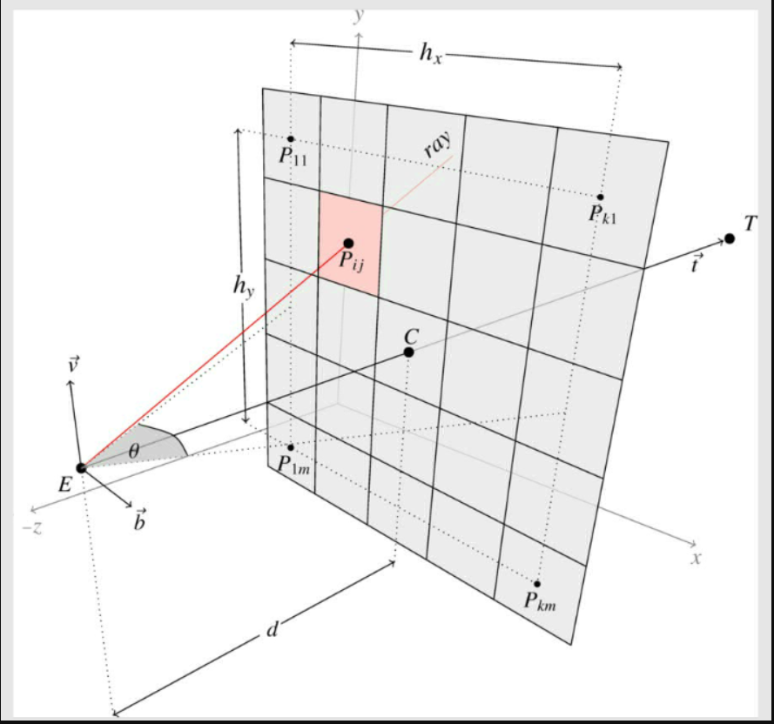
Generating camera rays
Create primary ray for each pixel of the frame which is used for intersection
  All objects in 3D scene are defined in world space
  Rays must be expressed in world space for correct intersection computation
Ray is traced from camera origin to pixel center
  Camera origin is point in camera space → apply camera-to-world matrix to obtain world space camera origin
  Point on a pixel must computed from frame pixel coordinates and transformed in world space using camera-to-world matrix
Frame pixel coordinates are in raster space
  Assume: top left of frame has pixel coordinates (0,0)
Image plane, where frame must be mapped is in camera space
  Assume: image plane is located one unit away from camera origin and aligned in negative z axis
  Assume: image plane is centered around camera origin
Task: find relation between pixels in raster space and coordinates of those pixels in world space

Slide 26
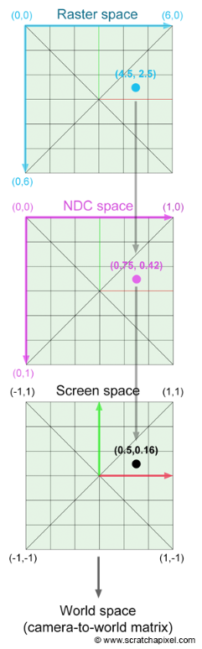
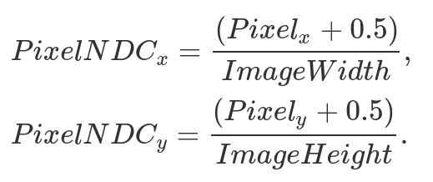

Pixel center coordinates
Pixel coordinates are originally defined in raster space [image_height, image_width]
  Integer coordinates (Pixel_{x}, Pixel_{y}) where left-top corner of frame is (0,0)
Pixel position must be first normalized using frame dimensions giving normalized device coordinates (NDC) [0,1]
Finally, pixels are transformed from NDC to screen space

Slide 27
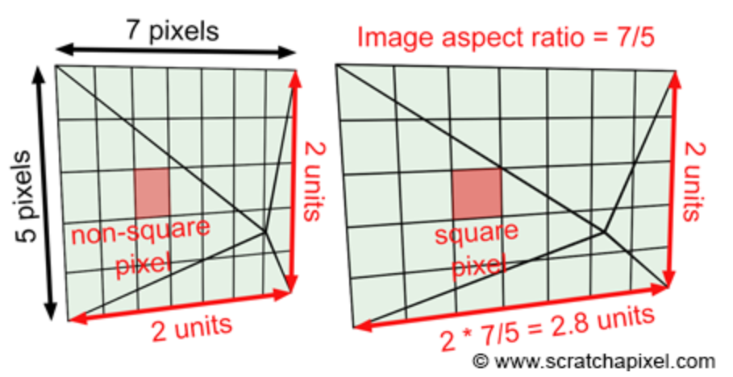
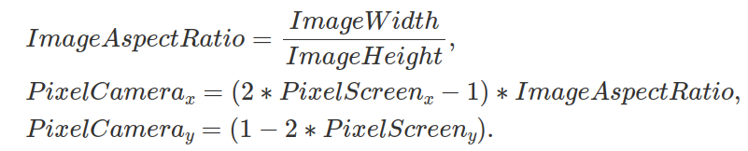


Pixel center coordinates: arbitrary image aspect ratio
To ensure square pixels for image arbitrary aspect ratio, use image aspect ratio to scale frame size.

Slide 28
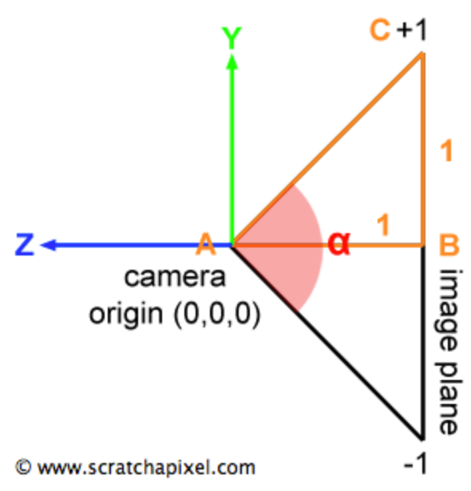
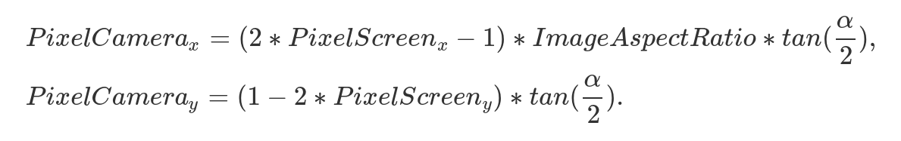
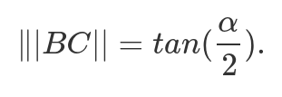
Pixel center coordinates: arbitrary field of view
Field of view α defines how much we see or zoom level.
To incorporate arbitrary field of view:

Slide 29
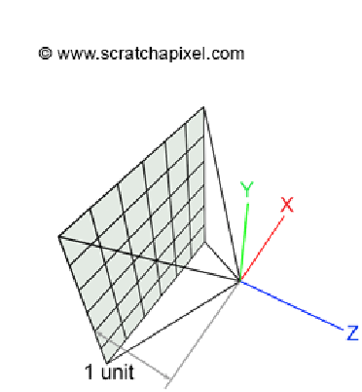

Pixel center coordinates: camera space
Now, pixel coordinates are expressed in camera coordinate system space
  Pixel coordinates are defined with regards to camera’s image plane → missing 3rd coordinate
Currently, camera is in default position (camera coordinate system is aligned with world coordinate system)
  Camera origin O (aperture): (0,0,0)
  Orientation: negative Z axis
  Image plane: 1 unit away from camera’s origin
3D Pixel coordinate position on the image plane in camera space

Slide 30
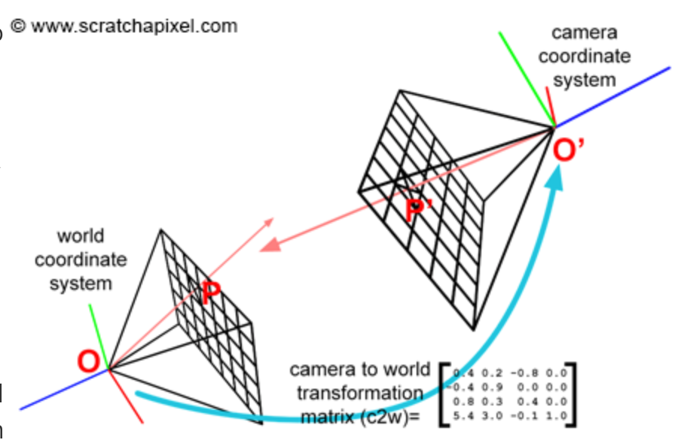
Generating camera rays: world space
Camera space ray can be constructed using camera origin and pixel position in camera space
  vector3 RayOrigin = cameraOrigin;
  vector3 rayDirection = normalize(pixelCameraPosition – cameraOrigin);
World space ray can be constructed:
  Camera-to-world matrix is first applied applied on pixel position and camera origin
  vector3 RayOrigin = cameraOriginWorld;
  vector3 rayDirection = normalize(pixelPositionWorld – cameraOriginWorld);
Camera-to-world can be constructed using look-at matrix.
Camera is originally set in its default position.
Camera-to-world matrix is used to move camera origin and pixel position for generating world space rays.

Slide 31
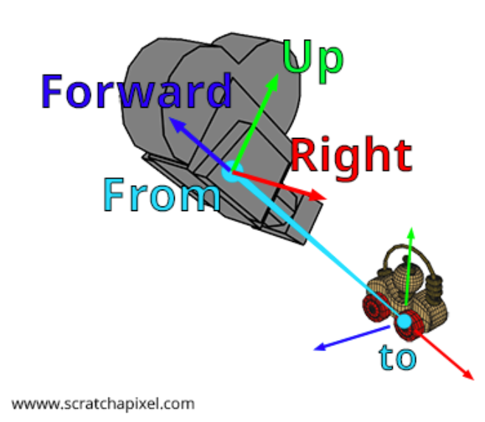
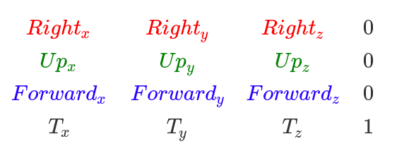
Camera-to-world matrix
4x4 transformation matrix → transformation of camera from its local (camera) space to world space in 3D scene: camera-to-world and its inverse world-to-camera matrix
Can be constructed from look-at notation
Forward = normalize(From – To)
Right = crossProduct(randomVec, Forward)
Up = crossProduct(forward, right)
From_{x}
From_{y}
From_{z}
RandomVec = (0,1,0) or other if Forward is close to (0,1,0) or (0,-1,0)

Slide 32
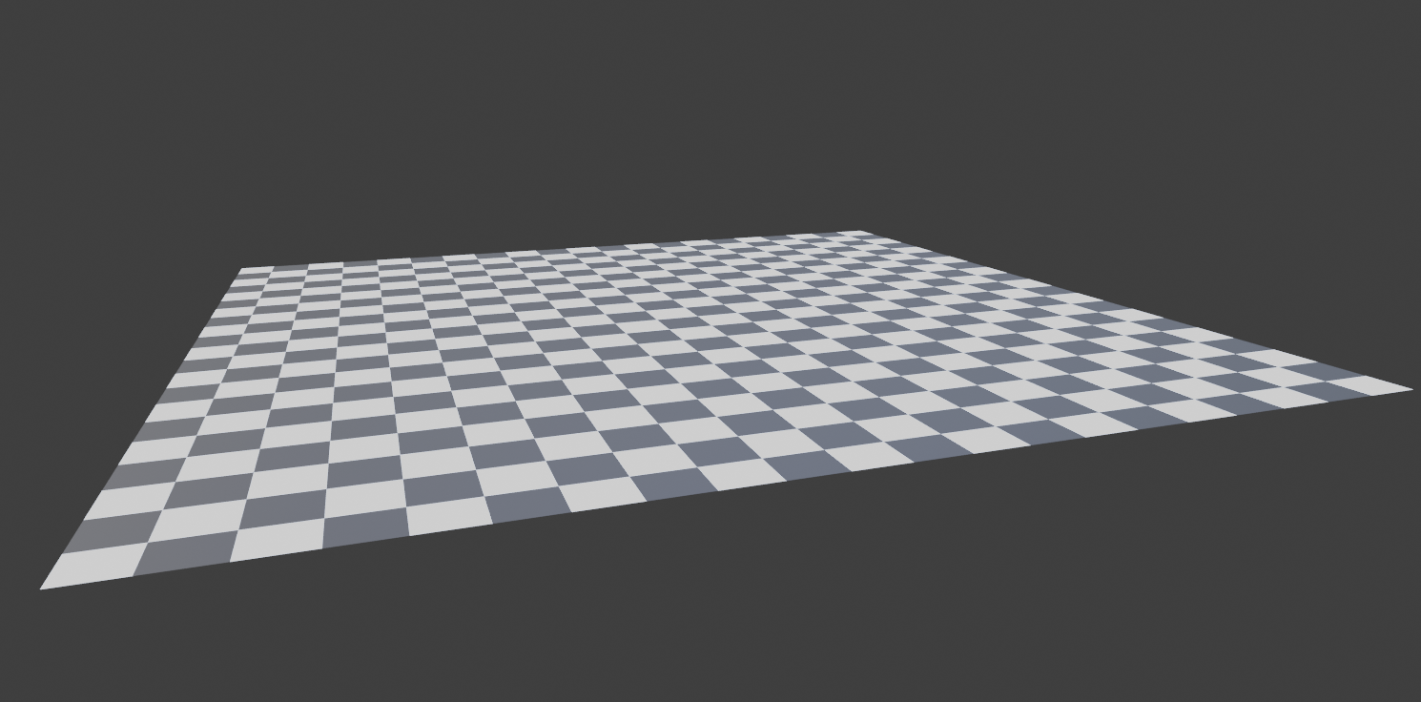

Generating multiple camera rays per pixel
Pixel footprint in 3D scene can cover large area with different textures and objects
  Problems: noise and aliasing
Since pixel can represent only one color, it is important to use multiple rays to obtain the color which is the most representative for the part of the scene covered by that pixel
  Instead of pixel center, random points on pixel area are taken for building rays (samples per pixel SPP)
Red cells are pixels

Slide 33
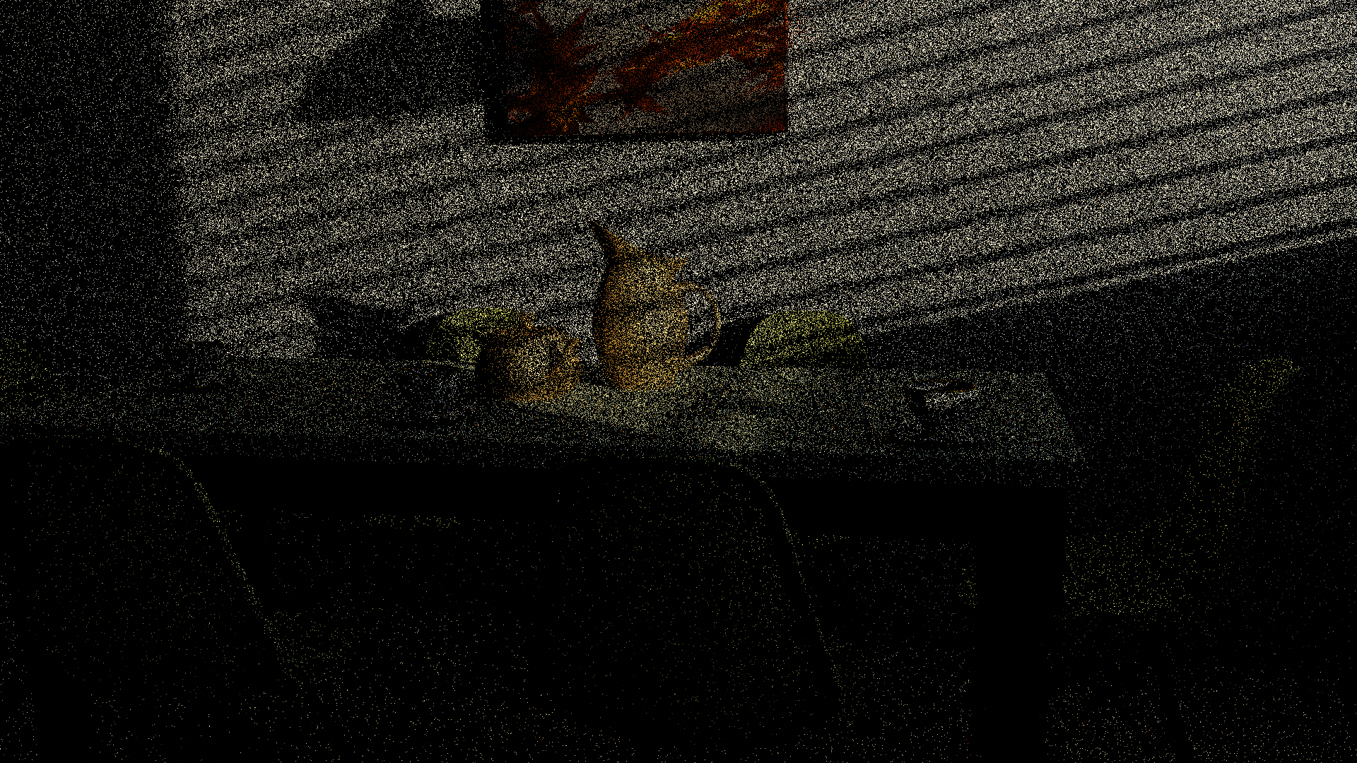
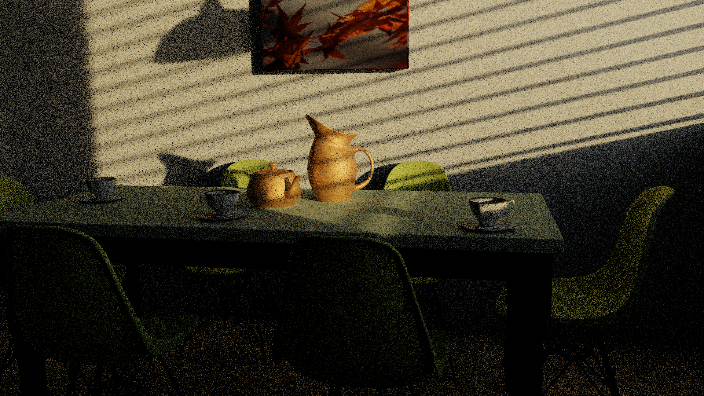
Generating multiple camera rays per pixel
Using multiple rays per pixels, reduces noise
1 ray per pixel
32 rays per pixel
Using multiple rays per pixel is especially important for methods building on raytracing and using stochastic sampling (e.g., Monte Carlo) such as path tracing.

Slide 34
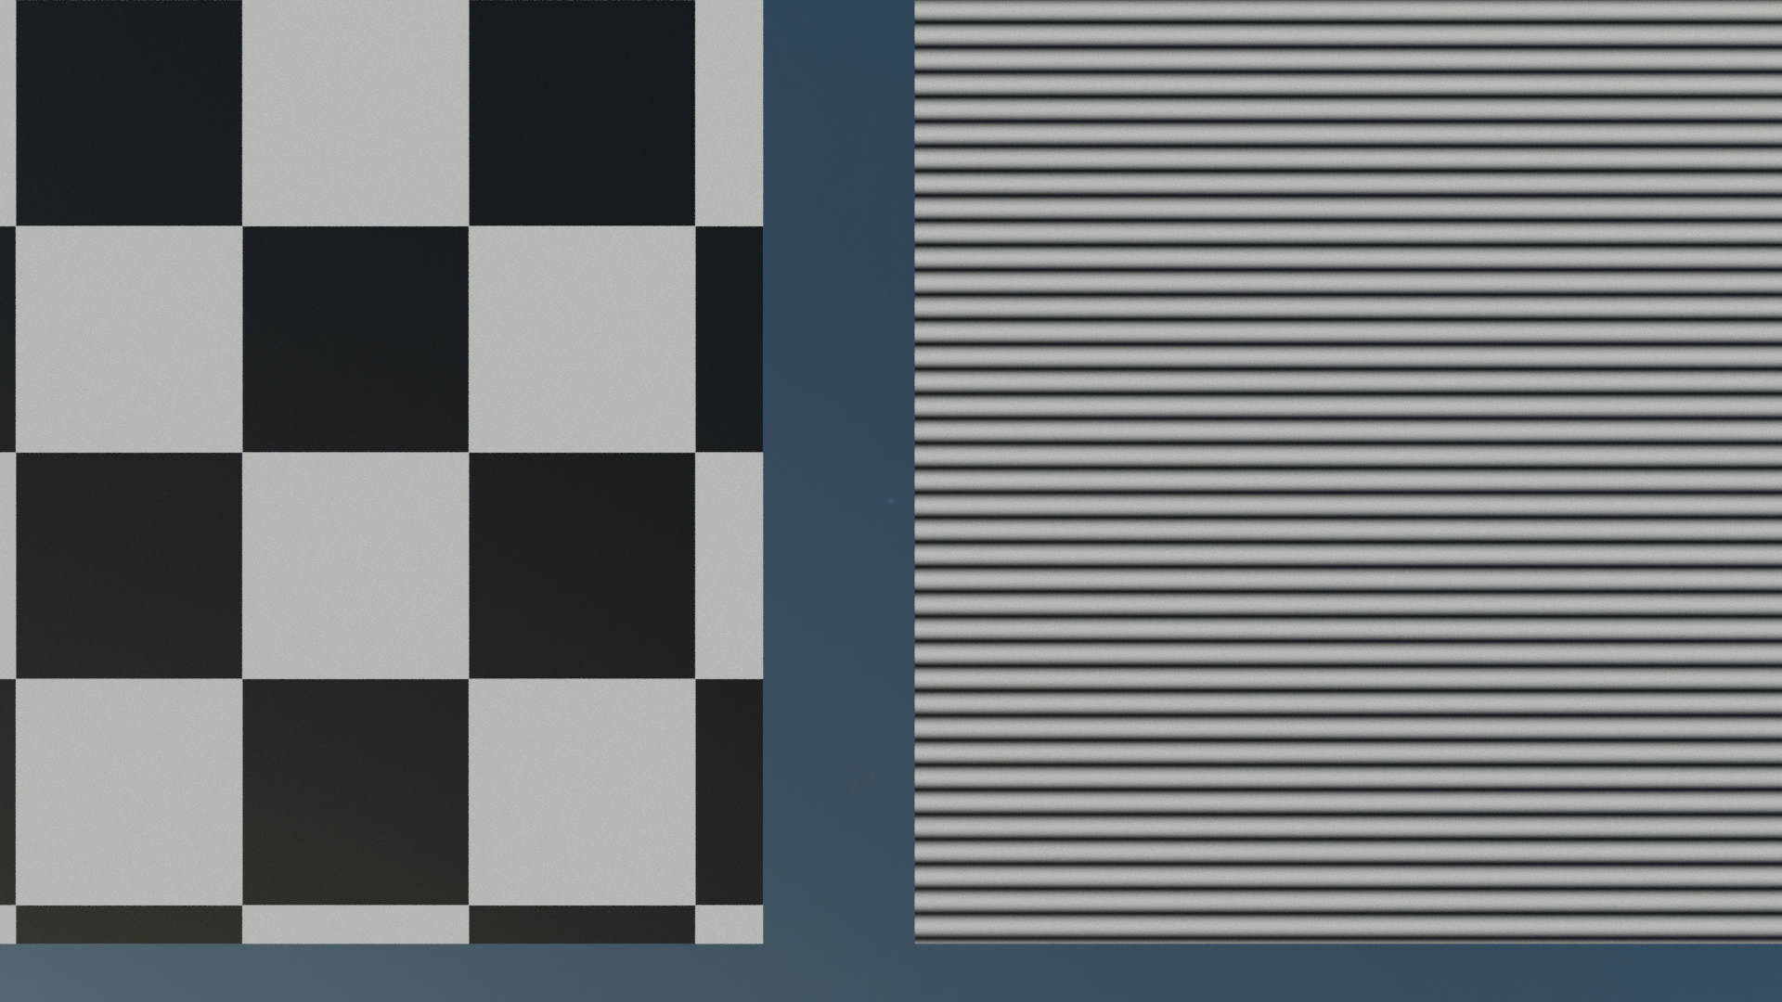
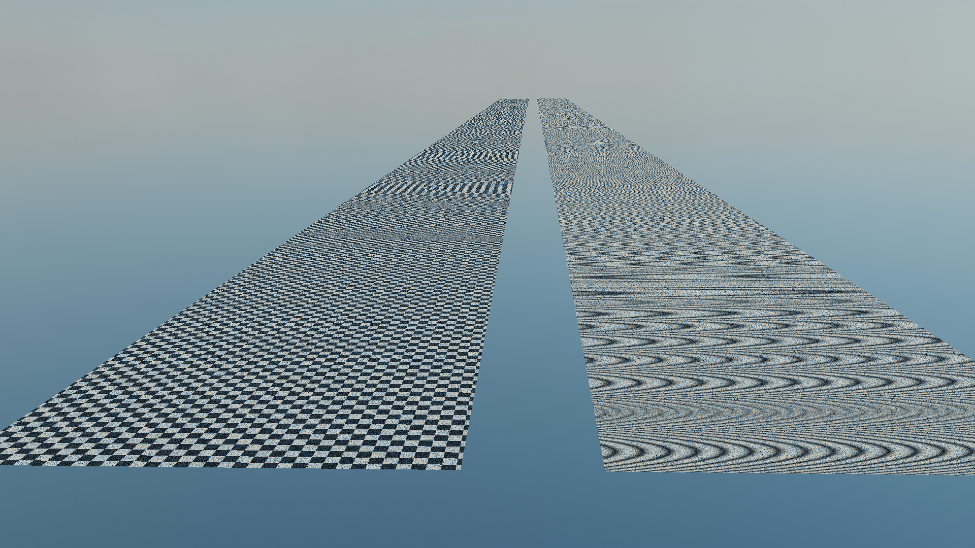
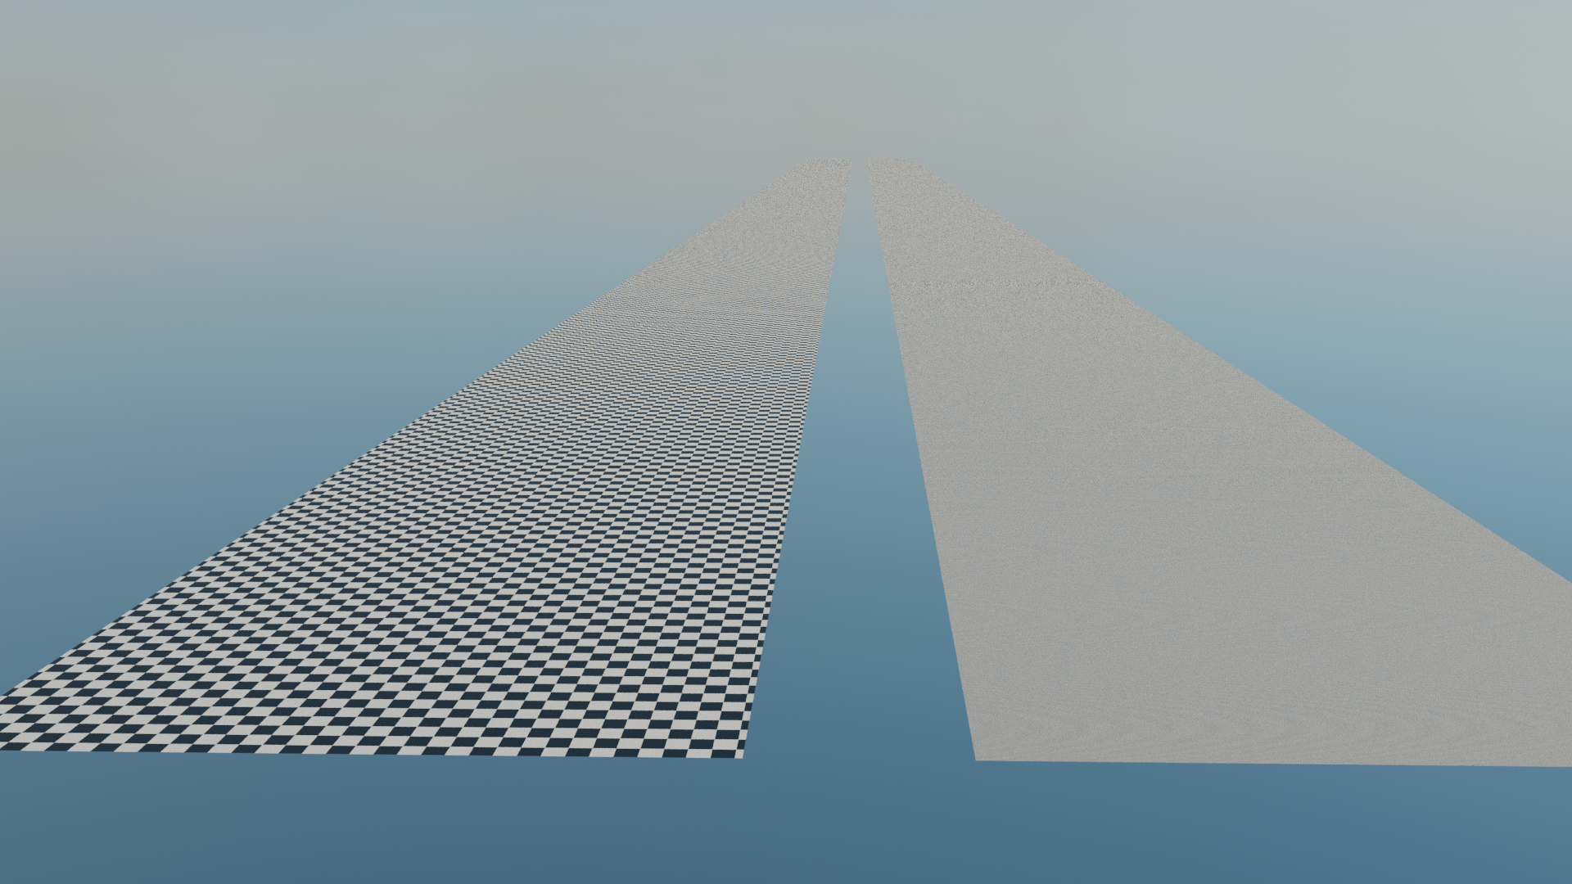
Generating multiple camera rays per pixel
Using multiple rays per pixels, reduces aliasing
1 ray per pixel
32 rays per pixel

Slide 35
Computing intersections

Slide 36

Ray-tracing: image centric method
Since rendering starts from virtual image plane, ray-tracing is called image centric approach
Once camera rays are generated, they are traced into scene and tested for intersections with objects
  Looping over all objects in 3D scene is performed and each is tested for intersection with current ray → visibility test
  Testing intersections with objects depends on object shape, i.e., triangulated mesh

Slide 37
Camera ray-objects intersection testing
…
Ray ray = buildCameraRay(i, j);
for (int k = 0; k < nObjectsInScene; ++k)
{
if (intersect(ray, objects[k], intersectionContext)
{
// Object hit. Compute shading using intersectionContext.
framebuffer[j * imageWidth + i] = shadingResult;
}
else
{
// Background hit. Compute background color...
framebuffer[j * imageWidth + i] = backgroundColor;
}
}
...
intersect() method depends on object shape
ShadingResult depends on object material.
That is why decoupling material and shape of 3D object is useful.

Slide 38
Testing ray-object intersections
Objects in 3D scene can be represented with different shape (geometry) representations
  Parametric representations
    Spheres, disks, planes, etc.
    Surfaces and curves (e.g., Bezier curves, NURBS, etc.)
  Implicit surfaces SDFs: spheres, cubes, etc.
  Polygonal meshes (e.g., triangles, quads) and subdivision surfaces
  Voxels
  Etc.
We will discuss:
  Ray-sphere intersection
  Ray-triangle intersection and its extension to triangulated meshes

Slide 39
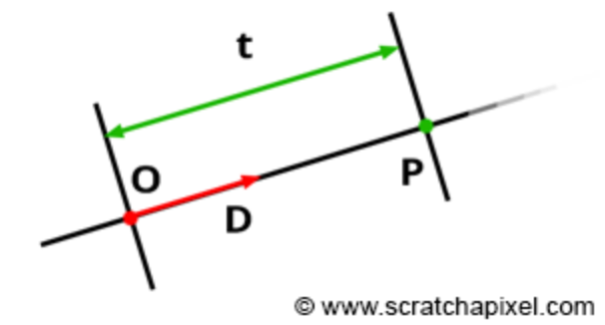
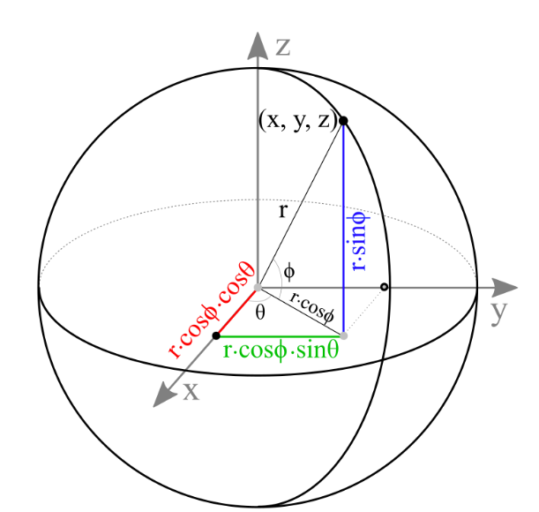
Ray-sphere intersection
Ray-sphere intersection is simplest ray-geometry intersection
Parametric ray description: P(t) = O + t * D
Implicit (algebraic) sphere form at world origin and radius R:
  x² + y² + z² = R²
    x,y,z are coordinates of a point on a sphere
  P² – R² = 0
    Implicit function which defines implicit sphere shape
    Equation is equal to zero if point P is on sphere
http://www.songho.ca/opengl/gl_sphere.html

Slide 40
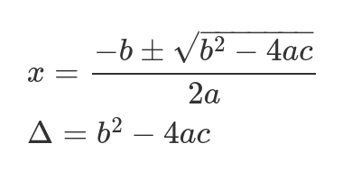
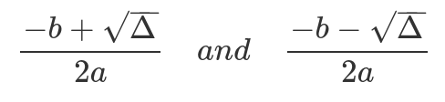
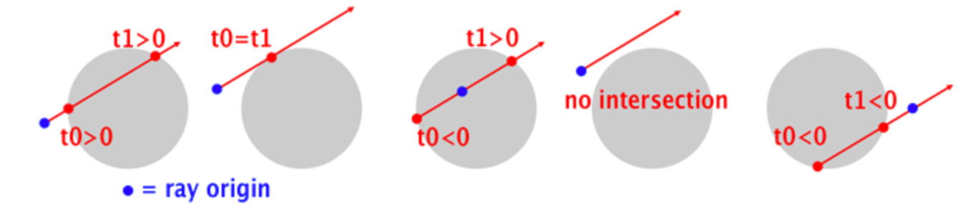
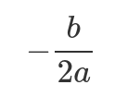
Ray-sphere intersection
Start with P² – R² = 0 and P(t) = O + t * D
Substitute P with ray equation: |O + t * D|² – R² = 0
  Develop: D²t² + 2ODt + O² – R² = 0
Quadratic equation: f(x) = ax² + bx + c:
  a = D², b = 2OD, c = O² – R². Solution:
  Δ > 0: ray intersects sphere in two points (t₀ and t₁):
  Δ = 0: ray intersects sphere in one point (t₀ = t₁):
  Δ < 0: ray doesn’t intersect the sphere
t

Slide 41
Ray-sphere intersection: arbitrary sphere position
If sphere is translated from origin to point C, then:
  |P – C|² – R² = 0
Substituting the ray equation:
  |O + t * D - C|² – R² = 0
Solving quadratic equation gives t₀ and t₁:
t
a = D² = 1 (ray direction D is normalized)
b = 2D(O – C)
c = |O – C|² - R²

Slide 42
Ray-sphere intersection: intersection point and intersection context
t₀ , when inserted into ray equation P(t) = O + t * D gives closest intersection point of ray with a sphere
  vector3 Phit = O + D * t₀
Next to intersection point Phit, renderer often computes additional intersection information – intersection context:
  Normal in intersection point
  Texture coordinate in intersection point
  Object/triangle index → material assigned to this object
  Etc.
Intersection context computation depends on object shape. Example: texture coordinates
  For parametric surfaces (u,v) parameters can be used as texture coordinates
  For polygonal (e.g., triangle) mesh, texture coordinates must be precomputed and stored per vertex. Intersection point is used to interpolate texture coordinates per triangle face (e.g., barycentric interpolation)
Intersection context contains information which is used for shading of intersection point

Slide 43
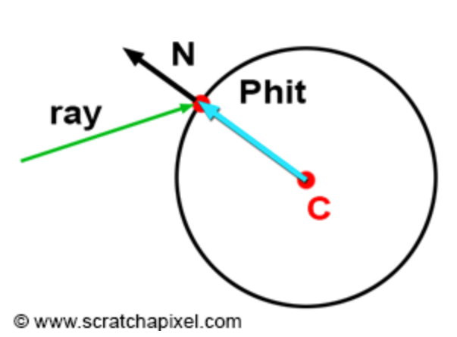
Ray-sphere intersection: normal
Normal calculation in intersection point depends on shape representation
For implicit sphere with center C(x,y,z)
  vector3 N = normalize(Phit - C)

Slide 44
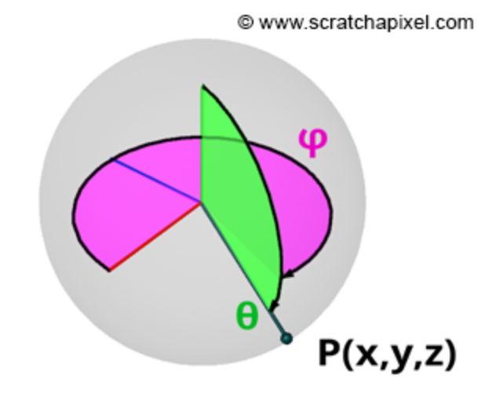
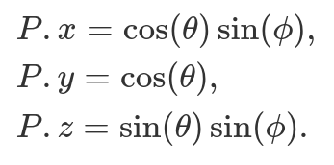
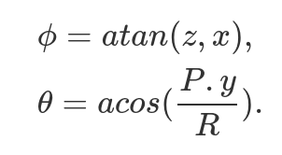
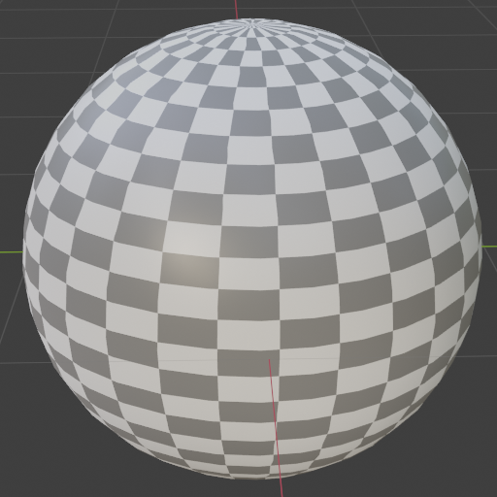
Ray-sphere intersection: texture coordinates
Sphere can be written in parametric form:
Texture coordinates for sphere are simply spherical coordinates:

Slide 45
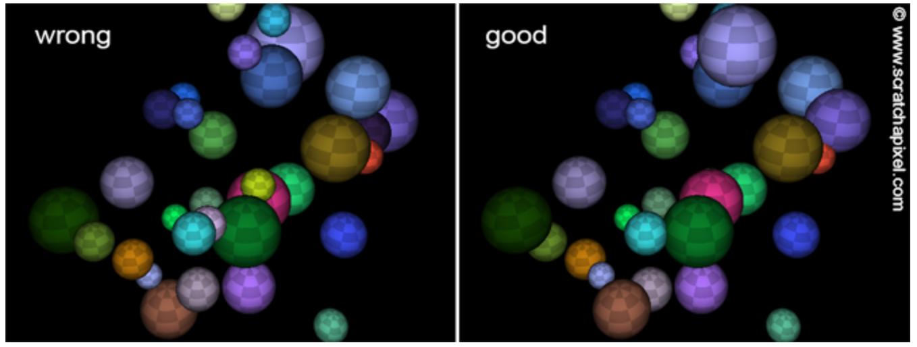
Ray-sphere intersection: intersection order
If scene contains multiple objects then certain depth sorting is needed
  Keep track of closest intersection distance, closest t, and use this value for comparison when testing intersection with new object

Slide 46
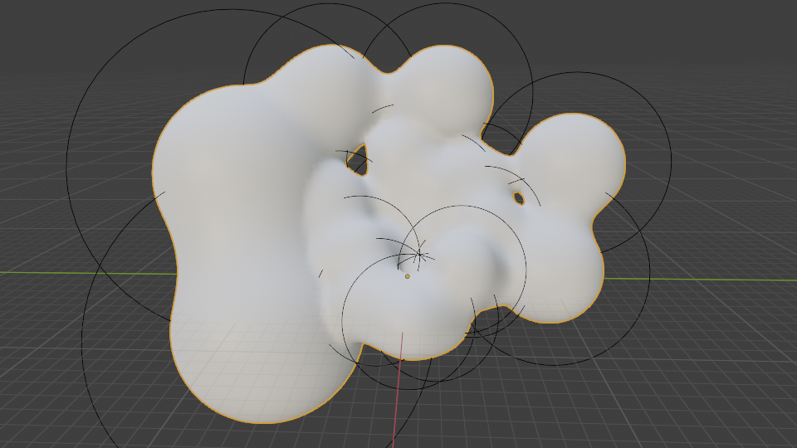
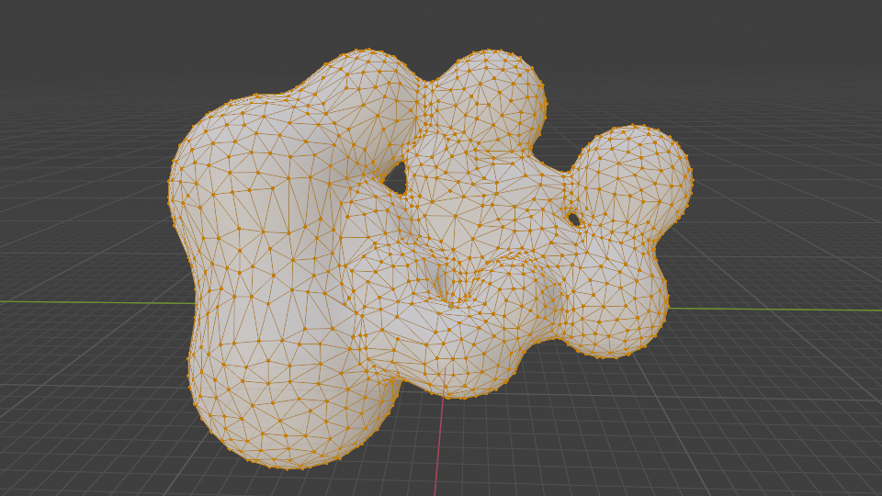
Intersecting other shape representations
Define ray-shape intersection for each representation separately (e.g., triangulated mesh and parametric curves)
Alternative solution: convert each shape representation to same internal representation which is used for rendering
  Professional rendering software often work on triangulated mesh which is obtained using triangulation
triangulation
Implicit spheres (metaballs) converted into triangle mesh.
Implicit spheres (metaballs).

Slide 47
Tessellation and triangulated mesh
Two sides of the computer graphics/image generation: authoring of 3D scene and rendering
  Some representations are much more easier and efficient to handle on authoring level
  Some are much more efficient to handle for rendering purposes
  Therefore, efficient mapping of those representations quite important and researched.
Renderer working with single primitive is much more efficient than supporting various primitives
Why triangles?
  Can approximate any surface and shape well
  Conversion of almost any type of surface to a triangulated mesh (tessellation) is well researched and feasible
  Triangulated mesh is also basic rendering primitive for rasterization-based renderers
  Graphics hardware is adapted and optimized to efficiently process triangles
  Triangles are necessary co-planar which makes various computations, such as ray-triangle, much easier
  Lot of research was devoted to efficient computation of ray-triangle intersection: https://www.realtimerendering.com/intersections.html
  For triangles we can easily compute barycentric coordinates which are essential to shading
Tessellation process can be done after modeling of shape is done and when exporting takes place or it can be done during rendering (render time)

Slide 48
Ray-triangle intersection test
Basic ray-triangle intersection is straight forward
Complexity comes due to multitude of different cases which must be taken in account
  Various ray-triangle intersection tests exist: https://www.realtimerendering.com/intersections.html
Ray-triangle intersection testing steps:
  1. Does ray intersect a plane defined by a triangle?
  2. Does ray intersect point inside the triangle?

Slide 49
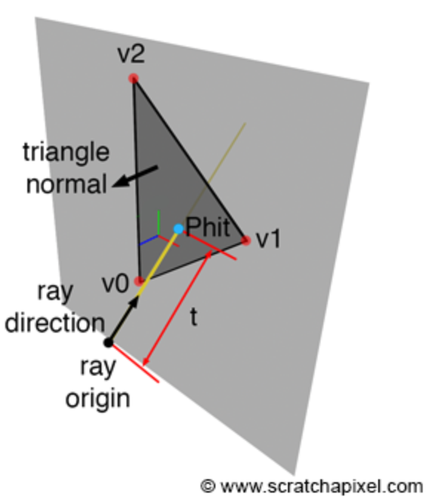


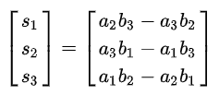
Ray-triangle intersection tools
Triangles are coplanar: vertices are lying on a plane and plane can be defined with those vertices
Using triangle vertices, normal can be computed
  Plane on which triangle lies has the same normal
    vector3 a = v1 – v0
    vector3 b = v2 – v0
    vector3 c = cross(a, b)
    vector3 normal = normalize(c)
  Winding order of vertices defines normal and thus surface orientation – important for shading!
https://en.wikipedia.org/wiki/Cross_product

Slide 50
Ray-triangle intersection test: intersecting plane
Intersected point is somewhere on ray:
  Phit = P(t) = O + t * R
Plane equation:
  Ax + By + Cz + D = 0
  D = -(Ax + By + Cz)
    A, B, C are coordinates of plane normal N = (A,B,C)
    D is distance from origin (0,0,0) to the plane
    x, y, z are coordinates of point on a plane
Normal N can be calculated using triangle vertices
D can be calculated using any triangle vertex v and normal N:
  D = dotProduct(N, v0) = -(N.x * v0.x + N.y * v0.y + N.z * v0.z);

Slide 51
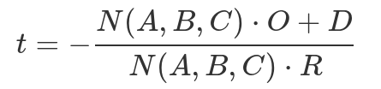
Ray-triangle intersection: intersecting plane
Substitute ray equation P(t) = O + t * R into plane equation Ax + By + Cz + D = 0:
  A * P.x + B * P.y + C * Pz + D = 0
  A * (O.x + t * R.x) + B * (O.y + t * R.y) + C * (O.z + t * R.z) + D = 0
Solving by t:
Finally, intersection point of ray and plane:
  float t = - (dot(N, O) + D) / dot(N, R)
  Vector3 Phit = O + t * R

Slide 52
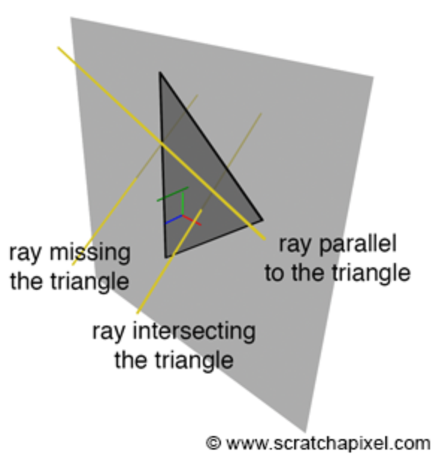
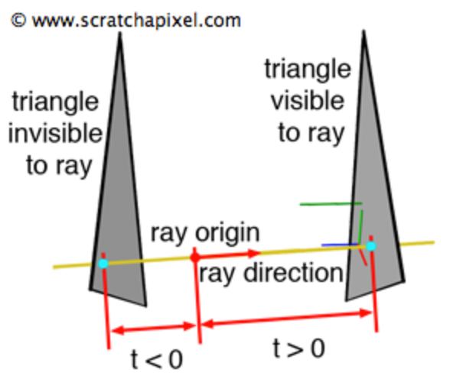
Ray-triangle intersection: intersecting plane
Special cases of non-intersection:
  Ray and triangle (plane) are parallel
    Triangle’s normal and ray direction are perpendicular
      dot(N, R) = 0
  Triangle is behind ray origin
    If t < 0 → triangle behind ray origin. Else, triangle is visible

Slide 53
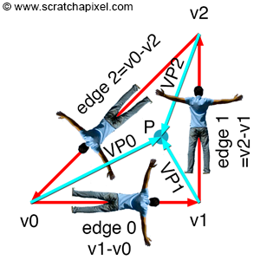
Ray-triangle intersection: point inside triangle?
We have found intersection point P on plane. Is it inside triangle?
Inside-out test
    vector3 edge0 = v1 – v0;
    vector3 edge1 = v2 – v1;
    vector3 edge2 = v0 – v2;
    vector3 C0 = P – v0;
    vector3 C1 = P – v1;
    vector3 C2 = P – v2;
    bool q1 = dotProduct(N, crossProduct(edge0, C0)) > 0;
    bool q2 = dotProduct(N, crossProduct(edge1, C1)) > 0;
    bool q3 = dotProduct(N, crossProduct(edge2, C2)) > 0;
    If (q1 and q2 and q3) then inside;
Inside-outside test:
Test if dot product of vector along edge and vector defined with first vertex of the test edge and P is positive → if P is on left side of the edge.
If P is on the left side of all three edges, then P is inside triangle

Slide 54
Ray intersection with triangle mesh
We have a routine to compute ray-triangle intersection
To test ray intersection with object which is represented as triangulated mesh:
  Loop over all triangles of triangulated mesh
    Test if ray intersects triangles of triangulated mesh
    Respect depth sorting by keeping track of nearest object
For generated camera ray, we can write intersect() function which:
  Takes triangulated meshes and ray
  Returns information on intersection
  Return information on intersection context
https://www.scratchapixel.com/lessons/3d-basic-rendering/ray-tracing-polygon-mesh/ray-tracing-polygon-mesh-part-1.html

Slide 55
Testing ray intersections: intersect() function
bool intersect (Ray ray, Object objects, &intersectionContext)
{
bool intersected = false;
for (int k = 0; k < objects.nObjects; ++k)
{
for (int n = 0; n < objects[k].nTriangles; ++n)
{
if(rayTriangleIntersect(ray, objects[k].triangle[n])
{
intersected = true;
IntersectionContext.objIdx = k;
IntersectionContext.triIdx = n;
IntersectionContext.N = N;
...
}
}
}
return intersected;
}
Intersect function can be used for:
finding intersections between camera rays and objects → camera visibility
Finding intersections between secondary rays and objects → light transport

Slide 56
intersect(): depth sorting
bool intersect (Ray ray, Object objects, &intersectionContext, &tNearest)
{
bool intersected = false;
tnearest = INFINITY;
for (int k = 0; k < objects.nObjects; ++k)
{
for (int n = 0; n < objects[k].nTriangles; ++n)
{
if(rayTriangleIntersect(ray, objects[k].triangle[n], t) and t < tNearest)
{
intersected = true;
IntersectionContext.objIdx = k;
IntersectionContext.triIdx = n;
tNearest = t;
}
}
}
Return intersected;
}
Ray may intersect several triangles.
Keep track of closest intersection and update it with each intersection

Slide 57


Triangle (surface) orientation
Inside
Outside
Winding order of triangle vertices and handedness of coordinate system defines normal orientation → surface orientation
  Surface normal pointing outward → outside surface
  Surface normal pointing inward → inside surface
Based on camera view, surface can be:
  Front-facing: if outside surface is facing camera
  Back-facing: if outside surface is not facing camera
Front-facing
Back-facing
Camera

Slide 58
Single and double sided triangle
During rendering, that is visibility computation, it is possible to specify:
  Single-sided primitives: only visible if are front-facing
  Double sided primitives: visible for both front-facing and back-facing
Back-face culling: discarding back-facing triangles during rendering
  For casting shadows, back-face culling can not be used.
  Test: dotProduct(ray.direction, N) > 0
Front-facing
Back-facing
Camera

Slide 59
intersect() function: intersection context
intersect() function must return information if ray intersects object (triangle) as well as intersection context:
  Object index of intersected triangle: objIdx → object material information
  Triangle index of intersected triangle: triIdx → triangle geometry and/or material information
  Ray parameter t for nearest intersection: tNearest
  Intersection point coordinates
  Intersection point normal
  Intersection point texture coordinates
  etc.
  Information of objIdx, triIdx and tNearest can be used to compute the rest of intersection context information
Often, triangulated meshes contain data stored per vertices → vertex attributes
  Barycentric interpolation is used to obtain value for any intersection point from vertex attributes
Intersection context information will be used for shading the intersected point

Slide 60

Recap: barycentric interpolation
Any point P on triangle can be described with barycentric coordinates u,v,w:
  P = uA + vB + wC, where A,B,C are triangle vertices
  u + v + w = 1
  If 0 <= u,v,w <=1 then P inside or on triangle edge. Otherwise P is outside of triangle.
Barycentric coordinates: u,v,w are proportional to area of sub-triangles defined by P
To interpolate vertex attributes:
  Using P, A,B,C calculate u,v,w
  Interpolate vertex arbitrary attribute in point P
    P_{attrib} = A_{attrib} * u + B_{attrib} * v + C_{attrib} * w
v
u
w
Area(Triangle(ABC)) = ||(B-A)x(C-A)||/2
u = Area(Triangle(CAP)) / Area(Triangle(ABC))
v = Area(Triangle(ABP)) / Area(Triangle(ABC))
w = Area(Triangle(BCP)) / Area(Triangle(ABC))

Slide 61


Intersection context: normal
Flat normal in intersection point can be computed using triangle vertices:
  vector3 a = v1 – v0
  vector3 b = v2 – v0
  vector3 c = cross(a, b)
  vector3 normal = normalize(c)
Smooth normals can be created when modeling triangulated mesh:
  Those are stored per vertex
  To obtain smooth normal in intersection point, barycentric interpolation can be performed using intersection point and triangle vertices

Slide 62
Intersection context: texture coordinates
Texture coordinates for each vertex of triangulated meshes are created during mesh modeling using:
  Mesh unwrapping
  Texture projections, e.g., spherical, cylindrical, triplanar, etc.
To compute texture coordinate in intersection point, barycentric interpolation is used
Note: texture projections can be also used to create texture coordinates on the fly
  Texture projections, e.g., spherical, cylindrical, triplanar, etc.

Slide 63
Testing intersections: complexity
Complexity of ray-tracing algorithm depends on:
  Number of pixels of virtual image plane, e.g., 1024x768 → number of camera rays
    Note that often multiple rays per pixel are used, e.g., 256
  Number of objects in the scene
Each camera ray must be tested for intersection with every object
Every secondary and shadow rays must be tested for intersection with every object
  Additional rays are generated per secondary ray intersections → recursion

Slide 64

Testing intersections: efficiency
Time to render a scene is (directly) proportional to the number of triangles in the scene
  For every camera ray, looping over all objects, that is triangles is needed
For shading purposes, all triangles must be stored into memory and each must be tested for intersection for ray
Therefore, various efficient ray-triangle and other ray-object intersection tests exist:
  Möller-Trumbore method: https://www.tandfonline.com/doi/abs/10.1080/10867651.1997.10487468
  Philip Dutré and Ares Lagae: https://www.tandfonline.com/doi/abs/10.1080/2151237X.2005.10129208
  Marta Löfstedt and Tomas Akenine-Möller: https://www.tandfonline.com/doi/abs/10.1080/2151237X.2005.10129195
  Inigo Quilez: https://www.shadertoy.com/view/MlGcDz
  More: https://www.realtimerendering.com/intersections.html

Slide 65




Moana Island
>90 million unique quads and triangles
>5 milion curves
>28 milion instances of objects
→ 15 billion primitives
https://disneyanimation.com/resources/moana-island-scene/

Slide 66

Accelerating intersection testing
If certain parts of the scene are not relevant for intersecting with current ray, they can be skipped
Spatial acceleration data structures
  3D scene and scene is spatially subdivided
  Now larger volumes of the scene can be tested for intersection
  If ray is not intersecting volume, all objects inside do not have to be tested for intersections
Acceleration structures require pre-computation overhead:
  Static scenes: only once before rendering
  Animated scenes: each frame, each time objects move
https://cs184.eecs.berkeley.edu/sp22/lecture/10/ray-tracing-acceleration

Slide 67
Spatial acceleration data structures
Bounding volumes
  Bounding box, sphere, etc.
Hierarchical spatial data structures
  Bounding volume hierarchy (BVH)
  Binary space partitioning (BSP) tree

Slide 68


Bounding volume
Bounding volume: tightest possible volume (e.g., box or sphere) surrounding object
Idea behind bounding volume:
  For all objects in 3D scene, first test bounding volume intersection with ray
    If ray doesn’t intersects volume, then skip complete object inside
    If ray intersects volume, loop over object triangles and test for intersection
Testing intersection between ray and bounding volume is simple:
  Sphere bounding volume: ray-sphere intersection
  Box bounding volume: box is triangulated mesh → ray-triangle intersection

Slide 69




Bounding box
Creating bounding box for any object is simple:
  Loop over all vertices of object mesh and find minimum and maximum value for each vertex (x,y,z)
  Found minimum and maximum coordinates are bounding box corners
Building bounding box can be constructed before rendering and and reused
X-Z
X-Y
Z-Y

Slide 70


Bounding volume optimization
Single bounding volume (e.g., box) may fit object too loosely
  Ray that intersect bounding box will often miss object
Bounding extent can be created out of multiple bounding volumes to fit objects more closely
  Gives better results but it is more costly to ray-trace

Slide 71
Spatial data structures
Organizes objects in 3D scene using hierarchical, tree-like structure
  Root defines whole scene
  Children nodes define its own volume of space which in turn contains its own children
Structure is nested and recursive
For n objects it gives improvement from O(n) to O(log(n)) for testing intersections
Main types:
  Bounding volume hierarchies → object subdivisions
  Binary space partitioning trees → space subdivision

Slide 72

Bounding volume hierarchies (BVH)
Encloses the regions of space surrounding objects
Bounding volumes are much simpler to intersect than the contained objects
Examples of bounding volumes:
  Spheres
  Axis-aligned bounding boxes (AABB)
  Oriented bounding boxes (OBB)
Scene is organized into a hierarchical tree structure consisting of a set of connected nodes
  Root node contains whole scene
  Internal nodes contain intermediate volumes and point to other internal nodes with smaller volumes
  Leaf nodes are volumes containing actual object geometries
https://courses.engr.illinois.edu/cs419/sp2017/Lecture-19-BVH%20and%20Octrees.pdf

Slide 73

Bounding volume hierarchies
Once BVH is constructed it can be used for intersection testing given ray
  Testing starts at the root
  If ray misses volume defined by root then skip testing for the rest of the BVH
  Otherwise, testing continues recursively by testing the children (internal) nodes.
    Any time when ray misses volume defined by child node the whole sub-tree can be discarded
  When ray hits leaf node, ray is tested for intersection with actual object geometry
For dynamic (animated) scenes, BVH must be recomputed at each frame when objects move
  Example: temporal bounding volume: https://ieeexplore.ieee.org/document/1274066
Ray intersection testing with BVH:
https://jacco.ompf2.com/2022/04/13/how-to-build-a-bvh-part-1-basics/

Slide 74
Binary space partitioning (BSP) trees
Entire space is subdivided and encoded into tree data structure
Tree is created by plane subdividing space in two, sorting geometry into these two spaces. Further division is done recursively.
Main types:
  Axis aligned BSP AKA kd trees
  Octrees
  Polygon aligned BSP

Slide 75

Axis-aligned BSP construction
Fist, whole scene is enclosed in axis-aligned bounding box (AABB)
Then, initial AABB is recursively subdivided into smaller boxes
At any level of recursion: one axis of box is choosen and perpendicular plane is used to divide space into two boxes
  Uniform: plane is positioned exactly at half of the box
  Non-uniform: plane is positioned adaptively inside box → more balanced tree
Objects intersecting the planes:
  Truly split object using plane into two separate objects
    Only once copy of object, deletion is easier
    Inefficient for smaller objects
  Create duplicate and place at both nodes
    Can give tighter bounds to larger objects
    Problem of duplicating object
https://www.bogotobogo.com/Games/spatialdatastructure.php

Slide 76


Octrees
First, scene is enclosed in a minimal axis-aligned (AA) box
Similarly, to AA-BSP the box is then split simultaneously along three axes recursively where split point is the center of the box
  Result is eight new boxes, which can be described with tree-like structure: octree
  Recursive splitting stops when maximum depth is achieved or when there are certain number of objects (triangles) in a box
https://developer.nvidia.com/gpugems/gpugems2/part-v-image-oriented-computing/chapter-37-octree-textures-gpu
https://developer.apple.com/documentation/gameplaykit/gkoctree

Slide 77
PLAN
From here on:
  Say that we are working with surface rendering (volumetric rendering is out of scope)
  Discuss rendering equation and say that this is solved by shading
  Introduce Light transport as a mean for computing incoming light
  Say that there are different light transport methods: directional, Whitted, global
    Then focus on direct illumination
    Focus on Whitted illuminiation
    Give few comparisons with global illumination: path tracing
  Finally, discuss materials which determined amount of light reflected in eye: BRDF and texture

Slide 78
Shading

Slide 79

Shading
Once intersection of camera ray with object is found (visibility is solved), we need to calculate color and intensity of that point → shading
  Intersection point → shading point
Shading and thus appearance of object (color) depends on:
  Material of the object surface (scattering model, texture)
  Shape of the object surface (normal)
  Amount of Incoming light on surface (direction, color, intensity)
  Camera viewpoint (position and orientation)
https://www.mdpi.com/1424-8220/22/17/6552

Slide 80


Rendering equation
Light (color) in shading point towards view direction is described with rendering equation
  Light L_{o} in intersected (shading) point p towards view direction ω_{o} is results of summing all incoming light L_{i} from hemisphere of directions Ω, multiplying it with BRDF f(p, ω_{o},ω_{i}) and attenuation factor max(0, dotProduct(n,ω_{i}))
L_{i}
ω_{o}
ω_{i}
Ω
L_{o}
Emission
Take in account contribution of light if surface is emissive
BRDF
Defines surface material
Uses texture information
Attenuation due to orientation of surface towards light.
Depends on surface shape (normal)
p
Incoming light
over hemisphere
of directions
https://www.mdpi.com/1424-8220/22/17/6552

Slide 81
Rendering equation decomposition
BRDF describes light reflection on surface, e.g., specular and diffuse surfaces
Attenuation factor: alignment of surface normal and incoming light direction
Incoming light: compute all possible incoming light on shading point → not possible to solve analytically → different light transport methods
    Solve using assumptions:
      Only take in account light coming from light sources: direct illumination, e.g., point and directional lights
      Only take in account light from point light source s and specular surfaces: Whitted ray-tracing
    Solve using estimation of rendering equation → global illumination
      Monte-Carlo ray-tracing: path-tracing
      Finite elements methods: radiosity

Slide 82
Rendering equation: assumptions
Assume: between objects is vacuum
  No participating media: fog, smoke, clouds, etc. → volumetic rendering equation is needed for describing light transport
    Light can not get attenuated while traveling between objects
Only surface interactions: e.g., specular or diffuse reflections
  No sub-surface scattering and transmission → further extensions on rendering equation
    Light will not scatter inside objects
https://www.pbr-book.org/3ed-2018/Light_Transport_I_Surface_Reflection

Slide 83
Shading
Color and intensity of object varies across surface. In intersection point - shading point**, color and intensity* depends on:
  Amount of incoming light – how much surface is oriented to emitter (direct light) or other surface which reflects emitter or another surface (indirect light) and how much light actually falls onto the shading point.
  Incoming light direction – from where is light falling on shading point
  Surface material – as discussed in object modeling lesson, material can be decomposed in scattering (reflection) characteristic described by BSDF (BRDF) and variation of its properties (color, roughness, etc.) across surface – Texture.
  Position of camera – as discussed in object modeling lesson, some materials (that is scattering functions) depend on viewer position and are not reflecting light equally in all directions.
* Several times it has been mentioned “color and intensity”. In real world this is the same part of phenomena we see. In computer graphics this is decomposed for easier simulation and handling. <TODO>
** At this stage, we can start call intersection point the shading point. This is popular and important term to keep in mind.

Slide 84


Incoming light
Computing incoming light on surface is essential to shading
  Direct illumination: compute contribution directly and only from light sources
  Indirect illumination: light reflected from another object surface
https://www.realtimerendering.com/Real-Time_Rendering_4th-Real-Time_Ray_Tracing.pdf

Slide 85




Direct illumination: directional lights
c_{lighti}
l_{i}
n
n
Loop over all directional light sources and evaluate surface color using:
  Light direction (l_{i}): direction of directional lights can be used directly
  Light color and intensity (c_{lighti}) is given are parameter of directional light and is constant over scene
f(l_{i},n,v)
v
Light source color
BRDF
Light direction

Slide 86


Direct illumination: point lights
n
s
v
l_{i}
C_{lighti}
Loop over all point (or spot) light sources and evaluate surface color:
  Ray is generated from shading point P(x,y,z) to light source S(x,y,z) (visibility solving):
    Light direction: l_{i}= normalize(S – P);
    Light color and intensity: c_{lighti}
      Given as parameter of point light
      Inverse square law: intensity falls with squared distance to light source
f(l_{i},n,v)
p
Light source color
BRDF

Slide 87

Direct illumination: area lights
Loop over all area light sources and evaluate surface color
  Sample points on light source geometry (Monte-Carlo methods)
  For each sampled point on light source geometry:
    Generate ray from shading point to sampled point
    Evaluate contribution of light
    Evaluate surface color using amount and direction of incoming light
Sampling light sources.
Different size of area light sources.
Different roughness of metal plates (top: smooth, bottom: rough)
https://www.pbr-book.org/3ed-2018/Light_Transport_I_Surface_Reflection/Direct_Lighting
https://www.pbr-book.org/3ed-2018/Light_Transport_I_Surface_Reflection/Sampling_Light_Sources

Slide 88



Shading: Multiple lights
3D scenes often contain multiple light sources
Contribution of each light source adds up linearly
Light1
Light2
Light1 + Light2

Slide 89


Light and shadows
While evaluating incoming light, rays are traced from shading point to light sources (or other surfaces) → shadow/secondary/light rays
Next to light direction, intensity and color, the purpose of shadow ray is to determine if it is obstructed by objects
If shadow ray is obstructed, it has zero light contribution → black color
https://help.autodesk.com/cloudhelp/2016/ENU/mental-ray-docs/mr_docs/manual/node102.html

Slide 90



Light attenuation
Surface normal N in shading point defines surface orientation
Alignment of surface normal (N) and incoming light direction (L) determines surface brightness:
    max(0, dotProduct(N, L))
Incoming light (from any direction or lights source) can get attenuated due to surface orientation
Light attenuation in case of directional lights
Light attenuation in case of point lights

Slide 91


Surface normal and attenuation
Triangulated mesh can’t represent perfectly smooth surface
Since shading depends on surface normal, triangulated meshes result in faceted look
  Flat shading
Solution: Gourad or Phong shading
  Smooth shading

Slide 92
BRDF
Given incoming light, color of object is result of how light is reflected in view direction
Incoming light is attenuated using the information on normal alignment with incoming light direction
The amount of light reflected in viewing direction is computed using BRDF f(L,N,V) which depends on:
  Incoming light direction L → ω_{i}
  Surface normal N in shading point p
  View direction V → ω_{o}
L_{i}
ω_{o}
ω_{i}
Ω
L_{o}
p

Slide 93

BRDF
Mathematical model approximating interaction of light and microscopic structure of object material
  Diffuse/Lambertian, specular, Phong, Blinn-Phong, Lafortune, Torrance-Sparrow, Cook-Torrance, Ward, Oren-Nayar, etc.
BRDF contains number of parameters which are varied over surface using texture
  Complete material description with BRDF and texture is defined in shader
General shading; one point light:
    shaded_color = f(L, V, N) * light_color * light_intensity * max(0, dotProduct(N, L))

Slide 94






Common BRDFs
Most real world surface can can be described with following BRDFs:
  Diffuse
  Glossy
  Specular

Slide 95
BRDF
Amount reflected light in view direction V given indicent direction L - BRDF: f(V,N,L)
  L – incoming/incident direction
    Angle of incidence: ω_{i} (between L and N)
  V – view direction
    Line connecting eye/camera E and shaded point
  R – outgoing/reflected light direction
    Angle of reflection: ω_{o} (between N and R)
Most materials can be described with following BRDFs:
  Mirror
  Diffuse/Lamberian
  Glossy

Slide 96


Diffuse BRDF (reflection)
Light incoming from any direction on diffuse surface will be equally reflected in all directions – over whole hemisphere at shading point P around normal N.
  Independent of view (ω_{o}) and light (ω_{i}) direction
Diffuse BRDF f(p,ω_{o,} ω_{o}) parameters:
  albedo = reflected_light / incident_light
  Albedo is given as RGB in [0,1]

Slide 97



Diffuse BRDF (reflection)
Color of diffuse object intersected by camera ray is result of how light reflects from diffuse surface
Albedo=(1,1,1)
Albedo=(095,0.1,0.1)

Slide 98


Specular BRDF (reflection)
Light reflects in direction symmetrical to incident direction around normal at shading point
  incident_angle = reflected_angle
Reflected direction (R) is calculated using light direction (L) and normal (N) → law of reflection
  R = L – 2 (N * L) * N
Reflection depends on view and light directions
Specular BRDF parameters:
  Reflectivity given as RGB in [0,1]

Slide 99


Specular BRDF (reflection)
Specular surfaces are only reflecting light from other surfaces or light sources
Without objects in 3D scene, specular sphere is not visible since there is not objects to reflect

Slide 100


Specular BRDF (reflection)
Using only direct illumination as method for computing incoming light will result in specular surface reflecting light from light source and not other surfaces!
To compute realistic light reflection from specular surfaces, indirect illumination must be used → Whitted ray-tracing

Slide 101



Glossy BRDF
Microfacet-based BRDFs
  Cook-Torrance, Oren-Nayar
Glossy reflection, similarly as specular, reflects other surfaces and light sources but reflections are blurred
  Amount of blur depends on surface roughness
Glossy spheres, direct illumination
Glossy spheres, global illumination

Slide 102

Direct illumination recap
For now we have:
  Created primary ray
  Traced primary ray for intersection
  Traced shadow ray from shading point to light source
  Calculate shading based on surface shape (normal), material, primary ray and shadow ray information

Slide 103
Light transport

Slide 104


Indirect illumination
Next to light from light sources, large contribution of light is also indirect
Light travels from light source, reflecting from objects and finally fall on shaded surface → indirect illumination
  Indirect diffuse
  Indirect specular
  Soft shadows
Gathering indirect light on shading point is called light transport
  Depends on visibility → geometrical problem
  Whitted ray-tracing
Direct illumination
Direct and indirect illumination
Indirect diffuse – diffuse objects reflect light which illuminates other objects in the scene
Indirect specular - specular objects reflect light which illuminates other objects in the scene

Slide 105

Indirect illumination
Besides material properties, geometrical shape also contributes to appearance of the scene:
  Soft shadows
https://renderman.pixar.com/resources/RenderMan_20/softShadows.html

Slide 106
Shading and light transport
Appearance of object and can be divided into:
  Shading: how light absorbs and reflects; light-surface interaction
    How light interacts with matter: what happens to light which reaches the surface and how light leaves the surface
    Uses scattering model (e.g., BRDF) and texture to compute color
    Effects: reflection, transparency, specular reflection, diffuse reflection, sub-surface scattering.
  Light transport: how much light object receives
    How light bounces from surface to surface
    Which paths light take and how does it depends on material
    Is light blocked by another surface?
    Uses scattering model (e.g., BRDF) for computing light reflection
    Effects: Indirect diffuse, indirect specular, soft shadows
Distinction between shading and light transport is very thin

Slide 107

Global illumination
Global illumination: simulating both direct and indirect illumination
This problem is described by reflectance equation:
  Color in intersected point L_{o} is results of summing all incoming light from hemisphere of directions ω, multiplying it with BRDF f(l,n,v) and with max(0, dotProduct(n,l))
Which is a special case of rendering equation
Solving rendering equation requires advanced light transport strategies

Slide 108
Global illumination and light transport
Rendering equation describes global illumination: direct and indirect light
Various light transport strategies based on ray-tracing for solving full rendering equation, most popular is path-tracing
Classical example of light transport on which other advanced methods are built is Whitted ray-tracing
  Not solving full global illumination: only light from light sources and specular surfaces
  Based on backward-tracing: tracing starts from camera
  Utilizing ray-tracing solving visibility and for “gathering” indirect illumination
Note: ray-tracing is method for solving visibility while path-tracing or Whitted ray-tracing are methods for solving light transport

Slide 109

Whitted ray-tracing
Whitted ray-tracing is solving light transport needed for shading points found by camera ray intersection
Assumptions
  Scene contains only point lights
  Surfaces are only specular (reflection, refraction) or diffuse
Light transport
  Generate secondary rays from camera ray intersection point into scene
  Direction of secondary rays is calculated using laws of reflection and refraction
  Follow path of these rays across the scene to find intersections with other objects
  To calculate color found at intersection:
    If intersection surface is diffuse → use diffuse BRDF to compute color
    If intersection surface is specular, trace additional rays → recursive nature

Slide 110
Whitted ray-tracing: case 1 – diffuse surface
Surface at intersection is point is diffuse:
  Cast a shadow ray in direction of light to find light direction, intensity, color or if it is shadowed
  If not in shadow use scattering model (BRDF) to compute color of the object: e.g., Lamberitan BRDF
  Path is here terminated, computed color is added to camera ray intersection color
Note: Whitted-ray tracing is terminating path when reaching diffuse surfaces and only directional illumination is used to compute the color.

Slide 111
Whitted ray-tracing: case 2 – specular reflection
Surface at intersection is point is specular:
  Trace secondary ray – reflection ray from intersection point in direction of specular reflection
    Reflected ray is calculated using incoming ray and surface normal at intersection → law of reflection
  This process is recursive until it hits background or diffuse surface
    Terminate with ray depth – trade off between render time and quality

Slide 112

Whitted ray-tracing: case 2 – specular reflection
Backward ray-tracing:
  Primary ray is generated and intersects specular surface at P1
  At intersected point P1 reflection ray is generated and intersects mirror surface at P2
  At intersected point P2 reflection ray is generated and intersects diffuse surface at P3
  At P3 color of the surface is calculated
Return color on created path
  Color at P3 becomes color at P2
  Color at P2 becomes color at P1
  Color at P1 is color of primary ray
  Color of primary ray is color of pixel from which primary ray was generated

Slide 113
Whitted ray-tracing: case 3 – specular transmission
Surface at intersection is point is transparent (specular transmission):
  Trace secondary ray – refraction ray from intersection point in direction of specular refraction
    Refraction ray direction is computed using Snell’s law
  Trace secondary – reflection ray in direction of specular reflection
Similarly as for specular reflection, specular transmission is recursive process and terminates once diffuse surface or background is intersected

Slide 114

Shading and BTDF
For transparent objects (e.g., glass), light is reflected and refracted
  Reflection: light changes direction traveling outside of the surface
  Refraction: light changes direction traveling inside of the surface
  Transmission: light that enters object on one side and leaves object on other side
Merge with prev

Slide 115


Shading and perfect specular transmission
Refraction direction is determined by Snell’s law
Amount of reflection and refraction is determined by Fresnel’s law
Similarly as for specular reflection, specular transmission is recursive tracing since its color depends on objects it reflects
Merge with prev

Slide 116

Whitted ray-tracing: case 3 – specular transmission
Backward ray-tracing:
  Primary ray is generated and intersects transparent surface at P1
  At intersected point P1 refraction ray is generated and intersects transparent surface at P2
  At intersected point P2 refraction ray is generated and intersects diffuse surface at P3
  At P3 color of the surface is calculated
Return color on created path
  Color at P3 becomes color at P2
  Color at P2 becomes color at P1
  Color at P1 is color of primary ray
  Color of primary ray is color of pixel from which primary ray was generated

Slide 117
Whitted light-transport properties: recursive nature
Shading process, which starts when camera ray intersection with object in the 3D scene is found, requires gathering light at shading point using light transport. Direct illumination only is about computing visibility between intersection point and light source. Indirect (global) illumination is much more complex:
  Each visible intersection of a ray with a surface produces more rays in reflection/refraction direction.
  If scene contains lot of reflective (mirror-like) objects, then the shading point is reflective and another ray is generated and traced into scene. This ray can intersect another object, if this object is reflective, then another ray is generated and traced into scene→ as we can see, this process can continue to infinity and it is of recursive nature.
  More complex case is if 3D scene also contains transparent objects. In this case, each intersection causes two new rays that are traced in the scene. Note that in this case we have two paths that have to be processed.
  To stop generation of new rays for path, it is required to set maximum number of bounces (recursions).
  Based on the discussion above, we can conclude that render time increases exponentially with the level of depth
  <IMAGE: tracing rays and recursion>

Slide 118

Whitted light-transport properties: recursive nature
Intersecting reflective surface causes generation of reflection ray
Intersection of transparent surface causes generation of two new rays: reflected and refracted
These rays can further intersect reflective or transparent surfaces → recursion
  To evade explosion, max recursion depth is exposed as parameter

Slide 119

Whitted light-transport properties: tree of rays
All secondary rays (reflection or refraction) spawned by primary or other secondary rays can be represented tree-like structure
Each intersection marks new depth/level of the tree and thus one level of recursion

Slide 120

Whitted ray-tracing and beyond
Whitted ray-tracing - classic light transport algorithm which computes indirect light from specular surfaces
Advanced light transport strategies simulate indirect light transport in scenes containing more complex surfaces
  Monte Carlo ray-tracing: path-tracing, bidirectional path-tracing, etc.
  Finite elements methods: radiosity
An Improved Illumination Model for Shaded Display. Turner Whitted, 1980

Slide 121

Whitted ray-tracing and beyond
Path tracing in production: Renderman
https://renderman.pixar.com/tech-specs

Slide 122
Whitted ray-tracing and beyond
Whitted ray-tracing is not full solution to global illumination
  Light reflected from any direction than mirror reflection or refraction is ignored
  Assumes only point lights
Fully evaluation of global illumination is is proposed by Kajiya as path-tracing method
  Path-tracing gives solution to global illumination

Slide 123
Whitted ray-tracing and beyond
Whitted ray-tracing is not full solution to global illumination
  Light reflected from any direction than mirror reflection or refraction is ignored
  Direct lights are only represented with point lights
Fully evaluation of global illumination is is proposed by Kajiya as path-tracing method
  Correct solution which generates global illumination
  After camera ray intersection is found and during shading evaluation,may rays are generated in different directions
    For diffuse surface, rays over hemisphere at intersection are shot
    For glossy surface, rays in lobe at intersection are shot
    Etc.
  Problem with this approach is explosion of rays, thus Monte Carlo sampling methods are employed for generating paths through environment.
    Several of such paths are averaged for each pixel
  General problem with path-tracing is noise and amount of rays that have to be shot
re-read

Slide 124

Categorization of light transport strategies
Light transport strategies vary by light paths (effects) they simulate
Each intersection of light ray from light source (L) to eye (E) can be:
  Diffuse (D)
  Specular (S)
  Glossy (G)
Advanced light transport strategies based on ray-tracing:
  Path-tracing
  Bidirectional path-tracing
  Metropolis light transport
re-read
https://www.researchgate.net/publication/220721861_Adaptive_Radiosity_Textures_for_Bidirectional_Ray_Tracing

Slide 125
Light transport based on ray-tracing
TODO
Reminder: difference between visibility method and light transport algorithm: light transport algorithm employs visibility for calculation.
Classical example of light-transport algorithm utilizing ray-tracing for computing visibility is Whitted-style-ray-tracing. This method employs backward tracing.
Whitted light transport algorithm simulates*:
  Diffuse and specular (glossy?) surfaces
  Reflections between objects. <Example: mirror-like and diffuse (diffuse one will be reflected in mirror-like surface) and two mirror-like objects (both objects will be reflected into each other)>
  Refraction when light enters and exits transparent objects. <Example: transparent surface and bending rays due to refraction while light passing through them>
<IMAGE: reflections and refractions vs mirror like surfaces without reflections>
When we discussed materials, we introduced concepts of reflection and refraction as well as their physical foundations. These are used in Whitted light transport for calculating light bouncing in 3D scene which contains mirror-like and transparent surfaces:
  Reflection direction depends on surface orientation (normal - property of object shape) and incoming light direction.
  Refraction direction depends on surface normal (property of object shape), incoming light direction and index of refraction (property of material).
    Tip: Higher refractive index of transparent object → stronger specular reflections.
    Tip: Higher angle between normal and angle of incidence → more light is reflected (Fresnel effect)
* Before Whitted introducted Whitted-ray-tracing light transport, there were already reflection models capable of simulating diffuse and specular surfaces – Phong scattering model. But note that specular surfaces (as they are mirror like) should reflect other objects in the scene – not only appear mirror-like. Also, nect to specular reflection we can also observe specular refraction that happens for example on glass. For exactly this effects, we need light-transport algorithm coupled with scattering model to produce them.

Slide 126
Whitted rendering method overview
TODO
Refraction or reflection rays falling on surface may have following cases*:
If surface is opaque and diffuse, then use diffuse scattering model (e.g., Phong) and other material properties (e.g., color) to calculate reflected color and intensity. As discussed, we need to know information about incoming light (and if it obstructed from those - shadow) and thus simple raycasting from intersection point to light is performed.
If surface is opaque and mirror-like, use specular reflection model to determine new ray from intersection
If surface is transparent, use specular reflection and refraction model to determine reflected and refracted ray from intersection point.
<IMAGE: different reflection/refraction possibilities: mirror-mirror-diffuse and how second first mirror take the color of diffuse object.>
<IMAGE: different reflection/refraction possibilities: transparent-transparent-diffuse and how second first transparent take the color of diffuse object. Higher refractive index: stronger distortion (e.g., glass vs diamond)>
* All of those effects are relying on ray-object intersections and visibility calculation performed by ray-tracing!

Slide 127
Practical raytracing-based rendering
Code

Slide 128
Shading and indirect illumination
TODO
Reflectance equation
“Gathering” incoming light on shading point → light transport.
  In real world: light is emitted from light source, bounces around the scene and small portion enters camera
  Computer graphics: light flow is simulated using backward ray-tracing: trace rays from camera to 3D scene objects
Light transport: tracing rays from intersection point into the 3D scene → secondary rays:
  Ray casted toward light is called shadow ray
  Ray casted from mirror/glossy/diffuse surface is called reflection ray
Secondary rays used in light transport are solving visibility problem! For example secondary ray casted towards light connects two points: intersection point and light position. And it is important to evaluate if these two points are visible to each other – if there is another object on this segment.

Slide 129
Light transport
TODO
Much of the shading process in shading point relies on simulating light bouncing off of the objects or light traveling through objects in 3D scene → light transport
  Essentially, seeing an object means that light is reflected by this object in the direction of camera/eye.
  Some (a lot actually!) objects in a 3D scene may reflect light in direction where camera is not placed, but due to indirect reflection, the light is reflected by another object in the scene*.
  Opaque surfaces (e.g., shiny) cause light reflection
  Transparent surfaces cause light refraction while entering, traveling and exiting such objects
Light transport must simulate light scenarios in acceptable amount of time and yet providing best visual accuracy possible.
  Light transport algorithm is strategy to solve light transport. Many strategies for light transport have been developed over time (and still are!)
Simulation of light bouncing in the scene requires:
  Models which determine how ray is reflected once it falls on object – for this purposes we use material and its component: BRDF/BSDF
  Efficient intersection tests for any object in 3D scene computing visibility. Besides computing intersections with first visible objects (objects visible from camera), we also need to compute visibility for arbitrary points in the scene after**. Note that next to ray-tracing we might employ other methods for visibility calculation and thus light transport.
* Note here once more the importance of material information. We said that material information is used during shading process which is true. But material information is also used during light transport to determine how will light bounce. Note that specifically scattering function in material description will give this information. By now we have mostly looked at scattering function as a function that gives us information how much light from camera ray intersection (shading point) will reflect into eye from incoming light direction. But in light transport, the same function is used to determine where the light will scatter given the input direction – thus the name “bidirectional” in BRDF/BSDF.
** This is one of the largest differences between ray-tracing-based and rasterization-based rendering. Rasterization fast to calculate what is visible from camera, but is is not suitable at all to give information which surfaces are visible to surfaces visible from camera and not to mention arbitrary suface visibility which is important for quality light transport. There are some approaches in radiosity light transport utilizing hemisphere and hemicube,but they are extremly slow – INVESTIGATE!.

Slide 130
Note: light transport and visibility
TODO
Important ingredient for photo-realistic images is high-quality light transport algorithm.
Light transport, as discussed relies on visibility calculation.
By now, we have introduced ray-tracing as one possible solution for visibility calculation. Another one is rasterization.
When considering rendering algorithm/software, it is important to understand which kind of light transport it employs and which visibility calculation method it uses.
  Visibility method dictates light transport and thus realism of rendered images.
  Amount of global illumination effects that can be simulation depends on light transport algorithm.
For example, light transport algorithms employing ray-tracing as visibility method are path-tracing and bidirectional path-tracing.
Practical tip: In DCC Tools, users are often provided with faster and lower quality rendering methods and slower and higher quality rendering methods. First one is used for preview and modeling. Second one are used for final renders.
<IMAGE: Workbench vs EEVEE vs Cycles in Blender>

Slide 131
Ray-tracing based rendering: verdict
Good:
  Ray-tracing based rendering is clear and straightforward method to implement
  It represent unified visibility solving framework
    Computing what is visible from camera (primary ray intersections), with inherent perspective/orthographics projection
    Computing light transport – visibility between surfaces and light sources in 3D scene (secondary ray intersections) required for the shading process.
  Powerful shading capabilities due to visibility computation

Slide 132
Ray-tracing based rendering: verdict
Bad:
  Requires efficient methods for testing ray-shape intersections:
    Sometimes hard to develop (good understanding of mathematics, particularly geometry and linear algebra for geometrical or analytical solutions)
    Core element during rendering and they are often very expensive
  For advanced light transport needed in shading stage, ray-tracing-based rendering must store all scene objects must be readily available for intersection testing and material evaluation.
    An example where is this needed is to compute indirect light or shadows casted by different objects.
  Additional acceleration datastructures are often desired to accelerate ray-scene intersections.
    Acceleration data structures require efficient development, cause additional pre-computations and require a lot of memory

Slide 133
Practical-raytracing based rendering
Production

Slide 134
Back to motivation scene
TODO
Show cycles rendering in Blender
TODO

Slide 135
Note: real-time ray-tracing
Moved to prev lesson
Due to nature of ray-tracing-based visibility and shading calculations, they are mostly written for CPUs
Porting ray-tracers to GPU was done in 90s
Ray-tracing ideas are often used on GPU and rasterizer renderers, but not to a full extent we discussed
  Hybrid approaches exists: rasterization might be used to determined objects/surfaces visible from camera. Raytracing may be employed for reflection and refraction calculations.
Newer graphics hardware (currently led by Nvidia with RTX family of graphics cars) and new graphics APIs (DirectX 12, Vulkan) are supporting hardware-accelerated ray-tracing – a new hardware and then software element called raytracing kernel can be now used in combination with rasterizer-based renderer to compute complex scene effects such are reflections, soft shadows, indirect illumination, etc.

Slide 136
More into topic
Generally about ray-tracing:
  https://www.scratchapixel.com
  https://raytracing.github.io/books/RayTracingInOneWeekend.html#overview
Acceleration datastructures:
  https://www.scratchapixel.com/lessons/3d-basic-rendering/introduction-acceleration-structure/bounding-volume-hierarchy-BVH-part2.html
  https://www.pbr-book.org/3ed-2018/Primitives_and_Intersection_Acceleration/Bounding_Volume_Hierarchies
  https://www.realtimerendering.com/

Slide 137
Summary questions
https://github.com/lorentzo/IntroductionToComputerGraphics/tree/main/lectures/12_rendering_raytracing

Slide 138
Literature
https://github.com/lorentzo/IntroductionToComputerGraphics

