Slide 1
Lecture 13: Post-processing and Imaging pipeline
DHBW, Computer Graphics
Lovro Bosnar
29.3.2023.

Slide 2
Syllabus
3D scene
  Object
  Light
  Camera
Rendering
Image and display
Image and display
  Image-space effects
  Displaying and storing images
  Aliasing and anti-aliasing
  Limitations of display device

Slide 3
Image-space effects

Slide 4
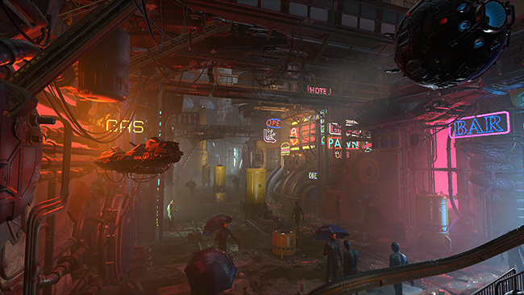
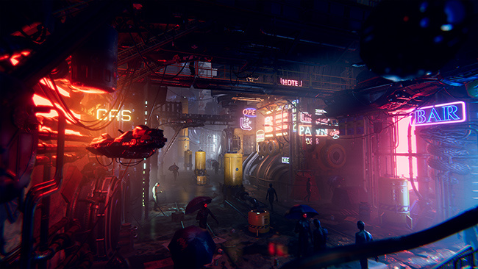
Image-space effects
Rendered image can be directly sent to display or additionally modified before display → post-processing
Post-processing is set of operations performed on a rendered image → image-space effects
  This way, additional effects for achieving realism or artistic styles is possible
Without post-processing
With post-processing

Slide 5
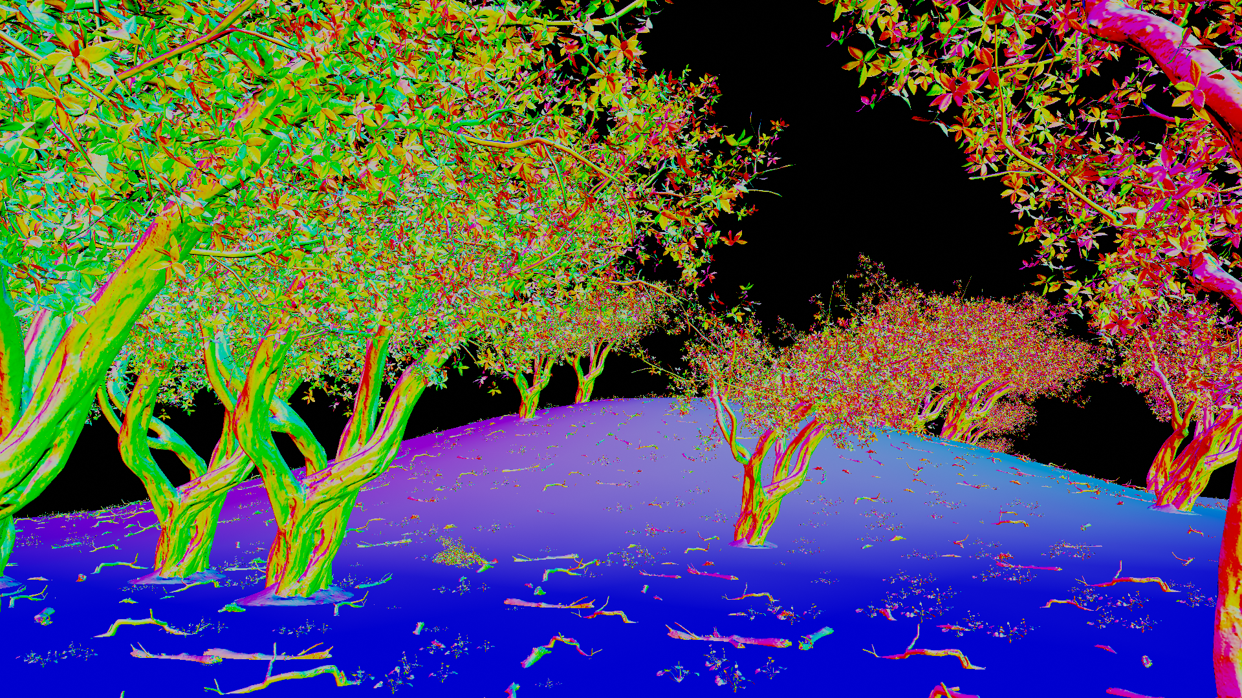
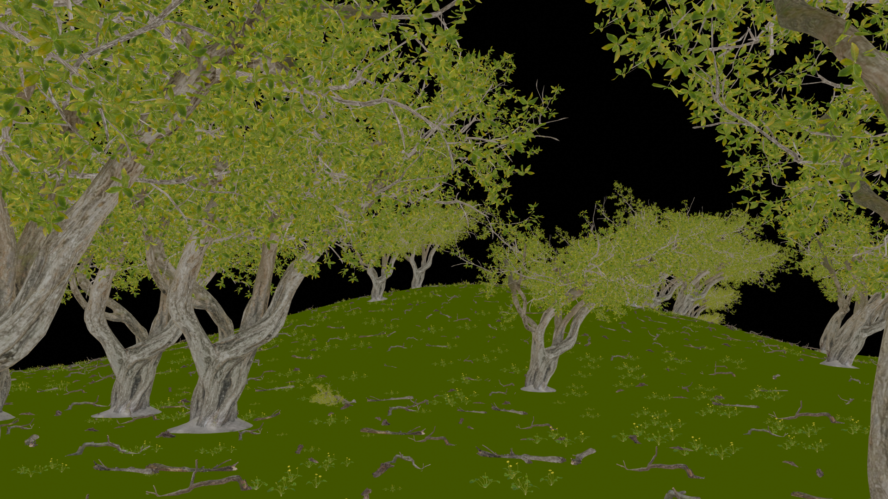
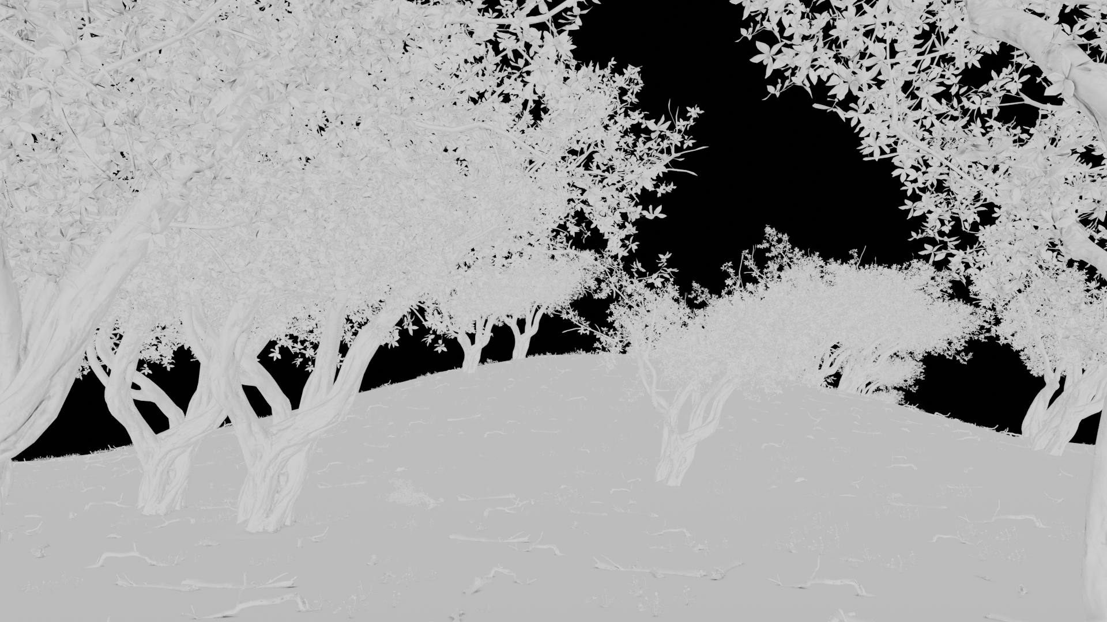
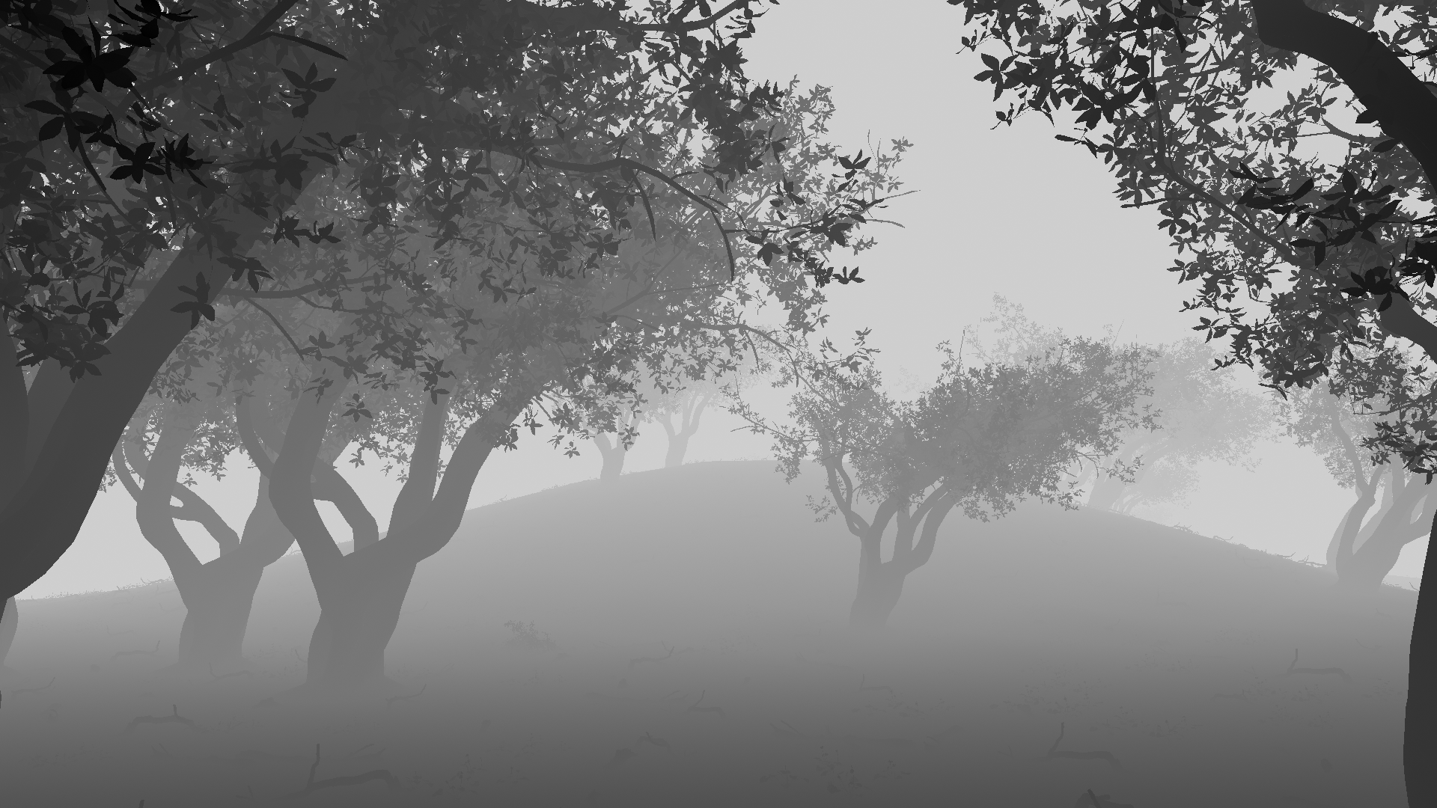
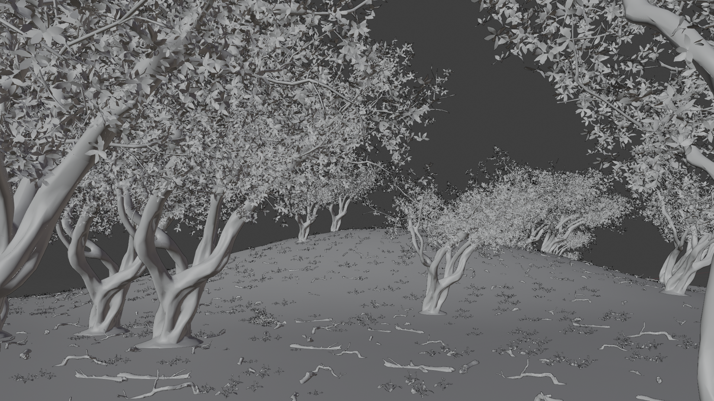
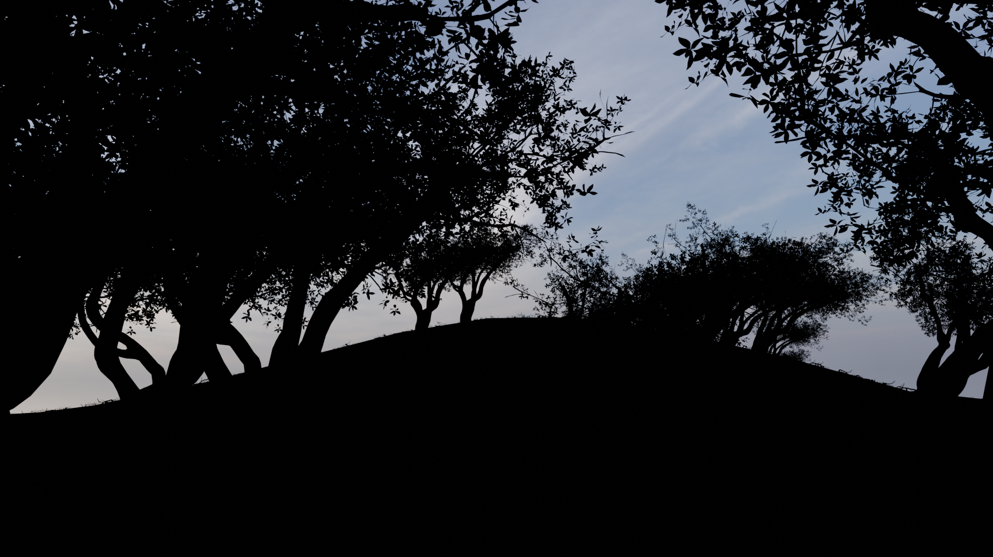
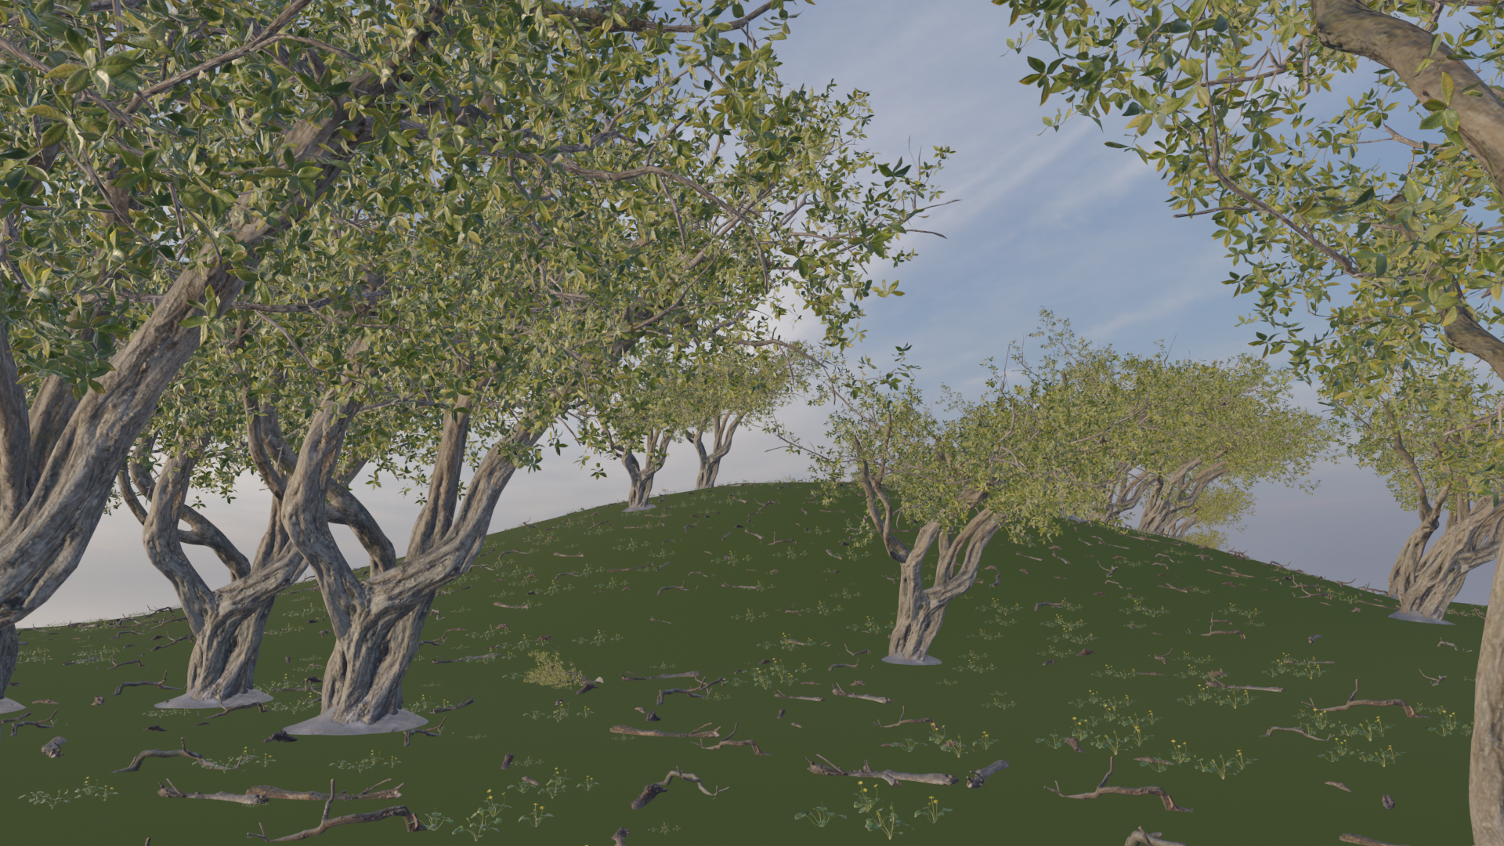
Post-processing data
Post-processing of one frame can use multiple buffers (images) obtained during rendering:
  Color, diffuse, normal, AO, depth, environment, etc.
Normals
Diffuse color parameter
AO
Depth
3D scene
Environment only
Color buffer

Slide 6
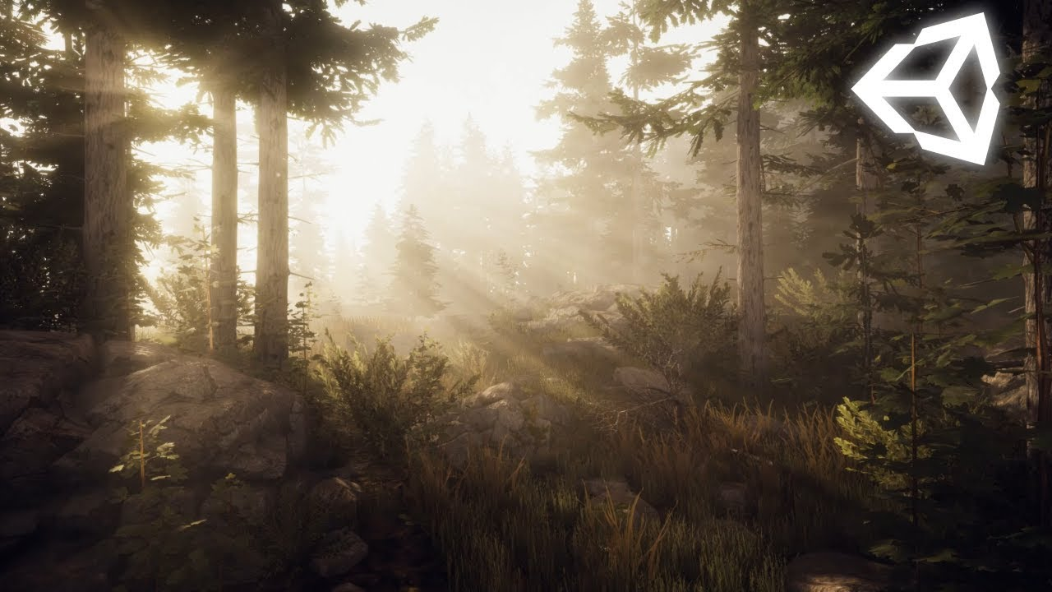
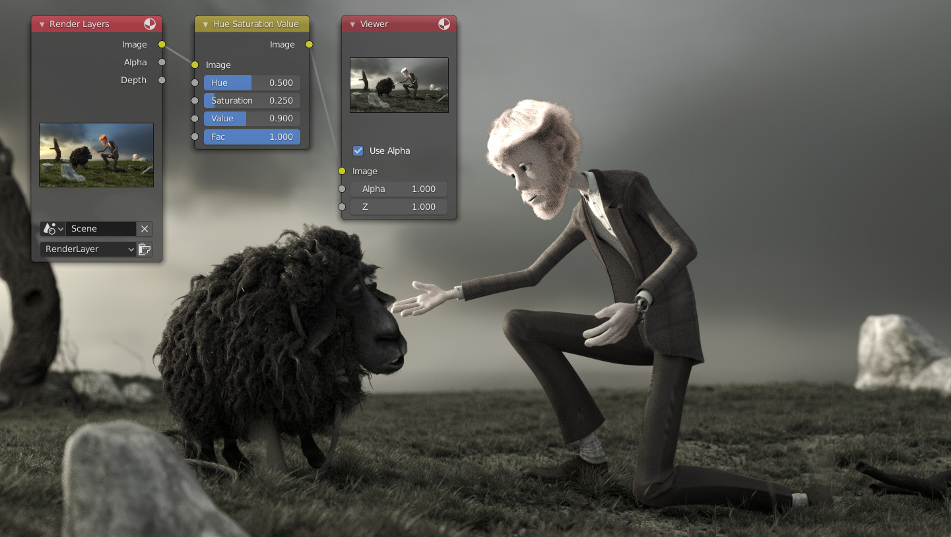
Performing post-processing
Depending on rendering environment, post-processing of frame can be performed:
  Real-time, multi-pass, render-time
    3D scene is rendered to an offscreen buffer, such as color (image) buffer
    Resulting image is treated as image texture which is applied on screen filling quad
    Post-processing is done on this texture using programmable GPU shaders (e.g., fragment or compute shaders)
  Offline, compositing software
    3D scene is rendered to image file
    Post-processing is done on images which are stored as separate frames
Render-time post-processing (e.g., Unity)
Offline post-processing (e.g., Blender compositor)

Slide 7
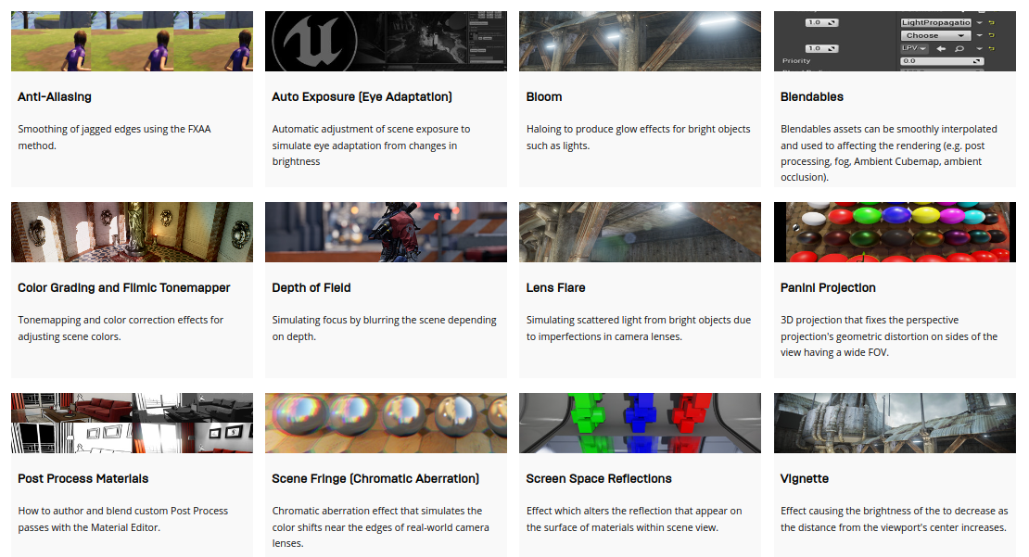
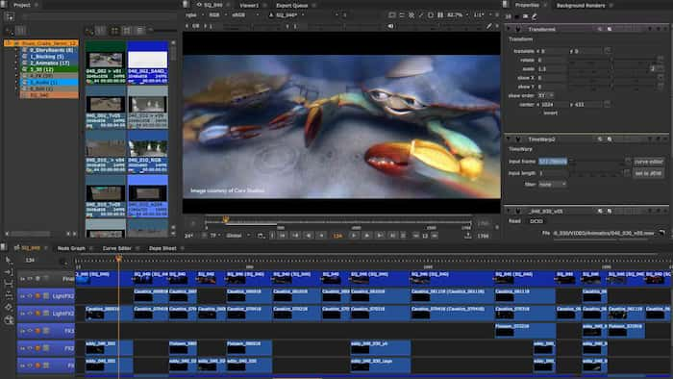
Post-processing in practice
Real-time, multi-pass:
  Unity: https://docs.unity3d.com/Manual/PostProcessingOverview.html
  Godot: https://docs.godotengine.org/en/stable/tutorials/shaders/custom_postprocessing.html
  Unreal: https://docs.unrealengine.com/4.27/en-US/RenderingAndGraphics/PostProcessEffects/
  OpenGL: https://learnopengl.com/In-Practice/2D-Game/Postprocessing
Offline:
  Blender: https://docs.blender.org/manual/en/latest/compositing/introduction.html
  Nuke: https://www.foundry.com/products/nuke-family/nuke
  After Effects: https://www.adobe.com/products/aftereffects.html
  Discussion: https://www.youtube.com/watch?v=7g4xCV0iv4w&ab_channel=InspirationTuts
Unreal post-process
Nuke post-process

Slide 8
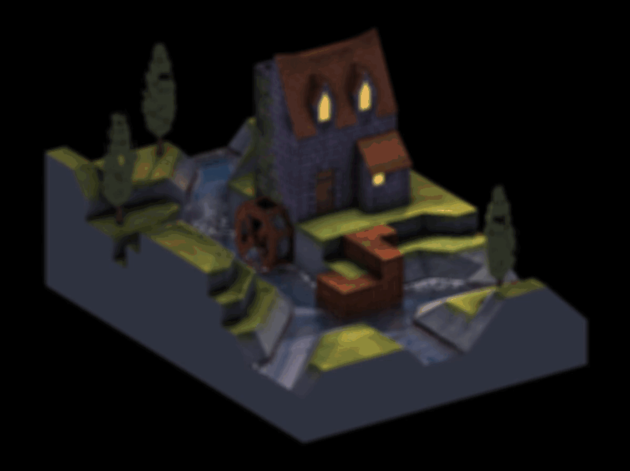
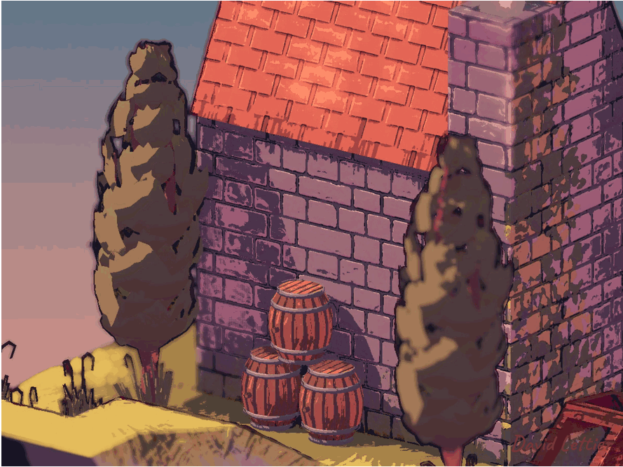
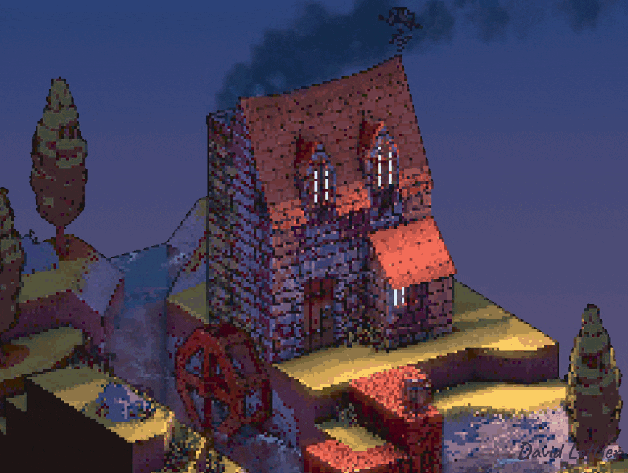
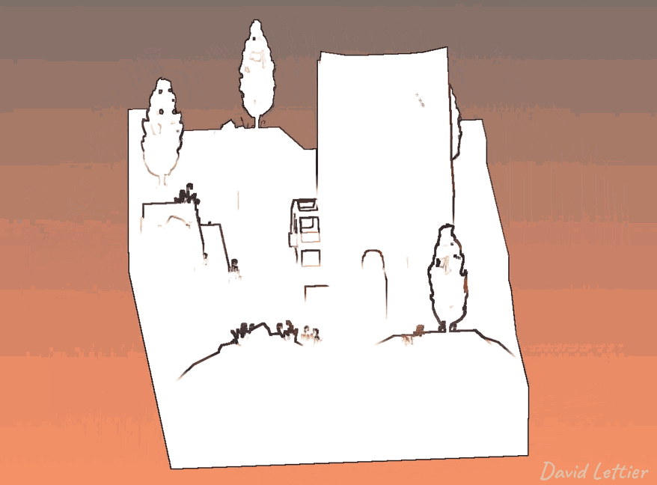
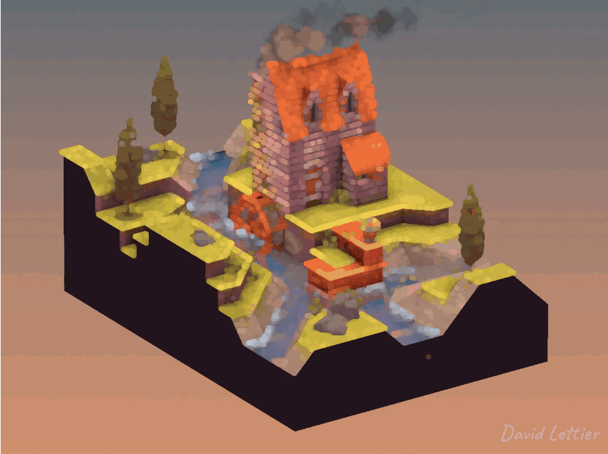
Post-processing using image processing
Rendered image can be post-processed as any other image using image processing techniques (filtering kernels) in shader or CPU.
Blur
Posterization/quantization
Pixelization
https://lettier.github.io/3d-game-shaders-for-beginners/posterization.html
Edge detect
Dilatation

Slide 9
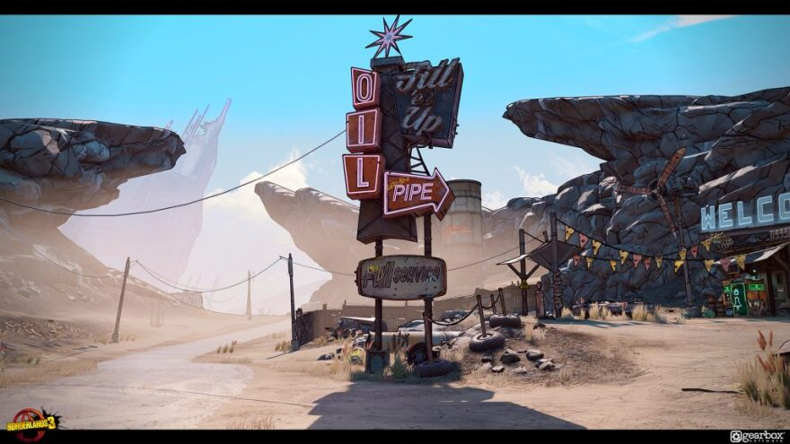
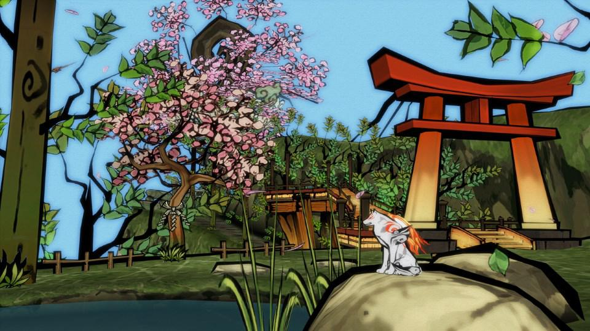
Post-processing and NPR
Often image processing techniques are used to achieve non-photo realistic rendering effects
Edge detection (Borderlands)
Edge detection and quantization (Okami)

Slide 10
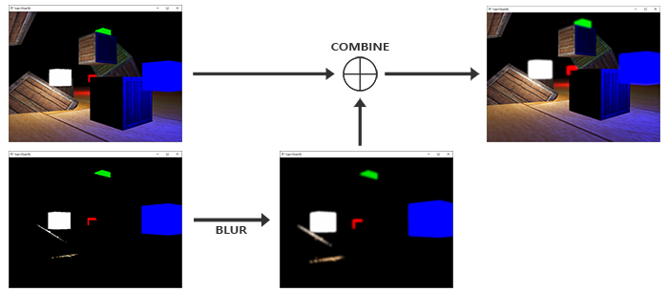
Post-processing: bloom
Bloom occurs in camera when charged site in CCD gets saturated and overflows into neighboring sites
Effect where extremely bright area spills over adjoining pixels → making image look overexposed where it is bright
Concept:
  Render whole scene in color buffer
  Render only bright objects into separate buffer
  Blur buffer with bright objects only (e.g., Gaussian Blur)
  Combine buffers
https://learnopengl.com/Advanced-Lighting/Bloom

Slide 11
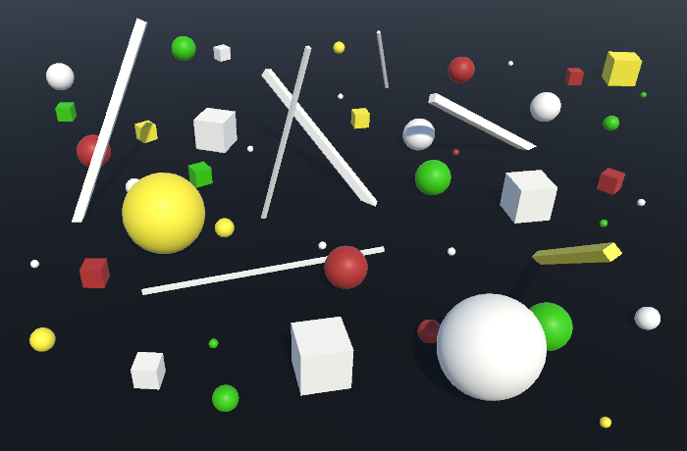
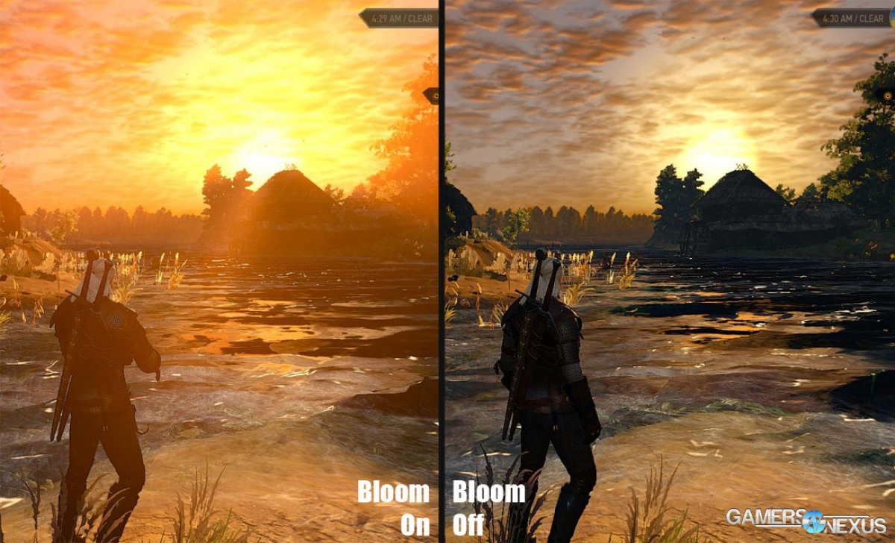
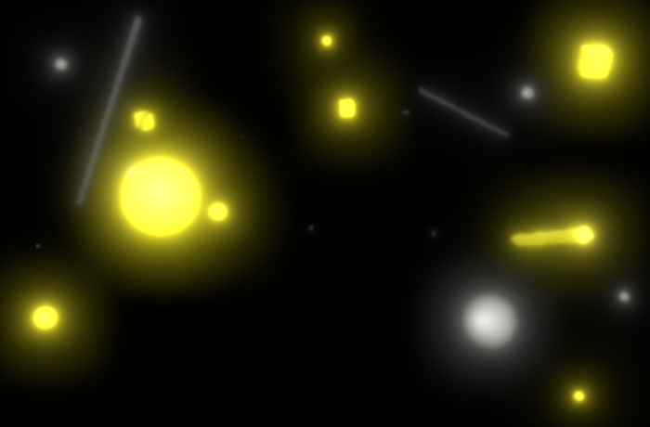
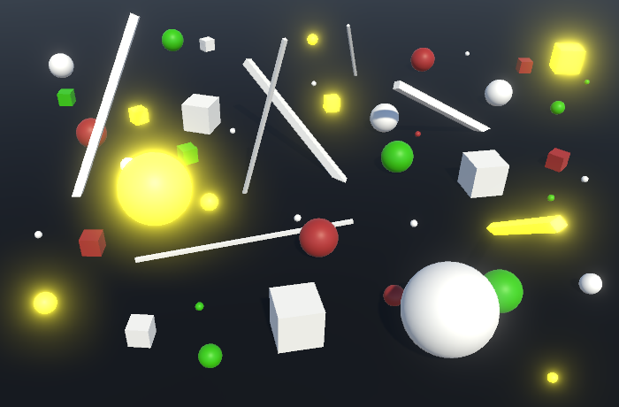
Bloom: examples
Bloom is one type of glare effects. Other glare effects are lens flare: halo and ciliary corona
Color buffer
Bloom
Blurred bright objects buffer
Combined buffers
https://catlikecoding.com/unity/tutorials/advanced-rendering/bloom/

Slide 12
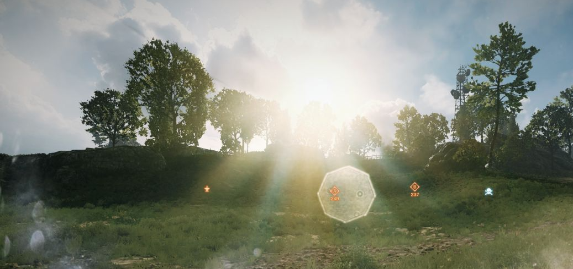
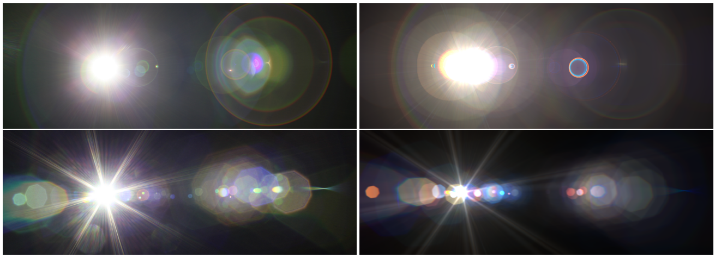
Post-processing: lens flare
Flare phenomena: caused by light traveling through a lens system
Main types: halo (ring around light) and ciliary corona (rays radiating from a point)
  Dependent on light source position
Various approaches exist. Examples:
  Set of squares with different textures, oriented on a line going from the light source potion screen through the screen’s center
  Light streaks from bright object can be simulated using steerable filter on a down sampled image
Lens flare (Battlefield)
Lens flare simulation https://resources.mpi-inf.mpg.de/lensflareRendering/pdf/flare.pdf

Slide 13
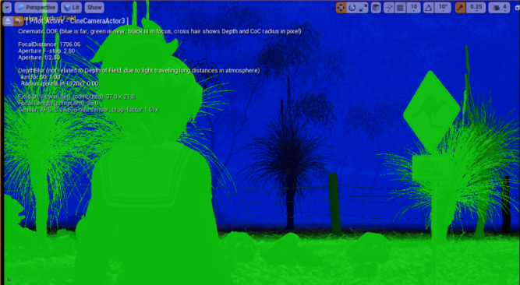
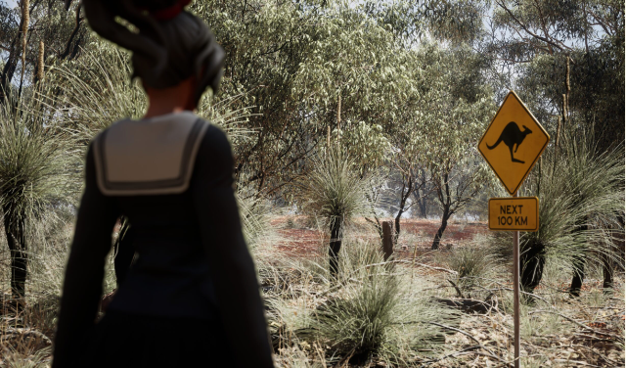
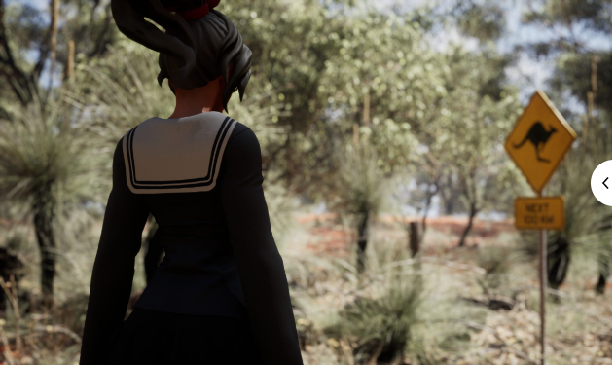
Depth of field
Depth of field: range where objects are in focus. Outside objects are blurred
Smaller camera aperture size → increased depth of field
  Pinhole cameras: infinite depth of field
Various methods exist. One solution:
  Create separate image layers: e.g. near, far
  Near and far layers are blurred
  Final image is made by combining blurred and layers in focus using back to front compositing
https://www.versluis.com/2022/01/ue4-dof/
https://catlikecoding.com/unity/tutorials/advanced-rendering/depth-of-field/
https://developer.nvidia.com/gpugems/gpugems/part-iv-image-processing/chapter-23-depth-field-survey-techniques

Slide 14
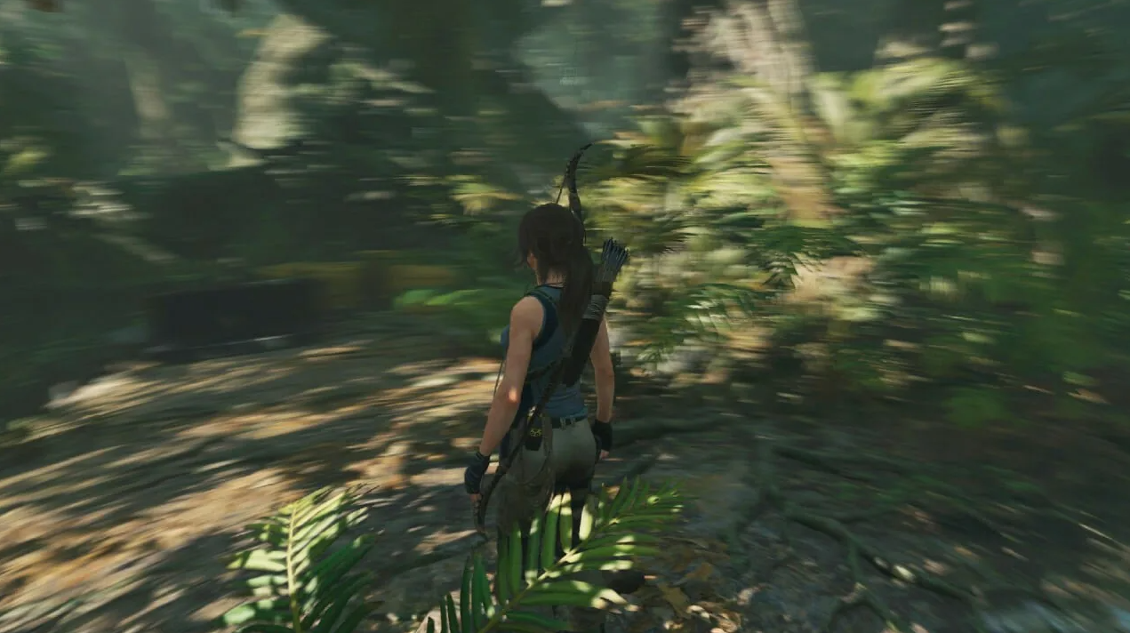
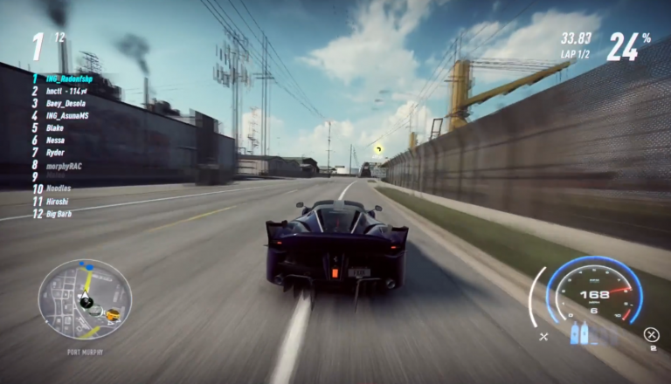
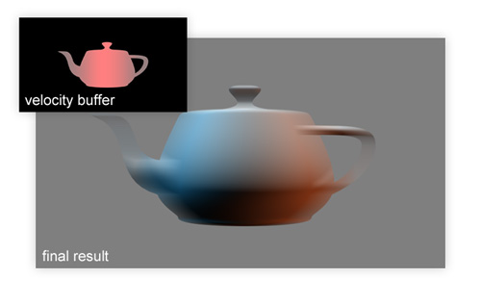
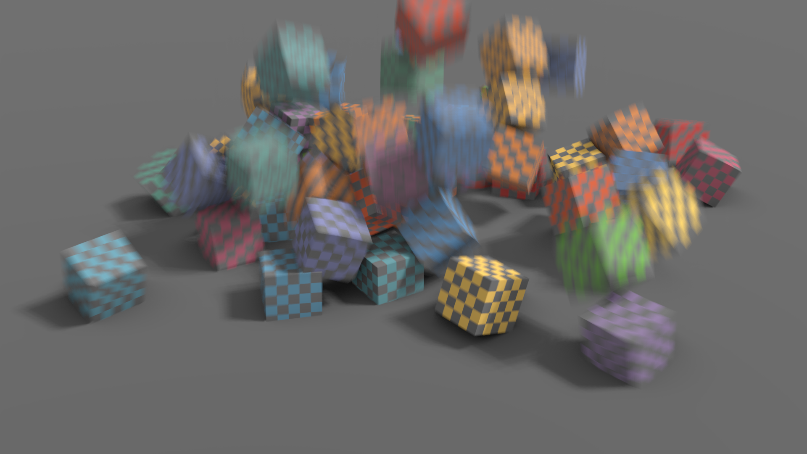
Motion blur
Motion blur comes from movement of an object across the screen or from camera movement
Different sources of motion blur require different methods
  Camera orientation changes → e.g., circular blur around view axis if camera is rotating around view axis or directional blur based on orientation direction
  Camera position changes → radial blur
  Object position/orientation changes → motion of each object is computed using depth or velocity buffer buffer for determining amount of blur
Directional blur due to camera orientation change (Tomb raider)
Radial blur due to camera position change (Need for speed)
Object rotation and position change blur using velocity buffer
http://john-chapman-graphics.blogspot.com/2013/01/per-object-motion-blur.html

Slide 15
Displaying and storing images

Slide 16
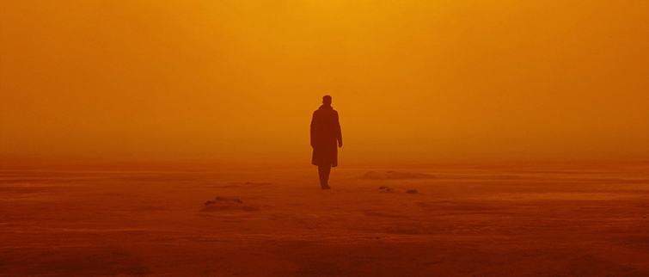
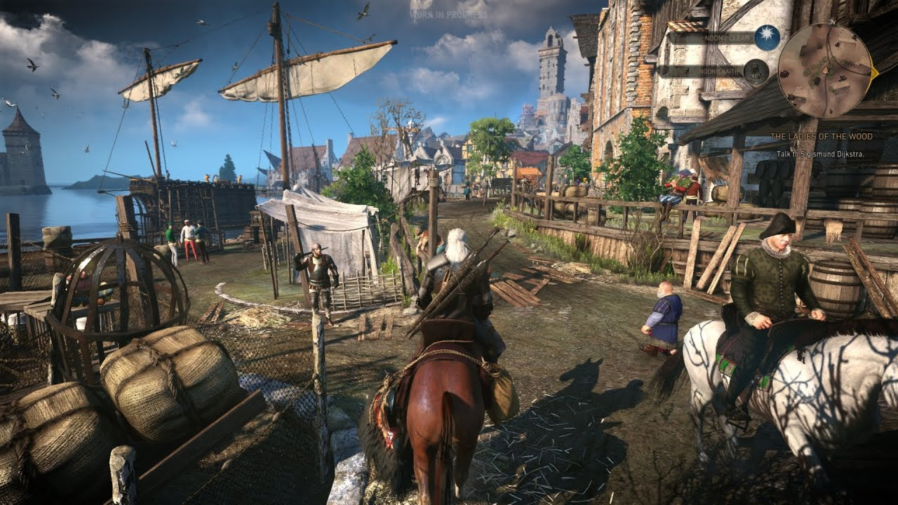
Digital imagery
Digital imagery appears in all forms of media. Most of these are:
  Digital photographs or other types of 2D pictures scanned or loaded in computer
  Images generated using computer graphics: 3D modeling and rendering software
Digital photography https://www.warnerbros.com/movies/blade-runner-2049
Rendered image: https://www.thewitcher.com/en/witcher3

Slide 17
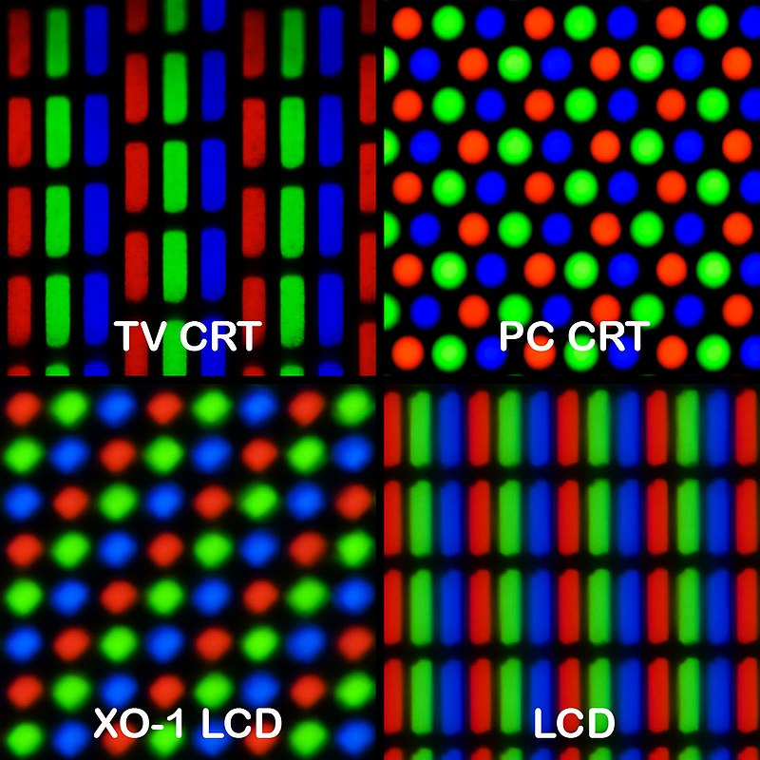
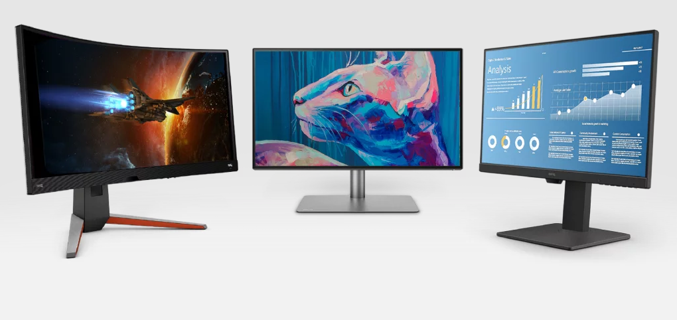
Display device
Digital images are displayed on a raster display device → raster images
  e.g., monitor, television screen, etc.
Raster display device is made of arrays of pixels → discrete representation
  For example, each pixel of image created with digital camera (or rendering) stores red, green and blue value used to drive the red, green and blue values of screen pixel
https://en.wikipedia.org/wiki/Pixel_geometry
https://www.benq.eu/en-eu/monitor.html

Slide 18
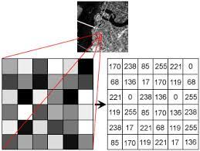
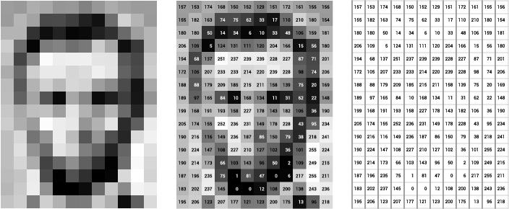
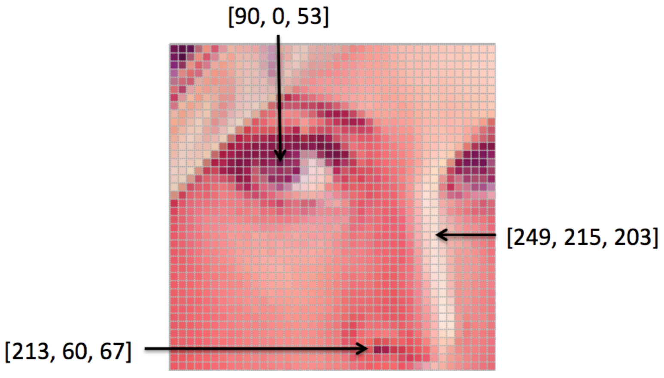
Raster image graphics
Raster images are rectangular array of values called pixels.
All values in such array have the same type, examples:
  Floating point numbers representing levels of gray
  Floating point triplets representing mixture of red, green and blue (RBG)
  Floating point numbers representing depth from camera
Such rectangular array of numbers can be interpreted in many ways
  Arbitrary information can be stored/encoded in such array
  Numbers in array do not have particular significance until stored in certain standardized file format
https://ai.stanford.edu/~syyeung/cvweb/tutorial1.html

Slide 19
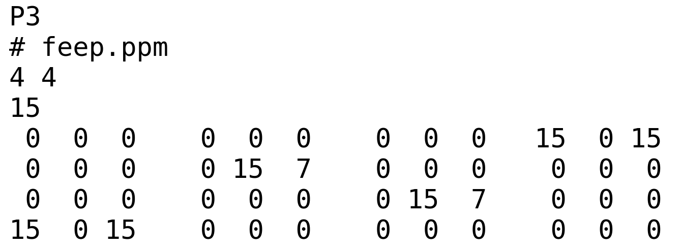
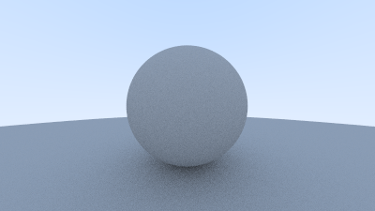
Naive image file format: PPM
Portable Pixel Map (PPM): text-based (P3) image file format
Header:
  Width(w) and height (h) of image is specified
  Maximum color value
Pixel values:
  3 * w * h color values representing red, green and blue components of pixel
  Pixel values ordering: left-to-right, top-to-bottom
  Separated by white-space
Naive image file format:
  Easy to write and analyze
  Inefficient and highly redundant (compression is not present)
  Little information about image
https://raytracing.github.io/books/RayTracingInOneWeekend.html
Text-based version carries code P3, binary version carries code P5. More information: https://netpbm.sourceforge.net/doc/ppm.html

Slide 20
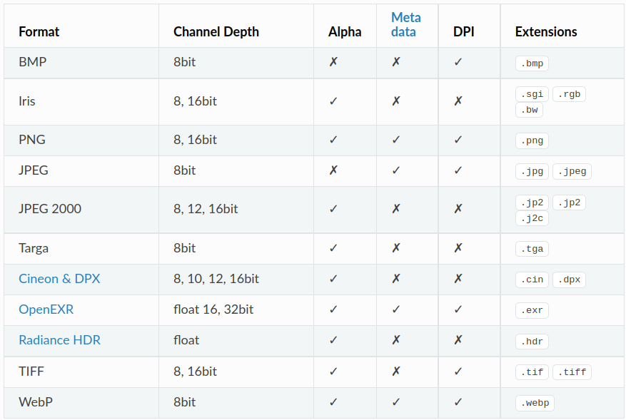
Raster image file formats
https://docs.blender.org/manual/en/latest/files/media/image_formats.html

Slide 21
Raster image file formats
Images are stored in many formats, closely related to the display format
File formats use different compression strategies:
  Lossless compression is one in which data occupies less space but from which original data can be reconstructred.
  Lossy compression is resulting in even less occupied space, but original data can not be restored. Nevertheless, existing data is enough for intended use
Content is described in terms of channels
  e.g., red values for all pixels represents red color channel
  e.g., depth values form depth channel
  e.g., transparency values from alpha channel
Some formats additionally store metadata
  e.g., bit depth of color channel (e.g., 8 bit)
  e.g. information on when and with which program the image was produced
https://www.gimp.org/tutorials/ImageFormats/

Slide 22
File formats in production
Digital painting and image manipulation
  Krita: bmp, jp2, jpeg, ora, pdf, png, ppm, raw, tiff, xcf https://krita.org/en/item/krita-features/
  Gimp: XCF, JPG, PNG, GIF, TIFF, Raw, etc. https://www.gimp.org/tutorials/ImageFormats/
3D modeling
  Blender: BMP, Iris, PNG, JPEG, Targa, OpenEXR , TIFF, HDR, etc. https://docs.blender.org/manual/en/latest/files/media/image_formats.html
  Houdini: png, gif, jpg, tiff, etc. https://www.sidefx.com/docs/houdini/io/formats/image_formats.html
Game engines:
  Unity: BMP, TIF, TGA, JPG, PNG, PSD, etc. https://docs.unity3d.com/2019.2/Documentation/Manual/AssetTypes.html
  Godot: BMP, OpenEXR, JPEG, PNG, SVG, etc. https://docs.godotengine.org/en/stable/tutorials/assets_pipeline/importing_images.html

Slide 23
Raster image file formats
Often used raster image file formats are:
  Joint Photographic Experts Group - JPEG
  Portable Network Graphics - PNG
  Tag Image File Format - TIFF/TIF
Advanced image file formats:
  OpenEXR (https://github.com/AcademySoftwareFoundation/openexr)
  HDRI: High Dynamic Range Image
Library for handling different file formats for computer graphics applications: https://github.com/OpenImageIO/oiio

Slide 24
JPEG
Recommended for display and storage of photography
Pros:
Efficient file compression
Universally supported for display
Most digital cameras produce JPEG images
Cons:
Lossy
  Problematic for comparing the image due to differences in compression algorithm
  Repeated editing degrades image quality
Artifacts can be seen for computer generated graphics and text
Doesn’t support transparency
Color channels are coded on 8 bits
http://www.faqs.org/faqs/jpeg-faq/part1/

Slide 25
PNG
Developed as an improved replacement for Graphics Interchange Format (GIF)
Recommended for web page widgets, computer graphics and screenshots
Pros:
Lossless format
Supports transparency
Small file size for most computer graphics generated images
Support by all browsers
PNG file format is more compact than PPM and equally easy to use
Support for RGB(A) and grayscale images
Cons:
Complex images are heavier
Color channels coded in 8 bits

Slide 26
TIFF
Used for storage and exchange of high quality images
TIFF is ideal for representing intermediate or final results
  In image editing and compositing tools, multiple images are often blended or laid atop one another
Pros:
Color coding in 16 bits
Supported by all image processing software
TIFF images store multiple channels (images/layers)
  Each channel store description of contents
Various compression schemes
  uncompressed
  Compressed with lossless scheme
  Compressed with lossy scheme
Cons:
Heavier on complex images

Slide 27
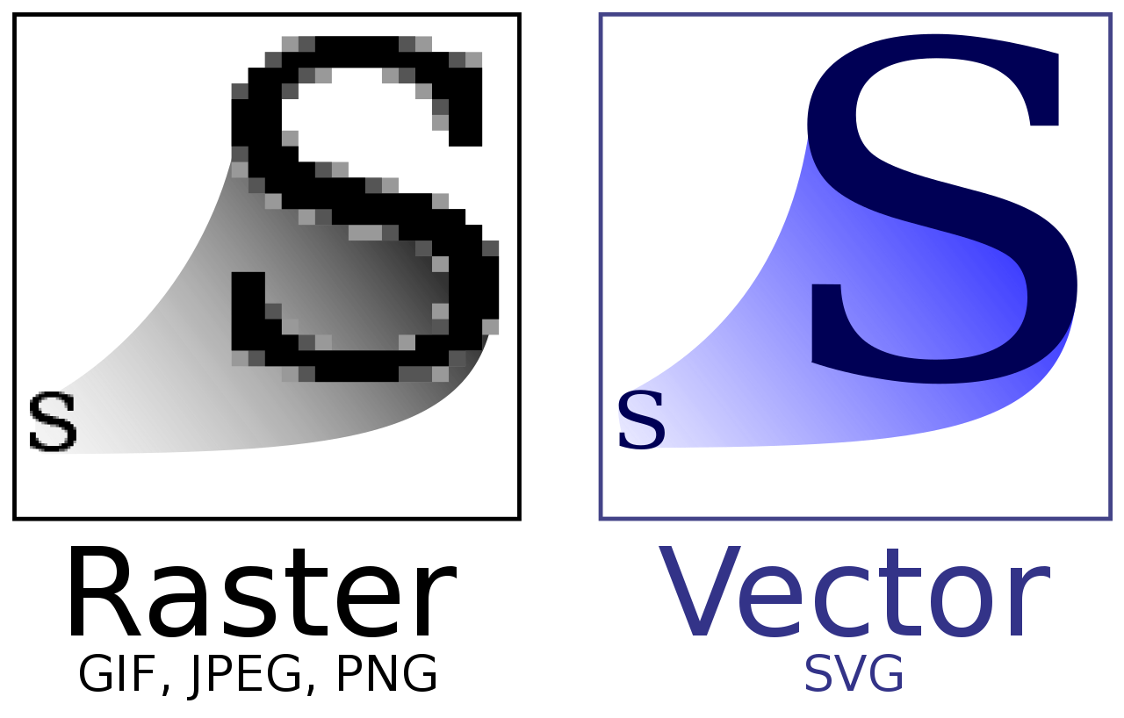
Vector graphics images
Alternative to raster graphics image is vector graphics image
  Images are created directly from geometric shapes defined on 2D Cartesian coordinate system
  Information in such image is stored as points, lines, curves and polygons
Today, raster-based monitors and printers are typically used
  Nevertheless, vector data and software is used in applications where geometric precision is required: engineering, architecture, typography, etc.
  To display an image, rendering is performed to evaluate analytically defines shapes on raster display
https://en.wikipedia.org/wiki/Vector_graphics

Slide 28
Aliasing and anti-aliasing
When continuous becomes discrete

Slide 29
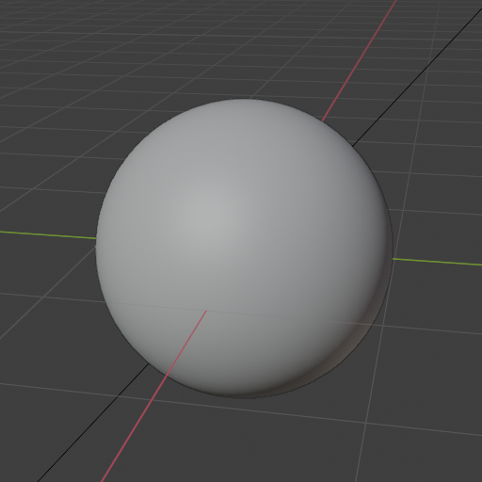
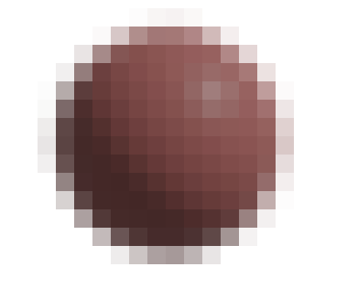
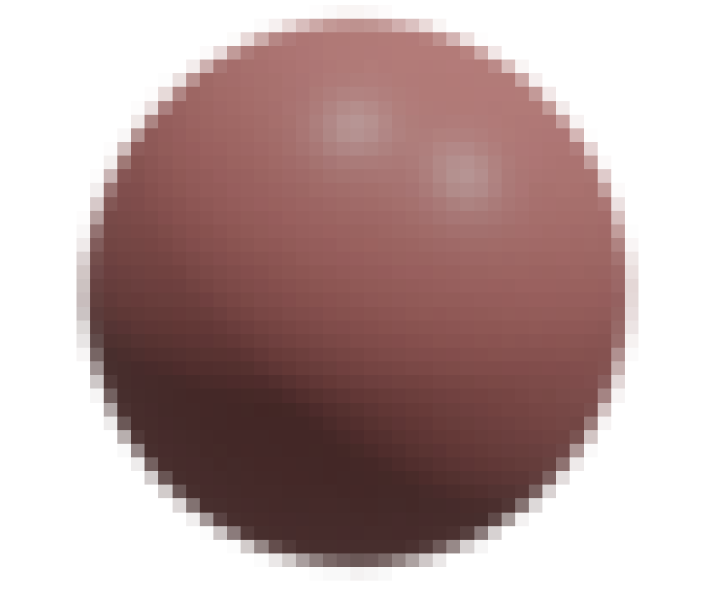
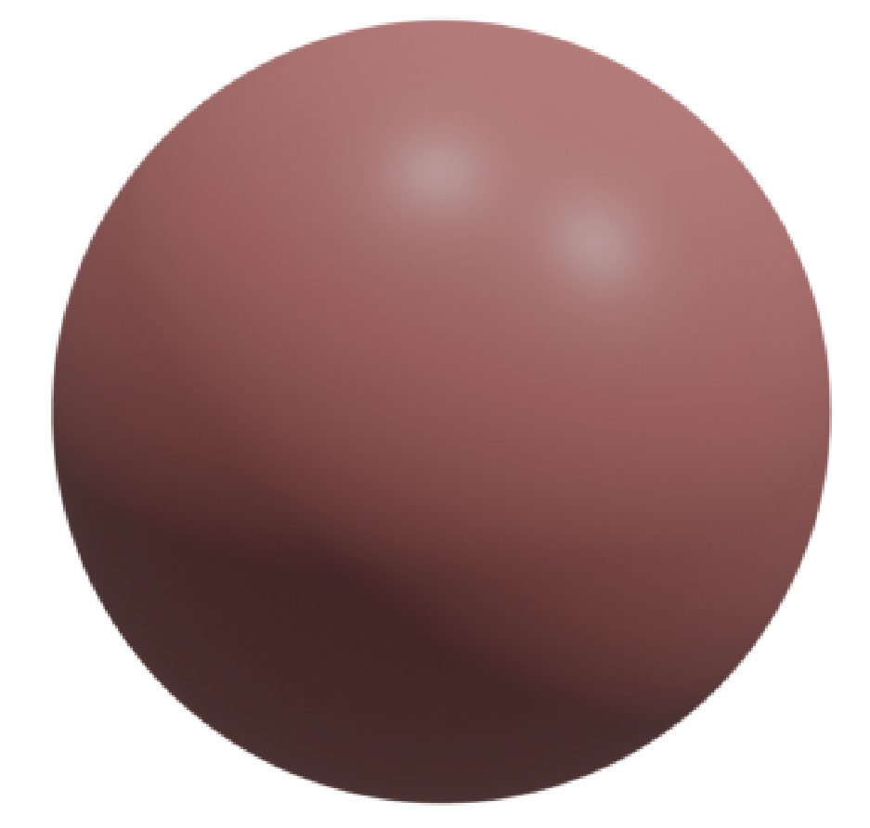
Continuous and discrete
Images are discrete array of pixels
3D scene objects, lights and thus color values are continuously changing
Rendering process, in order to create a discrete image of 3D scene, samples the pixels on image plane, finds corresponding sample in 3D scene and calculates color of the sample.
Render: 20x20px image size
Render: 64x64px image size
Render: 512x512px image size
Continuous object in 3D scene

Slide 30
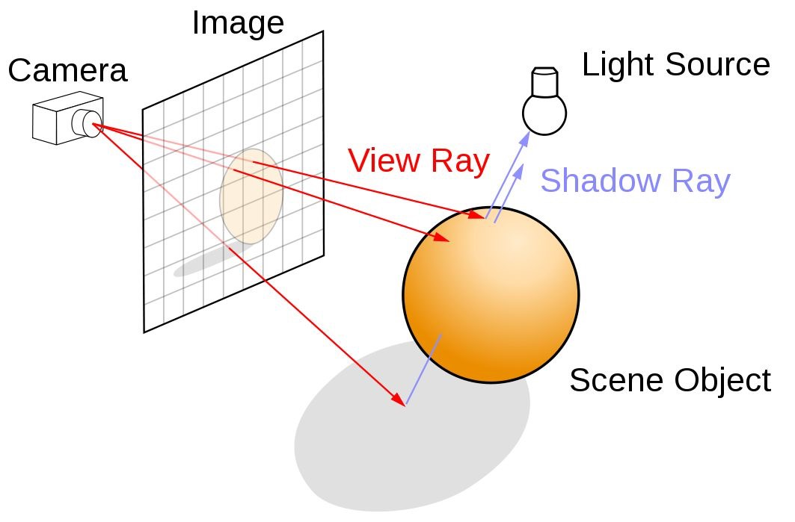


Scene sampling and Image buffer
Process of rendering images is inherently a sampling task
Rendering is the process of sampling a 3D scene in order to obtain colors for each pixel in the image
  Using camera information, samples per image pixel are generated
  For each sample, corresponding 3D scene point is found and color is calculated (ray-tracing, rasterization)
  Color of each pixel for each sample is combined into image buffer
128x128px
1spp
128x128px
64spp
Note that pixel can have only one color!
Pixels overlapping multiple objects/textures in 3D scene must be sampled with multiple rays to obtain correct representation.

Slide 31


Aliasing
Discretizing 3D scene (continuous information) may cause Aliasing
  Jagged edges, flickering highlights (firelfys), Moiré pattern
Discretization
Problem: Moiré pattern
Problem: Jagged edges

Slide 32



Aliasing: intuition
Projecting pixel into 3D scene can cover larger portion of 3D scene which contain multiple objects and thus color variation.
Any kind of rapid (high-frequency) change in geometry edges, textures, shadows, highlights can cause aliasing.
Extreme example: one whole object in pixel footprint.
Thread contains large amount of details covered by only one pixel
Changes in geometry, textures, highlights → sources of aliasing.

Slide 33




Aliasing
Blue: original signal
Red: samples
Green: reconstructed signal
Sampling freq is too small!
Aliasing – Occurs if signal is sampled at too low frequency
  Reconstruction of signal from samples can not be performed correctly, e.g., reconstructing final image from pixel samples (filtering)
Sampling theorem: Sampling frequency must be twice the maximum frequency of sampled signal; Nyquist rate/limit
  As maximum frequency must be known for determining the sampling rate, signal must be band-limited
3D scenes are normally never band-limited when rendering with point samples
  Sharp triangle or shadow edges → discontinuous changes → infinite frequencies
  Rapid change of color, e.g., specular highlights
Point sampling is almost always used and entirely avoiding aliasing is not possible
  Sampling pixel footprint which may contain lots of information requires a lot of samples
Sampling freq is too small!
Sampling freq is good!
Sampling freq is good!
http://195.134.76.37/applets/AppletNyquist/Appl_Nyquist2.html

Slide 34
Anti-aliasing
Most common anti-aliasing method: screen-based anti-aliasing
  Using multiple samples per pixel during rendering
Anti-aliasing can be applied on: geometry, textures, shadows, highlights, etc.
  At times, when it is possible to know if the signal is band limited and then anti-aliasing is performed
  Trade-off between: quality, ability to capture sharp details or other phenomena, appearance, memory and speed
Instead of one ray per pixel, generate multiple rays - samples

Slide 35



Multisample anti-aliasing
Aliasing appears always when there are a lot of details under a pixel footprint in the scene
To solve this, multiple sample per pixels can be used to “catch” high frequency details.
  This method is called Multisample anti-aliasing (MSAA)
One sample per pixel
MSAAx4
https://vulkan-tutorial.com/Multisampling
https://therealmjp.github.io/posts/msaa-overview/

Slide 36


Multisample anti-aliasing
Using more samples per pixel reduces aliasing.
  One sample per pixel is often not enough to reconstruct the image
1 ray per pixel
32 rays per pixel
Analogy
Analogy
Sampling freq is too small!
Sampling freq is good!

Slide 37

Antialiasing: sampling schemes
Using more samples per pixel and combining those results in more representative pixel color
Different pixel sampling schemes exists: trade-off between quality and speed

Slide 38
Supersampling
Supersampling or oversampling Antialiasing algorithms take more than one sample per pixel
  Full-screen anti-aliasing (FSAA) or super sampling antialiasing (SSAA)

Slide 39
Limitations of display device

Slide 40
Limitation of display device
3D scene contains:
  Continuous description of objects (e.g., triangles, parametric surfaces, etc.)
  Strong light sources and reflections (e.g., point lights, specular reflections)
Display devices are limited (discrete):
  Resolution (number of pixels)
  Brightness (intensity)
  Contrast
  Color (gamut)
Rendered images may contain values which can not be directly shown on display devices
* also optical-electrical transfer function describe the other end of the process for image and video capture devices

Slide 41
Display limitations
Display devices have nonlinear relationship between input voltage and display amount of light
  As energy level applied to pixel is increased, the amount of light emitted doesn’t grow linearly but according to power law → nonlinear relationship
    e.g., pixel set to 50% will emit 0.5² amount of light
Present since early display devices, e.g., cathode-ray tube (CRT) and also for modern display devices, e.g., LCDs
  Relationship between digital color values in image buffer and amount of light emitted from the display is described with electrical-optical transfer function (EOTF)*

Slide 42

Problem: displaying rendered images
All input values (e.g., texture image) for rendering and all values during rendering computation must be in linear colorspace
  Linear values are needed for correct addition and multiplication operations
Rendered image containing linear color space will not display correctly if shown directly on a display device
  Linear values will appear too dim on the screen
https://www.sidefx.com/docs/houdini/render/linear.html

Slide 43

Solution: display encoding
When encoding linear color values for display, the goal is to cancel out the effect of display transfer function
  Inverse of display transfer function (EOTF) is applied to color values in image buffer → gamma correction
  Standard transfer function for personal computer display is called sRGB
https://www.realtimerendering.com/

Slide 44
Gamma correction
Gamma correction is last step in rendering and post-processing – when everything is computed and image is ready for display.
  To encode rendered image which is in linear colorspace (x) for sRGB display (y) the following formula is applied to all color values:
    y = x^{1 / gamma} , gamma = 2.2

Slide 45


Problem: preparing data for rendering
When working in modeling tools users pick texture images or colors on screen - those colors are encoded for display device so we can see them properly
  Those colors can not be used in rendering computation directly because they are in non-linear space

Slide 46
Solution: inverse gamma correction
Everything we see on the screen (e.g., image textures or color-pickers in modeling tools) is display-encoded data and those values must be decoded to linear values for rendering
  To decode sRGB display encoded values (y) to linear colorspace (x) the following formula is applied to all color values:
    x = y^{gamma}, where gamma = 2.2

Slide 47
Advanced display encoding
We discussed display encoding for standard dynamic range monitors (SDR) which use sRGB display standard
High dynamic range (HDR) displays and different display devices used other display standards which must be applied accordingly.
Merge with prev

Slide 48
Imaging pipeline
Imaging pipeline describes color handling from initial rendering to final display.
Rendering: calculating image color based on 3D scene description.
  The results are pixel values in color buffer – display results still needs to be determined.
Display encoding is process in which linear color (radiance) values are converted to nonlinear values for display
Tone mapping: performed between rendering and display encoding
Scene-referred image state
Display-referred image state
Linear display
color
Non-linear
display
color
Linear
display
color
Rendering
Linear scene
color
Tone mapping
Display encoding
Display
Viewer/
User
Defined in reference to scene color (radiance) values
Physically-based rendering computations
Defined in reference to display color (radiance) values.
Appropriate for viewing

Slide 49
Tone mapping
Tone mapping (end-to-end or scene-to-screen transfer) is about converting scene color values to display color (radiance) values
  Goal 1: image reproduction - create display-referred image that reproduces, as closely as possible given display and viewing properties, perceptual impression that viewer would have if they were observing original scene.
  Goal 2: preferred image reproduction – create display-referred image that looks better (to some criteria) than original scene.

Slide 50

Tone mapping: (1) image reproduction
Reproduce a similar perceptual impression as the original scene, problems:
  Original scene luminance and saturation exceeds display capabilities
Exposure is critical to image reproduction
  Exposure in photography refers to controlling the amount of light falling on film/sensor.
  In rendering, exposure is a linear scaling operation performed on scene-referred image before tone mapping is applied.
re-read
https://learnopengl.com/Advanced-Lighting/HDR

Slide 51

Image reproduction: exposure
Different exposures of the same render: https://docs.blender.org/manual/en/latest/render/color_management.html

Slide 52
Image reproduction
Process of transforming floating point scene color values to the expected [0,1] range for low dynamic range display without loosing too much detail
Global tone mapping:
  Same mapping applied to the whole image → tone reproduction transform
Local tone mapping:
  Different mapping pixel-to-pixel based on surrounding pixels and other factors
re-read

Slide 53


Global tone mapping: tone reproduction transform
Reinhard tone reproduction operator
  Commonly used method for computing exposure: compute average of pixel brightness of rendered image
  Leaves dark values unchanged and bright values asymptotically to white
ACES tone mapping
  Standard for tone managing for motion picture and television
  Emerging in real-time applications: Unity and Unreal
Other tone mapping transforms
re-read
https://www.researchgate.net/publication/221039985_Spatio-temporal_Tone_Mapping_Operator_Based_on_a_Retina_Model

Slide 54
Tone mapping: (2) preferred image reproduction
Color grading: creative manipulation of image colors to obtain image desired artistic look
Grading look-up tables (LUTs) contain desired color transformations which are applied on image
  e.g., baked color curves
Color grading is possible on:
  Scene-referred images: produce high fidelity results
  Display-referred images: easier to set-up

Slide 55



Color grading
https://advances.realtimerendering.com/other/2016/naughty_dog/NaughtyDog_TechArt_Final.pdf

Slide 56
More into topic
Image space effects:
  Motion blur: https://www.nvidia.com/docs/io/8230/gdc2003_openglshadertricks.pdf
  Motion blur: https://developer.nvidia.com/gpugems/gpugems3/part-iv-image-effects/chapter-27-motion-blur-post-processing-effect
  Motion blur: https://www.bryanmcphail.com/wp/?p=600
  Motion blur: https://docs.blender.org/manual/en/latest/render/cycles/render_settings/motion_blur.html
  NPR: https://en.wikipedia.org/wiki/Non-photorealistic_rendering
  General post-processing: https://docs.unity3d.com/Packages/com.unity.render-pipelines.universal@7.1/manual/integration-with-post-processing.html
Color:
  https://developer.nvidia.com/sites/default/files/akamai/gameworks/hdr/UHDColorForGames.pdf
  https://cinematiccolor.org/
Color grading:
  http://filmicworlds.com/blog/minimal-color-grading-tools/
  https://docs.unrealengine.com/4.27/en-US/RenderingAndGraphics/PostProcessEffects/ColorGrading/

Slide 57
Repository
https://github.com/lorentzo/IntroductionToComputerGraphics

