Slide 1
Outro
DHBW, Computer Graphics
Lovro Bosnar
29.3.2023.

Slide 2
Plan
Review
Where to next?

Slide 3
Review

Slide 4
“Computer graphics is science and art of communicating visually via computer display and its interaction devices”

Slide 5
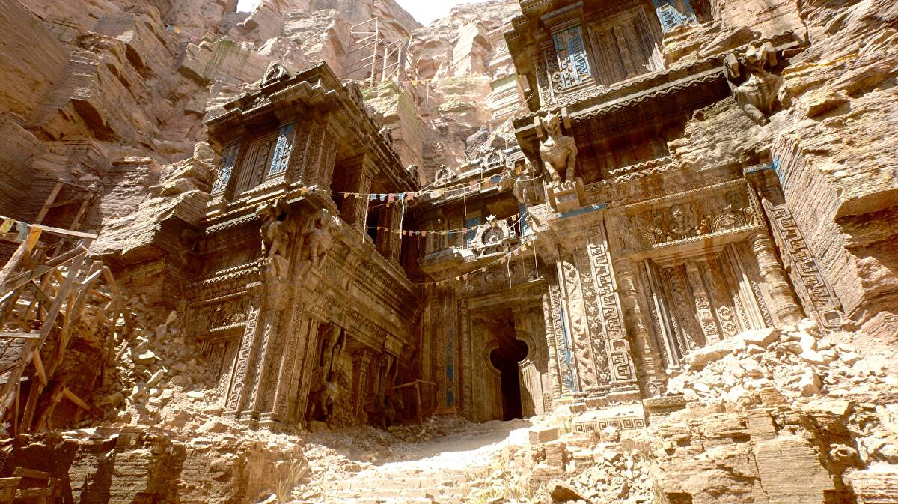
“Inspired by real world, incorporate science and art with technology to create virtual environments that exist or never could have existed for visualization and expression.”
https://www.unrealengine.com/en-US

Slide 6

“A collaboration between art and technology”
https://www.pixar.com/

Slide 7

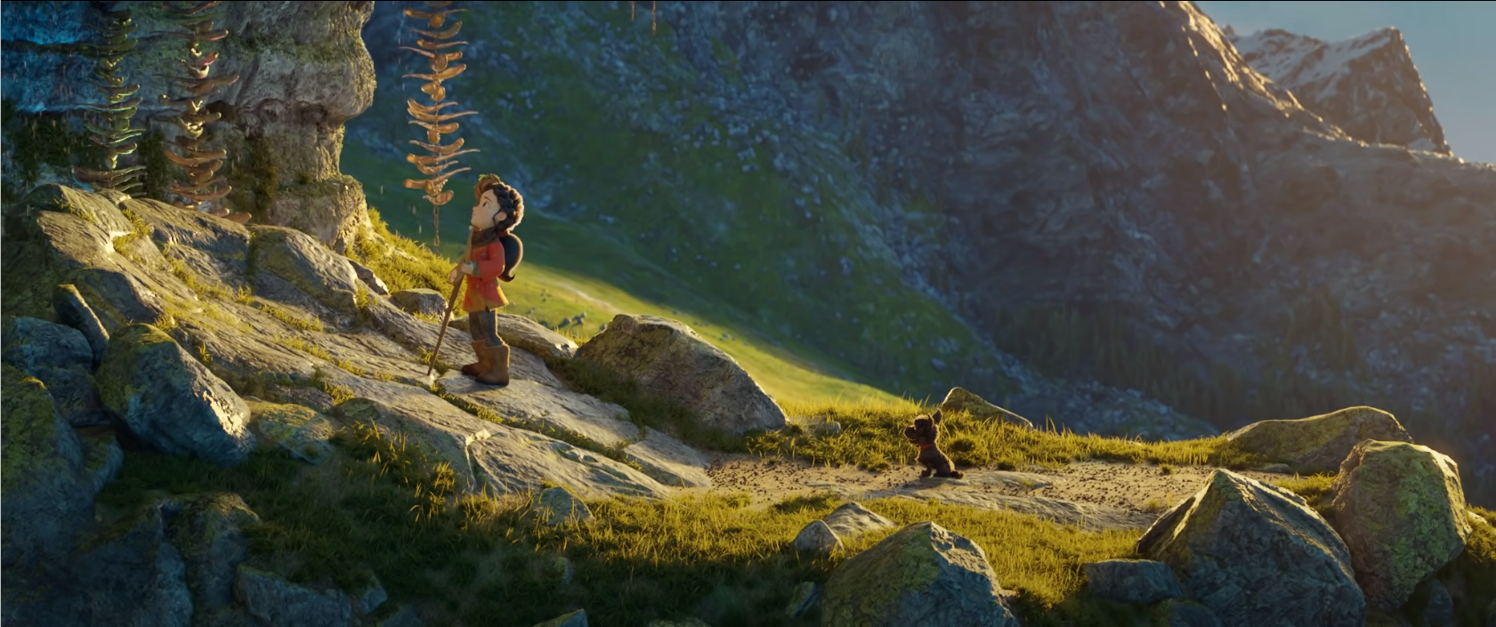

Computer graphics
“Generating images using computer”
https://www.blender.org/

Slide 8


Computer graphics
Generating images:
3D scene – what will be present in image
Rendering – how image is generated from 3D scene
Image display – how image is displayed

Slide 9
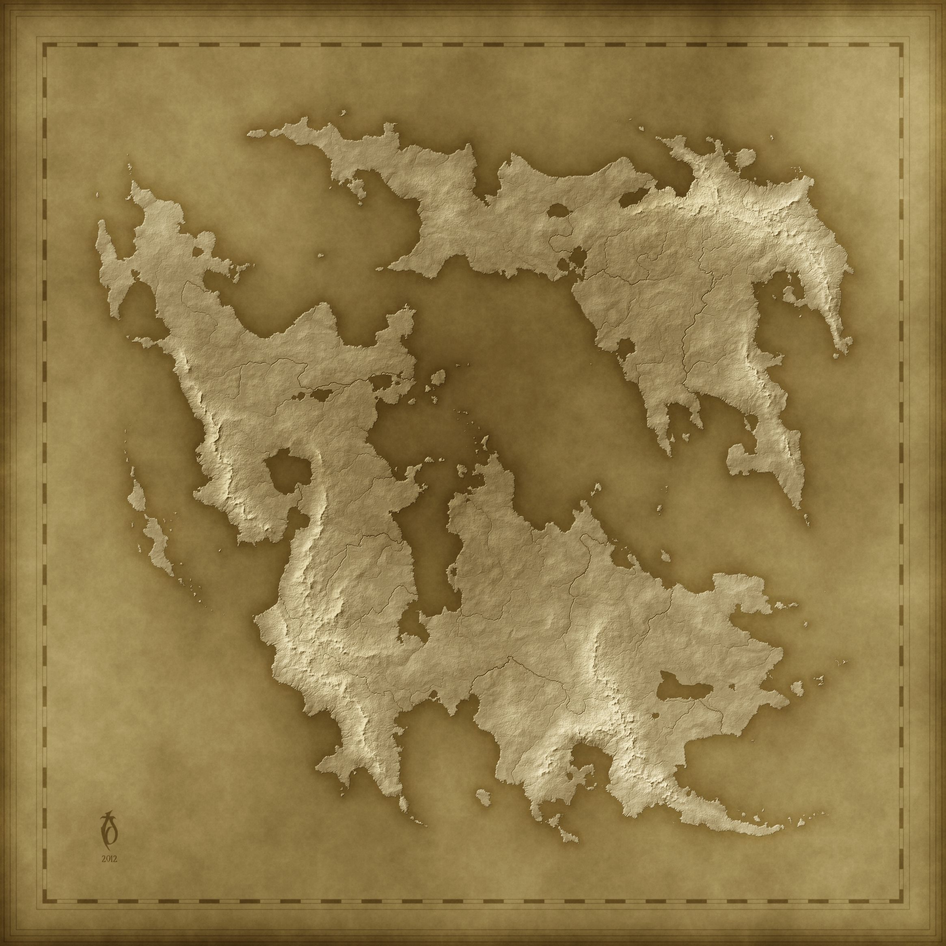
Map of computer graphics
You have the map of computer graphics
You have good foundations of computer graphics (even if you forget all the details!)
It is up to you now to explore further!
3D scene
Image
Rendering

Slide 10
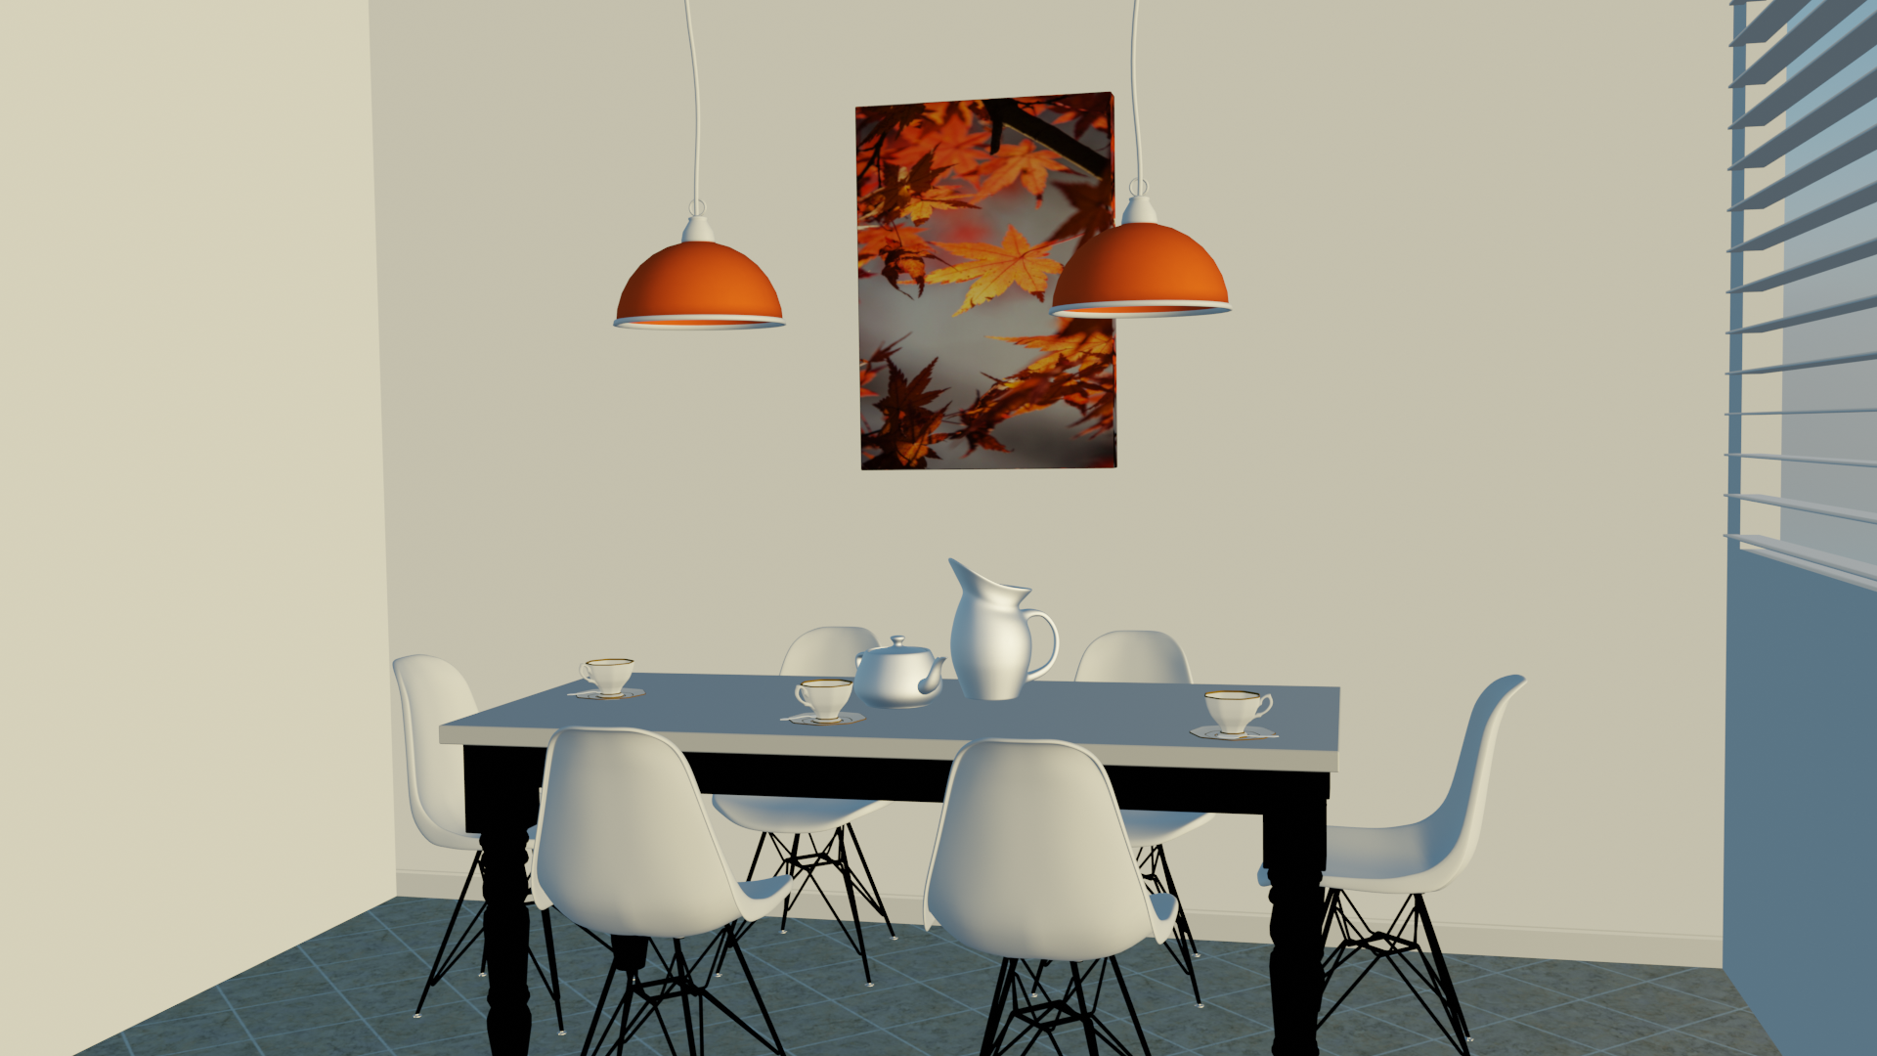
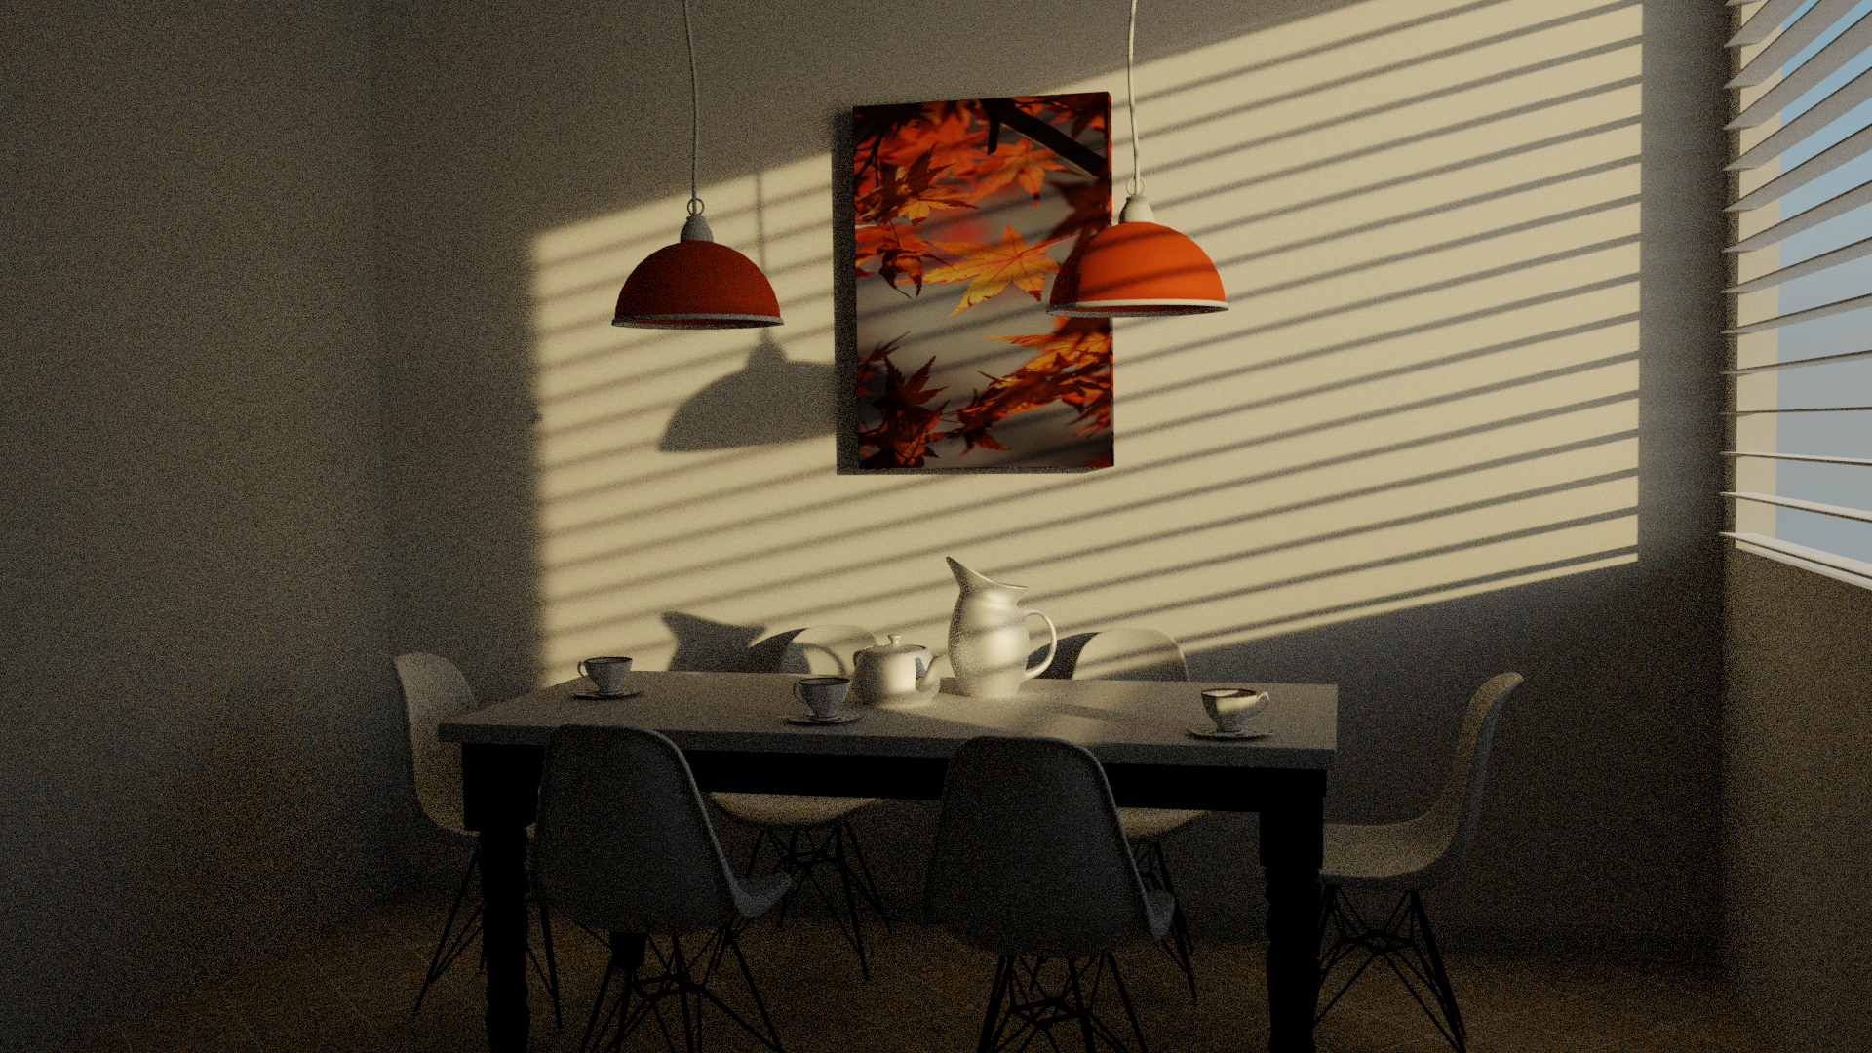
Special outcomes
“Seeing world with different eyes”
Foundations for visualization and expression

Slide 11
Where to next?

Slide 12
Where to next?
Practical directions:
  Think about where can you apply computer graphics methods in your work (master thesis?)
  Build on your project work or build rendering/modeling system from scratch
  Get familiar with industry-standard technology
Research directions:
  Look into and investigate topics which were “out of scope”
  Read a complete book covering computer graphics
  Follow conferences and read science papers

Slide 13
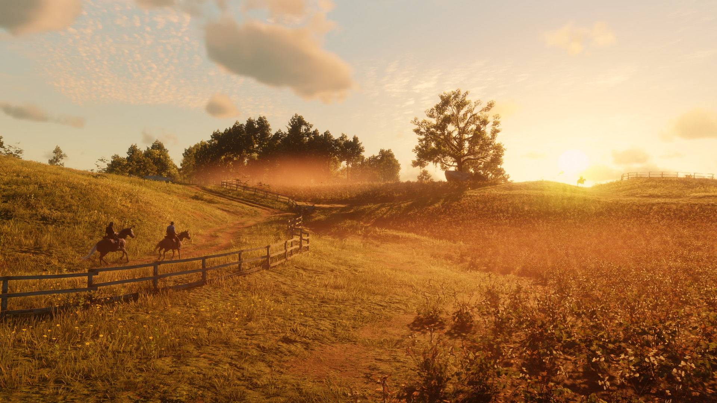
Graphics and computer games
https://www.rockstargames.com/reddeadredemption2/

Slide 14

Graphics and animated film
https://www.pixar.com/soul

Slide 15
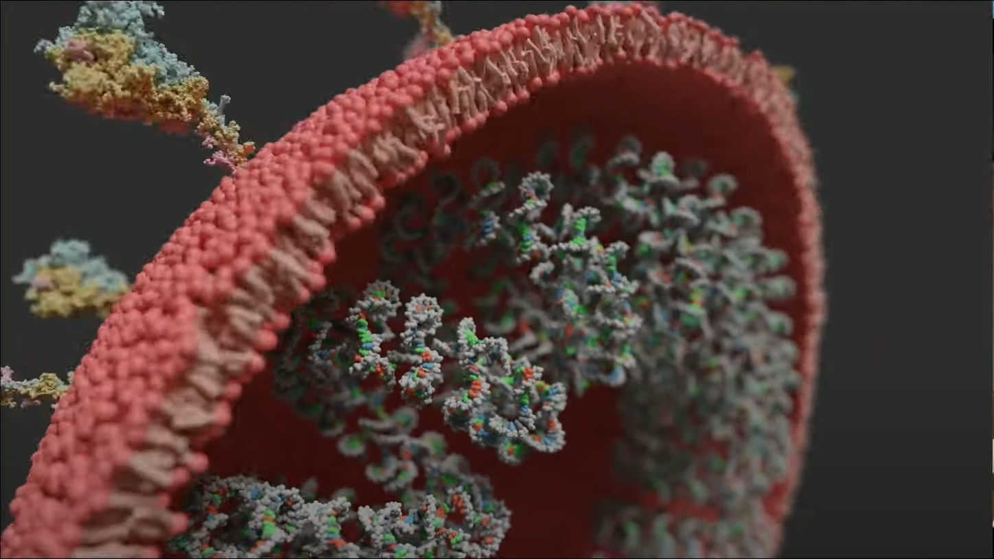
Graphics and scientific visualization
https://www.youtube.com/watch?v=adhTmwYwOiA&ab_channel=Blender

Slide 16
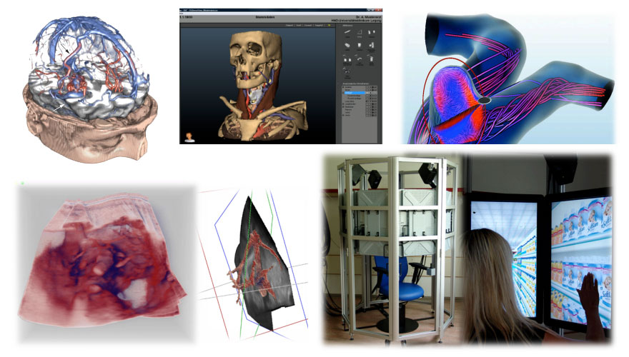
Graphics and medicine
https://www.siggraph.org/news/eurographics-celebrates-computer-graphics-in-medicine/

Slide 17
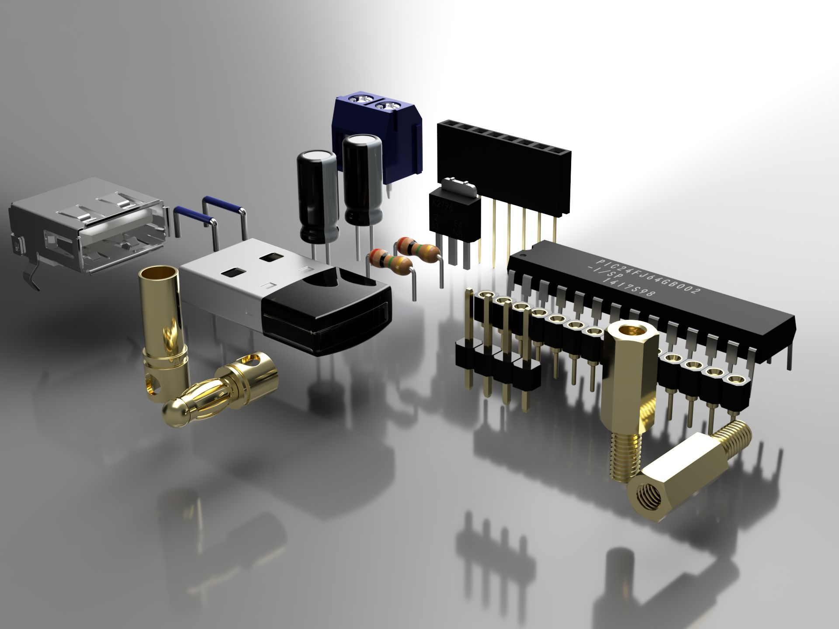
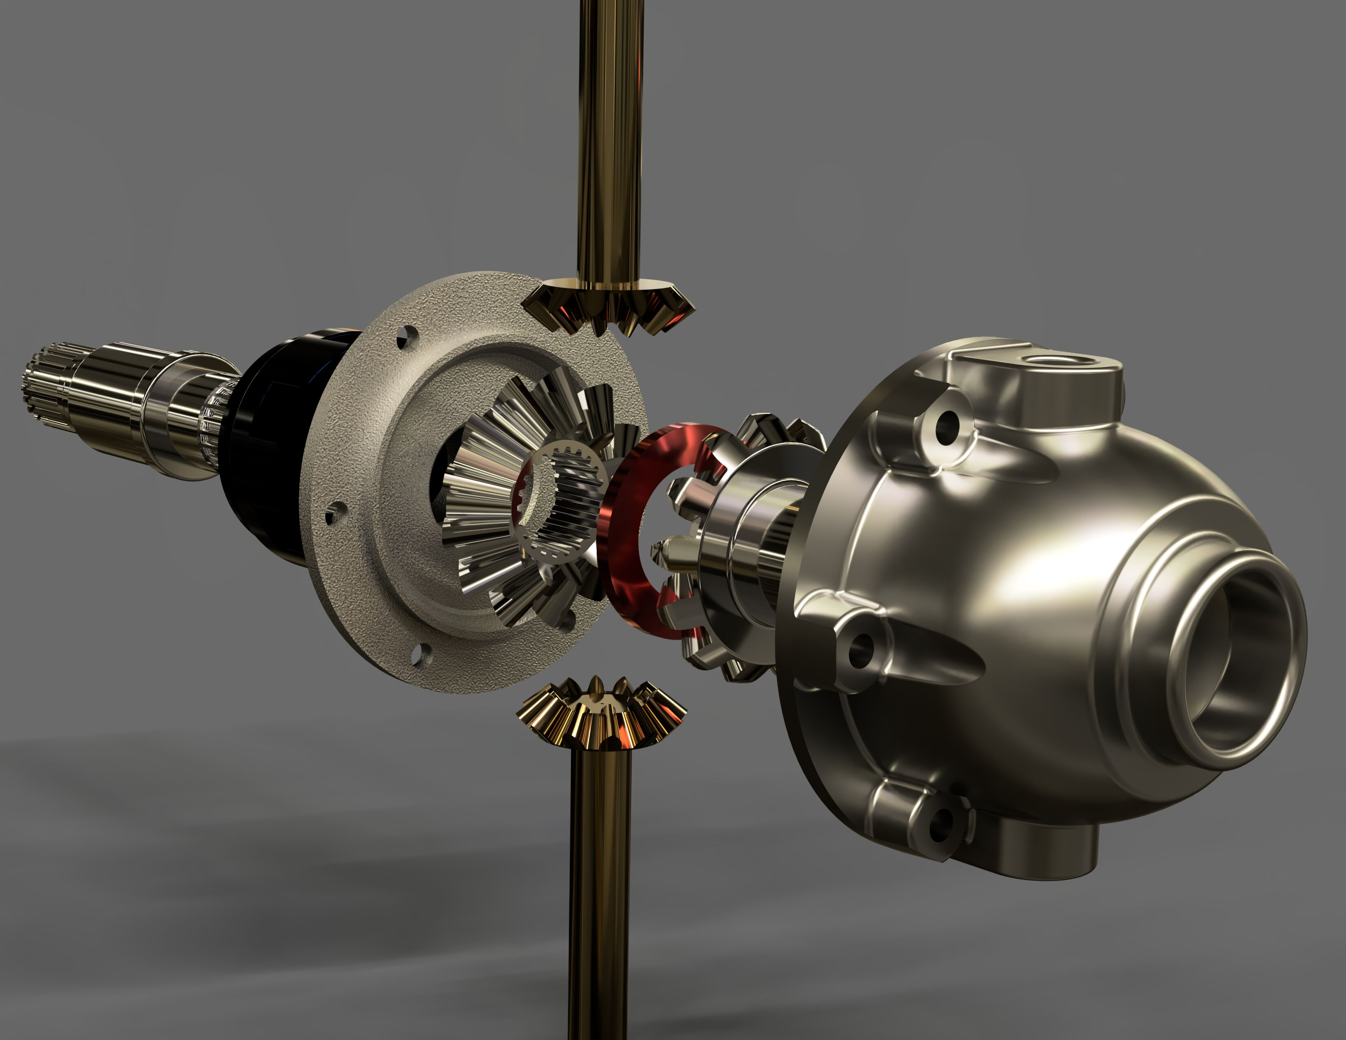
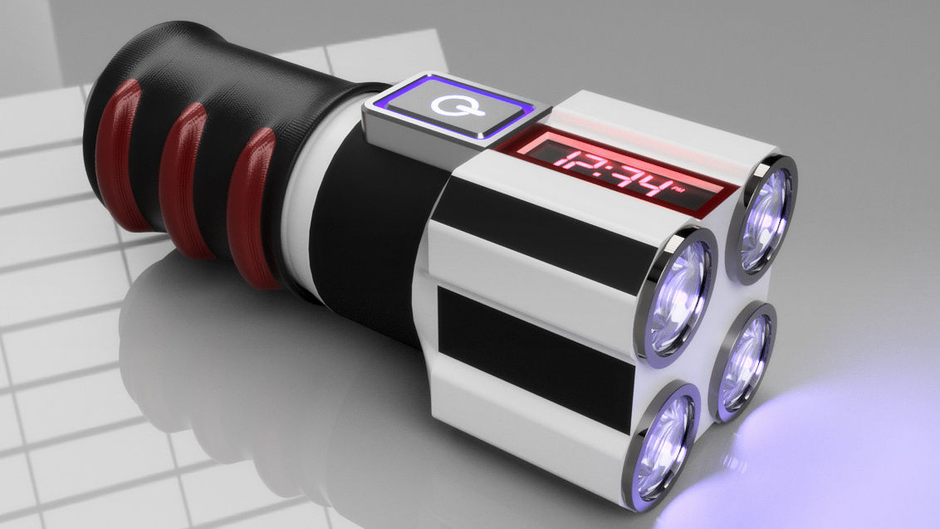
Graphics and CAD, manufacturing, engineering, product design
https://gallery.autodesk.com/projects/all#filters=%5B%5D&sort=popularity

Slide 18
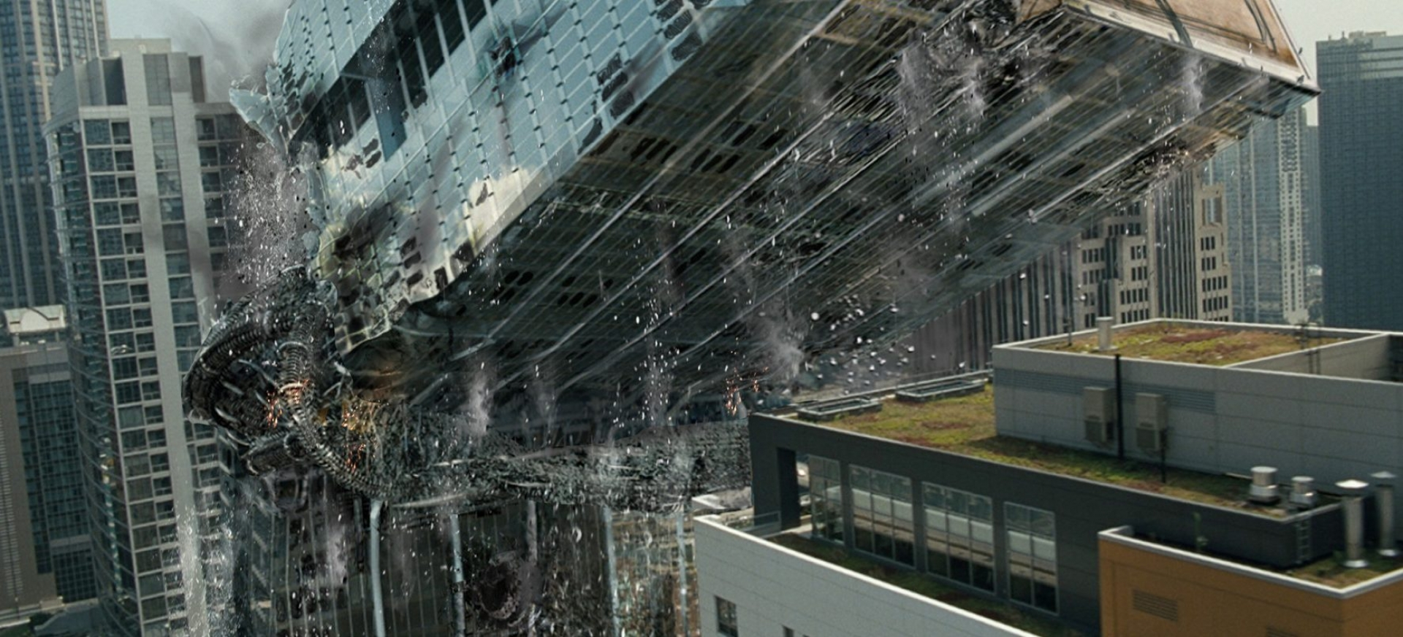
Graphics and VFX in film
https://www.ilm.com/art-department/vfx/

Slide 19
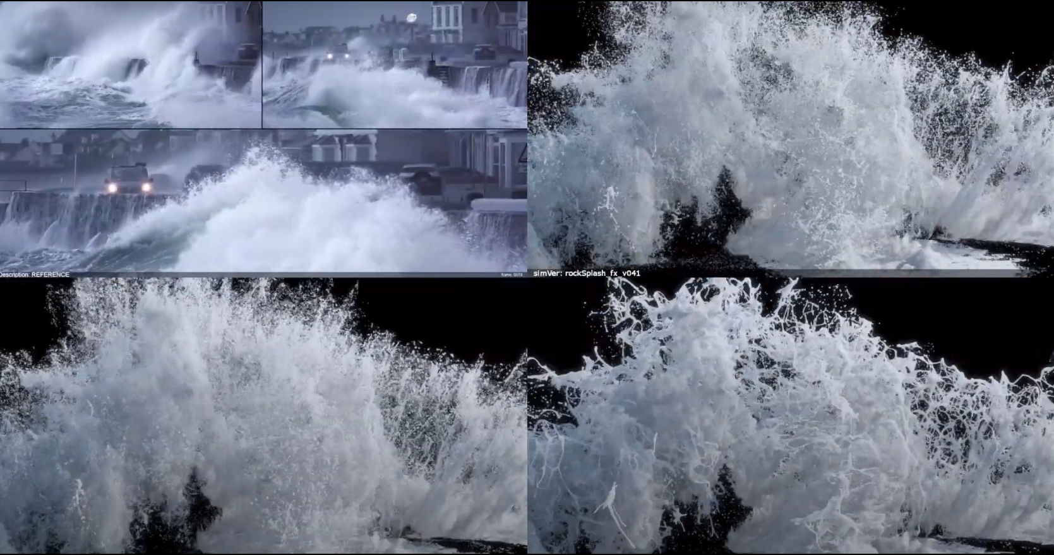
Graphics and simulation for VFX in film
https://www.youtube.com/watch?v=lS--1gRjfRk&ab_channel=Rebelway

Slide 20

Graphics and motion capture for VFX in film
https://www.fxguide.com/fxfeatured/weta-digitals-remarkable-face-pipeline-alita-battle-angel/

Slide 21
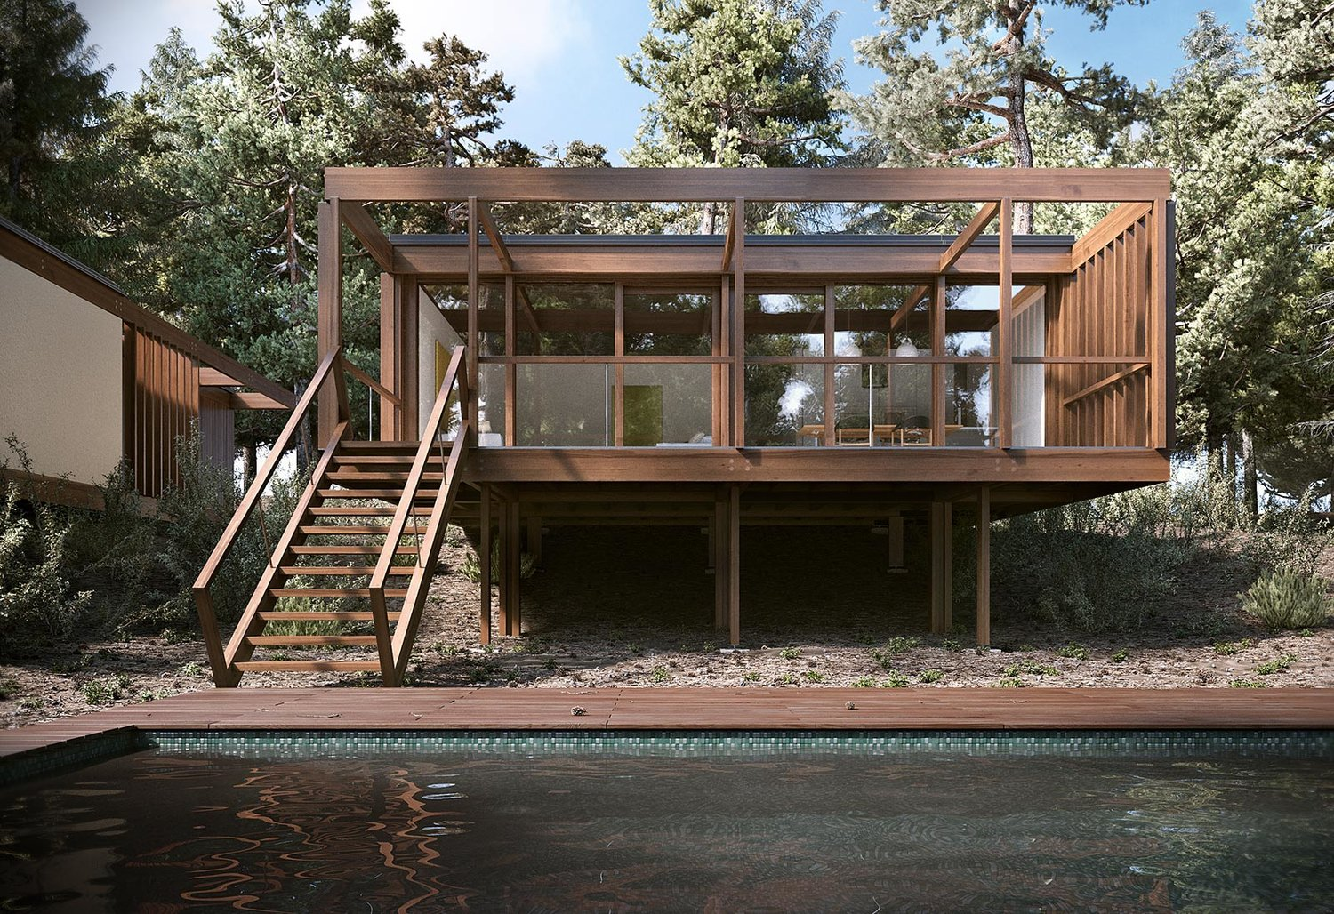
Graphics and arhitecture
https://www.blenderguru.com/articles/20-jaw-dropping-architectural-renders

Slide 22

Graphics and product design; product visualization
https://www.youtube.com/watch?v=-BscQpkhpJw&ab_channel=Houdini

Slide 23
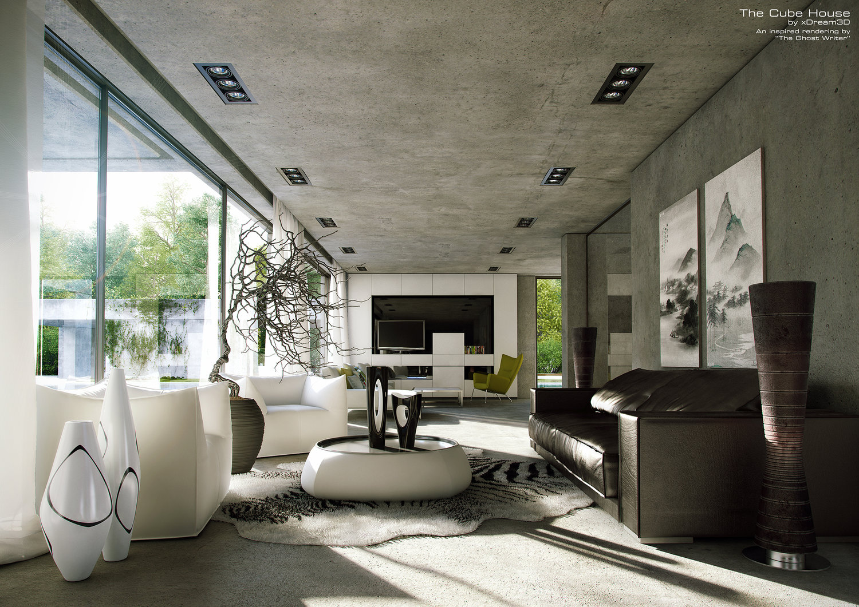
Graphics and interior design; ergonomic design
https://www.blenderguru.com/articles/20-jaw-dropping-architectural-renders

Slide 24
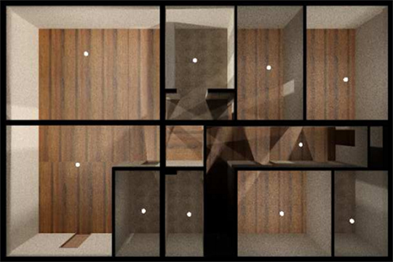
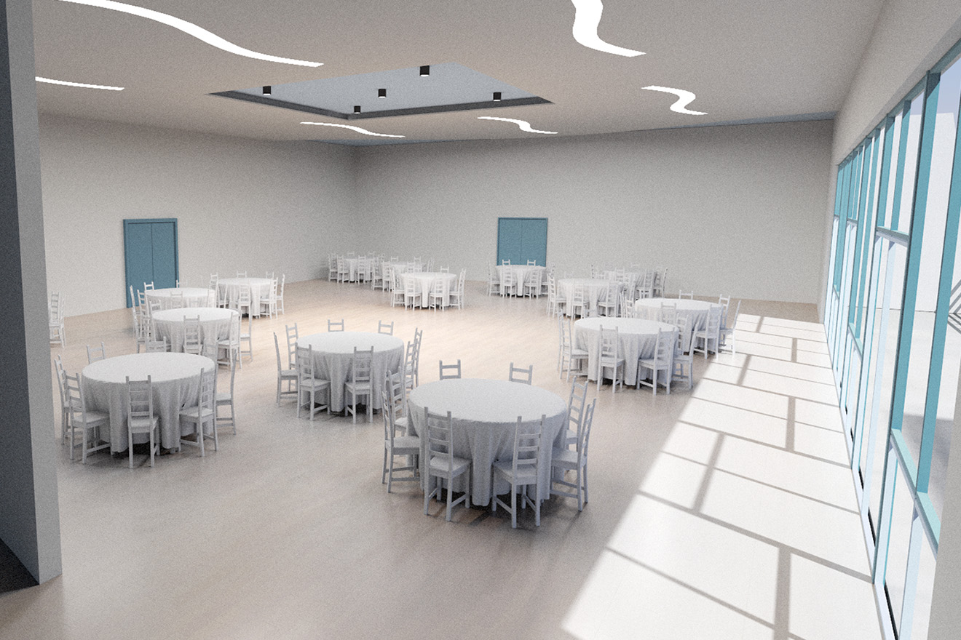
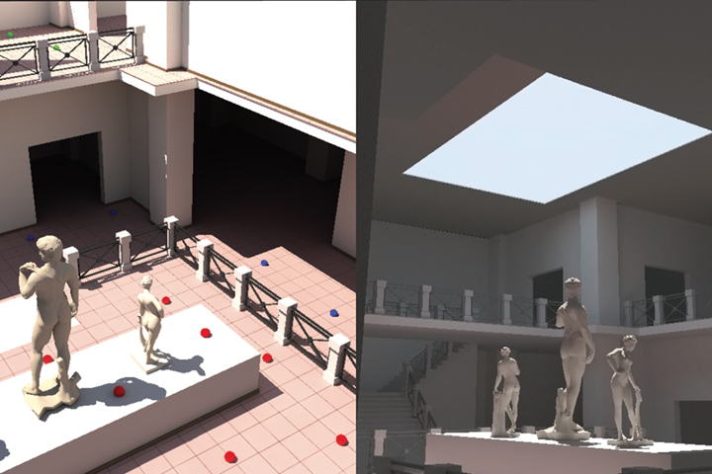
Graphics and illumination planning
http://graphics.cs.aueb.gr/graphics/research_lightingopt.html

Slide 25
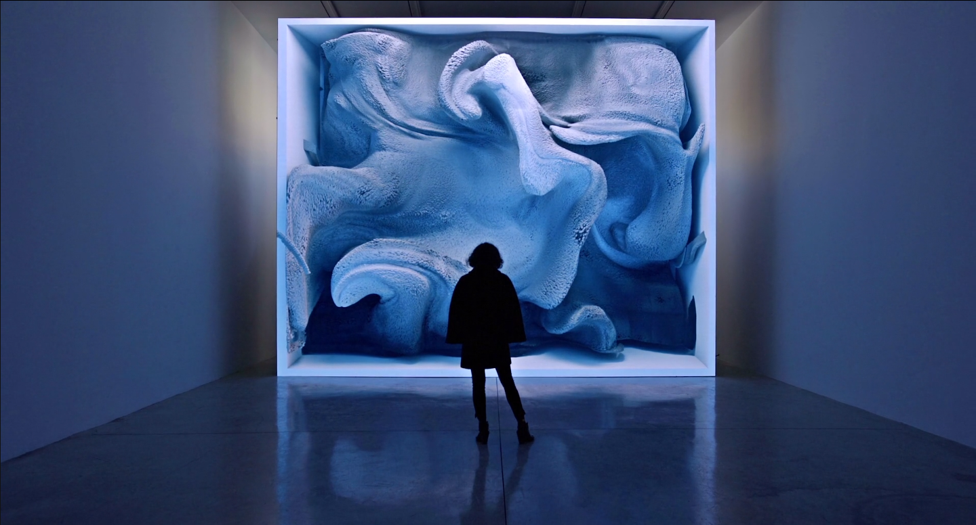
Graphics and new media art
https://refikanadol.com/

Slide 26
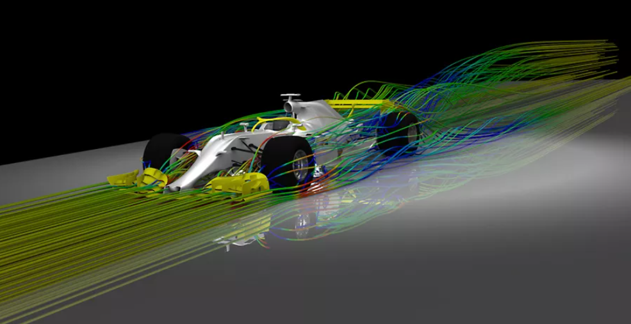
Graphics and predictive simulations
https://www.ansys.com/company-information/the-ansys-story

Slide 27
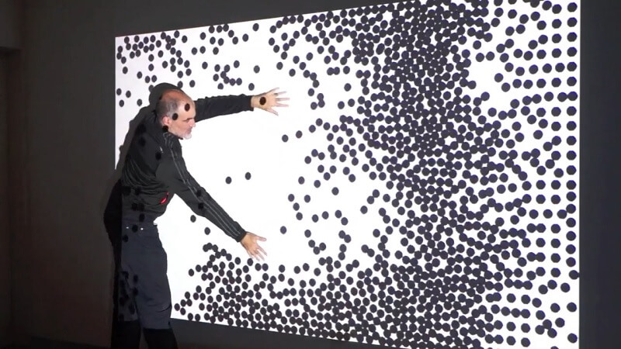
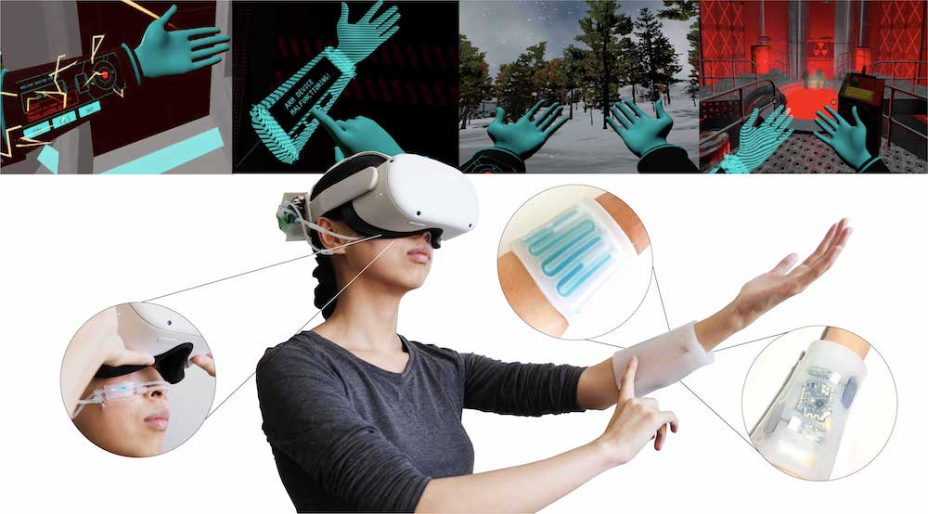
User interfaces
Graphics and user interfaces
https://parametrichouse.com/kinect/
http://plopes.org/

Slide 28
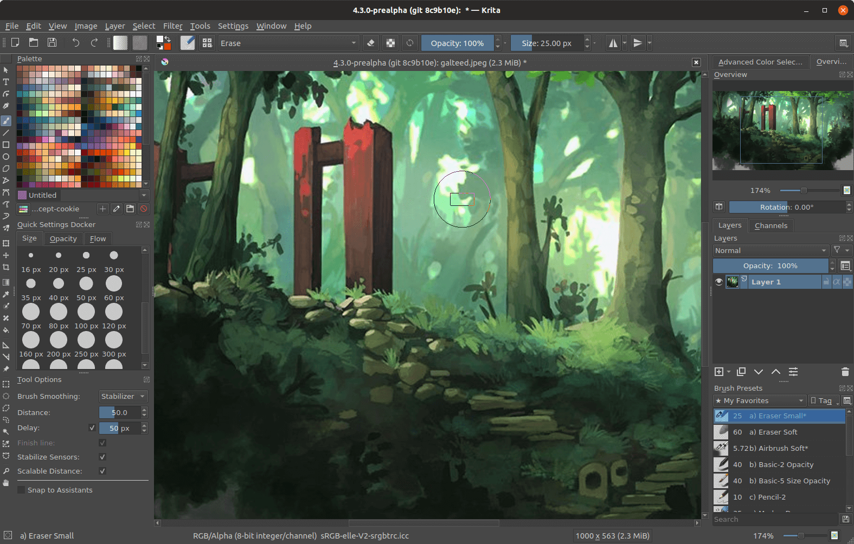
Image manipulation and digital drawing
https://krita.org/en/features/highlights/

Slide 29
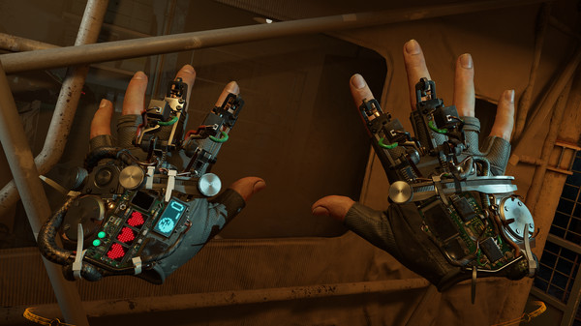
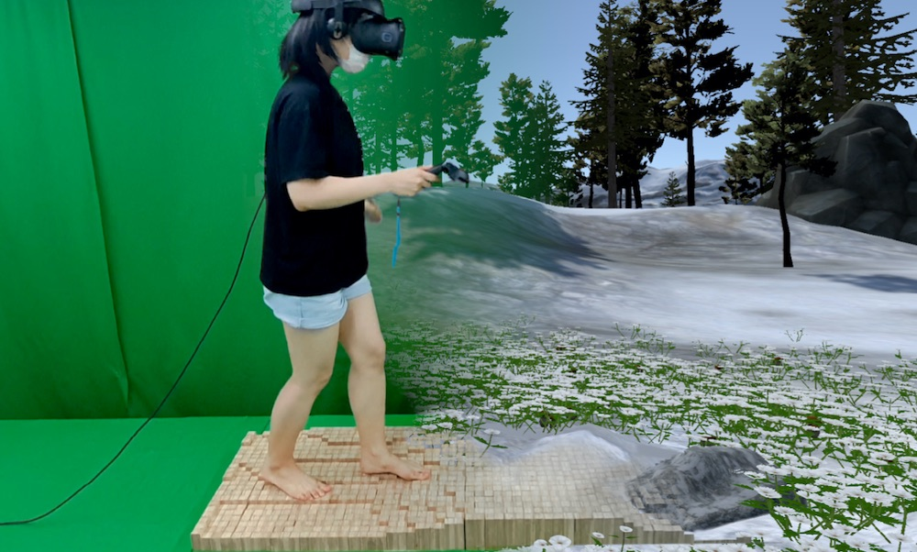
Graphics and VR
http://plopes.org/
https://store.steampowered.com/app/546560/HalfLife_Alyx/

Slide 30
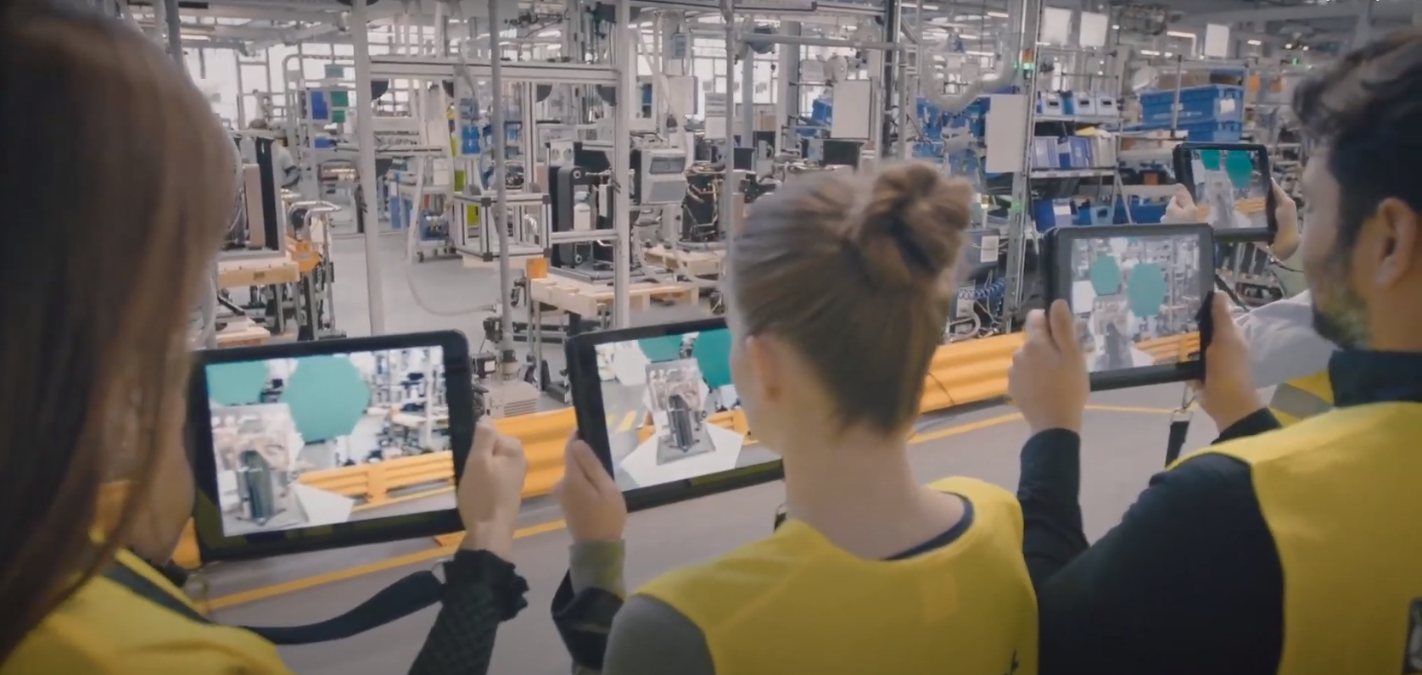
Computer graphics and AR
https://deltareality.com/portfolio/vaillant-ar-facility-tour/

Slide 31

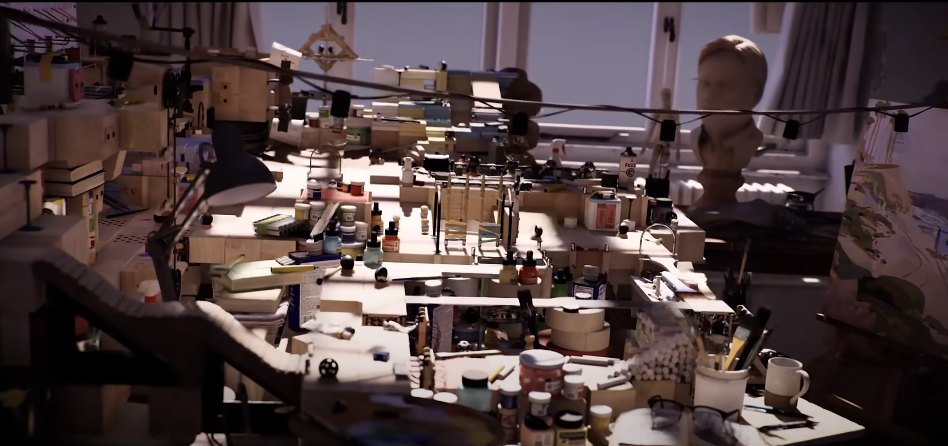
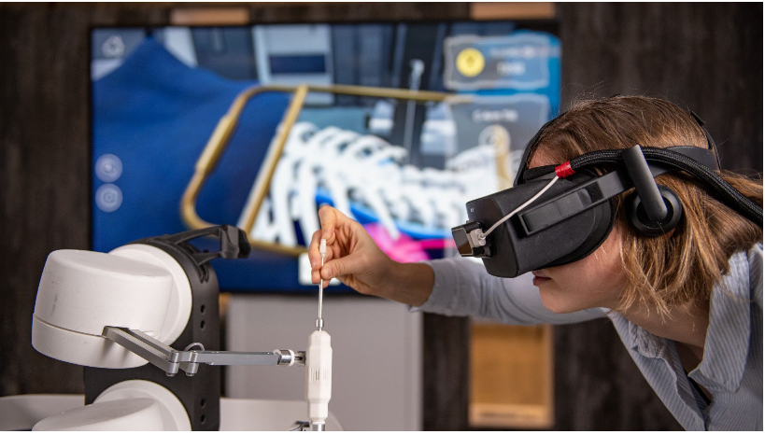
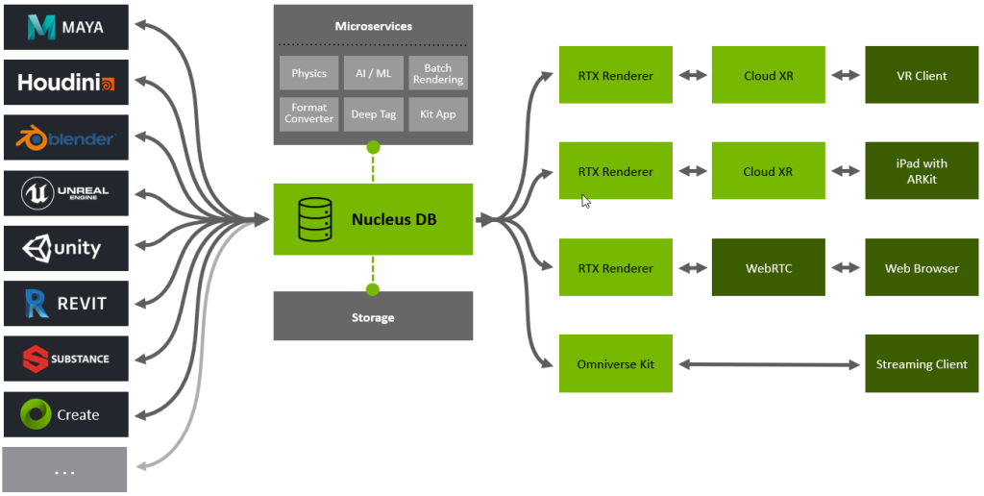
Computer graphics today
https://www.siggraph.org/
https://research.nvidia.com/research-area/real-time-rendering
https://www.research.autodesk.com/blog/inside-autodesk-research-exploring-our-research-teams/#industry-futures
https://www.nvidia.com/en-us/omniverse/

Slide 32
Computer graphics and you
You like physics and would like to see its practical applications in generating amazing imagery and effects.
You like mathematics: computer graphics is applied mathematics. Enough said.
You like programming: computer graphics is exciting application that employs complex architectures for modeling and rendering and in return gives very gratifying results.
You like art and design: Computer graphics is not only about tools which serve for simulating and rendering 3D scenes - it is also how we use those tools to create something that exists or never existed
You like animated films or VFX: yes there is a lot of computer graphics there combined with other disciplines to support stories to remember
You like computer vision or image processing: graphics is about creating and manipulating images
You like human-computer interaction: computer graphics enables visual interfaces and interaction
You like computer games: amazing application of computer graphics combined with different disciplines
You like visualization: biology? Chemistry? Geology? Astronomy? Computer graphics is there for you!

Slide 33
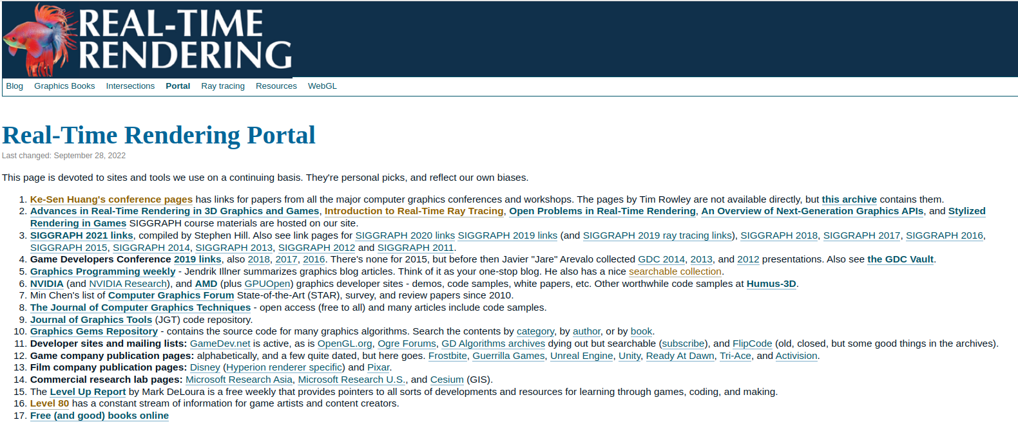
Landscape of computer graphics
https://www.realtimerendering.com/portal.html

Slide 34
Books
Scratchapixel: https://www.scratchapixel.com/
PBRT: https://pbrt.org/
Real-Time-Rendering Book: https://www.realtimerendering.com/
More books: https://www.realtimerendering.com/books.html

Slide 35
Conferences and research:
SIGGRAPH: https://www.siggraph.org/
Eurographics: https://www.eg.org/wp/
IEEE computer graphics: https://www.computer.org/csdl/magazine/cg
GDC: https://gdconf.com/
NVIDIA GTC: https://developer.nvidia.com/
List of conferences: https://kesen.realtimerendering.com/

Slide 36
Workshops and talks
List: https://www.sidefx.com/learn/talks/, https://www.autodesk.com/events
  Game Jam
  HIVE
  HEX
  OFFF
  FMX
  Blender conference
  Unity
  Epic/Unreal
  Autodesk
  Etc.

Slide 37
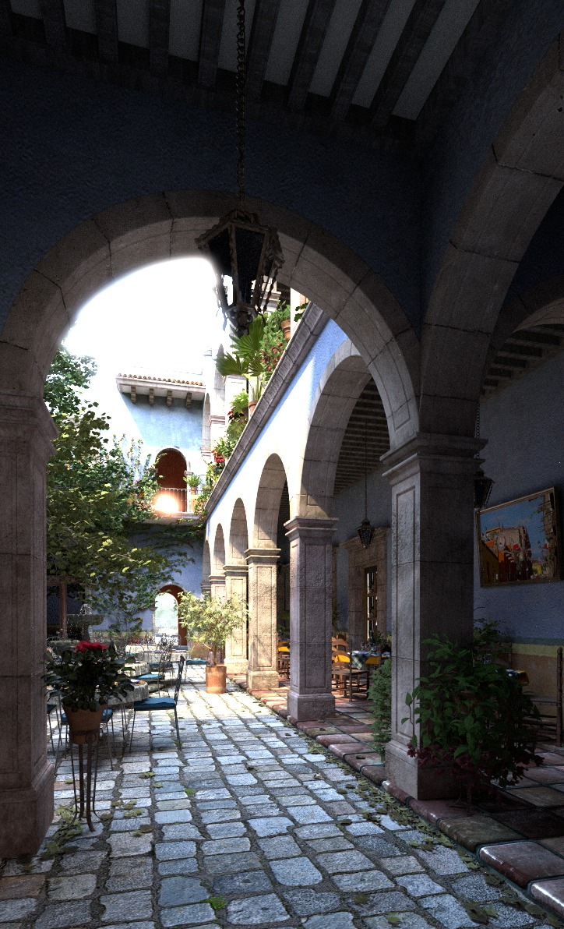
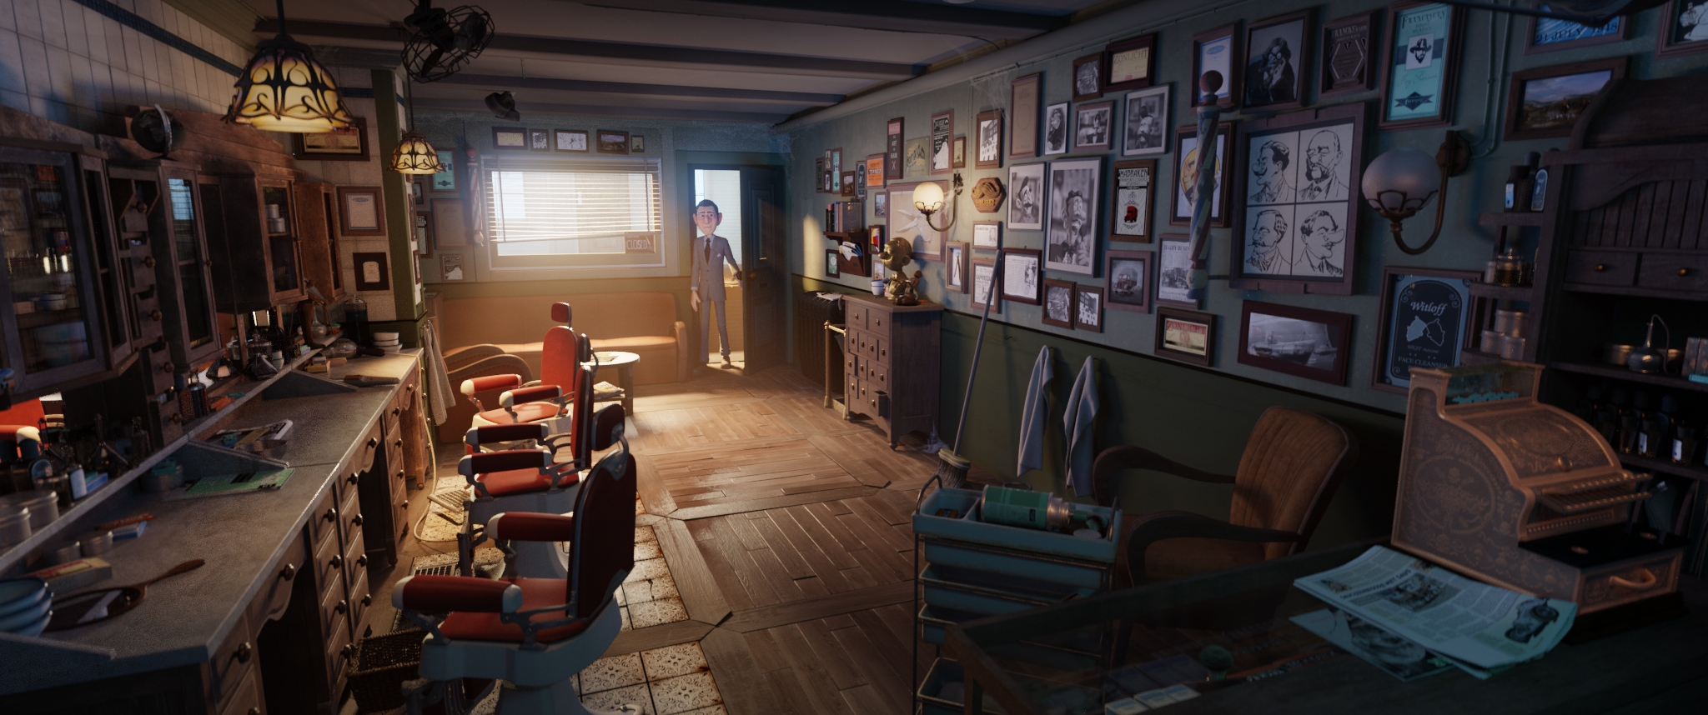
Practical considerations
Building more complex renderer with advanced features:
  https://pbrt.org/
  https://github.com/mmp/pbrt-v3
  https://github.com/mitsuba-renderer/mitsuba2
Investigating and contributing to production rendering engines:
  https://github.com/appleseedhq/appleseed
  https://www.cycles-renderer.org/
  https://luxcorerender.org/
https://www.cycles-renderer.org/
https://github.com/mmp/pbrt-v3

Slide 38
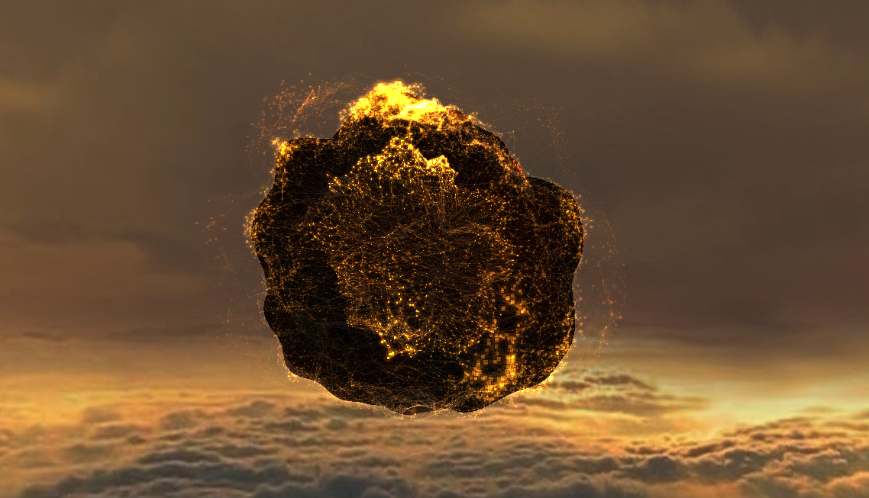

Practical considerations
Building advanced web-based 3D graphics:
  https://threejs.org/
Diving deeper into real-time, interactive rendering APIs:
  WebGL: http://learnwebgl.brown37.net/
  OpenGL: https://learnopengl.com/
  Vulkan: https://vulkan-tutorial.com/
Game engines for advanced interactive graphics:
  https://www.unrealengine.com/en-US
  https://unity.com/
  https://godotengine.org/
https://jhugheswebdev.github.io/sound-equalizer-threejs/
https://godotengine.org/

Slide 39
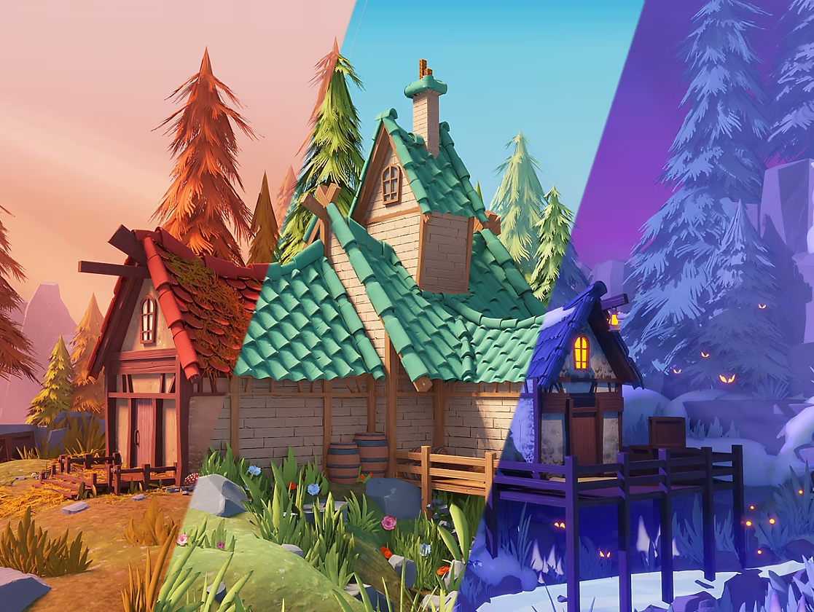
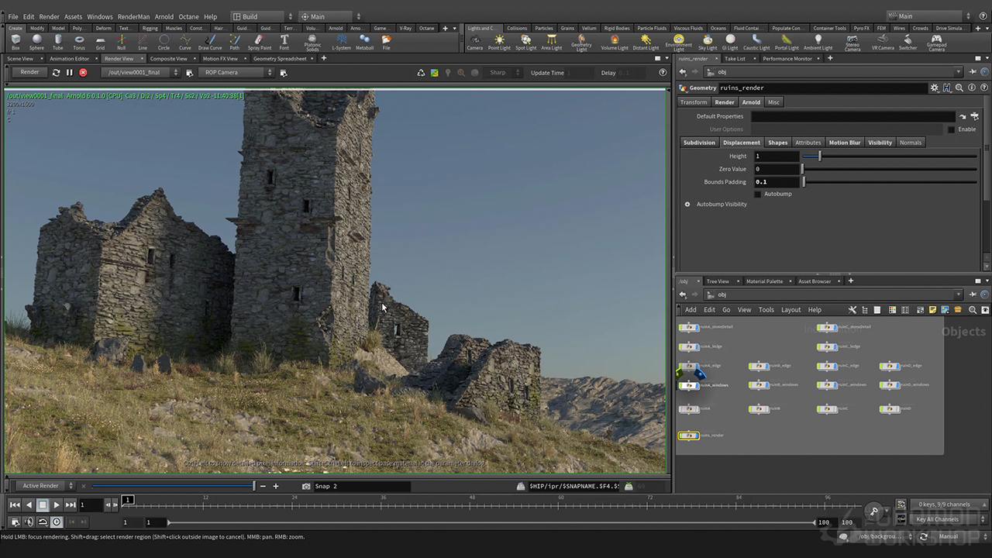
Practical considerations
Advanced 3D modeling, sculpting, lighting, material modeling, rendering and compositing in Blender and other content creation tools:
  https://www.blender.org/features/
  https://www.maxon.net/en/zbrush
  https://www.adobe.com/products/substance3d-painter.html
  https://renderman.pixar.com/
Advanced procedural modeling in Houdini:
  https://www.sidefx.com/
https://www.adobe.com/products/substance3d-painter.html
https://www.thegnomonworkshop.com/tutorials/creating-procedural-environments-in-houdini

Slide 40
Hot topics?
Real-time ray-tracing: https://developer.nvidia.com/rtx/ray-tracing
Physically-based rendering/shading: https://blog.selfshadow.com/publications/s2020-shading-course/
Physically-based animation: https://www.physicsbasedanimation.com/
Production unification: USD, Omniverse: https://developer.nvidia.com/usd
VR/AR: https://developer.nvidia.com/vrworks
ML/DL for rendering and modeling (NVIDIA GTC, SIGGRAPH, etc.)
Rendering and modeling for ML/DL – digital twins, graphics for industry (NVIDIA GTC)

Slide 41
Thank you!

Slide 42
Repo
https://github.com/lorentzo/IntroductionToComputerGraphics

