Slide 1
Lecture 7: Materials
DHBW, Computer Graphics
Lovro Bosnar
8.2.2023.

Slide 2
Syllabus
3D scene
  Object
    Shape
    Material
  Camera
  Light
Rendering
Image and display
Material
  Material observation
  Physics (optics) models for CG
  Material models in CG
    Scattering models

Slide 3
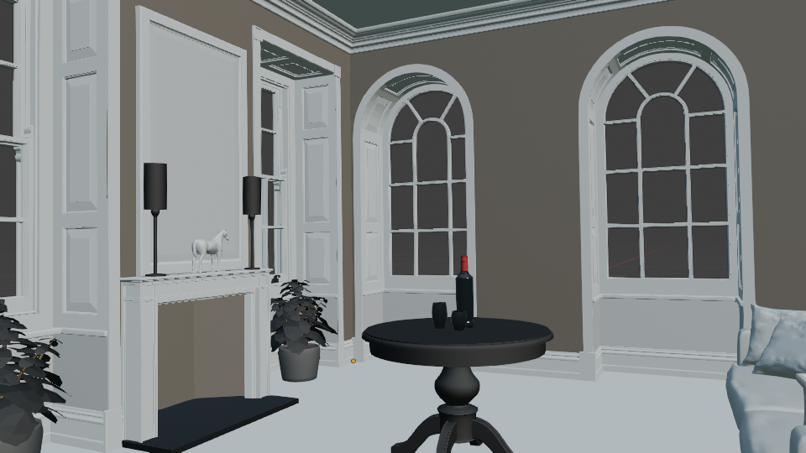

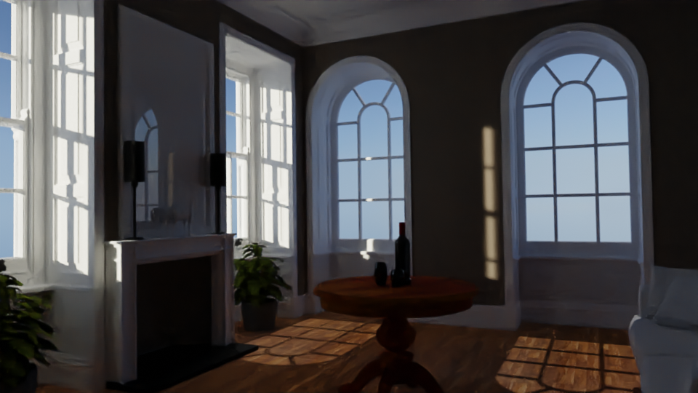
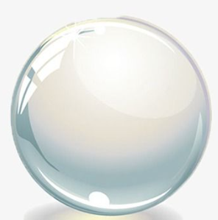
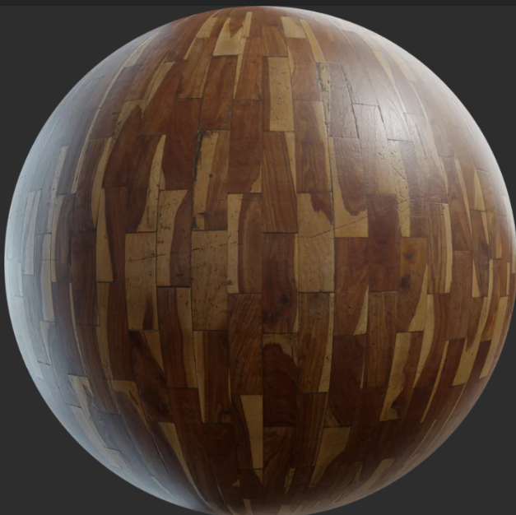
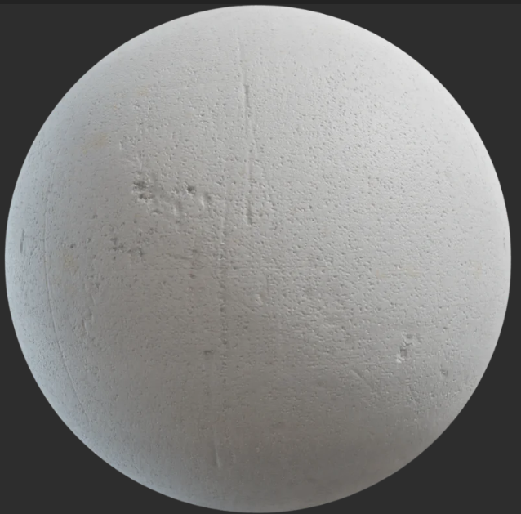
Big picture
3. Image
1. Scene modeling
Material modeling

Slide 4

Materials
https://www.exp-points.com/asking-the-masters-material-art

Slide 5
Material is important for object appearance.
Without material...

Slide 7
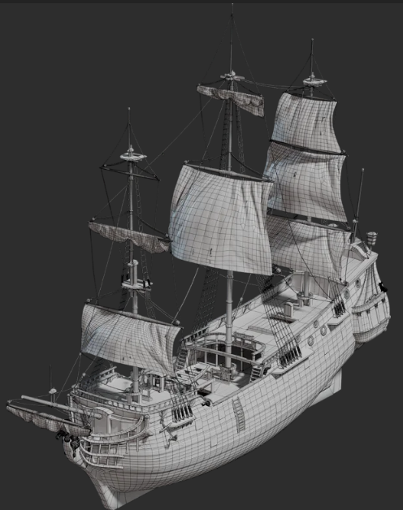
Shape and material
Rendering and creating objects in 3D scene to represent a real world objects requires:
  Shape representation
Shape is needed for:
  Modeling:
    Define object form, size, etc.
    Place object correctly in the scene with respect to other objects
  Rendering:
    Determine which objects are occluded and areas into which shadow is cast by object → visibility solving
https://polyhaven.com/a/ship_pinnace

Slide 8
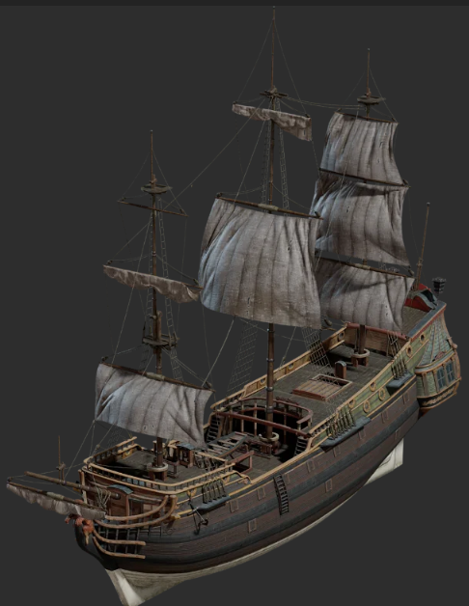
Shape and material
Rendering and creating objects in 3D scene to represent a real world objects requires:
  Shape modeling
  Visual appearance modeling → material
Material is needed for:
  Modeling: how object will look like
  Rendering: light-object interaction (shading)
https://polyhaven.com/a/ship_pinnace

Slide 9
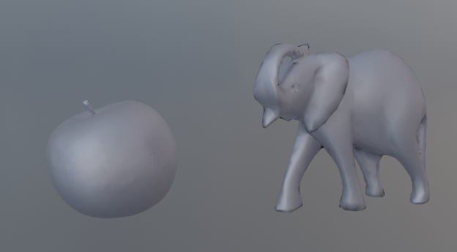
Shape and material
Material characteristics are independent of shape and position
    Material is modeled separately
Enough to model how specific material generally interacts with light
    This model is then used for arbitrary shape
Aluminum apple and aluminum statue – in both cases aluminum properties are the same. Also, changing position of aluminum apple in space doesn’t change aluminum properties.

Slide 10
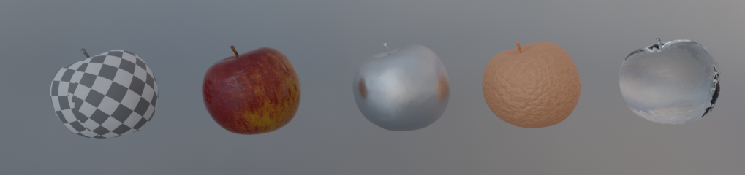
“Let the form of an object be what it may, - light, shade and perspective will always make it beautiful” – John Constable
Importance of material for appearance
Model and environment texture from PolyHaven: https://polyhaven.com/a/food_apple_01

Slide 11

Metal
Plastic
Glass
Wood
Fabric
Stone
Clouds
Water
Tree bark
Leafs
Plaster
Paper
Leather
Sky
Etc.
https://www.xomacenna.com/blog/a-guide-to-organic-modern-design

Slide 12
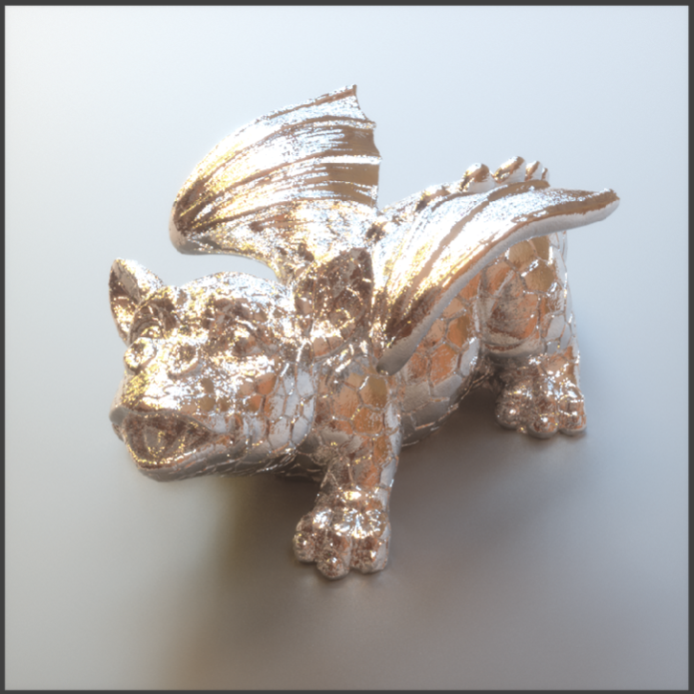
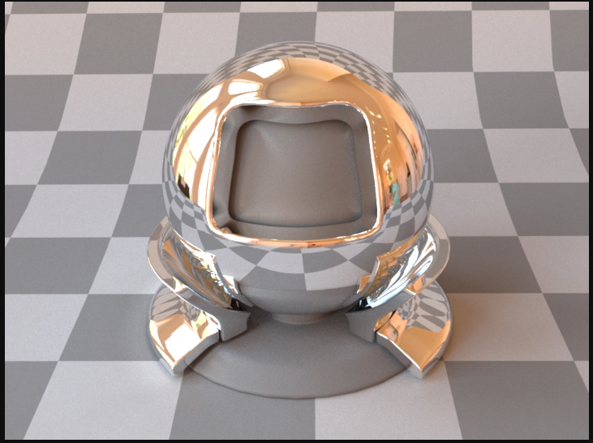
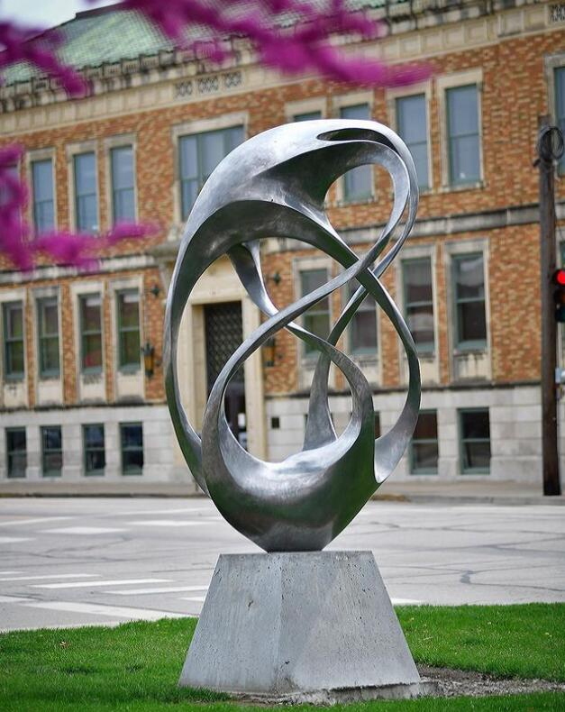
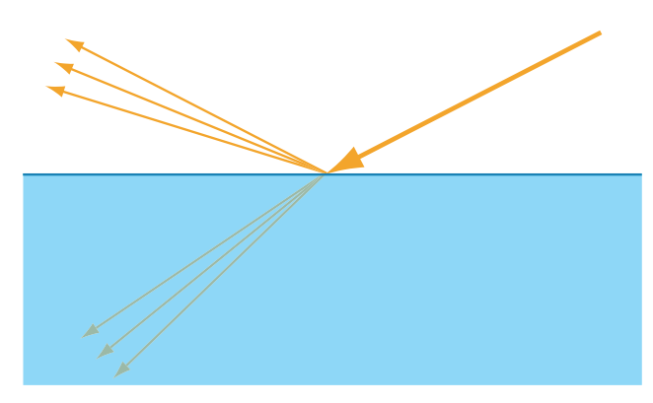
Appearance modeling and rendering
Observation
https://www.metalartstatue.com/amsculpture/cast-aluminum-sculpture/
Computer graphics
model
Modeling and rendering
Optics
https://mitsuba2.readthedocs.io/en/latest/generated/plugins.html#bsdfs
https://pbrt.org/

Slide 13

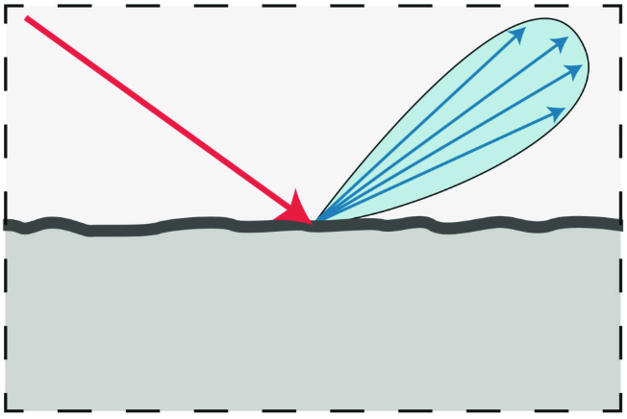
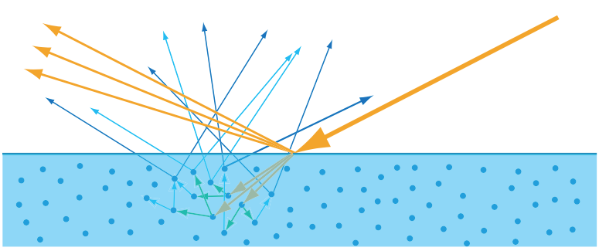
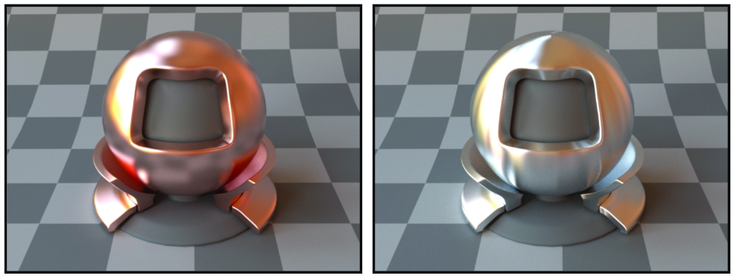
Materials: real world vs models
Real world materials are very complex are simplified using different models:
  Physical models: best description of real world materials
    Example: geometric optics
  Computer graphics models: simplification for creation and computational purposes
    Example: separating objects into shape and material
  Subjective, artist observation: based on perception – subjective model of the world
    Artist draw what they see, not what is physically-correct
Artist model:https://shelleyhannafineart.com/painting-silver-objects/
Physical model of light scattering
Computer graphics material model

Slide 14
Material observation
Modeling begins with observation

Slide 15
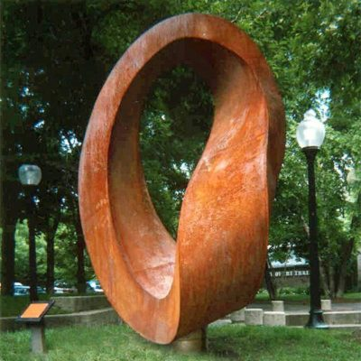
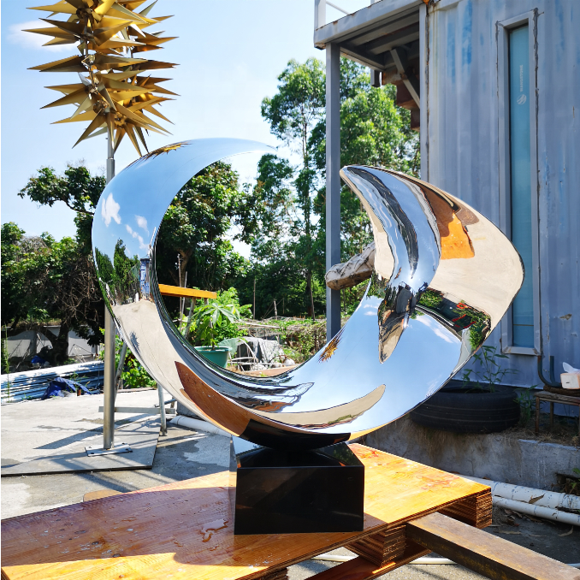

Observation
Observation goals:
  Understand what makes each material look different than other materials
  Observe characteristics which are responsible for object appearance
https://www.metalartstatue.com/amsculpture/outdoor-metal-bird-sculpture/

Slide 16
Observation
Characteristics responsible for object appearance:
  Shape: large scale form or geometry of object.
  Material: for computer graphics modeling purposes: fine-scale geometrical variations and substance properties
  Illumination: size, direction, color, etc.
  Sensor/Perception: point of view, camera properties, etc.

Slide 17
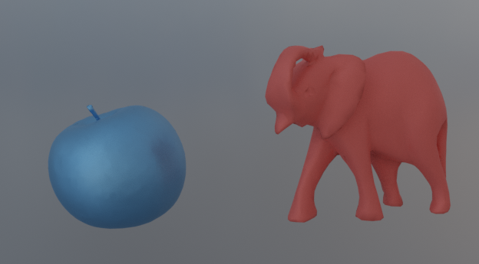
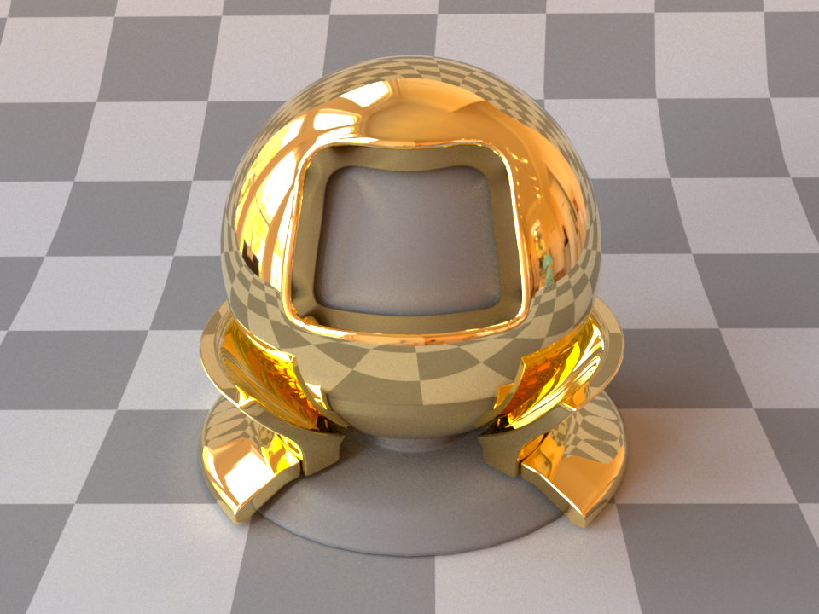
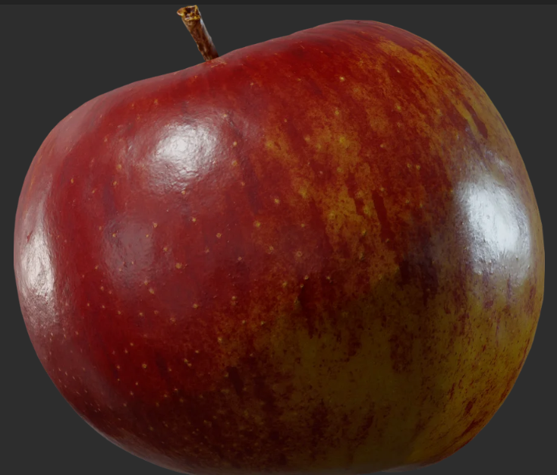
Classifying materials
Classifying materials enables us to understand which characteristics are needed to be modeled in order to obtain required appearance. We can classify any material by following variations:
Spectral: color
Directional
Texture

Slide 18
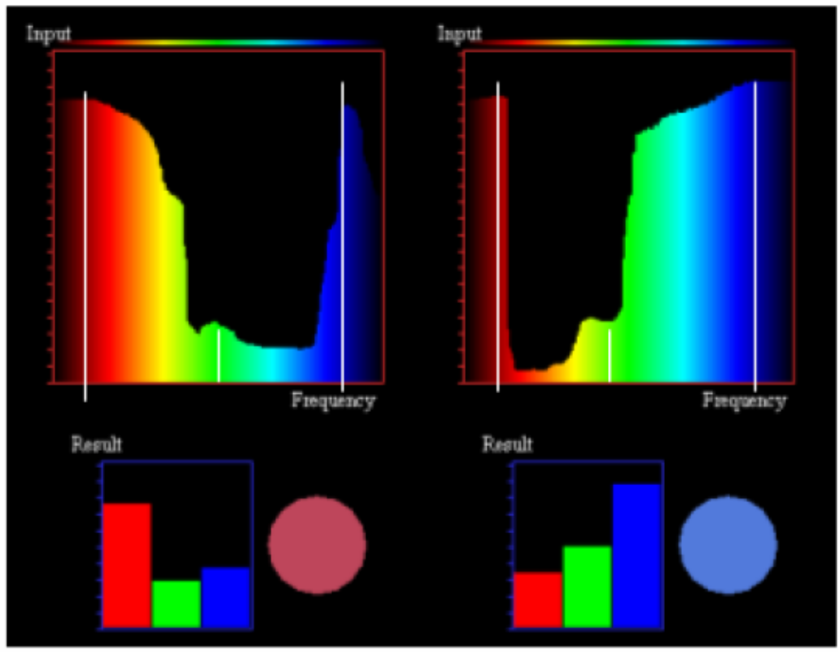
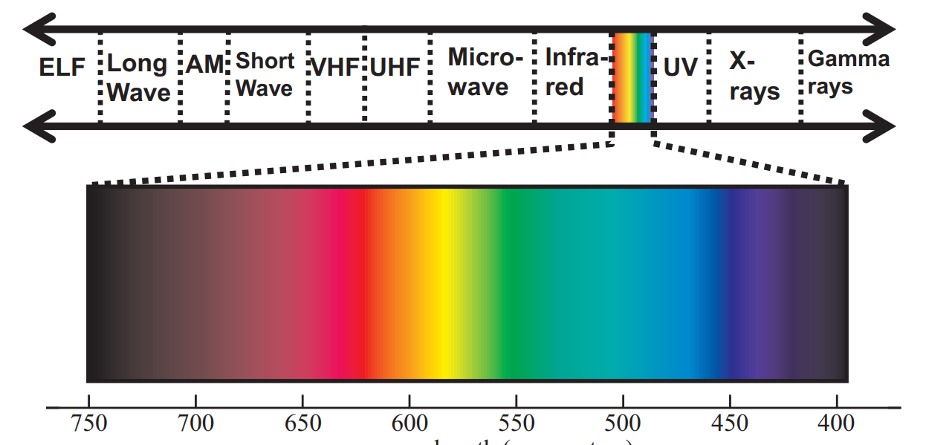
Spectral/color material characteristic
Light is a electromagnetic radiation in the spectrum of visible wavelength band 380-780nm
Light scattered from object surface (its material) is described using:
  Color is described with red, green and blue floating points (R, G, B) in [0,1]
  Brightness is floating point value [0, inf]
https://blog.selfshadow.com/publications/s2013-shading-course/hoffman/s2013_pbs_physics_math_notes.pdf
https://www.researchgate.net/publication/234814482_Digital_modeling_of_the_appearance_of_materials

Slide 19

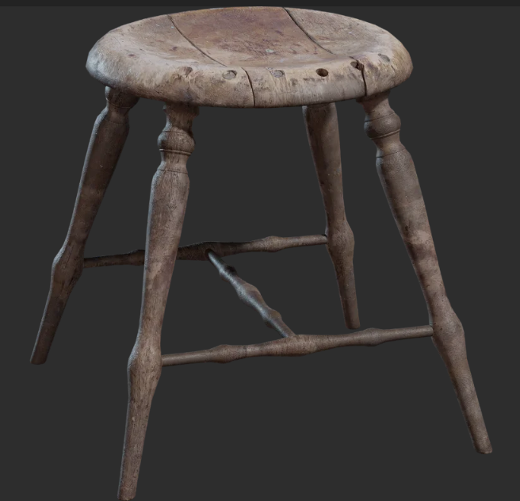
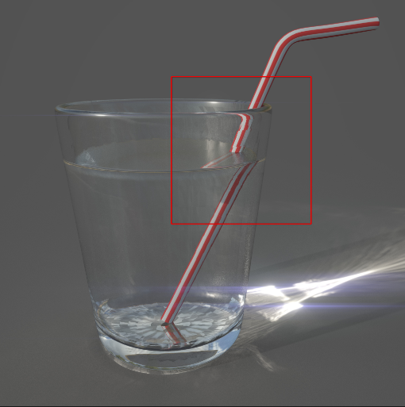
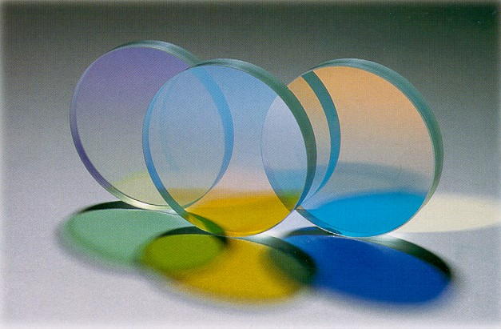
Directional material characteristic
Direction effects result from directionality of light scattering by the object
  Changes in object appearance as we change view (or light or object position)
Directional effects are “attached” to object (do not depend on environment)
Translucent
https://substance3d.adobe.com/tutorials/courses/the-pbr-guide-part-1
https://polyhaven.com/
https://en.wikipedia.org/wiki/Transparency_and_translucency
Shiny/glossy
Matte/diffuse
Transparent

Slide 20
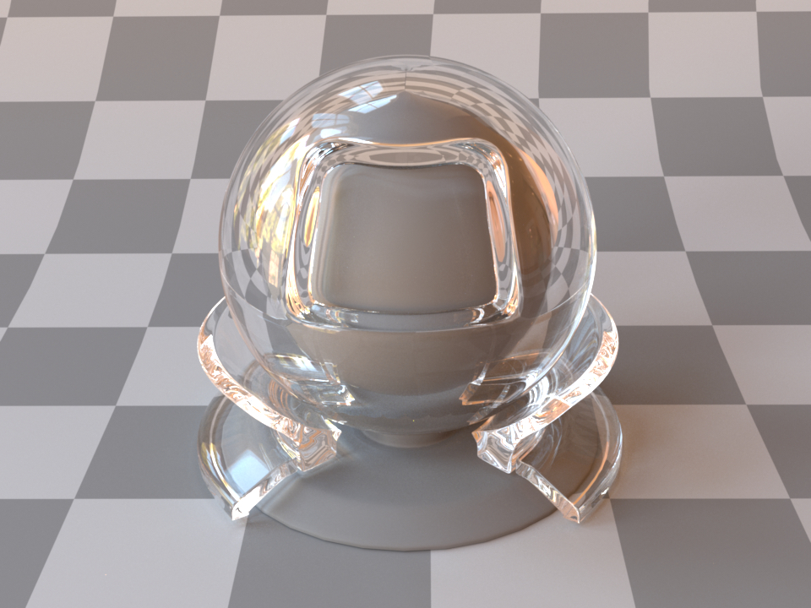
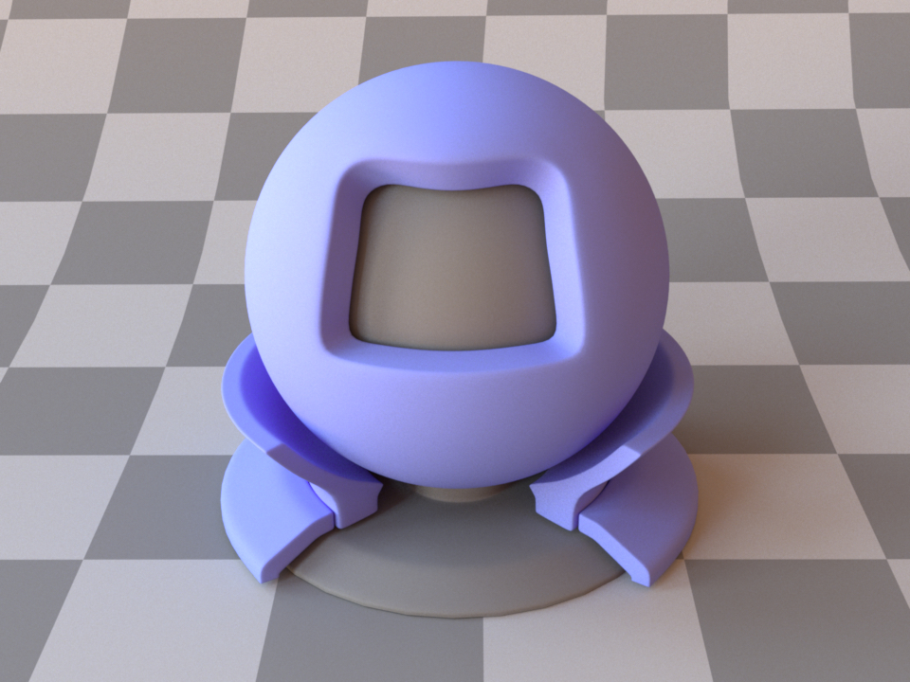
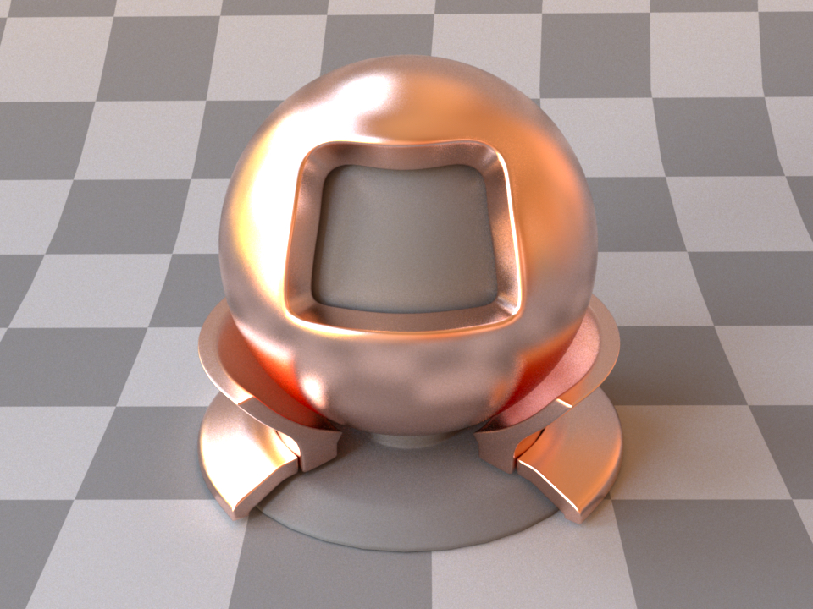
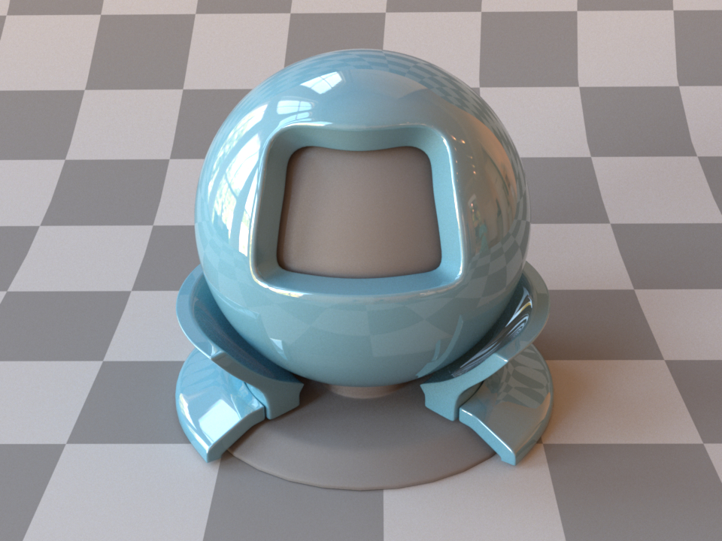
Directional material characteristic
In computer graphics, higher level description of scattering is used to describe directional – surface scattering - characteristics:
  Reflective
  Transmissive
  Specular (mirror)
  Glossy
  Lambertian (diffuse)
  Refractive
  Retroreflective
Reflective, specular (conductor, gold)
Transmissive, specular (dielectric, glass)
Reflective, Lambertian/diffuse (dielectric, plastic)
Reflective, glossy
Refractive, glossy (dielectric shiny plastic)

Slide 21
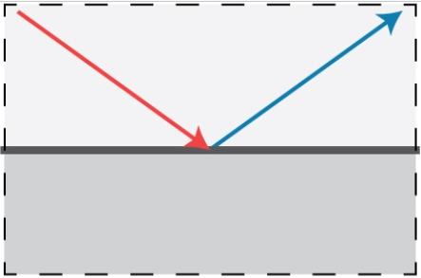
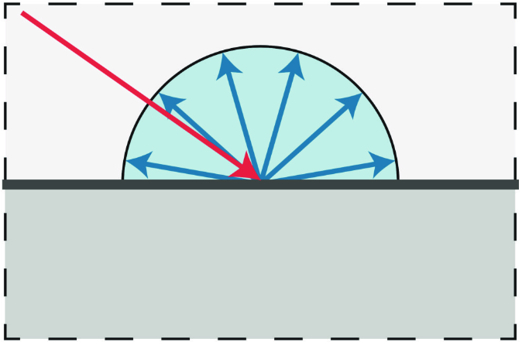
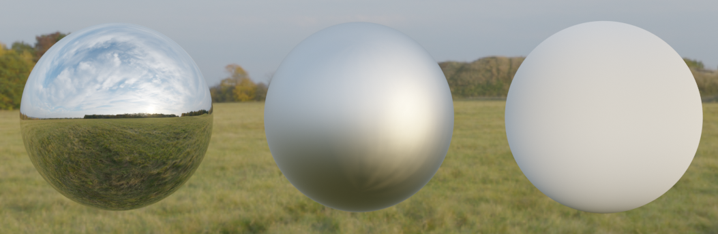
Surface scattering: scattering function
Surface directional effects (and color) are modeled using scattering function. Most important light scattering models are:
Specular (mirror direction)
Glossy (preferred direction)
Diffuse (all directions)
Polar plot visualization

Slide 22
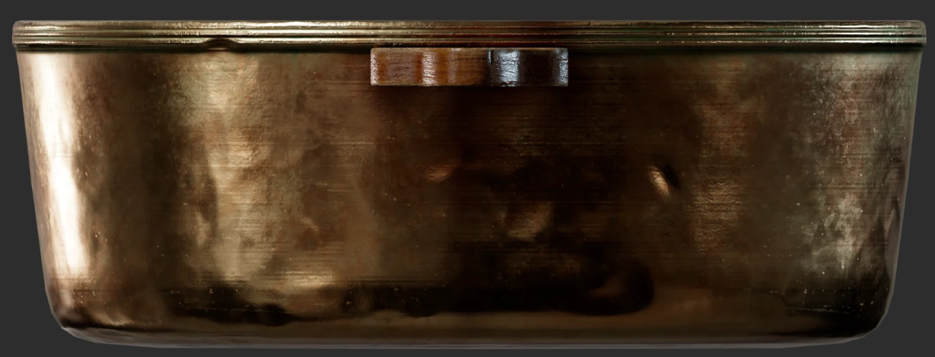
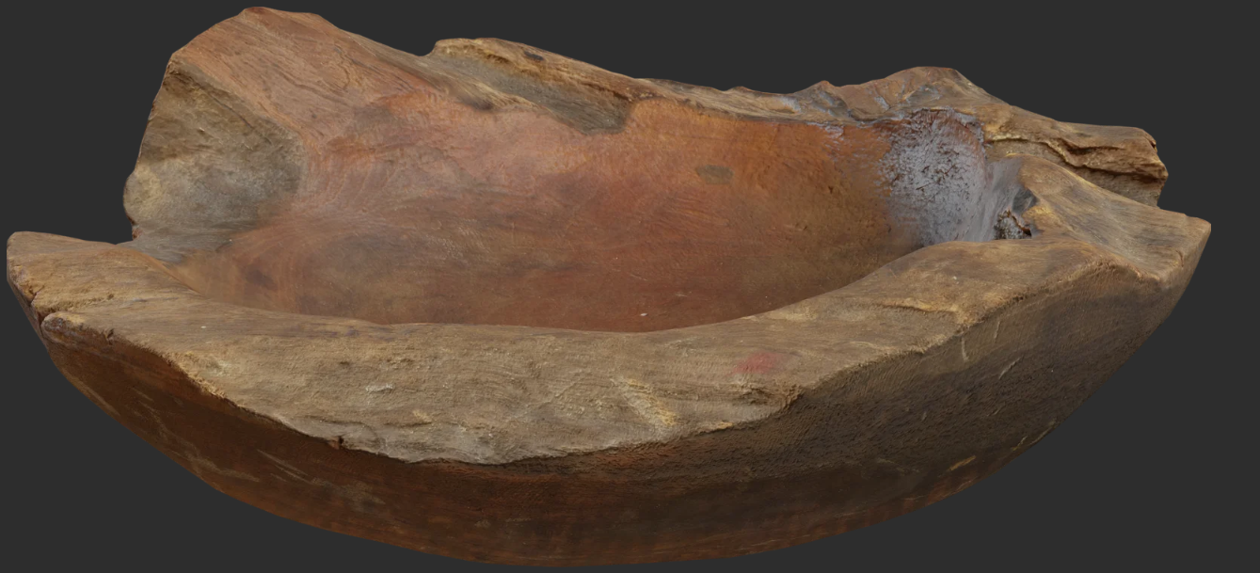
Material characteristics: texture
Visual variations on the object surface, much smaller scale than size of the object but larger than the wavelength of light - spatial variations:
  Directional or spectral (color)
  Small scale geometric variations: bumps and pores
Surfaces with spatial variation are observed as non-uniform: texture or pattern can be observed
Directional variation
Small scale geometrical variation
Color variation

Slide 23
Classifying materials
Classifying materials enables us to understand which characteristics are needed to be modeled in order to obtain required appearance. We can classify any material by following variations:
Spectral: color
Directional
Texture

Slide 24
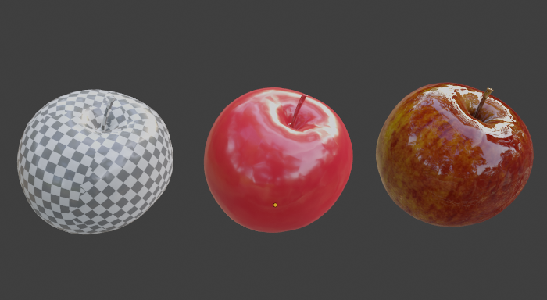
Materials in computer graphics
Geometry
Scattering function
Texture
Scattering function
Directional effects
Color
Texture
Surface patterns

Slide 25
Physical models for computer graphics
Modeling is founded on optics

Slide 26
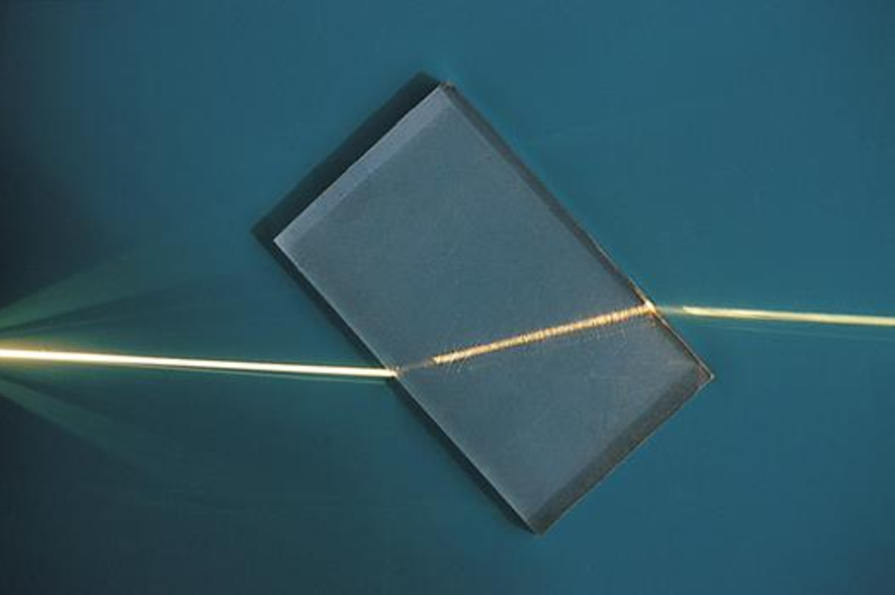
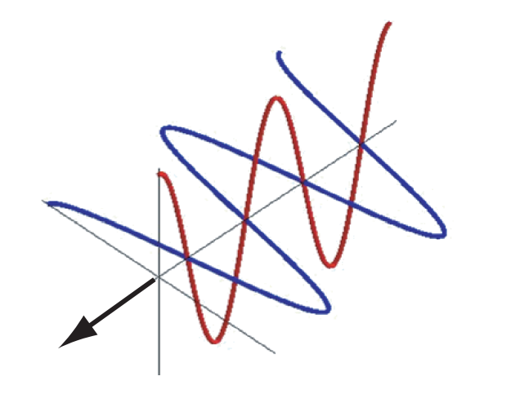

Light-matter interaction
Light is electromagnetic transverse wave → too complex for CG!
Geometrical optics
  Approximates light as rays
  Describes light-matter interaction via index of refraction (IOR) – a complex number:
    Real part determines speed of light → scattering
    Imaginary part determines absorption of light
Light can be represented as ray.https://ssteinberg.xyz/2022/04/03/practical_plt/
Light scattering due to difference in IOR.

Slide 27
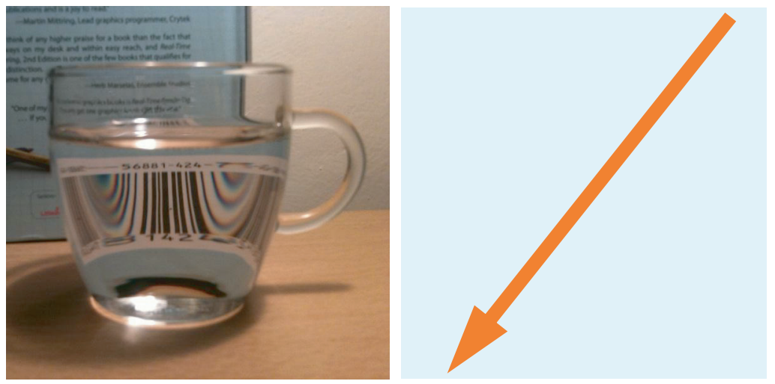
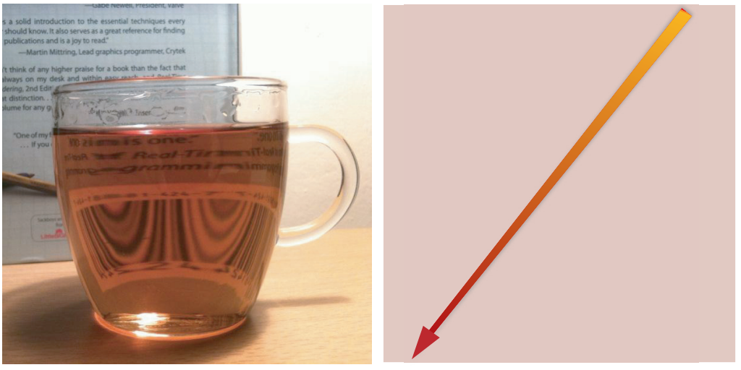
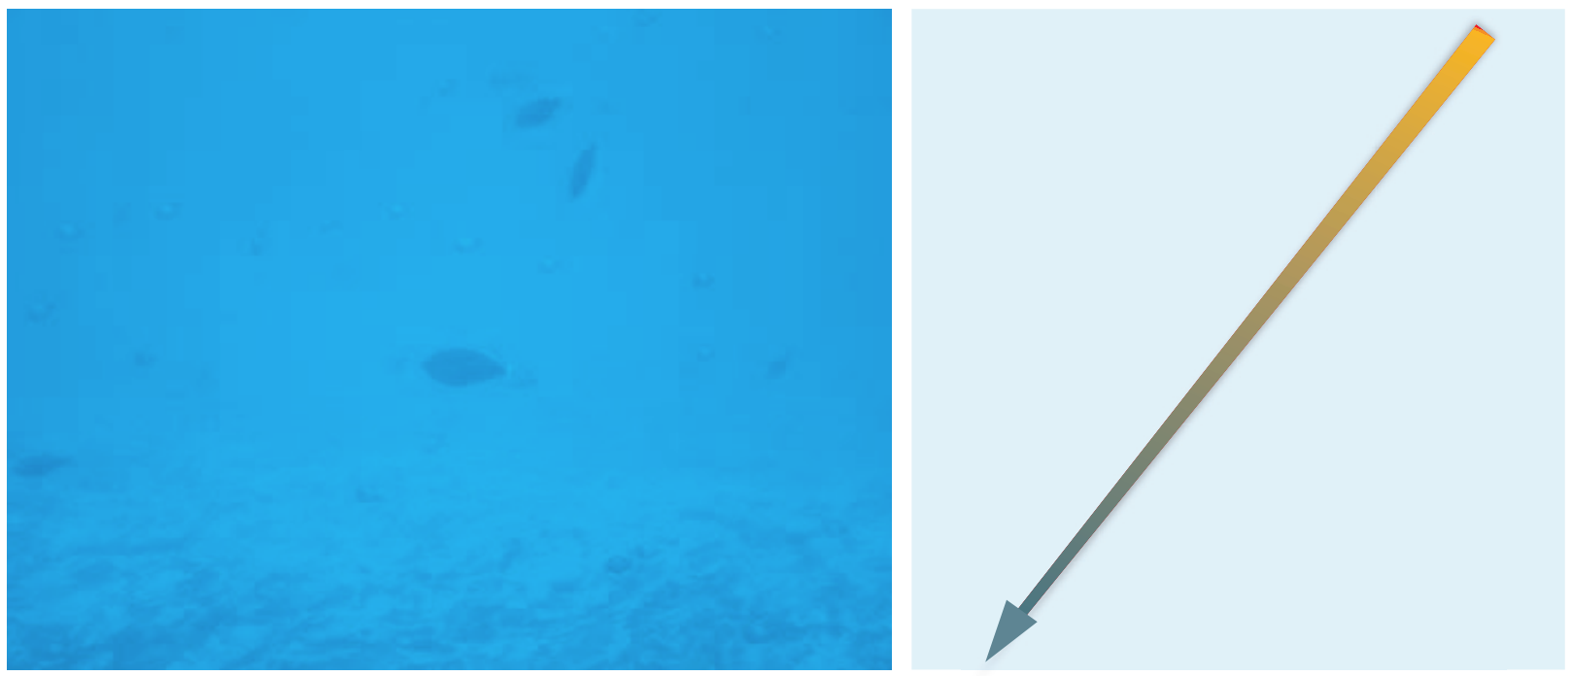
Light-matter interaction
Simplest light-matter interaction is light propagating through homogeneous medium.
  Uniform IOR: light travels on a straight line.
  It can only be absorbed: direction is same, intensity might be attenuated
Transparent media (water): straight line with same intensity (scattering only happens when light crosses air-glass-water homogeneous media since they have different (but constant) IORs.
Clear absorbent media (tea): straight line with loss of intensity – selective absorption (color is changed)
Absorption becomes significant with distance.
https://blog.selfshadow.com/publications/s2013-shading-course/hoffman/s2013_pbs_physics_math_notes.pdf

Slide 28
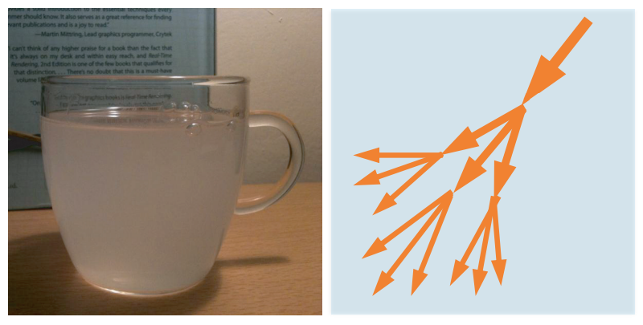
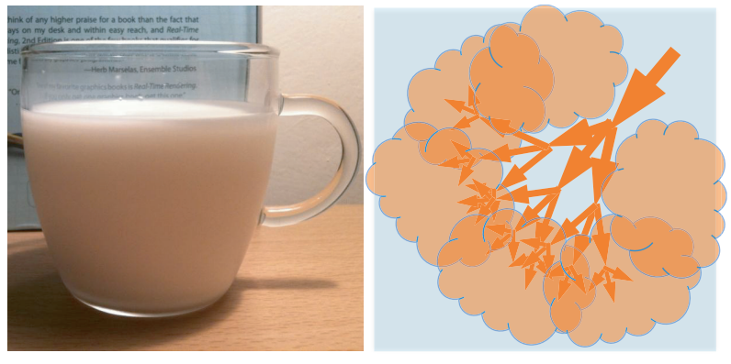
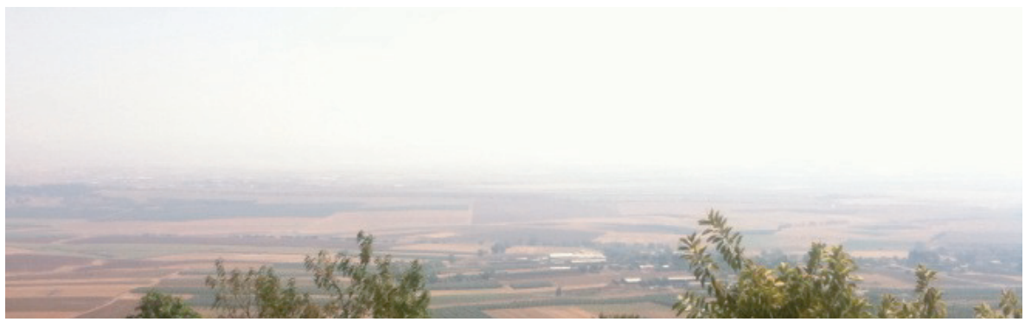
Light-matter interaction
In Heterogeneous medium IOR varies which causes light scattering
  Direction of light is changed but not the intensity
  Light can scatter in all directions, mostly non-uniformly: forward or back scattering (in or reverse of incoming direction)
Microscopic particles cause varying of IOR and light to scatter continuously in all possible directions.
Translucent or opaque materials → light is scattered so much that we can not see (clearly) through the object
Longer distances cause more scattering (e.g., clean air)
https://blog.selfshadow.com/publications/s2013-shading-course/hoffman/s2013_pbs_physics_math_notes.pdf

Slide 29
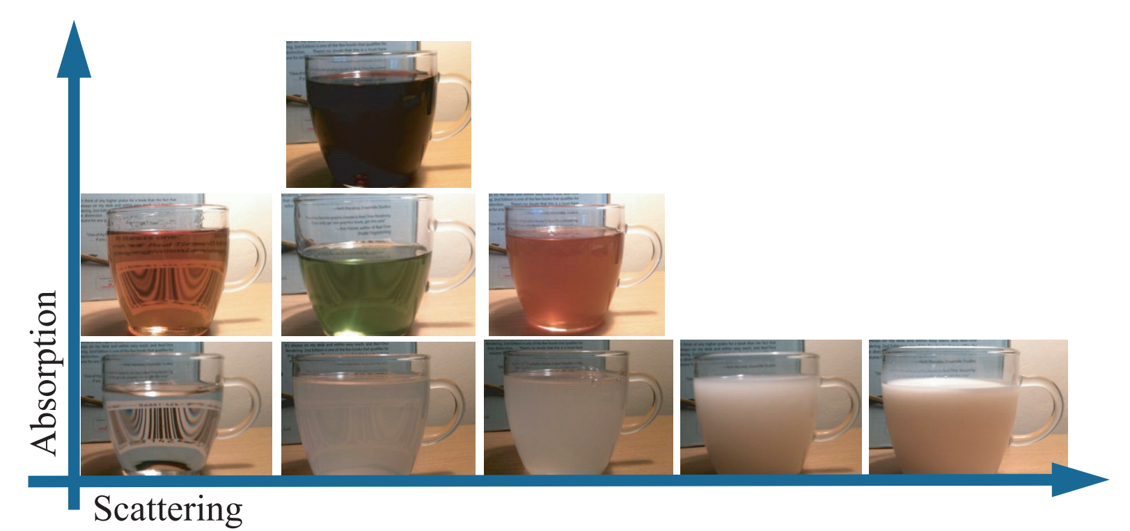
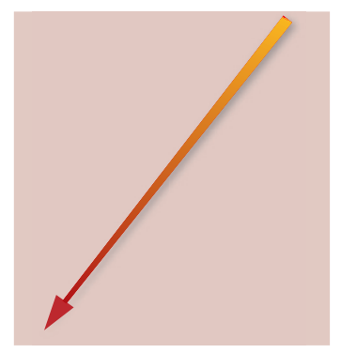

Light-matter interaction: scattering and absorption
Light traveling through medium, based on index of refraction will:
  Absorb
  Scatter
Appearance depends on both scattering and absorption
https://blog.selfshadow.com/publications/s2013-shading-course/hoffman/s2013_pbs_physics_math_notes.pdf

Slide 30
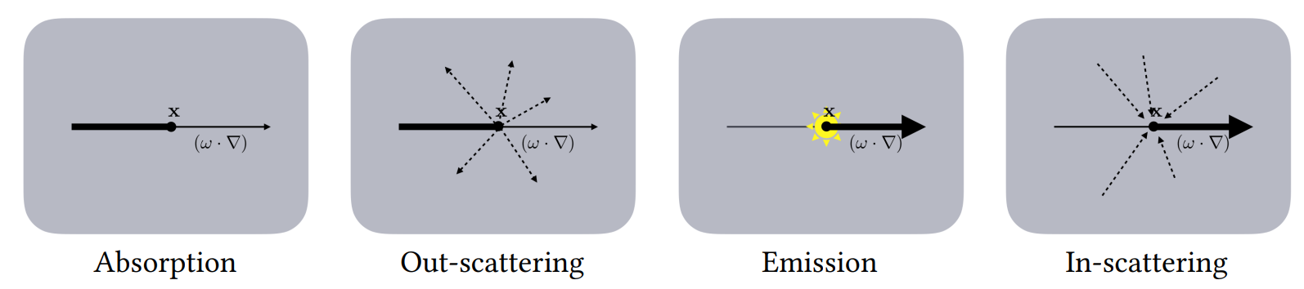
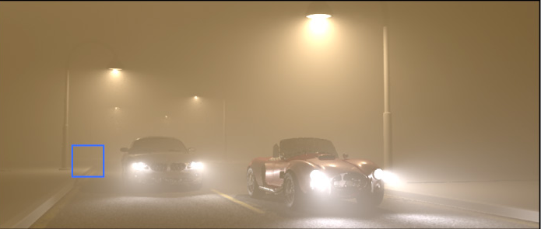
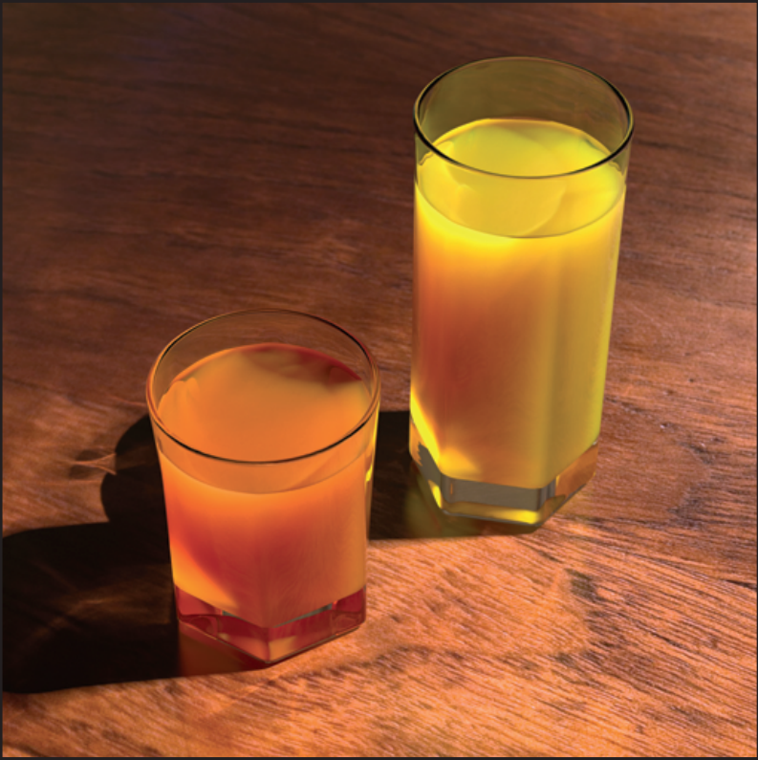
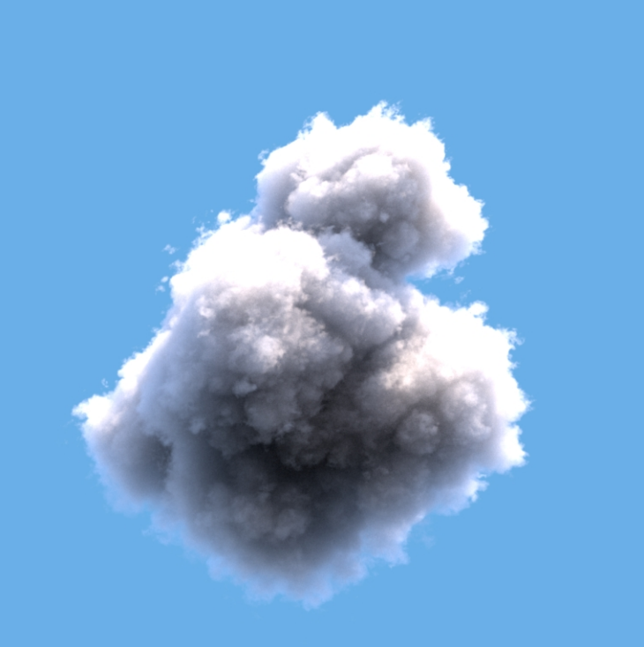
Participating media*
Participating media
  Medium between objects
  Simplest: vacuum
Light traveling inside medium in CG is called volumetric scattering
https://cs.dartmouth.edu/wjarosz/publications/jarosz08radiance.html
https://studios.disneyresearch.com/2012/08/05/virtual-ray-lights-for-rendering-scenes-with-participating-media/
https://graphics.pixar.com/library/ProductionVolumeRendering/paper.pdf

Slide 31
Foundations of materials: physics
Material defines interaction of light with objects
  Light is electromagnetic wave (visible part of spectrum). In computer graphics we work with geometrical optics which is approximation and light is represented using rays.
Light traveling through medium, based on index of refraction will*:
  Absorb
  Scatter
Homogeneous material: light travels on a straight line, it can only be absorbed, meaning that direction is same, but intensity might be lower.
  In transparent material (e.g. glass or water) light propagates in straight line – no scattering (scattering happens on interface – boundary between materials). Also, low absorption of light.
  Homogeneous material with higher absorption will attenuate light traveling through it or completely absorb it if distance is large – but the direction will not change! An example is water over larger distances.
  Note that also light can be selectively absorbed, meaning that it changes color (alongside intensity).
Heterogeneous material: light is scattered → direction of light is changed but not necessary the intensity
  Light can scatter in all directions, mostly non-uniformly: forward or back scattering
  Translucent or opaque materials are examples of heterogeneous materials → light is scattered so much that we can not see (clearly) through the object
  Longer distances cause more scattering, but not necessary more absorption (e.g., clean air)
<IMAGES OF REAL WORLD OBJECT SHOWING THOSE CHARACTERISTICS>
* Light interaction with matter (on geometrical optics) is determined by index of refraction – complex number. Real part determines speed of light, imaginary part determines absorption.Constant index of refraction is present in homogeneous materials where index of refraction is constant. For such materials, only absorption happens. Varying index of refraction is present in heterogeneous materials causing scattering (next to absorption).

Slide 32


Light-surface interaction
Light traveling between media of different index or refraction - Maxwell’s equations – too computationally heavy!
Simplification and assumptions:
  Interface between (volumes) media is perfectly (optically) flat, planar boundary* → object surface
  Geometrical optics: rays light representation, IOR
Solution: Fresnel equations and Snell’s law
* Surface should be infinitely large, but in comparison with wavelength of light, surface real objects can be considered as such.
https://manual.keyshot.com/manual/materials/general-parameters/refractive-index/

Slide 33
Reflection on optically flat surfaces
Light interaction with matter can be described with Maxwell’s equations. Those are too heavy for computer graphics thus we work with (1) geometrical optics approximations and (2) special case which is can be simplified and used in graphics for material modeling.
Perfectly planar (optically flat, perfectly smooth) surface* between two homogeneous materials with different index of refraction is starting point for describing the behavior of light interaction with surface. This special case is described with Fresnel's equations:
  Light falling on such surface can: reflect and refract
  Amount and directions of light depend on index of refraction
<IMAGE: REFLECTION AND REFRACTION>
* Surface should be infinetly large, but in comparison with wavelenght of light, surface real objects can be considered as such.

Slide 34




Surface
Surface: 2D interface separating volumes with different IOR (thin interface between media)
In CG it is described with shape representations, e.g., polygonal mesh
Behavior of light falling on surface depends on:
  Geometry → surface orientation (normal)
  Substance (material) → IOR

Slide 35


Light-surface interaction: reflection
Light falling on planar surface can reflect
  Direction: law of reflection – angle of reflection is equal to angle of incidence.
This is property of opaque objects:
Metals
Dielectrics (specular reflection)

Slide 36

More physically correct surface reflection
Real surfaces: small geometrical irregularities not visible by eye affecting reflection
Surface model: large collection of tiny optically flat surfaces – microfacets. Final appearance is aggregate result of relevant facets.
  Smaller deviation of those facets → mirror-like surface reflection
  Larger deviation of those faces → glossy surface reflection
Similar shape, different reflection.

Slide 37

Light-matter interaction: flat surface
Light falling on planar surface can refract:
    Direction or refraction: Snell’s law
Characteristic of dielectric objects:
  Example: glass

Slide 38



Surface refraction
Amount and direction of refracted light depends on material which we can separate in:
Metals (conductors)
Dielectrics (non-metals)
In case of metals, most of the light is reflected and rest is immediately absorbed. That is why mirrors are made using metal foundation. Conductors are spectrally selective and thus reflection color may vary
In case of dielectrics, light partially reflects and partially refracts. Refracted light is then absorbed and scattered inside surface (sub-surface scattering (SSS)) causing diffuse reflection.

Slide 39

Surface refraction
Refracted light on dielectric surface can:
  Sub-surface scatter, absorb and re-emit: opaque objects
  Transmit; pass through object: transparent objects
  Sub-surface scatter, absorb, re-emit and transmit: translucent objects
Opaque
Transparent
Translucent
https://www.hippopx.com/en/query?q=translucent

Slide 40



Light-matter interaction: flat surface
Amount of light reflected/refracted (transmitted) is described with Fresnel’s equations
Amount of reflected light
Amount of refracted light

Slide 41


Light-matter interaction: flat surface
Surface reflection and refraction is crucial for realistic synthesis
  Whitted ray-tracing for realistic image synthesis
http://www.jallmenroeder.de/2020/11/18/path-tracing-with-nori/

Slide 42

Diffuse and specular reflection
Two fundamental light-surface scattering processes:
  Diffuse: incoming light is distributed in all directions
  Specular/glossy: incoming light is reflected into single or preferred direction

Slide 43
Light-matter interaction: summary
Light traveling between objects can be scattered/absorbed
  Volumetric scattering in participating media
Light falling on object surface – surface scattering:
  Reflect (metals and dielectrics)
  Refract (only dielectrics)
Depending on dielectric material, refracted light can:
  Transmit (transparent, translucent surfaces)
  Sub-surface scatter and absorb (opaque and translucent object volume) → volumetric scattering
Participating media
Opaque dielectric: reflect + refract → SSS/diffuse
Transparent dielectric: reflect + refract → transmit
Translucent dielectric: reflect + refract → transmit
Metal: reflect

Slide 44

Material modeling
Four scattering models for this lecture: local surface models
Perfect specular reflection.
Light is reflected into only one direction.
Diffuse reflection.
Light is reflection into all directions equaly.
Glossy reflection.
Light is reflected into preferred direction.
Perfect specular reflection and transmission.

Slide 45

Modeling material characteristics
Scattering function describes small scale light-object interactions:
Color: light absorbtion
Directional effects: how light scatters
Uniform parameters of scattering function → smooth surfaces.
Texture describes surface variations visible by eye:
Varying scattering function parameters (e.g., color)
Varying surface details (e.g., normals)

Slide 46
Light-matter interaction: refraction
Besides of reflection on surface, light can also refract.
Amount and direction of refracted light depends on material which we can separate in:
  Metals
  Dielectrics
In case of metals, most of the light is reflected and rest is immediately absorbed. That is why mirrors are made using metal foundation.
In case of dielectrics, light partially reflects and partially refracts. Refracted light is then absorbed and scattered inside surface (sub-surface scattering*). Some of the light can also be re-emitted – causing diffuse reflection.
<IMAGES: REFLECTION ON METAL AND DIELECTRIC SURFACES>
<IMAGES: real world objects with such properties>
<IMAGE: reflection from metal and dielectric surface: not the color of reflection!>s
* Note that in this case, light is not exiting from the same point where it has entered, thus we need more than local information for calculating light behavior. Therefore, this is one of more complex effects that require advanced rendering methods or approximation methods.

Slide 47
Modeling appearance

Slide 48


Diversity of appearance models
Appearance models, depending on application, can range from photo-real to stylized.
“Rolling Teapot” - Model by Brice Laville, concept by Tom Robinson, render by Esteban Tovagliari - RenderMan ‘Rolling Teapot’ Art Challenge: https://appleseedhq.net/gallery.html#https%3A%2F%2Fappleseedhq.net%2Fimg%2Frenders%2Frolling-teapot.jpg
https://www.artstation.com/artwork/rANRe5

Slide 49

Material and rendering
Rendering: computing intensity and color of pixels of virtual image plane in virtual camera
For each pixel of virtual image plane, camera (viewing) ray is generated and traced into scene
  This simulates light entering the camera along set rays
View rays are tested for intersection with objects in the scene
  Closest intersected object surface is found → shading point
  Ignore participating media for now
Compute intensity and color of the surface intersected by viewing ray → shading

Slide 50

Materials and shading
Shading uses:
  Material model
  Viewing position
  Object shape
  Light information
Final color of surface is calculated by:
  Summing all incoming light that falls onto surface
    Light transport – also uses material information
  Calculating color and intensity of light reflected into camera using material description - shading

Slide 51
Material modeling
Model interaction of light in shading point → scattering model.
  Four scattering models for this lecture: local and surface-related
Perfect specular reflection.
Light is reflected into only one direction.
Diffuse reflection.
Light is reflection into all directions equaly.
Glossy reflection.
Light is reflected into preferred direction.
Perfect specular reflection and transmission.

Slide 52
Local scattering models
Local (direct) models: describe what happens when light falls on one point and scatters from that one point.
Surface scattering can be well described (approximated) with local models.
Macroscopically, non-optically flat surface can be treated as flat surfaces reflecting with multiple directions
Local models describe what happens at one point of intersection with object surface

Slide 53

Global scattering models
Volumetric scattering phenomena requires global scattering model
Can be approximated with local model (e.g., SSS with diffuse model)
Volumetric scattering inside surface (SSS) or in participating media requires global models: light path is not exiting the same point where it entered.

Slide 54
Material modeling
With material in CG we describe light-matter interaction → shading
Material in CG can is decomposed to describe:
  Color
  Directional effects
  Spatial variation:
    Of color and directional effects
    Small-scale geometrical information that is too small to represent explicitly by geometry/shape.

Slide 55
Material modeling: scattering
Material modeling describe how light behaves when interacts with objects:
  Light-surface interaction
  Light-volume interaction
Description of light interaction with surface, when considered locally, is called scattering.

Slide 56


Material modeling: texture
Same parameters of scattering model in each point of 3D surface results in homogeneous surface material: smooth surface
Scattering model parameters are varied using texture.
Homogeneous material: scattering model has the same parameters in all points of the surface.
In CG texture is used to vary scattering parameters over surface
Models: https://polyhaven.com/a/throw_pillows_01

Slide 57
Elements of material model
Material modeling in computer graphics is separated into:
  Scattering → description of light-matter interaction at a point (directional effects and color)
  Texture → variation of small-scale geometry and scattering properties across 3D object surface
Diffuse scattering model only.
Diffuse scattering model with texture.

Slide 58


Shading and light
L_{i}
Ω
L_{o}
Rendering equation – basis for physically based rendering
  Describes global illumination: light coming from any direction
p
Outgoing light in point p in direction ω_{o}
Emitted light in point p
(only if light source)
Scattering model
Incoming light in point p from light direction ω_{i}.
Calculated using light transport
Attenuation (cosine) factor: surface orientation towards light
For case when camera ray intersects the surface then:
L_{o} is shading results, a color
ω_{o} is equal to view direction
ω_{i} is equal to light direction
Note that this is recursive equation and for each light direction direction this equation must be evaluated again.
https://cgg.mff.cuni.cz/~jaroslav/teaching/2015-npgr010/slides/07%20-%20npgr010-2015%20-%20rendering%20equation.pdf

Slide 59

Shading and light
Reflectance equation. Special case of rendering equation.
  Describes global illumination but only for reflective surfaces.
Shading “collects” all incoming light and shading point and multiplies it with scattering model.
Collect light over whole hemisphere above shading point, placed on normal in shading point
Incoming light at shading point
Color in shading point.
Scattering model
Light attenuation due to surface orientation (cosine factor)
p

Slide 60


Shading and light
Simplification: direct illumination – take in account only light coming from light sources (e.g., point lights).
Attenuation
c_{light_2}
c_{light_1}
Scattering model
Color in shading point
l₁
p
l₂
c_{shaded}
Current light color
Sum over all lights in 3D scene

Slide 61
Scattering models

Slide 62
Surface scattering:
Reflection and transmission
specular
Diffuse
Glossy
transmission

Slide 63



Shape and brightness
n
Amount of light falling on surface depends on:
Shape
Light position/direction:
Alignment of surface normal towards light determines amount of surface brightness
  Light attenuation (cosine factor)
ω_{i}

Slide 64




Scattering model
Observing objects we can see that they have different appearance, although similar in shape
  This particular look of objects is defined by how light scatters when it falls on surface point
  This behavior is defined by surface scattering function - surface response to light
    Color and directional effects

Slide 65

Surface scattering function
Scattering function can be separated in reflection and transmission
  Model describing reflection is called “bidirectional reflectance distribution function” – BRDF.
  Model describing transmission is called “bidirectional transmission distribution function” – BTDF.
  Model describing both reflectance and transmission is called “bidirectional scattering distribution function” – BSDF.
Reflective – all light is scattered above surface
Transmissive – all light is scattered below surface
  Refractive – special case of transmissive
https://www.pbr-book.org/3ed-2018/Reflection_Models/Specular_Reflection_and_Transmission

Slide 66

Visualizing BRDF/BTDF
The way surface reflects light can be visualized using lobes – polar plot
  Given incident light direction, describes surface light reflection

Slide 67
BRDF
Describes reflectance phenomena: redirection of light hitting surface (shading point) back outward
Mathematical approximation of light interaction and microscopic structure of material:
  Surface reflection
  Re-emitted light from sub-surface scattering approximated with local model (e.g., diffuse model)
BRDF is evaluated at shading point

Slide 68

BRDF notation
BRDF f(v,n,l) describes light reflection on surface which depends on:
  Incoming – unit length vector - light direction (l)
  Outgoing – unit length vector - view direction (v)
  Shading point normal (n)
BRDF returns amount of light in outgoing direction given incoming direction (bidirectional)
Incoming (l) and outgoing (v) directions have 2 degrees of freedom, two angles relative to surface normal:
  Elevation (θ)
  Azimuth (Φ)
  Dimensionality of BRDF: 4

Slide 69
BRDF in shading
Direct (local) illumination.
Attenuation
c_{light_2}
Scattering model → BRDF
c_{light_1}
Color in shading point
p
l₁
l₂
c_{shaded}
Current light color
Sum over all lights in 3D scene

Slide 70

Base BRDFs
https://mitsuba2.readthedocs.io/en/latest/generated/plugins.html#bsdfs
Diffuse
Glossy
Specular
Light is scattered in all possible directions.
Independent of viewing direction.
Equally bright from all directions.
Example: rough wood
Scattered light is concentrated around particular direction (lobe).
Dependent of viewing direction.
Appears blurred.
Examples: brushed copper
Light is scattered in single direction (mirror-reflection direction).
Dependent of viewing direction.
Perfectly sharp reflection.
Example: smooth gold

Slide 71

Base BRDFs*
Real materials have complex lobes (reflections)
While modeling, several lobes can be combined with different weights and parameters
Wide range of materials can be described with these three basic reflection types:
  Specular
  Diffuse
  Glossy (rough specular)

Slide 72
Scattering models
Modeling approaches:
  Empirical
    Simulate observed scattering phenomena
  Data-based
    Scattering is measured from real world and stored in tables
  Physically-based
    Based on physical interaction of light with matter

Slide 73
Empirical models
Models based on observation of scattering phenomena rather than physical correctness
Phenomenological models: describe the quantitative properties of real-world surfaces by mimicking them
Easy to implement and use
Types:
  Lambertian → diffuse
  Specular → mirror
  Phong and Blinn-Phong → glossy

Slide 74


Lambertian (diffuse) model
Reflected light is equal in all directions and linearly depends on incoming light
Simplest BRDF model:
  Doesn’t depend view direction
  Constant reflectance value: diffuse color (albedo): (R, G, B)
Local model can be used to approximate sub-surface scattering
The basis for more complex models
Albedo = (1,1,1)
https://google.github.io/filament/Filament.html

Slide 75

Lamberitan in shading
Note that surface orientation will attenuate or increase incoming light making surface darker or brighter (attenuation factor)
Attenuation
Albedo = (0.9, 0.05, 0.05)
l1 = (1,1,1)
l2 = (1,1,1)
c_{light_2}
c_{light_1}
Lambertian scattering model
Color in shading point
l₁
p
l₂
c_{shaded}
Current light color
Sum over all lights in 3D scene

Slide 76





Lambertian (diffuse) model examples

Slide 77


Specular (mirror) model
Ideal reflection where incoming light is reflected completely in a single outgoing direction
  Mirror reflectance direction → θ_{l} = θ_{v}
Depends on view and light directions
Single parameter: reflectivity – a constant (R,G,B)

Slide 78

Specular model in shading
Attenuation
l₁
Current light color
c_{light_1}=(1,1,1)
Color in shading point
p
Sum over all lights in 3D scene
c_{shaded}
Specular scattering model
reflectivity = (1,1,1)
Reflects only light source!

Slide 79

Specular model in shading
c_{light_1}
Attenuation
l₁
p
c_{shaded}
Current light color
Color in shading point
Sum over all lights in 3D scene
Specular scattering model
Drawback of direct illumination
Only light sources are considered for incoming light

Slide 80


Specular model in shading
Ideal reflection where incoming light is reflected completely in a single outgoing direction – mirror reflectance direction
  Light has to be “gathered” from all directions above shading point:
    Light sources → direct illumination
    Surfaces in 3D scene → indirect illumination
p
Global illumination:
Direct illumination
Indirect illumination
Reflectance equation

Slide 81
Specular and diffuse reflection
More information on physical background:https://www.feynmanlectures.caltech.edu/II_toc.html
Metals
Dielectrics
Diffuse reflection gives color to the dielectric materials.
It is a result of re-emitted light which entered surface and partially absorbed.
Reflects almost all specularly but not in mirror direction!
Colored specular reflection (highlights)
Specular reflectivity parameter determines color for metals (conductors) – approximation of spectral selectivity
Specular highlight is the same color as light source color.

Slide 82

Phong model
Idea: wide range of materials can be described with combination of diffuse and specular components:
surface_color = diffuse() * K_{d} + specular() * K_{s}
Problem: some surfaces are not perfectly reflecting light in mirror specular reflection: sharp reflection
Glossy highlights: reflection of light source (or another object) on object surface is “blurred”
Perfect specular reflection
Blured specular reflection: glossy

Slide 83

Phong model: glossy observations
Glossy reflection is a result of rough surface which acts as “broken mirror”
Such surface can be represented as collection of small mirrors → micro-facets
Only fraction of light rays are reflected in eye direction by rough surface causing dimmer/blurred light reflection
Brightness of glossy reflection decreases as angle between view and ideal reflection increases
  This simulates decreasing number of microfacets reflecting in eye direction

Slide 84


Phong model: glossy observations
Maximum reflection is when viewer (V) aligns with reflection (R)
Reflection decreases as angle between viewer (V) and reflection (R) distance increases
  Reflection spreads across larger area
  Highlight brightness decreases as distance of object points from original reflected light position increases

Slide 85



Phong model: specular component
Glossy surface can be simulated by:
  Computing ideal specular reflection (R) of incident light ray (L)
  Computing dot product between reflected ray and view direction
  Raising dot product to power of n

Slide 86

Phong model: specular component
Empirical model: parameters doesn’t have physical meaning
  Parameters are tweaked by artist/user until desired appearance is achieved
  Specular highlights become “sharper” as n grows

Slide 87



Phong direct illumination model
i_{s}, i_{d}, i_{a}
Describes local shading (direct illumination)

Slide 88
Ambient: small amount of light that comes from around the scene
Parameter: k_{a} (R,G,B) – ratio of ambient reflection over incoming light i_{a} (R,G,B)
Diffuse reflection from rough surfaces; large highlights
Parameter: k_{d} (R,G,B) – ratio of diffuse reflection over incoming light i_{j,d} (R,G,B)
Specular reflection from shiny surfaces; small highlights
Parameter: k_{s} (R,G,B) – ratio of specular reflection over incoming light i_{j,s} (R,G,B)
Parameter: α – shininess constant: larger value causes smooth and mirror-like surfaces with small specular highlights

Slide 89


Blinn-Phong reflection model
Introducing half vector (h) between light (l) and view (v) vectors
  Maximum reflection: v = r, that is: n = h
  Reflection decreases when angle between N and H increases
Parameters:
  Lambertian (k_{L}) , range: [0,1]
  Glossy (k_{G}), range: [0,1]
Energy conserving if k_{L} + k_{G} <= 1

Slide 90


Blinn-Phong reflection model
https://en.wikipedia.org/wiki/Blinn%E2%80%93Phong_reflection_model
Phong and Blinn-Phong models are often perceived as “plastic”.
Physically-based microfacet models solve this problem
Example in OpenGL:https://learnopengl.com/Advanced-Lighting/Advanced-Lighting

Slide 91


Other empirical models
Lafortune model
  Generalization of Phong’s model
  Richer appearance with multiple lobes
https://cglearn.eu/pub/advanced-computer-graphics/physically-based-shading
Lafortune model. http://people.csail.mit.edu/addy/research/ngan05_brdf_eval_ppt.pdf

Slide 92
Scattering models
Modeling approaches:
  Empirical
    Simulate observed scattering phenomena
    Motivated specular, glossy and diffuse scattering models
  Data-based
    Scattering is measured from real world and stored in tables
  Physically-based
    Based on physical interaction of light with matter

Slide 93


Data-based models
BRDF measurement → gonioreflectomenter
  Measurements are stored in look-up table
  View and light direction is used for indexing the table
BRDF measurement of real-world can be used for:
  Evaluation of phenomenological and physically based models
  Modeling of material
Different real-world materials have been measured:
  Isotropic BRDFs
  Anisotropic BRDFs
  Texture characteristics
  Sub-surface scattering
Problems:
  Costly for rendering
  Memory → compression or better analytical models!
Isotropic materials:https://www.merl.com/brdf/
Anisotropic materials: Brushed aluminium,Yellow satin, Purple satin, Red velvet http://people.csail.mit.edu/addy/research/brdf/

Slide 94
Scattering models
Modeling approaches:
  Empirical
    Simulate observed scattering phenomena
    Motivated specular, glossy and diffuse scattering models
  Data-based
    Scattering is measured from real world and stored in tables
  Physically-based
    Based on physical interaction of light with matter

Slide 95
Physically-based models
Real-world surfaces have geometrical detail on multiple and thus very small scales
Small scale geometry is invisible to the eye directly, but its cumulative response is visible in light reflection
  Micro-facet theory – an approach of modeling small-scale surface geometry

Slide 96

Microfacet-based models
Small-scale surface irregularities (under one pixel) are expensive to model explicitly → model with BRDF!
Small scale irregularities are represented as optically-flat facets with microsurface normals → microfacet-based models.
  Geometric optics assumption: microfacets are much larger than light wavelength → they only cause light redirection
  Wave optics describes phenomena of light scattering where surface irregularities are comparable to light wavelength*
https://google.github.io/filament/Filament.html

Slide 97


Microfacet-based models
Cook-Torrance reflection model: model surface statistically as large number of microfacets
R_{s} – Specular component
  D – distribution of microfacet normals
  G – geometry term
  F – Fresnel term
R_{d} – Diffuse (Lamberitan) reflection model

Slide 98

D – distribution of microfacet normals
Statistical distribution of microfacet normal orientation. Distributions: Gaussian, Beckmann, GGX
Spread of this distribution is called roughness and it determines the regularity of microfacets
  Higher roughness → more blurred surface since micronormals will be more irregular (glossy).
  Small roughness → mirror-like surface (specular).
Glossy
High roughness
Specular
Small roughness
https://www.cs.cornell.edu/~srm/publications/EGSR07-btdf.html
https://google.github.io/filament/Filament.html

Slide 99

G – geometry term
Statistically describes attenuation at microfacet level
  Probability of microfacets shadowing or mask one another
Choice of geometry term model (G) depends on distribution of microfacet normals (D)
  Often Smith’s model is used for geometry term model.
Details on shadowing-masking: https://jcgt.org/published/0003/02/03/paper.pdf

Slide 100




F – Fresnel term
Determines amount of reflected vs refracted light
Depends on:
  Index of refraction
  Angle between surface normal and view direction
Specular reflection is high at grazing angles
  Large angle between normal and view direction → larger amount of reflection
Fresnel equations are well approximated with Schlick’s approxmation
Reflection at normal incidence
https://substance3d.adobe.com/tutorials/courses/the-pbr-guide-part-1
https://blog.selfshadow.com/publications/s2020-shading-course/
https://graphicscompendium.com/raytracing/11-fresnel-beer

Slide 101

Microfacet-based models
Assumption of microfacets which are optically-flat
  Diffuse
  Specular
Geometric optics can approximate how light interacts with each microfacet using IOR, Fresnel equations and Snell’s law

Slide 102


Microfacet-based models
Microfacet-based BRDFs are state of the art physically-based reflection models used in professional modeling and rendering software.
Fundamental models are:
  Torrance–Sparrow, Cook-Torrance for specular/glossy surfaces
    Assumption: microfacets are specular
  Oren-Nayar better approximation of diffuse reflection than Lambertian model
    Assumption: microfacets are diffuse
https://www.pbr-book.org/3ed-2018/Reflection_Models/Microfacet_Models

Slide 103

Physically-based models
Physically based models require:
  Helmholz reciprocity: f(l,v) = f(v,l) – input and output can be switched and the function value will stay the same
  Conservation of energy: outgoing energy can not be greater than incoming energy.
    BRDF which significantly violates this property leads to too bright and thus not realistic surfaces.
    Note that BRDF can have arbitrary large values in certain directions if the distribution it describes is highly non-uniform (e.g., specular highlights)
White furnace test*: white sphere is illuminated with white light from all directions. If energy conserving is satisfied, the sphere will disappear in white background.
https://boksajak.github.io/files/CrashCourseBRDF.pdf

Slide 104
Energy consevation*
Energy conservation is measured with directional-hemispherical reflectance R(l).
  It measures amount of light coming from given direction that is reflected into any outgoing direction in the hemisphere around normal – it measures energy loss for a given incoming direction.
  If BRDF is reciprocal then hemispherical-directional reflectance can be calculated as well giving the same value.
    Term for both reflectances in Directional albedo.
  The value must be in [0,1] to satisfy energy conservation: 0 is completely absorbed, 1 is completely reflected.
  Note that this restriction doesn’t apply to BRDF since it can have arbitrarily large values in certain direction (e.g., highlight direction).

Slide 105

Physically-based models
Disney BRDF
  Universal BRDF with few parameters capable of producing wide range of surfaces
Principled BRDF → Blender: https://docs.blender.org/manual/en/latest/render/shader_nodes/shader/principled.html
Disney BRDF: https://media.disneyanimation.com/uploads/production/publication_asset/48/asset/s2012_pbs_disney_brdf_notes_v3.pdf

Slide 106

Isotropic and anisotropic BRDF
Isotropic BRDF: rotating light and view directions around the surface normal does not affect the BRDF.
  Incoming and outgoing directions have the same relative angles between them: such BRDF can be parameterized with three angles.
Anisoptropic BRDF: reflection behavior changes when light and view vectors are rotated around normal
  Ward anisotropic BRDF: good for modeling surfaces with anisotropic structure, e.g., hair, grooves in metals
Anisotropic reflection: https://google.github.io/filament/Filament.html
Ward model: https://cseweb.ucsd.edu/~ravir/6998/papers/p265-ward.pdf

Slide 107


Isotropic and anisotropic BRDF
Anisoptropic light reflection is present due to the directional underlying surface structure
https://cs184.eecs.berkeley.edu/sp22/lecture/14-29/material-modeling

Slide 108




Blender is our friend
https://docs.blender.org/manual/en/latest/render/shader_nodes/shader/diffuse.html
https://docs.blender.org/manual/en/latest/render/shader_nodes/shader/glossy.html
https://docs.blender.org/manual/fr/2.79/render/blender_render/materials/properties/diffuse_shaders.html?highlight=diffuse%20shaders

Slide 109

Note: bidirectionality of BRDF
“Bidirectional” in BRDF means that given given incoming and outgoing direction, we can compute amount of reflected light in outgoing direction.
Further, bidirectionality can be used for:
  Given outgoing (view) direction, it specifies the relative contributions of incoming light
  Given incoming light direction, it specifies distribution of outgoing light
Contributions of incoming light given view direction
Distribution of outgoing light directions given incoming light direction
https://blog.selfshadow.com/publications/s2013-shading-course/hoffman/s2013_pbs_physics_math_notes.pdf

Slide 110

BTDF
Reflection
Transmission
Scattering function can be separated in reflection and transmission
  Model describing reflection is called “bidirectional reflectance distribution function” – BRDF.
  Model describing transmission is called “bidirectional transmission distribution function” – BTDF.
https://en.wikipedia.org/wiki/Bidirectional_scattering_distribution_function

Slide 111


Surface reflection and refraction/transmission
Specular, glossy and diffuse surface reflection models are similar for refraction/transmission.
https://www.gigahertz-optik.com/de-de/service-und-support/informationsportal/grundlagen-lichtmesstechnik/licht-farbe/reflex-trans-abs/

Slide 112



Common BTDF types
Perfect specular transmission.
Smooth dielectic, e.g, glass
Glossy transmission.
Rough dielectic, e.g., frosted glass
https://www.cs.cornell.edu/~srm/publications/EGSR07-btdf.html

Slide 113



BTDF: specular transmission
Light passing from one transparent to another transparent medium with different IOR
  Refraction – light changes direction – illusion of disproportional/broken object
Transmission direction depends on:
  IOR of both media: η₁ and η₂
  Incident direction: θ₁
https://www.britannica.com/science/refraction
Snell’s law: refracted angle
Refraction/transmission direction:

Slide 114

BTDF: specular transmission*
3D objects represent surfaces encapsulating media with different IOR
Space around 3D objects is often considered vacuum → lowest IOR
Light can travel:
  From lower to higher IOR medium, e.g., light hitting surface from outside
  From higher to lower IOR medium, e.g., light leaves volume of water
If light travels from inside object (from higher to lower IOR) then normal direction must be flipped and then used for computing normal direction
  Check the sign of dot product between incident ray direction and normal

Slide 115




BTDF: specular transmission
When angle of incidence is larger than critical angle, then 100% of the light is reflected
  Happens when light ray passes from higher to lower IOR (e.g., glass-water)
  Total internal reflection test: term under square root is negative
https://www.youtube.com/watch?v=NAaHPRsveJk&ab_channel=QuantumBoffin

Slide 116


BRDF and BTDF
How much light is reflected and refracted?
  Fresnel equations
  Approximation: Schlick’s equation
Amount of reflected/refracted light depends on:
  Media IOR: η₁ and η₂
  Angle of incidence → amount of transmitted light increases when angle of incidence decreases
Amount of reflected/transmitted light (in case when total internal reflection doesn't occurs)
https://shanesimmsart.wordpress.com/2018/03/29/fresnel-reflection/

Slide 117
BRDF in bigger picture
Reflectance equation:
  Lo = int (f * Li * N * l)
  Note that BRDF (f) defines local interactions, so in it is used in combination of light transport to obtain light from the scene
TODO: image explaining reflectance eq. Integral over hemisphere for incoming light l and Li.
Above expression uses global illumination
Simplification: sampling over hemisphere can be simplified with summing over light sources for direct illumination

Slide 118
Scattering and shading: a note
Scattering model is implemented in shading step in rendering for calculating color of the object
Shading model takes name of scattering model
  If Lambertian scattering model is implemented than shading is called Lamberitan shading.

Slide 119


Normal and BRDF (BTDF)
BRDF and attenuation factor evaluation depends on surface normal
  Normal defines basis – local coordinate system of BRDF
Note that perturbing the normal, would tilt the basis and reflected light would be different!
This enables modeling small scale geometrical details
Variation of surface normal is task for texturing

Slide 120


Scattering models parameters
Scattering models have various parameters: color, roughness, etc.
Uniform parameters result in overly smooth and perfect surface – not realistic.
If BRDF depends on position on which is evaluated then it is called spatially varying BRDF
  Variation of parameters over surface is done using texturing

Slide 121
Scattering models: practical tip
In graphics, various scattering models have been developed (and still are!) to represent surface even more correctly or efficiently.
  https://docs.blender.org/manual/en/latest/render/shader_nodes/shader/index.html
Choice of the model depends on application and desired appearance.
Practical tips:
  When modeling a material in DCC Tool, you will be often offered with multiple implementations of basic (or more advanced) models that you further combine to achieve desired material description. In this case, it is good that you are familiar with how they work and their parameters because a lot of time is actually spent on “tweaking” parameters to achieve desired appearance. Understanding parameters of scattering models help very much with upcoming topic: texturing. This is huge and important topic.
  If you are more interested in developing your own scattering models to achieve different appearance (not necessary photo-realistic, rather non-photorealistic which will be discussed later) then understanding of existing scattering models is great foundation to build on: you will see that advancements of scattering models just added more complexity to basic ones.

Slide 122
Volumetric scattering

Slide 123
Light-matter interaction: summary
Simplify
Light traveling to/between objects can be scattered/absorbed → volumetric scattering
Light falling on object surface – surface scattering - can:
  Reflect (metals and dielectrics)
  Refract (only dielectrics)
Depending on material, refracted light can:
  Transmit (transparent surfaces)
  Sub-surface scatter (opaque and translucent object volume) → volumetric scattering

Slide 124
Participating media
Light traveling to or between objects can be attenuated by participating media
  Atmosphere, clouds, fog, smoke, etc.

Slide 125
Sub-surface scattering
Light which is not reflected from surface (of dielectric) is scattering inside surface: sub-surface scattering.
  Translucent objects: wax, skin, leafs, etc.

Slide 126
Volumetric scattering
Complex topic which can not be described with direct (local) models
  When it comes to shading, advanced light transport must be utilized to capture volumetric effects
Often, for real-time applications, volumetric scattering can be simulated to look correct, without physically-based computation

Slide 127
Light-matter interaction
Ratio of light that gets through medium over certain distance is given by Beer-Lambert Law
Simple volumetric fog effect can be simulated using Beer-Lambert Law:
  F = e^{-(d * z)}, d – medium density, z – medium depth

Slide 128
More into topic
Various BSDFs are available in modeling tools for material creation. Core scattering models are deeply integrated into renderer source code and user is provided with an interface to those for combining and creation of complex material.
  Cycles/EEVEE (Blender): https://docs.blender.org/manual/en/latest/render/shader_nodes/shader/index.html
  Appleseed: https://appleseed.readthedocs.io/projects/appleseed-maya/en/master/shaders/shaders.html#materials
Similarly as for object shape (e.g., mesh), materials are meant to be transferable between applications. Note that it is up to applications renderer which scattering models are supported. Therefore, it is often a case that material defined in one modeling tool can not be easily fully and exactly transferred to another application.
  This requires matching supported scattering functions between applications. Example is Blender to Unity
In order enable easier communication and transfer, standardized BSDF is created and supported by diferent applications.
  Principled BSDF: Blender to Godot: https://docs.godotengine.org/en/3.0/tutorials/3d/spatial_material.html
  MaterialX: https://materialx.org/
Tendency is towards integrations of material modeling tool standards into game engines for easier transfer
  Example: https://substance3d.adobe.com/plugins/substance-in-unreal-engine/

Slide 129
More into topic
Note that BSDFs describe interaction of light with surface (opaque or transparent)
Other objects have specific appearance due to sub-surface scattering. Example for such material is wax. Such material is not transparent, but it is important what happens under surface since some light scatters outside and influences appearance – such material is called translucent and requires BSSRDF*.
  For simpler applications these materials can be approximated with diffuse BRDF (note that diffuse scattering is actually a result of sub-surface scattering and re-emitting as well as surface roughness)
  Different approaches take phenomenological approach were they model what we observe in reality. They result in realistic appearance but are not physically correct: https://www.ea.com/frostbite/news/approximating-translucency-for-a-fast-cheap-and-convincing-subsurface-scattering-look
  Finally, phyiscally based approaches model actual scattering of light inside of surface and its absorption, reflection and re-emission.
Next to translucent surfaces, there are many phenomena for which is important to model light scattering inside a volume. These are called volumetric rendering approaches and they rely both on scattering function and light transport.
  Volumentric rendering is highly researched and developed field: http://advances.realtimerendering.com/s2015/The%20Real-time%20Volumetric%20Cloudscapes%20of%20Horizon%20-%20Zero%20Dawn%20-%20ARTR.pdf
Often cloth is important material to render. BRDF for cloth (e.g., sheen BRDF) are developed and investigated.
https://www.realtimerendering.com/#visapp
* https://www.pbr-book.org/3ed-2018/Volume_Scattering/The_BSSRDF

Slide 130
More into topic
We discussed light scattering on geometric optics. Wave optics is active research area.
  Required if physical simulation of wave-effects such as diffraction is needed.
  Color is then not described with RBG triplets rather using spectral representation and wavelength dependence
  More information: https://ssteinberg.xyz/2022/04/03/practical_plt/

Slide 131
To remember
Material observation
  Directional effects
  Color
  Spatial variation
Optics for material
  Scattering and absorption
  Surface scattering
Material model
  BRDF
  Scattering parameters

Slide 132
Summary questions
https://github.com/lorentzo/IntroductionToComputerGraphics/tree/main/lectures/7_material

Slide 133
Literature
https://github.com/lorentzo/IntroductionToComputerGraphics/wiki
https://www.scratchapixel.com/lessons/3d-basic-rendering/introduction-to-shading/what-is-shading-light-matter-interaction.html

