Slide 1
Lecture 8: Texture and mapping
DHBW, Computer Graphics
Lovro Bosnar
15.2.2023.

Slide 2
Syllabus
3D scene
  Object
    Shape
    Material
      Scattering
      Texture
  Camera
  Light
Rendering
Image and display
Texture and mapping
  Texturing pipeline
  Image textures
  Procedural textures
  Textures and material modeling

Slide 3
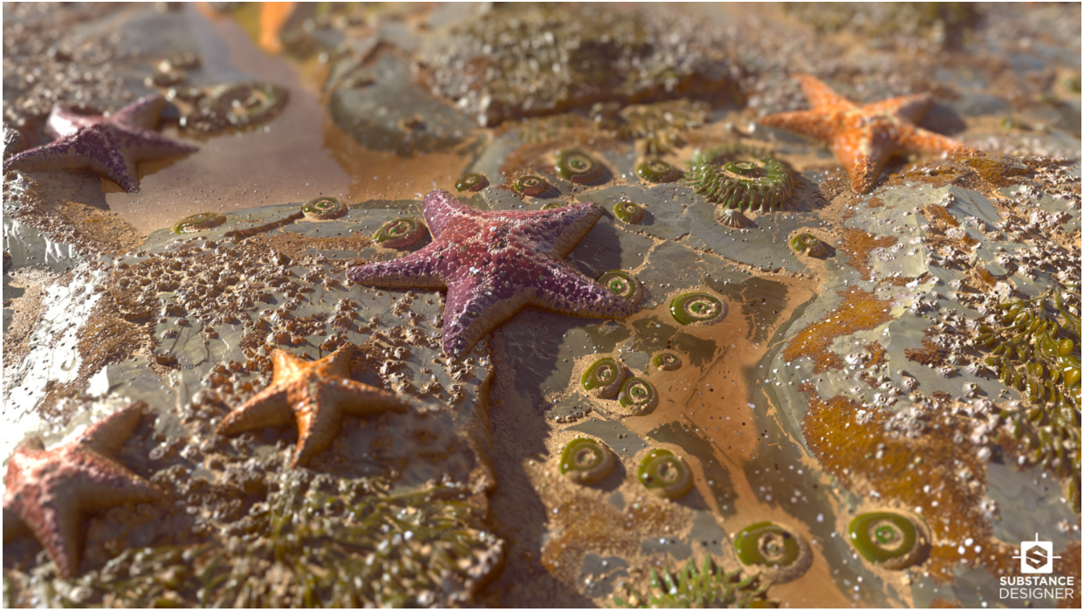
Introduction

Slide 4
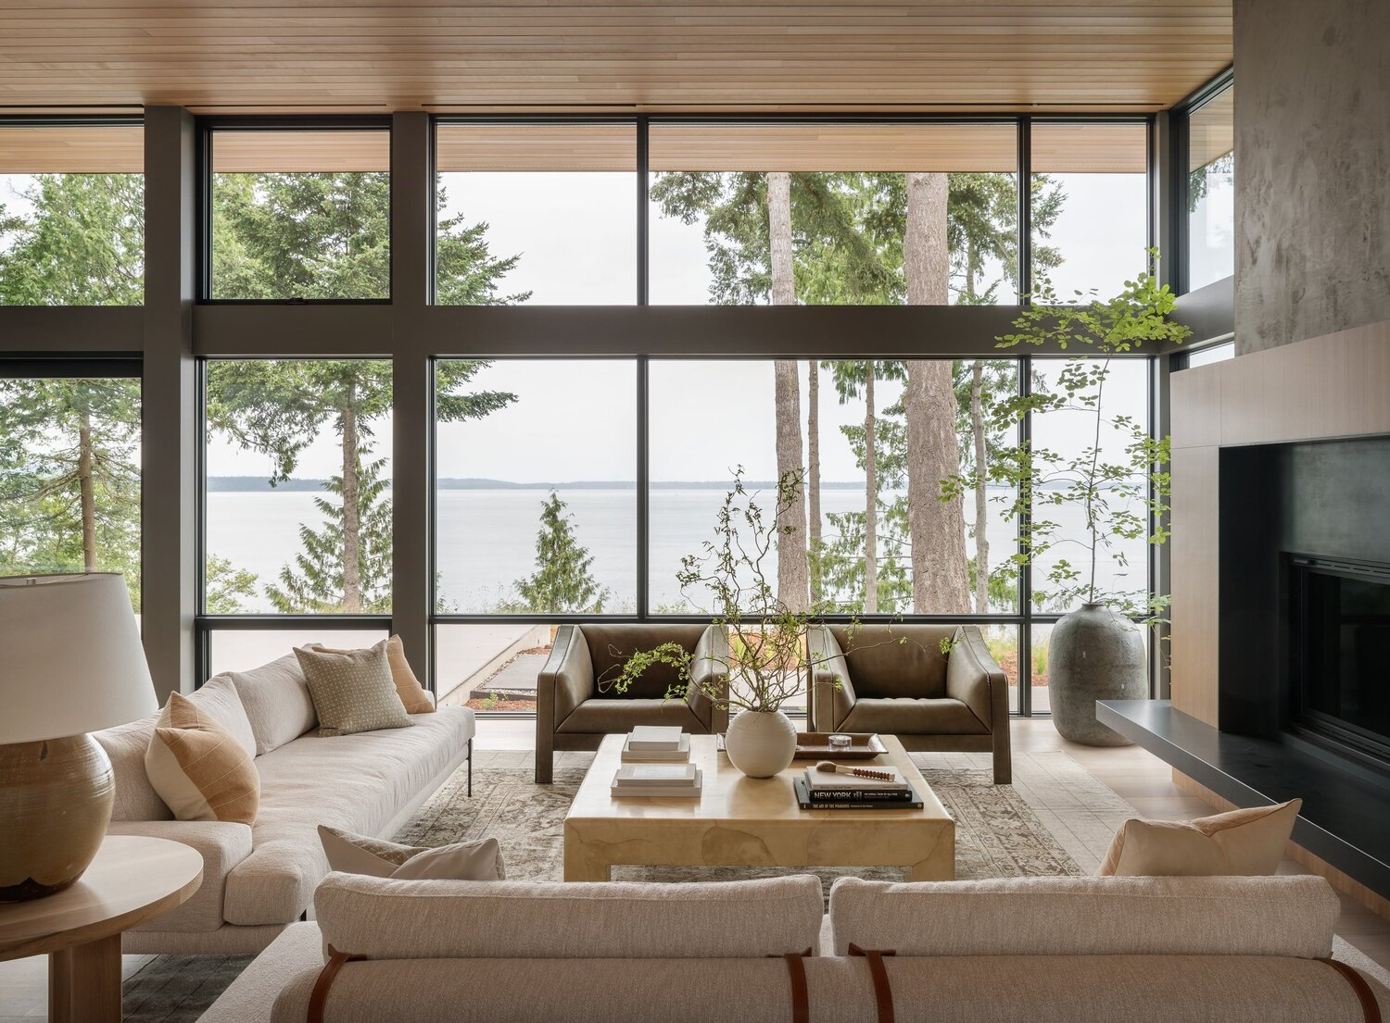
Metal
Plastic
Glass
Wood
Fabric
Stone
Clouds
Water
Tree bark
Leafs
Plaster
Paper
Leather
Sky
Etc.
https://www.xomacenna.com/blog/a-guide-to-organic-modern-design

Slide 5
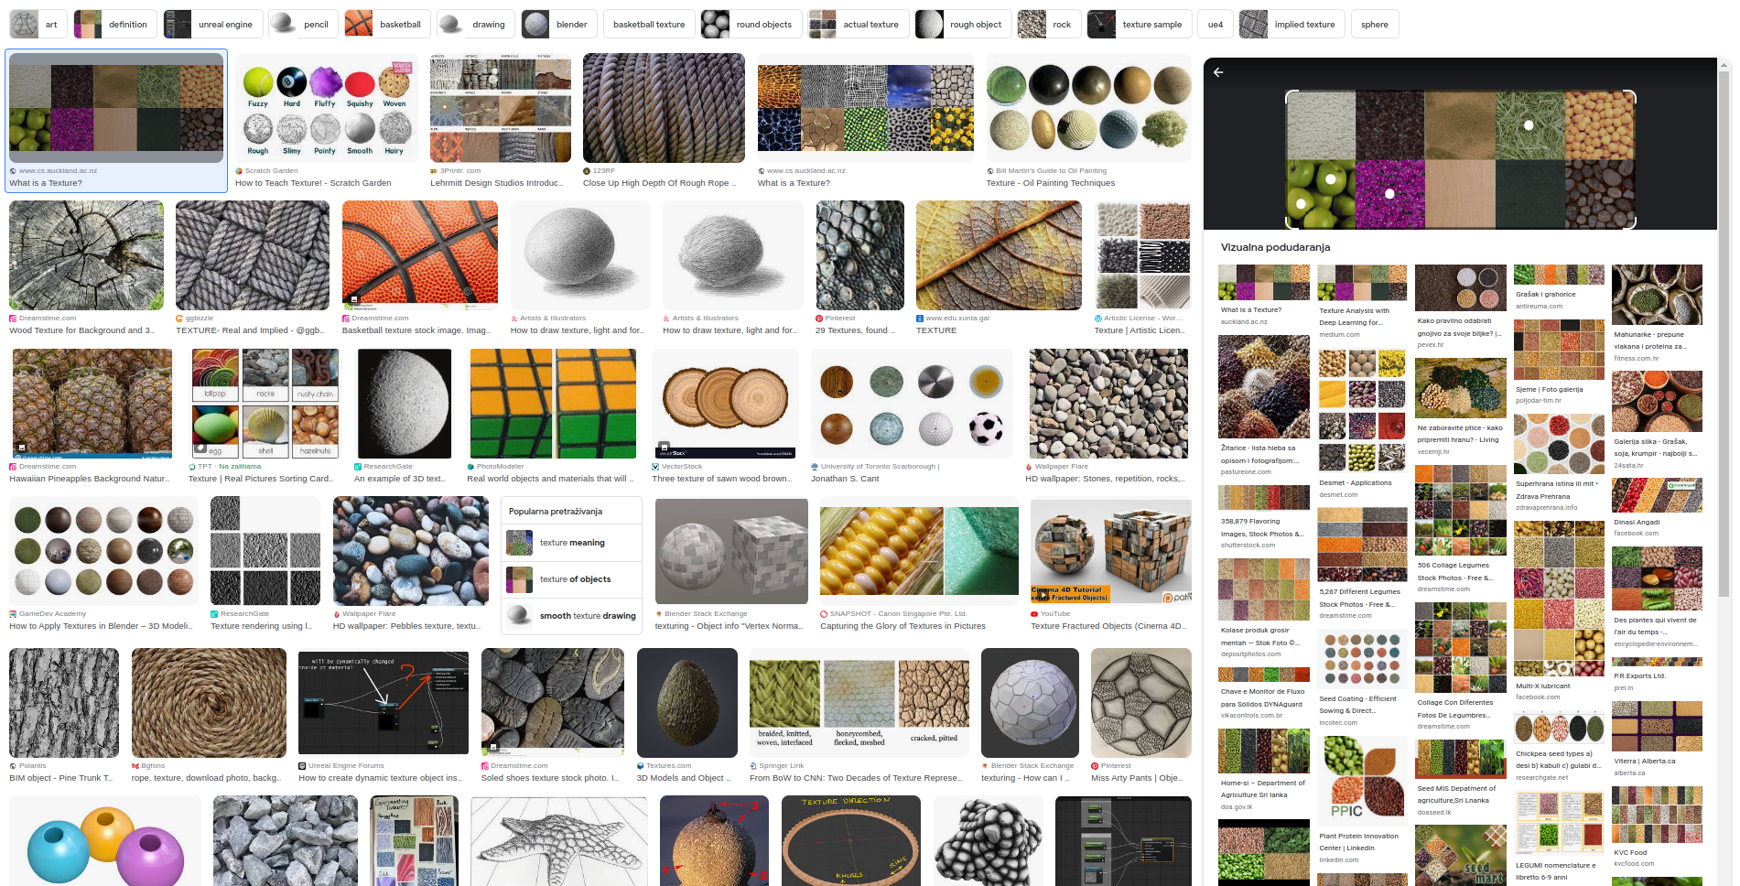
Term texture is used differently in various disciplines and everyday life: texture of fabric, texture of food, texture in music, texture in image processing, texture in...
Texture doesn’t have well established definition. It spans over multiple scales and over space.
Texture is something we perceive based on geometrical, physical and chemical properties of objects

Slide 6
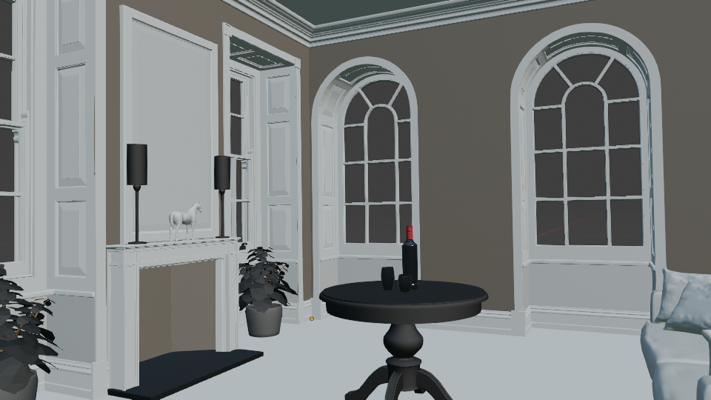

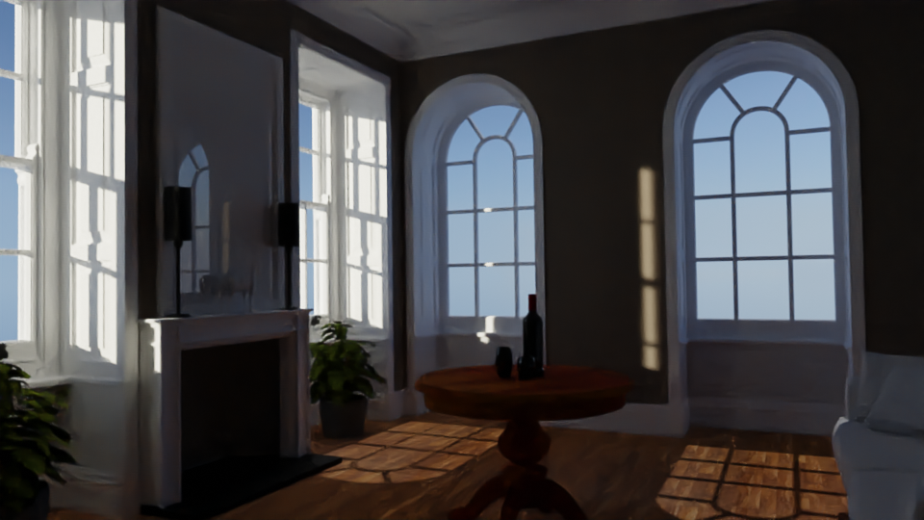
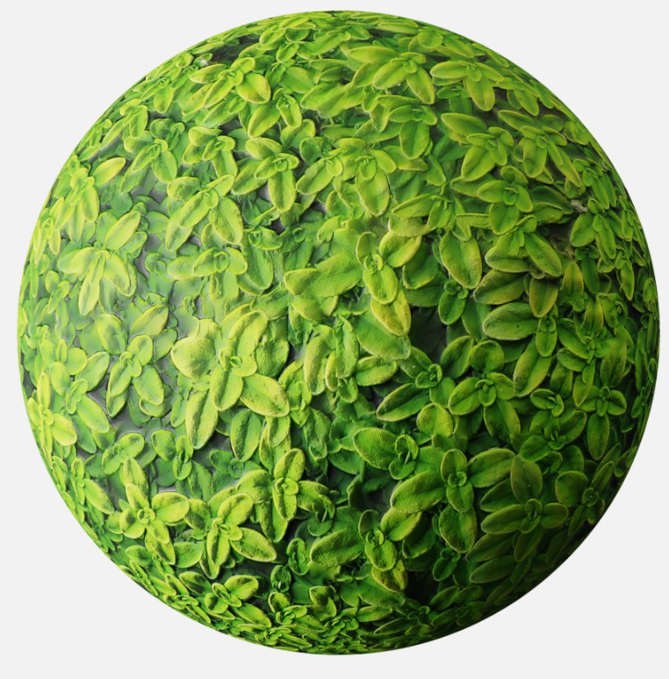
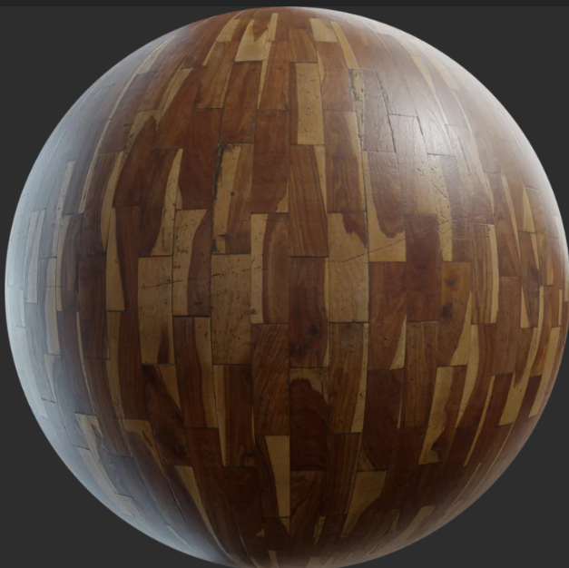
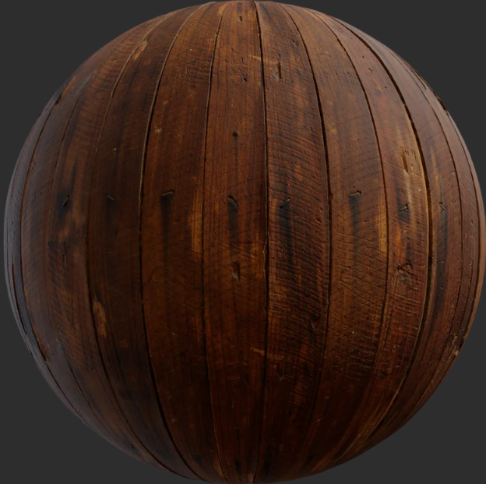
Big picture
3. Image
1. Scene modeling
Texture defines look and feel of objects

Slide 7
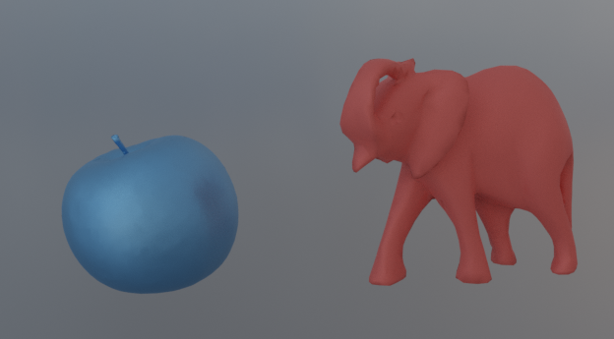
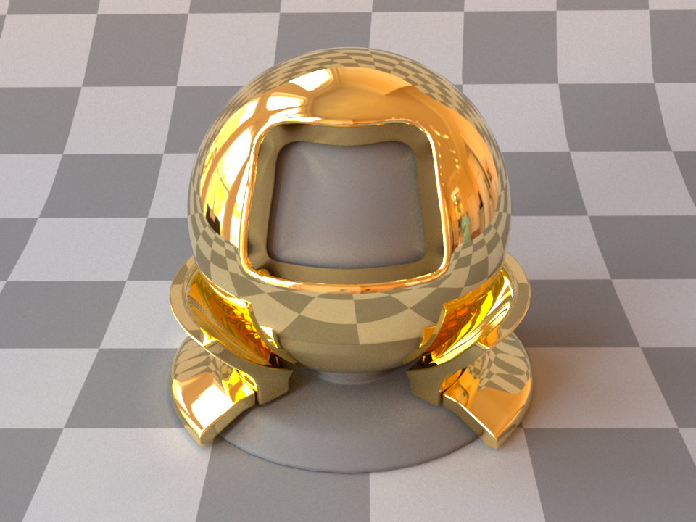
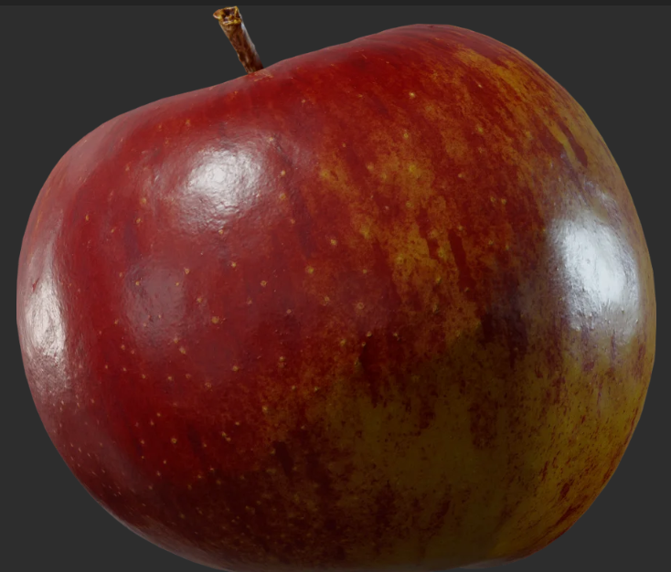
Material characteristics
Characteristics that needed to be modeled in order to obtain required appearance:
Color
Directional (e.g., reflectivity)
Texture and patterns

Slide 8
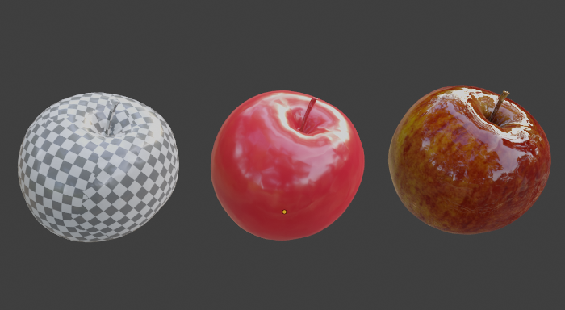
Texture in computer graphics
For 3D modeling, we can try to define texture as function which varies scattering function properties over surface.
Geometry
Scattering function
Texture

Slide 9
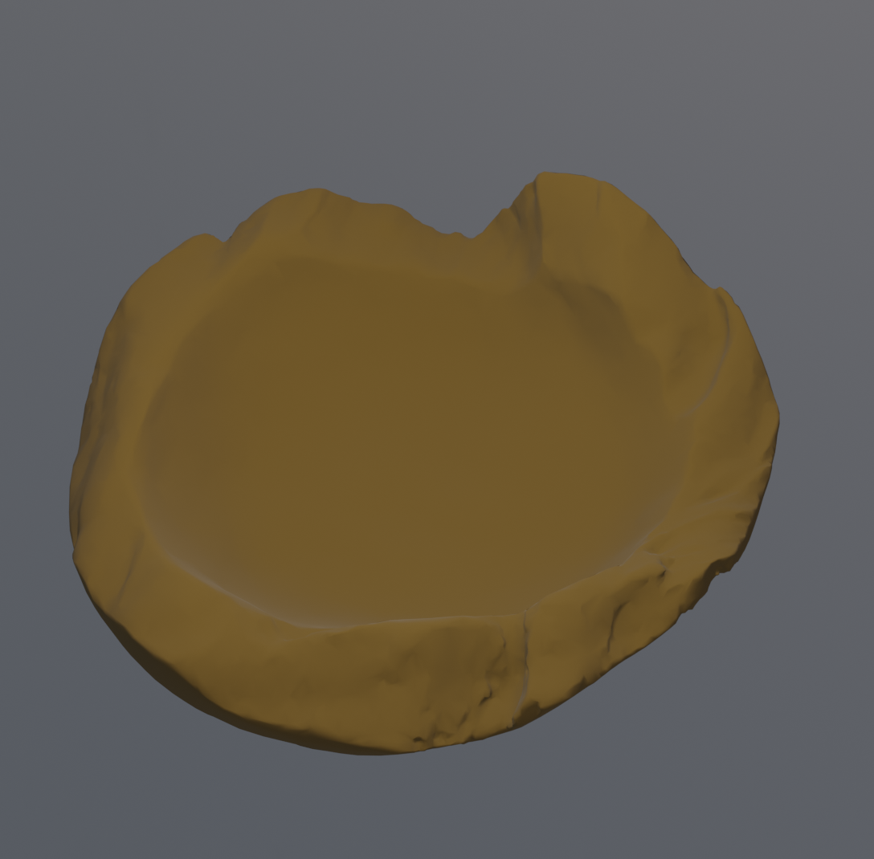
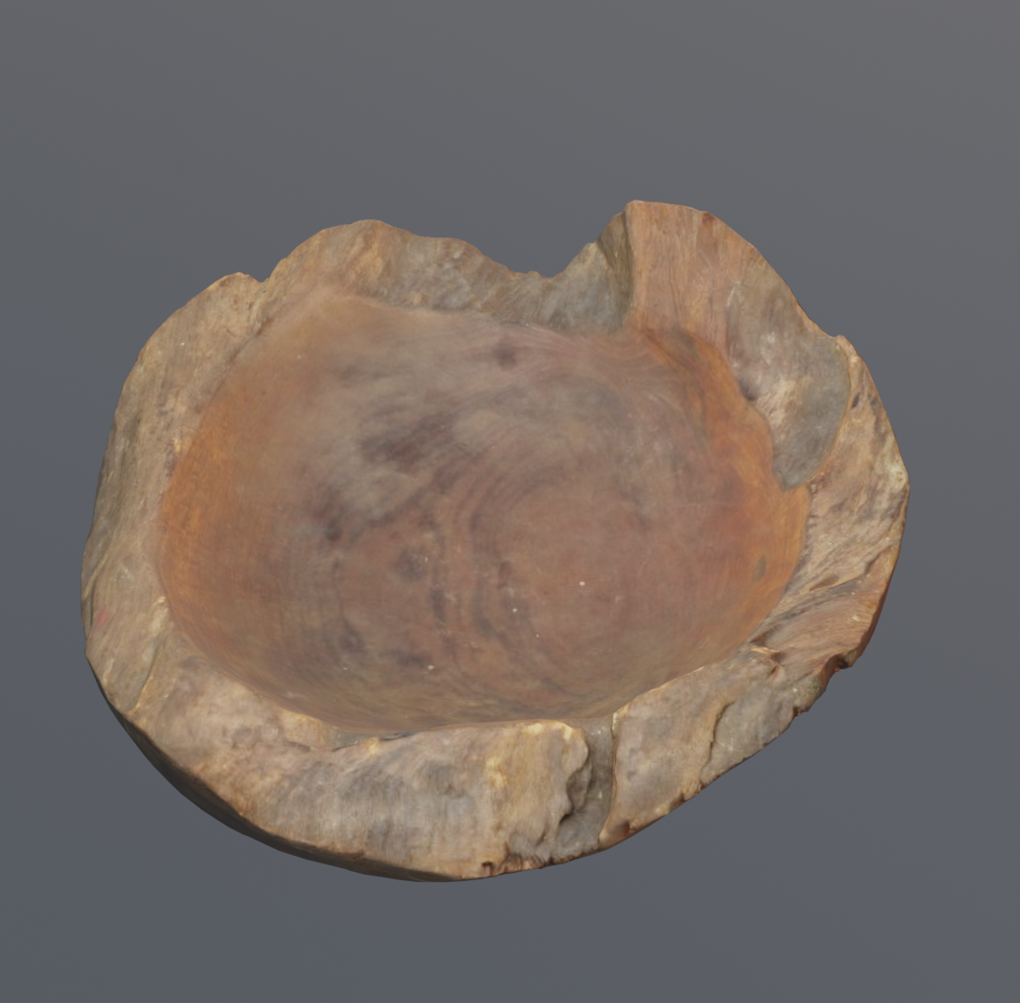
Variation of material over surface
Real objects rarely have only one material or same material properties over the surface → homogeneous material
  Example: wood has structure at a scale of about 1mm and lower. The material of wood fiber also varies. Therefore, the rich appearance of wood comes from structure and material variation of fibers. This richness is called texture.
Homogeneous materials are missing details and variations, thus look too smooth and too perfect.
Diffuse scattering model with constant albedo parameter → homogeneous material.
Diffuse scattering model with variation of albedo parameter using texture.

Slide 10
Texture
Visual variation on the object surface – spatial variation → details and richness of surface
  Directional or color characteristics → scattering function parameters
  Small-scale geometrical characteristics: bumps, pores, imperfections, etc. → surface normals
In computer graphics, texturing is process that takes surface and modifies its appearance at each location using image, function or other data source.
  Its function is to add details to object surface while keeping computational cost low
* Remember that computer graphics is all about simulation and approximation in order to achieve required appearance. It is a trade-off between quality and speed. Depending on viewing distance and size of objects in 3D scene, some details can be represented with lower quality. For example, modeling all details on geometrical (shape) level can be very expensive. Thus, texturing come in handy. Texture represents cheaper way to add details on object surface.

Slide 11
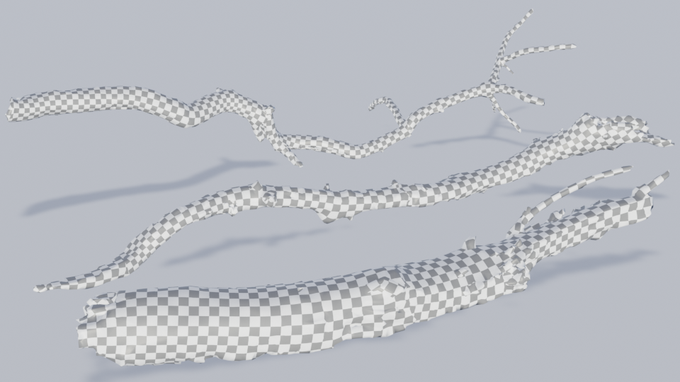
Shape (macro-scale)

Slide 12
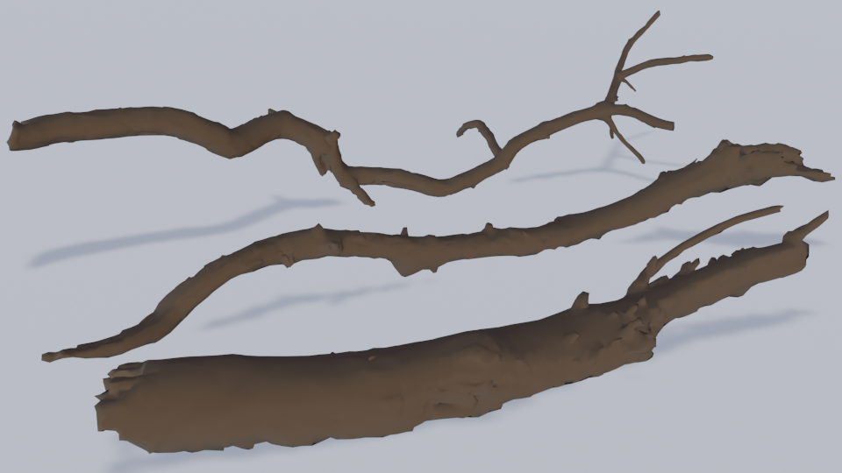
Shape (macro-scale)
Scattering function: diffuse (microscale)
  Albedo parameter (color) → constant

Slide 13
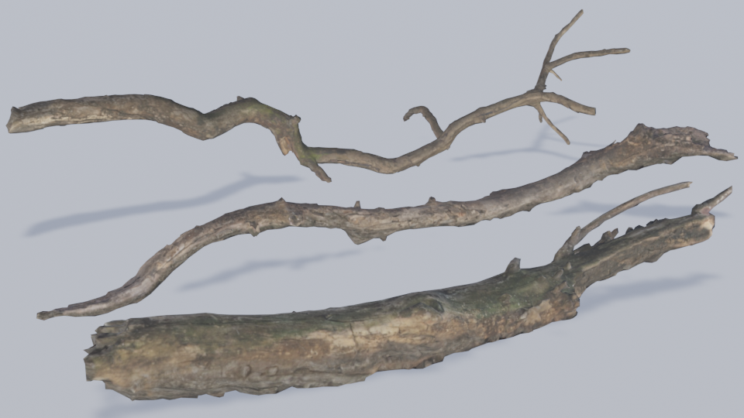
Shape (macro-scale)
Scattering function: diffuse (microscale)
  Albedo parameter (color) → texture variation

Slide 14
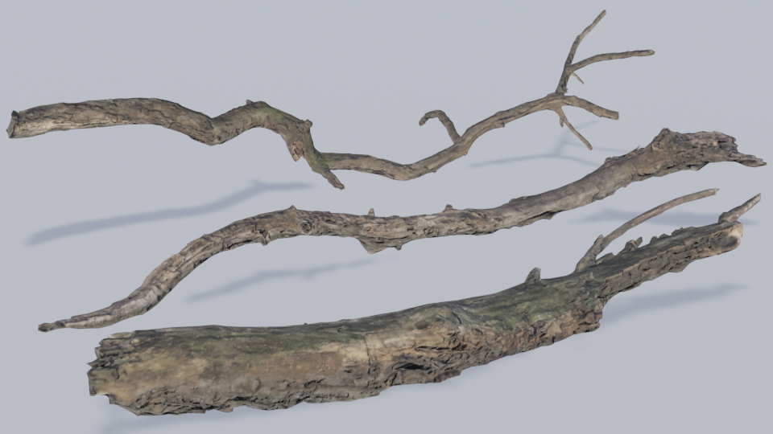
Shape (macro-scale)
Scattering function: diffuse (microscale)
  Albedo parameter (color) → texture variation
Small-scale geometry: surface normals (mesoscale)
  Normal perturbation → texture variation

Slide 15
Texturing: variation
Texturing: adding surface details which are too expensive to model explicitly with geometry
Textures introduce
  Scattering function parameters (e.g., color) variation
  Small-scale geometry variation → Shading normal variation
Texturing scale
  Microscale variation → scattering function parameters
  Mesoscale variation → shading normal perturbation
  Macroscale is given by the object shape

Slide 16
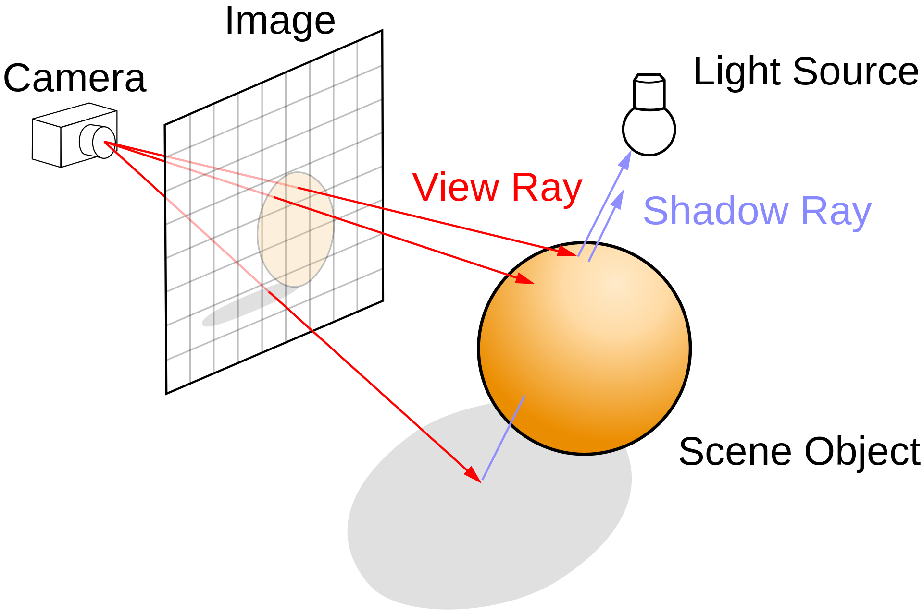
Texture and rendering
Rendering: computing color of pixels in the virtual image plane
Color of pixels → color of objects visible from camera
  For each pixel, viewing ray is generated, traced into scene for closest intersection → visibility solving
  Color is calculated at closest intersection → shading
  The result of shading is color of pixel from which ray was generated
Shading: calculating color at viewing ray intersection with object → shading point.

Slide 17
Texture and shading
Shading uses material, shape, viewing and light to calculate the color in shading point
Material describes interaction of light with surface:
  Scattering model
  Texture model
For each shading point, scattering model is evaluated using texture information at that point
Final rendered image, due to variation of colors and intensities over object, the surface will contain pattern
  Surface with pattern is called textured surface
Geometry
Scattering function
Texture

Slide 18
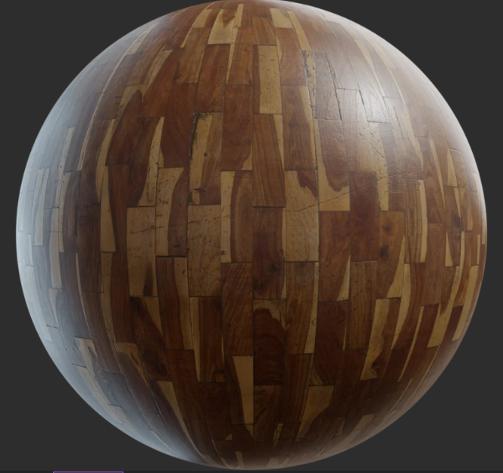
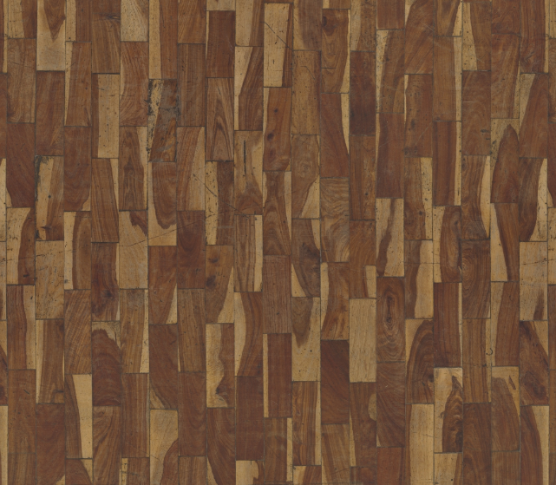
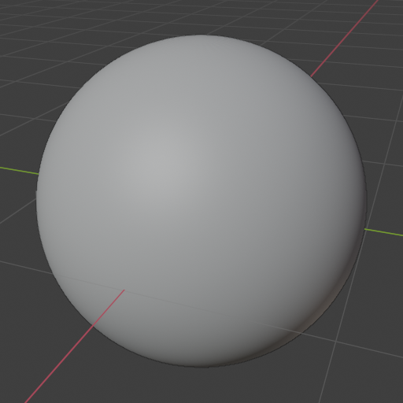
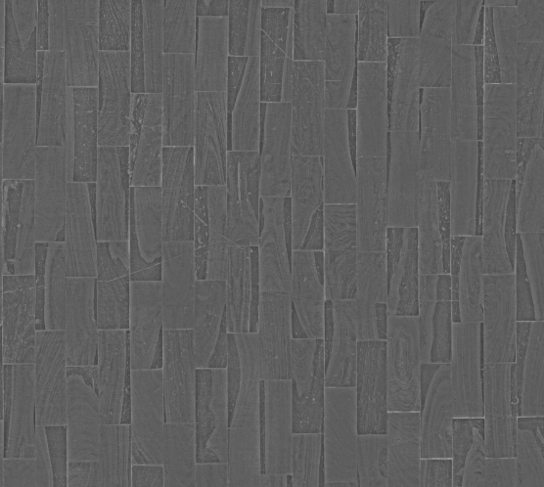
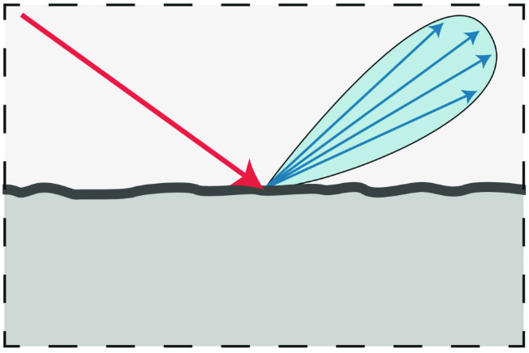
Note on “texture”
Illumination
Viewing
direction
Texture in modeling vs texture on rendered surface
Texture defines shading parameters over object surface → something that we model
Resulting pattern of colors on rendered surface → generated texture
Object
Material
Shape
Scattering
function

Slide 19
Note on “texture”
Texture is generally and in computer graphics overloaded term. Meaning depends on the context:
  Texture can be used for modeling object appearance (material)
  On GPU rendering, texture can be used as memory buffer to send arbitrary data (e.g., geometry) from CPU to GPU

Slide 20
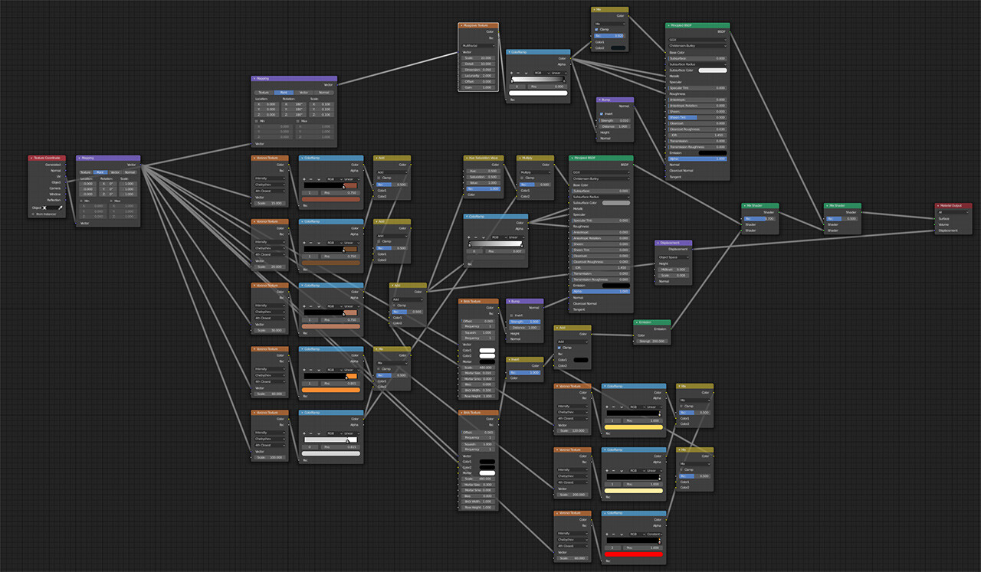
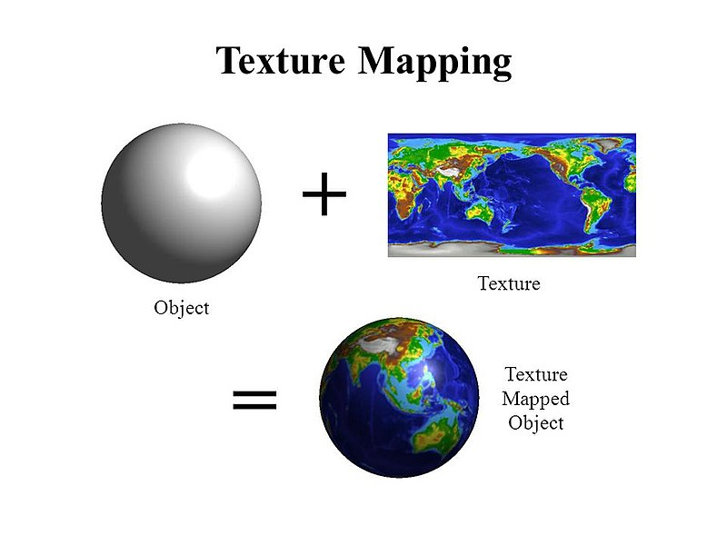
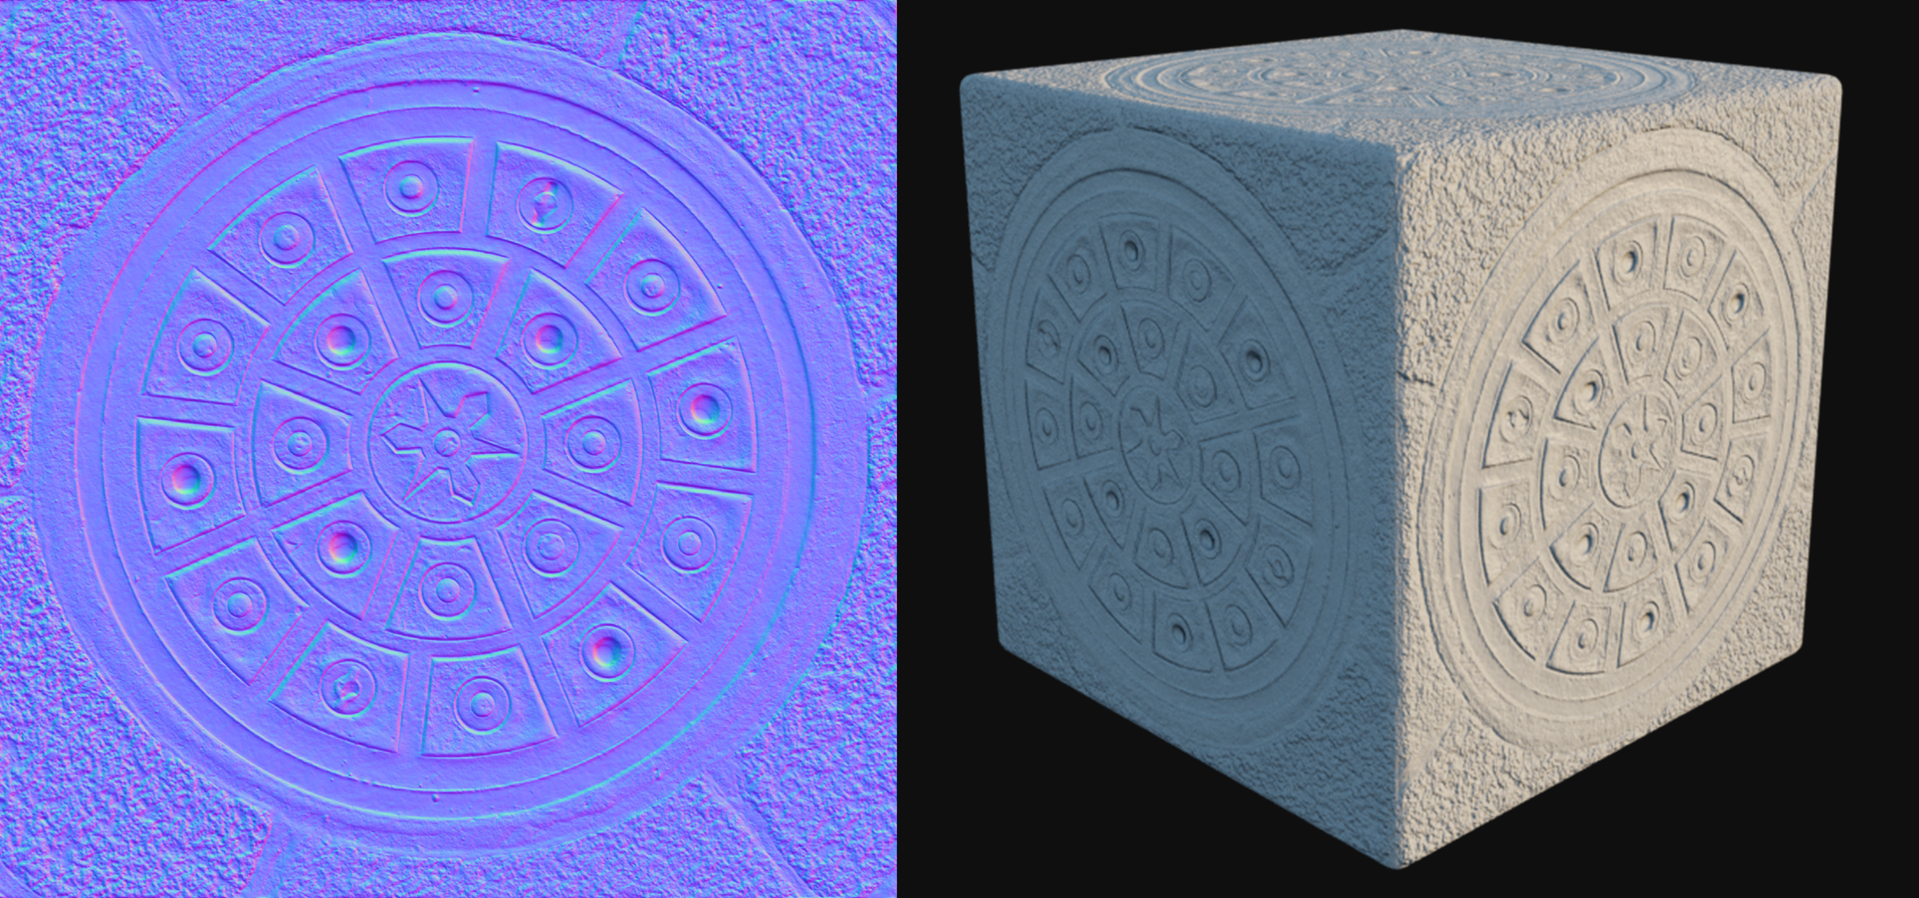
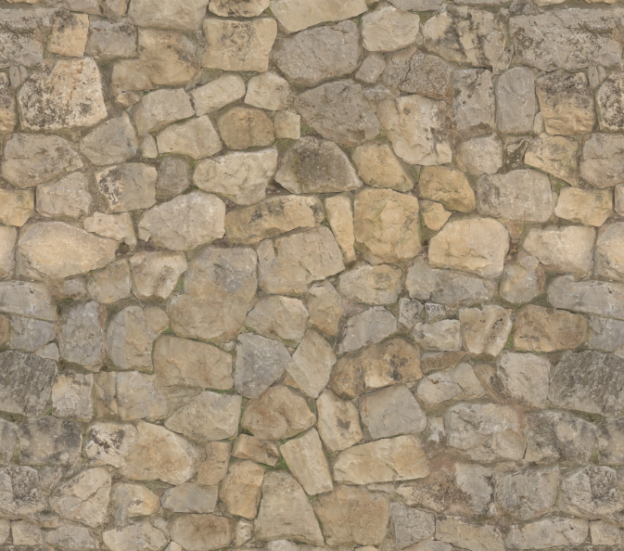
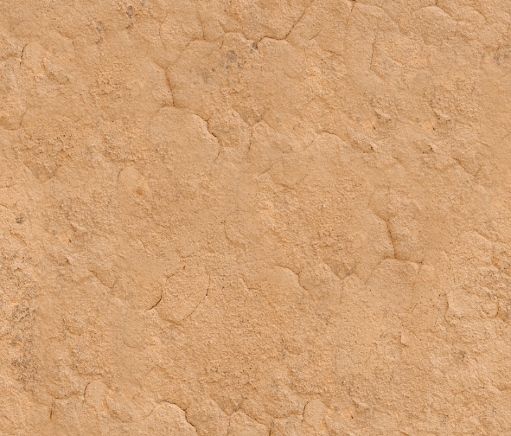
Learning objectives
How to use texture for material modeling → variation of scattering function parameters and small scale geometry
How to apply textures on objects → texturing pipeline
Texturing approaches → image and procedural

Slide 21
Texturing pipeline

Slide 22
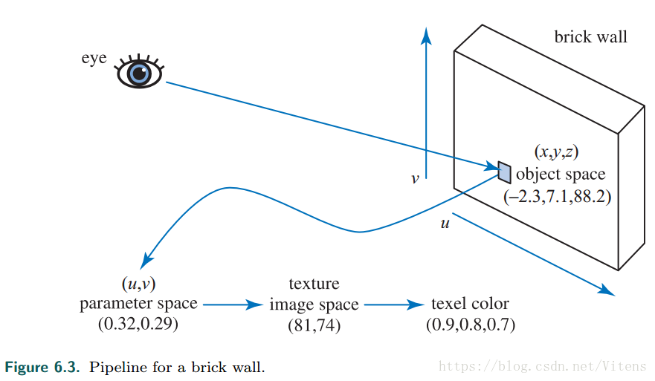
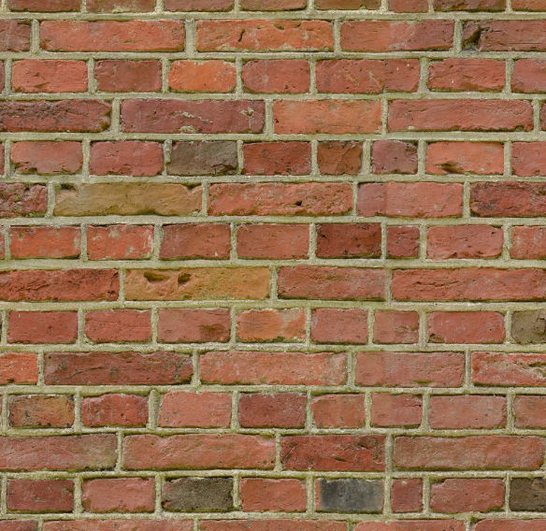
Texturing pipeline: example
Brick wall
  Camera ray → 3D object position (x,y,z)
  Projector function: mapping from 3D (x,y,z) to 2D (u,v) → texture coordinates
  Corresponder function: continuous texture coordinates (u,v) → discrete texel location (s,t) in the texture image.
  Texture reading: texel values (e.g., RGB color) are obtained using (s,t)
  Optional transformation on values
  Obtained value is used as input to scattering function which is evaluated for shading
https://www.realtimerendering.com/

Slide 23
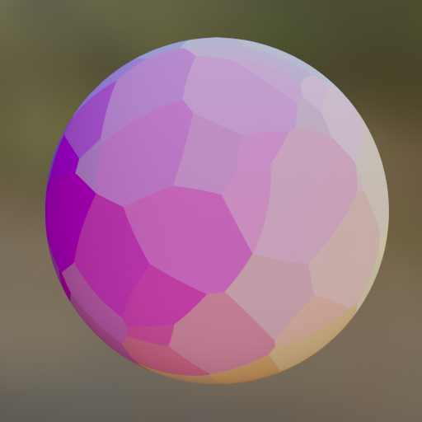
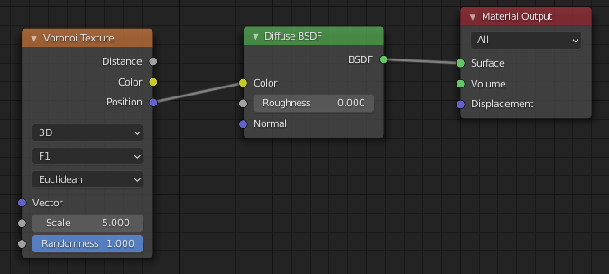
Texturing pipeline
Texturing pipeline is performed by rendering engine and can be applied on two main types of texturing:
FOCUS
Image Texturing
Procedural texturing
2D image (discrete 2D array of texels) is “pasted” on 3D object.
An algorithm generates pattern on 3D object

Slide 24
Texturing pipeline
Object space location
Texturing: variation of shading parameters over surface – position dependency
Object space location
  Shading point → 3D object-space coordinates (x,y,z), e.g., (1.2, 3.3, -3.4)
Projection function
  Mapping process: 3D object space coordinates → 2D texture space coordinates (u,v) in [0,1], e.g., (0.2, 0.5)
Corresponder function
  Transform: continuous texture space coordinates (u,v) → discrete texel locations in image texture (s,t) e.g., [image_width, image_height], e.g., [128, 44]
Obtaining texture values (sampling)
  Texture space location is used for obtaining texture value
Value transform
  Optional additional transformations are done on texture value
Usage
  Final value is used to modify property of surface at that point: scattering function parameter or normal.
Projector function
Texture coordinate
Corresponder function
Texture space location
Texture obtain
Texture value
Value transform
Transformed value

Slide 25
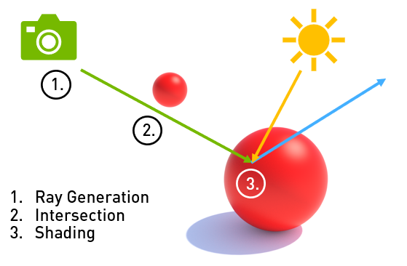
Object space location
Object space location
Projector function
Intersection (shading) point
  Object space location (x,y,z)
  World space object location can also be used
    In this case, as object moves, the coordinates change!
Texture coordinate
Corresponder function
Texture space location
Texture obtain
Texture value
Value transform
Transformed value
https://developer.nvidia.com/blog/rtx-best-practices/

Slide 26
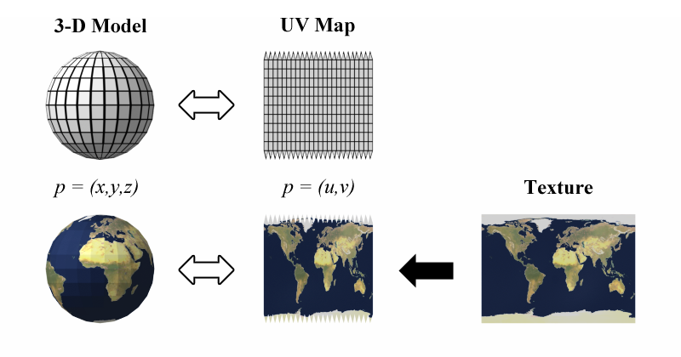
Projector function
Object space location
Projector function maps object space location into texture coordinate space
  Thus “texture mapping” term
For image texture: 3D object point (x,y,z) to 2D space (u,v) in [0,1]
Projector function
Texture coordinate
Corresponder function
Texture space location
Texture obtain
Texture value
Value transform
Transformed value
https://users.csc.calpoly.edu/~zwood/teaching/csc572/final10/wdhamilt/

Slide 27
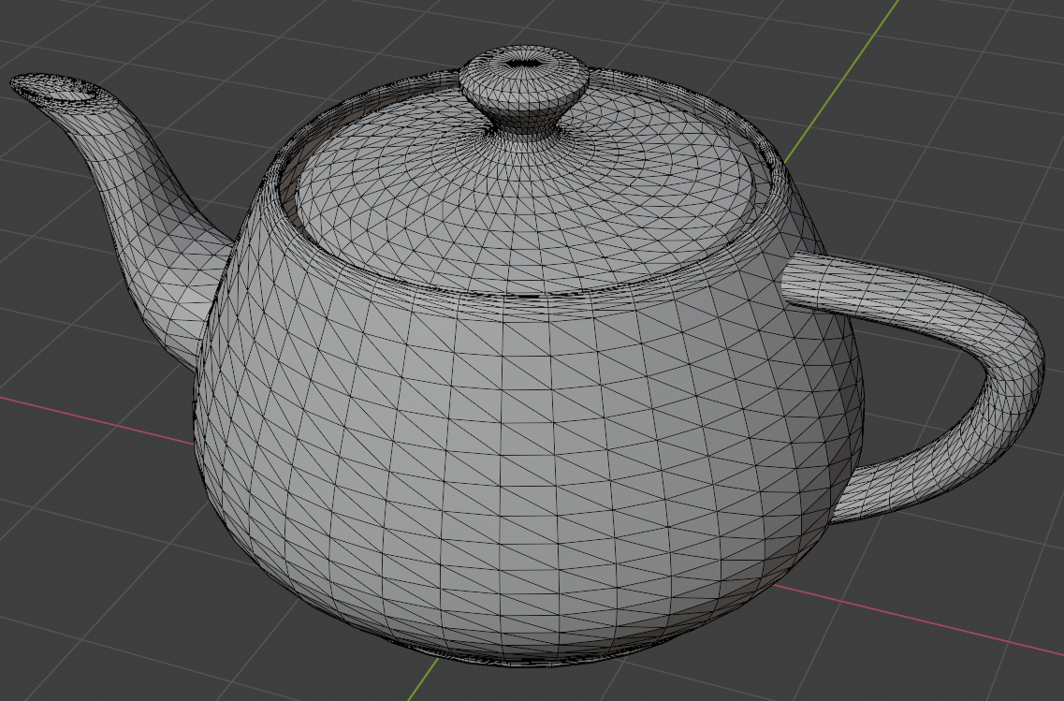
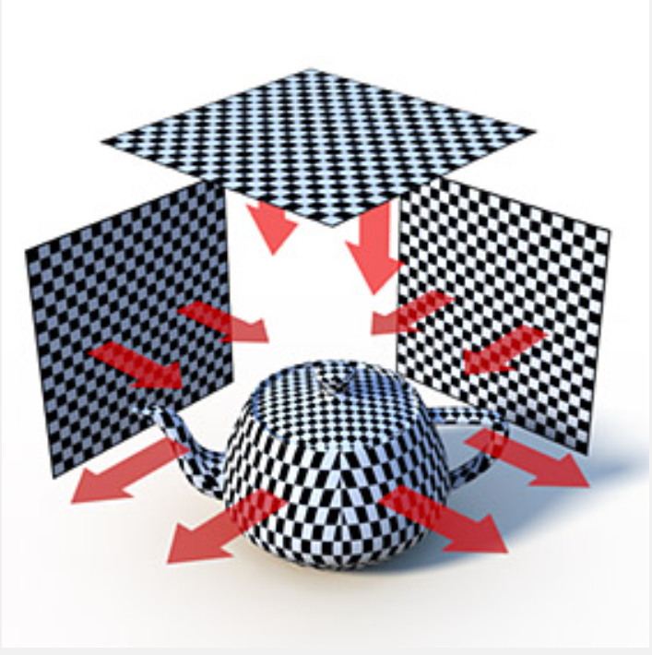
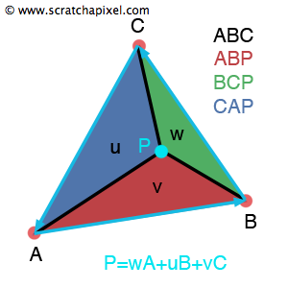
Projector function
Object space location is used to:
  Interpolate precomputed texture coordinates stored per vertex
  Calculate texture coordinates using texture projection on the fly
C(u,v)
B(u,v)
A(u,v)
Texture projection
Texture coordinates stored per vertex

Slide 28

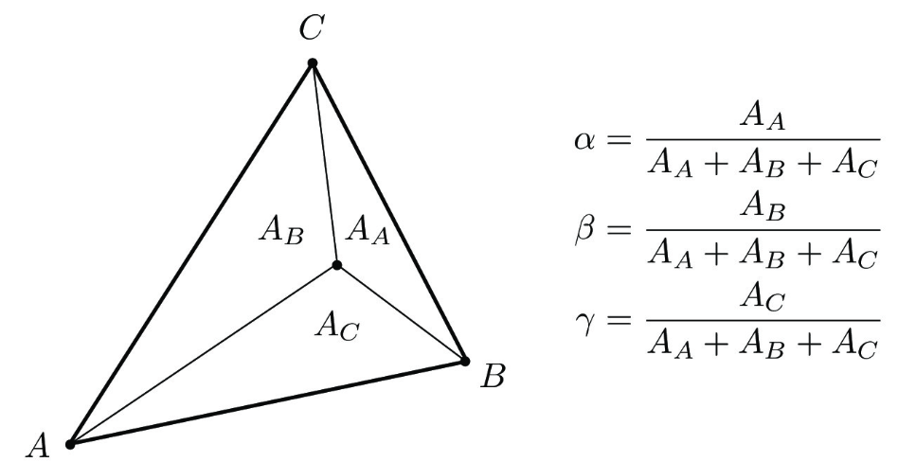
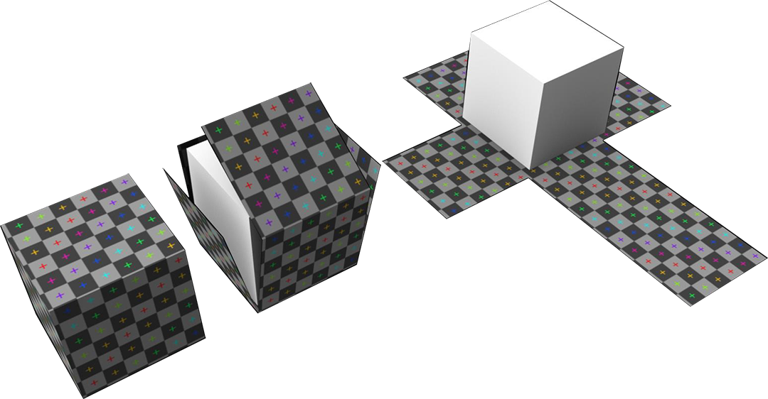
Vertex texture coordinates
For intersected/shading point P(x,y,z) on triangle of mesh, barycentric interpolation is used to calculate texture coordinate P(u,v) from ones stored per vertex.
C(u,v)
P(x,y,z)
P(u,v)
B(u,v)
A(u,v)
https://help.disguise.one/en/Content/3D-Workflow/UV-Mapping/What-is-UV-mapping.html
P(u,v) = αA(u,v) + βB(u,v) + γC(u,v)
α + β + γ = 1

Slide 29
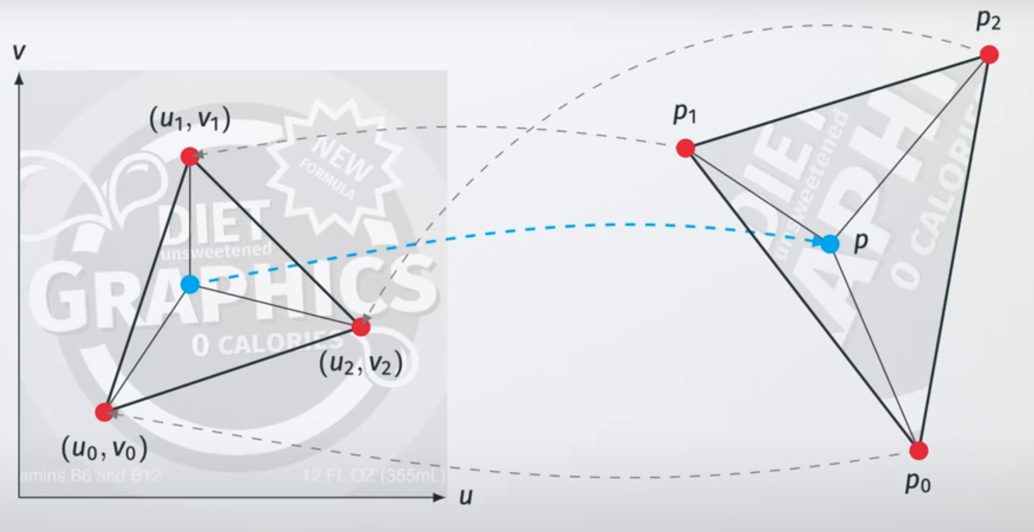
Vertex texture coordinates
https://www.youtube.com/watch?v=78kP5VaKPdQ&list=PL4TptkuzgxxUVZ-_DiO33kp4_rkoAy1BC&index=3&ab_channel=ChristophGarth

Slide 30
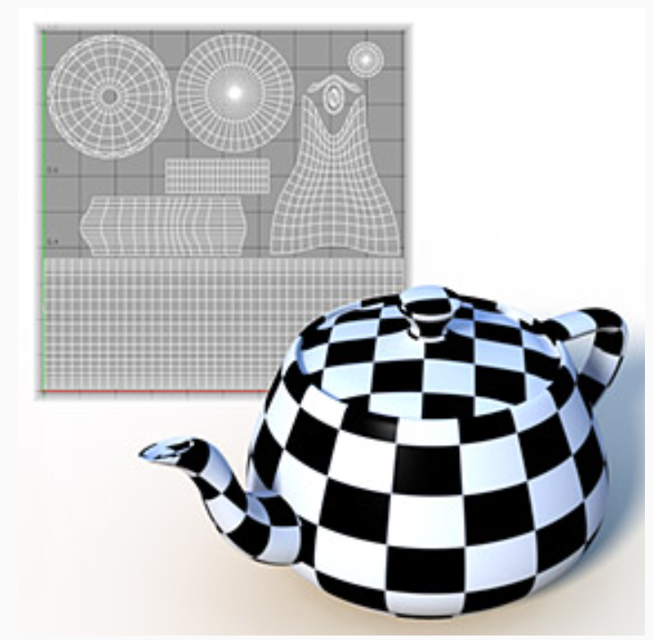
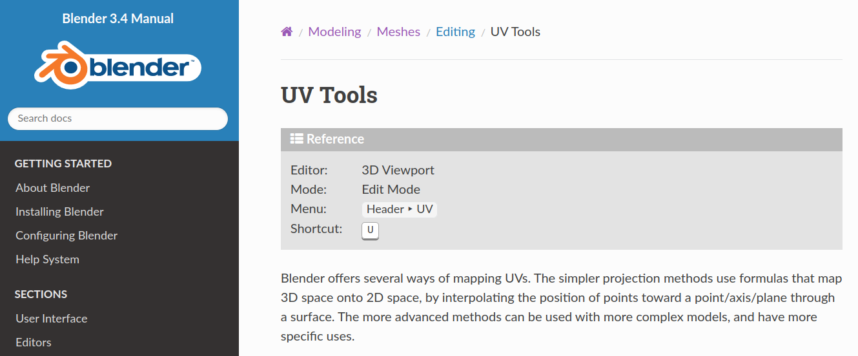
Generating vertex texture coordinates
Mesh unwrapping or texture projection → generates texture coordinates per triangulated mesh vertex (performed prior rendering)
Modeling packages implement different methods for generating texture coordinates per vertex and enable artist to edit texture coordinates
Unwrapping
Texture projection
https://docs.blender.org/manual/en/latest/modeling/meshes/editing/uv.html

Slide 31
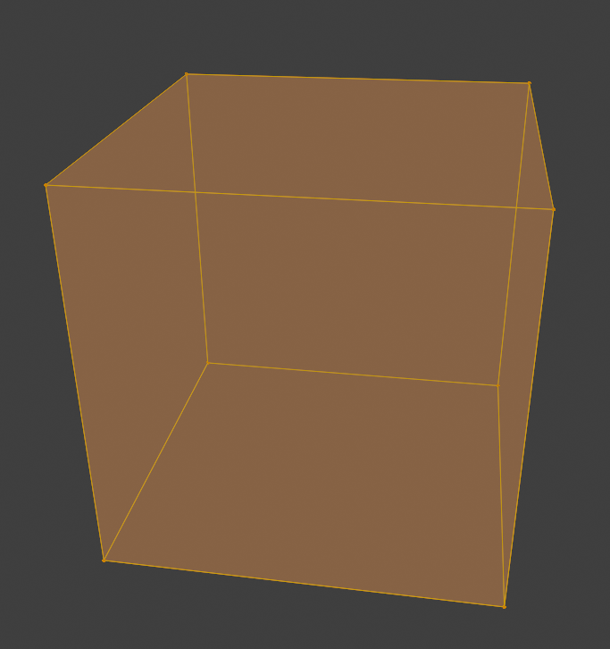
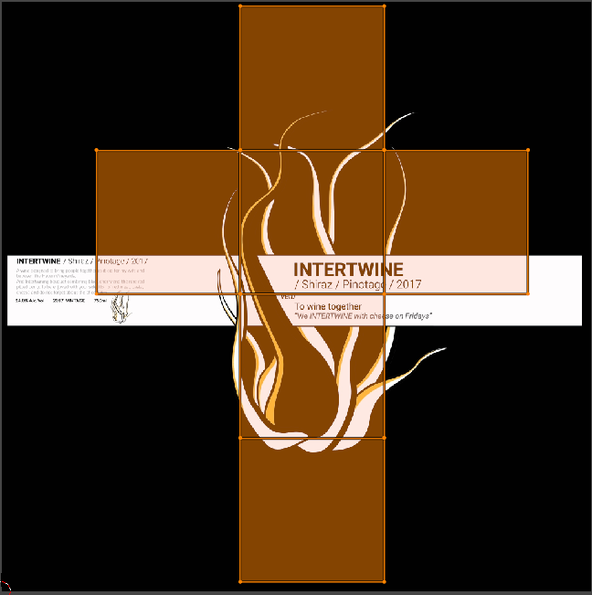
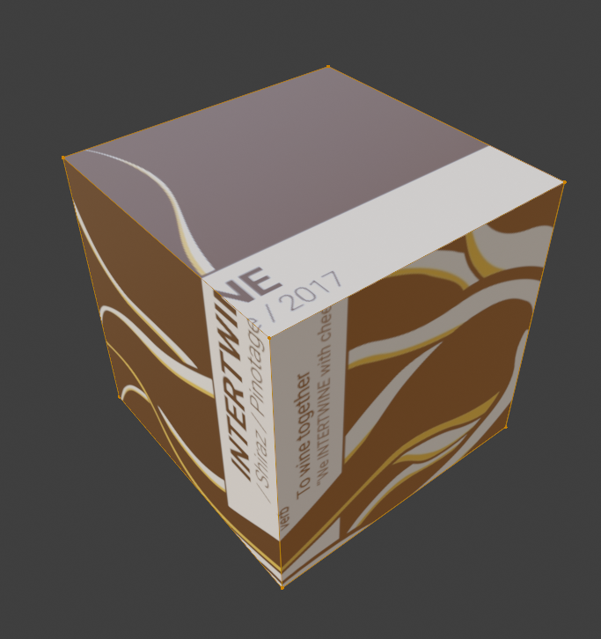
Mesh unwrapping
Mesh (UV) unwrapping: each vertex is assigned with 2D texture coordinate (u,v) in [0,1]
  Unwrapping methods belongs to larger field called mesh parametrization
Goal is that each polygon gets fair share of texture area (e.g., evade stretching) but maintaining connectivity – which determines where separate parts of texture meet and visible seams.

Slide 32
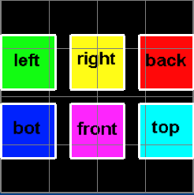
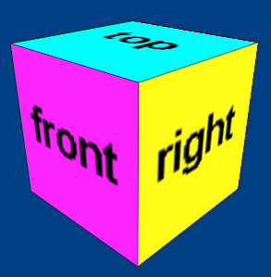
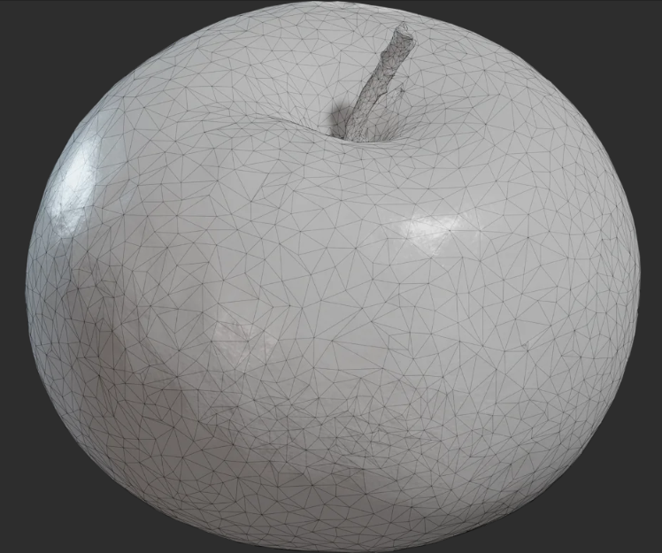
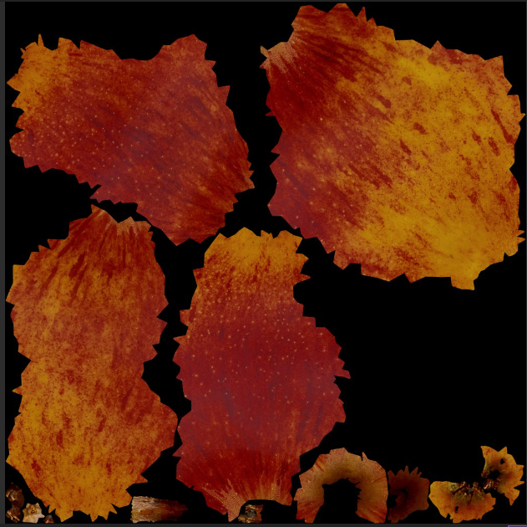

Mesh unwrapping and texture atlas
For complex meshes, unwrapping separates mesh into multiple parts which are more convenient to represent on flat plane.
Each mesh part is assigned with image texture → piecewise parametrization
All image textures for each part can be stored into singe texture → texture atlas
  Highly memory efficient
https://www.unwrap3d.com/u3d/tutorial_uv_mapping_texture_atlas.aspx
Blender example: https://www.youtube.com/watch?v=gZRDwbHEB34&ab_channel=GrantAbbitt

Slide 33



Texture atlas

Slide 34
Texture projection
Transform 3D object point (x,y,z) in space into texture coordinates (u,v) using projections:
  Spherical
  Cylindrical
  Planar
  Cubic
  Box
  Front

Slide 35


Spherical texture projection
Texture is wrapped into a spherical shape and projected onto a shape.
Good for texturing round objects.
Surfaces perpendicular to projection cause stretching.
Blinn and Newell developed environment mapping based on sphere projection that is called latitude-longitude mapping
https://learn.foundry.com/modo/901/content/help/pages/shading_lighting/shader_items/projection_type_samples.html

Slide 36


Spherical texture projection
Example: mapping 2D image texture on 3D sphere
Any point (x, y, z) on 3D sphere with radius r can be transformed to polar coordinates:
  Azimuth Φ in [0, 2π]
  Elevation θ in [0, π]
Azimuth and elevation coordinates are normalized to obtain texture coordinates u and v
u
v

Slide 37


Cylindrical texture projection
Texture is wrapped in cylindrical shape and projected onto surface.
  Cylinder coordinates(t,h) → texture coordinates
Good for cylindrical surfaces (cans, bottles).
Surfaces perpendicular to projection might cause stretching.
https://learn.foundry.com/modo/901/content/help/pages/shading_lighting/shader_items/projection_type_samples.html

Slide 38



Planar texture projection
Similar to concept of movie projector but image is projected orhographically.
  Any vector defining projection plane can be used.
Great for flat or nearly flat surfaces.
Other surfaces might cause stretching of texture.
Planar projection is useful for decal rendering.
https://docs.unity3d.com/Packages/com.unity.render-pipelines.universal@12.0/manual/renderer-feature-decal.html
https://learn.foundry.com/modo/901/content/help/pages/shading_lighting/shader_items/projection_type_samples.html

Slide 39
Cubic texture projection
Texture is planar-projected on a surface from all three axis directions: X, Y, and Z
Polygon receives a certain projection, based on its normal direction.
Best for cube-shaped objects, and occasionally on detailed surfaces where texture seams are not of great concern
https://learn.foundry.com/modo/901/content/help/pages/shading_lighting/shader_items/projection_type_samples.html

Slide 40


Box texture projection
Projects a texture in a planar fashion from all six directions, eliminating reverse projections on rear facing polygons inherent to the Cubic method (aka triplanar mapping)
Best on cube-shaped objects, and occasionally on detailed surfaces where texture seams are not of great concern
  For curved and tilted surfaces efficient blending of multiple projection planes must be used.
https://learn.foundry.com/modo/901/content/help/pages/shading_lighting/shader_items/projection_type_samples.html
https://ryandowlingsoka.com/unreal/triplanar-dither-biplanar/

Slide 41

Front texture projection
Texture is projected out from a camera or light's position
https://learn.foundry.com/modo/901/content/help/pages/shading_lighting/shader_items/projection_type_samples.html

Slide 42

Projector function: complex shapes
For highly complex shapes, separating into simpler shapes can be done and then texture projection can be done separately.
[983] Pagán, Tito, "Efficient UV Mapping of Complex Models," Game Developer, vol. 8, no. 8, pp. 28-34, August 2001

Slide 43
Projector function: different approaches
Texture coordinates must be generated in this step
  Using position and normal for deriving those is only one way of doing it
If object is supplied with any kind of additional information (e.g., curvature or temperature) it can be also used for texture coordinate generation

Slide 44

Projector function: inherent texture coordinates
Parametric surfaces (e.g., NURBS) have natural set of (u,v) texture coordinates which defines any (x,y,z) point on surface
In this case, we can say that surface representation already has inherent texture coordinates and projector function is not needed.
https://www.ebalstudios.com/blog/introduction-nurbs

Slide 45




Projector function: different texture coordinates
Some steps of texturing pipeline can be omitted depending on texturing method
Texture coordinate space doesn’t have to be always 2D → for volumetric objects, texture coordinates are (u,v,w)
Procedural texturing can directly use object space locations (x,y,z) – solid texturing
For animation, texture coordinates can be (u,v,w,t) where t is time and determines change in texture
Examples of solid texturing: https://johanneskopf.de/publications/solid/

Slide 46
Projector function: multiple texture coordinates*
Multiple textures can be applied on objects and thus multiple sets of texture coordinates can be applied
Idea is the same: those texture coordinates are interpolated across surface and used for obtaining texture value

Slide 47

Corresponder function
Object space location
Projector function
Transform: texture coordinates (u,v) in [0,1] → image texture texel locations (s,t) in [image_width, image_height]
  This transformation is independent of texture resolution! That is, image of any resolution can be used for sampling given texture coordinates.
Texture coordinate
Corresponder function
Texture space location
Texture coordinates space (u,v)
Image texture texels
Texel
Texture obtain
1
Texture value
image_height
Value transform
Transformed value
0
1
image_width

Slide 48


Corresponder function
Corresponder function deetermines which part of image texture will be used
1
0
1

Slide 49




Corresponder function
Transformations on texture coordinates: rotate, scale, translate, shear or project
Originally (u,v) is in [0,1]. Scaling can move (u,v) to be larger than one
  Image wrapping: repeat (other: wrap, mirror, clamp, border, wang tiles, etc.)
Demo: https://math.hws.edu/graphicsbook/demos/c4/texture-transform.html

Slide 50
Obtaining texture values
Object space location
Projector function
Texture space location is used for obtaining texture value:
  Reading image texture
  Evaluating procedural texture
Texture coordinate
Corresponder function
Texture space location
Texture obtain
Texture value
Value transform
Transformed value

Slide 51



Obtaining texture values
Corresponder function gave image texture texel coordinates
  Those coordinates are used for reading texel values
Note: procedural textures values can be obtained without corresponder function, e.g., directly from object or texture space coordinates

Slide 52
Transforming texture values
Object space location
Projector function
Optional additional transformations on texture value
  e.g., normalization of image texture values
Image textures contain RGB(A) values
  Many data types can be stored/encoded using those values.
  Although image textures always contain color values, those values can be interpreted differently then just color
Texture coordinate
Corresponder function
Texture space location
Texture obtain
Texture value
Value transform
Transformed value

Slide 53




Transforming texture values
Example: RGB values can be interpreted as vectors.
  Normal map image texture contains vectors encoded in RGB
Example: encoding normal vectors into image: normal maps

Slide 54
Learning objectives
How to use texture for material modeling → variation of scattering function parameters and small scale geometry
How to apply textures on objects → texturing pipeline
Texturing approaches → image and procedural

Slide 55
Image textures

Slide 56



Image textures
Image texturing process can be seen as “gluing” image on 3D surface
For particular position on surface (x,y,z) we explained how to obtain texture coordinates (u,v)
Image textures are usually 2^{m} x 2^{n} texels. Thus called power-of-two textures (POT)*
https://polyhaven.com/a/Television_01
Texture atlas
* Older GPUs couldn’t support mipmapping for non-POT textures. Modern GPUs handle all textures correctly.

Slide 57

Magnification and minification
If one or more pixels of virtual image plane falls under one image texture texel: magnification.
If one pixel of virtual image plane covers more then one image texture texels: minification.
Image texture texels
Pixel footprint
Virtual image pixel footprint can be:
Smaller than image texture texel
Larger than several image texture texels
Minification
https://cs184.eecs.berkeley.edu/sp21/lecture/5-40/texture-mapping

Slide 58






Texture magnification
System for reading image texture must magnify the image texture.
  https://docs.blender.org/manual/en/latest/render/shader_nodes/textures/image.html
  https://www.khronos.org/opengl/wiki/Sampler_Object
Magnification types:
No texture magnification needed.
Texture magnification needed!
Nearest neighbor (closest) Problem: pixelization
Linear
Cubic filtering
Bilinear interpolation
Problem: blur

Slide 59


Texture minification
Aliasing causes Moire pattern
If one pixel of virtual image plane covers more then one image texture texels → minification
  cumulative effect of texels influencing the pixel must be taken in account
  Nearest neighbour: heavy aliasing and temporal aliasing (when camera is moving)
  Bilinear interpolation: if pixel is covered by more than four texels then aliasing again becomes the problem
Red cells are pixels
https://textureingraphics.wordpress.com/what-is-texture-mapping/anti-aliasing-problem-and-mipmapping/

Slide 60


Aliasing
Frequency of a texture depends how closely are spaced texels on the screen.
Nyquist limit – texture frequency must be not larger than half the sample frequency.
  To properly display a texture on a screen, we need at least one textl per pixel
Anti-aliasing techniques:
  Texture frequency must decrease: mip-mapping - most popular anti-aliasing method
  Pixel sampling frequency must increase: multiple samples per pixel
Minification
https://www.researchgate.net/publication/3410856_MIP-map_Level_Selection_for_Texture_Mapping

Slide 61

Anti-aliasing: mip mapping
MIP – minimization filter
  Original image is filtered down repeatedly into smaller images.
  Before rendering, original image is augmented with sets of smaller versions of this image
Image pyramid, Mip map chain:
  Original texture is downsampled by quarter of original area
  New texel is calculated as average of four neighbor texels in original image.
  This process is repeated until one or both of image texture dimensions equal to one
High quality mip mapping requires:
  Good filtering: for averaging new texel value from 2x2 of texels it is recommended to use Gaussian, Lanczos or Kaiser filter
  Images must be in linear colorspace
MIP - (multum in parvo (latin)) – many things in small place

Slide 62



Anti-aliasing: mipmapping
Depending on camera distance to texture, different mipmaps levels are used to achieve 1:1 pixel to texel ratio to achieve Nyquist rate.
  OpenGL: https://www.khronos.org/opengl/wiki/Sampler_Object
https://paroj.github.io/gltut/Texturing/Tut15%20Needs%20More%20Pictures.html
http://wiki.polycount.com/wiki/Mip_Mapping

Slide 63

Anti-aliasing: mipmapping
Achieving 1:1 pixel to texel ratio removes aliasing
  Moire pattern is removed

Slide 64


Antialiasing: sampling
If one pixel of virtual image plane covers more then one image texture texels → minification
Aliasing appears always when there are a lot of details under a pixel footprint in the scene
To solve this, multiple sample per pixels can be used to “catch” high frequency details.
  This method is called Multisample anti-aliasing (MSAA)
MSAAx4
https://vulkan-tutorial.com/Multisampling

Slide 65



Alpha texture values
Image textures have (R,G,B) and alpha channels.
Alpha values are used for blending or alpha testing for transparency.
Decals/cutouts: rendering only parts of the image on object surface.
https://xoio-air.de/2017/10-free-cutout-trees-from-tony-textures/
Billboarding method is used for standalone flat polygons with image texture, always facing the camera.
https://80.lv/articles/how-to-fake-a-large-scale-forest-in-blender/

Slide 66

Alpha texture values
Alpha value is extensively used when adding VFX to rendered or real images - compositing.
https://www.soundstripe.com/blogs/the-best-techniques-tools-for-compositing

Slide 67


Sources of image textures
Texture image can be created by:
  Drawing on canvas: https://krita.org/en/
  Drawing on 3D object directly: https://docs.blender.org/manual/en/latest/sculpt_paint/texture_paint/index.html
  Taking photographs
  Performing measurements of real surfaces
  Creating from existing geometry or surfaces (process called baking: https://docs.blender.org/manual/en/latest/render/cycles/baking.html)
Library of textures:
  PolyHaven: https://polyhaven.com/textures
  Substance library: https://substance3d.adobe.com/assets/allassets?assetType=substanceMaterial&assetType=substanceAtlas&assetType=substanceDecal
Painting on canvas
Texture painting on 3D object

Slide 68



Volume textures
Extension of 2D image is 3D image, accessed with (u,v,w) coordinates
Object locations can be used as texture coordinates.
  Complex problem of finding good 2D parameterize for 3D mesh is not needed
Volume texture can represent volumetric structure of material such as wood or marble.
Example: medical imaging data
  Three dimensional grid is visualized as slices by moving polygon through it or using ray-casting.
Problem: volumetric image textures are very space demanding
https://developer.nvidia.com/sites/all/modules/custom/gpugems/books/GPUGems/gpugems_ch40.html
https://developer.nvidia.com/gpugems/gpugems/part-vi-beyond-triangles/chapter-39-volume-rendering-techniques

Slide 69
Procedural textures

Slide 70

Procedural textures
Umbrella term for a number of techniques in computer graphics to create 3D models and textures from sets of rules - code segments or algorithms that specify some characteristic of a computer-generated model or effect¹
1. Musgrave, F. K., Peachey, D., Perlin, K., & Worley, S. (1994). Texturing and modeling: a procedural approach. Academic Press Professional, Inc.
https://www.reddit.com/r/blender/comments/khkz98/finished_my_first_nodevember_link_in_comments/?utm_source=share&utm_medium=web2x&context=3

Slide 71


Procedural textures
Texture values, instead of image lookup, are evaluated from a function
Procedural texture defines values for every point in 3D space or 3D surface point → 3D solid textures
  Parametrization of surface is therefore not needed
https://www.rebelway.net/clouds-houdini-tutorial/
Often based on noise function.
Often used for natural phenomena such as seas, clouds and mountains, etc.
https://www.shadertoy.com/view/4ttSWf

Slide 72





Procedural textures: Perlin noise
Property: local changes are gradual, while global changes can be large
Most popular noise function upon which wide range of methods is built
Type of gradient noise.
  N dimensional grid where each grid intersection has associated n dimensional unit length gradient vector
  To calculate point inside grid:
    (1) find cell inside which point lies,
    (2) calculate dot product of vector from this point to cell corner and gradient vector,
    (3) interpolate dot products
https://en.wikipedia.org/wiki/Perlin_noise

Slide 73




Procedural textures: Cellular texture
Steven Worley introduced Voroni-like textures that can be used for many natural textures: cells, flagstones, lizard skin, etc.
  Another fundamental procedural texture upon which more complex procedural textures are built
This method is based on measuring distance from feature points
  Space is diced into cubes. Each cube contain random feature points.
  For current point, find cube inside which lies and check distance to feature points in this and neighboring cubes.
  First distance is used as value. More combinations with distances are possible.
https://thebookofshaders.com/12/
1. Musgrave, F. K., Peachey, D., Perlin, K., & Worley, S. (1994). Texturing and modeling: a procedural approach. Academic Press Professional, Inc.

Slide 74


Noise in production
More complex types of noise are built using Perlin and Worley noise:
  Fractal noise
  Simplex noise
Combining Perlin and Worley noise is often used for more richer details.
Volume textures are attractive application for procedural texturing since they can be synthesized on the fly
Perlin-Worley
3 layers of Worley
https://www.guerrilla-games.com/read/the-real-time-volumetric-cloudscapes-of-horizon-zero-dawn

Slide 75


Procedural texture: physical simulation
Perlin and Cellular textures are mathematical models and phenomenological models for representing natural phenomena
Physically based simulation can also be used to create textures
  Reaction-diffusion model
  Fluid simulation to texture
Raction-diffusion model: https://www.karlsims.com/rd.html
Fluid simulations:https://www.sidefx.com/ja/tutorials/channel-packing-pyro-data-using-the-texture-sheets-rop/

Slide 76
Procedural textures: Antialiasing*
Procedural texturing is much more popular in offline applications while in real-time rendering image textures are far more common
  GPUs are extremely efficient with image textures for which antialiasing is also easier
Antialiasing can be hard for procedural textures
Helping factor is that “inside information” about the texture is available:
  For example, if procedural texture is built on summing noise functions, then frequencies which would cause aliasing can be omitted

Slide 77
Learning objectives
How to use texture for material modeling → variation of scattering function parameters and small scale geometry
How to apply textures on objects → texturing pipeline
Texturing approaches → image and procedural

Slide 78
Textures and material modeling

Slide 79
Material mapping: variation of parameters
We discussed how to relate image or procedural texture to object surface
  To obtain texture value given location on object surface.
Now, we will discuss how texture values are used to modify material across object, that is scattering function and shading parameters over surface
  Example: 3D scene → rendering → shading: shading reads texture information and uses it for calculating surface color

Slide 80


Usage of texture values
Texture is used for varying material parameters over surface:
  Scattering function parameters: color, reflectance, roughness, etc.
  Small scale surface geometry: bumps, irregularities, etc.
https://mitsuba2.readthedocs.io/en/latest/generated/plugins.html#textures

Slide 81



Varying scattering function parameters
Texture can be used to vary scattering function parameters over surface
Texture variation of color, reflectance, roughness, etc.
Diffuse scattering model (Lambertian) with constant albedo (color) parameter
Diffuse scattering model (Lambertian) with varying albedo (color) parameter using texture
Diffuse scattering model (Lambertian) with varying albedo (color) parameter using texture

Slide 82
Varying small scale surface geometry
Texture can be used to represent small-scale surface details/geometry.
Texture is employed in shading step during rendering to give more richer 3D appearance than just color
  Surface doesn’t appear smooth
Glossy scattering model (Lambertian) with varying color parameter using texture
Glossy scattering model (Lambertian) with varying color and surface details using texture
https://mitsuba2.readthedocs.io/en/latest/generated/plugins.html#textures

Slide 83




Small scale surface geometry
Texture values are used for perturbing surface or surface normal
  Perturbing surface or surface normal causes perturbing of BSDF basis and results in variation in light reflection
Besides incoming and outgoing direction, scattering function (BRDF) depends on surface normal.
https://learnopengl.com/Advanced-Lighting/Normal-Mapping

Slide 84


Small-scale geometry: scale of modeling
Macro-features: cover many pixels.
Represented by model shape (e.g., polygonal mesh).
Example: pillars
Micro-features
Described with scattering function and texture
Simulates the microscopic response of surface geometry and substance
Example: glossy and diffuse effects are modeled on micro-scale
Meso-features: cover few pixels
Everything between two scales.
Represents detail that is too expensive for shape representation (e.g., polygonal mesh) but large enough to be observable.
Example: brick bumps and dents
For this scale family of bump mapping methods is used
https://www.pbr-book.org/3ed-2018/Materials/Bump_Mapping

Slide 85

Small-scale geometry variation
Methods which do not introduce additional geometrical information. Only approximation to achieve desired surface details:
  Bump, normal mapping
  Parallax mapping
Methods which introduce/require additional geometrical information. Give more realistic surface appearance but are computationally expensive:
  Displacement mapping
Bump mapping
Displacement mapping
Normal mapping

Slide 86

Bump mapping
Idea (Blinn method):
  Surface will appear to have small scale details if normal is slightly perturbed
  Geometry is not changed!
Information for perturbing surface normal can be encoded in image texture as color or procedural texture.
Original bump mapping – offset vector bump map
  Two signed values are store per texel in image texture – the amount of normal to be varied in u an v image axis
  Those values are used to scale vectors perpendicular to normal (tangent and bitangent) and are added to normal to change direction
https://www.researchgate.net/publication/228890410_Antialiasing_of_Bump_Maps
Original surface normal
Perturbed surface normal

Slide 87

Bump mapping
Modern approach is to use heightfield to modify surface normal direction
Image texture contains one floating point number per texel representing height
  Brigher color: higher values
Height values are used to derive u and v signed values similar to those in original method – this is done by taking differences between neighboring columns are rows to obtain u and v (e.g., Sobel filter)
https://en.wikipedia.org/wiki/Bump_mapping

Slide 88


Bump mapping
Actual geometrical details are simulated by just perturbing surface normals
No additional geometry is added!
Actual surface with actual geometrical details and corresponding normals.
Simulated geometrical details perturbing normals

Slide 89


Bump mapping: basis modification
Re-read
Perturbing surface normal must be done with respect to some frame of reference: tangent frame basis
Scattering model is evaluated on basis created from surface normal
  Perturbing the basis by perturbing the normal we achieve different incoming light and viewing directions – just like the surface would contain small bumps and dents.
  Also, directions of light and viewing are often transformed in this space – so they are in the same space as surface normal which is needed for correct for evaluation.
  Tangent frame is used to determine orientation of anisotropic surfaces
BRDF basis
Tangent frame:http://www.opengl-tutorial.org/intermediate-tutorials/tutorial-13-normal-mapping/
https://cgcookie.com/posts/normal-vs-displacement-mapping-why-games-use-normals

Slide 90




Normal mapping
Normal vectors are directly stored into image texture or evaluated from procedural texture.
Normal map image texture encodes (x,y,z) vector with values in [-1,1] to (R,G,B) image texture
  For PNG images, 8bit unsigned int is used. Therefore, conversion [-1,1] → [0,255] is performed
Normal map are often defined in tangent space
  Color of normal map is determined with (x,y,z) directions of encoded vectors
http://ycpcs.github.io/cs470-fall2014/labs/lab12-2.html
https://learnopengl.com/Advanced-Lighting/Normal-Mapping

Slide 91

Normal map types
Tangent space: based on tangent direction of face. Normal map can be then maximally reused for different objects, transformations and deformations.
  Blue: normal direction
  Red: left/right tangent direction
  Green: up/down tangent direction
Object space: based on entire object rather than each face individually
  Faster to compute, tied to to particular model which can not be deformed
World space: based on global coordinates
  Object must not be rotated
  Useful for large, static environment objects
https://cgcookie.com/posts/normal-vs-displacement-mapping-why-games-use-normals

Slide 92

Normal mapping
Advantage of normal (and bump) mapping is that complex geometry can be represented in cheap way.
https://helpx.adobe.com/substance-3d-painter/using/baking.html

Slide 93





Creating bump/normal maps
edit
Hand-painting normal maps.
https://docs.krita.org/en/reference_manual/brushes/brush_engines/tangen_normal_brush_engine.html
Normal map can be derived from height map.
Scanning heights from real world and converting them to normal map.
Image editing/painting software: converting photo textures into normal maps, procedural normal map images, hand-painting normal mapshttps://docs.gimp.org/2.10/en/gimp-filter-normal-map.html
Normal map baked from geometry
Baking normal maps from high quality 3D models (often done for real-time graphics applications)
High quality geometry from which normal map is baked and applied on low quality geometry to achieve computationally cheap high quality appearance.
http://wiki.polycount.com/wiki/Normal_map
https://en.wikipedia.org/wiki/Normal_mapping

Slide 94



Bump and Normal mapping: practical notes
Relationship between normal and shaded color is not linear*. Therefore, filtering of normal maps for anti-aliasing requires additional work.
Problem with normal mapping, as with bump mapping, is that additional geometry is not created. Thus effects of light being shadowed** by geometry and casting shadow on its own surface is not possible.
  Solution is horizon mapping method which enables normals having bumps which cast shadow on their surfaces.
Comparison of real geometry and normal mapped geometry https://en.wikipedia.org/wiki/Normal_mapping
Normal mapped surfaces do not have real geometrical deviationhttps://en.wikipedia.org/wiki/Bump_mapping
* Normal map applied to specular surface results in non-linear relationship between shaded color and normal map. Lambertian (diffuse) surface has almost linear relationship between shaded color and normal map since base of lamberitan shading is based on dot product with normal which is linear operation.
** Generally, when light falls on surface with bumps, multiple scattering, masking and shadowing effects happen which are not possible with normal mapping.

Slide 95



Parallax mapping
Bump and normal mapping never shift location with the view angle, nor block each other
Parallax: positions of objects move relative to one another as the observer moves
Parallax mapping: approximation technique which is offsetting texture coordinates based on height: what should have be seen in pixel by examining the height of what was found to be visible.
  Also known as virtual displacement mapping
When viewing surface at a given pixel, height value is retrieved at that location and used to shift the texture coordinate to retrieve a different part of the surface. Amount of shift is based on retrieved height and angle of the eye to the surface
Enhancement: parallax occlusion mapping or relief mapping: ray-marching is used along view vector until approximate intersection point on height-field texture
https://github.com/marcusstenbeck/tncg14-parallax-mapping/tree/master/documents

Slide 96




Displacement mapping
This method changes the locations of actual geometry vertices in a mesh using height texture information.
  Height map for displacement mapping can have negative values
Most computationally expensive technique since requires fine geometry
  Geometry must be subdivided prior or during rendering before displacement mapping
  Modern GPUs support on-the-fly tessellation (tessellation shader) for subdivision of base geometry
Good for modeling larger geometry features such as terrains.
https://ca.wikipedia.org/wiki/Displacement_mapping
https://garagefarm.net/blog/how-displacement-maps-work-and-how-to-optimize-them-in-v-ray-part-1

Slide 97

Note on small scale geometry
Note that texture is often used to represent small scale geometry which is expensive to represent and render directly.
However, there are rendering/representation techniques which enable modeling and rendering of high quality geometry without need for normal, bump, parallax or displacement mapping.
https://docs.unrealengine.com/5.0/en-US/nanite-virtualized-geometry-in-unreal-engine/

Slide 98






Distributing materials
Texture is also used to distribute different materials over surface
  Texture can be used as a “mask” which determines which scattering function and shading calculations will be performed where
https://mitsuba2.readthedocs.io/en/latest/generated/plugins.html#textures
https://blender.stackexchange.com/questions/231205/how-do-i-combine-these-two-textures

Slide 99
Texture modeling and texture application
Re-read
simplify
When we talk about textures in computer graphics, we can separate the work in creating/modeling a texture and applying it. Often, line between these two is blurred.
Reminder: we said that material modeling (which includes texture) can be performed separately of modeling 3D shape.
  Creation of texture is often separated of modeling 3D shape and it is done in so called “texture space”.
  Texture application is process where we “apply” texture on a 3D shape. That is, map it from texture to object space.
Texture modeling can be described as process of developing a function which maps some property to each point of the surface. Texture modeling can be separated into:
  Creating image textures
  Creating procedural textures
Texture application can be described as a process of adding actual texture on the object.
  Often, term texture mapping is used. This term is due to historical reasons where details were painted on 3D model and those details were stored in array of images called textures. The process of corresponding each vertex of model to a location in image was called mapping.
  Main task in texture application is to find mapping between texture and object space.
Texture, simply speaking, contains information about surface details. It can be color (albedo), normals, roughness, etc.

Slide 100
Storing and transferring materials
Links and examples
Similarly to mesh information, standards for material storage and transfer are defined
Material standards:
  MaterialX
Certain formats that we mentioned for mesh storage are used for storing the whole scene including the material:
  GLTF, USD

Slide 101
Practical note: textures
Re-read
simplify
Generally, outside of computer graphics field, term texture is overloaded
In computer graphics this term is also overloaded
On modeling level of abstraction, texture is a way to modify scattering function/shading parameters over surface.
On development level of abstraction, especially while programming in graphics API, texture is nothing more than a memory buffer that is sent from CPU to GPU.
  RGBA channels can encode any information. Examples: octree, mesh, etc.

Slide 102
Exploring textures
Examples and links
Industry standard texturing tool: https://www.adobe.com/products/substance3d-painter.html
Textures are often used for layering materials (RTR 9.12)
Procedural texturing
Texture mapping
https://www.realtimerendering.com/#texture

Slide 103
Practical insights

Slide 104
Show how is material generated in practice using different scattering functions and textures
Examples?

Slide 105
Summary
Questions: https://github.com/lorentzo/IntroductionToComputerGraphics/tree/main/lectures/8_texture
Texture is used to vary material properties over surface
Texturing pipeline
  Projection, corresponding, value obtain and transform
Image textures
  Aliasing and mip mapping
Procedural textures
  Noise functions
Material variation
  Scattering function parameters variation
  Small scale geometry: bump, normal, parallax and displacement mapping
Create questions

Slide 106
Literature
https://github.com/lorentzo/IntroductionToComputerGraphics

