Slide 1
News
28.2.2023.

Slide 2
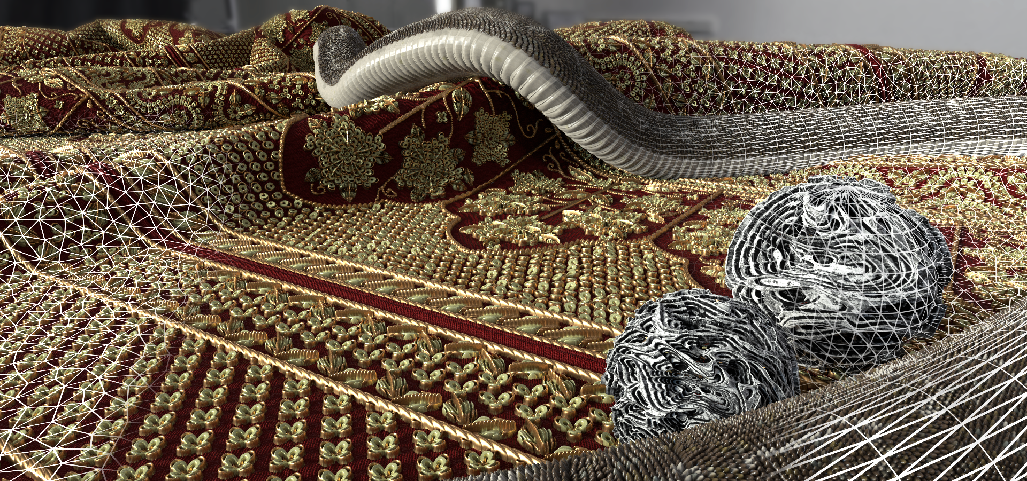
Using height/normal maps for hit/miss geometry
Tessellation-free displacement mapping: https://perso.telecom-paristech.fr/boubek/papers/TFDM/
  Displacement without need for additional surface geometry
  Look in related work; chapter 2 for additional methods

Slide 3
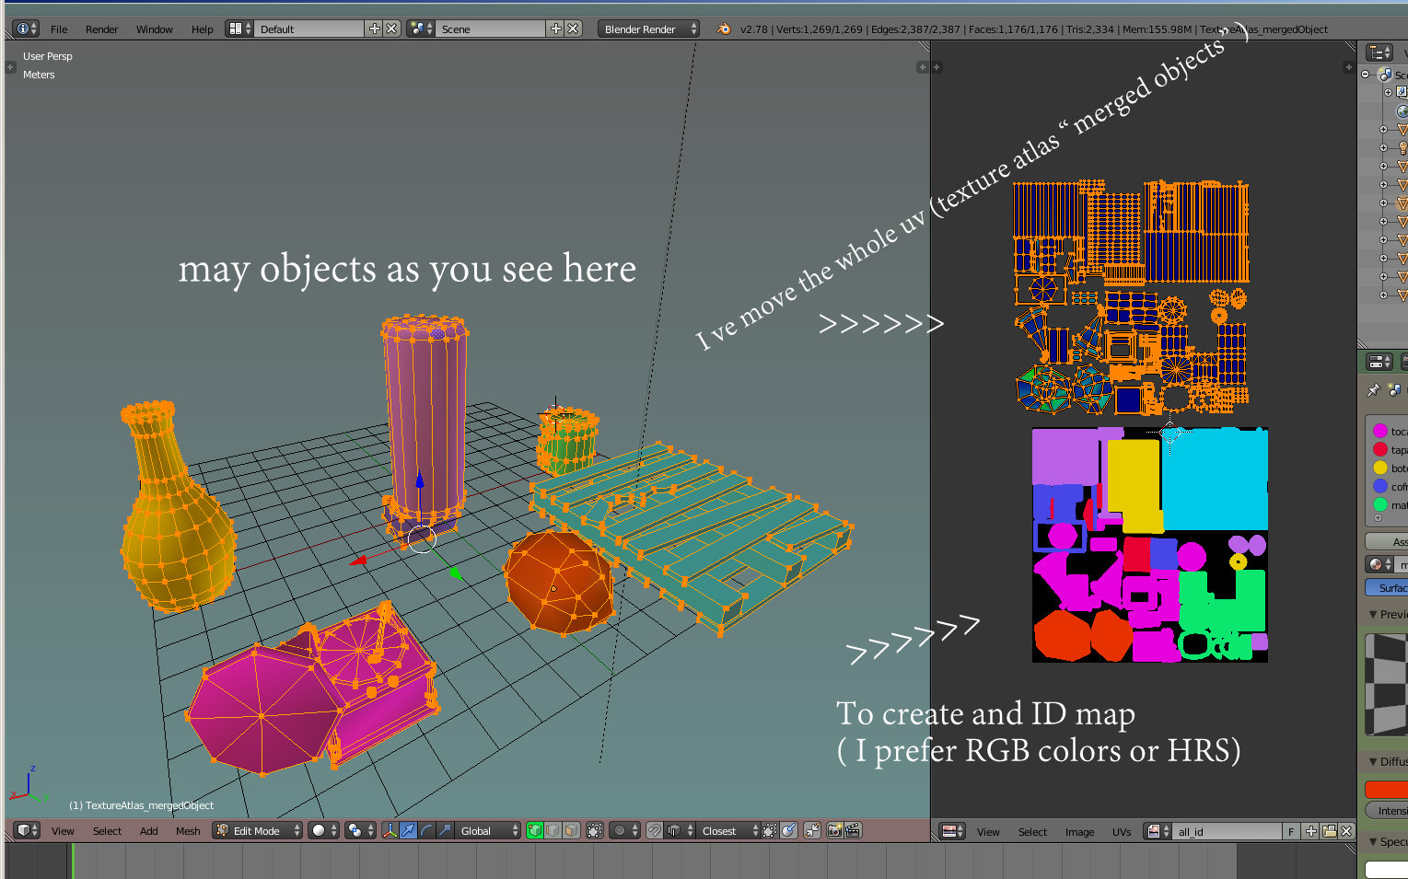
Texture atlas
Optimization idea: having multiple texture images in one image.
Let’s assume that scene contains multiple objects. UV coordinates for all objects must be calculated and for each image texture must be placed using those UV coordinates
  Image textures of those objects can be stored into one image for memory efficiency → texture atlas
  Example: https://www.creativeshrimp.com/game-level-texturing-texture-atlas-part-35.html
  Example: https://www.youtube.com/watch?v=Xwv4vPvVju4&ab_channel=AdobeSubstance3D
  Texture atlas baking example: https://www.youtube.com/watch?v=-rIANRJMaIs
If we are working with complex object, it has to be separated into parts which will have same textures. For those parts, UV coordinates are calculated and image texture is place using UV coordinates
  Again, all image texture can be saved into one image → texture atlas
  Example: https://www.youtube.com/watch?v=gZRDwbHEB34&ab_channel=GrantAbbitt
Textures on complex object can be 3D painted directly on mesh. Note that UV coordinates for mesh must be calculated before.
  3D painting software can store all painted textures per parts as texture atlas
  Example: https://www.youtube.com/watch?v=WjS_zNQNVlw&ab_channel=GrantAbbitt
  Example: https://armorpaint.org/manual.html

Slide 4
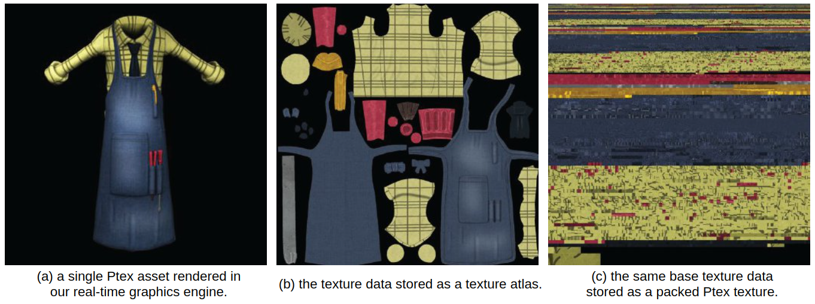
Texture atlas and Ptex
Texture is stored per quad face of mesh → UV unwrapping is not needed.
Direct painting on mesh is possible
Resulting texture is stored for each quad in same image → texture atlas
https://wwwx.cs.unc.edu/~sujeong/Ptex/
https://learn.foundry.com/mari/4.6/Content/user_guide/ptex/ptex.html
https://ptex.us/
https://www.sidefx.com/docs/houdini/shade/ptex.html

Slide 5
Lenses and fisheye effect
Real camera systems can produce fisheye effect especially for wide angles, that is larger field of view
  Either smaller field of view must be used or effect should be fixed in photo editing software
  Example: https://www.droneblog.com/barrel-fisheye-effect/
Achieving fisheye effect on purpose is done with wide-lens camera

Slide 6
Projects and exam
Exam: 29.3.2023. at 16h, Raum 136.1B
Projects deadline: 8.4.2023, 23:59
Questions?

