Slide 1
Foundations of Ray-tracing

Slide 2
Syllabus
3D scene
  Object
  Camera
  Light
Rendering
  Ray-tracing based rendering
  Rasterization-based rendering
Image
Ray-tracing based rendering

Slide 3
<TODO: image rendered with ray-tracing based rendering engine>

Slide 4
Raytracing-based rendering overview

Slide 5
Introduction
Ray-tracing is considered one of the most elegant techniques in computer graphics. Many phenomena such as shadows, reflections and refracted light are intuitive and straightforward to implement.
Ray-tracing is a method inspired by physics of light → realistic image synthesis
<TODO: image rendered with ray-tracing based rendering showing these effects>
Robert L. Cook Thomas Porter Loren Carpenter. "Distributed Ray-Tracing" (1984).

Slide 6
Introduction
Rendering process: visibility solving and shading
Ray-tracing, fundamentally, solves visibility problem: two points are visible to each other if line segment that joins them does not intersect any obstacle.
  First, we need to determine which objects are visible from camera – visibility problem! Based on defined camera, ray-tracing-based rendering is inherently providing perspective or orthographic projection in rendered image.
  Secondly, we need to determine color and intensity of visible objects. This is solved using shading which relies on light transport (which relies on visibility problem) to obtain incoming light to surface.

Slide 7
Three steps of ray-tracing-based rendering
Rendering: assign a color to each pixel of the frame
Generate ray for each pixel of film plane → camera ray
Ray-geometry intersection: testing intersection of generated ray and 3D scene objects to obtain what is visible from camera
Shading: calculating the color and intensity of intersected points
  Requires light-matter calculation
  Requires light transport for gathering incoming light

Slide 8
Ray-tracing-based rendering: trace & shade
Raytracing can be described with two functions:
  trace()
  shade()
trace() is geometrical part of algorithm and it is responsible for finding closest intersection between ray and the primitives in 3D scene.
Once intersection is found, trace() returns color of the ray by calling shade()

Slide 9
Trace() for camera rays
As the goal of rendering is to find colors of pixel in the image, trace() function is used for rays generated by camera: eye or camera rays
Now, the goal of trace() function is to find closest intersection of camera ray with 3D scene objects.
Naive trace() function loops through all n objects in the scene
  This is slow for complex scene → o(n) performance
  Spatial acceleration structure (BVH or k-d tree) is used to achieve O(log(n)) performance

Slide 10
shade() for closest intersection
Color in closest intersection is calculated using shade() it this is done using:
  Material information of intersected point
  Incoming light computed using trace() function
Shade() can be arbitrarily complex:
  It can just return the color of object
  It can use material information with incoming light information
    It can ask trace() for closest light sources
    It can ask trace() to gather all incoming light
Each shade() can call trace() and each trace() can call shade()
  Ray depth is term with indicates number of rays that have been shot recursively along a ray path.

Slide 11
trace() for light transport
Simplest case is that trace() calculate visibility between shaded point and light source
  Shadow ray: is shaded point in the shadow or visible to light source?
Trace() can also use normal at intersection and compute reflection or refraction ray
  Perflectly sharp reflections and/or refractions with sharp shadows is called Whitted ray-tracing.

Slide 12
Digression: ray-casting
Ray-casting is often used in trace() function for determining visibility between two points
<image: raycasting>
It is also very useful operation in different applications
  Ambient occlusion
  modeling

Slide 13
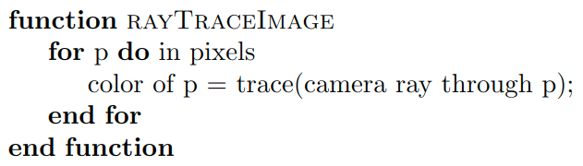
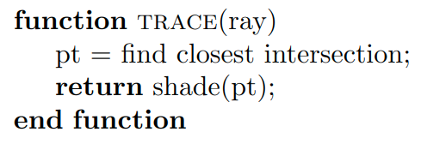
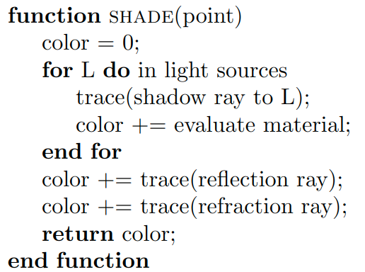
Practical foundations
Overall structure of Whitted ray-tracer which is bases of many other rendering variatns (e.g., path-tracing) can be described with three functions.
TODO: images - https://www.realtimerendering.com/Real-Time_Rendering_4th-Real-Time_Ray_Tracing.pdf

Slide 14
Shade() function is implemented by user
  This is were knowledge about materials: scattering functions and textures comes in
Traversial and intersection testing takes place in trace() function often implemented on CPU but moving to GPU using compute shaders in Vulkan or DXR

Slide 15
Whitted ray-tracing and beyond
Whitted ray-tracing is not full solution to global illumination
  Light reflected from any direction than mirror reflection or refraction is ignored
  Direct lights are only represented with point lights
Fully evaluation of global illumination is is proposed by Kajiya as path-tracing method
  Correct solution which generates global illumination
  After camera ray intersection is found and during shading evaluation,may rays are generated in different directions
    For diffuse surface, rays over hemisphere at intersection are shot
    For glossy surface, rays in lobe at intersection are shot
    Etc.
  Problem with this approach is explosion of rays, thus Monte Carlo sampling methods are employed for generating paths through environment.
    Several of such paths are averaged for each pixel
  General problem with path-tracing is noise and amount of rays that have to be shot

Slide 16
Whitted ray-tracing

Slide 17
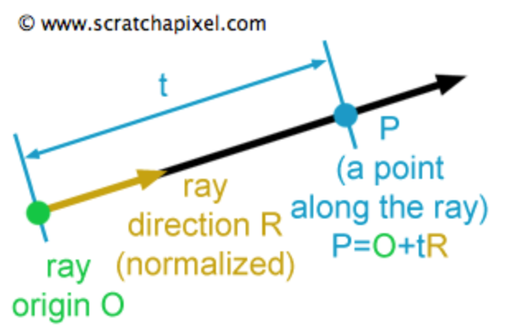
Ray
Ray is fundamental element of ray-tracing.
  Used for finding visible objects from camera
  Used for shading visible objects during light transport.
Ray is defined as:
  vector3f origin;
  vector3f direction;
Ray defines half-line and any point P on it is defined using parametric equation:
  P(t) = origin + t * direction;
  t – distance from origin to P
  t > 0 → P is in front of ray’s origin
  t < 0 → P is behind the ray’s origin

Slide 18
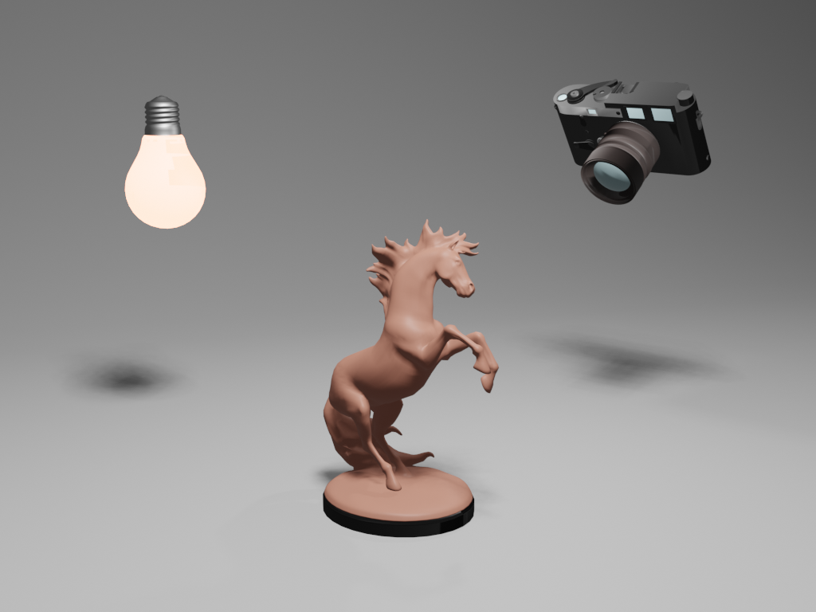
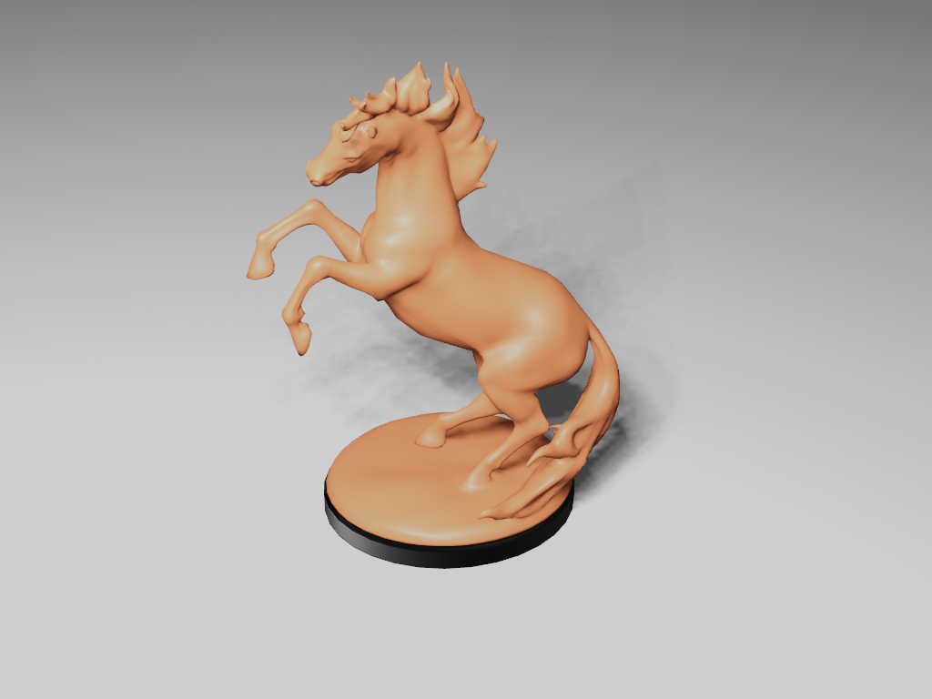
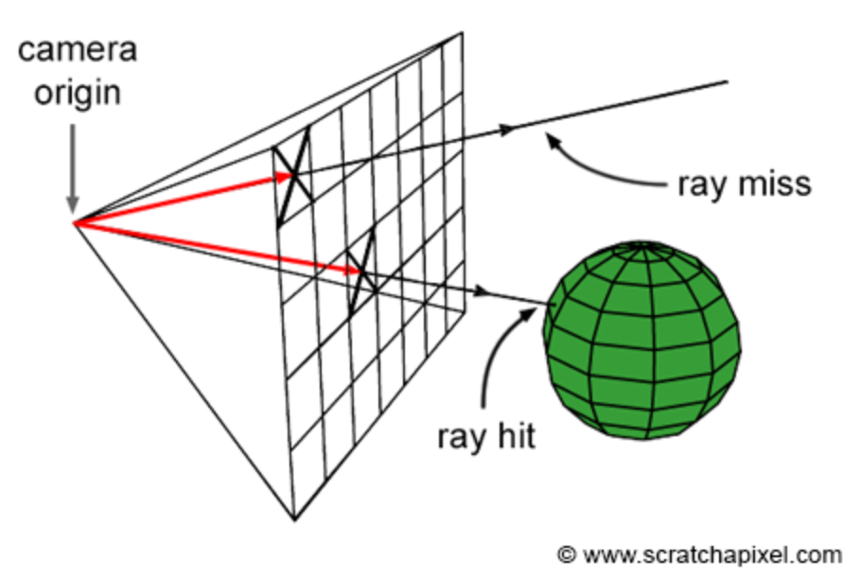
Generating camera rays
Camera defines:
  3D viewpoint: aperture (eye) position and orientation of camera line of sight
  Field of view: how much of the scene we see
  Frame: array of pixels
Rays are generated from camera: backward/eye-tracing
  Rays are generated by starting from camera origin (eye/aperture) and passing through the center of each pixel in the film plane.
Generated rays are called camera/primary rays.
  These rays will be used to compute the visible objects for current camera position → ray-casting

Slide 19
Generating camera rays
Vector3f framebuffer[imageWidth, imageHeight];
For (int j = 0; j < imageHeight; ++j)
{
For (int i = 0; i < imageWidth; ++i)
{
For (int k = 0; k < nObjectsInScene; ++k)
{
Ray ray = buildCameraRay(i, j);
if (intersect(ray, object[k])
{
// Object hit. Compute shading…
framebuffer[j * imageWidth + i] = shadingResult;
}
if (intersect(ray, object[k])
{
// Background hit. Compute background color...
framebuffer[j * imageWidth + i] = backgroundColor;
}
}
}
}

Slide 20
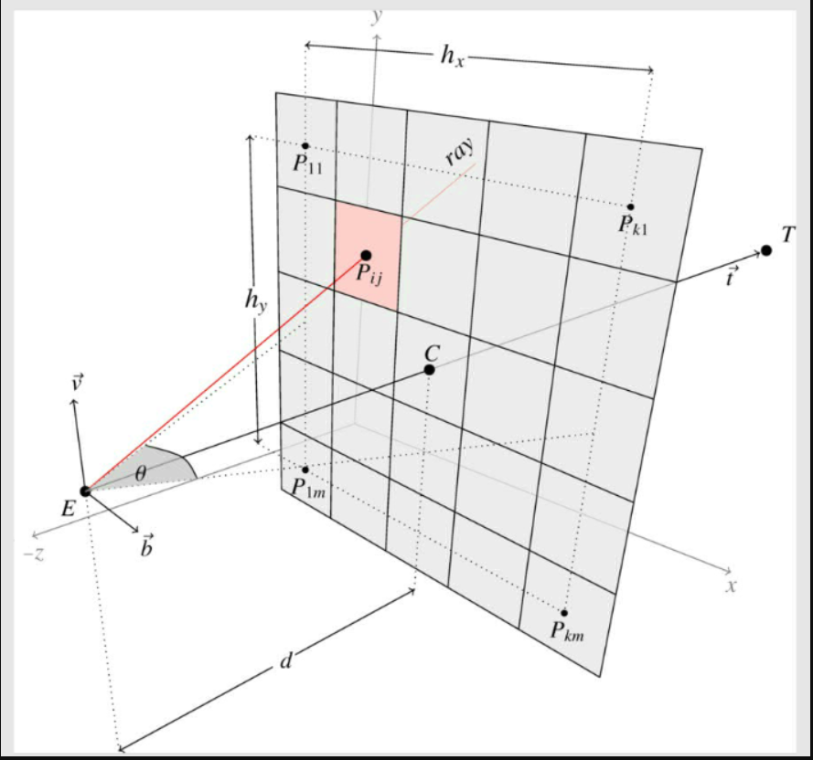
Generating camera rays
Create primary ray for each pixel of the frame which is used for intersection
  All objects in 3D scene are defined in world space
  Rays must be expressed in world space for correct intersection computation
Ray is traced from camera origin to pixel center
  Camera origin is point in camera space → apply camera-to-world matrix to obtain world space camera origin
  Point on a pixel must computed from frame pixel coordinates and transformed in world space using camera-to-world matrix
Frame pixel coordinates are in raster space
  Assume: top left of frame has pixel coordinates (0,0)
Image plane, where frame must be mapped is in camera space
  Assume: image plane is located one unit away from camera origin and aligned in negative z axis
  Assume: image plane is centered around camera origin
Task: find relation between pixels in raster space and coordinates of those pixels in world space

Slide 21
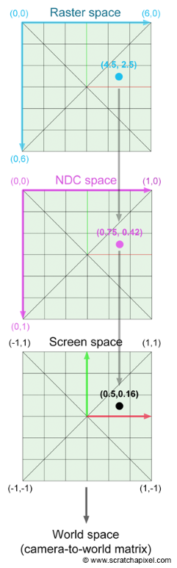
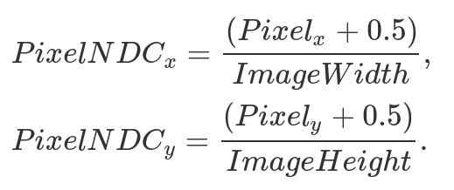

Generating camera rays (square frame)
Finding pixel center coordinate in world space
  Normalize pixel position using frame dimensions → NDC coordinates (space) [0,1]
  Remap NDC coordinates to screen/camera coordinates (space) [-1,1]

Slide 22
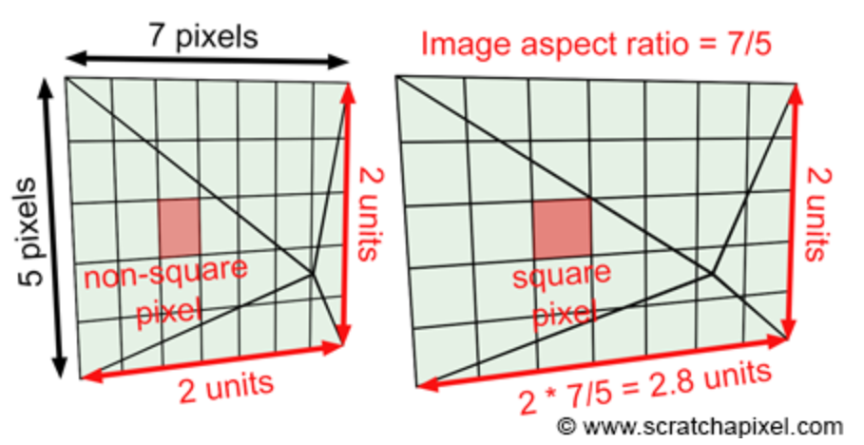
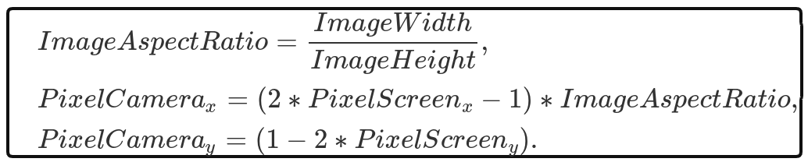
Generating camera rays (frame with arbitrary aspect ratio)
Task: Enable frame aspect ratio to be arbitrary
  Scale image plane by image aspect ratio
Having more pixels in width causes different height and width lengths of the frame. To make sure that frame pixels are squared, image plane must be scaled by image aspect ratio.

Slide 23
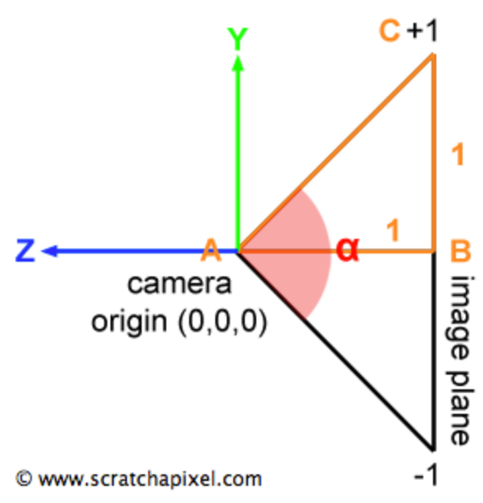
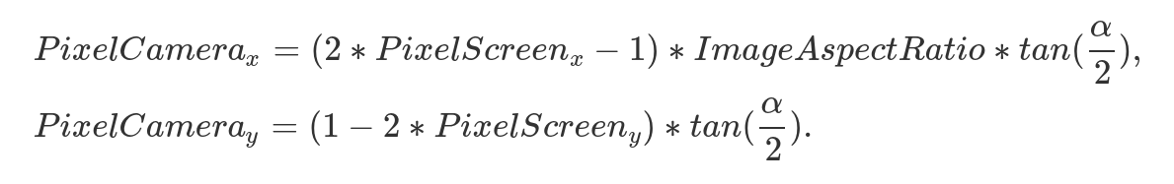

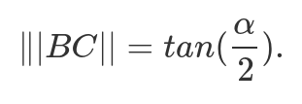
Generating camera rays: field of view
So far image plane y coordinates are in [-1,1] (screen space)
We know:
  image plane is 1 unit from camera origin
  Height of image plane is 2 (from -1 to 1)
Triangle joining camera’s origin and image (film) plane
  Angle alpha is field of view
Camera space pixel coordinates:

Slide 24
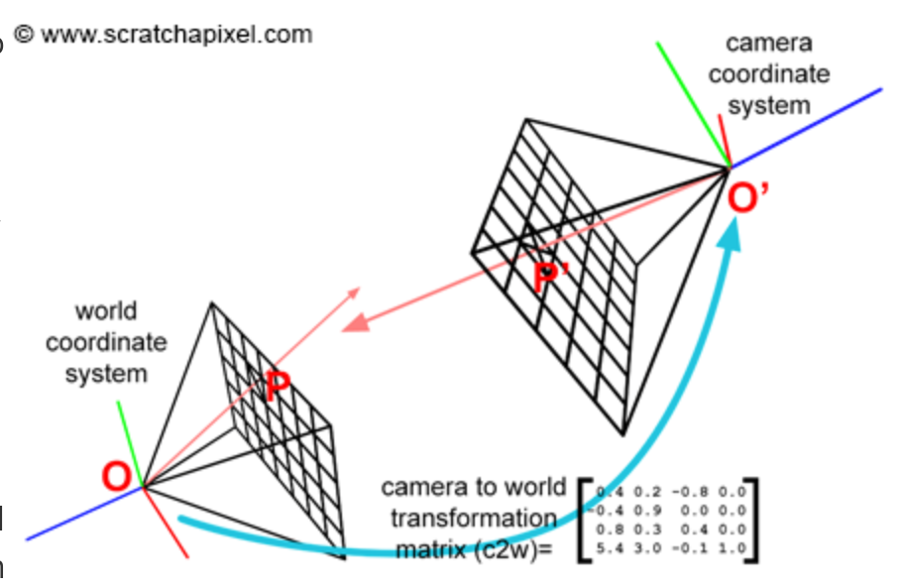
Generating camera rays: world space
Now camera origin and position of pixel in image plane of camera are in camera space.
Camera space ray can be constructed:
  vector3 RayOrigin = cameraOrigin;
  vector3 rayDirection = normalize(pixelPosition – cameraOrigin);
World space ray can be constructed:
  Camera-to-world matrix is first applied applied on pixel position and camera origin
  vector3 RayOrigin = cameraOrigin;
  vector3 rayDirection = normalize(pixelPosition – cameraOrigin);
Camera-to-world matrix is specified using look-at matrix.

Slide 25
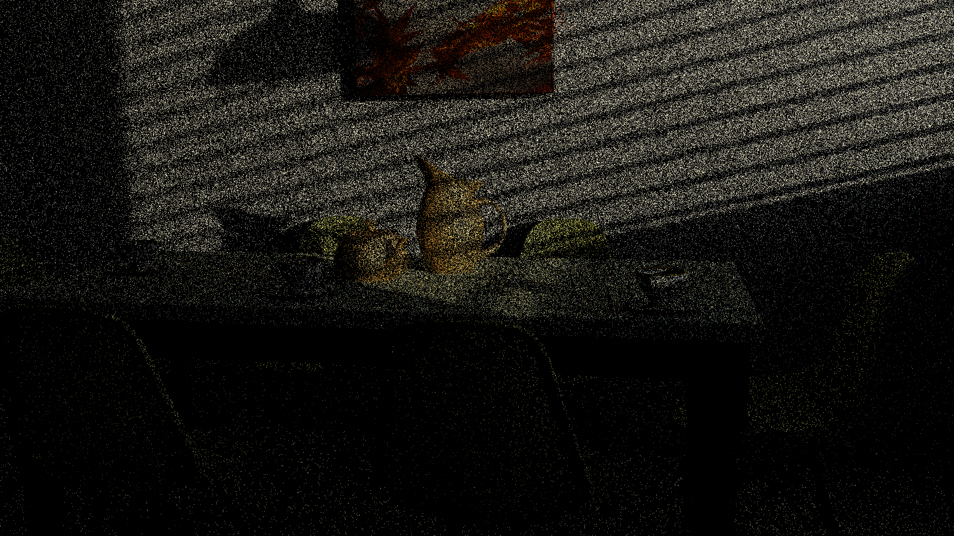
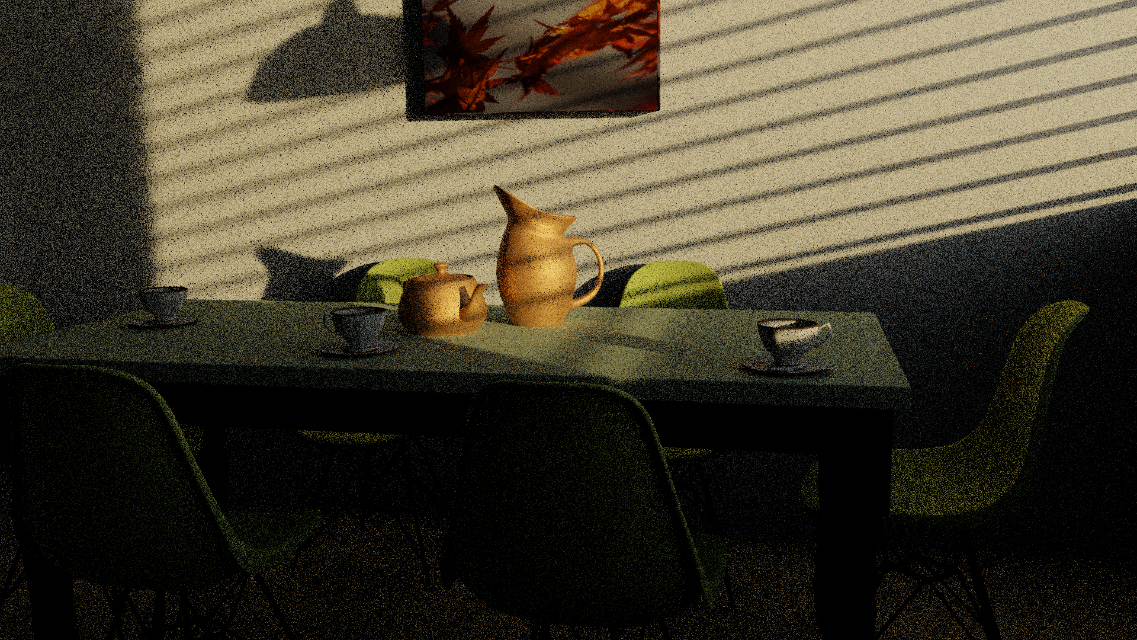
Generating camera rays: multiple rays
It is possible, and in practice always desired, to generate multiple rays for each pixel.
It is important to note that large portion of the scene is actually represented by only one pixel.
Since pixel can represent only one color, it is important to use multiple rays to obtain the color which is the most representative for that part of the scene covered by the pixel.
  Instead of pixel center, random points on pixel area are taken for building rays
  Multiple rays per pixel are also called multiple samples per pixel (SPP)
Using multiple rays per pixels, reduces:
  Noise
1 rays per pixel
32 rays per pixel

Slide 26
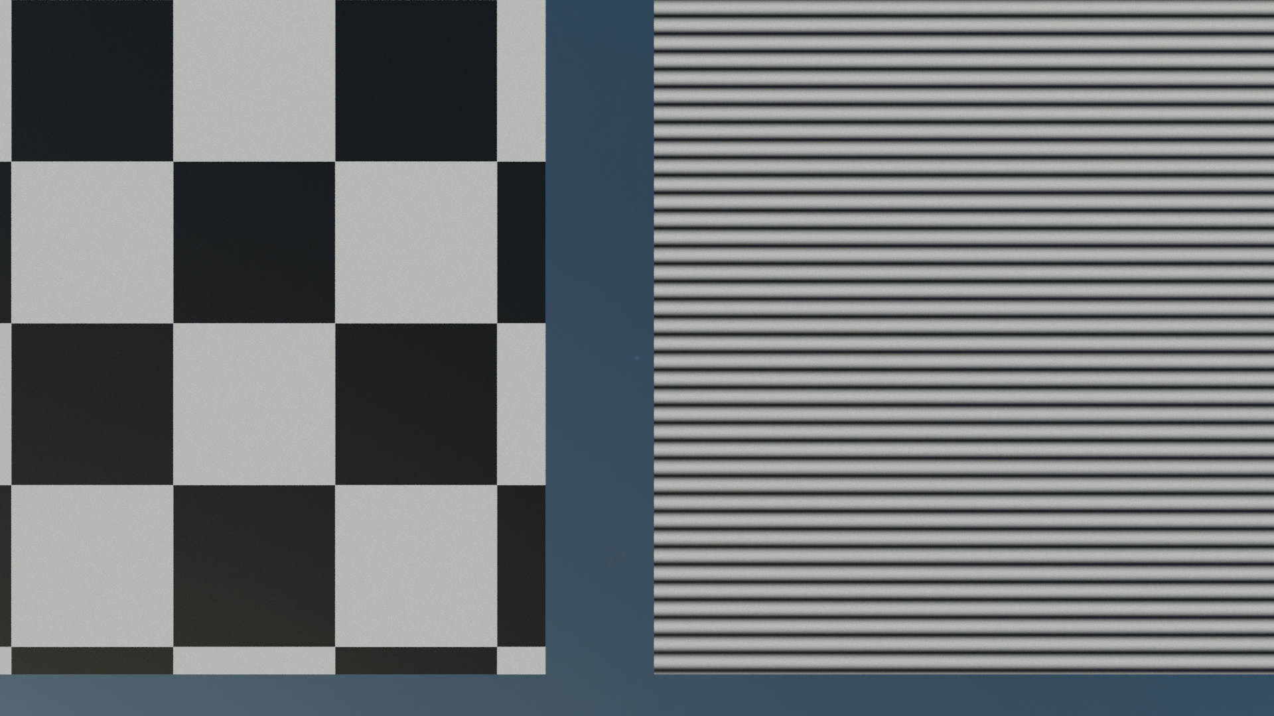
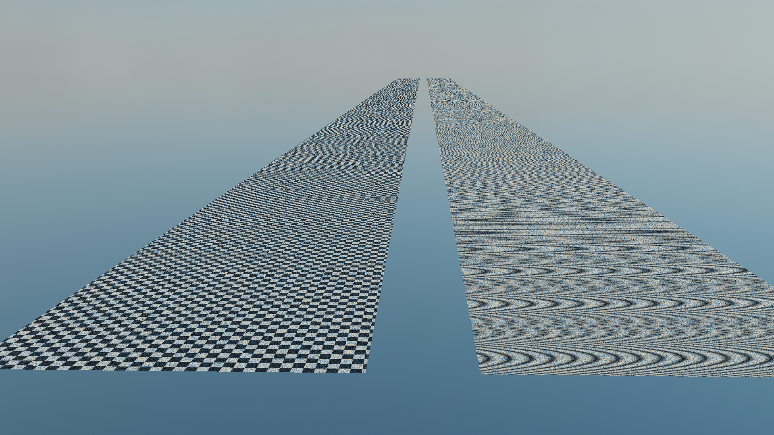
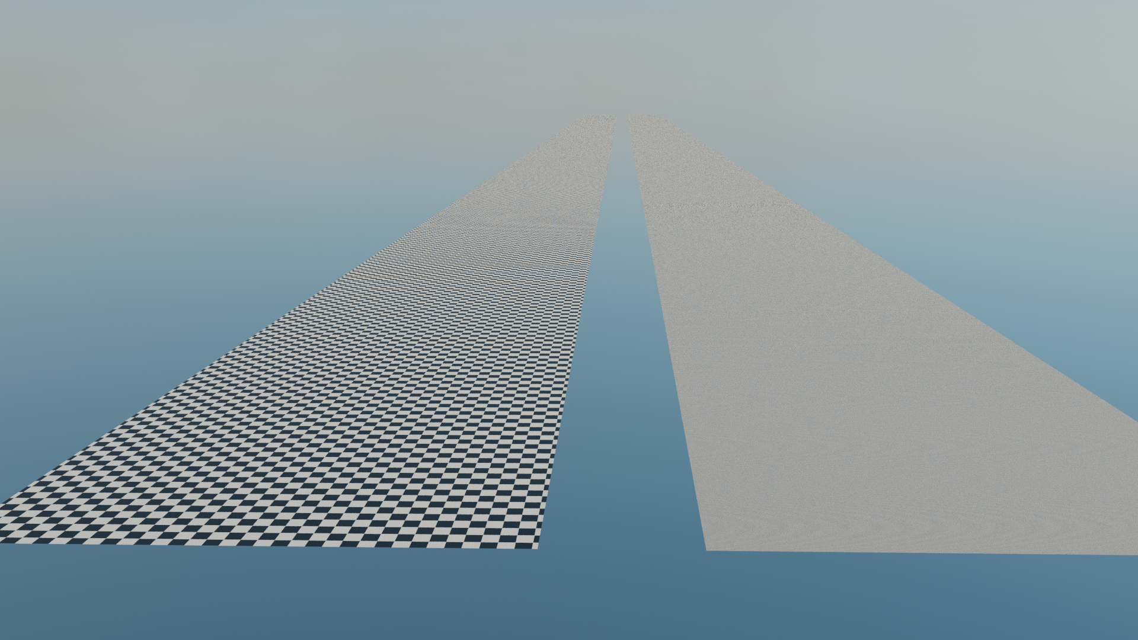
Generating camera rays: multiple rays
Using multiple rays per pixels, reduces:
  Aliasing
1 ray per pixel
32 rays per pixel

Slide 27

Ray-tracing: image centric method

Slide 28
Camera rays: testing for intersections
…
for (int k = 0; k < nObjectsInScene; ++k)
{
Ray ray = buildCameraRay(i, j);
if (intersect(ray, objects[k])
{
// Object hit. Compute shading…
framebuffer[j * imageWidth + i] = shadingResult;
}
if (intersect(ray, objects[k])
{
// Background hit. Compute background color...
framebuffer[j * imageWidth + i] = backgroundColor;
}
}
...
Generated camera rays are traced into the 3D scene
  Loop over all 3D objects in scene and test them for intersection with camera ray → visibility test!
In this step, we are interested in a shape of 3D object.
Once intersection is determined material will be used during the shading step.
Usefulness of decoupling material and shape of 3D object (if one decides on such rendering architecture decision).

Slide 29
Testing object intersections
Objects in 3D scene, come in various shape (geometry) representations
  Parametric representations
    Spheres, disks, planes, etc.
    Surfaces and curves (e.g., Bezier curves, NURBS, etc.)
  Polygonal mesh (triangulated, quad, etc.)
  Implicit surfaces: spheres, SDFs
  Subivision surfaces
  Voxels
  Etc.

Slide 30
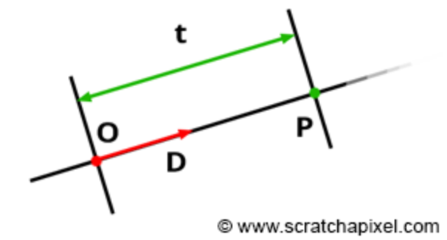
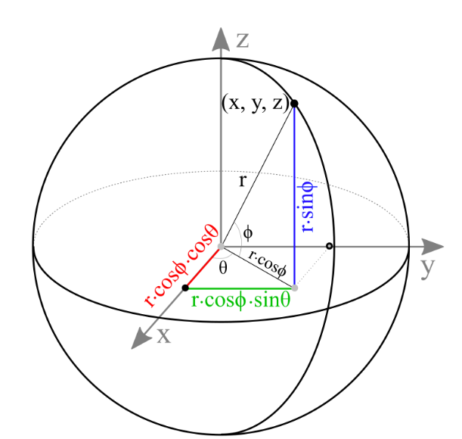
Ray-sphere intersection
Ray-sphere intersection is simplest ray-geometry intersection
  Very often, ray-tracing demo scenes contain spheres
Parametric ray description: P(t) = O + t * D
Implicit (algebraic) sphere form at world origin and radius R:
  x² + y² + z² = R²
  x,y,z are coordinates of point on a sphere:
    P² – R² = 0 → implicit function which defines implicit shape: sphere
http://www.songho.ca/opengl/gl_sphere.html

Slide 31
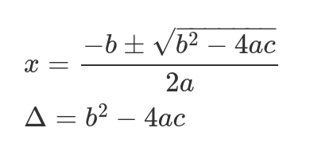
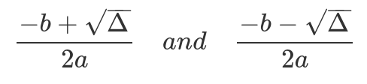
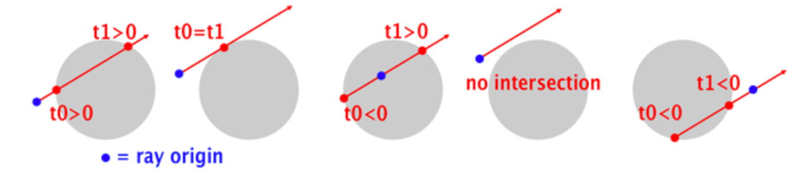
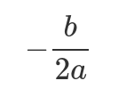
Ray-sphere intersection
Substitute P with ray equation: |O + t * D|² – R² = 0
  Develop: O² + (Dt)² + 2ODt – R² = O² + D²t² + 2ODt – R² = 0
Quadratic equation: f(x) = ax² + bx + c:
  a = D², b = 2OD, c = O² – R², x = t. Solution:
  Δ > 0: ray intersects sphere in two points (t₀ and t₁):
  Δ = 0: ray intersects sphere in one point (t₀ = t₁):
  Δ < 0: ray doesn’t intersect the sphere

Slide 32
Ray-sphere intersection: arbitrary sphere position
If sphere is translated from origin to point C, then:
  |P – C|² – R² = 0
Substituting the ray equation:
  |O + t * D - C|² – R² = 0
Solving quadratic equation gives t:
  a = D² = 1 (ray direction D is normalized)
  b = 2D(O – C)
  c = |O – C|² - R²

Slide 33
Ray-sphere intersection: intersection point
Now we know t₀ – closest intersection of ray with a sphere
To find intersection point, we use parametric ray equation:
  P(t) = O + t * D
Finally,
  vector3 Phit = O + D * t

Slide 34
Ray-sphere intersection: intersection context
Next to intersection point Phit, renderer often computes additional information regarding intersection – intersection context:
  Normal in intersection point
  Texture coordinate in intersection point
  Etc.
Intersection context contains information which is used further in rendering process, e.g., shading

Slide 35
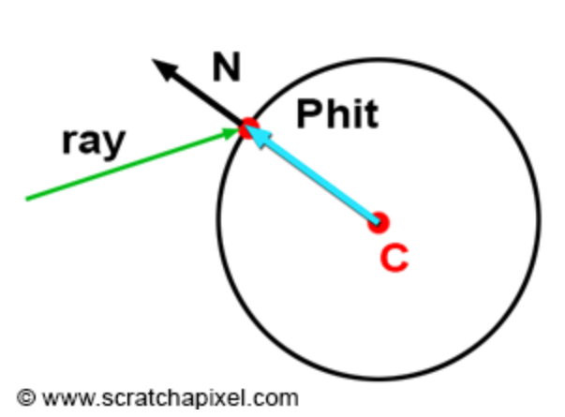
Ray-sphere intersection: normal
Normal calculation in intersection point depends on shape representation
For implicit sphere:
  vector3 N = normalize(Phit - C)

Slide 36
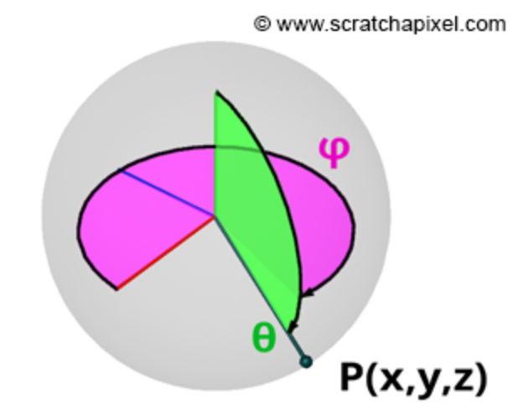
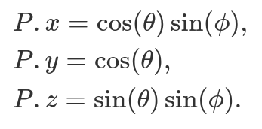
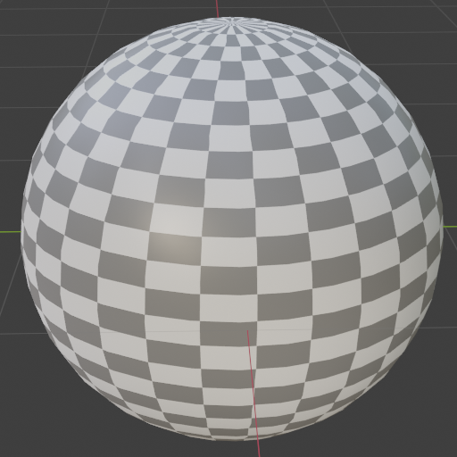
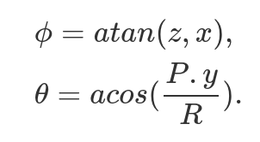
Ray-sphere intersection: texture coordinates
Calculation of texture coordinates depends on shape representation
  For parametric and implicit surfaces it can be calculated on the fly
  For polygonal (e.g., triangle) mesh, texture coordinates are stored per vertex. Intersection point is used to interpolate texture coordinates per triangle face.
Sphere can be written in parametric form:
Texture coordinates for sphere are simply spherical coordinates:

Slide 37
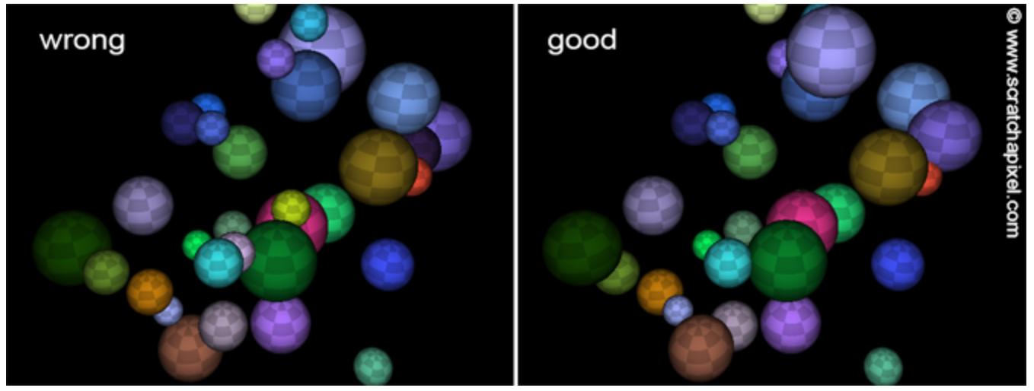
Ray-sphere intersection: intersection order
If scene contains multiple objects then certain depth sorting is needed
The solution is to keep track of closest intersection distance → closest t

Slide 38
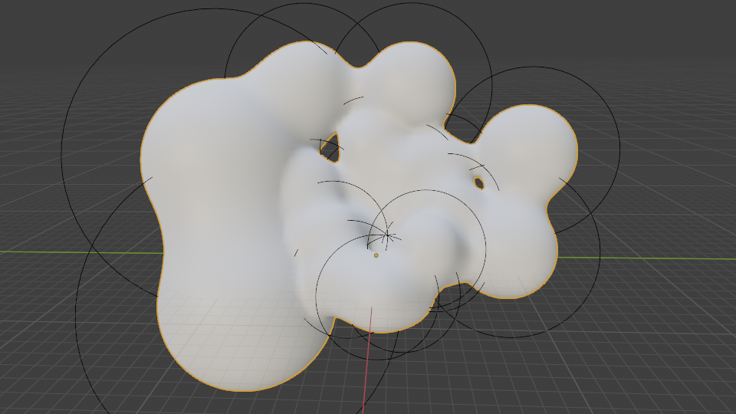
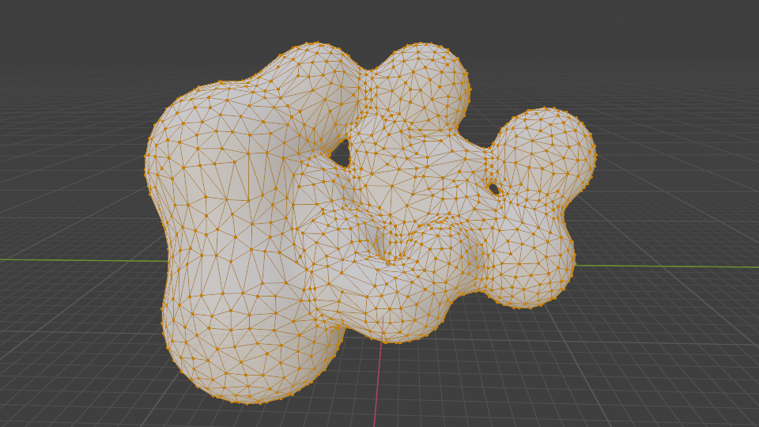
Intersecting other shapes
Ray-shape intersection must be defined for each representation separately*.
  e.g., different intersection test is performed for triangle meshes, quad meshes, parametric surfaces, etc.
Alternative solution: convert each shape representation to same internal representation which is used for rendering.
  This approach is taken by almost all professional rendering software
  Internal representation is in almost all cases triangulated mesh
  Process of converting different shape representations to triangulated mesh called tessellation
Implicit spheres (metaballs) converted into triangle mesh
* https://www.realtimerendering.com/intersections.html

Slide 39
Reading: Tessellation and triangulated mesh
Two sides of the computer graphics/image generation: authoring of 3D scene and rendering
  Some representations are much more easier and efficient to handle on authoring level
  Some are much more efficient to handle for rendering purposes.
  Therefore, efficient mapping of those representations quite important and researched.
Renderer working with single primitive is much more efficient than supporting various primitives
Why triangles?
  Can approximate any surface and shape well
  Conversion of almost any type of surface to a triangulated mesh (tessellation) is well researched and feasible.
  Triangulated mesh is also basic rendering primitive for rasterization-based renderers. G
  Graphics hardware is adapted and optimized to efficiently process triangles.
  Triangles are necessary co-planar which makes various computations, such as ray-triangle, much easier
  Lot of research was devoted to efficient computation of ray-triangle intersection
  For triangles we can easily compute barycentric coordinates which are essential to shading.
Tessellation process can be done after modeling of shape is done and when exporting takes place or it can be done during rendering (render time).

Slide 40
Camera rays: testing for intersections
…
for (int k = 0; k < nObjectsInScene; ++k)
{
for (int n = 0; m < objects[k].nTriangles; ++n)
{
Ray ray = buildCameraRay(i, j);
if (intersect(ray, object[k].triangles[n])
{
// Object hit. Compute shading…
framebuffer[j * imageWidth + i] = shade();
}
if (intersect(ray, object[k].triangles[n])
{
// Background hit. Compute background color...
framebuffer[j * imageWidth + i] = backgroundColor;
}
}
}
...
Generated camera rays are traced into the 3D scene
Loop over all 3D object triangles in scene and test them for intersection with camera ray → visibility test!

Slide 41
Intersecting triangle primitive
Basic ray-triangle intersection is straight forward, complexity comes due to multitude of different cases which must be accounted for
  Thus, there are several algorithms that have been developed and are being developed
Main questions:
  Does ray intersect a plane defined by a triangle?
  Does ray intersect point inside the triangle?

Slide 42
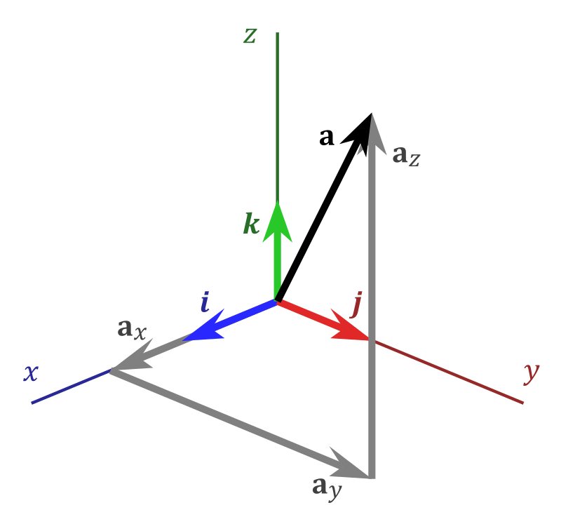
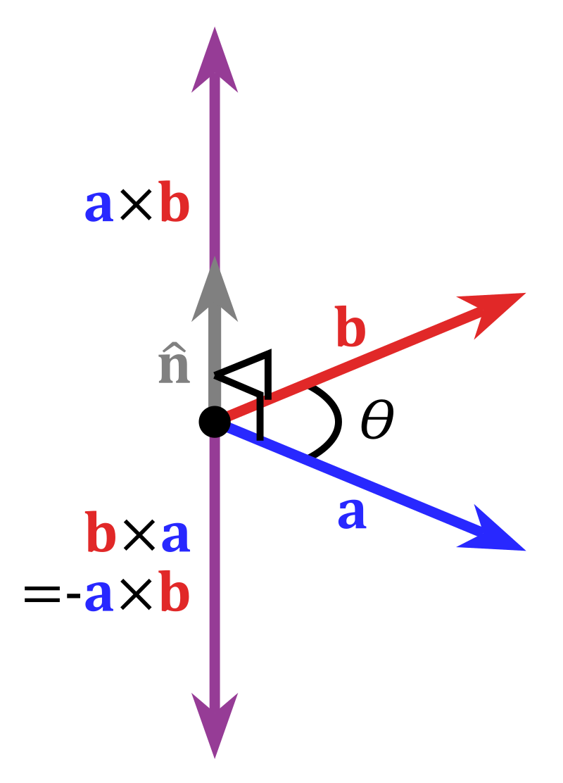

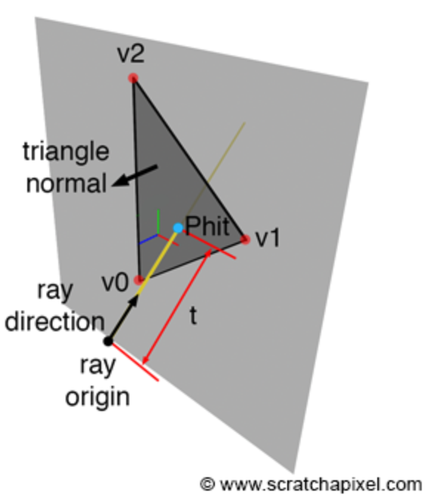

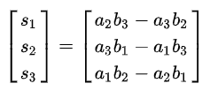
Intersecting triangle primitive: tools
Triangle vertices are lying on a plane
  Triangle is coplanar and defines a plane
Using triangle vertices, normal can be computed
  Plane defined with triangle has the same normal
    vector3 a = v1 – v0
    vector3 b = v2 – v0
    vector3 c = cross(a, b)
    vector3 normal = normalize(c)
  Winding order of vertices defines normal and thus surface orientation – important for shading!
https://en.wikipedia.org/wiki/Cross_product

Slide 43
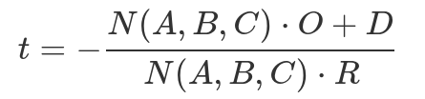
Intersecting triangle primitive: intersecting plane
Intersected point in somewhere on ray:
  Phit = P(t) = O + t * R
Plane equation:
  Ax + By + Cz + D = 0
  D = -(Ax + By + Cz)
  A, B, C are coordinates of plane normal N = (A,B,C)
    N is calculated using triangle vertices
  D is distance from origin (0,0,0) to the plane
    D can be calculated using any triangle vertex: D = dotProduct(N, v0) = -(N.x * v0.x + N.y * v0.y + N.z * v0.z);
  x, y, z are coordinates of point on a plane
Substitute ray equation into plane equation:
  A * P.x + B * P.y + C * Pz + D = 0
  A * (O.x + t * R.x) + B * (O.y + t * R.y) + C * (O.z + t * R.z)
  Solving by t:

Slide 44
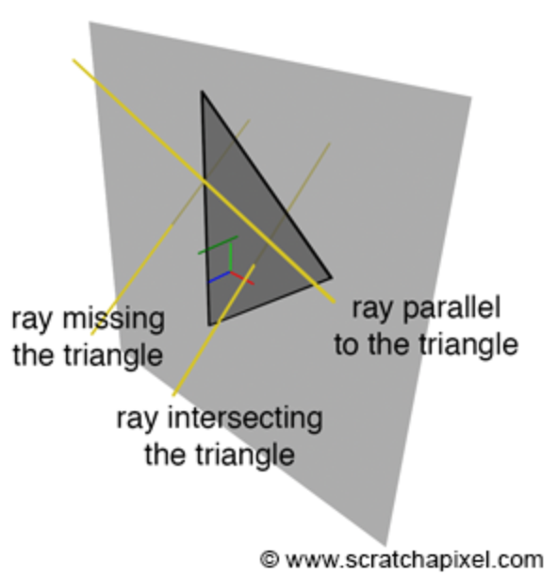
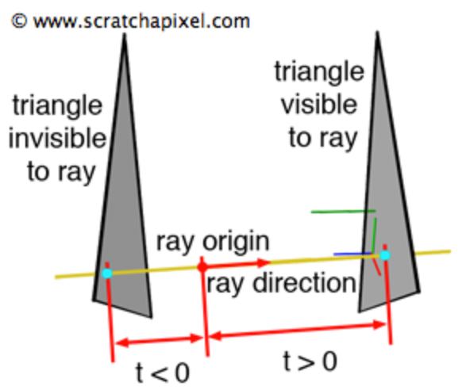
Intersecting triangle primitive: intersecting plane
Finally, intersection point:
  float t = - (dot(N, O) + D) / dot(N, R)
  Vector3 Phit = O + t * R
Special cases of non-intersection:
  Ray and triangle (plane) are parallel
    Triangle’s normal and ray direction are perpendicular
    dot(N, R) = 0
  Triangle is behind ray origin
    If t < 0 → triangle behind ray origin. Else, triangle is visible

Slide 45
Intersecting triangle primitive: point inside triangle?
We have found intersection point P. Is it inside triangle?
Inside-out test
    vector3 edge0 = v1 – v0;
    vector3 edge1 = v2 – v1;
    vector3 edge2 = v0 – v2;
    vector3 C0 = P – v0;
    vector3 C1 = P – v1;
    vector3 C2 = P – v2;
    bool q1 = dotProduct(N, crossProduct(edge0, C0) > 0);
    bool q2 = dotProduct(N, crossProduct(edge1, C1) > 0);
    bool q3 = dotProduct(N, crossProduct(edge2, C2) > 0);
    If (q1 and q2 and q3) then inside;
To test if P is inside triangle:
Test if dot product of vector along edge and vector defined with first vertex of the test edge and P is positive → if P is on left side of the edge.
If P is on the left side of all three edges, then P is inside triangle

Slide 46
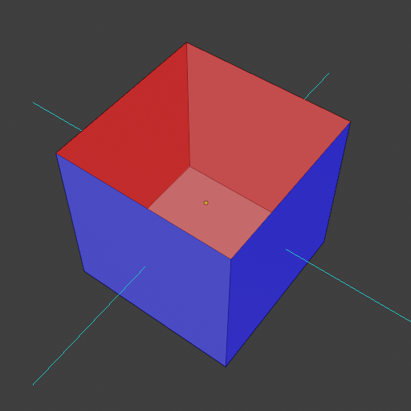
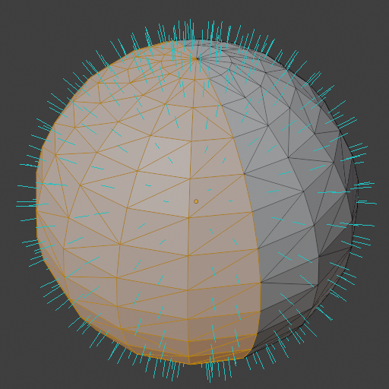
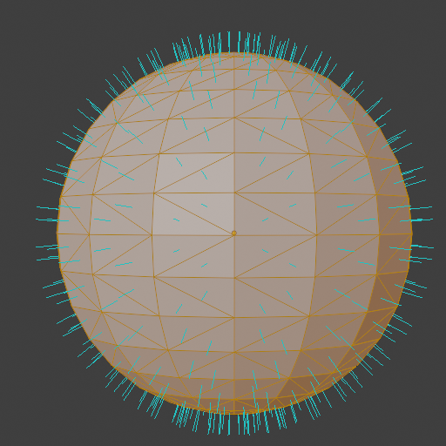
Single and double sided triangle
Winding order of triangle vertices defines normal orientation → surface orientation
  Surface normal pointing outside → outside surface
  Surface normal pointing inside → inside surface
Surface or triangle is front-facing if facing the camera, otherwise is back-facing
Single-sided primitives: only front-facing
Double sided primitives: both front- and back-facing
Back-face culling: back-facing triangles will not be rendered (drawn)
  For casting shadows, back-face culling can not be used.
  Test: dotProduct(ray.direction, N) > 0

Slide 47
Testing intersections: trace function
Inner loop responsible for testing intersections with all objects, that is triangles, can be encapsulated into trace() function
trace() can be used for any kind of tracing ray into the scene since only information is current ray and objects in the scene:
  Camera rays used to determine what is visible from camera
  Later in shading for light transport
bool trace (Ray ray, Object objects, &objIdx, &triIdx)
{
bool intersect = true;
for (int k = 0; k < objects.nObjects; ++k)
{
for (int n = 0; n < objects[k].nTriangles; ++n)
{
if(rayTriangleIntersect(ray, objects[k].triangle[n])
{
intersect = true;
objIdx = k;
triIdx = n;
}
}
}
return intersect;
}

Slide 48
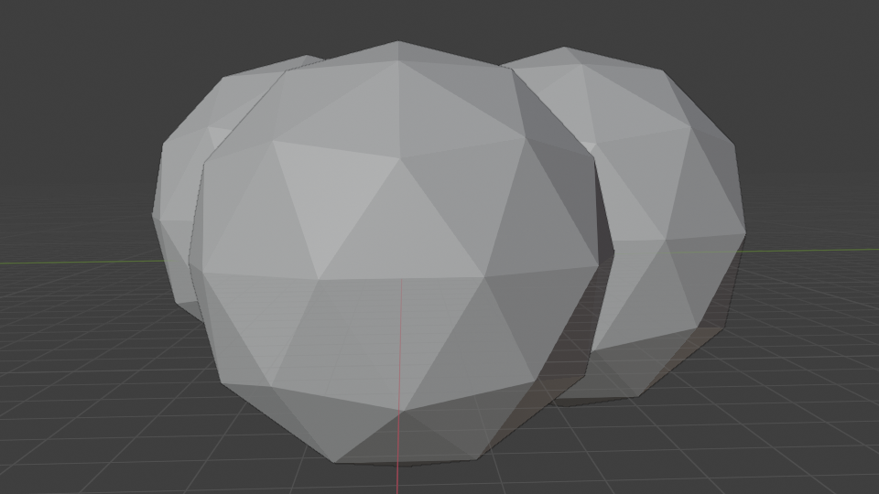
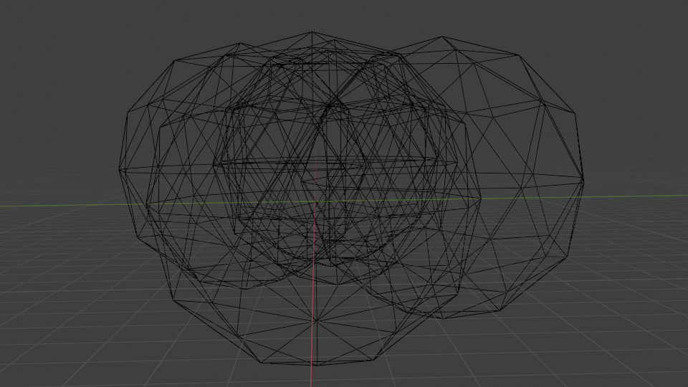
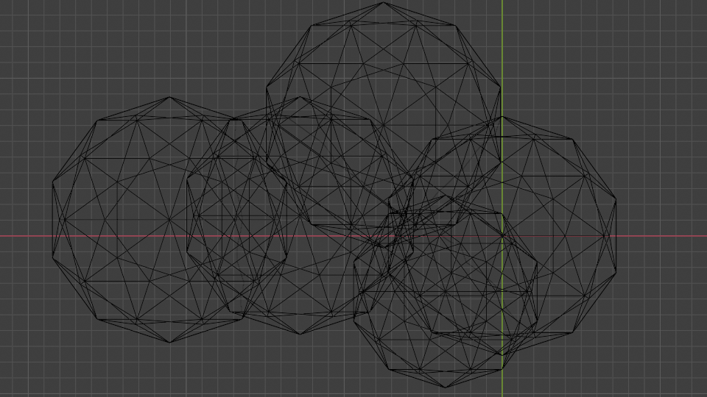
Testing intersections: trace function, depth
bool trace (Ray ray, Object objects, &objIdx, &triIdx, &tNearest)
{
bool intersect = true;
tnearest = INFINITY;
for (int k = 0; k < objects.nObjects; ++k)
{
for (int n = 0; n < objects[k].nTriangles; ++n)
{
if(rayTriangleIntersect(ray, objects[k].triangle[n], t) and t < tNearest)
{
intersect = true;
objIdx = k;
triIdx = n;
tNearest = t;
}
}
}
Return intersect;
}
Ray may intersect several triangles.
Keep track of closest intersection and update it with each intersection

Slide 49
Trace function, depth
TODO
Trace function returns the closest intersection, e.g., primary ray with object in the scene.
  This is fine for opaque objects – we are not interested what is behind the intersected surface
Nevertheless, we will be able to see through transparent objects as well
  This computation is performed in shading step.
  In shading step, additional rays for computing incoming light to intersected point are created, depending on object material.

Slide 50
Trace function: intersection context
Trace function returns objIdx, triIdx and tNearest
  This is needed to calculate intersection context used in shading:
    intersection point,
    normal,
    texture coordinates, etc.
Trace function can also directly calculate intersection context – depending on rendering engine design

Slide 51
Testing intersections
Time to render a scene is (directly) proportional to the number of triangles in the scene.
For shading purposes, all triangles must be stored into memory and each must be tested for intersection for ray
  Rasterization-based rendering discards triangle not visible from camera (e.g., back faces of object – back face culling) thus faster, but therefore has lower shading capabilities
Therefore, efficient ray-object intersections are needed!

Slide 52
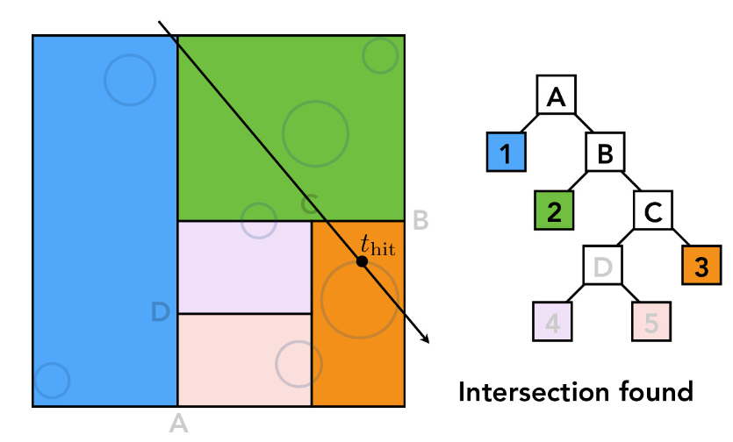
Testing intersections
If certain parts of the scene are not relevant for current ray, they can be skipped
  Spatial acceleration data structures
    object shape information is “sorted” in 3D scene and scene is spatially subdivided.
    Rays first test larger volumes of the scene and if that volume is not relevant, all objects inside do not have to be tested for intersections!
    Such acceleration structures require pre-computation overhead:
      Static scenes: only once before rendering.
      Animated scenes, these datastructures must be pre-computed each time objects move (each frame) before rendering.
https://cs184.eecs.berkeley.edu/sp22/lecture/10/ray-tracing-acceleration

Slide 53
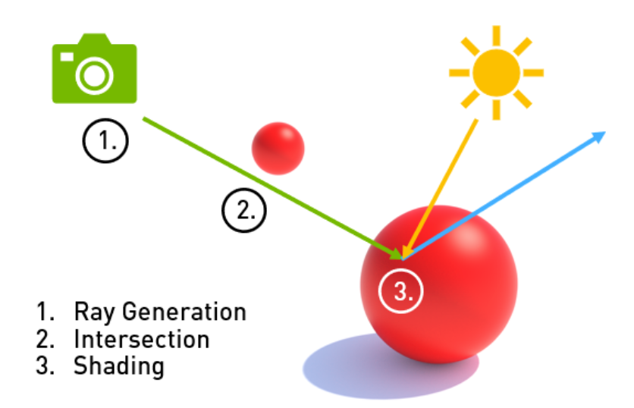

Shading
Once intersection of camera ray with object is found (visibility is solved), we need to calculate color and intensity of that point → shading.
  Intersection point → shading point.
Shading and thus appearance of object depends on:
  Material of the object surface (scattering model, texture)
  Shape of the object surface (normal)
  Incoming light on surface (direction, color, intensity)
  Camera viewpoint (position and orientation)
Color of an object at any point is the result of the way object reflects light falling on that point to camera.
https://developer.nvidia.com/blog/rtx-best-practices/
https://www.mdpi.com/1424-8220/22/17/6552

Slide 54


(Non-)Photo-realistic rendering
Level of photo-realism depends on reproducing the color and intensity of objects (appearance)
Shading plays crucial role for photo-realistic rendering
Shading, can be also utilized to render expressive or artistic images → non-photo-realistic rendering.
Photo-realistic rendering is useful for understanding physically-based shading from which non-photo realistic rendering can be derived with means of exaggeration
“Rolling Teapot” - Model by Brice Laville, concept by Tom Robinson, render by Esteban Tovagliari - RenderMan ‘Rolling Teapot’ Art Challenge: https://appleseedhq.net/gallery.html#https%3A%2F%2Fappleseedhq.net%2Fimg%2Frenders%2Frolling-teapot.jpg
https://www.artstation.com/artwork/rANRe5

Slide 55
Shading
Color and intensity of object varies across surface. In intersection point - shading point**, color and intensity* depends on:
  Amount of incoming light – how much surface is oriented to emitter (direct light) or other surface which reflects emitter or another surface (indirect light) and how much light actually falls onto the shading point.
  Incoming light direction – from where is light falling on shading point
  Surface material – as discussed in object modeling lesson, material can be decomposed in scattering (reflection) characteristic described by BSDF (BRDF) and variation of its properties (color, roughness, etc.) across surface – Texture.
  Position of camera – as discussed in object modeling lesson, some materials (that is scattering functions) depend on viewer position and are not reflecting light equally in all directions.
* Several times it has been mentioned “color and intensity”. In real world this is the same part of phenomena we see. In computer graphics this is decomposed for easier simulation and handling. <TODO>
** At this stage, we can start call intersection point the shading point. This is popular and important term to keep in mind.

Slide 56


Shading and light
Light is essential to shading
Incoming light to shaded surface point can be:
  Direct illumination: light emitted directly by light sources
  Indirect illumination: light reflected from another object surface
https://www.realtimerendering.com/Real-Time_Rendering_4th-Real-Time_Ray_Tracing.pdf

Slide 57

Direct illumination
Directional lights
  Light direction is given as vector L
  Light color and intensity
Point lights or spot lights
  Shadow rays are generated in from shading point P to light source S (visibility solving via raytracing):
  Light direction: L = normalize(S – P);
  Light color and intensity
    Inverse square law: intensity falls with squared distance to light source
https://en.wikipedia.org/wiki/Ray_tracing_(graphics)

Slide 58
Direct illumination
TODO
Area lights

Slide 59



Shading: normals
Surface normal is essential to shading
Surface normal N in shading point defines surface orientation
  Surface normal and light direction determine surface brightness
  Simple shading:
    shaded_color = surface_color * light_color * light_intensity * max(0, dotProduct(N, L))

Slide 60






Shading: normals
Implicit sphere
Triangulated mesh from implicit sphere
Triangulated mesh from implicit sphere with smooth shading
Triangulated mesh can’t represent perfectly smooth surface
Shading depends on surface normal and triangulated mesh gives faceted look
  Flat shading
Solution: Gourad shading
  Produce smooth shading over surface by using linearly interpolated vertex normals
  Linear interpolation of vertex normals is done using barycentric coordinates
Vertex normals are:
  Computed on the fly
  Given from smooth surface from which triangulated mesh was created

Slide 61

Shading: material
Appearance of object surface is further defined by reflectance model – BRDF f(L,N,V)
  Mathematical model approximating interaction of light and microscopic structure of object material
  Besides parameters, it depends on incident light direction L and view direction V
  Diffuse/Lambertian, specular, Phong, Blinn-Phong, Lafortune, Torrance-Sparrow, Cook-Torrance, Ward, Oren-Nayar, etc.
BRDF contains number of parameters which are varied over surface using texture
General shading; one point light:
    shaded_color = f(L, V, N) * light_color * light_intensity * max(0, dotProduct(N, L))

Slide 62






Shading and BRDF
Amount reflected light in view direction V given indicent direction L - BRDF: f(V,N,L)
  L – incoming/incident direction
    Angle of incidence: ω_{i} (between L and N)
  V – view direction
    Line joining eye/camera E and shaded point
  R – outgoing/reflected light direction
    Angle of reflection: ω_{o} (between N and R)
Most materials can be described with following BRDFs:
  Mirror
  Diffuse/Lamberian
  Glossy

Slide 63




Shading: diffuse/Lambert surface
Light falling on surface is attenuated based on surface normal and incoming light direction
  Lambert’s cosine law: dotProduct(N, L)
Diffuse BRDF: albedo / PI
  albedo RGB in [0,1]
  Albedo = (reflected_light / incident_light)
Diffuse surfaces are reflecting light in all directions equally – over whole hemisphere at shading point P around normal N. Final color:
  diffuse_surface = (albedo / PI) * light_color * light_intensity * max(0, dotProduct(N, L))
Surface is view independent

Slide 64


Shading: mirror surface
Light bounces in direction symmetrical to incident direction around normal at shading point → law of reflection
  incident_angle = reflected_angle
Reflected direction:
  R = L – 2 (N * L) * N
Surface is view dependent
Reflection of mirror surface:
  Reflection direction is calculated using view direction (primary ray direction) and normal in intersected point
  Primary ray color (shading result) is equal to color of reflected ray
  This process is recursive until it hits background or non-specular surface → terminate with ray depth – trade off between render time and quality
    Ray-tracing here is solving visibility!

Slide 65


Shading: shadows
After primary ray intersection has been found, shadow ray is sent from shading point to light source.
Beside information of light direction, intensity and color, the purpose of shadow ray is to determine if some objects are intersected on the path
If shading point is shadowed, it has zero light contribution → black color
https://docs.chaos.com/display/VMAYA/Basic+Ray+Tracing?preview=/60899647/64600173/RayTrace_1.png
https://help.autodesk.com/cloudhelp/2016/ENU/mental-ray-docs/mr_docs/manual/node102.html

Slide 66




Shading: Multiple lights
3D scene often contain multiple light sources
Contribution of each light source adds up linearly:

Slide 67
Direct illumintion recap
For now we have:
  Created primary ray
  Traced primary ray for intersection
  Traced shadow ray from shading point to light source
  Calculate shading based on surface shape (normal), material, primary ray and shadow ray information

Slide 68
Indirect illumination
Shading very much depends on incoming light
  Light coming directly from light source
  Light can travel from light source, reflecting from objects and finally fall on shaded surface → indirect illumination
    Indirect diffuse
    Indirect specular
    https://www.scratchapixel.com/lessons/3d-basic-rendering/rendering-3d-scene-overview/light-simulator
Gathering indirect light is called light transport

Slide 69
Shading and light transport
Appearance of object and can be divided into:
  Shading: how object appear
  Light transport: how much light object receives
  https://www.scratchapixel.com/lessons/3d-basic-rendering/rendering-3d-scene-overview/light-simulator

Slide 70
Indirect illumination
TODO
Reflectance equation, rendering equation
Light transport
Whitted ray-tracing
Global illumination
https://www.scratchapixel.com/lessons/3d-basic-rendering/ray-tracing-overview/light-transport-ray-tracing-whitted
https://www.scratchapixel.com/lessons/3d-basic-rendering/global-illumination-path-tracing

Slide 71
TODO
BRDF is also used for light transport!

Slide 72
Shading and indirect illumination
TODO
Reflectance equation
“Gathering” incoming light on shading point → light transport.
  In real world: light is emitted from light source, bounces around the scene and small portion enters camera
  Computer graphics: light flow is simulated using backward ray-tracing: trace rays from camera to 3D scene objects
Light transport: tracing rays from intersection point into the 3D scene → secondary rays:
  Ray casted toward light is called shadow ray
  Ray casted from mirror/glossy/diffuse surface is called reflection ray
Secondary rays used in light transport are solving visibility problem! For example secondary ray casted towards light connects two points: intersection point and light position. And it is important to evaluate if these two points are visible to each other – if there is another object on this segment.

Slide 73
Light transport
TODO
Much of the shading process in shading point relies on simulating light bouncing off of the objects or light traveling through objects in 3D scene → light transport
  Essentially, seeing an object means that light is reflected by this object in the direction of camera/eye.
  Some (a lot actually!) objects in a 3D scene may reflect light in direction where camera is not placed, but due to indirect reflection, the light is reflected by another object in the scene*.
  Opaque surfaces (e.g., shiny) cause light reflection
  Transparent surfaces cause light refraction while entering, traveling and exiting such objects
Light transport must simulate light scenarios in acceptable amount of time and yet providing best visual accuracy possible.
  Light transport algorithm is strategy to solve light transport. Many strategies for light transport have been developed over time (and still are!)
Simulation of light bouncing in the scene requires:
  Models which determine how ray is reflected once it falls on object – for this purposes we use material and its component: BRDF/BSDF
  Efficient intersection tests for any object in 3D scene computing visibility. Besides computing intersections with first visible objects (objects visible from camera), we also need to compute visibility for arbitrary points in the scene after**. Note that next to ray-tracing we might employ other methods for visibility calculation and thus light transport.
* Note here once more the importance of material information. We said that material information is used during shading process which is true. But material information is also used during light transport to determine how will light bounce. Note that specifically scattering function in material description will give this information. By now we have mostly looked at scattering function as a function that gives us information how much light from camera ray intersection (shading point) will reflect into eye from incoming light direction. But in light transport, the same function is used to determine where the light will scatter given the input direction – thus the name “bidirectional” in BRDF/BSDF.
** This is one of the largest differences between ray-tracing-based and rasterization-based rendering. Rasterization fast to calculate what is visible from camera, but is is not suitable at all to give information which surfaces are visible to surfaces visible from camera and not to mention arbitrary suface visibility which is important for quality light transport. There are some approaches in radiosity light transport utilizing hemisphere and hemicube,but they are extremly slow – INVESTIGATE!.

Slide 74
Note: light transport and visibility
TODO
Important ingredient for photo-realistic images is high-quality light transport algorithm.
Light transport, as discussed relies on visibility calculation.
By now, we have introduced ray-tracing as one possible solution for visibility calculation. Another one is rasterization.
When considering rendering algorithm/software, it is important to understand which kind of light transport it employs and which visibility calculation method it uses.
  Visibility method dictates light transport and thus realism of rendered images.
  Amount of global illumination effects that can be simulation depends on light transport algorithm.
For example, light transport algorithms employing ray-tracing as visibility method are path-tracing and bidirectional path-tracing.
Practical tip: In DCC Tools, users are often provided with faster and lower quality rendering methods and slower and higher quality rendering methods. First one is used for preview and modeling. Second one are used for final renders.
<IMAGE: Workbench vs EEVEE vs Cycles in Blender>

Slide 75
Light transport based on ray-tracing
TODO
Reminder: difference between visibility method and light transport algorithm: light transport algorithm employs visibility for calculation.
Classical example of light-transport algorithm utilizing ray-tracing for computing visibility is Whitted-style-ray-tracing. This method employs backward tracing.
Whitted light transport algorithm simulates*:
  Diffuse and specular (glossy?) surfaces
  Reflections between objects. <Example: mirror-like and diffuse (diffuse one will be reflected in mirror-like surface) and two mirror-like objects (both objects will be reflected into each other)>
  Refraction when light enters and exits transparent objects. <Example: transparent surface and bending rays due to refraction while light passing through them>
<IMAGE: reflections and refractions vs mirror like surfaces without reflections>
When we discussed materials, we introduced concepts of reflection and refraction as well as their physical foundations. These are used in Whitted light transport for calculating light bouncing in 3D scene which contains mirror-like and transparent surfaces:
  Reflection direction depends on surface orientation (normal - property of object shape) and incoming light direction.
  Refraction direction depends on surface normal (property of object shape), incoming light direction and index of refraction (property of material).
    Tip: Higher refractive index of transparent object → stronger specular reflections.
    Tip: Higher angle between normal and angle of incidence → more light is reflected (Fresnel effect)
* Before Whitted introducted Whitted-ray-tracing light transport, there were already reflection models capable of simulating diffuse and specular surfaces – Phong scattering model. But note that specular surfaces (as they are mirror like) should reflect other objects in the scene – not only appear mirror-like. Also, nect to specular reflection we can also observe specular refraction that happens for example on glass. For exactly this effects, we need light-transport algorithm coupled with scattering model to produce them.

Slide 76
Whitted rendering method overview
TODO
Refraction or reflection rays falling on surface may have following cases*:
If surface is opaque and diffuse, then use diffuse scattering model (e.g., Phong) and other material properties (e.g., color) to calculate reflected color and intensity. As discussed, we need to know information about incoming light (and if it obstructed from those - shadow) and thus simple raycasting from intersection point to light is performed.
If surface is opaque and mirror-like, use specular reflection model to determine new ray from intersection
If surface is transparent, use specular reflection and refraction model to determine reflected and refracted ray from intersection point.
<IMAGE: different reflection/refraction possibilities: mirror-mirror-diffuse and how second first mirror take the color of diffuse object.>
<IMAGE: different reflection/refraction possibilities: transparent-transparent-diffuse and how second first transparent take the color of diffuse object. Higher refractive index: stronger distortion (e.g., glass vs diamond)>
* All of those effects are relying on ray-object intersections and visibility calculation performed by ray-tracing!

Slide 77
Whitted light-transport properties: recursive nature
TODO
Shading process, which starts when camera ray intersection with object in the 3D scene is found, requires gathering light at shading point using light transport. Direct illumination only is about computing visibility between intersection point and light source. Indirect (global) illumination is much more complex:
  Each visible intersection of a ray with a surface produces more rays in reflection/refraction direction.
  If scene contains lot of reflective (mirror-like) objects, then the shading point is reflective and another ray is generated and traced into scene. This ray can intersect another object, if this object is reflective, then another ray is generated and traced into scene→ as we can see, this process can continue to infinity and it is of recursive nature.
  More complex case is if 3D scene also contains transparent objects. In this case, each intersection causes two new rays that are traced in the scene. Note that in this case we have two paths that have to be processed.
  To stop generation of new rays for path, it is required to set maximum number of bounces (recursions).
  Based on the discussion above, we can conclude that render time increases exponentially with the level of depth
  <IMAGE: tracing rays and recursion>

Slide 78
Whitted light-transport properties: tree of rays
TODO
All secondary rays (reflection or refraction) spawned by primary or other secondary rays can be represented tree-like structure
Each intersection marks new depth/level of the tree and thus one level of recursion
<IMAGE: tree of rays>

Slide 79
Shading and light transport: algorithm
TODO
TODO

Slide 80
Notes on ray-tracing based rendering
TODO
Pros:
  Ray-tracing based rendering is clear and straightforward method to implement*
  It represent unified framework for computing what is visible from camera (primary ray intersections), with inherent perspective/orthographics projection and computing light transport – visibility between surfaces in 3D scene (secondary ray intersections) required for the shading process.
Cons:
  It requires efficient methods for testing ray-shape intersections: sometimes hard to develop (good understanding of mathematics, particularly geometry and linear algebra for geometrical or analytical solutions)
  Ray-shape intersections test are core element during rendering and they are often very expensive
  For advanced light transport needed in shading stage, ray-tracing-based renderer must store all scene objects must be readly available for intersection testing and material evaluation**. An example where is this needed is to compute indirect light or shadows casted by different objects.
  Additional acceleration datastructures are often desired to accelerate ray-scene intersections. These datastructures require efficient development, cause additional precomputations (with tremendous acceleration times, though) and require a lot of memory – even more for animated scenes.
* Implementing production ray-tracing based rendering requires a lot of additional features than ones that we have discussed: support for render-time displacement mapping (shape vertices offsetting given height map), motion blur, programmable shading stage (a program which is evaluated for primary ray intersections).
** As we will discuss, this is not needed for rasterizer since only visible geometry is taken in account – which on the other hand disables advanced light transport (again, visibility calculation between objects in the scene) and thus shading.

Slide 81
Practical raytracing-based rendering
Code

Slide 82
Code
TODO
https://raytracing.github.io/books/RayTracingInOneWeekend.html#overview
https://www.scratchapixel.com/lessons/3d-basic-rendering/ray-tracing-overview/light-transport-ray-tracing-whitted

Slide 83
Practical-raytracing based rendering
Production

Slide 84
Back to motivation scene
Show cycles rendering in Blender
TODO

Slide 85
Note: real-time ray-tracing
Due to nature of ray-tracing-based visibility and shading calculations, they are mostly written for CPUs
Porting ray-tracers to GPU was done in 90s
Ray-tracing ideas are often used on GPU and rasterizer renderers, but not to a full extent we discussed
  Hybrid approaches exists: rasterization might be used to determined objects/surfaces visible from camera. Raytracing may be employed for reflection and refraction calculations.
Newer graphics hardware (currently led by Nvidia with RTX family of graphics cars) and new graphics APIs (DirectX 12, Vulkan) are supporting hardware-accelerated ray-tracing – a new hardware and then software element called raytracing kernel can be now used in combination with rasterizer-based renderer to compute complex scene effects such are reflections, soft shadows, indirect illumination, etc.

Slide 86
Acknowledgments
https://www.scratchapixel.com

