Slide 1
Rendering introduction

Slide 2
Cornerstones of image synthesis
3D scene
Rendering
Raster image

Slide 3
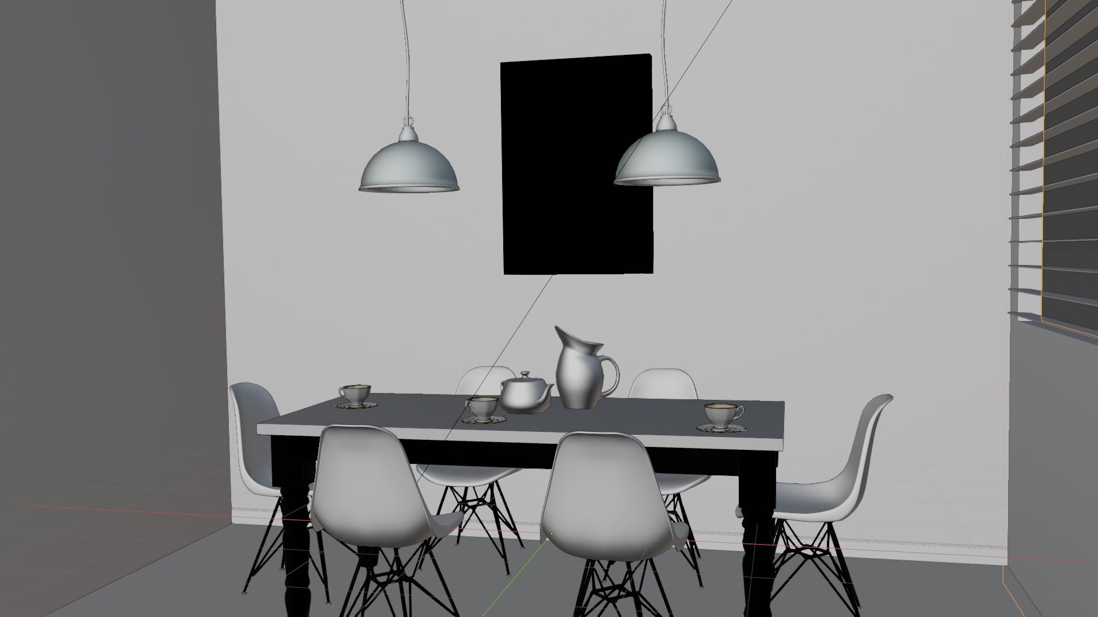
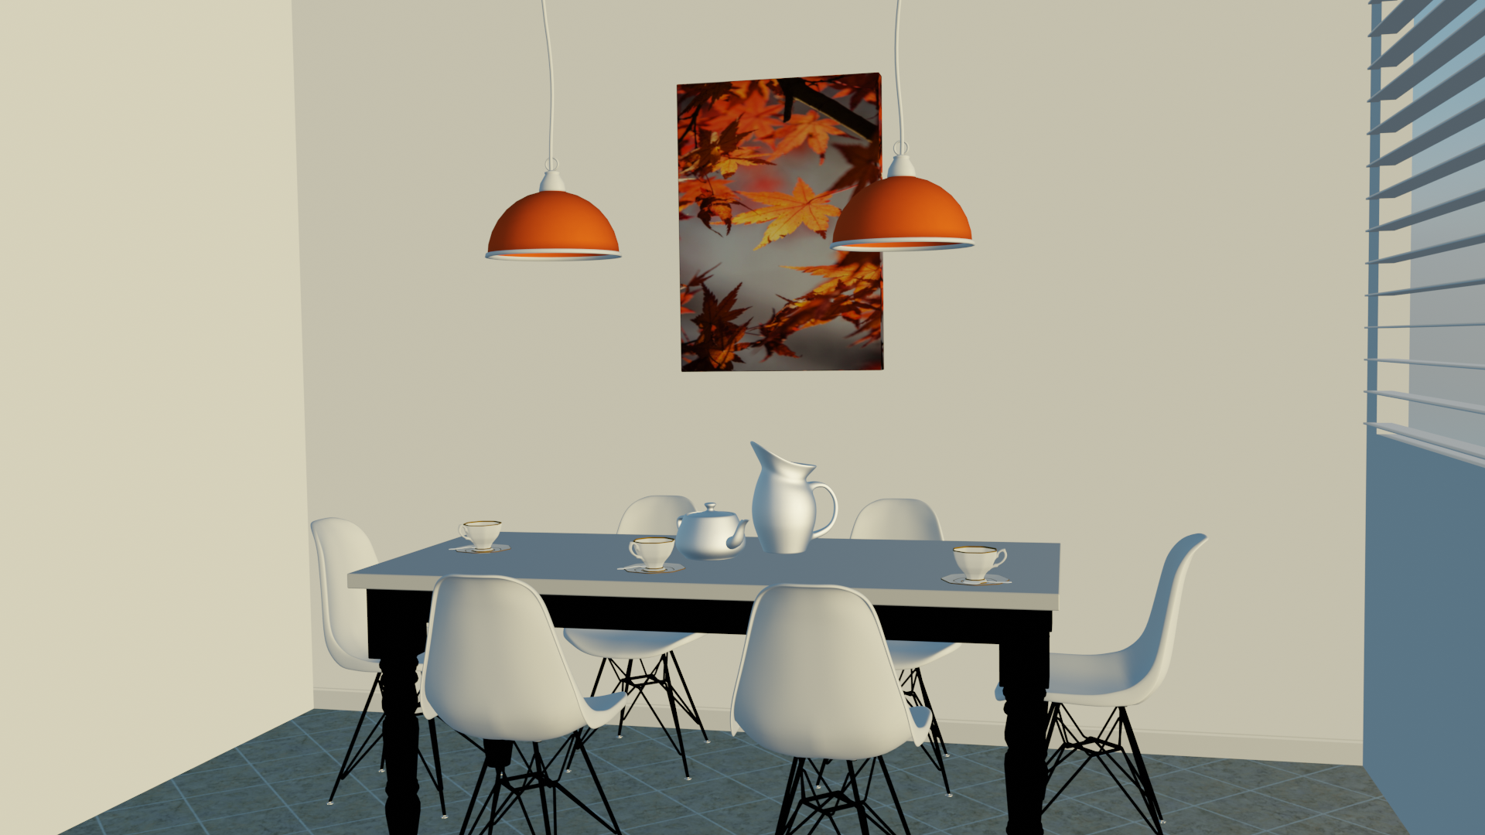
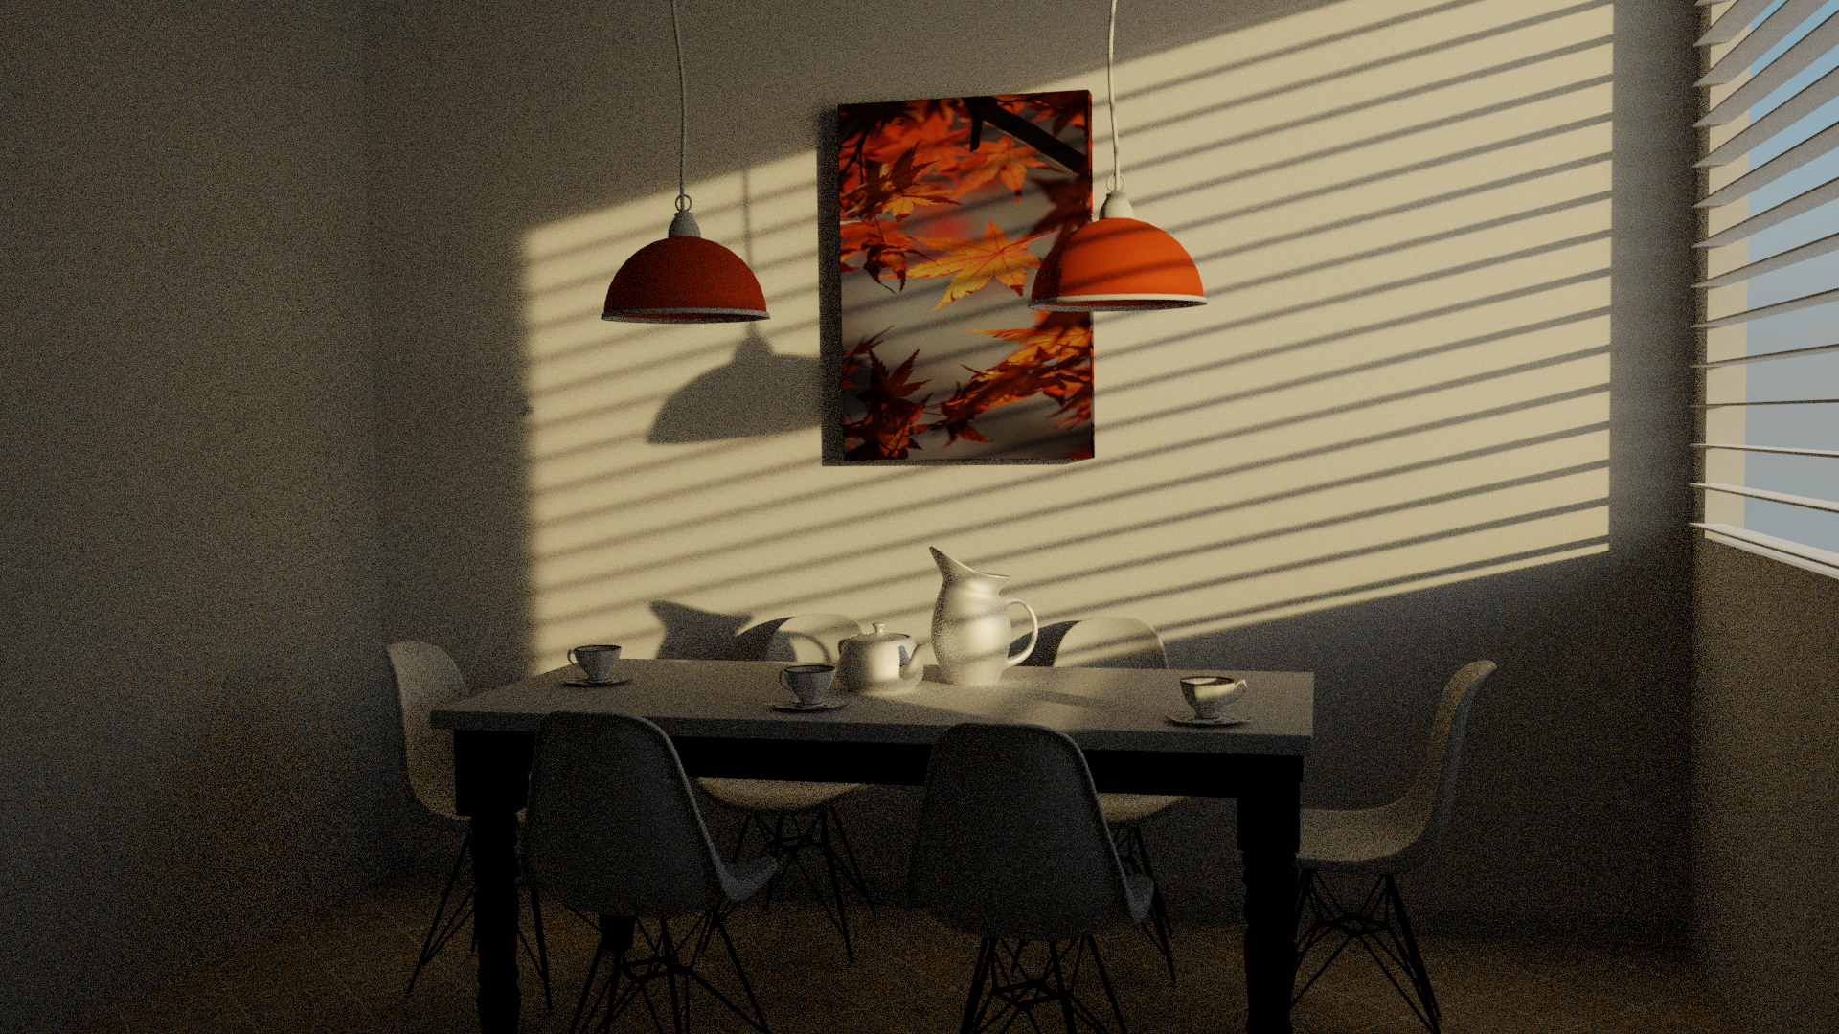
Recap
In previous lectures we have discussed how to model elements of 3D scene:
  3D model
  Light
  Camera
Now, we will discuss how to use scene elements to simulate interaction of light and objects to create an image

Slide 4
Rendering: intuition
Photography: Taking a photo from a real world:
  Light source is emitting light into the space
  Light travels through space and interacts with objects
  Small portion of that light falls into camera, where image is created
  <image>
Interaction of light with objects in space and camera is well described in physics (wave and geometrical optics).
Rendering is computer graphics tool which simulates light transport and interaction of light with objects in order to create an image.
  Rendering creates viewable 2D image from 3D scene

Slide 5
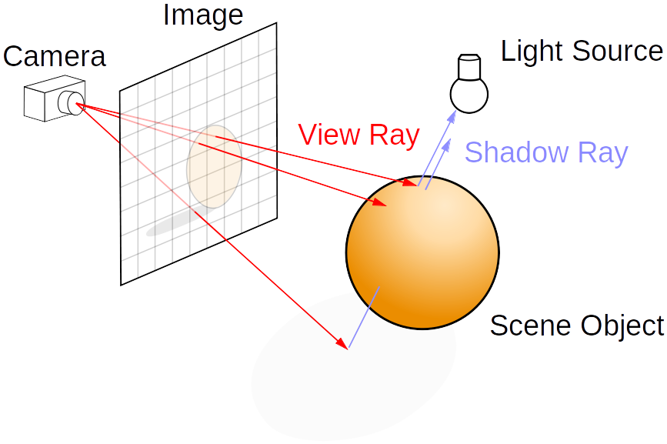
Rendering: main steps
Rendering is solving:
Visibility problem – which objects and surfaces are visible from camera
Shading problem – how does visible objects and surfaces look like

Slide 6
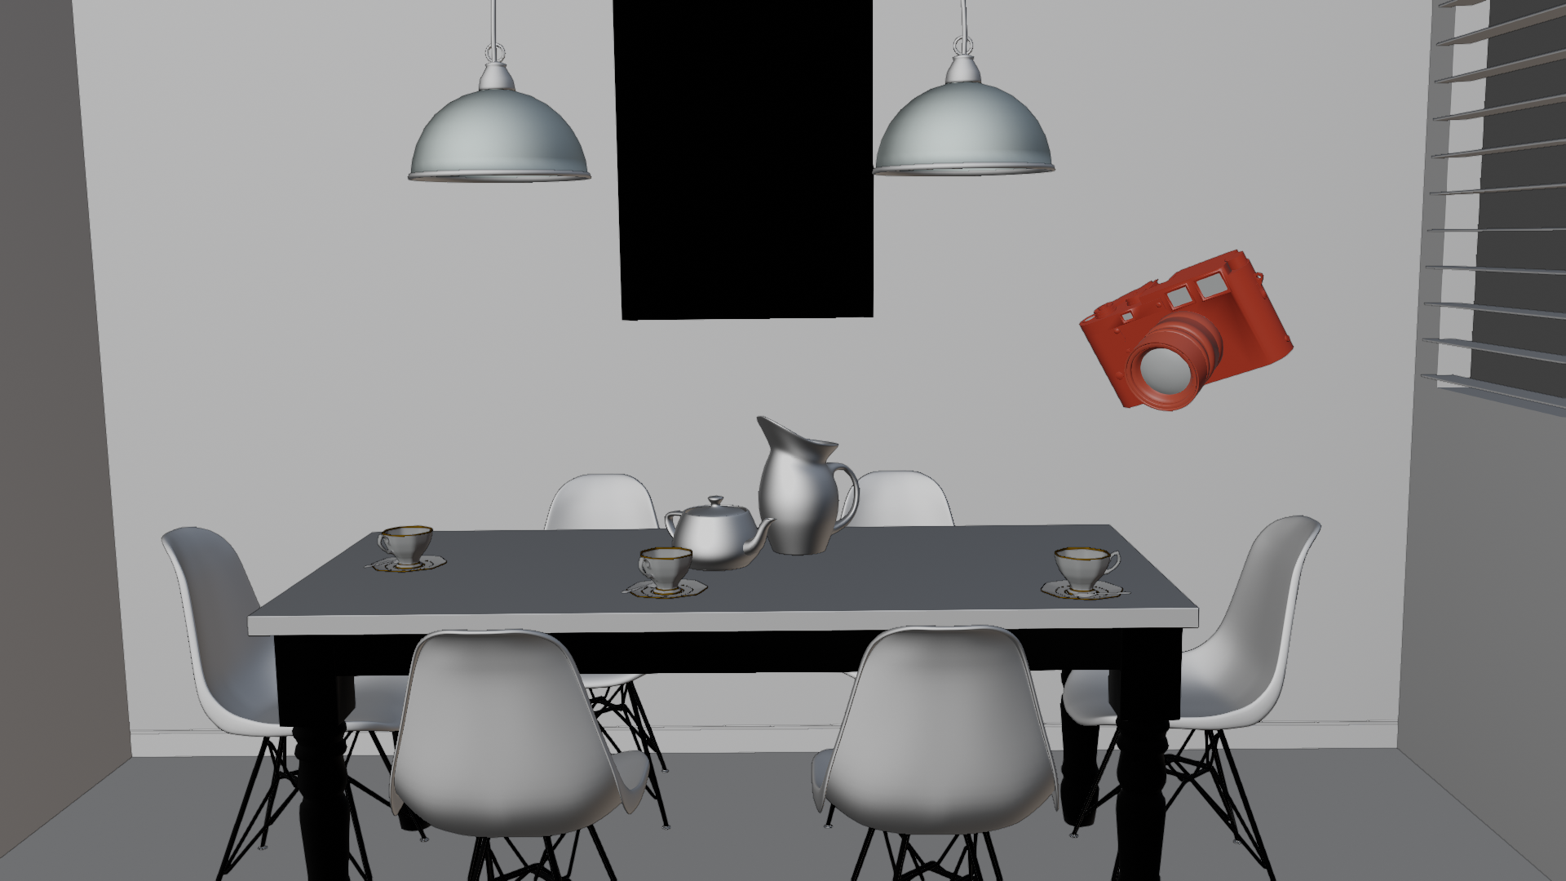
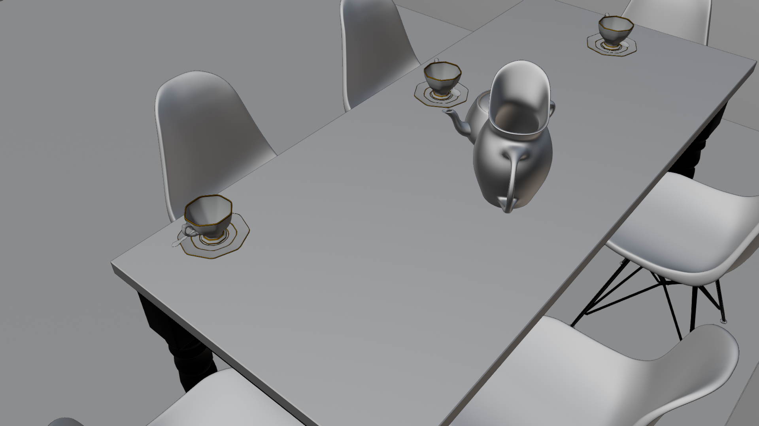
Visibility: high level
Visibility is about finding objects in 3D scene visible from camera
To solve visibility problem realistically, human visual system is simulated
  perspective projection
Note: Other applications might also solve visibility problem by using orthographic projection

Slide 7
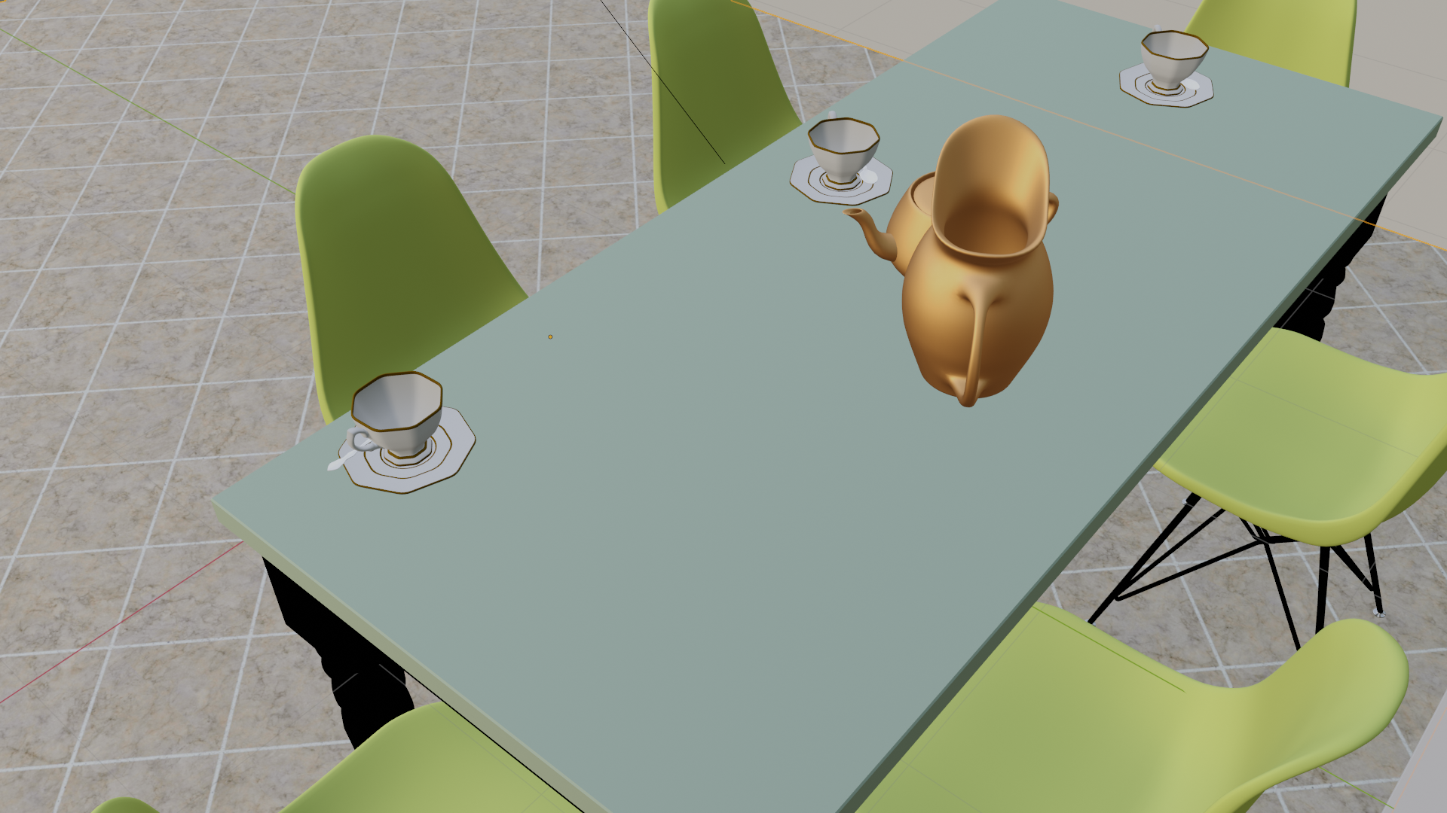
Shading: high level
Shading calculates color and brightness of visible surfaces and objects
Resulting color depends on:
  Object shape
  Object material
  Incoming light
Shading results heavily depend on amount of light falling on surface
  Form of visibility problem: which light sources and surfaces reflecting light are visible from shaded surface
  This computation is called light transport

Slide 8
Light transport: high level
Light transport computes the light falling on surface
This method also relies on concept of visibility
  In this case, visibility between surfaces and lights in 3D scene
Complexity of light transport significantly determines the resulting image realism

Slide 9
Practical rendering

Slide 10
Practical rendering approaches
Two main practical rendering approaches are based on:
Ray-tracing
Rasterization

Slide 11
Ray-tracing vs Rasterization
Compared to rasterization, ray-tracing is more directly inspired by the physics of light
  As such it can generate substantially more realistic images

Slide 12
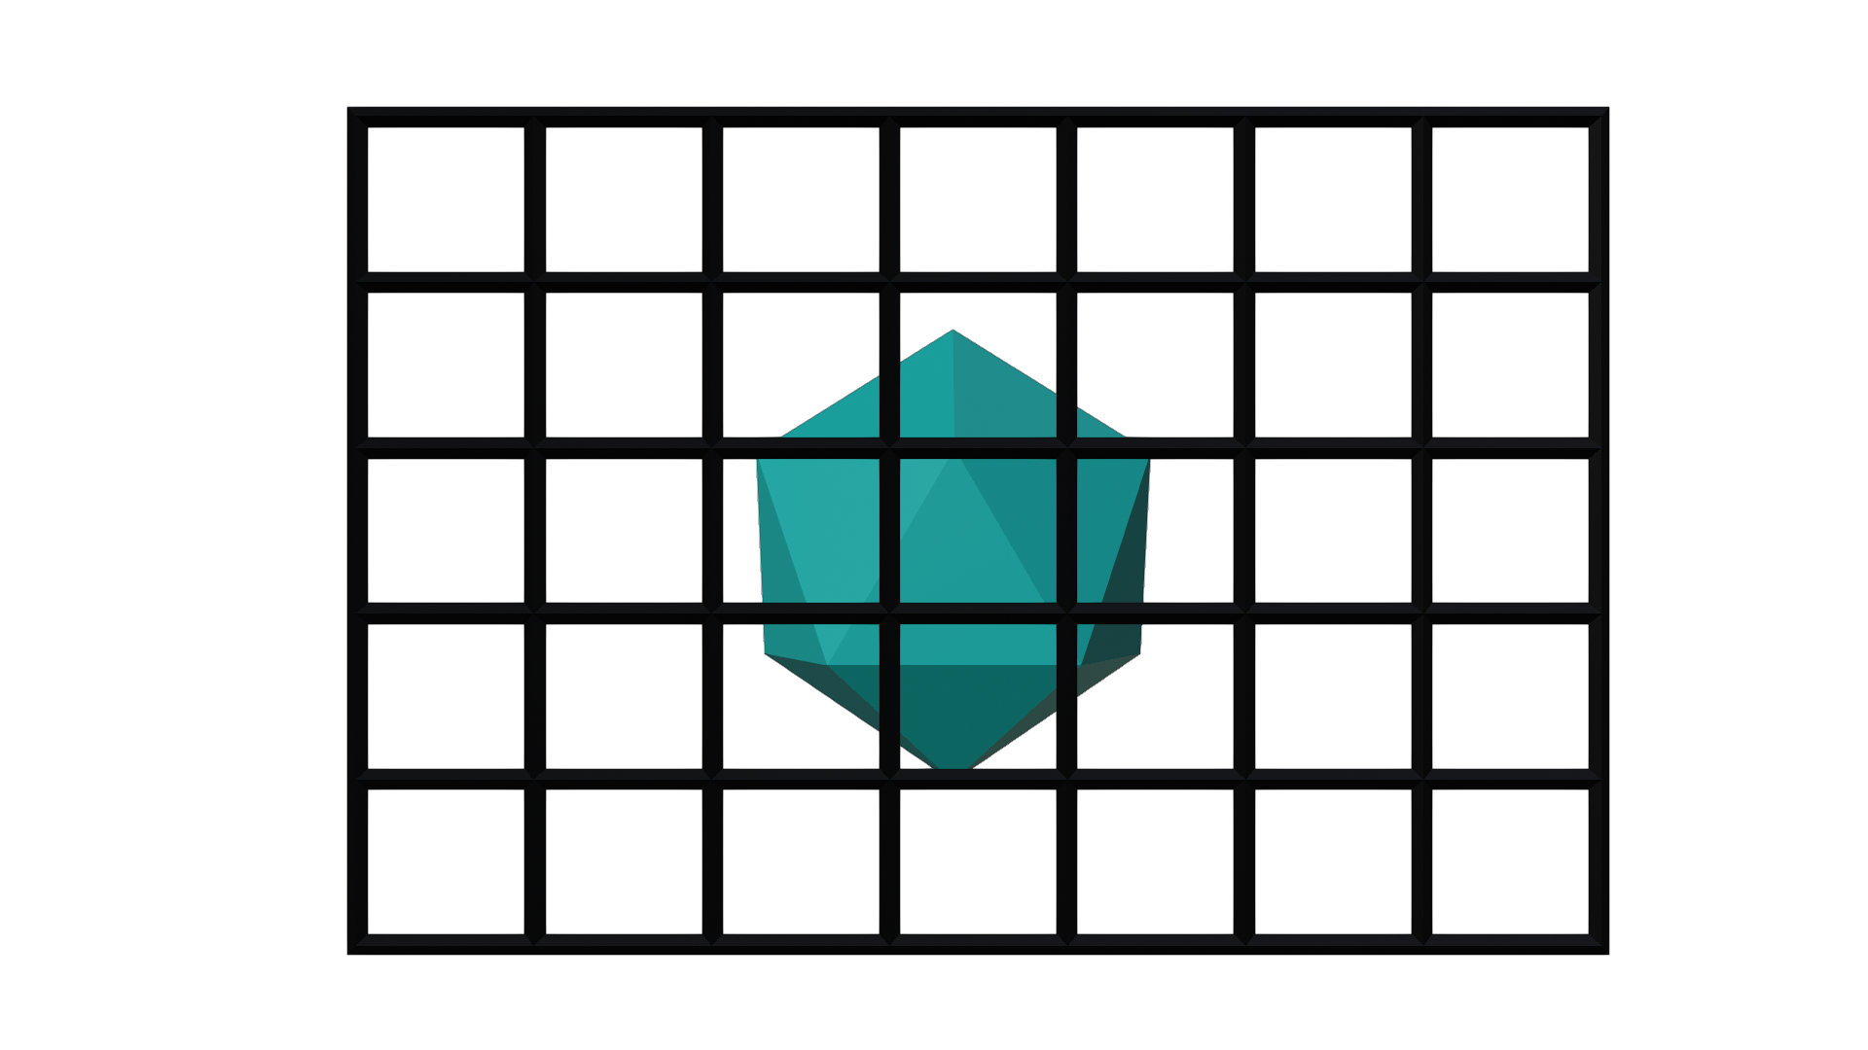
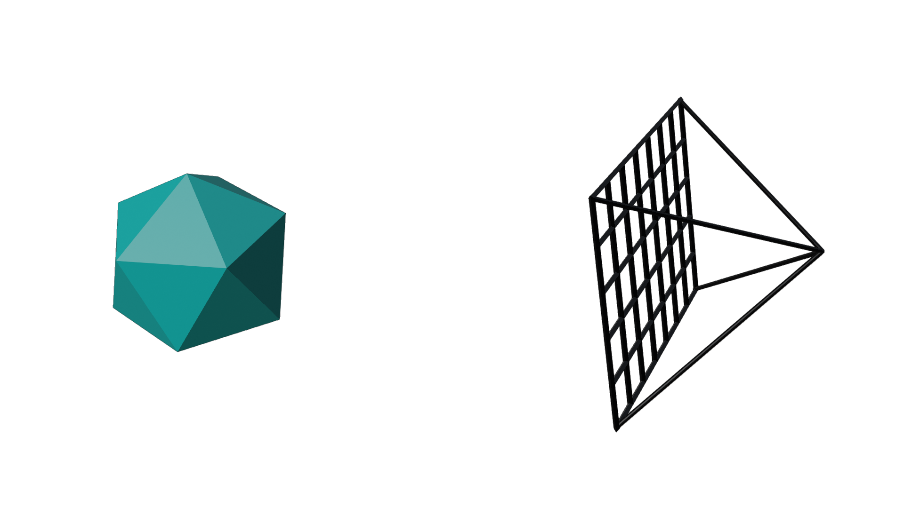
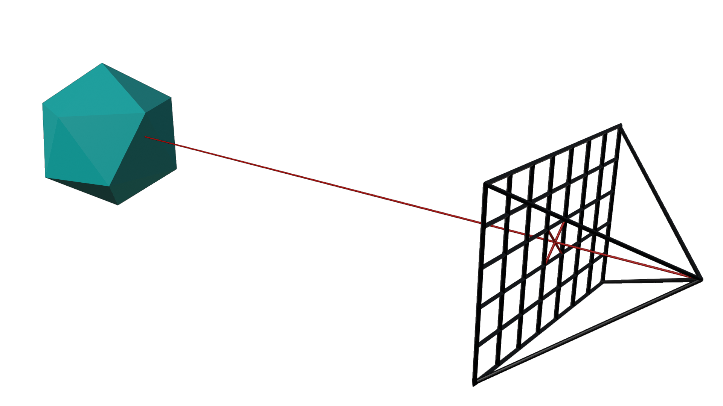
Visibility solvers
Rasterization and ray-tracing, are in their core, visibility from camera solvers!

Slide 13

Visibility: ray-tracing

Slide 14
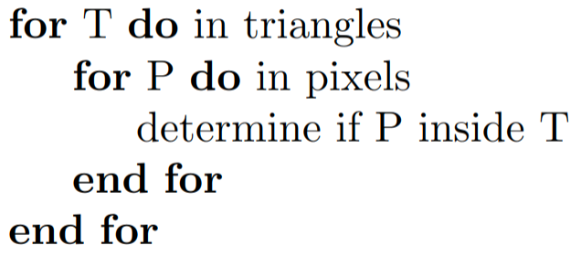
Visibility: rasterization

Slide 15
Raytracing vs rasterization
As we can see from the algorithm, raytracing iterates through all pixels of image plane, generates rays and then iterates over all objects (triangles) in the scene. This approach is called image centric.
On the other hand, rasterization is reversed: it loops over all geometric primitives in the scene (triangles), projects these primitives on image plane and then loops over all pixels of the image plane. This approach is called object centric.

Slide 16
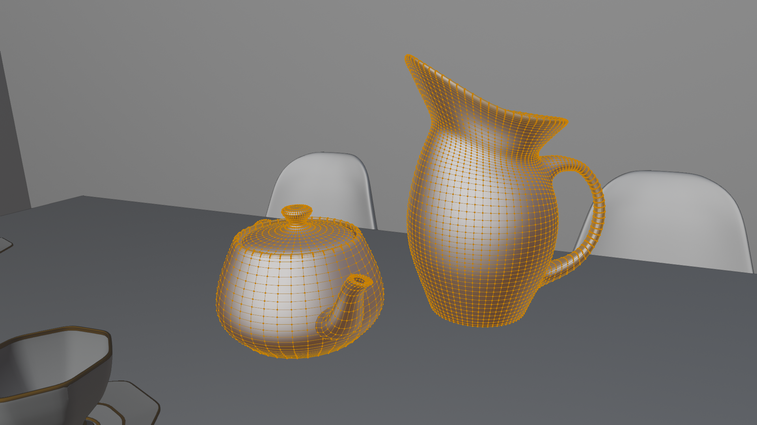
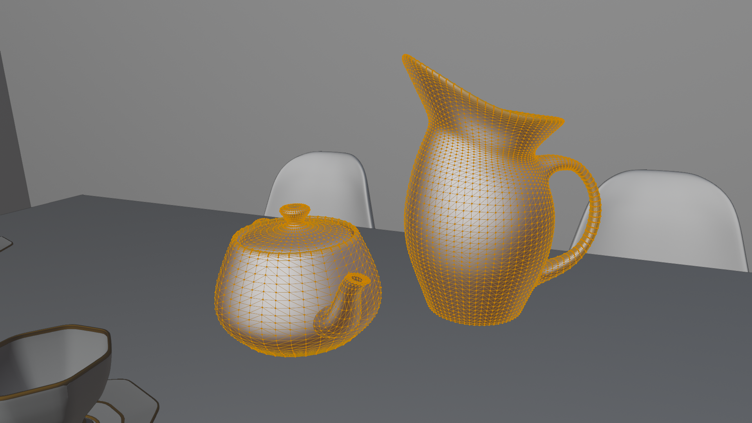
Reminder: triangles
Although various shape representations exists for modeling purposes, when it comes to rendering all object shapes are transformed to triangles using tessellation process.
https://www.scratchapixel.com/lessons/3d-basic-rendering/ray-tracing-rendering-a-triangle/why-are-triangles-useful

Slide 17
Speed: Ray-tracing vs Rasterization
Both algorithms are conceptually simple
To make them fast, additional code and hardware is needed, for n objects:
  Ray-tracing is utilizing spatial data structures* for achieving running time of O(log(n))
  Rasterization has also better running time than O(n) by using culling** algorithms and techniques*** which avoid full scene and primitive processing. Furthermore, GPUs are adapted for rasterization-based rendering
* Bounding volume hierarchy (BVH) or Kd tree. We will discuss those later.
** Occlusion culling, frustum culling. It will be discussed later.
*** e.g., Deferred shading. It will be discussed later.

Slide 18
Practical tip: Ray-tracing vs Rasterization
Important difference is that ray-tracing can shoot rays in any direction, not only from eye or light source
  As we will see, this makes it possible to render reflections, refractions and full rendering equation.
  On other words, images just look better
Content creation is simpler for ray-tracing than rasterization since for realistic effects are just present
  Additional artist work is required when rasterization-based rendering is used

Slide 19
Practical tip: Ray-tracing vs Rasterization
In production where final images are generated using ray-tracing, rasterization is used for preview and modeling, e.g., animation films
In production where final images are generated using rasterization, lot of artist hacks is needed. Sometimes ray-tracing can be used to precalculate some effects.
<image: animation film: rasterization for preview and modeling and final shoot>
<image: games: rasterization as final image with hacks and help from ray-tracing>

Slide 20
Practical: ray-tracing and noise
Often, in ray-tracing, noise is present*:
More samples per pixel → expensive!
Denoising algorithms?
* Noise comes when area lights, glossy surfaces, environment map or path-tracing is used.

Slide 21
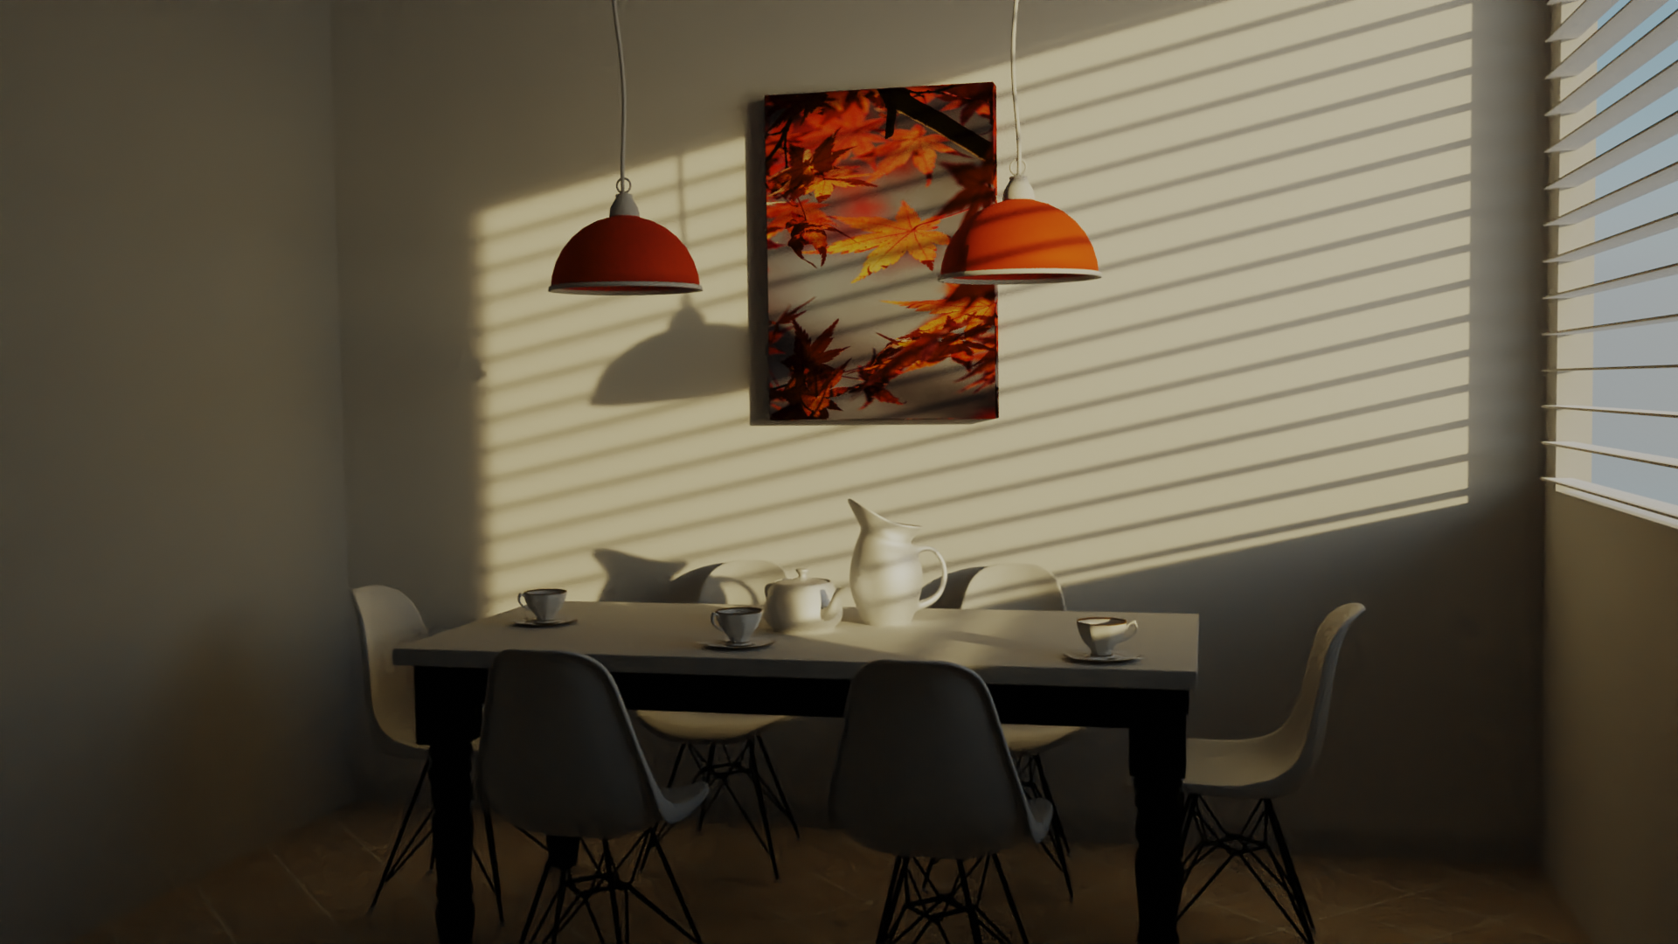
Practical: ray-tracing and denoising
Denoising is post-processing step, which means it is applied on rendered image:
It attempts to remove the noise based on intelligent image averaging

Slide 22
Towards real-time ray-tracing
Additional techniques and hardware improvements are needed.
Denoising is promising solution.
For short-term, clever combinations of rasterizations and ray-tracing are expected.
  https://docs.unrealengine.com/4.26/en-US/RenderingAndGraphics/RayTracing/
  https://unity.com/ray-tracing
  Rasterization seems to be not going anywhere any time soon!

Slide 23
Raytracing and rasterization
Raytracing is historically early method for image synthesis based on 3D scene description
Raytracing has always been recognized as best method for generating photo-realistic images. However, up until 1990-2000s it hasn’t been used widespread
Due to hardware advancements, rasterization-based rendering gained a lot of attention
Raytracing is intuitive and straightforward method of simulating physical phenomena of how image is created.
  Based upon raytracing, more advanced rendering methods are build.
  Furthermore, understanding ray-tracing gives good foundations for understanding rasterization-based rendering systems.

Slide 24
Rendering: intuition via ray-tracing

Slide 25
Intuition: camera in ray-tracing
Camera defines from where we look at 3D scene and a 2D surface on which 3D scene will be projected as an image.
  Rendering goal: compute color of pixels in the image.
  Viewing rays are generated from aperture position through each pixel of film plane
  Each ray will return information about color of the object it intersected in 3d scene using shading

Slide 26
Intuition: lights and objects in ray-tracing
To compute color of intersected point, shading: light-object interaction is computed
For shading calculation we need information about objects in 3D scene as well as light sources.
  Without light we wouldn’t see objects, without objects we wouldn’t see light.

Slide 27
Simulating light
Simulating physical (real-world) light-object interaction means simulating all light rays paths from light and their interactions with objects. Furthermore, only small amount of that light actually falls on camera. This kind of simulation is called forward ray-tracing or light tracing. Simulating this is not tractable! Therefore, we simplify:
  Only light-object interaction that are visible from camera should be simulated
  Therefore, we reverse the process: we start with rays that fall into camera and build from there.
Based on previous discussion, we trace rays from sensor to the objects. This simulation is called backward ray-tracing or eye-tracing*.
In rest of the lecture, by ray-tracing we mean backward ray-tracing.
* Introduced by Turner Whitted in paper “An Improved Illumination Model for Shaded Display”. Method in computer graphics using the concept of shooting and following rays from light or eye is called path-tracing.

Slide 28
Ray-tracing-based rendering idea
Generate viewing rays
  Generate ray using camera (eye and film) → primary/camera/visibility ray
Tracing ray into the scene. Possible outcomes:
  Intersects objects, find closest
  No intersection →hit background
Object intersection:
  Calculate amount of light falling on intersection point
    Shadow/light ray: directly traced from intersection to light source → direct illumination
    Advanced: sample various directions from this point in 3D scene to obtain reflections of other objects → global illumination
  Calculate amount of light reflected in primary ray direction using incoming light and material specification → shading

Slide 29
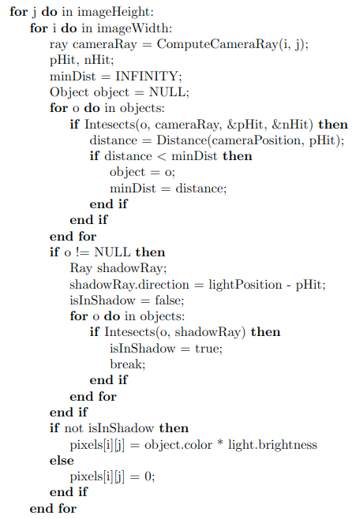
Practical raytracing
Algorithm*:
For each pixel in raster image:
  Generate primary ray by connecting eye and film using camera information
  Shoot primary ray into the scene
  For each object in the scene
    Check if intersected with primary ray. If intersect multiple objects, take one closest to the eye
  For intersection, generate shadow ray from intersection point to all lights in the scene
    If shadow ray is not intersecting anything, lit the pixel
* Arthur Appel in 1969 - "Some Techniques for Shading Machine Renderings of Solids"

Slide 30
Rasterization: algorithm reminder

Slide 31
Rasterization and raytracing
Both raytracing and rasterization are used to solve the visibility problem (which also contains perspective/orhographic projection solving).
Solving the visibility problem is only a part of rendering. Other part is determining the color and intensity of visible surface. This step is called shading and it uses light transport to gather light on visible surface and calculates light-matter interaction

Slide 32
Shading and light transport
Note that the in algorithm that was used to introduce raytracing and idea of rendering, we only determine objects which are visible from camera and shade them by calculating visibility between visible surface and light source.
With this approach, we disregard that other objects in the scene can also reflect light on objects that are visible from camera. Furthermore, objects that are visible from camera can be very reflective (imagine mirror like surface) and they would certainly reflect objects visible from them.
This effects are called indirect illumination and global illumination effects.
They can be simulated by generating additional rays in intersections: propagating rays and building paths that light might travel to the surface which is being shaded.
Classic examples that can be started with are mirror-like and transparent surfaces
https://www.scratchapixel.com/lessons/3d-basic-rendering/introduction-to-ray-tracing/adding-reflection-and-refraction
Depending on surfaces, light will scatter differently. Material defines, among others, scattering model* which is used to determine where light scatters (direction) and how much it scatters in particular direction (intensity).
Categorization of light transport algorithms based on lighting effects they simulate (Diffuse, Specular and other types of reflections and refractions).
* Scattering models might be also called illumination models. This name might make more sense in GPU-rasterization-based rendering (graphics rendering pipeline) since after determining surfaces visible from camera, illumination model is employed to directly calculate color and intensity taking in account positions of light and material of the objects. In ray-tracing-based rendering, shading part relies on more advanced light-transport which uses scattering models to determine how light bounces (scatters of the objects) in the scene.

Slide 33
Importance of visibility calculation for rendering
Based on previous discussions, we can highlight the importance of visibility calculation and how it is related to all concepts in rendering.
Visibility problem is concerned with determining visibility between points
First, when determining visible objects from camera, we solve visibility problem and utilize perspective/orthographic projection
Then, when calculating shading we require light transport information which is again based on visibility between surface and lights in 3D scene
  This is required to calculate shadows, soft shadows, global illumination effects such as reflection, refraction, indirect reflection and.
Rasterization is good for solving the visibility from camera to object. But it is not good for finding visibility between surfaces in 3D scene which is important for light transport and shading
Raytracing is good for solving the visibility from camera to object. And it also can be used for finding visibility between surfaces in 3D scene which is important for light transport and shading
<IMAGE: visibility in rasterization and raytracing>

Slide 34
Comparison with rasterization
Recursive ray-casting used in ray-tracing is something that rasterization-based rendering must approximate with different techniques to achieve just a sub-set of effects that can be obtained with ray-tracing
<image: example of approximation and ray-traced effect>

Slide 35
Practical aspects

Slide 36
Practical ray-tracing and rasterization
Raytracing method can be separated in:
  Determining visibility from camera: determine which point in 3D scene is visible for each pixel of image. Note that perspective projection is inherent due to camera which is used for generating rays
  Shading: calculating the color of visible point – this operation besides light-matter calculation also requires light transport to collect all light which influences the color and intensity of that point.
Both steps require extremely time-consuming intersections between rays and scene objects (geometry)
  Efficient ray-object intersection method is needed
  3D scene must be represented for fast and efficient spatial search of objects which should be tested for intesection
On the other hand, rasterization can solve the visibility problem (camera-object) very fast. That is why real-time graphics is predominantly using GPU rasterization approach. But when it comes to shading, due to the available information on 3D scene, it is not as good as raytracing.
Raytracing is slow for solving visibility problem, but it enables high-quality shading. For high-quality, photo-realistic production rendering, ray-tracing is almost always used*.
* However, real-time ray-tracing is now possible to certain degree with certain hardware and it is hot research topic!

Slide 37
Rasterization and Raytracing in practice
Examples of rasterization-based renderers in production
  Godot, Unity, Unreal
Examples of raytracing-based renderers in production
  Appleseed, Arnold, etc.
<IMAGE: differences and comparison between rasterizers and raytracers>
Important note that we can learn here, that occurs in almost any field of computer graphics is trade-off between speed and quality.
  Depending on application, best option for speed of rendering and quality of rendered images must be found. For games, it is important that frames are rendered in real-time (>30fps) and certain quality must be sacrificed. For animated films, rendering time can take up to several hours for only one frame therefore, focus can be put on quality.

Slide 38
Note: compexity of scenes and rendering
Although HW and methods advanced, the time of rendering the scenes stayed the same! This is because complexity of the 3D scenes as well as rendering algorithms increased.
  Blinn law

Slide 39
Reading Materials
https://github.com/lorentzo/IntroductionToComputerGraphics

