Slide 1
Light
Light makes it right

Slide 2
Syllabus
3D scene
  Object
  Camera
  Light
Rendering
Image
Light
  Light and color
  Real world light sources
  Light model
    Physical light
    Non-physcial light
  Shadow

Slide 3
Light and color

Slide 4
Color can not be fully described scientifically: is also result of vision system thus subjective
Color science:
  How brain processes visual stimuli into what is perceived as color
  Use of color from artist point of view
  Study of electromagnetic waves: nature of light
Color management
  Study of color for digital displays
Before color we need to investigate light

Slide 5
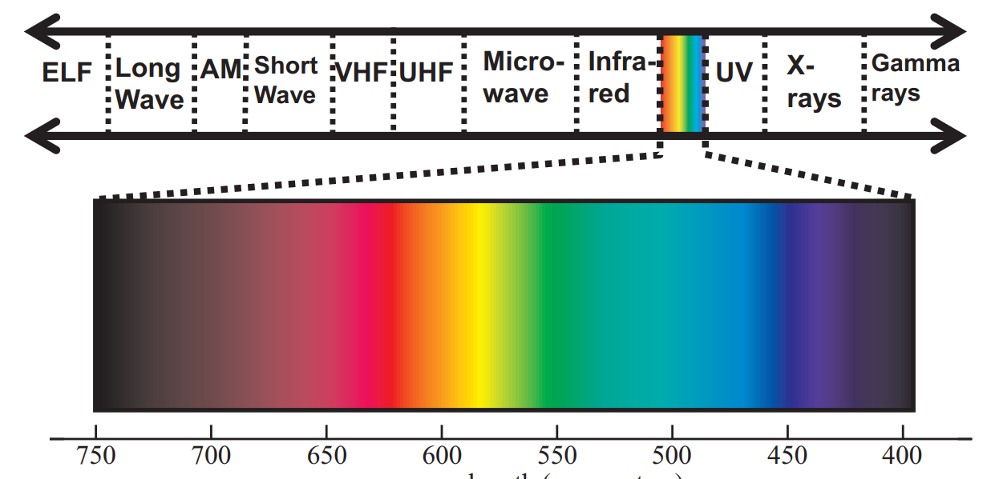
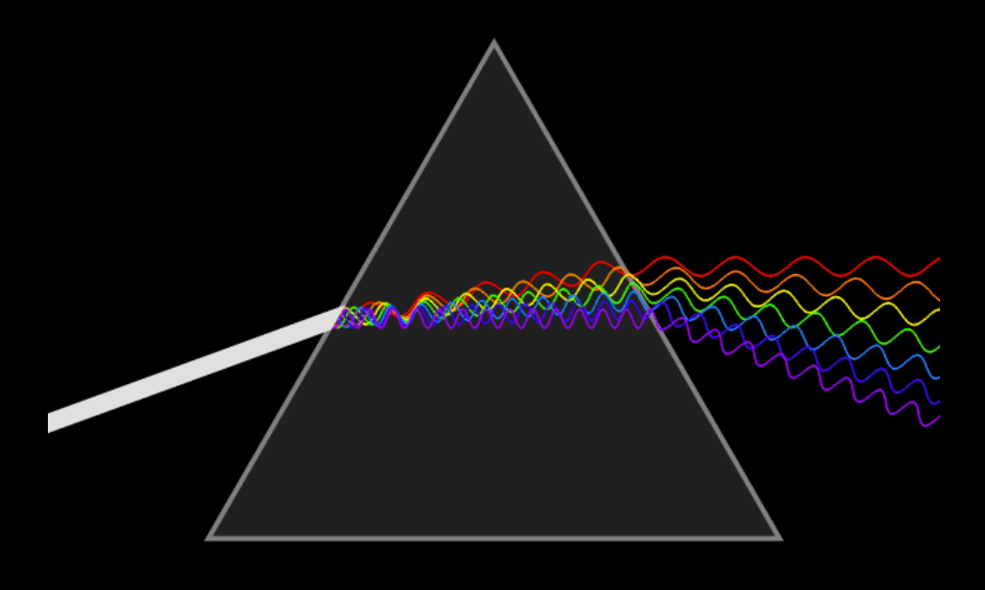
Light frequency and color
Light is electromagnetic wave (or particle) visible by eye
  Visible spectrum: wavelength 400 – 700 nm
  Different wavelengths (frequencies) are perceived as color - color is perceptual (psychophysical) phenomena rather than physical one.
  White light is made of all visible colors – adding all colors from light spectrum gives white light (color additivity, e.g. display)
https://blog.selfshadow.com/publications/s2013-shading-course/#course_content
https://en.wikipedia.org/wiki/Dispersive_prism

Slide 6
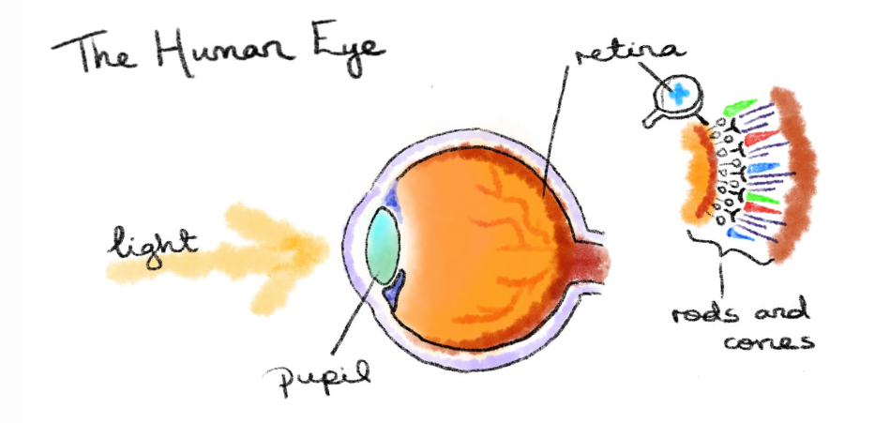
Light and eye
Human visual system; back of eye (the retina) is covered with light sensitive receptors – photo-receptive cells:
  Cone cells – responsible for trichromatic color vision
    Three types sensitive to: red, green and blue light
  Rod cells – sensitive to smaller amount of light but not reproducing colors
http://daisymolving.github.io/2018/07/30/design-fundamentals-colour.html

Slide 7
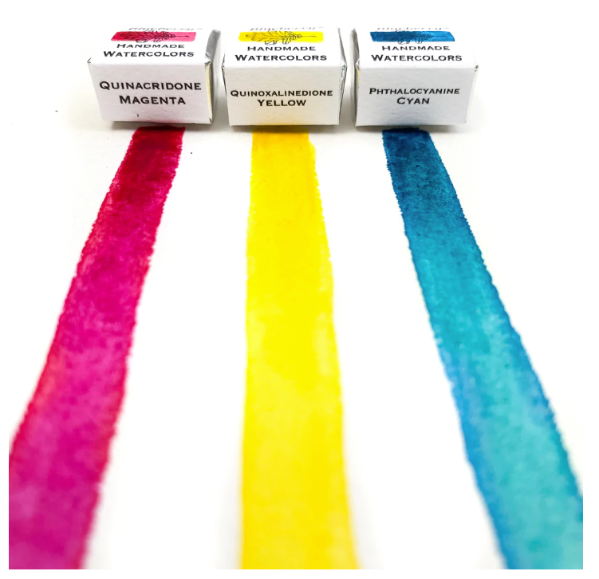
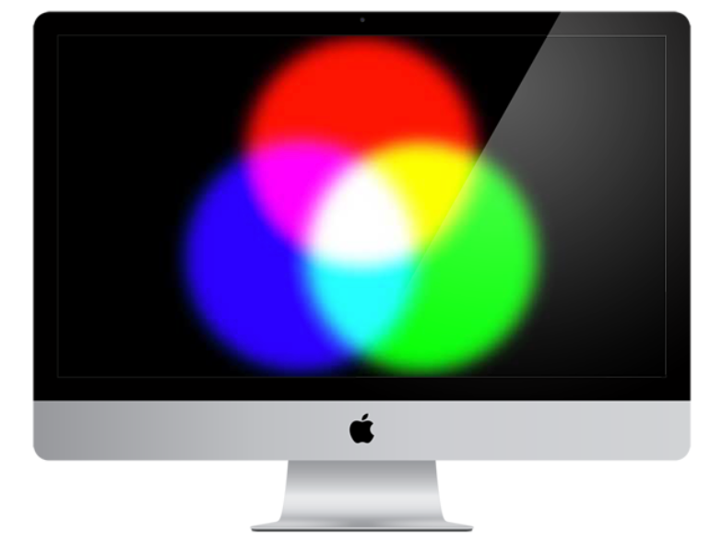
Additive and subtractive
Additive:
  Main colors: red, green, blue
  New colors and white light is made by adding
  Usage: computer science, lighting technology – colors are created with light emission
Subtractive:
  Main colors: yellow, magenta and cyan - white light is made by subtracting
  Usage: art, painting, printing – color from canvas is not a result of light emitted from canvas, but light reflected from canvas
    When white light hits canvas, what is not absorbed is reflected
https://carsonparkdesign.com/what-makes-white-on-the-screen/
https://www.greenleafblueberry.com/blogs/news/modern-primary-colors

Slide 8
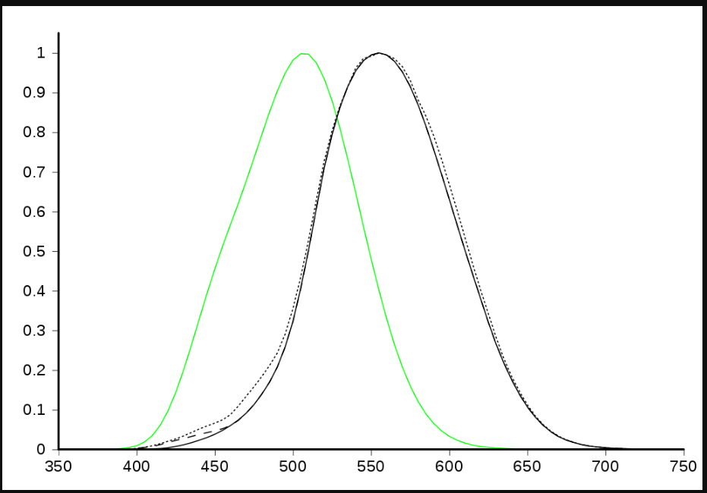
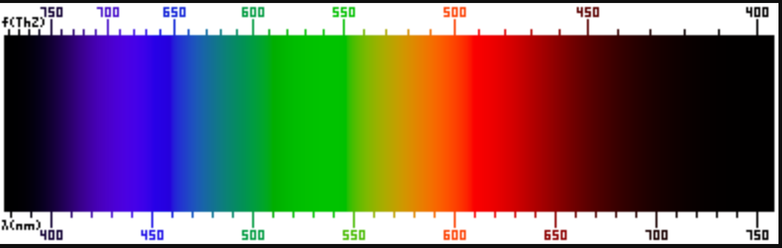
Color brightness
555 to 560 nm (green towards yellow) are perceived by the human eye as being the brightest
  Blue color: the dimmest
  Green color: the brightest
How bright color appear to hum eye: luminosity function
  Average sensitivity of human eye to different wavelengths for well lit conditions - photopic (cone rods).
Brightness or lightness is present in HSV color model
Photometry: science of measuring light taking in account human visual system
Luminosity function for photopic – green - (well lit) and scotopic (low lit) – black. https://en.wikipedia.org/wiki/Luminous_efficiency_function

Slide 9
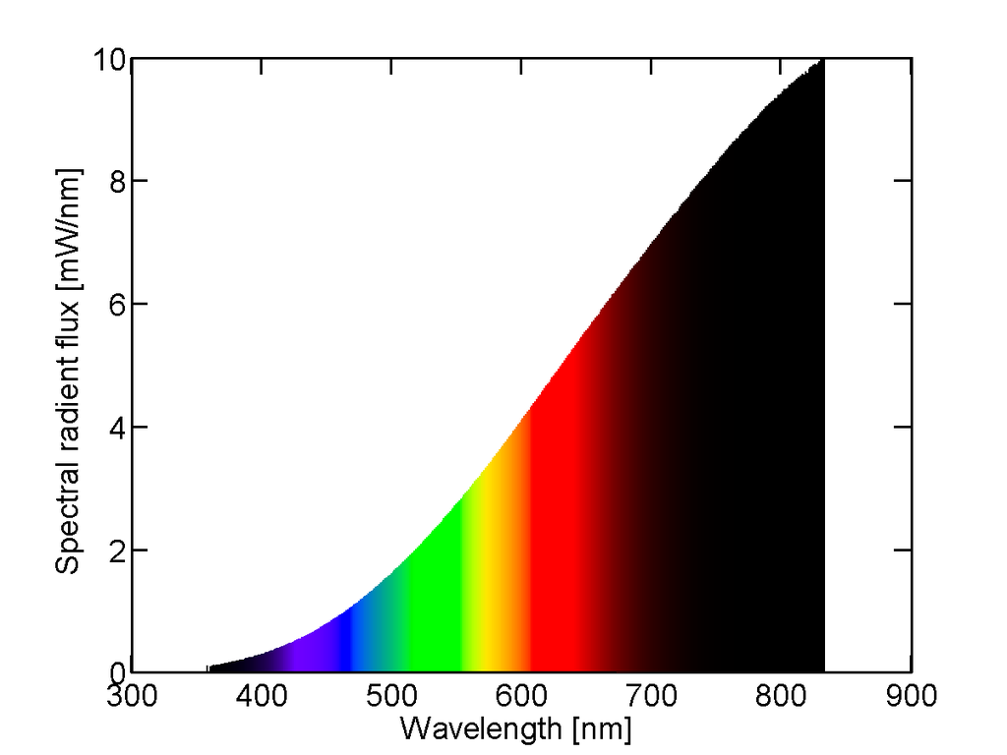
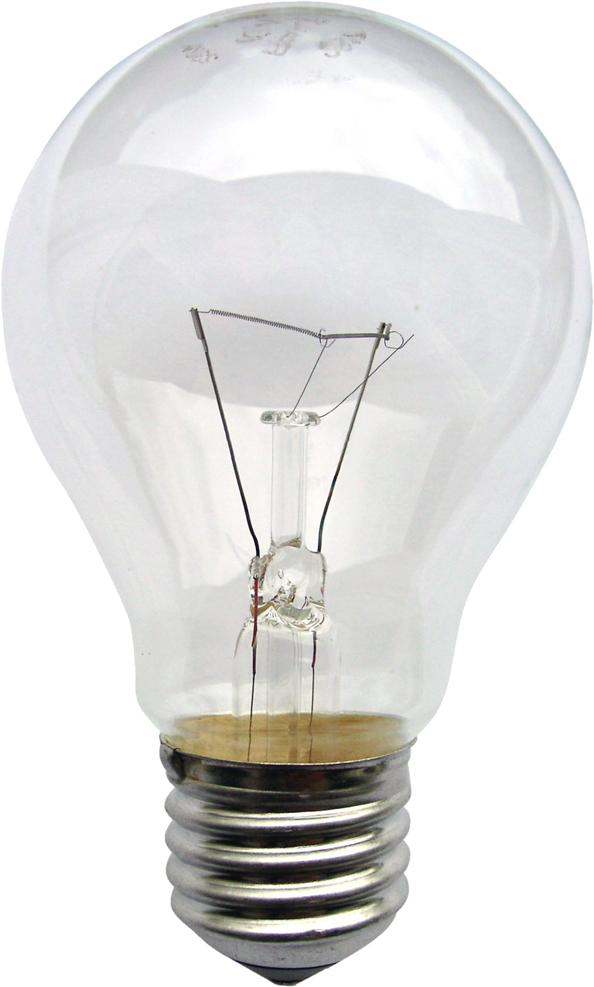
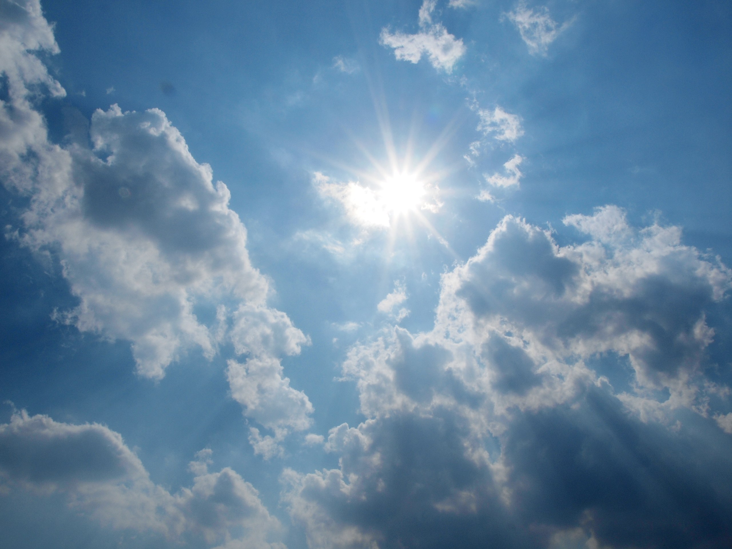
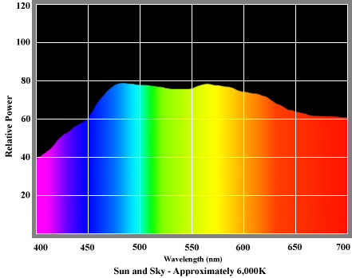
Spectral power distribution
Light is generally characterized by spectral power distribution (SPD)
  range and intensity of colors it produces at each wavelength in the visible spectrum
Sun is reference for natural light
  Standard: daylight illuminant - D65 by International Commission on Illumination (midday sun Western/Northern Europe)
Color rendering index
  Ability of light source to reproduce color of object seen under D65, standard by CIE (Commission Internationale de l'Eclairage)
White color is composed of all colors in equal amount: constant SPD
  Doesn’t exist in real world: CIE; E illuminant
Perceive light as yellow since eye is less sensitive to red
https://en.wikipedia.org/wiki/Incandescent_light_bulb
https://commons.wikimedia.org/wiki/File:Sun-in-the-sky.jpg
http://www.openphotographicsociety.org/photography/colour-light-and-optics/colour/203-spectral-power-distribution

Slide 10
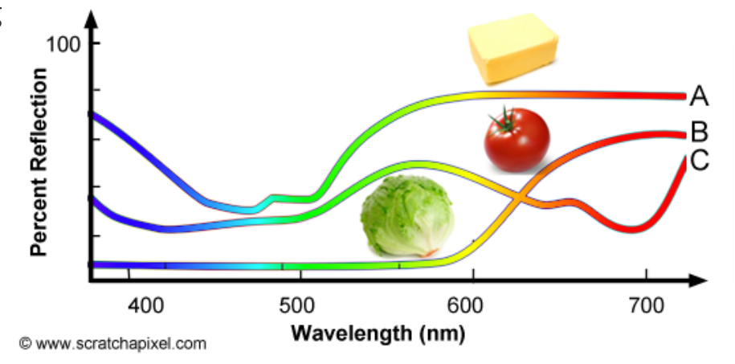
Spectral reflectance curve
SPD is also used for light reflected from objects: spectral reflectance curve
https://www.scratchapixel.com/lessons/digital-imaging/colors

Slide 11
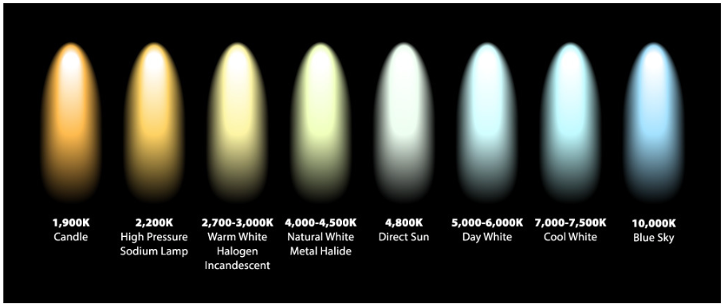
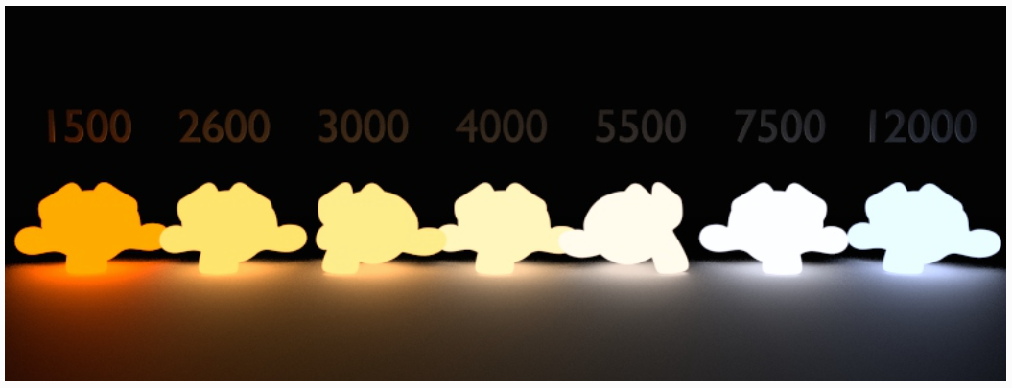
Color temperature
Object which is heated to certain temperature emits light
Color of emitted light depends on temperature
Black body radiation
https://www.inlineelectric.com/color_temperature
https://docs.blender.org/manual/en/latest/render/shader_nodes/converter/blackbody.html

Slide 12
Color space and PSD
Light from light source or reflected from the object is defined with PSD
Human visual system can not directly perceive PSDs
PSDs must be transformed in color models or color spaces suited for trichormatic vision
  Note PSDs is transformed in color hue and color brightness values which we can perceive
CIE XYZ is foundation for all color models
  RGB model is most important for computer graphics

Slide 13
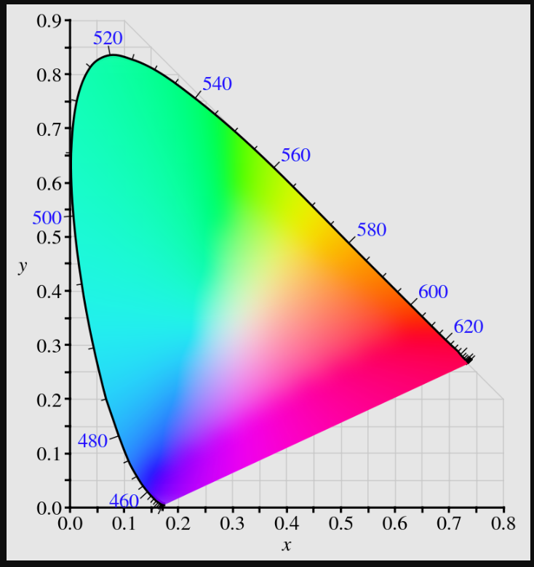
Colorspace
Colorspace
  Model to represent colors perceived by human visual system
Gamut
  Range of possible colors that can be represented by particular system
Gamut of XYZ color space - gamut human vision
  Full range of possible colors visible by human visual system
White point (E illuminant)
Gamut of XYZ color space: https://en.wikipedia.org/wiki/CIE_1931_color_space

Slide 14
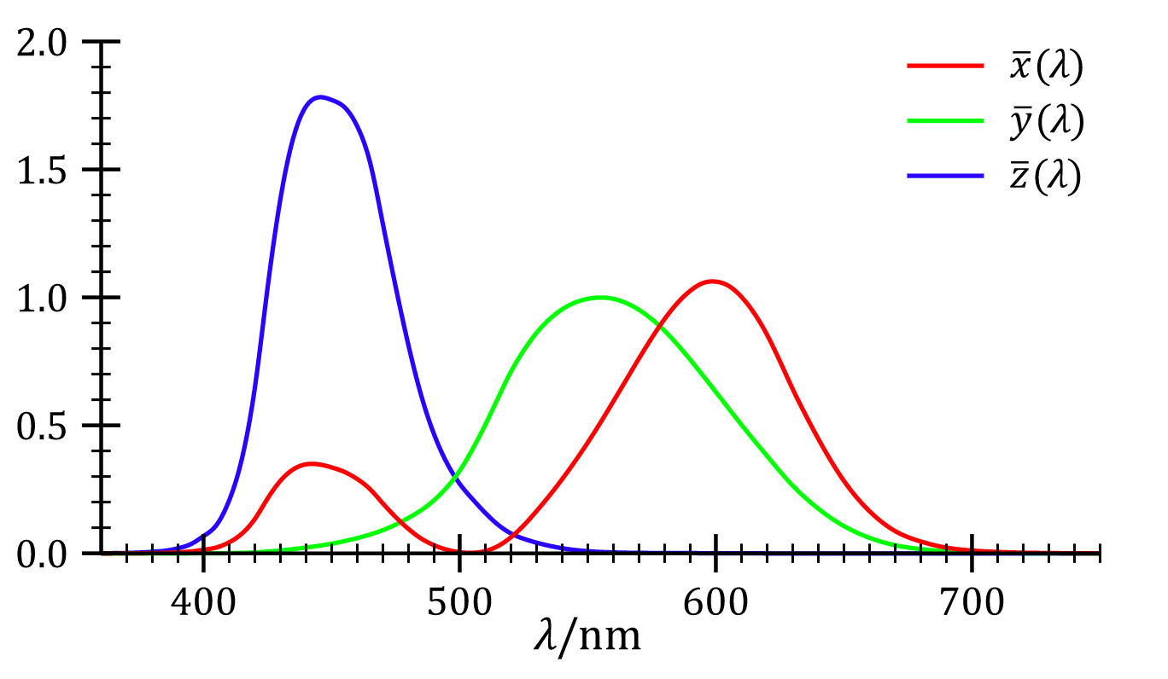
XYZ colorspace
Assumption: any color (in an additive color model) can be represented by a combination of red, green and blue light
  Based on cone cells – trichromatic system
Three curves: CIE standard observer color matching functions
  Y curve is close to luminosity function → expressing the brightness
Using color matching curve, PSD can be converted to X, Y and Z values – a system in which all colors that we can see
  spectrum and the color-matching functions are discrete in a computer
XYZ colorspace:
  System capable representing all colors human visual system can percieve
  Gold standard for color storage
  XYZ have to be transformed to RGB space to be visualized
XYZ
https://en.wikipedia.org/wiki/CIE_1931_color_space

Slide 15
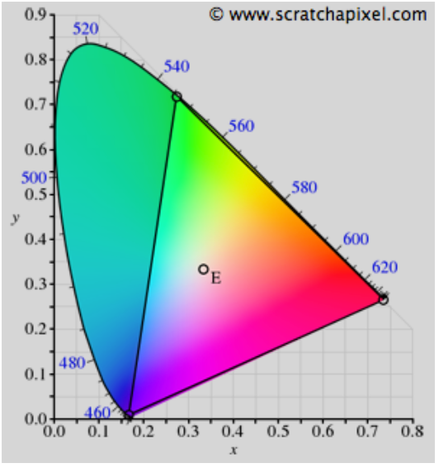
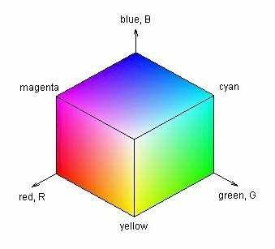
RGB colorspace
Similar as human visual system: represent colors as simple sum of primary colors (R, G, B).
Visualized as cube where R, G and B are placed on axis.
Limited gamut compared to XYZ colorspace
https://www.researchgate.net/publication/228719004_Human-centered_content-based_image_retrieval
https://www.scratchapixel.com/lessons/digital-imaging/colors/color-space

Slide 16
RGB colorspace
Most computer screens technology is based on system similar to RGB color model.
  Summing RGB gives white color
RGB as XYZ is linear colorspace
PSD is used in spectral rendering
  More correct rendering, but expensive: computing XYZ from PSD for calculation takes time
In rendering RGB color space is often used

Slide 17
XYZ to RGB
TODO: https://www.scratchapixel.com/lessons/digital-imaging/colors/color-space

Slide 18
Light characterization
Light can be described both on:
  Microscopic scale: wave optics
  Macroscopic scale: geometric optics
Light is measured both using:
  Radiometry – measurement of radiation, physical transmission of light
  Photometry – measurement related to human visual system
    Summary measures: computed from radiometic quantities.
  Colorimetry – Color perception

Slide 19
Light: microscopic level
Light is quantized – it comes in individual and indivisible packets called photons
At same time light is wavelike – radiometric radiation with frequency
  Light on microscopic level explains color and perception of light <spectrum image>
Microscopic level is important to mentions since some effects of light-matter interaction can be only explained (and thus modeled*) using wave optics:
  Interference
  polarization
  Diffraction
  Iridescence
  Pleochroism and birefringent
  examples
Also, knowing microscopic background often helps in getting intuition for some shading and light transport methods**
* It is important to note that complexity of model level depends on application. Often, in computer graphics wave effects can be “faked” to achieve desired apperance: https://developer.nvidia.com/gpugems/gpugems/part-i-natural-effects/chapter-8-simulating-diffraction. On the other hand, physically based methods for achieving wave-effects is actively researched area: https://sites.cs.ucsb.edu/~lingqi/publications/202203_practical_plt_paper_lowres.pdf
** For example photon mapping: http://web.cs.wpi.edu/~emmanuel/courses/cs563/write_ups/zackw/photon_mapping/PhotonMapping.html

Slide 20
Light: macroscopic level
Light in computer graphics is often modeled at macroscopic level.
  If features with which light interacts are relative to light wavelength (or larger) then light can be represented using geometric optics.
Energy that flows uninterrupted through empty space in straight line.
It absorbs and reflects from surfaces it meets.

Slide 21
Light: macroscopic level
Light passing from one to another medium changes speed. In geometric optics this phenomena is well represented using Index of refraction.
Index of refraction* is characteristics of medium which states the ratio of speed of light in vacuum to the speed of light in that medium
  This parameter is approximating microscopic level of light behavior – its interaction with medium
Difference in refractive index in different media causes light rays to be bend
  Snell’s law – angle of reflection and refraction example
  Important for physically based rendering of transparent objects. Important information for light transport since it determines angle of refraction/reflection on optically flat interface. <example>
Amount of reflected and refracted light is calculated using Fresnel equations.
  TODO
* IOR is dependent on light wavelength. Therefore, light of different wavelengths gets bent by different amounts. This can be seen by white light passing through prism creating rainbow. Also, this causes chromatic aberration – effect of camera lenses.

Slide 22
Radiometry
Measurement of electromagnetic radiation
Radiometric quantities:
  Energy
  Power – energy over time
  Power density over area or direction

Slide 23
Radiometric quantities
Radiant flux – flow of radiant energy over time (W)
Irradiance – density of radiant flux over area (Wm⁻²)
Digression: Solid angle
  3D extension of the concept of an angle: continous set of directions in 3D space measured in steradians (sr)
  Example: area of the intersection patch on an enclosing sphere with radius 1
  4*pi steradians close the whole area of unit sphere
Radiant intensity – flux density with respect to solid angle
Radiance – electromagnetic radiation in single ray. Density of radiant flux over area and solid angle.
  This area is measured in a plane perpendicular to ray, if surface has orientation then cosine correction factor must be used

Slide 24
Radiance
Radiance is what cameras measure – prime importance for rendering
The purpose of shading is to calculate radiance along a given ray from a shaded point on object to camera
  Radiance is physically based value which is simplified with color and intensity
Radiance distribution describes light traveling anywhere in space
  Rendering can be seen as evaluating radiance distribution for each eye-camera direction*
Radiance is not affected by distance
  TODO
* Image-based rendering uses this concept, namely light field technique.

Slide 25
Radiance and wavelengths
Most light waves contain mixture of many different wavelengths – polychromatic (light with one wavelength is called monochormatic).
  Visualized using spectral power distribution (SPD) – plot showing how light’s energy is distributed across wavelengths. <example>
All radiometric quantities have spectral distributions
  Using full SPDs for rendering is complex*, often radiometric quantities are represented as RGB triplets.
* Area of research dealing with spectral rendering exists and it is highly active. https://www.fxguide.com/fxfeatured/manuka-weta-digitals-new-renderer/

Slide 26
Photometry
Photometry is field like radiometry but it takes visual system in account.
Radiometric quantities are converted to photometric by using CIE photometric curve.
  TODO

Slide 27
Colorimetry
Relationship between SPD and perception of color
RGB
TODO

Slide 28
Recap: Light color and intensity
We have seen that light has physical but also perceptual properties
Photometry deals with human perception of light - perceived color is due to frequency/wavelenth.
Discussion on radiometry was needed to understand light intensity – proxy for radiance
Color and intensity are two main parameters of light that we need for modeling.

Slide 29
Sources of light

Slide 30
Sources of light
In a real world, every light source has a physical shape and size, e.g., Sun or very hot objects.
Motion of atomic particles that hold electrical charge causes objects to emit electromagnetic radiation over a range of wavelengths (Maxwell’s equations)
Different way how energy is converted into electromagnetic radiation:
  Incandescent (tungsten) lamps: flow of electricity through tungsten filament heats is up and causes to emit electromagnetic radiation with distribution of wavelengths depending on filament temperature. A frosted glass enclosure is often present to absorb some of the wavelengths.
  Halogen lamps: tungsten filament is enclosed in halogen gas. Part of the filament in an incandescent light evaporates when it’s heated. Halogen causes evaporated tungsten to return to filament
  Gas-discharge lamps: passing electrical current through hydrogen, neon, argon, or vaporized metal gas, causes light to be emitted at specific wavelengths that depend on the particular atom in the gas. Fluorescent coating on the bulb’s interior is often used to transform the emitted frequencies to a wider range.
  LED lights are based on electroluminescence: they use materials that emit photons due to electrical current passing through them.

Slide 31
Light model

Slide 32
Foundations of light modeling
Reminder: when we discussed the material of 3D models, we mentioned shading process which uses material information and light information to calculate appearance of the object surface.
Light is emitted from a light source, bounces around the scene, interacting with object and some (very small!) portion enters eye or camera enabling us to see objects in the scene
  Interaction with objects is described with material model, that is scattering model.
  Without light in a 3D scene (or real world) we wouldn’t see anything. Resulting image would be completely black.
If multiple light sources are present, they add up linearly
Light sources define position and distribution of light
  Light sources have size, shape, color and intensity.

Slide 33
Light models
Discussion before showed that lights have shape, size and certain light distribution.
Representation and modeling of light physically: with shape and size is very computationally expensive. Such lights are called geometric area light or physical lights*
  Interaction of physical lights with the scene can not be computed in closed form. Advanced, approximation-based methods such as Monte Carlo integration must be used
Simplification are lights with no physical size, thus called delta or non-physical lights
  enable us to control light fall-off with distance, which objects are illuminated, which objects cast shadows and so on.
* When we discussed surface material we mentioned scattering and absorption. Also, materials are able of emission. Therefore, physical lights have 3D shape and material which is emissive. Emissive material is modeled as black body meaning that is absorbs all light falling on it.

Slide 34
Light and shading

Slide 35
Light and shading
Light information is used in shading: rendering step in which color of the object is calculated:
  Shaded_color = color_unlit(n,v) + sum(color_light * color_lit(l,n,v))
For simple shading models, only direction of light is enough to compute the color
  <example>
Direct illumination considers only light coming from light sources
  Parameters: distance from light source, shadows, facing of surface towards light source
Advanced rendering takes in account direct and indirect light
  Surfaces which reflect light
  TODO

Slide 36
Light and shading
Effect of light on surface can be visualized as rays with the density of rays hitting the surface corresponding to the light intensity.
Density of light rays (their spacing) is proportional to cosine of angle between l and n
  Ray density is proportional to dot product when positive, otherwise light comes from behind surface
  Shaded_color = color_unlit(n,v) + sum((dot(l,m))color_light * color_lit(l,n,v))*
  <image>
* color_lit() is actually BRDF. If it is a constant color, then this corresponds to Lambertian shading – surface is perfectly matte.

Slide 37
Light in big picture
Incoming light on surface is element of reflectance equation
  TODO
Integrating over hemisphere is used in global illumination
  Surfaces are also reflecting light onto surface we are shading
  Phiscal lights have area which has to be sampled
Simplification is to sum over lights in the scene if only non-physical lights are used.
RTR 9.4

Slide 38
Recap: Light parameters
Color
Intensity
Direction
Position
Shape
Size

Slide 39
Light intensity and color
For each light source (physical or non-physical) next to shape, size, position and direction we need to define:
  Intensity – float value in [0, inf]
  Color – RGB value in [0,1]

Slide 40
Physical lights

Slide 41
Physical lights
Geometry with emissive material: shape and size
TODO:
  Examples
  Hint that it will be discussed later

Slide 42
Non-physical lights

Slide 43
Non-Physical lights
Directional (distant) lights
Point (spherical, omnidirectional) lights
For physically-based rendering, non-physical light should be avoided
  Example: size of reflection of object by glossy or mirror-like surface depends on its size and distance to reflective surface. If light source has no shape nor size how reflection should look like? Hack: size parameter which is only used during shading.

Slide 44
Directional lights
Directional lights are also called distance because they are considered so far from the objects in a 3D scene that they can be represented by parallel rays. As such, we only care of the direction of those parallel rays.
  Best example of directional light is Sun light on Earth. Sun has spherical shape, but it is so far and Earth is so small compared to it that light rays reaching Earth can be considered parallel (small cone of directions – solid angle).
  For scenes that cover small area of Earth’s surface, Sun light can be assumed parallel.
  General note: this is another example showing that it is always important to assess the application of Computer graphics and see what is really important to model.
<IMAGE: EXAMPLE OF DISTANT LIGHT>

Slide 45
Directional lights
Direction light is simplest model of light source
  No location, only direction
  Direction (l), color (c) and intensity (I) are constant over 3D scene
    light_color = light_color0
  Intensity may be attenuated by shadowing
<IMAGE: EXAMPLE OF DIRECTIONAL LIGHT VECTORS IN THE SCENE>

Slide 46
Point lights
Most common light sources in nature and around us are spherical (e.g., light bulbs or candle flame) or can be approximated as a collection of spherical light sources.
As opposed to directional lights:
  Point light position is important parameter, it is considered infinitesimally small in size thus no shape
  Light is emitted in all directions (omnidirectional, isotropic) therefore, no “direction” parameter
Point light position determines:
  Direction of incoming light ray for each surface position for each object in the scene
  Distance to the each surface position for each object in the scene – light falloff
    example

Slide 47
Point lights: light direction and falloff
Point lights emit radially
Direction and distance of point light to point on the surface is obtained by tracing ray between these two points.
Distance of point light to each point of surface of each object in the scene defined how much is that point illuminated – intensity of light varies as a function of distance.
Energy emitted from point light is distributed across the space as sphere. As the sphere keeps expanding in the space, energy becomes spread across much larger area → more distant objects in the scene receive less light – light falloff. <INVERSE SQUARE LAW FORMULA>
<IMAGE OF POINT LIGHT, ILLUMINATED OBJECTS, SOLID ANGLE>

Slide 48
Inverse square light attenuation
color_light(r) = color_light0 * (r0 / r)²
  Note the light falloff function can be any other function of distance; for stylized appearance different functions may be more interesting.
Problems:
  Small distances: as r goes to 0, light intensity increases to infinity
    color_light(r) = color_light0 * (r0 / r + epsilon)²
  Large distance: for efficient rendering, it is desired to light reach 0 at some point. Otherwise, light calculation should be done no matter how far the camera is from the light

Slide 49
Point lights: directional light falloff
Illumination intensity from real-world also varies by direction
  Generally, different directional light falloffs: color_light = color_light0 * f_dist(r) * f_dir(r)
Different choices of directional light falloff functions produce various light sources:
  Spotlights - emit light in a cone of directions from their position

Slide 50
Spotlights
Projects light in circular cone.
  <image>
Parameters:
  Angle of cone
  Angle of umbra
  Angle of penumbra
  <image>
Directional falloff function
  example

Slide 51
Other directional light falloff functions
Different types of directional variation of light intensity exist
  IES profiles: tabulated patterns measured from the real world
    example
  Textured lights
    example
  Goniophotometric diagram describes the angular distribution of luminance from a point light source; it is widely used in illumination engineering to characterize lights
    example

Slide 52
Practical tip: modeling with lights
Non-physical lights can be placed to simulate global illumination
  TODO
Placement of light greatly determines object appearance
  TODO

Slide 53
Shadows

Slide 54
Light and shadow
Light falling on object causes object to cast shadow – blocking light to fall on another surface
<IMAGE WITH AND WITHOUT SHADOW>
Shadows are important for:
  Understanding relation of objects to one another
  Realistic image synthesis
Simulating shadow depends on rendering algorithm (more specifically, algorithm for solving the visibility problem)
  As we will see, in rasterization-based rendering shadows will not be inherently present. Advanced, multi-pass rendering is required to obtain visibility of objects looking from the position of light. This way, shadow map is generated and used for rendering.
  In ray-tracing based rendering, shadows are inherently present due to way incoming light on surface is calculated

Slide 55
Intuition: calculating light and shadow
How to know if point of surface will be under shadow or not?
Generate ray from that point in light direction and if no intersections are found, shadow won’t be present.
  For point lights, we need to take in the account their maximum influence!
  Shadow-acne problem → Later!

Slide 56
Sharp vs smooth shadows
Size of light determines smoothness of shadows

Slide 57
Light and Shadow: Tips and Tricks
Non-physical light sources as well as shadows they cause can be simulated efficiently
For real-time rendering, full physically based simulation of light transport might not be feasible
When creating 3D scene, (environment) artists understand the how the scene should be illuminated given some main sources of light. Using this knowledge they place non-physical light to fake actual light flow through the scene
https://80.lv/articles/dishonored-interiors-lighting-props/

Slide 58
To remember

Slide 59
Literature
https://github.com/lorentzo/IntroductionToComputerGraphics/wiki/Foundations-of-3D-scene-modeling

