Slide 1
Camera

Slide 2
Syllabus
3D scene
  Object
    Shape
    Material
      Scattering
      Texture
  Camera
  Light
Rendering
Image
Camera
  Real camera system
  Image formation
  Pinhole camera model
  Pinhole camera in rendering

Slide 3
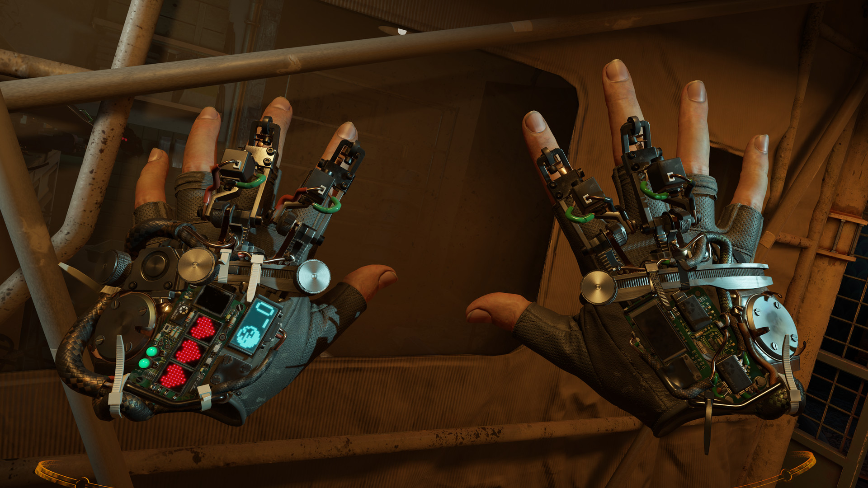
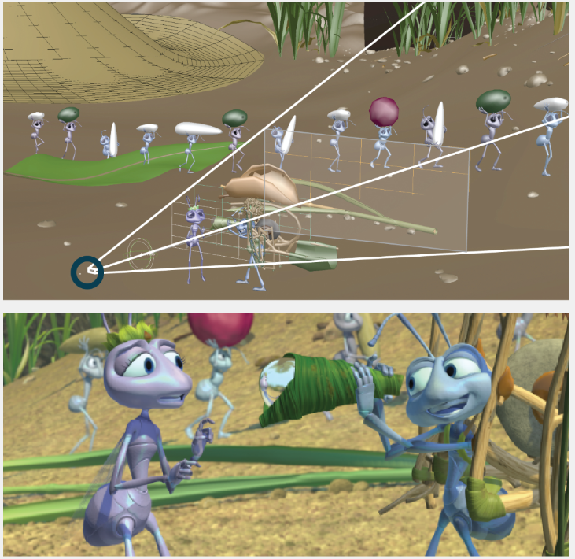
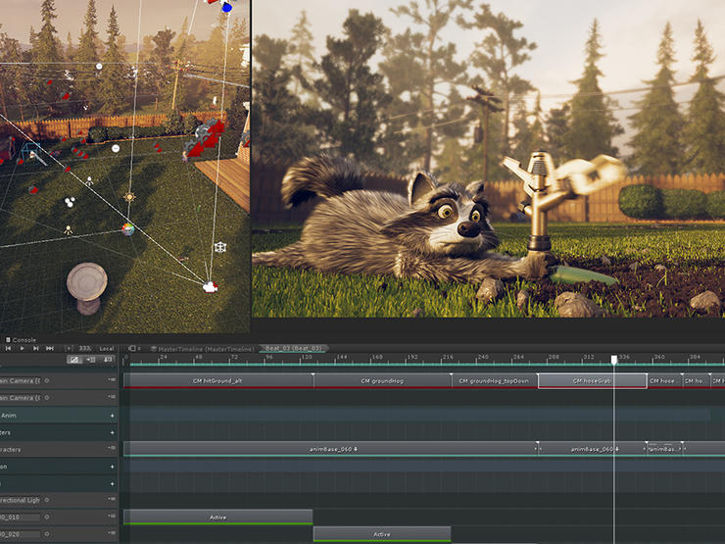
Where is camera?
https://www.half-life.com/en/alyx/
https://sciencebehindpixar.org/pipeline/sets-and-cameras
https://unity.com/solutions/film-animation-cinematics

Slide 4
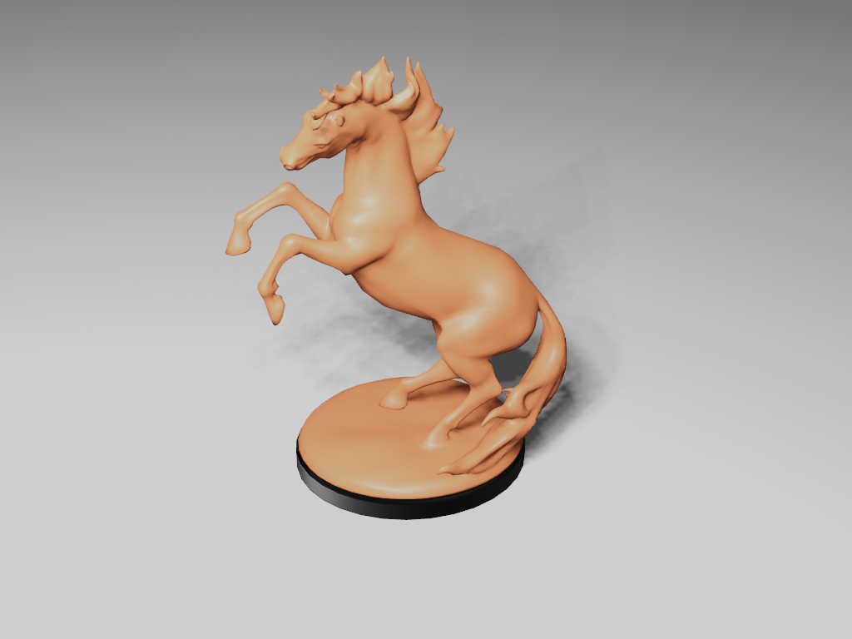
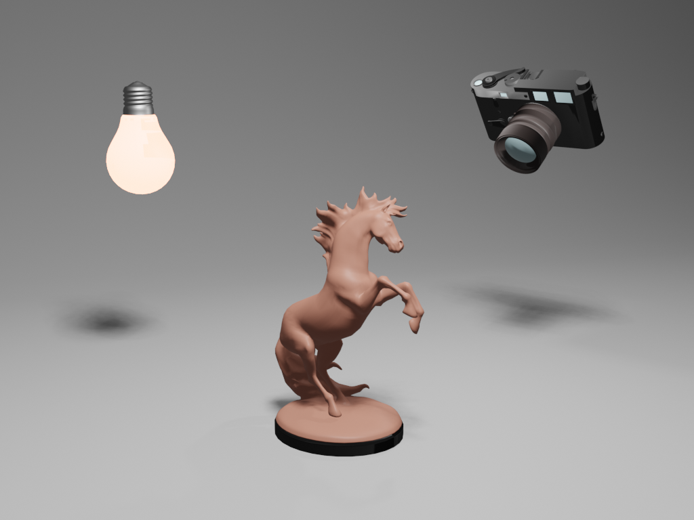
Where is camera?
In rendered images, camera is not seen – it defines what we see.

Slide 5
Camera in rendering
TODO
In rendering camera model is required to at least to:
  Define a portion of visible scene
  Type of projection: perspective/orthographic
Camera during image formation:
  Picks reflected light from 3D scene (light transport and shading)
  Forms image
Rendering process is calculating radiance (color) from shaded surface point to camera position.
  This simulates simplified model of an imaging system such as film/digital camera or human eye
  <image: object, camera>

Slide 6
Camera in rendering
TODO
During rendering, each shading surface point corresponds to single ray and thus to sample point on the sensor surface
  example
In chapter about image, we will discuss reconstructing image (signal) over each discrete sensor surface – reconstruction of continuous image signal from discrete samples

Slide 7
Real camera system

Slide 8
Real camera systems
Camera systems contain many small discrete sensors: cones in the eye, photodiodes in digital camera or dye particles in film camera
  Each of these sensors measures incoming radiance values and converts it to color signal
Exposing sensor to radiance will not produce image without light-proof enclosure with small opening – aperture.
  Such setup restricts light where light can enter and strike sensor
Lens is placed at the aperture to focus the light so each sensor receives light from only a small set of incoming directions
  Lens with aperture average light over small area and small set of incoming directions
<image: camera system elements: sensor, aperture, lens>

Slide 9
What camera measures?
TODO
Images are created when light falls on surface which is sensitive to light
For a film camera, this surface is film or sensor (CCD) for digital camera
Sensors measure average radiance which quantifies the brightness and color of single ray of light
This is motivation why in computer graphics we only care about light rays which are coming to camera and from them, how are they generated in the scene
  We will extend this idea in rendering chapters

Slide 10
Image formation

Slide 11
Principle of photography
Two main processes:
  How is image created in camera
  How is image stored on film/file*
* Physical support to store an image, thus simulating the photochemical processes used in traditional film photography is out of scope. Renderer which simulates image storage on film: https://maxwellrender.com/https://maxwellrender.com/

Slide 12
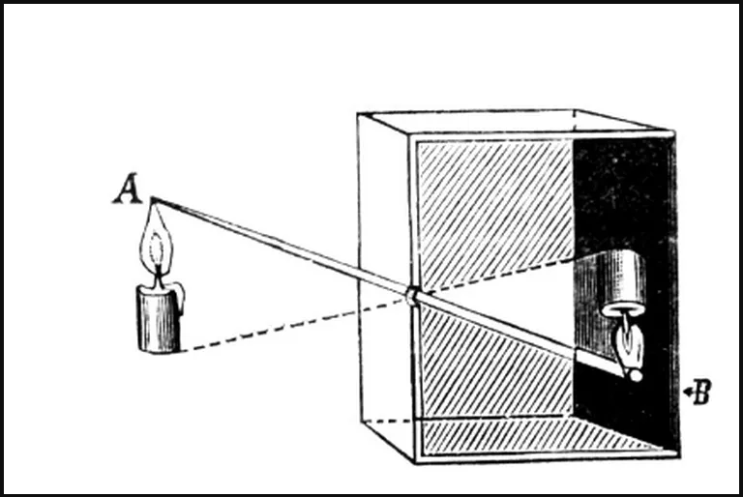
Image formation: camera obscura
Lightproof box with:
  black interior (to prevent light reflection)
  with very small hole – aperture
  light-sensitive film opposite to aperture
When aperture is opened, film is exposed to light
  Light passing through the hole forms an inverted image of the external scene on the opposite side of the box
  Time which aperture must be opened to capture image on film is called exposure
A foundation for modern photographic cameras
https://www.inquirer.com/philly/entertainment/20160806_Camera_Obscura_at_Fleischer_throws_new_light_on_photography.html

Slide 13
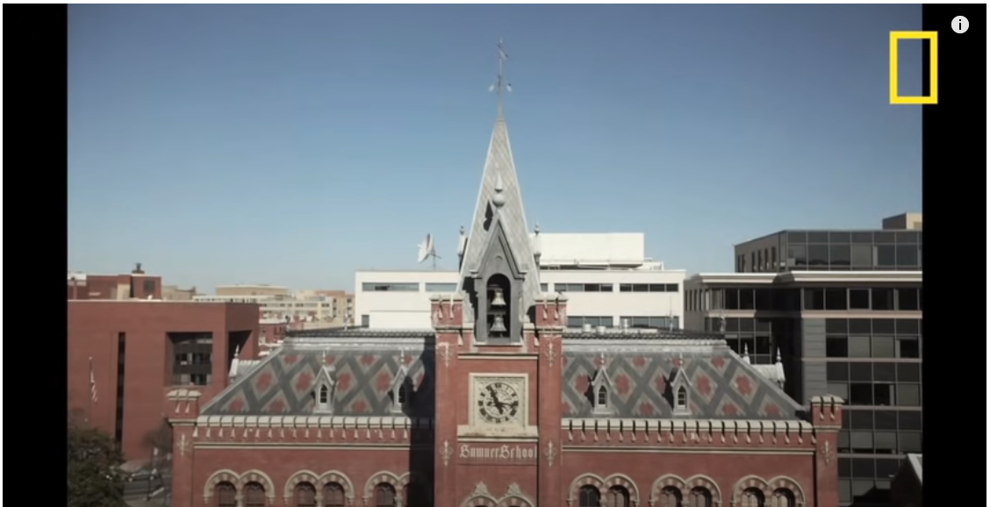
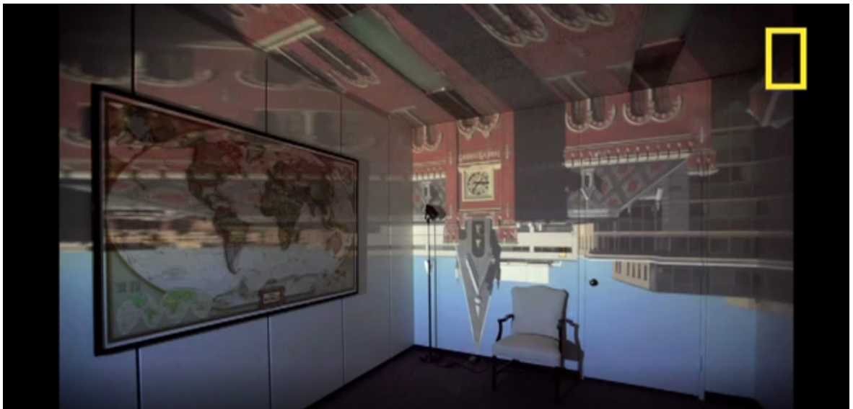
Camera obscura = Dark room
https://www.youtube.com/watch?v=gvzpu0Q9RTU&ab_channel=NationalGeographic

Slide 14
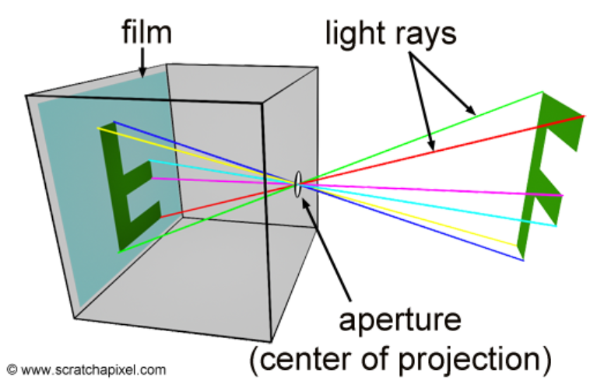
Image formation: pinhole camera
Simplest type of camera in real world is pinhole camera (camera obscura)
Main elements:
  Aperture: center of projection: all rays entering converge here and diverge from it to the other side
  Film
Image formation
  Aperture is opened to expose film to light
  Aperture must be very small: only one ray reflected from the world in point P enters the camera and intersects film in one point
  Each point in the visible portion of the scene corresponds to a single point on the film
https://www.scratchapixel.com/lessons/3d-basic-rendering/3d-viewing-pinhole-camera

Slide 15
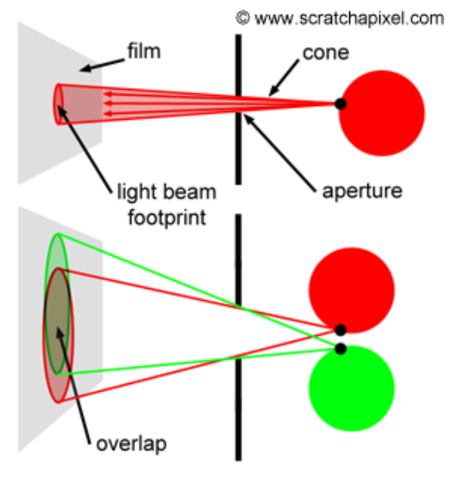
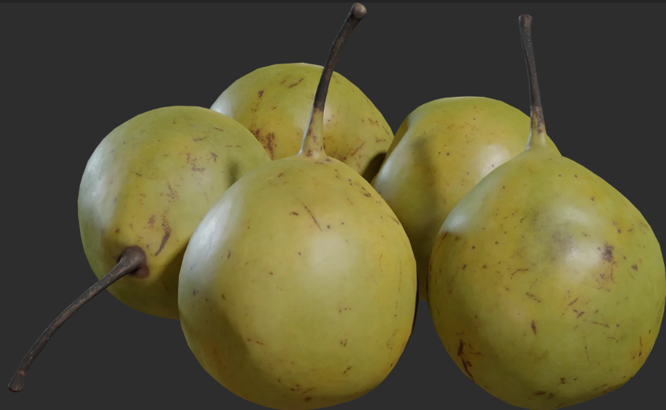

Pinhole camera: aperture size
Formed image is sharp if each point of the object maps to the one point of the film
Ideal pinhole: aperture is so small that only one ray passes through it
  Not possible in a real world because of diffraction of light
It is never a single ray that passes the aperture – cone of rays
  the cone of rays (its angle) is determined by a size of aperture.
  Smaller cone → sharper image
  Larger aperture → blurred image
Cones are overlapping and single point appears multiple times on film → blur (out of focus).
https://www.scratchapixel.com/lessons/3d-basic-rendering/3d-viewing-pinhole-camera
https://polyhaven.com/a/food_pears_asian_01

Slide 16
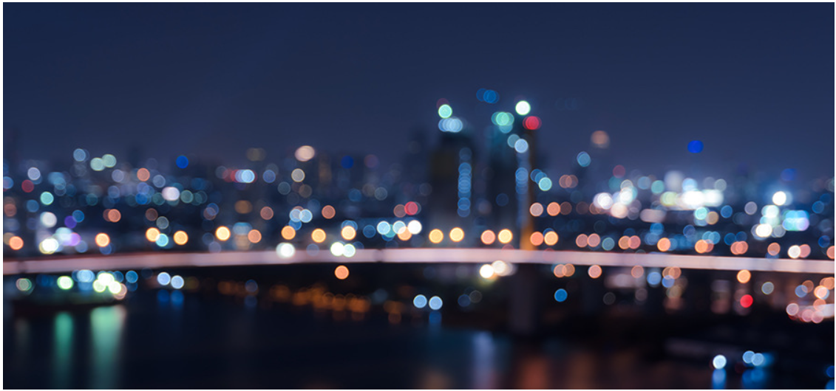
Bokeh
Out of focus emissive objects are aesthetically pleasing → bokeh effect.

Slide 17

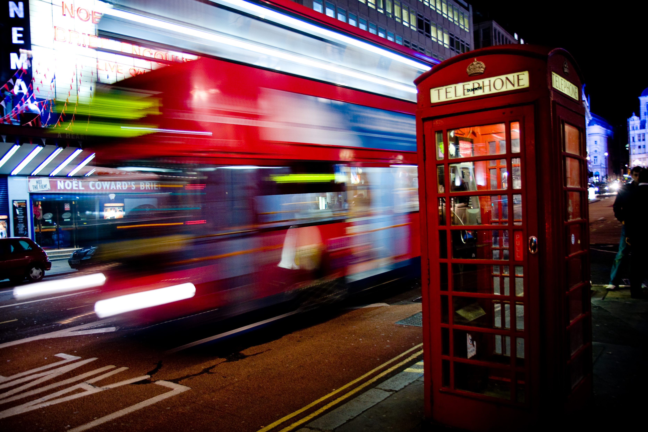
Pinhole camera: exposure
If aperture is very small, longer time is needed for image to form on a film.
Time of which the aperture is open is called exposure time
  In real cameras, longer exposure can produce blurred image if camera or objects in the scene are moving (not perfectly still)
  Simulated camera do not have problem with this since simulated light transport is considered instant, therefore, simulation of motion blur requires additional simulation
Therefore, generally, shorter exposure time is better, although simulation of motion blur is aesthetically pleasing
Earth rotation causes motion blur in long-exposure photos
https://en.wikipedia.org/wiki/Motion_blur

Slide 18
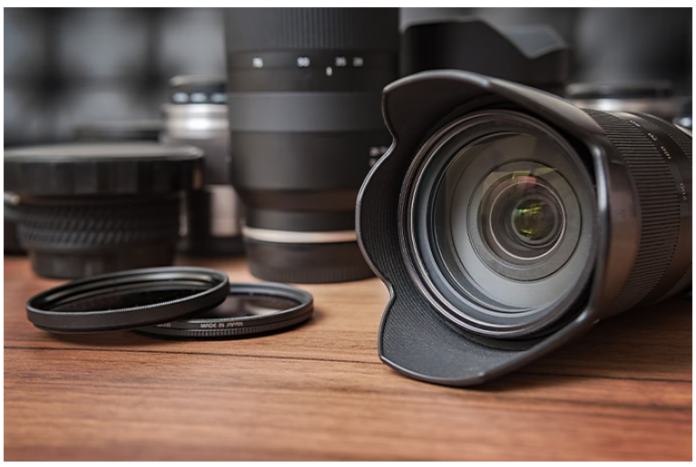
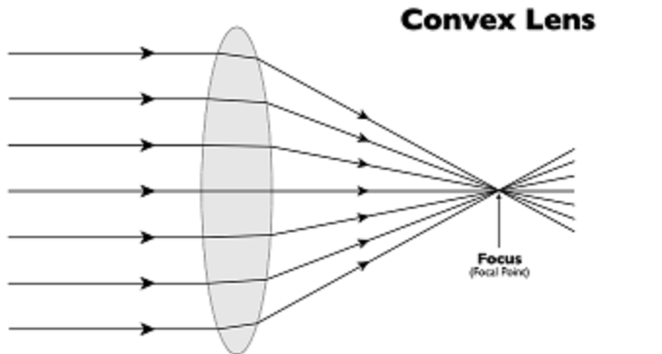
Aperture and Lens camera
Aperture trade-offs:
  Very small aperture requires long exposure times to form an image: motion blur
  Large aperture causes blurred images
Solution is to use lens in front of aperture
  Rays entering camera are gathered (converged) and focused them to one point on a film plane
  Aperture can now be larger enabling smaller exposure time while lenses canceling blur
https://photo.stackexchange.com/questions/95113/do-convex-lenses-make-light-from-different-points-converge-to-different-points

Slide 19


Depth of field
Lens camera introduce distance between nearest and the farthest object from the scene that appears sharp in the formed image – depth of field
Pinhole cameras have infinite depth of field
  Because of this, images rendered with pinhole cameras are completely sharp and thus look artificial
https://www.adobe.com/uk/creativecloud/photography/discover/bokeh-effect.html

Slide 20
Pinhole camera

Slide 21
Camera model
Now, we will model a real world camera.
  Such camera model is similar to ones used in production software (e.g., Blender, Maya, 3DSMax, Houdini)
  https://docs.blender.org/manual/en/latest/render/cameras.html
Simulating real world camera:
  photo-realistic rendering which may be combined with live action footage
  camera effects enable certain expressive and artistic possibilities

Slide 22
Camera model
Image generation with real world camera is governed by optical laws → very costly to simulate
We start with simplest camera model: pinhole camera
  Much easier way to reproduce images, therefore used in most 3D applications and games
Main elements:
  Film (image plane)
  Aperture (small opening)

Slide 23
Pinhole camera parameters
Film and aperture elements form several parameters:
  Focal length/focal distance, angle of view/field of view
  Film size

Slide 24
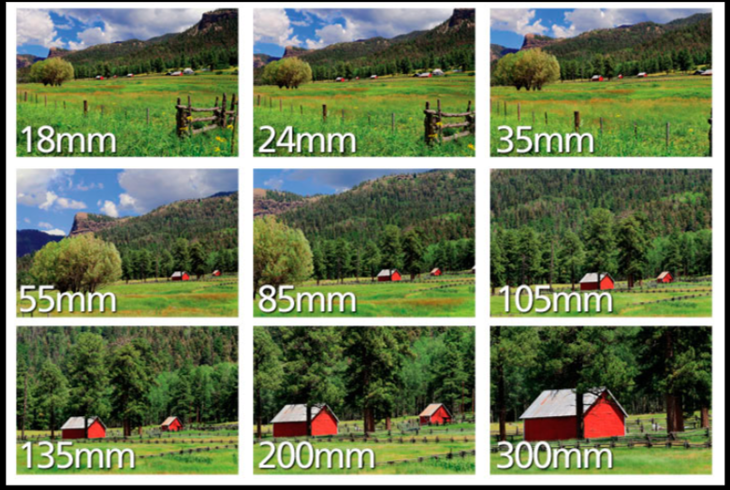
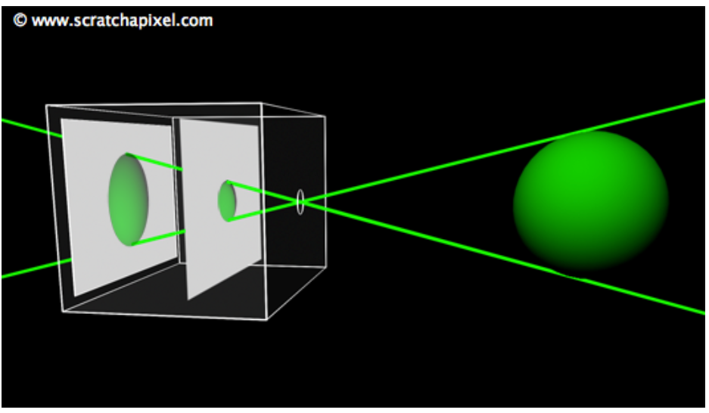
Focal length
Distance of film plane from aperture defines amount of scene that we see
  Moving image plane (film plane) closer to aperture effectively performs zoom out
  Moving film plane away from aperture effectively performs zooming in
This parameter is called focal length or focal distance
https://www.nikonusa.com/en/learn-and-explore/a/tips-and-techniques/understanding-focal-length.html

Slide 25
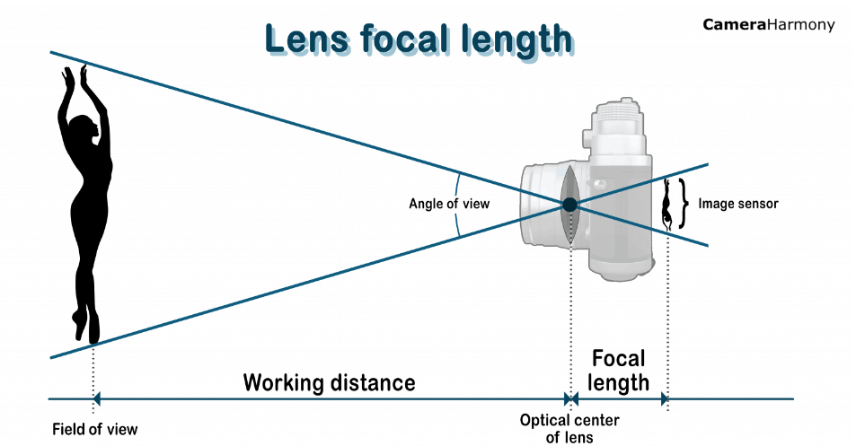
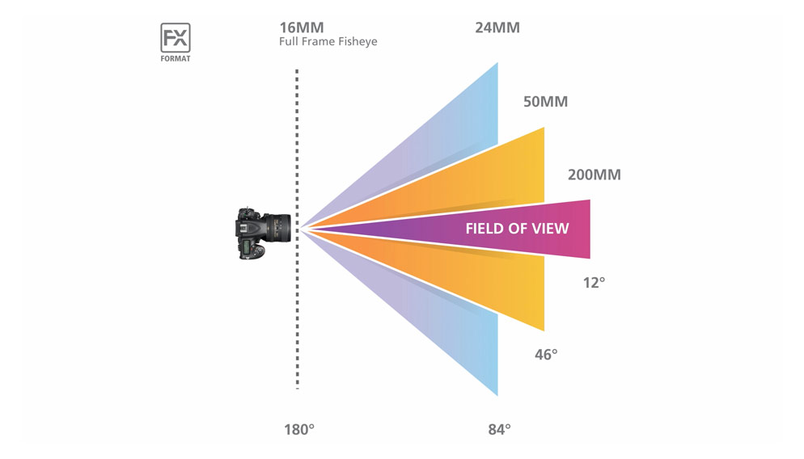
Pinhole camera parameters: angle of view
Zooming in and zooming out described by focal length (focal distance) can be also described by angle of the apex of triangle defined with aperture and film edges
This angle is called angle of view or field of view
https://www.nikonusa.com/en/learn-and-explore/a/tips-and-techniques/understanding-focal-length.html
https://cameraharmony.com/focal-length-explained/

Slide 26
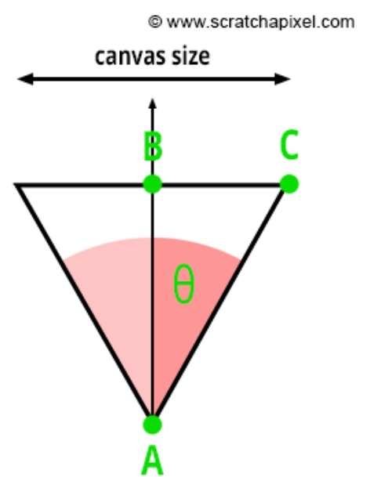
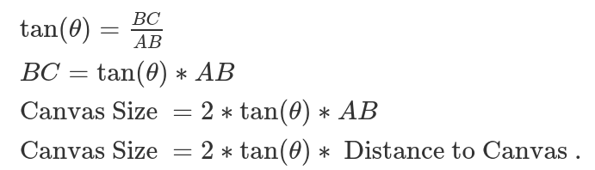
Focal length and angle of view
Relation between focal length and angle of view

Slide 27
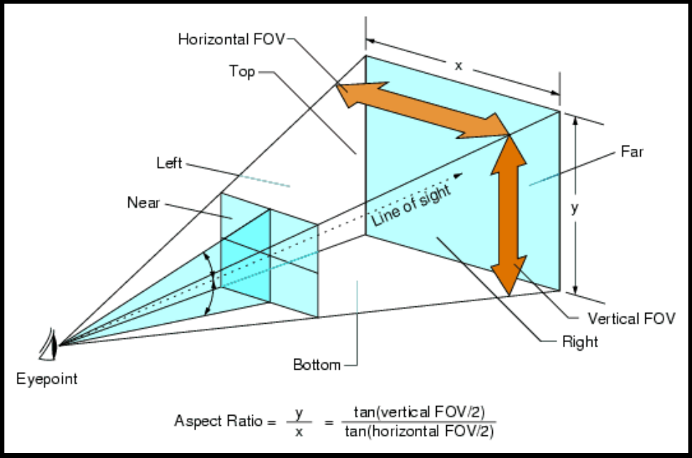
Field of view
In 3D, triangle defined with aperture and film edges is a pyramid and we distinguish horizontal and vertical FOV
https://www.pcgamingwiki.com/wiki/Glossary:Field_of_view_%28FOV%29

Slide 28
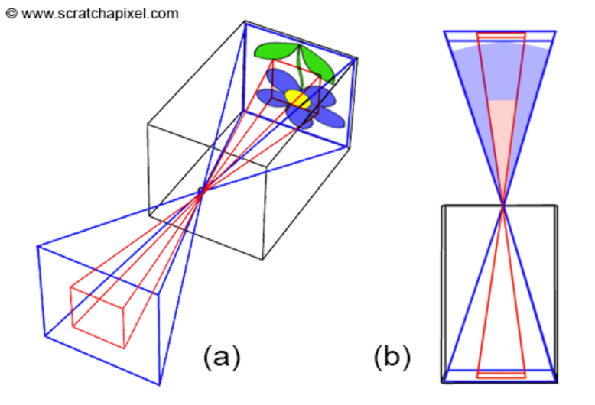
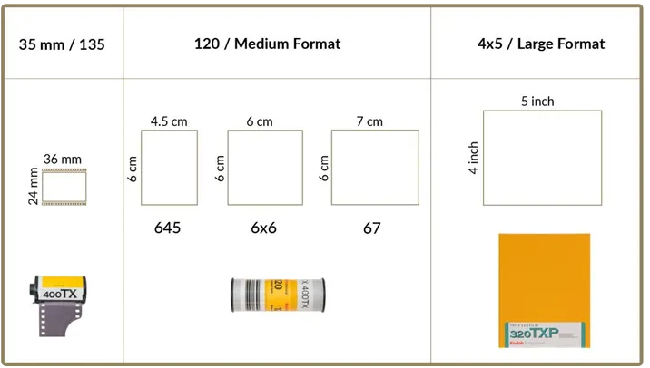
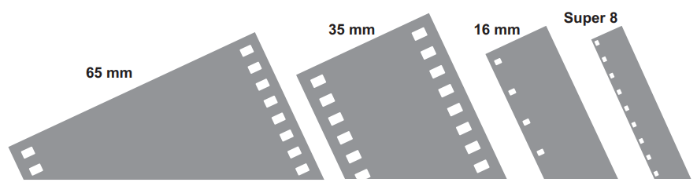
Pinhole camera parameters: film size
Amount of scene that is captured also depends on film size (image sensor)
  Film parameters are horizontal and vertical direction
Smaller area of film size implies smaller angle of view and vice versa.
Capturing the same extent of the scene with larger film requires adjusting focal length
Larger film formats were developed for more details and better image quality
In digital cameras, film is replaced with sensor, thus we talk about sensor size.
  Sensor size has the same role as film size
Gauge refers to the width of film. Four are common: 65mm, 35mm, 16mm, Super 8. http://www.theodoropoulos.info/attachments/076_kodak05_Film_Types_and_Formats.pdf
https://www.learnfilm.photography/guide-to-medium-format-photography/

Slide 29
Pinhole camera parameters: recap
Parameters:
  Focal length (focal distance)
  Angle of view (field of view)
  Film size
  With two parameters we can always infer the third one.
Angle of view is determined by:
  Focal length: longer focal length → narrower angle of view
  Film size: larger film size → wider angle of view

Slide 30
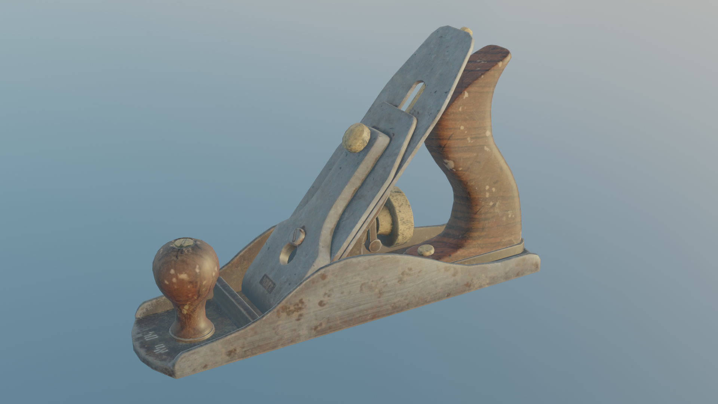

Film size and image resolution
1920x1080
Angle of view:
  Depends on film size (image sensor size)
  Doesn't depend on number of pixels on image sensor – image resolution
Size of sensor and number of pixels are independent parameters!
Image quality depends on:
  Image sensor size
  Number of pixels on sensor (resolution)
Higher resolution images will have more details
  Resolution is expressed in terms of pixels
  Width and height resolution
1920x1080 20%

Slide 31
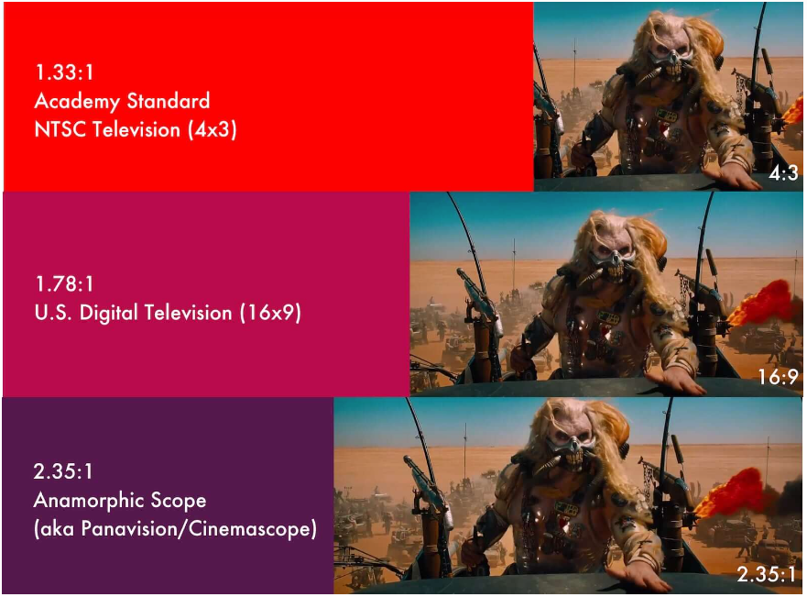
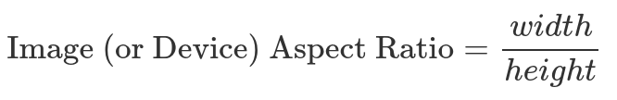
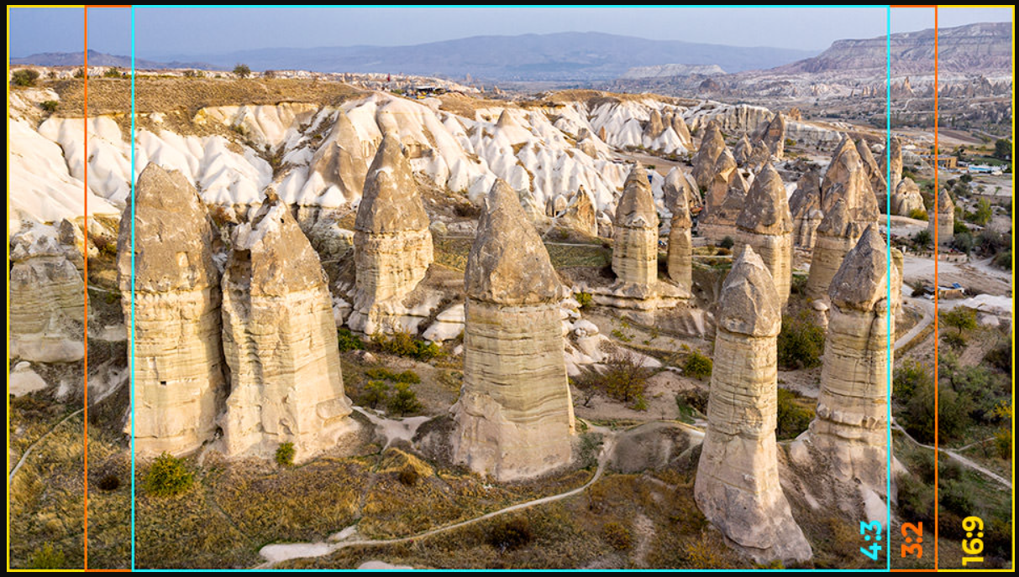
Image resolution and aspect ratio
Image aspect ratio (device aspect ratio) is calculated from image resolution (width and height):
Film and display devices (computer screens, television) have standard aspect ratios
  4:3
    Old television systems and computer monitors (e.g., resolution 640x480)
    Default for digital cameras
    35 film formats have aspect ratio 4:3
  5:3 and 1.85:1
    Aspect ratio used in film
  16:9
    Aspect ratio used by HD TV, monitors and laptops (resolution: 1920x1080)
https://www.studiobinder.com/blog/aspect-ratio/
https://photographylife.com/aspect-ratio

Slide 32
Note: film and image aspect ratio
In computer graphic camera model, sensor (film/canvas) aspect ratio can be different from the image (device) aspect ratio.
Difference in canvas (film) aspect ratio and the raster image aspect ratio leads to stretching the image in either x or y
Solution: canvas aspect ratio is often directly computed form the image aspect ratio.
  Example, is image resolution is 640x480, canvas aspect ratio will be set to 4:3.

Slide 33
Camera in rendering

Slide 34
Camera in rendering
Camera model in rendering is used to deliver image similar to those produced by a real pinhole camera.
  Size and shape of real and rendered object must be the same

Slide 35
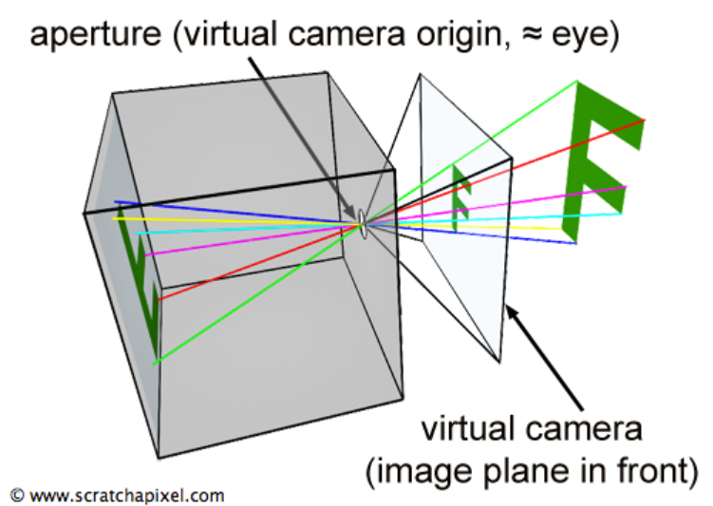
Virtual pinhole camera model
Real pinhole camera produces images which are upside down.
In computer graphics, this is avoided by setting film plane in front of aperture.
  This construction gives valid images
  Aperture is now position of the eye
https://www.scratchapixel.com/lessons/3d-basic-rendering/3d-viewing-pinhole-camera/virtual-pinhole-camera-model

Slide 36
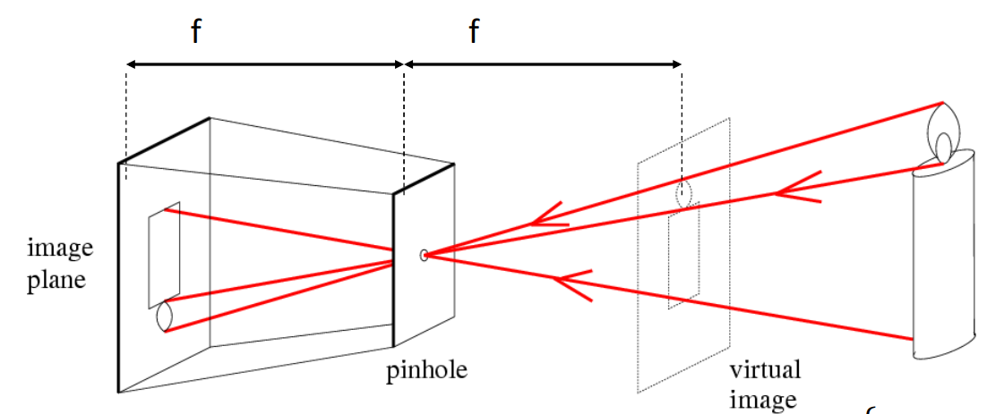
Perspective projection
This construction shows that image is constructed by following light rays from scene to the eye
This geometrical problem is called perspective projection.
http://vision.stanford.edu/teaching/cs131_fall1516/lectures/lecture8_camera_models_cs131.pdf

Slide 37
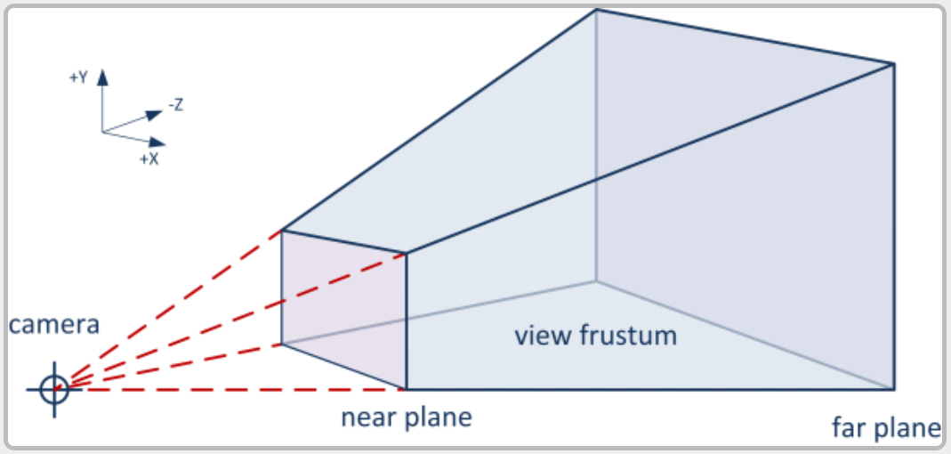
Viewing frustum
Near and far clipping planes are virtual planes placed in front of camera and parallel to image plane.
  Location of clipping planes is determined by camera’s line of sight (camera’s local z axis)
Objects in 3D scene closer than near or further than far plane are not visible in image plane.
  This defines viewing frustum
Near and far clipping planes are needed for resolving precision issues.
  Used in rasterization-based rendering
  Not needed for ray-tracing based rendering.
EYE
https://learnopengl.com/Guest-Articles/2021/Scene/Frustum-Culling

Slide 38
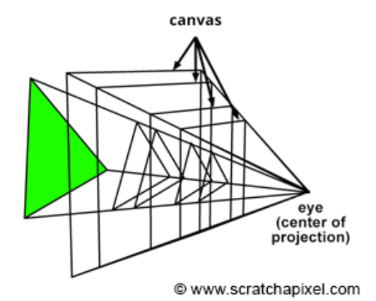
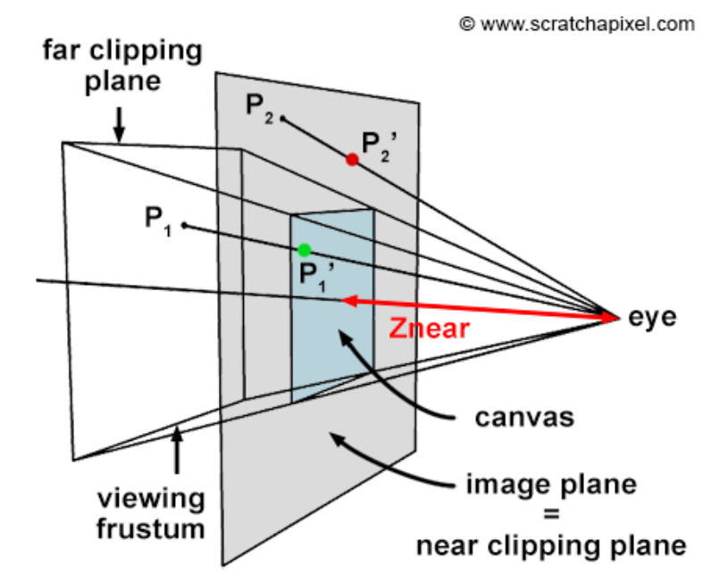
Image plane size
Image plane (canvas) can be anywhere on camera’s line of sight (camera’s local z axis) between near and far clipping planes
  Smaller distance from eye to image plane → canvas is smaller. And vice versa.

Slide 39
Recap
Main elements of pinhole camera are eye and film plane.
Main parameters of pinhole camera are focal length and sensor (film) size.
Virtual pinhole camera further introduces near and far clipping planes to tackle precision problems.
  Viewing frustum shape is defined with aperture point and angle of view
Virtual image plane (canvas, film) can be anywhere on camera’s line of sight
  We assume it is at near clipping plane
  Its boundaries are viewing frustum

Slide 40
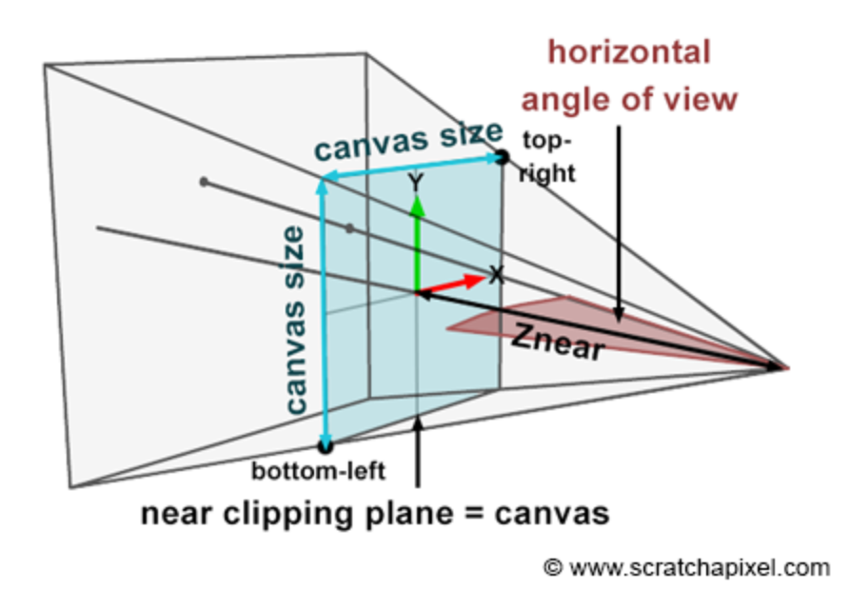
Canvas and visibility
Point in 3D scene is visible only if lies in canvas limits
Therefore, point is first projected on image plane and tested for canvas limits to determine visibility
Canvas is centered about the image plane coordinate system origin.
The canvas size itself depends on the angle of view and the near clipping plane (since it is placed at near clipping plane)

Slide 41
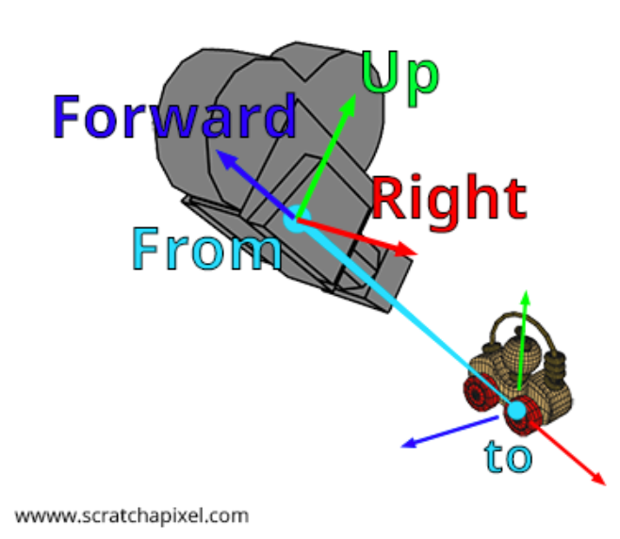
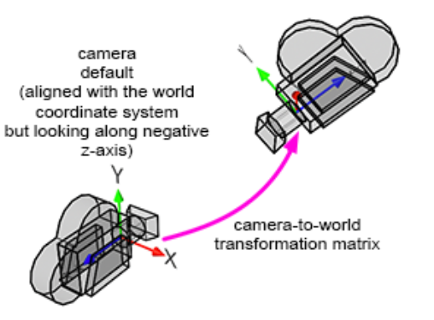
Camera movement
By default camera is located at origin and oriented at negative z axis.
  Movement of camera is defined with 4x4 transformation matrix.
Camera direction and orientation is simplified with look-at method:
  Point in space where camera is positioned
  Point in space where camera is looking
Look-at method gives look-at matrix, which defines 4x4 transformation matrix of camera from its local (camera) space to world space in 3D scene: camera-to-world and its inverse world-to-camera matrix.

Slide 42
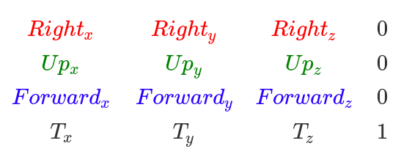
Camera movement: look at matrix
Forward = normalize(from – to)
Right = crossProduct(randomVec, forward)
  RandomVec = (0,1,0)
  If Forward is close to (0,1,0) or (0,-1,0) take another randomVec
Up = crossProduct(forward, right)
4x4 matrix:
T = from.

Slide 43
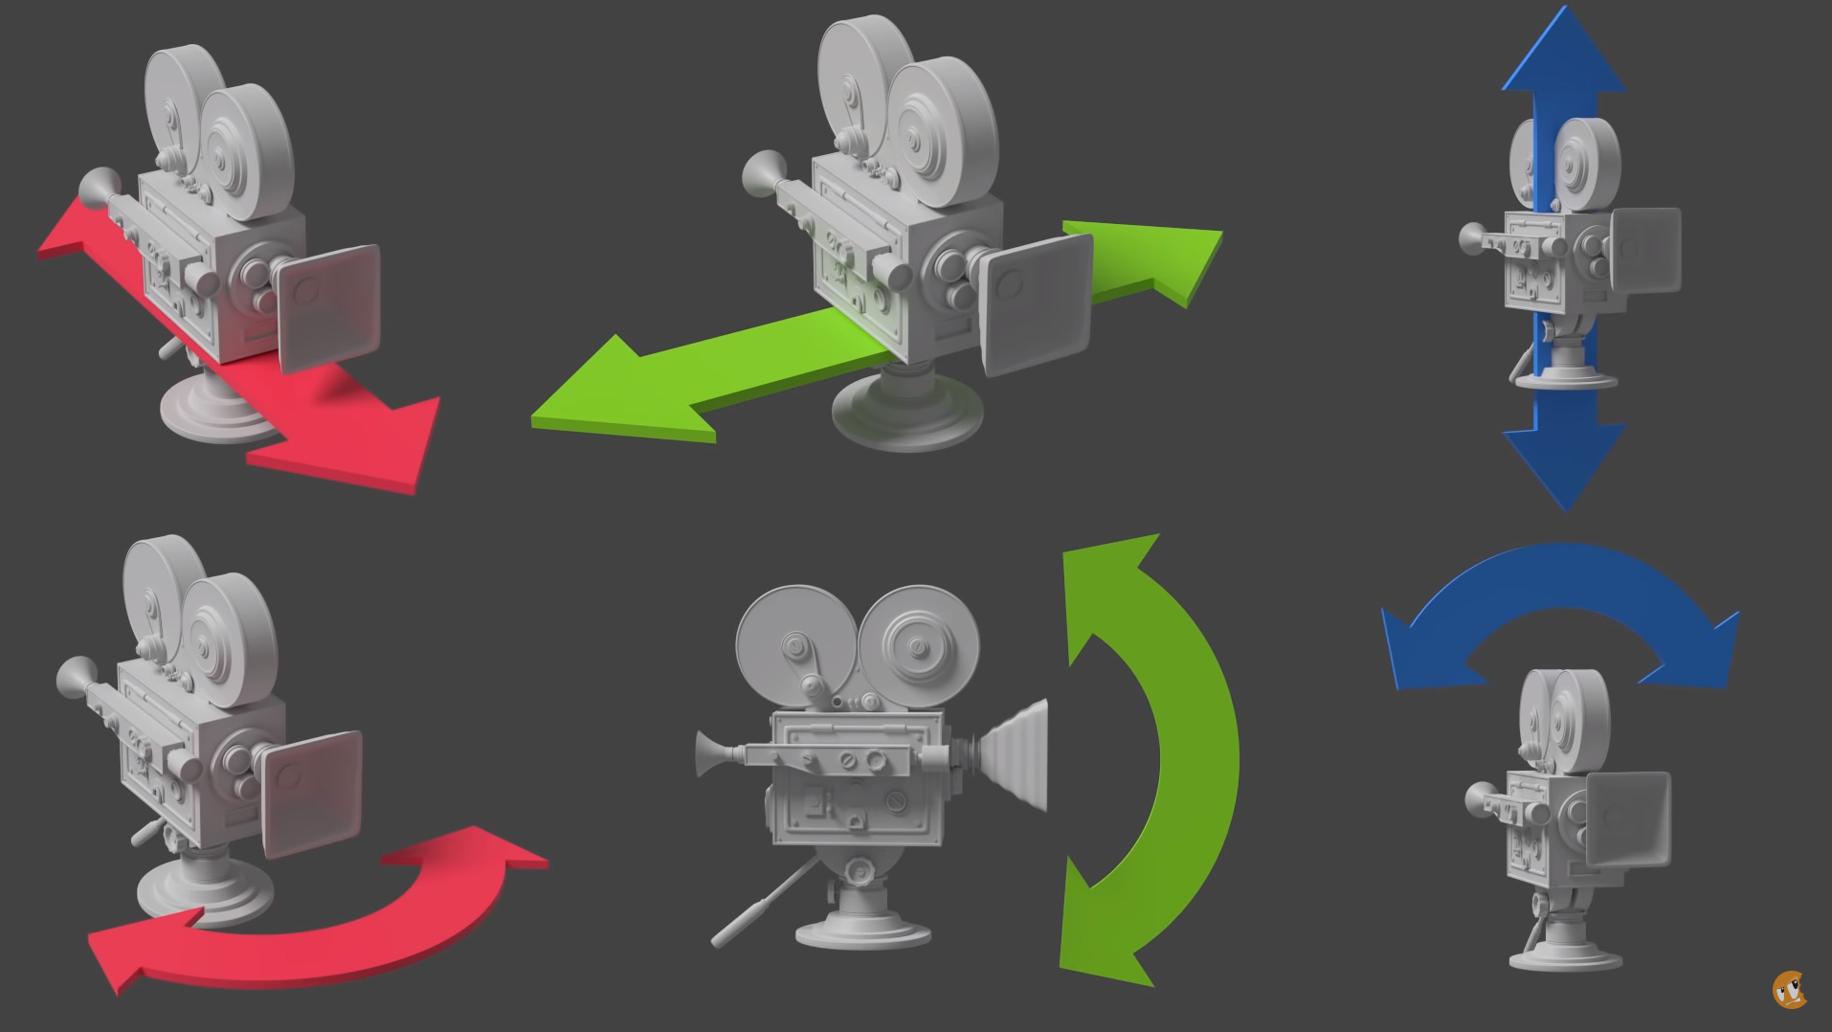
Camera movement
https://www.youtube.com/watch?v=El0V6fS7mpc&ab_channel=CGCookie

Slide 44
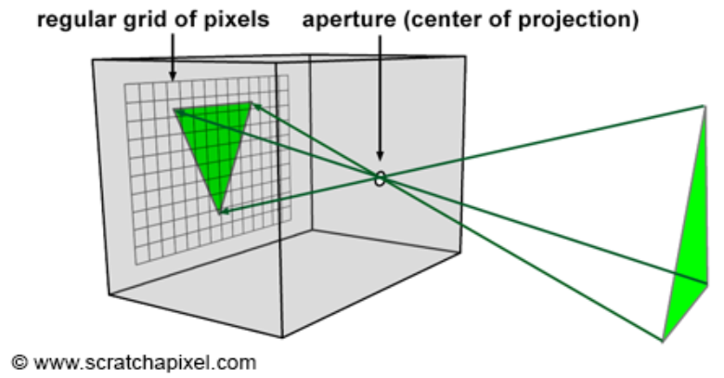
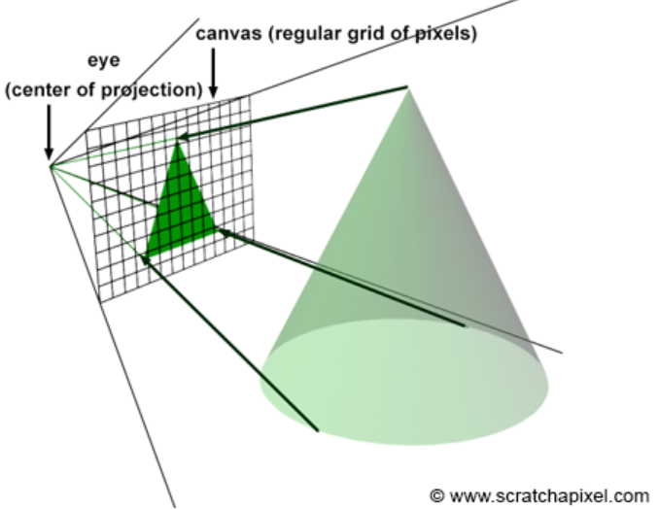
Virtual pinhole camera image formation
Pinhole image creation:
  Light rays are emitted from light source, intersect with object surfaces.
  For each of 3D scene points visible from camera, only some of reflected rays will fall on aperture and strike the film.
  If we divide film surface into grid of pixels, we obtain digital pinhole camera which we simulate by virtual pinhole camera.
Virtual pinhole camera follows the same idea but with film place in from of aperture.
How image is formed using virtual pinhole camera depends on rendering techniques:
  Ray-tracing-based rendering
  Rasterization-based rendering

Slide 45
Camera in ray-tracing
Real world: light ray reflected from 3D scene point P, passing through aperture is falling on film and is coloring the pixel
Ray-tracing based rendering simulates this process by associating each pixel with one or multiple rays.
The process is then reversed:
  Ray is generated using camera eye position and pixel position in camera image plane.
  Ray is traced into the 3D scene where it intersects the objects – ray casting (foundational method for ray-tracing).
  Color that is computed from intersecting the object is assigned to pixel

Slide 46
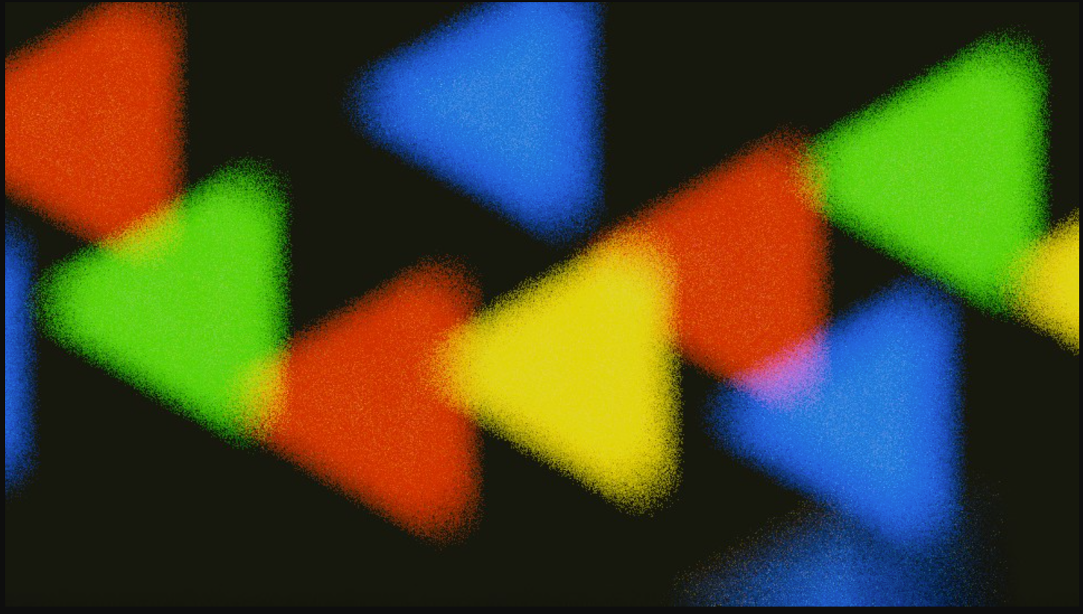
Camera in ray-tracing
Ray-tracing is image-centric
  For each pixel in image plane, ray is constructed and traced in 3D scene for intersection and computing color of intersection (shading).
Aperture is infinitesimally small – a point – from which we generate rays.
  Image will be perfectly sharp
  Additional methods are employed from simulating lens effects such as depth of field.
https://docs.blender.org/manual/en/latest/render/cameras.html

Slide 47
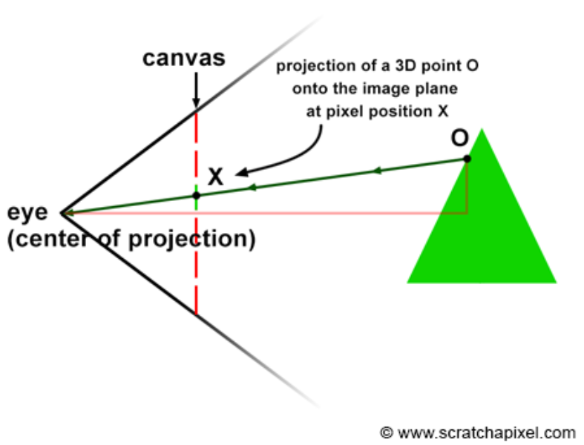
Camera in rasterization
Real world: light ray reflected from 3D scene point P, passing through aperture is falling on film and is coloring the pixel
Rasterization-based rendering is simulating this process by finding a position of 3D point P from 3D scene in image plane by “projecting” P on image plane.
  Perspective projection
The process of finding pixel coordinates on image plane of 3D point is done as follows:
  3D points from world space are transformed to camera space: world-to-camera matrix.
  Apply perspective projection matrix or perspective divide.
  Convert those points to raster space (image plane with pixels).

Slide 48
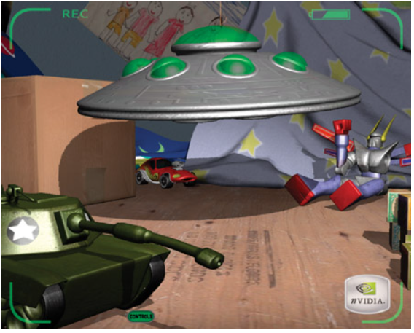

Camera in rasterization
Rasterization is Object-centric
  Rasterization-based rendering starts from 3D scene geometry and projects objects onto image plane to find colored pixels.
Each projected point from 3D scene has exactly one point on image plane
  Therefore, image will be perfectly sharp
  Additional methods are employed to introduce depth of field
https://docs.blender.org/manual/en/latest/render/eevee/render_settings/depth_of_field.html
https://developer.nvidia.com/gpugems/gpugems/part-iv-image-processing/chapter-23-depth-field-survey-techniques

Slide 49
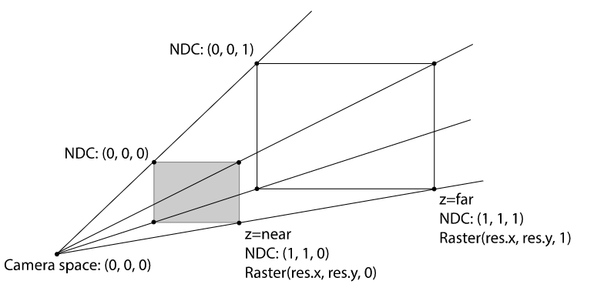
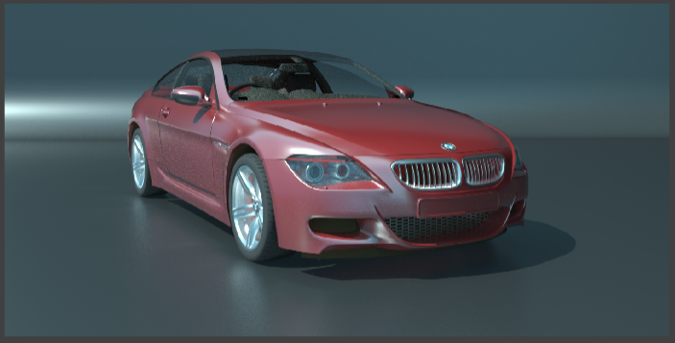
Perspective camera
Most often used from film and game rendering
https://www.pbr-book.org/3ed-2018/Camera_Models/Projective_Camera_Models

Slide 50
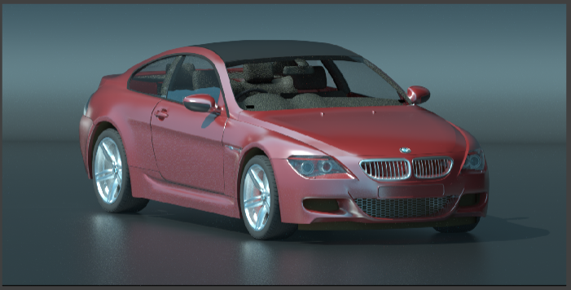
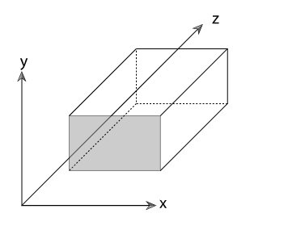

Orhographic camera
Useful from modeling in architecture and engineering
Often used in isometric games
https://store.steampowered.com/app/1573390/Lilas_Sky_Ark/

Slide 51
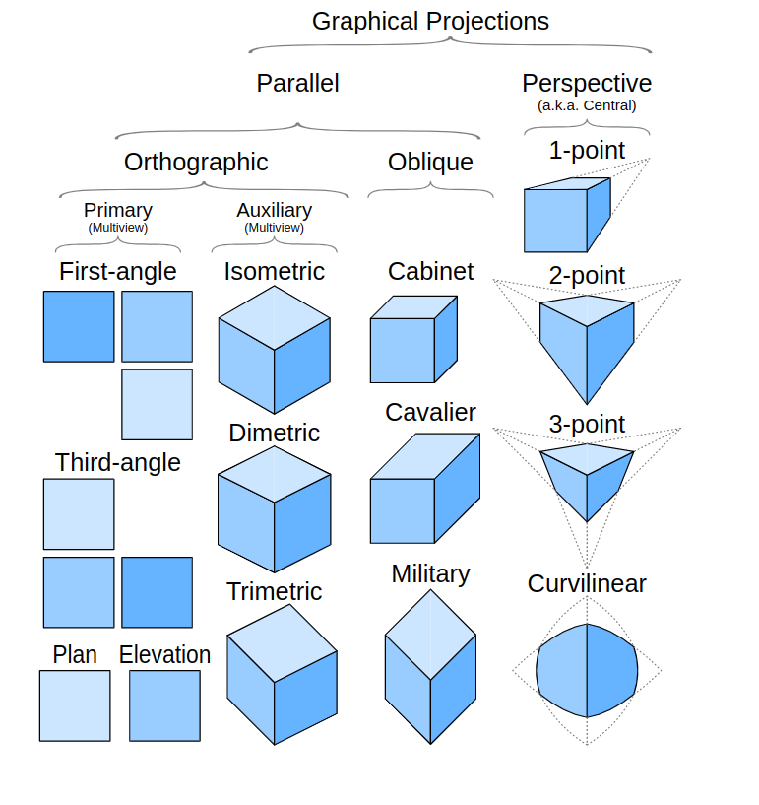
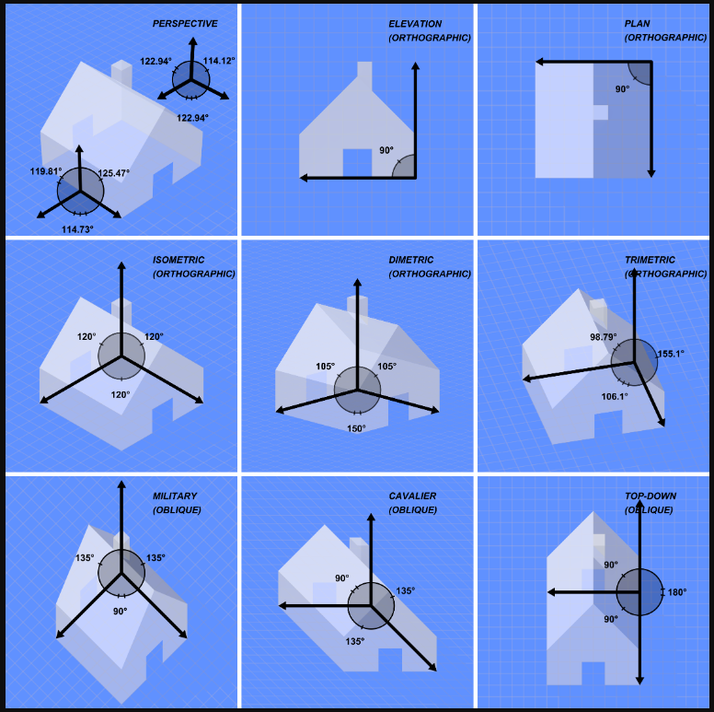

Other projections and comparisons
https://en.wikipedia.org/wiki/Orthographic_projection

Slide 52
Simulating lens camera
Real-world cameras transmit light through a lens that bends and focuses it onto the sensor. Because of this, objects that are a certain distance away are in focus, but objects in front and behind that are blurred.
https://docs.blender.org/manual/en/latest/render/cameras.html

Slide 53


Exposure in simulated camera
Exposure (time in which aperture is opened) in rendering is not used as camera parameter.
  Exposure is parameter which control brightness of already rendered image
Shutter speed (determining exposure) is used for motion blur.
https://docs.blender.org/manual/en/latest/render/cycles/render_settings/motion_blur.html
Different exposures of the same render: https://docs.blender.org/manual/en/latest/render/color_management.html

Slide 54
More into topic
More about film, aspect ratio: https://www.scratchapixel.com/lessons/3d-basic-rendering/3d-viewing-pinhole-camera/how-pinhole-camera-works-part-2
Lenses: https://www.pbr-book.org/3ed-2018/Camera_Models/Realistic_Cameras

Slide 55
To remember
Elements of camera system: aperture, film and lens
Pinhole camera
Pinhole camera in rendering
Field of view → sensor size, focal length
Depth of field → lenses, focal length, object distance
Exposure → aperture, shutter, ISO
Motion blur → shutter

Slide 56
Acknowledgements
Large part of this lecture is based on ScrachAPixel lession: https://www.scratchapixel.com/lessons/3d-basic-rendering/3d-viewing-pinhole-camera

Slide 57
Literature
https://github.com/lorentzo/IntroductionToComputerGraphics/wiki/Foundations-of-3D-scene-modeling

