Slide 1
Foundations of 3D Scene Modeling

Slide 2
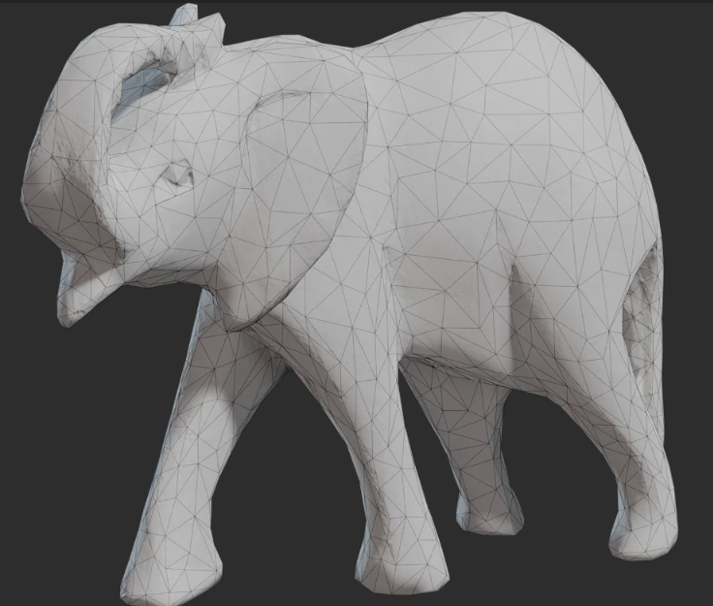
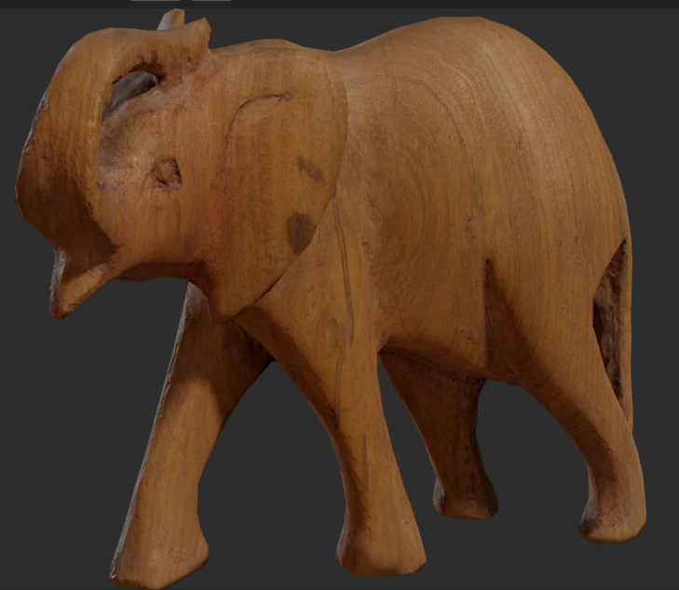
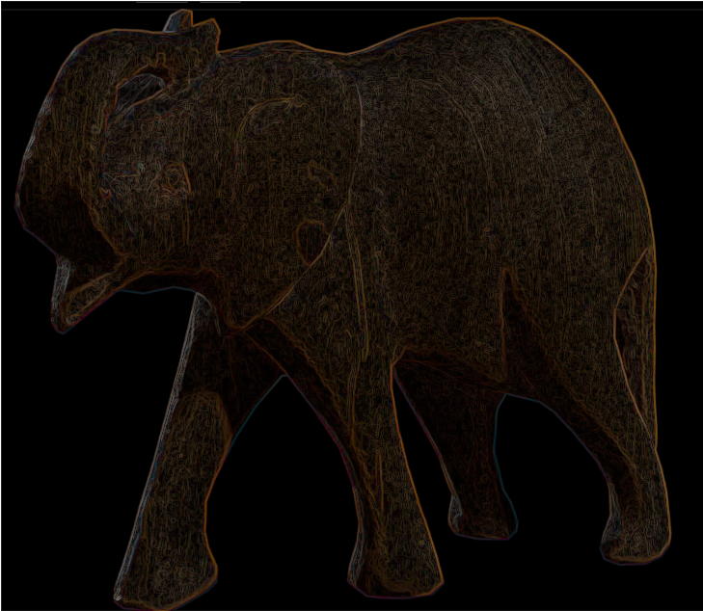
3D scene in big picture
Cornerstones of image generation:
3D scene modeling
  Representing 3D models, lights and cameras
  Animation and interaction
Rendering
  Creating 2D images from 3D scenes
Raster image
  Representing 2D images
  Post-processing
https://polyhaven.com/

Slide 3
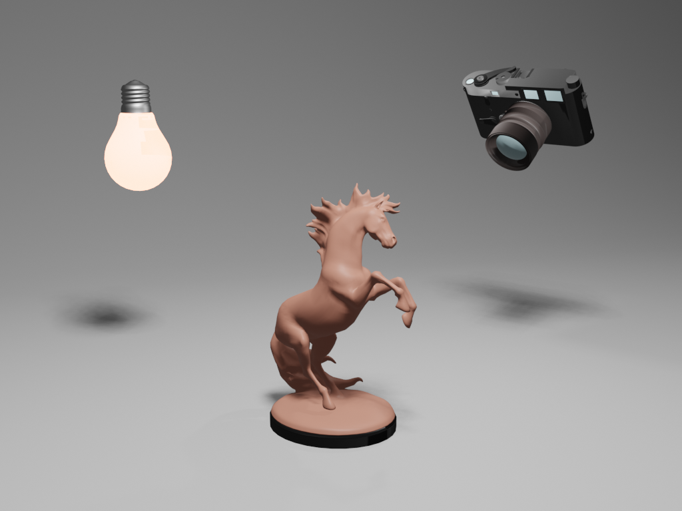
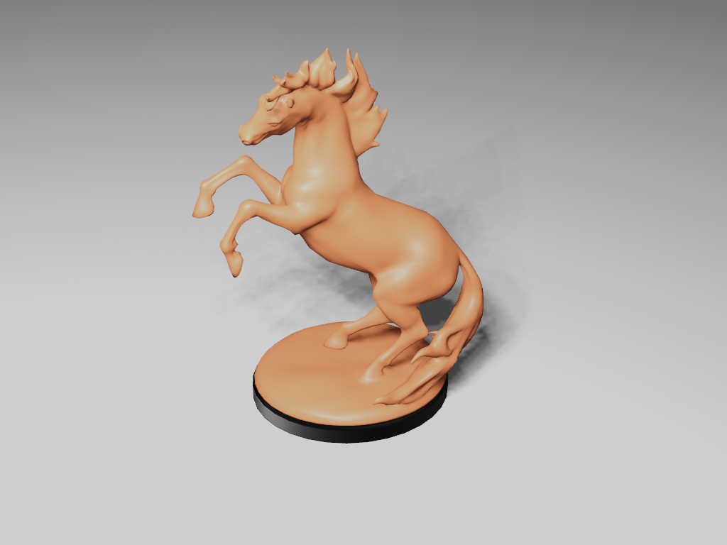
3D scene modeling for image synthesis
Image synthesis: rendering a 3D scene
Analogy: taking real world photograph/video
Elements:
  observer/camera placed somewhere in space,
  this space should contain objects with various shapes and materials
  and finally, light source must be present to shed light onto this space.
Models from:https://polyhaven.com/

Slide 4
3D scene modeling
A way of acquiring/creating, representing and manipulating:
Objects
Lights
Camera

Slide 5
3D scene modeling questions
How do we represent scene elements in a computer?
Intuitive for user?
Efficient for rendering?
How we create/acquire/manipulate scene elements?
How to use scene elements to create real-world phenomena and objects?
How do we manipulate 3D models?

Slide 6
3D modeling foundations
3D scene is approximated using 3D primitives:
3D space
Points
Vectors
Line segments
Rays
Lines
Planes
Polygons

Slide 7
3D objects

Slide 8
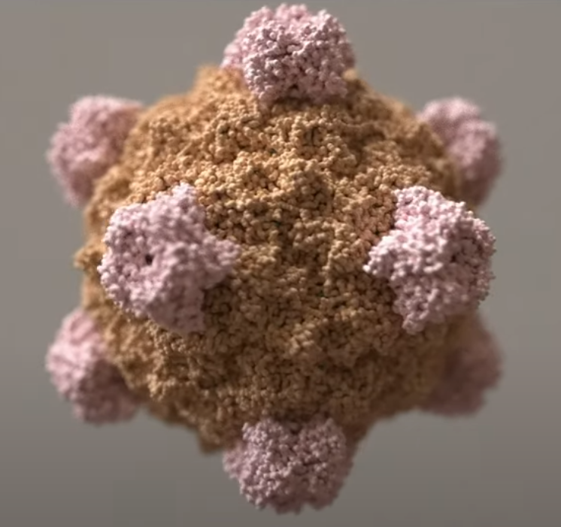
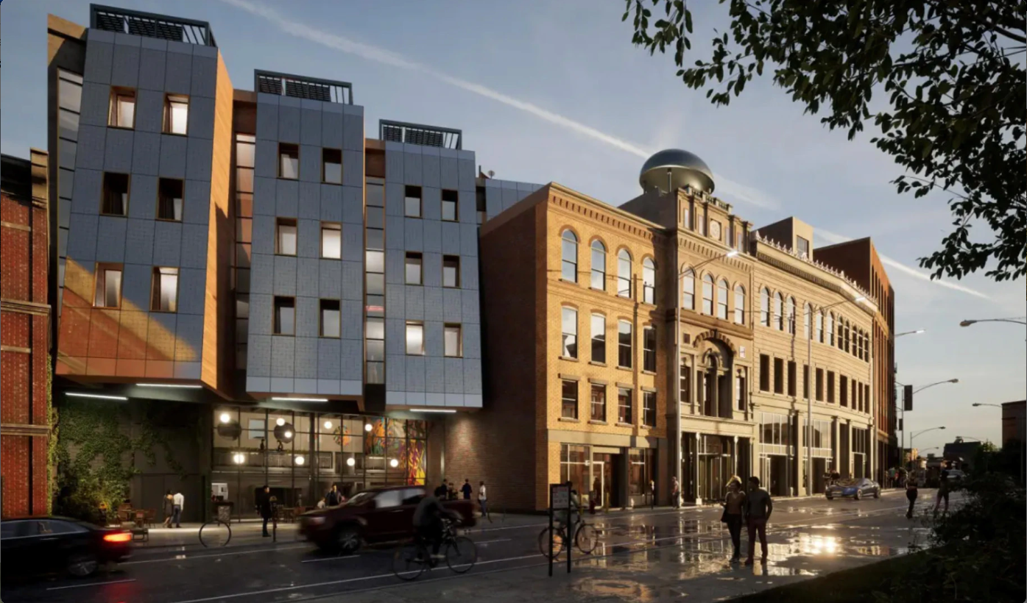
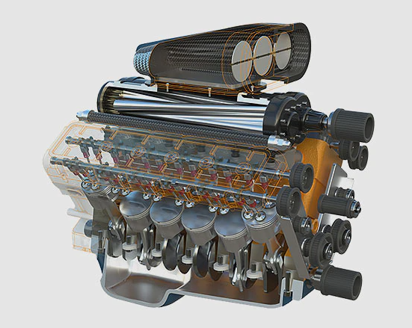
3D models: intuition
Depending on application, we would like our 3D scene to contain different elements
How do we even start with this?
Brady Johnston, Visaulising viruses: https://www.youtube.com/watch?v=adhTmwYwOiA&ab_channel=Blender
OTHER
Arhitecture, Revit: https://www.autodesk.com/products/revit
Autodesk Fusion 360: https://www.autodesk.com/products/fusion-360/overview

Slide 9
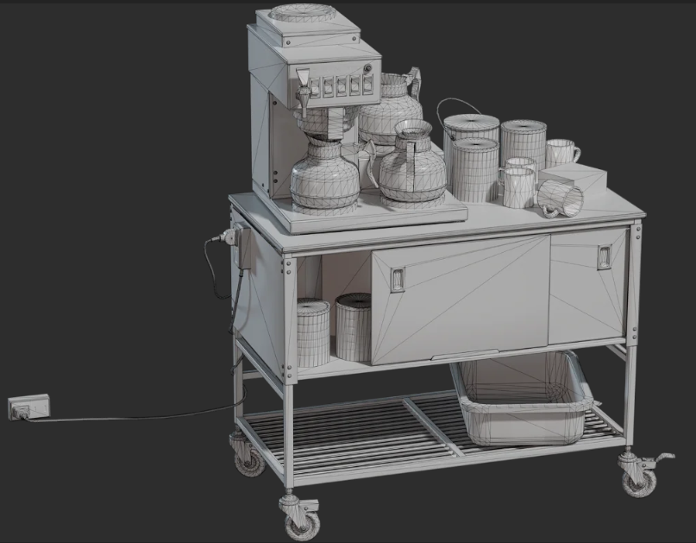
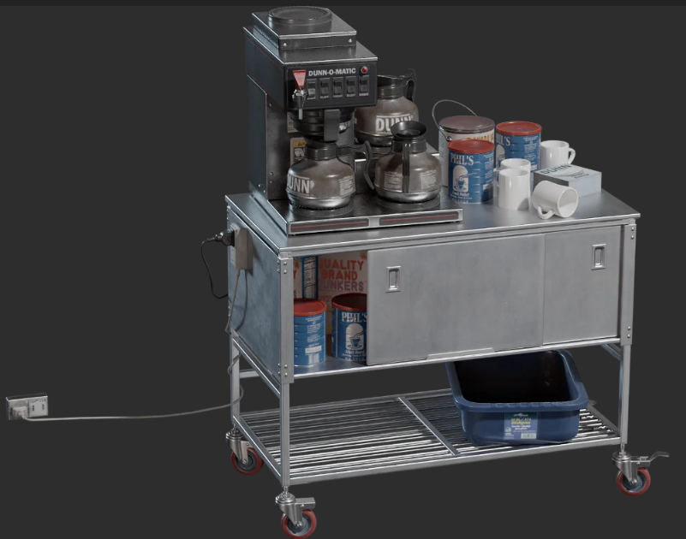
3D models: shape and material
Looking at real world phenomena, we can say that in order to create objects in a 3D scene, we need a way of representing:
Shape
Size, relative position in the space and to other shapes
Appearance
Therefore, we can conclude that representing 3D models requires:
Representation of shape - geometry
Representation of material – appearance

Slide 10
3D model shape representation

Slide 11
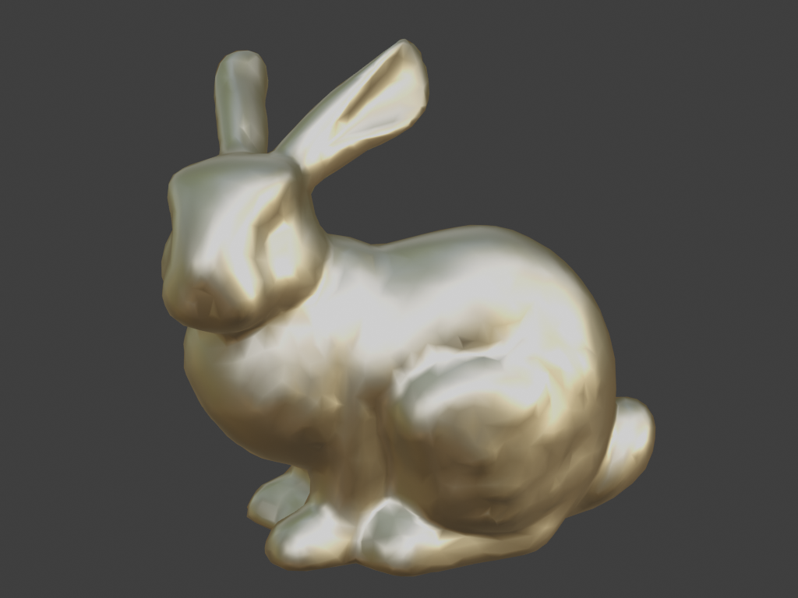
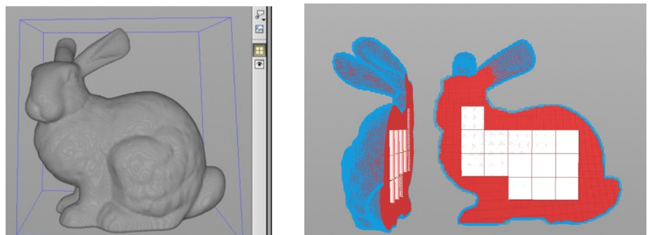

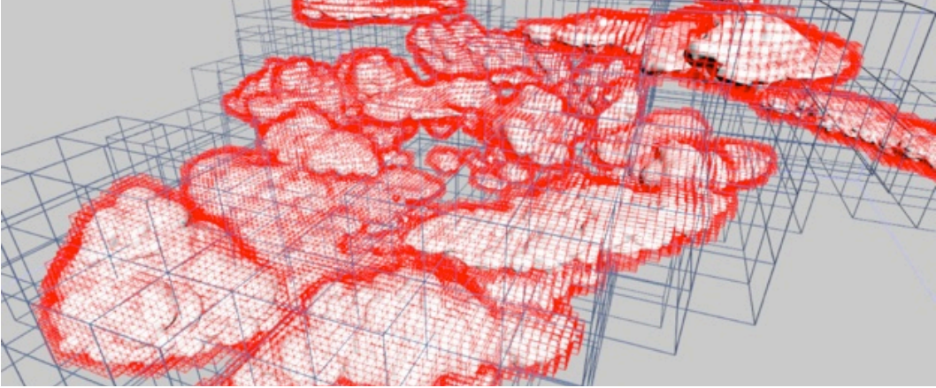
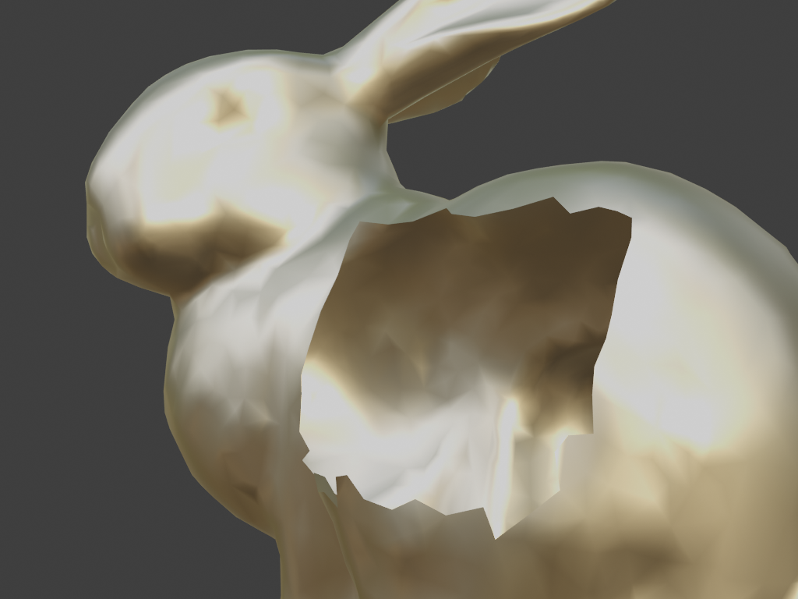
Shape representation: surface and volume
Shape representation can be used to describe:
  Surfaces
  Volumes
Decision on shape representations depends on phenomena that we are modeling
Production examples at dreamworks, OpenVDB: https://artifacts.aswf.io/io/aswf/openvdb/openvdb_production_2015/1.0.0/openvdb_production_2015-1.0.0.pdf
https://research.dreamworks.com/research_library/cloud-modeling-and-rendering-for-puss-in-boots/

Slide 12

Object shape representations
Points
  Point clouds
  Particles and Particle systems
Surfaces:
  Polygonal mesh
  Subdivision surfaces
  Parametric surfaces
  Implicit surfaces
Volumetric objects/solids
  Voxels
  Space partitioning data-structures
High-level structures
  Scene graph
Based on: https://www.cs.princeton.edu/courses/archive/spring22/cos426/lectures/Lecture-5.pdf

Slide 13
Shape representation 1: polygons
To define a surface, simplest way is to connect points to form a polygon. In computer graphics, for computation tractability, we often use co-planar – all points lying on the same plane - polygons and especially triangles.
  Triangle is widely used surface shape representation primitive.
  Very simple and holds great properties for easy calculation, often used for efficient rendering purposes.
  It is approximation method: curved surfaces are approximated with triangles
  Not suitable for modeling, thus different shape representations are introduced. For rendering purposes, often all representations are turned to triangles before/during rendering stage - using very elaborated method called triangulation.
Triangle is basic building block for creating more complex shapes. And modeling is all about creating complex shapes using basic building blocks.
<IMAGE: POINTS, TRIANGLES, COMPLEX SHAPES>

Slide 14
Shape representation 1: polygons
Some shapes do not have flat surfaces! Polygonal shape representation will always have flat surfaces*.
If we would like to represent curved surface, we would need smaller triangles which would fit the curved surface better. In this process we are placing more points on to surface (sampling). Generally, converting smooth surface to triangulated polygon representation – a triangulated mesh – is called tessellation.
Main point to take away is that we can represent any object using triangle polygons. Those objects will never be perfect representations of a real world, but triangles of which they consists of can be small enough to display objects in high quality taking in account restrictions of raster display.
  Amount of details increase realistic representation but also complexity of rendering. Computer graphics often deals with trade-off between visual quality and speed**.
* There are methods in rendering which make surface looks smooth although is represented using polygons. This method is called smooth shading and we will discuss it later.
** Finding good tradeoff between visual quality and object complexity is big research field in computer graphics. Note also that distance of viewing plays important role in amount of detail that it has to be represented.

Slide 15
Shape representation 2: parametric surfaces
Simple shapes can be described mathematically (parametrically), e..g., spheres, disks, planes

Slide 16
Shape representation 2: parametric surfaces
Although polygonal meshes are widely used and popular (e.g., games and film) there are other representations that are more suitable for modeling purposes
One of these are parametric surfaces - used to design manufactured objects and often used in CAD software.
Foundation of those representations are still points, but those points define a control mesh from which perfect curved surface can be generated using analytical description.
  Note that this kind of representation is much more compact than polygonal mesh.
Modeling using control points is very beneficial for curved objects. When it comes to rendering, this representation can not be rendered directly. As discussed, process called tessellation must be performed prior rendering.
<IMAGE: CURVED SURFACES>

Slide 17
Shape representation 3: subdivision surfaces
Polygon modeling can be used for fast creation of simple shapes
Then, subdivision surfaces method can be employed to alternatively refine simple polygon into smooth shapes
<example>

Slide 18
Shape representation 4: voxels
Polygonal or parametric surfaces are describing surfaces, to represent volume it is required to representing space inside such volume
  Example: simulation can be used for shape modeling, e.g., smoke simulation. For this purposes, it is required to represent 3D space in which simulation is performed as grid of cells which are called voxels. <example>
  Each voxel (a cell) is a small volume of space on which computation is performed. Simulation is performed in series of steps. Each step is recorded and transformed to triangulated mesh for rendering.
  This way, animated mesh can be generated.
Any kind of visualizations/simulations/interaction requiring volumetric representation can be well represented with voxels.
  https://sites.google.com/site/letsmakeavoxelengine/home/water
  <example: medical images>
Voxels are also widely used for any kind of modeling purposes where it is required to describe object’s interior – e.g., digital sculpting.
  Example: zbrush

Slide 19
Shape representation 5: implicit
Constructing complex shapes can be also done using basic primitives (box, sphere, etc.) and series of operations (add, substract, etc.). This kind of modeling is called Constructive Solid Geometry.
An representation for such basic primitives is called implicit since they are completely analytically defined. - SDFs
This enables fast and flexible modeling system, but when it comes to rendering, they need to be converted to triangulated mesh – similarly as for curved surfaces. Algorithm in this case is called marching cubes.
Often used in engineering and CAD modeling environments
<CSG AND IMPLICIT SHAPES MODELING>

Slide 20
Shape representation 6: sweeping surfaces
Surfaces that are generated from a section curve positioned along a path*
Blender:
  https://docs.blender.org/manual/en/latest/modeling/meshes/tools/spin.html
  https://docs.blender.org/manual/en/latest/modeling/meshes/editing/edge/screw.html
* https://www.ironcad.com/support/OnlineHelp/3D_Design_Environment/Part_Design_Process/Surface_Design_Process/Sweep_Surface1.htm

Slide 21
Shape representation 7: fractals
Complex, natural phenomena such as clouds, mountains, trees, vegetation, galaxies can be represented using fractals
Mandelbrot: https://www.mandelbulb.com/
Irregular geometrical shapes with symmetrical property
Generative art: http://blog.hvidtfeldts.net/
TODO

Slide 22
Shape representation 8: particle systems
Particles (points, images, simple shapes) which have dynamic behavior described by rules.
examples

Slide 23
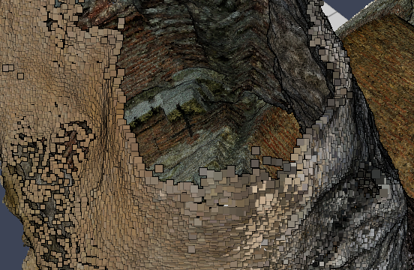
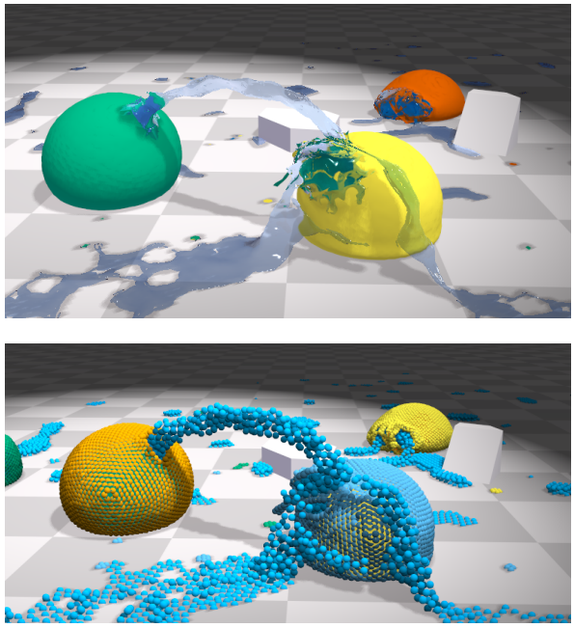
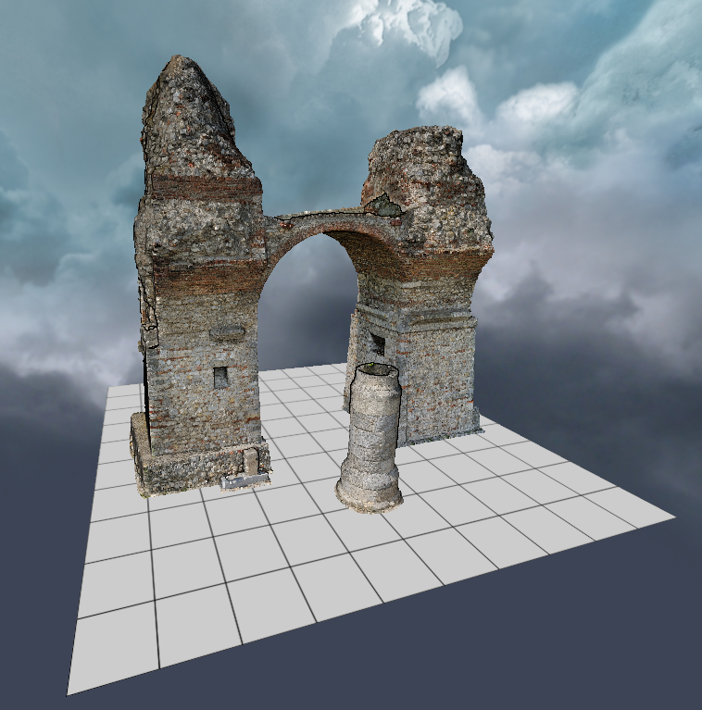
Shape representation 9: points and point clouds
Point clouds, Scans
Unified physics simulation using points representation:
https://github.com/potree/potree
Unified physics for real-time applications: https://mmacklin.com/uppfrta_preprint.pdf

Slide 24
Shape representation 10: image based modeling
TODO

Slide 25
Equivalence of representations
Each shape representation has capacity to describe shape of any geometric object
Different representations exist because certain tasks are more tractable with particular representation. For example:
  Rendering process
  3D modeling
  Simulation of objects
  Animation
  Acquisition/digitalization of objects from a real world
Different datastructures used for representations determine algorithms for processing

Slide 26
3D models: various representations?
Similar as in, e.g., drawing where drawing tools and shapes needed to be chosen, 3D models creation is based on set of representations and operations from which we must choose. Those representations are on the one hand flexible enough to be used for any shape and understandable to a computer, that is rendering program:
From the user-creation point of side: we need a representation of shape and material which is intuitive to handle (to author)
From the rendering point of side: we need to make sure that shape and material representation can be used for rendering process
  Shape representation will be used for determining visibility problem*: what objects we see from certain point of view
  Material representation will be used for determining the shading problem**: how the objects that we see appear
* As we will get to know more complex material representations we will see that this is not completely true. Visibility of objects will also depend on material. Imagine glass cup on the top of a book – book will be visible since glass is transparent.
** Shape and material information are both important for calculating how objects appear. We separate them to show that you can first purely focus on modeling a 3D shape and then model material afterwords. Also, separating objects in shape and material is desired for rendering architectures so that are decoupled.

Slide 27
3D models: various representations?
Different tasks require different representations - acquisition:
  Reconstructing from photographs: photogrammetry
  Creating isosurfaces from CAT or MRI
  Transforming data into surfaces or volumes
  Sampling real world objects using scanners, digitizers or other sensing devices
    Example: kinect

Slide 28
3D models: various representations?
Different tasks require different representations – modeling:
Manual modeling
Procedural modeling

Slide 29

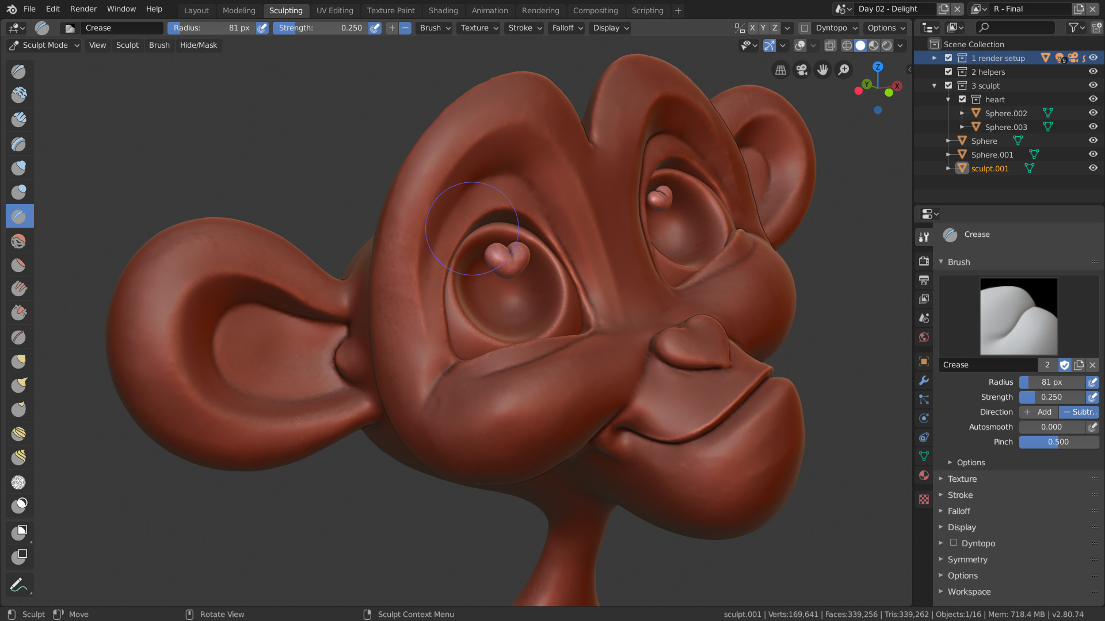
3D models: various representations?
Different tasks require different representations – modeling:
Sculpting
Jasmine, Zbrush, http://pixologic.com/zbrush/gallery/?year=2018
Blender, https://www.blender.org/features/sculpting/

Slide 30

3D models: various representations?
Different tasks require different representations – animation:
Manual, rigging
https://www.blender.org/features/animation/

Slide 31
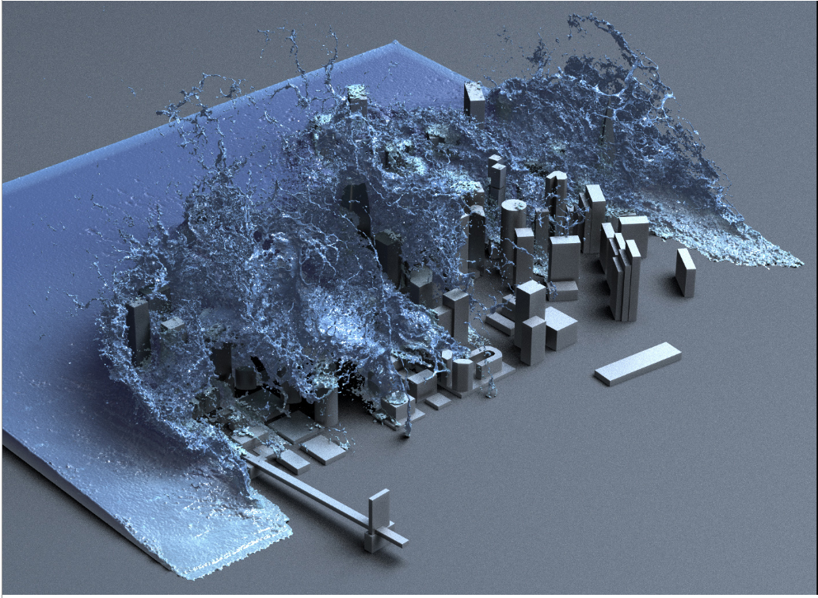
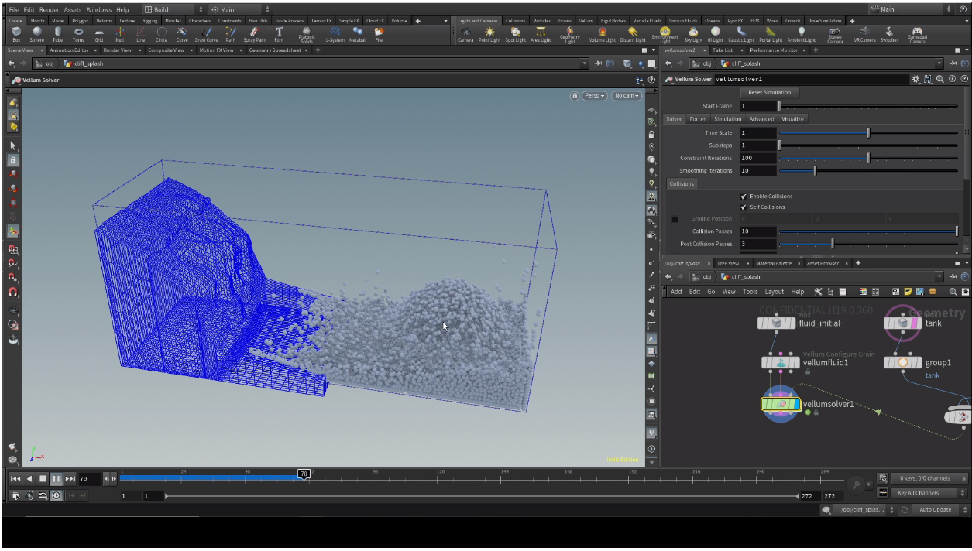
3D models: various representations?
Different tasks require different representations – animation:
procedural, simulation
Houdini, https://www.sidefx.com/tutorials/h19-vellum-fluids-starter-pack/
OpenVDB, https://people.csail.mit.edu/kuiwu/gvdb_sim.html

Slide 32
3D models: various representations?
Different tasks require different representations – rendering:
  Efficient visibility solving

Slide 33
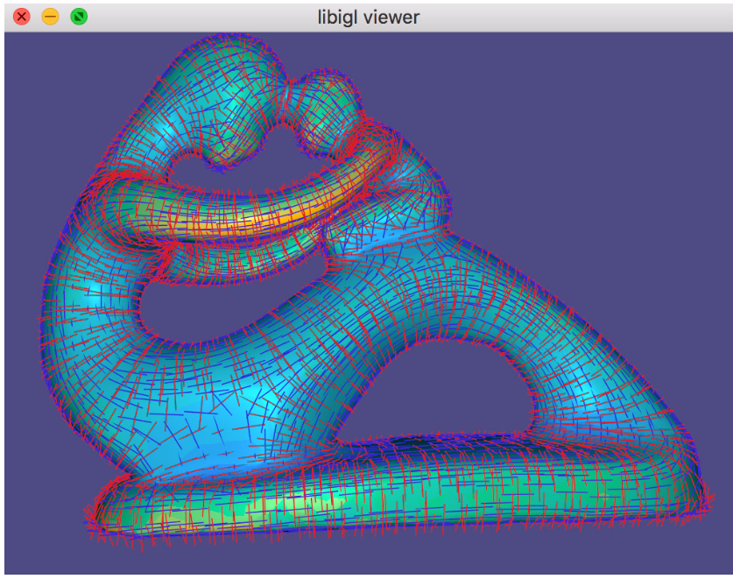
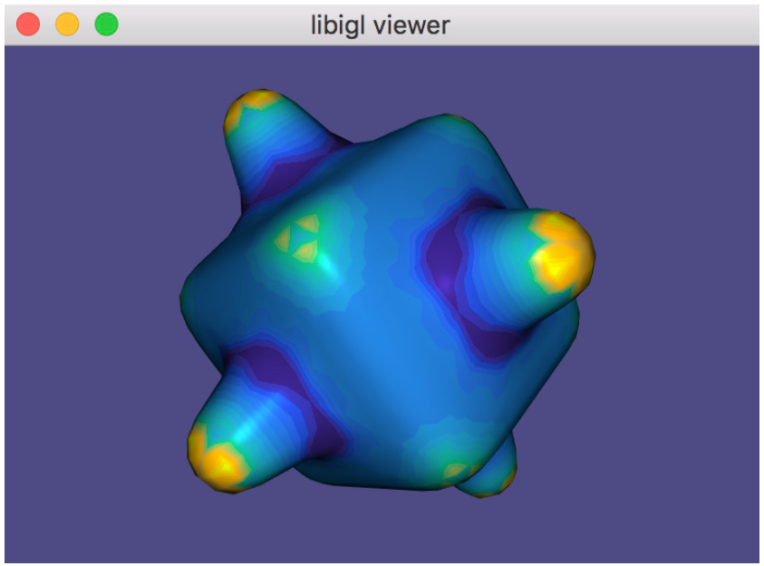
3D models: various representations?
Different tasks require different representations – analysis:
  Curvature
  Smoothness
Libigl: principled curvature directions vectors
Libigl: Gaussian curvature visualization using pseudocolor

Slide 34
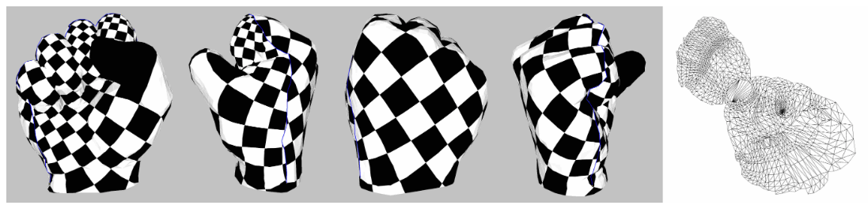
3D models: various representations?
Different tasks require different representations – texturing:
  Parameterization
CGAL: Least Squares Conformal Maps

Slide 35
3D models: various representations?
OTHER examples

Slide 36
Materials

Slide 37
How light interacts with objects?
TODO

Slide 38
Lights

Slide 39
How are light sources simulated
TODO

Slide 40
Cameras

Slide 41
How are cameras simulated
TODO

Slide 42
Complex scene
<IMAGE: An motivation image that we will understand by the end of the lecture.>

Slide 43
Literature
https://github.com/lorentzo/IntroductionToComputerGraphics/wiki/Foundations-of-3D-scene-modeling

