Slide 1
Texture

Slide 2
Syllabus
3D scene
  Object
    Shape
    Material
      Scattering
      Texture
  Camera
  Light
Rendering
Image
Texture
  Texturing pipeline
  Image textures
  Procedural textures
  Material variation

Slide 3
Introduction

Slide 4
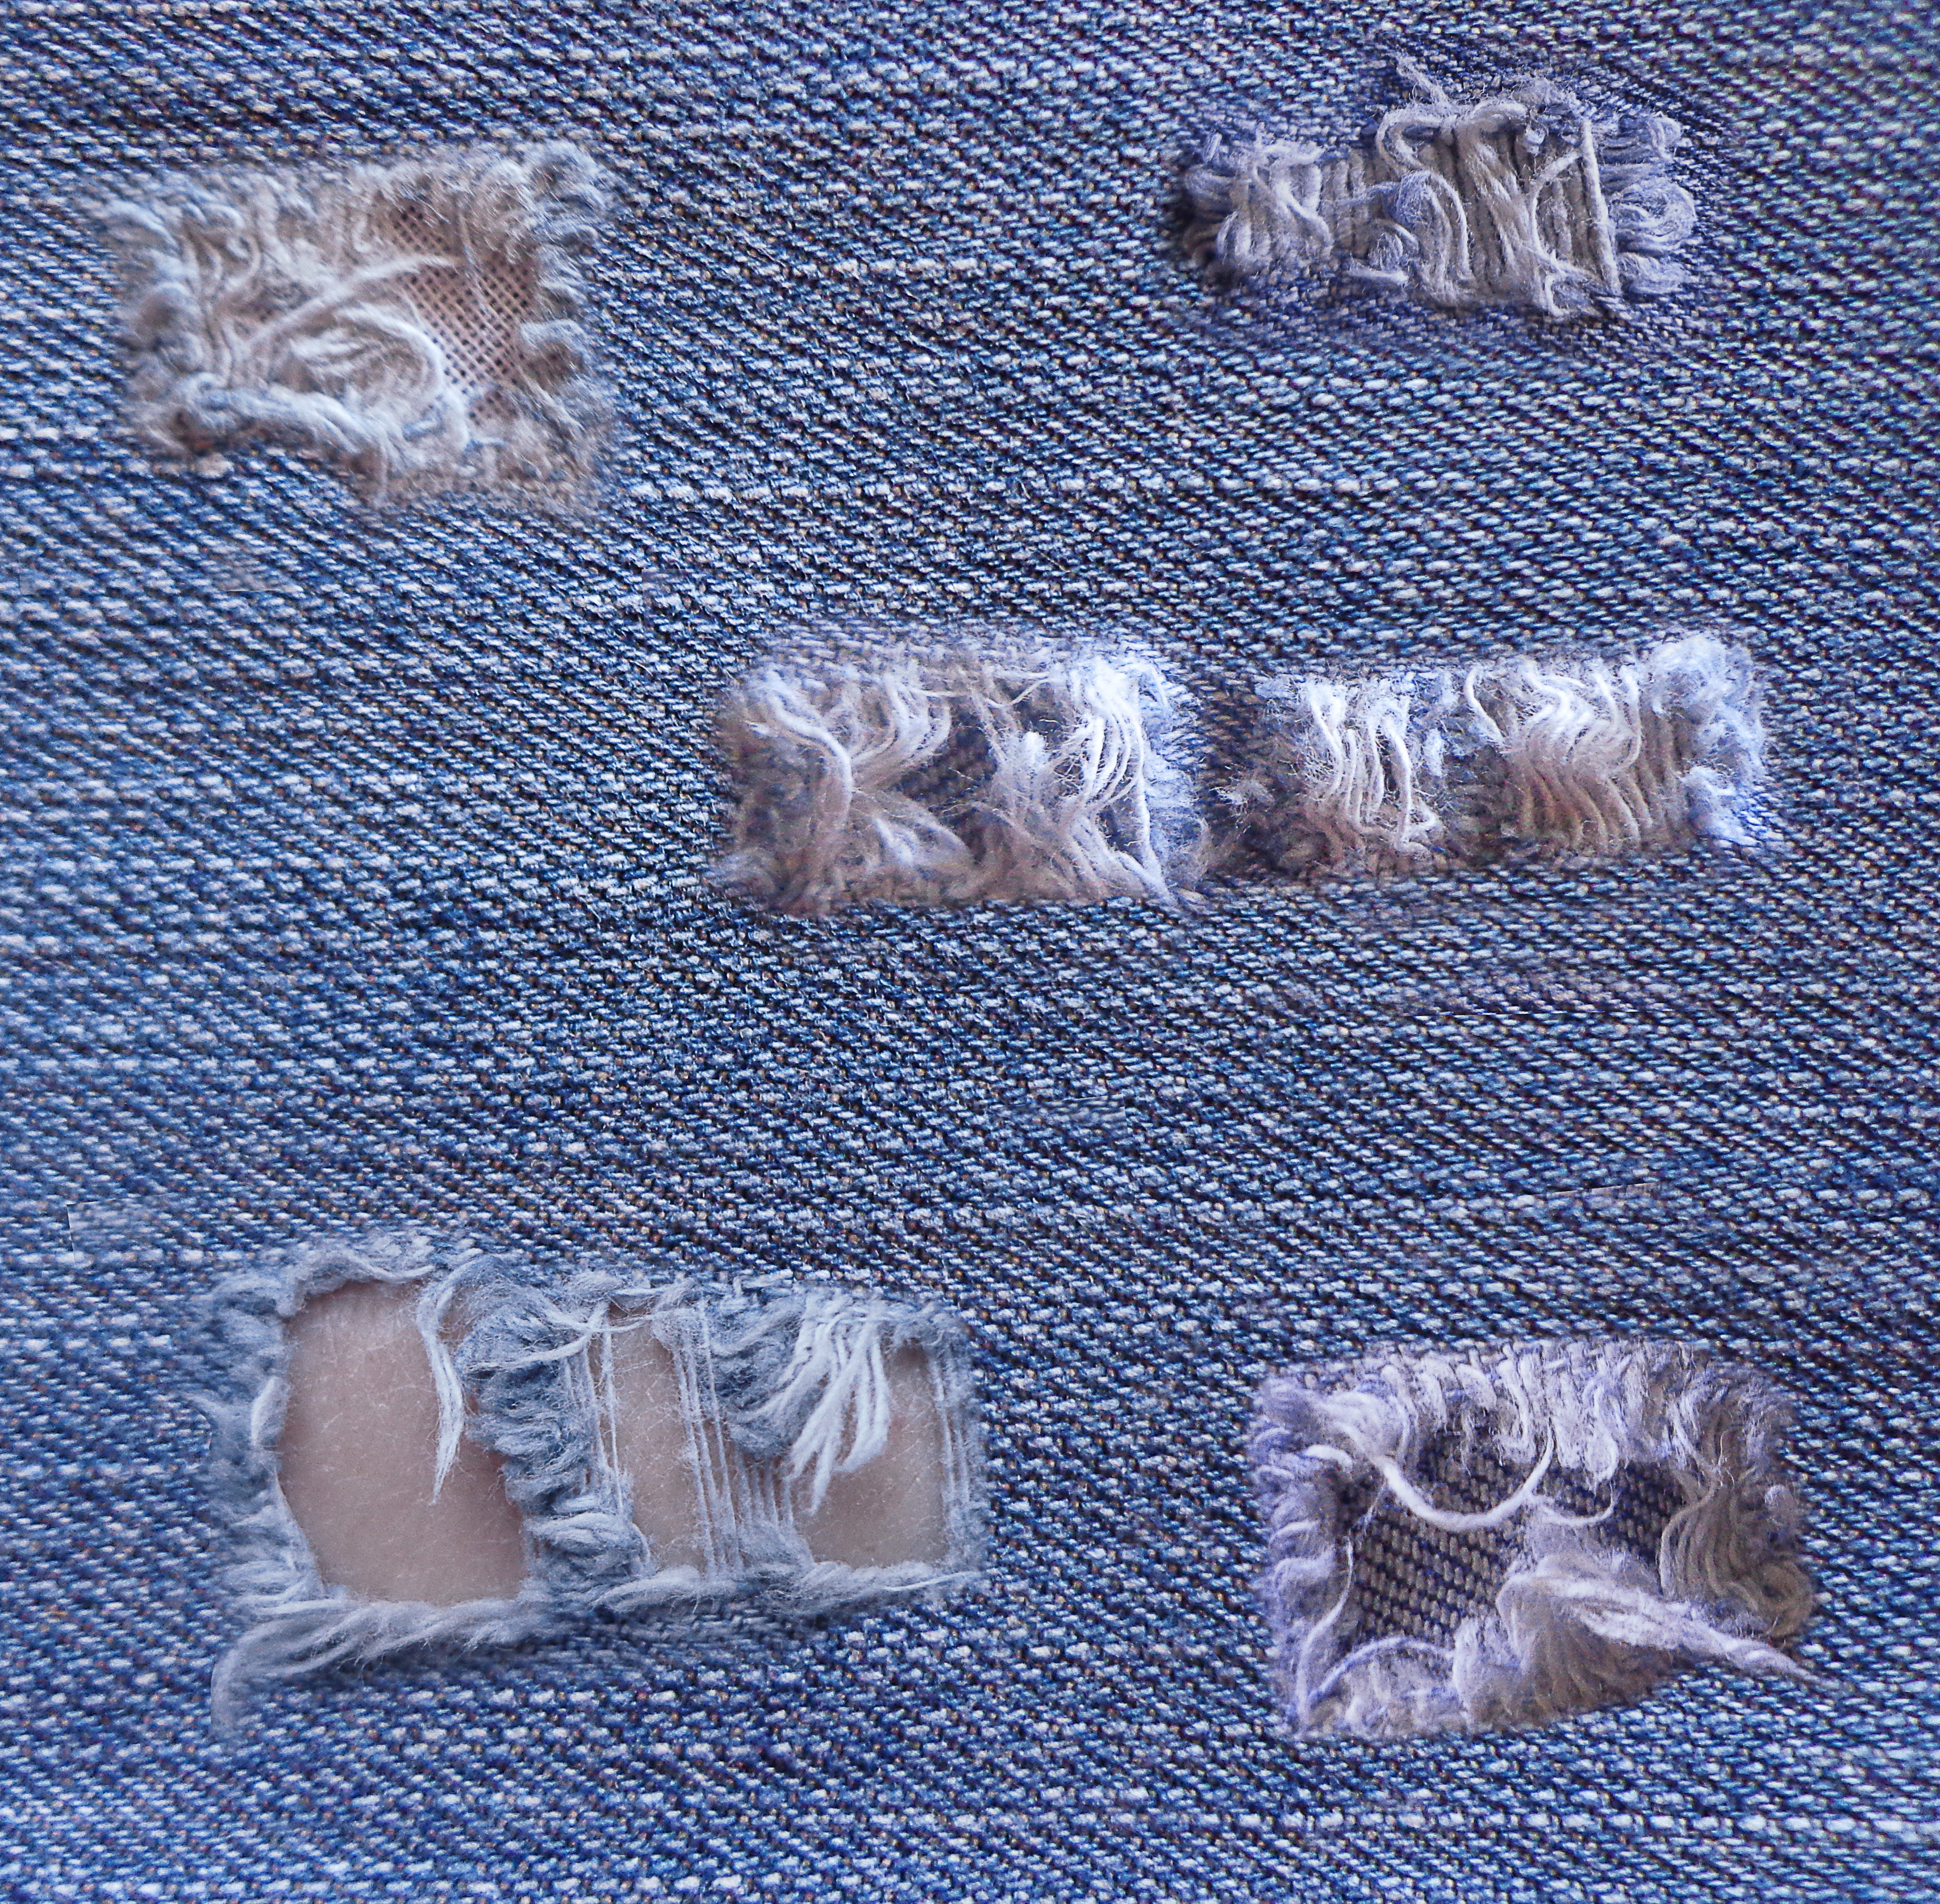
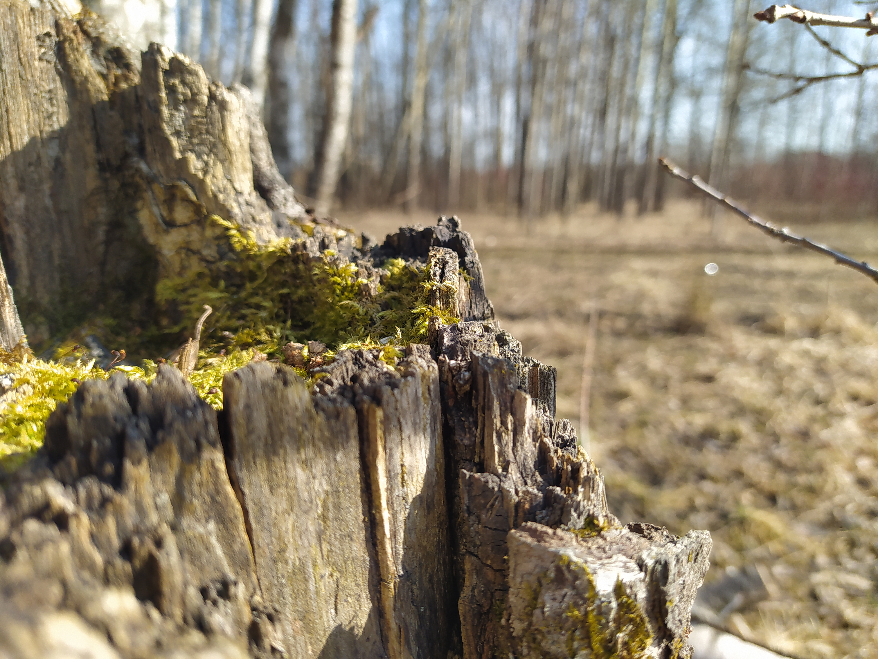
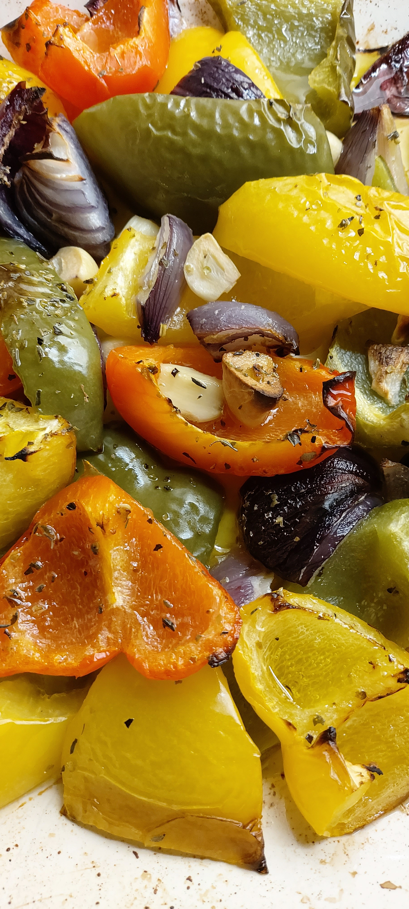
Texture
Term texture is used differently in various disciplines and everyday life: texture of fabric, texture of food, texture in music, texture in image processing, texture in...
Texture doesn’t have well established definition. It spans over multiple scales and over space.
Texture is something we perceive based on geometrical, physical and chemical properties of objects

Slide 5
Texture
For vision, surface texture is its look and feel
  Bark of a tree, surface of stones, oil painting, etc.
<IMAGE>

Slide 6
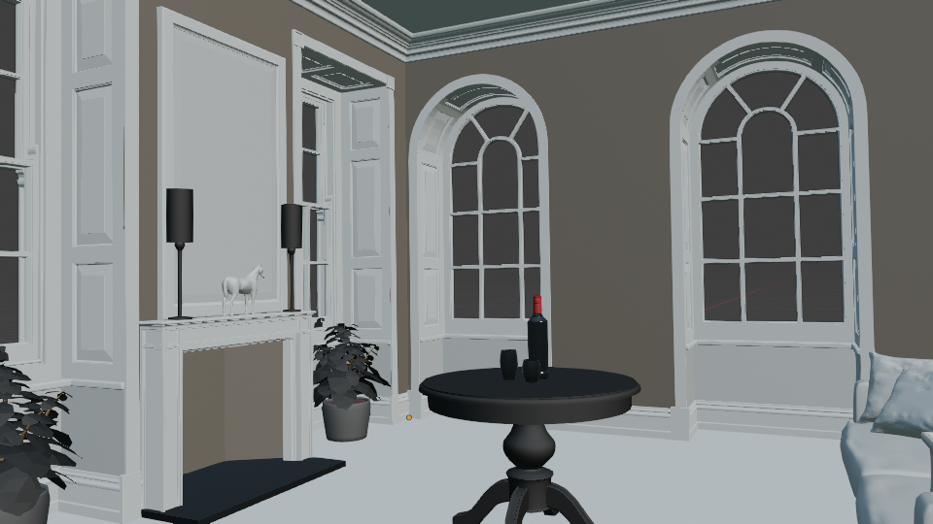

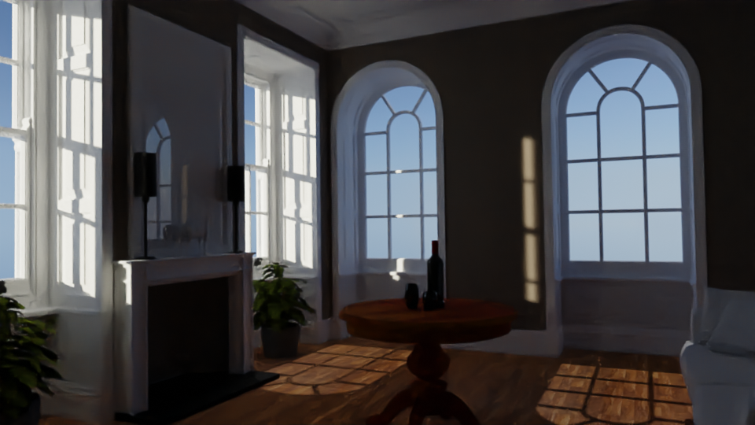
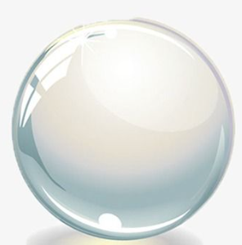
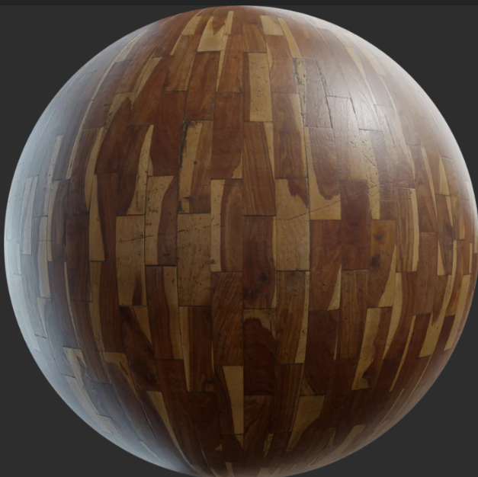
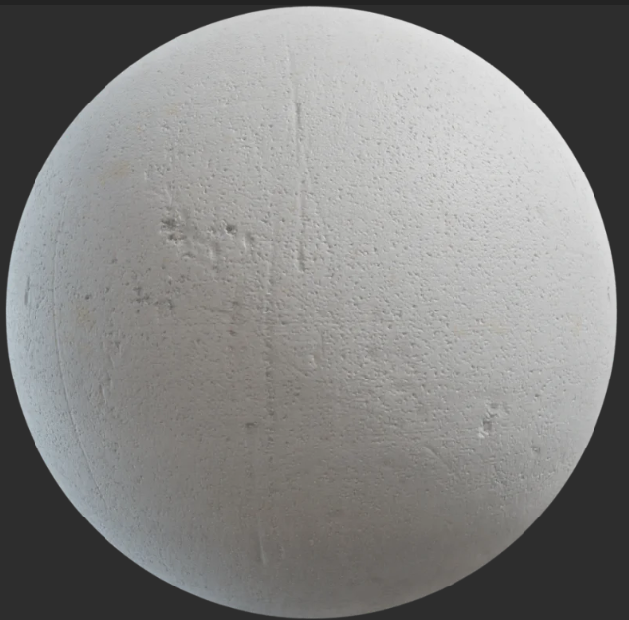
Big picture
3. Image
1. Scene modeling
Material modeling

Slide 7
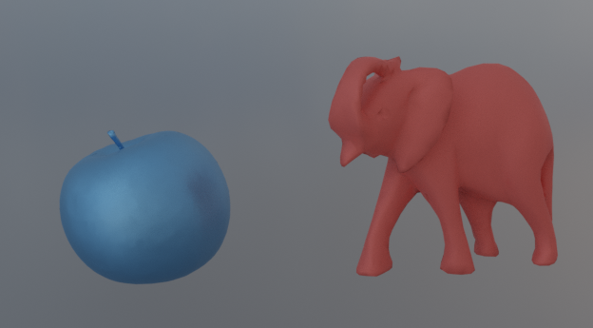
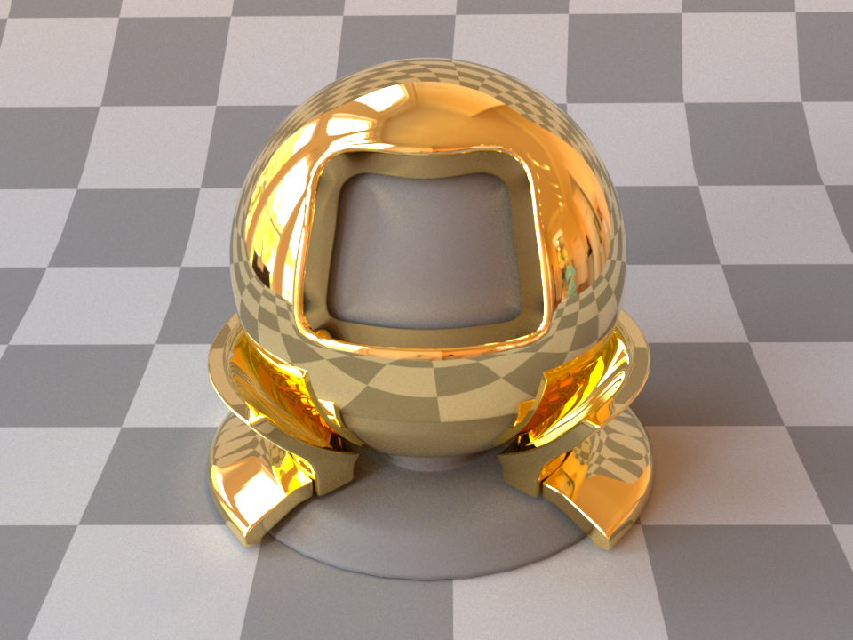
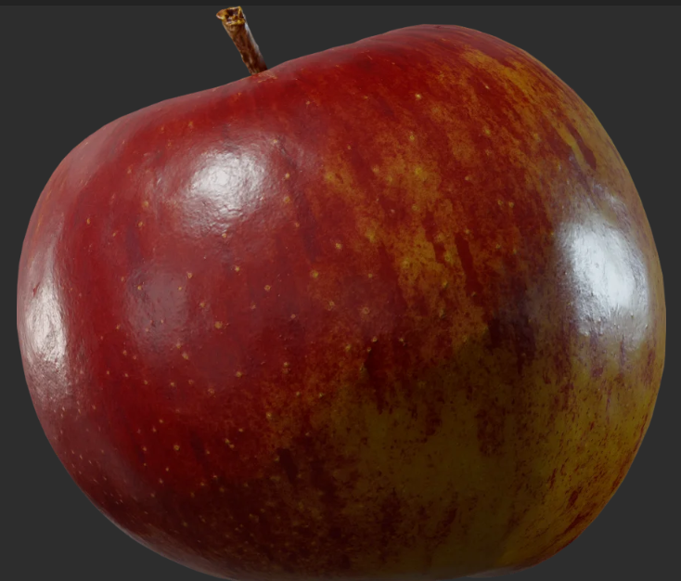
Material characteristics
Characteristics that needed to be modeled in order to obtain required appearance. We can classify any material by following variations:
Spectral: color
Directional
Spatial

Slide 8
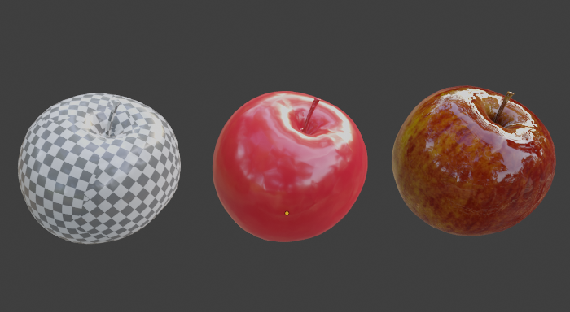
Texture in computer graphics
For 3D modeling, we can try to define texture as function which varies material properties over surface.

Slide 9
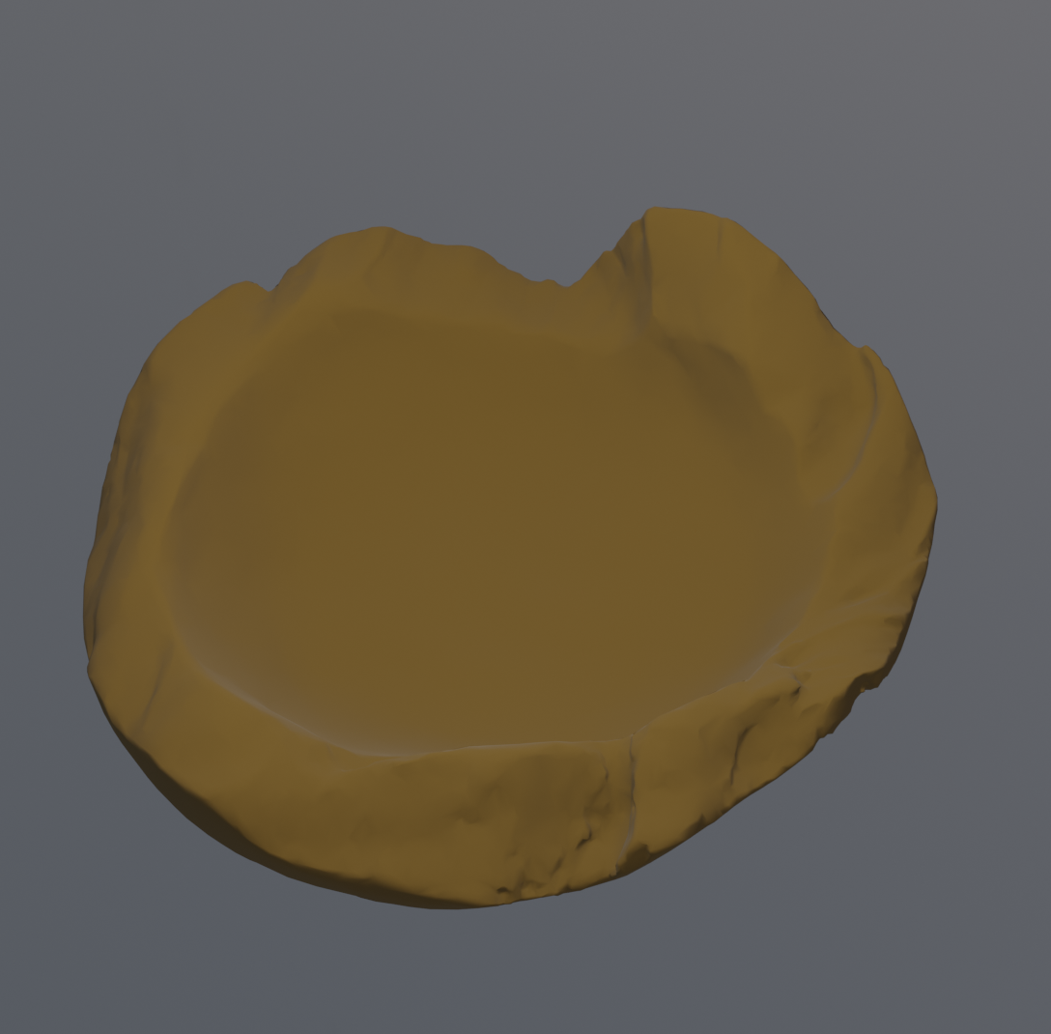
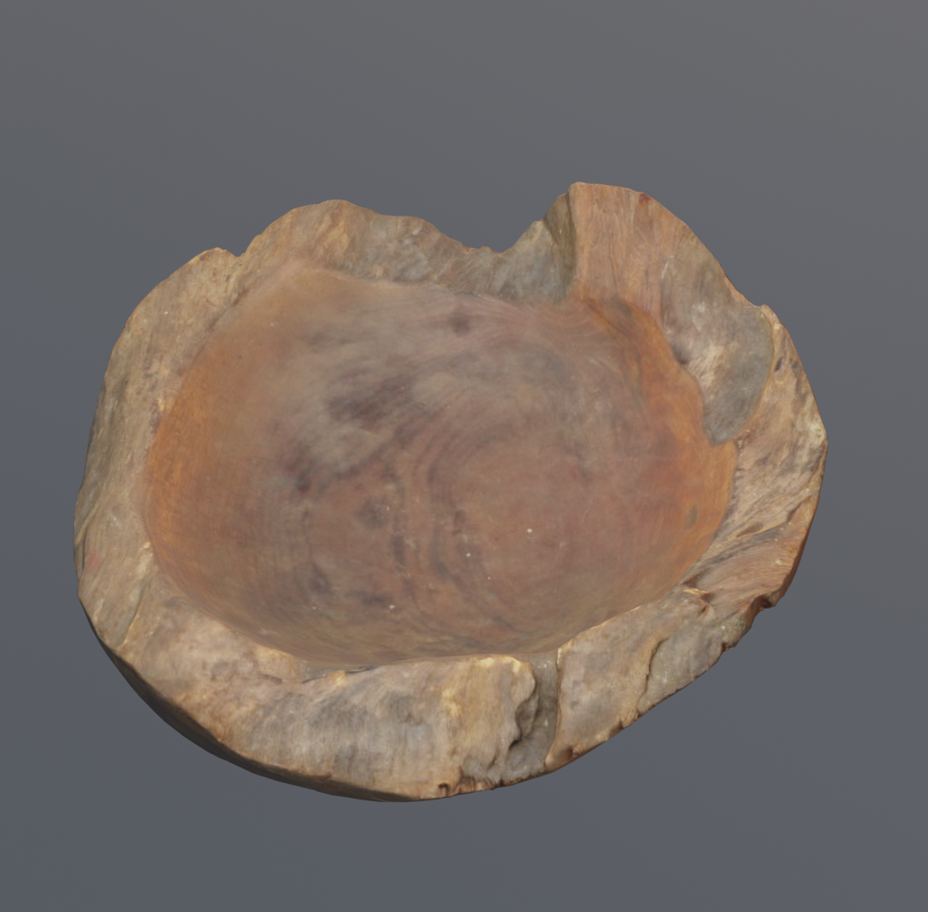
Variation of material over surface
Real objects rarely have only one material or same material properties over the surface → homogeneous material
  Example: wood has structural texture (e.g., grain) at a scale of about 1mm. Also it has cellular texture at lower scale. The material of wood fiber is different. Therefore, the rich appearance of wood comes from material variation of fibers. This richness is called texture.
Homogeneous materials look too smooth and perfect. Missing details, variations and imperfections.

Slide 10
Texture
Visual variation on the object surface – spatial variation:
  Directional or color characteristics → scattering function parameters
  Small-scale geometrical characteristics: bumps, pores, imperfections, etc. → surface normals
In computer graphics, texturing is process that takes surface and modifies its appearance at each location using image, function or other data source.
  Used to add details* and richness to surfaces
* Remember that computer graphics is all about simulation and approximation in order to achieve required appearance. It is a trade-off between quality and speed. Depending on viewing distance and size of objects in 3D scene, some details can be represented with lower quality. For example, modeling all details on geometrical (shape) level can be very expensive. Thus, texturing come in which represent cheaper way to model details.

Slide 11
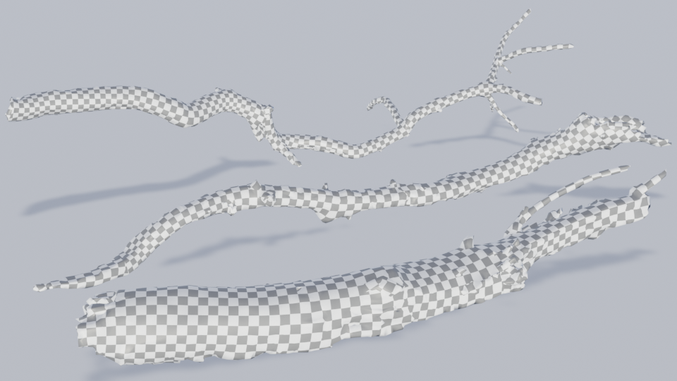
Texturing: practical example
Shape

Slide 12
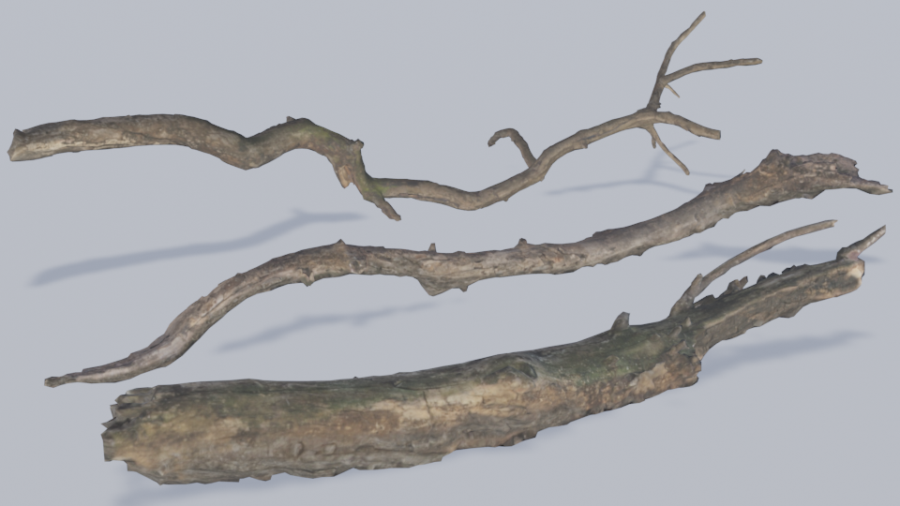
Shape
Scattering function (diffuse)
  Albedo parameter (color) → texture variation

Slide 13
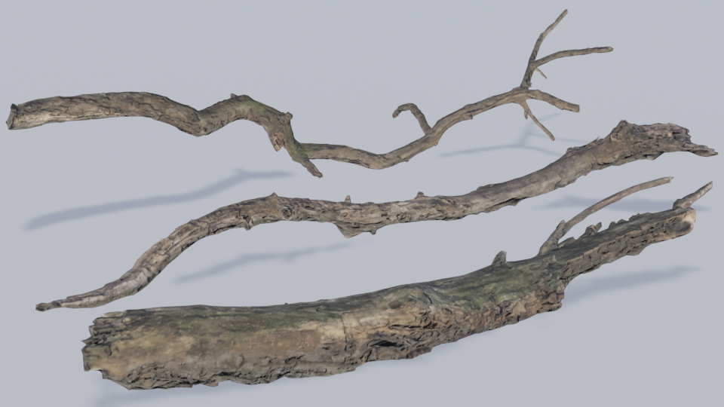
Shape
Scattering function (diffuse)
  Albedo parameter (color) → texture variation
Small-scale geometry (surface normals) → texture variation

Slide 14
Texturing: variation
Textures introduce
  Scattering function parameters and color variation
  Small-scale geometry variation → Shading normal variation
Texturing scale
  Variation on microscale → scattering function and color
  Variation mesoscale → shading normal
  Macroscale is given by the object shape.
Different texturing algorithms with varying complexity and thus quality exists.

Slide 15
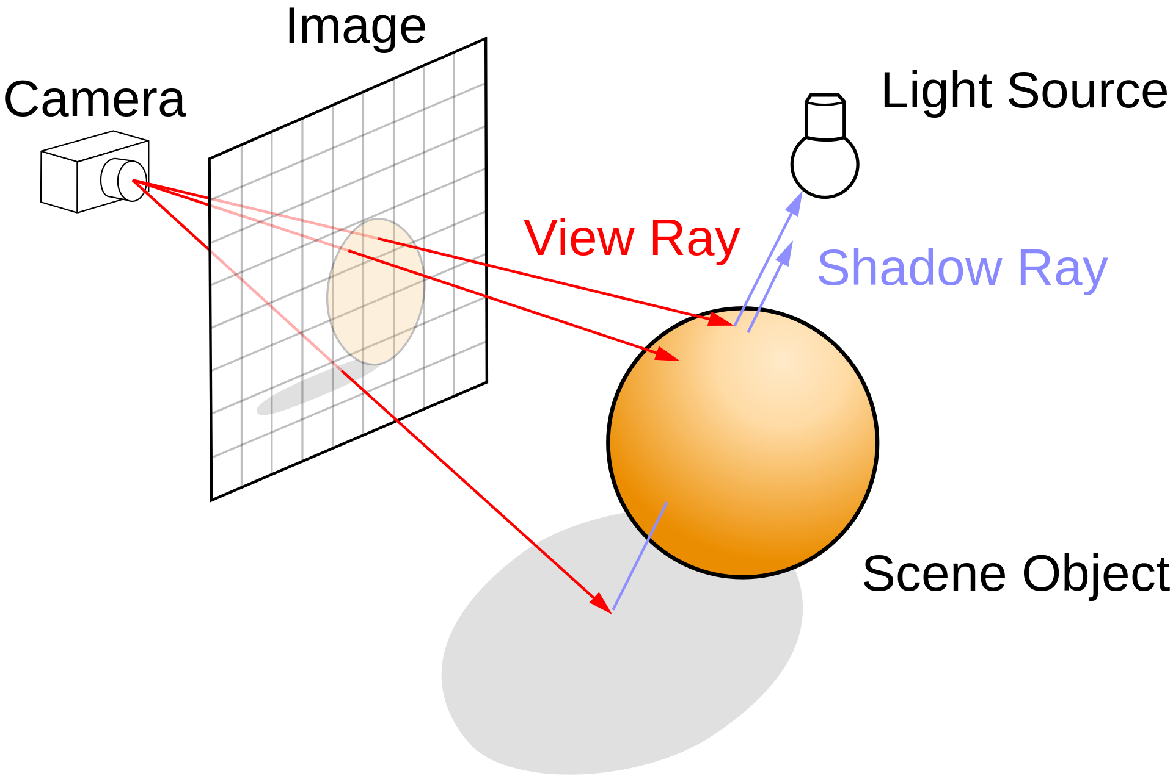
Texture and rendering
Rendering: computing color of pixels in an image
Color of pixels → color of objects visible from camera
  For each pixel, viewing ray is generated, traced into scene for closest intersection.
  Color calculated at intersection → pixel color.
Shading: calculating color at viewing ray intersection with object → shading point.

Slide 16
Texture and shading
Shading uses material, shape, viewing and light to calculate the color in shading point
Material describes interaction of light with surface:
  Scattering model
  Texture model
For each shading point, scattering model is evaluated using texture information at that point
Final rendered image, due to variation of colors and intensities over object, the surface will contain pattern
  Surface with pattern is called textured surface

Slide 17
Note on “texture”
Texture in material modeling context carries information needed for shading
  For example, color of texture is not one on one in the rendered image – it is used to calculate that color.
Texture function vs texture
  Texture function defines shading parameters over object surface → something that we model
  Texture is what we see as rendering result on a surface – a pattern
Texture is generally overloaded term and it is furthermore overloaded in computer graphics and depends on context:
  Texture can be used for modeling object appearance (material)
  On GPU, texture, besides material modeling, can be used as memory buffer to send arbitrary data (e.g., geometry) from CPU to GPU

Slide 18
Texturing pipeline

Slide 19
Texturing pipeline: example
TODO
Wooden floor
  During rendering, object position (x,y,z) on wooden floor is found
  Projector function finds mapping from (x,y,z) to (u,v). In this case simple projection can be used: u~=x, v~=y so that u,v are in [0,1] – texture coordinates
  Corresponder function uses texture coordinates for finding corresponding pixel in the image of wooden floor. If image has resolution 1024x1024 then pixel positions are integer of 1024*u, 1024*v
  Texture reading is performed using texture space locations
  Finally, color encoded in texture can not be directly used for rendering, transformation on values is done (e.g., sRBG → linear). Resulting values are used.
  <ILLUSTRATE>

Slide 20
Texturing pipeline
Object space location
Texturing: variation of shading parameters over surface – position dependency
Object space location
  Shading point → object-space coordinates (x,y,z), e.g., (1.2, 3.3, -3.4)
Projection function
  Mapping process: object space coordinates → texture space coordinates (u,v) in [0,1], e.g., (0.2, 0.5)
Corresponder function
  Transform: texture space coordinates → texture locations (s,t) e.g., [image_width, image_height], e.g., [128, 44]
Obtaining texture values (sampling)
  Texture space location is used for obtaining texture value
Value transform
  Optional additional transformations are done on texture value
Usage
  Final value is used to modify property of surface at that point: scattering function parameter or normal.
Projector function
Texture coordinate
Corresponder function
Texture space location
Texture obtain
Texture value
Value transform
Transformed value

Slide 21
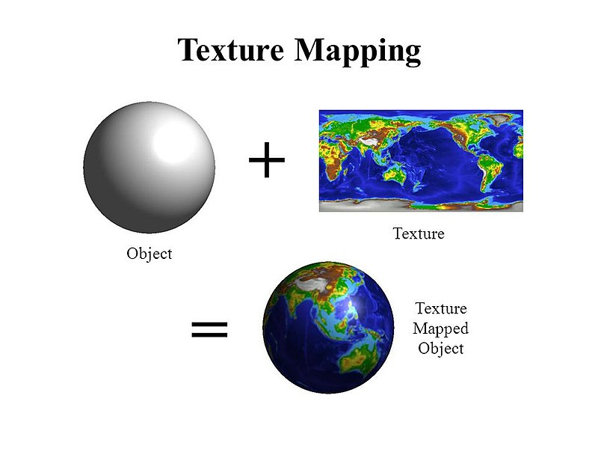
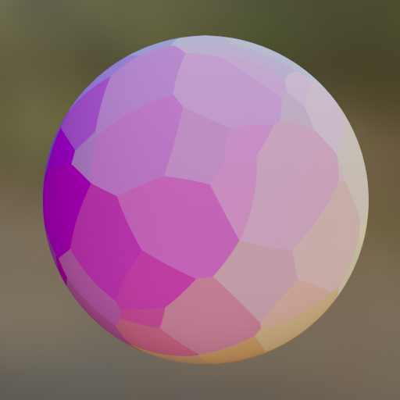
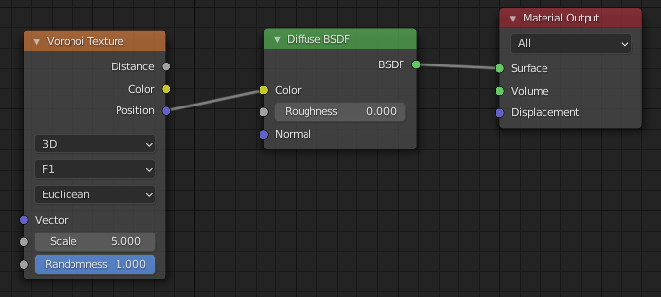
Texturing pipeline
Texturing pipeline is implemented in renderer and can be applied on two main types of texturing:
  Image texturing: e.g., 2D image is “pasted” on 3D object
  Procedural texturing: e.g., an algorithm generates pattern on 3D object
Some steps of texturing pipeline can be omitted depending on texturing method
  Example: procedural texturing can directly use object space location
For start, we will explain texturing pipeline for image textures
Image Texturing
Procedural texturing

Slide 22
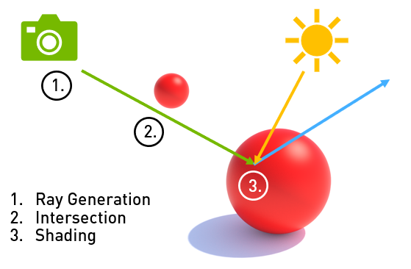
Object space location
Object space location
Projector function
Intersection (shading) point
  Object space location (x,y,z)
  World space object location can also be used
    In this case, as object moves, the coordinates change!
Texture coordinate
Corresponder function
Texture space location
Texture obtain
Texture value
Value transform
Transformed value
https://developer.nvidia.com/blog/rtx-best-practices/

Slide 23
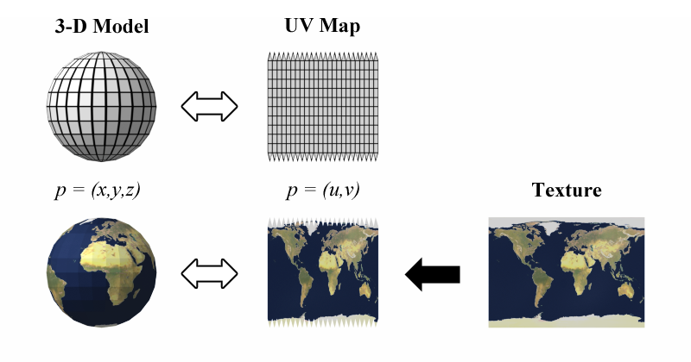
Projector function
Object space location
First step in texturing process;
  Projector function maps object space location into texture coordinate space
    Thus “texture mapping” term
For image texture: 3D object point (x,y,z) to 2D space (u,v) in [0,1]
Projector function
Texture coordinate
Corresponder function
Texture space location
Texture obtain
Texture value
Value transform
Transformed value
https://users.csc.calpoly.edu/~zwood/teaching/csc572/final10/wdhamilt/

Slide 24
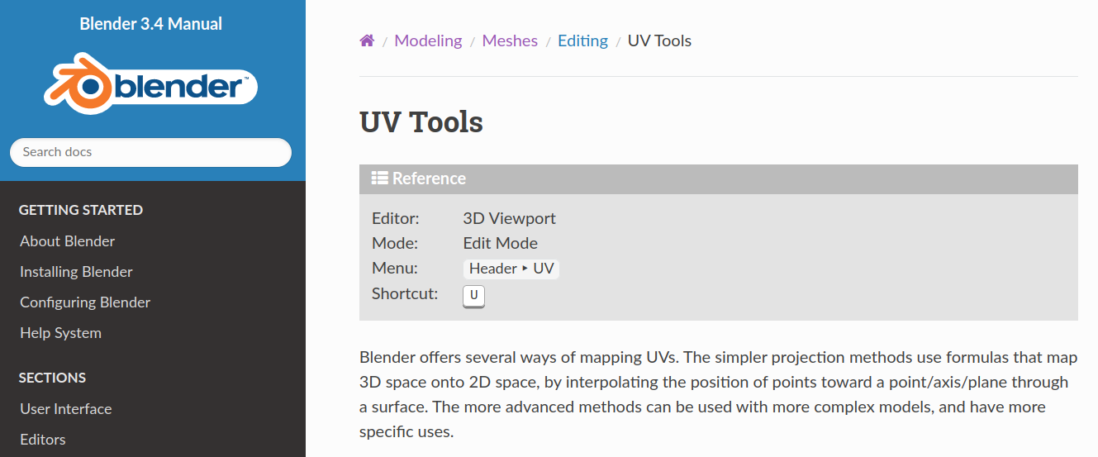
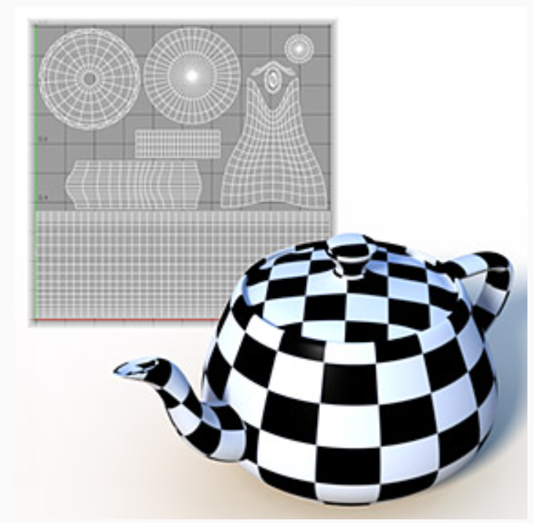
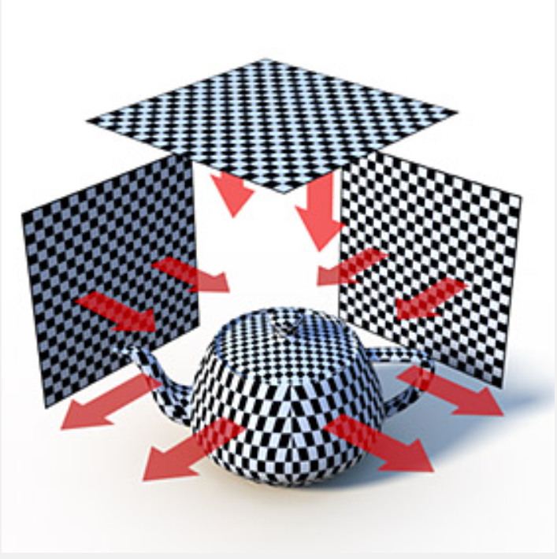
Projector function
Object space location is used to:
  Interpolate texture coordinates stored per vertex
    Mesh unwrapping or texture projection → generates texture coordinates per vertex (performed prior rendering)
    Modeling packages implement different methods for generating texture coordinates per vertex and enable artist to edit texture coordinates
  Calculate texture coordinates on the fly in render-time: texture projection
Unwrapping
Projection
https://docs.blender.org/manual/en/latest/modeling/meshes/editing/uv.html

Slide 25
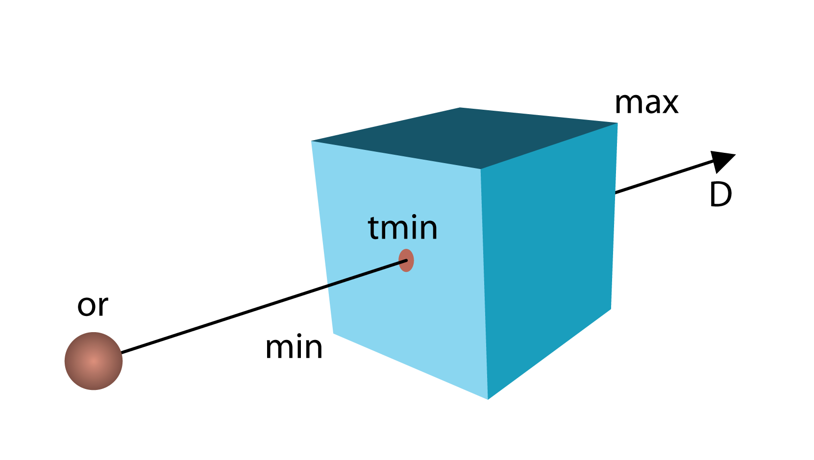
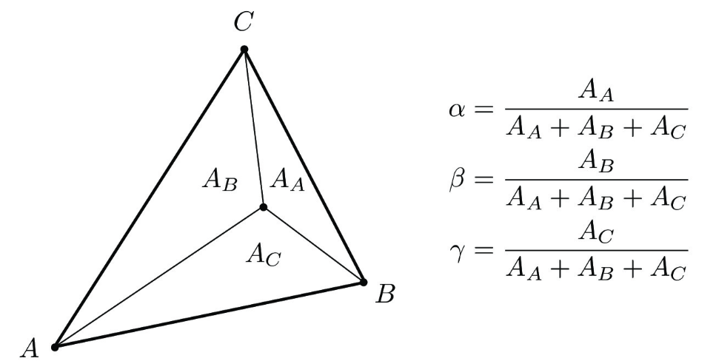
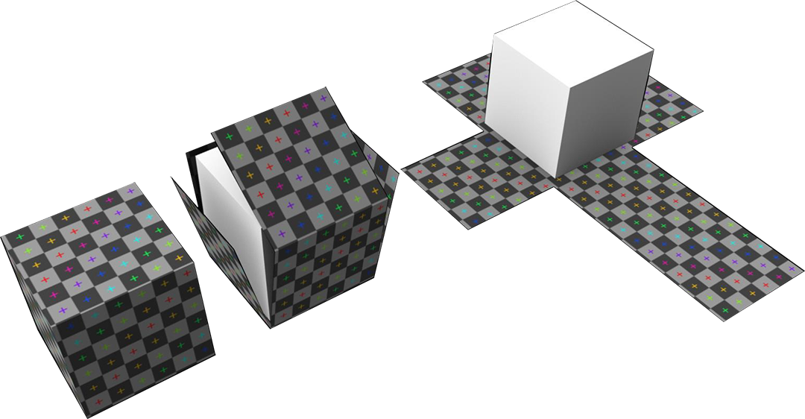
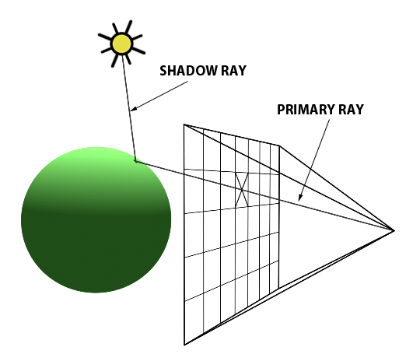
Vertex texture coordinates
Triangulated mesh can store texture coordinates per vertex
  Mesh unwrapping tries to “unwrap” 3D surface onto 2D space so that each vertex is assigned with 2D texture coordinate (u,v)
For any intersected/shading point P(x,y,z) on triangle of mesh, barycentric interpolation is used to calculate texture coordinate from ones stored per vertex
C(u,v)
P(x,y,z)
P(u,v)
B(u,v)
A(u,v)
https://help.disguise.one/en/Content/3D-Workflow/UV-Mapping/What-is-UV-mapping.html
P(u,v) = αA(u,v) + βB(u,v) + γC(u,v)
α + β + γ = 1

Slide 26
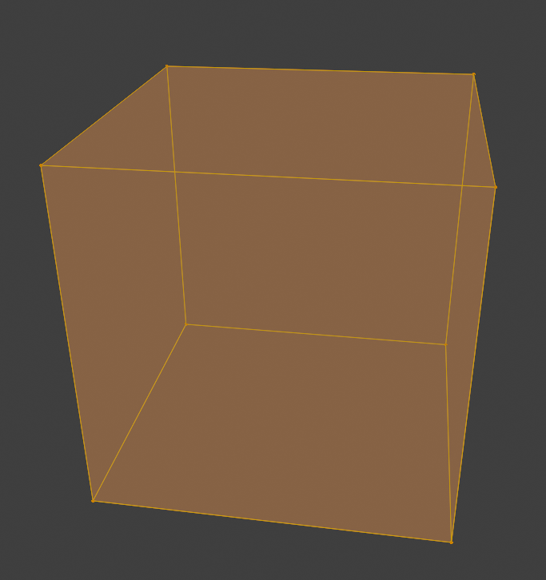
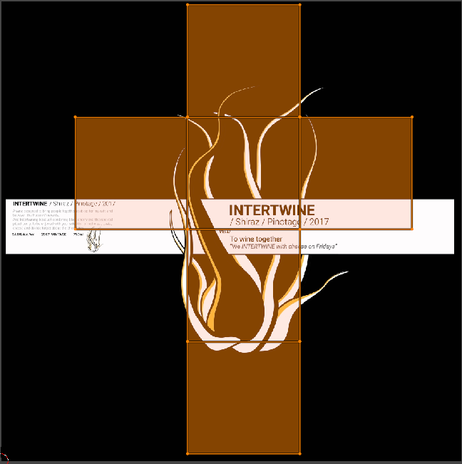
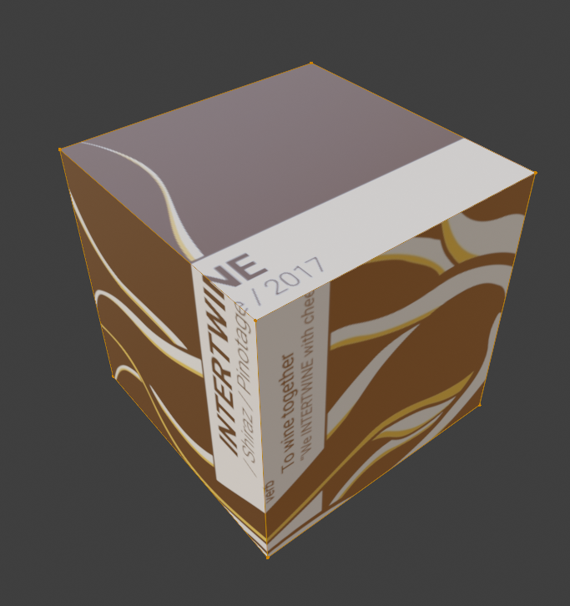
Projector function: mesh unwrapping
Mesh (UV) unwrapping: each vertex is assigned with 2D texture coordinate (u,v) in [0,1]
  Unwrapping methods belongs to larger field called mesh parametrization
Modeling packages offer different methods for unwrapping and a way to manually enhance the results
  Goal is that each polygon gets fair share of texture area (e.g., evade stretching) but maintaining connectivity – which determines where separate parts of texture meet and visible seams.

Slide 27
Texture projection
The goal is to transform 3D point in space into texture coordinate* using projections:
  Spherical
  Cylindrical
  Planar
  Cubic
  Box
  Front
* Note that the goal is really to find texture coordinates and not to find a way of pasting a 2D image on 3D object. This is more general. Once texture coordinates are found, different types of textures can be used: image or procedural, etc.

Slide 28
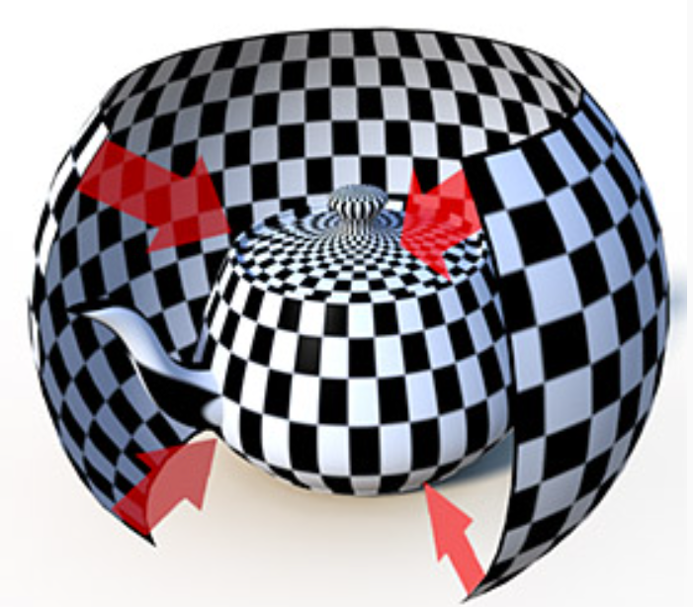
Spherical texture projection
Texture is wrapped into a spherical shape and projected onto a shape.
Good for texturing round objects.
Surfaces perpendicular to projection cause stretching
https://learn.foundry.com/modo/901/content/help/pages/shading_lighting/shader_items/projection_type_samples.html

Slide 29
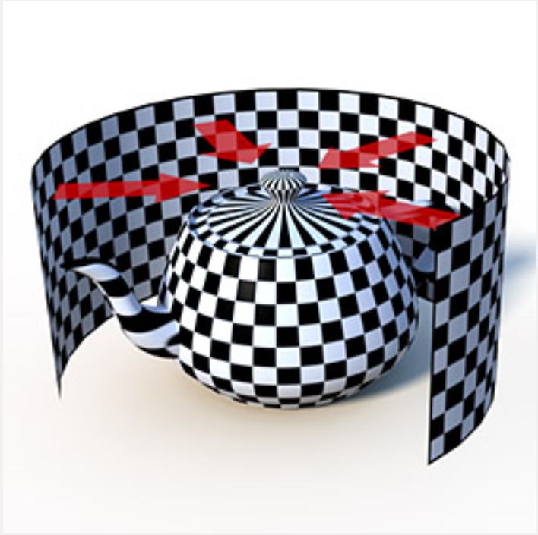
Cylindrical texture projection
Texture is wrapped in cylindrical shape and projected onto surface.
Good for cylindrical surfaces (cans, bottles).
Surfaces perpendicular to projection might cause stretching.
https://learn.foundry.com/modo/901/content/help/pages/shading_lighting/shader_items/projection_type_samples.html

Slide 30
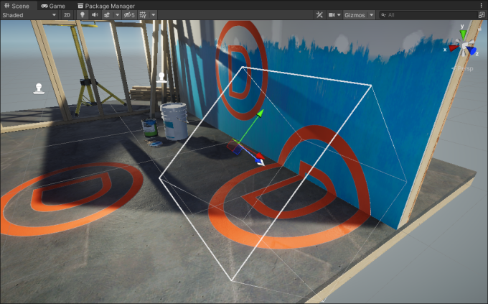
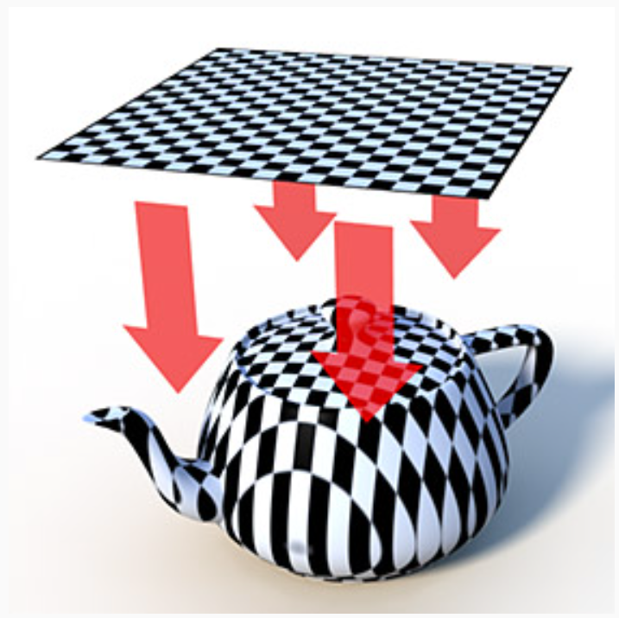
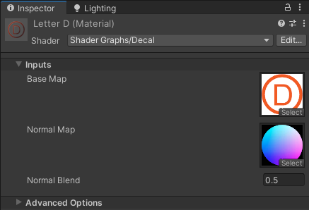
Planar texture projection
Similar to concept of movie projector but image is projected orhographically.
  Any vector defining projection plane can be used.
Great for flat or nearly flat surfaces.
Other surfaces might cause stretching of texture.
Planar projection is useful for decal rendering.
https://docs.unity3d.com/Packages/com.unity.render-pipelines.universal@12.0/manual/renderer-feature-decal.html
https://learn.foundry.com/modo/901/content/help/pages/shading_lighting/shader_items/projection_type_samples.html

Slide 31
Cubic texture projection
Texture is planar-projected on a surface from all three axis directions: X, Y, and Z
Polygon receives a certain projection, based on its normal direction.
Best for cube-shaped objects, and occasionally on detailed surfaces where texture seams are not of great concern
https://learn.foundry.com/modo/901/content/help/pages/shading_lighting/shader_items/projection_type_samples.html

Slide 32
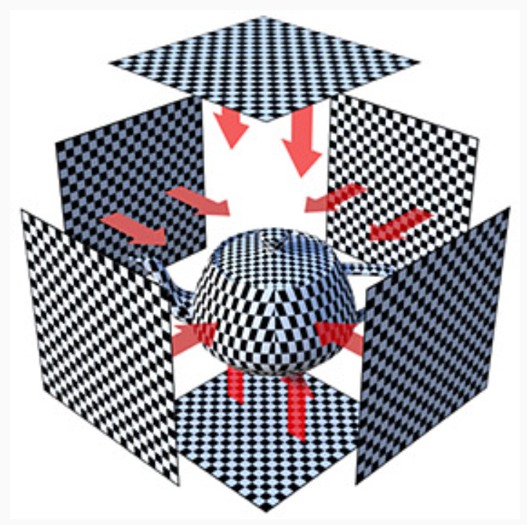
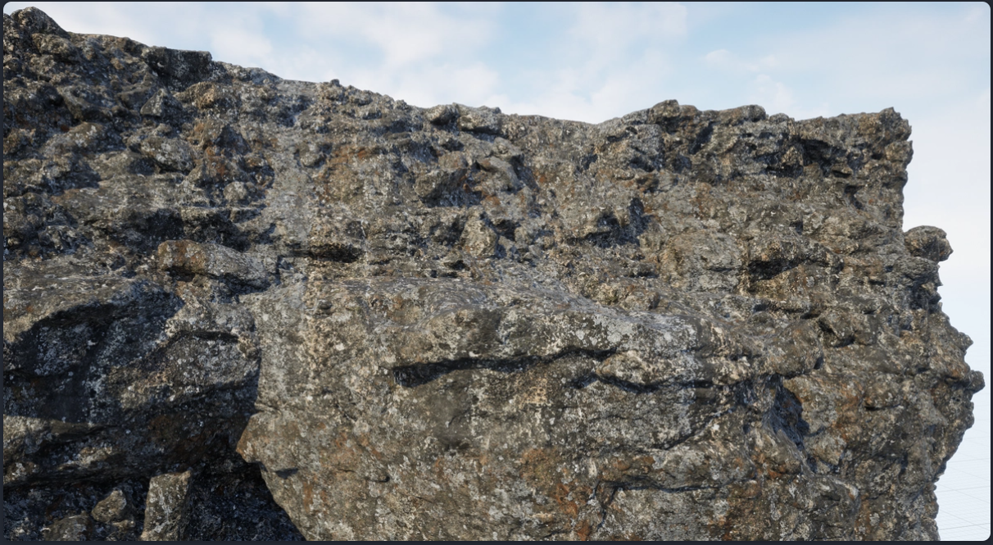
Box texture projection
Projects a texture in a planar fashion from all six directions, eliminating reverse projections on rear facing polygons inherent to the Cubic method (aka triplanar mapping)
Best on cube-shaped objects, and occasionally on detailed surfaces where texture seams are not of great concern
  For curved and tilted surfaces efficient blending of multiple projection planes must be used.
https://learn.foundry.com/modo/901/content/help/pages/shading_lighting/shader_items/projection_type_samples.html
https://ryandowlingsoka.com/unreal/triplanar-dither-biplanar/

Slide 33

Front texture projection
Texture is projected out from a camera or light's position
https://learn.foundry.com/modo/901/content/help/pages/shading_lighting/shader_items/projection_type_samples.html

Slide 34
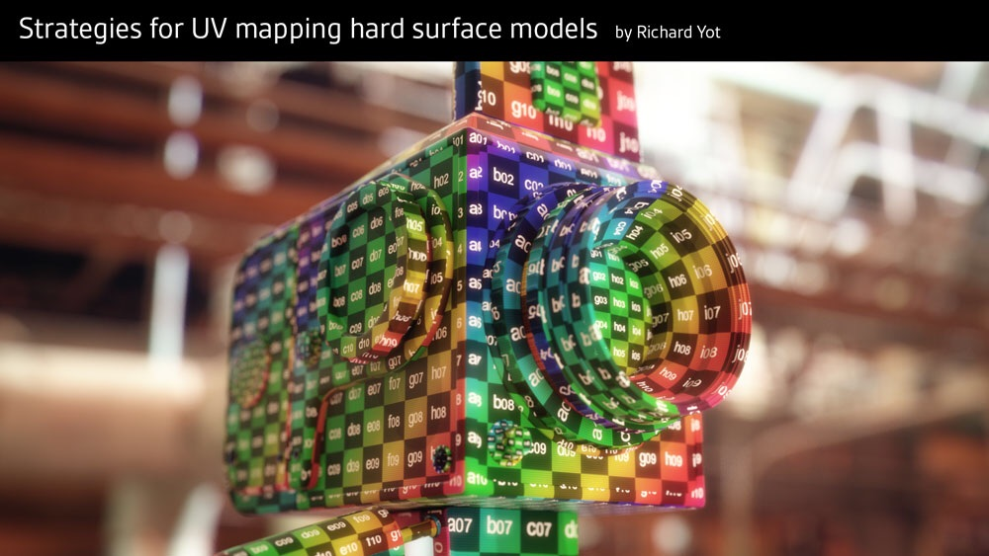
Projector function: complex shapes
For highly complex shapes, separating into simpler shapes can be done and then texture projection can be done separately.
[983] Pagán, Tito, "Efficient UV Mapping of Complex Models," Game Developer, vol. 8, no. 8, pp. 28-34, August 2001

Slide 35
Projector function: different approaches
If object is supplied with any kind of additional information (e.g., curvature or temperature) it can be also used for texture coordinate generation
Texture coordinates must be generated in this step.
  Using position and normal for deriving those is only one way of doing it.

Slide 36
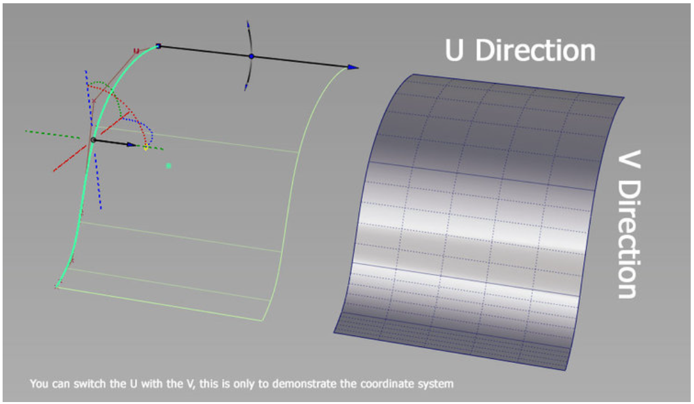
Projector function: inherent texture coordinates
Parametric surfaces (e.g., NURBS) have natural set of (u,v) texture coordinates which defines any (x,y,z) point on surface
In this case, we can say that surface representation already has inherent texture coordinates and projector function is not needed.
https://www.ebalstudios.com/blog/introduction-nurbs

Slide 37
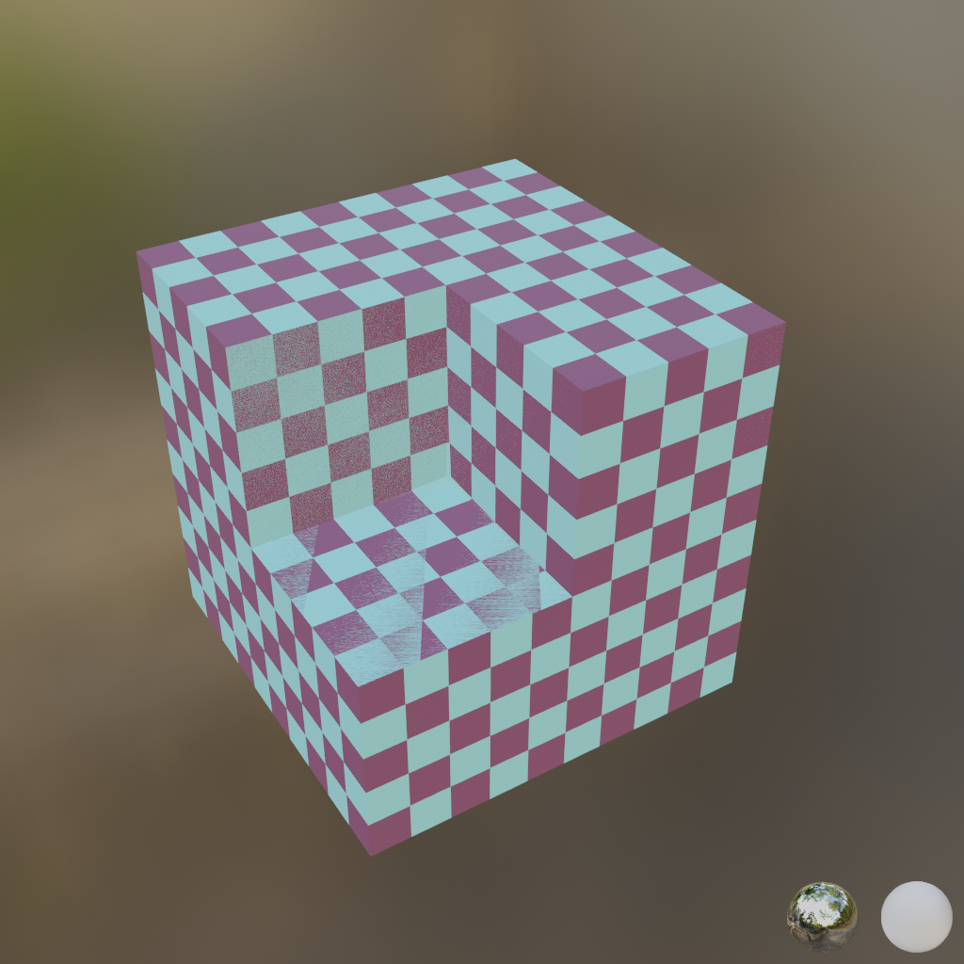
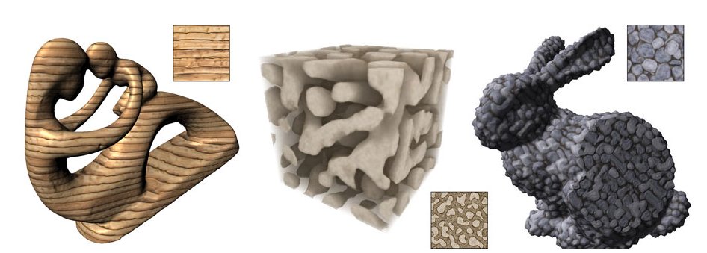
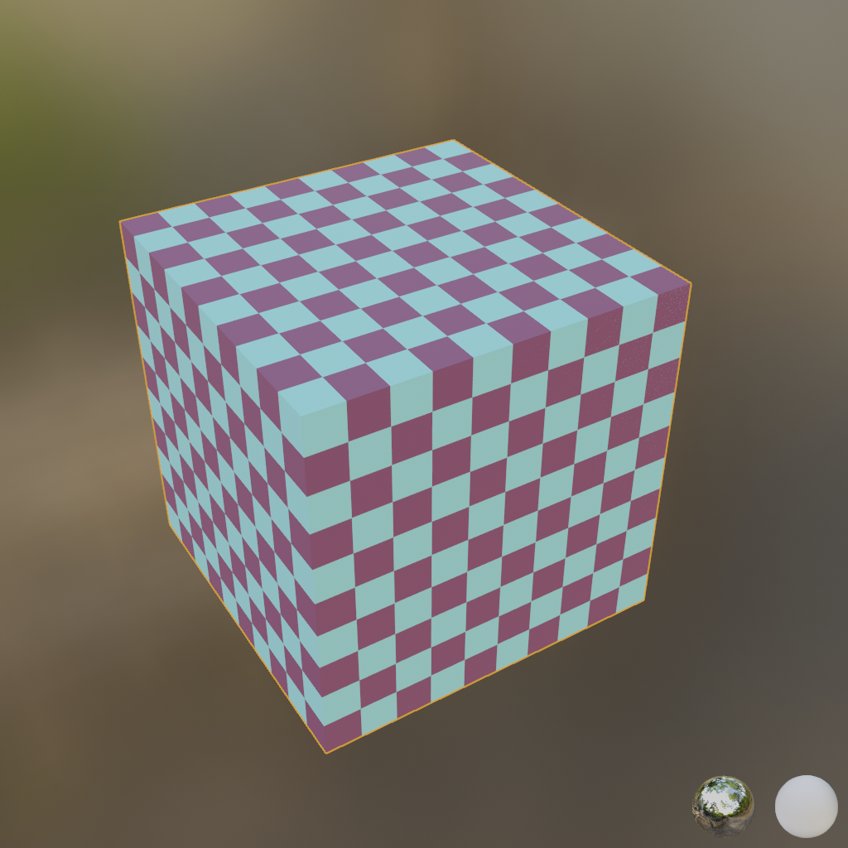
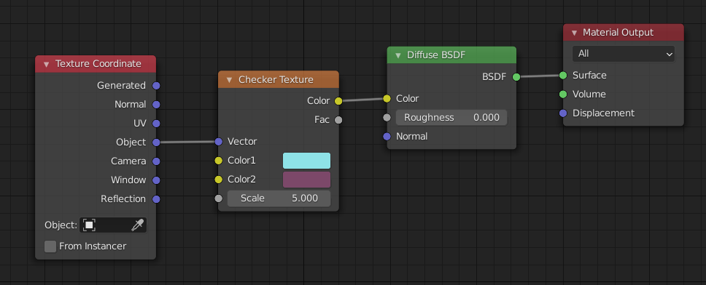
Projector function: different texture coordinates
Texture coordinate space doesn’t have to be always 2D
If texture is used for volumetric objects, then texture coordinates are (u,v,w)
  procedural texturing can directly rely on object locations (x,y,z) – solid texturing.
For animation, texture coordinates can be (u,v,w,t) where t is time and determines change in texture

Slide 38
Projector function: multiple texture coordinates
Multiple textures can be applied on objects and thus multiple sets of texture coordinates can be applied
Idea is the same: those texture coordinates are interpolated across surface and used for obtaining texture value
<example of multiple textures>

Slide 39
Corresponder function
Object space location
Projector function
Transform: texture coordinates → texture locations
For image texture, image indices to retrieve pixel values.
  Transform: (u,v) in [0,1] → (s,t) in [image_widht, image_height]
Texture coordinate
Corresponder function
Texture space location
Texture obtain
Texture value
Value transform
Transformed value

Slide 40
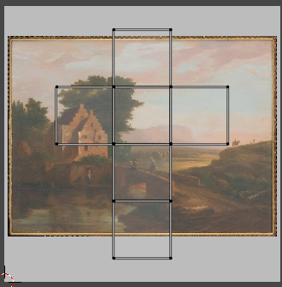
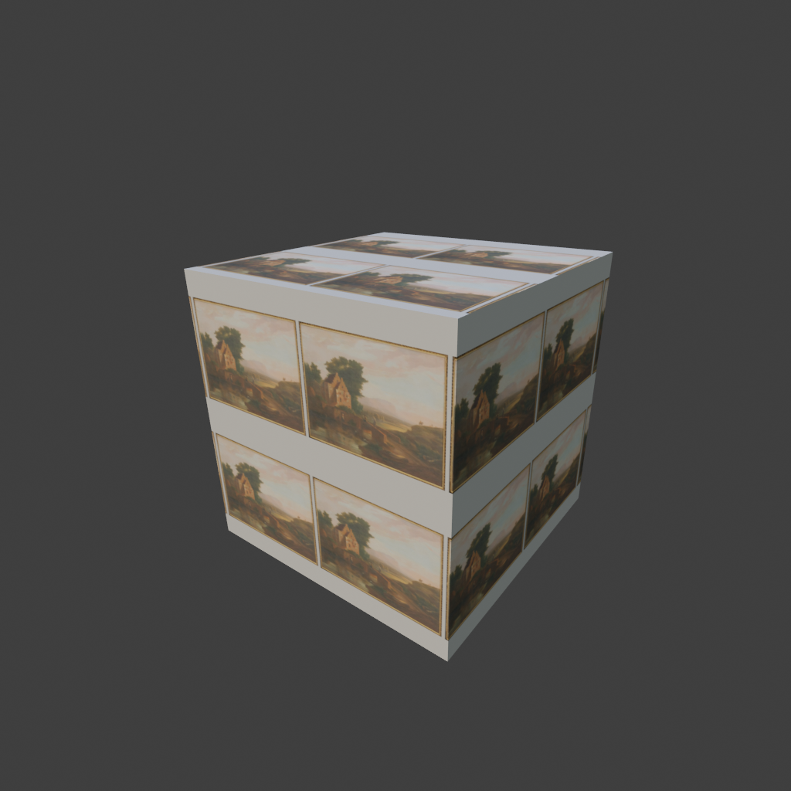
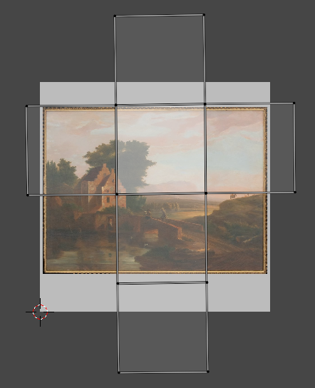
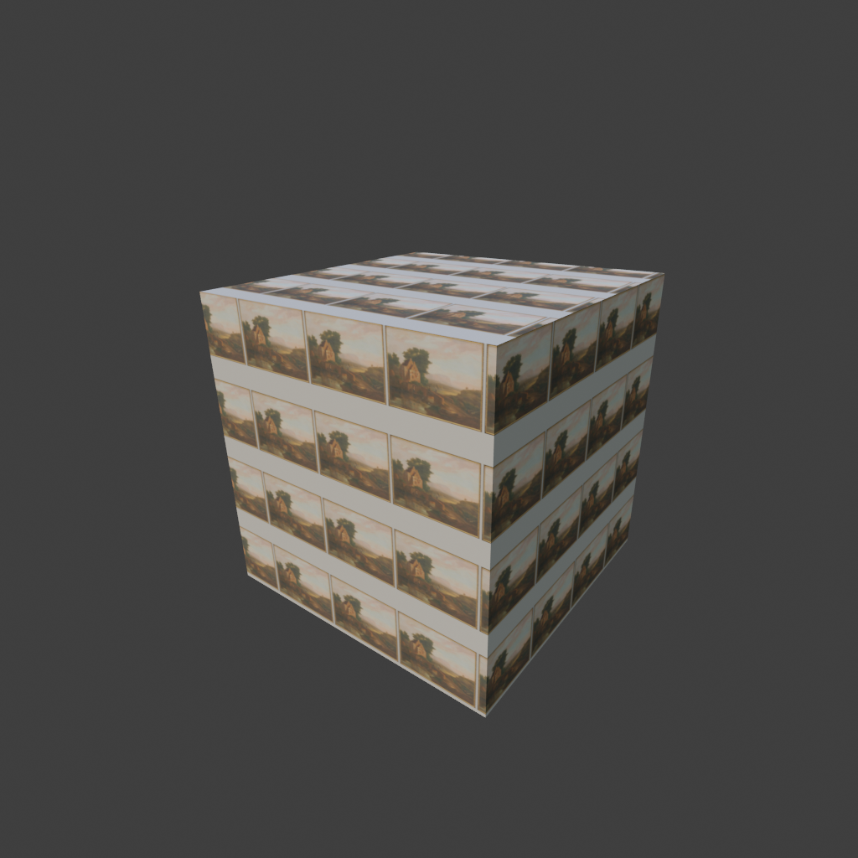


Corresponder function
Corresponder function:
  Determine which part of texture will be used
  Transformations: rotate, scale, translate, shear or project
  Originally (u,v) is in [0,1]. Scaling can move (u,v) to be larger than one
    Image wrapping: repeat (other: wrap, mirror, clamp, border, wang tiles, etc.)
Demo: https://math.hws.edu/graphicsbook/demos/c4/texture-transform.html

Slide 41
Obtaining texture values
Object space location
Projector function
Texture space location is used for obtaining texture value:
  Reading image texture
  Evaluating procedural texture
Texture coordinate
Corresponder function
Texture space location
Texture obtain
Texture value
Value transform
Transformed value

Slide 42



Obtaining texture values
Corresponder function gave texture space coordinates
Those coordinates are used for:
  Obtaining image texture values
  Evaluating procedural textures values

Slide 43
Transforming texture values
Object space location
Projector function
Optional additional transformations are done on texture value
Texture coordinate
Corresponder function
Texture space location
Texture obtain
Texture value
Value transform
Transformed value

Slide 44




Transforming texture values
Image textures contain RGB(A) values.
Many data types can be stored/encoded using those values.
  Thus, although image textures always contain color values, those values can be interpreted differently then color.
Therefore, values obtained from texture are optionally transformed to required datatype.
Example: encoding normal vectors into image: normal maps

Slide 45
Image textures

Slide 46



Image textures
Image texturing process can be seen as “gluing” image on 3D surface
For particular position on surface we explained how to obtain texture coordinates. These coordinates are (u,v)
Image textures are usually 2^{m} x 2^{n} texels. Thus called power-of-two textures (POT)*
* Older GPUs couldn’t support mipmapping for non-POT textures. Modern GPUs handle all textures correctly.
https://polyhaven.com/a/Television_01

Slide 47


Magnification and minification
If more than one pixel cover a texel: magnification.
If more then on texels cover pixel: minification
https://jcsites.juniata.edu/faculty/rhodes/graphics/texturemap.htm

Slide 48






Texture magnification
Texture system must magnify the texture. Magnification types:
  Nearest neighbor (closest): pixelization
  Linear
  Cubic filtering
  Bilinear interpolation: blur

Slide 49


Texture minification
If several texels cover pixel cell, minification takes place, then cumulative effect of texels influencing the pixel must be taken in account.
  Nearest neighbour: heavy aliasing and temporal aliasing (when camera is moving)
  Bilinear interpolation: if pixel is covered by more than four texels then aliasing again becomes the problem
Red cells are pixels
https://textureingraphics.wordpress.com/what-is-texture-mapping/anti-aliasing-problem-and-mipmapping/

Slide 50

Aliasing
Frequency of a texture depends how closely are spaced texels on the screen.
Nyquist limit – texture frequency must be not larger than half the sample frequency. To properly display a texture on a screen, we need at least one texel per pixel
Anti-aliasing techniques:
Texture frequency must decrease: mip-mapping - most popular anti-aliasing method
  Pixel sampling frequency must increase: multiple samples per pixel

Slide 51


Anti-aliasing: mipmapping
MIP – multum in parvo (latin) – many things in small place – minimization filter
  Original image is filtered down repeatedly into smaller images.
  Before rendering, original image is augmented with sets of smaller versions of this image
  Using mipmaps to achieve 1:1 pixel to texel ratio to achieve Nyquist rate.
Image pyramid, Mipmap chain:
  Original texture is downsampled by quarter of original area. New texel is calculated as average of four neighbor texels in original image. Newly create texture is called sub-texture
  This process is repeated until one or both of image texture dimensions equal to one.
High quality mip mapping requires:
  Good filtering: averaging new texel value from 2x2 of texels it is recommended to use Gaussian, Lanczos or Kaiser filter
  Images must be in linear colorspace

Slide 52


Antialiasing: sampling
With image minifacation we introduced the problem of aliasing
Aliasing appears always when there are a lot of details under a pixel footprint in the scene
To solve this, multiple sample per pixels can be used to “catch” high frequency details.
  This method is called Multisample anti-aliasing (MSAA)
MSAAx4
https://vulkan-tutorial.com/Multisampling

Slide 53




Alpha texture values
Image textures have (R,G,B) and alpha channels.
Alpha values are used for blending or alpha testing for transparency. This enables:
  Decals/cutouts: rendering only parts of the image on object surface.
  Billboarding method is used for standalone flat polygons with image texture, always facing the camera.
  Alpha value is very much used when adding VFX to rendered or real images - compositing.
https://www.soundstripe.com/blogs/the-best-techniques-tools-for-compositing
Billboarding
Cut-out texture: only part of image is rendered
https://80.lv/articles/how-to-fake-a-large-scale-forest-in-blender/
https://xoio-air.de/2017/10-free-cutout-trees-from-tony-textures/

Slide 54
Sources of image textures
Texture image can be created:
  By drawing
  Taking photographs
  Measurements
  Baking
Image textures can be:
  Drawn on 2D canvas (image) and projected/wrapped on object
  Directly painted on object (which is stored as image)
  Photographed/scanned
Library of textures:
  Substance library: https://substance3d.adobe.com/assets/allassets?assetType=substanceMaterial&assetType=substanceAtlas&assetType=substanceDecal
  PolyHaven: https://polyhaven.com/textures

Slide 55



Volume textures
Extension of 2D image is 3D image accessed with (u,v,w) coordinates
Complex problem of finding good 2D parameterize for 3D mesh is not needed since object locations can be used as texture coordinates.
Volume texture can represent volumetric structure of material such as wood or marble.
Example: medical imaging data
  Three dimensional grid is visualized as slices by moving polygon through it or using ray-casting.
Problem: volumetric image textures are very space demanding
https://developer.nvidia.com/sites/all/modules/custom/gpugems/books/GPUGems/gpugems_ch40.html
https://developer.nvidia.com/gpugems/gpugems/part-vi-beyond-triangles/chapter-39-volume-rendering-techniques

Slide 56
Procedural textures

Slide 57


Procedural textures
Umbrella term for a number of techniques in computer graphics to create 3D models and textures from sets of rules - code segments or algorithms that specify some characteristic of a computer-generated model or effect¹
1. Musgrave, F. K., Peachey, D., Perlin, K., & Worley, S. (1994). Texturing and modeling: a procedural approach. Academic Press Professional, Inc.
https://www.reddit.com/r/blender/comments/khkz98/finished_my_first_nodevember_link_in_comments/?utm_source=share&utm_medium=web2x&context=3

Slide 58


Procedural textures
Texture values, instead of image lookup, are evaluated from a function
Procedural texture defines values for every point in 3D space or 3D surface point.
  Parametrization of surface is therefore not needed
  This way natural phenomena such as seas, clouds and mountains can be created.
They are often based on noise function.
https://www.rebelway.net/clouds-houdini-tutorial/
https://www.shadertoy.com/view/4ttSWf

Slide 59





Procedural textures: Perlin noise
Property: local changes are gradual, while global changes can be large
Most popular noise function upon which wide range of methods is built
Type of gradient noise.
  N dimensional grid where each grid intersection has associated n dimensional unit length gradient vector
  To calculate point inside grid: (1) find cell inside which point lies, (2) calculate dot product of vector from this point to cell corner and gradient vector, (3) interpolate dot products
https://en.wikipedia.org/wiki/Perlin_noise

Slide 60




Procedural textures: Cellular texture
Steven Worley introduced Voroni-like textures that can be used for many natural textures: cells, flagstones, lizard skin
  Another fundamental procedural texture upon which more complex procedural textures are built
This method is based on measuring distance from feature points
  Space is diced into cubes. Each cube contain random feature points.
  For current point, find cube inside which lies and check distance to feature points in this and neighboring cubes.
  First distance is used as value. More combinations with distances are possible.
https://thebookofshaders.com/12/
1. Musgrave, F. K., Peachey, D., Perlin, K., & Worley, S. (1994). Texturing and modeling: a procedural approach. Academic Press Professional, Inc.

Slide 61


Noise in production
More complex types of noise are built using Perlin and Worley noise:
  Fractal noise
  Simplex noise
Combining Perlin and Worley noise is often used for more richer details.
Volume textures are attractive application for procedural texturing since they can be synthesized on the fly
Perlin-Worley
3 layers of Worley
https://www.guerrilla-games.com/read/the-real-time-volumetric-cloudscapes-of-horizon-zero-dawn

Slide 62


Procedural texture: physical simulation
Perlin and Cellular textures are mathematical models and phenomenological models for representing natural phenomena
Phyiscally based simulation can also be used to create textures
  Reaction-diffusion model
  Fluid simulation to texture
https://www.karlsims.com/rd.html
https://www.sidefx.com/ja/tutorials/channel-packing-pyro-data-using-the-texture-sheets-rop/

Slide 63
Procedural textures: Antialiasing
Procedural texturing is much more popular in offline applications while in real-time rendering image textures are far more common
  GPUs are extremely efficient with image textures and antialiasing is easier.
Procedural textures can be hard to antialias
Helping factor is that “inside information” about the texture is available:
  For example, if procedural texture is built on summing noise functions, then frequencies which would cause aliasing can be omitted

Slide 64
Material variation

Slide 65
Material mapping: variation of parameters
We discussed how to relate image or procedural texture to object surface
  To obtain texture value given location on object surface.
Now, we will discuss how texture values are used to modify material across object, that is scattering function and shading parameters over surface
  Example: 3D scene → rendering → shading: shading reads texture information and uses it for calculating surface color

Slide 66


Usage of texture values
Texture is used for varying material parameters over surface:
  Scattering function parameters: color, reflectance, roughness, etc.
  Small scale surface geometry: bumps, irregularities, etc.
https://mitsuba2.readthedocs.io/en/latest/generated/plugins.html#textures

Slide 67
Scattering function parameters
Color, reflectance, roughness, etc.

Slide 68





Small scale surface geometry
Small scale surface geometry is represented using texture which values are used for perturbing surface or surface normal
  Perturbing surface or surface normal causes perturbing of BSDF basis and variation in light reflection
https://mitsuba2.readthedocs.io/en/latest/generated/plugins.html#textures
https://learnopengl.com/Advanced-Lighting/Normal-Mapping

Slide 69


Small-scale geometry: scale of modeling
Details on object can be classified:
  Macro-features: cover many pixels. Represented by model shape (e.g., polygonal mesh). For character modeling, limbs are modeled at macroscale
  Meso-features: cover few pixels across. Everything between two scales. It represents detail that is too complex to render using shape representation (e.g., polygonal mesh) but large enough to be observable. For character modeling: skin or cloth wrinkles are modeled on mesoscale. For this scale family of bump mapping methods is used.
  Micro-features. Described with scattering function in shading step. It uses texture values for computing the color. It simulates the microscopic response of surface geometry and substance. Shiny and diffuse objects are modeled on micro-scale
https://www.pbr-book.org/3ed-2018/Materials/Bump_Mapping

Slide 70

Small-scale geometry: models
Texture is employed in shading step during rendering to give more richer 3D appearance than just color
Methods which do not introduce additional geometrical information. Only approximation to achieve desired surface details:
  Bump, normal mapping
    Large family of small-scale detail representations
  Parallax mapping
Methods which require additional geometrical information. Give more realistic surface appearance but are computationally expensive:
  Displacement mapping
https://helpx.adobe.com/substance-3d-painter/using/baking.html

Slide 71


Bump mapping
Main idea (Blinn method):
  Surface will appear to have small scale details is during shading process, if surface normal is slightly perturbed.
Information for perturbing surface normal can be encoded in image texture as color or procedural texture.
Original bump mapping – offset vector bump map - method required two signed values to be stored per texel in texture
  Those correspond to amount of normal to be varied in u an v image axis – which way surface faces at the point.
  Those values are used to scale vectors perpendicular to normal (tangent and bitangent)
  Resulting vectors are added to normal to change direction
Another approach is to use heightfield to modify surface normal direction
  Image texture contains one floating point number per texel representing height
  Those values are used to derive u and v signed values similar to those in original method – this is done by taking differences between neighboring columns are rows to obtain u and v (Sobel filter an be used)
https://www.researchgate.net/publication/228890410_Antialiasing_of_Bump_Maps
https://en.wikipedia.org/wiki/Bump_mapping

Slide 72

Bump mapping: frame of reference
Perturbing surface normal must be done with respect to some frame of reference: tangent frame basis
On this basis, scattering model is evaluated
  Perturbing the basis by perturbing the normal we achieve different incoming light and viewing directions – just like the surface contain small bumps and dents.
  Also, directions of light and viewing are often transformed in this space – so they are in the same space as surface normal which is needed for correct for evaluation.
  Tangent frame is used to determine orientation of material on the surface which is important for anisotropic surfaces
https://learnopengl.com/Advanced-Lighting/Normal-Mapping
http://www.opengl-tutorial.org/intermediate-tutorials/tutorial-13-normal-mapping/

Slide 73





Normal mapping
Normal vectors can be directly stored into image texture or evaluated from procedural texture.
Normal map image texture encodes (x,y,z) vector with values in [-1,1] to (R,G,B) image texture
  For PNG images, 8bit unsigned int is used. Therefore, [-1,1] → [0,255]
Normal map are often defined in tangent space*
  Color of normal map is determined with x,y and z directions of encoded vectors
https://cgcookie.com/posts/normal-vs-displacement-mapping-why-games-use-normals
http://ycpcs.github.io/cs470-fall2014/labs/lab12-2.html
https://learnopengl.com/Advanced-Lighting/Normal-Mapping
* Originally, they were defined in world or object space but this was limited to specific geometry for particular orientation.

Slide 74

Normal map types
Tangent space: based on tangent direction of face. Normal map can be then maximally reused for different objects, transformations and deformations.
  Blue: normal direction
  Red: left/right tangent direction
  Green: up/down tangent direction
Object space: based on entire object rather than each face individually
  Faster to compute, tied to to particular model which can not be deformed
World space: based on global coordinates
  Object must not be rotated
  Useful for large, static environment objects
https://cgcookie.com/posts/normal-vs-displacement-mapping-why-games-use-normals

Slide 75





Creating bump/normal maps
Baking normal maps from high quality 3D models (often done for real-time graphics applications)
Image editing/painting software: converting photo textures into normal maps, procedural normal map images, hand-painting normal maps
Scanning heights from real world and converting them to normal map.
Normal map can be derived from height map.
Hand-painting normal maps.
https://docs.krita.org/en/reference_manual/brushes/brush_engines/tangen_normal_brush_engine.html
https://docs.gimp.org/2.10/en/gimp-filter-normal-map.html
Normal map baked from geometry
High quality geometry from which normal map is baked and applied on low quality geometry to achieve computationally cheap high quality appearance.
http://wiki.polycount.com/wiki/Normal_map
https://en.wikipedia.org/wiki/Normal_mapping

Slide 76



Bump and Normal mapping: practical notes
Relationship between normal and shaded color is not linear*. Therefore, filtering of normal maps for anti-aliasing requires additional work.
Problem with normal mapping, as with bump mapping, is that additional geometry is not created. Thus effects of light being shadowed** by geometry and casting shadow on its own surface is not possible.
  Solution is horizon mapping method which enables normals having bumps which cast shadow on their surfaces.
https://en.wikipedia.org/wiki/Normal_mapping
https://en.wikipedia.org/wiki/Bump_mapping
* Normal map applied to specular surface results in non-linear relationship between shaded color and normal map. Lambertian (diffuse) surface has almost linear relationship between shaded color and normal map since base of lamberitan shading is based on dot product with normal which is linear operation.
** Generally, when light falls on surface with bumps, multiple scattering, masking and shadowing effects happen which are not possible with normal mapping.

Slide 77




Parallax mapping
Bump and normal mapping never shift location with the view angle, nor block each other
Parallax: positions of objects move relative to one another as the observer moves
Parallax mapping: approximation technique which is offsetting texture coordinates based on height: what should have be seen in pixel by examining the height of what was found to be visible.
  Also known as virtual displacement mapping
When viewing surface at a given pixel, height value is retrieved at that location and used to shift the texture coordinate to retrieve a different part of the surface. Amount of shift is based on retrieved height and angle of the eye to the surface
Enhancement: parallax occlusion mapping or relief mapping: ray-marching is used along view vector until approximate intersection point on height-field texture
https://github.com/marcusstenbeck/tncg14-parallax-mapping/tree/master/documents

Slide 78




Displacement mapping
This method changes the locations of actual geometry vertices in a mesh using height texture information.
  Height map for displacement mapping can have negative values
Most computationally expensive technique which requires fine geometry (a lot of vertices which can be displaced).
Good for modeling larger geometry features such as terrains.
https://ca.wikipedia.org/wiki/Displacement_mapping
https://garagefarm.net/blog/how-displacement-maps-work-and-how-to-optimize-them-in-v-ray-part-1

Slide 79

Note on small scale geometry
Note that texture is often used to represent small scale geometry which is expensive to represent and render directly.
However, there are rendering/representation techniques which enable modeling and rendering of high quality geometry without need for normal, bump, parallax or displacement mapping.
https://docs.unrealengine.com/5.0/en-US/nanite-virtualized-geometry-in-unreal-engine/

Slide 80






Merging materials
Texture is also used to distribute different materials over surface
  Texture can be used as a “mask” which determines which scattering function and shading calculations will be performed where
https://mitsuba2.readthedocs.io/en/latest/generated/plugins.html#textures
https://blender.stackexchange.com/questions/231205/how-do-i-combine-these-two-textures

Slide 81
Texture modeling and texture application
When we talk about textures in computer graphics, we can separate the work in creating/modeling a texture and applying it. Often, line between these two is blurred.
Reminder: we said that material modeling (which includes texture) can be performed separately of modeling 3D shape.
  Creation of texture is often separated of modeling 3D shape and it is done in so called “texture space”.
  Texture application is process where we “apply” texture on a 3D shape. That is, map it from texture to object space.
Texture modeling can be described as process of developing a function which maps some property to each point of the surface. Texture modeling can be separated into:
  Creating image textures
  Creating procedural textures
Texture application can be described as a process of adding actual texture on the object.
  Often, term texture mapping is used. This term is due to historical reasons where details were painted on 3D model and those details were stored in array of images called textures. The process of corresponding each vertex of model to a location in image was called mapping.
  Main task in texture application is to find mapping between texture and object space.
Texture, simply speaking, contains information about surface details. It can be color (albedo), normals, roughness, etc.

Slide 82
Storing and transferring materials
Similarly to mesh information, standards for material storage and transfer are defined
Material standards:
  MaterialX
Certain formats that we mentioned for mesh storage are used for storing the whole scene including the material:
  GLTF, USD

Slide 83
Practical note: textures
Generally, outside of computer graphics field, term texture is overloaded
In computer graphics this term is also overloaded
On modeling level of abstraction, texture is a way to modify scattering function/shading parameters over surface.
On development level of abstraction, especially while programming in graphics API, texture is nothing more than a memory buffer that is sent from CPU to GPU.
  RGBA channels can encode any information. Examples: octree, mesh, etc.

Slide 84
Exploring textures
Industry standard texturing tool: https://www.adobe.com/products/substance3d-painter.html
Textures are often used for layering materials (RTR 9.12)

Slide 85
More into topic
Procedural texturing
Texture mapping
https://www.realtimerendering.com/#texture

Slide 86
Practical insights

Slide 87
Show how is material generated in practice using different scattering functions and textures

Slide 88
To remember
Texture is used to vary material properties over surface
Texturing pipeline
  Projection, corresponding, value obtain and transform
Image textures
  Aliasing and mip mapping
Procedural textures
  Noise functions
Material variation
  Scattering function parameters variation
  Small scale geometry: bump, normal, parallax and displacement mapping

Slide 89
Literature
https://github.com/lorentzo/IntroductionToComputerGraphics/wiki/Foundations-of-3D-scene-modeling

