Slide 1
3D space, transformations and scene organization

Slide 2
Syllabus
3D scene
  Objects
  Lights
  Cameras
Rendering
Image
3D scene
  3D space
  Transforms
  Scene organization

Slide 3
Introduction
Objects, lights and cameras are placed in 3D scene relatively to each other
To define their spatial position and movement we use points, vectors and coordinate systems.
TODO

Slide 4
3D space

Slide 5
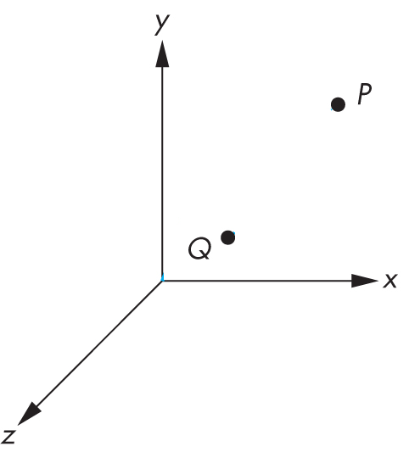
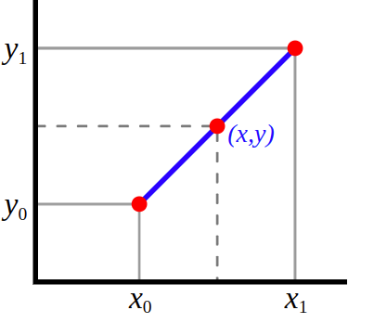
Points
Zero-dimensional location with respect to coordinate system:
  2D space (x,y)
  3D space: (x,y,z)
Homogeneous points
  Adding 4th element to point: (x,y,z,w), w = 1
  Used when multiplying with matrices
Interpolation between points: linear interpolation
  lerp(v1, v2, t) = (1 - t) * v₀ + t * v₁;
v₁
t
v₀

Slide 6

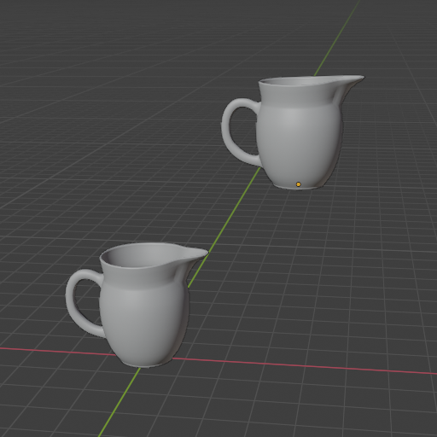
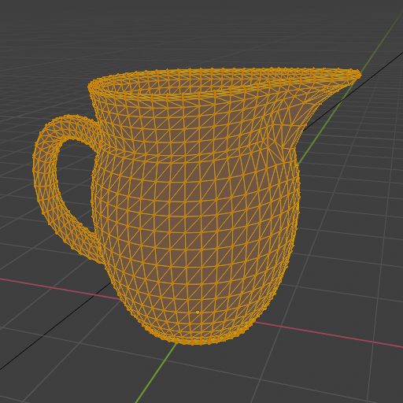

Points
Points are used to:
  Describe shape
  Define position of object in space

Slide 7
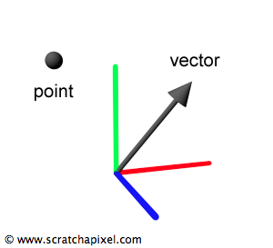
Vectors
Magnitude (norm/length) and direction in 2D or 3D space
  Two coordinates (x,y) – usually for texture space
  Three coordinates (x,y,z) – for any 3D elements

Slide 8
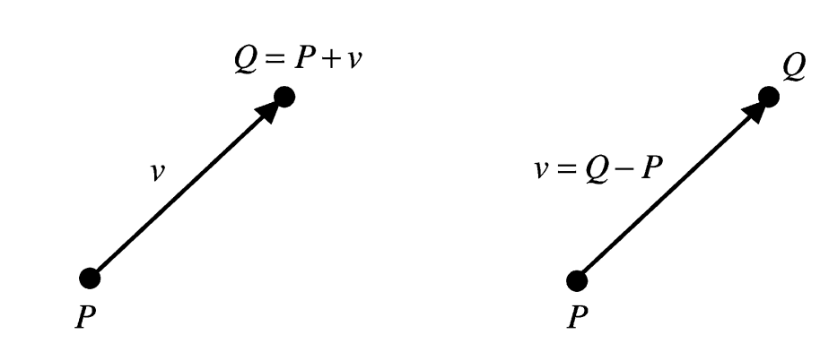
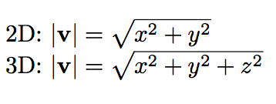
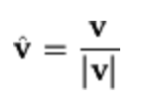
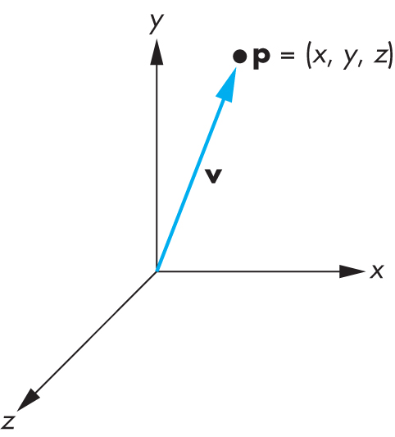
Points and vectors
Subtracting or adding point with vector results in new point
Distance between two points results in vector which contains length and direction.
Points and vectors are transformed – moved in space - using linear transformations – multiplication with matrix
Direction obtained by normalization
Magnitude (length)
Adding point to vector
Subtracting point from a point
https://www.researchgate.net/publication/220184055_On_the_algebraic_and_geometric_foundations_of_computer_graphics
http://www.c-jump.com/bcc/common/Talk3/Math/Vectors/W01_0090_dot_product.htm

Slide 9
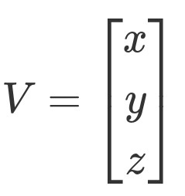

Row major and column major
Points and vectors can be written as:
  [1x3] matrix → row major order (Direct X, Maya)
  [3x1] matrix → column major order (OpenGL, PBRT, Blender)

Slide 10
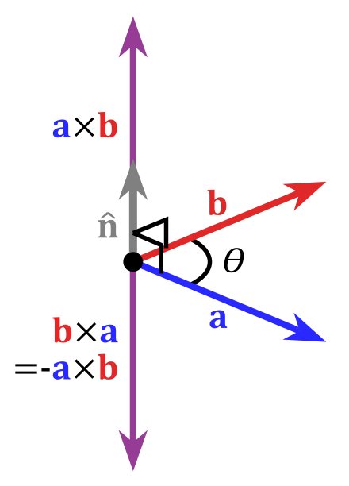
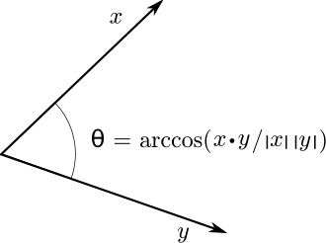
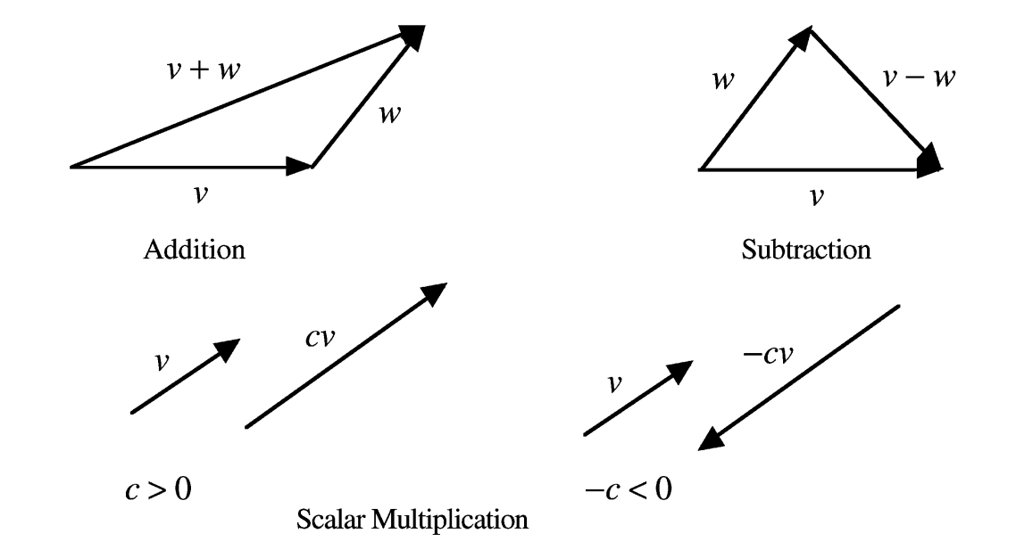
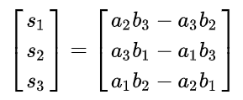
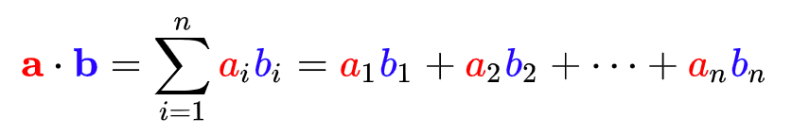
Common vector operations
Addition, substracton, multiplication with scalar, etc.
Dot (dotProduct(a,b)) and cross product (crossProduct(a,b)) operators
Normalization → length of vector = 1 (unit vector)
Dot product
https://en.wikipedia.org/wiki/Dot_product
Cross product
https://en.wikipedia.org/wiki/Cross_product

Slide 11
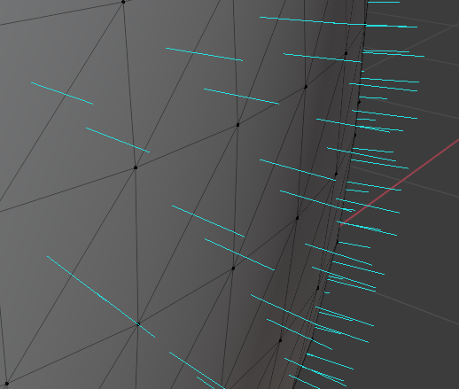
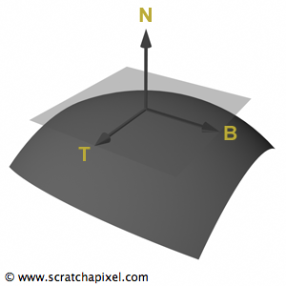
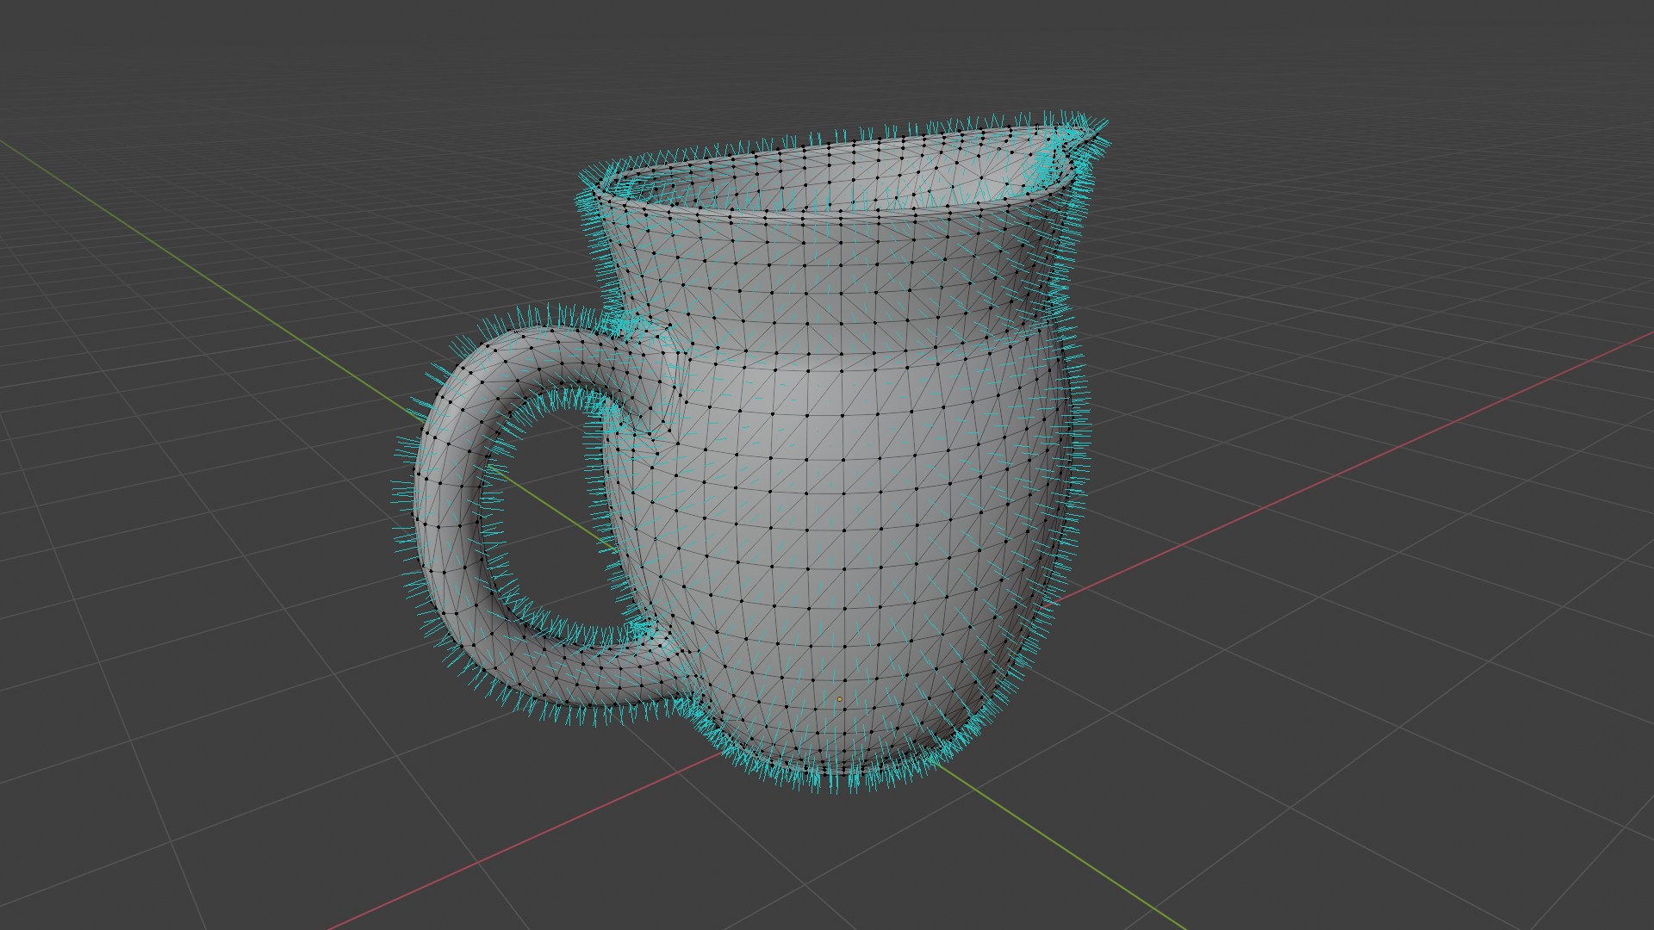
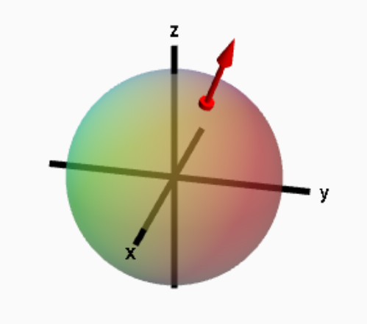
Normals
Normal (x,y,z)describes orientation of surface of a geometric object at a point
  Perpendicular to surface at a point
  Similar to vectors but they are defined in relationship to a particular surface: they behave differently in some situations, particularly when applying transformations
It can be defined as cross product of any two non-parallel tangent vectors at that point.
https://www.scratchapixel.com/lessons/mathematics-physics-for-computer-graphics/geometry/points-vectors-and-normals.html
https://mathinsight.org/parametrized_surface_orient

Slide 12
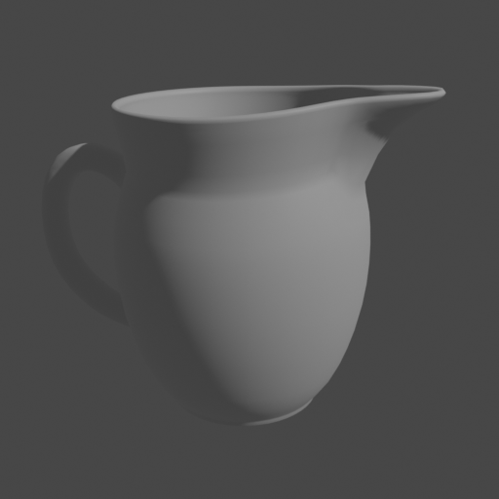

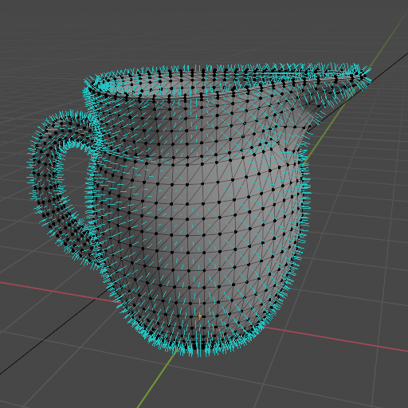
Normals
Crucial information for rendering and modeling
  Example: brightness of object

Slide 13
Rays
Line specified by its origin (point) and direction (vector)
Often constructed by camera scene element
Ray is parametrically expressed as a function of scalar value t:
  r(t) = o + t * d, 0 < t < inf
Ray differential: camera rays offset by one sample in x and y direction from main ray on film plane
  Used for antialiasing of textures

Slide 14
Bounding boxes
Acceleration of rendering often relies on subdividing the image or 3D scene into smaller elements and computing those either in parallel or ignoring if not needed.
Examples of space subdivision:
  Axis aligned boxes
  Oriented bounding boxes
  Bounding volume hierarchy

Slide 15
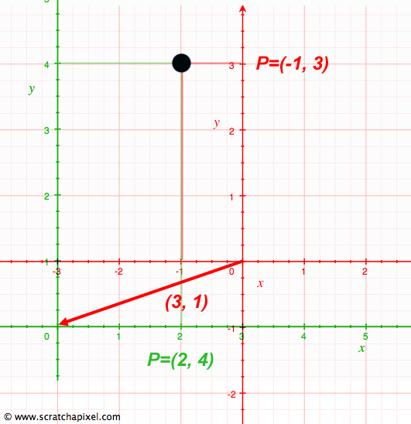
Coordinate system
Defining shape, location, orientation and other properties of 3D scene elements relies on points and vectors.
Points and vectors are represented with three coordinates: (x,y,z)
These values are meaningless without a coordinate system which defines:
  Origin of the space: a point
  Basis: three linearly independent vectors that define X, Y and Z axis of a space.
Origin and three vectors define a frame which defines coordinate system.
  Cartesian coordinate system: perpendicular axes
  Euclidean space
Point or vector in 3D space depend on its relationship to the frame – point can have same absolute position in space but its coordinates depend on frame.

Slide 16
Coordinate system
Infinite number of coordinate systems can be defined
  Coordinates of point depend on referent coordinate system
Transformation of point from one coordinate system to another is done by matching their origins and basis - transformation

Slide 17
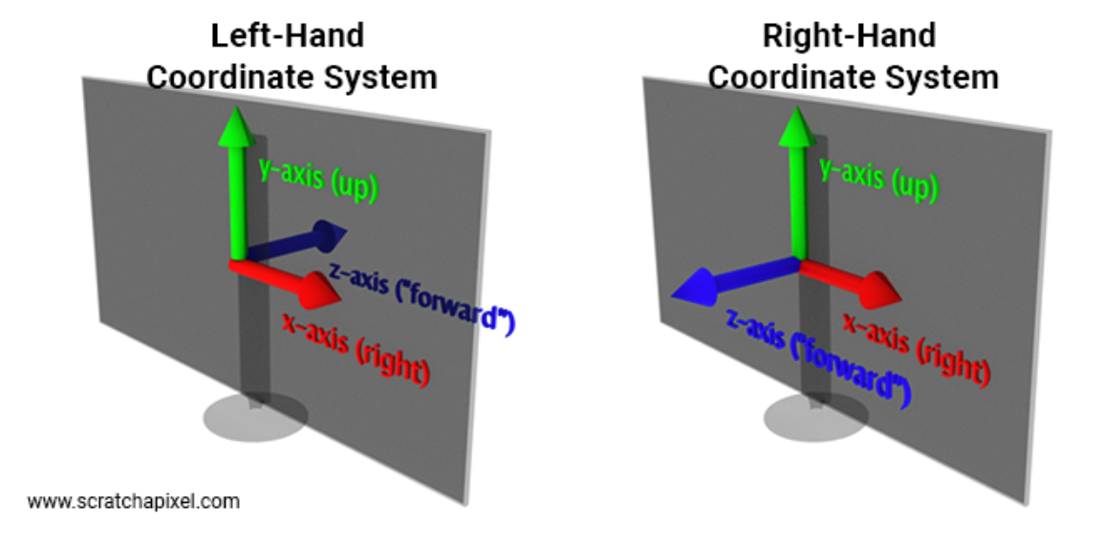
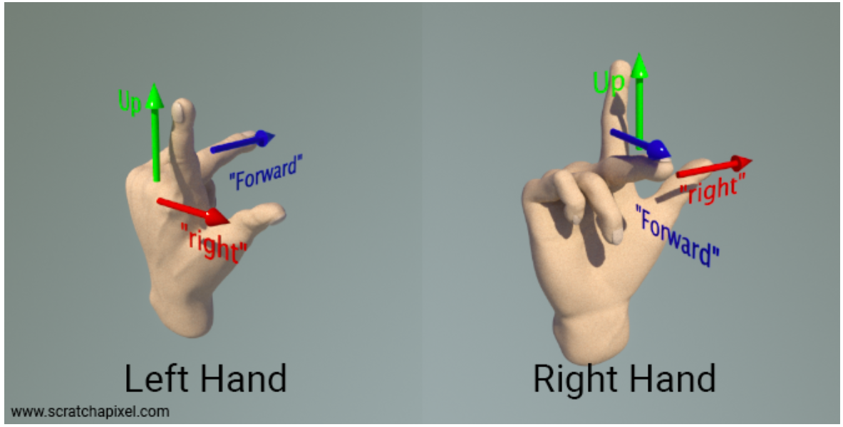
Coordinate system handedness
Axis of X, Y and Z vectors defining coordinate system can face in one of two directions:
  Left-handed coordinate system
  Right-handed coordinate system
https://www.scratchapixel.com/lessons/mathematics-physics-for-computer-graphics/geometry/coordinate-systems.html

Slide 18
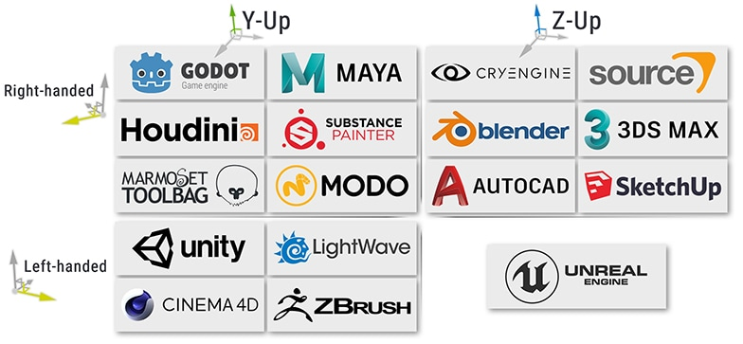
Coordinate system handedness and naming
Handedness of coordinate system is defined by orientation of left/right vector relative to up and forward vectors
Naming convention – how axis are labeled (e.g., X, Y or Z) has nothing to do with handedness, e.g. up is not necessary Z axis, this depends on renderer/3D application.
  Industry standard: right-handed, x – right, y – up and z – outward
  Maya and OpenGL use right-handed
  DirectX, PBRT and RenderMan use left-handed coordinate system
Exporting from one application to another requires special care of coordinate systems!
https://www.techarthub.com/a-guide-to-unitys-coordinate-system-with-practical-examples/

Slide 19
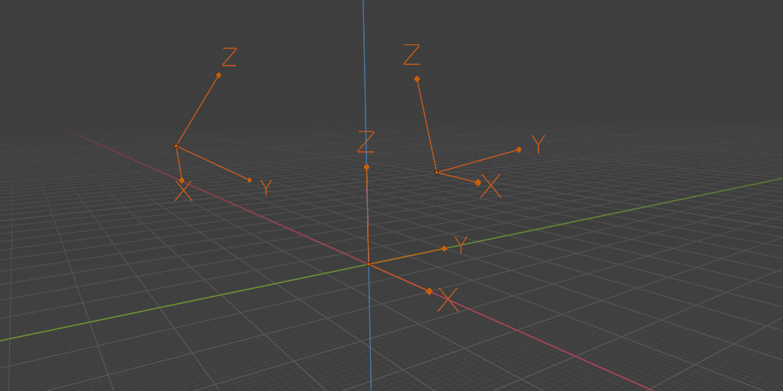
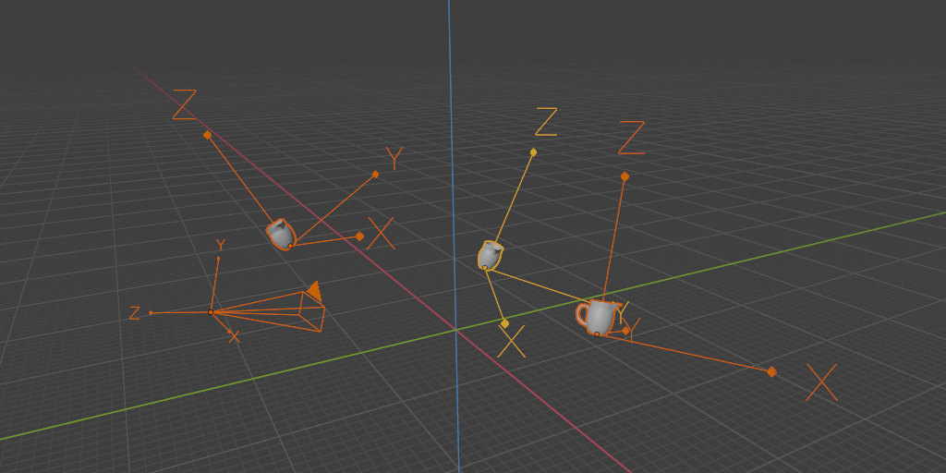
World coordinate system
Coordinate system is defined with origin and basis.
Point and vectors depend on coordinate system!
World coordinate system – a standard frame:
  Origin
  Basis
All other frames – local coordinate systems - will be defined with respect to this world coordinate system.

Slide 20
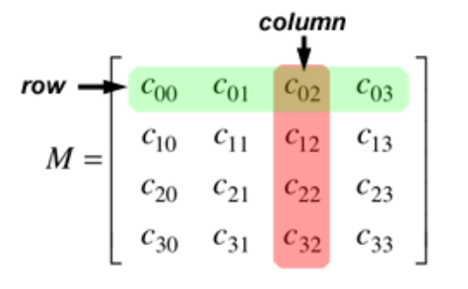
Matrices
Matrices are essential for moving elements within 3D scene
  Scaling, rotation and translation transformations are described with matrices
  Multiplying point or vector with matrix returns transformed point or vector
Matrix (M): 2D array of numbers: m x n – number of rows (m) and columns (n)
  M_{ij} – matrix element at (i,j) position
For computer graphics square matrices 3x3 and 4x4 are most important

Slide 21
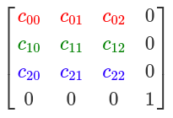
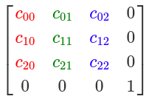
Row major and column major
Matrices can be written as:
  Row major order (Direct X, Maya, PBRT)
  Column major order (OpenGL)

Slide 22
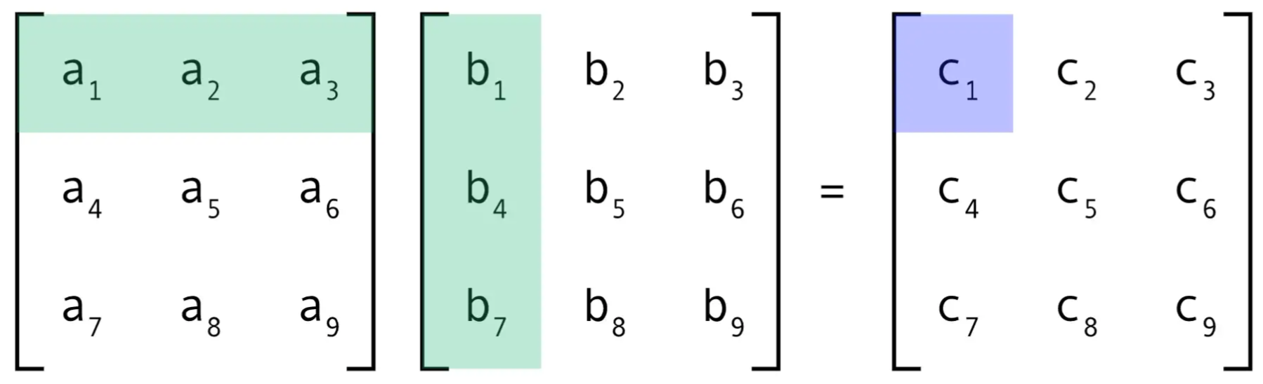
Matrix operations
Matrix-matrix multiplication gives matrix
  Useful for representing multiple transforms with one matrix
  Not commutative: order of multiplications, thus transforms is important!

Slide 23
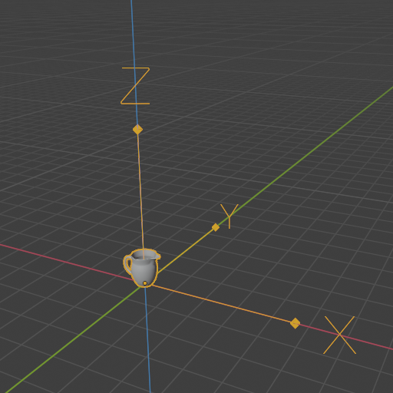
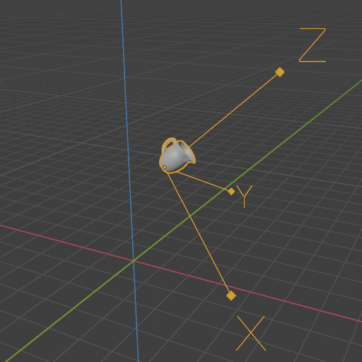
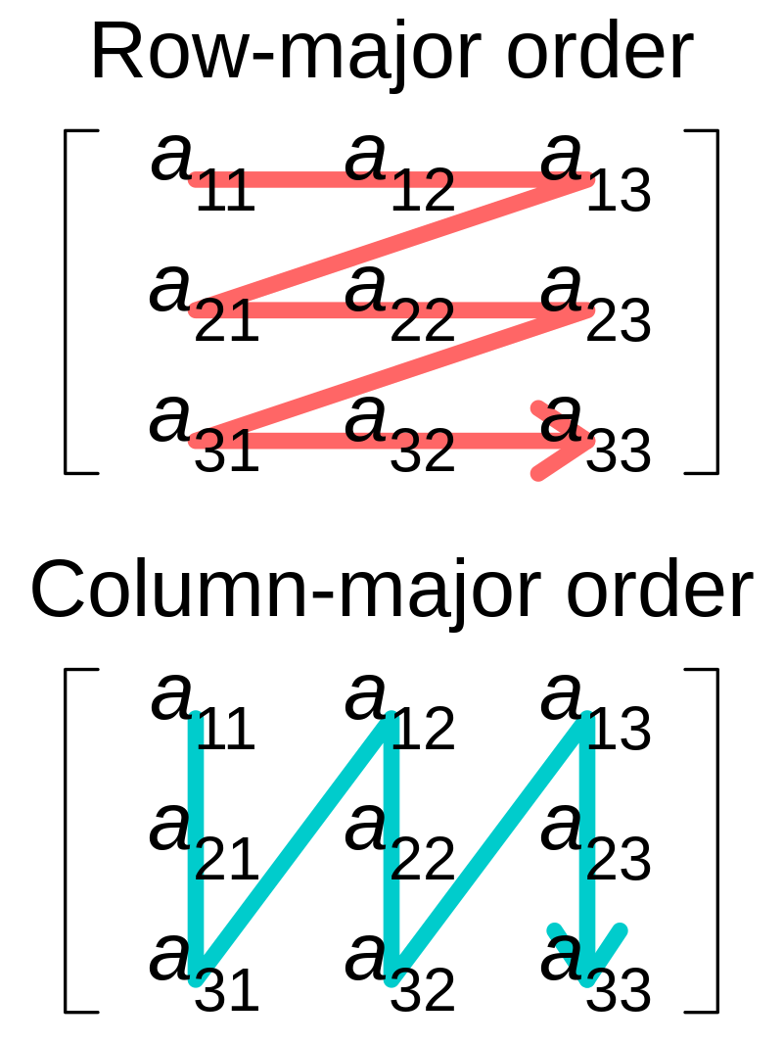

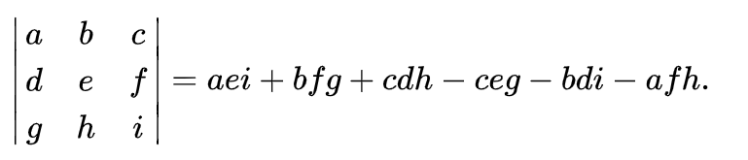
Matrix operations
M⁻¹
Operators:
  Inverse: multiplying point A with matrix M given point B. Multiplying point B with inverse of matrix M gives point A.
    MM⁻¹ = I (identity matrix)
    Gauss-Jordan method: https://www.scratchapixel.com/lessons/mathematics-physics-for-computer-graphics/matrix-inverse/matrix-inverse.html
  Transpose: switch row and column indices of a matrix. Row-mayor to column-mayor and vice versa
  Determinant:
M
Identity matrix (I)

Slide 24
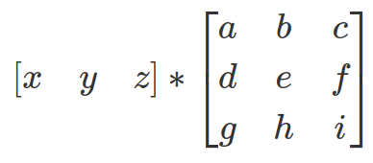

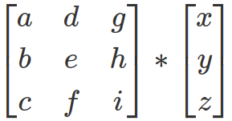


Matrix operations
Matrix-point/vector multiplication gives new point/vector → transform
  Row-major/column-major vector order dictates matrix operation order and matrix order
  Row-major points and vectors are written as [1x3] or [1x4] matrices and then multiplied with matrix which is [3x3] or [4x3]
Both conventions are correct and give the same result but operations must be consistent.
Row major order: point is on left side
Column major: point is on right side
https://www.scratchapixel.com/lessons/mathematics-physics-for-computer-graphics/geometry/row-major-vs-column-major-vector.html

Slide 25
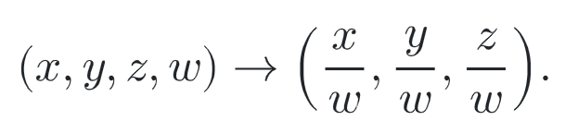
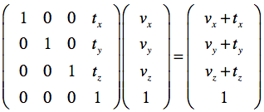
Matrix operations on points and vectors
Point (x,y,z)can be written as [1x3] matrix
  Often, transformation matrices are [4x4]
  To multiply point with such matrices we need to present point as homogeneous point/coordinate: (x,y,z,w), [1x4].
  If the resulting w coordinate is not 1, then x,y,z must be divided by w to obtain usable Cartesian point.
As vectors represent only direction, translation transformation is meaningless.
https://www.pbr-book.org/3ed-2018/Geometry_and_Transformations/Applying_Transformations
Column-major notation

Slide 26
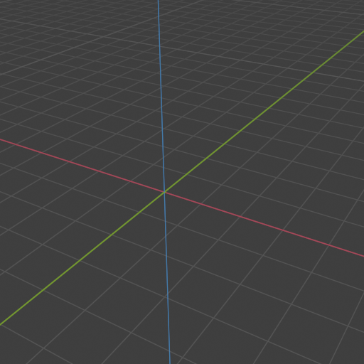
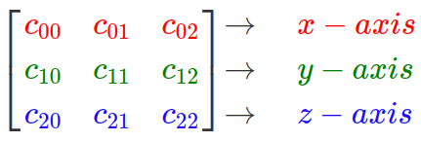
Matrix and coordinate system
Matrices can represent basis of a coordinate system
  Each row of matrix represents an axis of coordinate system – orthogonal vectors → orthogonal matrix
  Such matrix is called orientation matrix – no translation
Inverse of orthogonal matrix is equal to its transpose
Row-major notation

Slide 27
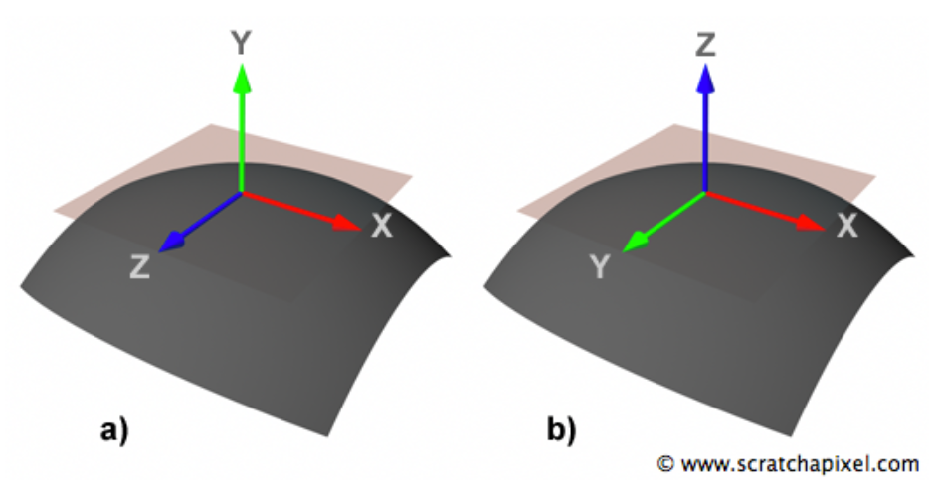
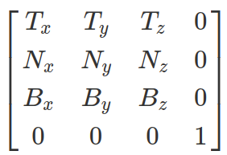
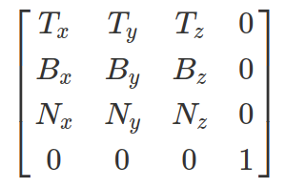
Local coordinate system
Local coordinate system can be constructed using single vector using cross product.
Often, local coordinate system using normal is constructed
  Normal is one axis of local coordinate system
  Tangent and bi-tangent are other to axes
  Example: Normal corresponds to up vector, tangent to right vector and bi-tangent to forward vector
Up is Y
Up is Z
Row-major notation
Row-major notation

Slide 28
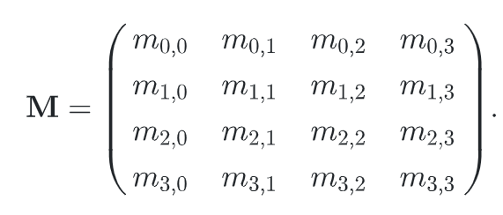
Matrix, coordinate system and transform
Transforming points from one coordinate system to another is done by transformation matrix
  Orientation (rotation), size (scale), and position (translation) of coordinate system represents the transformation that will be applied to the points when they are multiplied by this matrix
  TODO: https://www.pbr-book.org/3ed-2018/Geometry_and_Transformations/Transformations - discussion on frame transforms
  Matrix M transforms points from one coordinate system to another
    Basis vector and origin of current coordinate system are transformed by matrix M
    Points and vectors are expressed in terms of current coordinate system frame. Applying transformation matrix to points and vectors is equivalent to applying transformation matrix to current coordinate system frame
TODO: image from “Virtualna okruzenja: interaktivna 3D grafika”
  Transformation matrix is 4x4 and it contains translation and rotation!
TODO

Slide 29
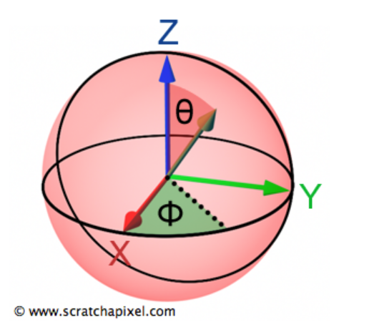
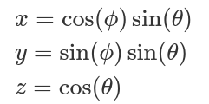
Spherical coordinate system
Spherical coordinates simplify computation needed for rendering
Representing vectors in spherical coordinate system
  Two angles: polar angle [0, PI] and azimuth angle [0, 2PI]
Converting from spherical to Cartesian coordinate system
Converting from spherical to Cartesian coordinate system
Vector representation in spherical coordinate system using polar and azimuth angle.

Slide 30
Transforms

Slide 31
Transforms
Basic tool for manipulating 3D scene elements; points and vectors:
  Position, orientate, reshape and animate objects, lights and cameras (3D scene modeling)
  Essential for rendering computations
Linear transforms: scaling, rotation
Affine transforms: translation, rotation, scaling, reflection, shearing
  Preserve parallelism of lines but not necessary lengths and angles
  Require homogeneous point notation

Slide 32
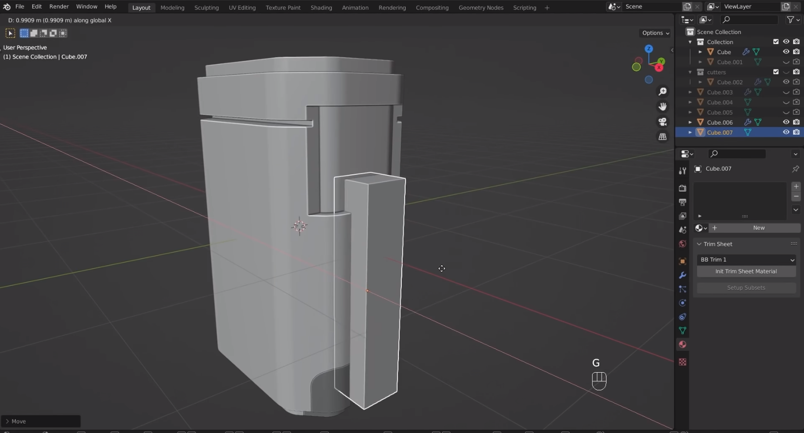
Transforms in modeling
Essential modeling tool: https://www.youtube.com/watch?v=1qVbGr_ie30&t=1s&ab_channel=JoshGambrell

Slide 33

Transforms in animation
Crucial tool for animation: https://www.youtube.com/watch?v=CBJp82tlR3M

Slide 34
Transforms in rendering
All calculations must be preformed in the same coordinate system
  Example: light-surface interaction calculation
  Example: camera space – easier calculations
Another example is projecting objects onto plane which is used for rasterization-based rendering.

Slide 35
Transforms in professional software
Godot: https://docs.godotengine.org/en/stable/classes/class_transform.html
Unity: https://docs.unity3d.com/ScriptReference/Transform.html
Unreal: https://docs.unrealengine.com/4.27/en-US/BlueprintAPI/Math/Transform/
Blender: https://docs.blender.org/manual/en/latest/scene_layout/object/properties/transforms.html
GLM: https://github.com/g-truc/glm

Slide 36
Basic transformations
Modeling elements, 3D scene and animations relies on transformations
  Translation
  Rotation
  Scale
  Shear
  Look-at notation

Slide 37
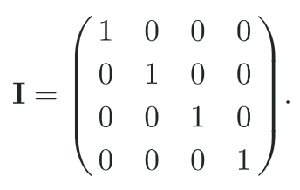
Identity transform
Identity transformation is default transformation
Represented by identity matrix (I)
  A * I = A, A – vector or point

Slide 38
Transforming points and vectors
Transformation matrices are [4x4] matrices.
Homogeneous notation is needed:
  Points: P(x,y,z,1)
  Vectors: V(x,y,z,0)

Slide 39
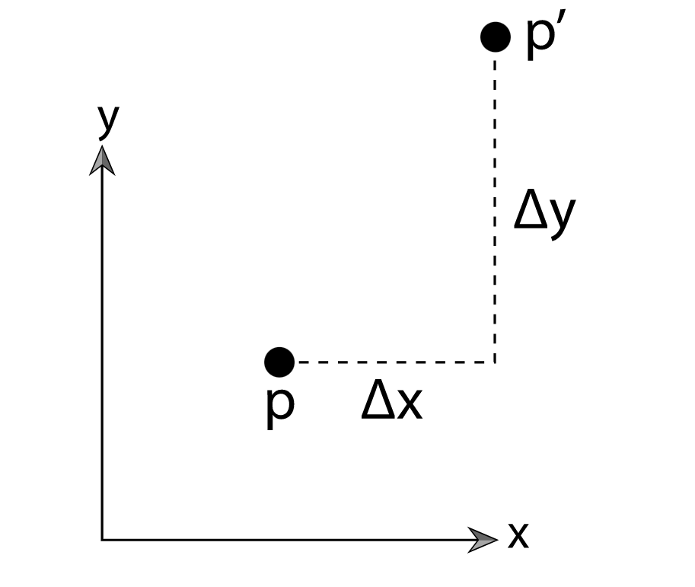




Translation transform
Changes point from one location to another
  Translation transform translates coordinates of point P(x,y,z) by (Δx, Δy, Δz)
  Translation only affects points, leaving vectors unchanged!
Represented by translation matrix T
T
Translation matrix on point.

Slide 40

Translation transform
Inverse: T⁻¹(t) = T(-t)
Rigid-body transform: preserves distances between points and headedness
T
Translation matrix on point.
T⁻¹
Translation matrix on vector.

Slide 41
Translation transform
Instancing example
TODO

Slide 42





Scale transform
Enlarging or diminishing objects
  Multiply points P or vectors V components (x,y,z) by scale (s_{x}, s_{y}, s_{z})
  Represented by scaling matrix S
If all scaling factors are same: uniform (isotropic) scaling, else non-uniform (anisotropic).
Original
Uniform
Anisotropic (z)
Anisotropic (x,y)

Slide 43




Scale transform
Inverse
Negative value of scaling factor gives reflection (mirror) matrix
  Triangle with clockwise orientation will have counter-clockwise orientation after reflection
S(-x,1,1)
S
S(1,1,-z)
S⁻¹
Original
Uniform

Slide 44
Scale transform
Instancing example
TODO

Slide 45







Rotation transformation
Rotates objects around arbitrary axis from origin to any direction for a given angle
  Most common rotations: rotation around X, Y and Z coordinate axes by angle θ
  Represented by rotation matrices R_{x}(θ), R_{y}(θ), R_{z}(θ)
  Clockwise vs counter-clockwise rotation by angle θ
left-handed coordinate system, the matrix for clockwise rotation

Slide 46


Rotation transformation
Rigid-body transform: preserve distance between points and headedness
Inverse
Rotation around arbitrary axis
  Rotation around arbitrary axis (x,y,z) is represented by rotation matrix R_{x,y,z}(θ) – a combination of R_{x}(θ), R_{y}(θ), R_{z}(θ)
  Matrix consist of unit vectors → orthogonal matrix
R_{x,y,z}(θ)
R_{x,y,z}(θ)

Slide 47
Rotate transform
Instancing example
TODO

Slide 48
Rotation transformation
Orientation matrix
  Rotation matrix associated with camera view or object → local coordinate system
  Defines its orientation in space: directions for up and forward are needed to define this matrix

Slide 49



Combining rotation matrices
Rz(80) * Ry(60)
Ry(60) * Rz(80)

Slide 50




Rotation and translation
If object is not in world origin, rotation origin can be local or world coordinate system
  Pivot point
For orienting object which is not in world origin
  object is first translated so that pivot point in the center and then rotation is performed after which object is again transformed so that pivot point is in the same position as before.
R_{z}(60)
R_{z}(60)

Slide 51

Shear transform
6 basic shearing matrices for 3D case: xy, xz, yx, yz, zx, zy
http://15462.courses.cs.cmu.edu/fall2019/lecture/transformations/slide_028

Slide 52







Concatenation of transforms
Matrix multiplication is non-commutative: order of multiplication matters
Example: objects in 3D scene must be scaled, rotated and translated
  Matrix is concatenated into one matrix which is used for multiplication of points P
  Such matrix must be composited as C = TRS, C * P = TRS * P
    Scaling is applied first, then rotation and finally translation
Concatenation of only translation and rotation matrices results in rigid-body transform.

Slide 53



Look-at transform
Often used for transforming camera in 3D scene
Look-at methods gives look-at transform which defines transformation matrix
Row-major, right-handed coordinate system.
Forward = normalize(from – to)
Right = crossProduct(tmp, forward), tmp = (0,1,0)
Up = crossProduct(forward, right)

Slide 54

Special care: transformations of normals
Normal can not be transformed with the same matrix used for transforming points and vectors.
  It has to be multiplied with transpose of the inverse of that matrix.
Wrong
Correct
Original
https://paroj.github.io/gltut/Illumination/Tut09%20Normal%20Transformation.html

Slide 55
Special transforms
Euler transform
Rotation about an arbitrary axis
Quaternions
Othographic projection
Perspective projection

Slide 56


Euler transform
Represented by Euler matrix, a concatenation of R_{x}(θ), R_{y}(θ), R_{z}(θ) – rotation matrices around X, Y and Z axes
Establish default view, e.g., facing positive X with Z up.
Angles of rotation: yaw, pitch, roll
Problems:
  Gimbal lock: e.g., when pitch and roll become aligned, changes to roll and yaw result in same rotation
  Two different sets of Euler angles can give same orientation
  Interpolation between two Euler angle sets is not as simple as interpolating each angle
Good: angles can be easily extracted from Euler matrix → matrix decomposition
https://www.researchgate.net/publication/335854843_Special_Orthogonal_Group_SO3_Euler_Angles_Angle-axis_Rodriguez_Vector_and_Unit-Quaternion_Overview_Mapping_and_Challenges
Gimbal lock: one degree of freedom (rotation angle) is lost.
https://en.wikipedia.org/wiki/Gimbal_lock

Slide 57

Rotation about arbitrary axis
Rotate by some angle θ around arbitrary axis r
  Transform to space where axis we want to rotate around is X
    Local coordinate system is created using axis r via cross product → basis
    Obtained basis is aligned with world coordinate system basis and r is aligned with X
  Perform rotation
    Rotation around X axis
  Return to original space

Slide 58
Quaternions
Orientation is represented by a single rotation around particular axis
  Quaternion: q = s + xi + yj + zk
    S – scalar
    i, j, z – three spatial axes
    (x,y,z) represent axis
Unit quaternion can represents any 3D rotation
Advantage: Interpolating between two quaternions is stable and constant
Supported in various modeling tools and APIs:
  https://github.com/g-truc/glm/blob/master/manual.md#-311-quaternion-functions
  https://docs.blender.org/api/current/mathutils.html#mathutils.Quaternion

Slide 59



Orthographic projection
Projects points P(x,y,z) on plane z = 0

Slide 60




Perspective projection
Projects points P(x,y,z) on plane z = 1

Slide 61
Scene organization

Slide 62
Introduction
Elements of a 3D scene: lights, cameras and objects coupled with transformations
Production scenes are often complex, containing large amount of objects, lights and cameras.
To simplify scene organization, editing, rendering, storage and transfer scene graphs are used
TODO

Slide 63

Complex objects are represented in hierarchical fashion.

Slide 64

3D scene as scene-graph
3D scene representation has inherent tree-like structure
3D scene can be represented with scene-graph
  Defines structure and hierarchy of 3D scene
Hierarhical datastructure for organizing and structuring storing whole 3D scene, with all its elements
https://learnopengl.com/Guest-Articles/2021/Scene/Scene-Graph

Slide 65

https://github.com/godotengine/godot-demo-projects/tree/master/3d/rigidbody_character

Slide 66

https://docs.unrealengine.com/4.27/en-US/AnimatingObjects/SkeletalMeshAnimation/Persona/VirtualBones/

Slide 67
Scene graph
Arrangement between user who builds 3D scene and renderer
User oriented data structure for modeling and organizing scene elements and their relationships in hierarchy
  Edited and created by user: artists and designers
Support for rendering
  Scene graph is traversed to render the scene

Slide 68
Scene graph
Scene graph:
  Root – starting point for whole scene
    Data: type of coordinate system, scene units, etc.
  Internal nodes – organize scene into hierarchy. Often those are transformation information (where and how are objects positioned)
  Leaf nodes – contain elements of the scene: objects, camera, lights. As objects in the scene can repeat, these nodes can be duplicated
  image
TODO

Slide 69
Leaf nodes
Contain elements of the scene:
  Object meshes
  Object materials
  Lights
  Cameras
  EXAMPLES
TODO

Slide 70
Internal nodes
Often those are transformation nodes defining positions of sub-trees: translations, rotations, scaling, etc.
Other types:
  Grouping – contain nodes without any other function
  Conditional – type of grouping node which enables activation only the particular children node
  Level of detail – contains children nodes where each has a copy of objects with varying level of detail and only one is active depending on camera distance
  Billboard – groupping node which orientates all children node towards camera
  EXAMPLES
As materials and textures are often shared between different objects, they can be stored as internal node which is references by children nodes
TODO

Slide 71
Scene graph and scene transfer
Different modeling, rendering and interaction software has different formats for scene description
  Transfer between them requires standardized formats
  For different formats, different importer/exporter functions are needed
  Different formats exists which differ by scene elements support
Storing and transferring scene requires data described by scene graph
Standardized scene description that can be shared between different rendering, modeling and interaction tools

Slide 72
Scene graph and scene transfer
Tendency towards standardized formats is required
Popular scene description formats:
  GlTF: https://github.com/KhronosGroup/glTF
  USD: https://graphics.pixar.com/usd/release/index.html

Slide 73

Scene graph example: glTF
https://github.com/KhronosGroup/glTF-Tutorials/blob/master/gltfTutorial/gltfTutorial_002_BasicGltfStructure.md

Slide 74

Scene graph example: glTF

Slide 75

Elements of 3D scene in production
https://github.com/appleseedhq/appleseed/wiki/Project-File-Format
Scene graph can be stored in various formats: e.g., XML
TODO

Slide 76
Literature
https://github.com/lorentzo/IntroductionToComputerGraphics/wiki/Foundations-of-3D-scene-modeling

