Slide 1
Lecture 10: Camera
DHBW, Computer Graphics
Lovro Bosnar
8.3.2023.

Slide 2
Syllabus
3D scene
  Object
  Light
  Camera
Rendering
Image and display
Camera
  Real camera system
  Image formation
  Pinhole camera model
  Virtual pinhole camera

Slide 3
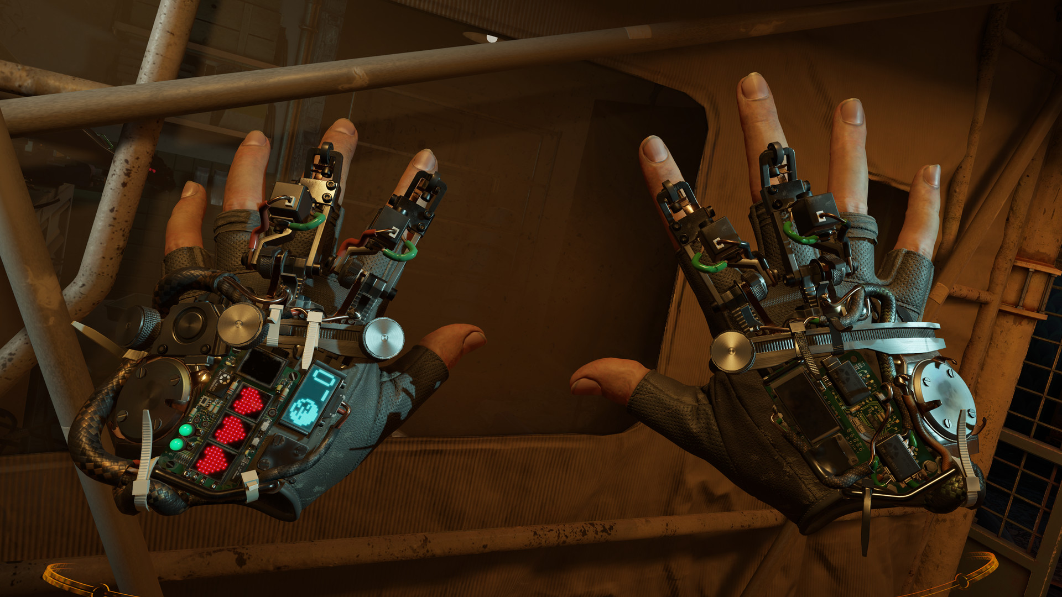
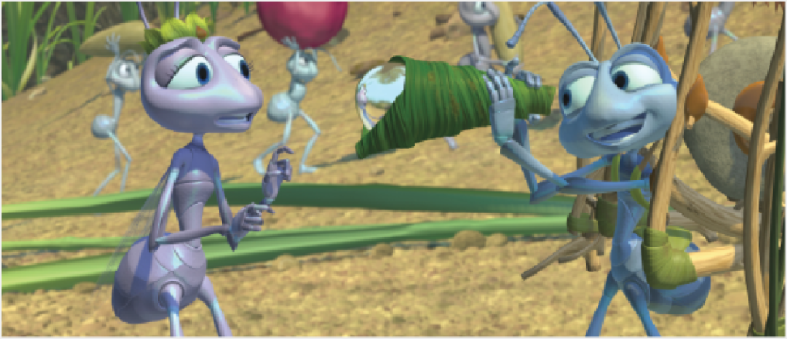
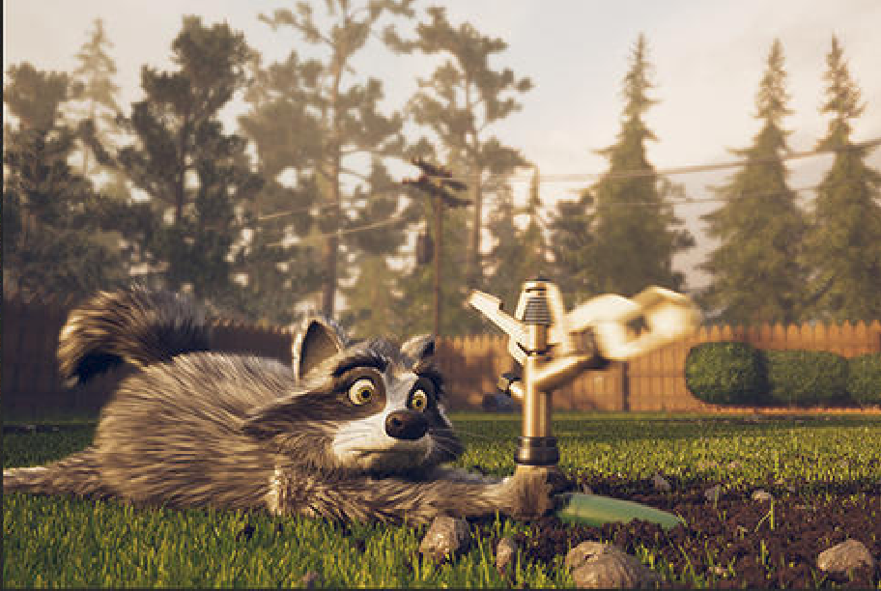
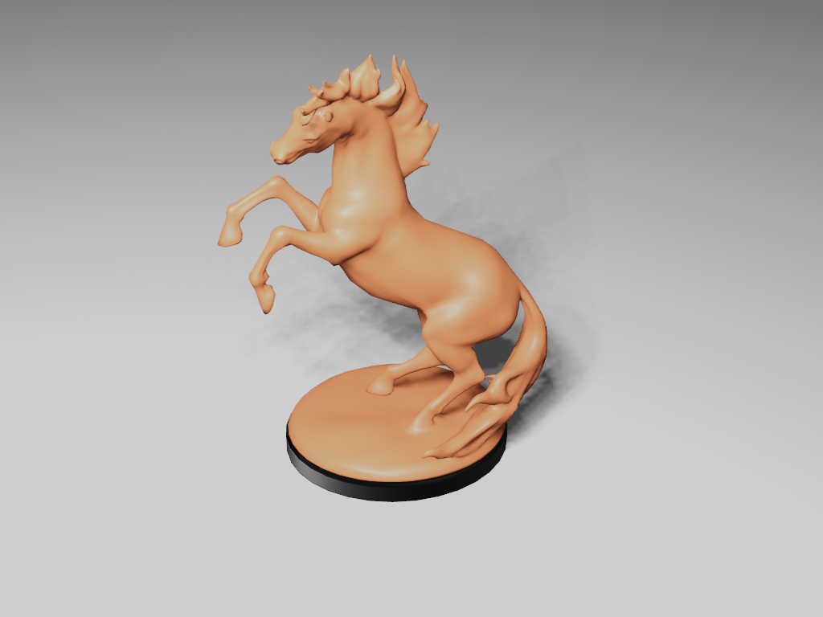
Where is camera?
https://www.half-life.com/en/alyx/
https://sciencebehindpixar.org/pipeline/sets-and-cameras
https://unity.com/solutions/film-animation-cinematics

Slide 4
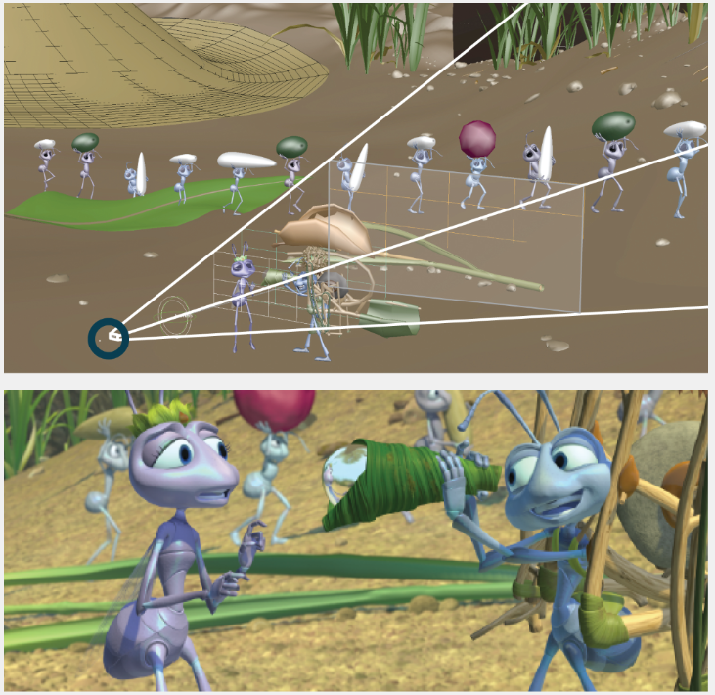
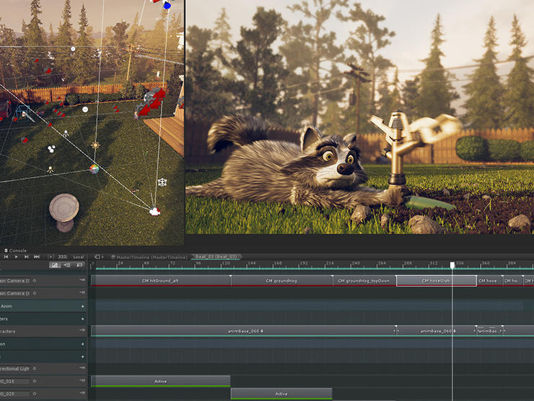
Where is camera?

Slide 5
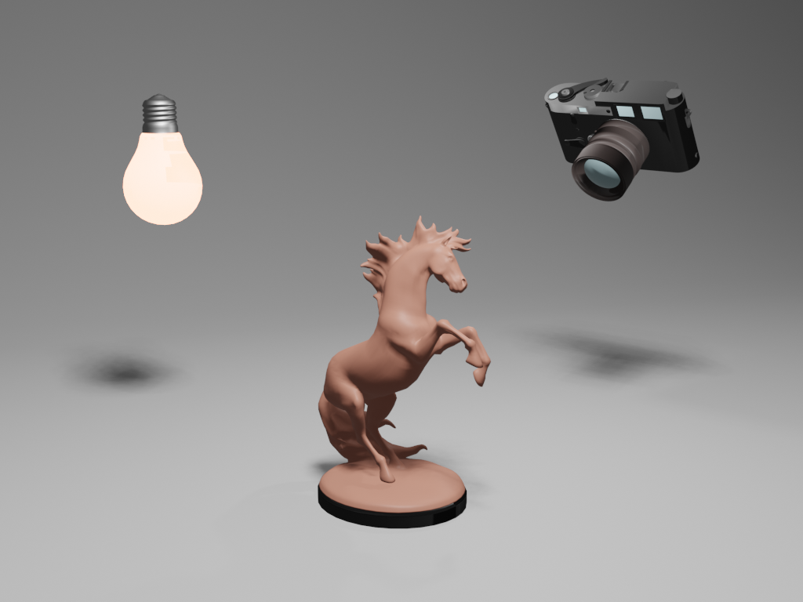
Where is camera?
In rendered images, camera is not seen – it defines what we see.

Slide 6
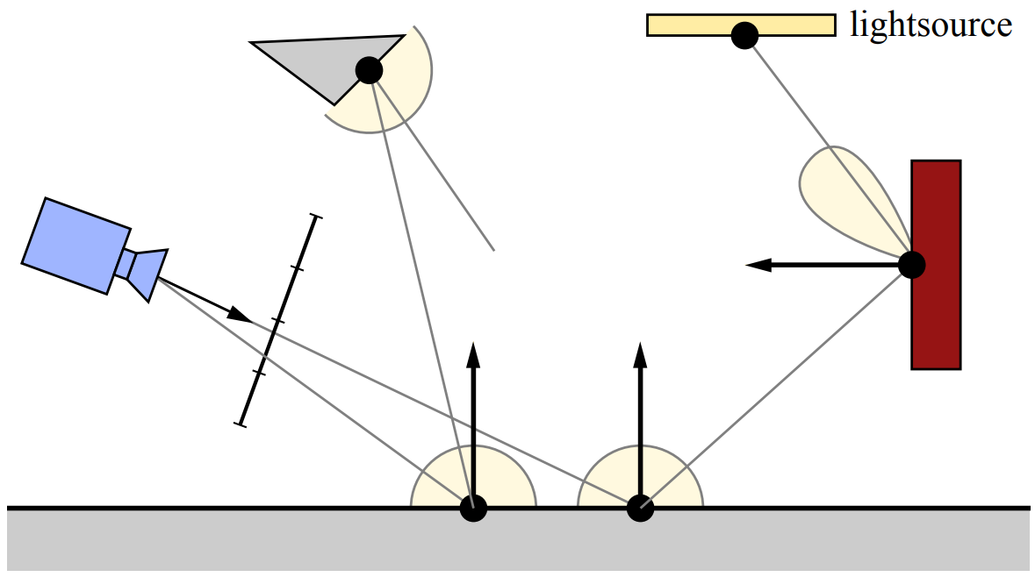
Camera in rendering
Camera defines a portion of visible scene
Light falling on camera sensor forms an image
To find light contributing to pixel colors, rays are traced from camera to 3D scene
  Backward tracing
Camera
Captures light
Light reflection
Light travel
Light reflection

Slide 7
Camera and image formation
Image is created when light falls digital sensor (array of photo-detector cells)
Sensors measure average radiance which quantifies the brightness and color of single ray of light
In computer graphics we only care about light falling on sensors
  That is why we generate rays from camera into the scene → backward tracing

Slide 8
Camera in rendering
TODO
During rendering, each shading surface point corresponds to single ray and thus to sample point on the sensor surface
  example
In chapter about image, we will discuss reconstructing image (signal) over each discrete sensor surface – reconstruction of continuous image signal from discrete samples

Slide 9
Real camera systems

Slide 10
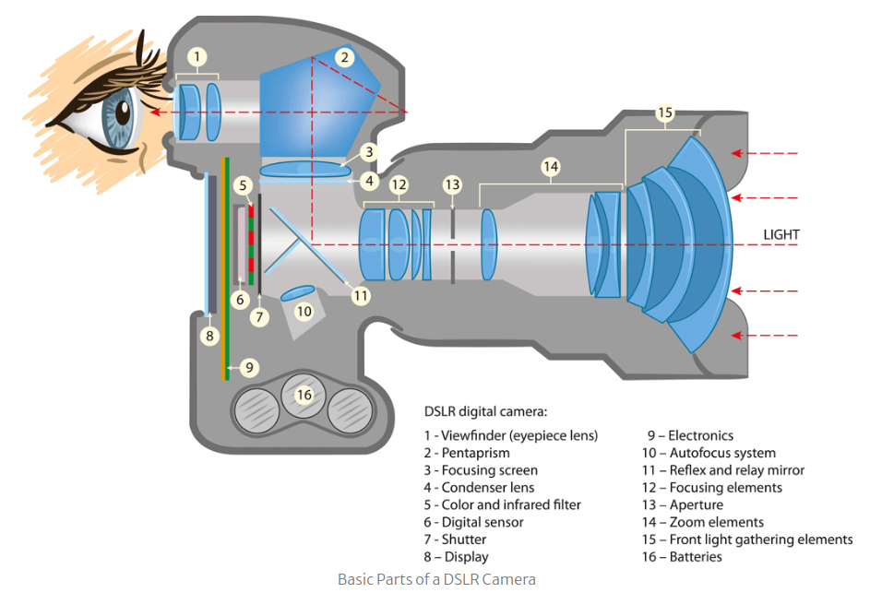
Real camera systems
Lens system
Aperture
Digital sensor

Slide 11
Real camera systems
Camera contains many small discrete sensors: CMOS/CCD
  Each measures incoming radiance values and converts it to color signal
  Radiance: light energy per ray
Sensors are placed into light-proof enclosure with small opening - aperture
  Such setup restricts light where light can enter and strike sensor
Lens is placed at the aperture to focus the light so each sensor receives light from only a small set of incoming directions

Slide 12
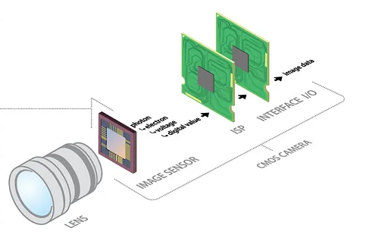
Camera image sensor
Sensor converts incident light energy into analog signal (e.g., voltage) which is later represented as color
Array of sensors are used to form an image
CMOS or CCD image sensor.
https://thinklucid.com/tech-briefs/understanding-digital-image-sensors/

Slide 13
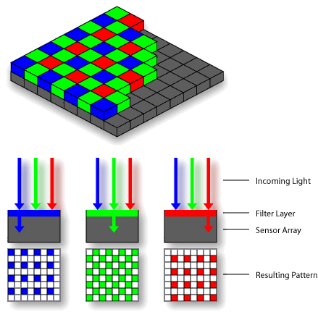
Camera image sensor
Each sensor records incoming light energy per second
Only one signal over whole cell area is captured
Sensor measures only R,G,B wavelengths
Sensor cell can be seen as a pixel
https://simple.wikipedia.org/wiki/Bayer_filter

Slide 14
Image formation

Slide 15
Principle of photography
Two main processes:
  How is image created in camera
  How is image stored on film/file*
* Physical support to store an image, thus simulating the photochemical processes used in traditional film photography is out of scope. Renderer which simulates image storage on film: https://maxwellrender.com/https://maxwellrender.com/

Slide 16
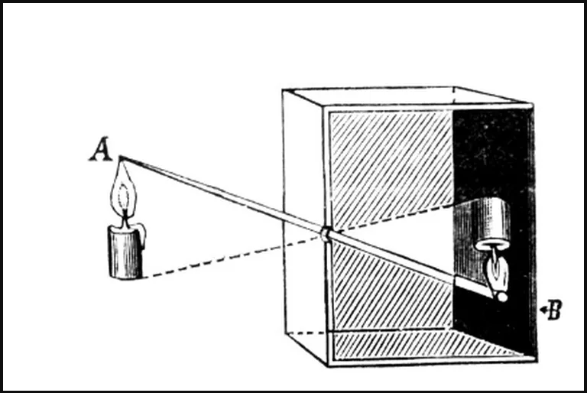
Camera obscura
Aperture
Film
Lightproof box with:
  Black interior (to prevent light reflection)
  Very small opening: aperture
  Light-sensitive film opposite to aperture
When aperture is opened, film is exposed to light
  Light passing through the hole forms an inverted image of the external scene on the film
  Time which aperture must be opened to capture image on film is called exposure
A foundation for modern photographic cameras
https://www.inquirer.com/philly/entertainment/20160806_Camera_Obscura_at_Fleischer_throws_new_light_on_photography.html

Slide 17
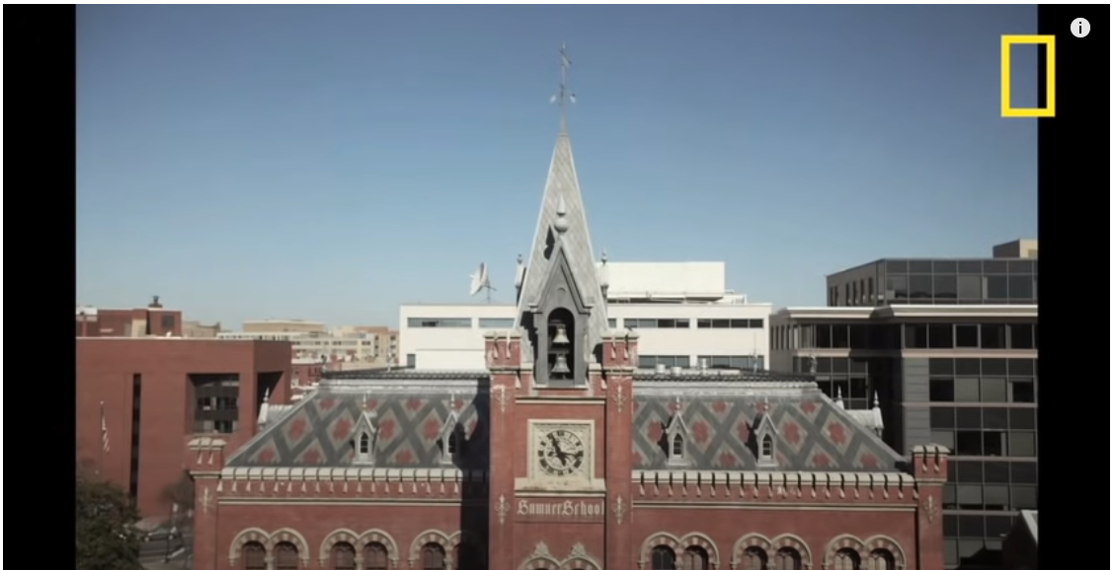
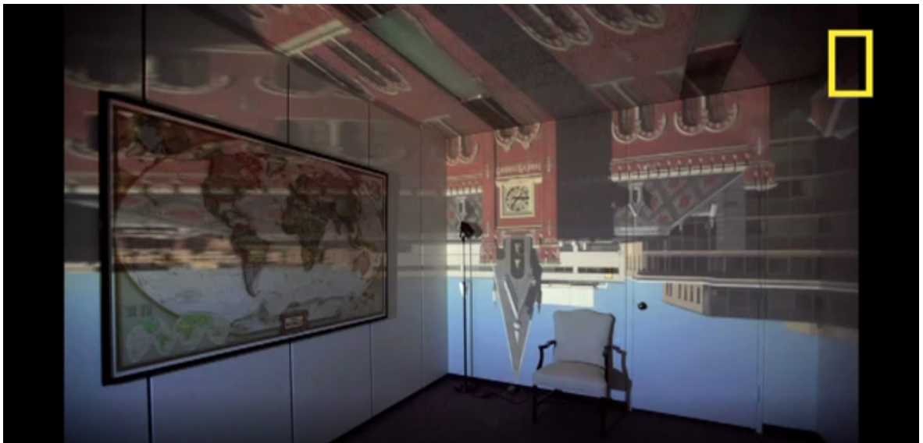
Camera obscura = Dark room
Room made into camera obscura projecting view from the window on the wall.
View from the window.
https://www.youtube.com/watch?v=gvzpu0Q9RTU&ab_channel=NationalGeographic

Slide 18
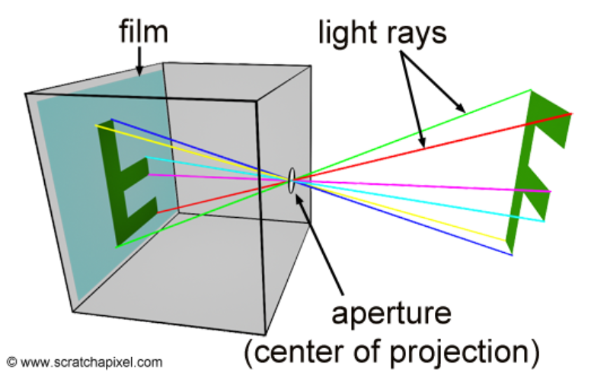
Pinhole camera
Main elements:
  Aperture: center of projection: all rays entering converge here and diverge from it to the other side
  Film: light hitting the film forms the image
Image formation
  Aperture is opened to expose film to light
  Ray reflected from the world in point P enters the camera and intersects film in one point
  Each point in the visible portion of the scene corresponds to a single point on the film
https://www.scratchapixel.com/lessons/3d-basic-rendering/3d-viewing-pinhole-camera

Slide 19
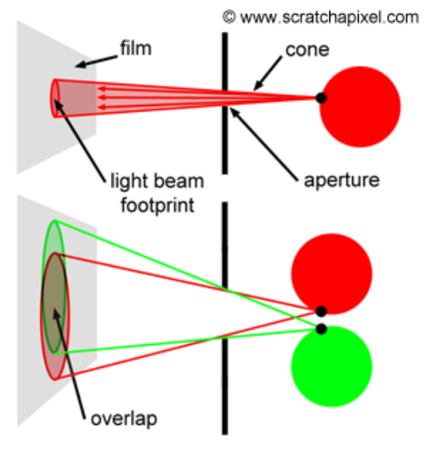
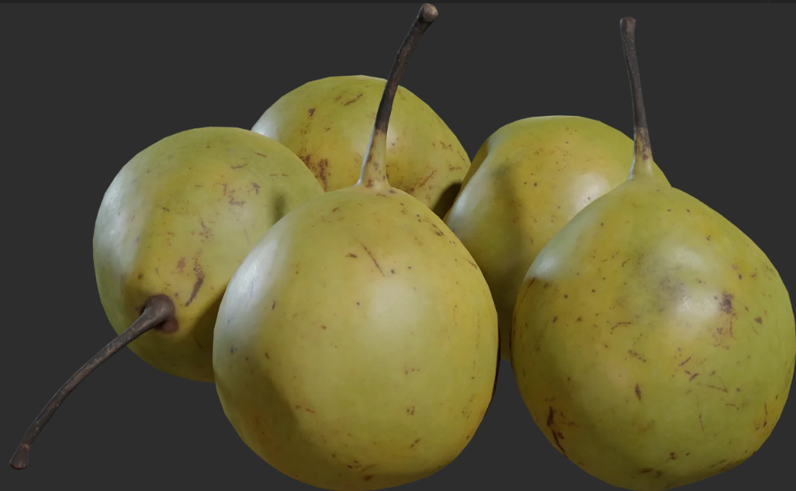

Aperture size
Ideal pinhole: aperture is so small that only one ray passes through it
  Formed image is sharp since each point of the object maps to the one point of the film
Aperture has certain size
  Angle of cone of rays is determined by the size of aperture
  Smaller aperture → smaller cone → sharper image
  Larger aperture → larger cone → blurred image
Cones are overlapping and single point appears multiple times on film → blur (out of focus).
https://www.scratchapixel.com/lessons/3d-basic-rendering/3d-viewing-pinhole-camera
https://polyhaven.com/a/food_pears_asian_01

Slide 20
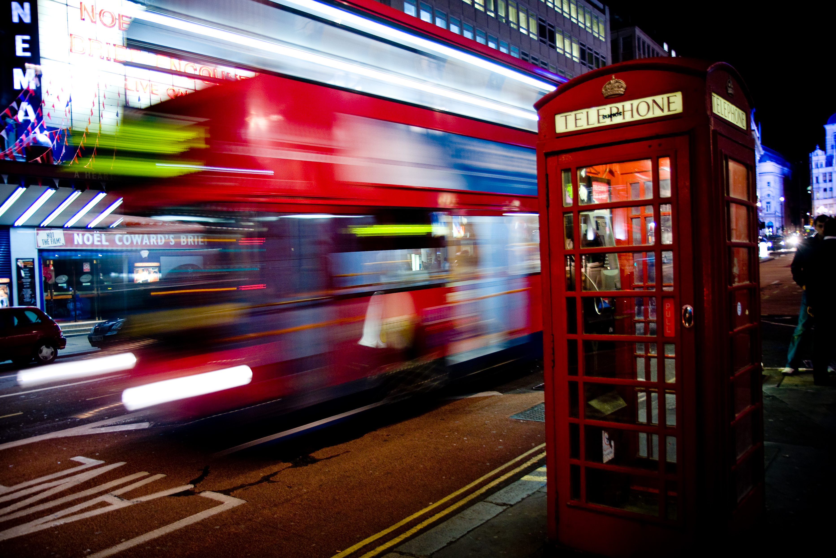
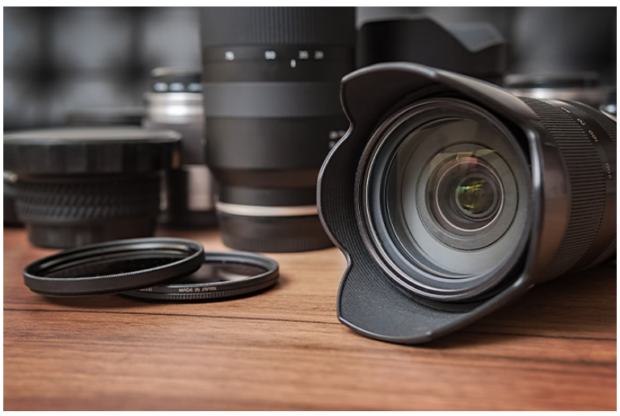
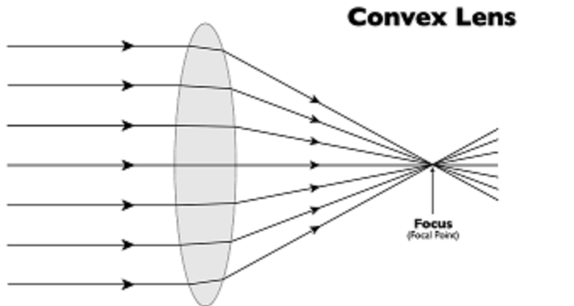
Aperture and Lenses
Small aperture: sharp image, but long exposure times needed leading to motion blur
Large aperture: shorter exposure time but image will be blurred
Solution is to use lens in front of aperture
  Rays entering camera are gathered (converged) and focused to one point on a film plane
  Aperture can now be larger enabling smaller exposure time while blur is canceled with lens
https://photo.stackexchange.com/questions/95113/do-convex-lenses-make-light-from-different-points-converge-to-different-points

Slide 21

Depth of field
Lens camera introduce depth of field: distance between nearest and the farthest object from the scene that appears sharp in the formed image
Pinhole cameras have infinite depth of field
  Because of this, images rendered with pinhole cameras are completely sharp and thus look artificial
Depth of field: https://www.adobe.com/uk/creativecloud/photography/discover/bokeh-effect.html

Slide 22

Bokeh
Lights out of focus are aesthetically pleasing → bokeh effect.

Slide 23
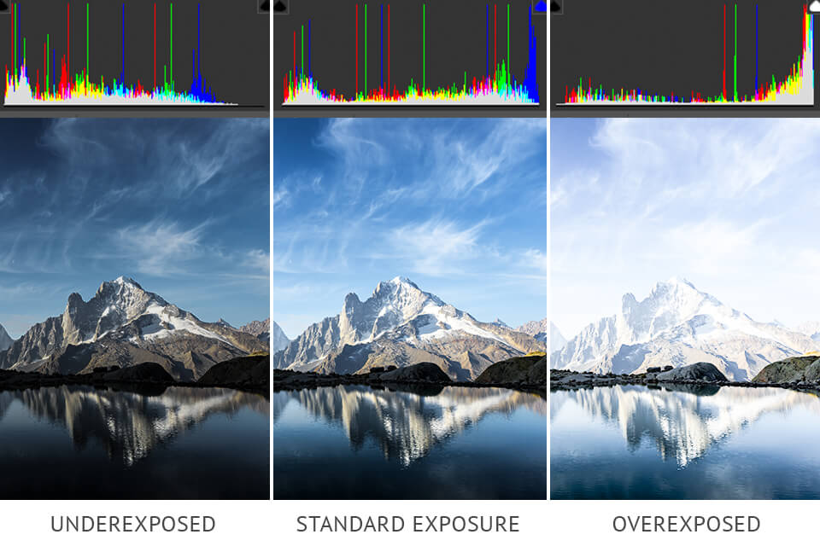
Exposure
Time in which the film is exposed to light is called exposure time
  Determines image brightness
High-contrast image contains both dark shadows and bright highlights
Dynamic range: ratio between the maximum and minimum measurable light intensities
  Determines amount of visible details in lit and shadowed areas
  Real world and 3D scenes can have high difference in dynamic range, but cameras and display devices are limited in capturing and showing them
https://fixthephoto.com/what-is-exposure-composition.html
https://www.adobe.com/creativecloud/video/discover/dynamic-range.html

Slide 24

Exposure
If aperture is small, longer time is needed for image to form on a film
  In this case, motion blur can appear for objects which are not perfectly still
Earth rotation causes motion blur in long-exposure photos
https://en.wikipedia.org/wiki/Motion_blur

Slide 25
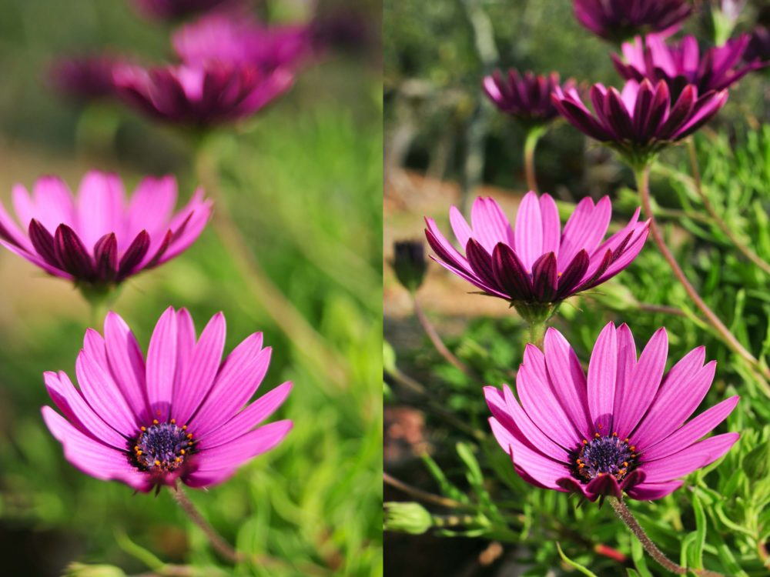
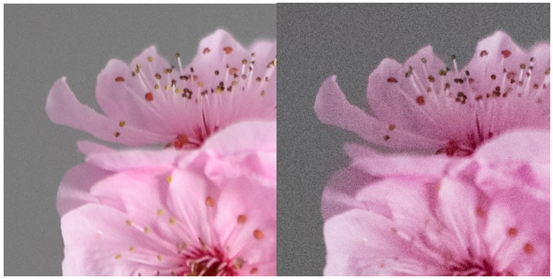
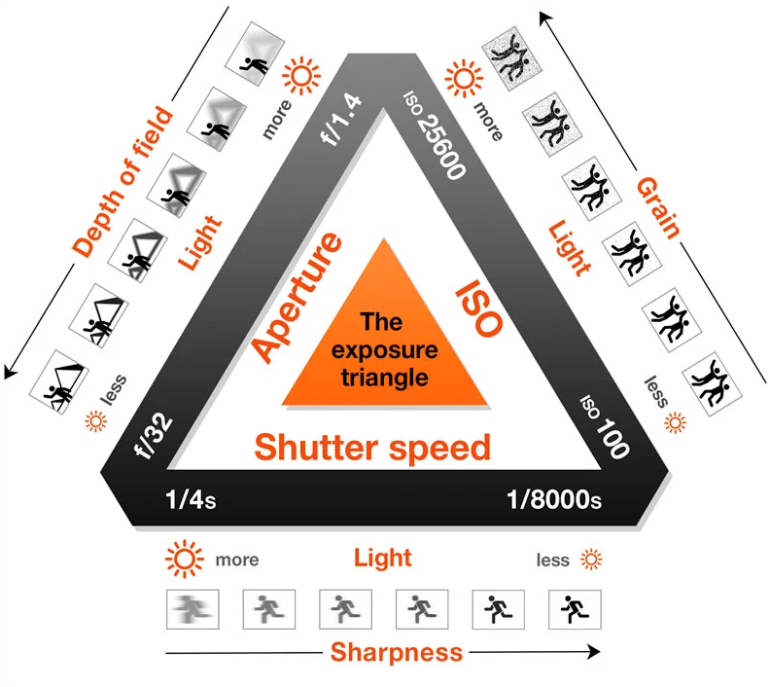
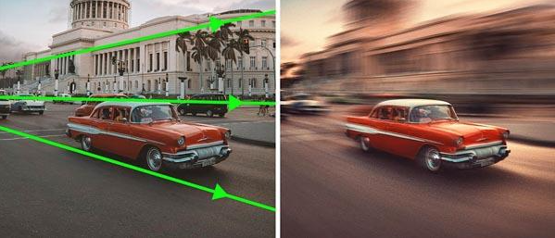
Exposure
Exposure is controlled with:
  Aperture size (f-stop) → depth of field
  Shutter speed → motion blur
  Sensitivity (ISO) (gain) → noise
https://photonify.com/3-steps-for-adjusting-the-depth-of-field-on-your-camera/
https://petapixel.com/exposure-triangle/
https://actioncamera.blog/2017/02/22/the-exposure-triangle/
https://www.shutterbug.com/content/give-photos-dramatic-perspective-motion-and-blur-simple-photoshop-technique-video

Slide 26
Pinhole camera model

Slide 27
Pinhole camera model
Complex lens system is simplified: pinhole camera
Main elements:
  Film (image plane)
  Aperture (small opening)
Parameters:
  Focal length
  Angle of view
  Film size

Slide 28
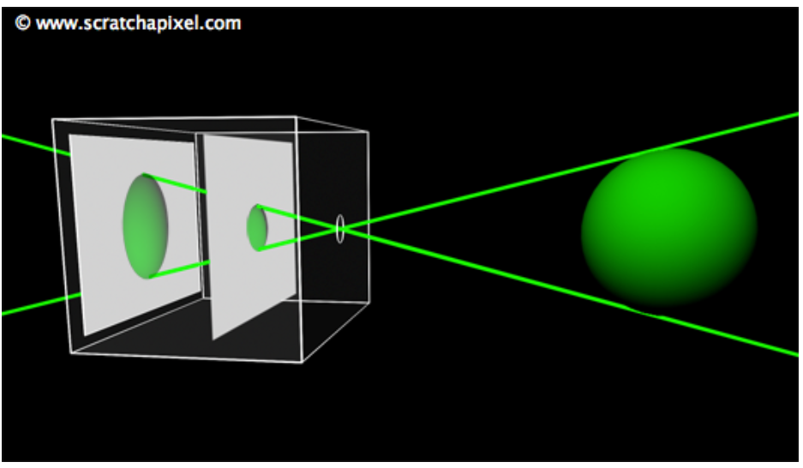
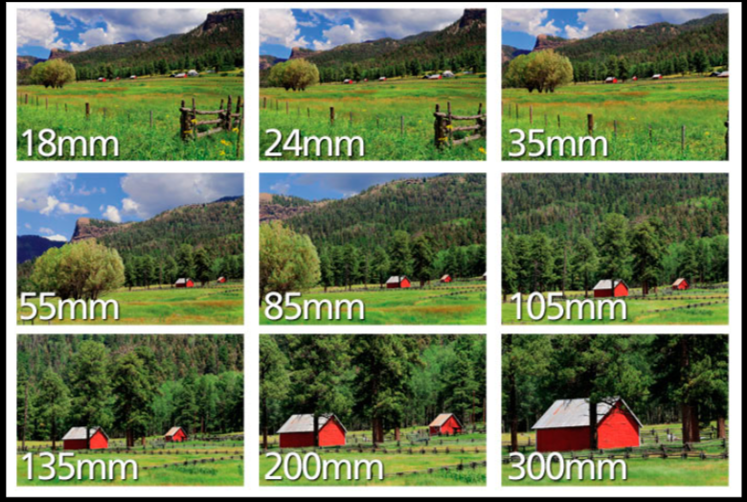
Focal length
Distance of film plane from aperture defines amount of scene that we see
  Moving image plane (film plane) closer to aperture effectively performs zoom out
  Moving film plane away from aperture effectively performs zooming in
This parameter is called focal length or focal distance
https://www.nikonusa.com/en/learn-and-explore/a/tips-and-techniques/understanding-focal-length.html

Slide 29
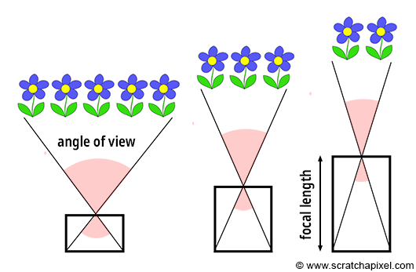
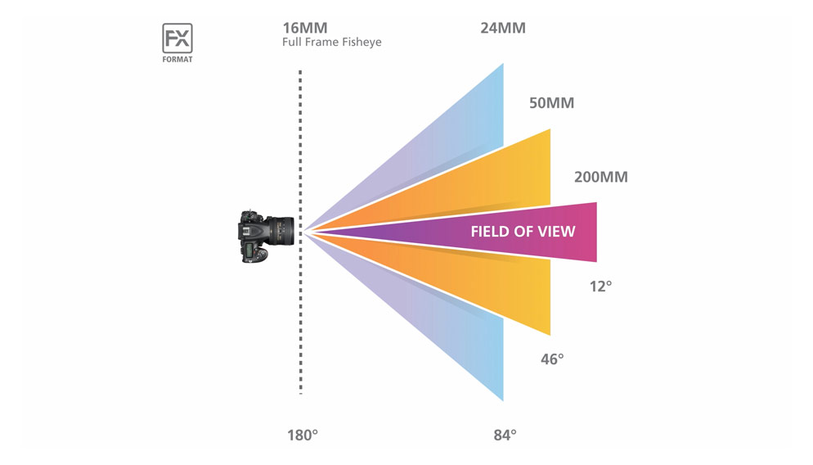
Angle of view
Angle of triangle apex defined with aperture and film edges is called angle of view (AOV) or field of view (FOV)
Changing focal length, changes AOV/FOV
Focal length and corresponding field of viewhttps://www.nikonusa.com/en/learn-and-explore/a/tips-and-techniques/understanding-focal-length.html

Slide 30
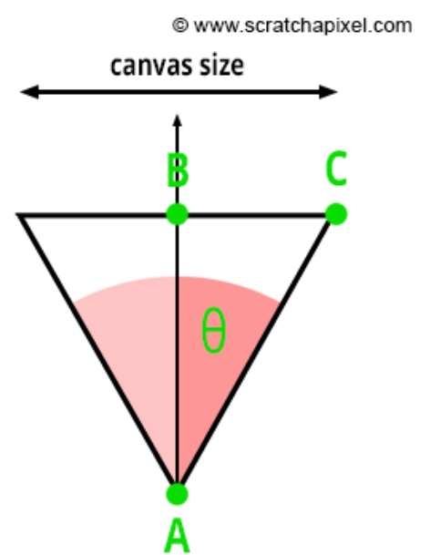
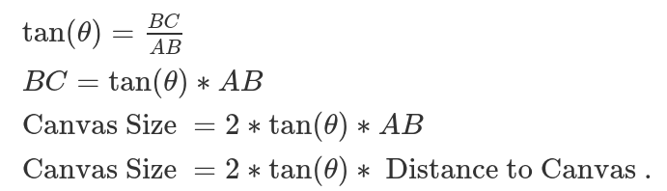
Focal length and angle of view
Relation between focal length (f = AB) and angle of view (θ)
Longer focal lengths result in smaller FOV (more zoom)
Short focal length results in larger FOV (less zoom)

Slide 31
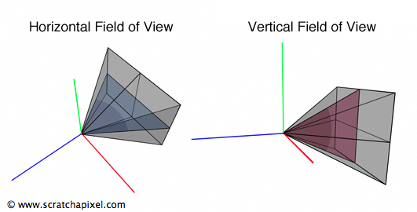
Field of view
Triangle defined with aperture and film edges is a pyramid and we distinguish horizontal and vertical angle (field) of view (AOV/FOV)
Using fixed film aspect ratio, horizontal field of view determines vertical field of view and vice versa

Slide 32
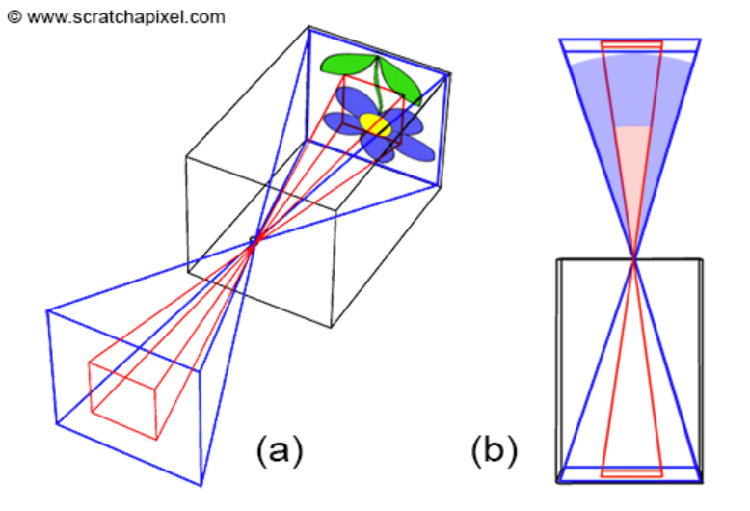
Film size
Angle of view depends on film (image plane) size
  Film has horizontal and vertical dimensions
  Using fixed film aspect ratio, horizontal dimension determines vertical dimension
Smaller area of film size implies smaller angle of view and vice versa.
  Capturing the same extent of the scene with larger film requires adjusting focal length

Slide 33
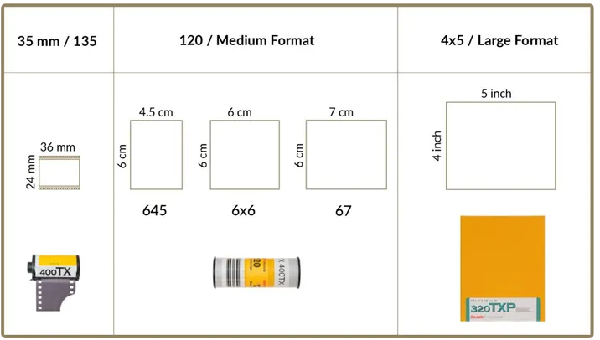
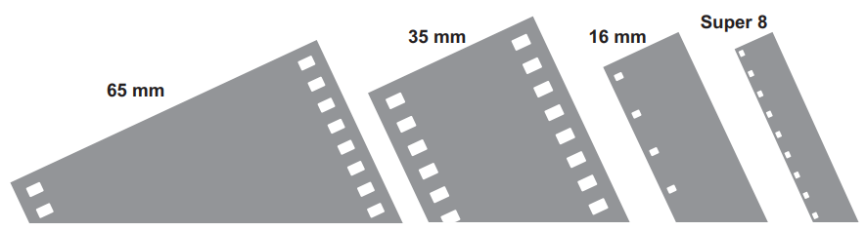
Film size
Larger film formats were developed enabling more details and better image quality
In digital cameras, film is replaced with sensor, thus we talk about sensor size
  Sensor size has the same role as film size
Gauge refers to the width of film. Four are common: 65mm, 35mm, 16mm, Super 8. http://www.theodoropoulos.info/attachments/076_kodak05_Film_Types_and_Formats.pdf
https://www.learnfilm.photography/guide-to-medium-format-photography/

Slide 34
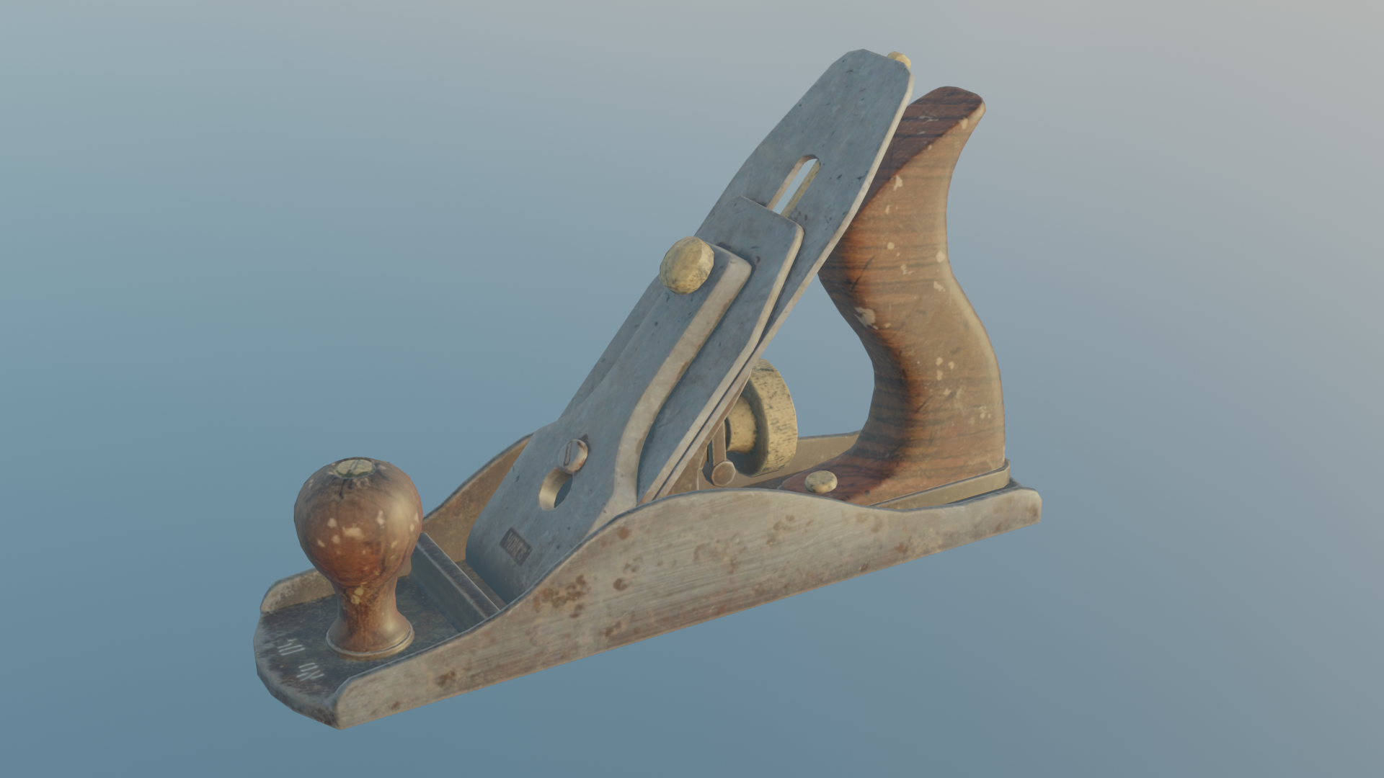

Sensor size and image resolution
1920x1080
Image resolution: width x height pixels
Size of sensor and number of pixels on sensor are independent parameters
  Angle of view doesn’t depend on number of pixels on image sensor
Image quality depends on:
  Image sensor size
  Number of pixels on sensor (resolution)
Higher resolution images will have more details
20% of 1920x1080

Slide 35
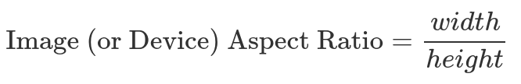
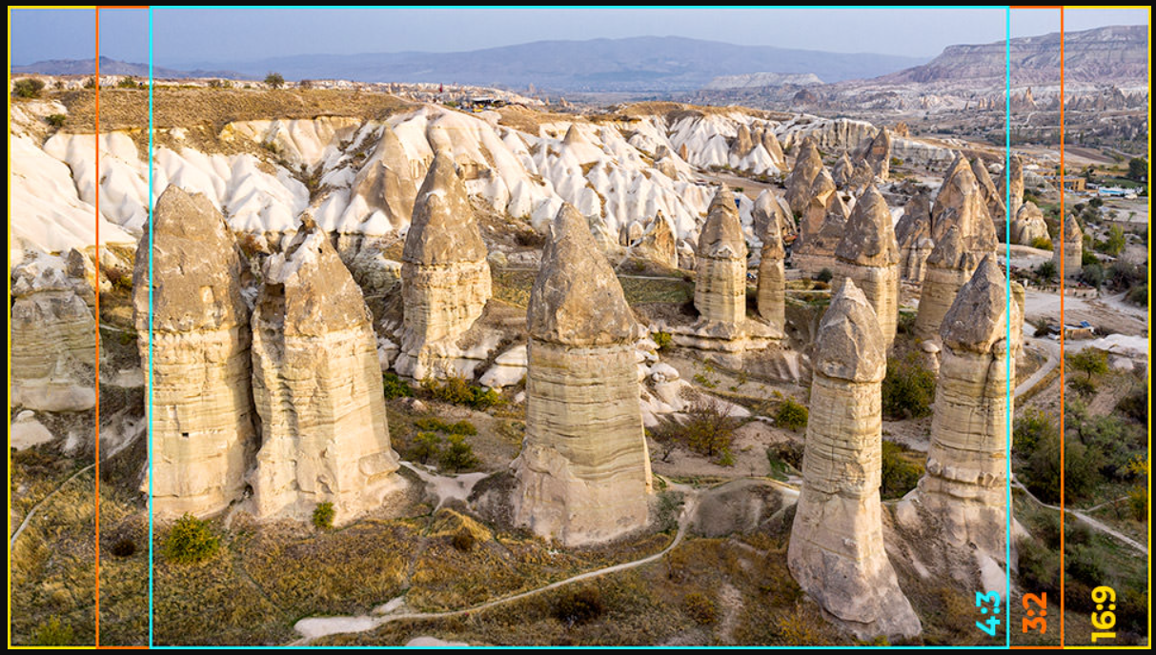
Image resolution and aspect ratio
Image aspect ratio (device aspect ratio) is calculated from image resolution (width and height):
Film and display devices (computer screens, television) have standardized aspect ratios
  4:3
    Old television systems and computer monitors (e.g., resolution 640x480)
    Default for digital cameras; 35mm films
  5:3 and 1.85:1
    Often used for film
  16:9
    Aspect ratio used by HD TV, monitors and laptops (e.g., resolution: 1920x1080)
https://photographylife.com/aspect-ratio
https://www.studiobinder.com/blog/aspect-ratio/

Slide 36
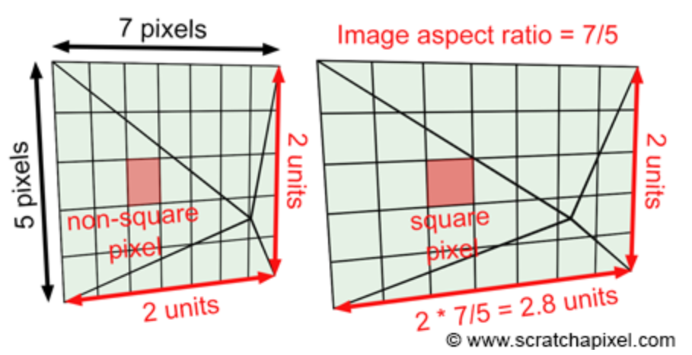
Film and image aspect ratio*
In computer graphic camera model, sensor (film/canvas) aspect ratio can be different from the image (device) aspect ratio.
  Difference leads to stretching the image in either x or y directions
Solution: canvas aspect ratio is often directly computed form the image aspect ratio
  Example, is image resolution is 640x480, canvas aspect ratio will be set to 4:3.

Slide 37
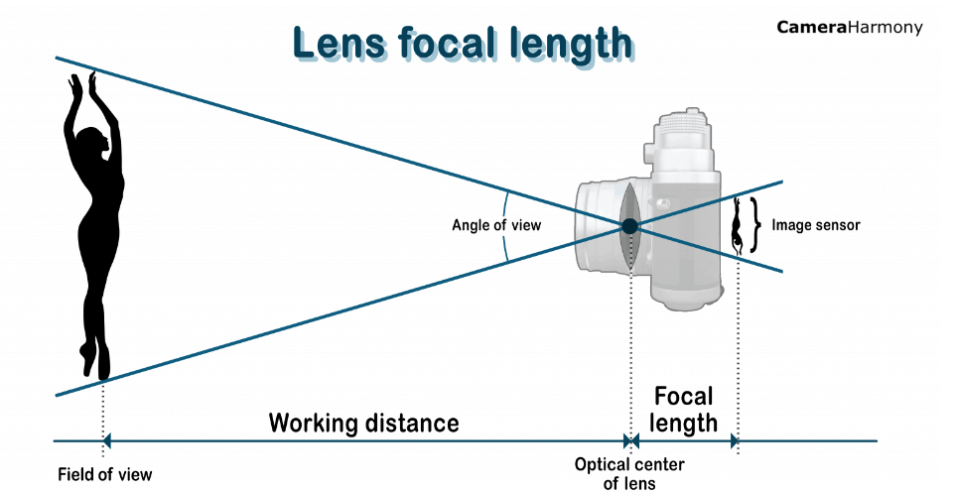
Pinhole camera parameters: recap
Parameters:
  Focal length (focal distance)
  Angle of view (field of view)
  Film size
With two parameters we can always infer the third one
Angle of view is determined by:
  Focal length: longer focal length → narrower angle of view
  Film size: larger film size → wider angle of view

Slide 38
Virtual pinhole camera
Camera model for rendering

Slide 39
Virtual pinhole camera
Virtual pinhole camera model in rendering is used to deliver image similar to those produced by a real camera
  Size and shape of real and rendered object must be the same
  Combining rendered and live action footage must be possible
  Expressive and artistic possibilities must be enabled
Pinhole camera model is used in almost all production software
  Godot: https://docs.godotengine.org/en/stable/classes/class_camera.html
  Unity: https://docs.unity3d.com/ScriptReference/Camera.html
  Blender: https://docs.blender.org/manual/en/latest/render/cameras.html
  Houdini: https://www.sidefx.com/docs/houdini/nodes/obj/cam.html

Slide 40
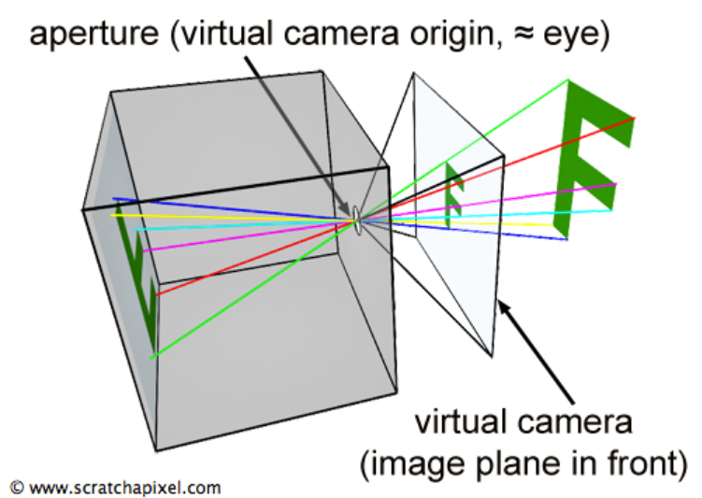
Virtual pinhole camera
In graphics, pinhole camera geometry is not directly simulated
Virtual pinhole camera simulates only directions from which sensors (pixel) receive light
Virtual image plane is placed in front of aperture and rays are traced from aperture to each pixel in virtual image plane
  Camera rays → color of virtual image plane pixels
https://www.scratchapixel.com/lessons/3d-basic-rendering/3d-viewing-pinhole-camera/virtual-pinhole-camera-model

Slide 41
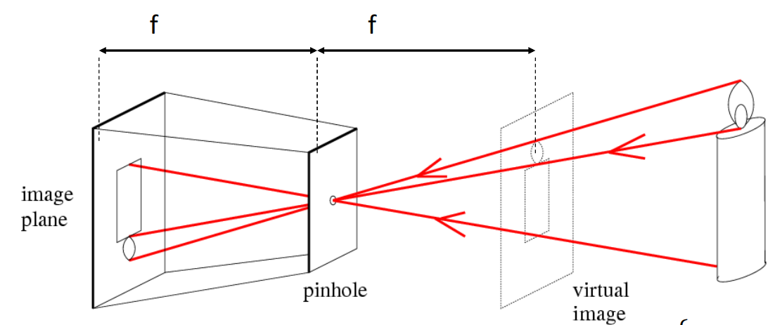
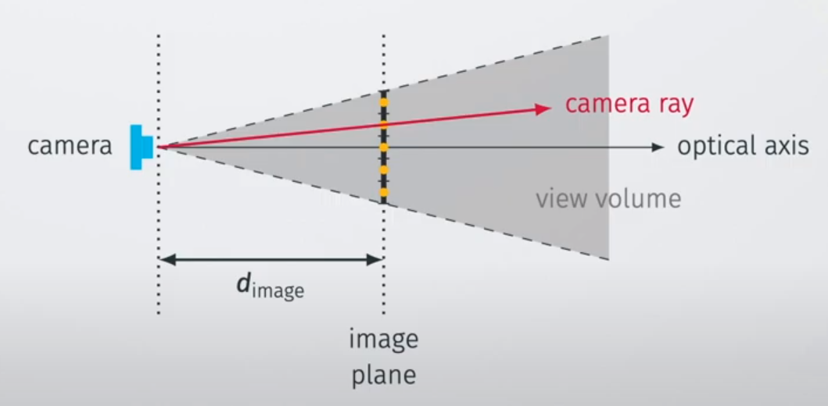
Virtual pinhole camera
Following rays from aperture to image plane pixels and into the scene forms image on image plane
  This results in perspective projection
Virtual image plane is placed on the distance of focal length (f) in front of aperture
Real pinhole camera produces images which are upside down
Simulated pinhole camera produces images which are correctly orientated
Distance from camera to image plane is focal length
http://vision.stanford.edu/teaching/cs131_fall1516/lectures/lecture8_camera_models_cs131.pdf

Slide 42
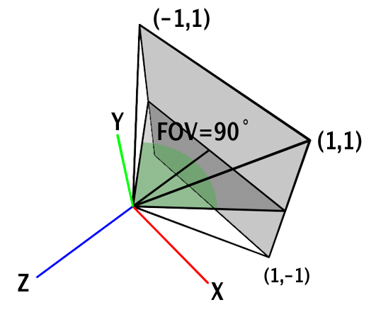
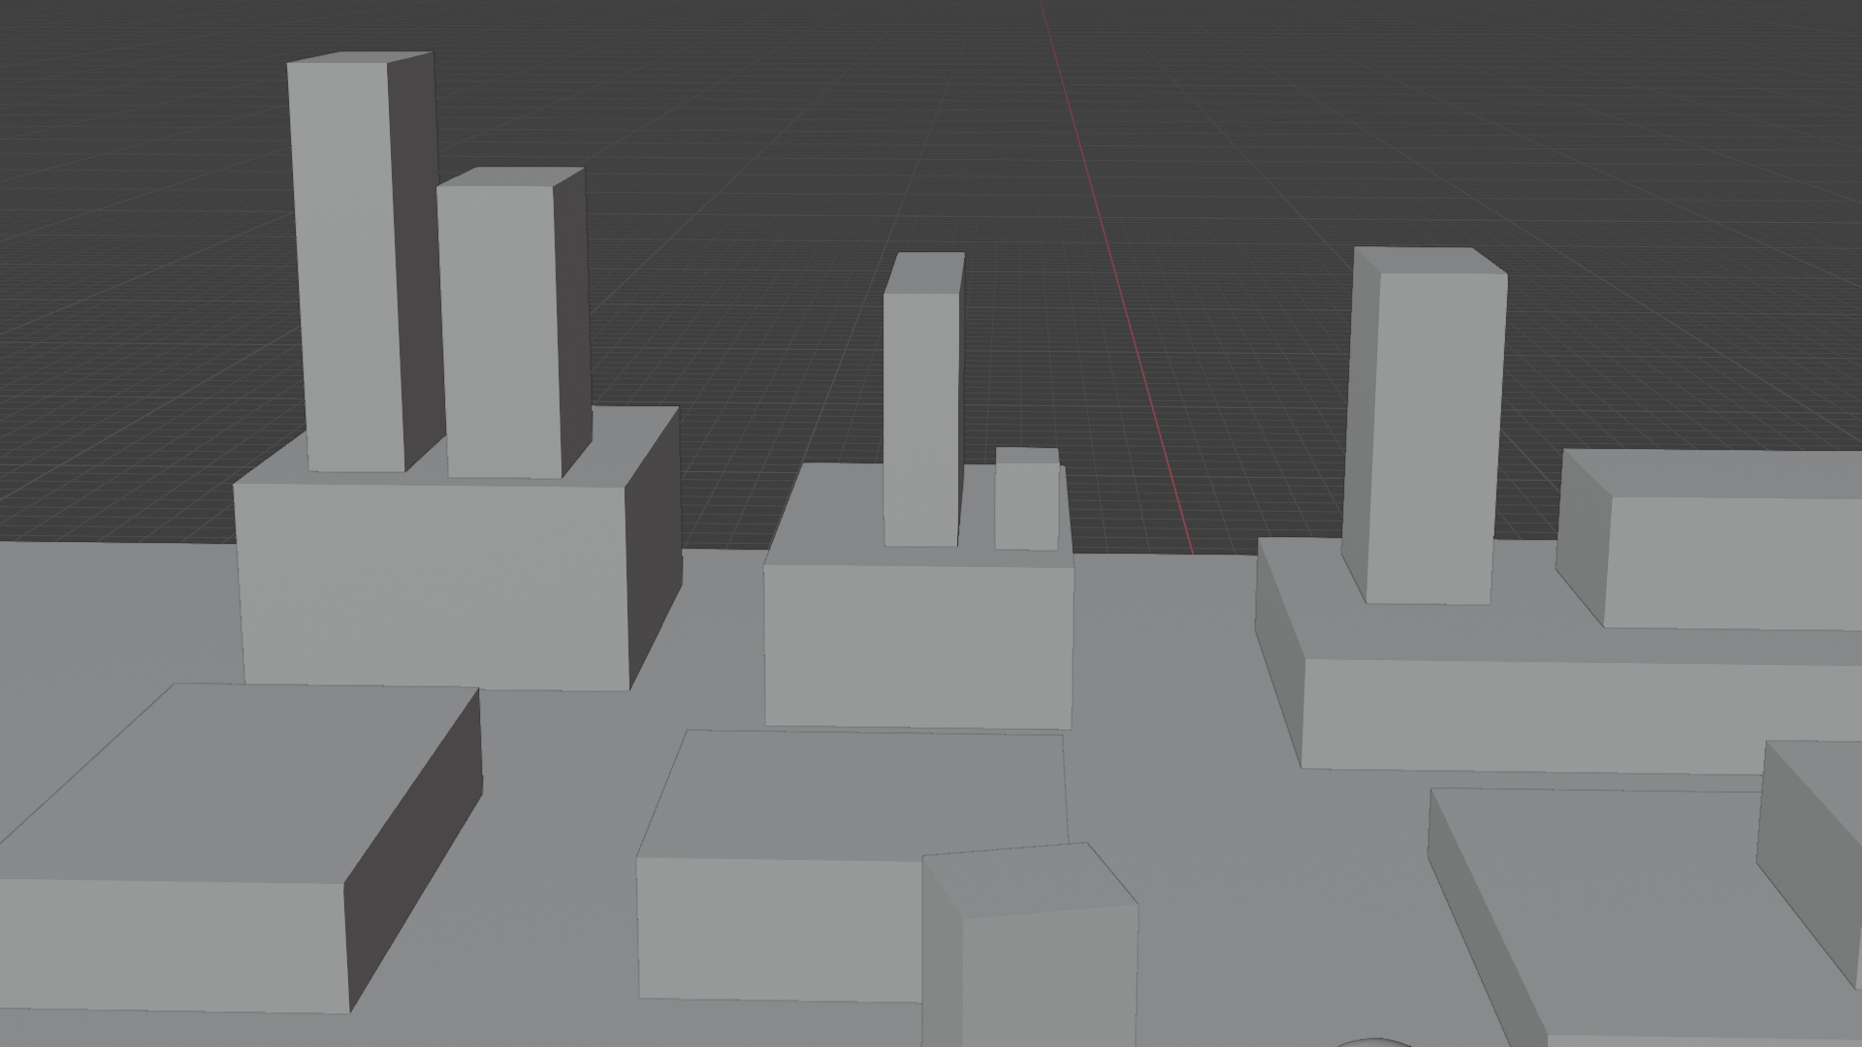
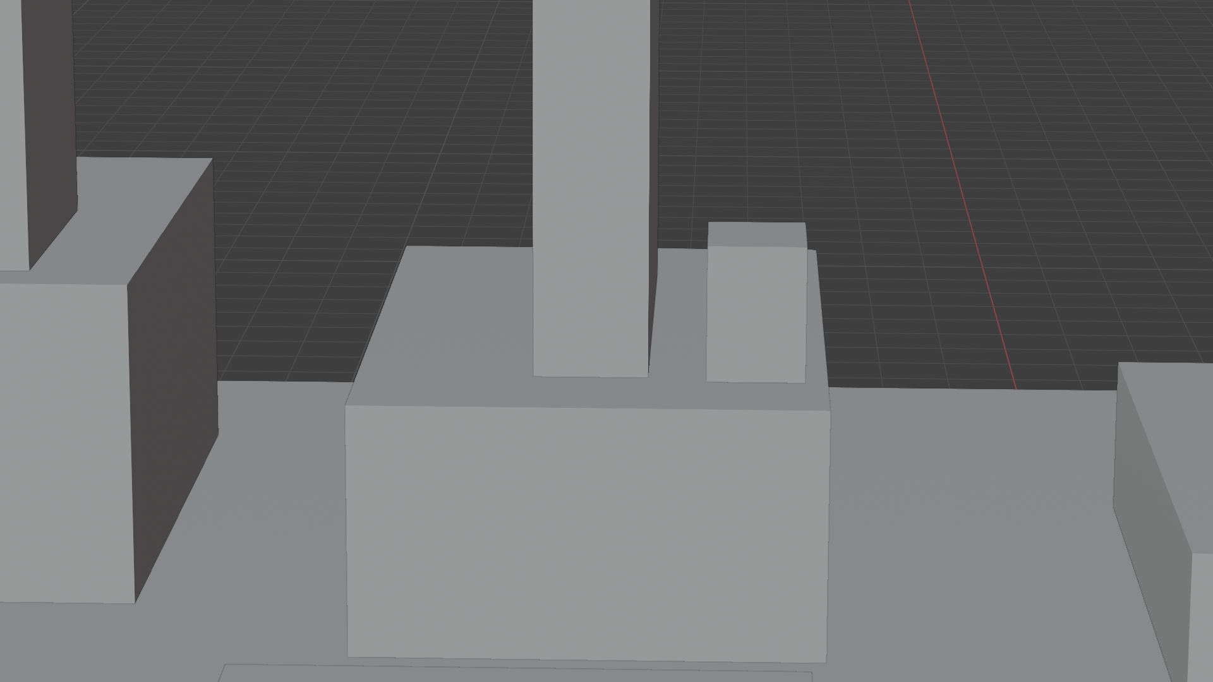
Viewing frustum
Viewing frustum defines portion of scene visible to camera
Viewing frustum of pinhole camera is defined with:
  Camera origin (eye, aperture)
  Field (angle) of view: film size and focal length
Focal length 50mm
Focal length 120mm
https://www.scratchapixel.com/lessons/3d-basic-rendering/perspective-and-orthographic-projection-matrix/building-basic-perspective-projection-matrix.html

Slide 43
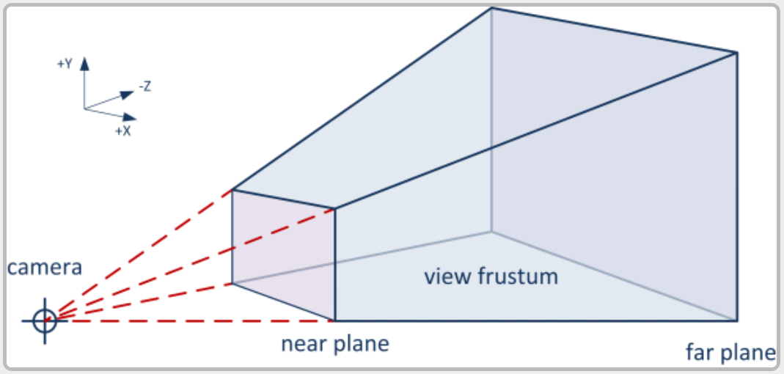
Near and far clipping planes
Virtual pinhole camera additionally has near and far clipping planes
  Virtual planes placed in front of camera and parallel to image plane.
  Location of clipping planes is measured along camera’s line of sight (camera’s local z axis)
Objects in 3D scene closer than near or further than far plane are not visible in image plane.
Near and far clipping planes are needed for resolving precision issues
  Precision can be lost if distance between closest and furthest object is too large
Aperture
https://learnopengl.com/Guest-Articles/2021/Scene/Frustum-Culling

Slide 44
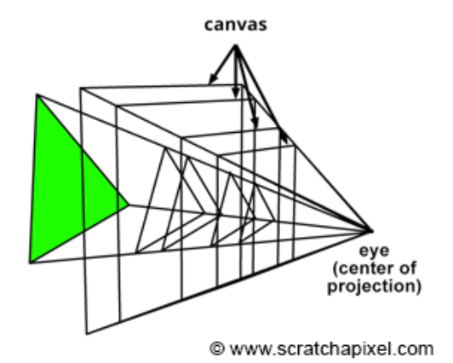
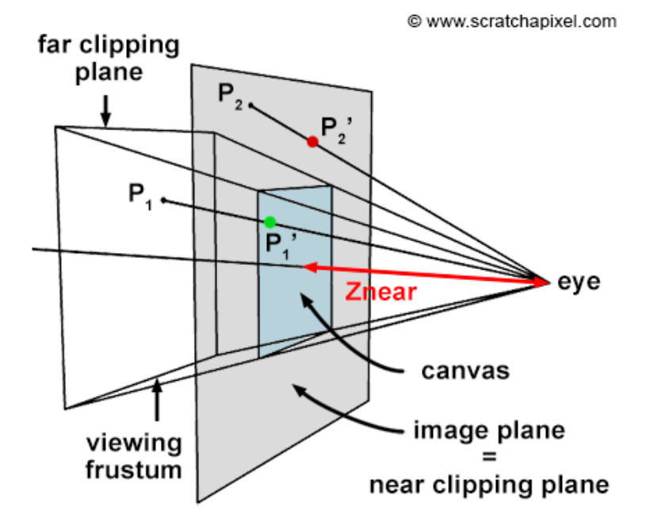
Image plane and clipping planes
Image plane is often placed at near clipping plane for computation simplicity
  Image plane can be placed anywhere on camera’s line of sight (camera’s local z axis) between near and far clipping planes
  Size of image plane depends on distance from eye.

Slide 45
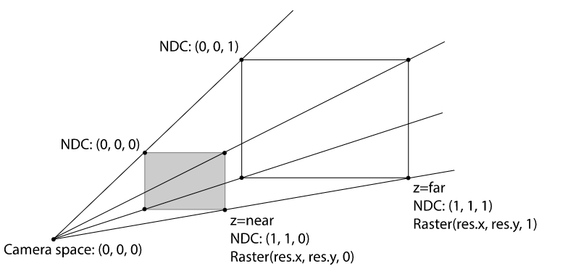

Perspective camera
Most often used from film and game rendering
Rays are generated from one point (eye, aperture) through virtual image plane
Simulates foreshortening effect: more distant objects appear smaller
https://www.pbr-book.org/3ed-2018/Camera_Models/Projective_Camera_Models

Slide 46



Orthographic camera
Useful for architecture, engineering, design, isometric games, etc.
Rays are generated parallel through virtual image plane
Objects are of same size regardless of distance
https://store.steampowered.com/app/1573390/Lilas_Sky_Ark/

Slide 47


Other camera projection types
https://en.wikipedia.org/wiki/Orthographic_projection

Slide 48

Recap
Main elements of pinhole camera are eye and film plane.
Main parameters of pinhole camera are focal length and sensor (film) size.
Virtual pinhole camera further introduces near and far clipping planes to tackle precision problems.
  Viewing frustum shape is defined with aperture point and angle of view
Virtual image plane (canvas, film) can be anywhere on camera’s line of sight
  We assume it is at near clipping plane
  Its boundaries are viewing frustum

Slide 49

Image plane and visibility
Point in 3D scene is visible only if lies in canvas limits → inside view frustum
Image plane is centered about the image plane coordinate system origin
The image plane size itself depends on the angle of view and the near clipping plane (since it is placed at near clipping plane)

Slide 50


Camera orientation and position
Camera orientation is defined with Forward, Up, Right vectors.
Camera orientation and position can be defined with look-at notation:
  Point in space where camera is positioned (From)
  Point in space where camera is looking (To)
Look-at matrix
  Forward, Up, Right can be calculated based on From,To
  Forward, Up, Right, From define look-at matrix
  Defines complete transformation needed for moving camera in 3D scene

Slide 51

Look at matrix
4x4 transformation matrix → transformation of camera from its local (camera) space to world space in 3D scene: camera-to-world and its inverse world-to-camera matrix
Forward = normalize(From – To)
Right = crossProduct(randomVec, Forward)
Up = crossProduct(forward, right)
From_{x}
From_{y}
From_{z}
RandomVec = (0,1,0) or other if Forward is close to (0,1,0) or (0,-1,0)

Slide 52

Moving camera*
Translations: moving in axis directions
Rotations: rotation around axis
https://www.youtube.com/watch?v=El0V6fS7mpc&ab_channel=CGCookie

Slide 53
Virtual pinhole camera image formation
How image is formed using virtual pinhole camera depends on rendering techniques:
  Ray-tracing-based rendering
  Rasterization-based rendering

Slide 54

Camera in ray-tracing
Image centric approach: generate ray for each pixel of virtual image plane
  Ray is generated using camera eye position and pixel position in camera image plane.
  Ray is traced into the 3D scene where it intersects the objects – ray casting (foundational method for ray-tracing).
  Color that is computed from intersecting the object is assigned to pixel

Slide 55

Generating rays
Assume: image plane is [-1,1]x[-1,1]
Rays r(t) can be generated if:
  Image resolution r_{x} x r_{y} is given
  Position of eye (aperture) e is given
  Vectors Forward, Right, Up are given
  Focal length f or angle of view α is given
  Pixel position (i,j) is given
r(t) = e + t * (f * Forward + (i + 0.5) / r_{x} * Right + (j + 0.5) / r_{y} * Up)

Slide 56

Camera in rasterization
Object-centric approach: project object (triangle) points from 3D scene onto image plane and for each pixel find a position on projected object:
  3D points from world space are transformed to camera space: world-to-camera matrix
  Projection matrix is applied on transformed point to project it onto image plane
  Resulting points are convert to raster space (image plane with pixels)

Slide 57



Projection matrix
In rasterization, camera is used to define perspective projection matrix.
General perspective projection matrix is defined with viewing frustum near (n), far (f), left (l), right (r), top (t) and bottom (b)
https://www.scratchapixel.com/lessons/3d-basic-rendering/perspective-and-orthographic-projection-matrix/opengl-perspective-projection-matrix.html

Slide 58


Virtual pinhole camera notes
Virtual pinhole camera has infinitesimally small aperture
  Image will be perfectly sharp
  Additional methods are needed from simulating lens effects such as depth of field
  Lens system introduce focus plane in 3D scene where objects are in sharp focus and blurred otherwise
Perfectly sharp image
Depth of field
https://docs.blender.org/manual/en/latest/render/cameras.html

Slide 59

Virtual pinhole camera notes
Virtual pinhole camera has infinitesimally small aperture → light energy is carried instantaneously by ray
Time in image plane is exposed to light doesn’t affect amount of light falling on image plane
  Exposure is simulated in already rendered image or adding it as parameter to lights
Different exposures of the same render: https://docs.blender.org/manual/en/latest/render/color_management.html

Slide 60

Virtual pinhole camera notes
In simulated camera, light transport is considered instant, therefore, simulation of motion blur requires additional simulation
Motion blur must be additionally simulated using shutter speed: time in which camera door is opened to allow incoming light
Motion Blurhttps://docs.blender.org/manual/en/latest/render/cycles/render_settings/motion_blur.html

Slide 61

Simulating lens camera
Real-world cameras transmit light through a lens that bends and focuses it onto the sensor. Because of this, objects that are a certain distance away are in focus, but objects in front and behind that are blurred.
https://docs.blender.org/manual/en/latest/render/cameras.html

Slide 62


Camera in rasterization
Each projected point from 3D scene has exactly one point on image plane
  Therefore, image will be perfectly sharp
  Additional methods are employed to introduce depth of field
https://docs.blender.org/manual/en/latest/render/eevee/render_settings/depth_of_field.html

Slide 63
More into topic
More about camera film, aspect ratio: https://www.scratchapixel.com/lessons/3d-basic-rendering/3d-viewing-pinhole-camera/how-pinhole-camera-works-part-2
Simulating camera lenses:
  https://www.pbr-book.org/3ed-2018/Camera_Models/Realistic_Cameras
  https://github.com/appleseedhq/appleseed/pull/2914
  https://developer.nvidia.com/gpugems/gpugems/part-iv-image-processing/chapter-23-depth-field-survey-techniques

Slide 64
To remember
Move to summary
questions
Elements of camera system: aperture, film and lens
Pinhole camera
Pinhole camera in rendering
Field of view → sensor size, focal length
Depth of field → lenses, focal length, object distance
Exposure → aperture, shutter, ISO
Motion blur → shutter

Slide 65
Summary questions
https://github.com/lorentzo/IntroductionToComputerGraphics/tree/main/lectures/9_light

Slide 66
Literature
https://github.com/lorentzo/IntroductionToComputerGraphics
ScrachAPixel lession: https://www.scratchapixel.com/lessons/3d-basic-rendering/3d-viewing-pinhole-camera

