Slide 1
Lecture 11: Rendering overview
DHBW, Computer Graphics
Lovro Bosnar
8.3.2023.

Slide 2
Syllabus
3D scene
  Object
  Light
  Camera
Rendering
Image and display
Rendering overview
  Big picture
  Practical rendering
    Ray-tracing
    Rasterization
  Intuition via ray-tracing

Slide 3
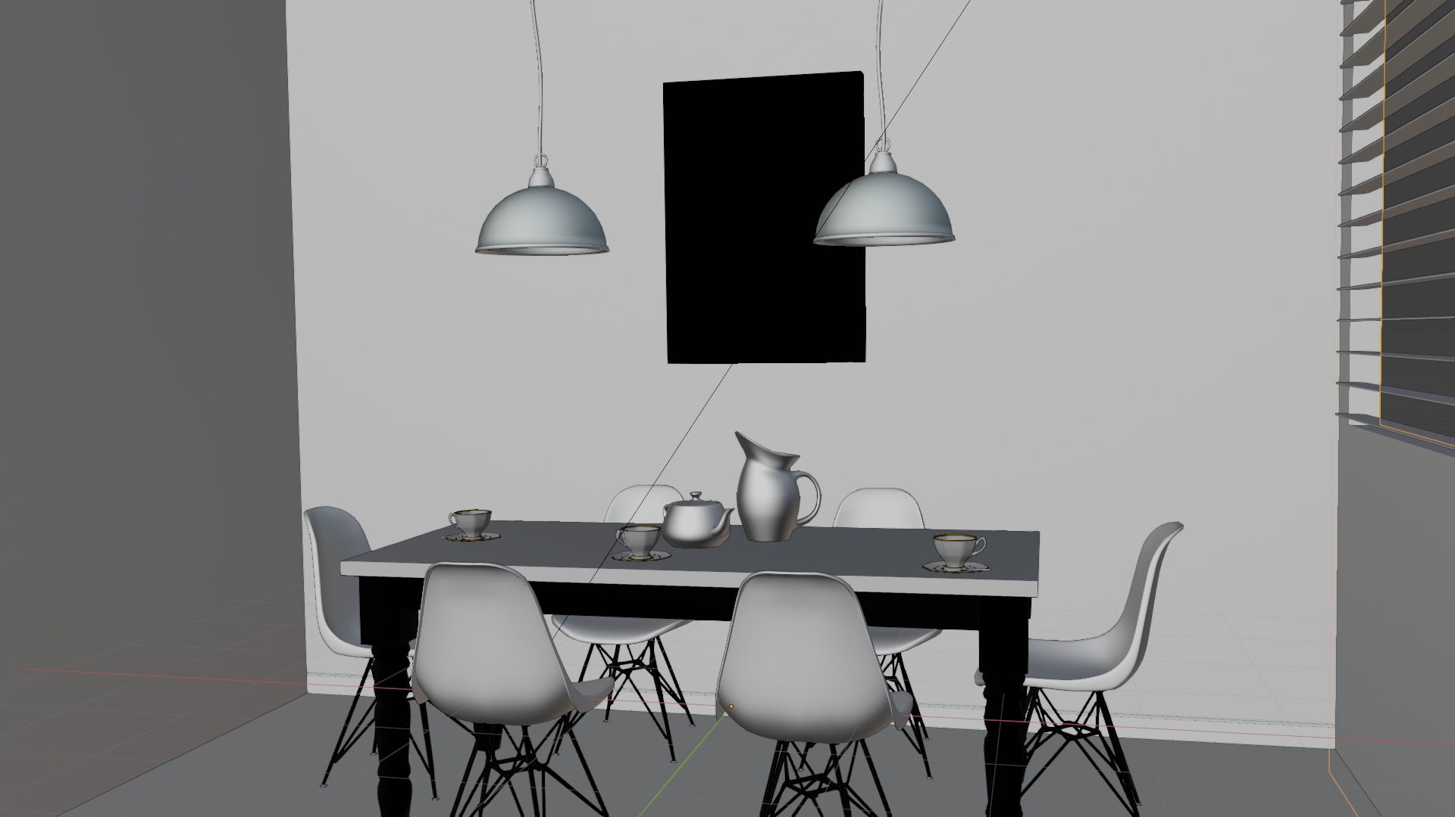
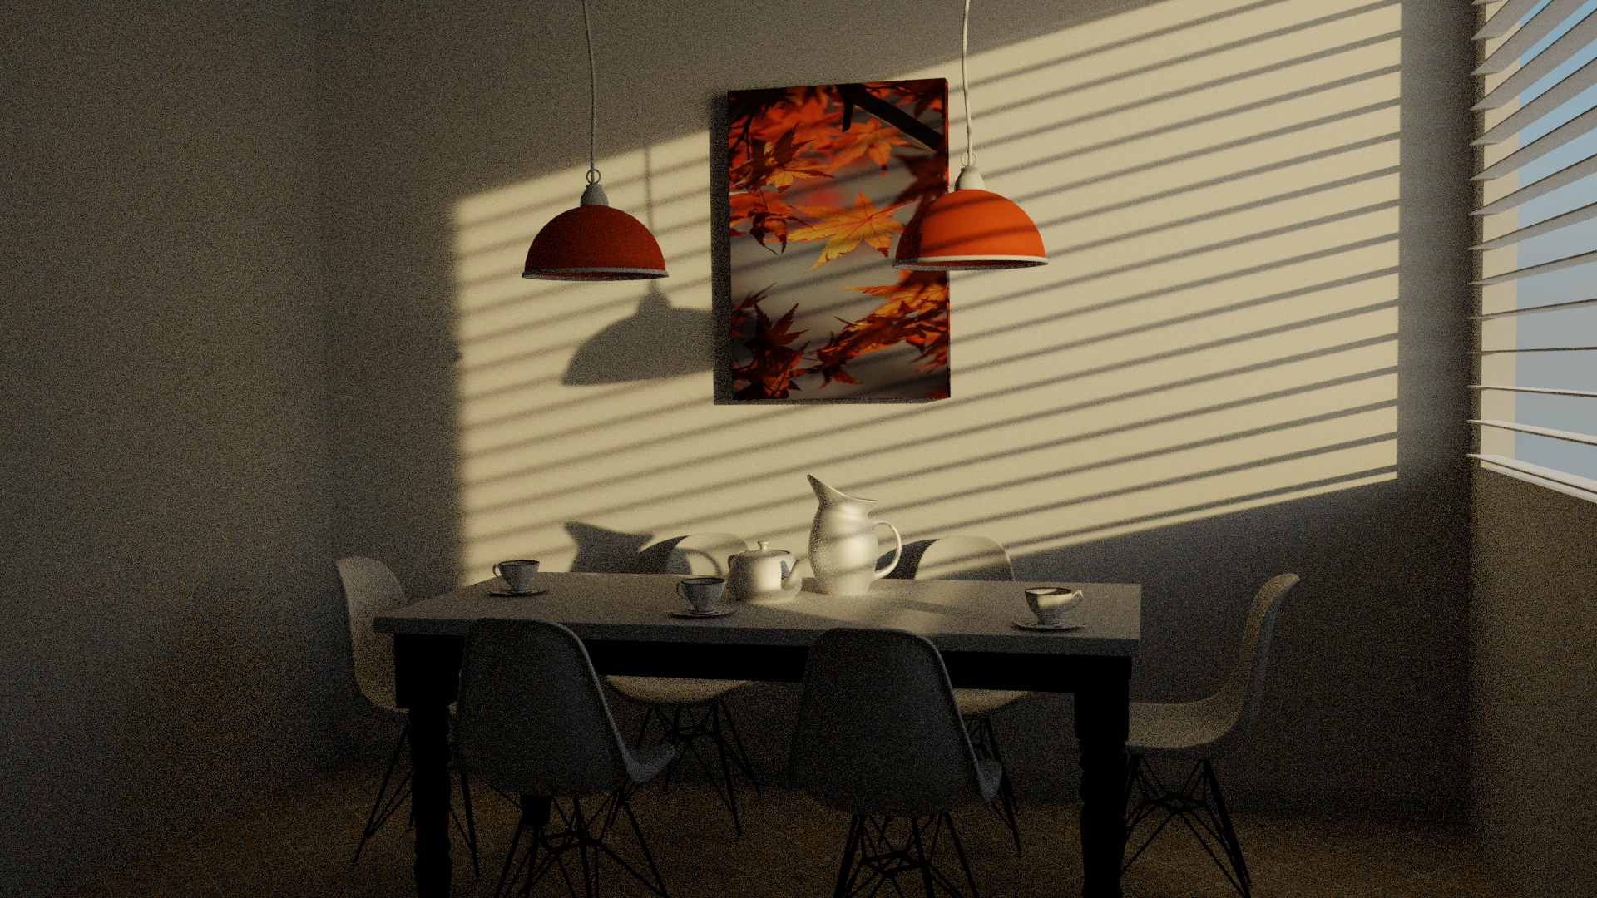
3D scene and rendering
3D scene elements
  Objects: shape and material
  Lights
  Cameras
Rendering creates an image from 3D scene
  Information on 3D scene is used to simulate interaction of light with objects
3D scene
Render

Slide 4

Rendering: big picture
The goal of rendering is to create viewable 2D image from 3D scene which can be displayed on raster display devices → images are 2D array of pixels
The task of rendering is to compute color for each pixel of virtual image plane of virtual camera in 3D scene
  Find which objects are visible virtual camera
  Calculate color of visible objects
1. 3D scene
3. Image

Slide 5
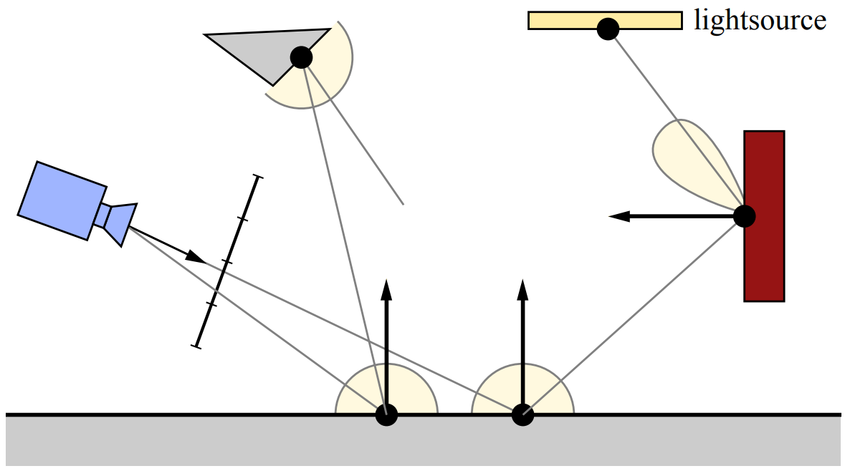
Rendering: light simulation
Idea of computing pixel colors of virtual image plane is similar to how digital camera sensor forms an image
Digital camera sensor is made of array of photo-sensitive cells (pixels) which convert incoming light into colors
Light falling on camera is reflected from objects in the scene
Therefore, we are only interested into light falling on camera sensor
Camera
Captures light
Light reflection
Light travel
Light reflection

Slide 6
Rendering: physical and perceptual considerations
Light emission, travel and interaction with objects and camera sensor is well described in physics (wave and geometrical optics)
We also need to take in account human visual system
  Size and shape of objects gets smaller if are more further → foreshortening effect
    Cameras produce images on this principle
    As we are computing flat representation (on image plane) of 3D scene we need to use perspective projection
  Which objects can we see → visibility problem
  How objects appear → color visible objects

Slide 7
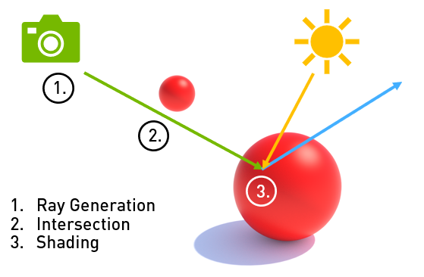
Rendering: main tasks
Rendering is solving:
Visibility problem – which objects and surfaces are visible to each other or from camera using:
  Rasterization
  Ray-tracing
Shading problem – how visible objects and surfaces look like → color
https://developer.nvidia.com/blog/rtx-best-practices/

Slide 8
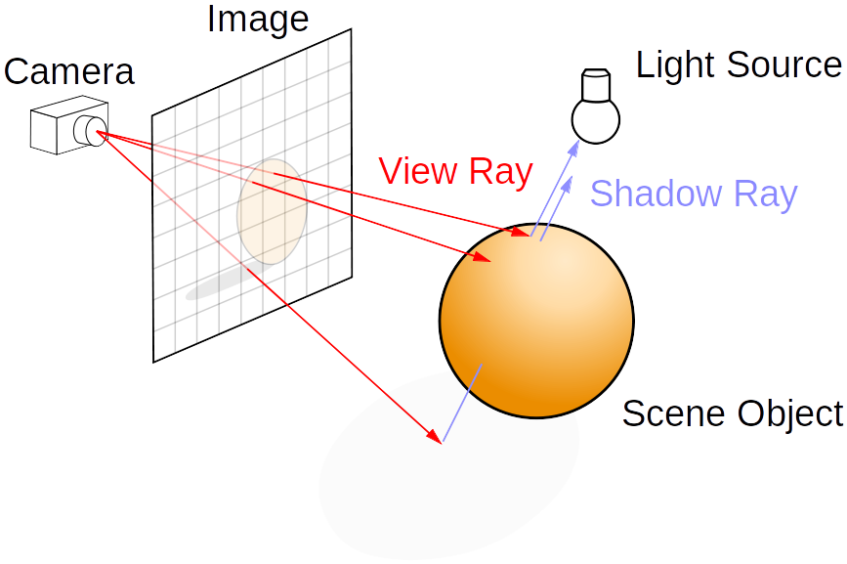
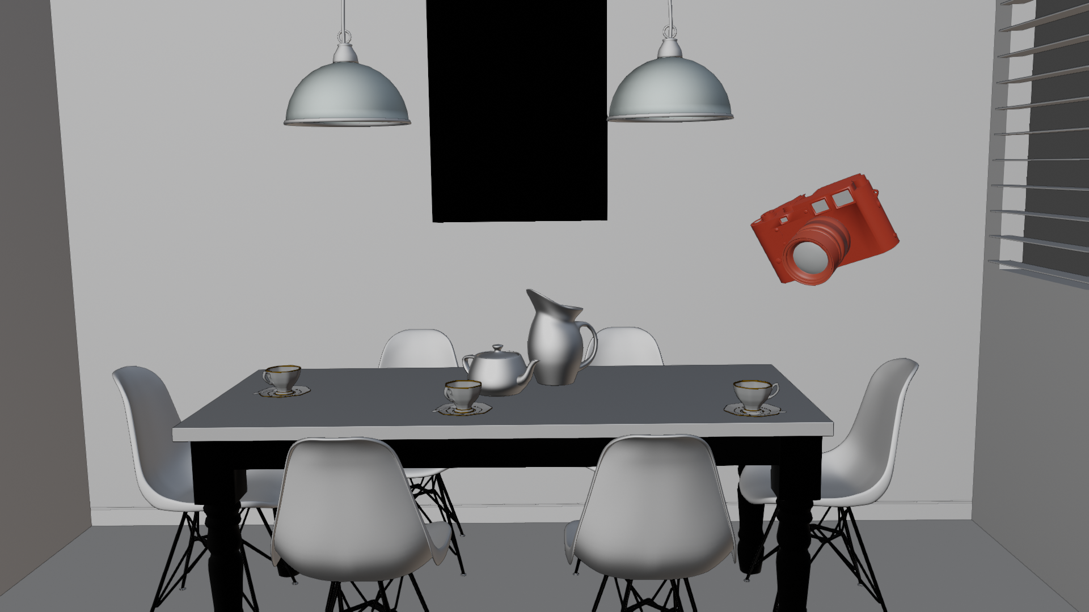
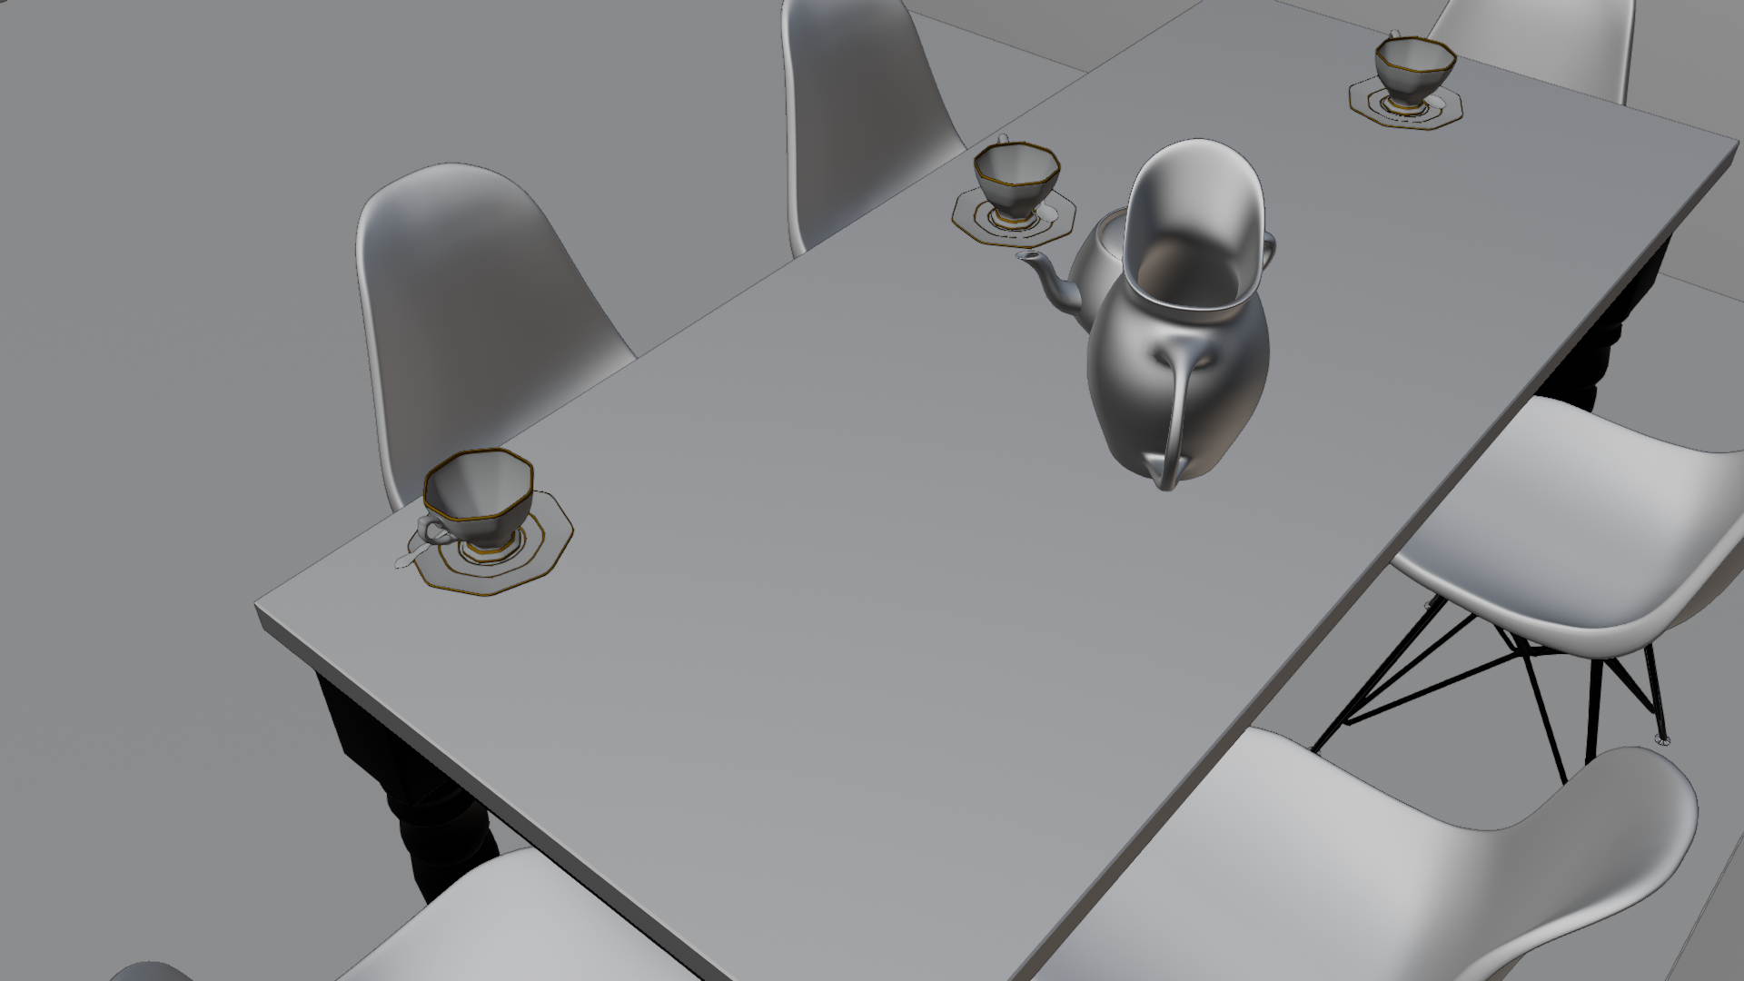
Visibility
Visibility determines if two points are visible one to another
Often, it is used to determine which objects are visible to camera
  Virtual camera is used to simulate human visual system → perspective projection

Slide 9
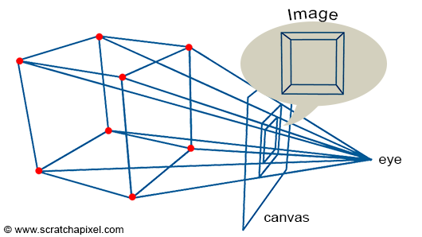
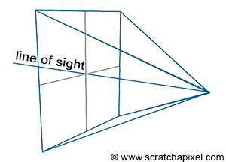
Camera and Perspective projection
Image is representation of 3D scene on a flat surface, e.g., image plane
Perspective projection simulates how human visual system forms images
  Objects are projected on image plane using virtual perspective projection camera
  Foreshortening effect: more distant objects appear smaller
Perspective projection is defined by camera which also defines view frustum
  Objects outside of frustum are not visible
  Shape of frustum depends on image planes size and focal length
Different projections are possible, e.g., orthographic projection
Image plane
eye
Focal length

Slide 10
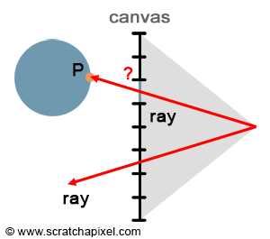
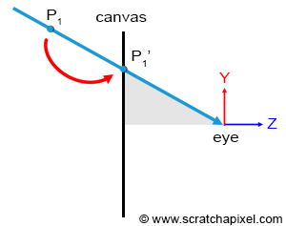
Visibility and projection
Ray-tracing based rendering generates rays from camera to solve visibility
  Rays are generated from camera aperture for each pixel
  Perspective projection will be inherently present
Rasterization-based rendering projects object vertices on screen to solve visibility
  Objects are transformed in camera space (world-to-camera matrix)
  Objects are projected using perspective projection matrix

Slide 11
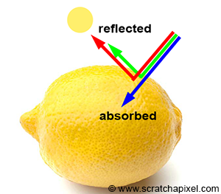
Shading
Shading calculates appearance (color) of objects visible to camera
Color (hue) and brightness of objects is determined by:
  Incoming light
    Light amount (intensity) determines brightness of the object
    Light color
  Material
    How light reflects
    How much light is absorbed determines object color (hue)
    Object can not reflect more light that it receives
    Color of object: ratio of reflected light over amount of incoming (white) light → RGB in [0,1] (note that reflected light may be larger than 1)
https://www.scratchapixel.com/lessons/3d-basic-rendering/rendering-3d-scene-overview/introduction-shading.html

Slide 12
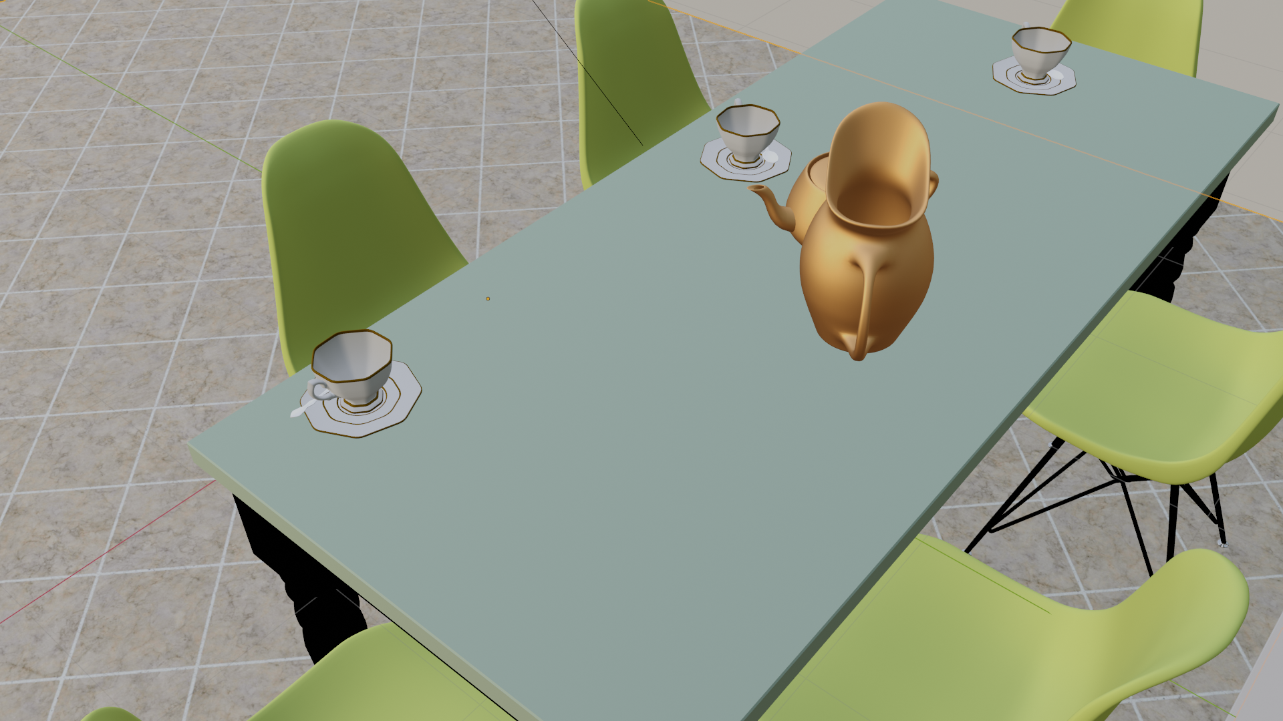
Shading
Mathematical model describing light-object interaction is called shader and it depends on:
  Object shape (e.g., normal)
  Object material (e.g, diffuse, specular, etc.)
  Viewing direction
  Incoming light and its direction
Shading depends on amount of light falling on surface
  Visibility problem: which light sources and surfaces reflecting light are visible from shaded surface
  This computation is called light transport

Slide 13
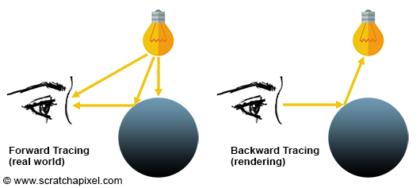
Light transport
Light transport is used to find amount of light falling on object surface
  Forward tracing starts from light, bounces around the scene and enters camera → expensive!
  Backward tracing starts from camera, bounces around the scene and finds a way to light source

Slide 14
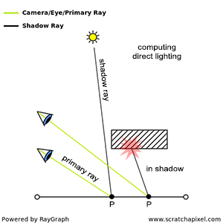
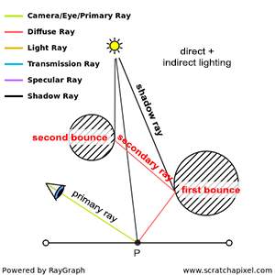
Light transport
Backward tracing: direct illumination
  Only takes in account direct contribution from light source (shadow ray)
Backward tracing: global illumination
  Takes in account both direct and indirect light contribution - reflections from other surfaces (secondary rays)

Slide 15
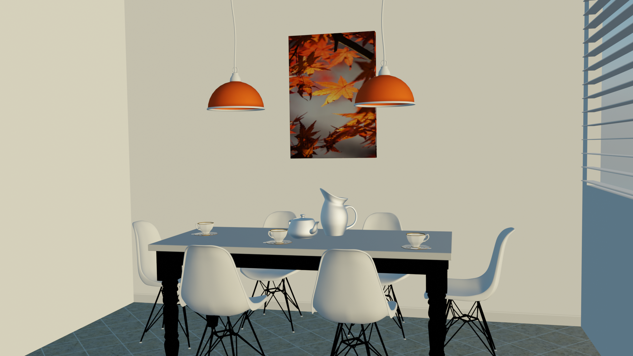
Light transport
Relies on concept of visibility
  Which light sources are visible to shaded surface → direct illumination
  Which surfaces are visible to shaded surface that may reflect light → indirect illumination
Light transport significantly determines the resulting image realism
Rasterization (EEVEE, Blender)
Ray-tracing (Cycles, Blender)

Slide 16
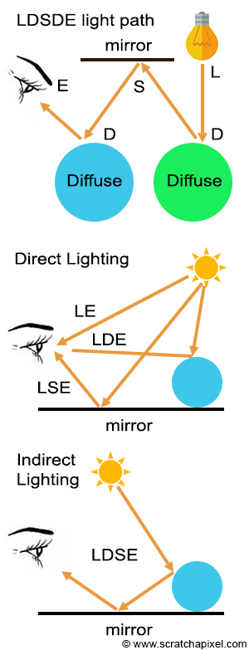
Light transport
Light is emitted from light source (L), reflects on objects, small amount enters the eye (E)
Direction of light reflection depends on object material:
  Diffuse surface (D)
  Specular surface (S)
Different light transport algorithms can be characterized using path labeling: L, E, D, S
  Paul Heckbert: “Adaptive Radiosity Textures for Bidirectional Ray Tracing”
Rendering equation can be described as L(D|S)*E
  “*” - represents zero or more occurrences, “|” - represents either/or

Slide 17
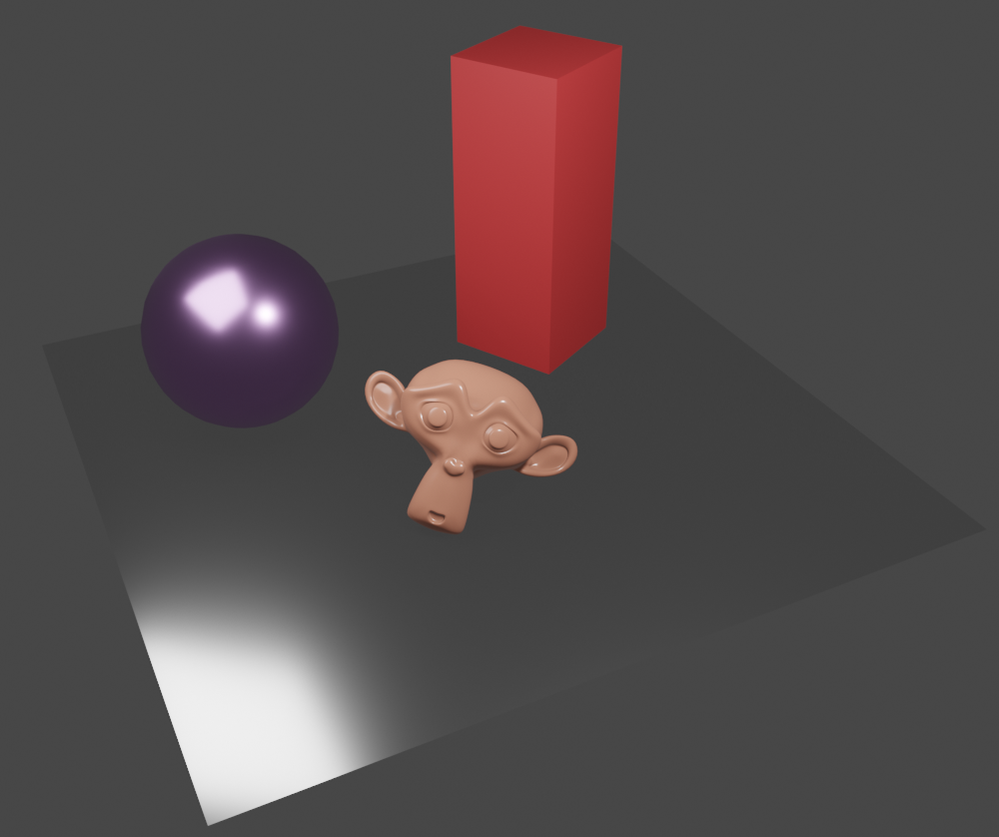
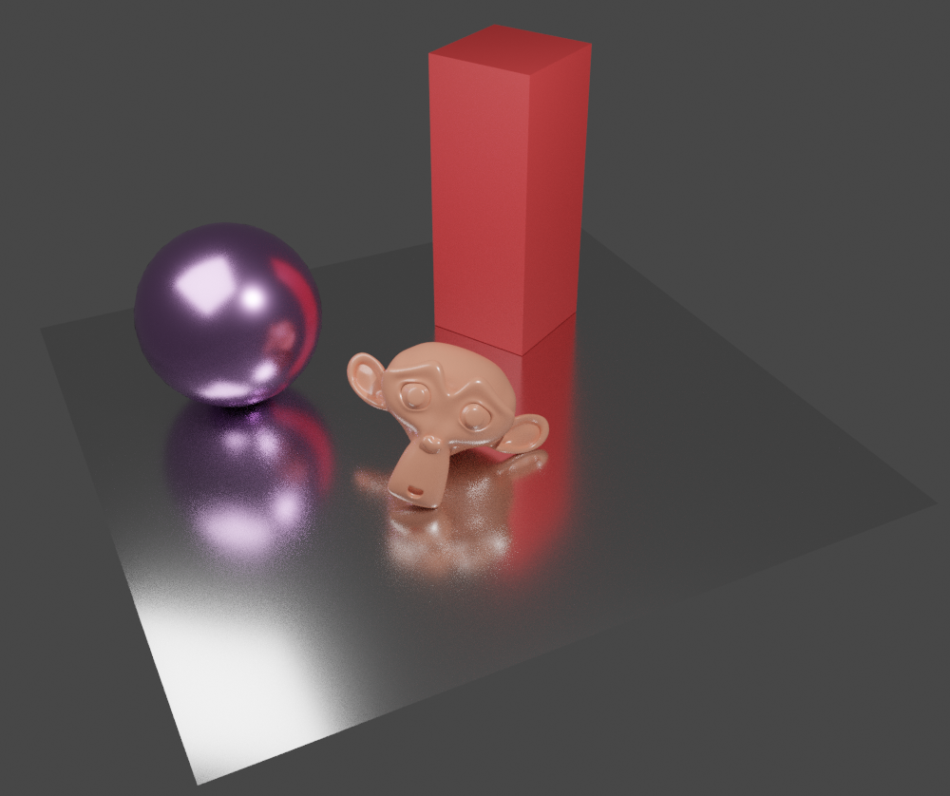
Shading and light transport
Object appearance (color) depends on:
  How much light falls on object and from which direction
  How much light is absorbed and reflected into view direction
Shading: light-object interaction computation
  Reflection, refraction, transparency, diffuse, specular, glossy, etc.
Light transport: how much light falls on surface
  Direct illumination: light from light sources
  Indirect illumination: inter-reflections (indirect diffuse, indirect specular), soft shadows, transmission
  Global illumination: direct + indirect illumination
Shading with direct illumination
Shading with global illumination

Slide 18
Decoupling rendering steps
Visibility & projection
  Perspective projection
  Rays and camera
  Ray-triangle intersection
  Ray-mesh intersection
  Ray-shape intersection
  Object transformations
  Rasterization
  Ray-tracing
  Etc.
Shading & light transport
  Rendering equation
  Light transport algorithms: path-tracing
  Non-physical lights (e.g., point lights)
  Physical (area) lights
  Material
  Texture
  Scattering functions; BRDF
  Diffuse, glossy, specular
  Etc.

Slide 19
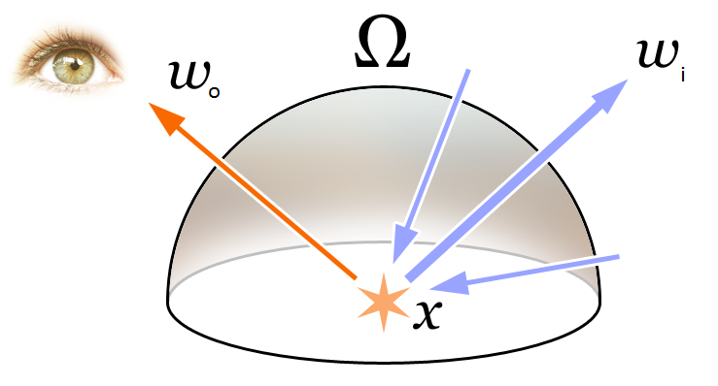

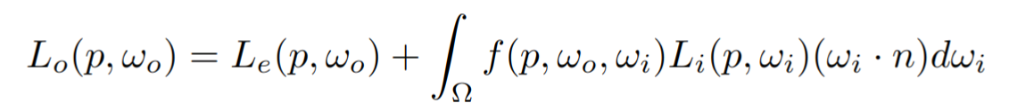
Rendering equation
L_{o}
L_{i}
Shading and light transport are described by rendering equation
  foundation of physically-based rendering
p
Emission
Scattering → reflection
Emission
BRDF
Incoming light
Attenuation due to surface orientation
Kajiya - rendering equation (1986): https://dl.acm.org/doi/10.1145/15886.15902

Slide 20
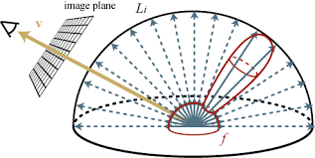
Rendering equation: incoming light
Incoming light is possible from any direction (thus integration is needed) on surface point P
Not possible to be solved analytically, solutions:
  Direct illumination: only take in account light sources
  Estimate indirect illumination by tracing smaller number of incoming light directions
    Those represent directions from which other surfaces may contribute
ω_{o}
ω_{i}
P

Slide 21
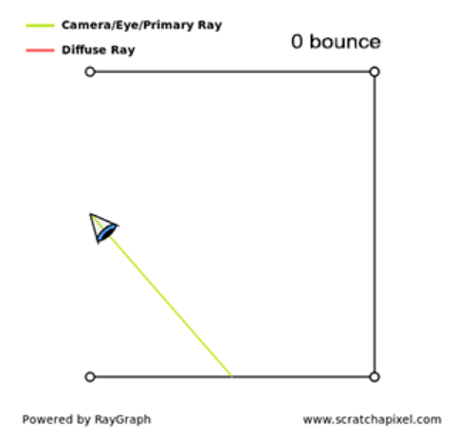
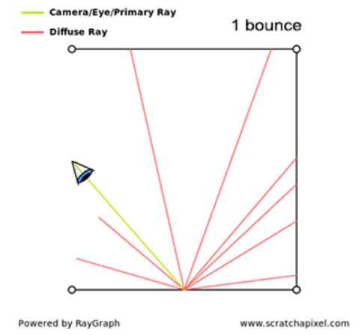
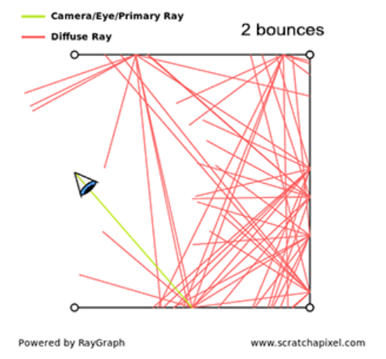
Incoming light: recursive nature
For each light direction incoming from another surface, the rendering equation must be evaluated again to calculate amount of light falling on that surface → recursive equation

Slide 22
Light transport solvers
Rendering equation is very general: describes wide range of light transport phenomena
  Not possible to solve analytically
Different methods compute incoming light with simplifications or approximations:
  Direct illumination: usually done in rasterization-based rendering
  Whitted ray-tracing: consider only point light sources, specular and diffuse surfaces
  Direct and indirect illumination, full rendering equation:
    Monte-Carlo methods based on ray-tracing → path tracing, bidirectional path tracing, metropolis light transport, etc.
    Finite element methods → radiosity

Slide 23
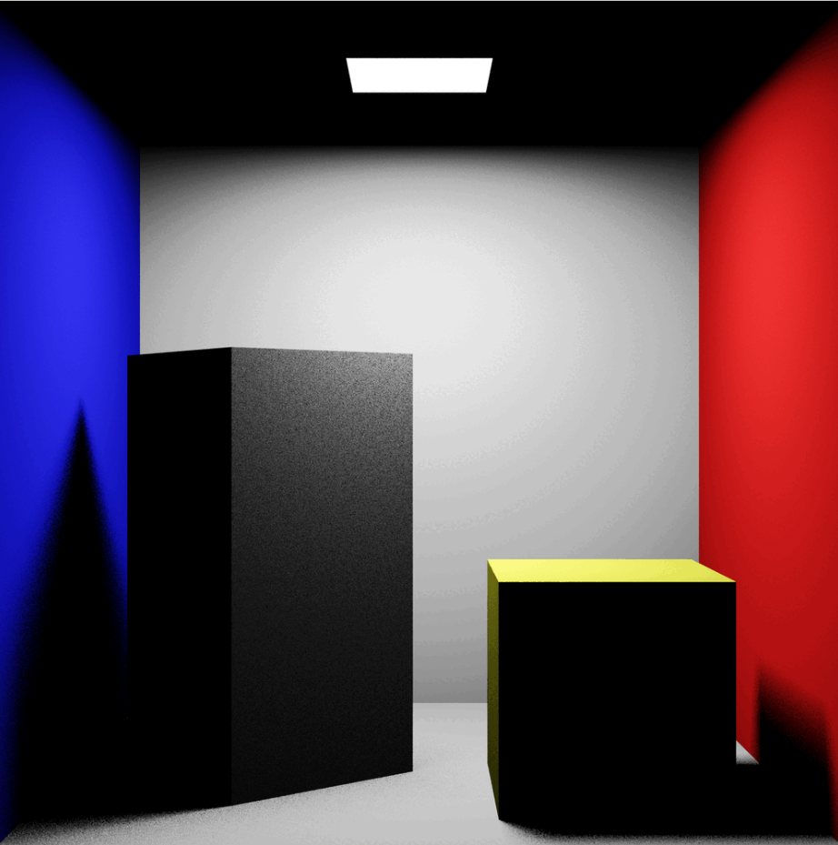
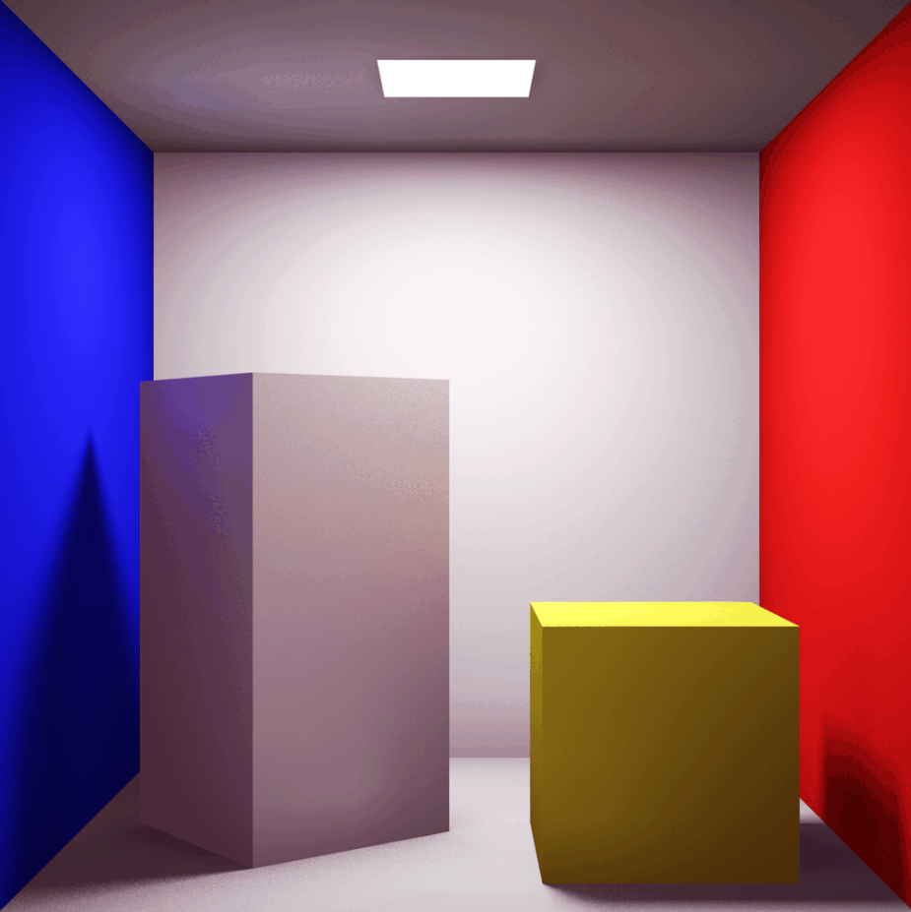
Radiosity light transport
First computer graphics technique to simulate light transport on diffuse surfaces
  Assumption: all indirect light is from diffuse surfaces
  Using Heckbert notation it can be described as LD*E
Idea: turn on the light, light reaches equilibrium in the scene, consider each surface as light source
It can compute inter-reflections and soft shadows from area lights
https://dl.acm.org/doi/10.1145/964965.808601
https://people.cs.kuleuven.be/~philip.dutre/GI/TotalCompendium.pdf
https://en.wikipedia.org/wiki/Radiosity_%28computer_graphics%29
Direct illumination
Radiosity

Slide 24
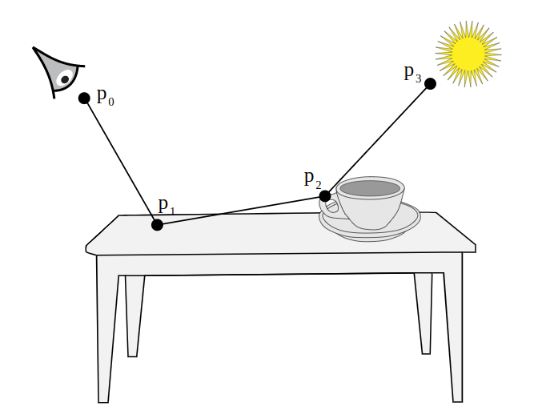
Path-tracing light transport
For each camera ray intersection we need to solve rendering equation
Based on ray-tracing principles, shooting rays and evaluating how much light they carry is used, to solve full rendering equation
  Random rays are generated across hemisphere and traced: Monte-Carlo sampling
  For each intersection, rendering equation is evaluated again (recursive nature)
  As ray bounces across scene, a path is built
    Light carried along each path represents one evaluation of rendering equation
Solves specular (glossy) or diffuse surfaces: L(D|S)*E
Ensures rendering of soft shadows, transparent objects and caustics
Can be extended for handling participating media and sub-surface scattering
Offline path tracing: https://pbrt.org/

Slide 25
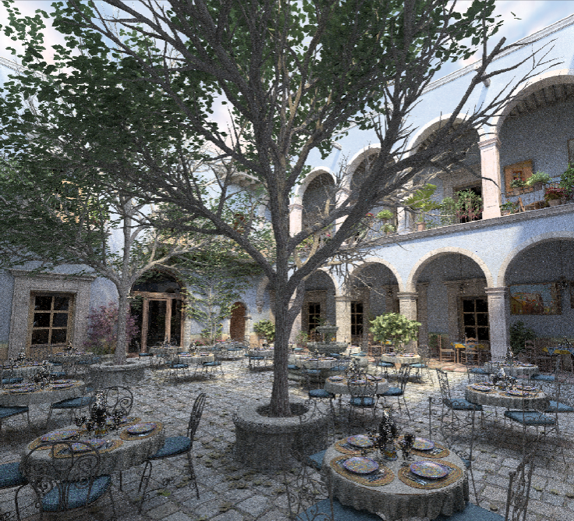
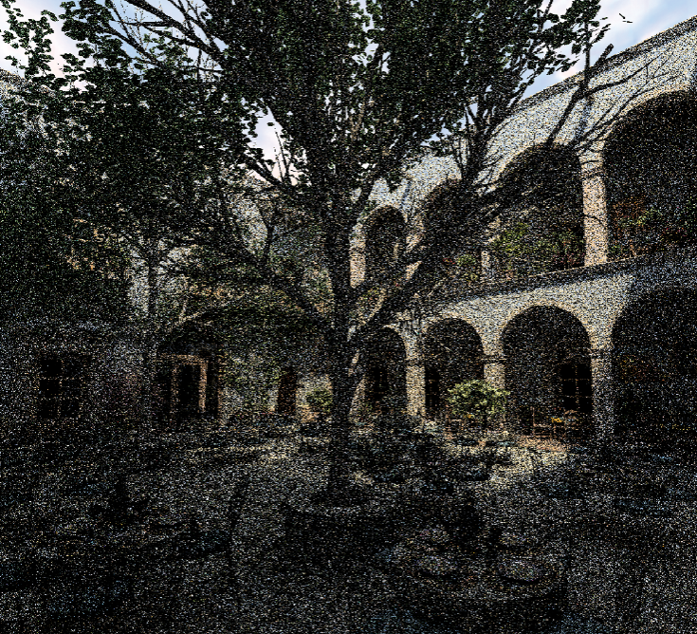
Path-tracing: noise
1024 samples per pixel
Problem of path-tracing is high variance → noise in the rendered image
High visual fielity (more correct estimate of rendering equation) is achieved with:
  Large number of rays per pixel
  Large number of traced paths
Optimizations:
  Importance sampling – rays are traced in direction where most of the light comes
  Denoising rendered image
8 samples per pixel
Monte-Carlo light transport: http://graphics.stanford.edu/papers/veach_thesis/
Rendering equation: https://www.cs.cmu.edu/afs/cs/academic/class/15462-s13/www/lec_slides/86kajiyaRenderingEquation.pdf

Slide 26
Noise
Often, in path-tracing, noise is present*:
More samples per pixel → expensive!
Denoising algorithms?

Slide 27
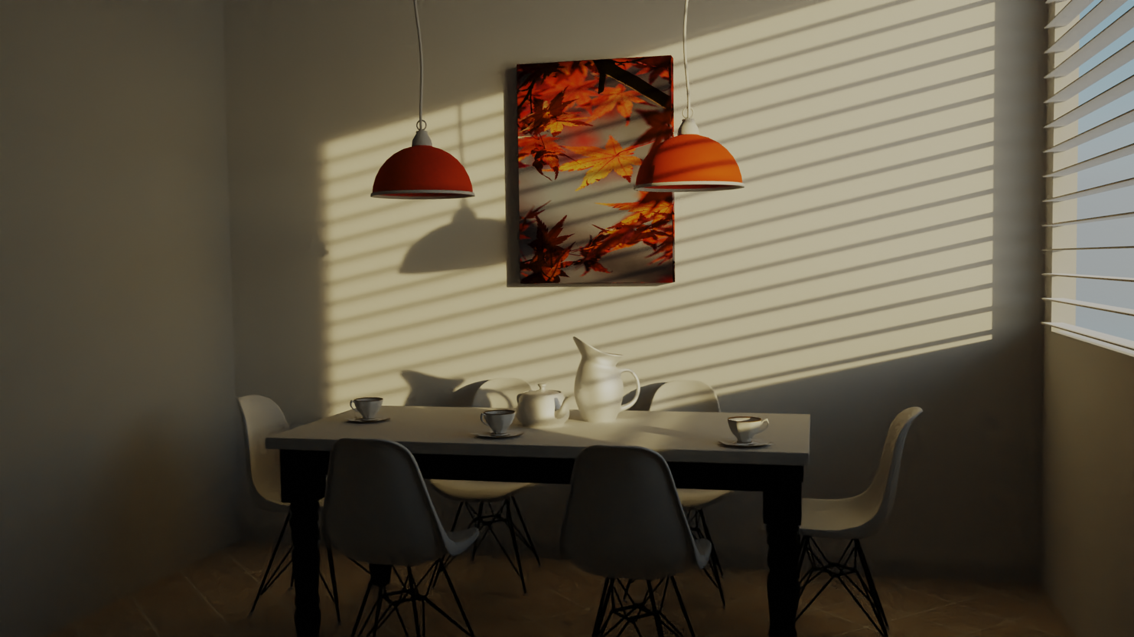
Denoising
Denoising is post-processing step, which means it is applied on rendered image:
It attempts to remove the noise based on intelligent image averaging

Slide 28
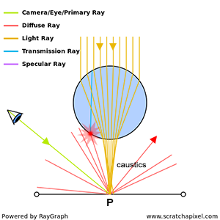
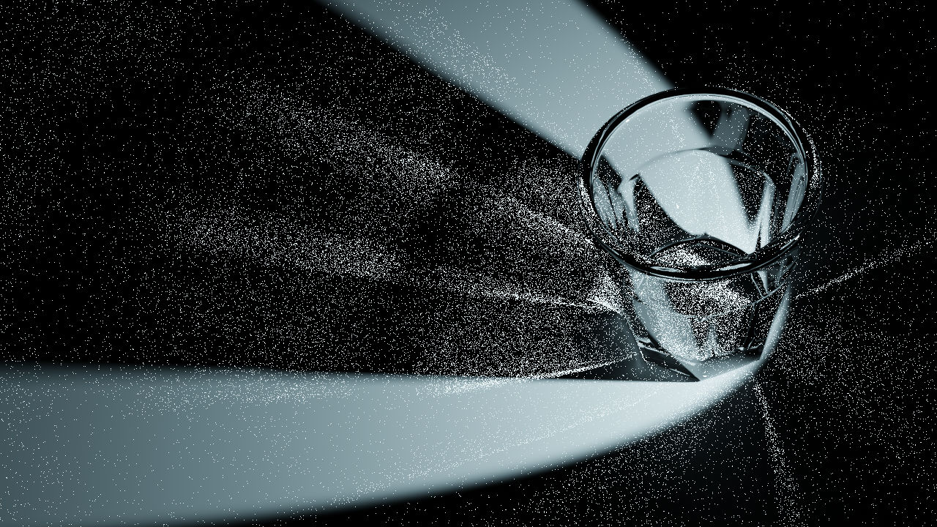
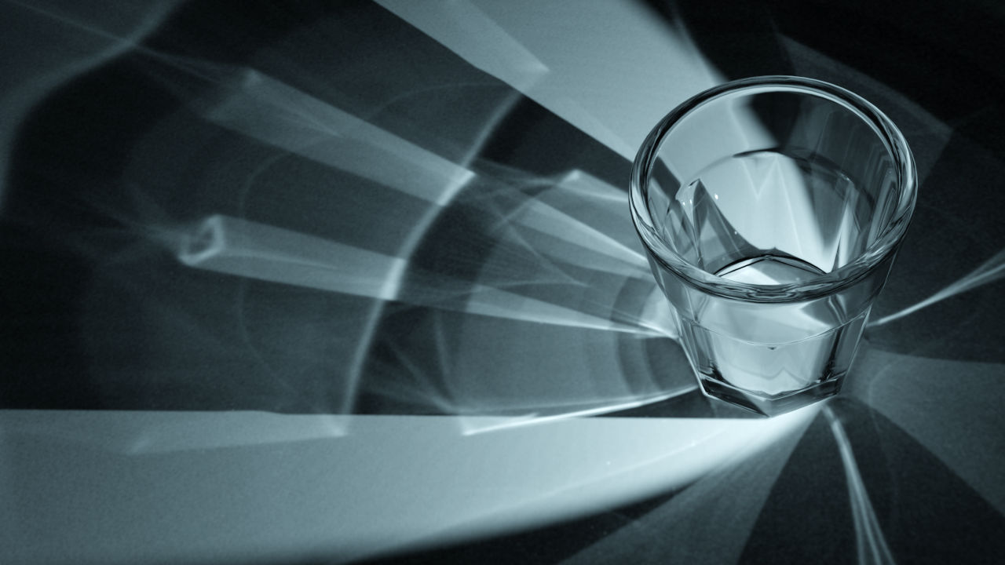
Light transport complexity example: caustics
Different light transport methods were developed to handle different types of surface reflections and light paths
Example: hard problem are specular transmission surfaces (S) illuminating diffuse surfaces (D): LSDE
  Foward tracing: light is emitted, refracted through glass object and due to refraction, light is concentrated towards few points → caustics
  Solving via backward tracing: start from eye, intersect diffuse surface and try to find incoming direction → since diffuse surfaces reflect in all direction and specular surface resulted in concentrated set of directions it is hard to find incoming light
https://www.blenderdiplom.com/en/tutorials/all-tutorials/649-rendering-caustics-in-blender-with-appleseed.html

Slide 29
Rendering equation extensions
Rendering equation describes light emission and surface reflection in vacuum.
Limitations:
  Transmission
  Sub-surface scattering: https://www.pbr-book.org/3ed-2018/Volume_Scattering/The_BSSRDF
  Volumetric scattering: https://www.pbr-book.org/3ed-2018/Volume_Scattering/Volume_Scattering_Processes
  Wave optics effects: polarization, diffraction, interference, etc.
images

Slide 30
Rendering equation: global illumination
Object appearance:
  Object material and shape
  Light source
  Viewing direction
Local (direct) illumination: takes in account only light sources
  Problem: no inherent shadows
Global illumination: takes in account both light sources and indirect reflections
  Multiple reflections, transmissions, shadows

Slide 31
Practical rendering

Slide 32
Practical rendering approaches
Two main rendering approaches are based on:
Ray-tracing
Rasterization

Slide 33
Ray-tracing and Rasterization
Two main rendering approaches are based on: Ray-tracing and rasterization
Compared to rasterization, ray-tracing is more directly inspired by the physics of light
  As such it can generate substantially more realistic images: shadows, multiple reflections, indirect illumination, etc.
Rasterization (EEVEE, Blender)
Ray-tracing (Cycles, Blender)

Slide 34
Visibility solvers
Rasterization and ray-tracing are methods for solving visibility
Both methods solve visibility from camera
Ray-tracing can be further used to solve visibility between any points in 3D scene
  particularly useful for shading and light transport
Global illumination effects are much more elegantly implemented in ray-tracing rendering

Slide 35
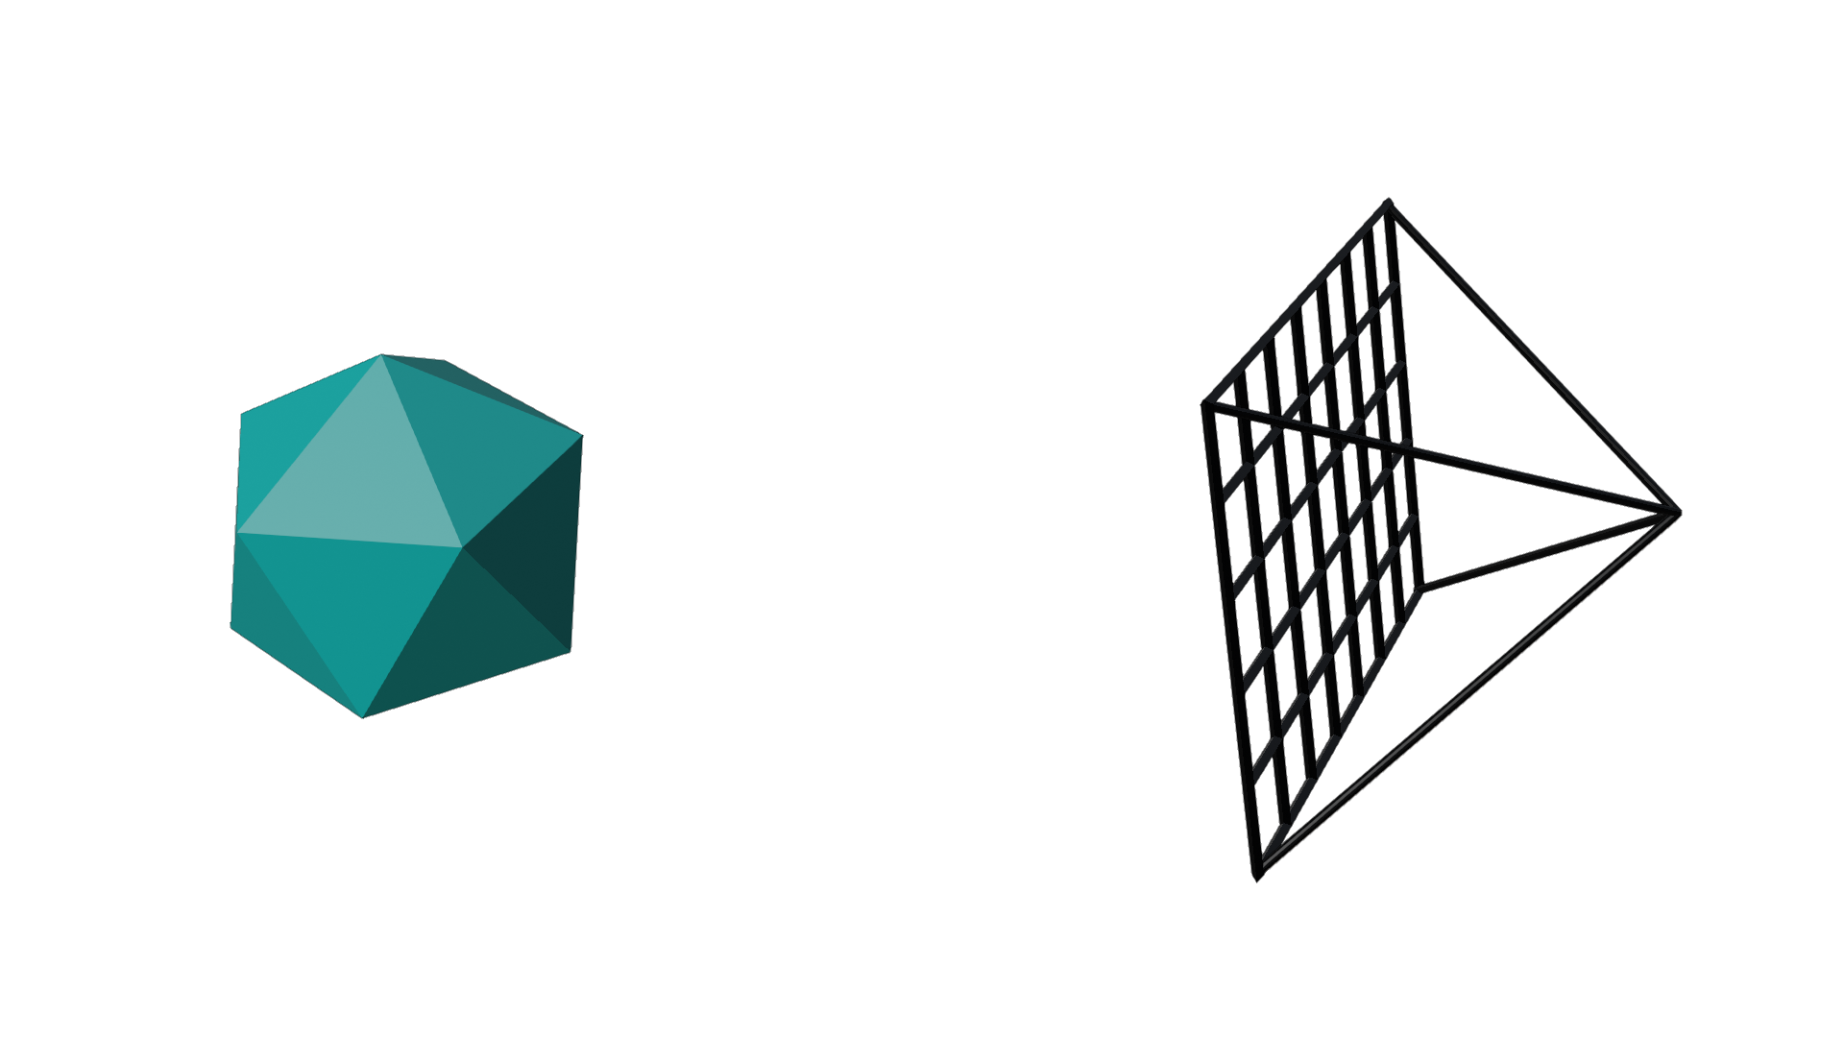
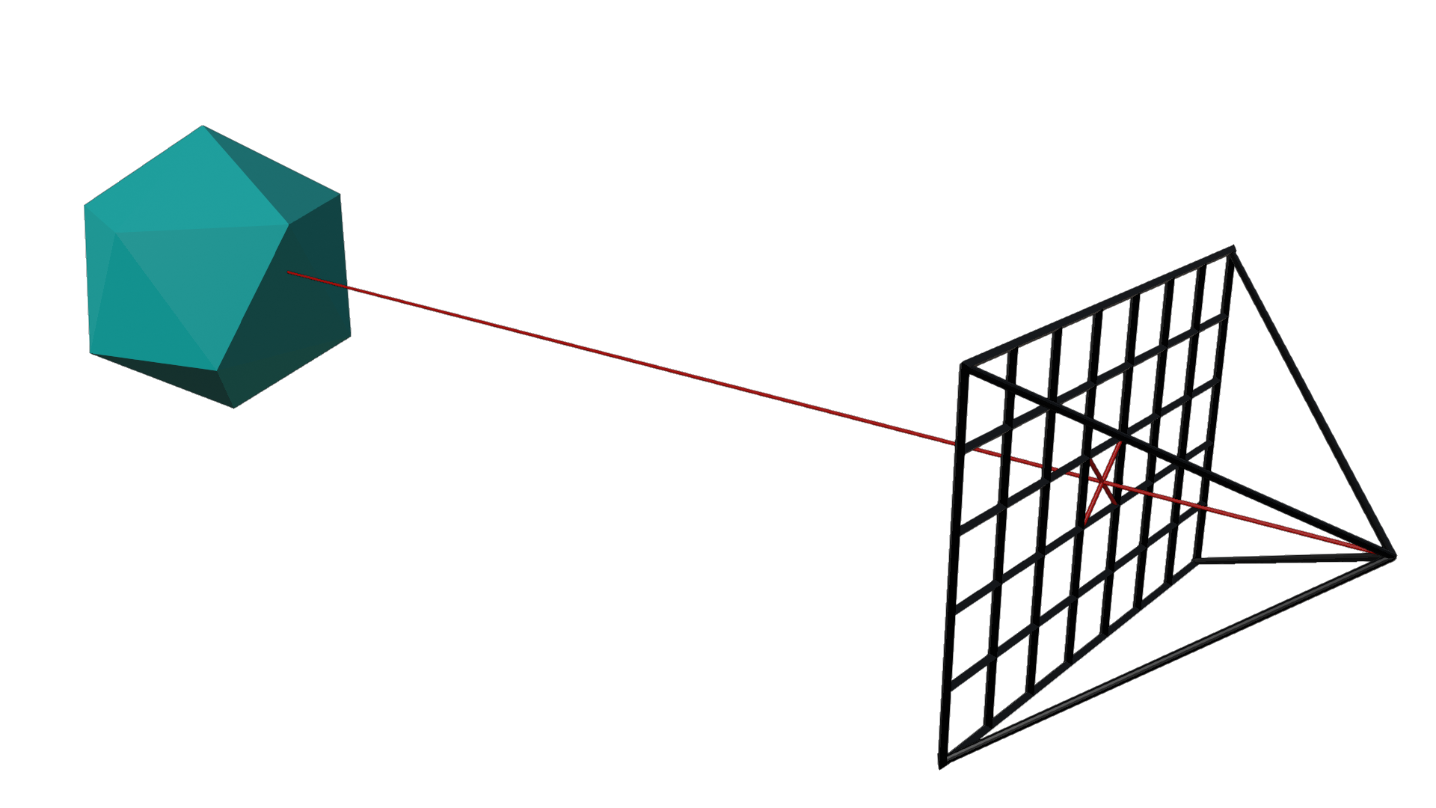

Visibility: ray-tracing
Image centric approach:
Ray-tracing generates rays for each pixel of virtual image plane
Rays are constructed using camera and are tested for intersection with objects in 3D scene
Closest intersection determines objects visible from camera

Slide 36
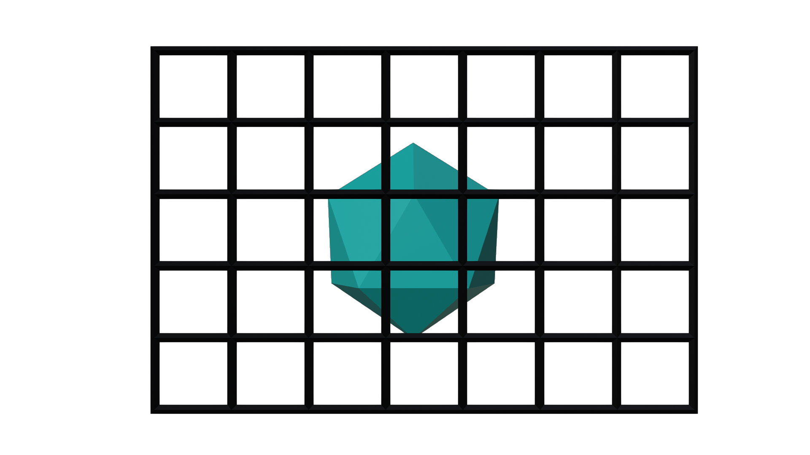
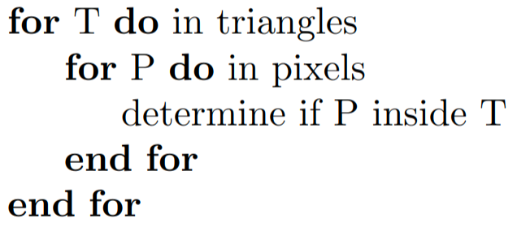
Visibility: rasterization
Object centric approach:
Objects are transformed into camera space (world-to-camera matrix)
Camera information is used to construct (perspective) projection matrix
Objects are projected on virtual image plane using projection matrix
For each pixel of virtual image plane find which objects are covered by pixel and take closest

Slide 37
Rasterization and raytracing
Both raytracing and rasterization are used to solve the visibility problem (which also contains perspective/orhographic projection solving).
Solving the visibility problem is only a part of rendering. Other part is determining the color and intensity of visible surface. This step is called shading and it uses light transport to gather light on visible surface and calculates light-matter interaction
Extend based on prev chapter

Slide 38
Importance of visibility computation
Visibility: determine if two points in 3D scene are visible to each other
  Objects visible from camera: solve visibility problem using perspective/orthographic projection
  Shading, that is, light transport is based on visibility between surface and lights in 3D scene
    This is required to calculate shadows, soft shadows, global illumination effects such as reflection, refraction, indirect reflection and.
Rasterization is solving the visibility from camera to object very fast. But it is not good for finding visibility between surfaces in 3D scene which is important for light transport and shading
  Real-time rendering is predominantly done using rasterization approach on GPU
Ray-tracing is good for solving the visibility from camera to object. And it also can be used for finding visibility between surfaces in 3D scene which is important for light transport and shading.
  Both steps require extremely time-consuming intersections between rays and scene objects (geometry)

Slide 39
Practical ray-tracing and rasterization
re-read
Raytracing method can be separated in:
  Determining visibility from camera: determine which point in 3D scene is visible for each pixel of image. Note that perspective projection is inherent due to camera which is used for generating rays
  Shading: calculating the color of visible point – this operation besides light-matter calculation also requires light transport to collect all light which influences the color and intensity of that point.
Both steps require extremely time-consuming intersections between rays and scene objects (geometry)
  Efficient ray-object intersection method is needed
  3D scene must be represented for fast and efficient spatial search of objects which should be tested for intesection
On the other hand, rasterization can solve the visibility problem (camera-object) very fast. That is why real-time graphics is predominantly using GPU rasterization approach. But when it comes to shading, due to the available information on 3D scene, it is not as good as raytracing.
Raytracing is slow for solving visibility problem, but it enables high-quality shading. For high-quality, photo-realistic production rendering, ray-tracing is almost always used*.
* However, real-time ray-tracing is now possible to certain degree with certain hardware and it is hot research topic!

Slide 40
Practical tip: Ray-tracing vs Rasterization
In production where final images are generated using ray-tracing, rasterization is used for preview and modeling, e.g., animation films
In production where final images are generated using rasterization, lot of artist hacks is needed. Sometimes ray-tracing can be used to precalculate some effects.
<image: animation film: rasterization for preview and modeling and final shoot>
<image: games: rasterization as final image with hacks and help from ray-tracing>
Merge with prev slide

Slide 41
Comparison with rasterization
Recursive ray-casting used in ray-tracing is something that rasterization-based rendering must approximate with different techniques to achieve just a sub-set of effects that can be obtained with ray-tracing
<image: example of approximation and ray-traced effect>
Merge with prev slide

Slide 42
Practical tip: Ray-tracing vs Rasterization
Important difference is that ray-tracing can shoot rays in any direction, not only from eye or light source
  This makes it possible to render reflections, refractions and approximate rendering equation.
Content creation is simpler for ray-tracing than rasterization since for realistic effects are just present
  Additional artist work is required when rasterization-based rendering is used

Slide 43
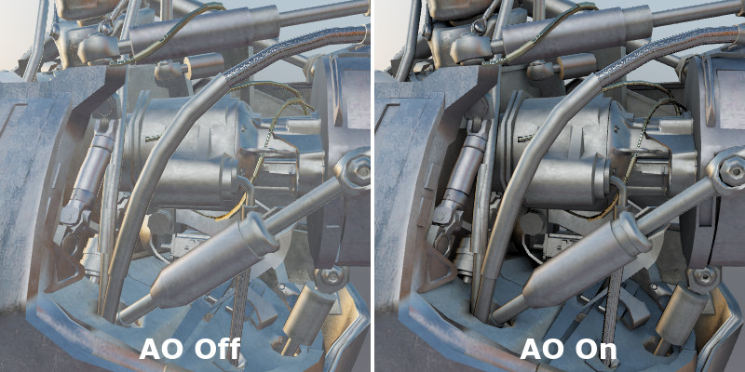
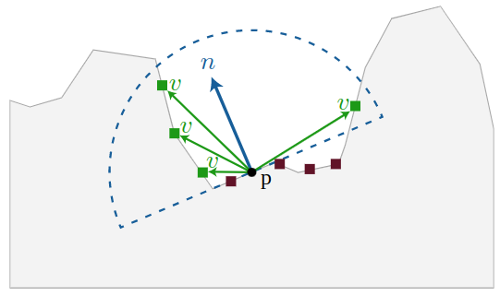
Ambient occlusion: global illumination approximation
Simplest approximation of global illumination possible for rasterization-based rendering
Ambient illumination: light incoming from all directions on intersection point
Ambient occlusion: some incoming light on intersection point may be blocked by other parts of the object
  The more the surface is occluded the darker it will be → shadow effect
https://learnopengl.com/Advanced-Lighting/SSAO
http://frederikaalund.com/a-comparative-study-of-screen-space-ambient-occlusion-methods/
https://developer.playcanvas.com/en/user-manual/graphics/lighting/ambient-occlusion/

Slide 44
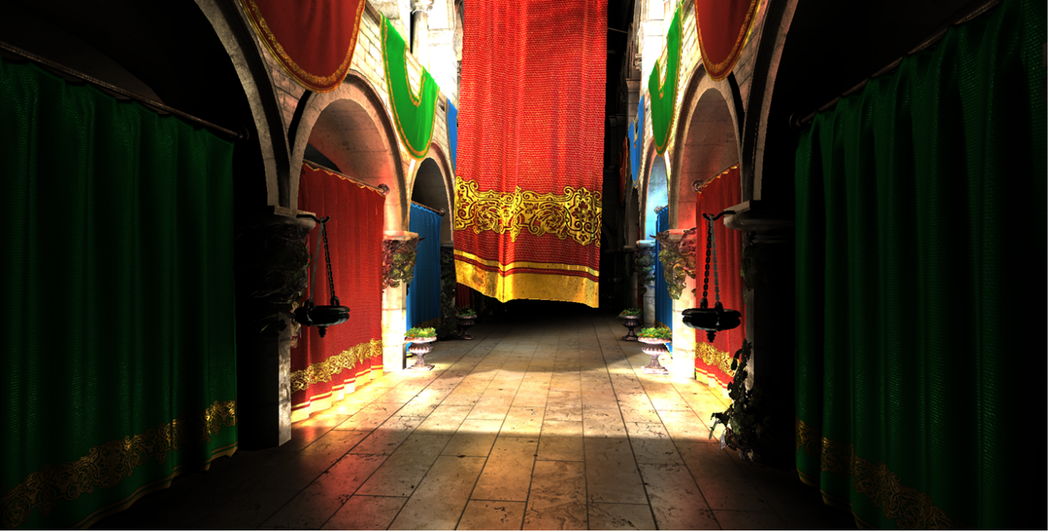
Other global illumination approximations
Ambient occlusion gives poor approximations for visibility when dealing with large area light sources or small point light sources → directional occlusion methods are used and can be categorized into:
  Precomputed, e.g., using spherical sign distance functions*
  Dynamic, e.g, using cone tracing**
Light can be pre-computed using path-tracing or radiosity
  Works fine for static objects
Dynamic computation of indirect light with simplifications:
  Only diffuse or specular surfaces**
  Example: voxel cone tracing**
Interactive indirect illumination using voxel cone tracing: https://research.nvidia.com/sites/default/files/publications/GIVoxels-pg2011-authors.pdf
* https://www.microsoft.com/en-us/research/wp-content/uploads/2009/12/sg.pdf
** https://godotengine.org/article/vulkan-progress-report-5/
**https://bc3.moe/vctgi/

Slide 45
Visibility: geometrical problem
Visibility is a geometrical problem depending on object shape, e.g., triangulated mesh
Raytracing iterates through all pixels of image plane, generates rays and then iterates over all objects (triangles) in the scene.
Rasterization loops over all geometric primitives in the scene (triangles), projects these primitives on image plane and then loops over all pixels of the image plane.

Slide 46
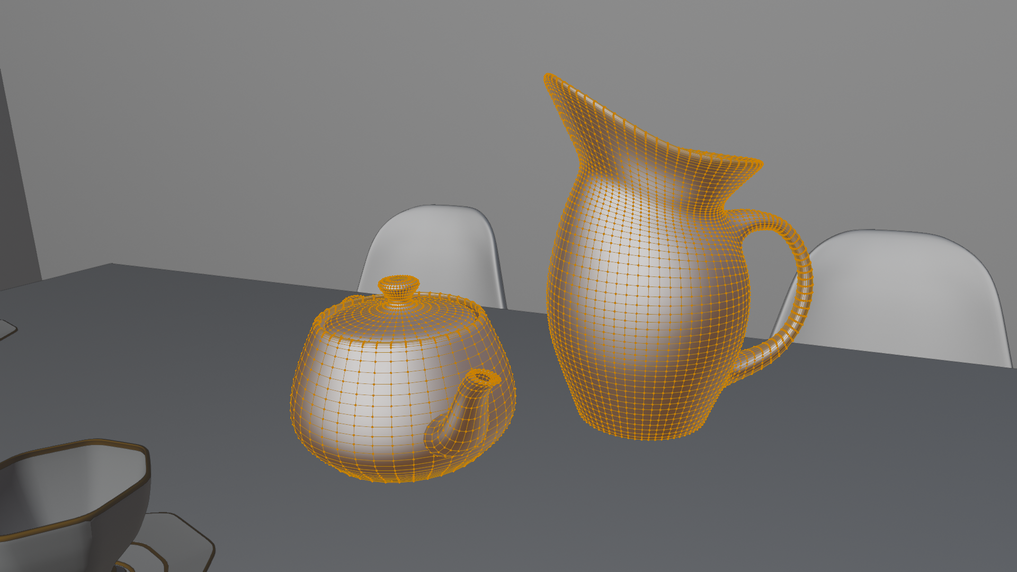
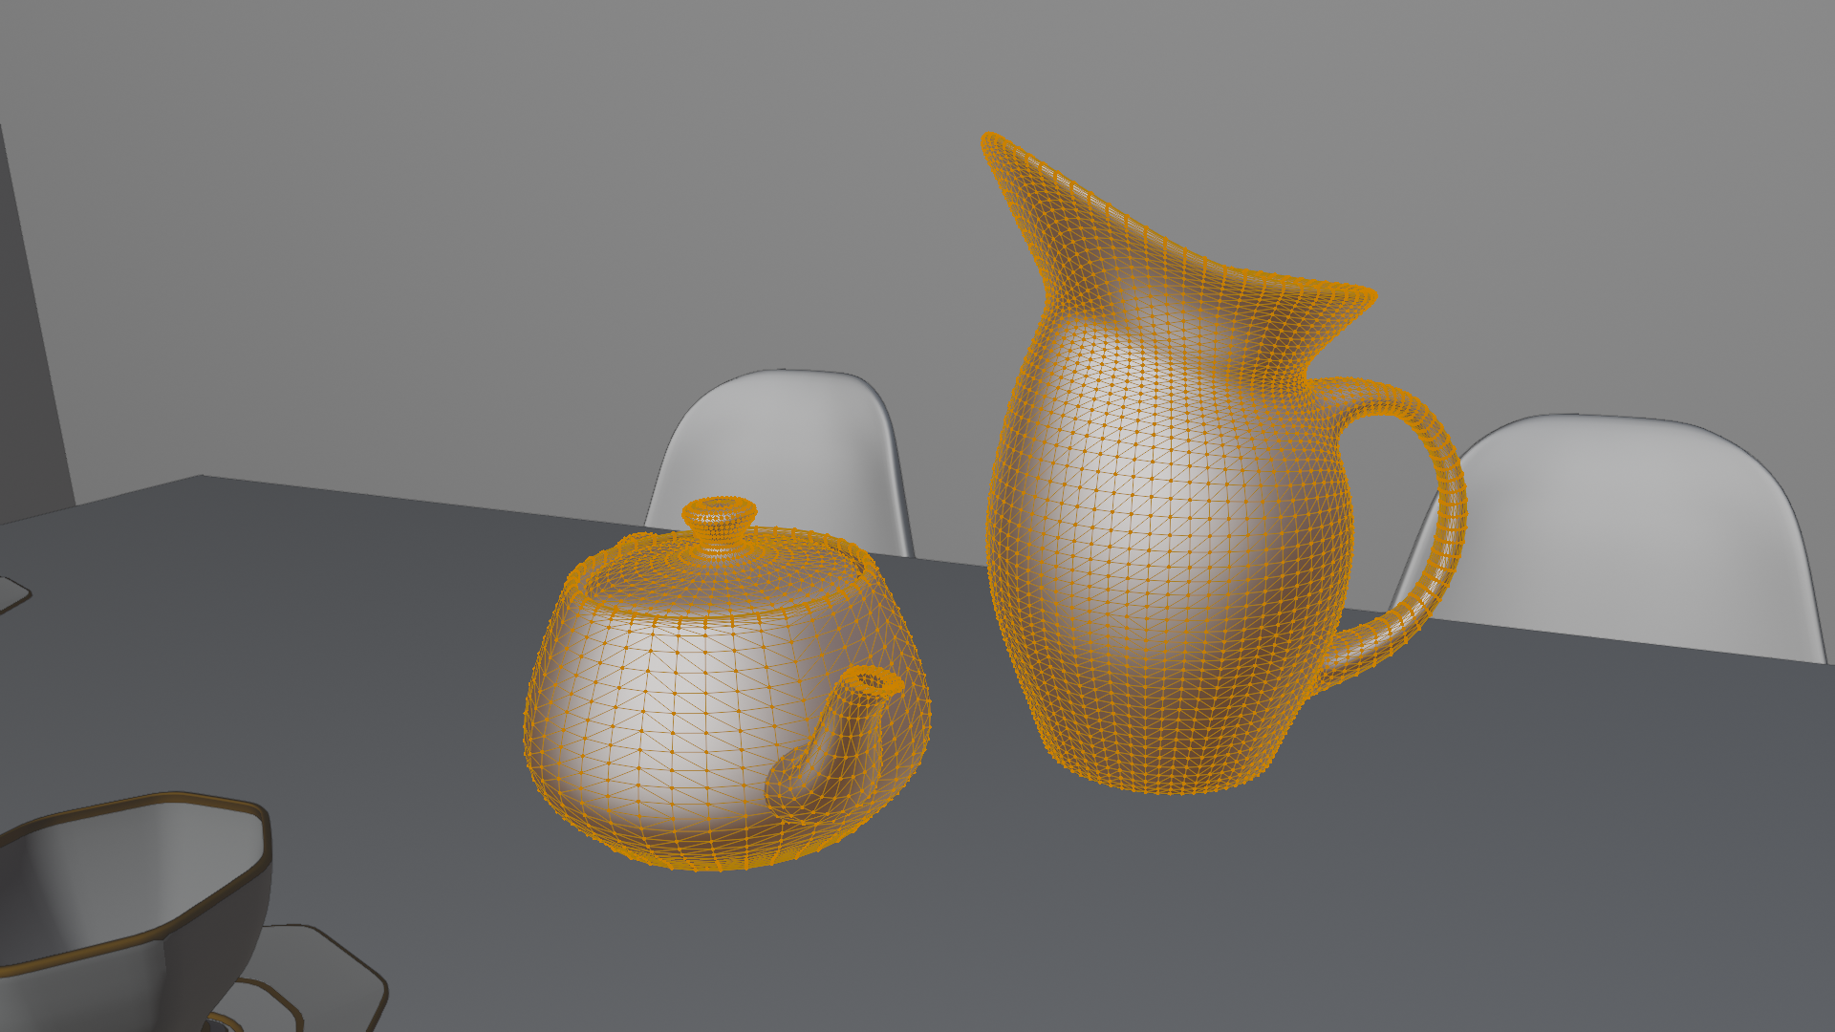
Reminder: triangulated mesh
Although various shape representations exists for modeling purposes, when it comes to rendering, often all object shapes are transformed to triangles using tessellation process.
Quad mesh to triangle mesh
https://www.scratchapixel.com/lessons/3d-basic-rendering/ray-tracing-rendering-a-triangle/why-are-triangles-useful

Slide 47
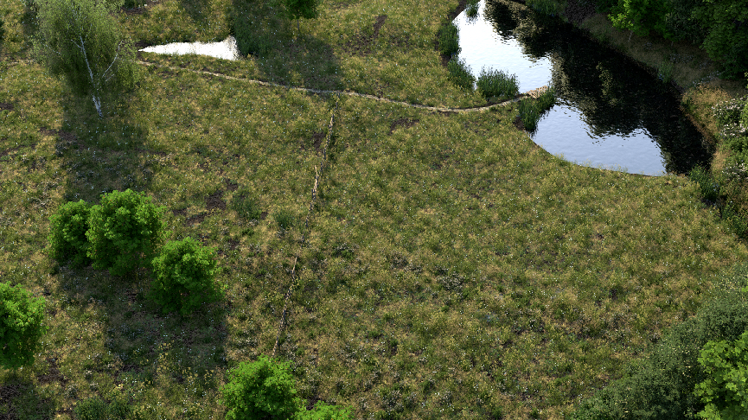
Rendering speed: Ray-tracing and Rasterization
3D scenes are complex and often large
24 million unique triangles
  Object reuse via instancing results in 3.1 billion triangles
https://www.pbr-book.org/3ed-2018/Primitives_and_Intersection_Acceleration

Slide 48
Rendering speed
Number of rendered images for display per second is called frames per second (FPS):
  Real-time graphics > 30 FPS
  Interactive graphics 1 < x < 20 FPS
  Offline graphics < 1 FPS
Trade-off between speed and quality
  Depending on application, best option for speed of rendering and quality of rendered images must be found
  For games, it is important that frames are rendered in real-time (>30fps) and certain quality must be sacrificed
  For animated films, rendering time can take up to several hours for only one frame therefore, focus can be put on quality

Slide 49
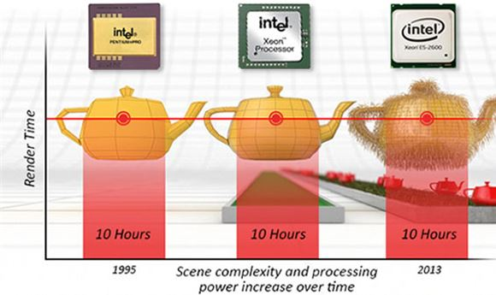
Rendering time: Blinn’s law
Rendering time tends to remain constant although GPU hardware gets faster
This is because complexity of the 3D scenes as well as rendering algorithms increased
https://en.wikipedia.org/wiki/Jim_Blin

Slide 50
Accelerating ray-tracing and rasterization
Both algorithms are conceptually simple
To make them fast and usable in practice:
  Ray-tracing is utilizing acceleration spatial data structures for achieving running time of O(log(n))
    Acceleration data structures: bounding volume hierarchy (BVH) or Kd tree
  Rasterization relies on culling and hardware support ensuring better running time than O(n)
    Culling methods for avoiding full scene processing: occlusion culling, frustum culling, backface culling
    GPUs are adapted for rasterization-based rendering
    Deferred shading*: shading only points which will end on screen
n – number of primitives, e.g., triangles
* https://learnopengl.com/Advanced-Lighting/Deferred-Shading

Slide 51
Ray-tracing acceleration
Tracing single ray through the scene naively would require testing intersection with all objects in 3D scene → linear in the number of primitives in the scene → slow!
  This is not optimal since rays might pass nowhere near to vast majority of primitives
  To reduce number of ray-object intersection tests, acceleration structures are used
Two main categories of acceleration structures:
  Object subdivisions: bounding volume hierarchy (BVH)
  Spatial subdivisions: binary space partitioning (BSP) trees

Slide 52
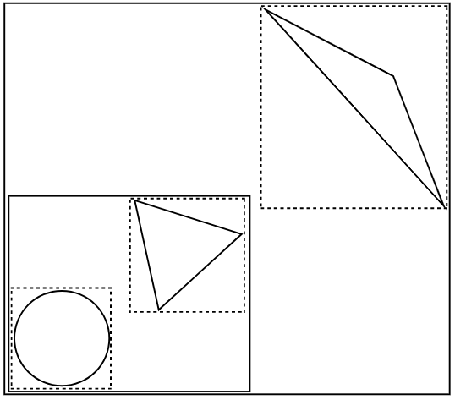
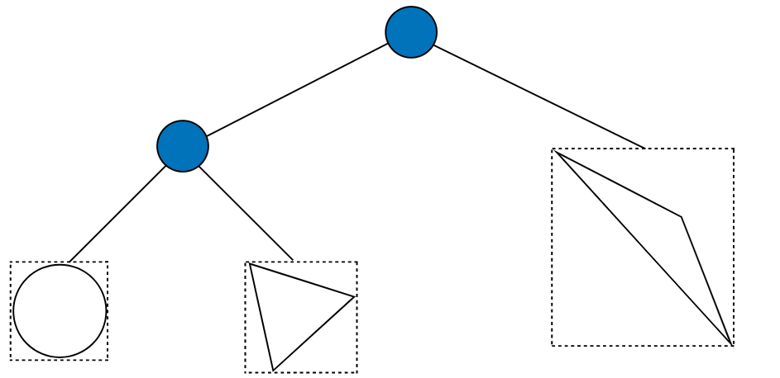
Object subdivisions: BVH
Progressively breaking down objects in the scene into smaller parts of objects
  Example: room can be separated into walls, floor, ceiling, table, chairs, etc.
Resulting parts are in a hierarchical, tree-like structure
  For each ray, instead of looping through objects, traversal through the tree is performed
If ray is not intersecting the parent object then its parts, children objects, are not tested for intersection
  Example: if room is not intersected, then table can not be intersected as well
Root node holds the bounds of the entire scene
Internal nodes contain smaller volumes (e.g., bounding boxes) of the scene
Leaf nodes contain objects
https://www.pbr-book.org/3ed-2018/Primitives_and_Intersection_Acceleration/Bounding_Volume_Hierarchies

Slide 53
Spatial subdivisions: BSP trees
Adaptively subdivide scene into regions using planes and record which primitives are overlapping regions
  Process starts by bounding box encompassing whole scene
  If the number of objects is larger then some defined threshold, box is split
  Repeated until maximum depth or tree contains small enough regions
Two BSP variants:
  Kd trees
  Octree
When tracing rays, only objects in regions through which ray passes are tested for intersection

Slide 54
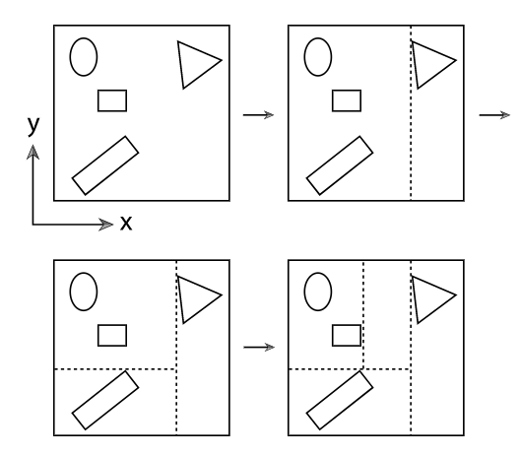
Spatial subdivisions: kd-trees
Subdivision rule: planes must be perpendicular to one of coordinate axes

Slide 55
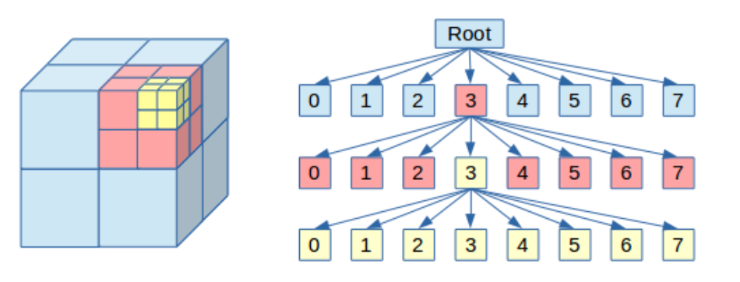
Spatial subdivisions: octrees
Subdivision is done by three axis-perpendicular planes which splits box into eight smaller boxes
https://geidav.wordpress.com/2014/07/18/advanced-octrees-1-preliminaries-insertion-strategies-and-max-tree-depth/

Slide 56

Rasterization acceleration
Whole scene processing is avoided using:
  Frustum culling
  Occlusion culling
  Back face culling
Note: projecting objects on image plane and discarding objects outside of view frustum, occluded objects and back faces enables fast visibility solving from camera, but lot information of the scene is lost therefore light transport for shading is thus limited.
https://bruop.github.io/frustum_culling/

Slide 57


Frustum culling
Instead of processing all triangles, determine only those visible to camera frustum
https://learnopengl.com/Guest-Articles/2021/Scene/Frustum-Culling
https://docs.unrealengine.com/4.27/en-US/RenderingAndGraphics/VisibilityCulling/

Slide 58

Occlusion culling
Objects which are occluded by other objects from current camera view are not rendered.
https://www.gamedeveloper.com/programming/occlusion-culling-algorithms
https://docs.unrealengine.com/4.27/en-US/RenderingAndGraphics/VisibilityCulling/

Slide 59
Back face culling
Surface normal defines surface orientation:
  Outside surface: normal pointing outward
  Inside surface: normal pointing inward
Based on surface normal alignment with camera view surface is:
  Front-facing: outside surface is facing camera
  Back-facing: outside surface is not facing camera
Back-face culling:
  Discard back-facing triangles of surface
https://learnopengl.com/Advanced-OpenGL/Face-culling

Slide 60
Raytracing and rasterization
Raytracing is historically early method for image synthesis based on 3D scene description
Raytracing has always been recognized as best method for generating photo-realistic images. However, up until 1990-2000s it hasn’t been used widespread
Due to hardware advancements, rasterization-based rendering gained a lot of attention
Raytracing is intuitive and straightforward method of simulating physical phenomena of how image is created.
  Based upon raytracing, more advanced rendering methods are build.
  Furthermore, understanding ray-tracing gives good foundations for understanding rasterization-based rendering systems.
re-read

Slide 61
Rasterization and Raytracing in practice
Rasterization-based renderers: interaction and games
  Godot: https://docs.godotengine.org/en/stable/tutorials/rendering/index.html
  Unity: https://unity.com/srp/High-Definition-Render-Pipeline
  Unreal: https://docs.unrealengine.com/4.27/en-US/RenderingAndGraphics/Overview/
  Vulkan-based renderers: https://vulkan.org/tools#engines
Examples of raytracing-based renderers: animation and VFX
  Renderman: https://renderman.pixar.com/
  Arnold: https://arnoldrenderer.com/
  Appleseed: https://github.com/appleseedhq/appleseed

Slide 62

Real-time ray-tracing*
GPU hardware is optimized for rasterization-based rendering enabling real-time graphics
Graphics hardware is being developed for ray-tracing support
  https://developer.nvidia.com/rtx/ray-tracing
  https://www.khronos.org/blog/ray-tracing-in-vulkan
  https://learn.microsoft.com/en-us/samples/microsoft/directx-graphics-samples/d3d12-raytracing-samples-win32/
Generating large number of rays per pixels with long paths is still expensive → noise
  Denoising is promising solution enabling real-time ray-tracing
  https://www.youtube.com/watch?v=NRmkr50mkEE&ab_channel=TwoMinutePapers
  https://research.nvidia.com/publication/2021-06_restir-gi-path-resampling-real-time-path-tracing
For short-term, clever combinations of rasterizations and ray-tracing are used
  Example: ray-tracing for shadows
  https://docs.unrealengine.com/4.26/en-US/RenderingAndGraphics/RayTracing/
  https://unity.com/ray-tracing

Slide 63
Rendering: intuition via ray-tracing

Slide 64
[hide]
In this chapter discuss:
  Color of pixel is equal to color of camera ray
  Camera ray is generated and traced into 3D scene
  Once we find surface we use rendering equation
  Camera ray tracing can get attenuated before reaching surface: participating media and volumetric scattering and rendering(ignore for now)
  NOTE: we only have surfaces and volumes (participating media). For surfaces we use rendering equation. For volumes we use volumentric rendering equation.
    We will be only focusing on surfaces
    rendering equation. Light hitting surface must compute rendering equation. Rendering equation requires integrators (path tracing) to solve the integral.
https://www.pbr-book.org/3ed-2018/Light_Transport_I_Surface_Reflection

Slide 65
Ray-tracing based rendering
Rendering: process of creating 2D image from 3D scene
Task: calculate pixel colors of virtual image plane of virtual camera in 3D scene
  This implies computing light falling into camera

Slide 66


Simulating light
Simulating real-world light-object interaction means simulating all light rays paths from light and their interactions with objects
  Only small amount of that light actually falls on camera forming an image
  This kind of simulation is called forward ray-tracing or light tracing
  Too expensive!
It is enough to compute only light which enters the camera
  Therefore, rays are traced from sensor to the objects which may reflect light into camera
  This simulation is called backward ray-tracing or eye-tracing*
* Introduced by Turner Whitted in paper “An Improved Illumination Model for Shaded Display”.

Slide 67
Generating camera rays
Virtual camera defines from where we look at 3D scene and a virtual image plane
Start from virtual camera and generate camera rays for each pixel of virtual image plane into the scene
  Camera rays are generated from aperture position through each pixel of film plane
The color (light) which will be computed for each ray will correspond to pixel color from which this ray was generated

Slide 68
Intuition: camera in ray-tracing
Camera defines from where we look at 3D scene and a 2D surface on which 3D scene will be projected as an image.
  Rendering goal: compute color of pixels in the image.
  Viewing rays are generated from aperture position through each pixel of film plane
  Each ray will return information about color of the object it intersected in 3d scene using shading
Extend based on prev chapter

Slide 69
Camera ray intersections
To compute color (light) for each camera ray, find closest intersection of this ray and objects in 3D scene
This way object closest to camera, that is, objects visible to camera which will reflect light into camera are found
Ray-object intersection is geometrical problem and it depends on object shape representation
Although magnitude of different shapes exist, we can assume that in rendering time we will have triangulated mesh

Slide 70
Shading
Once intersection with object is found we need to find amount of light reflected from this point into camera
  This is process is generally described with rendering equation
Therefore, task is to calculate object color taking in the account:
  Current view ray direction on shading point
  Incoming light ray direction and color on shading point → light sources and/or other surfaces
  Object material and shape (normal) in shading point
Intersection point can be now also called shading point

Slide 71
Shading
Amount of light reflected in view direction, that is color of visible surface is defined with rendering equation
Computing incoming light on shading point is called light transport
L_{i}
ω_{o}
ω_{i}
Ω
L_{o}
BRDF
Defines surface material
Uses texture information
Attenuation due to orientation of surface towards light.
Depends on surface shape (normal)
p
Incoming light
over hemisphere
of directions

Slide 72


Light transport: incoming light
Direct illumination: calculating visibility between shading point and light source
Indirect illumination: calculating visibility between shading point and all directions above shading point which may contribute with light
  Additional rays are generated from shading point into hemisphere of directions above surface
  For any found intersection, rendering equation must be re-evaluated
  Material determines determines direction and amount of light scattering
  Different light transport algorithms simulate different light paths: diffuse, specular, etc.
Global illumination: direct and indirect illumination
  Path-tracing represents method for solving global illumination which extends ray-tracing
Direct illumination
Indirect illumination

Slide 73



Shading: light-matter interaction
Once incoming light on shading point is computed, material information is used to determine amount of light being absorbed and reflected in view direction
For this purpose, BRDF is used
  Given light (l) and view (v) directions, BRDF determines ratio of reflected light in view direction
  BRDF further uses texture parameters which varies with shading point position
BRDF notation
Diffuse BRDF
Diffuse BRDF with texture

Slide 74


Participating media*
We assume that media between object surfaces is vacuum
  In this case, light which is reflected from object or incoming on object will not be attenuated
If other medium is present then light will be attenuated by scattering and absorption
  This is called participating media
  To solve this, volumetric rendering equation is used
https://graphics.pixar.com/library/ProductionVolumeRendering/paper.pdf
https://www.scratchapixel.com/lessons/3d-basic-rendering/volume-rendering-for-developers/intro-volume-rendering.html

Slide 75

Surface vs volume rendering
Surfaces:
  Shape representation: meshes, parametric surfaces, implicit surfaces, etc.
  Material: transmissive, reflective, glossy, diffuse, specular, etc.
Volumes (participating media):
  Shape representation: voxels, meshes (consider its volume), etc.
  Material: sub-surface scattering, participating media density scattering

Slide 76
Shading and light transport
Note that the in algorithm that was used to introduce raytracing and idea of rendering, we only determine objects which are visible from camera and shade them by calculating visibility between visible surface and light source.
With this approach, we disregard that other objects in the scene can also reflect light on objects that are visible from camera. Furthermore, objects that are visible from camera can be very reflective (imagine mirror like surface) and they would certainly reflect objects visible from them.
This effects are called indirect illumination and global illumination effects.
They can be simulated by generating additional rays in intersections: propagating rays and building paths that light might travel to the surface which is being shaded.
Classic examples that can be started with are mirror-like and transparent surfaces
https://www.scratchapixel.com/lessons/3d-basic-rendering/introduction-to-ray-tracing/adding-reflection-and-refraction
Depending on surfaces, light will scatter differently. Material defines, among others, scattering model* which is used to determine where light scatters (direction) and how much it scatters in particular direction (intensity).
Categorization of light transport algorithms based on lighting effects they simulate (Diffuse, Specular and other types of reflections and refractions).
* Scattering models might be also called illumination models. This name might make more sense in GPU-rasterization-based rendering (graphics rendering pipeline) since after determining surfaces visible from camera, illumination model is employed to directly calculate color and intensity taking in account positions of light and material of the objects. In ray-tracing-based rendering, shading part relies on more advanced light-transport which uses scattering models to determine how light bounces (scatters of the objects) in the scene.

Slide 77
Intuition: lights and objects in ray-tracing
To compute color of intersected point, shading: light-object interaction is computed
For shading calculation we need information about objects in 3D scene as well as light sources.
  Without light we wouldn’t see objects, without objects we wouldn’t see light.
Extend based on prev chapter

Slide 78
Surface rendering summary
Generate ray using camera information → primary/camera/visibility ray
Trace ray into the scene. Possible outcomes:
  Intersects objects, find closest surface
  No intersection →hit background
Surface intersection:
  Calculate amount of light falling on intersection point
    Direct illumination: directly traced from intersection to light source
    Indirect illumination: sample various directions from this point in 3D scene to obtain reflections of other contributing surfaces
  Calculate amount of light reflected in primary ray direction using incoming light and material specification → shading

Slide 79

Surface rendering summary
For each pixel in raster image:
Generate primary ray by connecting eye pixel position
Trace primary ray into the scene
For each object in the scene:
  Check if it is intersected with primary ray. Find closes intersection.
For intersection, generate shadow ray from intersection point to all lights in the scene
  If shadow ray is not intersecting anything, calculate color
Calculated color is color of pixel
Arthur Appel, 1969, "Some Techniques for Shading Machine Renderings of Solids"

Slide 80
More into topic
Surface rendering
  https://www.pbr-book.org/3ed-2018/Light_Transport_I_Surface_Reflection
  https://www.scratchapixel.com/lessons/3d-basic-rendering/rendering-3d-scene-overview/computer-discrete-raster.html
Volumetric rendering
  https://www.scratchapixel.com/lessons/3d-basic-rendering/volume-rendering-for-developers/volume-rendering-summary-equations.html
  https://www.pbr-book.org/3ed-2018/Light_Transport_II_Volume_Rendering
  https://graphics.pixar.com/library/ProductionVolumeRendering/paper.pdf
  Sub-surface scattering: https://www.pbr-book.org/3ed-2018/Volume_Scattering/The_BSSRDF
Wave optics rendering
  https://ssteinberg.xyz/2022/04/03/practical_plt/

Slide 81
Summary questions
https://github.com/lorentzo/IntroductionToComputerGraphics/tree/main/lectures/11_rendering_overview

Slide 82
Reading Materials
https://github.com/lorentzo/IntroductionToComputerGraphics

