Slide 1
Lecture 5: Mesh Shape Representation
DHBW, Computer Graphics
Lovro Bosnar
1.2.2023.

Slide 2
Syllabus
3D scene
  Objects
    Shape
    Material
  Lights
  Cameras
Rendering
Image
Object shape
  Polygon mesh
  Subdivision surfaces
  Mesh and rendering
  Mesh data structures
  Mesh modeling and acquisition

Slide 3

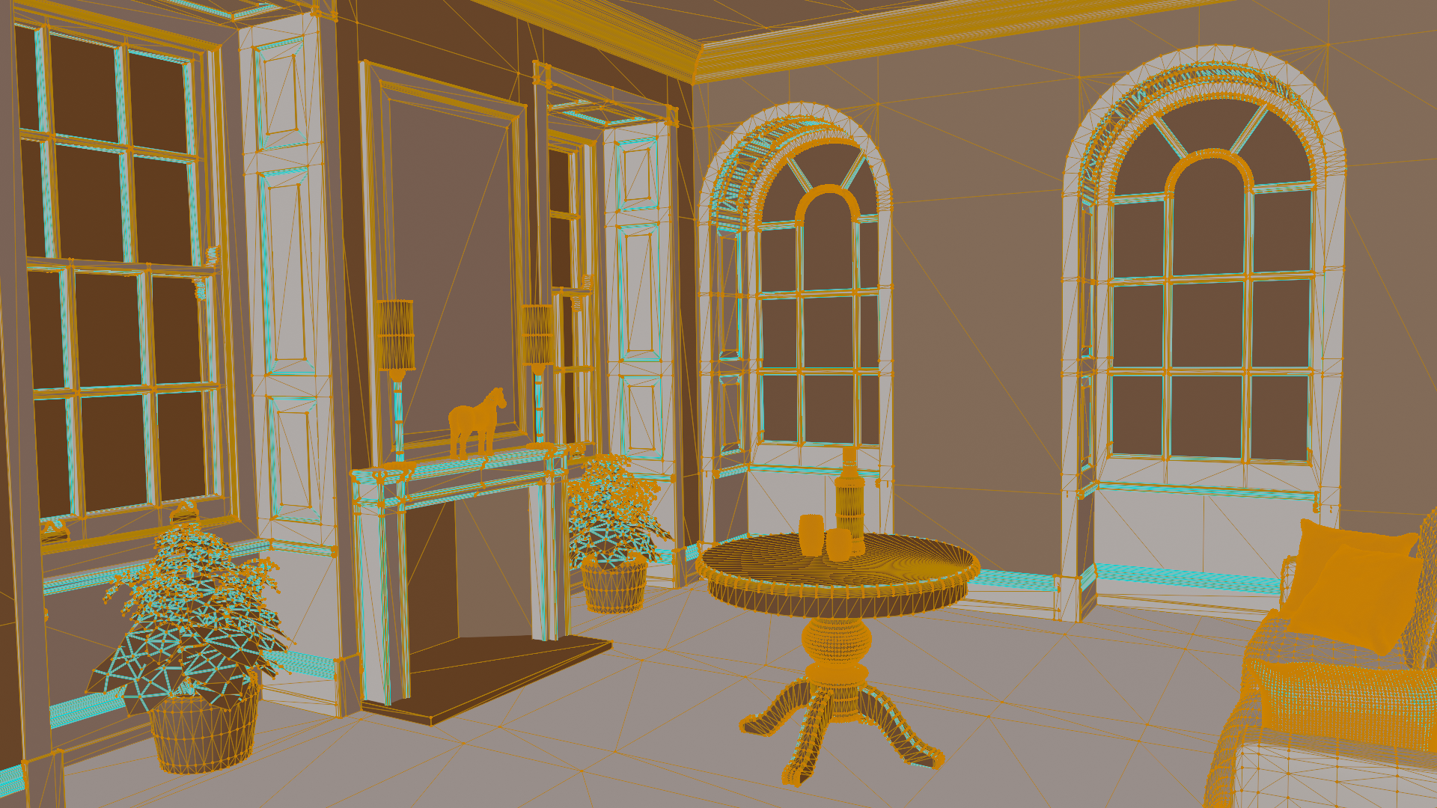
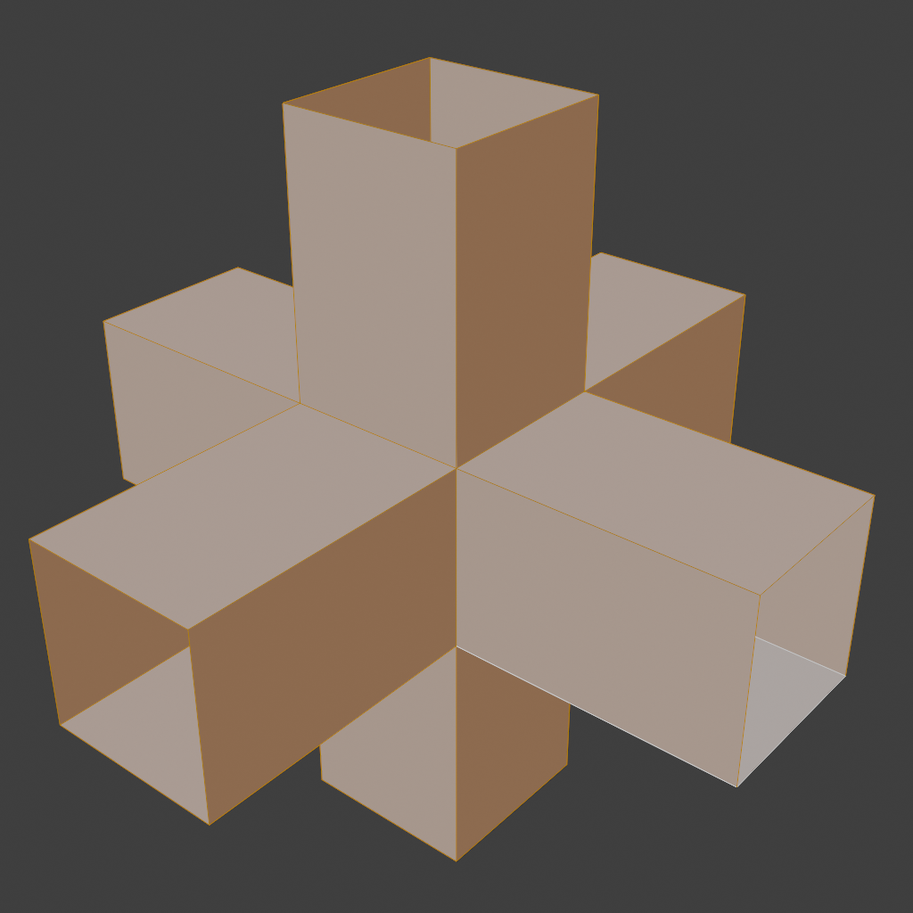
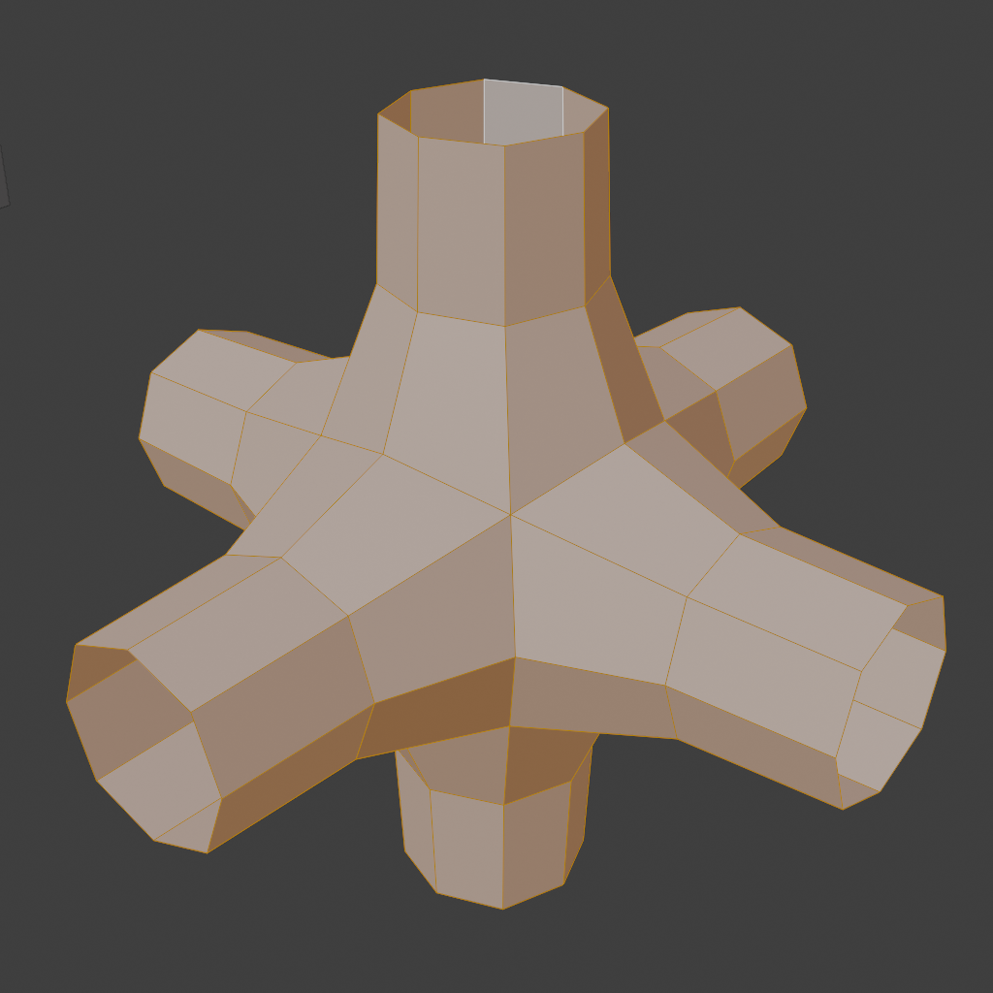
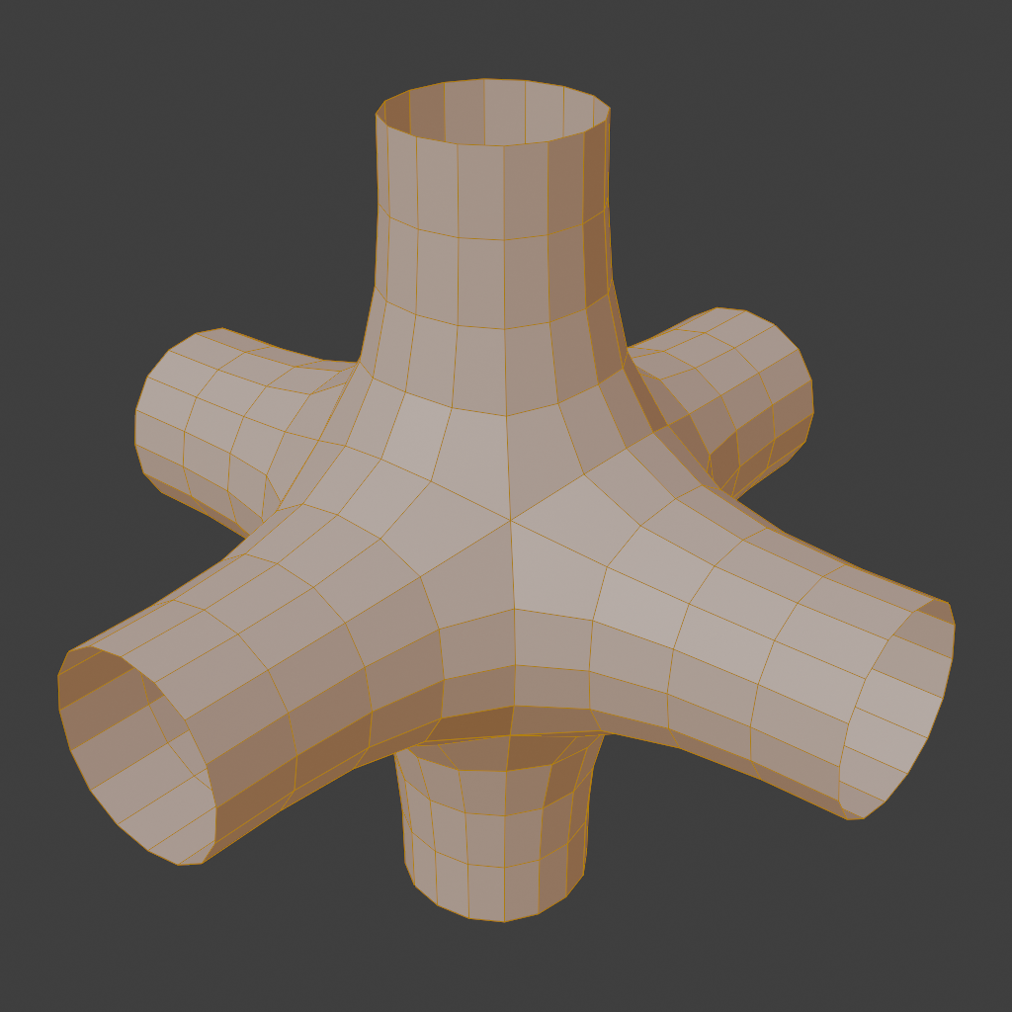
Recap: shape representations
Points
  Point clouds
  Particle systems
Surfaces:
  Polygonal mesh
  Subdivision surfaces
  Parametric surfaces
  Implicit surfaces
Volumetric objects/solids
  Voxels
  Space partitioning data-structures
Examples of polygonal mesh
Subdivision surfaces

Slide 4

Recap: shape representations
Points
  Point clouds
  Particles and Particle systems
Surfaces:
  Polygonal mesh
  Subdivision surfaces
  Parametric surfaces
  Implicit surfaces
Volumetric objects/solids
  Voxels
  Space partitioning data-structures
High-level structures
  Scene graph

Slide 5
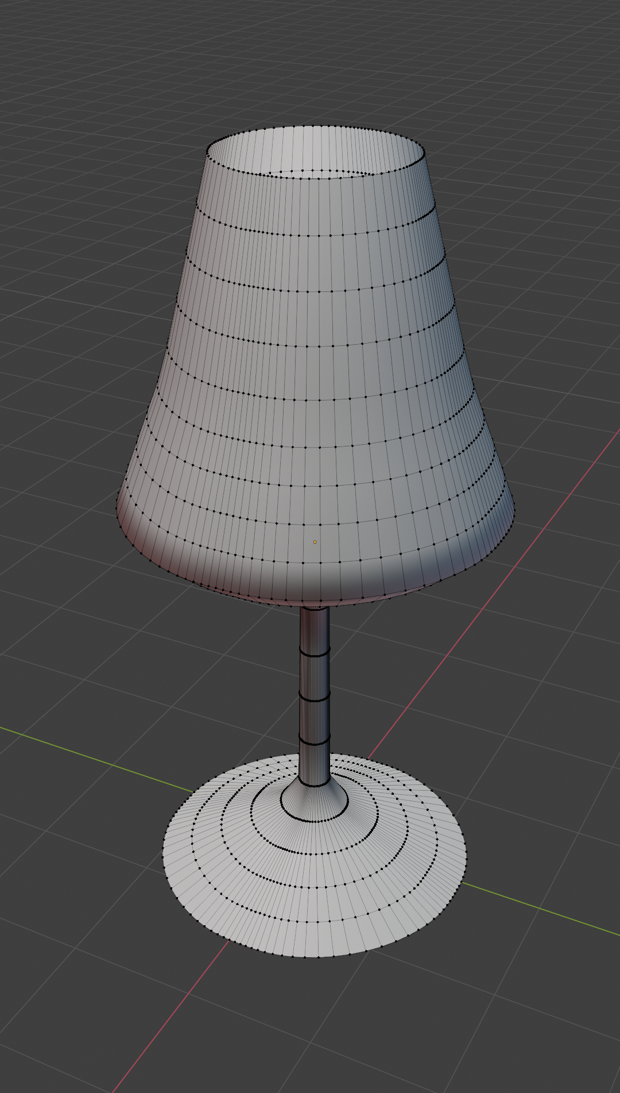
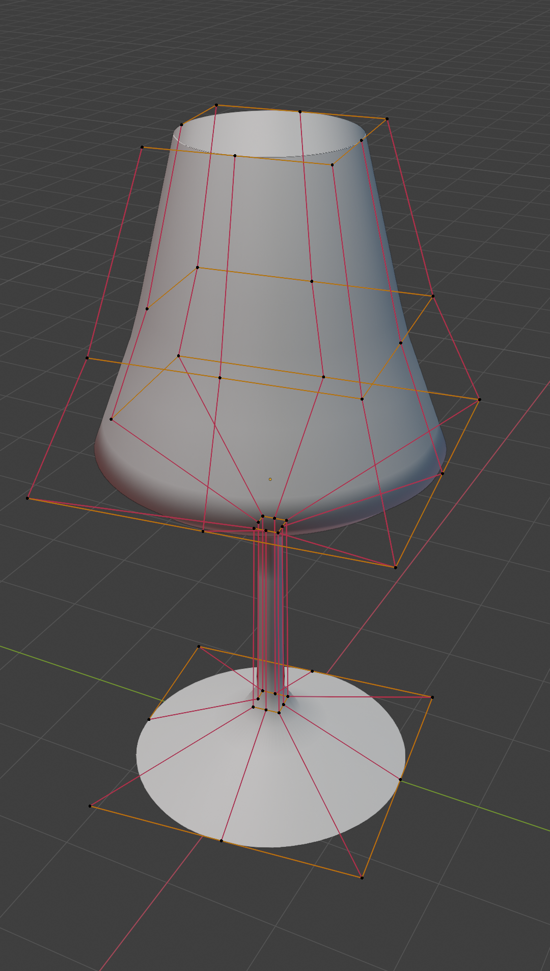
Foundations of 3D surface representation
Foundational surface shape representations found in geometrical modeling are*:
Polygon meshes
Parametric surfaces
*Note that these representations are used to describe surface of the shape (a manifold – 2D surface in 3D world). Later, we will discuss how to describe interior of object (its volume). Interior of object can be described purely with spatially varying material enclosed in described surface. Also, advanced shape representations (e.g., voxels) can be used to efficiently describe the mesh. Since the topic of volumetric representation requires more knowledge about material and/or advanced shape representations, it will be covered later.

Slide 6
Polygonal mesh

Slide 7
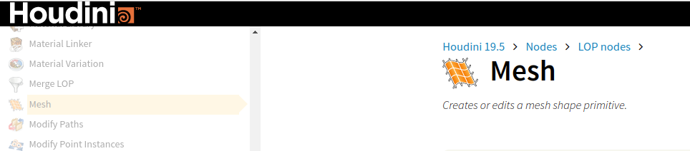
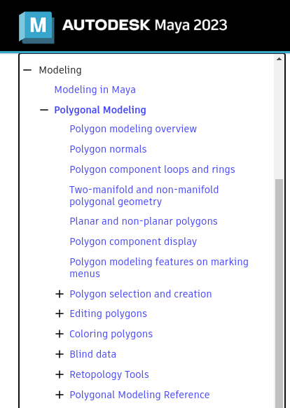
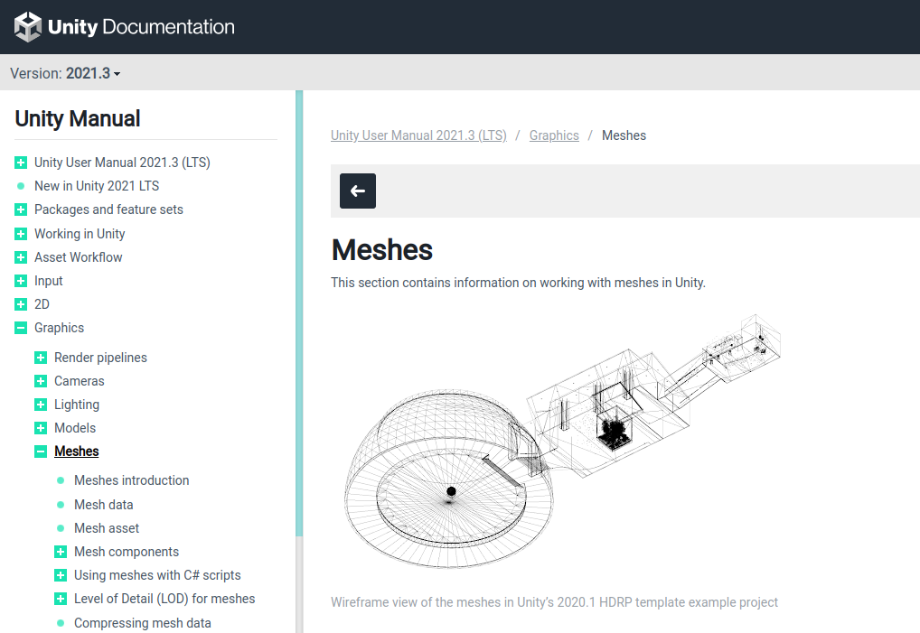
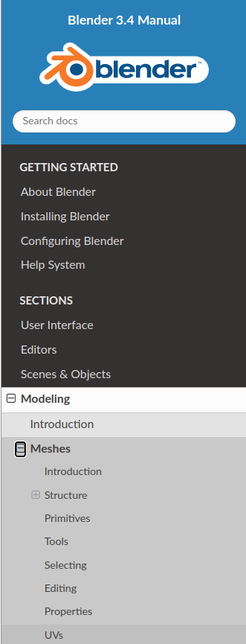
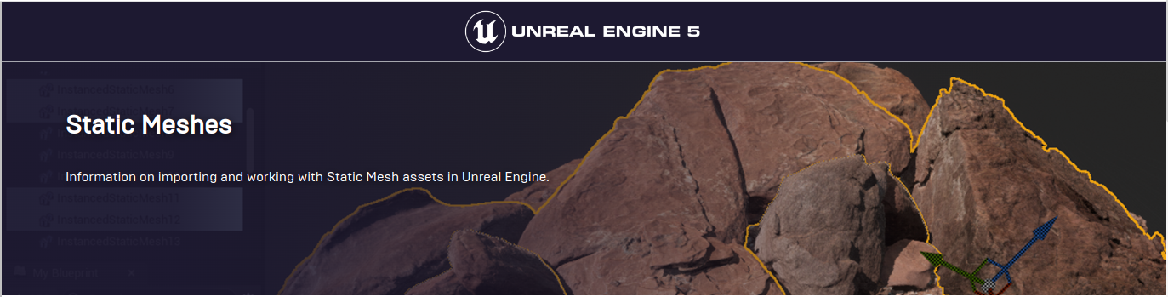
Polygon meshes
Polygon mesh (shortly mesh) representation is one of the oldest, most popular and widespread geometry representation used in computer graphics
  All DCC tools or game engines offer mesh representation that is used either for modeling or for rendering
Blender: https://docs.blender.org/manual/en/latest/modeling/meshes/index.html
Maya: https://help.autodesk.com/view/MAYAUL/2023/ENU/
Houdini: https://www.sidefx.com/docs/houdini/nodes/lop/mesh.html
Unity: https://docs.unity3d.com/Manual/class-Mesh.html
Unreal: https://docs.unrealengine.com/4.26/en-US/WorkingWithContent/Types/StaticMeshes/
* Very often, mesh is commonly used for transporting models and scenes from DCC tools to game engines. DCC tools enable modeling using different shape representations, but in a lot of cases, all shapes are transformed to mesh representation and exported to other programs.

Slide 8
Polygon mesh

Slide 9
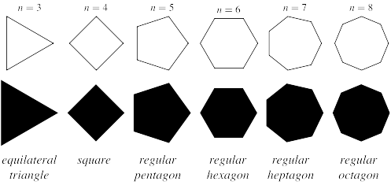
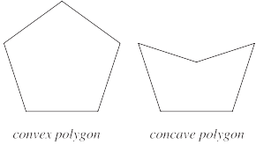
Polygon
Polygon is planar shape defined by connecting array of points.
Vertices (vertex, singular) - individual points
  In 2D they are defined using two coordinates,e.g., (x,y)
  In 3D they are defined using three coordinates, e.g., (x,y,z)
Edges - lines connecting two vertices
Polygon (face) – inner part of a connected and closed line of edges
  Order of connecting vertices (winding direction): clockwise or counterclockwise
  Face orientation, defined by normal, depends on winding direction
Regular polygons: https://mathworld.wolfram.com/RegularPolygon.html
Convex polygon: connection of any two points completely lies inside polygon: https://mathworld.wolfram.com/ConvexPolygon.html

Slide 10
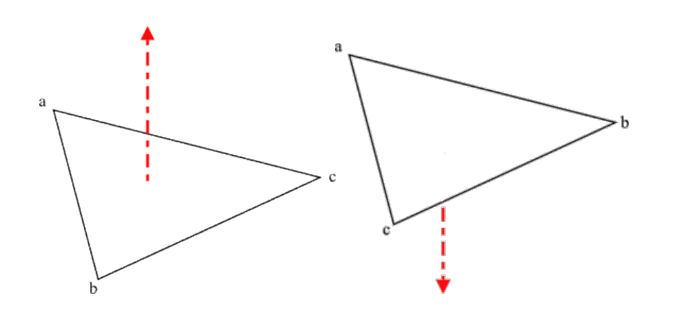
Polygon
Winding order: order of connecting vertices clockwise or counterclockwise
Face orientation, defined by normal, depends on winding direction
Left: anticlockwise. Right: clockwise
https://research.ncl.ac.uk/game/mastersdegree/graphicsforgames/indexbuffers/Tutorial%208%20-%20Index%20Buffers.pdf

Slide 11
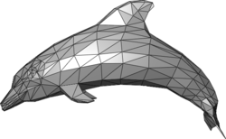
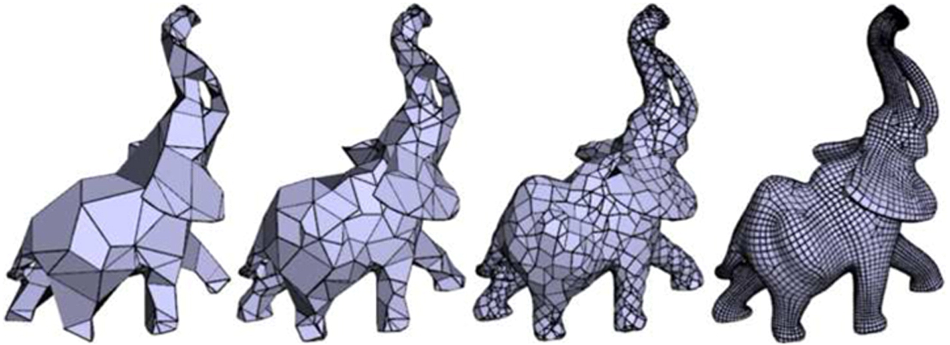
Polygon mesh
Polygonal (surface) mesh: boundary representation of an object
  2D surface embedded in 3D space
Assumption: objects are hollow and can be represented by an approximation of their surface using polygons
  Note that this representation is not good for example smoke and volumetric effects.
Typical polygons: triangles and quads
Triangle mesh:https://en.wikipedia.org/wiki/Polygon_mesh
Quad mesh: https://www.sciencedirect.com/science/article/abs/pii/S0097849312000623

Slide 12
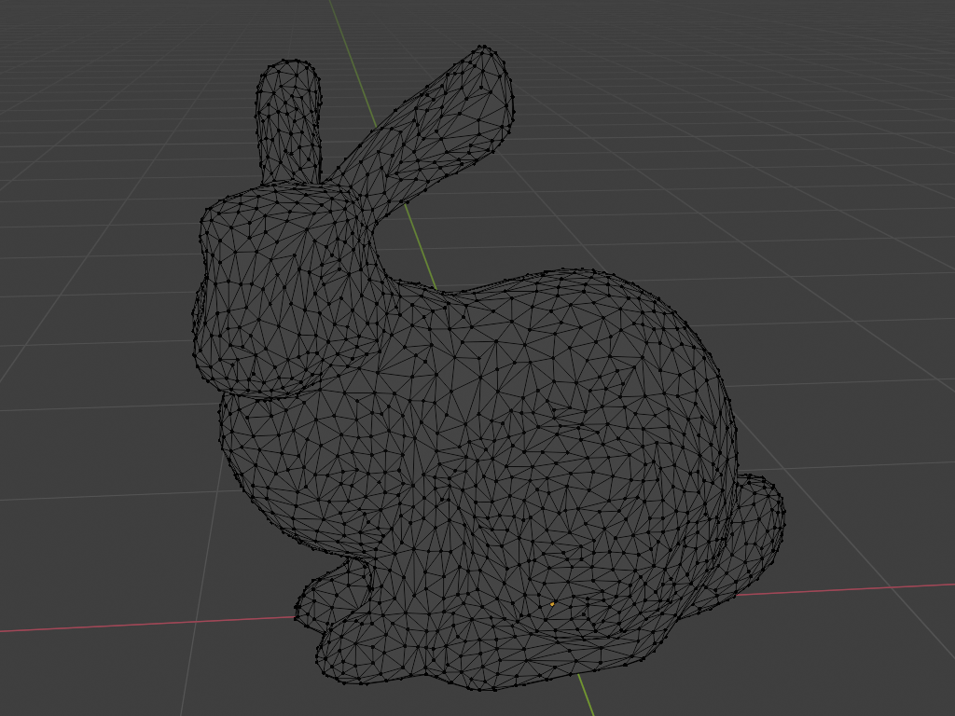
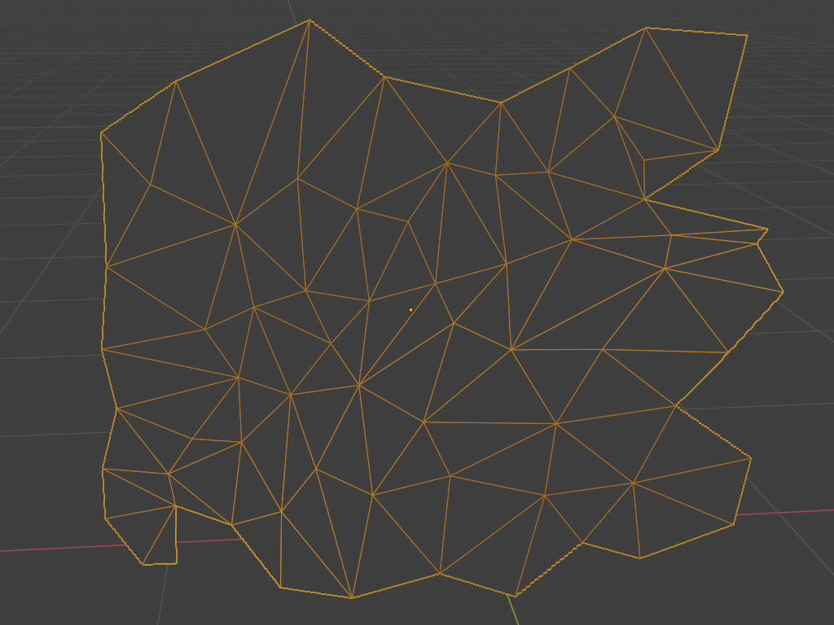

Triangle mesh
Polygon with three vertices → triangle polygon.
Triangle mesh consists of many triangles joined along their edges to form a surface

Slide 13
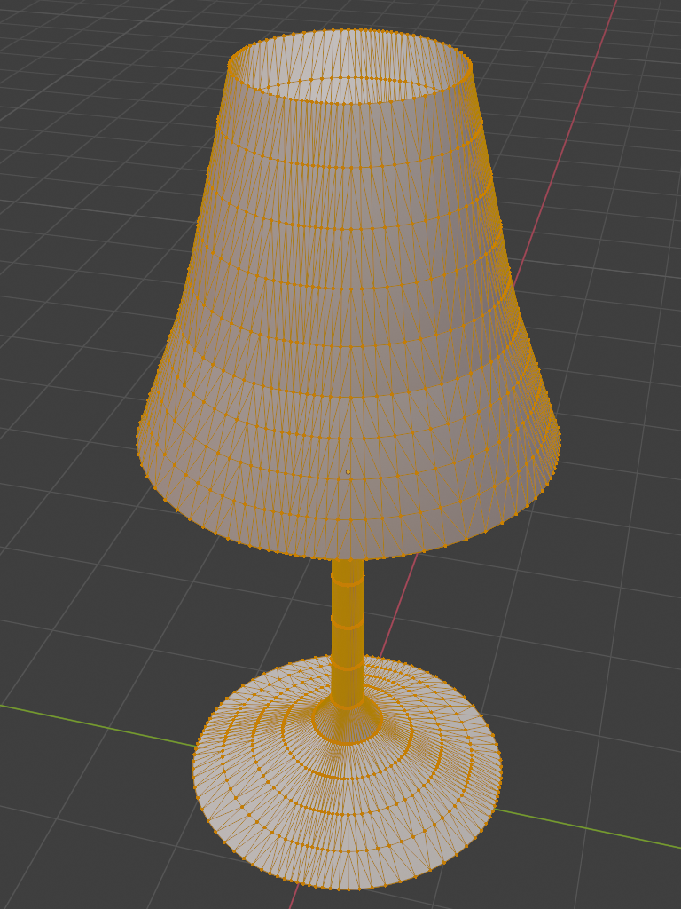

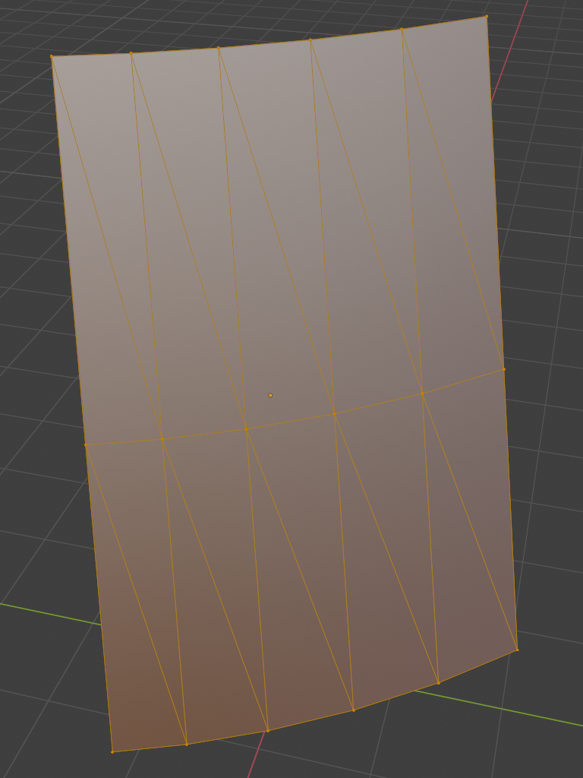
Triangle mesh
Polygon with three vertices → triangle polygon.
Fundamental for computer graphics

Slide 14
Triangle mesh
Triangle mesh is foundational and most widely used data-structure for representation of a shape in graphics
  All vertices lie in the same plane – always coplanar
  GPU graphics rendering pipeline is optimized for working with triangles
  Easy to define ray-triangle intersections needed for ray-tracing-based rendering
  Easy to subdivide in smaller triangles – triangle is replace with several smaller triangles (e.g., smoothing)
  Texture coordinates and other data are easily interpolated across triangle
Different shape representations used in modeling and acquisition can be transformed to triangle mesh

Slide 15
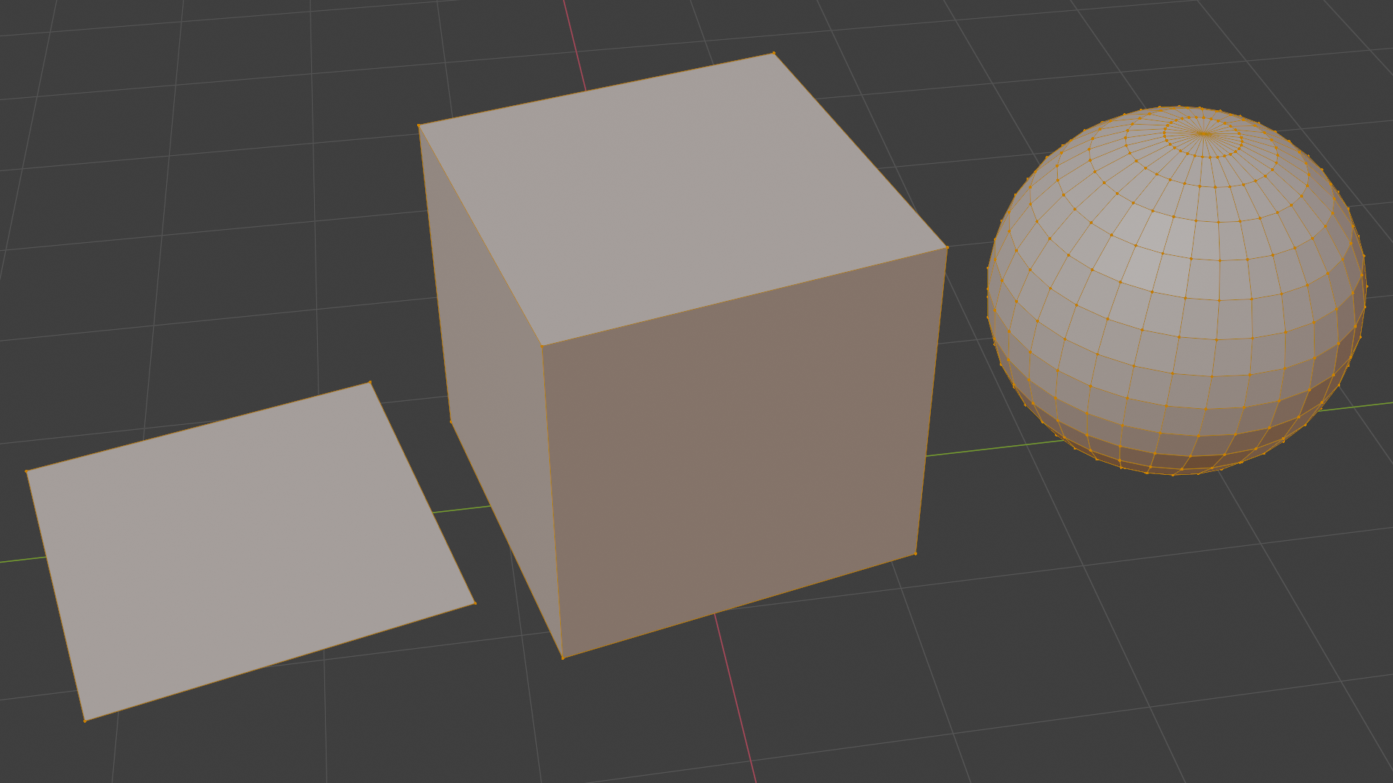
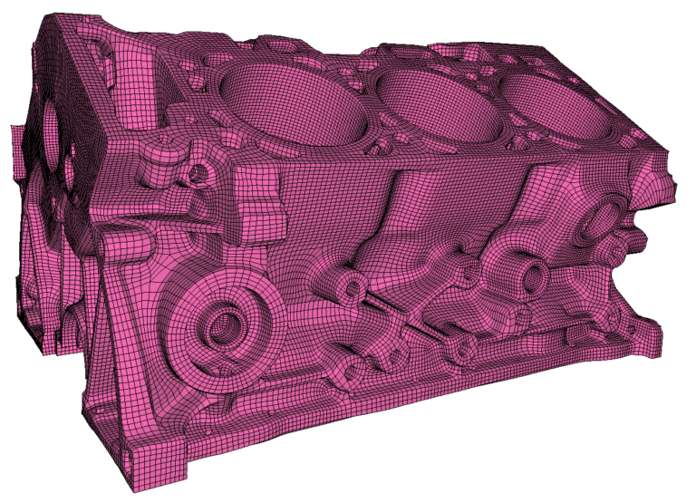
Quad mesh
Polygon with four vertices → quadrilateral polygon, shortly quad
Often used as a modeling primitive
Problem: not all quad vertices lie on a plane (not necessary coplanar)
  More complex ray intersection testing
For rasterization-based rendering converted to triangle mesh
Ray-tracing rendering can define ray-plane intersection
Blender mesh: https://docs.blender.org/manual/en/latest/modeling/meshes/index.html
https://geometryfactory.com/products/igm-quad-meshing/

Slide 16
Quad mesh
Often used as a modeling primitive
In graphics pipeline it is always transformed to triangle.
  Optionally, In ray-tracing-based rendering plane-ray intersection may be defined and then triangle representation is not needed*.
* As we will see, there is always a trade-off between which representation is good for modeling and which representation is good for rendering. Ray-tracing-based rendering can get very flexible with rendering wide representations of shapes but then there is a question if this is feasible to implement and maintain. Often, mapping between different shape representation is researched and used so that on higher level users are provided with intuitive authoring tools and on low level, rendering engine is given efficient representation for rendering process.

Slide 17
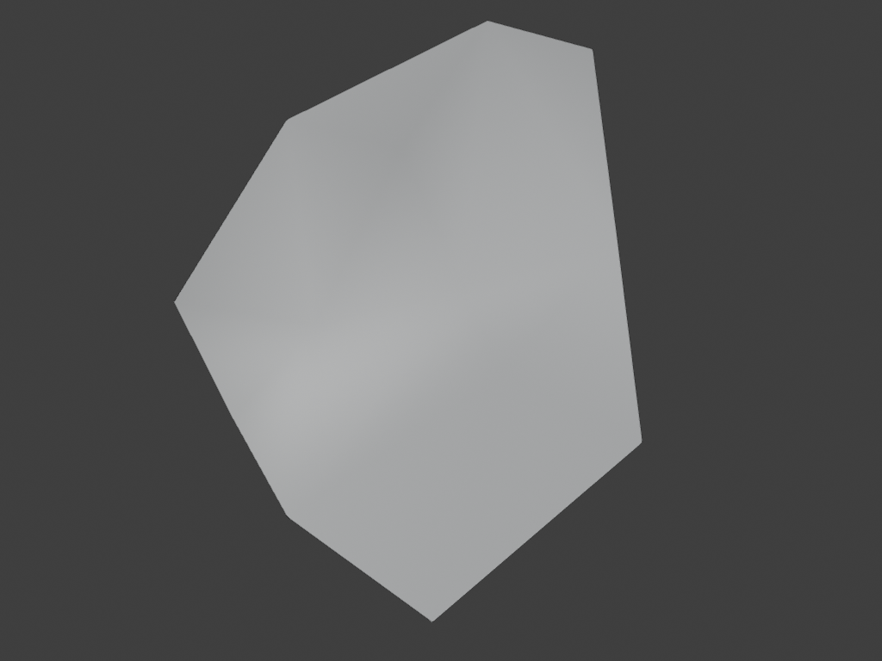
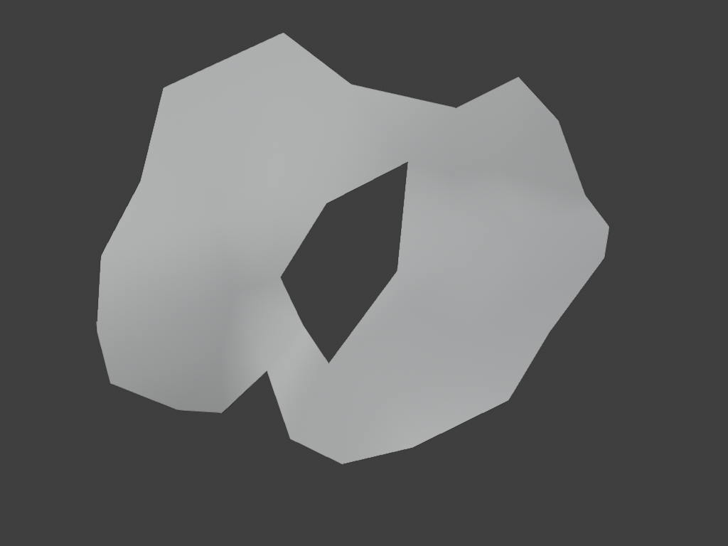
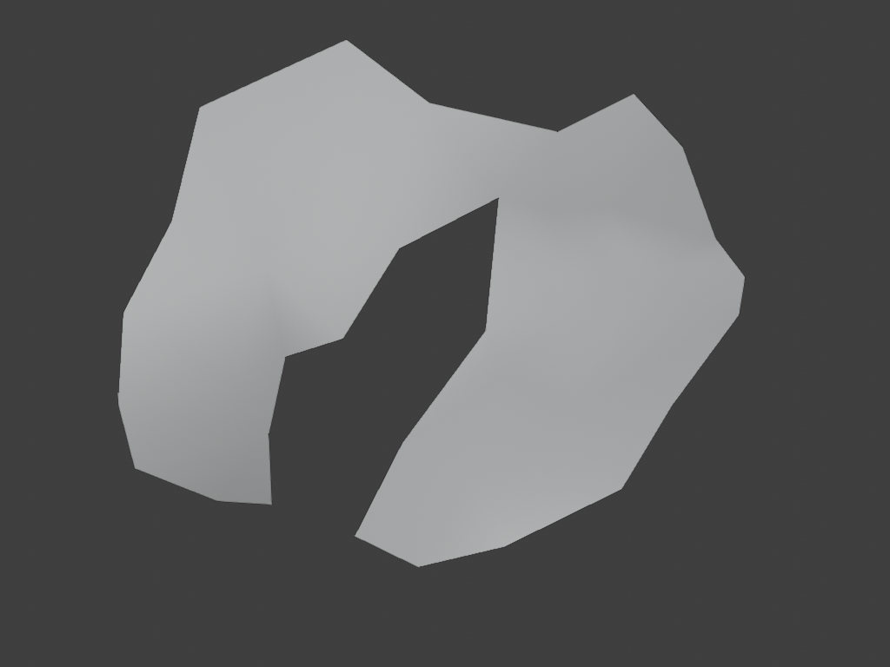
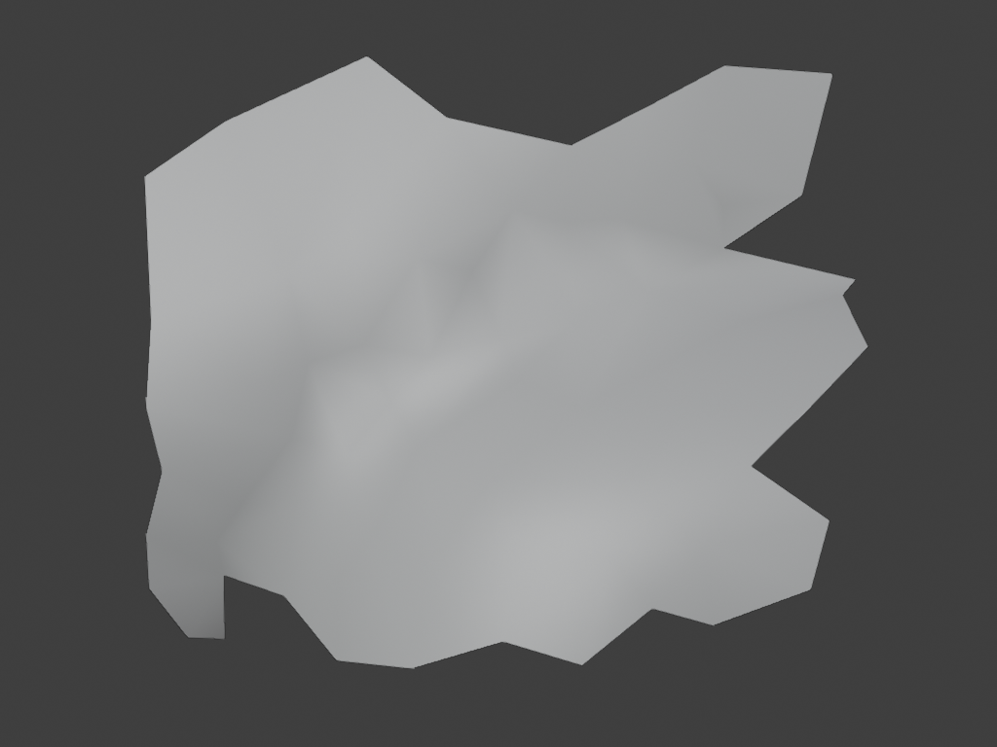
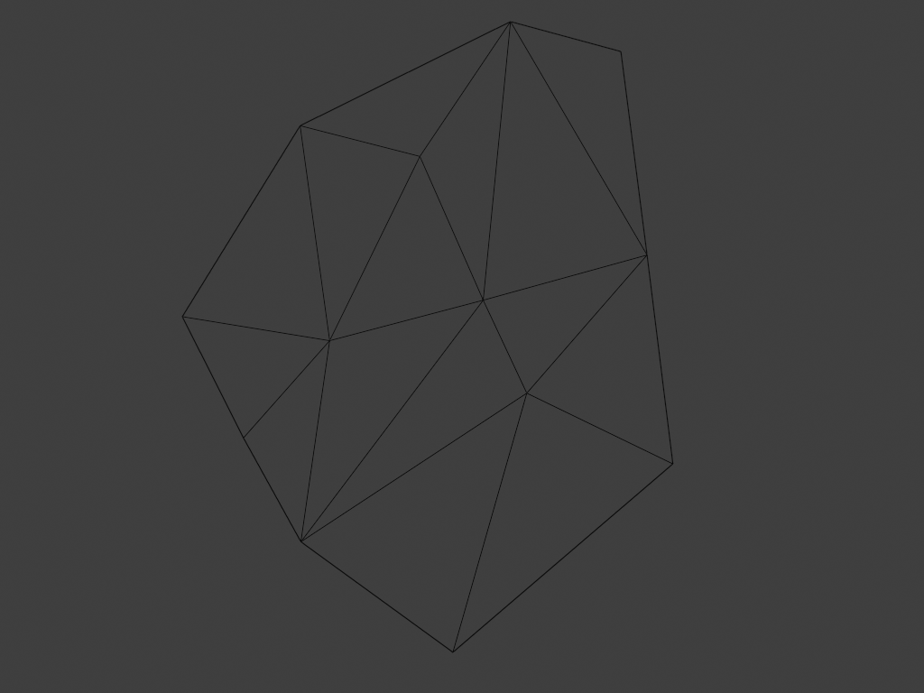
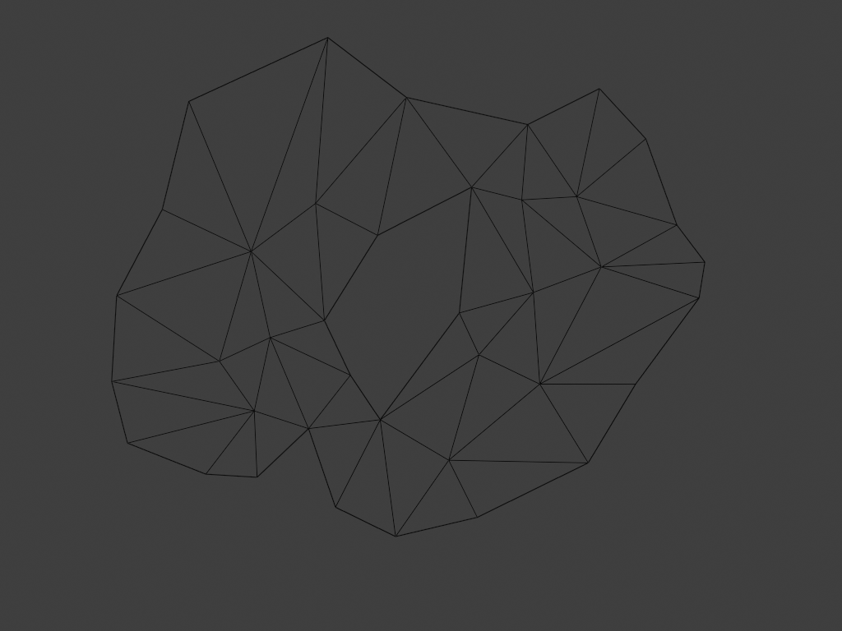
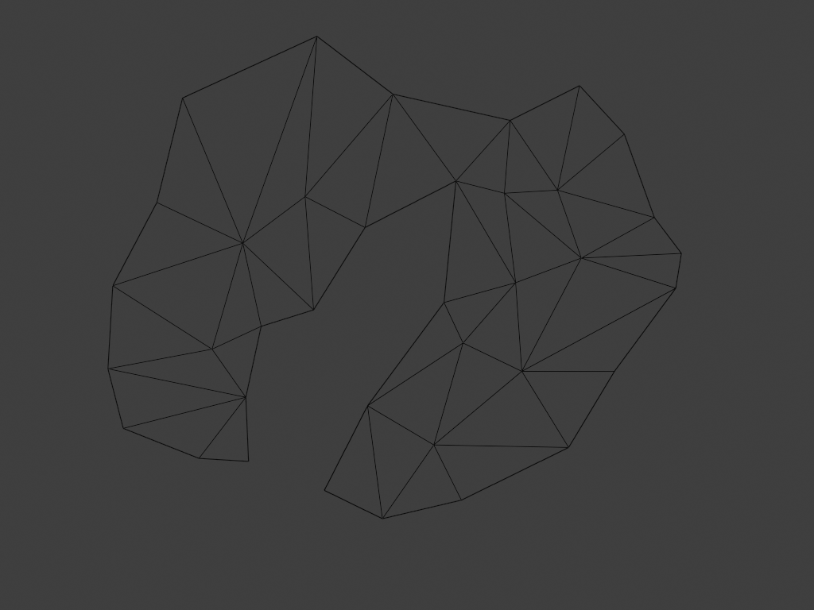
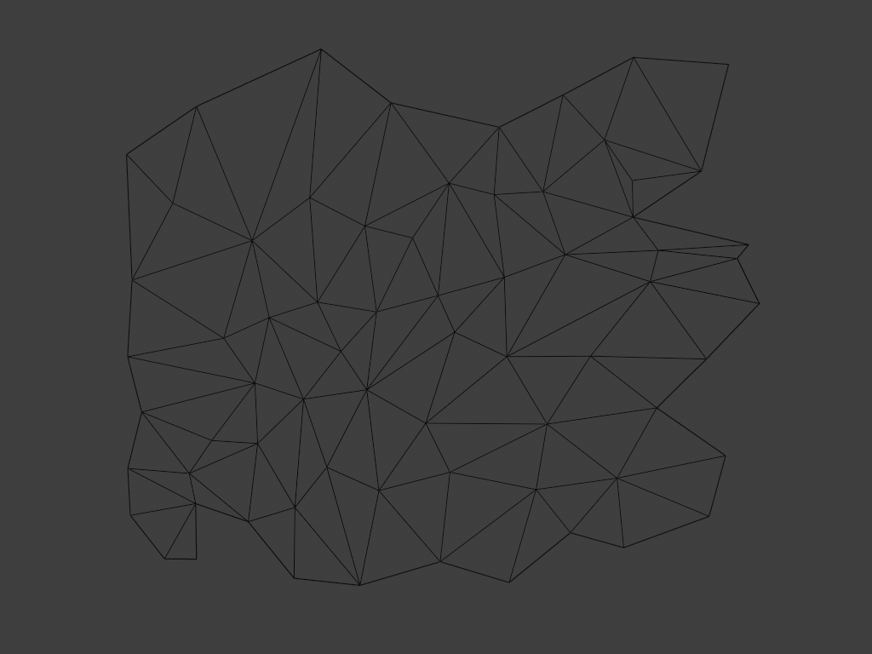
General polygon
General polygon: polygon with more than four vertices
  Can be quite complex, e.g., holes.
Face (atomic element) of mesh can be any polygon.
  Good practice: keep atomic elements as simple as possible (so that computation is easier) and combine those atomic elements into more complex shapes, e.g., convex or concave meshes or meshes with holes.

Slide 18

Polygon mesh representation
Basic information needed for representing and storing any polygonal mesh:
  Vertex positions: represented by coordinates (x,y,z) → geometry
  Vertex connectivity: how are vertices connected to form polygon mesh → topology

Slide 19
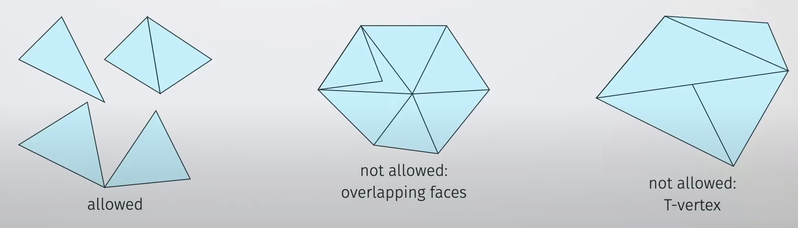
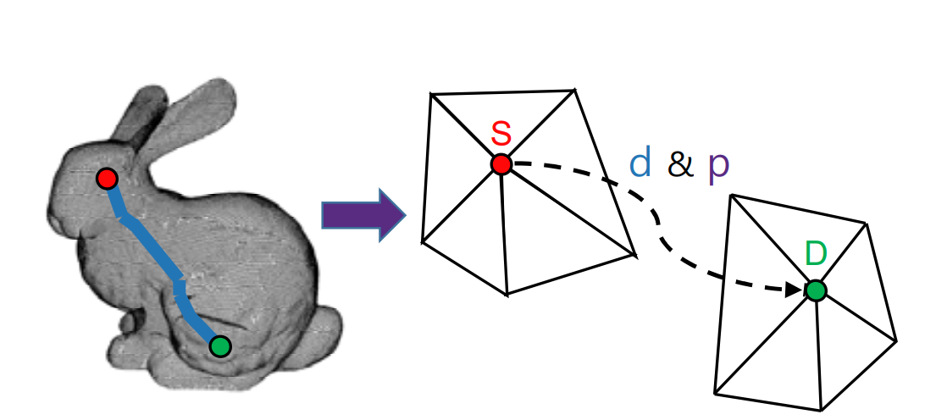
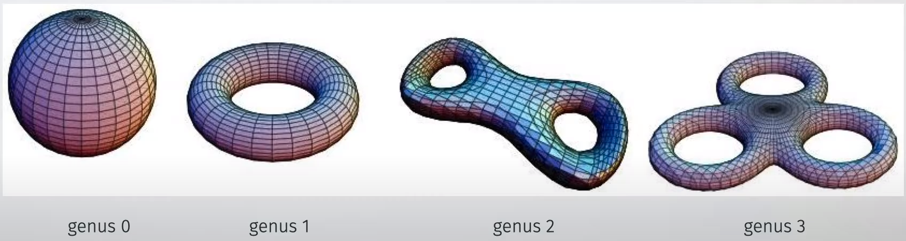
Properties of meshes
Manifold mesh
  Mesh is manifold if the intersection of two polygons is empty, a common vertex or a common line
  Desired property of many algorithms and general in graphics
Mesh genus
  Intuition: “number of holes”
  Important for computational topology
Meshes as graphs
  Vertices, edges and faces
  Application of graph algorithms, e.g., shortes edge path between two vertices
Manifold properties
Mesh genus
https://www.youtube.com/watch?v=V3Npa0uZYlE&list=PL4TptkuzgxxUVZ-_DiO33kp4_rkoAy1BC&index=6&ab_channel=ChristophGarth
Mesh as graph: http://www.jatit.org/volumes/Vol95No18/12Vol95No18.pdf

Slide 20
Important properties of meshes
Mesh boundary: formal sum of vertices
Closed mesh: mesh boundary is zero. Required for defining what is “inside” and “outside” by winding number rule
Manifold mesh: each vertex has arriving and leaving edge
  Mesh is manifold if the intersection of two polygons is empty, a common vertex or a common line
  Desired property of many algorithms
  Smooth vs not smooth manifolds (e.g., cube)
  Self-intersecting meshes are not manifolds
  In graphics we generally use polyhedral manifolds
Oriented vs unoriented meshes
  We use oriented meshes so that boundary can be defined
Manifold illustration

Slide 21
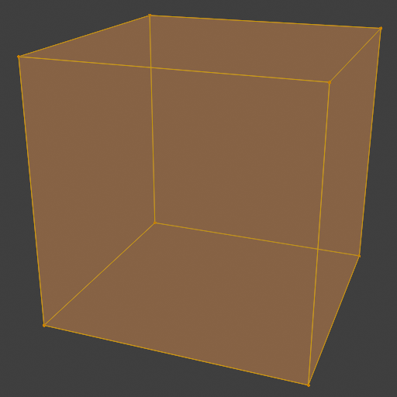
Connectivity
Complex polygons depend on vertex connectivity information.
Example: cube
  Define 8 vertices
  Define how are those vertices connected to form faces

Slide 22
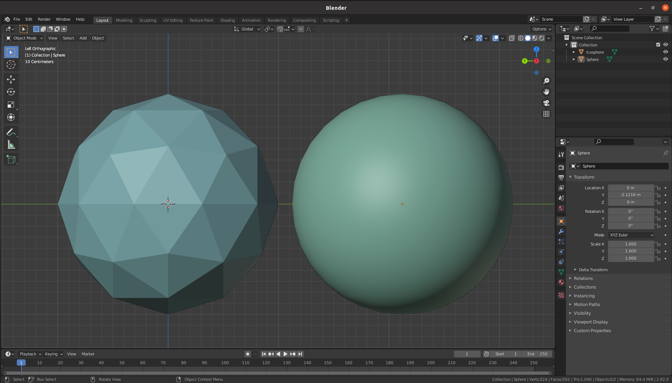
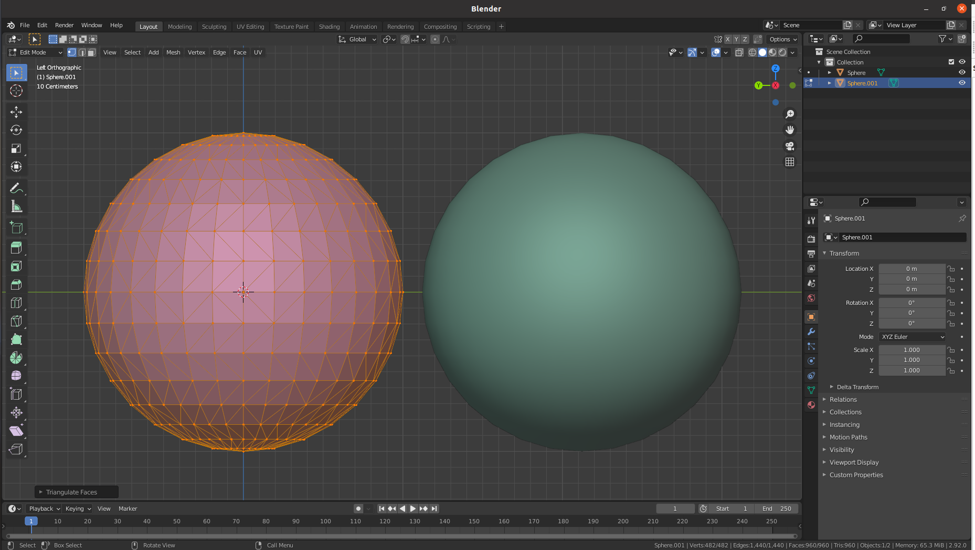
Polygonal appoximation
Example: ideal sphere vs polygon sphere
Polygonal approximation: piece-wise linear (flat) approximation of continuous surface with polygonal mesh

Slide 23
Subdivision surfaces

Slide 24
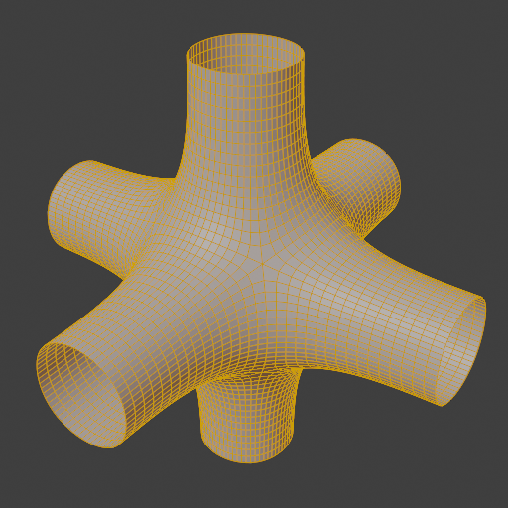
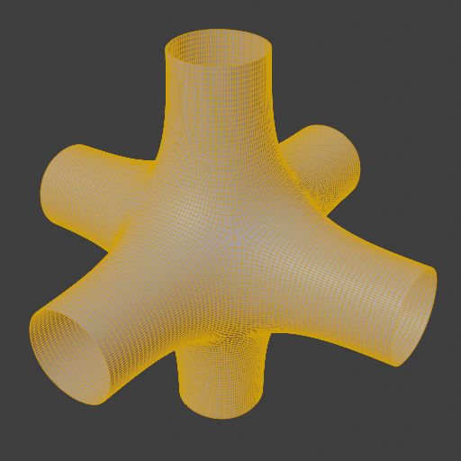
Representing smooth surfaces
Subdivision surfaces: methods for defining smooth and continuous surfaces from meshes with arbitrary topology
  Infinite level of detail: as many as needed triangles can be generated

Slide 25
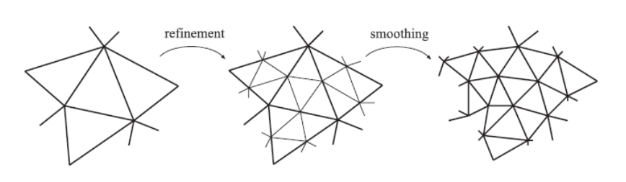
Subidivsion surfaces
Initial input is polygonal mesh: control mesh (cage)
Two-phase process:
  First, refinement phase, creates new vertices and reconnects them to create new smaller polygons
  Second, smoothing phase, computes new positions for some or all vertices in the mesh
https://www.realtimerendering.com/

Slide 26
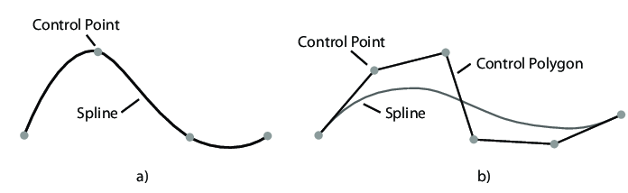
Subidivsion surfaces
Different subdivision schemes are determined by Refinement and Smoothing:
  Loop subdivision
  Catmull-Clark subdivision
  Doo-Sabin subdivision
Choice of rules gives different surfaces:
  Level of continuity
  Approximative or interpolating surface
Subdivision schemes characterization:
  Stationary vs non-stationary: always use same rules at every subdivision step or change rules
  Uniform vs non-uniform: use same rules for all vertices and edges or change rules
  Triangle vs polygon: only triangles or arbitrary polygon
Interpolation – passing through control points (a) Approximation – doesn’t lie on control points (b)

Slide 27
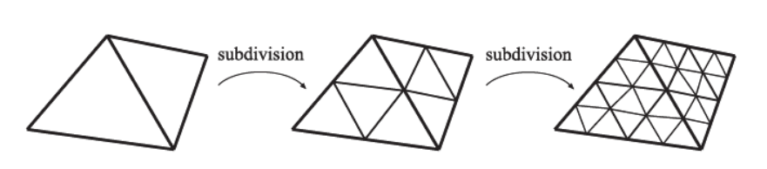
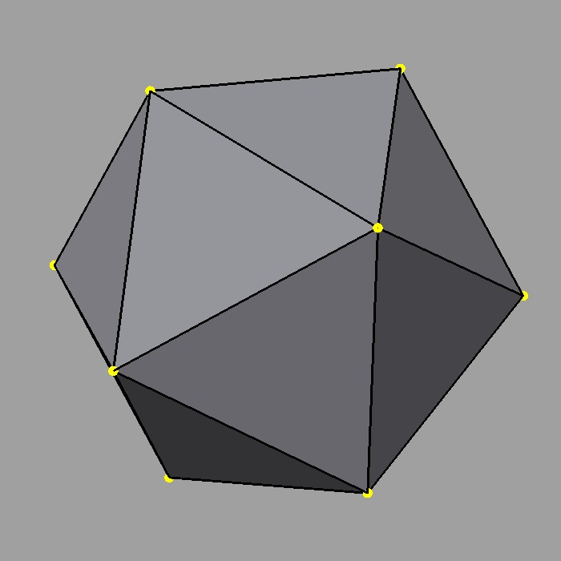
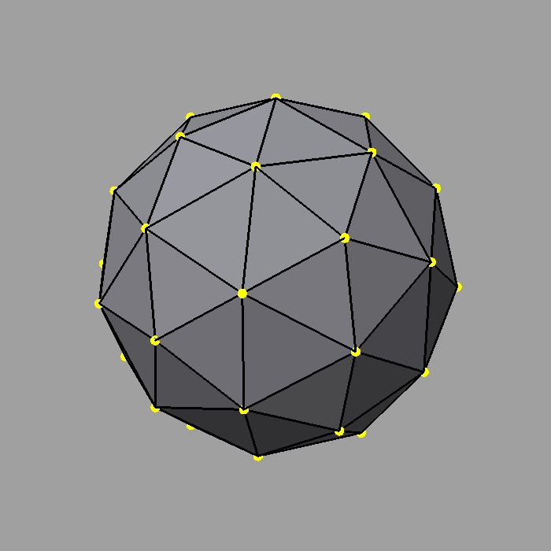
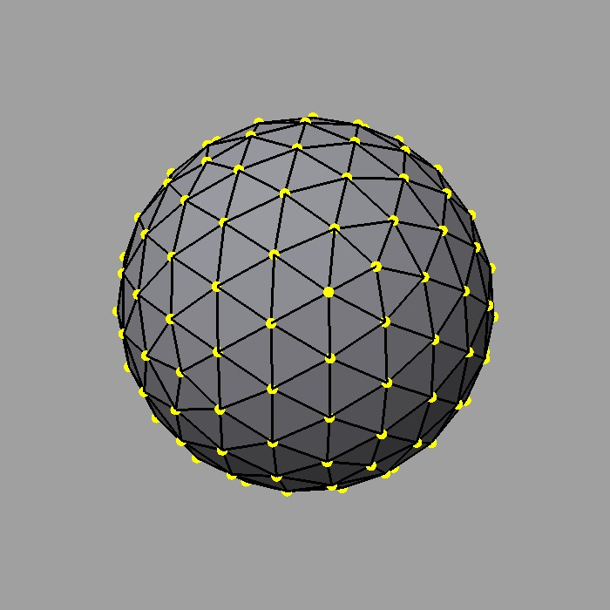
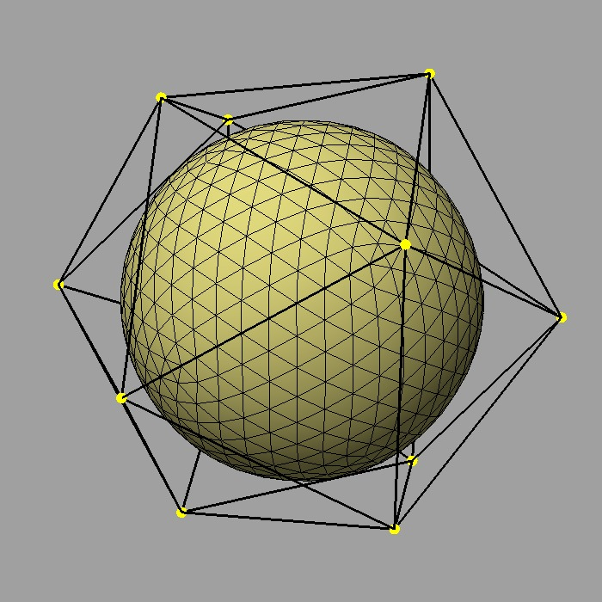
Loop subdivision
Stationary, triangle based
Starts with control mesh, updates each existing vertex and creates new vertex for each edge
  At each step, triangle is subdivide into four new triangles. After n steps → 4^{n} triangles
Resulting surface is approximative → smooth but shrinked
  To reduce shrinking, more vertices must be defined in control mesh
  Final surface is contained in convex hull of the original control points

Slide 28
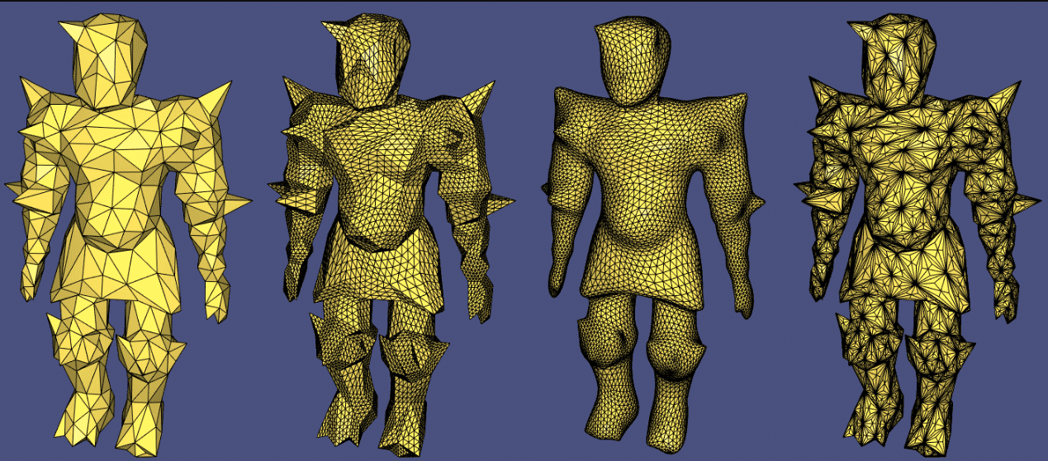
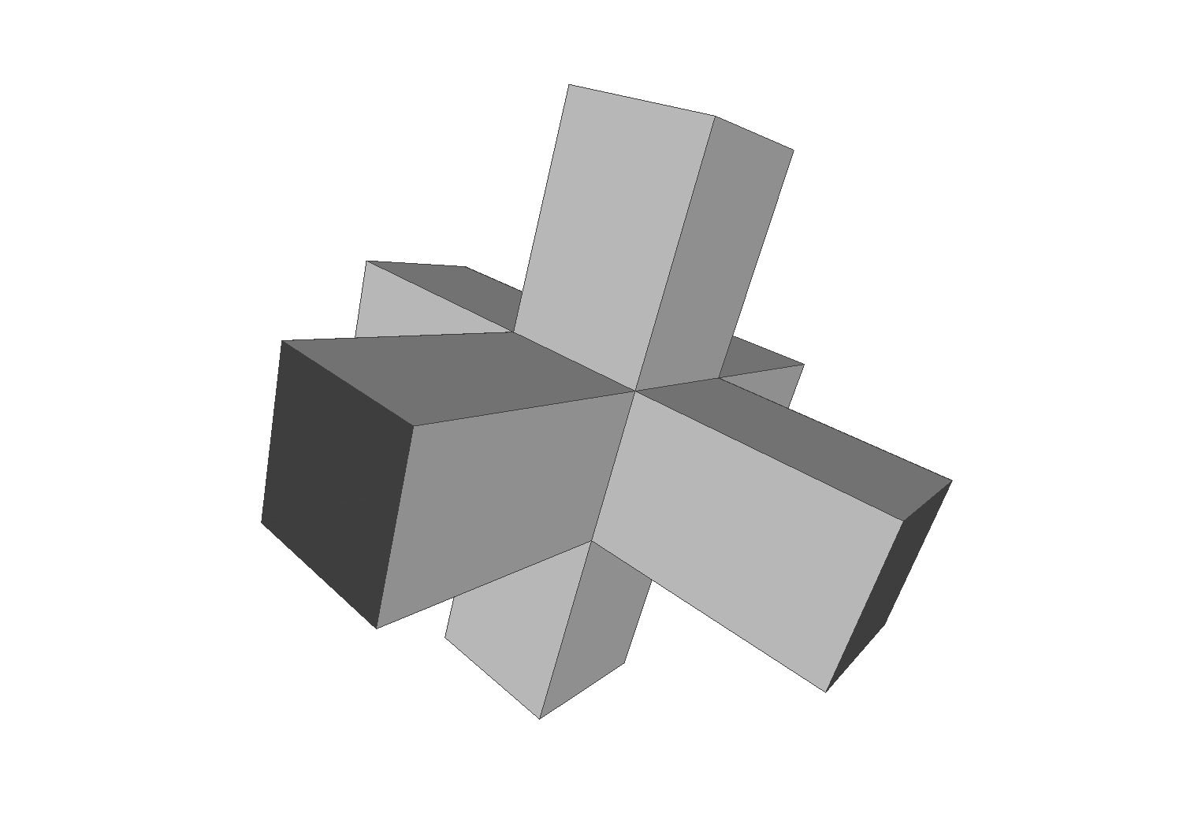
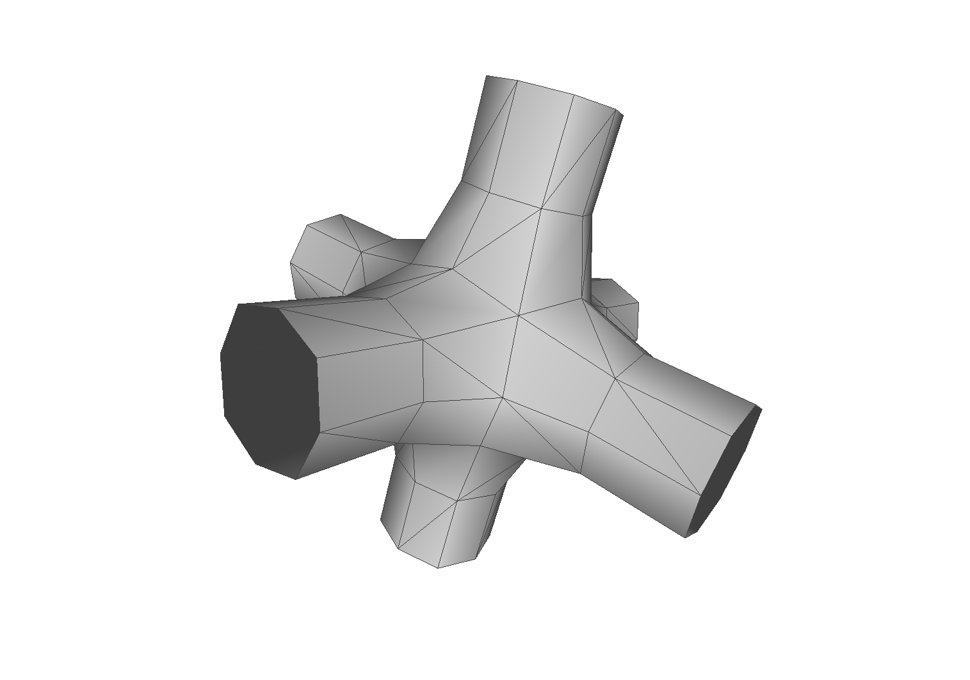
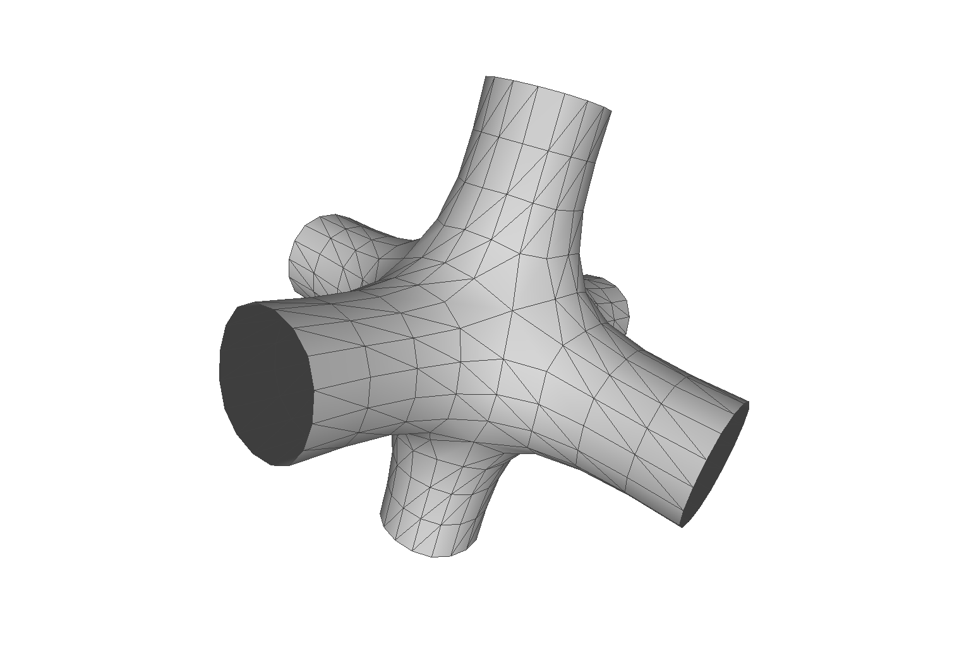
Loop subdivision
libigl subdivision: https://libigl.github.io/tutorial/ (original, upsample, loop and barycentric.
Meshlab loop subdivision: https://pymeshlab.readthedocs.io/en/latest/filter_list.html#meshing_surface_subdivision_loop
https://github.com/cnr-isti-vclab/meshlab

Slide 29
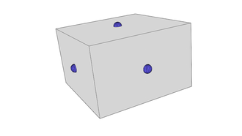










Catmull-Clark
Method of arbitrary polygons
Starts with control mesh, recursive process defining rules for*:
  Computing new face point
  Computing new edge point
  Updating vertices, creating new edges and faces
*https://graphics.pixar.com/library/Geri/paper.pdf
https://en.wikipedia.org/wiki/Catmull%E2%80%93Clark_subdivision_surface

Slide 30


Catmull-Clark subdivision
Most commonly used subdivision surface method
  Used in all Pixar feature films from Toy Story 2 onward
  Used from making models for games
Tends to generate more symmetrical surfaces
OpenSubdiv: State of the art subdivision library for production: https://graphics.pixar.com/opensubdiv/docs/intro.html
Catmull-Clark Subdivision in Blender (OpenSubdiv backend):https://docs.blender.org/manual/en/latest/modeling/modifiers/generate/subdivision_surface.html

Slide 31


Surface details
Flat and curved surfaces are too smooth and thus not realistic while lacking detail
Detail on surface can be added with:
  Geometrical enhancements: displacement
  Material modeling:
    Scattering function parameters variation: e.g., color patterns
    small scale surface variations: surface normal perturbation

Slide 32





Displaced subdivision
https://www.alanzucconi.com/2019/07/03/interactive-map-01/
Detail can be added on subdivided surface using displacement mapping
Often displacement mapping moves vertices (v) in direction of surface normal vector (N) for distance (d):
  v’ = v + d * N
Generally, displacement can be done using arbitrary vector (M)
  v’ = v + M
Scalar distance values (d) or vector values (M)used for displacement are described with image or procedural texture

Slide 33



Examples of polygonal meshes
https://polyhaven.com/

Slide 34


Examples of polygonal meshes
https://polyhaven.com/

Slide 35
Mesh and rendering

Slide 36
Mesh and rendering
Rendering uses object shape to solve visibility problem
  What is visible from camera
  Which surfaces are visible to each other → which might reflect light onto each other (light transport, shading)
Rasterization and ray-tracing based rendering are optimized for working with triangulated mesh
Any shape representation can be transformed into triangulated mesh using tessellation, specifically, triangulation:
  Uniform
  Adaptive

Slide 37

Uniform tessellation
uniformly sized triangles are created for whole surface.
Uniform tessellation of implicit representation of a sphere.

Slide 38





Non-uniform (adaptive) tessellation
Triangles of varying sizes are created for surface, based on:
  Distance to surface
https://www.hindawi.com/journals/tswj/2014/979418/
https://www.blenderguru.com/tutorials/introduction-microdisplacements

Slide 39


Non-uniform (adaptive) tessellation
triangles of varying sizes are created for surface, based on:
  Distance to surface
  Amount of surface details (surface curvature)
Curved parts of surface are represented with more triangles while flat parts can be represented with less triangles: https://gamma.cs.unc.edu/SDSDA/

Slide 40

Level of detal
Depending on camera distance, mesh can contain more or less details
Static: multiple object shapes with different amount of polygons (polygonal resolutions) are stored and used depending on camera distance.
Dynamic: amount of polygons in object shape is computed and used on the fly
  https://www.gamedeveloper.com/programming/real-time-dynamic-level-of-detail-terrain-rendering-with-roam
Static level of detail: https://3dstudio.co/3d-lod-level-of-detail/

Slide 41


Triangulated mesh and rendering
Triangle surface is continuous, to be displayed on raster image discretization must be performed
  Due to discretization, aliasing problems might appear
  Solution: multiple rays/samples per pixel
https://www.beyond3d.com/content/articles/122/4
https://docs.unity3d.com/560/Documentation/Manual/PostProcessing-Antialiasing.html

Slide 42
Vertex attributes
Besides vertex positions (geometry) and connectivity information (topology), additional information is used for rendering.
This information is stored per vertex - vertex attributes*:
  Normal
  Texture coordinate
  Color
  Any kind of information that can be encoded and used for rendering: weights, temperature, etc.
* Those are in general called primitive variables. Primitive is generic term in computer graphics which describes object which is understandable by program.

Slide 43
Vertex attributes
Vertex attributes are, during rendering (shading), interpolated across triangle or quad
  Example ray-tracing: ray hitting inside of a polygon
  Example rasterization: color of pixel inside polygon
Interpolation depends on polygon types:
  Triangles: barycentric interpolation
  Quads: bilinear interpolation

Slide 44

Barycentric interpolation
Express position of any point located on triangle with three scalars.
  P = uA + vB + wC, where A,B,C are triangle vertices
  u,v,w are barycentric coordinates
    u + v + w = 1 and
    0 <= u,v,w <=1, otherwise P is outside of triangle. If equal then P is on triangle edge.
Areal coordinates: u,v,w are proportional to area of sub-triangles defined by P
  u = Area(Triangle(CAP)) / Area(Triangle(ABC))
  v = Area(Triangle(ABP)) / Area(Triangle(ABC))
  w = Area(Triangle(BCP)) / Area(Triangle(ABC))
  Area(Triangle(ABC)) = ||(B-A)x(C-A)||/2
Interpolating vertex data
  We know P and A,B,C. Calculate, u,v and w and use this factors for interpolating

Slide 45



Bilinear interpolation
Any point on quad can be found with bilinear interpolation
  Thus, and value stored per vertex of quad can be interpolated in the same way

Slide 46


Normals
Orientation of surface in each point is determined by normal vector.
Normal vector is core information for rendering (shading) and modeling.
Mesh normal can be defined per:
  face
  per vertex

Slide 47

Computing normals
Normal in surface point is vector perpendicular to tangent in that surface point
Computation of normals depends on shape representation
  Sphere normal
  Mesh face normals can be calculated using triangle or quad polygon edges.

Slide 48




Normals: per face
Cross product between triangle or quad edges
Winding order of vertices defines orientation of normal
For right-handed coordinate system, polygons with counter clockwise winding will be front facing
N = (B-A).crossProduct(C-A);

Slide 49

Normals: per vertex
Multiple normals, one for each face, can be stored per vertex.

Slide 50





Normals: per vertex
One normal per vertex is calculated as:
  Calculate normal for each face connected to vertex
  Average calculated face normals

Slide 51




Normals: per vertex
One normal for each face per vertex vs one normal per vertex

Slide 52




Using normals: shading
Appearance of object depends both on shape and material.
  Normal is main shape information used in shading: evaluation of scattering function depends on normal
Flat shading: evaluation of scattering model using per-face normals (no interpolation)
Gouraud (smooth) shading: evaluation of scattering model at vertices and interpolating resulting color (e.g., barycentric interpolation)
  Problem: unnatural highlights for larger polygons since largest highlights appear at vertices of mesh and less on polygon during interpolation
  “Vertex” light calculation
Phong (smooth) shading
  Normals per vertex are linearly interpolated over triangles (using barycentric coordinates) and then scattering model is evaluated.
  “Per-pixel” light calculation
  Note: phong shading vs phong lighting model
Smooth shading:
Geometry is not changed: note faceted silhouette
Illusion of smooth surface is created during shading

Slide 53

https://slideplayer.com/slide/16683696/

Slide 54


Flat vs smooth shading

Slide 55





Using normals: shading
Amount of light incident on surface depends on cosine of the angle between light direction and surface normal
  Lambert’s Cosine law
  cos(θ) = dot(N, L)

Slide 56


Using normals: surface details
Face or vertex normals result in smooth and too perfect surface
These normals, during rendering, can be perturbed for each point on surface which give appearance of surface details
  Bump/normal mapping
https://learnopengl.com/Advanced-Lighting/Normal-Mapping

Slide 57







Using normals: geometric manipulation
Example: extrusion
  Basic modeling operations which moves mesh face in direction of normal
Example: procedural modeling
  Using normal direction for displacing mesh vertices

Slide 58




Additional mesh information: vertex colors
Similarly as normals are defined per vertex and interpolated over triangle for shading purposes, the same can be done with color
Simplest way to introduce variation over object surface – a form of texture
This method works fine for meshes with finer structure → more colors can be assigned to more vertices.
  When it is not possible to have fine mesh, then texture is used.
https://docs.blender.org/manual/en/latest/sculpt_paint/vertex_paint/index.html

Slide 59

Additional mesh information: vertex weights
Vertex attributes can be any information that can be used for rendering
Example: vertex weight designating density for instancing objects (e.g., particles)
https://www.youtube.com/watch?v=oPenYcM6Usw&ab_channel=HelperGround

Slide 60



Additional mesh information: texture coordinates
To add more details on object, often images and procedural patterns are used → textures.
The problem of applying texture image on 3D object is often quite complex than on flat plane.
  A a way of mapping a 2D image/pattern to 3D shape can be done by “unwrapping” mesh onto 2D plane.
https://polyhaven.com/a/wine_bottles_01

Slide 61






Mesh unwrapping: intuition
Mesh is unwrapped into 2D plane we can imagine it lies in 2D coordinate system.
Vertices of unwrapped mesh now have coordinates in this 2D coordinate system (u,v) → texture coordinates*
  (u,v) are in [0,1] range
  Unwrapped faces can be manipulated, but then texture might get deformed
  Whole unwrapped mesh can be translated or rotated or scaled to achieve different texture positioning
  Several faces can overlap

Slide 62



Texture coordinates: mesh unwrap
* Note: this is one way of calculating texture coordinates. Texture coordinates can also be calculated on the fly during rendering or other methods that we will discuss later.

Slide 63
Polygon Mesh: datastructures, storing and transfer

Slide 64
Datastructures and representation
There are multiple data structures for polygonal meshes that offer trade-off between run-time complexity and memory requirements
  Efficient topology traversal
  Efficient mesh updates
Different data structures are better for rendering, storage or modeling
Often algorithms on polygonal meshes perform:
  Computation of normal vectors
  Mesh smoothing, refining, simplification, compression, etc.

Slide 65
Mesh data structure
Mesh data structure must at least describe:
  Geometry: position of vertices specified using coordinates
  Connectivity/topology information for vertices → how are edges and faces formed from the vertices. Options:
    For each polygon, list all vertices that define it
    Polygon topology: specify edges of mesh in terms of pairs of vertices (connection between vertices and edges)
    Mesh topology: for each edge, state which polygons are incident connection between edges and polygons (connection between edges and polygons)
  Other information not explicitly given can be calculated from given information

Slide 66

Explicit face representation
Triangle soup: each triangle is represented using vertex coordinates (topology is not represented explicitly)
  Triangle: 3 vertices each having 3 coordinates (x,y,z).
  n triangles: n * 3 * 3 = 9 * n floats → high redundancy!
Data format used in production:
  STL (STereoLitography)

Slide 67


Example: STL file format
STL file format (ASCII and binary type) stores triangles by explicitly listing vertices and normals: https://all3dp.com/1/stl-file-format-3d-printing/

Slide 68


Shared vertex representation
AKA: indexed face set
  Reduce redundancy
Store vertex coordinates in a separate array: vertex array (3 * n floats)
Specification of triangles refers to vertex array table by storing indices of triangles: triangle/face array (3 * n integers)
Data formats used in production:
  OBJ
  OFF

Slide 69
Example: representing a cube in a computer
8 vertices: vertex array – geometry information
  vert_array = {{-1,1,1},{1,1,1},{1,1,-1},{-1,1,-1},{-1,-1,1},{1,-1,1},{1,-1,-1},{-1,-1,-1}}
6 quads for representing faces. Each quad requires 4 vertices: face index array – topology information.
  face_index_array = {4, 4, 4, 4, 4, 4}
  size(face_index_array) = number of polygons used for representing a shape
For each face, which indices of vertex array are used: vertex index array – topology information.
  vertex_index_array = {0, 1, 2, 3, 0, 4, 5, 1, 1, 5, 6, 2, 0, 3, 7, 4, 5, 4, 7, 6, 2, 6, 7, 3}
  size(vertex_index_array) = sum of all values in face index array
  Note: each face of the cube shares some vertices with other faces

Slide 70
Texture coordinates
Representing texture coordinates:
  Texture coordinate per vertex: list of (u,v) coordinates equal to the number of vertices. Example: texture_coordinates = {{0,0.5}, {1,0.5}, {0.5,1}, {0,0.5}, {0.5,0}, {1,0.5}}
  In UV space it is possible that multiple vertices have same texture coordinates thus connectivity information can be used to reduce number of texture coordinates to be written down

Slide 71


Example: OBJ file format
Less redundancy than explicit representation (e.g., STL)
Separates geometry (vertices) and topology (connectivity)
This representation is costly for computation
Each line starts with letter representing type of data:
  v – vertices
  vt – texture coordinates
  vn – normals
  f – faces (index of vertex, vertex texture coordinate, vertex normal
OBJ file format is further extensible: https://en.wikipedia.org/wiki/Wavefront_.obj_file

Slide 72


Example: specific data structures
Data structures for minimal redundancy and memory efficient representation by implicit topology:
  Triangle/quad strip
  Triangle fan
Complex meshes are represented as set of strips and fans
  Used for hardware rendering (OpenGL - https://www.khronos.org/opengl/wiki/Primitive)
Triangle strip: implicit representation of strip-like sequence of triangles. https://en.wikipedia.org/wiki/Triangle_strip
Triangle fan: set of triangles sharing one vertex
https://www.khronos.org/opengl/wiki/Primitive

Slide 73
Recap: representing and storing mesh
To describe a mesh we need:
  Vertex array (vertex positions)
  Face index array (how many vertices each face is made of)
  Vertex index array (connectivity)
  Primitive variables:
    Vertex color
    Normals
    Texture coordinates
    Other optional application-specific values

Slide 74
Storing polygons: practical note
Even single polygon mesh in a 3D scene can can be quite large (10⁵-10⁶ vertices is not unusual)
Storing vertices and connectivity information must be performed efficiently
  All vertices must be stored
  Different techniques exist which try to minimize the amount of data needed for representing connectivity → yielding different standards, formats and API specifications for storing and transferring mesh data, e.g., OBJ or FBX*.
* Those are popular and widely used standards. We will discuss them more when we will be talking about triangle meshes. RenderMan, on the other hand, defines API specification for representing mesh data.

Slide 75
Storing and transferring mesh objects
Mesh data is often transferred between different modeling, rendering and interactive tools.
Interface between different tools and specification of how mesh should be stored is defined by standards*: https://renderman.pixar.com/resources/RenderMan_20/ribBinding.html
Different implementations of mesh storage formats exists, which are:
  Are more or less compact
  Are more or less human-readable
  Can contain additional object data which is described with the mesh (textures, materials, etc.)
  Can contain various metadata (e.g., physical behavior of object described with mesh)
  Store only mesh information
  Store whole scene and mesh is only one of elements
Popular formats:
  https://all3dp.com/2/most-common-3d-file-formats-model/
  https://www.sidefx.com/docs/houdini/io/formats/geometry_formats.html
3D scene is not necessary created, rendered and used in same software. Usually, whole pipeline of software is used, at least:
  DCC → game engines
Formats: OBJ, GLTF, USD
Interesting: https://www.scratchapixel.com/lessons/3d-basic-rendering/introduction-polygon-mesh/polygon-mesh-file-formats
* note that tendency is towards standardization of whole scene description. Which, besides mesh polygons, include materials, lights, cameras, different shape representations, etc.

Slide 76
Practical note: using different formats
Professional file formats and representations are commonly used and are very efficient
Using modeling/interactive/rendering tools, user is often provided with “importer/exporter” – feature which enables importing and exporting different file formats
  Example: https://www.sidefx.com/docs/houdini/io/formats/index.html
The problem comes if one writes its own rendering program and parsing file formats for import can be not that easy. Luckily, different libraries can be used for this purposes:
  Example: https://github.com/assimp/assimp

Slide 77
Practical note: units
Note that until now we haven’t discussed units in which shape is stored.
Units are important for preserving consistent scale among different modeling/rendering tools in which object might be transferred.
Let’s discuss creation of two meshes in Blender. Mesh, that is, vertices are defined in a coordinate system. In this coordinate system we can have two same objects where one is larger and another is smaller. By relation/proportion we can distinguish the scale and we might not care about units.
  Since positions of vertices are relative to coordinate system, the axis of coordinate system must specify units.
But what happens if one of this objects in exported into another tool, for example Unity? Unity might use different coordinate system unit scale and object might be too big or too small in this coordinate system!
  Example: different scales with same coordinates.
Unit is defined by user who models the object and it must be taken care of during transfer.

Slide 78
Mesh polygons: modeling and acquisition

Slide 79

Manual/interactive modeling
DCC Tools provides basic shapes from which complex shapes are created.
1. Blender: https://docs.blender.org/manual/en/latest/modeling/meshes/primitives.html
2. Maya: https://knowledge.autodesk.com/support/maya/learn-explore/caas/CloudHelp/cloudhelp/2022/ENU/Maya-Basics/files/GUID-45D2EAD4-5BCF-42DA-A1AB-EC6EE09FE705-htm.html
3. 3DS Max: https://knowledge.autodesk.com/support/3ds-max/learn-explore/caas/CloudHelp/cloudhelp/2021/ENU/3DSMax-Modeling/files/GUID-66152BDE-BA64-423F-8472-C1F0EB409E16-htm.html
4. Houdini: https://www.sidefx.com/docs/houdini/model/create.html

Slide 80









Practical tip: complex shapes from base shapes
Anything can be decomposed in simple forms^{1,2}: box, sphere, cylinder, torus, cones, etc.
https://www.youtube.com/watch?v=Q0qKO2JYR3Y&ab_channel=BlenderSecrets
1. http://www.thedrawingwebsite.com/2015/02/18/practicing-your-draw-fu-forms-forms-are-like-sentences/
2. https://www.youtube.com/watch?v=6T_-DiAzYBc&list=RDCMUClM2LuQ1q5WEc23462tQzBg&start_radio=1&rv=6T_-DiAzYBc&t=1343&ab_channel=Proko

Slide 81

Constructive solid geometry
Boolean operations applied on meshes:
  Union
  Intersection
  Difference
Union, intersection and difference Boolean operators applied on meshes: https://docs.blender.org/manual/en/latest/modeling/modifiers/generate/booleans.html

Slide 82


Subidvision surfaces and displacement
Subdivision surfaces for smooth surfaces in Pixar:
https://graphics.pixar.com/library/Geri/paper.pdf
https://www.fxguide.com/fxfeatured/pixars-opensubdiv-v2-a-detailed-look/
Blender displacement of subdivided surface: https://docs.blender.org/manual/en/latest/render/materials/components/displacement.html

Slide 83





Practical tip: complex shapes from base shapes
Sculpting base shapes.
https://www.youtube.com/watch?v=p4Y1hVCMMXw&ab_channel=RealEnay

Slide 84




Practical tip: complex shapes from base shapes
Procedural modeling
https://www.youtube.com/watch?v=fxOxygaEOFk&ab_channel=SimonHoudini

Slide 85


Simulations
Polygonal model can be generated using simulations (e.g., fluid simulation using voxel representation) which is then tessellated into polygons for rendering.
Houdini fluid simulation: https://www.sidefx.com/tutorials/crashing-wave/
Fluid simulation in Blender: https://andi-siess.de/designing-a-book-cover-as-3d-vector/

Slide 86


Procedural modeling
Similarly to simulations, polygonal mesh can be created by writing programs that create such data – procedural modeling
Procedural modeling in Houdini: https://entagma.com/category/tutorials/
Blender procedural modeling using geometry nodes: https://blenderartists.org/t/procedural-abandoned-house-with-geometry-nodes/1363024

Slide 87

Transforming data into visualizations
Data found in different forms can be converted to polygon data. Example: visualizing protein data using spheres.
Visualizing viruses in Blender: https://www.youtube.com/watch?v=adhTmwYwOiA&ab_channel=Blender

Slide 88



Scanning and photogrammetry
Polygonal model can be generated using scanning and photogrammetry which results in point clouds and then is transformed into polygons for rendering.
Scan the world: https://www.myminifactory.com/scantheworld/
Sans Factory: https://www.scansfactory.com/
Mega Scans: https://quixel.com/megascans/home/
Art Station 3D scanning and photogrammetry:https://www.artstation.com/channels/photogrammetry_3d_scanning?sort_by=popular

Slide 89

Data from volumetric scans
Generating surface from volume data scanned with CT or MRI.
MRI to mesh in Blender: https://www.blendernation.com/2019/07/15/converting-a-video-into-a-dicom-and-a-3d-mesh/

Slide 90
Mesh polygons: outlook

Slide 91




Deeper into topic
Polygonal mesh is highly used and researched method in computer graphics. We have covered foundations. There are many other topics. Some of those will be discussed later, some are out of scope for this course:
  Remeshing
  Simplification, level of detail
    replacing the mesh with the simpler one which has the similar shape (topological or geometrical)
  Mesh compression
  Consolidation, mesh reparation
  Animation, skinning and deformation

Slide 92
Exploring meshes
Meshlab is open-source tool for mesh manipulation and processing
  Mesh smoothing and sharpening
  Re-meshing: subdivide, re-sample, simplify,
  Topological operations: fill holes, fix self-intersections
  Boolean operations
libigl and CGAL libraries for mesh processing
Blender
  Modeling with meshes
  Procedural meshes with Python
Sources of mesh data:
  https://casual-effects.com/data/index.html
  https://polyhaven.com/models
  https://sketchfab.com/
  http://graphics.stanford.edu/data/3Dscanrep/
More informations:
  https://www.realtimerendering.com/#polytech

Slide 93
Mesh shape representation: verdict
Pros:
  Most common surface representation
  Simple for representing and intuitive for modeling and acquisition
  A lot of effort has been made to represent various shapes with meshes
  Lot of research has been done to convert other shape representations to mesh representation
  Graphics hardware is adapted and optimized to work with (triangle) meshes → fast rendering
Cons:
  Not Guaranteeing smoothness
  Triangle meshes are not efficient or intuitive for manual/interactive modeling
  Not every object is well suited to mesh representation:
    Shapes that have geometrical detail at every level (e.g., fractured marble)
    Some objects have structure which is unsuitable for mesh representation, e.g., hair which has more compact representations

Slide 94
Reading material
https://www.youtube.com/watch?v=V3Npa0uZYlE&list=PL4TptkuzgxxUVZ-_DiO33kp4_rkoAy1BC&index=6&ab_channel=ChristophGarth
https://www.scratchapixel.com/lessons/3d-basic-rendering/introduction-polygon-mesh/introduction.html
https://www.pbr-book.org/3ed-2018/Shapes
Real-time rendering book
  Chapters: 16 and 17
Computer graphics practices and principles book
  Chapters 8, 9, 23 and 25

