Slide 1
Lecture 13: Rasterization-based rendering
DHBW, Computer Graphics
Lovro Bosnar
22.3.2023.

Slide 2
Syllabus
3D scene
  Object
  Light
  Camera
Rendering
  Ray-tracing based rendering
  Rasterization-based rendering
Image and display
Rasterization-based rendering
  Rasterization: the core
  Graphics rendering pipeline
  Logical GPU model/API

Slide 3
Rasterization
The core for visibility solving

Slide 4
Rasterizaton-based rendering
Rasterization-based rendering is quite old method extensively used and researched still today (and will stay with us for some time as we will see).
Techniques used to produce an image with this method were developed 1960-1980*
Rasterization is method used by GPUs to produce images. Rasterization-based techniques for image generation are so fundamental that they are deeply integrated within the GPU hardware architecture
GPUs changed a lot from their beginnings but fundamental methods they implement for generating images haven’t changed much. GPUs changed in efficiency and flexibility with some extensions. The pipeline and methods for generating images fundamentally stayed the same.
* https://www.scratchapixel.com/lessons/3d-basic-rendering/rasterization-practical-implementation

Slide 5
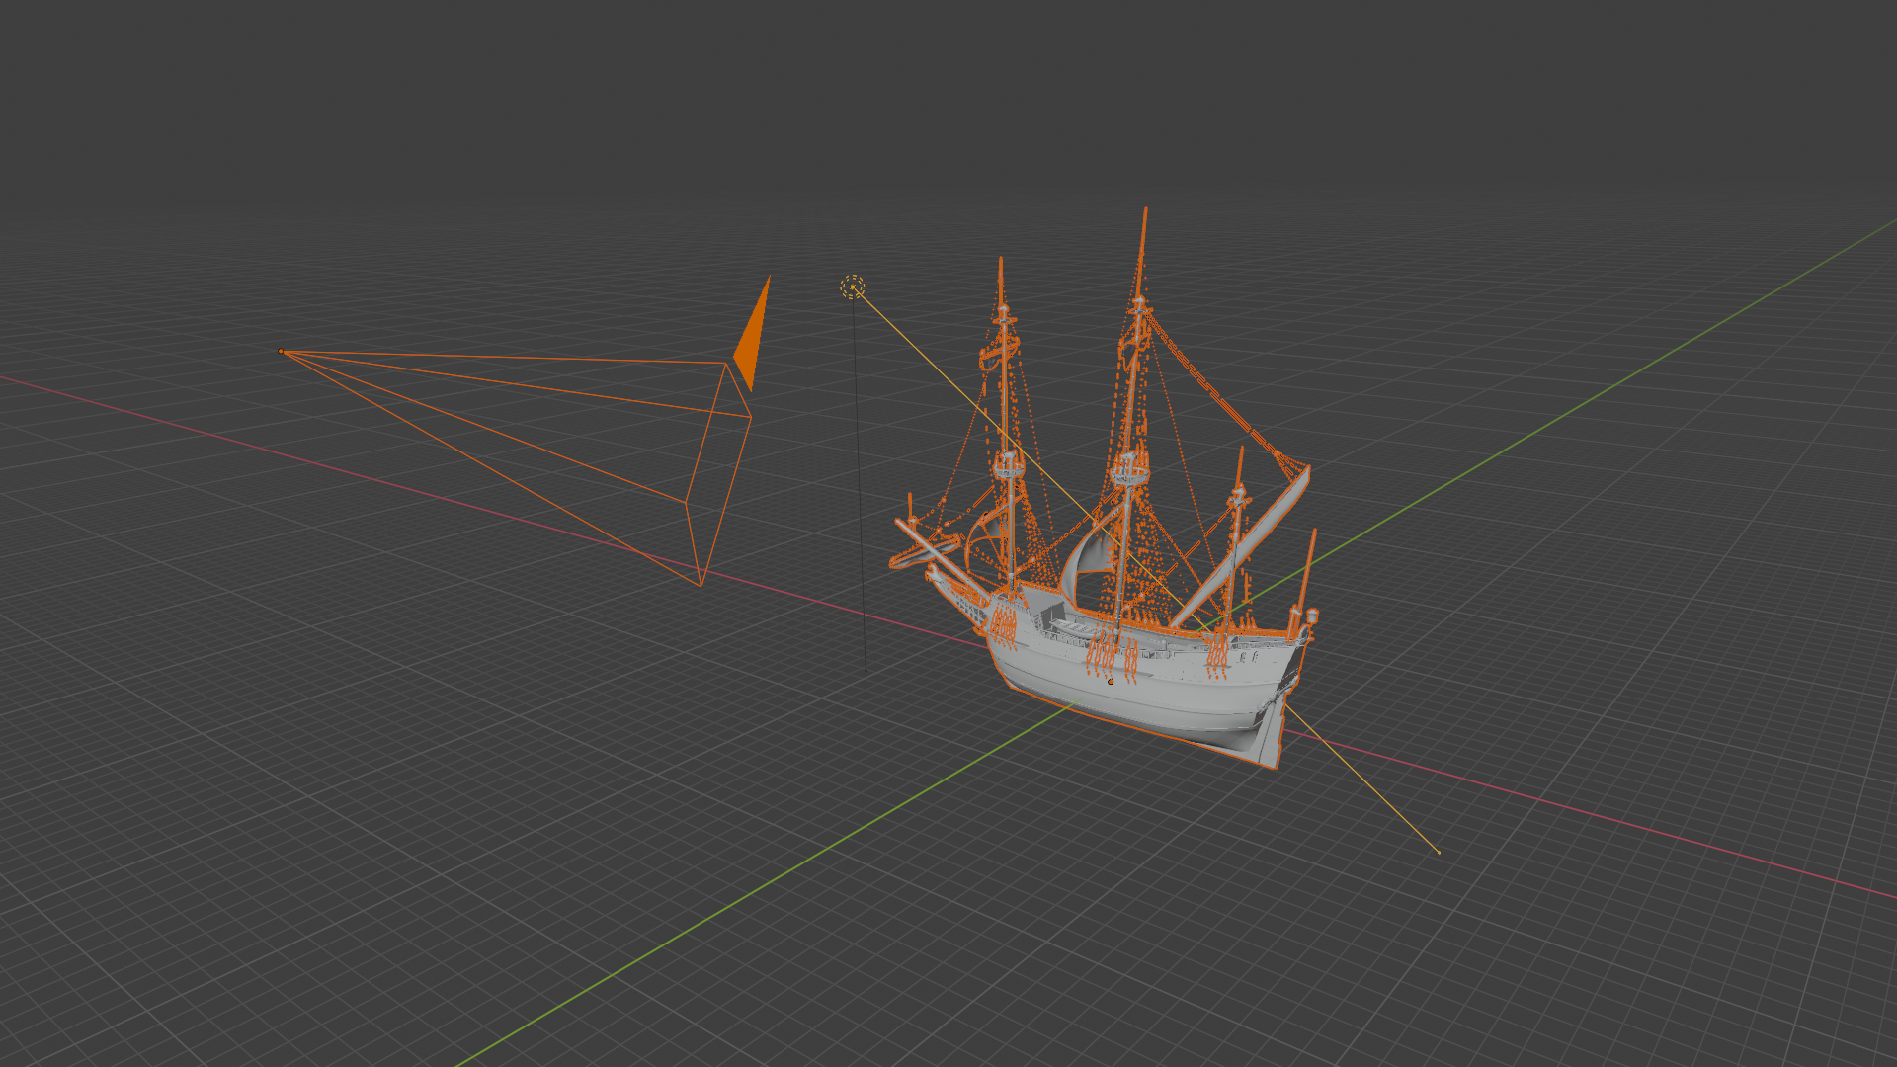
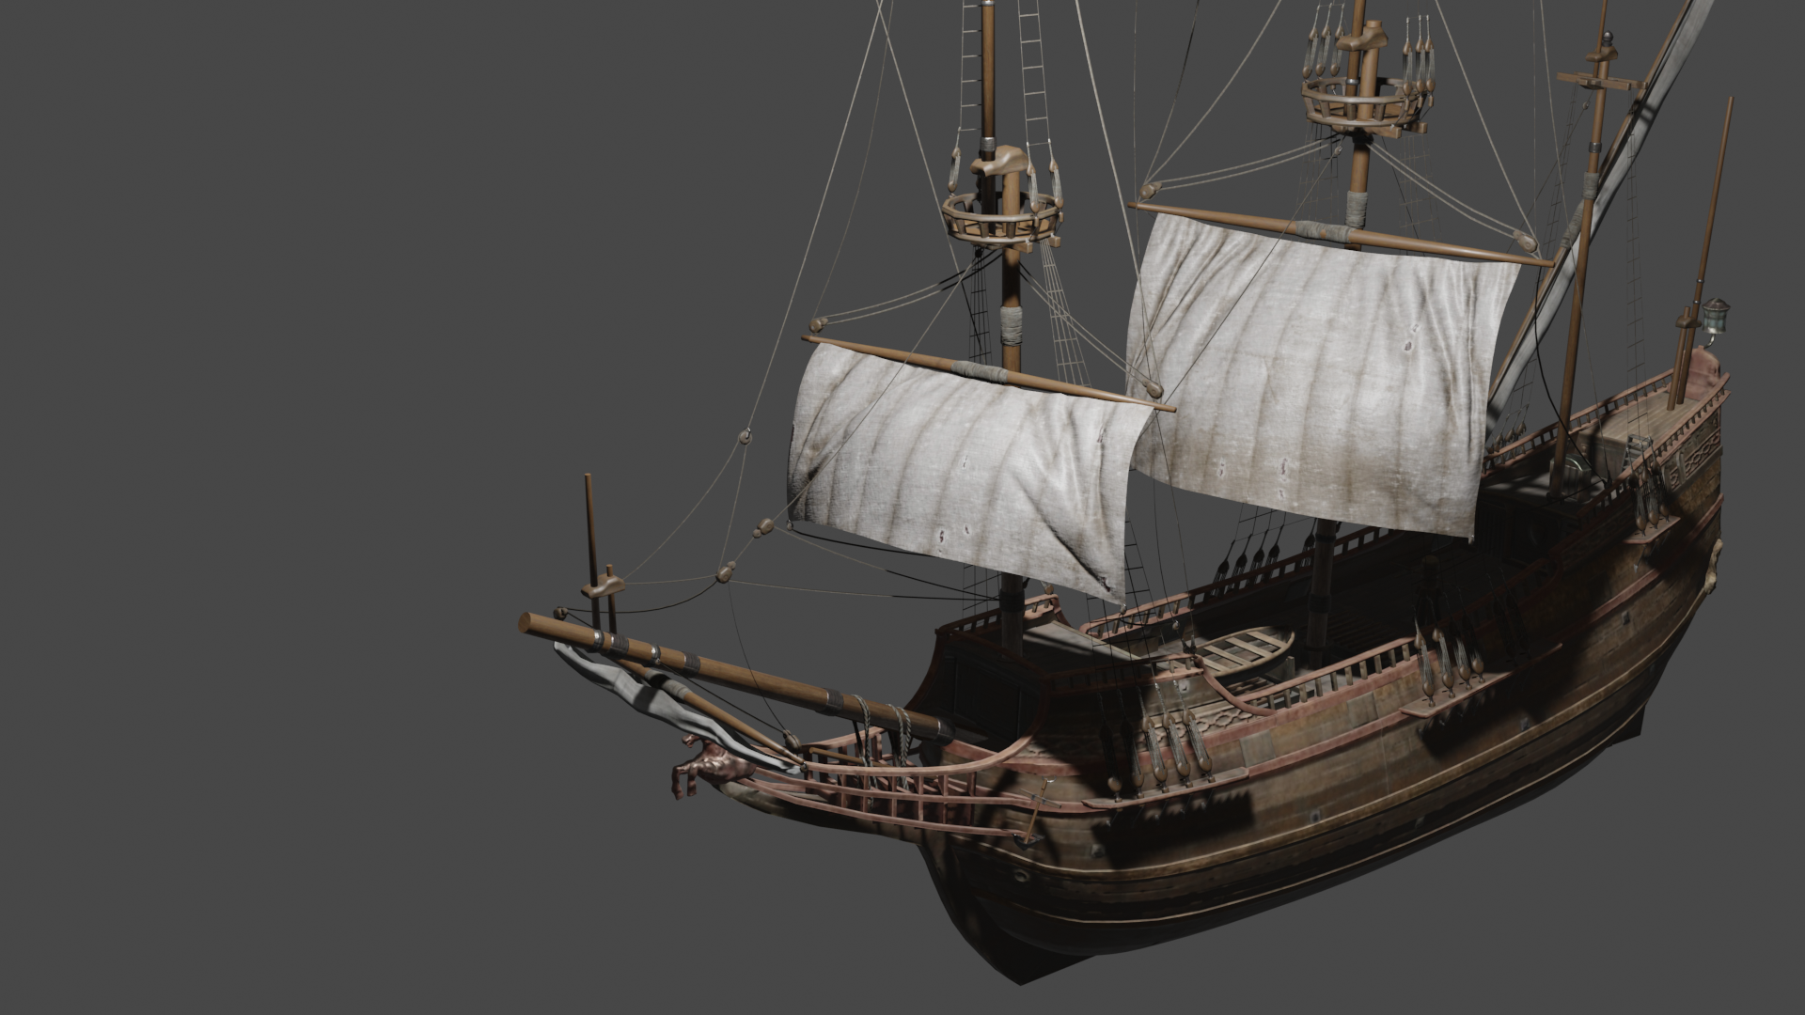
Rendering
Camera
Light
Object
Rendering: process of creating 2D image from 3D scene
Two main tasks of rendering:
  Visibility solving: compute objects visible from camera
  Shading: compute colors of visible objects
3D scene
2D image (render)

Slide 6
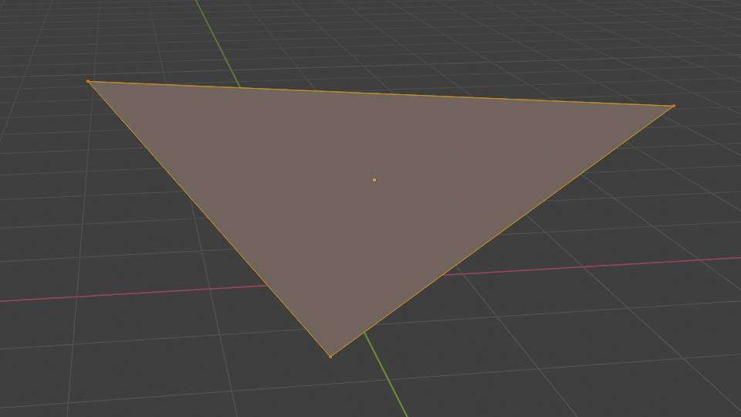
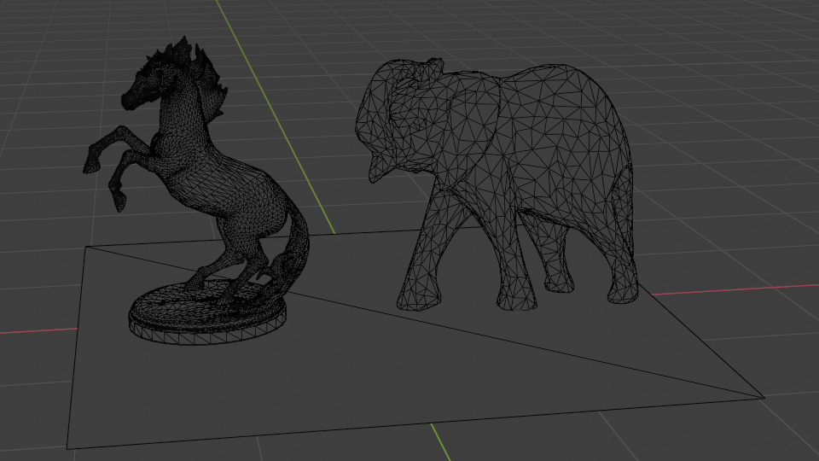
Visibility problem
Visibility is geometrical problem using object shape representation to determine which points in 3D scene are visible to each other
Triangulated mesh is shape representation used for efficient visibility solving
  Different shape representations can be converted to triangulated mesh using triangulation
Main approaches for solving visibility:
  Ray-tracing
  Rasterization

Slide 7
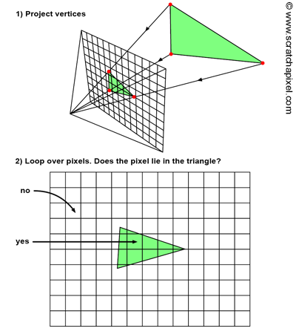
Rasterization: visibility solving
To find objects visible from camera, rasterization can be decomposed in two main stages:
  Triangle projection: project 3D vertices of mesh triangles onto image plane (aka screen) using perspective projection matrix
  Triangle rasterization: for each pixel of image plane check if it is contained in projected triangle

Slide 8
Rasterization: solution to visibility problem
TODO
Rendering: visibility and shading.
Raytracing-based rendering visibility
  Camera rays: which objects are visible from camera
  Secondary rays: which surfaces are visible to each other during light transport in shading phase
Rasterization is another method for computing visibility.
  Extremely efficient for finding objects that are visible from camera
  Not very good when it comes to visibility needed for light transport.
  Rasterization and ray-tracing should produce the same images until the point the shading is applied
Calculation of visibility using rasterizer as it was in raytracing-based rendering, relies on geometrical techniques

Slide 9
Reminder: ray-tracing
TODO
Reminder: ray-tracing-based rendering starts from image plane, generates rays which are traced into scene and tested for intersections. This method is call image centric and has two loops:
  Outer loop that iterates over all pixels (and generates ray)
  Inner loop that iterates over all objects in 3D scene (and tests for intersection)
Now it is very important to do a quick recap on object shape representation. We discussed that ray-tracing based rendering can work with any shape representation as long as intersection of ray and the shape in question is defined. We also concluded (as it is done by almost all professional software) that user should be provided with shape representations which are easy to work with while renderer should be provided with the shape information which is tractable for rendering process.
  Converting geometry to trangulated mesh makes process of rendering much simpler due to simplicity of triangle primitive.
  Therefore, the shape representation which is almost always used for rendering purposes is triangulated mesh. Thus our rendering primitive is triangle and we will assume we always have triangulated mesh when we discuss rasterization-based rendering.

Slide 10
Rasterization
TODO
To solve the visibility problem, rasterization takes the opposite approach to ray-tracing – it starts from objects (which are triangulated mesh) in 3D scene.
First, it projects triangles (which compose the object) onto image plane (e.g., perspective projection). This is done by multiplying triangle vertices with projection matrix.
  This will be done using perspective divide and remapping resulting coordinates to raster space.
Secondly, a method is employed to compute which pixels of image plane are covered by the projected triangles. This is done by looping all pixels in the image and test if they lie within 2D triangles.
The resulting pixels from rasterization are used for shading (which is separate process from rasterization)

Slide 11
Rasterization: algorithm
Projection step
for each triangle in the scene:
// STEP 1: project vertices using perspective projection
vector v0 = perspectiveProjection(triangle.v0);
vector v1 = perspectiveProjection(triangle.v1);
vector v2 = perspectiveProjection(triangle.v2);
for each pixel in the image:
// STEP 2: compute if pixel is contained in the projected triangle
if(pixelCointainedIn2DTriangle(triangle.v0, triangle.v1, triangle.v2,pixel.x, pixel.y):
image(pixel.x, pixel.y) = triangle.color
Rasterization step
Object centric approach: first loops over triangles, then loops over image pixels
Note: looping over all triangles in 3D scene and all pixels in image is computationally expensive: further optimizations are introduced (e.g., culling)

Slide 12
Rasterizer: hint on optimization
TODO
The naive implementation is looping through all pixels in the image even small numbers of pixels may be contained within triangle.
Solution to this problem is computing the bounding box around the projected triangle and iterating only over pixels in this bounding box*.
<IMAGE: bounding box>
Note: Idea of using bounding box to optimize algorithms that perform some kind of spatial search is often used in computer graphics. More general term for those are acceleration structures which are used in all stages of rendering.
* In practice, even more optimizations is performed, this is just a hint.

Slide 13
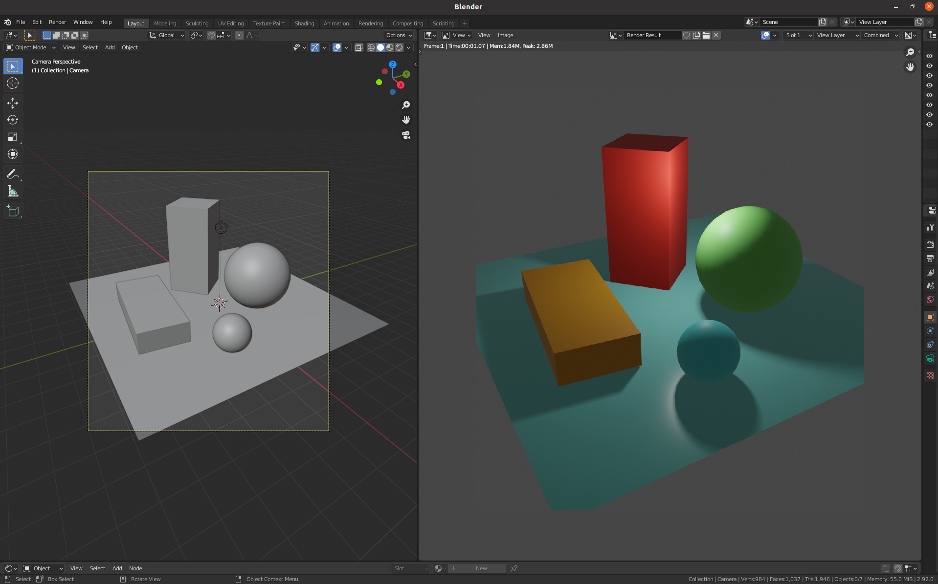
Rasterization: image and color buffer
Rasterization: process of decomposing triangles into pixels → raster image
During the process of rasterization, pixel color is stored in a color buffer – a 2D array of pixels
After rasterization, color buffer contains image ready for display
Before rendering, color-buffer is created with all pixels set to black color
During rendering, when triangles are rasterized, for each pixel that overlaps triangle store that triangle color in color-buffer at that pixel location
After rendering, when all triangles are rasterized and pixels are processed, the color-buffer will contain the final image of the scene
3D scene left. Color buffer, result of the rasterization-based rendering (right)

Slide 14
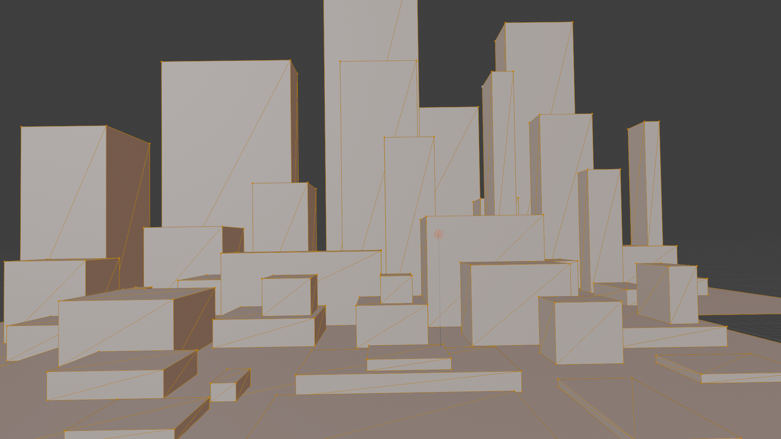
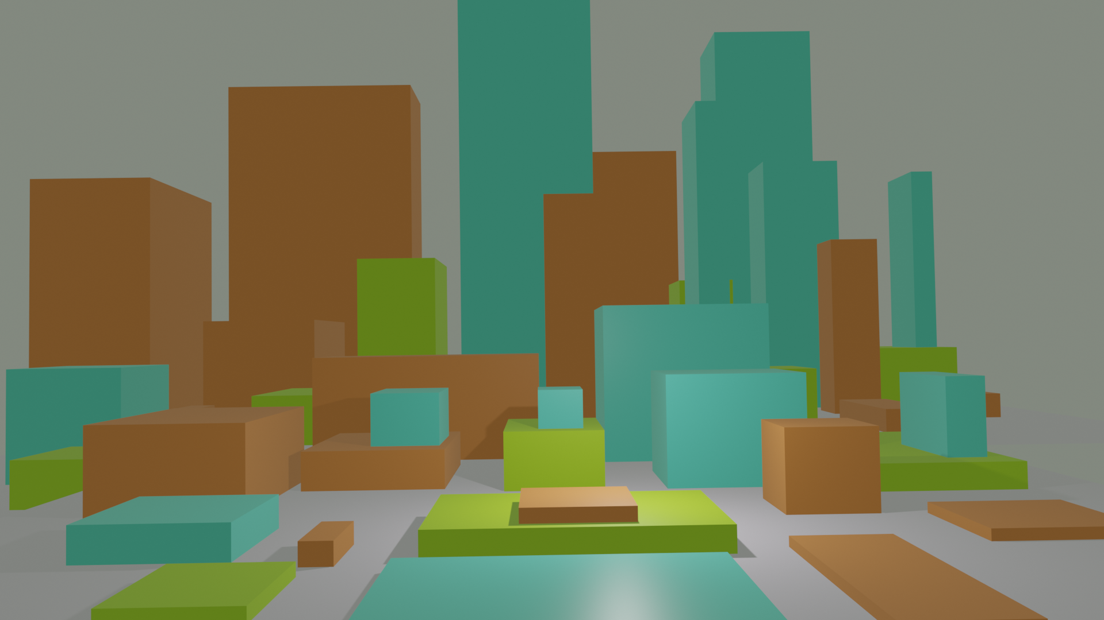
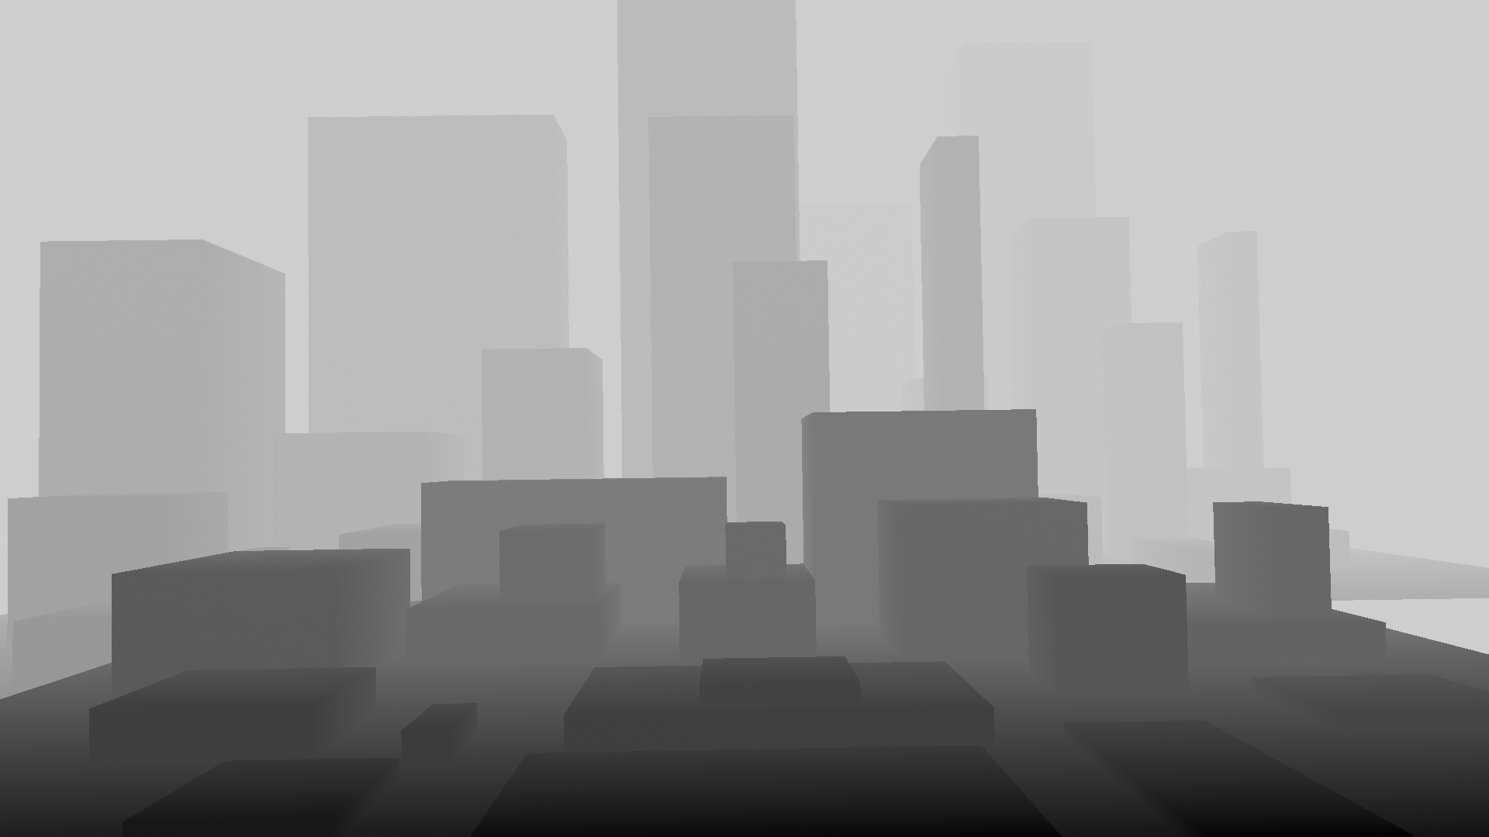
Rasterization: buffers
During rasterization-based rendering, various pixel information is stored in buffers
  Buffer: 2D array of pixels which has same size as final image
Framebuffer generally consists of all buffers on a system
  Multiple different buffers can be created during rasterization-based rendering for achieving various effects
Common buffers:
  Color buffer: 2D array containing colors of rasterized triangles
  Depth buffer aka z-buffer: 2D array containing depths of rasterized triangles
3D scene
Color buffer
Depth buffer

Slide 15
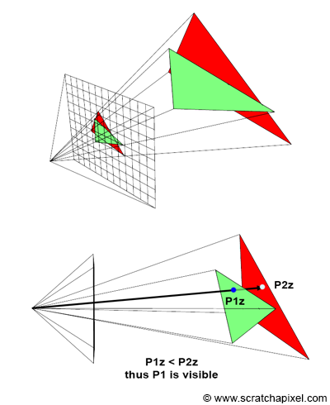
Rasterization: z-buffer
Multiple triangles may overlap the same pixel in image
To correctly solve visibility, rasterization must find the first visible triangle
This is done using z-buffer or depth buffer
  2D array with same dimensions as image but instead of colors it contains array of floating point numbers
  z-buffer stores the distance of each pixel to the nearest object in the scene

Slide 16
Rasterization: z-buffer
Multiple triangles may overlap the same pixel in the image
To solve visibility, that is find closest triangle, z-buffer is used:
  Before rendering z-buffer is initialized to a very large number
  When pixel overlaps triangle, compute distance to this triangle and compare it to the distance in z-buffer at that pixel position
  If distance to triangle is smaller then value in z-buffer, then triangle is visible for that pixel:
    Update z-buffer with this distance
    Update color-buffer with color of this triangle at this pixel position
Alternative visibility computation approach: Painter’s algorithm
  Sorting objects by distance

Slide 17
Rasterization: color-buffer and z-buffer
color color_buffer = new float[imageWidth, imageHeight];
float z_buffer = new float[imageWidth, imageHeight];
for (int i = 0; i < imageWidth * imageHeight; ++i):
color_buffer[i] = color(0,0,0);
z_buffer[i] = INF;
for each triangle in scene:
vector v0 = perspectiveProjection(triangle.v0);
vector v1 = perspectiveProjection(triangle.v1);
vector v2 = perspectiveProjection(triangle.v2);
float z;
if (pixelContainedIn2DTriangle(triangle.v0, triangle.v1, triangle.v2, pixel.x, pixel.y, z):
if (z < z_buffer(pixel.x, pixel.y)):
z_buffer(pixel.x, pixel.y) = z;
color_buffer(pixel.x, pixel.y) = triangle.color
Projection stage
Rasterization stage

Slide 18
Projection and rasterization
Projection stage
  Project triangle vertices from world space to image plane (screen) space and convert projected coordinates to raster space
    When triangle vertices are converted to same space as pixels it is possible to compare their coordinates
    This way, we can find which pixels are overlapping triangle knowing only vertex positions
Rasterization stage
  Loop over all pixels on image plane (screen) and determine which pixels are overlapping the triangle

Slide 19
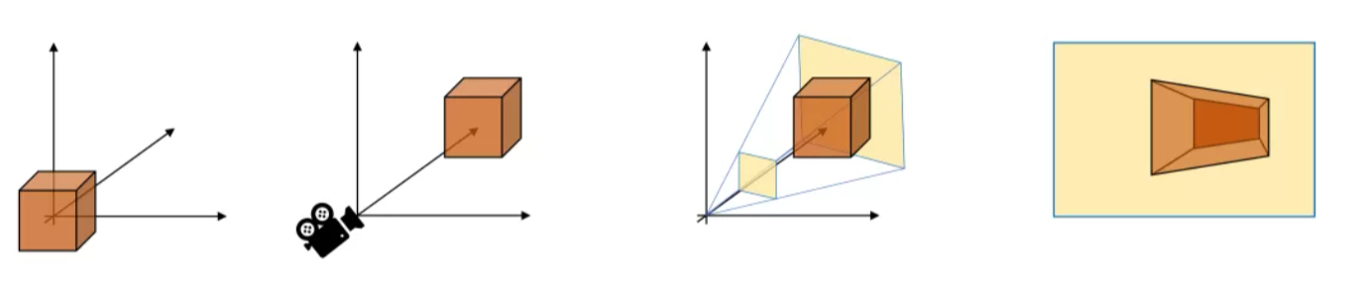
Projection stage
Projection stage is responsible for transforming triangle vertices from world space to raster space:
  1. World space to camera space
  2. Camera space to screen (image plane) space
  3. Screen space to normalized device coordinate (NDC) space
  4. NDC space to raster space
Object space
World space
Camera space
Screen space → NDC → raster space
Objects are originally defined in object space and then moved to world space.
Thus transformation from world space to camera and screen space, NDC and raster space is needed.

Slide 20
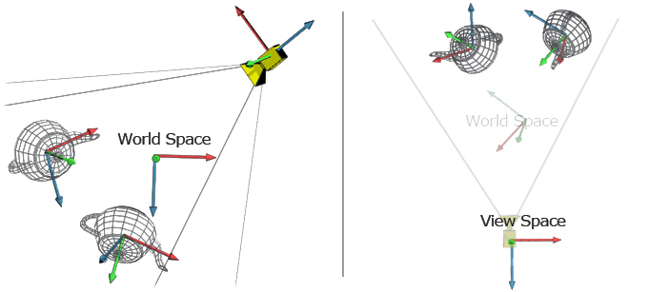
1. World to camera (view) space
All triangles (object triangulated mesh) and camera are initially positioned in world space
Transform all triangle vertices P_{world}(x,y,z) and camera so that camera is in origin, faces negative z, y points up and x points right → view transform
After view transformation triangle vertices are in camera space P_{camera}(x,y,z)
http://www.codinglabs.net/article_world_view_projection_matrix.aspx

Slide 21

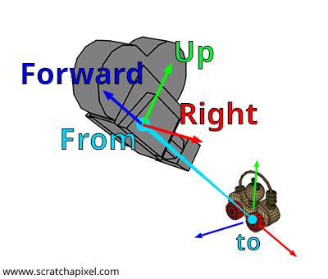
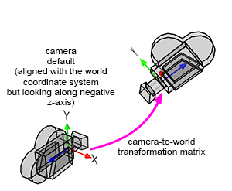
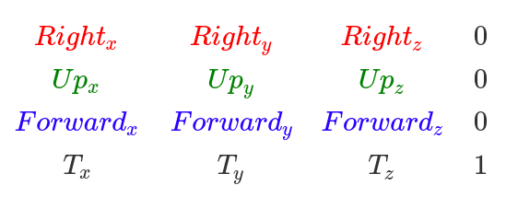
View transformation
View transformation is done using world-to-camera matrix
World-to-camera transformation matrix can be constructed using look-at notation
inverse
M_{camera-to-world}=
Forward = normalize(From – To)
Right = crossProduct(randomVec, Forward)
Up = crossProduct(forward, right)
Reading: https://www.scratchapixel.com/lessons/3d-basic-rendering/computing-pixel-coordinates-of-3d-point/mathematics-computing-2d-coordinates-of-3d-points.html

Slide 22
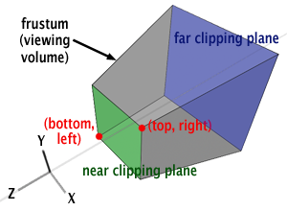
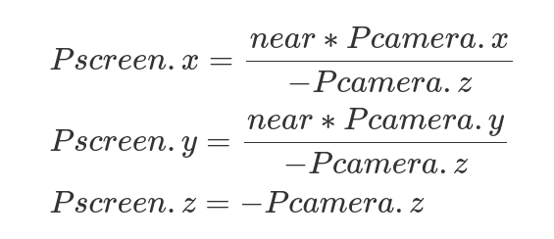
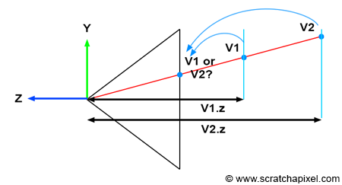
2. Camera to screen space
Project camera space vertex coordinates P_{camera}(x,y,z)to screen (image plane) coordinates P_{screen}(x,y,z)
Perspective projection is used to transform points → perform perspective divide
Image plane is positioned at near clipping plane at distance near → multiply with near
Points in screen space P_{screen}(x,y,z) are still 3D:
(x,y) coordinates have undergone a perspective distortion
z contains original vertex distance from camera → this will be needed for resolving visibility and overlapping triangles

Slide 23
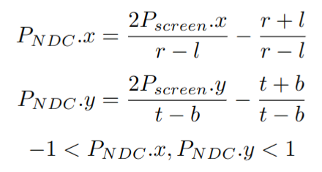
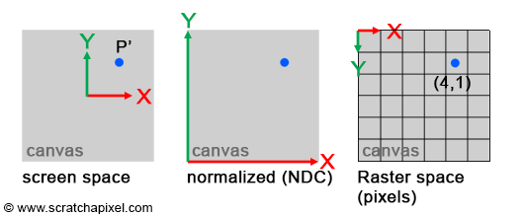
3. Screen to NDC space
NDC space coordinates are in range:
  [left,right] → [l,r] for x coordinate
  [bottom, top] → [b,t] for y coordinate
GPU and real-time rendering standard (e.g., OpenGL, DirectX): NDC is [-1,1] for both coordinates
(x,y) coordinates from screen space are converted NDC space using:
Left, right, bottom, top are coordinates of the image plane (screen)
Z coordinate is remapped to [0,1] or [-1,1]
  If P lies on near clipping plane then remap to 0 (or -1)
  If P lies on far clipping plane then remap to 1

Slide 24
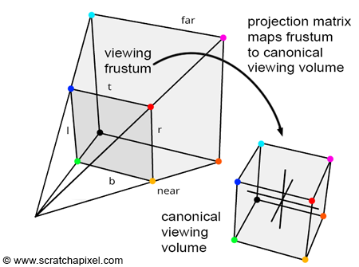
Note: Screen and NDC space
Transforming vertices into screen space and further to NDC space normalizes viewing frustum into canonical view volume a unit cube with extreme points at (-1, -1, -1), (1,1,1)

Slide 25
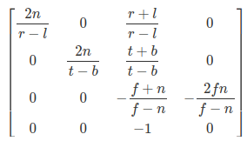
Note: Screen and NDC space
Conversion of vertex coordinates from camera space to NDC space can also be done using projection matrix, which contains:
  Perspective divide operation
  Remapping from screen to NDC space
Perspective projection matrix is built using far (f), near (n), right (r), left(l), top (t), bottom (b) parts of view frustum which can be calculated using angle of view and image aspect ratio.
Read: https://www.scratchapixel.com/lessons/3d-basic-rendering/perspective-and-orthographic-projection-matrix/projection-matrix-introduction.html

Slide 26
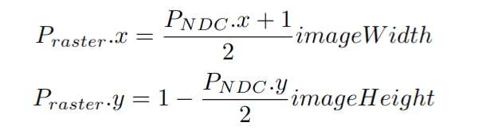
4. NDC to raster space
Converting coordinates from NDC to raster space (integer pixel coordinates) requires remapping from [-1,1](float) to [imageWidth, imageHeight](int)
Note: In raster space the y-axis goes down while in NDC space it goes up. Therefore, change y direction during remapping process

Slide 27
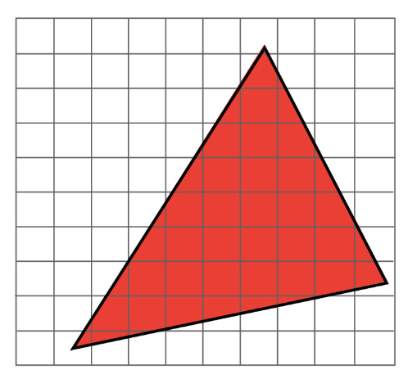
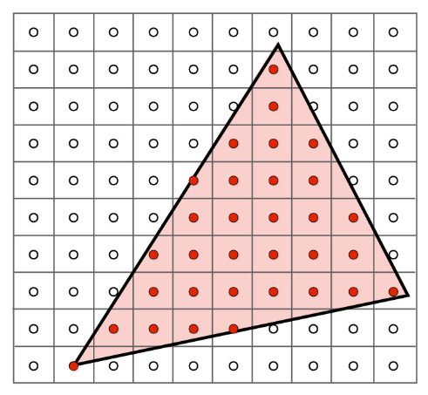
Projection and rasterization
Projection stage
  Triangle vertex coordinates (x,y) are now converted to same space as pixels (raster space), z value contains depth
  Now it is possible to compare pixel and vertex coordinates in order to find which pixels are overlapping triangle
    This way, whole triangle can be rendered knowing only vertex positions
Rasterization stage
  Loop over all pixels in image plane and determine which pixels are overlapping the triangle

Slide 28
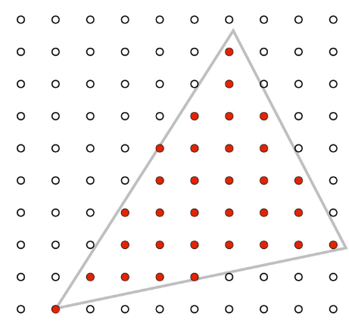
Triangle rasterization
Goal: convert projected triangle to a 2D image:
  Loop over all pixels in 2D image to determine which pixels overlap the projected triangle
    Inside-outside (aka coverage) test
    Alternative method: scanline rasterization → based on Bresenham algorithm for drawing lines
  For each pixel that overlaps triangle, compute:
    Barycentric coordinates
    Interpolated depth
    Etc.
Needed for visibility and shading

Slide 29
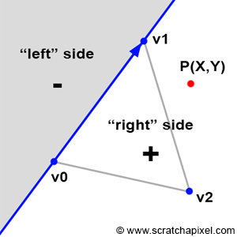
Inside-outside test: edge function
Triangle edges can be seen as lines splitting planes
Edge function E₀₁(P) returns (clockwise winding of triangle vertices):
  Negative number if point P is on left side of the line
  Positive number if point is on the right side of the line
Edge function interpretation:
Magnitude of cross product between (v1-v0) and (P-v0)
Determinant of 2x2 matrix defined with components of vectors (v1-v0) and (P-v0)
Reading: https://www.scratchapixel.com/lessons/3d-basic-rendering/rasterization-practical-implementation/rasterization-stage.html

Slide 30
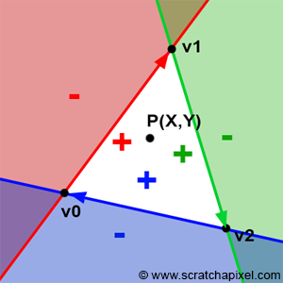
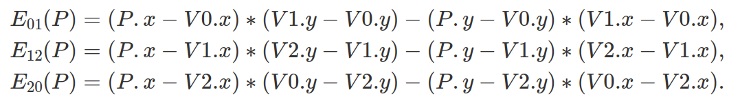
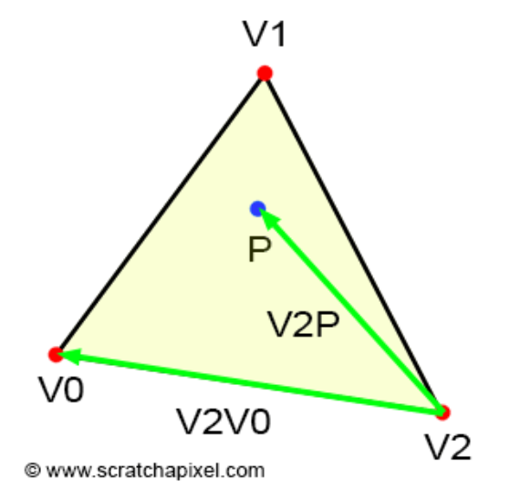
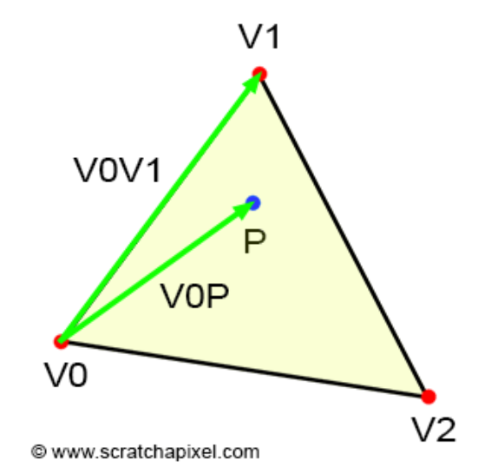
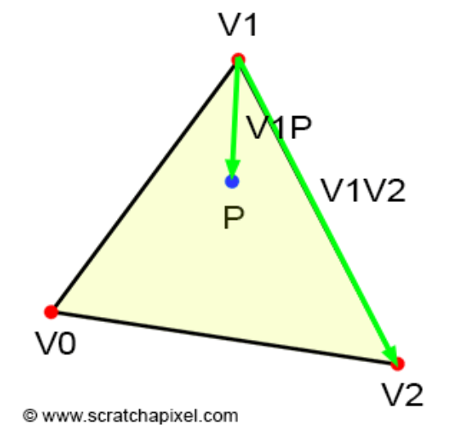
Inside-outside test: edge function test
Loop over all pixels in 2D image:
  Pixel position P(x,y) must be tested for all 3 triangle edges
  If edge function returns positive value for all edges, then pixel position is inside triangle
Note: winding order of triangle matters
  For counterclockwise winding, the sign of edge function is inverted

Slide 31
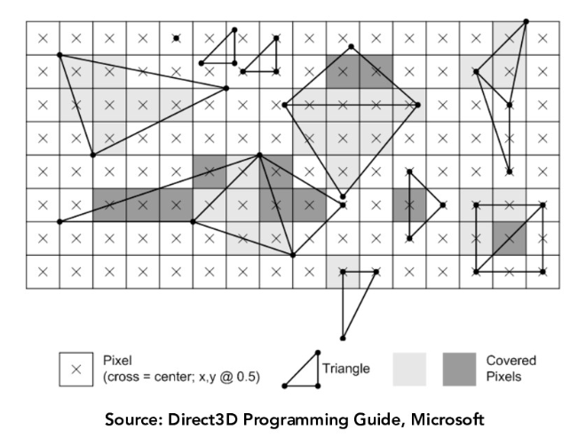
Inside-outside test: example
Testing if pixel is overlapping the triangle

Slide 32
Depth and visibility
Once it is determined that pixel is inside the triangle, check if it is visible
If pixel overlaps two or more triangles use z-buffer for visibility solving
  Compare current z-coordinate (depth) of pixel overlapping the triangle with value stored at z-buffer at that pixel position
  If current depth value is smaller than value from z-buffer, update color-buffer with color of current triangle and z-buffer with depth of current point on triangle
To find depth values for pixel overlapping the triangle, barycentric interpolation of depth values stored per triangle vertices is used.

Slide 33
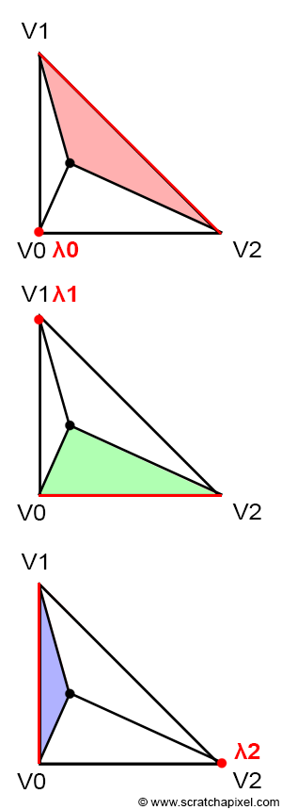
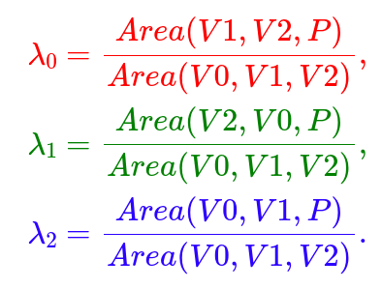

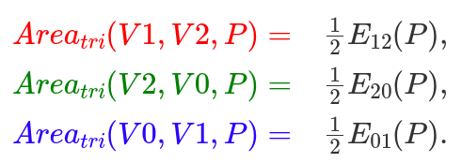
Barycentric coordinates and edge function
P
Barycentric (λ₁, λ₂, λ₃) coordinates can be used to define any point on the triangle.
  Can be computed as the ratio between area of sub-triangles and the whole triangle.
  Area of sub-triangle is calculated using edge function.
P
P

Slide 34
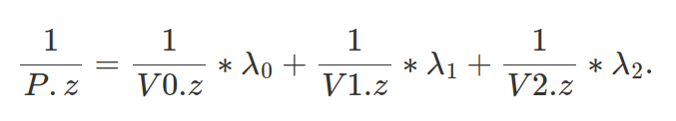
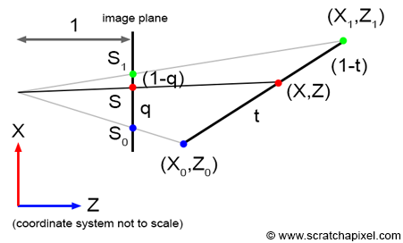
Depth and barycentric interpolation
For current pixel overlapping triangle, z-value is found using barycentric interpolation
  In projection stage, original camera space z-coordinate is stored for each vertex of a triangle
Problem: perspective distortion: perspective projection preserves lines but not distances
Solution: perspective correct barycentric interpolation: compute the inverse of P z-coordinate
Perspective projection doesn’t
preserve distances.

Slide 35
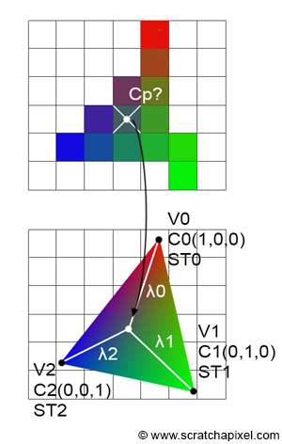

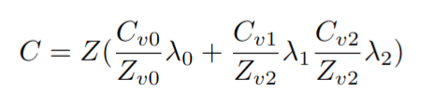
Vertex attributes and barycentric interpolation
Triangle vertices can also have assigned vertex attributes: colors, normals, texture coordinates, etc.
Vertex attributes are used during shading of pixels overlapping the triangle
Barycentric coordinates (λ₁, λ₂, λ₃) are used to interpolate vertex attributes for any pixel overlapping the triangle
Due to distortion introduced by perspective projection, it is required to preform perspective correction for vertex attribute interpolation
Example: interpolating color at point P where each vertex has color attribute: C_{v0},C_{v1},C_{v2}
P
C_{v0} = (1,0,0)
C_{v1} = (0,1,0)
C_{v2} = (0,0,1)
Z – current pixel depth
Z_{v0}, Z_{v1}, Z_{v2} – triangle vertices depth

Slide 36
Barycentric coordinates: perspective correct interpolation
Due to distortion introduced by perspective projection, it is required to preform perspective correction for vertex attribute interpolation
Example: perspective correct color vertex attribute interpolation
Z – current pixel depth
Z_{v0}, Z_{v1}, Z_{v2} – triangle vertices depth
C_{v0}, C_{v1}, C_{v2} – triangle vertices colors

Slide 37
Raytracing vs rasterization
TODO
Both algorithms are solving visibility
Both are in principle simple
In ray-tracing, computing ray is easy but computing intersection of ray with object is complex
In rasterization, vertices of triangles are projected which is simple and fast as well as finding pixels covered by those triangles.
When it comes to shading, ray-tracing-based approaches have more information to work with and are more intuitive way of producing advanced effect inherently.

Slide 38
Rasterization-based rendering on GPU
Rasterization is elegant algorithm for solving visibility:
  Projecting vertices of triangulated mesh onto image plane
  Looping over image pixels to find which pixels lie in projected triangle
Both tasks are well suited for GPU and can be performed fast
  GPU rendering uses rasterization approach for solving visibility
  GPU rendering is conceptually described with graphics rendering pipeline with rasterization as one module of the pipeline
  Graphics rendering pipeline is foundation for real-time rendering

Slide 39
Rasterization-based rendering on GPU
Rasterization-based rendering technique is deeply integrated in GPU hardware for rendering. Raytracing-based rendering is purely implemented on CPU.
Rasterization-based rendering can also be completely implemented on CPU. For learning purposes this is useful to understand all the aspects of it. There are some special use-cases which also benefit from CPU implementation of rasterization based-rendering*.
Almost all professional software which uses rasterization-based rendering is using GPU hardware implementation which can be further programmed using graphical APIs such as OpenGL, Vulkan, DirectX, Metal, etc.
TODO
* Cases when objects that are rendered are smaller than pixel. Those are advanced topics and are related to point rendering (https://www.cg.tuwien.ac.at/research/publications/2022/SCHUETZ-2022-PCC/) or micropolygon rendering (https://docs.unrealengine.com/5.0/en-US/nanite-virtualized-geometry-in-unreal-engine/ or https://graphics.pixar.com/library/Reyes/)

Slide 40
Graphics rendering pipeline: conceptual overview
Using rasterization for rendering on GPU

Slide 41
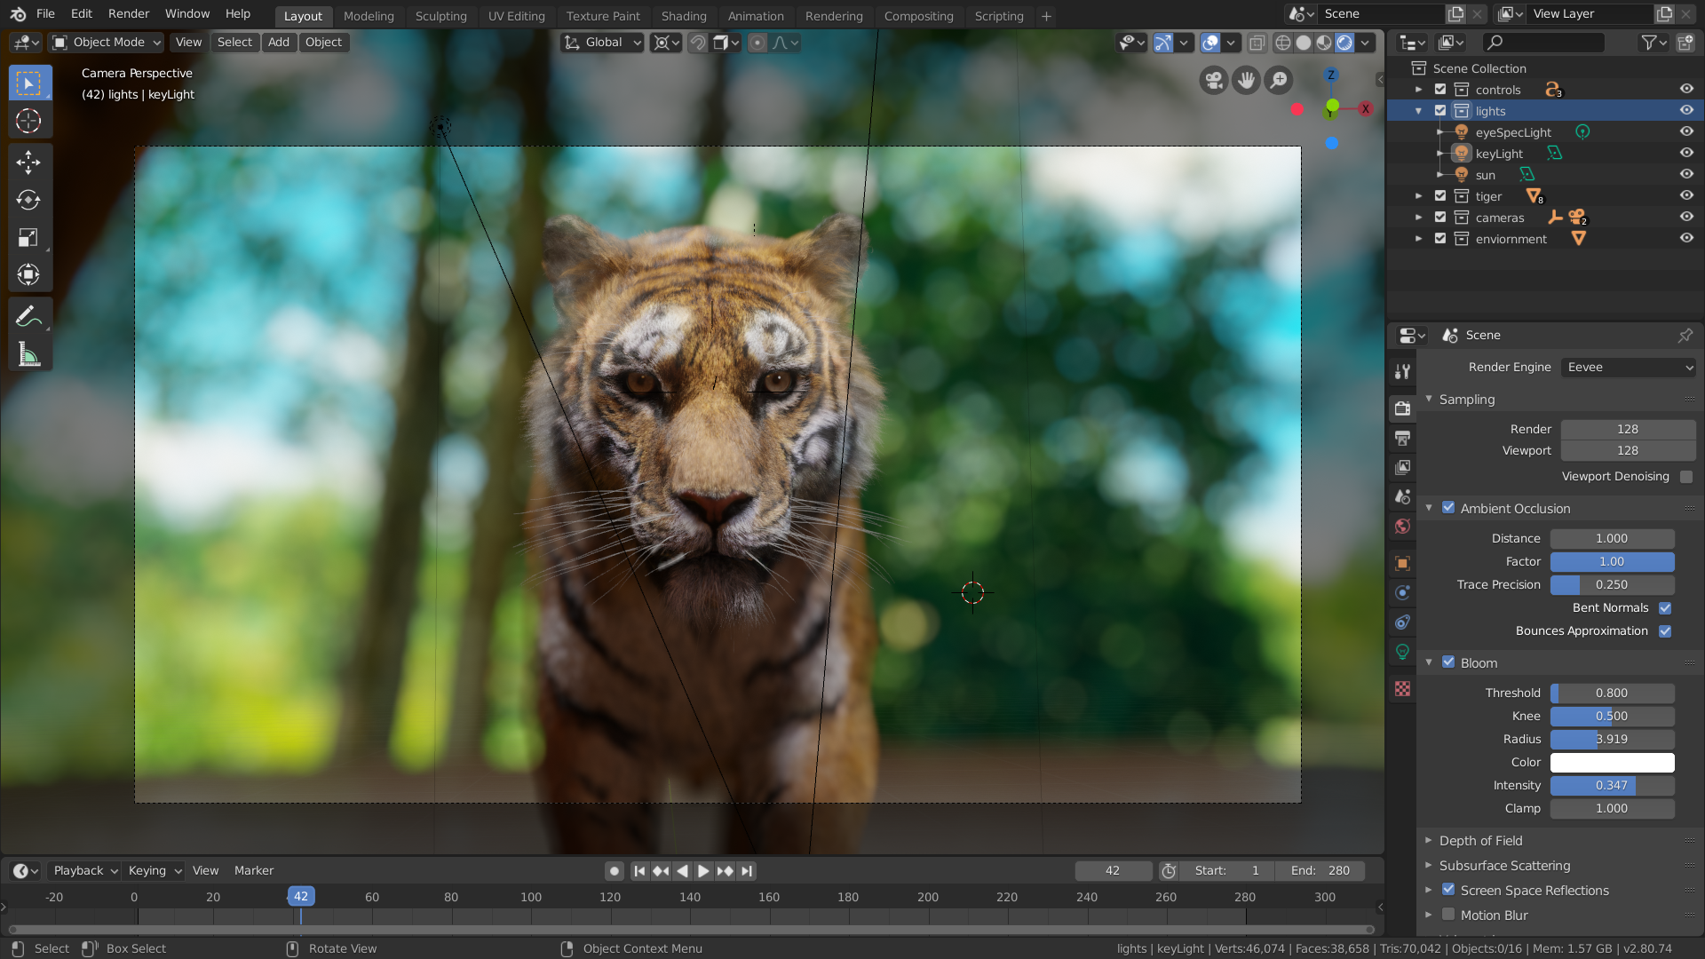
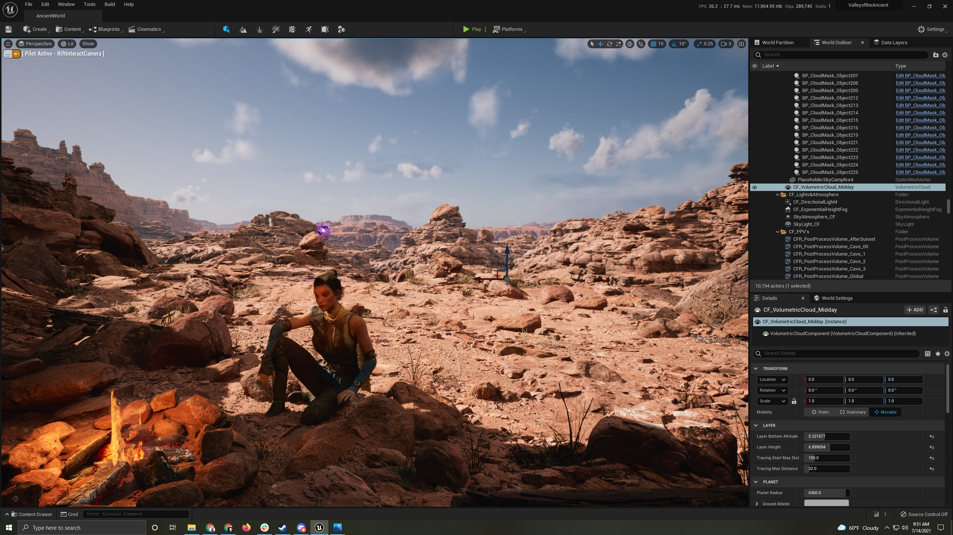
Motivation
Rasterization is deeply integrated in GPU hardware for rendering.
Graphics rendering pipeline conceptually describes rasterization-based rendering on graphics processing unit (GPU)
It is used for:
  Real-time rendering applications
  Interactive rendering applications
  Games, modeling, visualization, etc.
  VR, AR, etc.
Blender, EEVEE:
https://docs.blender.org/manual/en/latest/render/eevee/introduction.html
Unreal engine: https://docs.unrealengine.com/4.27/en-US/
GPU – graphics processing unit, term coined by NVIDIA to differentiate GeForce 256 from previous rasterization chips. From then on, this term is still used.

Slide 42
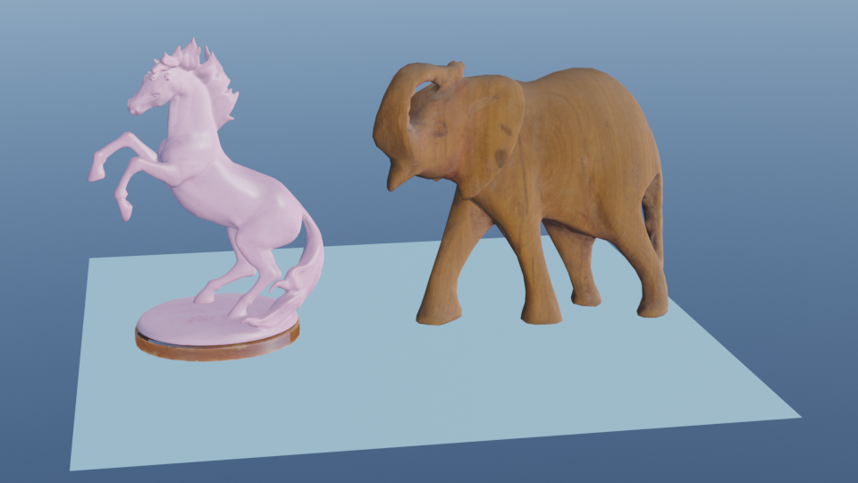
A intro note
For graphics rendering pipeline, we assume that all objects in 3D scene, that is, their shape is triangulated mesh.
When describing graphics rendering pipeline, we will then focus on one triangle or one vertex – but keep in mind that this is also done for all triangles for all objects/models in 3D scene

Slide 43
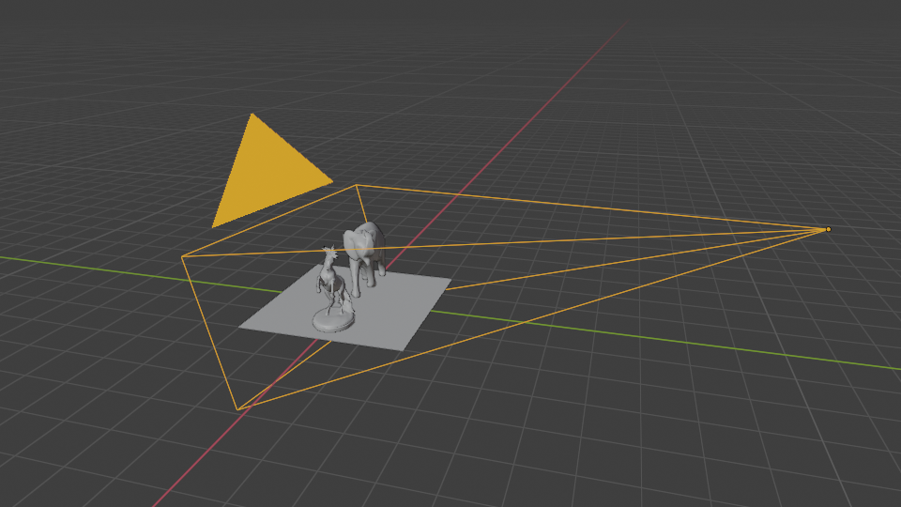
Graphics rendering pipeline
Main function of graphics rendering pipeline: generate a 2D image from 3D scene
Rendering:
  Visibility calculation: which objects are visible from camera
  Shading calculation: computing color of visible objects that is light-matter calculation and light transport

Slide 44
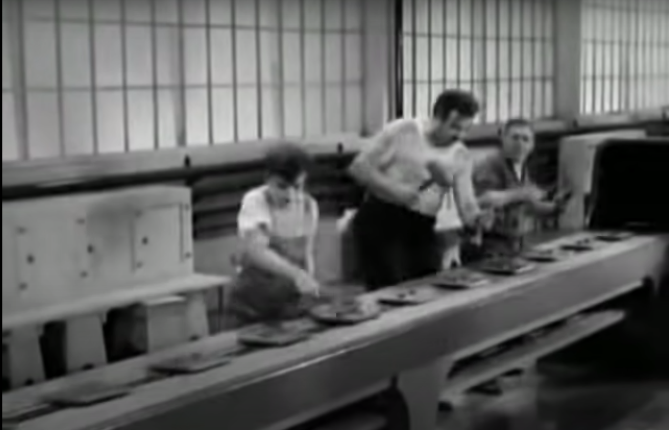
Graphics rendering pipeline
Graphics rendering pipeline is decomposed in smaller steps or stages
  Each stage performs part of a larger task
  Input of any given stage depends on the output of previous stage
Sequence of stages forms rendering pipeline
  Pipeline stages, although working in parallel, are stalled until slowest stage is finished
  Slowest stage is said to be bottleneck
  Stages which are waiting are called starved

Slide 45
Pipeline description
Pipeline can be described using different abstractions levels:
  Functional/conceptual stages – describes tasks that rendering pipeline must perform but not how
  Physical/Implemented stages – describes how are functional stages implemented in hardware. Physical model is up to the hardware vendor (e.g., nvidia, AMD, Intel, etc.)
  Logical model of GPU –describes rendering pipeline interface exposed to a programmer by API

Slide 46
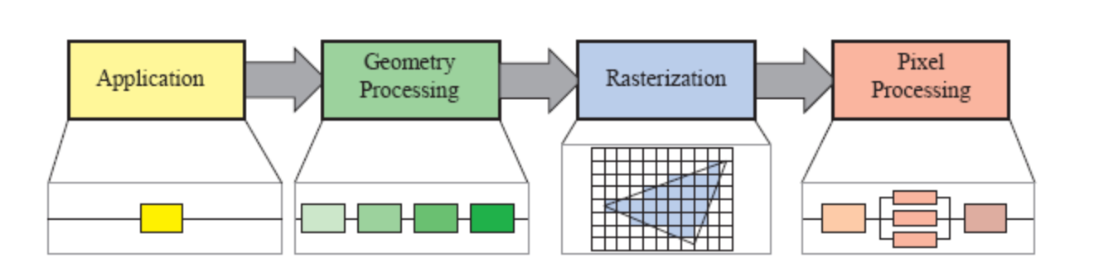
Graphics rendering pipeline: conceptual stages
Graphics rendering pipeline can be conceptually divided in four stages.
Stages can be:
Fixed (no programmer control)
Partially configurable (control over parameters)
Fully programmable (shaders)
Trend is towards programmability and flexibility.
May consists of several sub-stages
May be partly parallelized
https://www.realtimerendering.com/

Slide 47
Graphics rendering pipeline: conceptual vs logical (API) model
Graphics rendering pipeline
Application
Geometry processing
Rasterization
Pixel processing
Application
Vertex
shader
Tessellation
shader
(Optional)
Geometry
Shader
(Optional)
Clipping
Screen mapping
Triangle setup
Triangle
traversial
Pixel shader
Merging
Compute shader
Programmable
- Conceptual/functional abstraction
Configurable
Fixed
- Logical model of GPU - API

Slide 48
Pipeline: CPU and GPU
CPU
GPU
CPU implements application stage.
  CPUs are optimized for various data structures and large code bases, they can have multiple cores but in mostly serial fashion (SIMD processing is exception)
GPU implements what is conceptually describes as geometry processing, rasterization and pixel processing stage.
  GPUs chips contain large set of processors called shader cores – small processors that do independent and isolated task (no information sharing and shared writable memory) in a massively parallel fashion.
  Different types of programmable shaders enable controling GPU rendering.

Slide 49
Pipeline: speed run
Application stage (CPU)
  Driven by application implemented in software running on CPU, e.g., 3D modeling tool application
  3D scene elements are defined here: objects (geometry, material), cameras, lights
Geometry processing (GPU)
  Per-triangle or per-vertex operations: transformations, projections; what, how and where it is drawn
  Implemented on GPU that contains many programmable shader cores
Rasterization (GPU)
  Takes 3 vertices which form a triangle, finds all pixels inside triangle and forwards them to next phase
  Fixed implementation on GPU
Pixel processing (GPU)
  Shading operation per pixel: calculating color and depth testing → programmable GPU shading cores
  Per-pixel operations, e.g., blending new and old pixel color → partially configurable

Slide 50
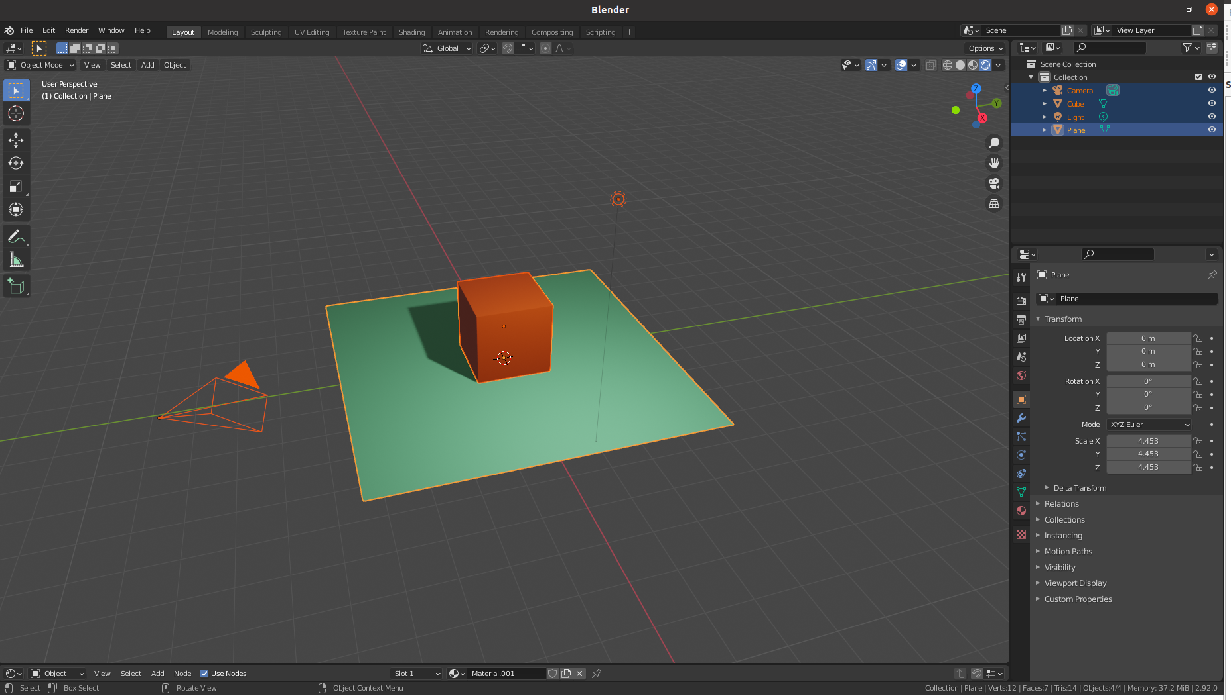
Pipeline example: 3D modeling program
Application stage:
  Enables user to select and move parts of the model and/or camera using mouse/keyboard
    Translate user input into transformation matrices (e.g., translation or rotation)
  For each frame (interactive modeling) provide information to next stages for rendering: camera position, lighting and triangles of the model.
Geometry processing
  Use camera information and object transformation matrices to transform object triangles in view (camera) space
  Project object triangles onto image plane (screen) space. Triangles not visible to camera are discarded
  Finally, vertices are mapped into the raster space
Rasterization
  All triangles coming from geometry stage are rasterized: all pixels (fragments) inside a primitive are found and sent for pixel processing
Pixel processing
  Color of each pixel obtained from rasterization is computed using material and light information (colors, textures, shading equations) and visibility is resolved using z-buffer algorithm with optional discard and stencil testing.
  Each object is processed and final image is displayed.

Slide 51
1. Application stage

Slide 52
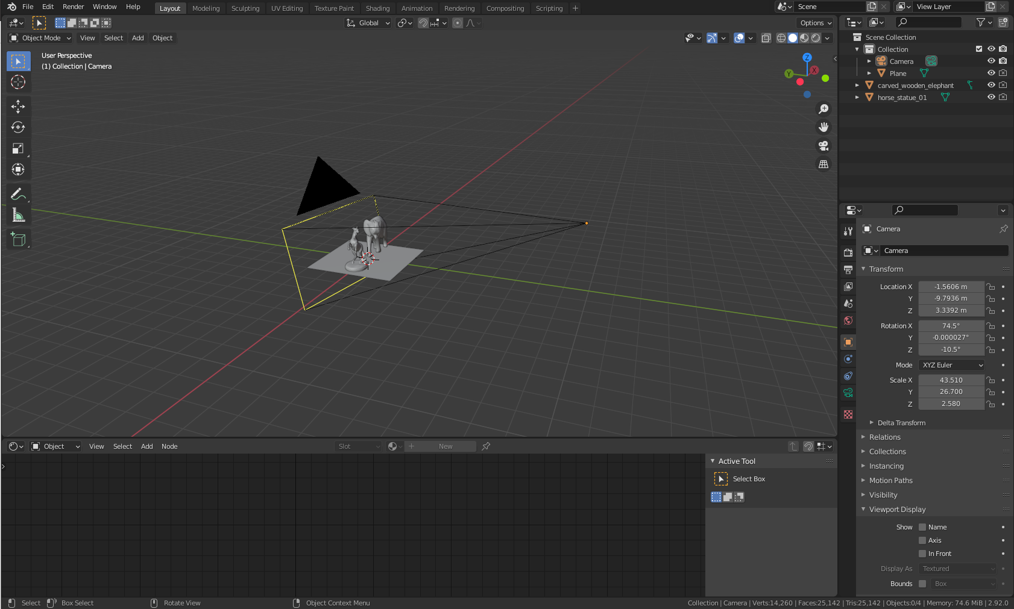
1. Application stage
Driven by application (e.g., 3D modeling application)
Typically implemented on CPU (optionally on multiple threads)
Developer has full control over what happens in this stage and how is what implemented
Software-based implementation: not subdivided into stages

Slide 53
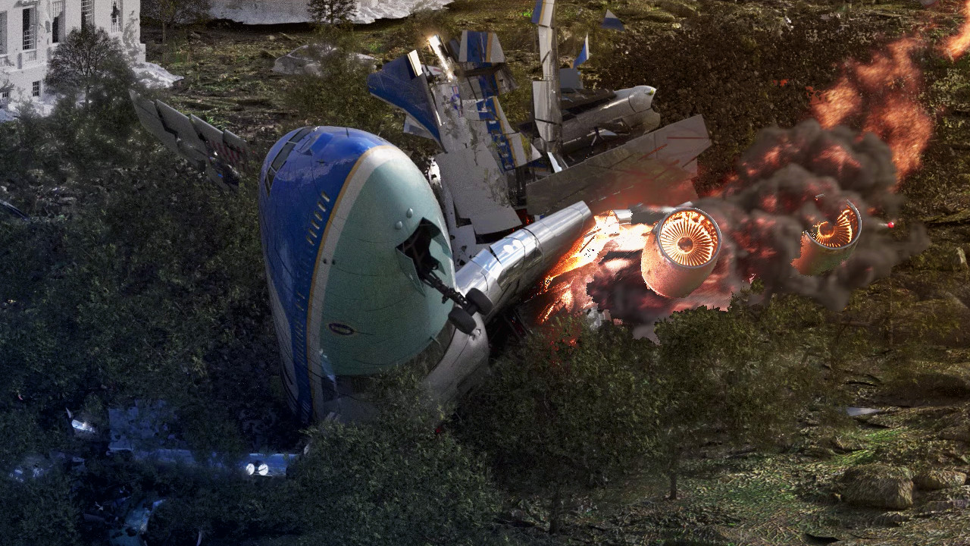
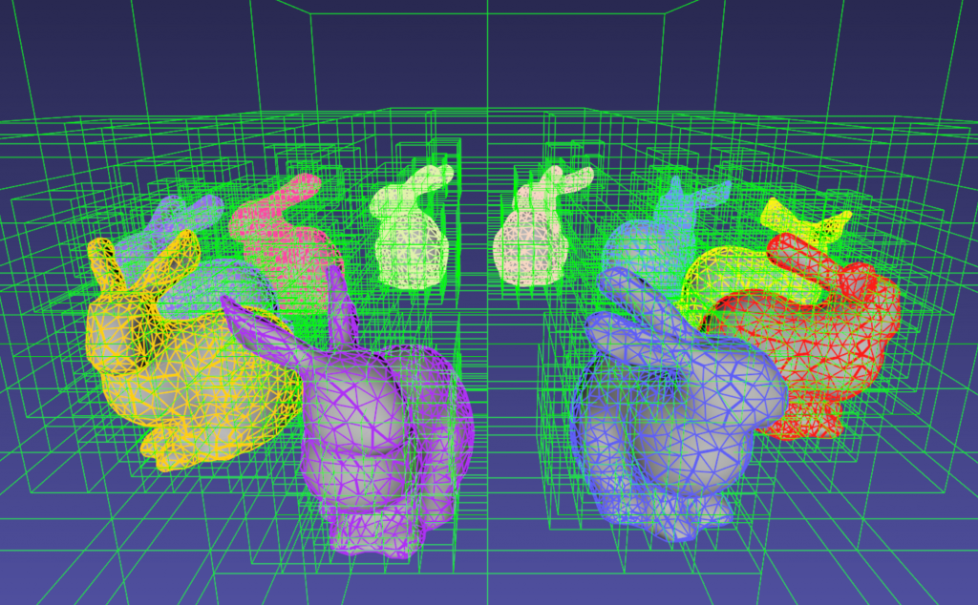


Application stage tasks
Application stage includes tasks such as:
  Taking care of user input from keyboard, mouse, etc. for interaction
  Animation
  Physics simulation
  Collision detection – detection of collision between two objects and generating response
  3D scene acceleration structures (e.g., culling algorithms)
  Compositing
  Other tasks depending on application which subsequent stages of pipeline can not handle
User input
Physics simulation
Collision and acceleration data structures
Animation
Compositing
https://www.kitware.com/octree-collision-imstk/
https://www.blender.org/features/

Slide 54

Application stage: scene definition
On application stage elements of 3D scene to be rendered are defined:
  Objects:
    Geometry (shape representation): triangulated mesh, vertices, normals, texture coordinates per vertex
    Transformation matrices
    Material parameters (e.g., color, roughness, normal map, etc.) → per vertex
  Cameras
    Transformation matrix (e.g., transformation build using look at notation)
    Camera parameters (e.g., focal length)
  Lights
    Position and/or direction (transformation matrices or vectors)
    Intensity, color
    Shape, size (geometry)
Light
Camera
Object

Slide 55


Application stage: compute shader
Some work on application stage can be sent to GPU for processing – compute shader.
  Idea treat GPU as highly parallel general processor rather than rendering pipeline processor
Particle simulation using compute shader:https://arm-software.github.io/opengl-es-sdk-for-android/compute_particles.html
Compute shaders for point clouds animation:https://catlikecoding.com/unity/tutorials/basics/compute-shaders/

Slide 56

Compute shader
https://vkguide.dev/docs/gpudriven/compute_shaders/
https://vulkan-tutorial.com/Compute_Shader
https://learnopengl.com/Guest-Articles/2022/Compute-Shaders/Introduction
Compute shader is form of GPU computing which is not necessary rendering
  CUDA and OpenCL are used to control the GPU as massive parallel processor
It is closely tied to the graphics rendering but not locked into a specific location in the graphics pipeline
  It is used alongside vertex, pixel and other shaders
Can be used for:
  Post-processing: modifying rendered image with certain operations
  Particle systems: computing behavior of particles
  Mesh processing: facial animation
  Culling
  Image filtering
  Improving depth precision
  Shadows calculation
  Depth of field computation
  Computing tessellation
Rendering point clouds with compute shaders:
https://www.cg.tuwien.ac.at/research/publications/2021/SCHUETZ-2021-PCC/

Slide 57

Application stage output
Application stage outputs data to geometry processing stage:
  Object geometry to be rendered → rendering primitives: points, lines and triangles
  Vectors, matrices, textures describing object materials, light and camera parameters
Efficiency of this stage is propagated to further into pipeline
  Example: programmer defines amount of geometry (triangles) sent to GPU and how optimized description is
https://antongerdelan.net/opengl/vertexbuffers.html

Slide 58
2. Geometry processing stage

Slide 59

2. Geometry processing stage
Responsible for most of the per-triangle and per-vertex geometry operations
  Deals with transformations, projections and all other geometry handling
Prepares triangle vertices for rasterization stage
Divided into following functional stages:
  2.1. Vertex shading
  2.2. Projection
  2.3. Clipping
  2.4. Screen mapping

Slide 60
2.1 Vertex shading
Two main tasks:
  2.1.1 Transform position of vertex inputted from application stage to space needed for projection
  2.1.2 Evaluate/set-up vertex attributes: any additional vertex data output desired by programmer such as normal, texture coordinates, colors, vertex shading, etc.

Slide 61

2.1.1 Vertex shading: compute vertex position
Vertex positions of a 3D model (object) are minimal information that has to be passed from application stage to vertex shading stage.
Vertex shading performs transformation of a 3D model in several different spaces or coordinate systems:
  Model/local space
  World space
  View/camera space

Slide 62


Model space
At start, model (vertex coordinates) resides is in its own model space
  Model has not been transformed at all
Each model can be associated with model transform
  Model transform matrix applied on model coordinates gives world space coordinates
  Inverse model transform matrix applied on world coordinates gives model coordinates
Model transform is 4x4 matrix applied on model’s vertices and normals
  Basic transformations: Translation (T), Rotation (R), Scaling (S)
  Complex transformation: Euler, Quaternions, look-at transformation matrix, etc.
  Library: https://github.com/g-truc/glm
World coordinates

Slide 63



Model transformation matrix
Defines model-to-world or world-to-model transformation of mesh vertices
  Model transform matrix applied on model coordinates gives world space coordinates
  Inverse of model transform matrix applied on world coordinates gives model coordinates
Model transform is 4x4 matrix which can describe:
  Basic transformations: Translation (T), Rotation (R), Scaling (S)
  Complex transformation: Euler, Quaternions, look-at transformation matrix, etc.
Build transformation transformation matrices is supported by many math libraries
  Example: https://github.com/g-truc/glm

Slide 64


World space
After model transform has been applied on model coordinates, the model is said to be in world coordinates or world space
World space is unique and after all models have been transformed with their respective model transforms, they all exist in this same space
Model transform is defined on application stage as 4x4 matrix, sent to GPU and applied in vertex shading stage.
World coordinates
World coordinates
Model transform

Slide 65

Model transform: instancing
Each model can have multiple transforms
  This allows copying the same model across the 3D scene without specifying additional geometry – instancing
  Same model can have different locations, orientations and sizes in the same scene.
Same geometry is instanced using translation, rotation and scaling.

Slide 66

Instancing
Often used for repeated placement of same geometry with variations
  Example: environment art
https://www.exp-points.com/junliang-zhang-procedural-environment-houdini-ue4

Slide 67

Camera (view, eye) space
After model transform, 3D model (its triangles) is in the world space, but only models visible from camera are rendered
Camera has a location and orientation in world space defined with camera-to-world matrix (e.g., look-at transform)
Further pipeline stages require camera to be placed in world origin, aimed in negative z axis with y pointing up and x pointing right
Therefore, world-to-camera matrix - view transform - is applied on all model vertices and camera
After view transform, the model is said to be in camera (view or eye) space
View transform is defined as 4x4 matrix on application stage and performed in vertex shading stage.
Negative z axis convention. Another convention is positive z axis convention. Actual position and direction after view transform are dependent on underlying API.
https://www.realtimerendering.com/

Slide 68


Camera (view, eye) space
After view transform, the model is said to be in camera (view or eye) space.
Model and view transform can be implemented as one 4x4 matrix for efficient multiplication with vertex and normal vectors.
  Note: programmer has full control over how the position and normals are computed.
X
Y
Z
Model and view transform

Slide 69
Camera in graphics pipeline
Graphics rendering pipeline doesn’t use camera as described in ray-tracing based rendering
Camera position and orientation is used to create view transform matrix which is used transform all objects in 3D scene from world into camera space
  Camera space is used later in sub-subsequent rendering stages: projection
Various libraries exist for computing view matrix
  https://github.com/g-truc/glm/blob/master/manual.md#-52-glm-replacements-for-glu-functions
Often, view matrix is constructed using look-at notation

Slide 70


2.1.2 Computing/setting-up vertex attributes
n
s
v
l_{i}
C_{lighti}
Vertex attributes: colors, texture coordinates, normals, etc.
Shading can also be performed on this stage → vertex shading
  Computing color is done by evaluating shading equation using vertex data (position, normal, material) and light information defined on application stage
  Shading equation example: direct illumination equation
  Resulting color is stored as color per vertex which is later interpolated and used across triangle and pixels
Vertex shading was traditionally used thus the name “vertex shader”
  Modern GPUs perform shading during pixel processing stage and vertex shader is more general unit dedicated to setting up data associated with each vertex
p
f(l_{i},n,v)
Light source color
BRDF

Slide 71
2.2 Projection
After 3D models (their vertices) are transformed to camera space, a projection is applied transforming vertices to clip space
Projection is represented as 4x4 matrix and can be combined with other geometry transforms: model and view
  Projection matrix is defined in application stage and applied during geometry processing stage (on GPU) on object vertices
Projection transforms the view volume into canonical view volume
  A unit cube with extreme points at (-1,-1,-1), (1,1,1)
  Doing so makes clipping stage easier

Slide 72



2.2 Projection
Two commonly used projections are:
  Orthographic projection
  Perspective projection
https://blender.stackexchange.com/a/649
Perspective projection
Orthographic projection

Slide 73


Orthographic projection
One type of parallel projection
View volume is rectangular box
Characteristics:
  parallel lines remain parallel
  Objects maintain the same size regardless of distance from camera
Expressed as matrix:
  Simple orthographic projection: projects onto plane z = 0
  z coordinate is simply set to 0 → store original value in depth buffer
Orthographic projection

Slide 74


Orthographic projection
General orthographic projection is expressed using orthographic frustum
  Extremes are viewing frustum near (n), far (f), left (l), right (r), top (t) and bottom (b)
  This projection transforms rectangular box view volume into unit cube → canonical view volume
    OpenGL: (-1,-1,-1), (1,1,1),
    DirectX: (-1,-1,0) and (1,1,1)
Matrix scales and translates axis aligned bounding box formed by these planes into axis-aligned cube centered around origin.
https://stackoverflow.com/q/36573283
Derivation: https://www.scratchapixel.com/lessons/3d-basic-rendering/perspective-and-orthographic-projection-matrix/orthographic-projection-matrix.html

Slide 75


Perspective projection
View volume (frustum) is truncated pyramid with rectangular base
Mimics how human visual system forms image
  The further the object, the smaller appears → foreshortening effect
  Parallel lines converge at single point
Expressed as matrix
Orthographic projection

Slide 76

Perspective projection
Simple perspective projection is a matrix projecting points on a plane z = 1
After multiplication with perspective matrix:
  Homogeneous coordinate w_{c} will be equal to z vertex coordinate
  Other vertex coordinates stay the same
Converting to Euclidean space: dividing by homogeneous coordinate results in Perspective divide
  Vertex coordinates (x,y) have undergone perspective distortion
  Vertex coordinate z is equal to 1. Its original value is stored in depth buffer

Slide 77

Perspective projection
General perspective projection matrix is defined with viewing frustum near (n), far (f), left (l), right (r), top (t) and bottom (b)
Camera’s field of view (FOV) and image aspect ratio are used to compute left, right, bottom and top → perspective projection matrix
OpenGL perspective projection matrix: column-major order
Derivation: https://www.scratchapixel.com/lessons/3d-basic-rendering/perspective-and-orthographic-projection-matrix/opengl-perspective-projection-matrix.html

Slide 78
Perspective projection
General perspective projection is matrix transforming viewing frustum to canonical view volume
  A unit cube with extremes at (-1,-1,-1) and (1,1,1)
Construction of this matrix depends on viewing furstum and is supported by various libraries:
  Opengl: glFrustum(float left, float right, float bottom, float top, float near, float far);
  OpenGL Utility Library (GLU): void gluPerspective(float fovy, float aspect, float zNear, float zFar);
  GLM: https://github.com/g-truc/glm/blob/master/manual.md#-52-glm-replacements-for-glu-functions

Slide 79
Camera in graphics pipeline
In contrast to ray-tracing based rendering, graphics rendering pipeline uses camera information (field of view and image aspect ratio) to construct projection matrix
Projection matrix is applied on all objects in 3D scene to project them on image plane
  This process simulates camera projection, e.g. perspective projection
  Remember that prior to projection step, objects have been transformed to camera space
Graphics pipeline then further does computation on projected vertex coordinates

Slide 80
Clip space
After projection step vertex coordinates are in clip space - clip coordinates
  Those are homogeneous coordinates (x,y,z,w)
  Obtaining 3D (Euclidean) coordinates, requires division of (x,y,z) with w → perspective division
  Perspective division to obtain Euclidean coordinates occurs after clipping stage

Slide 81
Vertex shading: computing additional vertex output data
By now we discussed how vertices are processed in vertex shading stage. This data gives information about object shape but not its appearance.
Appearance is dependent on object material and light sources in the scene.
  Materials and lights can be modeled in any number of ways: from simple color to elaborated physical descriptions which determine or are used for computing the color.
Alongside vertex position and normal, material and light sources data are used in shading. Shading involves computing the shading equation which relies on those data.
Shading is performed at various points on object. It can be performed both in vertex shading stage or pixel processing stage.
Data used for shading can be stored per vertex: location, normal, material parameters (e.g., color, texture coordinates) or any other numerical information needed for evaluating shading equation.
All the mentioned data is sent to rasterization and pixel processing stage for interpolation across triangle and shading in each pixel of triangle.

Slide 82


2.3 Clipping
After projection, only primitives that are partially or fully in view volume need to be passed to the rasterization stage and pixel processing for drawing on screen.
Primitive that is fully in view volume will be passed further without clipping.
Primitives that are partially in view volume require clipping.
  After projection, clipping of primitive is done against unit cube.
  Vertex that are outside of view volume are removed. New vertices are created on clipping position.

Slide 83

Culling
Objects not visible by camera are discarded:
  Frustum culling
  Occlusion culling
  Back face culling

Slide 84


2.3 Clipping
Clipping in normally done with respect to six clipping planes of viewing frustum (view volume)
Additional clipping planes can be introduced by programmer to chop the visibility of objects: sectioning
Only view volume clipping
View volume and additional plane clipping

Slide 85
2.3 Clipping and NDC
Clipping uses homogeneous vertex coordinates - clip coordinates (x,y,z,w) resulted from projection step
  Coordinate (w) contains depth (z) value
  Depth value is needed for visibility, correct interpolation of vertex attributes over triangle and clipping
After clipping, perspective division is performed:
  Dividing (x,y,z) with w (depth, z value)
  Resulting triangle positions are in canonical view volume a 3D normalized device coordinates (NDC)
    This view volume ranges from (-1, -1, -1) to (1,1,1).
Clipping is fixed stage in rendering pipeline → user doesn’t have influence, it is done automatically
Resulting coordinates are sent to screen mapping stage

Slide 86

2.4 Screen mapping
(x,y,z) coordinates entering this stage are vertex NDC coordinates (-1, -1, -1) to (1,1,1)
(x,y) coordinates are mapped to raster image with dimensions (x₁,y₁) and (x₂, y₂)resulting in raster coordinates.
z coordinate is mapped to [-1,1] in OpenGL or [0,1] in DX.
(x,y) raster coordinates with re-mapped z coordinate are called window coordinates.
Window coordinates are passed to the rasterization stage.
https://www.realtimerendering.com/

Slide 87


Optional vertex processing
Every GPU pipeline has the described vertex processing
However, there are few optional stages that can take place on GPU:
  Tessellation – generating additional triangles to better represent curved surfaces
    Sub-stages: hull shader, tessellator and domain shader
  Geometry shader – takes in various primitives (e.g., points, triangles) and creates new vertices
    Often used for particle generation – e.g., for each input vertex representing particle position generate additional vertices to create square on which texture can be mapped
  Stream output – instead of sending vertices down the pipeline, use them for further processing on CPU/GPU
    Often used for particle simulation
Note: not all GPU hardware support those stages
Tessellation
Particle simulation
https://catlikecoding.com/unity/tutorials/advanced-rendering/tessellation/
http://www.opengl-tutorial.org/intermediate-tutorials/billboards-particles/particles-instancing/

Slide 88


Vertex processing applications
Animating character’s body and face: skinning, morphing, etc.
Procedural animation and deformations: cloth, water, etc.
Instancing objects: copying same object across 3D scene using different transformation matrices
Particle creation: creating triangle mesh (particle) from input vertices
Effects: lens distort, heat haze, water ripples, page curls, etc.
Terrain modeling: applying height fields given by texture
Etc.
Cloth simulation:
https://andrewdcampbell.github.io/clothsim/
Terrain:
https://docs.godotengine.org/en/3.0/tutorials/3d/vertex_displacement_with_shaders.html

Slide 89
3. Rasterization stage

Slide 90

3. Rasterization stage
Given transformed and projected vertices (with associated vertex attributes data for shading) the goal is to find all pixels which are inside the primitive (e.g., triangle) to be used in pixel processing stage.
  Typically takes input of 3 vertices forming a triangle, finds all pixels that are considered inside the triangle and forwards those further for pixel processing
Rasterization (aka screen conversion) is conversion from 2D vertices in screen space into pixels on the screen.
  These 2D vertices have associated z value (depth) and vertex attributes for shading (e.g., normals)

Slide 91


3. Rasterization stage
To test if triangle is overlapping a pixel then a pixel point sampling is needed:
  Only center of pixel: if center of pixel is inside triangle → pixel is considered inside triangle
  Multiple samples per pixel are desired to evade aliasing problems → super-sampling or multi-sampling anti-aliasing.
    Each tested pixel sample inside triangle is called fragment and it contributes to color of the pixel
Another approach is to define pixel overlaps triangle if at least part of pixel overlaps triangle.
MSAAx4
https://vulkan-tutorial.com/Multisampling

Slide 92

3. Rasterization stage
Two functional sub-stages:
  3.1. Triangle setup
  3.2. Triangle traversal
Process of “synchronization” between geometry processing and pixel processing
This stage can also process lines and points but triangles are most often used

Slide 93
3.1 Rasterization: triangle setup
In this step all data for the triangle needed for sub-sequent stages are computed using triangle information
  Edge function needed for inside outside test
  Barycentric coordinates and data needed for interpolating depth values and vertex attributes
Computed data is needed for:
  Triangle traversal and inside outside test
  Interpolation of shading data produced by geometry stage (e.g., normals)
Fixed-function hardware is used for this stage → programmer has no control over it.

Slide 94

3.2 Rasterization: triangle traversal
Triangle traversal: each image pixel center or sample is checked if covered by a triangle: inside-outside test
Fragment is generated for part of the pixel that overlaps the triangle
Fragment properties are generated by interpolating vertex data
  Due to perspective distortion, perspective-correct interpolation is needed
  Fragment properties include: fragment depth and any shading data from geometry processing stage stored per vertex, e.g., color, normal, etc.
All pixels, that is fragments, inside primitive are sent to pixel processing stage.
More info: https://people.csail.mit.edu/ericchan/bib/pdf/p15-mccormack.pdf

Slide 95
4. Pixel processing stage

Slide 96
4. Pixel processing stage
Per-pixel or per-fragment computations are done on pixels or samples (fragments) inside a primitive
  Visibility solving using depth value
  Shading: color computation
  Blending: combining computed pixel colors into color buffer
Pixel processing stage can be divided into:
  4.1 Pixel shading
  4.2 Pixel merging

Slide 97
4.1 Pixel shading
Per-pixel/fragment shading is performed here
  Interpolated vertex attributes and shading data from previous stage are used to compute color
Pixel shading stage is performed by programmable GPU cores
  Programmer supplies a program for pixel (fragment) shader that contains any desired computations
  A shader program is executed per-pixel/per-fragment to determine its color
  To compute object color, shader program defines shading equations: e.g., direct illumination equation using scattering function and texture (image or procedural)
Result of this stage is one or more colors for each pixel/fragment that are passed further the pipeline

Slide 98
Pixel shading: computing pixel color
Pixel/fragment shader use shading equation to compute the pixel color
Shading equation often describes direct illumination. To compute color it uses:
  Light position (s) and color (c_{light})
  Camera view direction (v)
  Object material (BRDF, texture): f(l_{i},n,v)
  Object shape: normal (n)
n
s
v
l_{i}
C_{lighti}
p
f(l_{i},n,v)
Light source color
BRDF

Slide 99
4.2 Pixel merging
Information for each pixel generated in pixel/fragment shader is stored in color buffer
  Color buffer: Rectangular array of of colors (r,g,b) same size as image
Task of merging stage is to combine new fragment color produced by pixel shading stage with the color currently stored in color buffer.
This stage is not fully programmable, but highly configurable for achieving various effects (e.g., transparency).
  Tendency is towards more programmability
DirectX calls this stage output merger. OpenGL calls this stage per-sample operations.

Slide 100

Pixel merging: color blending and visibility
Color blending: blending of new and current fragment color in color buffer
  For opaque surfaces blending is not needed: fragment color simply replace the previously stored color
  For transparent surfaces blending is needed: new and old fragment color in color buffer must be combined
  Blending can perform a large number of operations involving color and alpha values (useful for compositing)
    Combinations of multiplication, addition, subtractions, min, max, bit-wise logic, etc.
Resolving visibility: depth testing
  Color buffer should contain only color of triangles visible from camera point of view
  Solved using z-buffer/depth-buffer
https://learnopengl.com/Advanced-OpenGL/Blending

Slide 101
Pixel merging: frame buffers
Pixel merging stage stage can use following buffers for computations:
  z-buffer
  Alpha channel (part of color buffer)
  Stencil buffer
Frame buffer generally consists of all buffers on a system.
Different buffers that are generated can be used for compositing purposes.

Slide 102
z-buffer
When the whole scene has been rendered, the color buffer should contain colors of the primitives (e.g., triangles) in the scene visible from camera point of view.
For most graphics hardware this is achieved using, z-buffer (depth buffer).
  Z-buffer has same size and shape as color buffer, but for each pixel it stores z-value to the closest triangle.
Depending on depth value of current triangle for current pixel and depth value for current pixel in z-buffer, color-buffer and z-buffer are updated:
  1. When a triangle is being rendered at a certain pixel, z-value at that pixel is being computed and compared to the z-buffer
  2. If new z-value is smaller then value in z-buffer then that pixel is rendered closer to camera than previous pixel: color buffer and z-buffer must be updated with color and z-value of that pixel.
  3. Otherwise, color and z-buffer are not changed.

Slide 103


z-buffer example
Once all triangles have been processed, depth buffer contains distance to visible object from camera
  Gray scale image where each pixel represents depth from camera to triangle
  Depth is useful for visibility solving, shading and post-processing (e.g., depth of field, fog, shadow mapping, etc.)
Color buffer.
z-buffer.
https://docs.chaos.com/display/VFBlender/Z-Depth

Slide 104


z-buffer example
Z-buffer can be rendered not only from camera’s point of view but also from light’s point of view enabling shadow mapping technique
Rendering from light’s point of view fills z-buffer with depth to closest visible objects to the light.
https://learnopengl.com/Advanced-Lighting/Shadows/Shadow-Mapping

Slide 105
z-buffer properties
O(n) complexity, where n is number of triangles
Order independent: allows triangles to be rendered in any order.
z-Buffer stores only single depth value for each pixel
  Can not be used for partially transparent objects
Partially transparent objects must be rendered after all opaque triangles using end to front order
early-z: many GPUs perform some merge testing before pixel shader is exectued
  z value of fragment is available after rasterization and it can be used for testing visibility and culling before pixel shader
  Pixel shader can change z-depth of the fragment or discard whole fragment. In this case, early-z is not possible.

Slide 106




Alpha channel
Alpha channel is associated with color buffer and stores opacity, alpha, value for each pixel.
Alpha value can be used for selective discarding of pixels using alpha test feature or pixel (fragment) shader.
  This ensures that fully transparent pixels/fragments do not affect the z-buffer.
With alpha value
Without alpha value
https://learnopengl.com/Advanced-OpenGL/Blending

Slide 107



Stencil buffer
Stencil buffer is offscreen buffer that records locations of rendered primitives
  Buffer contents are used to control rendering into color and z-buffer
  Example: filled rectangle is rendered into stencil buffer. This buffer is then used to render scene primitives into the color buffer only where the rectangle is present
Stencil buffer is used in combination with different operators for generating special effects
Stencil buffer can be used to generate object outlines: https://learnopengl.com/Advanced-OpenGL/Stencil-testing
Stencil buffer can be used to render in color buffer only on specific locations.
https://www.ronja-tutorials.com/post/022-stencil-buffers/

Slide 108

Multiple render targets
Instead of storing results of pixel shader program directly to color buffer and z-buffer, multiple sets of values can be generated for each fragment and saved to different buffers each called render targets.
Single rendering pass can generate multiple rendering targets:
  Color image
  Object identifies
  Depth values
  Surface normals
  Etc.
https://stackoverflow.com/questions/6180259/point-to-multiple-render-targets

Slide 109

Forward vs deferred rendering/shading
Rendering pipeline discussed for now is called forward rendering/shading
Multiple rendering targets inspired different type of rendering pipeline called deferred rendering (shading), a multi-pass pipeline:
  First (geometry) pass resolves visibility and stores data relevant for shading in buffers, e.g., object’s location buffer, normals buffer, albedo buffer, material properties, z-buffer, etc. → G (geometric) buffer
  Successive (lighting/shading) passes efficiently use G buffer information for shading
Deferred shading is practical rendering method often used in production renderers
G-buffer is full-screen image (buffer) in which relevant data for shading is stored.
https://learnopengl.com/Advanced-Lighting/Deferred-Shading

Slide 110


Deferred shading
With deferred shading, shading is applied only actually visible fragments G-buffer information.
This way, large number of lights with complex shading performed in fragment shader can be computed more efficiently.
Problems:
  Since only one surface is stored per pixel, basic deferred shading can not support transparency
    Combination of forward shading for transparent and deferred shading for opaque objects can be used
  Anti-aliasing is memory expensive
    Detecting edges with image processing tools makes anti-aliasing more tractable since only those regions require more samples per pixel
Reading: https://www.beyond3d.com/content/articles/19/

Slide 111
Digression: Note on pixel shader
Pixel shader can write to a render target at only the fragment location handed to it – reading of current results from neighboring pixels is not possible – computations are performed only at given pixel.
To solve this problem, output image can be created with all required data and accessed by a pixel shader in a later pass.
Also, pixel shader is provided with the amounts by which any interpolated values change per pixel along x and y direction – gradient (derivative) information.
  This is, for example, useful for texture filtering – where it is important to know how much of texture image covers a pixel.
Graphics APIs (e.g., OpenGL, Vulkan and DirectX) are constantly evolving enabling more flexibility*.
* DX11 introduced a buffer type that allows write access to any location – unordered access view (UAV). OpenGL calls this buffer shader storage buffer object (SSBO).

Slide 112

Displaying pipeline output
Triangles that have reached and passed rasterizer stage are visible from camera point of view and their colors will be stored in color buffer.
Display device (screen) will show color buffer after all operations are done.
Since this takes time, double buffering method is used:
  Rendering is performed in a back buffer.
  Contents of back buffer are swapped with the contents of front buffer – buffer which is shown on display device.
  Swapping occurs during vertical trace – a time when it is safe to do so.
https://developer.samsung.com/sdp/blog/en-us/2019/07/26/vulkan-mobile-best-practice-how-to-configure-your-vulkan-swapchain

Slide 113
Logical GPU model
Programming API

Slide 114
Graphics rendering pipeline: conceptual vs logical (API) model
Graphics rendering pipeline
Application
Geometry processing
Rasterization
Pixel processing
Application
Vertex
shader
Tessellation
shader
(Optional)
Geometry
Shader
(Optional)
Clipping
Screen mapping
Triangle setup
Triangle
traversial
Pixel shader
Merging
Compute shader
Programmable
- Conceptual/functional abstraction
Configurable
Fixed
- Logical model of GPU - API

Slide 115

Logical GPU model: API
Logical GPU rendering model is exposed to programmer as API
Underlying hardware implementation of conceptual graphics pipeline varies by hardware vendor (e.g., Nvidia, AMD, etc.)
CPU
GPU
Application
Programmable
Configurable
Fixed

Slide 116
Graphics stages
Application stage
  Specification of 3D scene: objects (geometry, material, transformations ,etc.), lights (color, transformations, etc.), cameras (transformations, focal length, field of view, etc.)
  Specification of shader program (e.g., vertex and fragment shaders)
  Configuration of graphics pipeline state (e.g., depth testing)
  Draw (rendering) commands (i.e., sending information to GPU for rendering)
Driver:
  Translation of API instructions to hardware operations
  Compilation of shader programs
Graphics hardware (GPU)
  Geometry processing, rasterization, pixel processing → shaders
  Visibility resolving, clipping, shading, etc.

Slide 117
Programming API
Application stage (CPU) can be written in various languages: C, C++, Python, Rust, etc.
Graphics API for accessing GPU hardware:
    OpenGL (cross-platform), https://www.khronos.org/
      WebGL (browser-based graphics)
      OpenGL ES (embedded systems)
    Vulkan (cross-platform), https://www.khronos.org/
    DirectX (Windows), https://devblogs.microsoft.com/directx/
    Metal (iOS), https://developer.apple.com/metal/
Focus: OpenGL

Slide 118

Evolution of graphics API and hardware
https://www.realtimerendering.com/

Slide 119

Logical GPU stages
Application
Definition of a 3D scene
Triangle vertices and vertex attributes
Application
Vertex stream
Geometry processing
Transformation and projection of triangulated mesh vertices
Object → world → camera → screen → clip coordinates
Vertex shader
Vertex stream
Rasterization
Rasterization
Resolving visibility
Generating fragment for each pixel covering triangle
Fragment stream
Fragment shader
Fragment stream
Pixel/Fragment processing
Shading
Light and color computation
Output / Blending
https://www.youtube.com/watch?v=F7bpcyPhiH8&ab_channel=2etime

Slide 120
Shader programming
Modern graphics programming relies on programmable vertex and fragment shaders for rendering
  Unified shader design: vertex, pixel, geometry, tessellation shaders share common programming model – same instruction set arhitecture (ISA)
  GPU with cores which supports unified shader design: unified shader architecture
Shading languages:
  GLSL (OpenGL, Vulkan)
  HLSL (DirectX)
Life cycle:
  Written and compiled on application stage
  Linked at shader stages
  Run when rendering objects

Slide 121
Vertex shader
Per-draw call
Responsible for geometry processing, executes per each vertex:
  Transformation of mesh vertices from model to world space
  Transformation of mesh vertices from world space to clip coordinates
Inputs are specificed by application:
  Vertex attributes: vertex coordinates, normals, color, texture coordinate, etc.
  Constants – uniforms: e.g., transformation matrices
Outputs: vertex variables – varyings:
  Position in clip space (gl_Position)
  Vertex variables (e.g., colors, normals, etc.)
Uniforms
Model transform matrix
View transform matrix
Projection transform matrix
Etc.
Vertex Attributes
Position (model space)
Normals
Colors
Texture coordinates
Etc.
Vertex
Shader
Varyings
Position (clip space)
Normals
Colors
Texture coordinates
Etc.
Per-vertex
Per-vertex

Slide 122

Vertex shader program
https://learnopengl.com/Lighting/Basic-Lighting

Slide 123

Application stage: preparing uniforms for vertex shader program

Slide 124

Application stage: preparing geometry for vertex shader program

Slide 125

Rasterization
Given transformed and projected vertices (with associated vertex attributes data for shading) the goal is to find all pixels/fragments which are inside the triangle to be used in fragment shader.
For each pixel, multiple samples (points) are created and tested if are inside triangle → fragments generation
Rasterization outputs fragments with:
  Pixel coordinates
  Interpolated varyings (vertex attributes) using barycentric interpolation
  Interpolated depth value

Slide 126
Fragment shader
Per-draw call
Responsible for shading, that is, computation of fragment color which is then combined into pixel color of color buffer
Fragment shader input:
  Interpolated vertex attributes from vertex shader
  Texture samplers (texture image)
  Uniforms (constant parameters)
Fragment shader output:
  Fragment color
Uniforms
Texture sampler
Light color and direction
Material parameters
Etc.
Interpolated Attributes
Positions
Normals
Colors
Texture coordinates
Etc.
Fragment
Shader
Color
Fragment color
Per-Fragment
Per-Fragment

Slide 127

Fragment shader program

Slide 128

Output and blending
Resolving visibility
  Color buffer should contain only color of triangles visible from camera point of view
  Performed using z-buffer/depth-buffer
Blending new fragment color and existing pixel color in color buffer
Alpha value testing
Stencil testing
https://casual-effects.com/research/McGuire2017Transparency/index.html

Slide 129

Rendering effects
Specular surface
Directional light
Environment illumination
Test scene
Large number of diffuse objects (shadow casters)

Slide 130

Ray-tracing based rendering (Blender, Cycles):
Direct + indirect illumination
Soft shadows
Environment illumination

Slide 131

Basic rasterization-based rendering (Blender, EEVEE):
Direct illumination

Slide 132

Basic rasterization-based rendering (Blender, EEVEE):
Direct illumination
Environment mapping → environment illumination

Slide 133

Basic rasterization-based rendering (Blender, EEVEE):
Direct illumination
Environment mapping → environment illumination
Shadow mapping → shadows

Slide 134

Basic rasterization-based rendering (Blender, EEVEE):
Direct illumination
Environment mapping → environment illumination
Shadow mapping → shadows
Ambient occlusion → more shadows

Slide 135
Rendering effects
Ray-tracing based rendering (Blender, Cycles)
Rasteriztion-based rendering (Blender, EEVEE) + environment mapping + shadow mapping + ambient occlusion
To render advanced light phenomena which can be elegantly achieved in ray-tracing, rasterization-based rendering requires additional work performed by vertex and fragment shaders:
Shadow mapping
Ambient occlusion
Environment mapping

Slide 136

More into topic
Scratchapixel:
  https://www.scratchapixel.com/lessons/3d-basic-rendering/computing-pixel-coordinates-of-3d-point/perspective-projection.html
  https://www.scratchapixel.com/lessons/3d-basic-rendering/rasterization-practical-implementation/overview-rasterization-algorithm.html
  https://www.scratchapixel.com/lessons/3d-basic-rendering/perspective-and-orthographic-projection-matrix/projection-matrix-introduction.html
OpenGL:
  https://graphicscompendium.com/opengl/
  https://www.khronos.org/opengl/wiki/Rendering_Pipeline_Overview
  https://learnopengl.com/Lighting/Basic-Lighting
Graphics pipeline in general:
  https://alaingalvan.gitbook.io/a-trip-through-the-graphics-pipeline/
  https://www.g-truc.net/post-0580.html
  https://fgiesen.wordpress.com/2011/07/09/a-trip-through-the-graphics-pipeline-2011-index/
Vulkan: https://vulkan-tutorial.com/Introduction
More links: https://www.realtimerendering.com/
OpenGL 4.3. Pipeline map

Slide 137
Summary questions
https://github.com/lorentzo/IntroductionToComputerGraphics/tree/main/lectures/13_rendering_rasterization

Slide 138
Repository
https://github.com/lorentzo/IntroductionToComputerGraphics

