Slide 1
Parametric curves and surfaces

Slide 2


Slide 3
Another shape representation
Representing surface using mesh is the most used and widespread option for both authoring and transfer.
  Triangle mesh and thus triangle is basic atomic rendering primitive for GPU graphics pipelines and most ray-tracers.
However, objects made in modeling systems can have many underlying geometric descriptions.
  Different geometric descriptions enable easier and efficient modeling and representation of shapes on the user side.
  On the rendering side, all higher-level geometrical descriptions are evaluated as set of triangles and then used.
<IMAGE: show THE CONCEPT OF USER AND RENDERING SIDE AND HOW OBJECTS CAN BE REPRESENTED>

Slide 4
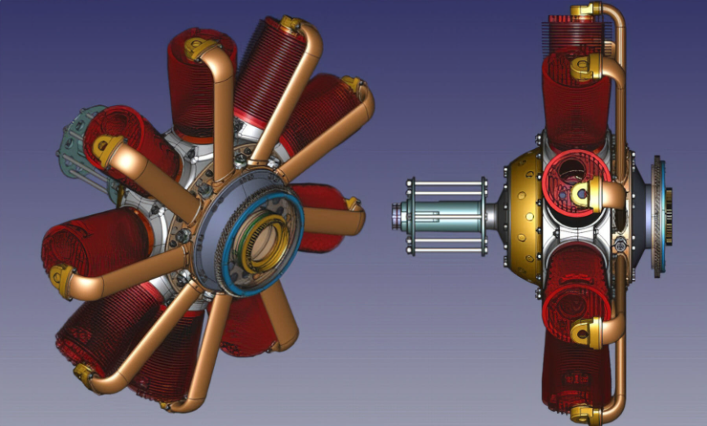
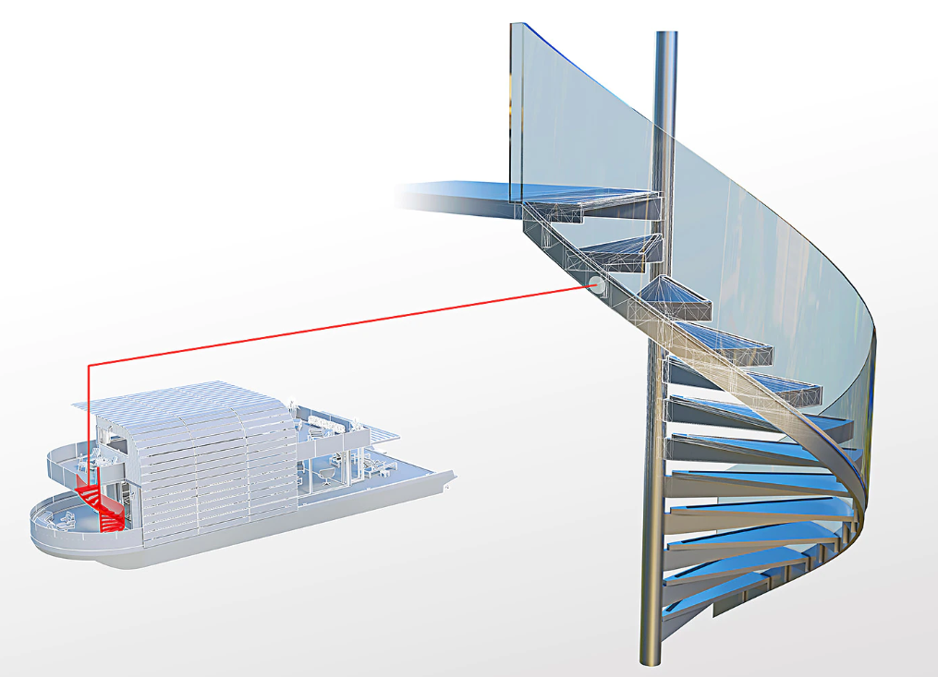
Applications
Design: cars, ships, airplanes, etc.
architecture,
Engineering,
Nature,
Animation,
Vector graphics,
https://www.freecadweb.org/
https://www.autodesk.com/products/autocad/included-toolsets/autocad-architecture

Slide 5
Parametric surfaces vs Mesh
Parametric surfaces are one of alternative geometric representations that have certain advantages over meshes in certain scenarios.
Some advantages of curves and curved (subdivision) surfaces are:
  They are represented by equations and thus have more compact representation than meshes (less memory for storing and transfer) and less transformation operations are needed
  Since they are represented by equations they provide salable geometric primitives – geometry can be generated on the fly by evaluating the equations (Analogy: vector and raster images)
  They can represent smoother and more continuous primitives than lines and triangles, thus more convenient for representing object like hair, organic and curved objects
  Other scene modeling tasks can be performed more simpler and faster, e.g., animation and collision
<IMAGES: APPLICATION OF CURVES AND CURVED SURFACES>

Slide 6
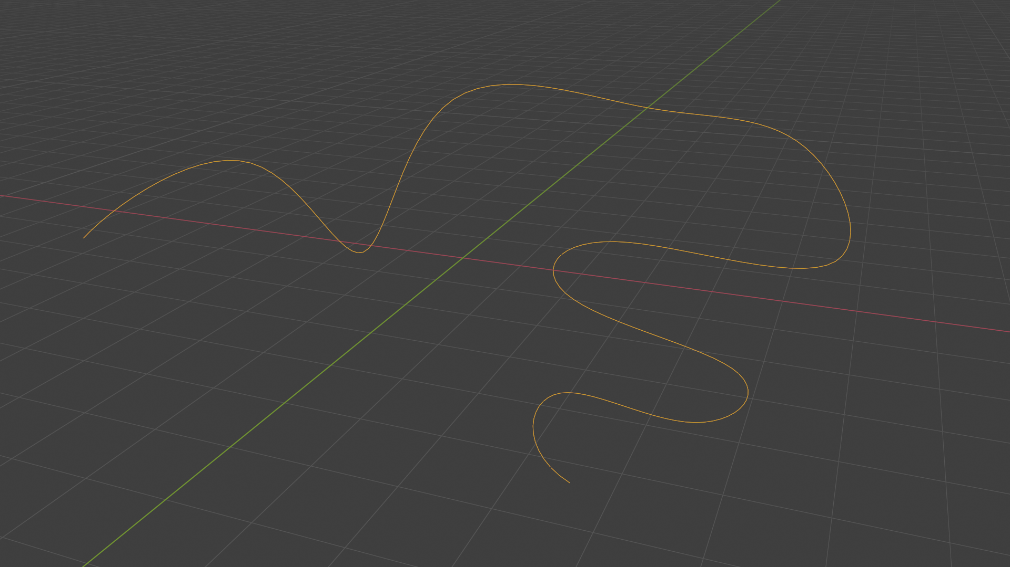
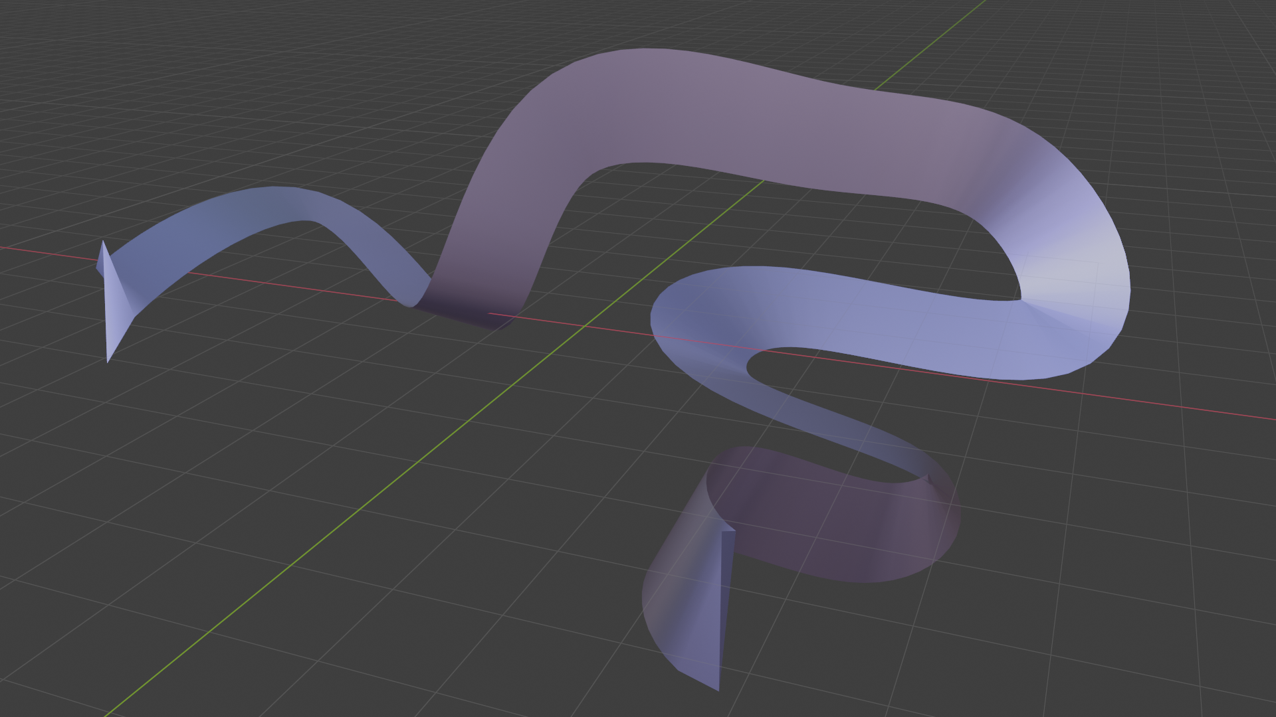
Parametric curves and surfaces
To understand parametric surfaces, we will start with parametric curves

Slide 7
Parametric curves

Slide 8

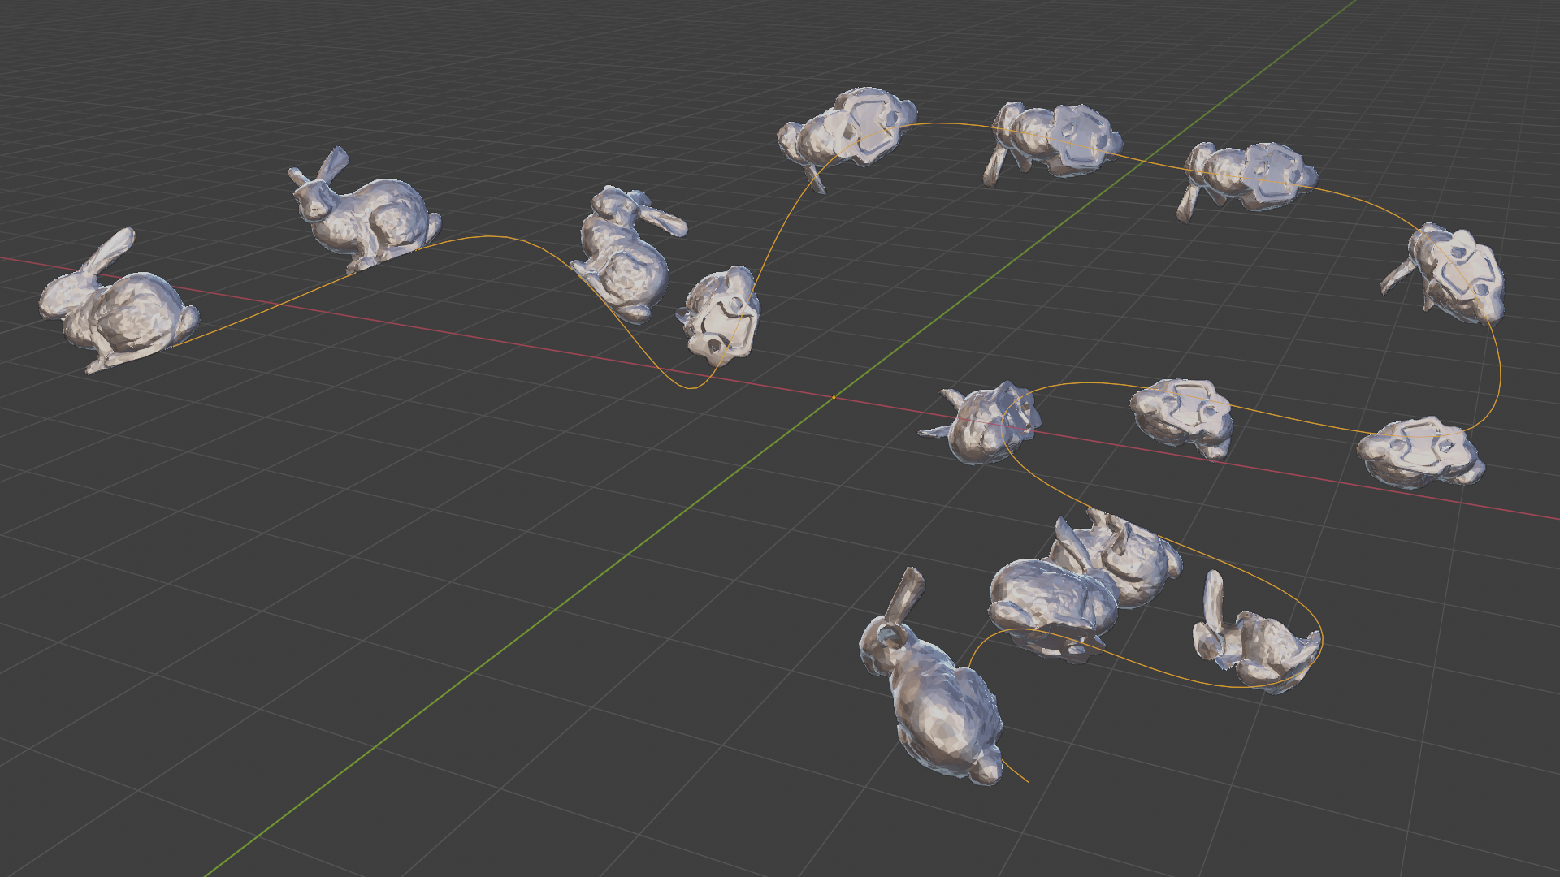
Parametric curves
Wide context of usages:
  Animating object/camera/light over path: position and orientation
  Rendering hair
https://developer.nvidia.com/gpugems/gpugems2/part-iii-high-quality-rendering/chapter-23-hair-animation-and-rendering-nalu-demo

Slide 9
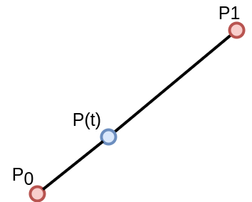
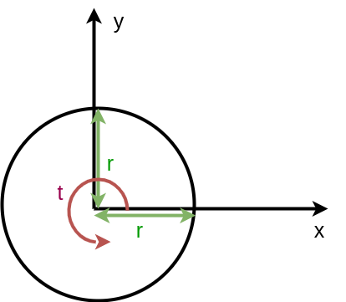
Parametric curves
Described with a formula as a function of parameter t: p(t), t in [a,b]
  Generated points are continuous
Example: line segment
  p(t) = (1-t) p₀ + t p₁
Example: circle
  x(t) = r cos(2 * PI * t), t in [0,1]
  y(t) = r sin(2 * PI * t), t in [0,1]

Slide 10
Arbitrary curves? Various implementations:
  Bezier curve
  Hermite curve
  Catmull-Rom spline
  B-Splines

Slide 11
Bezier curves: linear interpolation
Linear interpolation between two points – control points - p₀ and p₁ traces out straight line.
  p(t) = (1-t) p₀ + t p₁, short: lerp(p₀, p₁, t)
  For 0 < t < 1, generated points are on straight line between p₀ and p₁. Otherwise outside.
  p(0) = p₀ and p(1) = p₁

Slide 12
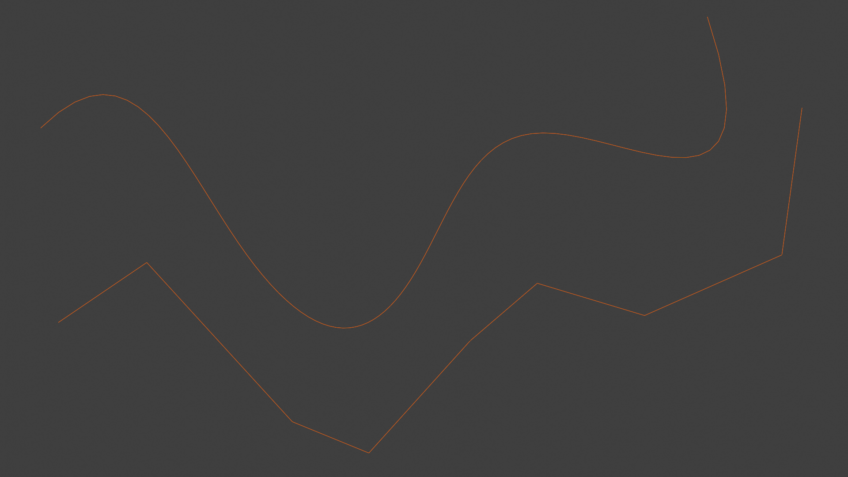
Bezier curves: linear interpolation
Linear interpolation is fine for two points. But interpolating between multiple points gives us straight segments with sudden (discontinuous) changes at joints between.

Slide 13

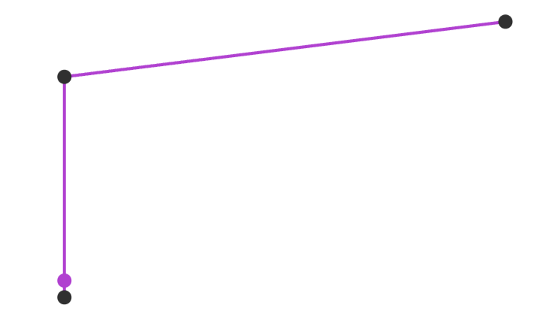
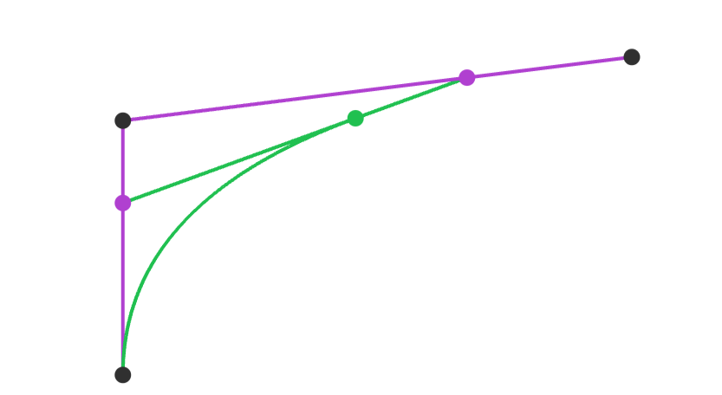
Bezier curves: repeated interpolation
https://acko.net/files/fullfrontal/fullfrontal/wdcode/online.html

Slide 14
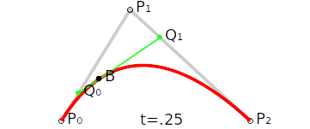
Bezier curves: repeated interpolation
This problem can be solved by taking linear interpolation one step further and linearly interpolate repeatedly → Bezier curves*
  To repeat interpolation, control points are added: P₂
  Example: 3 control points: P₀ ,P₁, P₂
  Linearly interpolate P₀ and P₁ to obtain Q₀
  Linearly interpolate P₁ and P₂ to obtain Q₁
  Linearly interpolate Q₀ and Q₁ to obtain curve point B
  B(t) = lerp(lerp(P₀,P₁,t),lerp(P₁,P₂,t),t)
https://en.wikipedia.org/wiki/B%C3%A9zier_curve
* Independently discovered by Paul de Casteljau and Pierre Bezier for use in French car industry.

Slide 15
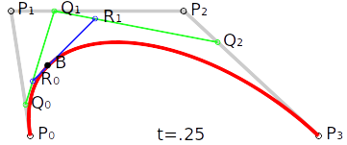
Bezier curves: degrees
Degree of curve is n, if n +1 control points are used.
  More control points → more degrees of freedom
  n = 1 → 1st degree, linear curve
  n = 2 → 2nd degree, quadratic curve
  n = 3 → 3rd degree, cubic curve

Slide 16
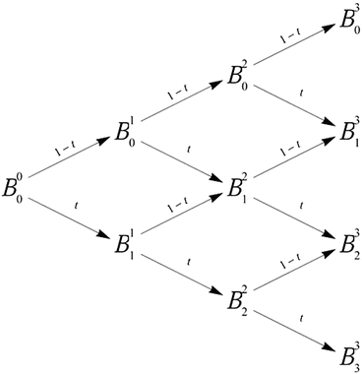
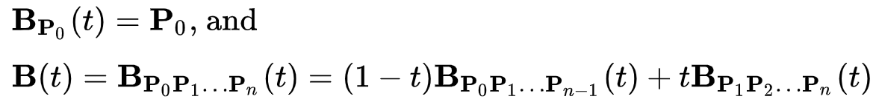
Bezier curves: repeated interpolation
Repeated or recursive linear interpolation is often referred as de Casteljau algorithm.
Linear Bezier:
Quadratic Bezier:
Cubic Bezier: …
Higher degree: recursive formula:
De Casteljau algorithm gives pyramid of coefficients

Slide 17
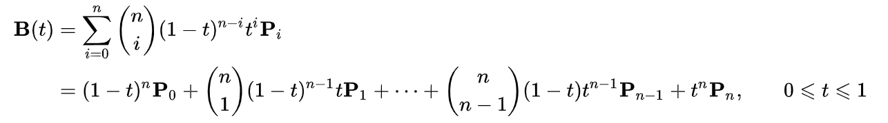
Bezier curve: another representation
Quadratic Bezier:
Quadratic Bezier re-arranged → algebraic description
Every Bezier curve can be described with algebraic fromula. Therefore, repeated interpolation is not needed.
Generalized algebraic description: Bernstein form:

Slide 18
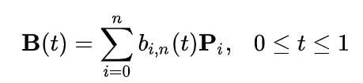

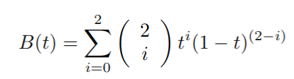
Bezier curve: Bernstein form
Bernstein form:
Bernstein polynomials aka Bezier basis functions:
If n = 2 (quadratic)

Slide 19
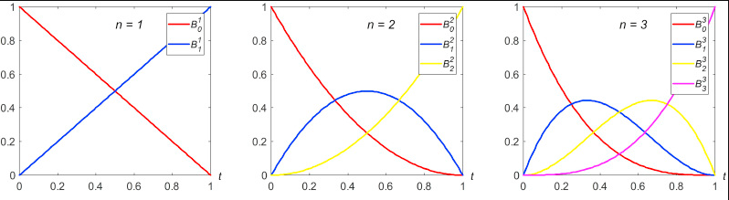
Bernstein polynomials
When t increases, blending weight form P0 decreases and blending weight for p1 increases, and so on...
Bernstein polynomials aka blending functions
https://www.sciencedirect.com/science/article/abs/pii/S0997753817306381

Slide 20

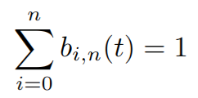
Bernstein polynomials
Bernstein function contains Bezier basis function (Bernstein polynomials) that defines properties of the curve:
Polynomials are in [0,1] when t is given in [0,1]
Curve will stay close to the control points P_{i}.
  Furthermore, whole Bezier curve will be located in convex hull of control points – useful for computing bounding area or volume of curve.

Slide 21
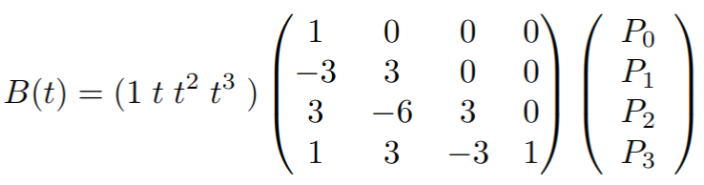
Bezier curve: matrix representation
In practice, it is useful (faster calculation) to represent Bezier curve in matrix form.
In practice, cubic Bezier curves are often used.
https://blog.demofox.org/2016/03/05/matrix-form-of-bezier-curves/

Slide 22
Bezier curves: good properties
Intuitive theory, good for understanding curves: repeated interpolation
Compact form: Bernstein form and matrix representation, power form*
Derivative of curve is straightforward: derivation of polynomial → tangent vector of curve point
Useful: Arbitrary number of points can be generated on curve
  If rotation of those points is needed, then curve (few control points) are rotated and then points are generated.
More on topic: https://www.youtube.com/watch?v=aVwxzDHniEw&ab_channel=FreyaHolm%C3%A9r
* Real-time rendering book, ch 17.1.

Slide 23
Bezier curves: problems
Bezier curves do not pass through all control points (except endpoints)
Not many degrees of freedom:
  Only control points can be chosen freely
  Not every curve can be described with Bezier curve (e.g., simple circle can not be described with one or collection of Bezier curves)
  Alternative is rational Bezier curve*
Degree increases with number of control points
  Hard to control if higher degree curve is used, complex computation
  Bernstein polynomials do not interpolate well
  For this reason, lower degree curves (often cubic curves) are concatenated to form larger spline
* Hoschek, J. and Lasser, D. (1993) Fundamentals of Computer Aided Geometric Design. A K Peters.

Slide 24
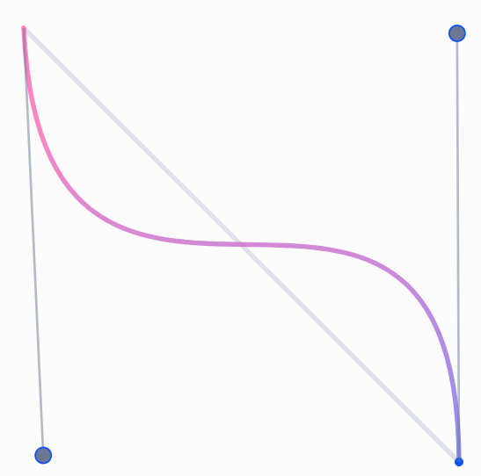
Joining Bezier curves
Often, multiple Bezier curves of lower degree are joined together to form splines
  Lower degree curves lower the complexity of computation
  Resulting curves will go through set of of points
For this purpose, cubic degree is often used
  Cubic curves are lowest degree curves that can describe S-shaped curve called inflection
Cubic Bezier with inflection: https://blog.maximeheckel.com/posts/cubic-bezier-from-math-to-motion/

Slide 25
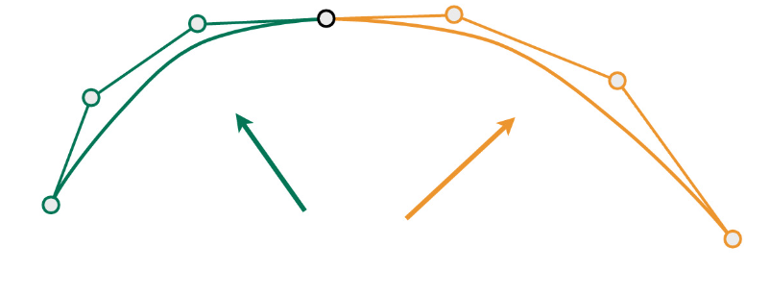
Joining cubic Bezier curves
L₀
L₁
Example: two cubic Bezier curves with 4 control points:
  L_{i}, i = 0, 1, 2, 3
  K_{i}, i = 0, 1, 2, 3
To join the curves we can set L₃ = K₀ → joint - point where curves are joined
Composite curve formed from several curve pieces is called piecewise Bezier curve, p(t)
  Now t is in [t1, t2]
  First curve is p(t’), where t’ in [0,1].
  Second curve is p(t’), where t’ = (t – t1) / (t2 - t1)
Two curves connected just using L₃ = K₀ will not be smooth at joint.
Improved smoothness is achieved using tangent constraint: (K₁ – K₀) = c (L₃ – L₂), c > 0*
L₂
L₃=K₀
K₁
K₂
K₃
* Curves and Surfaces in Computer Aided Geometric Design, Farin, Gerald
https://cs184.eecs.berkeley.edu/sp22/lecture/7-77/intro-to-geometry-splines-and-be

Slide 26
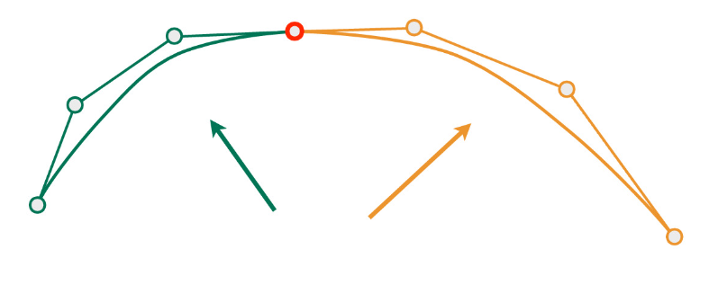
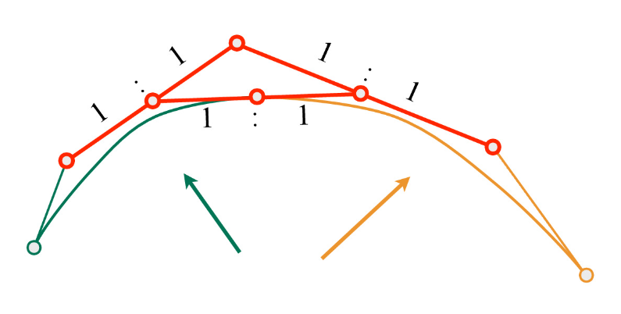
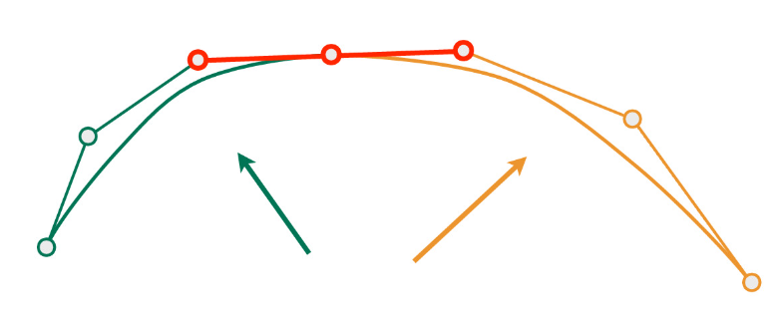
Joined curves continuity
This way, many cubic Bezier curves are chained into piecewise cubic Bezier line
Continuity of joined curves:
  C⁰ – positional continuity - segments should joint at the same point
  C¹ – velocity continuity - derivation of any point (including joints) must be continuous
  C² - acceleration continuity - first and second derivatives are continuous functions
C⁰
C^{2 –} “A Frame” construction
C¹
https://cs184.eecs.berkeley.edu/sp22/lecture/7/intro-to-geometry-splines-and-be

Slide 27
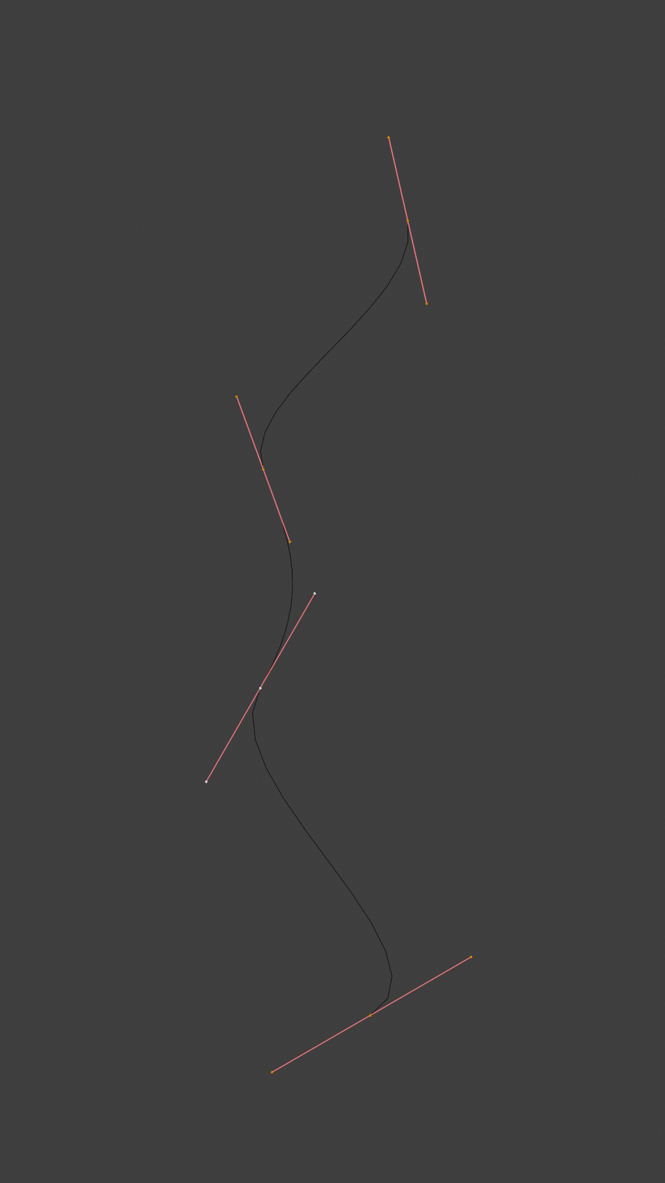
Joined curves continuity
Geometrical continuity for describing joined curve smoothness
  G⁰ – positional continuity: holds when the end points of two curves or surfaces coincide
  G¹ – tangent continuity - tangent vectors from curve segments that meet at joint should be parallel and have same direction – no sharp edges. Continuous edges make splines look natural – often sufficient measure
  G² – curvature continuity - tangent vectors from curve segments that meet at joint should be of same length and rate of length change – perfectly smooth surface – two joined surfaces appear as one

Slide 28
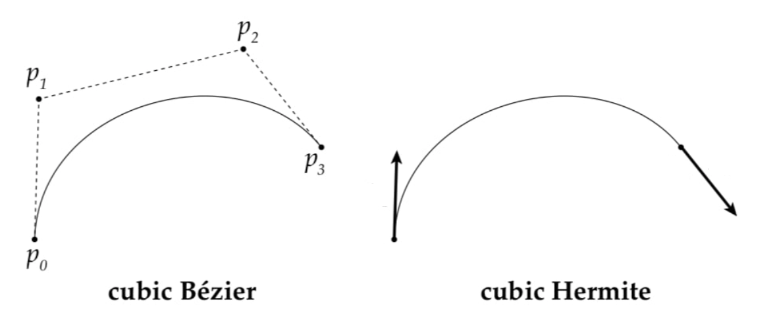
Cubic Hermite curve
Bezier curves are good for describing theory behind smooth curves but are not controllable for authoring.
Cuves with cubic Hermite interpolation are easier to control and require:
  2 points. Starting and ending control points: p₀ and p₁
  2 vectors. Starting and ending tangents: m₀ and m₁ (longer tangents influence the shape)
Cubic Hermite curve interpolates p₀ and p₁ with tangents m₀ and m₁ at these points.
p₁
m₀
m₁
p₀
http://15462.courses.cs.cmu.edu/fall2020/article/10

Slide 29
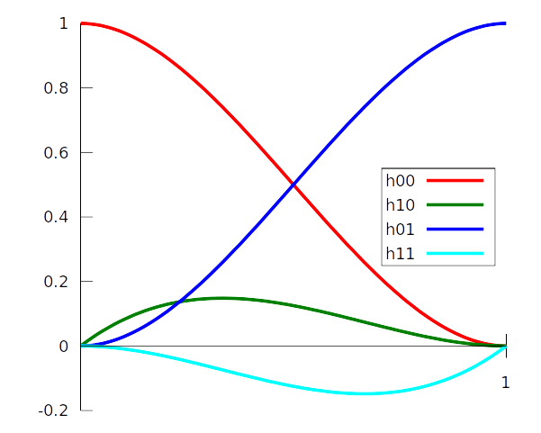
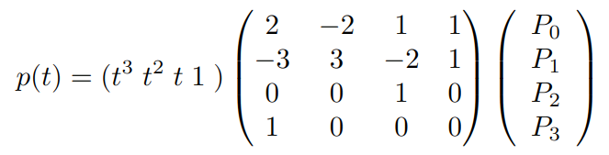
Joining cubic Hermite curve
Cubic Hermite curve (aka interpolant aka segment aka spline segment) p(t), t in [0,1]:
Similarly as discussed with Bezier: Bernstein form with Hermite basis function exist
When interpolating more than two points, several Hermite curves can be connected together (similarly as done with Bezier).
https://en.wikipedia.org/wiki/Cubic_Hermite_spline

Slide 30
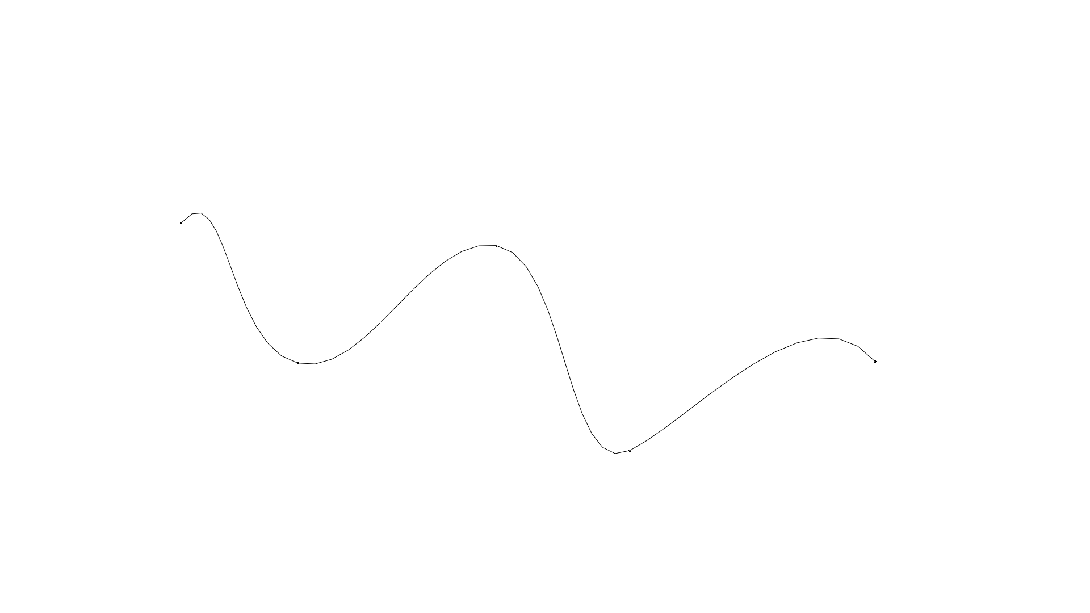
Splines: assembly of curves
Connecting multiple points P₀...P_{n}
  n – 1 cubic Hermite curves must be used
  resultant is assembly of curves called spline
  elements of assembly are called segments (e.g., Hermite sements)
P₃
P₀
P₀
P₅
P₁
P₄

Slide 31
Catmull-Rom spline
Given points P₀...P_{n}, the goal is to calculate tangents for Hermite curves which would create spline: continuous differentiable curve passing through each point.
Solution:
  Catmull-Rom spline

Slide 32

Catmull-Rom spline
Kochanek-Bartels: method for computing tangents at joints
Assume that there is only one tangent per control point
  Tangent at Pi can be computed as combination of two chords: P_{i}-P_{i-1} and P_{i+1}-P_{i}:
  Tension parameter - a: length of tangent, higher values → sharper bends
  Bias parameter - b: direction of tangent
Kochanek-Bartels method can be extended with additional, continuity, parameter and which is incorporated with calculating 2nd tangent at joint*.
* Real-time rendering book, ch 17.1.

Slide 33

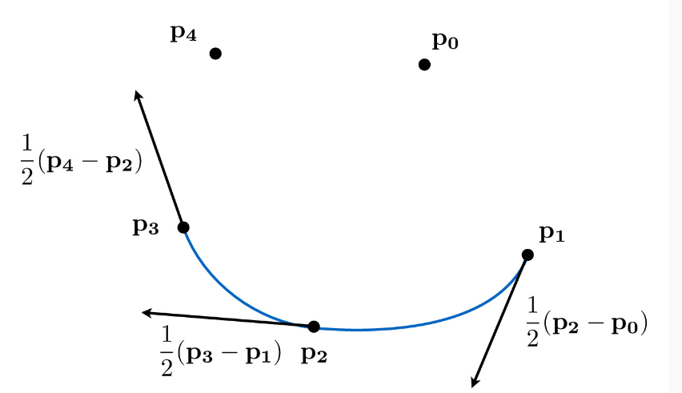
Catmull-Rom spline
Catmull-Rom spline is a special case of Kochanek-Bartels Spline where tension and bias parameters are set to 0. Tangents in P₀...P_{n} are calculated using:
Properties:
  Rapid finding points on Catmull-Rom spline is possible
  Interpolating curve: passing through all control points but doesn’t stay inside convex hull of points
https://cs184.eecs.berkeley.edu/sp22/lecture/7-50/intro-to-geometry-splines-and-be

Slide 34
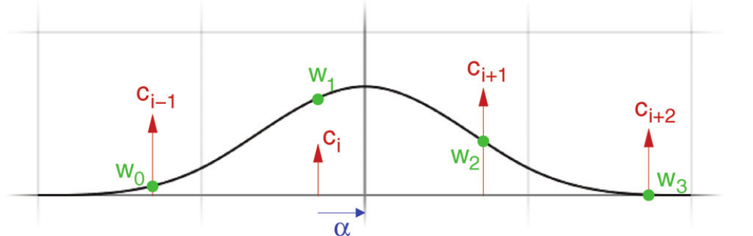
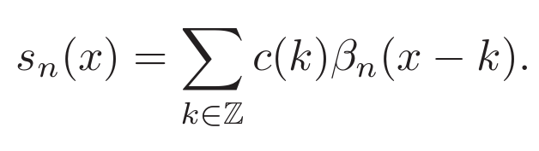
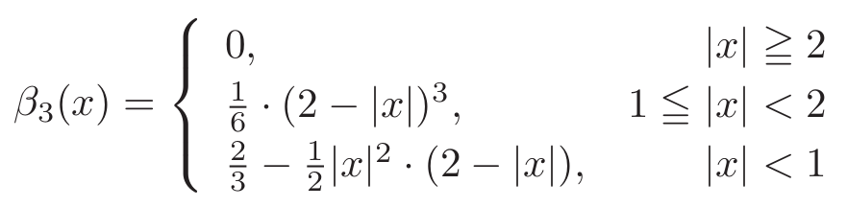
B-spline
Two types:
  Uniform: uniformly space control points
  Non-Uniform
Similarly to Bezier curve, it is parameterized function of x
  Where: n-1 – degree, c(k) – control points, β_{n} - basis function
Cubic B-spline is most widely used. Uniform cubic B-spline basis function:
Uniform cubic B-spline basis function
https://www.researchgate.net/publication/220494113_Efficient_GPU-Based_Texture_Interpolation_using_Uniform_B-Splines

Slide 35
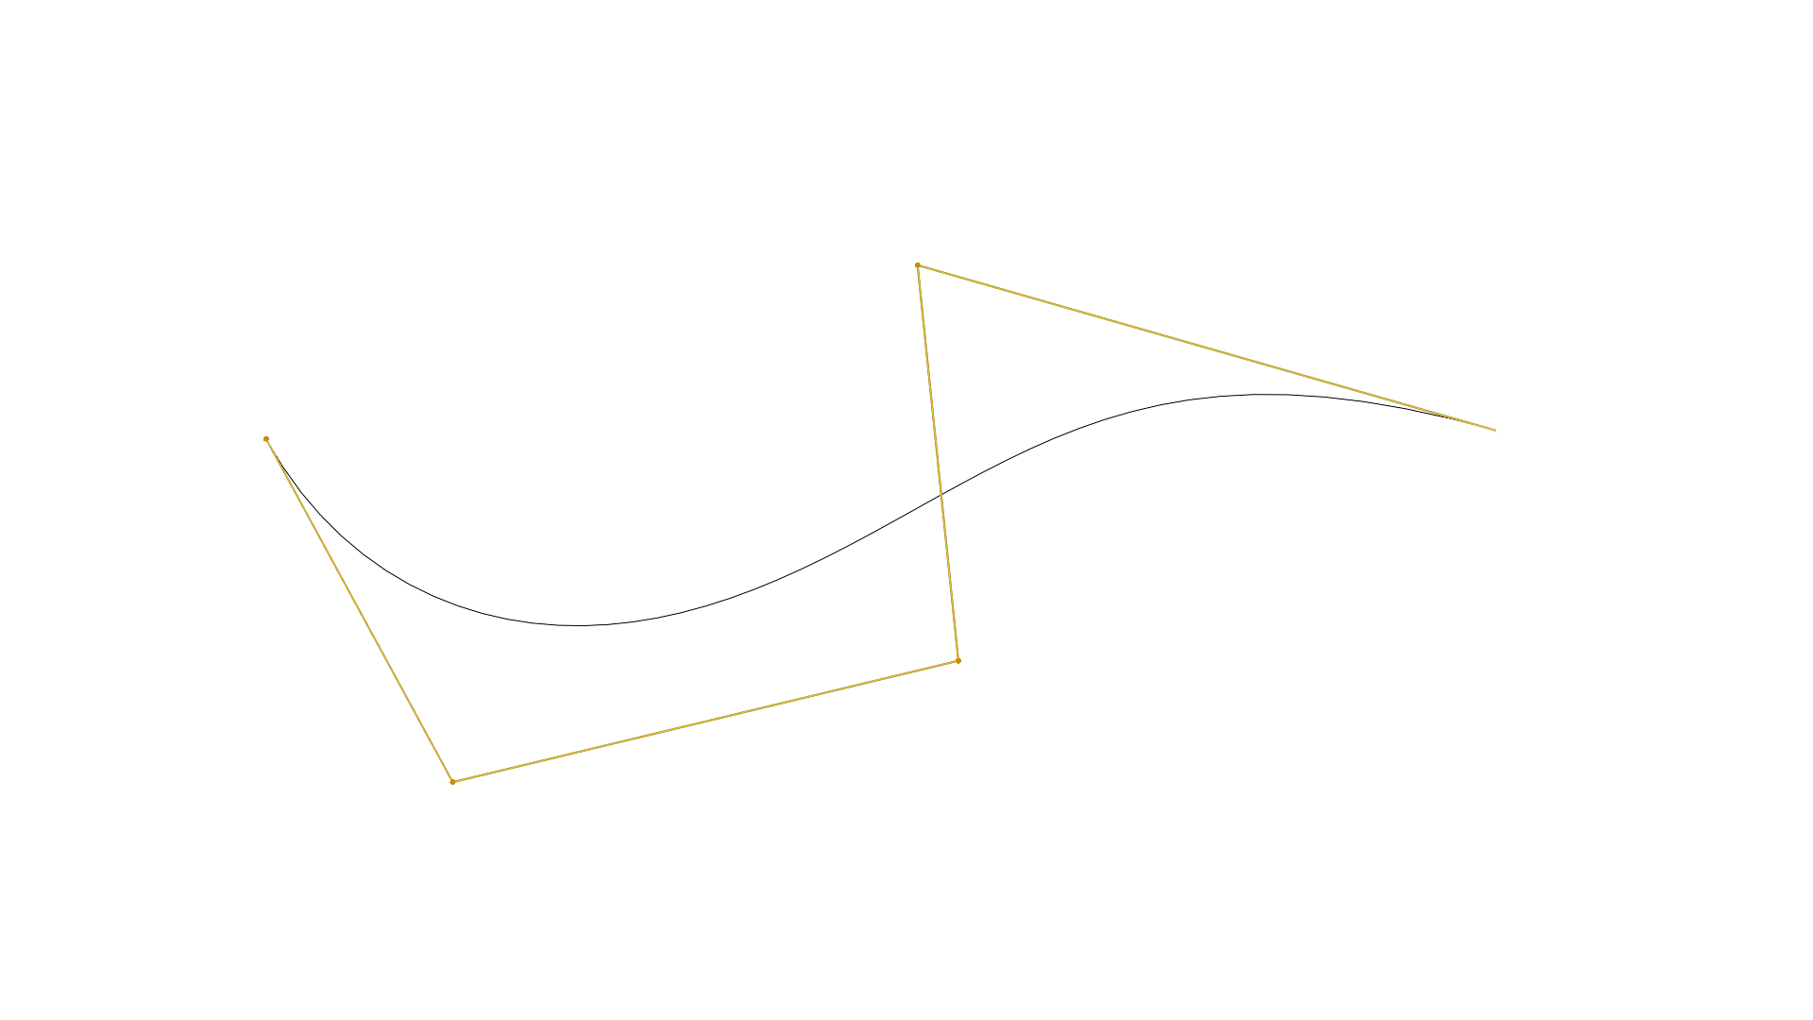
Uniform cubic B-spline
Cubic B-spline is non-interpolating
  it is passing near control points, not through them. No guarantee that it is interpolating the control points
Multiple uniform cubic B-splines curves can be joined together as a spline
  Cubic B-spline is C² continuous
  Curve composited of multiple B-splines will be C² continuous

Slide 36
B-spline generalizations
B-splines explained so far have limitations
One limitation is that representing circle is not possible
  Solution, a generalization is to introduce additional coordinate to B-spline
  Rational B-spline → traversal of circles and conic sections is now possible
Another limitation is requirement of uniformly spaced control points: animation when positions of object are known at t = 1, 2, 3 and 10.
  Futher generalization: Non-uniform rational B-splines (NURBS)
  Very often used in CAD tools

Slide 37
Parametric surfaces

Slide 38
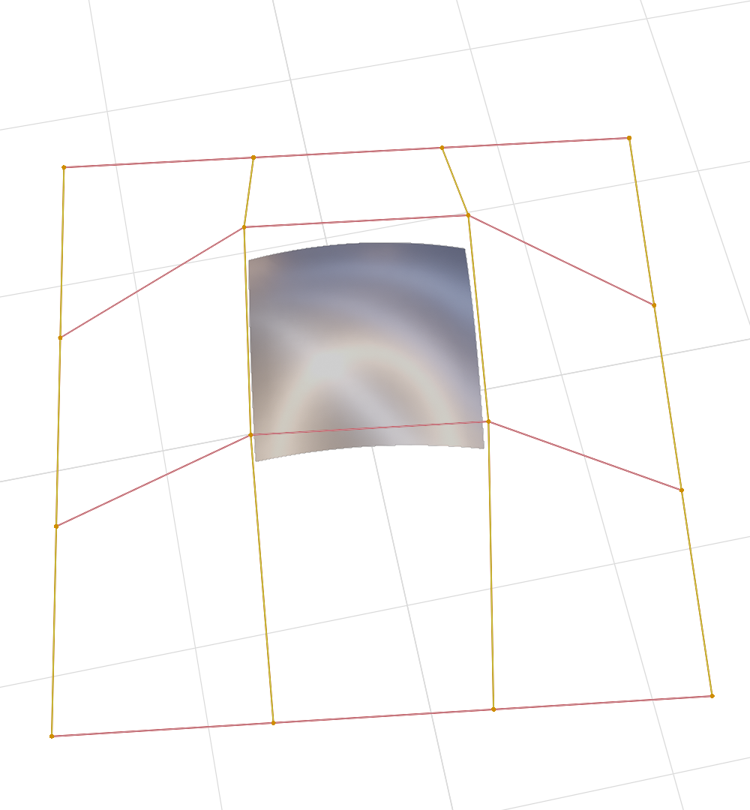
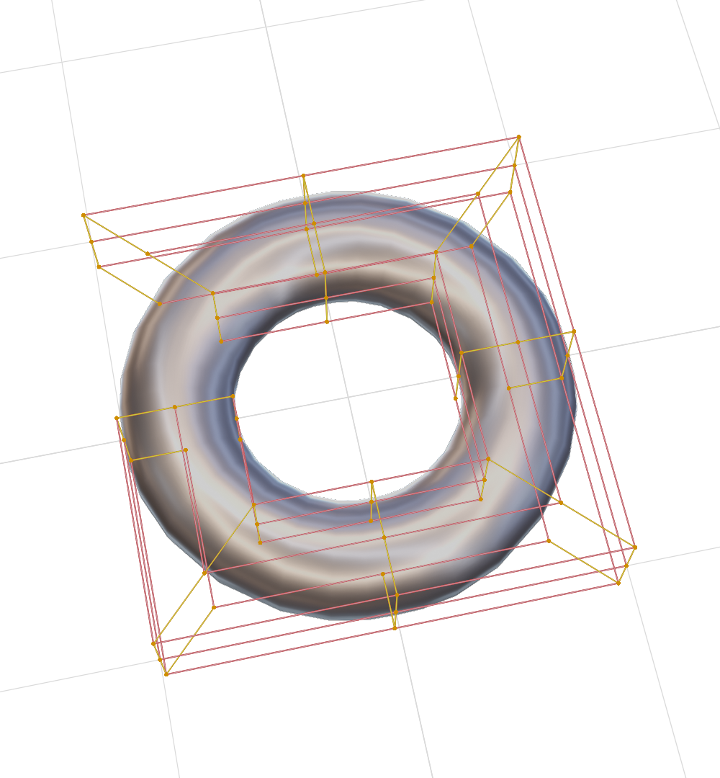
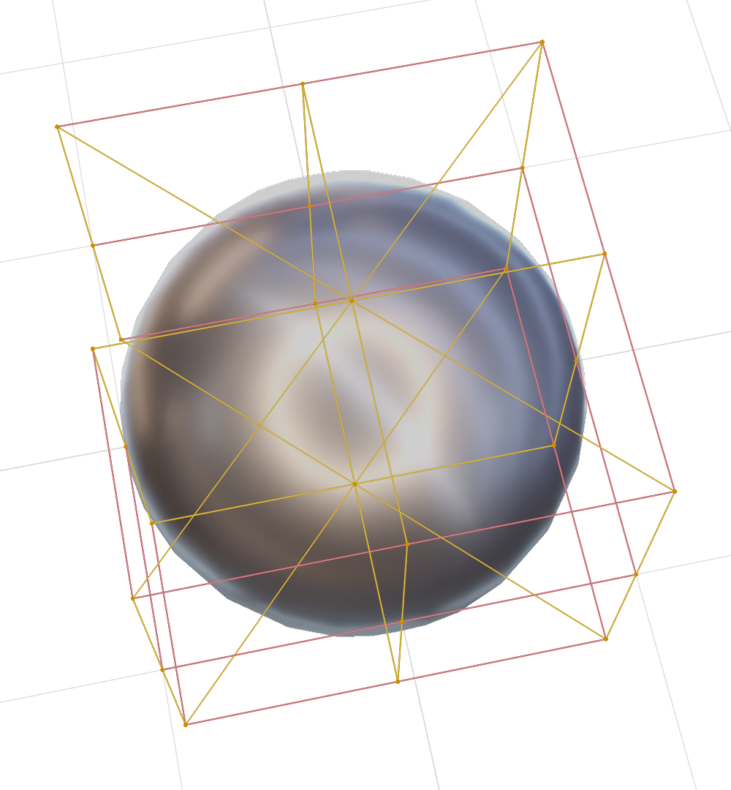
Parametric surfaces
Natural extension of parametric curves are parametric surfaces
  Similarly as triangle or polygon is extension of a line segment
Very useful for modeling curved surfaces
As curves, parametric surfaces are defined with small number of control points

Slide 39
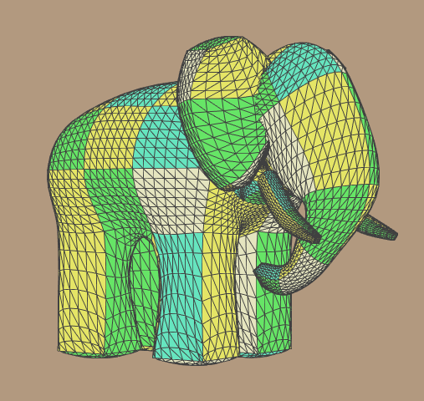
Parametric surfaces
Common types
  Bezier surfaces
  B-spline surfaces
Ed Catmull's "Gumbo" model, composed from Bezier patches

Slide 40
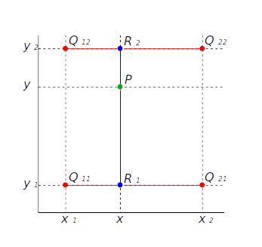
Bezier surface: bilinear interpolation
Bezier curve is extended so it has two parameters (u,v) which define surface.
Similarly as we started with Bezier curve by explaining linear interpolation, we explain Bezier patch by explaining bilinear interpolation*.
  R₁(u) = lerp(Q₁₁,Q₁₂,u)
  R₂(u) = lerp(Q₁₂,Q₂₂,u)
  P(u,v) = lerp(R₁(u), R₂(u), v)
* Bilinear interpolation is crucial for computations in computer graphics. It is extensively used and one example is texture mapping.

Slide 41
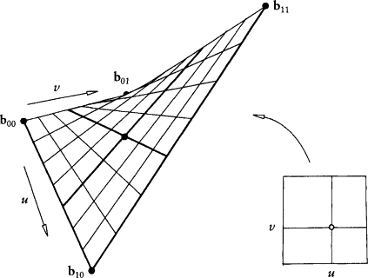
Bezier surface: patch
p(u,v) is simplest, non-planar parametric surface with (u,v) in [0,1]. It has rectangular domain and thus resulting surface is called a patch.
https://www.sciencedirect.com/topics/computer-science/bilinear-interpolation

Slide 42
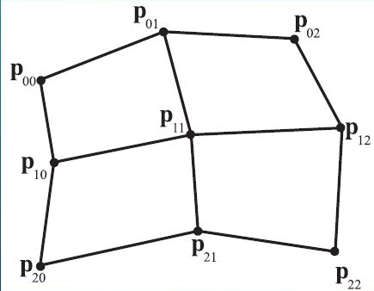
Bezier surface
Similarly as we added more points to linear interpolation to obtain Bezier curve, we add more points to bilinear interpolation to obtain Bezier surface
Example: biquadratic Bezier surface:
  9 control points

Slide 43
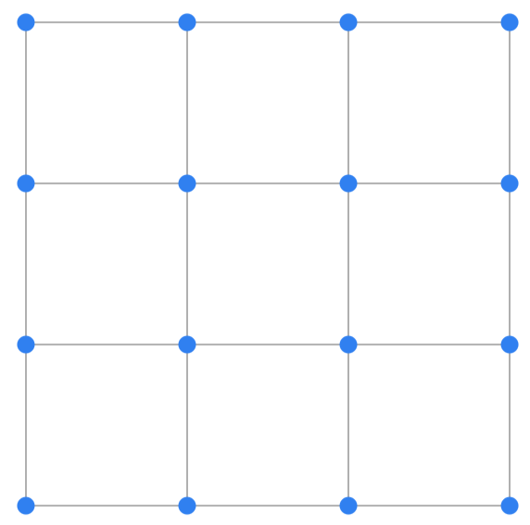
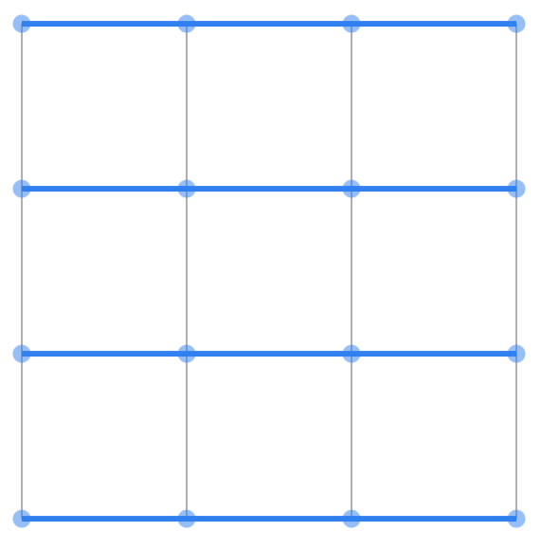
Bezier surface: repeated bilinear interpolation
Repeated bilinear interpolation is extension of de Casteljau’s algorithm to patches.
Starting control points:
https://acko.net/files/fullfrontal/fullfrontal/wdcode/online.html

Slide 44
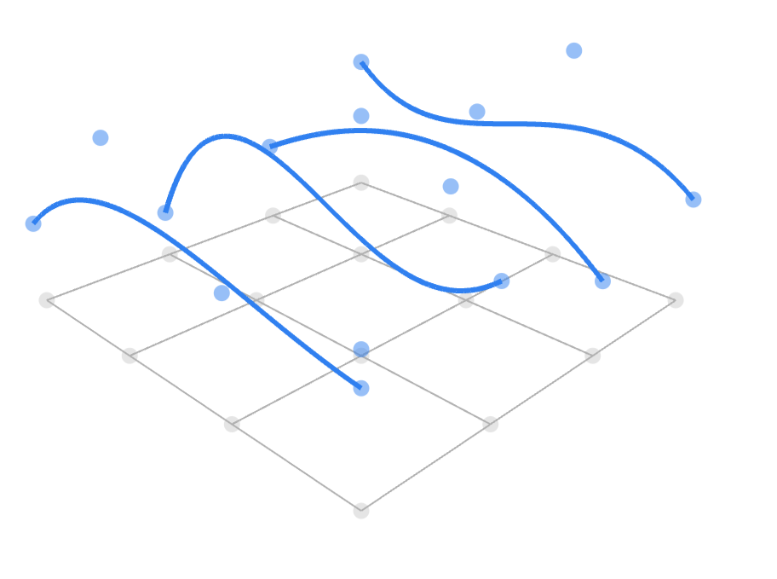
Bezier surface: repeated bilinear interpolation
Repeated linear interpolation:

Slide 45
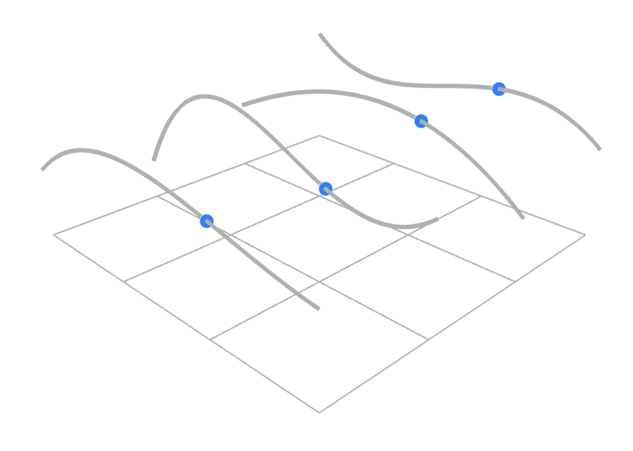
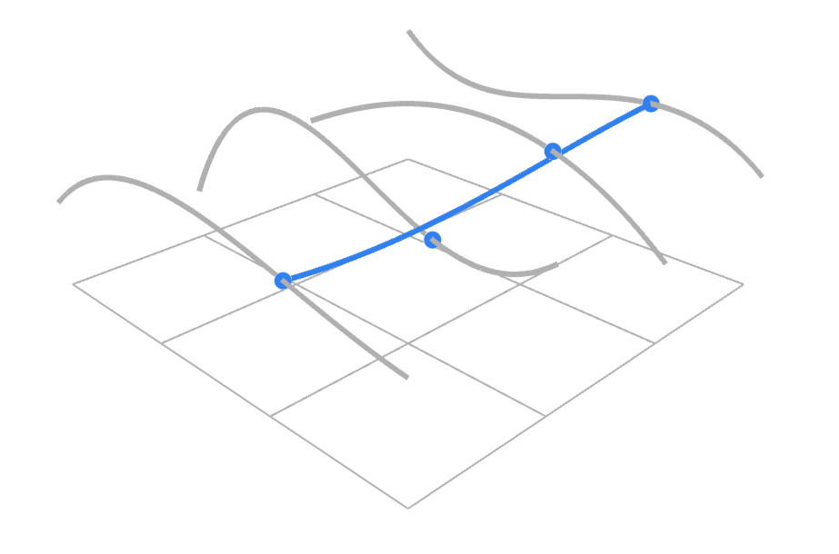
Bezier surface: repeated bilinear interpolation
Repeated bilinear interpolation

Slide 46
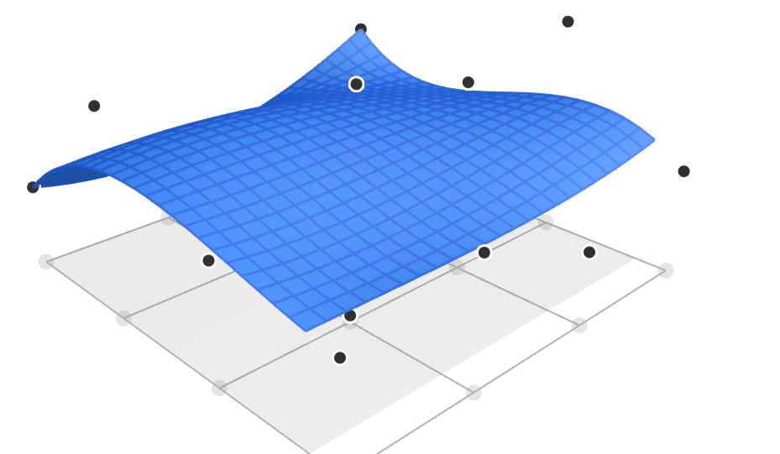
Bezier surface: repeated bilinear interpolation
Final Bezier surface

Slide 47
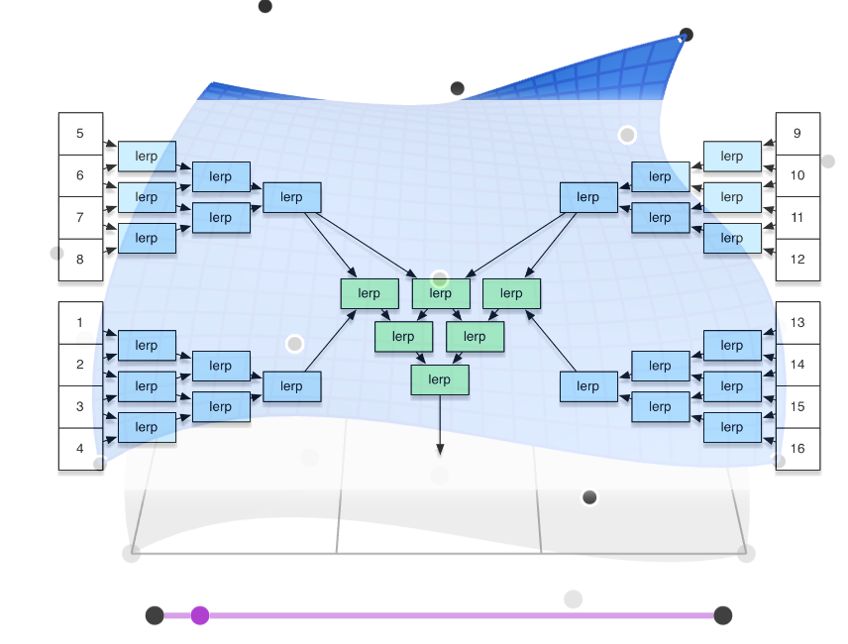
Bezier surface
Repeated bilinear interpolation is extension of De Casteljau algorithm to patches patches
Point on Bezier Patch can be described in Bernstein form using Bernstein polynoms

Slide 48
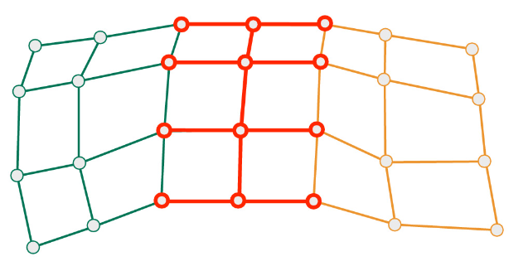


Bezier surface: continuity
  C⁰ – positional continuity – joined at the same point
  C¹ – velocity continuity - derivation of any point (including joints) must be continuous
  C² - acceleration continuity - first and second derivatives are continuous functions
https://cs184.eecs.berkeley.edu/sp22/lecture/7-96/intro-to-geometry-splines-and-be

Slide 49

Bezier surface properties
Passes through only corner control points
Boundary of the patch is described with Bezier curve of degree n formed by the points on the boundary
Tangents at border points are described with Bezier curve at border points – each corner control point has two tangents: for u and v direction
Patch lies within convex hull of its control points.
Control points can be generated and then points on patch will be rotated when evaluated (faster than other way around)
Derivative is straightforward (derivation of polynomials)
More on the topic: rational Bezier patches

Slide 50

Other parametrized surfaces
Bezier triangles
  Control points are located in triangulated grid
  Based on repeated interpolation: de Casteljau, Bernstein triangles
  Constructing complex object requires stitching Bezier triangles so that composite surface contains desired properties and look: continuity
Real-time rendering book, ch 17.2.

Slide 51

Other parametrized surfaces
Point-Normal (PN) Triangles
  Given triangle mesh with normals at each vertex, the goal is to construct “better looking” surface using just triangles
  This data is enough to construct surface using Bezier triangles*
  PN methods tries to improve mesh shading and silhouettes by creating curve surface to replace each triangle
Properties:
  Creases in PN triangles are hard to control
  Continuity between Bezier triangles is C0 but looks acceptable for certain applications
* Game engines (e.g., unity and unreal) support those methods since triangle mesh is basic building primitive.
https://alex.vlachos.com/graphics/CurvedPNTriangles.pdf

Slide 52

Other parametrized surfaces
Phong tessellation
  Similar as PN triangles, given the triangle points with normals, construct “better-looking” surface
  Phong tessallation attempts to create geometric version of Phong shading normal using repeated interpolation resulting in Bezier triangles.
Mesh, Butterfly subidivision, PN Triangles, Phong Tessellation
https://perso.telecom-paristech.fr/boubek/papers/PhongTessellation/

Slide 53


B-Spline surfaces
B-Spline curves can be extended to B-Spline surfaces which are similar to Bezier Surface
Often bicubic B-Spline surface is used to form composite surface
  Essencial for Catmull-Clark subidivison surfaces (will be discussed later)
Non-uniform rational B-Spline surface (NURBS) is often used in 3D modeling software
https://www.youtube.com/watch?v=1zNfh_g8jXM&ab_channel=BlenderSecrets
https://forums.cgsociety.org/t/audi-r8-v10-2010-nurbs-model-with-rhino-3d/1761843/3

Slide 54



Rendering of curved surfaces
Model made with parametric surfaces is tessellated for efficient rendering process.
  Surface can be tessellated in any number of triangles making it perfect for tuning trade-off between quality and speed (more triangles → better shading and silhouettes)
  Another advantage is that animation can be done on control points and then surface is tessellated for rendering.
For rendering purposes (both rasterization- and raytracing-based) it is beneficial to transform curved surface into triangulated mesh – tessellation

Slide 55

Modeling and transferring parametric surfaces
Parametric surfaces are stored using:
  STEP file format
  IGES file format
CAD programs are used to create and edit parametric surfaces.
https://www.freecadweb.org/

Slide 56
Exploring parametric curves and surfaces
Blender NURBS surfaces: https://docs.blender.org/manual/en/latest/modeling/surfaces/introduction.html
Blender NURBS and Bezier curves: https://docs.blender.org/manual/en/latest/modeling/curves/index.html
Tutorial on curves in Blender: https://behreajj.medium.com/scripting-curves-in-blender-with-python-c487097efd13
Houdini: https://www.sidefx.com/docs/houdini/nodes/sop/curve.html
Library for creating and manipulating NURBS surfaces and curves: http://verbnurbs.com/
More examples: https://www.realtimerendering.com/#curves

Slide 57
Further into topic
Parametric curves and surfaces are highly used and researched method in computer graphics. Until now we have covered foundations. There are many other topics. Some of those will be discussed later, some are out of scope for this course:
  NURBS: https://www.gamedeveloper.com/programming/using-nurbs-surfaces-in-real-time-applications

Slide 58
Literature
https://github.com/lorentzo/IntroductionToComputerGraphics/wiki/Foundations-of-3D-scene-modeling

