Slide 1
News
8.3.2023.

Slide 2
Perspective problems for object detection
Problem: model trained on top-down view fails when view changes → perspective distortion
Solutions:
  Always augment your dataset with imperfections and distortions to make model more robust on changes. Library: https://albumentations.ai/
    This way perspective distortions can be learned and changes in view shouldn’t affect results drastically: https://albumentations.ai/docs/getting_started/keypoints_augmentation/
    Besides viewpoint distortions, wide range of other distortions such as color and noise are always good to have in dataset: https://www.v7labs.com/blog/data-augmentation-guide
  Use OpenCV for feature-based image alignment:
    https://opencv.org/
    https://learnopencv.com/image-alignment-feature-based-using-opencv-c-python/
General tips:
  Keep it plausible (decide what to use depending on what can and will happen)
  Keep it simple and fast (save time and energy)
  Keep your eyes on the goal (solve only the bare minimum you need for the task, you can upgrade later if needed)
Acknowledgments:
Thanks to Juraj Fulir
https://www.itwm.fraunhofer.de/de/abteilungen/bv/mitarbeiter/juraj-fulir.html

Slide 3
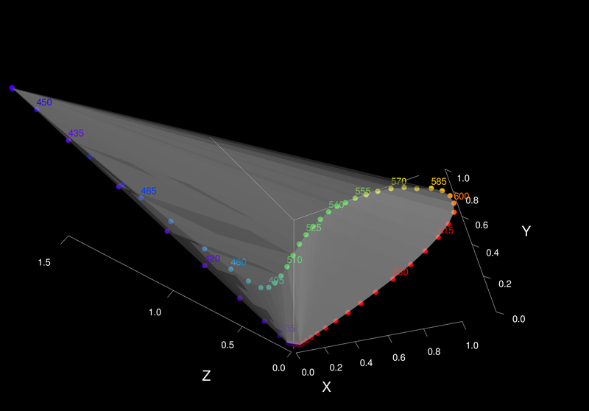
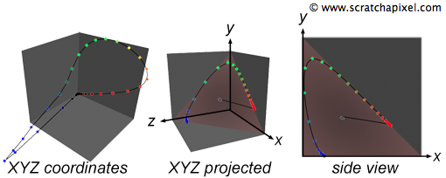
Visualizing XYZ color space
Each color in the range 380 to 700 (from the visible spectrum) is converted into an XYZ color using the color matching functions. These can be plotted in a 3D Cartesian coordinate system.
https://www.scratchapixel.com/lessons/digital-imaging/colors/color-space.html
https://fmiranda.me/projects/color-gamut/
https://ninedegreesbelow.com/photography/xyz-rgb.html
https://www.youtube.com/watch?v=x0-qoXOCOow&ab_channel=JeremySelan
https://github.com/mittimithai/colorspacegraphs/blob/master/XYZ.png

Slide 4
Projects and exam
Exam: 29.3.2023. at 16h, Raum 136.1B
Projects deadline: 8.4.2023, 23:59
Questions?

