Slide 2
Graphics rendering pipeline – logical model of GPU

Slide 3
Pipeline abstraction
Functional/conceptual stages – task to be performed but not how
  Physical/Implemented stages – how are functional stages implemented in hardware and exposed to the user as API.
Logical model of GPU – exposed to a programmer by API. Physical model is up to the hardware vendor.

Slide 4
Graphics rendering pipeline overview
Graphics rendering pipeline
Application
Geometry processing
Rasterization
Pixel processing
Application
Vertex
shader
Tessellation
Geometry
shader
Clipping
Screen mapping
Triangle setup
Triangle
traversial
Pixel shader
Merging
(Optional)
(Optional)
Compute shader
Programmable
- Conceptual/functional abstraction
Configurable
Fixed
- Logical model of GPU - API

Slide 5
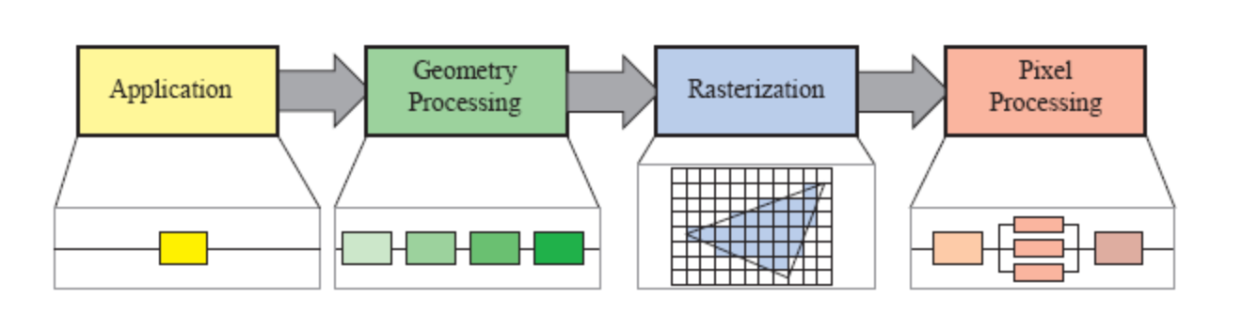
GPU graphics rendering pipeline
GPU implements conceptual rendering pipeline

Slide 6
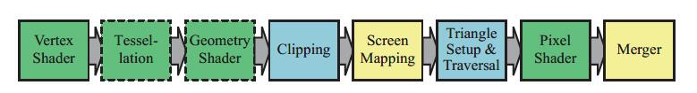
GPU graphics rendering pipeline
Logical model is exposed to used as API
  Underlaying hardware implementation varies by hardware vendor (e.g., Nvidia, AMD, Intel, etc.)

Slide 7
Programming a GPU renderer
As programmers, we are interested in:
  Application stage
  GPU programmable and configurable stages: vertex shader, pixel shader, screen mapping and merger
CPU
GPU
Application
Programmable
Configurable
Fixed

Slide 8
Programming a GPU renderer
Unified shader design: vertex, pixel, geometry, tessellation shaders share common programming model – same instruction set arhitecture (ISA)
GPU with cores which supports unified shader design: unified shader architecture

Slide 9
Programming a GPU renderer
Application stage can be written in various languages:
  C, C++
  Python
  Rust
  etc.
Different APIs enable GPU rendering:
  OpenGL (cross-platform), OpenGL shading language (GLSL)
  DirectX (Windows), High-level shading language (HLSL)
  Vulkan (cross-platform)
  Metal (iOS)

Slide 10
Programming a GPU renderer
Parameters and states of graphics API are defined on application stage
Draw call invokes graphics API to draw primitives
  Causing graphics pipeline to execute and run its shaders
Programmable shaders have two types of inputs:
  Uniform inputs: values remain the same through draw call, e.g., transformation matrix of static object, color of light source, texture, etc.
  Varying inputs: data that come from triangle vertices or rasterization, e.g., triangle surface location changes per pixel

Slide 11
Shading languages
Vertex, geometry, tessellation shader
  Enables programming of geometry behaviour
Fragment shader
  Enables programming material models, light interaction, post-processing effects
Shading languages support common graphics computations:
  Additions, multiplications, etc.
  Intrinsic functions: cos(), atan(), log(), etc.
  Complex operations: vector normalization, reflection, cross product, matrix operations, etc.
  Flow control on uniforms (static flow control) and varyings (dynamic control flow)

Slide 12
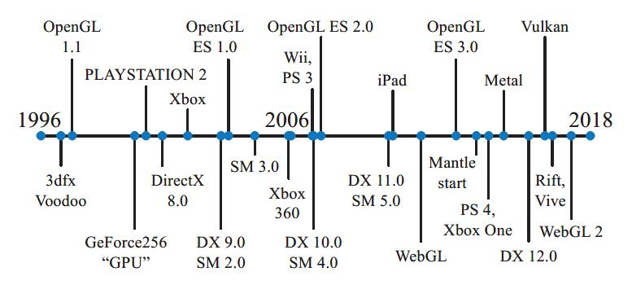
Evolution of graphics API and hardware
https://www.realtimerendering.com/

Slide 13
Graphics rendering pipeline – OpenGL demo

Slide 14
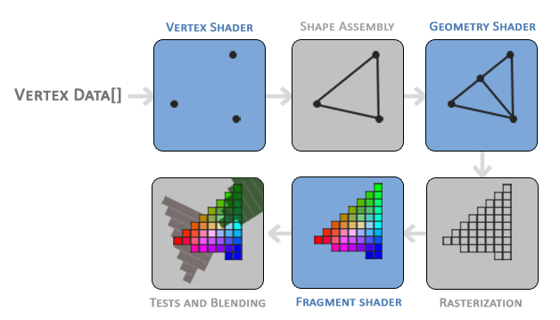
OpenGL rendering pipeline
Application stage
Vertex shader
Fragment shader
Application

Slide 15
Application stage
TODO
Define:
  Camera
  Light
  Object: geometry and material
  Shader parameters
  Configurable GPU pipeline parameters
Draw call
https://learnopengl.com/code_viewer_gh.php?code=src/2.lighting/2.2.basic_lighting_specular/basic_lighting_specular.cpp

Slide 16
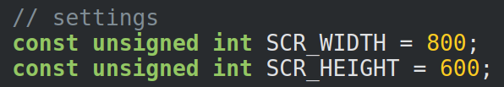
Application stage: camera
TODO
Resolution
Position, orientation
  View and projection matrix

Slide 17

Application stage: light
TODO
Point light:
  Position
  Color

Slide 18
Application stage: object
TODO

Slide 19
Application stage: shader programs
TODO
Shader parameters

Slide 20
Application stage: pipeline state
TODO

Slide 21
Application stage: whole
TODO
https://learnopengl.com/code_viewer_gh.php?code=src/2.lighting/2.2.basic_lighting_specular/basic_lighting_specular.cpp

Slide 22
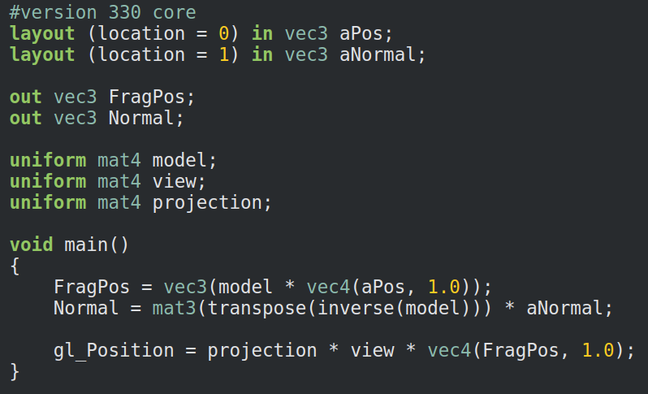
Vertex shader
TODO
https://learnopengl.com/code_viewer_gh.php?code=src/2.lighting/2.2.basic_lighting_specular/2.2.basic_lighting.vs

Slide 23
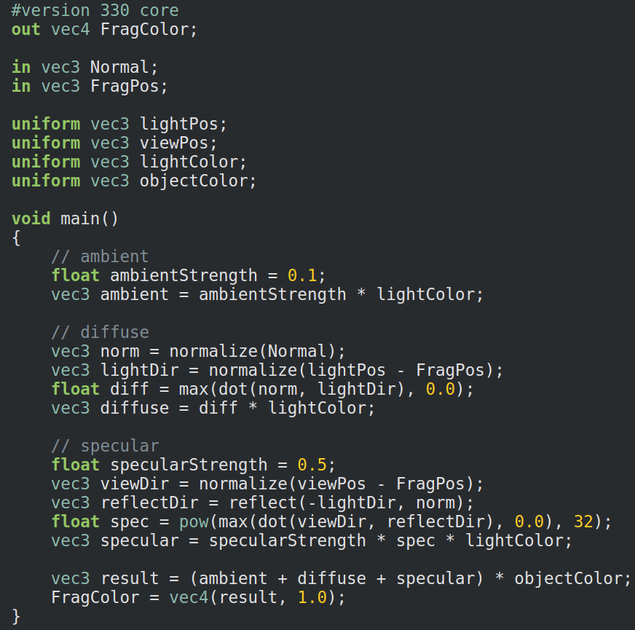
Fragment shader
TODO
https://learnopengl.com/code_viewer_gh.php?code=src/2.lighting/2.2.basic_lighting_specular/2.2.basic_lighting.fs

Slide 24
Output
TODO

