Slide 1
Rasterization-based rendering

Slide 2
Rasterization-based rendering: introduction
Introduction based on https://www.scratchapixel.com/lessons/3d-basic-rendering/rasterization-practical-implementation/overview-rasterization-algorithm.html

Slide 3
Rasterizaton-based rendering
Rasterization-based rendering is quite old method extensively used and researched still today (and will stay with us for some time as we will see).
Techniques used to produce an image with this method were developed 1960-1980*
Rasterization is method used by GPUs to produce images. Rasterization-based techniques for image generation are so fundamental that they are deeply integrated within the GPU hardware architecture
GPUs changed a lot from their beginnings but fundamental methods they implement for generating images haven’t changed much. GPUs changed in efficiency and flexibility with some extensions. The pipeline and methods for generating images fundamentally stayed the same.
* https://www.scratchapixel.com/lessons/3d-basic-rendering/rasterization-practical-implementation

Slide 4
Rasterization: solution to visibility problem
Rendering: visibility and shading.
Raytracing-based rendering,
  Camera rays visibility (which objects are visible from camera)
  Secondary rays visibility (which surfaces are visible to each other during light transport in shading phase).
Rasterization is another method for computing visibility.
  Extremely efficient for finding objects that are visible from camera
  Not very good when it comes to visibility needed for light transport.
  Rasterization and ray-tracing should produce the same images until the point the shading is applied
Calculation of visibility using rasterizer as it was in raytracing-based rendering, relies on geometrical techniques

Slide 5
Reminder: ray-tracing
Reminder: ray-tracing-based rendering starts from image plane, generates rays which are traced into scene and tested for intersections. This method is call image centric and has two loops:
  Outer loop that iterates over all pixels (and generates ray)
  Inner loop that iterates over all objects in 3D scene (and tests for intersection)
Now it is very important to do a quick recap on object shape representation. We discussed that ray-tracing based rendering can work with any shape representation as long as intersection of ray and the shape in question is defined. We also concluded (as it is done by almost all professional software) that user should be provided with shape representations which are easy to work with while renderer should be provided with the shape information which is tractable for rendering process.
  Converting geometry to trangulated mesh makes process of rendering much simpler due to simplicity of triangle primitive.
  Therefore, the shape representation which is almost always used for rendering purposes is triangulated mesh. Thus our rendering primitive is triangle and we will assume we always have triangulated mesh when we discuss rasterization-based rendering.

Slide 6
Rasterization
To solve the visibility problem, rasterization takes the opposite approach to ray-tracing – it starts from objects (which are triangulated mesh) in 3D scene.
First, it projects triangles (which compose the object) onto image plane (e.g., perspective projection). This is done by multiplying triangle vertices with projection matrix.
  This will be done using perspective divide and remapping resulting coordinates to raster space.
Secondly, a method is employed to compute which pixels of image plane are covered by the projected triangles. This is done by looping all pixels in the image and test if they lie within 2D triangles.
The resulting pixels from rasterization are used for shading (which is separate process from rasterization)

Slide 7
Rasterization*: algorithm
for each triangle** in the scene:
project vertices using perspective projection;
for each pixel in the image:
compute if pixel is inside the projected triangle;
This algorihtm is object centric – it starts from object geometry and then uses image pixels.
Represented algorithm is only the simplest form. In actual implementations, various optimizations are performed.
  For example, if two triangles overlap the same pixel(s) in the screen.
* Technically, this process is refers to as rasterization of the triangles into and image of frame buffer. Term rasterization comes from the fact that triangles are decomposed into pixels of a raster image.
** For developing the intuition; in production, it is often that portion of scene contains millions of triangles.

Slide 8
Rasterizer: hint on optimization
The naive implementation is looping through all pixels in the image even small numbers of pixels may be contained within triangle.
Solution to this problem is computing the bounding box around the projected triangle and iterating only over pixels in this bounding box*.
<IMAGE: bounding box>
Note: Idea of using bounding box to optimize algorithms that perform some kind of spatial search is often used in computer graphics. More general term for those are acceleration structures which are used in all stages of rendering.
* In practice, even more optimizations is performed, this is just a hint.

Slide 9
Storing results
Similarly as in raytracing, we aim to obtain an image using rasterization-based rendering.
Once rasterization is performed, shading takes place for found pixels and those are stored in so called frame-buffer
Frame-buffer is 2D array of colors that has the size of the image.
Frame-buffer is initialized before rendering (e.g., setting all colors to black), pixels that overlap the triangle (rasterization) are recorded as colors in framebuffer (shading).
When rendering is done, frame-buffer will contain the image of the scene visible from camera.

Slide 10
Rasterization: hint on visibility
As rasterizuation is solving the visibility problem, it needs to determine which surfaces of 3D objects are visible from camera.
Often problem is that more than one triangle may overlap the same pixel in the image.
Rasterization commonly employs method called z-buffer or depth buffer.
  Similarly as frame buffer, this is another 2D array with same dimensions as image but instead of colors it contains array of floating point numbers.
  Before rendering, z-buffer is initialized to a very large number.
  When pixel overlaps the triangle, we read value stored in z-buffer at that pixel and use it for determining the visibility. When pixel Pi overlaps triangle Ti distance from camera to Ti is used and compared to depth buffer at pixel Pi and updated. When the same pixel Pi overlaps triangle Tj then again distance from camera to Tj is compared to depth buffer. If the distance is smaller then Tj is visible otherwise Ti is visible.
  Z-buffer stores the distance of each pixel to the nearest object in the scene.

Slide 11
Raytracing vs rasterization
Both algorithms are solving visibility
Both are in principle simple
In ray-tracing, computing ray is easy but computing intersection of ray with object is complex
In rasterization, vertices of triangles are projected which is simple and fast as well as finding pixels covered by those triangles.
When it comes to shading, ray-tracing-based approaches have more information to work with and are more intuitive way of producing advanced effect inherently.

Slide 12
Application of rasterization
Rasterization is very well suited for GPU
Rasterization is commonly employed rendering technique on GPU - a graphics rendering pipeline which is the term used in real-time rendering.
NOTE: Rasterization is only one part of graphics rendering pipeline (used for visibility calculation)

Slide 13
Practical note: rasterization-based renderer
Rasterization-based rendering technique is deeply integrated in GPU hardware for rendering. Raytracing-based rendering is purely implemented on CPU.
Rasterization-based rendering can also be completely implemented on CPU. For learning purposes this is useful to understand all the aspects of it. There are some special use-cases which also benefit from CPU implementation of rasterization based-rendering*.
Almost all professional software which uses rasterization-based rendering is using GPU hardware implementation which can be further programmed using graphical APIs such as OpenGL, Vulkan, DirectX, Metal, etc.
* Cases when objects that are rendered are smaller than pixel. Those are advanced topics and are related to point rendering (https://www.cg.tuwien.ac.at/research/publications/2022/SCHUETZ-2022-PCC/) or micropolygon rendering (https://docs.unrealengine.com/5.0/en-US/nanite-virtualized-geometry-in-unreal-engine/ or https://graphics.pixar.com/library/Reyes/)

Slide 14
Note: evolution of graphics API and hardware
RTR fig 3.5

Slide 15
Graphics rendering pipeline
Based on Real-time rendering book.

Slide 16
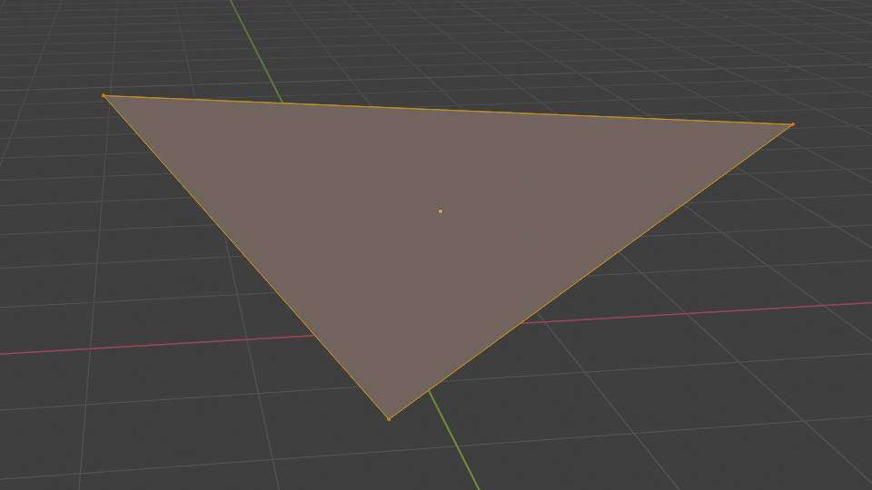
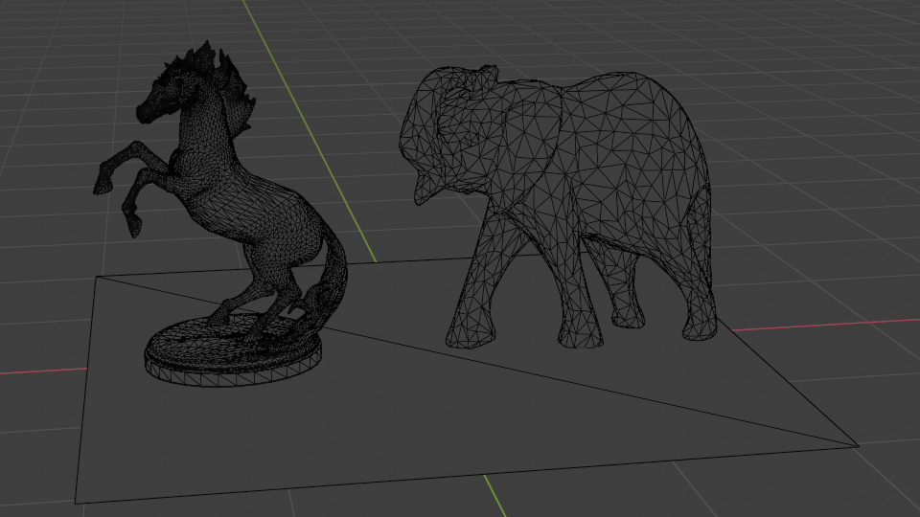
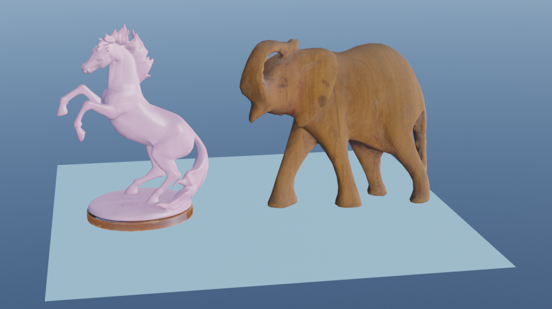
A intro note
For graphics rendering pipeline, we assume that all objects in 3D scene, that is, their shape is triangulated mesh.
When describing graphics rendering pipeline, we will then focus on one triangle or one vertex – but keep in mind that this is also done for all triangles for all objects/models in 3D scene

Slide 17
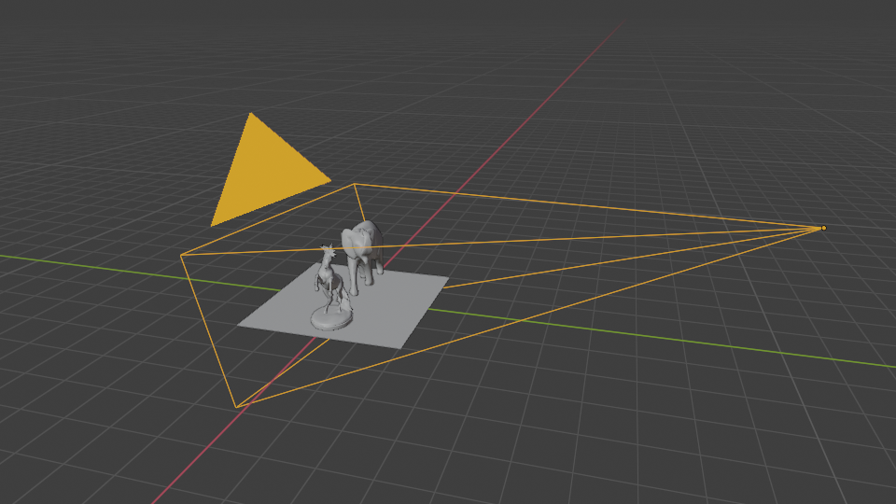
Graphics rendering pipeline
Virtual camera frustum and 3D objects.
Visibility: locations and shapes are determined by object geometry and camera placement.
Shading: appearance of objects detpends on materials, lights, textures, etc.
Main function of graphics rendering pipeline (shortly pipeline): render a 2D image from 3D scene (objects, lights, cameras)
  Underlying tool for real-time rendering
Rendering:
  Visibility calculation (which objects are visible from camera)
  Shading calculation (light-matter calculation and light transport)

Slide 18
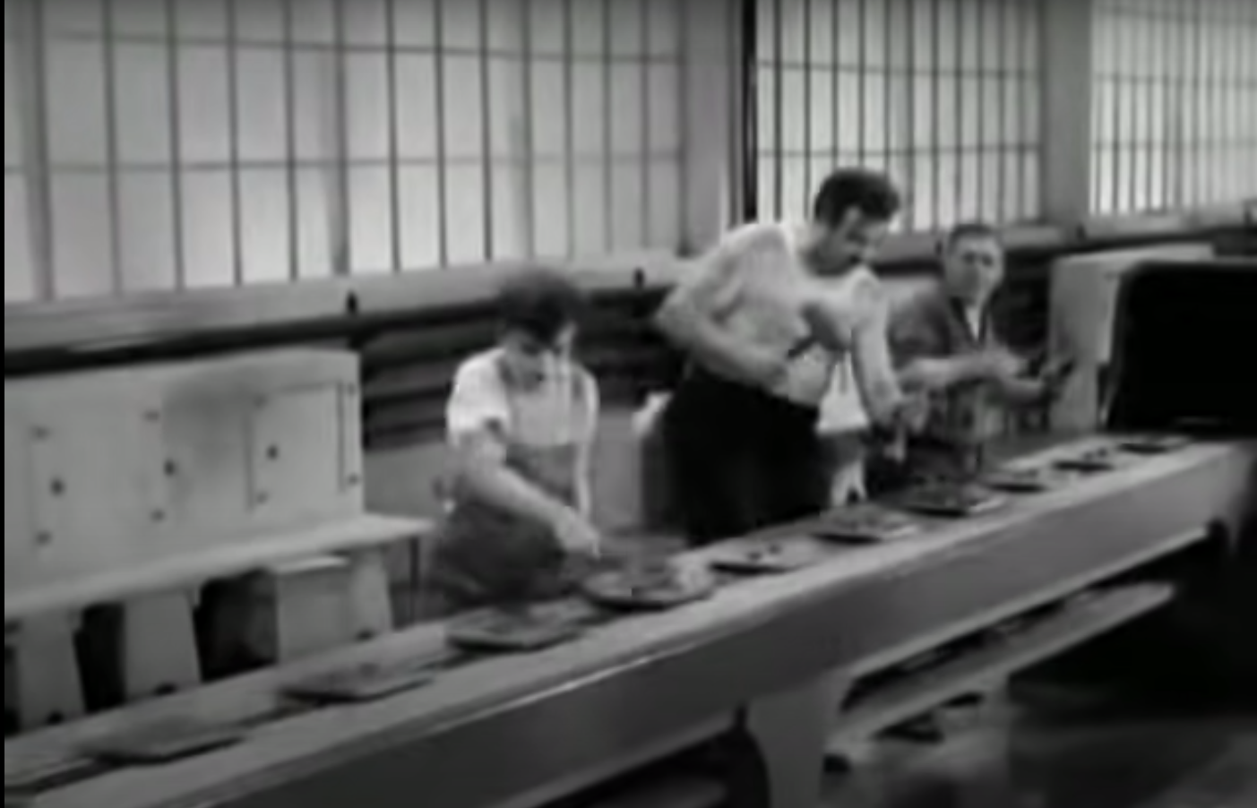
Graphics rendering pipeline
Graphics rendering pipeline is decomposed in smaller steps or stages:
  Each stage performs part of larger task
  Input of any given stage depends on the output of previous stage
  Sequence of stages forms rendering pipeline
  Pipeline stages, although working in parallel, are stalled until slowest stage is finished.
    Slowest stage is said to be bottleneck. Stages which are waiting are called starved.

Slide 19
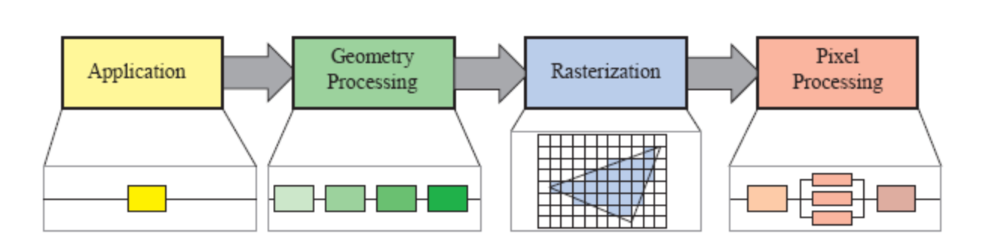
Graphics rendering pipeline: stages
Graphics rendering pipeline can be coarsely divided in four stages:
  Application
  Geometry processing
  Rasterization
  Pixel processing
May consists of several substages.
May be partly parallelized
Certain stages are fixed, some are configurable to certain extent and some are fully programmable. Trend is towards programmability and flexibility.
https://www.realtimerendering.com/

Slide 20
Graphics rendering pipeline overview
Graphics rendering pipeline
Application
Geometry processing
Rasterization
Pixel processing
Application
Vertex
shader
Tessellation
Geometry
shader
Clipping
Screen mapping
Triangle setup
Triangle
traversial
Pixel shader
Merging
(Optional)
(Optional)
Compute shader
Programmable
Configurable
Fixed

Slide 21
A note on pipeline abstraction
Functional stages – task to be performed but not how
Implemented stages – how are functional stages implemented in hardware and exposed to the user as API.
Logical model of GPU – exposed to a programmer by API. Physical model is up to the hardware vendor.

Slide 22
Pipeline: CPU and GPU
CPU implements application stage.
  CPUs are optimized for various data structures and large code bases, they can have multiple cores but in mostly serial fashion (SIMD processing is exception)
GPU* implements conceptual geometry processing, rasterization and pixel processing stage.
  GPUs are dedicated to large set of processors called shader cores – small processors that do independent and isolated task (no information sharing and shared writable memory) in a massively parallel fashion**.
* GPU – graphics processing unit, term coined by NVIDIA to differentiate GeForce 256 from previous rasterization chips. From then on, this term is still used.
** Memory access and transfer is huge topic and efficient handling of data transfer from CPU memory to GPU memory is important for efficient rendering. The term latency describes how much processor must wait for data access.

Slide 23
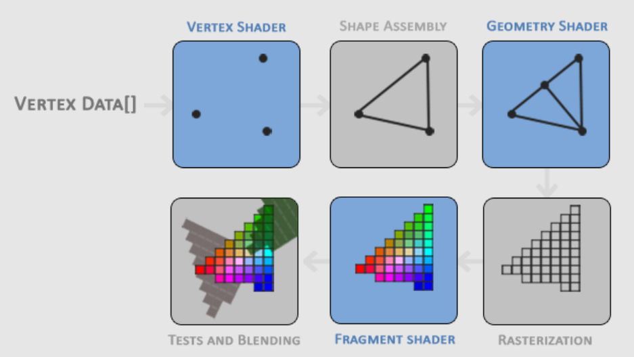
Pipeline: speed run
Application stage
  Driven by application implemented in software running on CPU
  e.g., for modeling tool application, user input is handled on application stage
Geometry processing
  Geometry handling (triangulated mesh): transformations, projections; what, how and where it is drawn
  Implemented on GPU that contains many programmable shader cores
Rasterization
  Takes 3 vertices which form a triangle, finds all pixels inside triangle and forwards to next phase
  Fixed implementation on GPU
Pixel processing
  Shading operation per pixel: calculating color and depth testing → programmable GPU shading cores
  Per-pixel operations, e.g., blending new and old pixel color → implemented on GPU
https://learnopengl.com/Getting-started/Hello-Triangle

Slide 24
1. Application stage

Slide 25
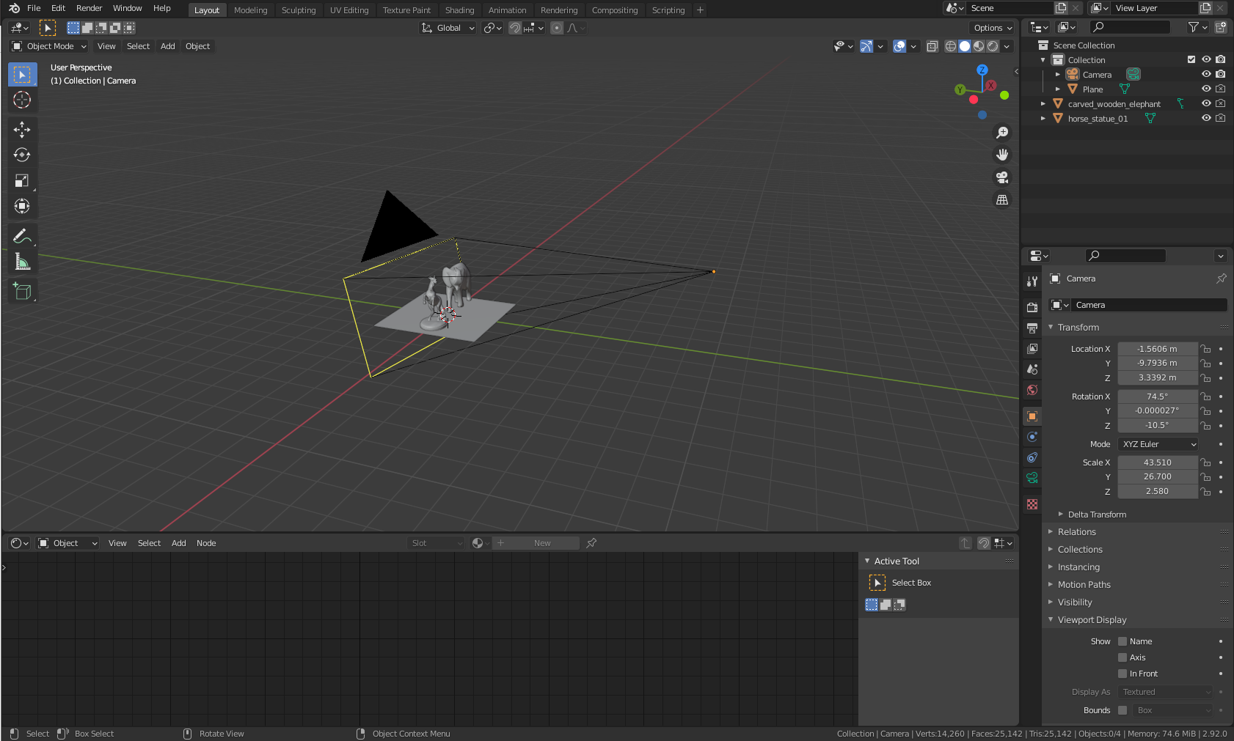
1. Application stage
Driven by application (e.g., modeling tool) and typically implemented on CPU (optionally on multiple threads).
  Developer has full control over what happens in this stage and how it is implemented

Slide 26
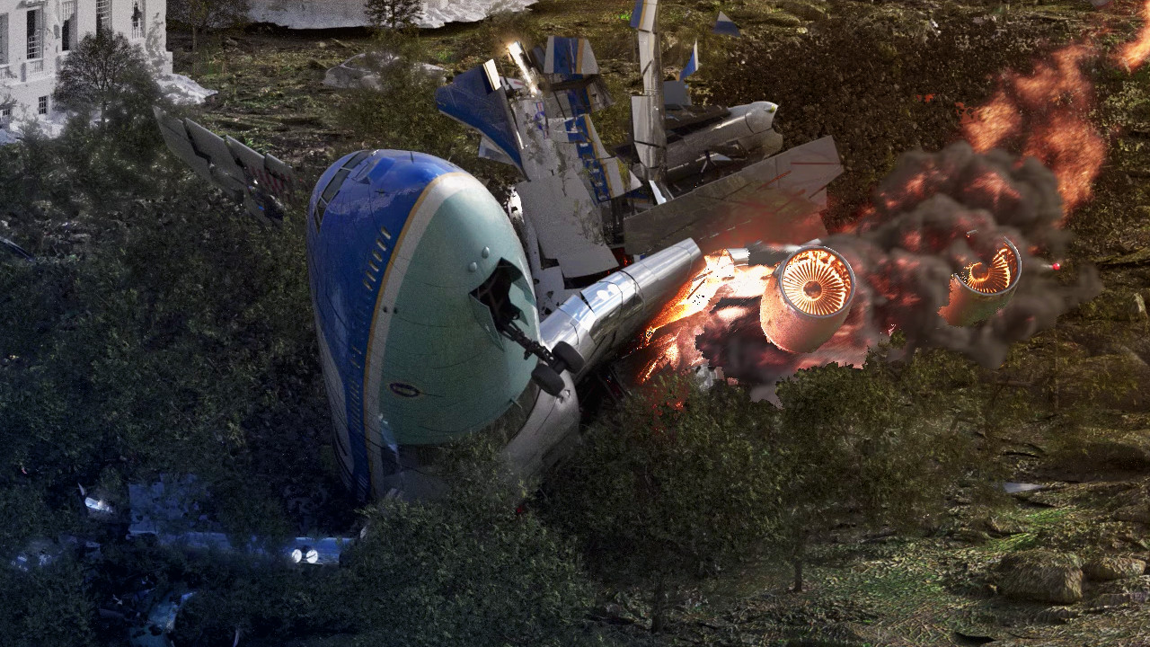
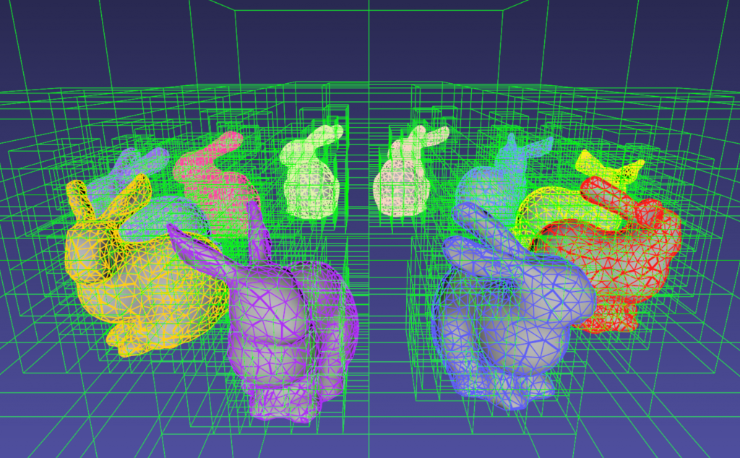

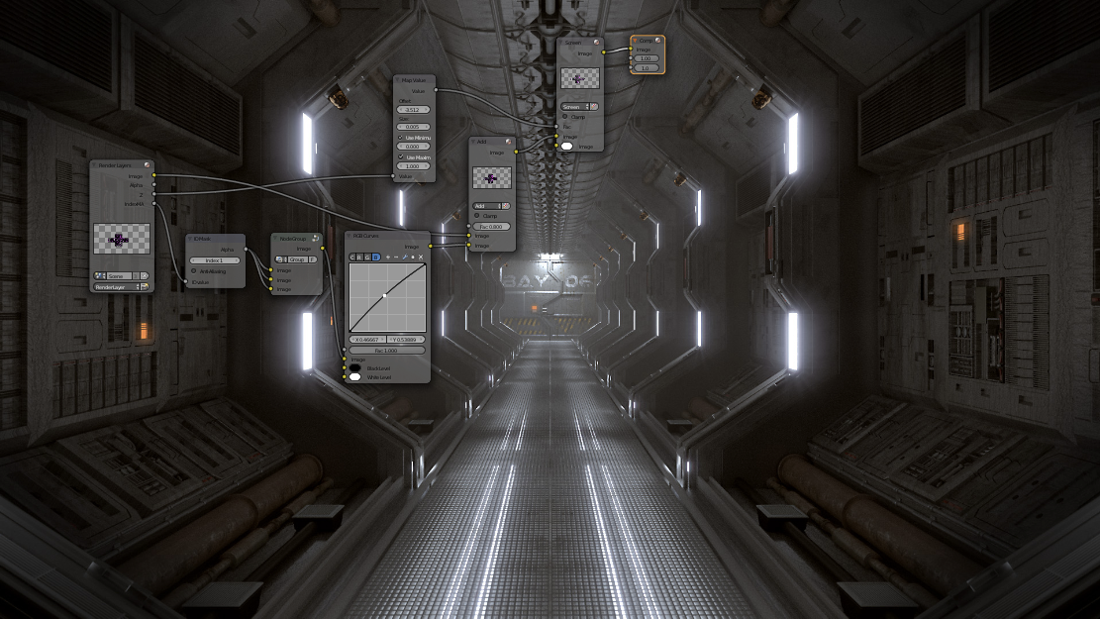
1. Application stage
Application stage includes tasks such as:
  taking care of user input from keyboard, mouse, etc. for interaction
  animation
  physics simulation
  collision detection – detection of collision between two objects and generating response
  3D scene acceleration structures (e.g., culling algorithms)
  Composition
  Other tasks depending on application which subsequent stages of pipeline can not handle
https://www.kitware.com/octree-collision-imstk/
https://www.blender.org/features/

Slide 27
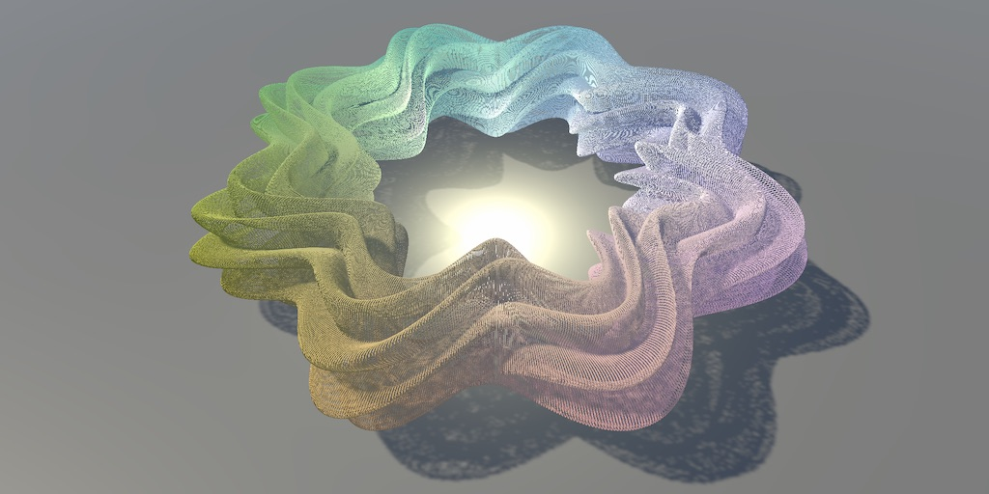
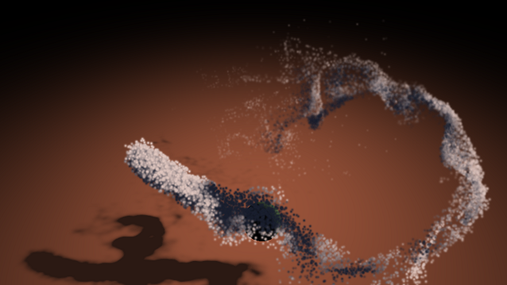
1. Application stage
Some work on application stage can be sent to GPU for processing – compute shader.
  Treat GPU as highly parallel general processor
https://arm-software.github.io/opengl-es-sdk-for-android/compute_particles.html
https://catlikecoding.com/unity/tutorials/basics/compute-shaders/

Slide 28
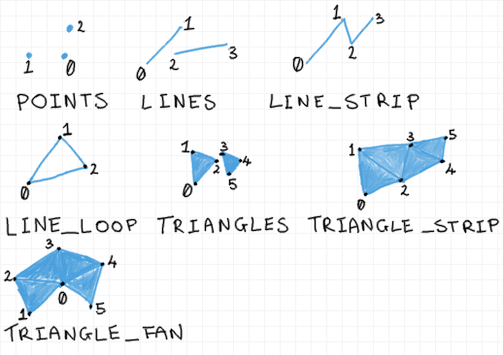
1. Application stage
Application phase outputs geometry to be rendered – rendering primitives: points, lines and triangles
Efficiency of this stage is propagated to further stage: geometry processing
  e.g., amount of geometry (triangles) sent to GPU
https://antongerdelan.net/opengl/vertexbuffers.html

Slide 29
2. Geometry processing stage

Slide 30
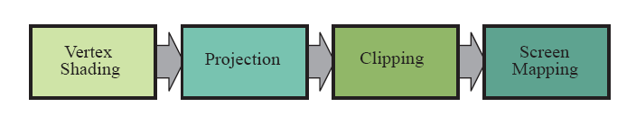
2. Geometry processing stage
Responsible for most of the per-triangle and per-vertex geometry operations
  Deals with transformations, projections and all other geometry handling
Computes what is drawn, how and where
Divided into following functional stages:
  2.1. Vertex shading (vertex shader)
  2.2. Projection
  2.3. Clipping
  2.4. Screen mapping

Slide 31
2.1. Vertex shading
First stage on GPU, completely under programmer’s control.
Before this stage, data manipulation from application stage is done by input assembler
  For example, an object can be represented by array of positions and array of colors. Input assembler would create object’s primitives (e.g., triangle) by creating vertices with positions and colors.
First stage to process a triangle mesh. It provides a way to modify, create or ignore values associated with each triangle’s vertex (e.g., color, normal, texture coordinates and position).
  Note that normals do not have to be triangle normals rather normals of smooth shape which triangle mesh represents.
  Note that vertex shader can not create new vertices or destroy existing ones
Two main tasks:
  Compute position of vertex given input from application stage
  Evaluate/set-up any additional vertex data output desired by programmer such as normal and texture coordinates

Slide 32
Vertex shading applications
An example of vertex shader task is animating objects using transformations on vertices.
  Vertex blending – RTR 4.4
  Morphing – RTR 4.5.
Object generation: creating mesh once and then deforming it by vertex shader
Animating characters using skinning and morphing
Procedural deformations such as cloth or water
Instancing objects: copying same object in different positions in the scene.
Particle creation: using degenerate (no area) mesh down the pipeline and using those as positions where instancing takes place
VFX: lens distort, heat haze, water ripples, page curls
Terrain modeling by applying height fields given by texture

Slide 33
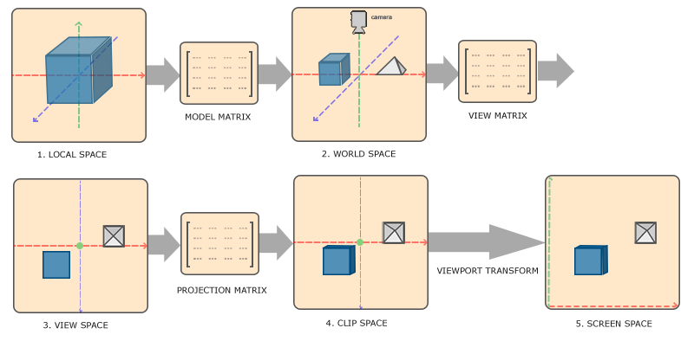
Vertex shading: computing vertex position
Vertex positions of a model is minimal information that has to be passed from application stage to vertex shading stage.
On the way to rasterization stage, vertex shading performs transformation of a model in several different spaces or coordinate systems:
  Model/local space
  World space
  View/camera space

Slide 34
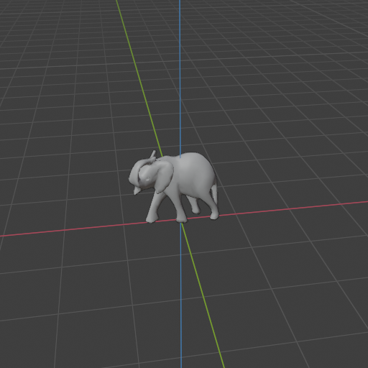
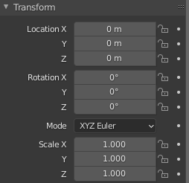
Model space
Originally, model (vertex positions) given to vertex shading stage is in its own space – model space.
  Model space → model has not been transformed at all.
Each model can be associated with model transform – for positioning and orienting
Model transform is applied on model’s vertices and normals.
  Coordinates of a object are also called model coordinates.
World coordinates

Slide 35
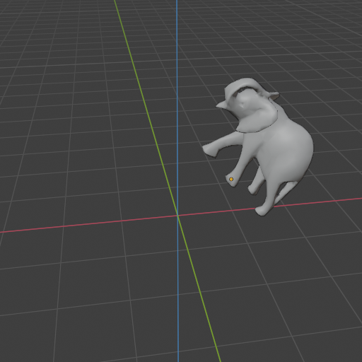
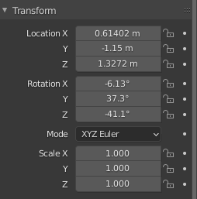
World space
After model transform has been applied on model coordiantes, the model is said to be in world coordinates or world space.
  World space = scene
World space is unique and after all models have been transformed with their respective model transforms, they all exist in the same space – world space.
Model transform is defined on application stage and performed by vertex shader.
Model transform
World coordinates
World coordinates

Slide 36
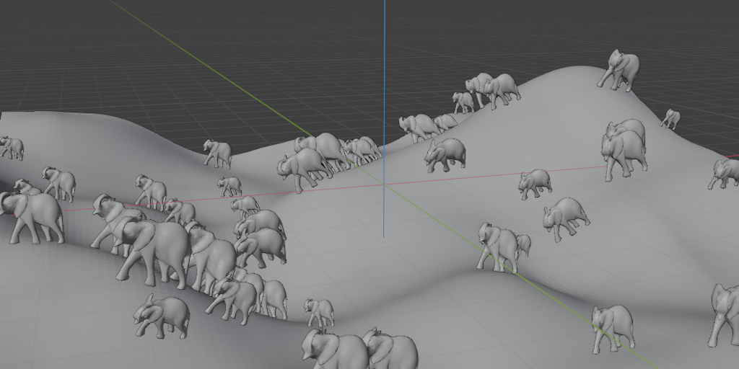
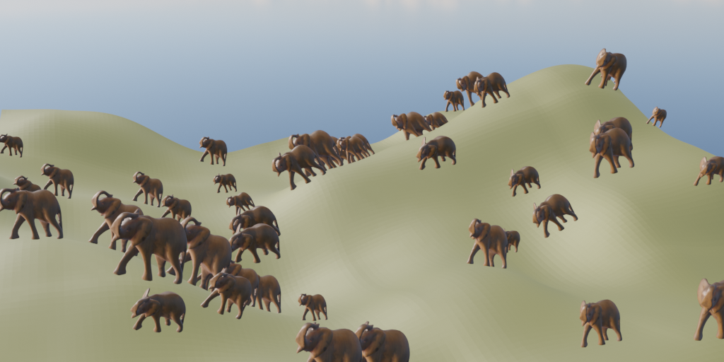
Model transform
Each model can have multiple transforms
  This allows copying the same model across the 3D scene without specifying additional geometry – instancing
  Same model can have different locations, orientations and sizes in the same scene.

Slide 37
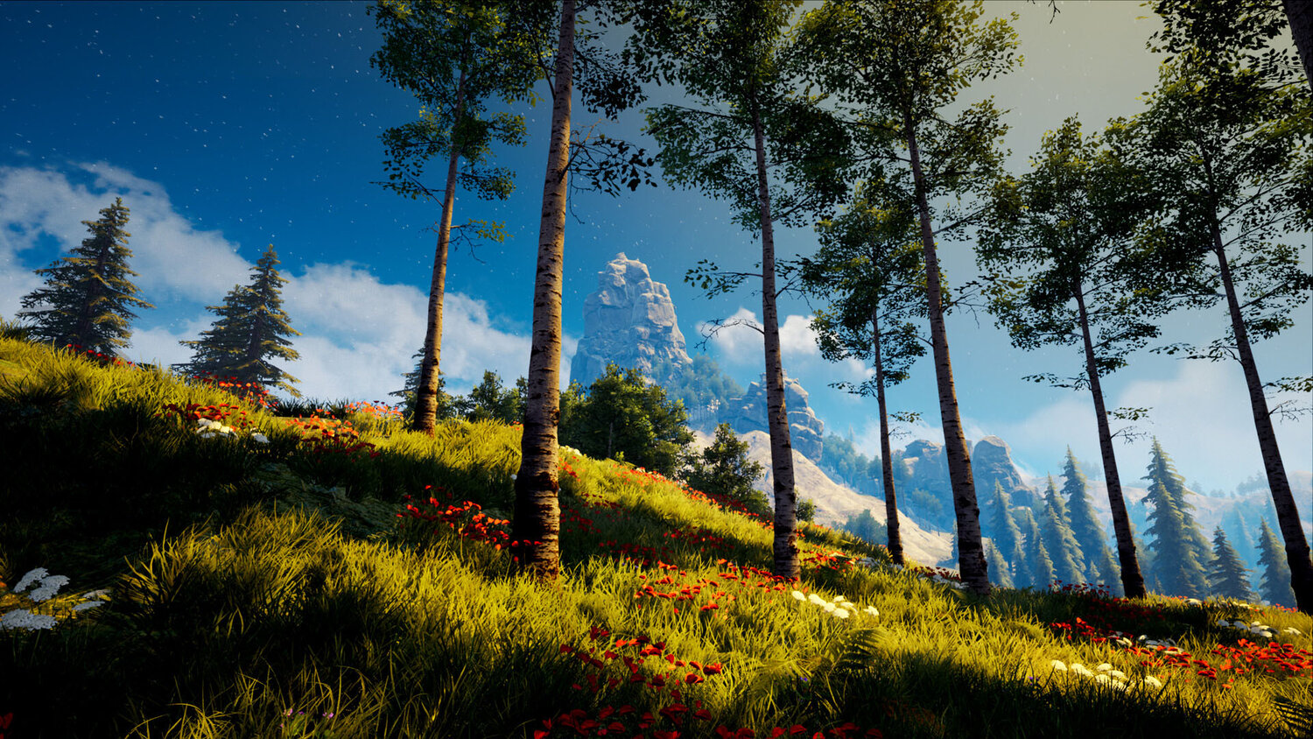
Instancing
Very much used for environment art and object placing repeating objects in 3D scene
https://www.exp-points.com/junliang-zhang-procedural-environment-houdini-ue4

Slide 38
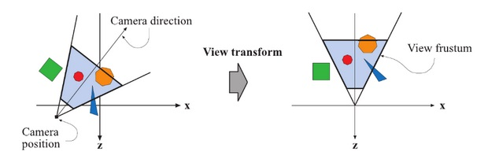
Camera (view, eye) space
Only objects visible from camera are rendered.
Camera has a location and orientation in world space.
Further pipeline stages (projection and clipping) require camera and all objects to be in view (camera) space.
View transform is applied to all objects and camera
  Result: camera is placed in world origin and aimed in negative z axis with y pointing up and x pointing right*.
View transform is defined on application stage and performed by vertex shader.
https://www.realtimerendering.com/
* This convention is called negative z axis convention. Another convention is positive z axis convention. All are fine but must be consistently used when decided. Actual position and direction after view transform are dependent on underlying API.

Slide 39
Digression: camera
Similarly as object vertices are defined on application stage, camera properties are also
Camera properties can be described with location and transformation matrices which are sent further down the pipeline

Slide 40
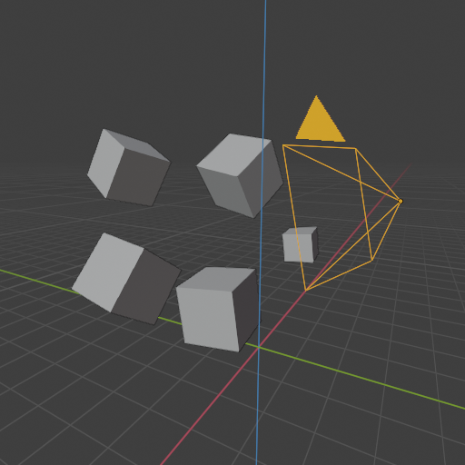
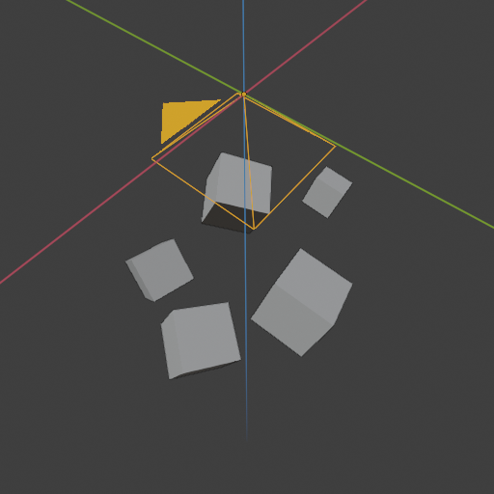
Camera (view, eye) space
After view transform, the model is said to be in camera (view or eye) space.
Model and view transform can be implemented as one 4x4 matrix for efficient multiplication with vertex and normal vectors.
  Note: programmer has full control over how the position and normals are computed.
X
Y
Z
Model and view transform

Slide 41
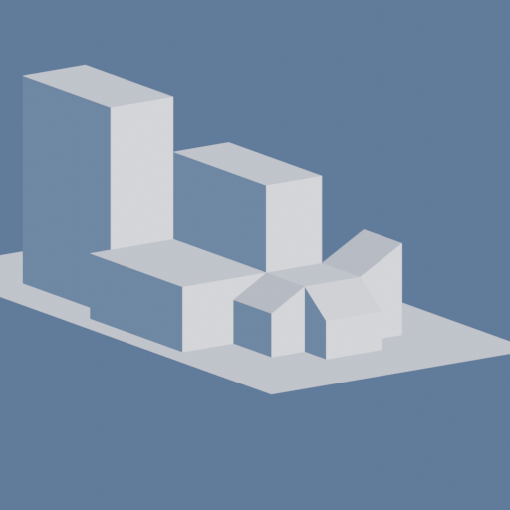
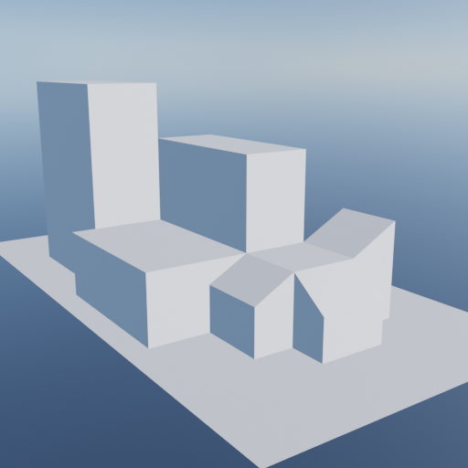
Projection
After models are transformed to camera space, a projection is applied.
Two commonly used projection methods:
  Orthographic
  Perspective
Projection is represented as matrix and can be combined with other geometry transforms: model and camera.
  Projection matrix is defined in application stage and applied in vertex shader on object vertices.

Slide 42
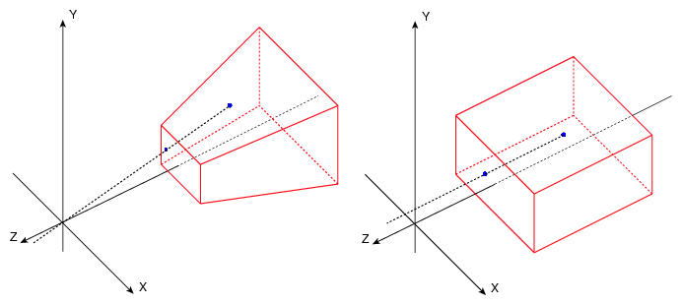
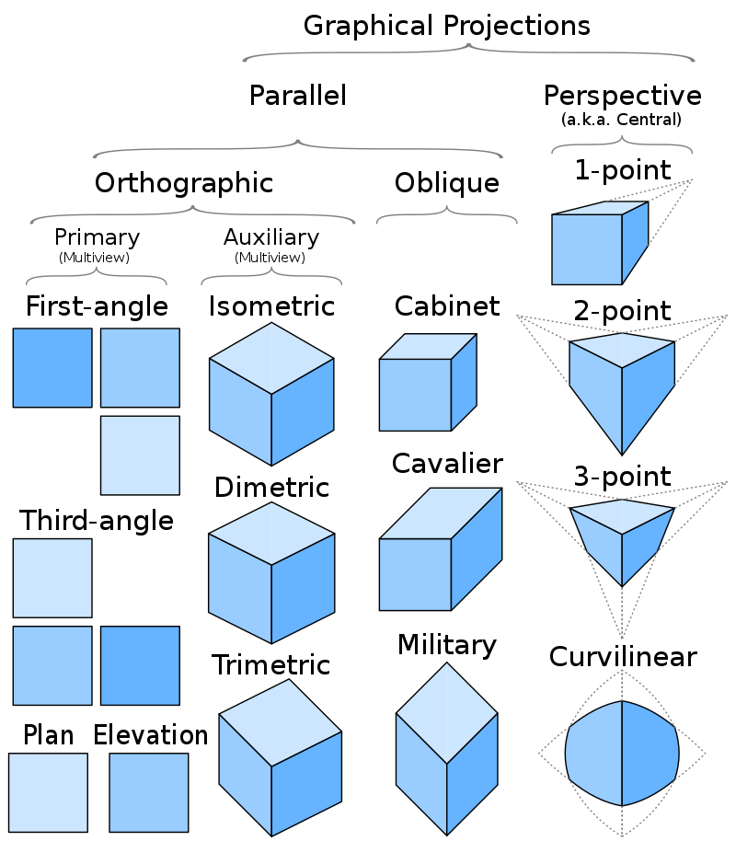
Orthographic projection
Orthographic projection is just one type of parallel projection.
View volume of orthographic projection is rectangular box
Characteristics:
  parallel lines remain parallel
  Objects maintain the same size regardless of distance from camera
https://blender.stackexchange.com/a/649

Slide 43
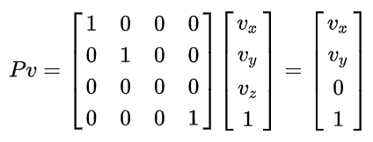
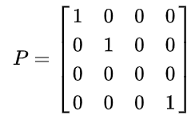
Orthographic projection
Simple orthographic projection projects onto plane z = 0
  View volume of orthographic projection is rectangular box
  z coordinate is simply set to 0 → information of depth is lost!

Slide 44
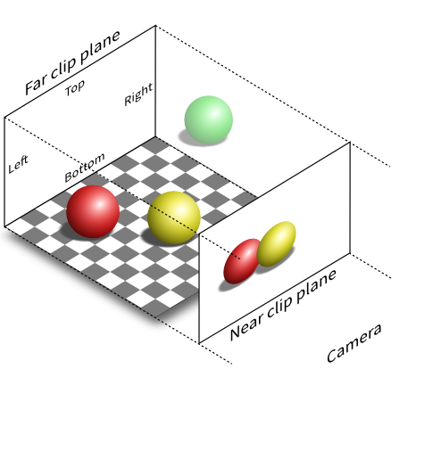
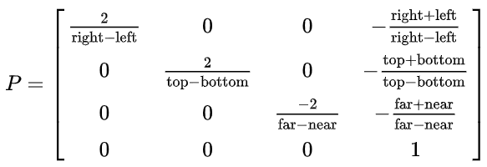
Orthographic projection
General orthographic projection is expressed using orthographic frustum
  Extremes are viewing frustum near (n), far (f), left (l), right (r), top (t) and bottom (b)
  This matrix scales and translates axis aligned bounding box formed by these planes into axis-aligned cube centered around origin
  In OpenGL*, minimum corner is (-1,-1,-1) and maximum (1,1,1) → canonical view volume
* DirectX has bounds (-1,-1,0) and (1,1,1)
https://stackoverflow.com/q/36573283

Slide 45
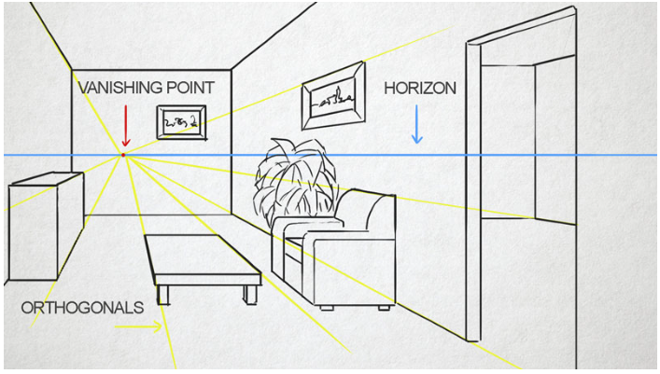
Perspective projection
The view volume is called fustum
  Truncated pyramid with rectangular base
Characteristics:
  The further the object, the smaller appears
  Parallel lines converge at single point → mimics how humans perceive objects
https://thevirtualinstructor.com/onepointperspective.html

Slide 46
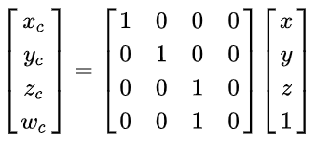
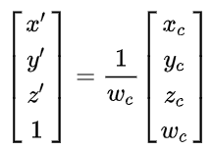
Perspective projection
Simple perspective projection is projecting points on a plane z = 1 → information on depth is lost!
After multiplication with perspective matrix, homogeneous coordinate w_{c} will be equal to vertex coordinate z. Other stays the same
Perspective divide gives vertex on a plane

Slide 47
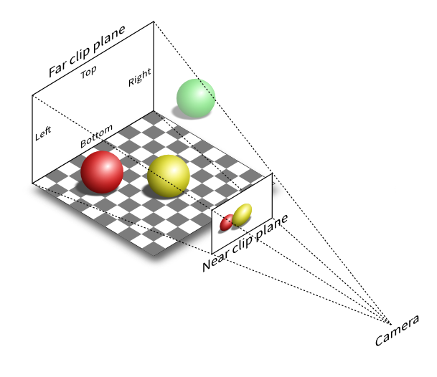
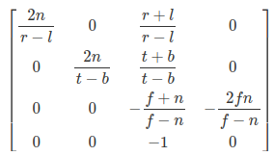
Perspective projection
General perspective projection transforms viewing frustum to cube for which minimum corner is (-1,-1,-1) and maximum (1,1,1) → canonical view volume
  General perspective projection matrix is defined with viewing frustum near (n), far (f), left (l), right (r), top (t) and bottom (b)
Construction of this matrix is supported by various libraries and supported in OpenGL Utility Library (GLU) as gluPerspective() https://registry.khronos.org/OpenGL-Refpages/gl2.1/xhtml/gluPerspective.xml

Slide 48
Projection
After projection coordinates are in clip space - clip coordinates
  These are homogeneous coordinates (division with w occurs later)
  Vertex shader must output this type for next, clipping stage
z-coordinate is not stored in generated image but as a depth-buffer/z-buffer
  Model is projected from three to two dimensions.

Slide 49
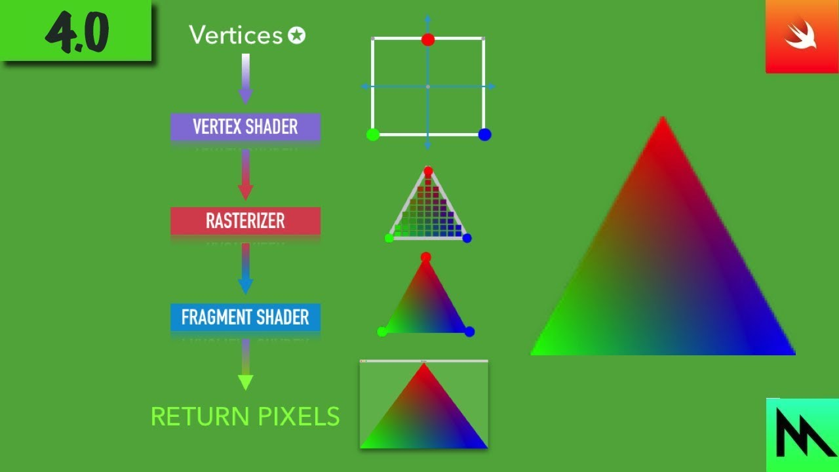
Vertex shading: computing additional vertex output data
Shading can also be performed on this stage*
  Computing color using on vertex data (position, normal, material) and light
  Result is stored as color per vertex which is later interpolated and used cross triangle and pixels
  Vertex shading is performed using vertex shader using vertex data defined on application stage.
https://www.youtube.com/watch?v=F7bpcyPhiH8&ab_channel=2etime
* Used when simpler and more faster shading is needed. This is why programmable vertex processing unit was named “vertex shader” also the name: “vertex shading” performed by this stage which is kept even today. In modern GPU-s and API-s, some or all shading takes place in pixel processing stage. Vertex shading stage is more general and doesn’t have to perform equation at all – depending on programmer. Vertex shader is more ge neral unit dedicated to setting up data associated with each vertex.

Slide 50
Vertex shading: computing additional vertex output data
By now we discussed how vertices are processed in vertex shading stage. This data gives information about object shape but not its appearance.
Appearance is dependent on object material and light sources in the scene.
  Materials and lights can be modeled in any number of ways: from simple color to elaborated physical descriptions which determine or are used for computing the color.
Alongside vertex position and normal, material and light sources data are used in shading. Shading involves computing the shading equation which relies on those data.
Shading is performed at various points on object. It can be performed both in vertex shading stage or pixel processing stage.
Data used for shading can be stored per vertex: location, normal, material parameters (e.g., color, texture coordinates) or any other numerical information needed for evaluating shading equation.
All the mentioned data is sent to rasterization and pixel processing stage for interpolation across triangle and shading in each pixel of triangle.

Slide 51
Optional vertex processing
Standard use of GPU’s pipeline is to send data through vertex shader, then rasterize the resulting triangles and process those in the pixel shader.
Optional processing are:
  Tessellation – curved surface can be generated with appropriate number of triangles. Sub-stages: hull shader, tessellator and domain shader
  Geometry shader – takes in various primitives (e.g., triangles) and creates new vertices. Often used for particle generation – e.g., a set of vertices are given and square can be created for more detailed shading.
  Stream output – instead of sending vertices down the pipeline, these can be outputted for further processing to CPU or GPU.
Usage of those depends on GPU hardware (not all GPU supports those stages) and application.

Slide 52
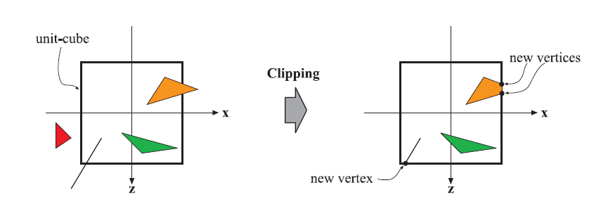
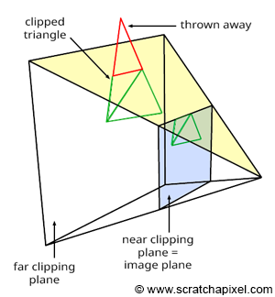
Clipping
Only primitives that are partially of fully in view volume need to be passed to the rasterization stage and pixel processing for drawing on screen.
Primitive that is fully in view volume will be passed further without clipping
Primitives that are partially in view volume require clipping.
  After projection, clipping of primitive is done against unit cube.
  Vertex that are outside of view volume is removed. New vertices are created on clipping position.
Clipping uses clip coordinates resulted from projection.
  Fourth coordinate is used for correct interpolation and clipping if perspective projection is used.
Finally perspective division is performed
  Resulting triangle positions are in normalized device coordinates (NDC) – a canonical view volume that ranges from (-1, -1, -1) to (1,1,1).

Slide 53
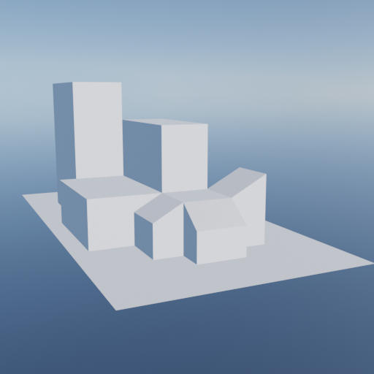
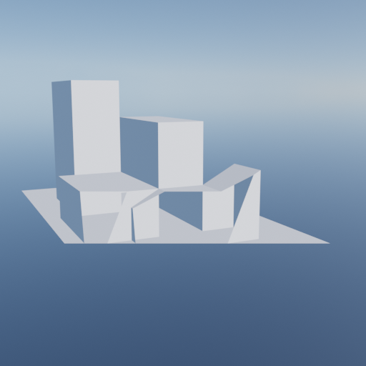
Clipping
Additional clipping planes can be introduced by programmer to chop the visibility of objects

Slide 54
Screen mapping
Clipped primitives inside view volume are passed on screen mapping.
Coordinates entering this stage are still 3D.
y and y coordinates are transformed to form screen coordinates.
  Screen mapping is translation followed by scaling to map to screen with dimensions (x1,y1) and (x2, y2).
  <IMAGE>
Screen coordinates with z coordinates are called window coordinates.
  Z coordinates are mapped in (0,1). DX vs GL.
  <IMAGE>
Window coordinates are passed to the rasterizer stage.

Slide 55
3. Rasterization stage
Given transformed and projected vertices (with associated shading data) the goal is to find all pixels which are inside the primitive (e.g., triangle*) to be used in pixel processing stage.
  Typically takes input of 3 vertices forming a triangle, finds all pixels that are considered inside the triangle and forwards those further
  Rasterization (screen conversion) is conversion from 2D vertices in screen space into pixels on the screen.
  To test if triangle is overlapping a pixel, different methods exist. Point sampling may be used where only center of pixel is used for testing. Often, multiple samples per pixel are desired to evade aliasing problems – multi-sampling or anti-aliasing.
Two functional sub-stages**:
  3.1.Triangle setup
  3.2 Triangle traversal
* Point and line primitives sent down the pipeline also create fragments for covered pixels.
** Those can also process points and lines, but triangle is most often used primitive and thus the name.

Slide 56
3.1 Rasterization: triangle setup
Data needed for triangle traversal, interpolation and shading are computed here (e.g., differentials, edge equations)
Programmer has no control over it.

Slide 57
3.2 Rasterization: triangle traversal
Each pixel sample is checked if covered by a triangle. Finding which samples for which pixels are inside a triangle is called triangle traversial
Part of the pixel that overlaps the triangle is generated and called the fragment
Each triangle fragment properties are generated using data interpolated among three triangle vertices, taking in account perspective – perspective-correct interpolation*.
  Properties: fragment depth and any shading data from geometry processing stage.
All pixels, that is fragments are sent to pixel processing stage.
* Another type of interpolations are available; such as screen-space interpolation where perspective is not taken in account.

Slide 58
4. Pixel processing stage
All pixels or pixel fragments that are considered inside a triangle (or other primitive) are found in previous stages. Now, computations on those are made.
Pixel processing stage can be divided into:
  4.1 Pixel shading
  4.2 Pixel merging
Executes program per pixel to determine its color and if color is visible (depth testing) as well as blending of pixel colors with newly computed with old color.
Runs on GPU.

Slide 59
4.1 Pixel processing: pixel shading
Any per-pixel (fragment) shading performs here
  For computation, interpolated shading data from previous stage is used
Result of this stage is one or more colors for each pixel/fragment that are passed further the pipeline
Pixel shading stage is peformed by programmable GPU cores
  Programmer supplies a program for pixel (fragment) shader that contain any desired computations.
  Most commonly, here we can define shading equations (scattering function) and texturing: putting one or more images to the object or procedural defining a texture pattern.

Slide 60
4.2 Pixel processing: pixel merging
Information for each pixel (generated in pixel shader) is stored in color buffer – rectangular array of of colors (r,g,b).
This stage is responsible to combine (blend) fragment color produced by pixel shading stage with the color currently stored in color buffer using depth values of those fragments (also available after pixel shader stage).
  For opaque surfaces not blending is needed: fragment color simply replace the previously stored color
  Blending of fragment and stored color is important for transparent objects and compositing operations.
  This stage is also called raster operations pipeline (ROP) or render output unit*.
This stage is not fully programmable, but highly configurable** for achieving various effects (e.g., transparency). It uses following buffers for computations:
  Z-buffer
  Alpha channel (part of color buffer)
  Stencil buffer
Frame buffer generally consists of all buffers on a system.
* DirectX calls this stage output merger. OpenGL calls this stage per-sample operations.
** Some APIs have support for raster order views – pixel shader ordering – which enables programmable blending capabilities (Real-Time Rendering Book).

Slide 61
Pixel processing: z-buffer
When the whole scene has been rendered, the color buffer should contain colors of the primitives (e.g., triangles) in the scene visible from camera point of view.
For most graphics hardware this is achieved using, z-buffer (depth buffer).
  Z-buffer is same size and shape as color buffer, but for each pixel it stores z-value to the closest primitive.
Z-value and color of pixel are updated with z-value and color of pixel being rendered
  When a primitive is being rendered at a certain pixel, z-value at that pixel is being computed and compared to the z-buffer: if new z-value is smaller then one in z-buffer then that pixel is rendered closer to camera than previous pixel - which means updating color and z-buffer. Otherwise, color and z-buffer are not changed.
Z-buffer algorithm is simple and of O(n) complexity, where n is number of primitives
Z-buffer algorithm works for any primitive for which z-value can be computed, allows primitives to be rendered in any order and thus very much used – order independent.
Z-Buffer stores only single depth value for each pixel – in the case of partially transparent objects; those must be rendered after all opaque primitives with end to front order* (or using order-independent algorithm), thus transparency is major weakness of z-buffer.
* Many algorithms require a specific order of execution. Often example is drawing transparent objects. In the standard pipeline, the fragment results are sorted in merger stage before being processed. DirectX API introduced rasterizer order views (ROV) to enforce order of exectution.

Slide 62
Pixel processing: z-buffer
Let’s recap the pipeline for now:
  Fragment generated by rasterization
  Fragment is then run through pixel shader
  Finally, in merging stage, this fragment is tested for visibility using z-buffer
In third step, fragment can be discarded and all processing that was done was unnecessary.
Therefore, many GPUs perform some merge testing before pixel shader is exectued.
  Z value of fragment is available after rasterization and it can be used for testing visibility and culling if hidden before pixel shader → early-z technique
  Note that pixel shader can change z-depth of the fragment or discard whole fragment. In this case, early-z is not possible.

Slide 63
Pixel processing: alpha channel
Color buffer also contains information about alpha value – alpha channel.
Alpha value stores opacity value for each pixel.
Alpha value can be used for selective discarding of pixels using alpha test feature of pixel (fragment) shader.
  Using this test, we can ensure that fully transparent pixels/fragments do not affect the z-buffer

Slide 64
Pixel processing: stencil buffer
Stencil buffer is the type of so called offscreen buffer* – buffer that records locations of rendered primitives but not for directly showing on a screen rather used for pixel merging stage.
  For example, we can render filled rectangle into stencil buffer. This buffer is then used to render scene primitives into the color buffer only where the rectangle is present
Stencil buffer is used in combination with different operators which are offers powerful tool for generating some special effects.
* This type of buffer is often used for advanced rendering (shading) techniques not only for stencil buffer.

Slide 65
Pixel merging: color blending
As mentioned, merging stage is not programmable but highly configurable.
Color blending in particular can be set up to perform a large number of operations: combinations of multiplication, addition, subtractions, min, max, bitwise logic involving color and alpha values

Slide 66
Multiple render targets
Instead of sending results of pixel shader’s program to just color and z-buffer, multiple sets of values can be generated for each fragment and saved to different buffers – render targets.
Multiple rendering targets functionality is powerful aid in performing rendering algorithms more efficiently.
  Single rendering pass can generate a color image in one target, object identifiers in second and world space distances in third.
  This inspired different type of rendering pipeline called deferred shading – visibility pass and shading are done in separate passes. First pass stores data about object’s location and material at each pixel. Successive passes can efficiently apply illumination and other effects.
Different buffers that are generated can be used for compositing purposes.

Slide 67
Digression: Note on pixel shader
Pixel shader can write to a render target at only the fragment location handed to it – reading of current results from neighboring pixels is not possible – computations are performed only at given pixel.
To solve this problem, output image can be created with all required data and accessed by a pixel shader in a later pass.
Also, pixel shader is provided with the amounts by which any interpolated values change per pixel along x and y direction – gradient (derivative) information.
  This is, for example, useful for texture filtering – where it is important to know how much of texture image covers a pixel.
Graphics APIs (e.g., OpenGL, Vulkan and DirectX) are constantly evolving enabling more flexibility*.
* DX11 introduced a buffer type that allows write access to any location – unordered access view (UAV). OpenGL calls this buffer shader storage buffer object (SSBO).

Slide 68
Compute shader
Compute shader is form of GPU computing, not locked into a location in the graphics pipeline.
  It is like shader we discussed: it has some input data, can access buffers (e.g., texture) for input and output.
  Using hardware this way is called GPU computing – CUDA and OpenCL are used to control the GPU as massive parallel processor.
It is closely tied to the process of rendering graphics API: it is used alongside vertex, pixel and other shaders.
It is used in:
  Post-processing: modifying rendered image with certain operations
  Particle systems: computing behavior of particles
  Mesh processing: facial animation
  Culling
  Image filtering
  Improving depth precision
  Shadows calculation
  Depth of field
  Replacing tessellation hull shaders.
With compute shaders, GPU can be used more than implementing traditional graphics pipelines:
  Training neural networks

Slide 69
Displaying pipeline output
Primitives that have reached and passed rasterizer stage (remember that a lot of those are discarded) are visible from camera point of view
Display device will show color buffer after all operations are done.
As this takes some time (visible to human eye), a technique called double buffering is used.
  Rendering of screen is performed in a back buffer – a off screen buffer.
  Contents of back buffer are swapped with the contents of front buffer – buffer which is shown on display device.
  Swapping process occurs* during vertical trace – a time when it is safe to do so.
* In APIs such as OpenGL and Vulkan the term swap chain is used for this process https://en.wikipedia.org/wiki/Swap_chain

Slide 70
Example of pipeline in application
Example: CAD program
Application stage:
  Enables user to select and move parts of the model. Selection and movement is done using mouse pointer. Thus, application stage must translate mouse movement into transformation matrix (e.g., translation or rotation) which is used in subsequent stage
  Enables user to move camera in 3D scene to view the model from different angles. Thus, camera parameters such as position and view direction must be updated by application.
  For each frame (CAD programs are real-time when in modeling mode) application must provide information for next – geometry stage: camera position, lighting and primitives of the model.
Geometry processing
  Application provided parameters of the camera which includes projection matrix. Next, application, for each object, calculates a matrix which describes location and orientation of the object.
  Object is put in view space and optionally shading per vertices is preformed using provided light and material information.
  Projection is applied on the object tranforming it in unit cube space that represents what the eye sees. Primitives outside of that cube are discarded. Primitives intersecting this cube are clipped.
  Finally, vertices are mapped into the window on the screen
Rasterization
  All primitives coming from geometry stage are rasterized: all pixels (fragments) inside a primitive are found and sent for pixel processing.
Pixel processing
  Color of each pixel obtained from rasterization is computed using material information (colors, textures, shading equations) and visibility is resolved using z-buffer algorithm with optional discard and stencil testing.
  Each object is processed and final image is displayed.

Slide 71
Graphics rendering pipeline in practice
Code

Slide 72
Application of graphics rendering pipeline
Graphics rendering pipeline is implemented on GPUs and is basis for real-time rendering
Now, we will discuss practical application of graphics rendering pipeline.

Slide 73
Graphics rendering pipeline: OpenGL
Application
  Assimp
  RTR: 16.4.
Vertex shader
Fragment shader
  https://learnopengl.com/Lighting/Basic-Lighting
Output

Slide 74
Graphics rendering pipeline in practice
Production

Slide 75
Show graphics pipeline rendering example in Blender EEVEE

