Slide 1
Lecture 9: Light, Color and Shadows
DHBW, Computer Graphics
Lovro Bosnar
22.2.2023.

Slide 2
Syllabus
3D scene
  Object
  Light
  Camera
Rendering
Image and display
Light
  Light and color
  Real world light sources
  Light models
    Physical lights
    Non-physical lights
    Environment illumination
  Shadows

Slide 3
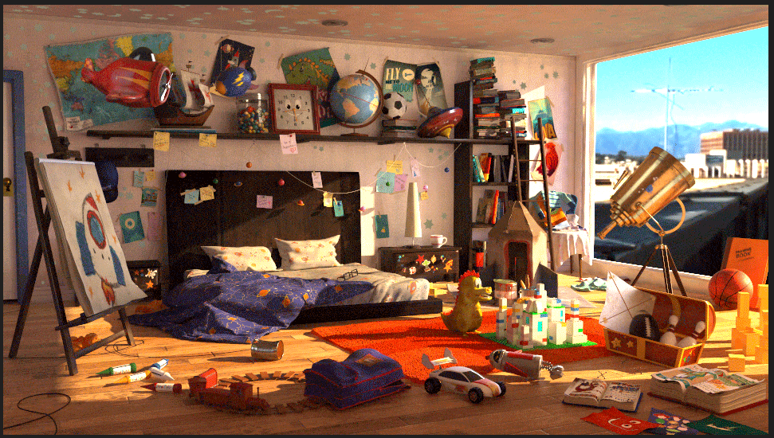
https://discover.therookies.co/2018/06/24/learn-how-to-light-and-render-like-a-pixar-artist/

Slide 4
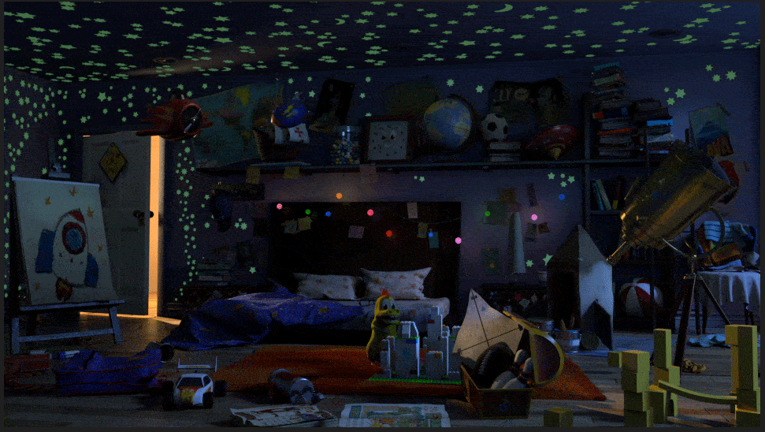
https://discover.therookies.co/2018/06/24/learn-how-to-light-and-render-like-a-pixar-artist/

Slide 5
Light is important because without light...

Slide 6
Light sources with size and shape would be visible if we would look towards them.

Slide 7
Light and color

Slide 8
Light and color
Color: visual perception of light spectrum
Color can not be fully described scientifically: is also result of vision system thus subjective
Color science:
  Approach 1: how brain processes visual stimuli into what is perceived as color
  Approach 2: use of color from artist point of view
  Approach 3: study of electromagnetic waves: nature of light
Color management
  Study of color for digital displays

Slide 9
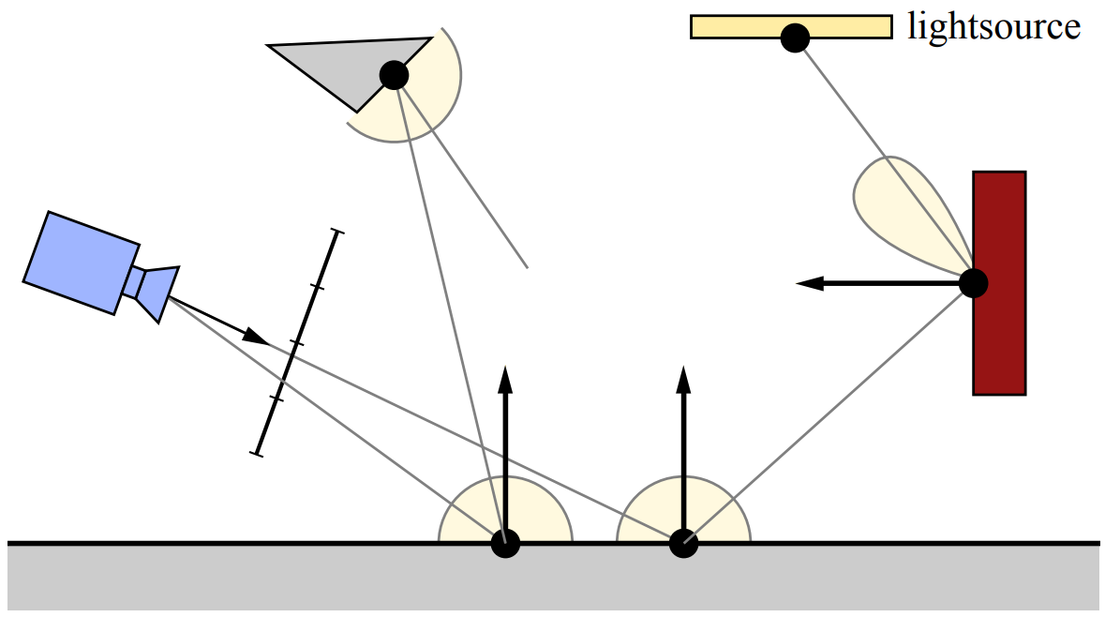
Light and image formation
Light is emitted from light sources, travels along rays and interacts with object in the scene (e.g., surface reflection)
Image created when light falls on the sensor (e.g., camera film)
This process is described with rendering equation
Camera
Captures light
Light reflection
Light travel
Forward tracing
VS
Backward tracing
Light reflection

Slide 10
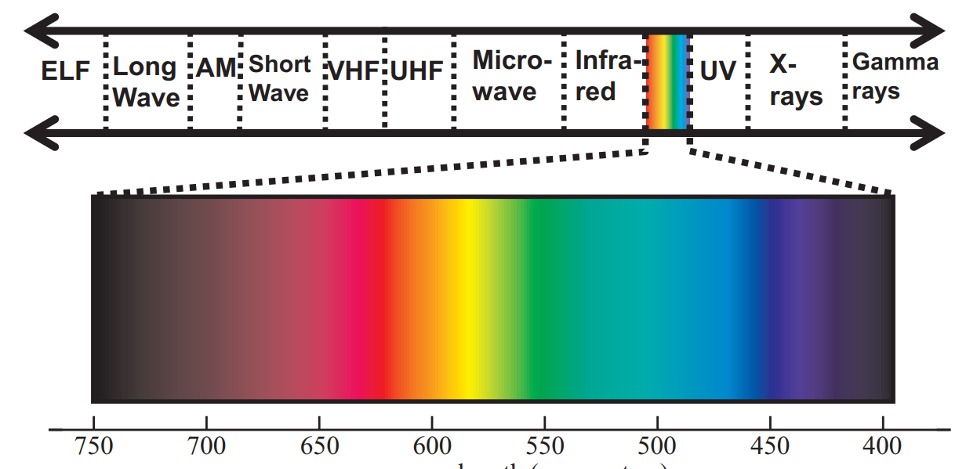
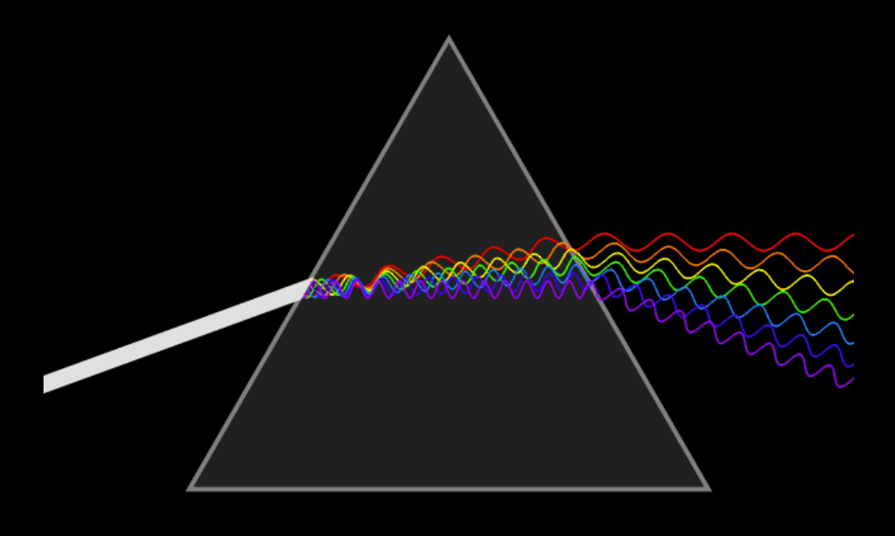
Light frequency and color
Light is electromagnetic wave (or particle) visible by eye
  Visible spectrum: wavelength 400 – 700 nm
Different wavelengths (frequencies) are perceived as different color
  color is perceptual (psychophysical) phenomena rather than physical one
White light is made of all visible colors https://en.wikipedia.org/wiki/Dispersive_prism
https://blog.selfshadow.com/publications/s2013-shading-course/#course_content

Slide 11
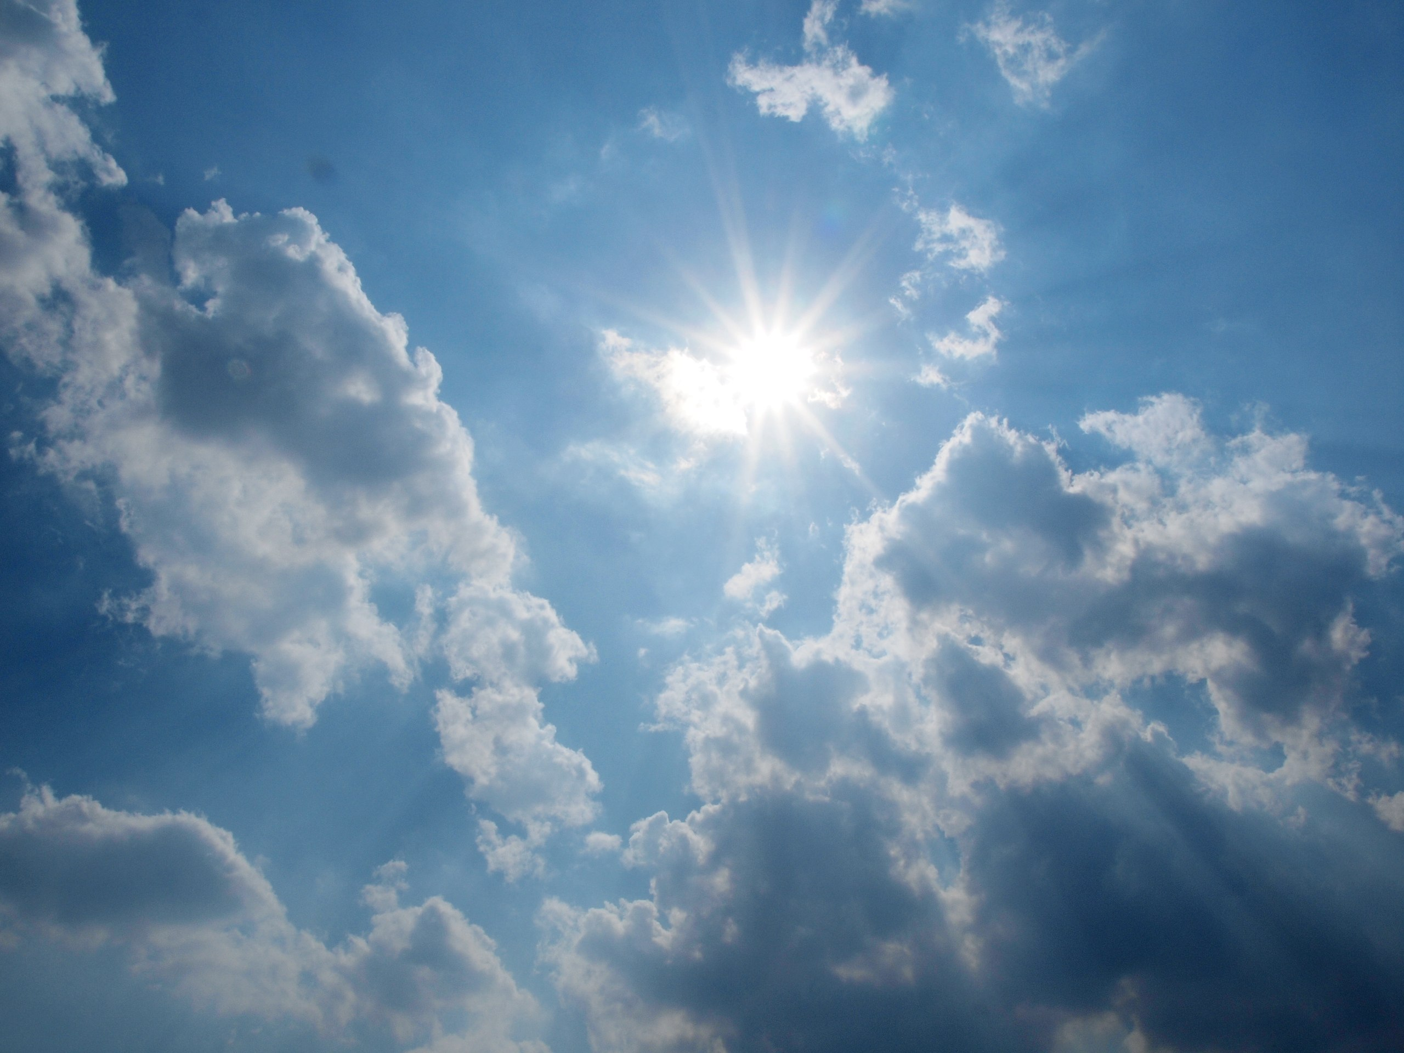
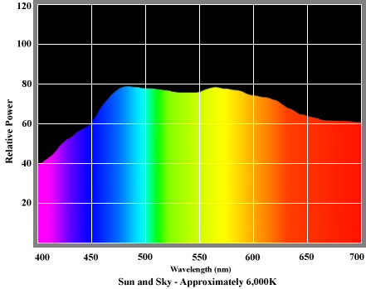
Spectral power distribution
Light is characterized by spectral power distribution (SPD)
  Range and intensity of colors light produces at each wavelength in the visible spectrum
Sun (midday sun Western/Northern Europe) is reference for natural light
  Daylight illuminant - D65 by CIE - International Commission on Illumination
https://commons.wikimedia.org/wiki/File:Sun-in-the-sky.jpg
http://www.openphotographicsociety.org/photography/colour-light-and-optics/colour/203-spectral-power-distribution

Slide 12
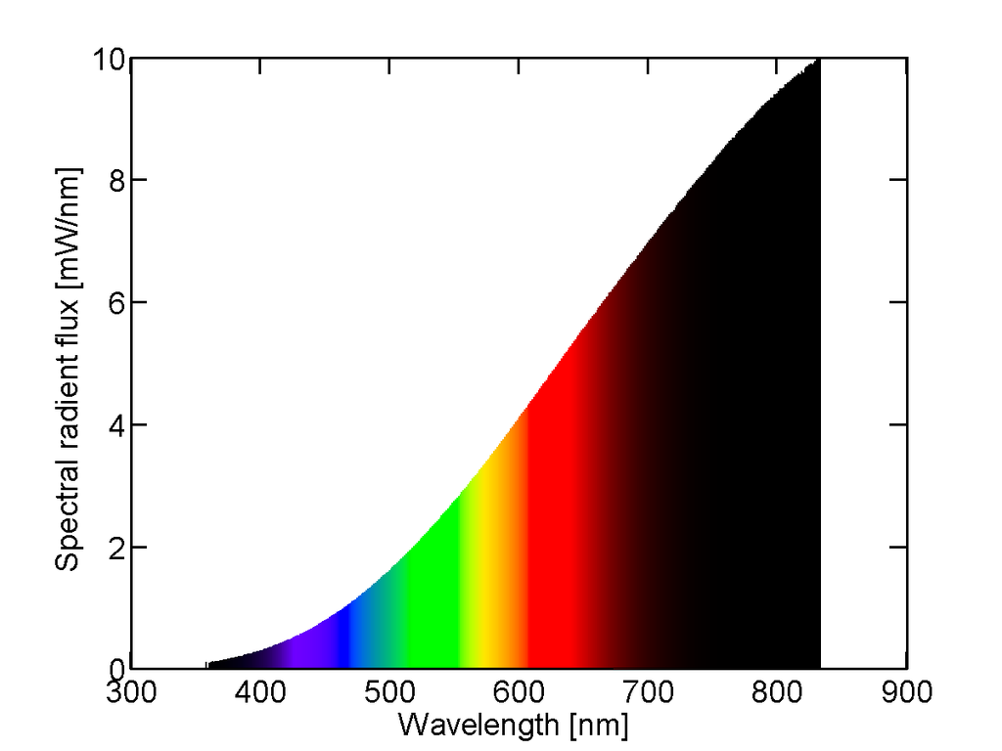
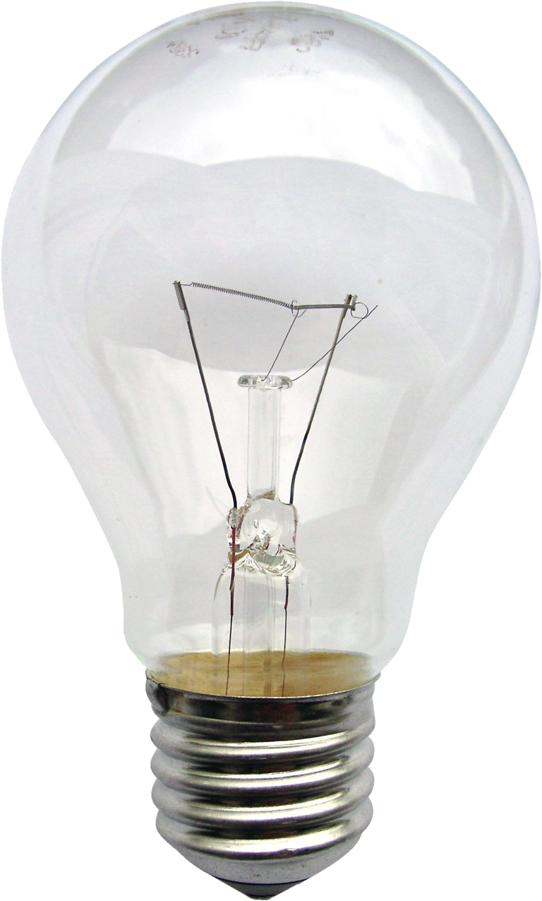
Spectral power distribution
Light sources can be grouped into either natural or artificial light sources.
Color quality of artificial forms of lighting is compared to natural light
Color rendering index: ability of light source to reproduce color of object seen under D65 (natural light)
https://en.wikipedia.org/wiki/Incandescent_light_bulb
SPD of incandescent light source. Light is perceived as yellow since eye is less sensitive to red.

Slide 13
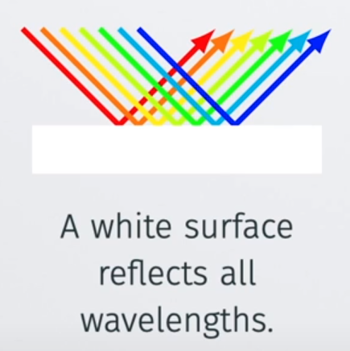
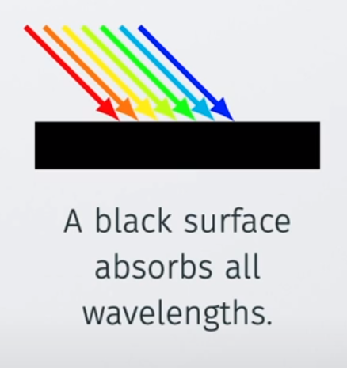
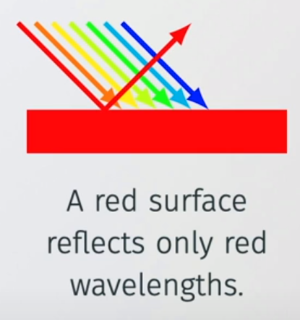
Material reflectance
Light falling on opaque surface will reflect and absorb
Reflected light is perceived as color of object surface
Different materials are characterized with different spectral reflectance curves

Slide 14
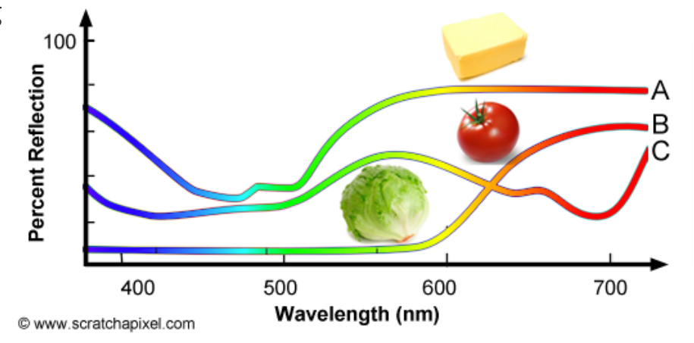
Spectral reflectance curve
SPD of light source defines its color and intensity
Spectral reflectance curve: SPD describing light reflected from objects
  Fraction of the light reflected by the surface of the object over the amount of white light illuminating the object
https://www.scratchapixel.com/lessons/digital-imaging/colors

Slide 15
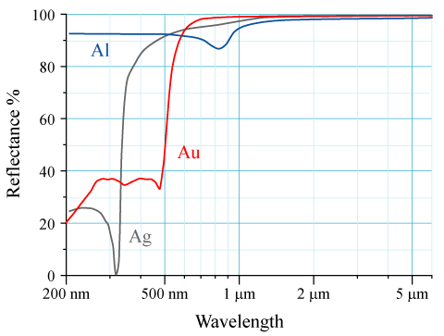
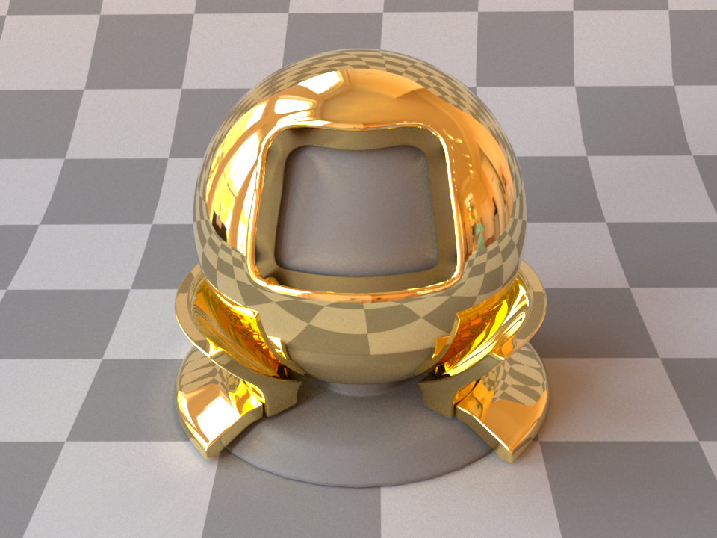
Material reflectance
Reflected energy depends on:
  Incoming light energy (E)
  Reflectance (R) or absorption A = 1 – R, A + R = 1
    R and A are spectral values, but in graphics we use RGB values
Reflected = E * R
Power spectral distribution of light → incoming light energy (E)
Spectral reflectance curve → Material reflectance (R)
https://en.wikipedia.org/wiki/Reflectance

Slide 16
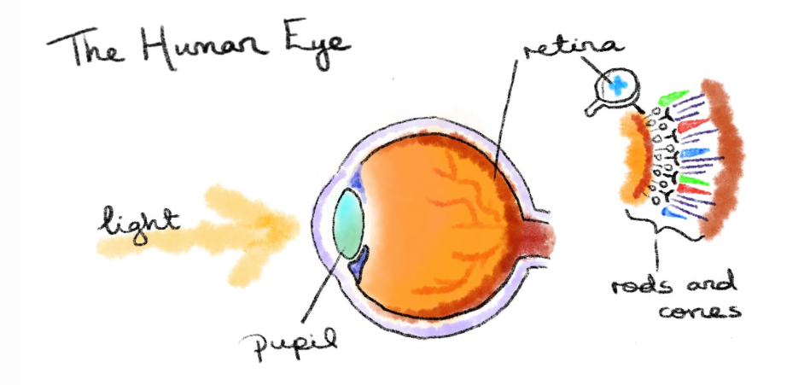
Light and human visual system
Human visual system; back of eye (the retina) is covered with light sensitive receptors – photo-receptive cells
Cone cells – responsible for trichromatic color vision
  “Active” in well lit environments (e.g., daylight)
  Three types sensitive to: red, green and blue light
Rod cells – sensitive to smaller amount of light intensity but not reproducing colors
  “Active” in low lit environments (e.g., night)
http://daisymolving.github.io/2018/07/30/design-fundamentals-colour.html

Slide 17
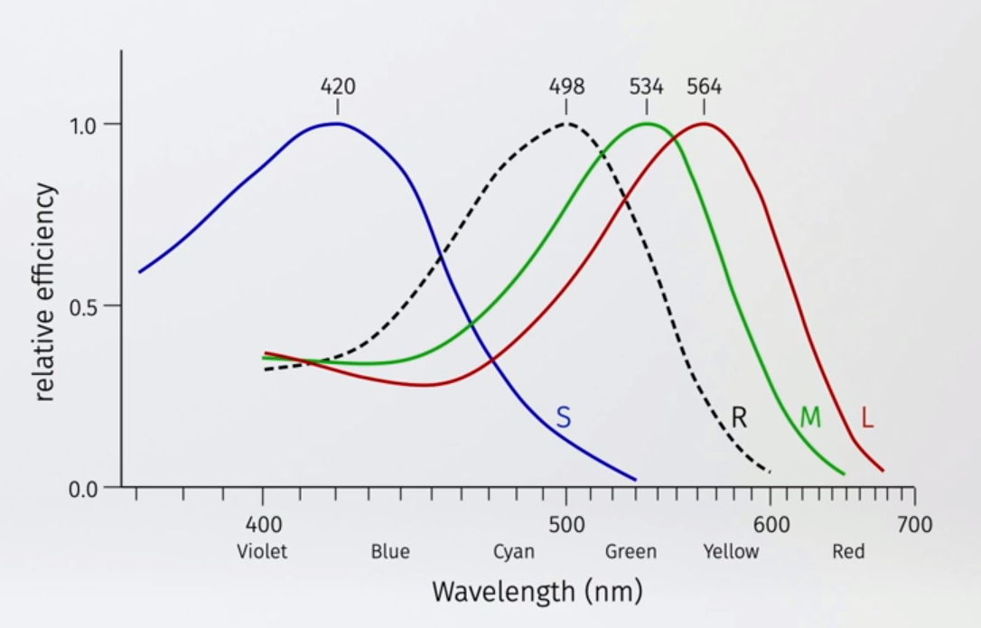
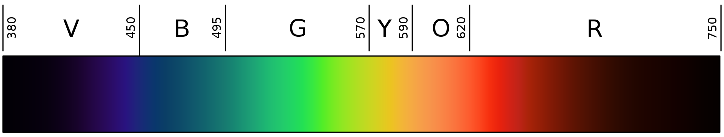
Light and human visual system
Cone cells
  Trichromatic color vision (RGB)
  Well-lit scenes
Rod cells
  Intensity
  Low-lit scenes
Rod cells: intensity
Cone cells: RGB
https://www.handprint.com/HP/WCL/color1.html

Slide 18
From SPD to color
Light from light source is characterized with spectral power distribution (SPD)
Light reflected from object is defined with SPD; spectral reflectance curve
Specifying colors as wavelengths is impractical and in most cases not needed
  For rendering we will ignore wave effects such as diffraction, interference and polarization will be ignored
  Colors must be represented so that they can be visualized to human visual system
SPDs must be transformed in color spaces suited for trichormatic vision
  SPD is transformed in color hue and color brightness values
  Light is described with rays which “carry” intensity (brightness) and color (hue)
More on spectral rendering: https://jo.dreggn.org/path-tracing-in-production/2017/talk-jo/

Slide 19
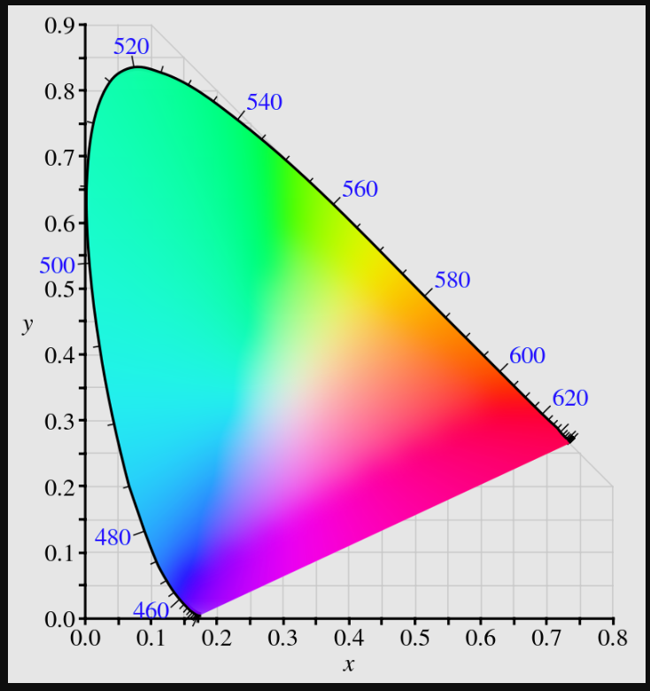
Color space and gamut
White color is composed of all colors in equal amount: constant SPD. Doesn’t exist in real world.
Colorspace
  Model to represent colors perceived by human visual system
  Way of representing colors through numerical values (e.g., image pixels or calculation)
  CIE XYZ is foundation for all color spaces
  RGB model is most important for computer graphics
Gamut
  Range of possible colors that can be represented by particular colorspace
White point (E illuminant)
Gamut of XYZ color space: https://en.wikipedia.org/wiki/CIE_1931_color_space

Slide 20
XYZ colorspace
Gamut of XYZ color space
Trichromatic system motivated idea that any color can be represented by combination of three values
  Artificial additive primary colors (X, Y, Z)
XYZ values would serve as basis for converting SPD to color spaces visible to human visual system
Gamut of XYZ color space - full range of possible colors visible by human visual system
To find transfer function from SPD to XYZ colorspace, color matching experiment was performed
White point (E illuminant)

Slide 21
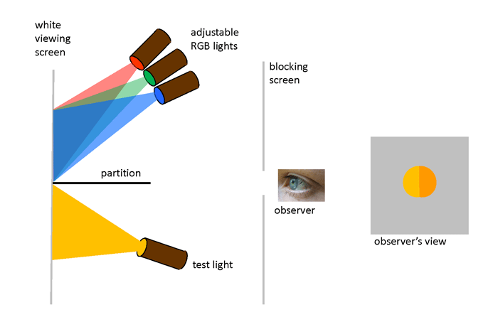
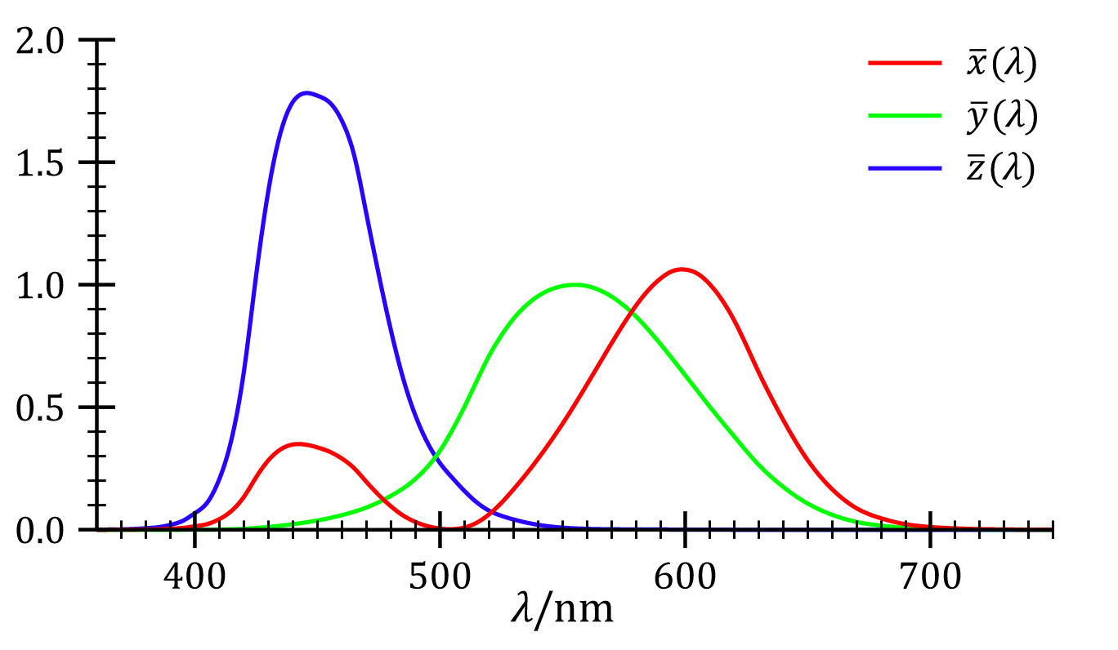
Color matching experiment
Any color perceived by human visual system can be achieved by combining R, G, B signals (trichromatic theory of color vision)
Colormatching experiment used trichromatic theory to form color matching functions
CIE standard observer color matching functions
Y curve is close to luminosity function expressing the brightness
https://www.oceanopticsbook.info/view/photometry-and-visibility/chromaticity

Slide 22
From SPD of light source to XYZ
XYZ colorspace is obtained from SPD of light source using color matching functions
  SPD and the color-matching functions are in tabular descriptions
X = v1
Y = v2
Z = v3
SPD of light source
Color matching curves
https://en.wikipedia.org/wiki/CIE_1931_color_space
XYZ color space

Slide 23
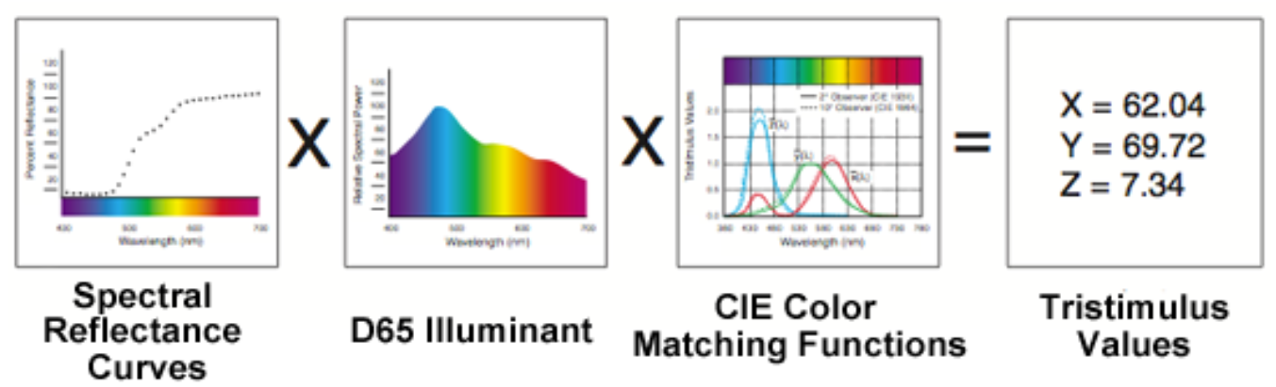
From SPD of reflected light to XYZ
Light reflected from object is represented as spectral reflectance curve
  Therefore it must be multiplied by white light which caused the reflection and the standard is D65.
https://www.scratchapixel.com/lessons/digital-imaging/colors/color-space

Slide 24
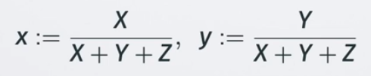
XYZ color space
International, device-independent standard for color specification
System capable representing all colors human visual system can percieve
Gold standard for color storage
XYZ have to be transformed to, e.g., RGB space to be visualized
X + Y + Z = 1, gamut can be visualized using:

Slide 25
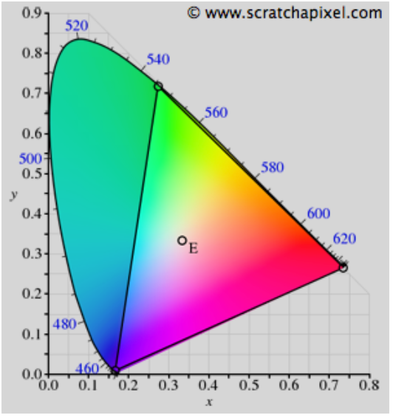
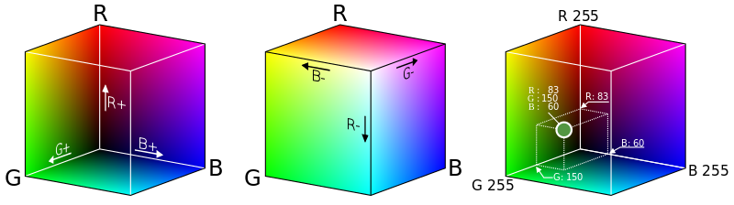
RGB colorspace
Similar as human visual system: represent colors as simple sum of primary colors (R, G, B)
Visualized as cube where R, G, B are placed on axis
R,G,B intensities are in [0,1]
XYZ
1.0
RGB
1.0
1.0
XYZ vs RGB gamut
https://www.scratchapixel.com/lessons/digital-imaging/colors/color-space

Slide 26
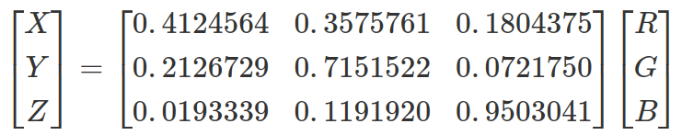
XYZ to RGB
XYZ and RBG color spaces are defined with three coordinates
  XYZ and RGB define a 3D space (e.g., cube for RGB)
Conversion of color from XYZ to RGB can be seen as moving a point from one 3D space to another
  Linear transformation performed using 3x3 matrix
  Color is not changed, only expressed in different colorspace
http://www.brucelindbloom.com/index.html?Eqn_RGB_XYZ_Matrix.html
http://www.russellcottrell.com/photo/matrixCalculator.htm
https://www.oceanopticsbook.info/view/photometry-and-visibility/from-xyz-to-rgb
https://terathon.com/blog/rgb-xyz-conversion-matrix-accuracy/

Slide 27
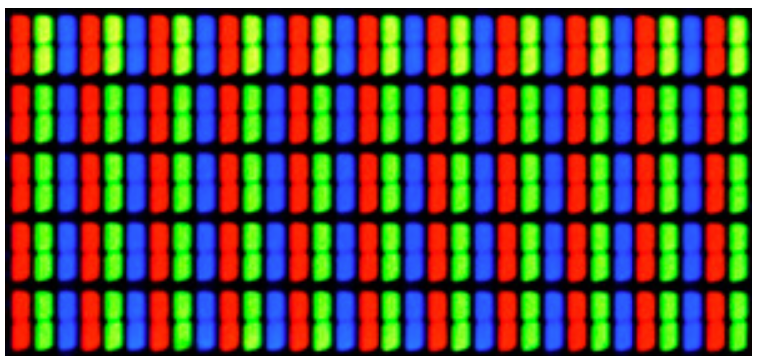
RGB colorspace
Most computer screens technology is based on systems similar to RGB color model.
  Additive colorspace: summing all RGB values gives white color
Most rendering systems work with RGB colorspace
  RGB and XYZ are linear colorspace → linear property is required for correct rendering (shading) computation
Close-up of LCD screen: https://jakubmarian.com/the-illusion-of-rgb-screens/

Slide 28
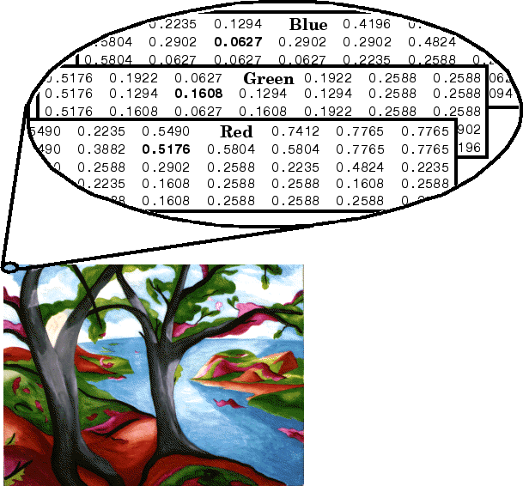
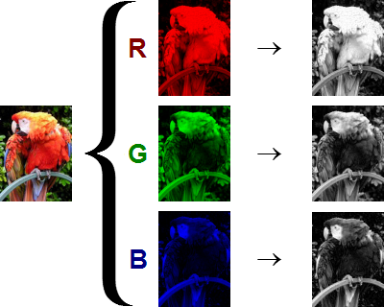
RGB colorspace
Typical image formats store three intensities in three channels: R, G, B.
  e.g., standard images: 8 bit per channel [0,255] range
    2^{(8x3)} = 16.7 milion colors (term: true color)
  e.g., HDR images: 10 or 12 bit per channel
https://www.mathworks.com/help/matlab/creating_plots/image-types.html

Slide 29
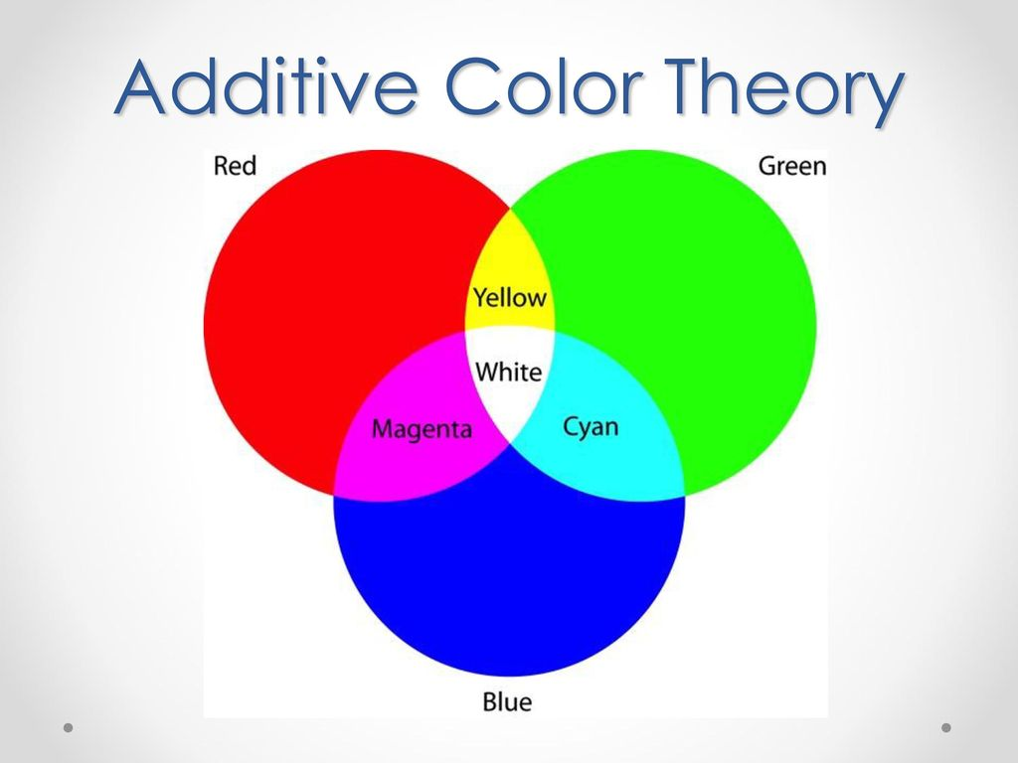
Additive colorspaces
Any color is created by adding red, green or blue
White color is made of red, green and blue
Usage: display devices, computer science, lighting technology → colors are created with light emission
Display device (e.g., monitor) can further increase or decrease the overall global image intensity (brightness)
https://carsonparkdesign.com/what-makes-white-on-the-screen/

Slide 30
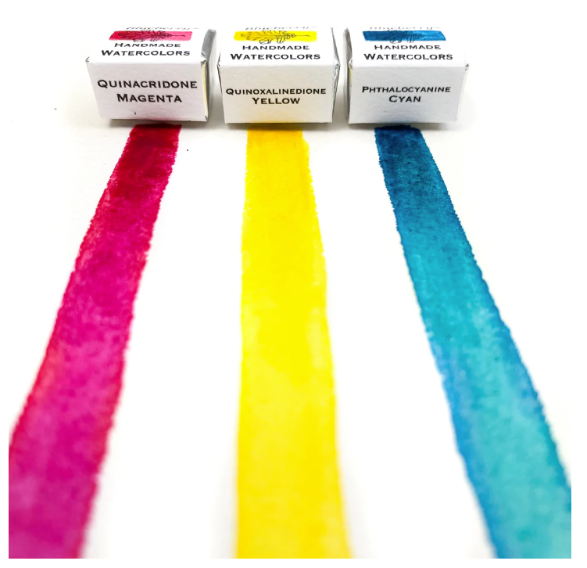
Subtractive colorspaces
Main colors: cyan, magenta, yellow - white light is made by subtracting
Usage: art, painting, printing
Color from canvas is not a result of light emitted from canvas, but light reflected from canvas
  When white light hits canvas, what is not absorbed is reflected
https://www.greenleafblueberry.com/blogs/news/modern-primary-colors

Slide 31
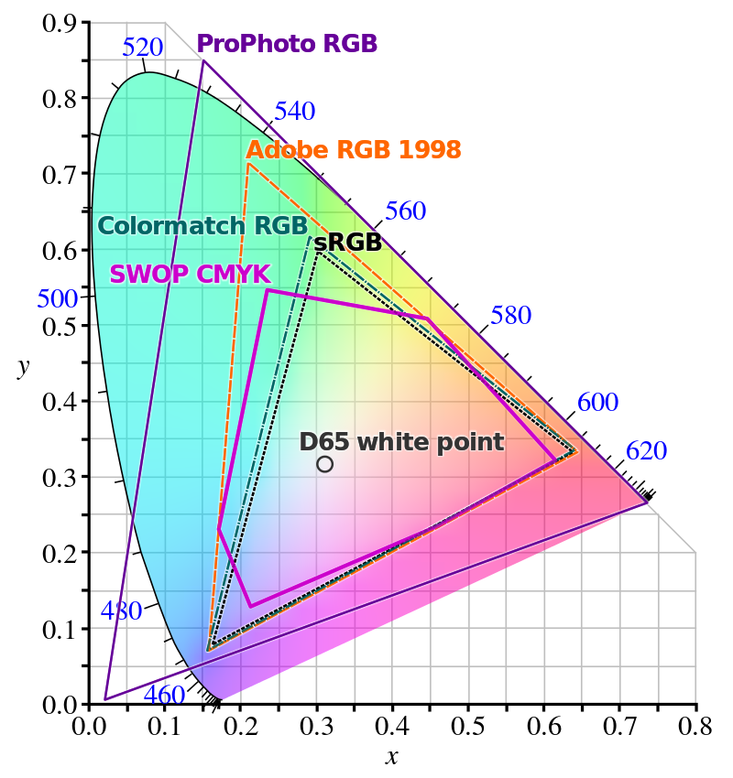
Other colorspaces
Different colorspaces represent different gamut of colors
RGB and CMY have small gamut! → device limitations
RGB and XYZ are linear colorspaces (transformed using 3x3 matrix)
Not all colorspaces are linear, e.g., sRGB, HSV, HSL
Any non-linear colorspace must be converted to linear colorspace before 3x3 matrix transformation

Slide 32
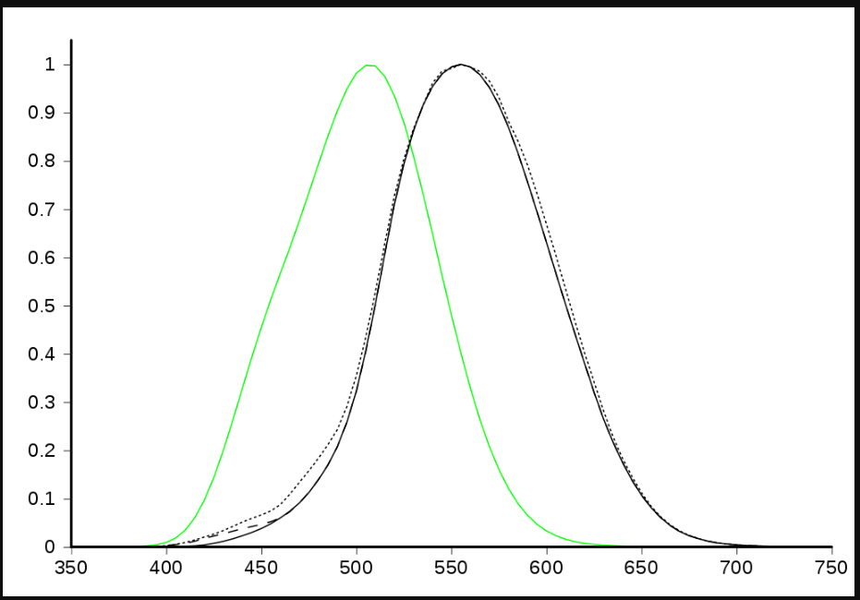
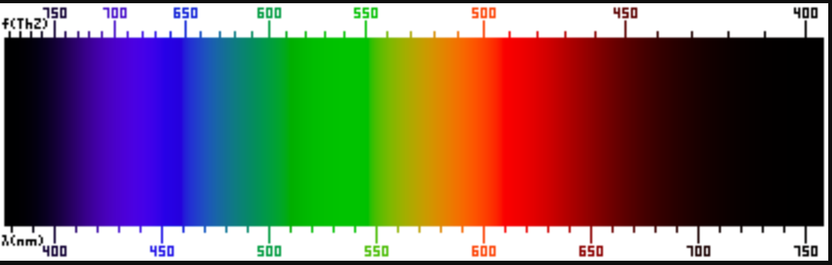
Color brightness
555 to 560 nm (green towards yellow) are perceived by the human eye as being the brightest
  Blue color: the dimmest
  Green color: the brightest
How bright color appear to human eye: luminosity function
  Average sensitivity of human eye to different wavelengths for well lit conditions
Brightness or lightness is present in HSV and YUV color models
Luminosity function for photopic – green - (well lit conditions) and scotopic (low lit conditions) – black. https://en.wikipedia.org/wiki/Luminous_efficiency_function

Slide 33
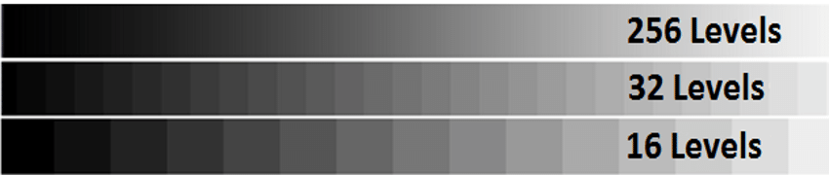
Brightness (luminance)
Human eye can very well see small changes in brightness
Many levels for brightness is needed to describe it without visual discontinuities
Dynamic range: ratio between image with brightest white level and image with darkest black level
  Very high ratios are possible in real world → image and display limitations!
https://www.researchgate.net/publication/318818149_Article_title_Graph-Based_Video_Sequence_Matching_Using_Dominant_Colour_Graph_Profile_DCGP

Slide 34
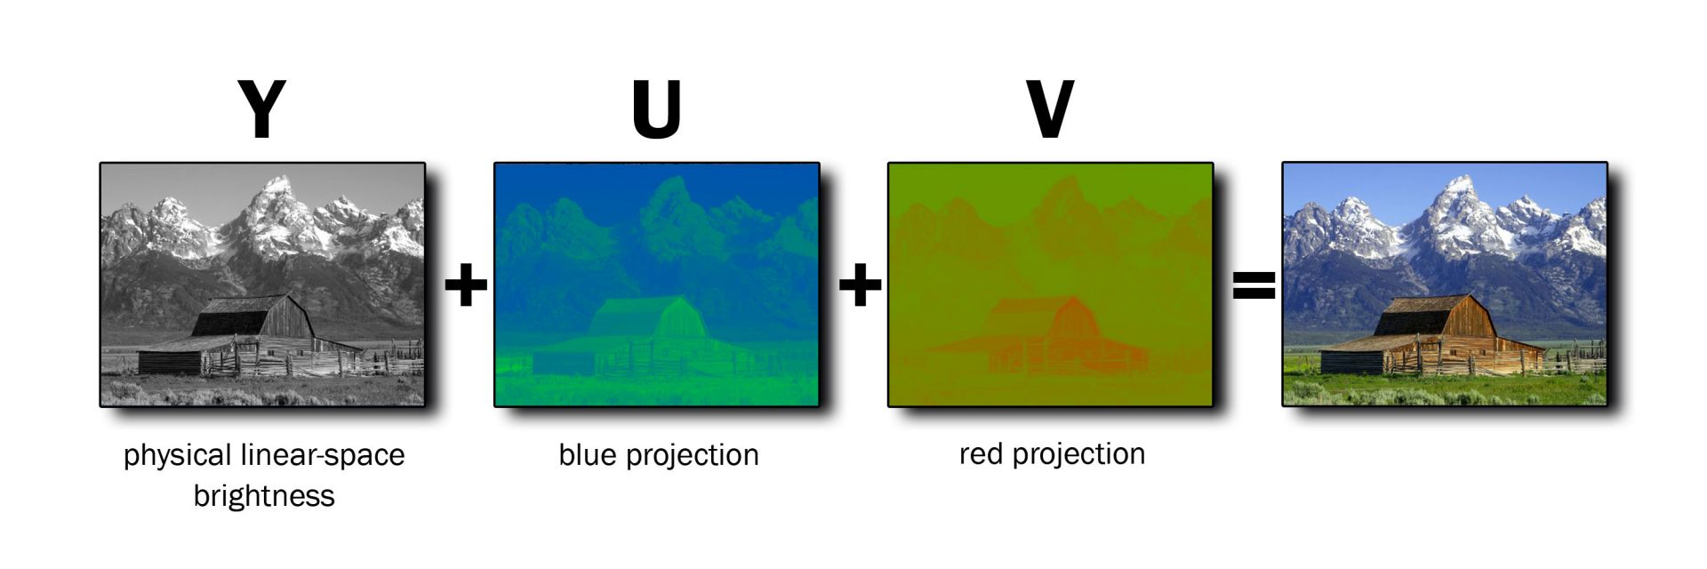
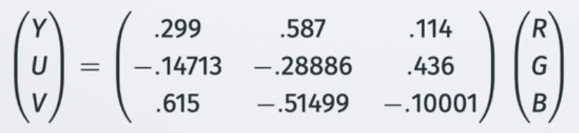
YUV color space
Human eye is more sensitive to spatial variations in brightness (gray scale) than to spatial variations in color
YUV color space can be particularly useful to highlight the importance of gray scale brightness
  Y – brightness (luminance)
  U and V – color (chroma)
YUV can be obtained from RGB using linear transformations
YUV is useful for compression: Y channel should get the most resolution (e.g., JPEG and H.264/H.265 formats)

Slide 35
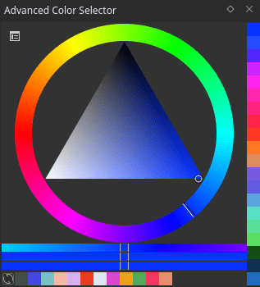
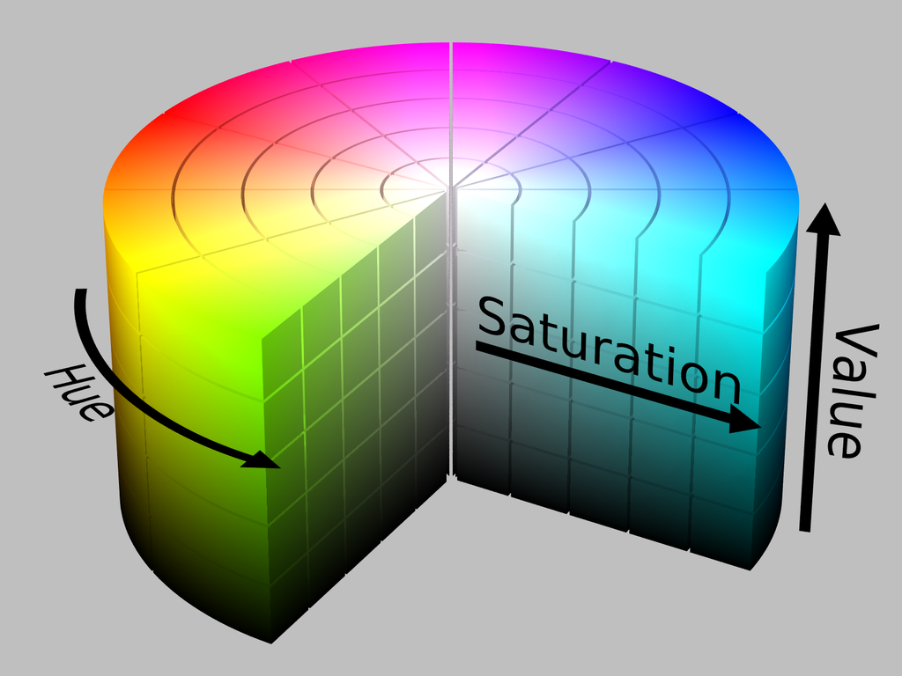
HSV colorspace
HSV is more intuitve than RGB:
  H – Hue - color (rainbow of colors), wheel, given as angle
  S – Saturation - how white the color is, how much color is mixed with white
  V – Value – brightness of color
HSV is often used for colorpicking in modeling environments or painting programs: https://docs.krita.org/en/reference_manual/dockers/advanced_color_selector.html

Slide 36
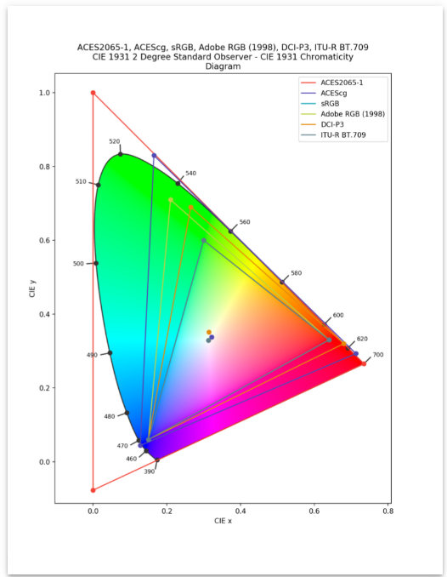
ACES colorspace
Academy Color Encoding Specification (ACES)
  Academy of Motion Picture Arts & Science technology committee
Designed to cover the full gamut
Goal: images should always look the same regardless of used camera and display device.
Images in ACES color space can't be directly displayed to the screen. Conversion steps:
  Reference rendering transform: from scene values to display-neutral output space
  Output device transform: depends on display device (computer monitor, digital projector, etc.)
Becoming de facto standard for professional production
https://acescolorspace.com/

Slide 37
Color in production
Digital drawing and image manipulation:
  Krita: https://docs.krita.org/en/general_concepts/colors/color_models.html
  Gimp: https://docs.gimp.org/2.10/en/gimp-imaging-color-management.html
3D modeling:
  Blender: https://docs.blender.org/manual/en/latest/render/color_management.html
  Houdini: https://www.sidefx.com/docs/houdini/render/linear.html
  Substance painter: https://substance3d.adobe.com/documentation/spdoc/color-management-223053233.html
Game engines:
  Godot: https://docs.godotengine.org/en/3.0/tutorials/3d/high_dynamic_range.html
  Unreal: https://docs.unrealengine.com/4.26/en-US/WorkingWithMedia/OpenColorIO/

Slide 38
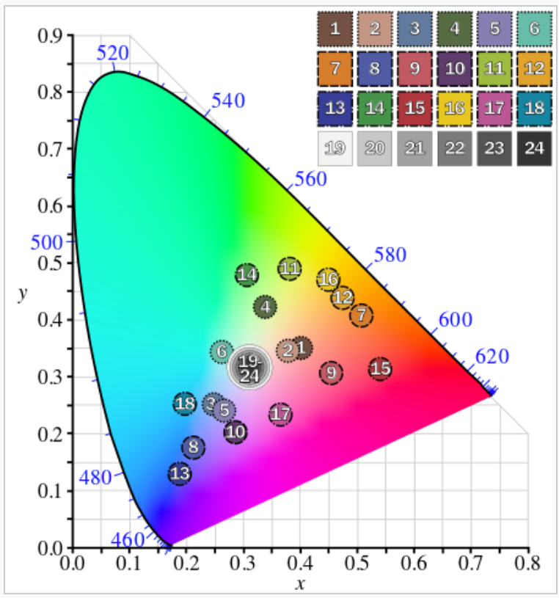
Note: Macbeth ColorChecker
Colors have spectral reflectances mimicking materials which are often photographed.
  Human skin, sky, flowers, etc.
Goal: consistent color appearance under varying lighting conditions
  Reference for tweaking exposition and color settings of camera
https://en.wikipedia.org/wiki/ColorChecker

Slide 39
Light characterization
Radiometry – measurement of radiation, physical transmission of light
Photometry – like radiometry but related to human visual system
Colorimetry – perception of color

Slide 40
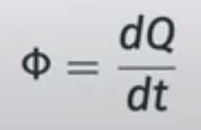
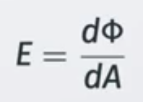
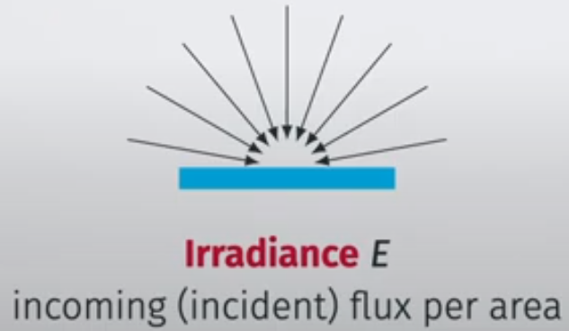
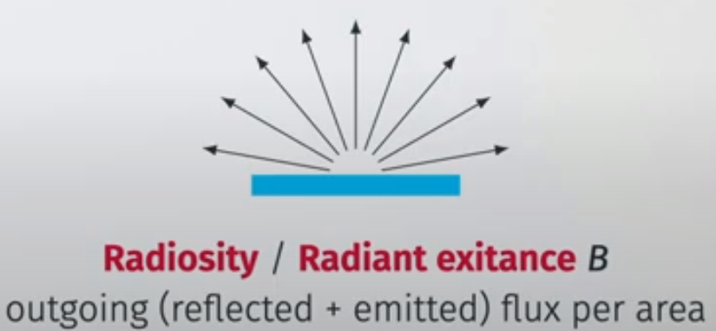
Radiometric quantities
Radiant energy (Q) – energy carried by light (photons) [J]
Radiant flux (Φ) – power carried by light - energy over time [W=Js⁻¹]
Flux density (E) – radiant flux over area [Wm⁻²]

Slide 41
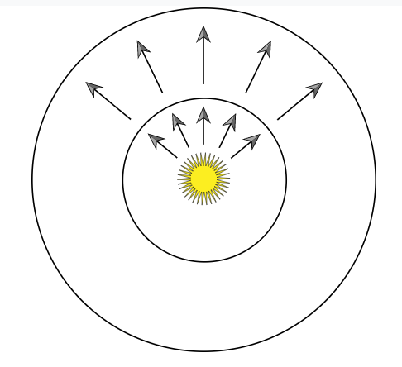
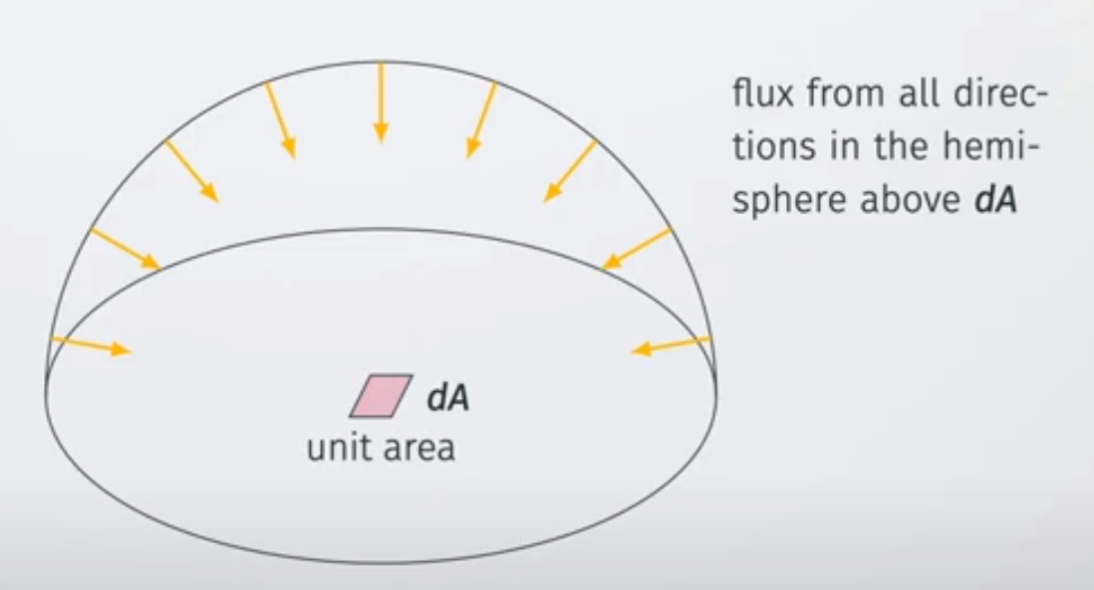
Radiometric quantities
Radiant exitance – radiant flux (light flow) leaving a light source.
Amount of energy received from a light falls off with the squared distance from the light. https://www.pbr-book.org/3ed-2018/Color_and_Radiometry/Radiometry
Irradiance – overall radiant flux (light flow) incoming onto surface.
BRDF gives information of reflected light given irradiance.

Slide 42
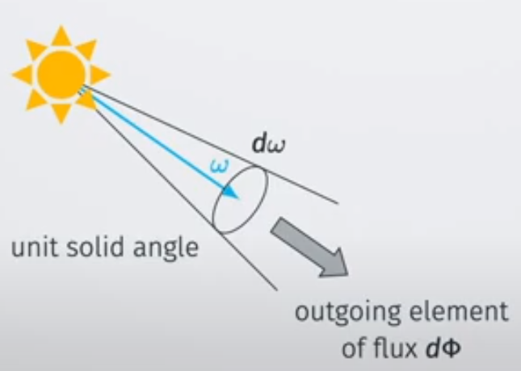
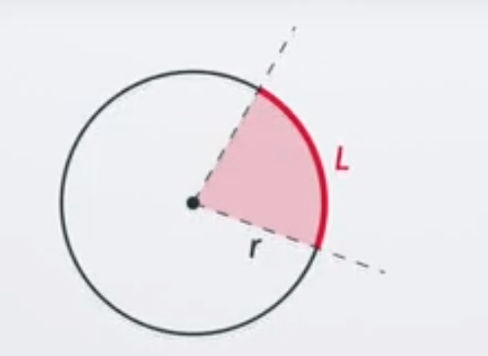
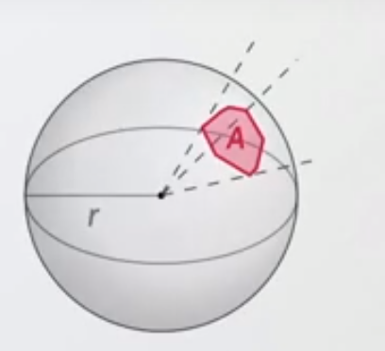




Radiometric quantities
Planar angle: angle of segment of length L on a circle of radius r
Solid angle: area of size A on a sphere of radius r (3D extension of the concept of plane angle)
Radiant intensity (I) – radiant flux with respect to solid angle [W / sr]
Radiant flux of light source in specific direction.
Radiant flux reaching certain point from some point.
Angle of full circle:
Angle of full sphere:

Slide 43


Radiometric quantities
Radiance (L) –radiant flux per unit solid angle, per unit projected area [W / (m² sr)]
  Incident on surface, emerging from surface or passing through surface in certain direction
L(p, ω) – radiance of small area at p along small solid angle dω in direciton ω
  Elementary description of light
  Electromagnetic radiation in single ray
Radiance area is measured in a plane perpendicular to ray, if surface has orientation then cosine correction factor must be used.
* Image-based rendering uses this concept, namely light field technique.

Slide 44


Radiometric quantities
Radiance is what cameras measure – prime importance for rendering
  Rendering can be seen as evaluating radiance for each camera ray
The purpose of shading is to calculate radiance along a camera ray
  Radiance is simplified with color and intensity
Conservation of radiance along rays
  If two points on two surfaces can “see each other”, then radiance outgoing from one surface and incoming to another surface is same and vice versa → light can be traced between surfaces until it reaches the sensor
  Radiance is not affected by distance if light is traveling in a vacuum
    Intensity is lower for surfaces which are more distant since light covers less area

Slide 45

Radiometric quantities and SPD
Most light waves contain mixture of many different wavelengths – polychromatic (light with one wavelength is called monochormatic).
  Visualized using spectral power distribution (SPD) – plot showing how light’s energy is distributed across wavelengths.
All radiometric quantities have spectral distributions
  Using full SPDs for rendering is complex*, often radiometric quantities are represented as RGB triplets.
* Area of research dealing with spectral rendering exists and it is highly active. https://www.fxguide.com/fxfeatured/manuka-weta-digitals-new-renderer/

Slide 46
Photometry
Photometry: science of measuring light (like radiometry) but taking in account human visual system
Each radiometric quantity has equvivalent photometric quantity
  Radiant flux → Luminous flux (lumen - [lm])
  Irradiance → Illuminance (lux - [lx])
  Radiant intensity → Luminous intensity (candela - [cd])
  Radiance → Luminance ([cd / m²])
Radiometric quantities are converted to photometric by using CIE photopic spectral luminous curve.
  Average sensitivity of human eye to different wavelengths for well lit conditions
Luminosity function for photopic – green - (well lit) and scotopic (low lit) – black. https://en.wikipedia.org/wiki/Luminous_efficiency_function

Slide 47
Colorimetry
Colorimetry: relationship between SPD and perception of color
CIE standard observer color matching functions
  SPD → XYZ colorspace
Define colorspaces and their gamut for visualization
RGB color spaces are most interesting for rendering
Gamut comparison
CIE standard observer color matching functions

Slide 48
Rendering and RGB
For interactive and appearance-based applications (e.g., film) RGB rendering often acceptable.
  Object surface reflection is defined using RGB in [0,1] rather than spectral reflectance curve
  Light sources are described with RGB in [0,1] and intensity multiplier rather than SPD
RGB is perceptual rather than physical quantity → category error in physically based rendering
  Correct: use spectral quantities for rendering and RGB conversion for visualization
For predictive simulations rendering spectral quantities must be used
  SPD is used in spectral rendering - more correct, but expensive
  https://hal.inria.fr/hal-03331619/document

Slide 49
Recap
Light has physical but also perceptual properties.
Discussion on radiometry, photometry and colorimetry was needed to understand light and its perception:
  Color (hue)
  Intensity
Light in computer graphics is represented using:
  RGB values in [0,1]
  Intensity, multiplier of RGB values

Slide 50
Real world light and sources of light

Slide 51
Light description
Light can be described both on:
  Microscopic scale: wave optics and photons
  Macroscopic scale: geometric optics

Slide 52


Light: microscopic level
Light is quantized – it comes in individual and indivisible packets called photons
At same time light is wave-like
Some effects of light-matter interaction can be only explained (and thus modeled*) using wave optics:
  Interference
  polarization
  Diffraction
  Iridescence
  Pleochroism and birefringent
  Etc.
Also, knowing microscopic background often helps in getting intuition for some shading and light transport methods**
Color pattern of Birefringence effect when a plastic box is placed in between two polarizers: https://en.wikipedia.org/wiki/Polarization_(waves)
White light interference in a soap bubble – iridescence phenomena (thin-film interference) - https://en.wikipedia.org/wiki/Wave_interference
* It is important to note that complexity of model level depends on application. Often, in computer graphics wave effects can be “faked” to achieve desired apperance: https://developer.nvidia.com/gpugems/gpugems/part-i-natural-effects/chapter-8-simulating-diffraction. On the other hand, physically based methods for achieving wave-effects is actively researched area: https://sites.cs.ucsb.edu/~lingqi/publications/202203_practical_plt_paper_lowres.pdf
** For example photon mapping: http://web.cs.wpi.edu/~emmanuel/courses/cs563/write_ups/zackw/photon_mapping/PhotonMapping.html

Slide 53


Light: macroscopic level
Light in computer graphics is often modeled at macroscopic level – geometric optics.
  Assumption: features with which light interacts are relative to light wavelength (or larger)
  Light is described with rays.
  Microscopic light behavior is described with index of refraction (IOR)
In medium of constant IOR, light energy travels in a straight line
  It only can get absorbed
Light passing from one to another medium with different IOR changes speed
  This is described with light scattering
  Interface between media is represented by surface
Scattering of light on surface is described with reflection and refraction described with Snell law (light direction) and Fresnel equations (light energy).
https://blog.selfshadow.com/publications/s2013-shading-course/hoffman/s2013_pbs_physics_math_notes.pdf

Slide 54
Light: macroscopic level
Index of refraction is characteristics of medium which states the ratio of speed of light in vacuum to the speed of light in that medium
  This parameter is approximating microscopic level of light behavior – its interaction with medium
Difference in refractive index in different media causes light rays to be bend
  Snell’s law – angle of reflection and refraction example
  Important for physically based rendering of transparent objects. Important information for light transport since it determines angle of refraction/reflection on optically flat interface. <example>
Amount of reflected and refracted light is calculated using Fresnel equations.
  TODO
* IOR is dependent on light wavelength. Therefore, light of different wavelengths gets bent by different amounts. This can be seen by white light passing through prism creating rainbow. Also, this causes chromatic aberration – effect of camera lenses.

Slide 55

Sources of light
In a real world, every light source has a physical shape and size, e.g., Sun or very hot objects.
Motion of atomic particles that hold electrical charge causes objects to emit electromagnetic radiation over a range of wavelengths (Maxwell’s equations)
Different way how energy is converted into electromagnetic radiation:
  Incandescent (tungsten) lamps
  Halogen lamps
  Gas-discharge lamps
  LED lights
https://education.nationalgeographic.org/resource/sun

Slide 56


Color temperature
Object which is heated to certain temperature emits light
Color of emitted light depends on temperature
Black body radiation
https://www.inlineelectric.com/color_temperature
https://docs.blender.org/manual/en/latest/render/shader_nodes/converter/blackbody.html

Slide 57




Color temperature
Secrets of photorealism: https://www.youtube.com/watch?v=Z8AAX-ENWvQ&t=2s&ab_channel=Blender

Slide 58


Sources of light
Incandescent (tungsten) lamps:
  flow of electricity through tungsten filament heats is up and causes to emit electromagnetic radiation with distribution of wavelengths depending on filament temperature.
  A frosted glass enclosure is often present to absorb some of the wavelengths.
Halogen lamps: tungsten filament is enclosed in halogen gas. Part of the filament in an incandescent light evaporates when it’s heated. Halogen causes evaporated tungsten to return to filament
https://en.wikipedia.org/wiki/Halogen_lamp

Slide 59


Sources of light
Gas-discharge lamps: passing electrical current through hydrogen, neon, argon, or vaporized metal gas, causes light to be emitted at specific wavelengths that depend on the particular atom in the gas.
Fluorescent coating on the bulb’s interior is often used to transform the emitted frequencies to a wider range.
Helium: https://en.wikipedia.org/wiki/Gas-discharge_lamp
  LED lights are based on electroluminescence: they use materials that emit photons due to electrical current passing through them.
LED lights: https://en.wikipedia.org/wiki/Light-emitting_diode

Slide 60
Light model

Slide 61
Rendering and light
Light is emitted from a light source,
Light propagates through vacuum (ignore participating media)
Light interacts with objects (e.g., reflection) which depends on object material
Very small portion of light enters camera, falls on film producing image

Slide 62

Rendering and light
Rendering: calculating colors of pixels on virtual image plane
  For each pixel, camera ray is generated and tested for intersection with objects in 3D scene → visibility solving
  Color of intersection point (shading point) is calculated in shading step
    Shading takes in account 3D object shape (i.e., normal), object material, viewing direction and incoming light
    Without light resulting image would be completely black

Slide 63

Rendering and light
Rendering equation: color (radiance) of shading point p in (view) direction ω
Incoming light
BRDF
attenuation
Emission
Reflection
Foundation of physically-based rendering
Describes global illumination phenomena – light coming from all directions above object surface
Recursive equation - not possible to solve analytically: approximation methods are used
Rendering equation: https://dl.acm.org/doi/10.1145/15886.15902

Slide 64

Global illumination
Global illumination: light can fall on surface from any direction:
  Light sources
  Surfaces reflecting light
L_{i}
Ω
L_{o}
p

Slide 65


Rendering and light
Rendering equation is very general equation: different rendering approaches solve different parts of this equation
Direct illumination: takes in account only light from light sources (e.g., non-phyiscal light sources; point lights)
Often used in rasterization-based rendering
Problem: additional work needed for shadows, reflections, etc.
Global illumination: takes in account light from light sources and indirect light: reflections from other surfaces
Often solved using ray-tracing-based rendering methods
Multiple reflections, transmissions and shadows can be elegantly incorporated
More advanced methods, e.g., path tracing, further build on raytracing to solve this problem more correctly

Slide 66


Local (direct) illumination
Local illumination: shading is considering only light coming from light sources (discrete incoming light angles)
  l_{i} is given as color and intensity.
  Direction of light source is given or calculated from its position
n
v
l_{i}
C_{lighti}
f(l_{i},n,v)
p
https://www.scratchapixel.com/lessons/3d-basic-rendering/global-illumination-path-tracing/introduction-global-illumination-path-tracing.html

Slide 67


Local (direct) illumination
If multiple light sources are present, they add up linearly
Different types of light sources differ in light color and intensity and position/direction.

Slide 68




Local (direct) illumination
Enhance
Shading: calculating color of the objects in 3D scene
Simple shading: light color and scattering model f(l,n,v)
If multiple light sources are present, they add up linearly
Effect of light on surface can be visualized as rays
  Density of rays hitting the surface correspond to the light intensity.
  Density of light rays (their spacing) is proportional to cosine of angle between l and n.
  Ray density is proportional to dot product when positive, otherwise light comes from behind surface

Slide 69
Local (direct) illumination
Enhance
Final, simplified shading:
If f(l,n,v) is constant color, → Lamberitan shading
Conclusion, light source interacts with shading model with:
  Vector l pointing toward light
  Light color
Different types of light sources differ in how these two parameters are varied over the scene

Slide 70



Local and global illumination
Direct illumination
No shadows
Direct illumination with shadows
Areas in shadow are completely black
Global illumination
Shadows
Multiple reflections
Color bleeding

Slide 71



Global illumination
Light refraction can not be solved with local illumination methods: https://www.youtube.com/watch?v=rJghpp8RVmw&ab_channel=yuichiroyama
Indirect light causes caustics.
Blender and appleseed: https://www.blenderdiplom.com/en/tutorials/all-tutorials/649-rendering-caustics-in-blender-with-appleseed.html
Participating media and volumetric objects can not be accurately represented with direct illumination: https://forums.jangafx.com/t/blender-cycles-test-rendering-of-the-free-vdb-cloud-pack/1273/3

Slide 72




Local and global illumination
Local illumination is used in rasterization-based rendering (Blender, EEVEE)
More generally, light reflected from surface is represented with reflectance equation:
If shading is considering only light coming from light sources: local illumination
  L_{i} is given as color and intensity. Position of light source is calculated from its position
  Therefore, introduced simplified version can be used
Any surface can reflect light on another surface: indirect illumination → global illumination
  Integrating over hemisphere to gather all incoming light L_{i} is needed
  Global illumination algorithms simulate light transport through the scene.
  They solve rendering equation where reflectance equation is special case.
Global illumination is used in ray-tracing-based rendering (Blender, Cycles)

Slide 73
Light and rendering (shading)
Light sources must define
  Position or direction of light
  Color and intensity of light
Additionally, light sources can have:
  Size
  Shape

Slide 74




Light models
Representation and modeling of lights physically, with shape and size → geometric area light or physical lights*.
Physical lights are computationally expensive.
Simplification of lights with no physical size, are called delta or non-physical lights.
* When we discussed surface material we mentioned scattering and absorption. Also, materials can be emissive. Therefore, physical lights have 3D shape and material which is emissive. Emissive material is modeled as black body meaning that is absorbs all light falling on it.

Slide 75

Light models parameters
Non-physical lights:
Color: RGB in [0,1]
Intensity: float [0,1] (multiplier)
Position → Direction
Physical Lights
Color (RGB)
Intensity (float)
Position
Shape
Size

Slide 76
Physical lights

Slide 77


Physical lights
Shapes that emit light from their surface (emissive material)
  Color and intensity
  Position
  shape and size
Umbra
Emissive plane (shape and size)
Penumbra

Slide 78


Physical lights
Shape and size of light matters
  Amount of brightness
  Softness and size of shadows

Slide 79

Physical lights
Intensity and color of emission is given as distribution over emissive surface
Diffuse physical light: uniform spatial and directional intensity and color distribution
  Light is emitted in direction defined with surface normal
At each point in the scene, light from physical light source can be incident from many directions → integration over emissive surface is needed*

Slide 80
Physical lights
Computing intensity of physical lights requires computing integrals over emissive surface and often can not be computed in closed form
Ray-tracing based approaches try to approximate this problem by sampling only smaller number of directions
Rasterization-based rendering simplifies and approximates effects of physical lights

Slide 81

Physical lights: ray-tracing-based rendering
Ray-tracing-based rendering simulates physical flow of light, emission from physical lights and their effects on 3D scene (e.g., shadows) can be elegantly solved
Physical lights have area which has to be sampled
  Approximation-based methods such as Monte Carlo integration must be used
  Global illumination methods: path-tracing
https://www.scratchapixel.com/lessons/3d-basic-rendering/global-illumination-path-tracing/introduction-global-illumination-path-tracing.htm

Slide 82

https://help.autodesk.com/view/ARNOL/ENU/?guid=arnold_user_guide_ac_lights_html

Slide 83

Physical lights: rasterization-based rendering
Rasterization-based rendering is not simulating natural flow of light. Therefore, physical lights and their effects require simplifications and approximations.
Physical lights in ray-tracing (path-tracing, Blender, Cycles)
Physical lights in rasterization (Blender, EEVEE)

Slide 84


Physical lights: rasterization-based rendering
Special cases of phyiscal lights - rectangular planes, can be approximated in rasterization-based renderer*
Rectangular plane emission (Blender, EEVEE):https://docs.blender.org/manual/en/latest/render/lights/light_object.html#area-light
Emissive plane and rectangular plane emission approximation (Blender, EEVEE)

Slide 85
Physical lights: rasterization-based rendering
Alternative is to pre-compute effects of physical lights using path-tracing and store it in texture which is then used during shading*
  https://docs.blender.org/manual/en/latest/render/cycles/baking.html
  https://catlikecoding.com/unity/tutorials/rendering/part-16/
Effects of physical lights can be approximated using non-physical lights

Slide 86
Non-physical lights

Slide 87
Non-Physical lights
Non-phyiscal lights simulate effects of physical lights: light fall-off with distance, which objects are illuminated, which objects cast shadows, etc.
Types:
  Directional (distant, parallel) lights
  Point (spherical, omnidirectional) lights
    Spot lights
    Other variations

Slide 88

Directional (parallel) lights
Directional lights are considered so far from the objects in a 3D scene that they can be represented by parallel rays.
  We only care for the direction of those parallel rays
Example of directional light: is Sun light on Earth.
Sun has spherical shape, but it is so far and Earth is so small compared to it that light rays reaching Earth can be considered parallel (small cone of directions – solid angle).
For scenes that cover small area of Earth’s surface, Sun light can be assumed parallel.
https://www.scratchapixel.com/lessons/3d-basic-rendering/introduction-to-shading/shading-lights

Slide 89



Directional (parallel) lights
Directional light is simplest model of light source.
  Direction (l) – unit vector (not affected by position!)
  Color (c) – RGB vector in [0,1]
  Intensity (i) – float value in [0,inf]
  Direction (l), color (c) and intensity (i) are constant over 3D scene
Intensity may be attenuated by shadowing and surface orientation
https://link.springer.com/chapter/10.1007/978-1-4842-4457-9_12

Slide 90


Practical tip: modeling with lights
Orientation of light greatly determines scene appearance
https://www.youtube.com/watch?v=Ys4793edotw&t=1s&ab_channel=BlenderGuru

Slide 91



Point lights
Point light
  Infinitesimally small in size → no shape
  Light is emitted uniformly in all directions (omnidirectional, isotropic)
Parameters
  Position – vector determining position in world space (lights can be also transformed using 4x4 matrices)
  Color – RGB vector in [0,1]
  Intensity – float value in [0,inf]
  Not affected by scale or rotation.
Most common light sources in nature and around us are spherical (e.g., light bulbs) or can be approximated as spherical light sources.
https://www.scratchapixel.com/lessons/3d-basic-rendering/introduction-to-shading/shading-lights

Slide 92


Non-Physical lights: note
For correct physically-based rendering, non-physical light should be avoided
Example: size of reflection of object by glossy or mirror-like surface depends on its size and distance to reflective surface. If light source has no shape nor size how reflection should look like? Hack: size parameter which is only used during shading.
Point lights have parameter “size” which determines light reflection size: https://docs.blender.org/manual/en/latest/render/lights/light_object.html#point-light

Slide 93



Point lights
Point light position determines direction and distance of incoming light ray for each surface point of objects in the scene
    PointToLight = P – L_{p}
    LightDistance = length(PointToLight)
    LightDirection = normalize(PointToLight)
Intensity=200
Intensity=50

Slide 94


Point lights: direction and light falloff
Distance from point light to surface point determines light falloff
Point light sources emit light radially
  Energy of light source is redistributed over sphere
  As the sphere keeps expanding in the space, energy becomes spread across much larger area → more distant objects in the scene receive less light → light falloff.
  Distance of point light to surface point determines how much is that point illuminated → intensity of point light varies as a function of distance.

Slide 95



Point light - light falloff
Point light distributes energy spherically.
Larger distance → larger sphere → smaller energy → attenuated light - inverse square law falloff:
https://www.youtube.com/watch?v=Z8AAX-ENWvQ&t=2s&ab_channel=Blender
https://petapixel.com/inverse-square-law-light/

Slide 96


Point light - light falloff
https://www.youtube.com/watch?v=Z8AAX-ENWvQ&t=2s&ab_channel=Blender

Slide 97

Point light - light falloff
Problems:
  Small distances: as r → 0, light intensity → infinity. Fix:
  Large distance: for efficient rendering, it is desired to light reach 0 at some point. Otherwise, light calculation should be done no matter how far the camera is from the light
Notes:
  Light falloff function can be any other function of distance
  For stylized appearance different functions may be more interesting

Slide 98


Practical tip: modeling with lights
Orientation of light greatly determines scene appearance
https://www.youtube.com/watch?v=Ys4793edotw&t=1s&ab_channel=BlenderGuru

Slide 99
Point lights: directional light falloff
Next to distance light falloff, real-world illumination intensity also varies by direction, generally:
Different choices of distance and directional light falloff functions produce different light sources:
  Spotlights - emit light in a cone of directions from their position

Slide 100

Spotlights
Projects light in circular cone
Directional falloff function is rotational symmetric around a spotlight direction
https://docs.blender.org/manual/en/latest/render/lights/light_object.html

Slide 101



Spotlights
Parameters:
  Spotlight direction: s
  Angle of umbra θ_{u}
    Outer cone shell
  Angle of penumbra θ_{p}
    Inner cone where the light is at full intensity
  Color: RGB vector in [0,1]
  Intensity: float in [0, inf]
https://seblagarde.files.wordpress.com/2015/07/course_notes_moving_frostbite_to_pbr_v32.pdf

Slide 102


Other distance and directional light falloff functions
Textured lights
  Use of texture for visual richness of light sources: intensity, color and directional/distance variations
  For cone-type lights: projective textures (slide projector effect, gobo/cookie lights)
  For omni-directional-type lights: texture for distance falloff – attenuation maps (e.g., light beams)
https://developer.valvesoftware.com/wiki/Env_projectedtexture
https://www.researchgate.net/publication/220183756_A_Programmable_System_for_Artistic_Volumetric_Lighting

Slide 103



Other distance and directional light falloff functions
Tabulated patterns
  Standard: Illuminating Engineering Society (IES profiles)
  Measured from the real world using: Goniophotometer
IES profiles: https://ieslibrary.com/en/home

Slide 104



Non-physical lights
Directional, point, spot light

Slide 105



Multiple lights
Contribution of light adds up linearly
  Basis of photo-realistic rendering where scene contains multiple lights
  Required for compositing of rendered images: adding multiple rendered images where each has contribution from one light

Slide 106
Environment illumination

Slide 107

Environment illumination
Until now, we have considered point and directional lights which limits surfaces to receive light from small number of discrete directions.
In reality, scenes receive light from all directions otherwise surfaces would appear too dark or completely black if facing away from light sources
  Example: ambient term in Phong model; constant color added to each point of surface
To approximate light coming for different directions and large sources of light such as sky and clouds, environment lighting is used.
  Such emitters solve the problem of objects being too dark

Slide 108


Environment illumination
Light coming from point or directional light sources can be described with discrete incoming light directions to surface point
Environment illumination is described with light coming from all directions to surface point
Only point light
Point light and constant environment

Slide 109

Environment illumination
Environment illumination is described with light coming from all directions to surface point
Variation in intensity from different directions can be obtained using texture
Point light and constant environment
Point light and textured environment

Slide 110
Environment illumination
Note that environment illumination is not global illumination
  Knowledge of other surfaces which might reflect light is not used
  Only more directions of light from light emitter are used
However, this approximation can be used for simulating global illumination effects, that is, indirect light.

Slide 111
Environment illumination
Variation in intensity depends only on incoming direction and not position
  Assumption: environment light is infinitely far away.
Such illumination can be represented by spherical functions
  Defined over surface of unit sphere or space of directions
Spherical function representations:
  Tabulated forms: discrete points/directions over sphere containing intensity values which are interpolated
  Spherical basis: spherical radial basis functions, spherical harmonics, etc.
  Environment mapping: storing spherical function into texture, e.g., image texture
    Most widely used, more memory costly but fast compared to other representations

Slide 112

Environment mapping
Environment illumination is stored into image texture → environment map
  Unlike surface textures, environment textures have color intensities larger than 1 → high dynamic range
Global spherical function assumption: light intensity only depends on a direction
Basic case of environment mapping: reflection mapping
  For each reflective material, compute normal (n) at the location on the surface of the object
  Compute reflection vector (r) from view vector (v) and normal vector (n)
    r = 2 (n v) n - v
  Use reflected view vector (r) to compute environment map texture location
  Read value from environment map texture and use it as light intensity
n
r
v

Slide 113
Reflection mapping
Variety of projector functions mapping from reflected view vector (r) to environment texture location:
  Latitude-longitude mapping
  Sphere mapping
  Cube mapping
More on environment mapping: http://cg.iit.bme.hu/~szirmay/specstar11.pdf

Slide 114

Latitude-longitude mapping
φ
Blinn and Newell method, first environment mapping method, 1976
  Environment map idea: imagine that globe is viewed from inside
Reflected view vector r (r_{x}, r_{y}, r_{z})is converted to spherical coordinates:
  Longitude Φ in [0,2π] → Φ = atan2(r_{y}, r_{x})
  Latitude φ in [0,π] → φ = arccos(r_{z})
Spherical coordinates are used to access the environment map

Slide 115



Cube mapping
Most widely used method, Greene 1986
Cube map is created by projecting environment on the sides of a cube positioned with its center at camera’s location
Visualized as “cross” diagram, stored as six square textures
Reflected view vector (r) can be directly used as three-component texture coordinate to fetch intensity data stored in cube map
https://learnopengl.com/Advanced-OpenGL/Cubemaps

Slide 116
Shadows

Slide 117


Slide 118


Slide 119

Scene from: https://casual-effects.com/data/index.html

Slide 120


Slide 121


Shadows
Shadows are important for:
  Providing user with visual cues about object placement and relation to other object
  Realistic image synthesis: needed for understanding details and surface characteristics
https://creativecoding.soe.ucsc.edu/courses/cs488/reportsA/shadows.pdf
https://lumion.com/blog/feature-spotlight-sky-light-soft-shadows-and.html

Slide 122

Light and shadow
Light falling on object causes object to cast shadow – blocking light to fall on another surface
Occluders: objects casting shadow
Light source: point light
Recievers: objects on which the shadow is cast

Slide 123



Sharp vs smooth shadows
Small light sources (e.g., point lights) → hard shadows; only umbra component
Size of light determines shadow smoothness
  Hard-edge shadows: sharp shadow edges
  Soft shadows: fuzzy shadow edges
  Softer shadow edges are more realistic, but more expensive to render
Large light sources (e.g, physical lights) → soft shadows; both umbra and penumbra component
https://creativecoding.soe.ucsc.edu/courses/cs488/reportsA/shadows.pdf

Slide 124

Elements of a shadow
Penumbra
  Partially shadowed region
Umbra
  Fully shadowed region
  Its region decreases in size as the light source gets larger
NOTE: having any kind of shadow is more important than having soft shadows and penumbra.
https://en.wikipedia.org/wiki/Umbra,_penumbra_and_antumbra

Slide 125
Rendering and shadow
Simulating shadow depends on how rendering is solving visibility problem
In ray-tracing based rendering shadows can be calculated in single pass without complex workarounds
In rasterization-based rendering multi-pass rendering or additional work is required to simulate/approximate shadows

Slide 126


Shadow in ray-tracing
For each pixel of virtual image plane, a ray is generated and tested for intersection with objects in 3D scene
For found intersection, color is calculated using shading
During shading, additional ray is casted towards light source – shadow ray
  If shadow ray intersects object on its way, then shaded surface point is in shadow
  If object is opaque, shadow is dark
  If object is transparent, shadow is brighter
https://en.wikipedia.org/wiki/Ray_tracing_(graphics)

Slide 127
In real world, shadow is result of light being obstructed by object.
In computer graphics, rays are traced from camera for intersections and then additional rays are sent to check if shadowing occurs. https://www.scratchapixel.com/lessons/3d-basic-rendering/introduction-to-shading/ligth-and-shadows

Slide 128



Shadow in ray-tracing: shadow acne
Due to numerical limits in precision, some intersection point positions might end up under the surface
  Casting shadow ray from this point causes intersection and thus light obstruction → shadow acne
  Solutions:
    Use double float precision
    Add small displacement to intersection point in direction of normal: shadow bias parameter
https://www.scratchapixel.com/lessons/3d-basic-rendering/introduction-to-shading/ligth-and-shadows
https://bheisler.github.io/post/writing-raytracer-in-rust-part-2/

Slide 129
Shadow in rasterization
Shadow computation in ray-tracing is elegantly solved due to nature of visibility solving which simulates physical light flow
In rasterization, all objects in 3D scene are projected onto virtual image plane and information of 3D scene is partially lost
Therefore, various methods are develop to simulate and introduce shadows
  Different methods solve different special and simplified cases of shadow occurrence
    Planar shadows
    Volume shadows
    Shadow mapping
More about shadows in rasterization-based rendering: https://www.realtimeshadows.com/

Slide 130


Planar shadows
Simple case of shadowing: object cast shadow onto a planar surface
Method: projection shadows
Projection matrix M is constructed to project object vertices v onto plane π with respect to the light source l giving shadow point p.
Light source
Light source
Object
Object

Slide 131

Projection shadows
To render shadow, projection matrix M is applied to all objects (their vertices v) which should cast shadow on plane π
Projected object is obtained which is rendered with darker color and no illumination.
Light source
Notes:
Projected object must be above plane π (introduce bias parameter controlling distance)
Shadows may fall outside of plane π – this breaks the illusion and clipping must be performed
Anti-shadow can be generated if light is between object and plane π
Light source
Anti-shadow

Slide 132


Projection shadows
Soft shadows can be simulated.
Simulating area light: multiple point lights are placed where area light would be placed, resulting shadows are accumulated and and averaged (Heckbert and Herf’s method)
Blurring hard-shadow generated from a single point light.

Slide 133


Shadow volumes
More general approach for receivers of different shapes
Volume of space is formed by occluder and light source
Any object inside this volume is in shadow

Slide 134

Shadow volumes
To determine if object is in shadow, counting method is used.
  Ray is traced from view to object
  Every time when ray passes through front-facing triangle of shadow volume the counter is increased
  Every time when ray passes through back-facing triangle of shadow volume the counter is decreased
  If counter is equal to zero than object is illuminated (not in shadow)

Slide 135
Shadow volumes
Drawback: extreme variability
  High difference in computation time depending on camera, object and light position
  If camera is in shadow volume, the shadow volume fills the whole screen resulting in high computation → slow rendering
  Consistent frame-rate is not guaranteed
On GPU rasterization-based rendering counting is performed using depth and stencil buffers*

Slide 136

Shadow maps
Efficient rendering of shadows on various receivers
Idea: solve shadow casting as visibility problem
  Points visible to light source are illuminated
  Points invisible to light source are in shadow
GPU rasterization uses z-buffer to solve visibility and store distance to closest objects in depth buffer*

Slide 137

Shadow maps
Rendering from light source
Rendering from camera
Render the scene from position of light source that is to cast shadows
  Store distances of visible objects in a texture → shadow map
Render the scene once more, now from camera point of view → multi-pass rendering
  Distance of rendered points to light source are compared to distances stored in shadow map
  If point is farther from light source than the corresponding value in shadow map, then point is in shadow, otherwise it is not

Slide 138
Shadow maps
Shadow map creation depends on type of light:
  Distant lights: ortographic projection is used since light direction is parallel
  Spotlight: frustum is defined with spotlight shape
  Point light: omnidirectional shadow maps – six view cube (similar to environment mapping)
Shadow map approach is predictable
  Shadow map contains only objects that can can cast shadows – objects inside light frustum
  Cost of building shadow map is linear with number of triangles
  Shadow map can be generated once and reused for all frames where light and objects are not moving

Slide 139


Shadow maps
Quality of shadows depend on shadow map resolution
  Quality of shadows depends on objects distance to light source → more samples for shadow map is needed for better approximation
  Low shadow map resolution highlights aliasing
Quality of shadows depend on shadow map resolution
https://developer.download.nvidia.com/assets/events/GDC15/hybrid_ray_traced_GDC_2015.pdf

Slide 140


Shadow maps
Self-shadow aliasing and shadow acne becomes apparent due to numerical limits and slight differences in light and camera view values
  Bias parameter must be introduced which is correcting distances in camera and light view
Self-shadowing (shadow acne) → moire pattern
Ground self-shadowing leads to aliasing (Moire pattern)

Slide 141


Hybrid ray-traced shadows*
Shadow maps are most often used method and still exhibit a lot of problems: aliasing, acne, etc.
Solution is to combine rasterization-based rendering with ray-tracing for shadow computation
https://developer.nvidia.com/content/hybrid-ray-traced-shadows

Slide 142
Light and Shadow: Tips and Tricks
Global illumination gives correct light reflection and shadows effects but it is expensive for real-time applications
Physical lights more correctly describe light color and intensity distribution but are expensive to compute in real-time
Non-physical light sources and direct illumination can be solved fast and efficiently and can to some extent approximate shadows and global illumination effects but require additional work

Slide 143

Light and Shadow: Tips and Tricks
When creating 3D scene, artists understand the how the scene should be illuminated. Using this knowledge they place non-physical lights which are rendered with direct illumination to simulate global-illumination effects such as reflections and shadows.
https://80.lv/articles/dishonored-interiors-lighting-props/

Slide 144
More into topic
Lighting for artists:
  https://www.artstation.com/channels/lighting
  https://80.lv/articles/amazing-lighting-for-simple-scenes/
  https://www.youtube.com/watch?v=Ys4793edotw&ab_channel=BlenderGuru
Path-tracing lights
  https://www.pbr-book.org/3ed-2018/Light_Sources/Area_Lights
  http://graphics.stanford.edu/papers/veach_thesis/
  https://schuttejoe.github.io/post/arealightsampling/
  https://www.scratchapixel.com/lessons/3d-basic-rendering/global-illumination-path-tracing/introduction-global-illumination-path-tracing.html
Area lights approximation in rasterization-based rendering (OpenGL): https://learnopengl.com/Guest-Articles/2022/Area-Lights
Shadows in rasterization:
  https://www.realtimeshadows.com/sites/default/files/Playing%20with%20Real-Time%20Shadows_0.pdf
  https://www.cs.montana.edu/courses/spring2005/525/students/Thiesen2.pdf
  https://web.cse.ohio-state.edu/~shen.94/781/Site/Slides_files/shadow.pdf
  https://cg.informatik.uni-freiburg.de/course_notes/graphics_07_shadows.pdf
Hybrid shadow computation methods (rasterization + ray-tracing):
  https://gpuopen.com/learn/hybrid-shadows/
  https://developer.nvidia.com/content/hybrid-ray-traced-shadows

Slide 145
To remember
Light and color
  PSD
  Colorspaces (XYZ, RGB) and gamut
  Rendering with RGB
Light model
  Geometric optics
  Directional, points and spot lights
Shadow
  Rasterization vs raytracing
  Shadow elements

Slide 146
Summary questions
https://github.com/lorentzo/IntroductionToComputerGraphics/tree/main/lectures/9_light

Slide 147
Literature
https://github.com/lorentzo/IntroductionToComputerGraphics

