Slide 1
3D Models: Material

Slide 2
Syllabus
3D scene
  Object
    Shape
    Material
  Camera
  Light
Rendering
Image
Material
  Material observation
  Physics (optics) models for CG
  Material models in CG
    Scattering models

Slide 3
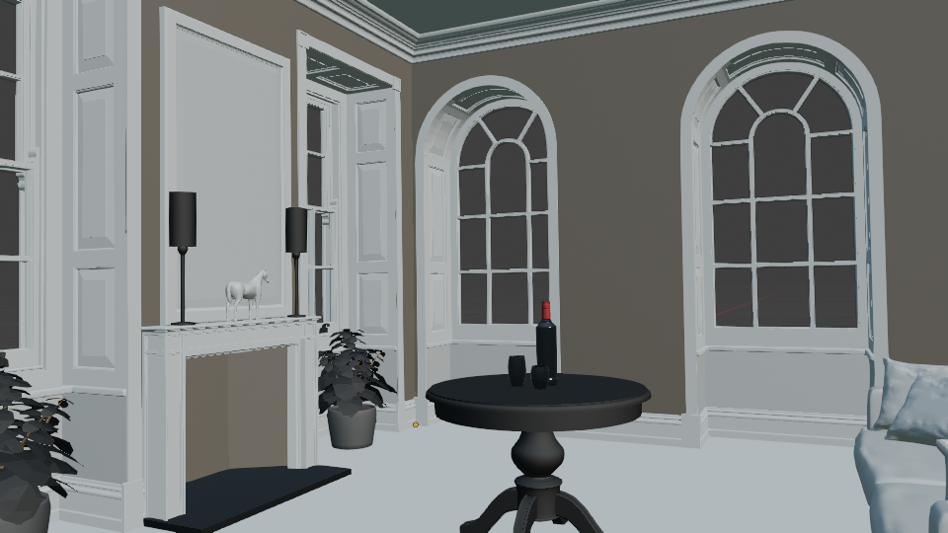

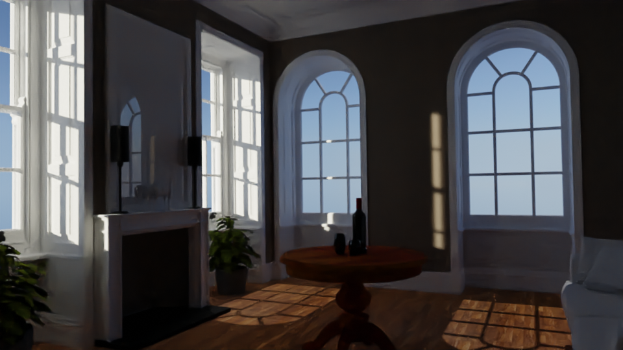
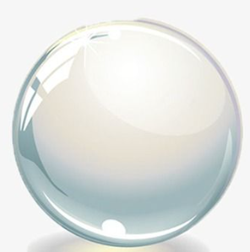
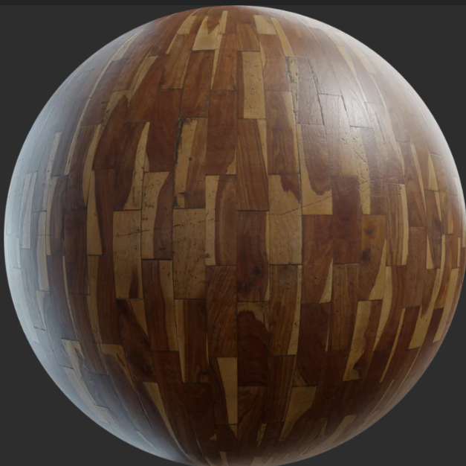
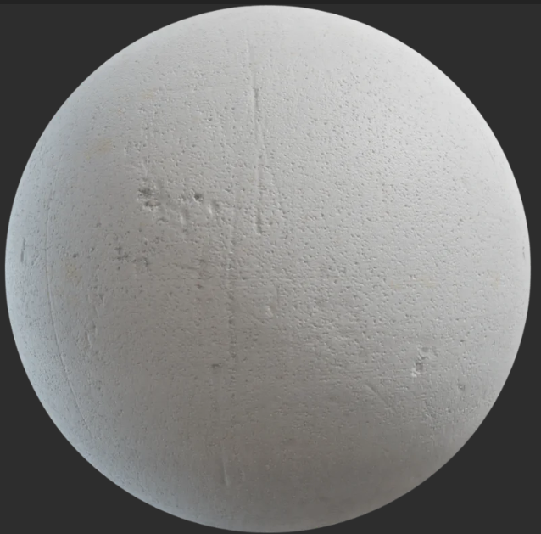
Big picture
3. Image
1. Scene modeling
Material modeling

Slide 4

https://www.exp-points.com/asking-the-masters-material-art

Slide 5
Material is important for object appearance.
Without material...

Slide 7
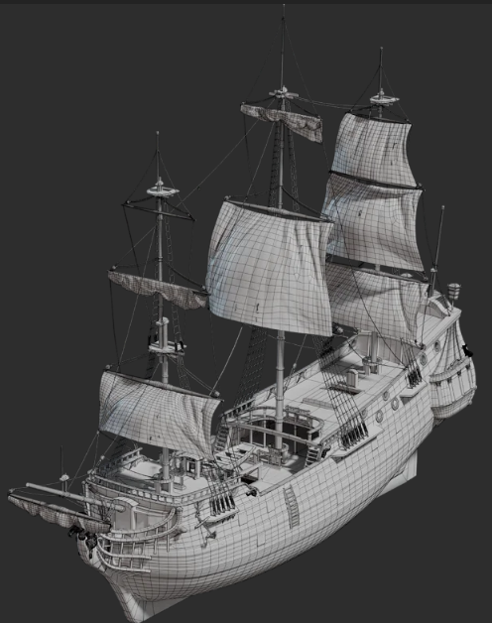
Shape and material
Rendering and creating objects in 3D scene to represent a real world objects requires:
  Shape modeling
Shape is needed to:
  Define object form, size, etc.
  Place object correctly in the scene with respect to other objects
  Determine which objects are occluded and areas into which shadow is cast by object
https://polyhaven.com/a/ship_pinnace

Slide 8
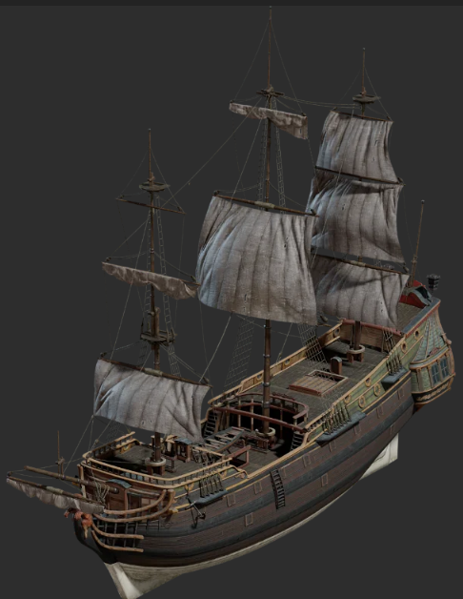
Shape and material
Rendering and creating objects in 3D scene to represent a real world objects requires:
  Shape modeling
  Visual appearance modeling → material
Material describes light-object interaction: how object will look like
https://polyhaven.com/a/ship_pinnace

Slide 9
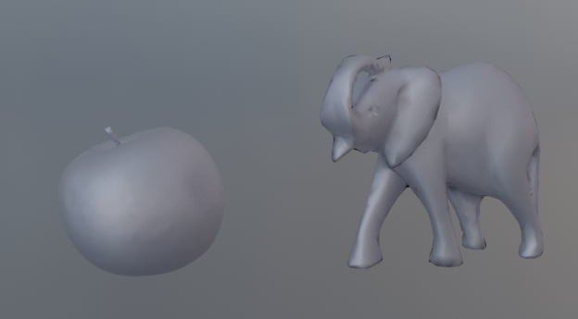
Shape and material
3D object: shape and material.
  Material characteristics are independent of shape and position.
    Material is modeled separately
  It is enough to model how specific material generally interacts with light.
    This model is then used for arbitrary shape.
Aluminum apple and aluminum statue – in both cases aluminum properties are the same. Also, changing position of aluminum apple in space doesn’t change aluminum properties.

Slide 10
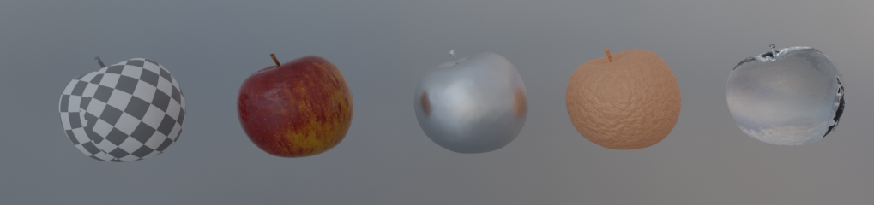
“Let the form of an object be what it may, - light, shade and perspective will always make it beautiful” – John Constable
Importance of material for appearance
Model and environment texture from PolyHaven: https://polyhaven.com/a/food_apple_01

Slide 11

Metal
Plastic
Glass
Wood
Fabric
Stone
Clouds
Water
Tree bark
Leafs
Plaster
Paper
Leather
Sky
Etc.
https://www.xomacenna.com/blog/a-guide-to-organic-modern-design

Slide 12
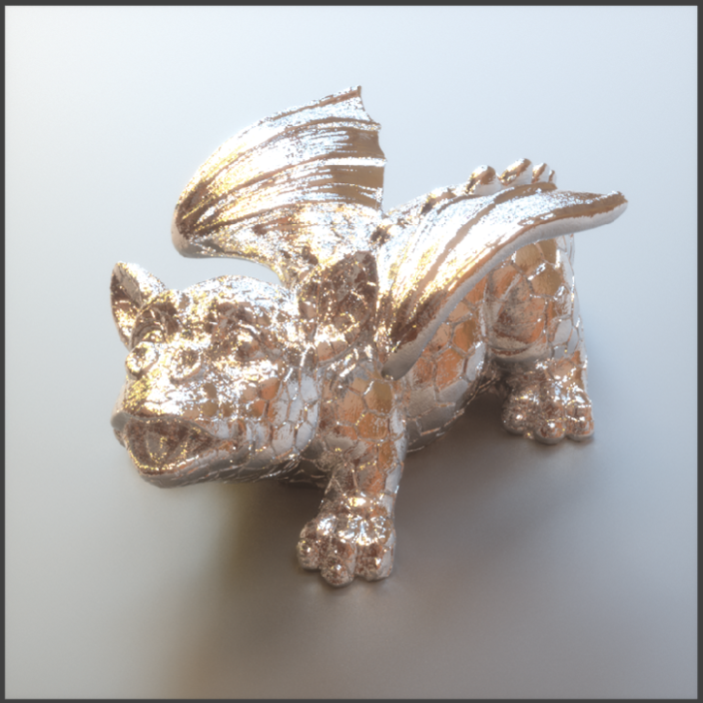
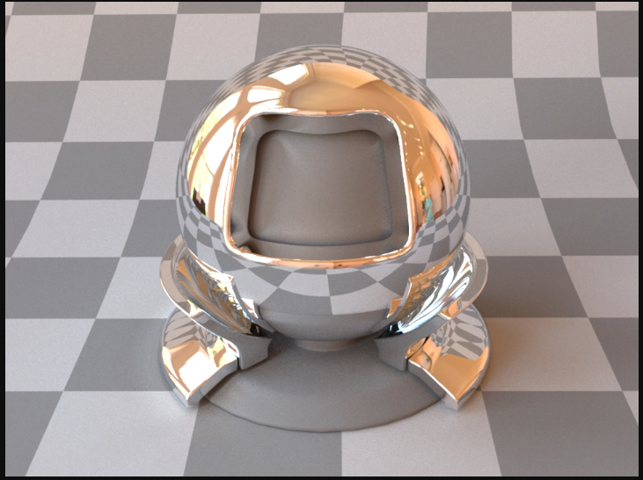
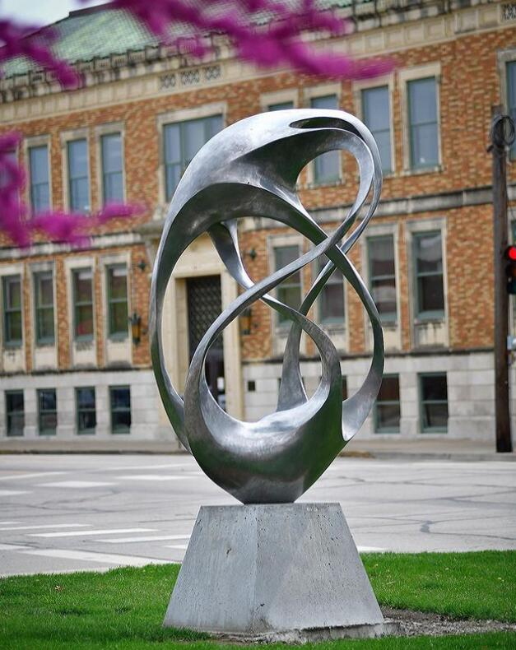
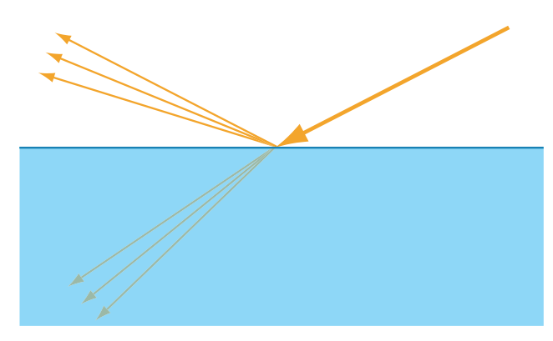
Appearance modeling
Material modeling in computer graphics relies on:
  Material observation
  Physics (optics) models
Observation
https://www.metalartstatue.com/amsculpture/cast-aluminum-sculpture/
Computer graphics
model
Modeling and rendering
Optics
https://mitsuba2.readthedocs.io/en/latest/generated/plugins.html#bsdfs
https://pbrt.org/

Slide 13

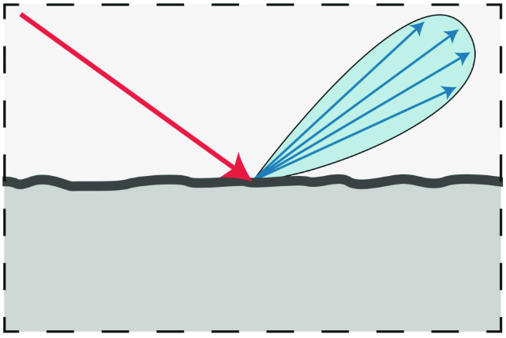
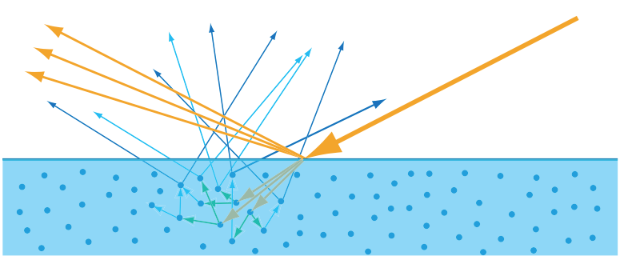
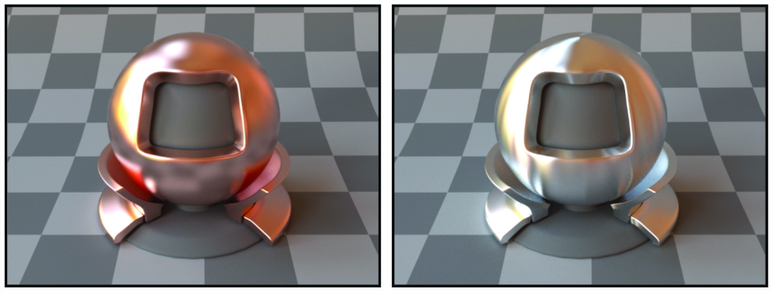
Materials: real world vs models
Real world materials are very complex are simplified using different models:
  Physical models: best description of real world materials
    Example: geometric optics
  Computer graphics models: simplification for creation and computational purposes
    Example: separating objects into shape and material
  Artist observation: based on perception – subjective model of the world
    Artist draw what they see, not what is physically-correct
Artist model:https://shelleyhannafineart.com/painting-silver-objects/
Physical model of light scattering
Computer graphics material model

Slide 14
Material observation
Modeling begins with observation

Slide 15
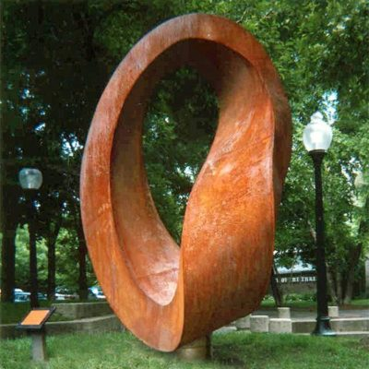
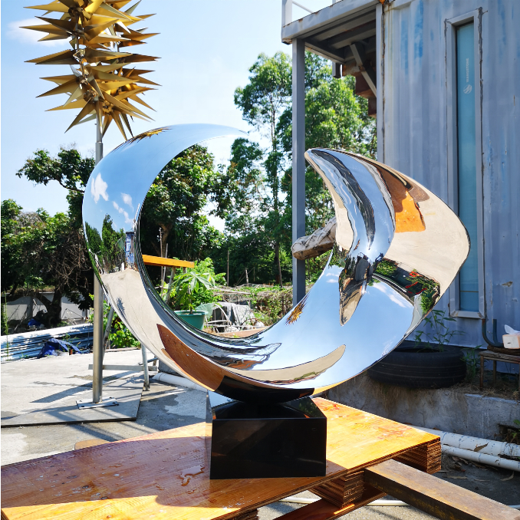

Observation
Observation goals:
  Understand what makes each material look different than other materials
  Observe characteristics which are responsible for object appearance
https://www.metalartstatue.com/amsculpture/outdoor-metal-bird-sculpture/

Slide 16
Observation
Characteristics responsible for object appearance:
  Shape: large scale form or geometry of object.
  Material: for computer graphics modeling purposes: fine-scale geometrical variations and substance properties
  Illumination: size, direction, color, etc.
  Sensor/Perception: point of view, camera properties, etc.

Slide 17
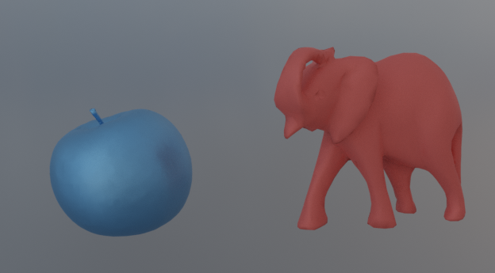
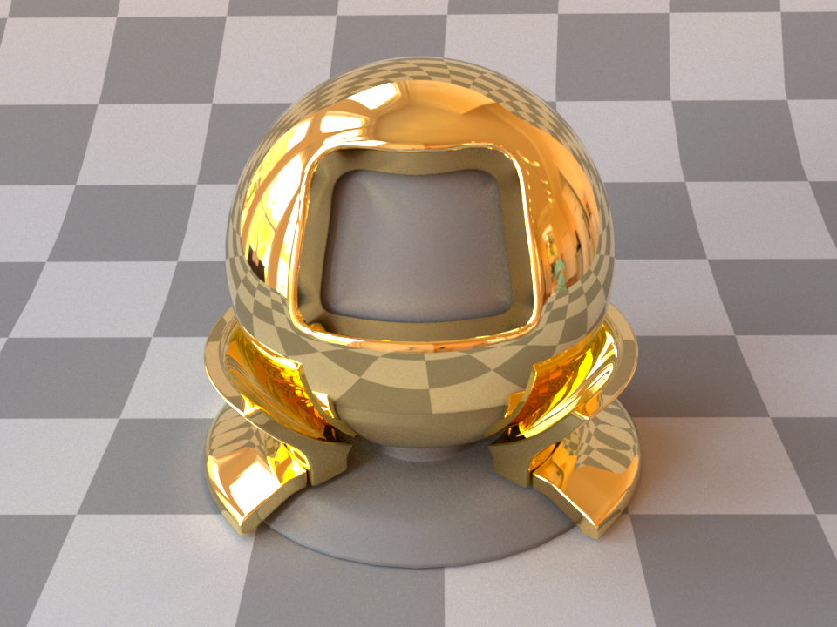
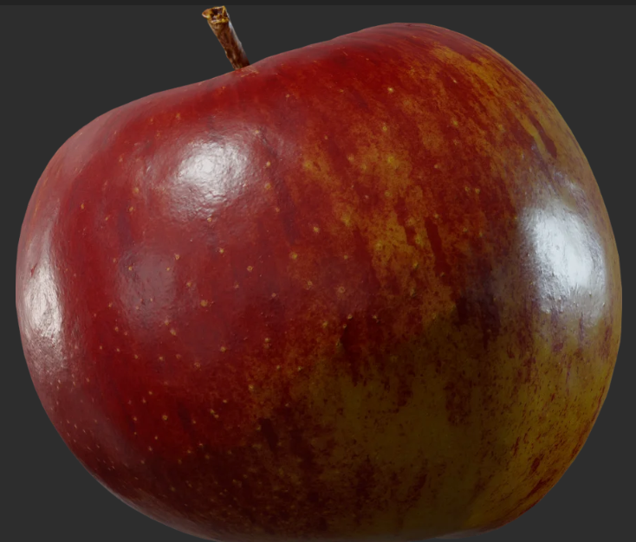
Classifying materials
Classifying materials enables us to understand which characteristics are needed to be modeled in order to obtain required appearance. We can classify any material by following variations:
Spectral: color
Directional
Spatial

Slide 18
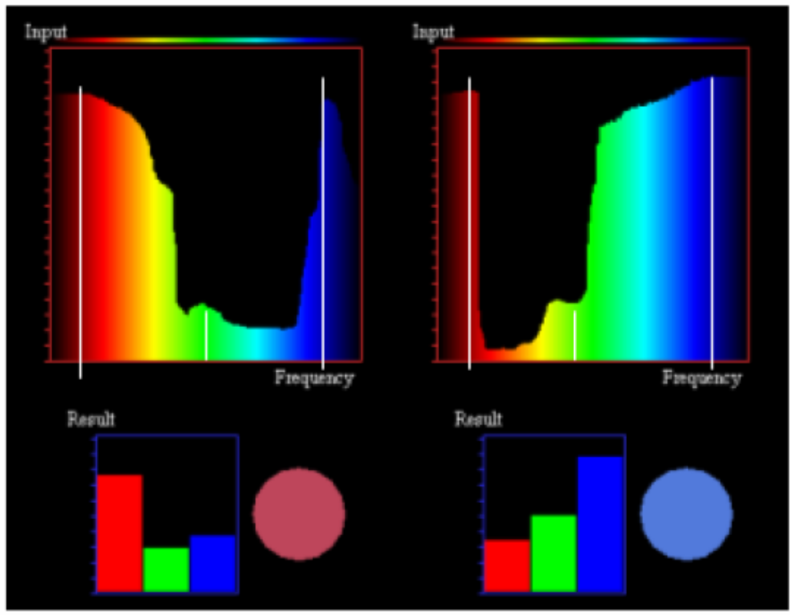
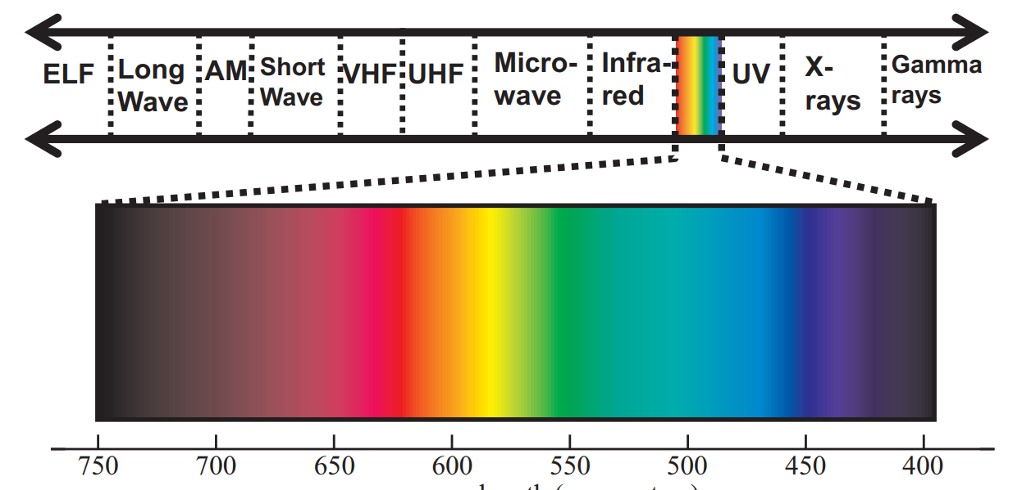
Spectral/color material characteristic
Light is a electromagnetic radiation in the wavelength band 380-780nm
Light scattered from object surface (its material) is described using:
  Color is described with red, green and blue floating points (R, G, B) in [0,1]
  Brightness is floating point value [0, inf]
https://blog.selfshadow.com/publications/s2013-shading-course/hoffman/s2013_pbs_physics_math_notes.pdf
https://www.researchgate.net/publication/234814482_Digital_modeling_of_the_appearance_of_materials

Slide 19
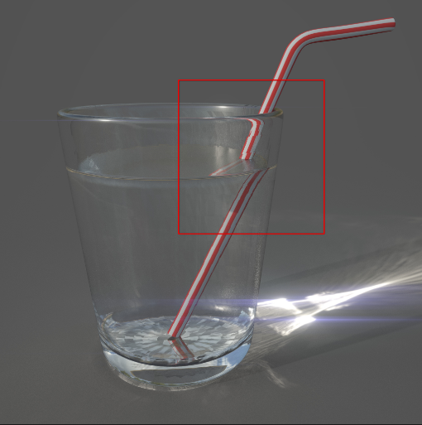

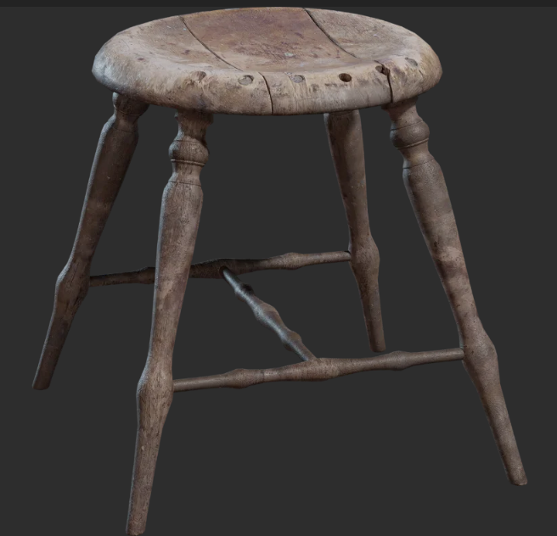

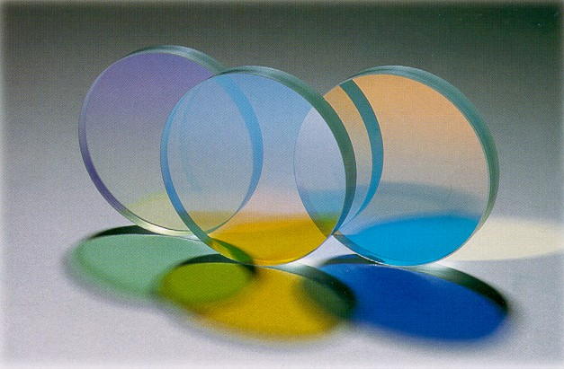
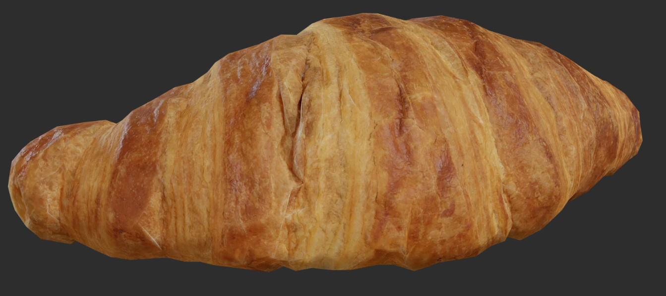
Directional material characteristic
Result from directionality of light scattering by the object
Directional effects: whether we see changes in object as we change view (or light or object position)
  Those effects are due to structures at a length scale shorter than the visible to the eye → can be observes on completely flat surfaces (what we consider flat by looking at it)
Directional effects that are attached to object (do not depend on environment):
  Shiny
  Hazy
  Glossy
  Matte
  Dull
  Translucent
  Transparent
https://substance3d.adobe.com/tutorials/courses/the-pbr-guide-part-1
https://polyhaven.com/
https://en.wikipedia.org/wiki/Transparency_and_translucency

Slide 20
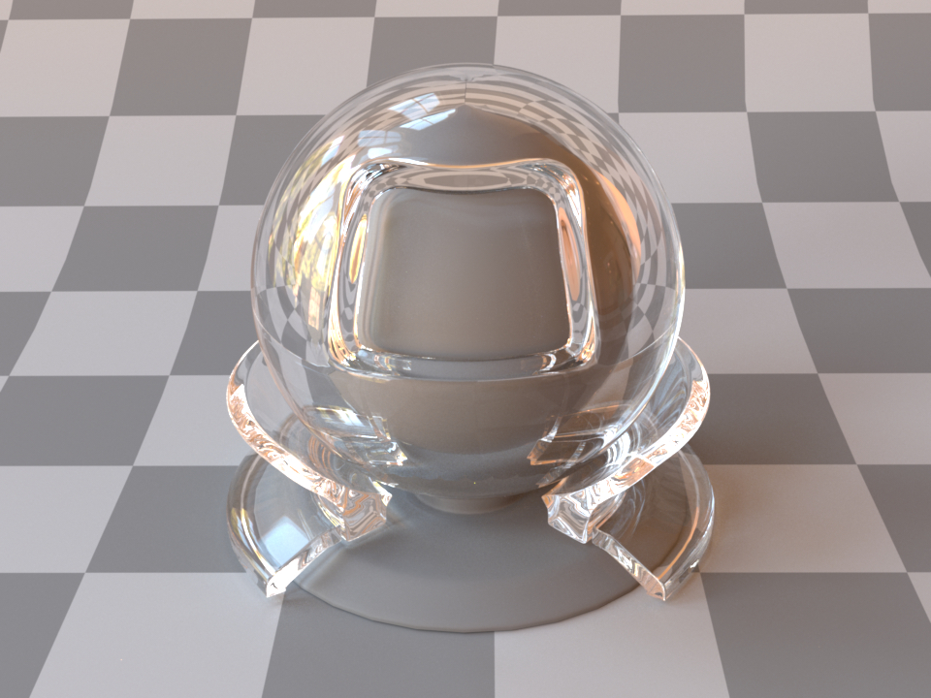
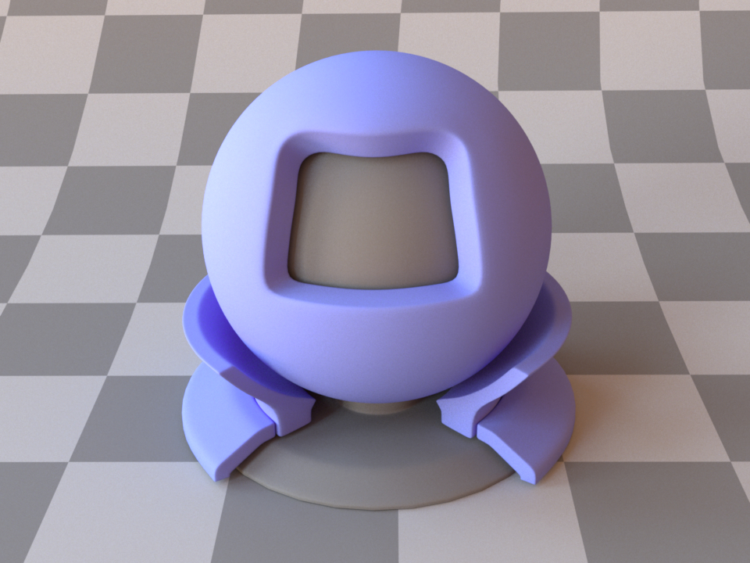
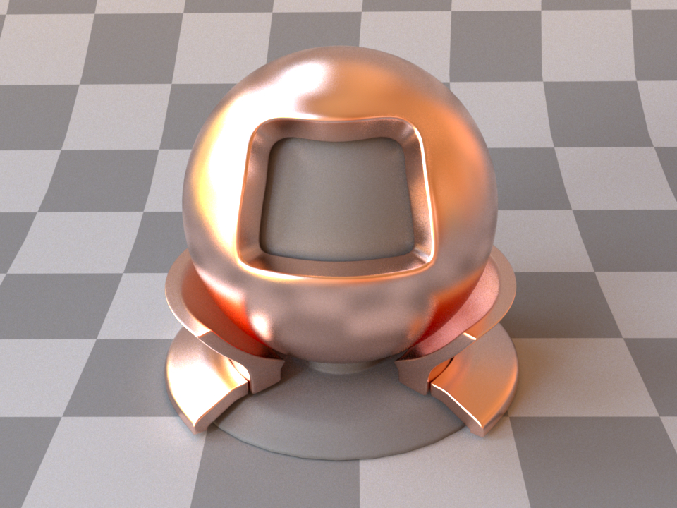
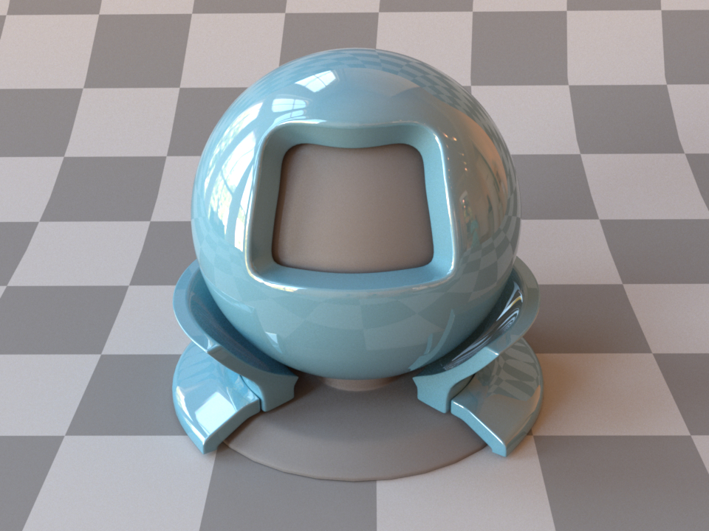
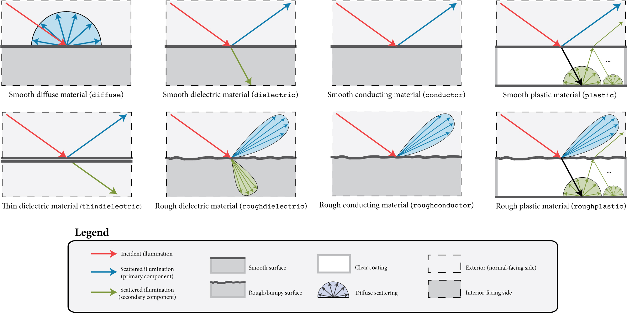
Directional material characteristic
In computer graphics, higher level description of scattering is used to describe directional – surface scattering - characteristics:
  Reflective
  Transmissive
  Specular (mirror)
  Glossy
  Lambertian (diffuse)
  Refractive
  Retroreflective
Reflective, specular (conductor, gold)
Transmissive, specular (dielectric, glass)
Reflective, Lambertian/diffuse (dielectric, plastic)
Reflective, glossy
Refractive, glossy (dielectric shiny plastic)

Slide 21
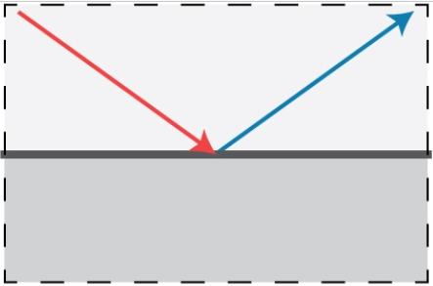
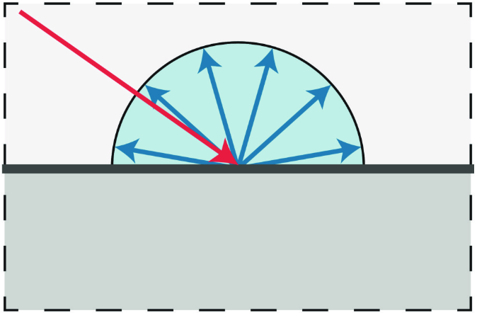
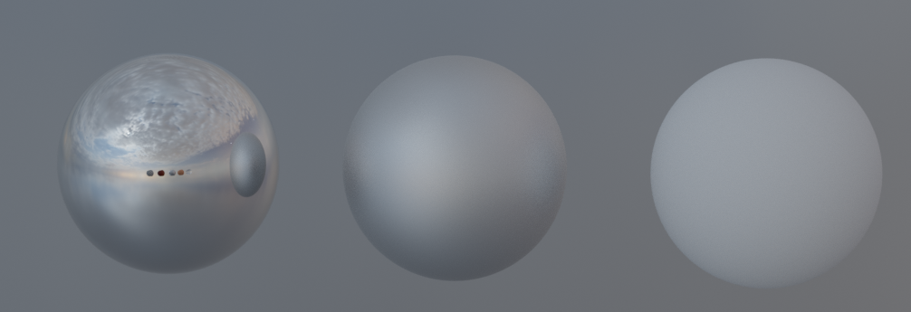
Surface scattering: scattering function
Surface directional effects are modeled using scattering function. Most important light scattering models are:
  Specular (mirror direction)
  Glossy (preferred direction)
  Diffuse (all directions)

Slide 22
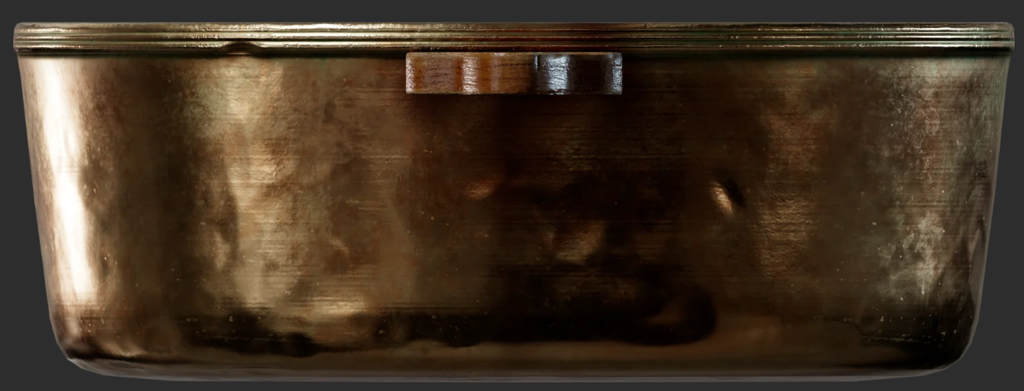
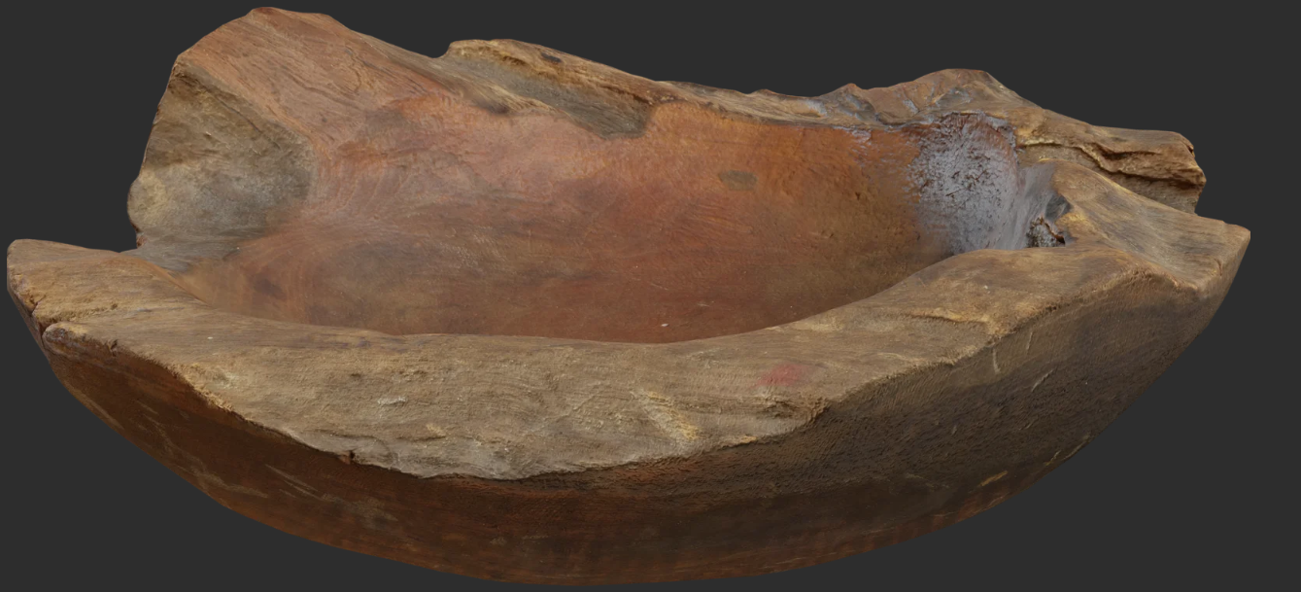
Material characteristics: texture
Visual variations on the object surface, much smaller scale than size of the object but larger than the wavelength of light - spatial variations:
  Directional or spectral (color)
  Small scale geometric variations: bumps and pores
Surfaces with spatial variation are observed as non-uniform: texture or pattern can be observed
Directional variation
Small scale geometrical variation
Color variation

Slide 23
Classifying materials
Classifying materials enables us to understand which characteristics are needed to be modeled in order to obtain required appearance. We can classify any material by following variations:
Spectral: color
Directional
Spatial

Slide 24
Physical models for computer graphics
Modeling is founded on optics

Slide 25
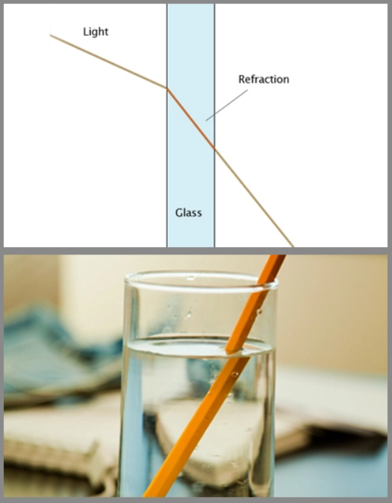
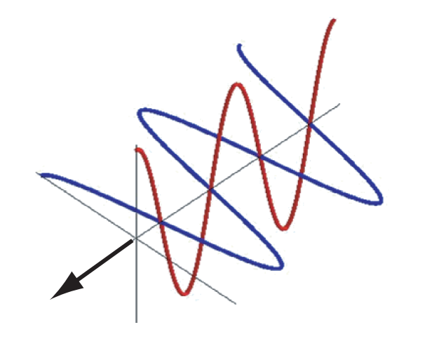

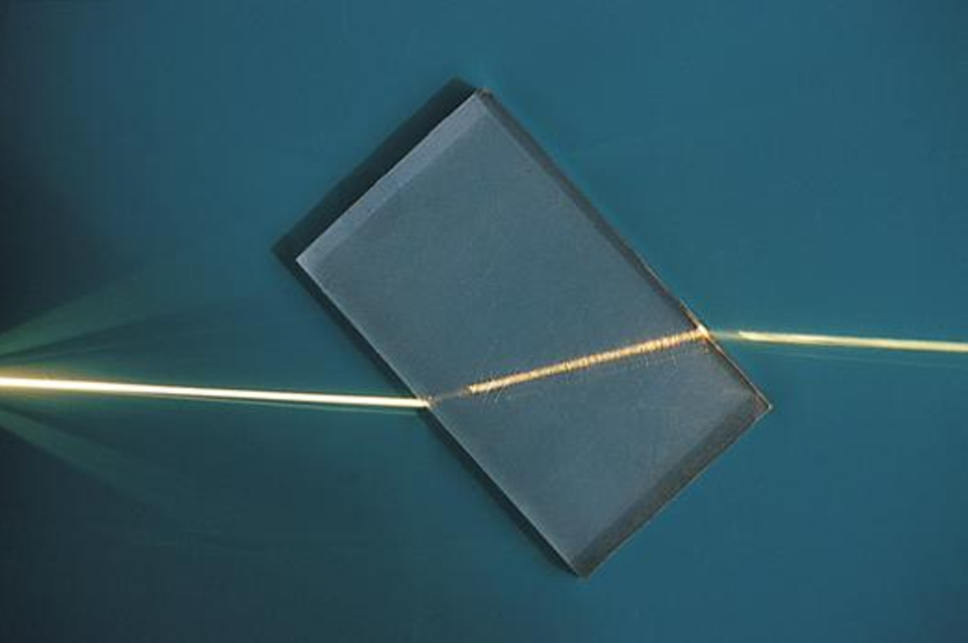
Light-matter interaction
Light is electromagnetic wave → too complex for CG!
Geometrical optics approximates light as rays and effect that material has on light using index of refraction (IOR) – a complex number:
  Real part determines speed of light → scattering
  Imaginary part determines absorption of light
Light is an electromagnetic transverse wave which can be represented as a ray.
https://manual.keyshot.com/manual/materials/general-parameters/refractive-index/

Slide 26
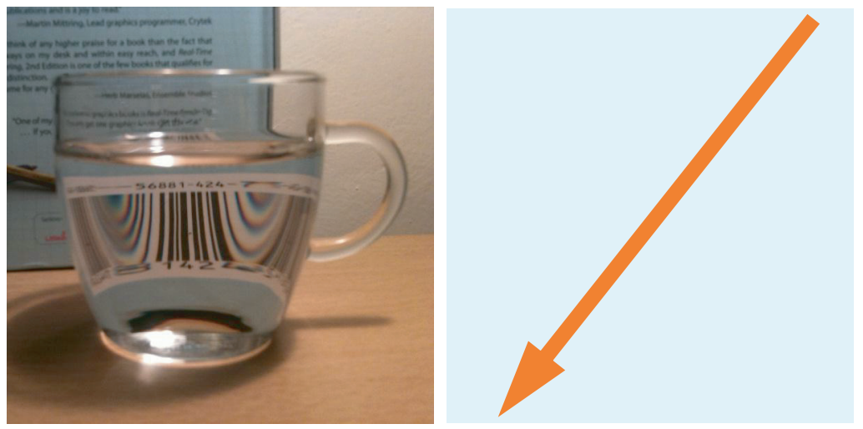
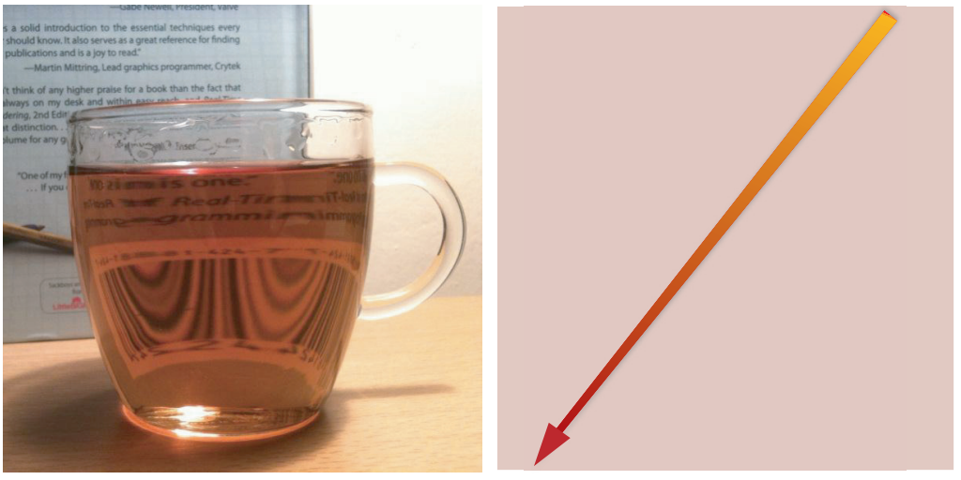
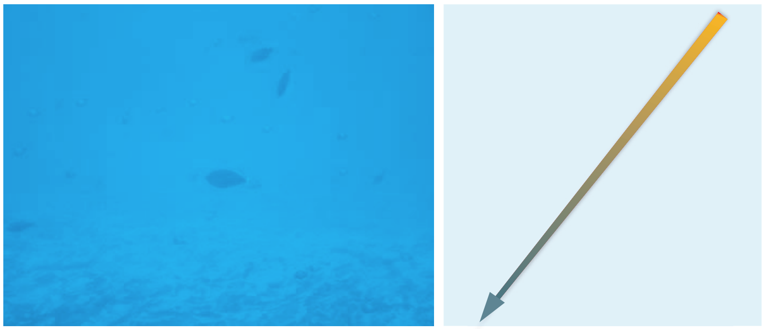
Light-matter interaction
Simplest light-matter interaction is light propagating through homogeneous medium.
  Uniform IOR: light travels on a straight line. It can only be absorbed: direction is same, intensity might be attenuated
  Examples: transparent materials; glass or water.
Transparent media: straight line with same intensity (scattering only happens when light crosses air-glass-water homogeneous media since they have different (but constant) IORs.
Clear absorbent media: straight line with loss of intensity – selective absorption (color is changed)
Slight absorption becomes significant with distance
https://blog.selfshadow.com/publications/s2013-shading-course/hoffman/s2013_pbs_physics_math_notes.pdf

Slide 27
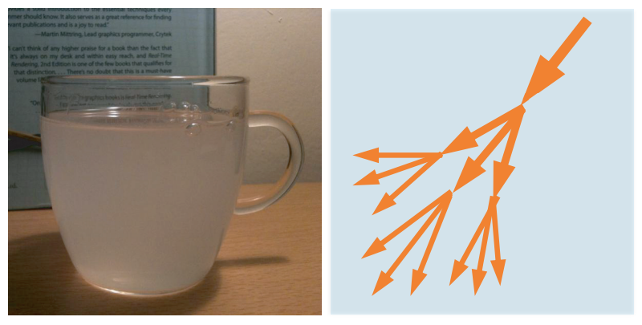
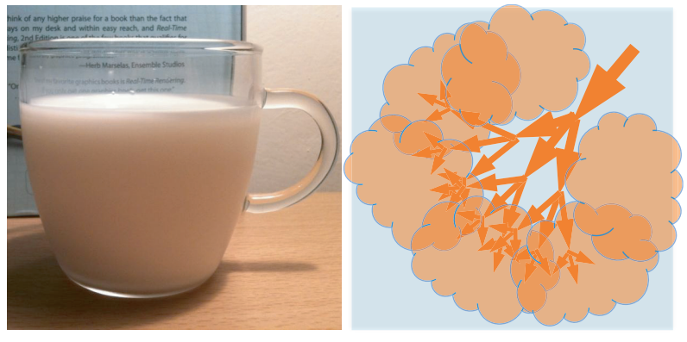
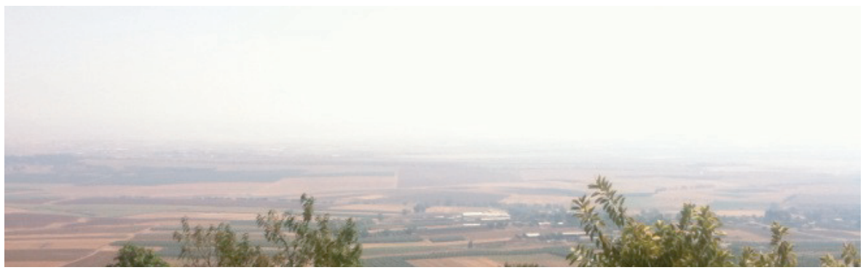
Light-matter interaction
In Heterogeneous medium IOR varies which causes light scattering
  Direction of light is changed but not the intensity
  Light can scatter in all directions, mostly non-uniformly: forward or back scattering (in or reverse of incoming direction)
Microscopic particles cause varying of IOR and light to scatter continuously in all possible directions.
Translucent or opaque materials → light is scattered so much that we can not see (clearly) through the object
Longer distances cause more scattering (e.g., clean air)
https://blog.selfshadow.com/publications/s2013-shading-course/hoffman/s2013_pbs_physics_math_notes.pdf

Slide 28
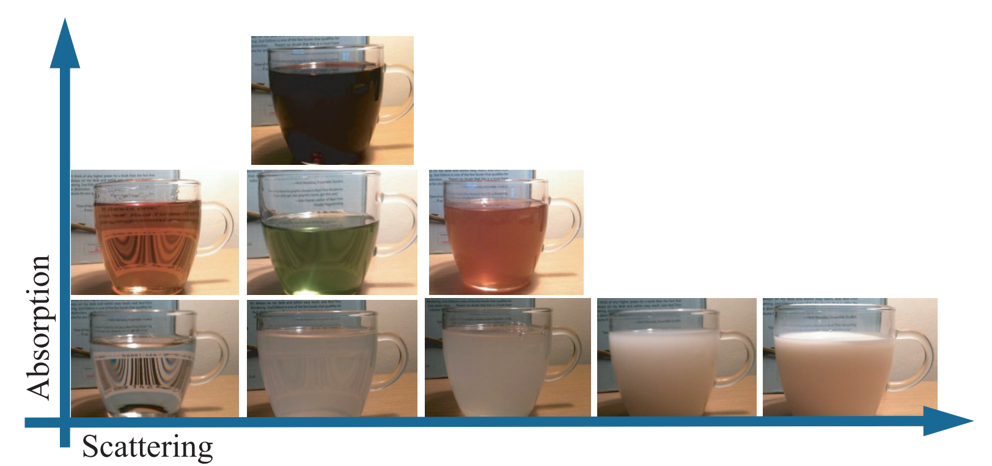
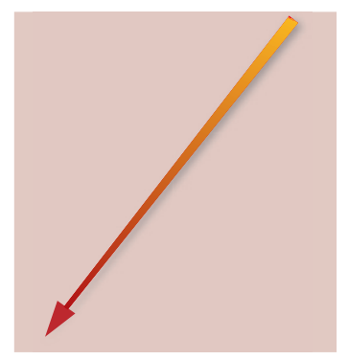

Light-matter interaction: scattering and absorption
Light traveling through medium, based on index of refraction will:
  Absorb
  Scatter
Appearance depends on both scattering and absorption
https://blog.selfshadow.com/publications/s2013-shading-course/hoffman/s2013_pbs_physics_math_notes.pdf

Slide 29
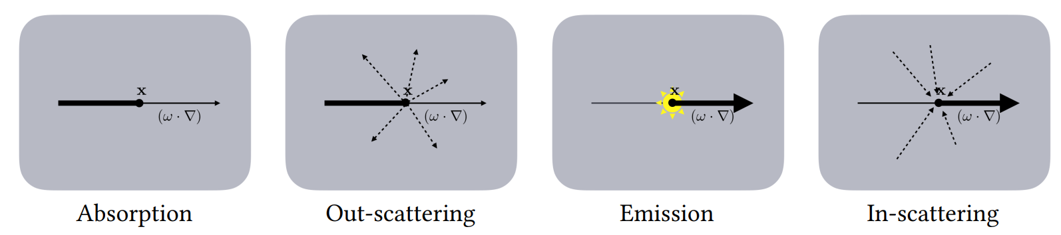
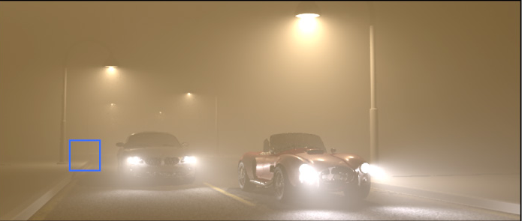


Light-matter interaction
Light scattering inside medium in CG is called volumetric scattering
Participating media
  Volume between objects
https://cs.dartmouth.edu/wjarosz/publications/jarosz08radiance.html
https://studios.disneyresearch.com/2012/08/05/virtual-ray-lights-for-rendering-scenes-with-participating-media/
https://graphics.pixar.com/library/ProductionVolumeRendering/paper.pdf

Slide 30
Foundations of materials: physics
Material defines interaction of light with objects
  Light is electromagnetic wave (visible part of spectrum). In computer graphics we work with geometrical optics which is approximation and light is represented using rays.
Light traveling through medium, based on index of refraction will*:
  Absorb
  Scatter
Homogeneous material: light travels on a straight line, it can only be absorbed, meaning that direction is same, but intensity might be lower.
  In transparent material (e.g. glass or water) light propagates in straight line – no scattering (scattering happens on interface – boundary between materials). Also, low absorption of light.
  Homogeneous material with higher absorption will attenuate light traveling through it or completely absorb it if distance is large – but the direction will not change! An example is water over larger distances.
  Note that also light can be selectively absorbed, meaning that it changes color (alongside intensity).
Heterogeneous material: light is scattered → direction of light is changed but not necessary the intensity
  Light can scatter in all directions, mostly non-uniformly: forward or back scattering
  Translucent or opaque materials are examples of heterogeneous materials → light is scattered so much that we can not see (clearly) through the object
  Longer distances cause more scattering, but not necessary more absorption (e.g., clean air)
<IMAGES OF REAL WORLD OBJECT SHOWING THOSE CHARACTERISTICS>
* Light interaction with matter (on geometrical optics) is determined by index of refraction – complex number. Real part determines speed of light, imaginary part determines absorption.Constant index of refraction is present in homogeneous materials where index of refraction is constant. For such materials, only absorption happens. Varying index of refraction is present in heterogeneous materials causing scattering (next to absorption).

Slide 31

Light-matter interaction: between media
Light traveling between media of different index or refraction - Maxwell’s equations – too computationally heavy!
Simplification and assumptions:
  Geometrical optics: rays light representation, IOR
  Interface between (volumes) media is perfectly (optically) flat, planar boundary* → object surface
Solution: Fresnel equations and Snell’s law
  Describe light reflection and refraction direction and amount
* Surface should be infinetly large, but in comparison with wavelenght of light, surface real objects can be considered as such.

Slide 32
Reflection on optically flat surfaces
Light interaction with matter can be described with Maxwell’s equations. Those are too heavy for computer graphics thus we work with (1) geometrical optics approximations and (2) special case which is can be simplified and used in graphics for material modeling.
Perfectly planar (optically flat, perfectly smooth) surface* between two homogeneous materials with different index of refraction is starting point for describing the behavior of light interaction with surface. This special case is described with Fresnel's equations:
  Light falling on such surface can: reflect and refract
  Amount and directions of light depend on index of refraction
<IMAGE: REFLECTION AND REFRACTION>
* Surface should be infinetly large, but in comparison with wavelenght of light, surface real objects can be considered as such.

Slide 33




Surface
Surface is thin interface between two media
In CG it is described with shape representations, e.g., polygonal mesh

Slide 34





Light-matter interaction: flat surface
Surface: 2D interface separating volumes with different IOR
Behavior of light falling on surface depends on:
  Geometry → surface orientation (normal)
  Substance → IOR
Light falling on planar surface can:
  Reflect
    Direction: law of reflection
    Amount: Fresnel equations
  Refract (transmit)
    Direction: Snell’s law
    Amount: Fresnel equations
Snell’s law
Fresnel equations

Slide 35


Light-matter interaction: flat surface
Surface reflection and refraction is crucial for realistic synthesis
  Whitted ray-tracing for realistic image synthesis
http://www.jallmenroeder.de/2020/11/18/path-tracing-with-nori/

Slide 36

More physically correct surface reflection
Real surfaces: small geometrical irregularities* not visible by eye but affecting light reflection
Surface model: large collection of tiny optically flat surfaces – facets. Final appearance is aggregate result of relevant facets.
  Smaller deviation of those facets cause more mirror-like surface reflection (small roughness)
  Larger deviation of those faces causes more blurred surface reflection (glossy, high roughness)
Both surfaces look smooth but surface on bottom is rougher. Roughness difference is on microscopic scale - microgeometry.
Macroscopically, non-optically flat surface can be treated as flat surfaces reflecting with multiple directions
* not optically flat surfaces: irregularities are larger than wavelength (causing light to reflect differently) and too small to render since this interaction happens under one pixel.

Slide 37



Surface refraction
Besides of reflection on surface, light can also refract inside object.
Amount and direction of refracted light depends on material which we can separate in:
Metals (conductors)
Dielectrics (non-metals)
In case of metals, most of the light is reflected and rest is immediately absorbed. That is why mirrors are made using metal foundation. Conductors are spectrally selective and thus reflection color may vary
In case of dielectrics, light partially reflects and partially refracts. Refracted light is then absorbed and scattered inside surface (sub-surface scattering (SSS)) causing diffuse reflection.

Slide 38

Diffuse and specular reflection
Two fundamental light-surface scattering processes:
  Diffuse
  Specular/glossy

Slide 39

Surface refraction
Refracted light on dielectric surface can be:
  Absorbed and re-emitted: opaque objects
  Transmitted: transparent objects
  Partially transmitted: translucent objects
Opaque
Transparent
Translucent

Slide 40
Light-matter interaction: summary
Light traveling to/between objects can be scattered/absorbed → volumetric scattering
Light falling on object surface – surface scattering - can:
  Reflect (metals and dielectrics)
  Refract (only dielectrics)
Depending on material, refracted light can:
  Transmit (transparent surfaces)
  Sub-surface scatter (opaque and translucent object volume) → volumetric scattering
Participating media
Opaque dielectric: reflect + refract → SSS/diffuse
Transparent dielectric: reflect + refract → transmit
Translucent dielectric: reflect + refract → transmit
Metal: reflect

Slide 41

Local vs global models
Local (direct) models: describe what happens when light falls on one point
Volumetric scattering phenomena requires global model
  Can be approximated with local model (e.g., SSS with diffuse model)
SSS – in this case, light is not exiting from the same point where it has entered, thus we need more than local information for calculating light behavior. Therefore, this is one of more complex effects that require advanced rendering methods or approximation methods.
Local models describe what happens at one point/pixel

Slide 42

Modeling material characteristics
Physical considerations gave foundations to small scale light behavior:
  Directional effects → scattering
  Color
Larger scale variations visible by eye are simulated by varying scattering models or their parameters over surface.
  Texture
Modeling only scattering function (small scale) can represent different directional and color characteristics but surfaces are smooth.
Varying scattering model parameters results in textured objects

Slide 43
Light-matter interaction: refraction
Besides of reflection on surface, light can also refract.
Amount and direction of refracted light depends on material which we can separate in:
  Metals
  Dielectrics
In case of metals, most of the light is reflected and rest is immediately absorbed. That is why mirrors are made using metal foundation.
In case of dielectrics, light partially reflects and partially refracts. Refracted light is then absorbed and scattered inside surface (sub-surface scattering*). Some of the light can also be re-emitted – causing diffuse reflection.
<IMAGES: REFLECTION ON METAL AND DIELECTRIC SURFACES>
<IMAGES: real world objects with such properties>
<IMAGE: reflection from metal and dielectric surface: not the color of reflection!>s
* Note that in this case, light is not exiting from the same point where it has entered, thus we need more than local information for calculating light behavior. Therefore, this is one of more complex effects that require advanced rendering methods or approximation methods.

Slide 44
Modeling appearance

Slide 45


Diversity of appearance models
Appearance models, depending on application, can range from photo-real to stylized.
“Rolling Teapot” - Model by Brice Laville, concept by Tom Robinson, render by Esteban Tovagliari - RenderMan ‘Rolling Teapot’ Art Challenge: https://appleseedhq.net/gallery.html#https%3A%2F%2Fappleseedhq.net%2Fimg%2Frenders%2Frolling-teapot.jpg
https://www.artstation.com/artwork/rANRe5

Slide 46

Material and rendering
Rendering: computing intensity and color of light entering the camera along set of viewing rays.
Viewing rays are intersecting objects in the scene → intensity and color of viewing ray comes from closest intersected object surface
  Ignore participating media for now
Compute intensity and color of the surface intersected by viewing ray → shading

Slide 47

Materials and shading
Shading uses material model and couples it with with viewing position, object shape and light information to calculate the object color in intersected point.
  Light-object interaction in shading point
Final color of surface is calculated by:
  Summing all incoming light that falls onto surface – light transport – also uses material information
  Calculating color and intensity of light reflected into camera using material description - shading

Slide 48

Material modeling
Model interaction of light in shading point → scattering model:
Specular surface
Diffuse surface
Transmissive surface

Slide 49
Material modeling
With material in CG we describe light-matter interaction → shading
Material in CG can is decomposed to describe:
  Color
  Directional effects
  Spatial variation:
    Of color and directional effects
    Small-scale geometrical information that is too small to represent explicitly by geometry/shape.

Slide 50
Material modeling: scattering
Material modeling describe how light behaves when interacts with objects:
  Light-surface interaction
  Light-volume interaction
Description of light interaction with surface, when considered locally, is called scattering.

Slide 51


Material modeling: texture
Same description of material for each point of the 3D object, results in homogeneous material: smooth surface
Scattering model can be parameterized to vary its properties over the surface.
Homogeneous material: scattering model has the same parameters in all points of the surface.
In CG texture is used to vary scattering parameters over surface
Models: https://polyhaven.com/a/throw_pillows_01

Slide 52
Elements of material model
Material modeling is separated into:
  Scattering → description of light-matter interaction at a point
  Texture → variation of small-scale geometry and scattering properties across 3D object surface

Slide 53



Shading and light
p
Shading “collects” all incoming light and shading point and multiplies it with scattering model.
Collect light over whole hemisphere above shading point, placed and normal in shading point
Incoming light at shading point
Reflectance equation.
Special case of rendering equation.
Color in shading point.
Scattering model
Light attenuation due to surface orientation
p

Slide 54


Shading and light
Simplification: sum light from light sources
Attenuation
c_{light_2}
c_{light_1}
Scattering model
Color in shading point
l₁
p
l₂
c_{shaded}
Current light color
Sum over all lights in 3D scene

Slide 55
Scattering models

Slide 56
Light-matter interaction: summary
Light traveling to/between objects can be scattered/absorbed → volumetric scattering
Light falling on object surface – surface scattering - can:
  Reflect (metals and dielectrics)
  Refract (only dielectrics)
Depending on material, refracted light can:
  Transmit (transparent surfaces)
  Sub-surface scatter (opaque and translucent object volume) → volumetric scattering
Participating media
Opaque dielectric: reflect + refract → SSS/diffuse
Transparent dielectric: reflect + refract → transmit
Translucent dielectric: reflect + refract → transmit
Metal: reflect

Slide 57
Surface scattering
Reflection and transmission

Slide 58


Scattering model
By now we know that amount of light falling on surface depends on shape and light:
Surface normal in point is crucial for determining how much the surface is oriented towards light

Slide 59




Scattering model
Observing objects we can see that they have different appearance, although similar in shape
  This particular look of objects is defined by how light scatters when it falls on surface point.
  This behavior is defined by surface scattering function - surface response to light

Slide 60

Surface scattering function
Scattering function can be separated in reflection and transmission
  Model describing reflection is called “bidirectional reflectance distribution function” – BRDF.
  Model describing transmission is called “bidirectional transmission distribution function” – BTDF.
  Model describing both reflectance and transmission is called “bidirectional scattering distribution function” – BSDF.
Reflective – all light is scattered above surface
Transmissive – all light is scattered below surface
  Refractive – special case of transmissive
https://www.pbr-book.org/3ed-2018/Reflection_Models/Specular_Reflection_and_Transmission

Slide 61
Visualizing BRDF/BDTF
The way surface reflects light can be visualized using lobes
  Describes unique surface light reflection

Slide 62
BRDF
Describes reflectance phenomena: redirection of light hitting surface (shading point) back outward
Mathematical approximation of light interaction and microscopic structure of material:
  Surface reflection
  Local sub-surface scattering (e.g., diffuse model)
BRDF is evaluated at shading point

Slide 63

BRDF notation
BRDF f(v,n,l) describes surface response which depends on:
  Incoming – unit length vector - light direction (l)
  Outgoing – unit length vector - view direction (v)
  Shading point normal (n)
Incoming (l) and outgoing (v) directions have 2 degrees of freedom, two angles relative to surface normal:
  Elevation (θ)
  Azimuth (Φ)
  Dimensionality of BRDF: 4

Slide 64
BRDF in shading
Attenuation
c_{light_2}
c_{light_1}
Scattering model → BRDF
Color in shading point
l₁
p
l₂
c_{shaded}
Current light color
Sum over all lights in 3D scene

Slide 65


Common BRDFs
Diffuse, Diffuse textured.
Light is scattered in all possible directions. Independent of viewing direction. Equally bright from all directions.
Glossy: Copper, Aluminium.
Scattered light is concentrated around particular direction (lobe). Appears blurred. Dependent of viewing direction.
Specular (gold)
Light is scattered in single direction (mirror-reflection direction). Perfectly sharp. Dependent of viewing direction.
https://mitsuba2.readthedocs.io/en/latest/generated/plugins.html#bsdfs

Slide 66

BRDF reflection
Real materials have complex lobes
While modeling, several lobes are combined with different weights and parameters
Wide range of materials can be described with these three basic reflection types:
  Specular
  Diffuse
  Glossy (rough specular)

Slide 67
Scattering models
Modeling approaches:
  Empirical
    Simulate observed scattering phenomena
  Data-based
    Scattering is measured from real world and stored in tables
  Physical-based
    Based on physical interaction of light with matter

Slide 68
Empirical models
Models based on observation of scattering phenomena rather than physical correctness
Phenomenological models: describe the quantitative properties of real-world surfaces by mimicking them
Easy to implement and use
Types:
  Diffuse → Lambertian
  Specular → Mirror
  Phong and Blinn-Phong

Slide 69


Lambertian (diffuse) model
Scattered amount of light in all directions is the same and linearly depend on incoming light
Simplest BRDF model:
  Doesn’t depend view direction
  Note that surface orientation will attenuate or increase incoming light making surface darker or brighter (attenuation factor)
  Constant reflectance value: diffuse color (albedo): (R, G, B)
Local model used to approximate sub-surface scattering
The basis for more complex models
https://google.github.io/filament/Filament.html

Slide 70

Lamberitan in shading
Attenuation
c_{light_2}
c_{light_1}
Lambertian scattering model
Color in shading point
l₁
p
l₂
c_{shaded}
Current light color
Sum over all lights in 3D scene

Slide 71


Specular (mirror) model
Ideal reflection where incoming light is reflected completely in a single outgoing direction – mirror reflectance direction
Depends on view and light directions
Single parameter: reflectivity – a constant (R,G,B)

Slide 72

Specular in shading
Ideal reflection where incoming light is reflected completely in a single outgoing direction – mirror reflectance direction
Attenuation
Color in shading point
Specular scattering model
l₁
c_{light_1}
p
Current light color
Sum over all lights in 3D scene
c_{shaded}
Nothing to reflect!

Slide 73

Specular in shading
Ideal reflection where incoming light is reflected completely in a single outgoing direction – mirror reflectance direction
Attenuation
Color in shading point
Specular scattering model
c_{light_1}
l₁
Current light color
p
c_{shaded}
Sum over all lights in 3D scene
Drawback of direct illumination

Slide 74

Specular in shading
Ideal reflection where incoming light is reflected completely in a single outgoing direction – mirror reflectance direction
  Light has to be gathered from all surfaces in 3D scene → reflectance equation
Global illumination: direct and indirect illumination
p

Slide 75
Specular and diffuse model
Specular reflectivity parameter is color for conductors
  Conductors have colored specular reflection due to spectral selectivity
Diffuse
Specular highlight.
Dielectrics: specular highlight the same as light source color
Conductors: colored specular highlight

Slide 76

Phong model
Idea: wide range of materials can be described with diffuse and specular component:
  surface_color = diffuse() * K_{d} + specular() * K_{s}
Some surfaces exhibit glossy highlights: reflection of light source (or another object) on object surface
  Compared to perfect specular mirror reflection, glossy is blurred and broken up
  This kind of rough surface acts like “broken mirror” and it is modeled as collection of small mirrors → micro-facets
Only fraction of light rays are reflected in eye direction by rough surface causing dimmer/blurred light reflection
Brightness of glossy reflection decreases as angle between view and ideal reflection increases – number of microfacets reflecting in eye decreses

Slide 77


Phong model: glossy observations
Brightness of specular reflection decreases as the distance increases between:
  point on the surface of the object and
  point where the reflection of the light source would be formed if the surface was a perfect mirror
Reflection brightness decreases as light source reflection spreads across larger area
Highlight brightness decreases as distance of object points from original reflected light position increases

Slide 78



Phong model
Phong observation: glossy surface can be simulated by:
  Computing ideal specular reflection (R) of incident light ray (L)
  Computing dot product between reflected ray and view direction
  Raising dot product to power of n

Slide 79

Phong model
Empirical model: parameters doesn’t have physical meaning
  Parameters are tweaked by artist/user until desired appearance is achieved
Physically based models build on this concept and provide physically-based parameters
Graph of (V*R)^{n}

Slide 80



Phong illumination model
Phong illumination model describes complete shading
A phenomenological model using:
  Diffuse reflection: rough surfaces; large highlights
    Parameter: k_{d} – ratio of reflection of the diffuse term of incoming light
  Specular reflection: shiny surfaces; small highlights
    Parameter: k_{s} – ratio of reflection of the specular term of incoming light
    Additional parameter: alpha – shininess constant: larger for smooth and mirror-like surfaces and small specular highlights
  Ambient term: small amount of light that comes from around the scene
    Parameter: k_{a} – ratio of reflection of the ambient term for all points on the surface
i_{s}, i_{d}, i_{a}

Slide 81



Blinn-Phong
Modification to Phong model, a BRDF
Introducing half vector between light and view vectors
Parameters: Lambertian (k_{L}) and glossy (k_{G}), range: [0,1]
Energy conserving if k_{L} + k_{G} <= 1
Example in OpenGL:https://learnopengl.com/Advanced-Lighting/Advanced-Lighting
https://en.wikipedia.org/wiki/Blinn%E2%80%93Phong_reflection_model

Slide 82


Other empirical models
Lafortune model
  Generalization of Phong’s model
  Richer appearance with multiple lobes
https://cglearn.eu/pub/advanced-computer-graphics/physically-based-shading
Lafortune model. http://people.csail.mit.edu/addy/research/ngan05_brdf_eval_ppt.pdf

Slide 83


Data-based models
BRDF measurement → gonioreflectomenter
  Measurements are stored in table on which lookup with view and light direction is performed
BRDF measurement of real-world can be used for:
  Evaluation of phenomenological and physically based models
  Modeling of material
Different real-world materials have been measured:
  Isotropic BRDFs
  Anisotropic BRDFs
  Texture characteristics
  Sub-surface scattering
Problems:
  Costly for rendering
  Memory
Isotropic materials:https://www.merl.com/brdf/
Anisotropic materials: Brushed aluminium,Yellow satin, Purple satin, Red velvet http://people.csail.mit.edu/addy/research/brdf/

Slide 84


Physically-based models
Real-world surfaces have geometrical detail on multiple and thus very small scales
  Although we can not see those small-scale details individually, we can see their aggregate response and they define how surface actually appears
Small-scale surface irregularities (smaller than a pixel) can not be modeled explicitly, therefore this is modeled using BRDF
  Geometric optics assumption: these irregularities are much smaller than light wavelength (they have not effect of appearance) or much larger than light wavelength (they cause light redirection). Wave optics describes phenomena in between.
https://google.github.io/filament/Filament.html

Slide 85

Physically-based models
Small scale geometry is invisible to the eye directly, but its cumulative response is visible.
Transition from glossy to specular is determined by small scale irregularities
Glossy
Specular
https://google.github.io/filament/Filament.html

Slide 86

Physically-based models
Small scale irregularities are represented as facets with microsurface normals*.
  Micro-facet theory: statistical distribution of microfacets which have strong peak at macrosurface normal. Spread of this distribution is called roughness
  Higher roughness means more blurred surface since micronormals will be more spread (glossy-diffuse). Small roughness gives mirror-like surface (specular).
https://docs.quixel.com/mixer/1/en/topic/pbr-physically-based-rendering
* Note how important normal information in computer graphics is. Different scales of geometry are always described with normal information.

Slide 87

Physically-based models
Assumption of microfacets which are optically-flat
  Diffuse
  Specular
Geometric optics can approximate how light interacts with each microfacet using IOR, Fresnel equations and Snell’s law

Slide 88


Physically-based models
Microfacet-based BRDFs are state of the art reflectance models using in professional modeling and rendering software.
Fundamental models are:
  Torrance–Sparrow for glossy surfaces
  Oren-Nayar for diffuse surfaces
https://www.pbr-book.org/3ed-2018/Reflection_Models/Microfacet_Models

Slide 89




Blender is our friend
https://docs.blender.org/manual/en/latest/render/shader_nodes/shader/diffuse.html
https://docs.blender.org/manual/en/latest/render/shader_nodes/shader/glossy.html
https://docs.blender.org/manual/fr/2.79/render/blender_render/materials/properties/diffuse_shaders.html?highlight=diffuse%20shaders

Slide 90

Physically-based models
Physically based rendering imposes two laws:
  Helmholz reciprocity: f(l,v) = f(v,l) – input and output can be switched and the function value will stay the same
  Conservation of energy*: outgoing energy can not be greater than incoming energy. BRDF which significantly violates this property leads to too bright and thus not realistic surfaces.
    Note that BRDF can have arbitrary large values in certain directions if the distribution it describes is highly non-uniform. An example are highly reflective surfaces with highlights.
White furnace test: white sphere is illuminated with white light from all directions. If energy conserving is satisfied, the sphere will disappear in white background
https://boksajak.github.io/files/CrashCourseBRDF.pdf
* Energy conservation is measured with directional-hemispherical reflectance R(l). It measures amount of light coming from given direction that is reflected into any outgoing direction in the hemisphere around normal – it measures energy loss for a given incoming direction. If BRDF is reciprocal then hemispherical-directional reflectance can be calculated as well giving the same value. Term for both reflectances in Directional albedo. The value must be in [0,1] to satisfy energy conservation: 0 is completely absorbed, 1 is completely reflected. Note that this restriction doesn’t apply to BRDF since it can have arbitrarily large values in certain direction (e.g., highlight direction).

Slide 91

Isotropic and anisotropic BRDF
Isotropic BRDF: rotating light and view directions around the surface normal does not affect the BRDF.
  Incoming and outgoing directions have the same relative angles between them: such BRDF can be parameterized with three angles.
Anisoptropic BRDF: reflection behavior changes when light and view vectors are rotated around normal
https://google.github.io/filament/Filament.html

Slide 92


Isotropic and anisotropic BRDF
Anisoptropic behavior is present due to underlying surface sturcture which is directional
https://cs184.eecs.berkeley.edu/sp22/lecture/14-29/material-modeling

Slide 93

Note: bidirectionality of BRDF
“bidirectional” in BRDF means that given given incoming and outgoing direction, we can compute amount of reflected light in outgoing direction.
Further, bidirectionality can be used for:
  Given outgoing (view) direction, it specifies the relative contributions of incoming light
  Given incoming light direction, it specifies distribution of outgoing light
Contributions of incoming light given view direction
Distribution of outgoing light directions given incoming light direction
https://blog.selfshadow.com/publications/s2013-shading-course/hoffman/s2013_pbs_physics_math_notes.pdf

Slide 94

BDTF
Scattering function can be separated in reflection and transmission
  Model describing reflection is called “bidirectional reflectance distribution function” – BRDF.
  Model describing transmission is called “bidirectional transmission distribution function” – BTDF.
Reflection
Transmission
https://en.wikipedia.org/wiki/Bidirectional_scattering_distribution_function

Slide 95



Common BDTF types
Specular transmission
Smooth dielectic
Glossy transmission
Rough dielectic
https://mitsuba2.readthedocs.io/en/latest/generated/plugins.html#bsdfs

Slide 96



BTDF: specular transmission
Light passing from one transparent to another transparent medium with different IOR
  Refraction – light changes direction – illusion of disproportional/broken object
New - transmission - direction depends on:
  IOR η
  Incident direction
Snell’s law: refracted angle
Refraction/transmission direction:
https://www.britannica.com/science/refraction

Slide 97

BTDF: specular transmission
3D objects represent surfaces encapsulating media with different IOR
Space around 3D objects is often considered vacuum → lowest IOR
Light can travel:
  From lower to higher IOR medium, e.g., light hitting surface from outside
  From higher to lower IOR medium, e.g., light leaves volume of water
If light travels from inside object (from higher to lower IOR) then normal direction must be flipped and then used for computing normal direction
  Check the sign of dot product between incident ray direction and normal

Slide 98



BTDF: specular transmission
When angle of incidence is larger than critical angle, then 100% of the light is reflected
  Happens when light ray passes from higher to lower IOR (e.g., glass-water)
  Total internal reflection
  Check: term under square root is negative c₂ =
https://www.youtube.com/watch?v=NAaHPRsveJk&ab_channel=QuantumBoffin

Slide 99


BRDF and BTDF
How much light is reflected and refracted?
  Fresnel equations
Amount of reflected/refracted light depends on:
  Media IOR
  Angle of incidence → amount of transmitted light increases when angle of incidence decreases
Amount of reflected/transmitted light (in case when total internal reflection doesn't occurs)
https://shanesimmsart.wordpress.com/2018/03/29/fresnel-reflection/

Slide 100
BRDF in bigger picture
Reflectance equation:
  Lo = int (f * Li * N * l)
  Note that BRDF (f) defines local interactions, so in it is used in combination of light transport to obtain light from the scene
TODO: image explaining reflectance eq. Integral over hemisphere for incoming light l and Li.
Above expression uses global illumination
Simplification: sampling over hemisphere can be simplified with summing over light sources for direct illumination

Slide 101
Scattering and shading: a note
Scattering model is implemented in shading step in rendering for calculating color of the object
Shading model takes name of scattering model
  If Lambertian scattering model is implemented than shading is called Lamberitan shading.

Slide 102


Normal and BRDF (BTDF)
BRDF evaluation depends on surface normal
  Normal defines so called basis
Note that perturbing the normal, would tilt the basis and reflected light would be different!
This enables modeling small scale geometrical details
Variation of surface normal is task for texturing.

Slide 103


Scattering models parameters
Scattering models are parameterized: color, roughness, etc.
Uniform parameters result in overly smooth and perfect surface – not realistic.
If BRDF depends on position on which is evaluated then it is called spatially varying BRDF
  Variation of parameters over surface is done using texturing

Slide 104
Scattering models: practical tip
In graphics, various scattering models have been developed (and still are!) to represent surface even more correctly or efficiently.
Choice of the model depends on application and desired appearance.
Practical tips:
  When modeling a material in DCC Tool, you will be often offered with multiple implementations of basic (or more advanced) models that you further combine to achieve desired material description. In this case, it is good that you are familiar with how they work and their parameters because a lot of time is actually spent on “tweaking” parameters to achieve desired appearance. Understanding parameters of scattering models help very much with upcoming topic: texturing. This is huge and important topic.
  If you are more interested in developing your own scattering models to achieve different appearance (not necessary photo-realistic, rather non-photorealistic which will be discussed later) then understanding of existing scattering models is great foundation to build on: you will see that advancements of scattering models just added more complexity to basic ones.

Slide 105
Exploring BSDFs
Various BSDFs are available in modeling tools for material creation. Core scattering models are deeply integrated into renderer source code and user is provided with an interface to those for combining and creation of complex material.
  Cycles/EEVEE (Blender): https://docs.blender.org/manual/en/latest/render/shader_nodes/shader/index.html
  Appleseed: https://appleseed.readthedocs.io/projects/appleseed-maya/en/master/shaders/shaders.html#materials
Similarly as for object shape (e.g., mesh), materials are meant to be transferable between applications. Note that it is up to applications renderer which scattering models are supported. Therefore, it is often a case that material defined in one modeling tool can not be easily fully and exactly transferred to another application.
  This requires matching supported scattering functions between applications. Example is Blender to Unity
In order enable easier communication and transfer, standardized BSDF is created and supported by diferent applications.
  Principled BSDF: Blender to Godot: https://docs.godotengine.org/en/3.0/tutorials/3d/spatial_material.html
Tendency is towards integrations of material modeling tool standards into game engines for easier transfer
  Example: https://substance3d.adobe.com/plugins/substance-in-unreal-engine/

Slide 106
Volumetric scattering

Slide 107
Light-matter interaction: summary
Light traveling to/between objects can be scattered/absorbed → volumetric scattering
Light falling on object surface – surface scattering - can:
  Reflect (metals and dielectrics)
  Refract (only dielectrics)
Depending on material, refracted light can:
  Transmit (transparent surfaces)
  Sub-surface scatter (opaque and translucent object volume) → volumetric scattering

Slide 108
Volumetric scattering
Light traveling to object can be attenuated by participating media
Light which is not reflected from surface is scattering inside surface: sub-surface scattering.

Slide 109
Participating media
Sky, atmosphere, clouds, fog, smoke, etc.

Slide 110
Sub-surface scattering
Translucent objects: wax, skin, leafs, etc.

Slide 111
Volumetric scattering
Complex topic which can not be described with direct (local) models
  When it comes to shading, advanced light transport must be utilized to capture volumetric effects
Often, for real-time applications, volumetric scattering can be simulated to look correct, without physically-based computation

Slide 112
Light-matter interaction
Ratio of light that gets through medium over certain distance is given by Beer-Lambert Law
Simple volumetric fog effect can be simulated using Beer-Lambert Law:
  F = e^{-(d * z)}, d – medium density, z – medium depth

Slide 113
To remember
Material observation
  Directional effects
  Color
  Spatial variation
Optics for material
  Scattering and absorption
  Surface scattering
Material model
  BRDF
  Scattering parameters

Slide 114
To remember
Material observation
  Directional effects
  Color
  Spatial variation
Optics for material
  Scattering and absorption
  Surface scattering
Material model
  BRDF
  Scattering parameters

Slide 115
More into topic
Note that BSDFs describe interaction of light with surface (opaque or transparent)
Other objects have specific appearance due to sub-surface scattering. Example for such material is wax. Such material is not transparent, but it is important what happens under surface since some light scatters outside and influences appearance – such material is called translucent and requires BSSRDF*.
  For simpler applications these materials can be approximated with diffuse BRDF (note that diffuse scattering is actually a result of sub-surface scattering and re-emitting as well as surface roughness)
  Different approaches take phenomenological approach were they model what we observe in reality. They result in realistic appearance but are not physically correct: https://www.ea.com/frostbite/news/approximating-translucency-for-a-fast-cheap-and-convincing-subsurface-scattering-look
  Finally, phyiscally based approaches model actual scattering of light inside of surface and its absorption, reflection and re-emission.
Next to translucent surfaces, there are many phenomena for which is important to model light scattering inside a volume. These are called volumetric rendering approaches and they rely both on scattering function and light transport.
  Volumentric rendering is highly researched and developed field: http://advances.realtimerendering.com/s2015/The%20Real-time%20Volumetric%20Cloudscapes%20of%20Horizon%20-%20Zero%20Dawn%20-%20ARTR.pdf
Often cloth is important material to render. BRDF for cloth (e.g., sheen BRDF) are developed and investigated.
We discussed light scattering on geometric optics. Wave optics is active research area.
https://www.realtimerendering.com/#visapp
* https://www.pbr-book.org/3ed-2018/Volume_Scattering/The_BSSRDF

Slide 116
Literature
https://github.com/lorentzo/IntroductionToComputerGraphics/wiki

