Slide 1
Lecture 3: 3D scene overview
DHBW, Computer Graphics
Lovro Bosnar
1.2.2023.

Slide 2
Syllabus
3D scene
Rendering
Image and display
3D scene
  Objects
    Shape representation
    Material
  Lights
  Cameras

Slide 3
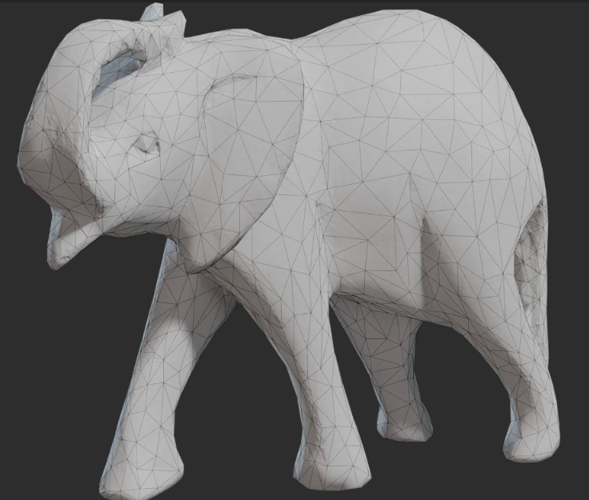
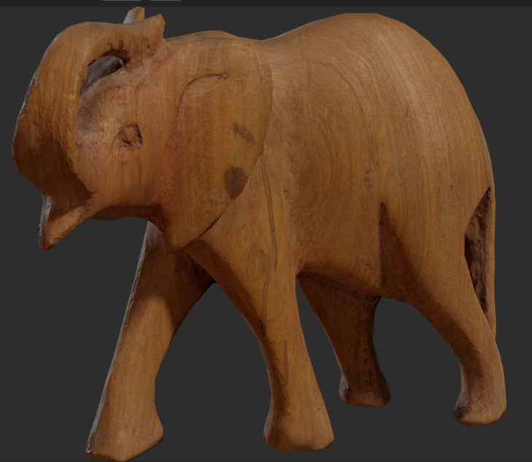
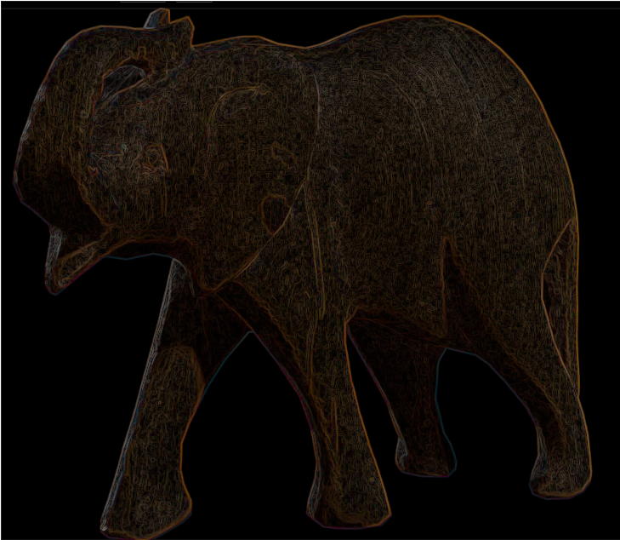
3D scene in big picture
Cornerstones of image generation:
3D scene modeling
  Representing 3D objects, lights and cameras
  Animation and interaction
Rendering
  Creating 2D images from 3D scenes
Raster image
  Displaying 2D images
  Post-processing
https://polyhaven.com/

Slide 4
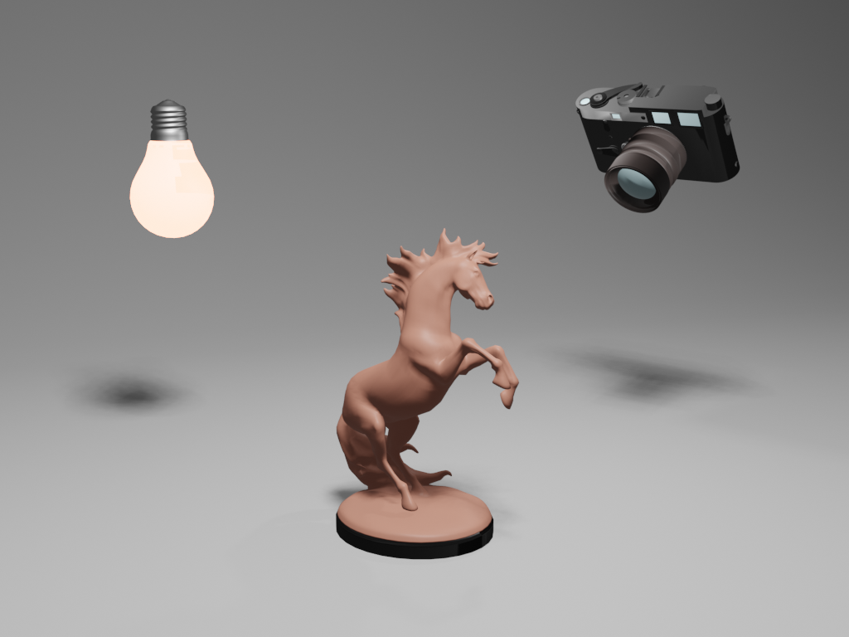
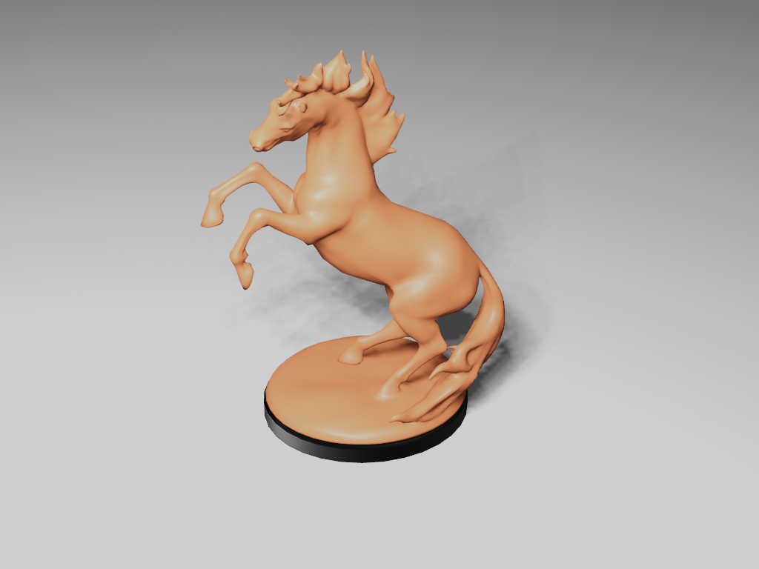
3D scene modeling for image synthesis
Image synthesis: rendering a 3D scene
  Analogy: taking real world photograph/video
Elements:
  Camera placed somewhere in space
  Space contains objects with various shapes and materials
  Light source emits light in space
Models from:https://polyhaven.com/

Slide 5
3D scene modeling
A way of creating, acquiring, representing and manipulating:
Objects
Lights
Cameras

Slide 6
3D scene modeling questions
How do we represent scene elements in a computer?
Intuitive for user?
Efficient for rendering?
How we create/acquire/manipulate scene elements?
Objects? Lights? Cameras?
How to use scene elements to create real-world phenomena and objects?

Slide 7
3D modeling foundations
3D scene is approximated using 3D primitives:
3D space
Points
Vectors
Line segments
Rays
Lines
Planes
Polygons

Slide 8
Objects

Slide 9
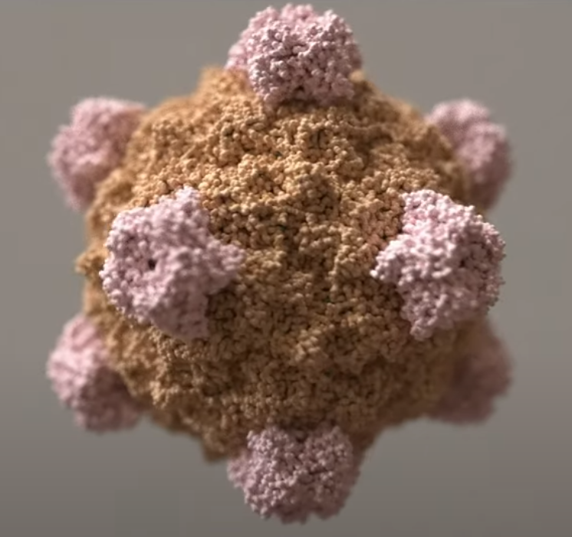
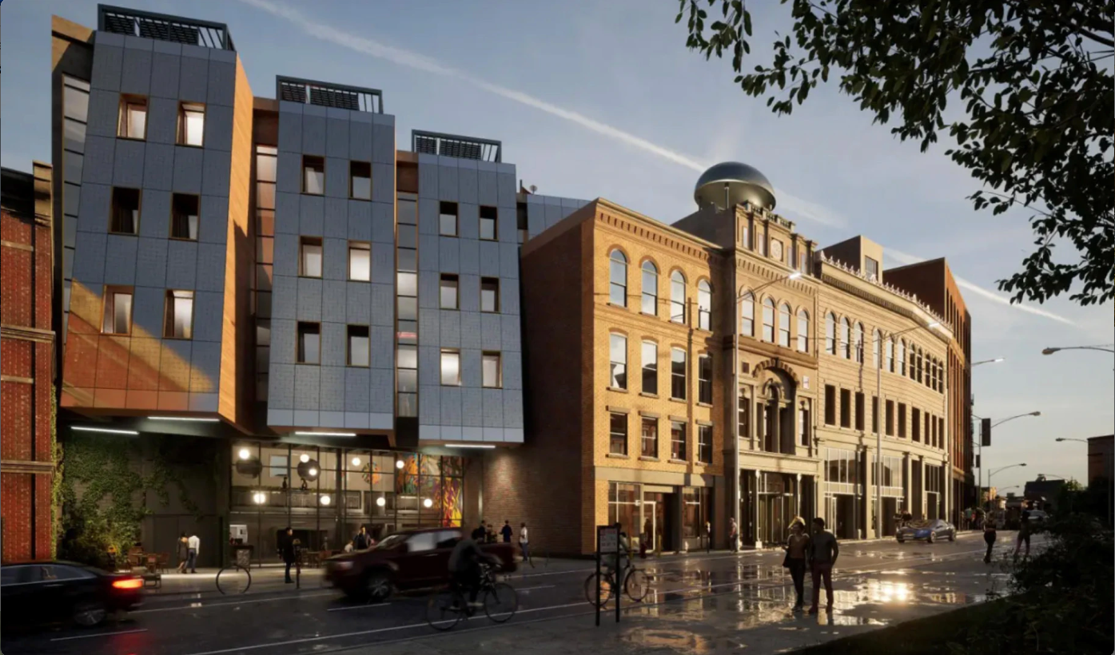
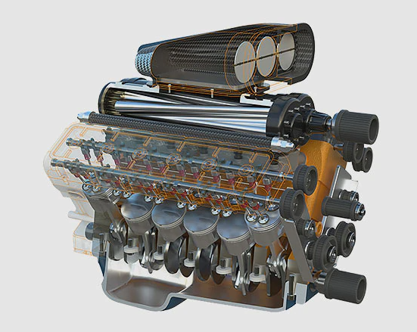

Objects: intuition
Depending on application, we would like our 3D scene to contain various objects
How do we even start with this?
Brady Johnston, Visaulising viruses: https://www.youtube.com/watch?v=adhTmwYwOiA&ab_channel=Blender
Arhitecture, Revit: https://www.autodesk.com/products/revit
Autodesk Fusion 360: https://www.autodesk.com/products/fusion-360/overview
Production examples at dreamworks, OpenVDB: https://www.openvdb.org/

Slide 10
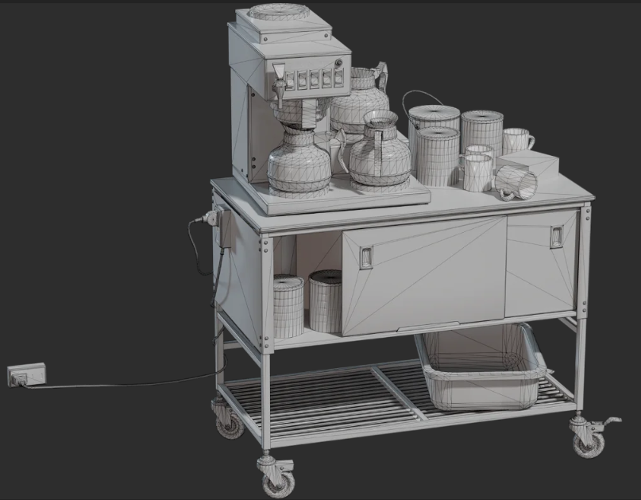
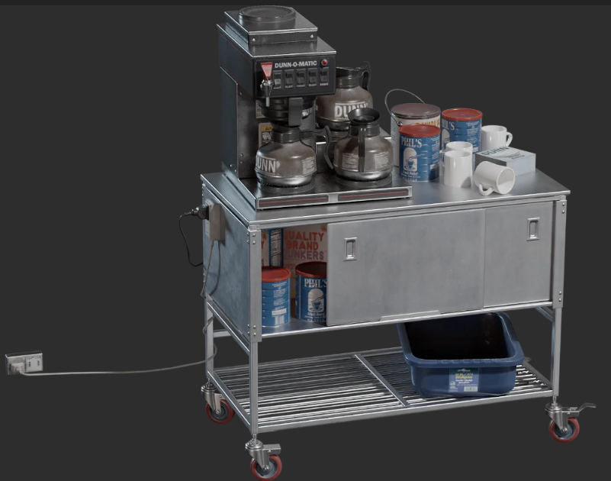
Objects: shape and material
For 3D modeling and rendering, real-world phenomena is decoupled into:
Shape: geometry
  Modeling: process of creating 3D objects by defining size, form, relative position and proportion to other objects
  Rendering: solving visibility problem
Appearance: material
  Modeling: process of achieving desired object appearance
  Rendering: calculating light-surface interaction → shading
https://polyhaven.com/models

Slide 11
Objects: shape representation

Slide 12
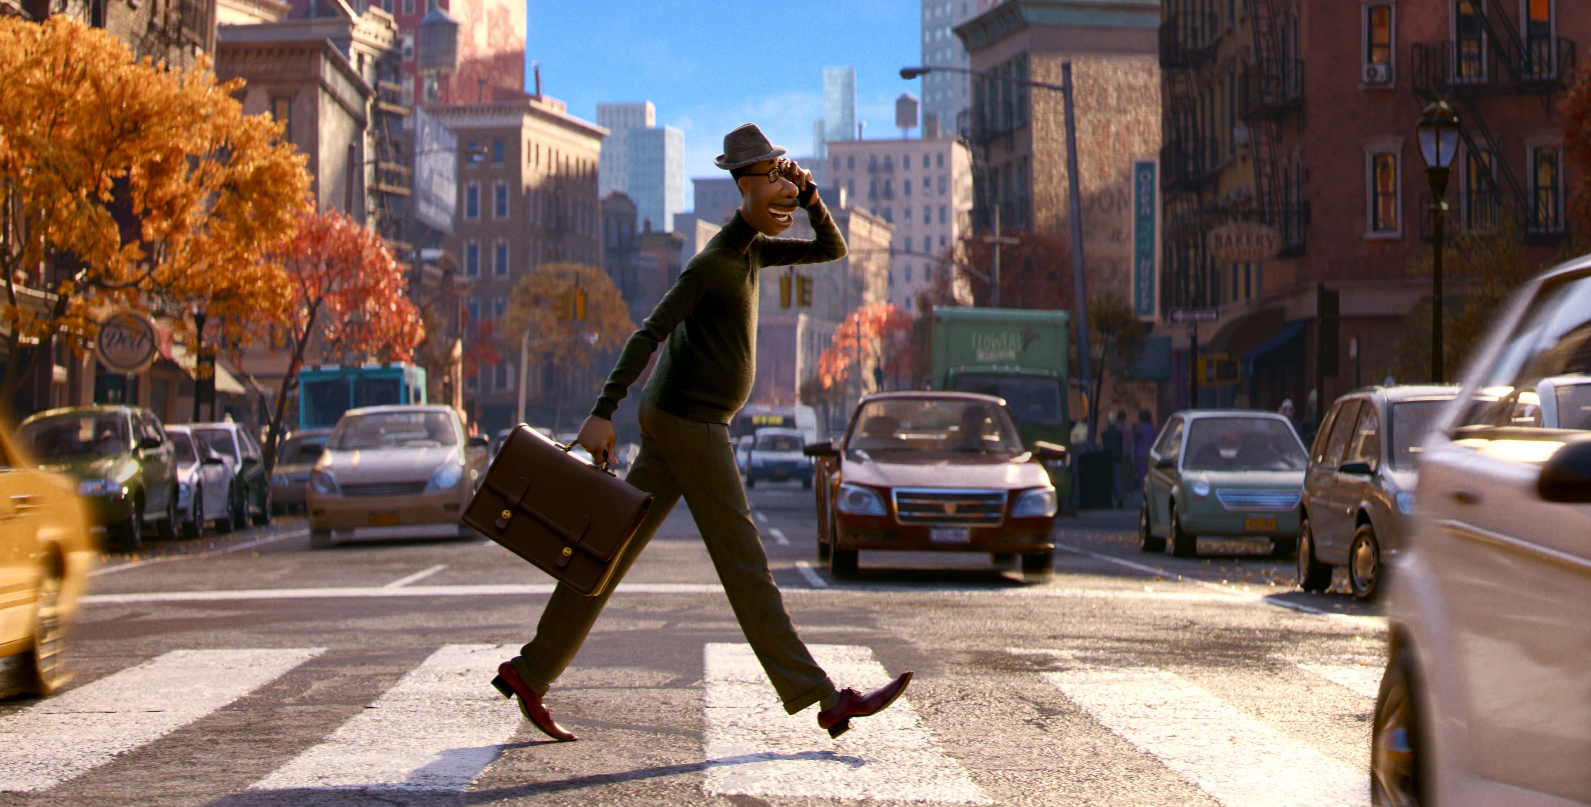
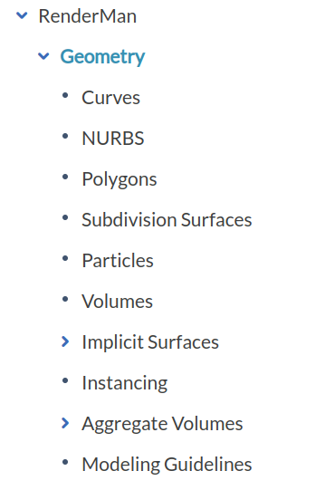
Object shape representations
Points
  Point clouds
  Particle systems
Lines/curves
  Parametric curves
Surfaces
  Polygonal mesh
  Subdivision surfaces
  Parametric surfaces
  Implicit surfaces
Volumetric objects/solids
  Voxels
  Space partitioning data-structures
Modeling objects in 3D scene requires different shape representations.
https://rmanwiki.pixar.com/display/REN24/Geometry

Slide 13
Object shape representations
Some representations are more convenient for user and modeling
  Example: modeling curved surface (e.g., car) is very hard by using triangles
  In 3D modeling tools, user is provided with various shape representations to work with
Some representations are more suitable for rendering
  Having one shape representation for rendering enables more efficient rendering procedures
  Prior rendering, different representations are transformed into triangles*
Panel on high performance geometry: modeling vs rendering https://www.youtube.com/watch?v=CoGo_3C7xR0&t=14103s&ab_channel=High-PerformanceGraphics
* Not all real-world phenomena can be well represented with triangles. Especially volumetric effects such as smoke or clouds. For such cases ray-casting and ray-tracing are often used.

Slide 14

Object shape representations
Points
  Point clouds
  Particles and Particle systems
Surfaces:
  Polygonal mesh
  Subdivision surfaces
  Parametric surfaces
  Implicit surfaces
Volumetric objects/solids
  Voxels
  Space partitioning data-structures
High-level structures
  Scene graph
Just link some popular engines:
https://rmanwiki.pixar.com/display/REN24/Geometry
Based on: https://www.cs.princeton.edu/courses/archive/spring22/cos426/lectures/Lecture-5.pdf

Slide 15

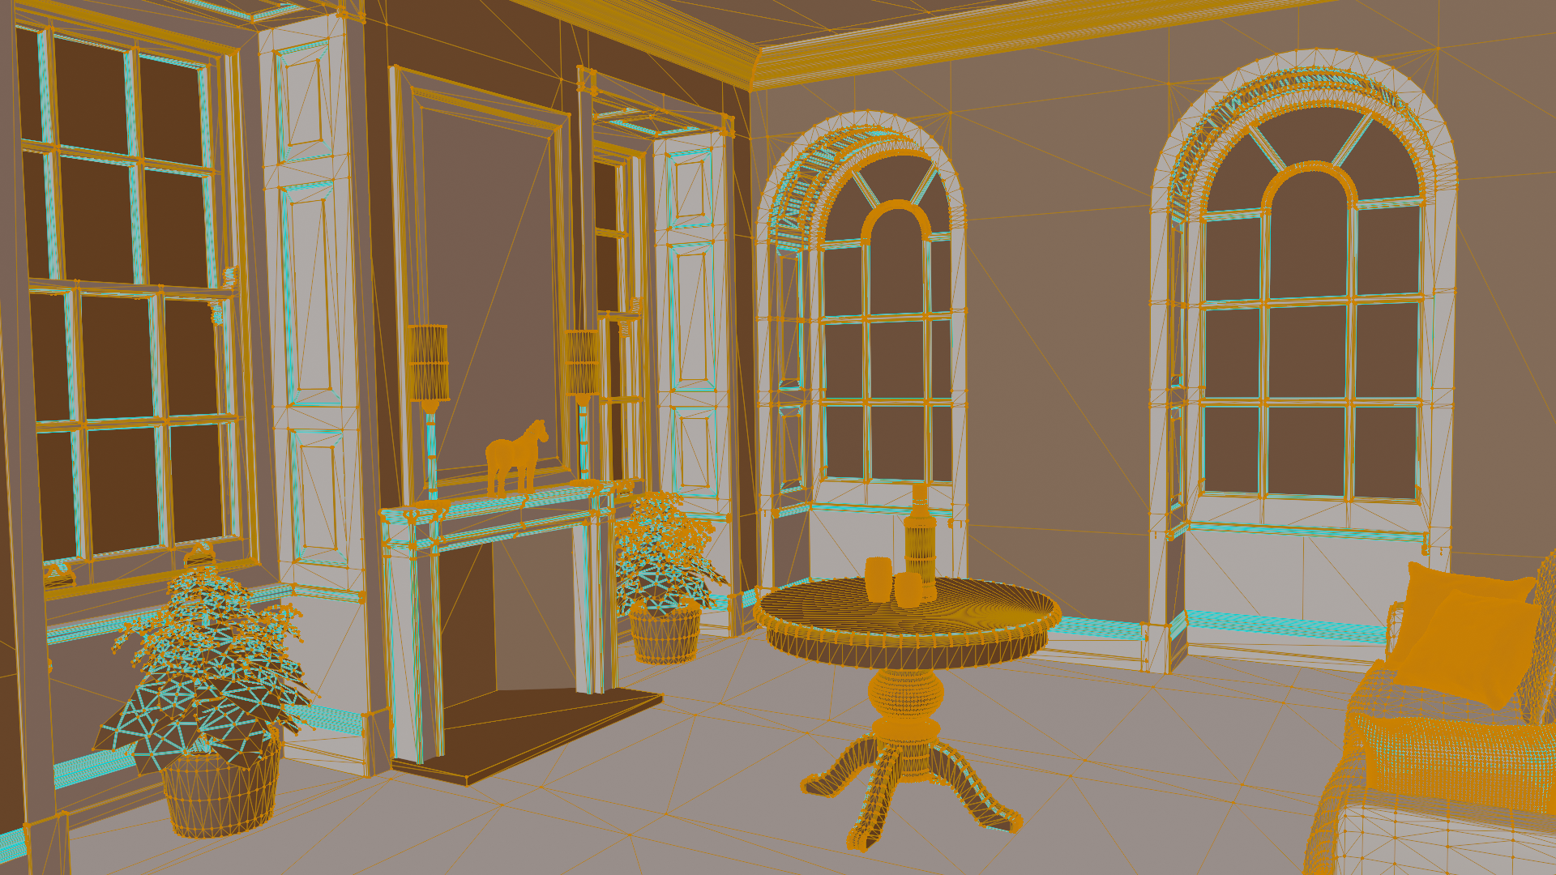


Shape representation 1: triangles
Simplest way to define surface is using triangles
  Polygons with three points all lying on a plane (co-planar)
  Widely used surface shape representation primitive - especially in rasterization-based rendering engines, e.g. Unity (https://unity.com/)
  Approximation primitive: very well approximating various objects, e.g., curved surfaces (with a larger number of triangles)
  Very simple, great properties for easy calculation, often used for efficient rendering purposes
  Not intuitive for modeling, thus different shape representations are introduced

Slide 16
Shape representation 1: polygons
To define a surface, simplest way is to connect points to form a polygon. In computer graphics, for computation tractability, we often use co-planar – all points lying on the same plane - polygons and especially triangles.
  Triangle is widely used surface shape representation primitive.
  Very simple and holds great properties for easy calculation, often used for efficient rendering purposes.
  It is approximation method: curved surfaces are approximated with triangles
  Not suitable for modeling, thus different shape representations are introduced. For rendering purposes, often all representations are turned to triangles before/during rendering stage - using very elaborated method called triangulation.
Triangle is basic building block for creating more complex shapes. And modeling is all about creating complex shapes using basic building blocks.
<IMAGE: POINTS, TRIANGLES, COMPLEX SHAPES>

Slide 17
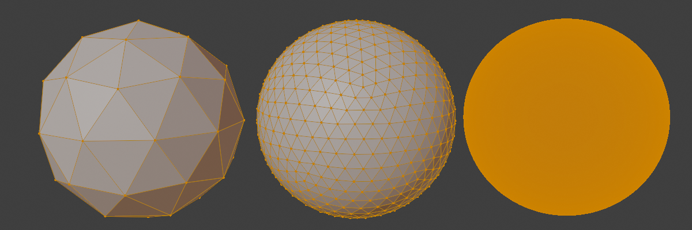
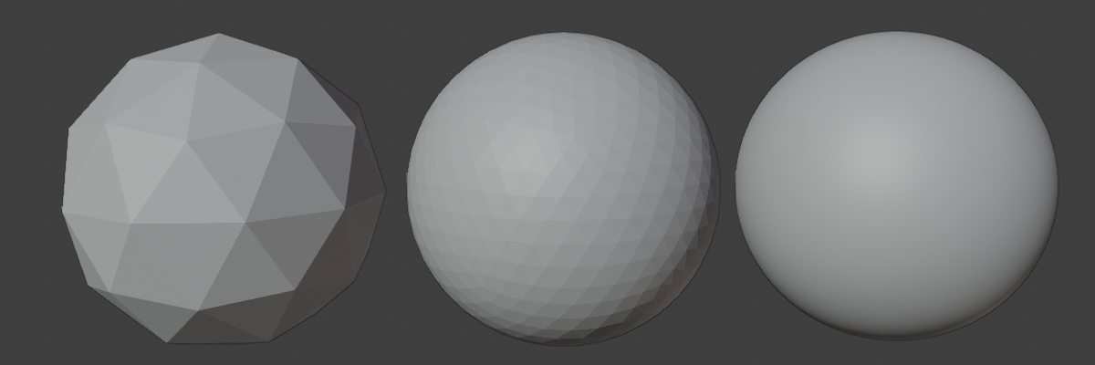
Shape representation 1: triangles
Different shape representations can be converted to triangles:
  Triangulation: converting shape to triangles
  Tessellation: converting shape to polygons (of any sort)
Any object can be represented using triangles
  Higher quality approximation of curved surfaces requires more smaller triangles better fitting surface
  Amount of details increase realistic representation but also complexity of rendering. Computer graphics often deals with trade-off between visual quality and speed*.
https://www.youtube.com/watch?v=x4RZRs3PD4Q&ab_channel=Udacity
* Finding good tradeoff between visual quality and object complexity is big research field in computer graphics. Note also that distance of viewing plays important role in amount of detail that it has to be represented.

Slide 18
Shape representation 1: triangles
Some shapes do not have flat surfaces! Triangle representation will always have flat surfaces*.
If we would like to represent curved surface, we would need smaller triangles which would fit the curved surface better. In this process we are placing more points on to surface (sampling). Generally, converting smooth surface to triangulated polygon representation – a triangulated mesh – is called tessellation.
Main point to take away is that we can represent any object using triangle polygons. Those objects will never be perfect representations of a real world, but triangles of which they consists of can be small enough to display objects in high quality taking in account restrictions of raster display.
  Amount of details increase realistic representation but also complexity of rendering. Computer graphics often deals with trade-off between visual quality and speed**.
TODO
* There are methods in rendering which make surface looks smooth although is represented using polygons. This method is called smooth shading and we will discuss it later.
** Finding good tradeoff between visual quality and object complexity is big research field in computer graphics. Note also that distance of viewing plays important role in amount of detail that it has to be represented.

Slide 19
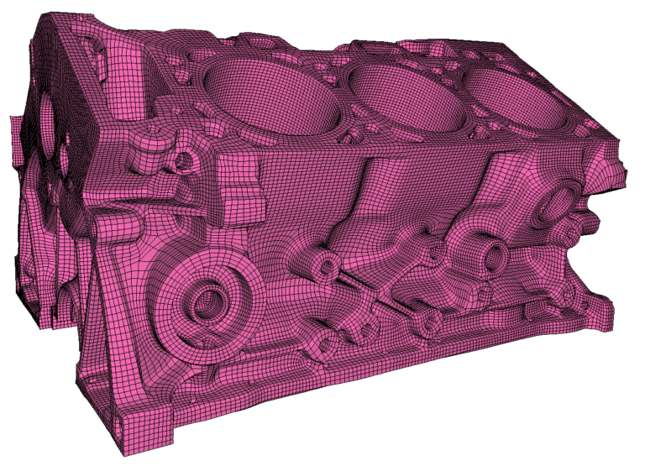
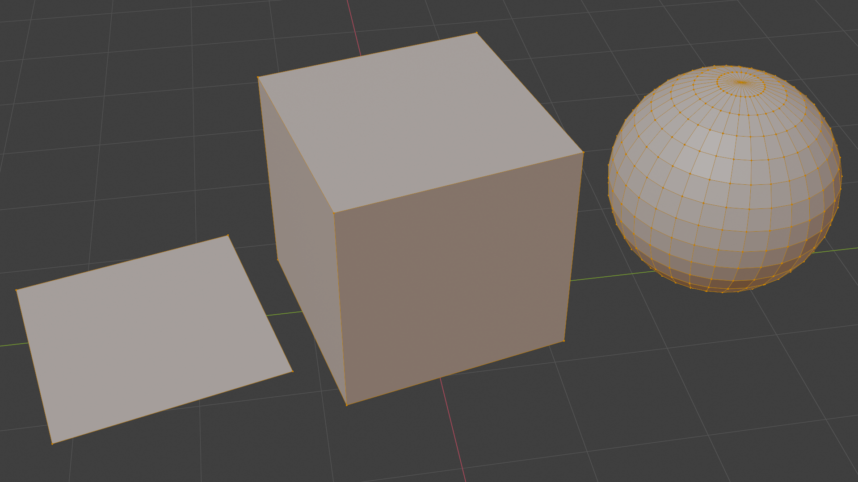
Shape representation 2: quad mesh
Polygons with four vertices, not necessary co-planar
Often provided by professional 3D modeling tools
Often used for modeling (especially hard-surface modeling)
Blender mesh: https://docs.blender.org/manual/en/latest/modeling/meshes/index.html
https://geometryfactory.com/products/igm-quad-meshing/

Slide 20
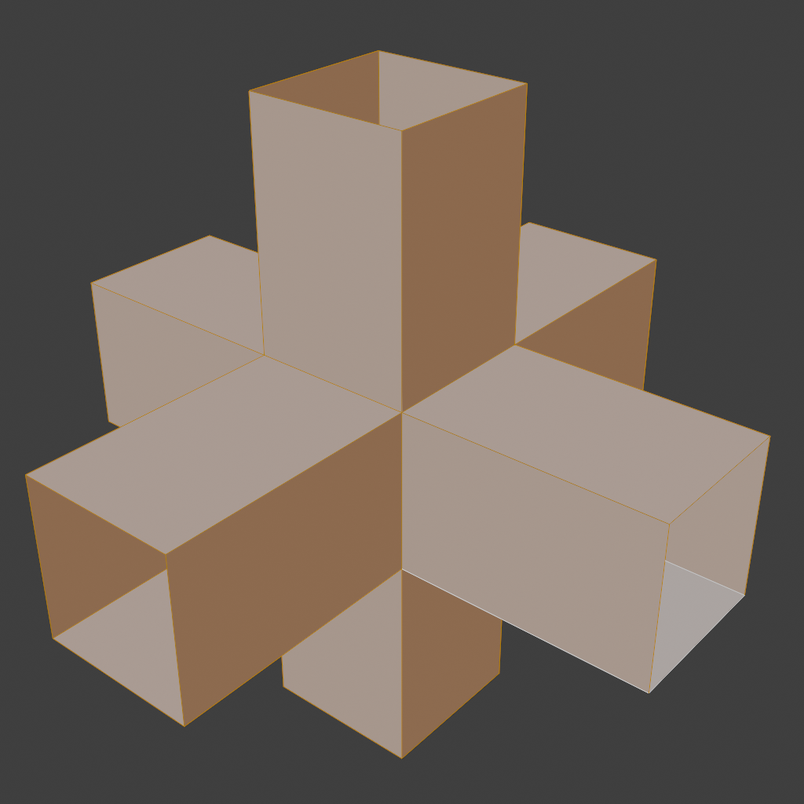
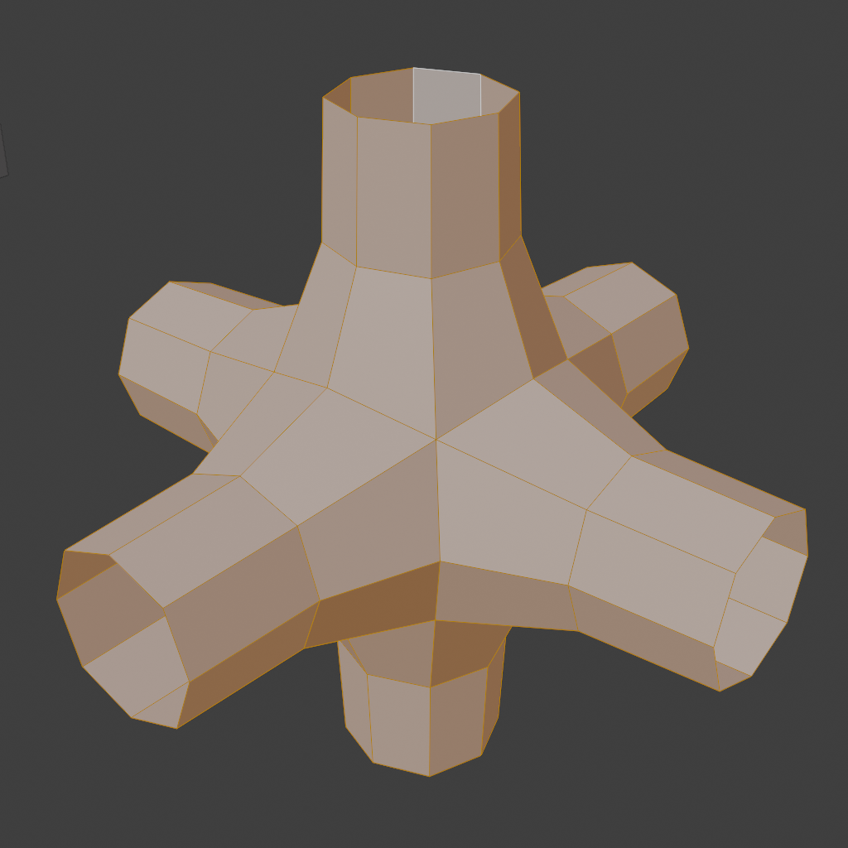
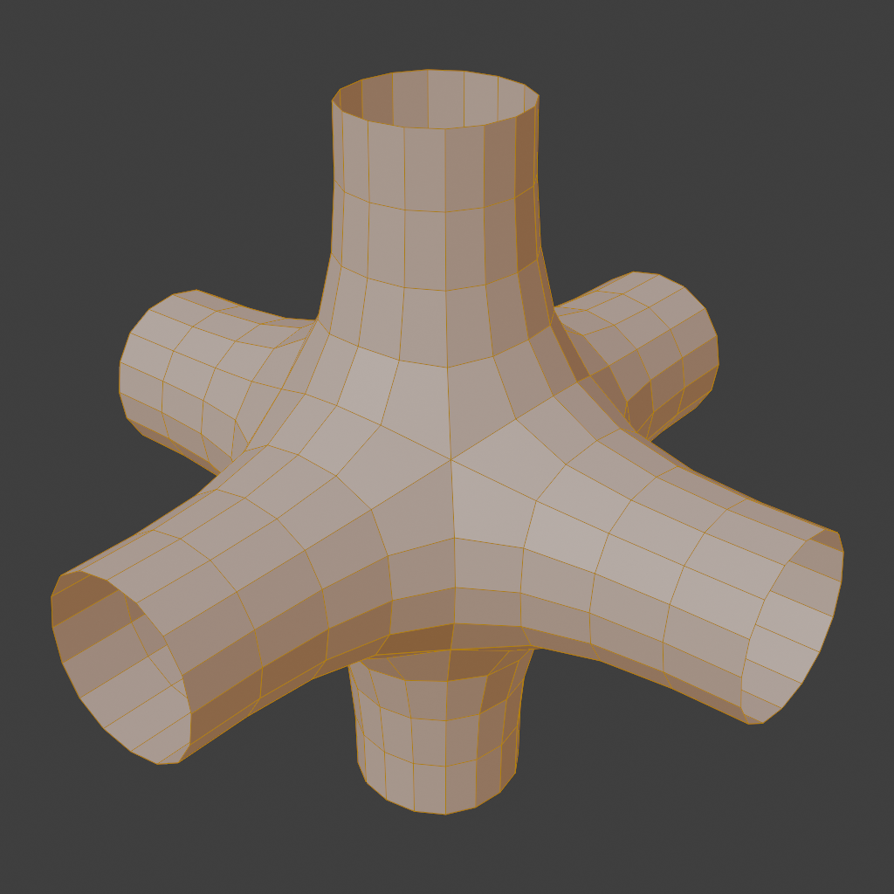
Meshes: subdivision surfaces
Paradigm for defining smooth and continuous surfaces from polygon meshes
Provides infinite level of detail: as many triangles as needed can be generated.
Approaches:
  Loop’s method
  Catmull-Clark subdivision
Original (control) mesh
1st iteration of refinement and smoothing: Catmull-Clark
2nd iteration of refinement and smoothing: Catmull-Clark

Slide 21
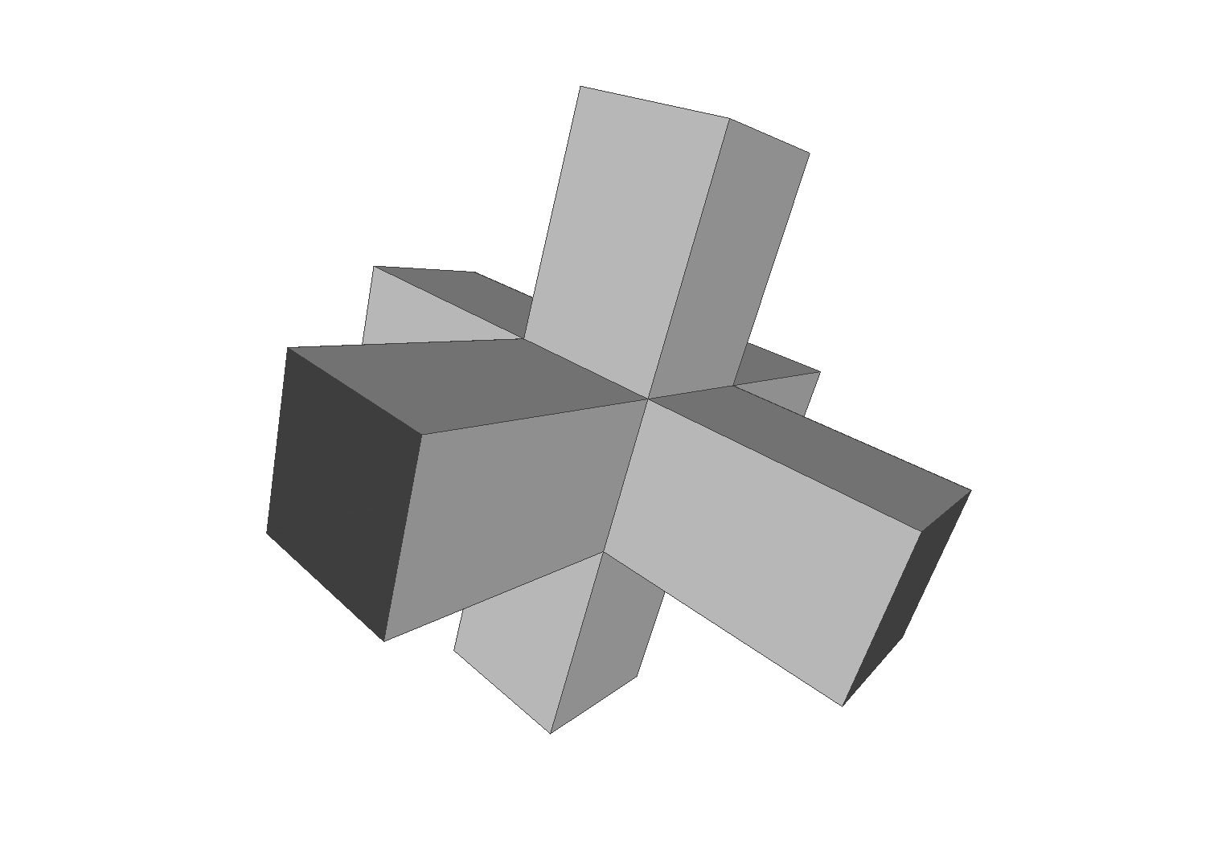
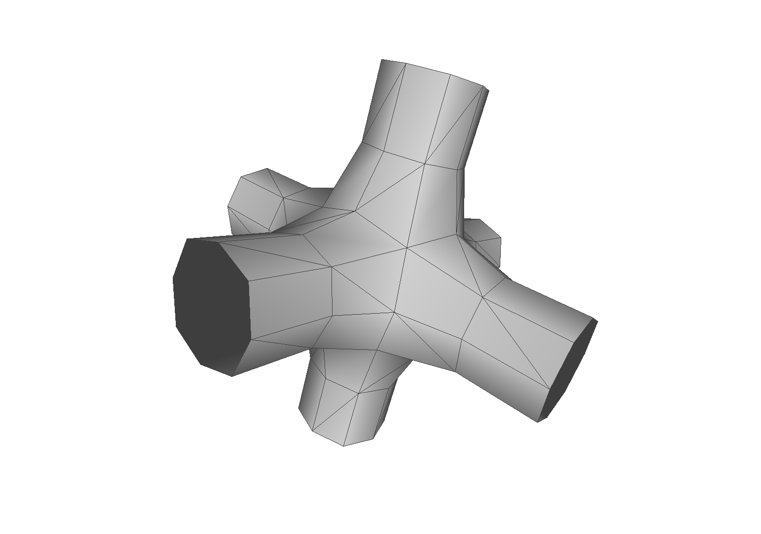
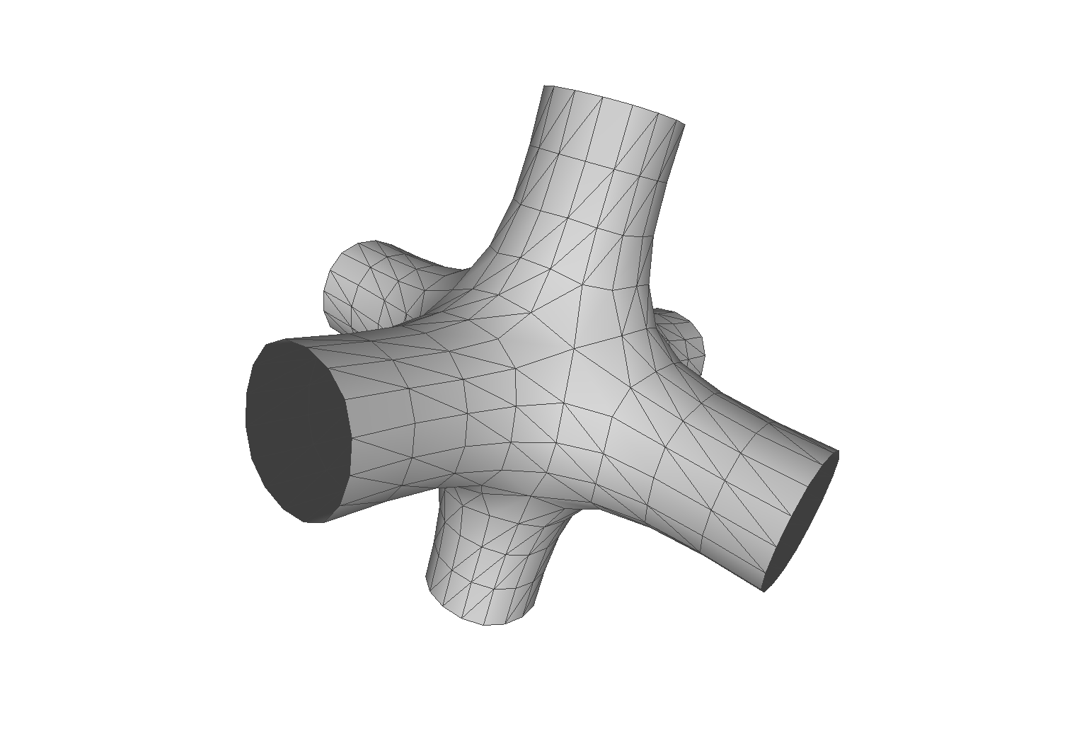
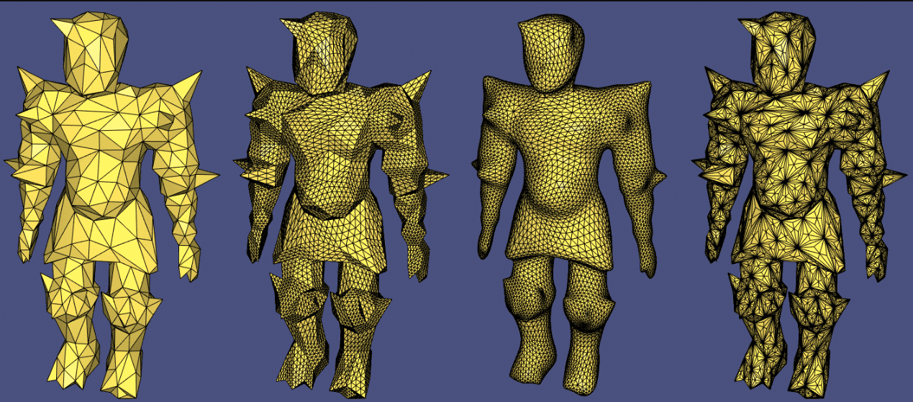
Meshes: subdivision surfaces
Meshlab loop subdivision: https://pymeshlab.readthedocs.io/en/latest/filter_list.html#meshing_surface_subdivision_loop
https://github.com/cnr-isti-vclab/meshlab
Libigl subdivision: https://libigl.github.io/tutorial/ (original, upsample, loop and barycentric.

Slide 22
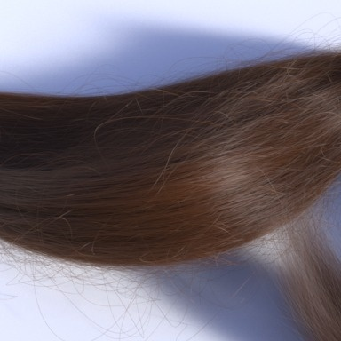
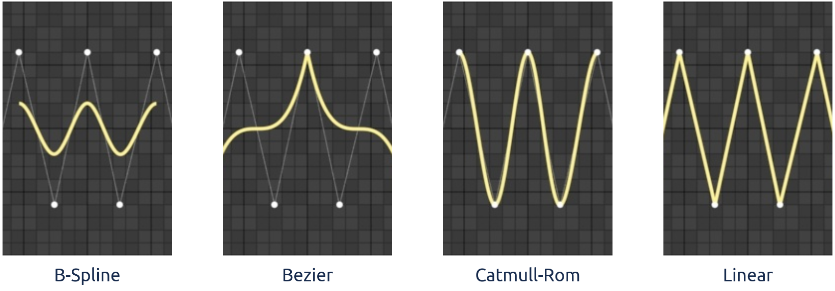
Shape representation 3: Parametric curves
Useful for modeling large number of thin strands
  Fur, hair, etc.
Also used for animation (interpolation between keyframes)
Arbitrary, smooth curve shape is determined by control points and parametric equation.
Methods: Linear, Bezier curve, B-Spline, Catmull-Rom
https://rmanwiki.pixar.com/display/REN24/Curves

Slide 23
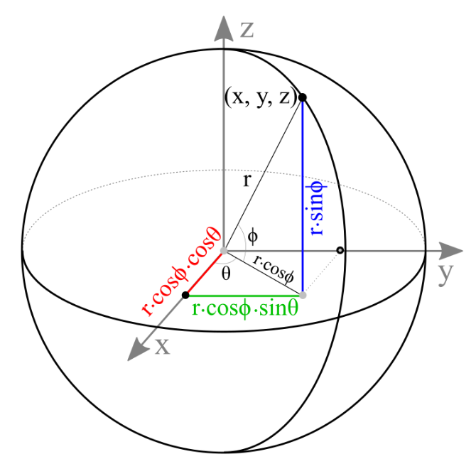
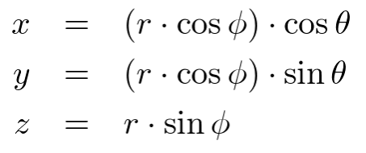
Shape representation 4: parametric surfaces
Simple shapes can be described mathematically using parametric equations, e.g., spheres, disks, planes
Equation of sphere with origin C(c_{x}, c_{y}, c_{z}) and radius r:
  (x-c_{x})² + (y-c_{y})² +(z-c_{z})² = r²
Arbitrary point on sphere is computed using parametric equations:
More on spheres in OpenGL: http://www.songho.ca/opengl/gl_sphere.html

Slide 24
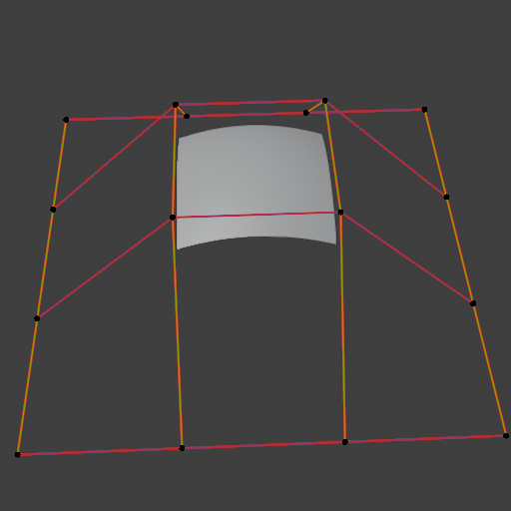
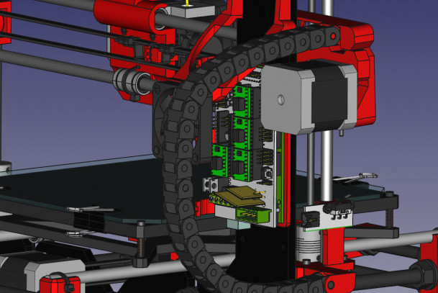
Shape representation 4: parametric surfaces
More complex surfaces are represented by points which define a control mesh from which perfect curved surface can be generated using parametric description.
  Note that this kind of representation is much more compact than polygonal mesh.
Approaches: Bezier patches, B-Spline surfaces, NURBS, etc.
  Often used in CAD software, e.g., design of objects for manufacturing
This representation can not be rendered directly. Tessellation must be performed prior rendering.
NURBS surface Blender: https://docs.blender.org/manual/en/latest/modeling/surfaces/index.html
FreeCAD: https://www.freecadweb.org/features.php

Slide 25
Shape representation 2: sweeping surfaces
Surfaces that are generated from a section curve positioned along a path*
This is more of a modeling tool rather than shape representation...
Blender:
  https://docs.blender.org/manual/en/latest/modeling/meshes/tools/spin.html
  https://docs.blender.org/manual/en/latest/modeling/meshes/editing/edge/screw.html
* https://www.ironcad.com/support/OnlineHelp/3D_Design_Environment/Part_Design_Process/Surface_Design_Process/Sweep_Surface1.htm

Slide 26
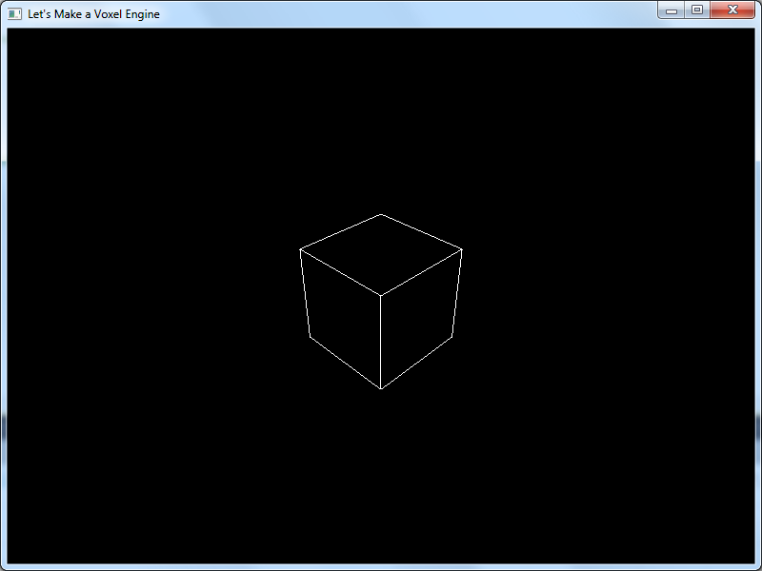
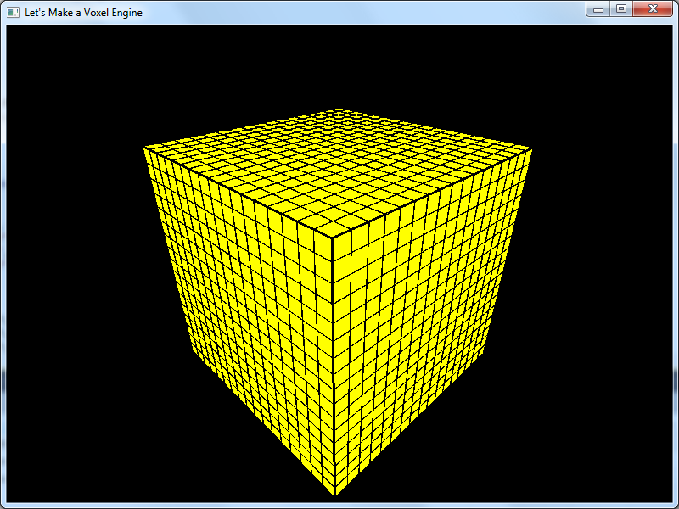
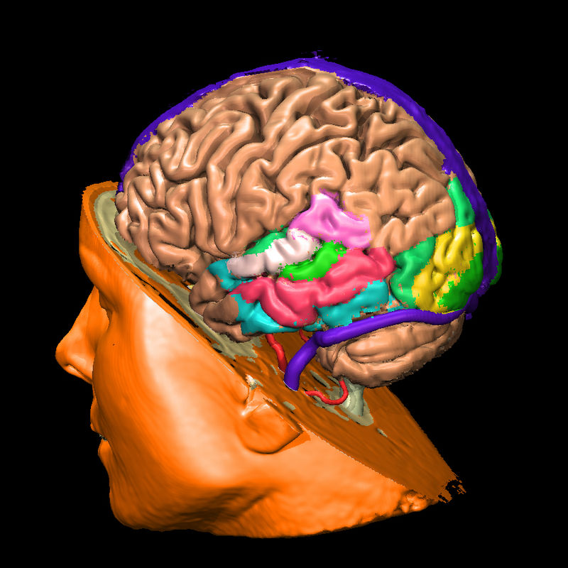
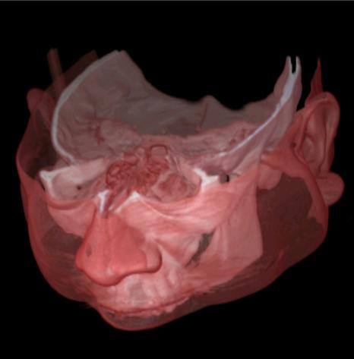
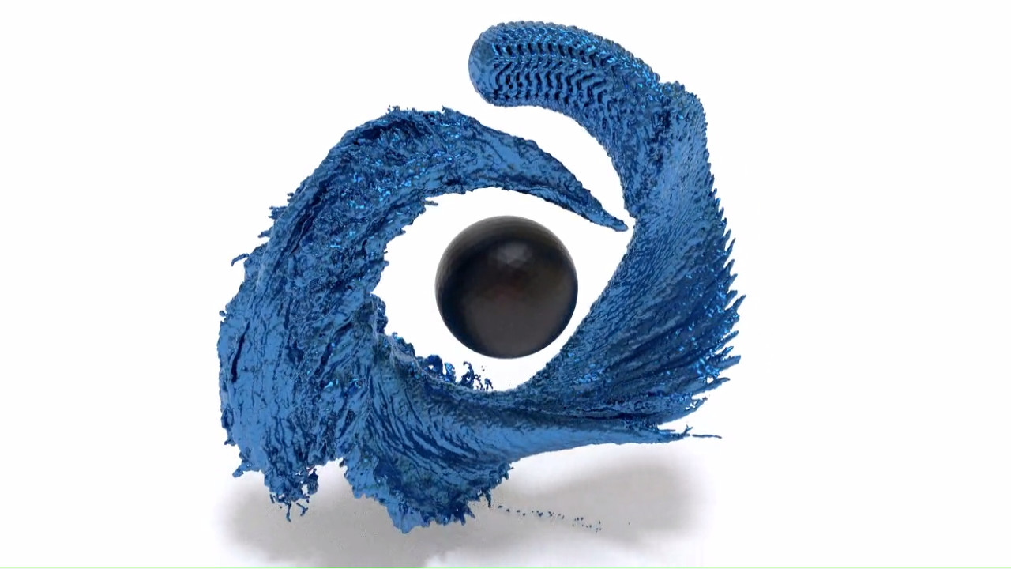
Shape representation 5: voxels
Voxel: represents volume of space, e.g., cube in 3D uniform regular grid (index of the grid determines voxel location)
Used for representing volumetric data (not only surface as in e.g., polygonal mesh)
  Example: fluid (smoke or liquid) simulation requires computation on grid of cells – voxels
Each voxel can contain various information:
  Density or opacity information, e.g., medical applications, CT acquisition
  One bit representing if its center is inside or outside surface, e.g., scanning or modeling
Getting started with voxels: https://sites.google.com/site/letsmakeavoxelengine/home/water
https://github.com/rlguy/GridFluidSim3D
Voxels in medicine:https://www.voxel-man.com/3d-navigators/downloads/
http://ablesw.com/3d-doctor/volume.html

Slide 27
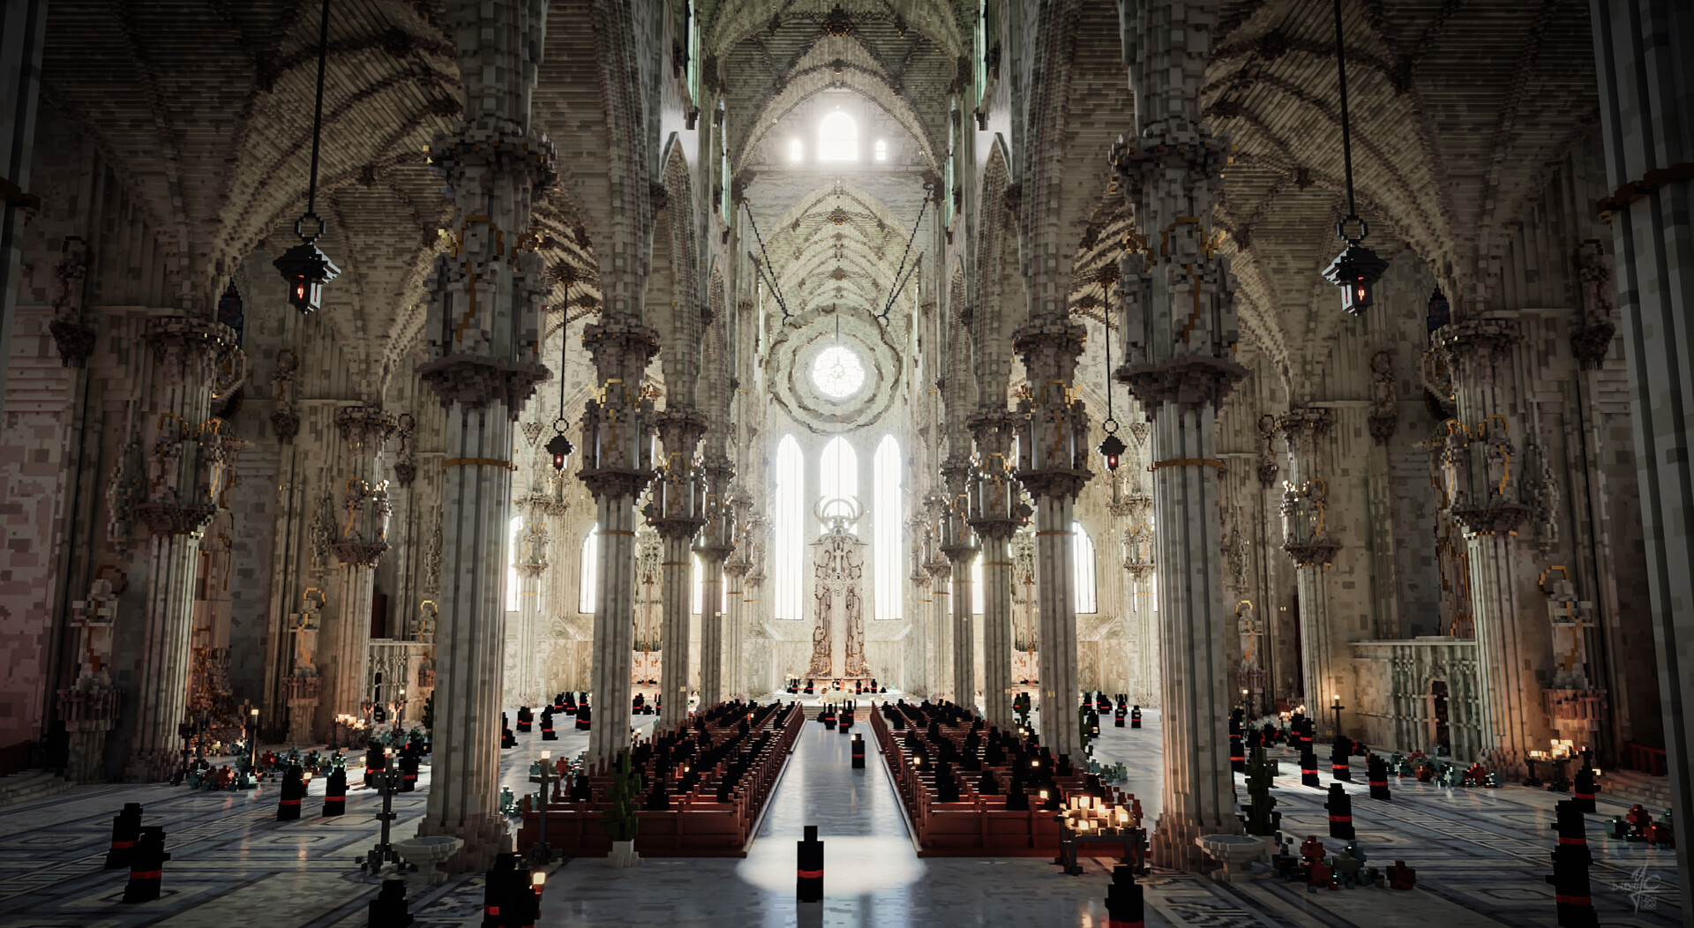
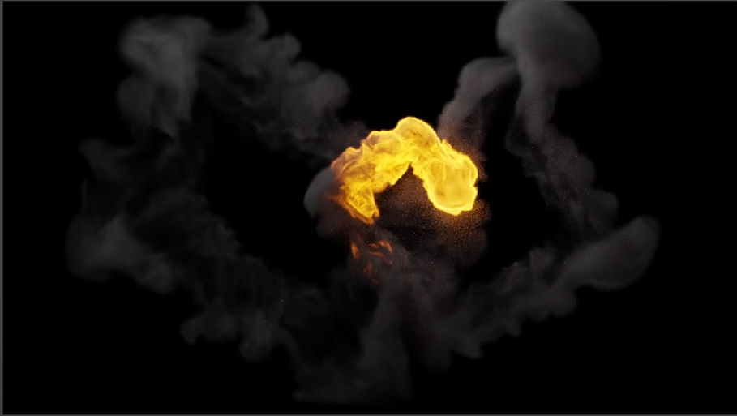
Shape representation 5: voxels
Voxel-based modeling: https://ephtracy.github.io/
Smoke simulation in Blender:
https://docs.blender.org/manual/en/3.4/physics/fluid/index.html https://www.youtube.com/watch?v=zyIJQHlFQs0&ab_channel=Polyfjord
Rendering: ray-tracing or converting to polygons using maching cubes algorithm.
Large voxel grids are memory expensive.
  Often, not all voxels in grid are needed and thus memory lighter sparse-voxel representations, e.g., sparse voxel octrees are used: https://www.nvidia.com/docs/IO/88972/nvr-2010-001.pdf

Slide 28
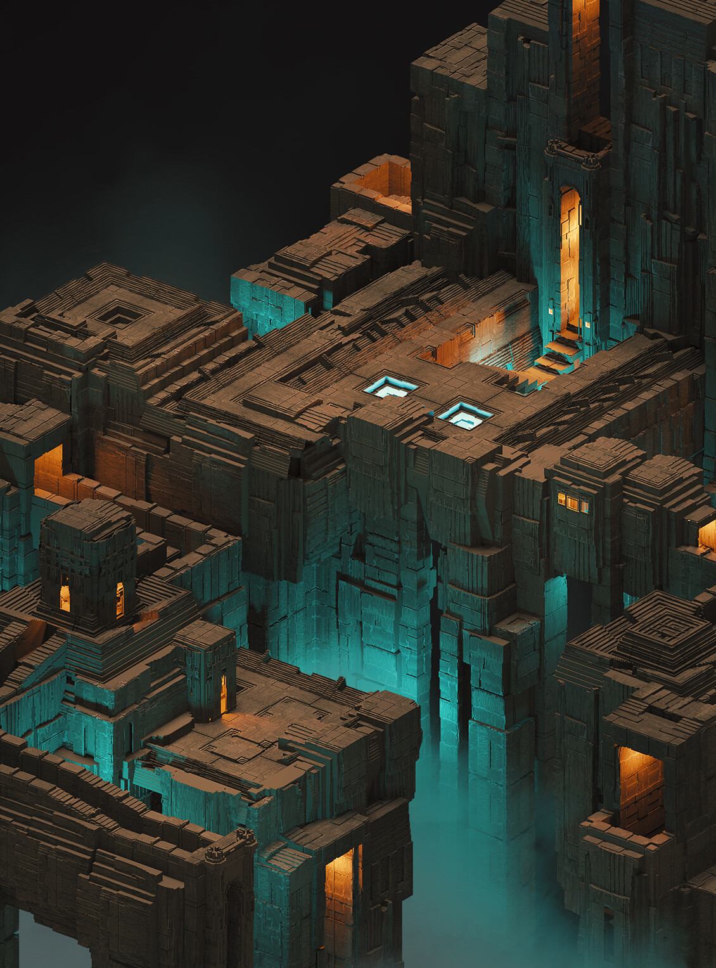
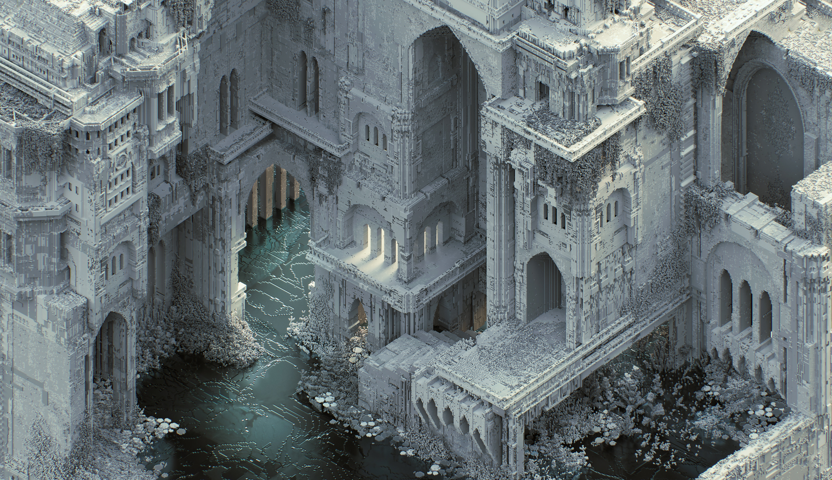
Shape representation 5: voxels
Voxel art: https://www.artstation.com/madmaraca

Slide 29
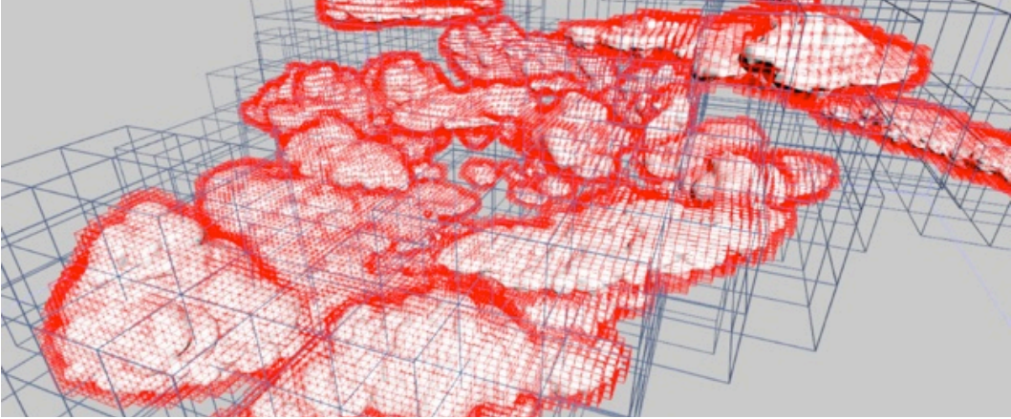
Shape representation 5: voxels
https://research.dreamworks.com/research_library/cloud-modeling-and-rendering-for-puss-in-boots/

Slide 30
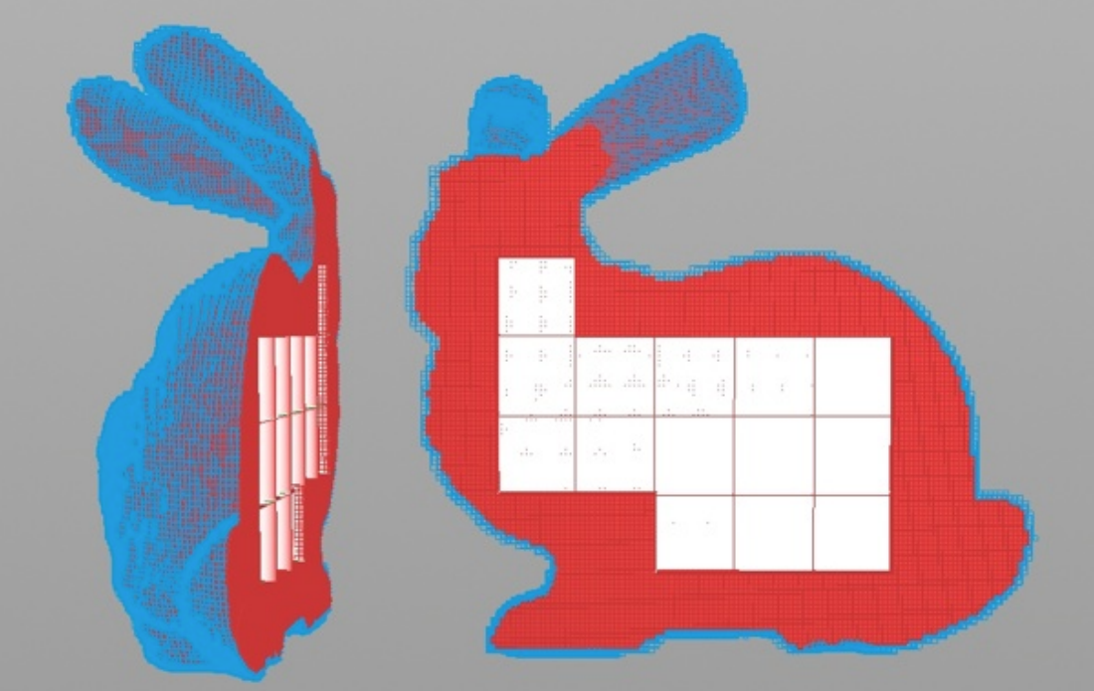
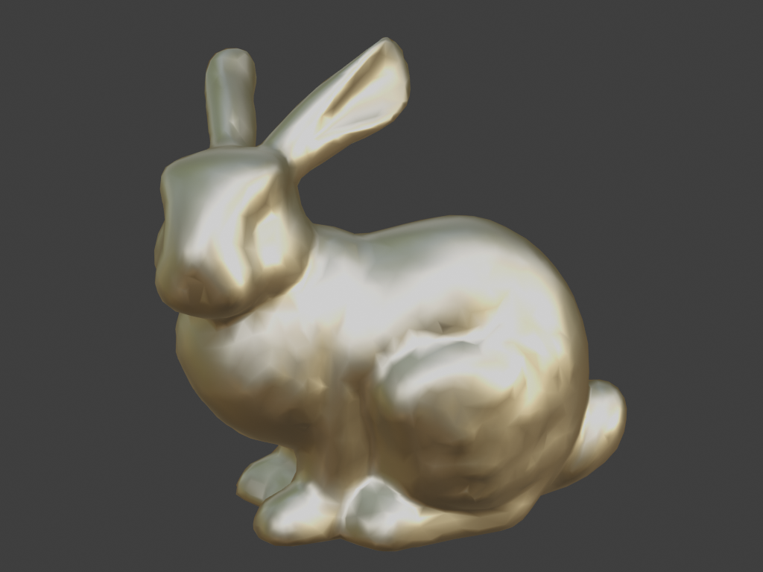
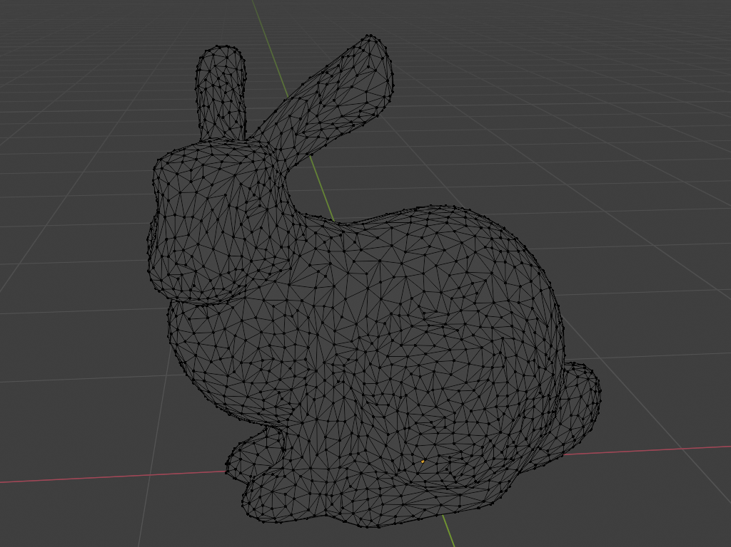
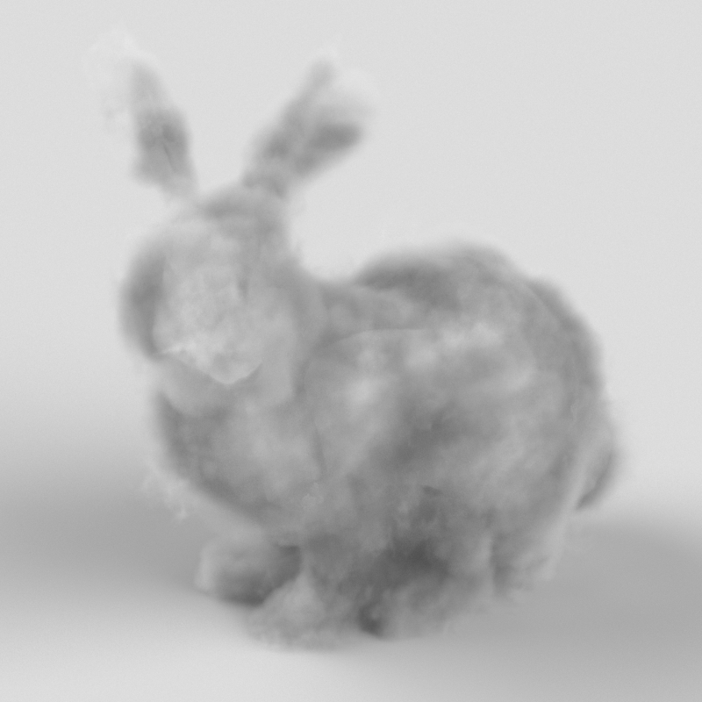
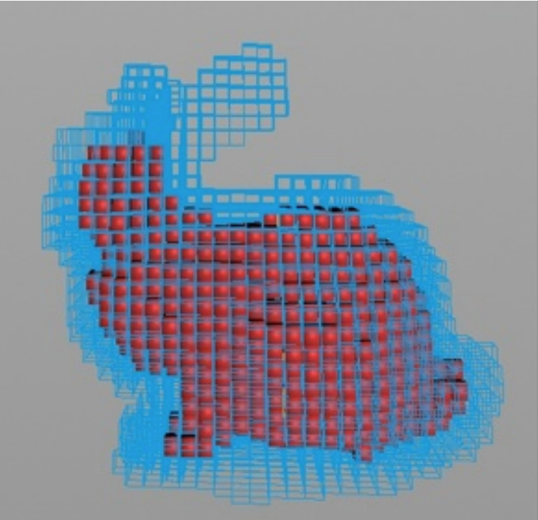
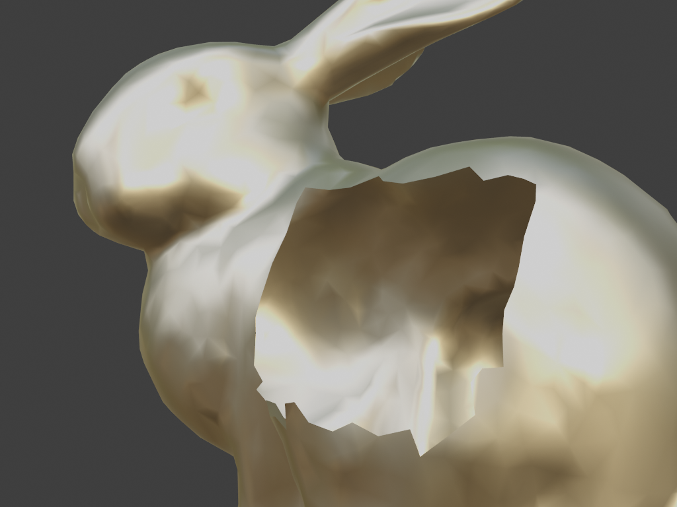
Shape representation: surface and volume
Shape representation can be used to describe:
  Surfaces, e.g., mesh or parametric surfaces
  Volumes, e.g., voxels
Example: for smoke or other participating media, information inside object is important (e.g., density of smoke)
Example: for opaque objects, we don’t care about object interior (approximated with material model)
Volume rendering: https://help.maxon.net/c4d/s26/en-us/Content/_REDSHIFT_/html/Volume+Rendering.html
Production examples at dreamworks, OpenVDB: https://artifacts.aswf.io/io/aswf/openvdb/openvdb_production_2015/1.0.0/openvdb_production_2015-1.0.0.pdf

Slide 31
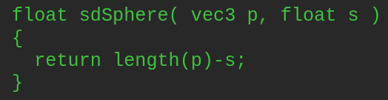
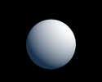
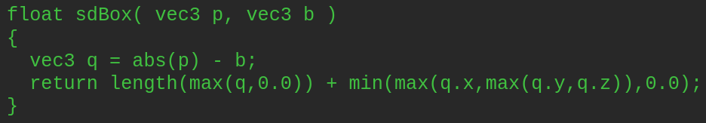
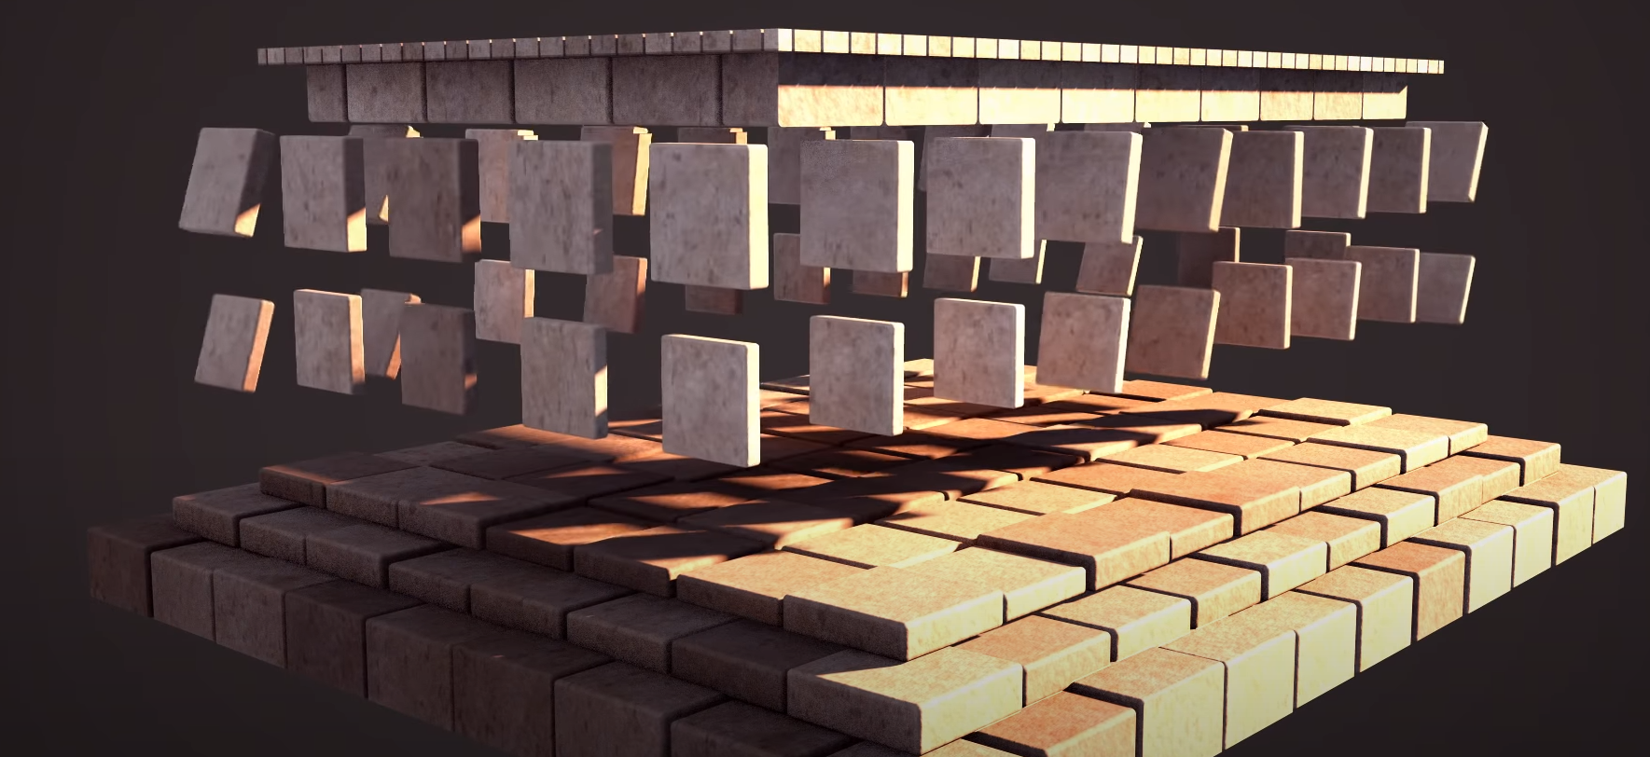


Shape representation 6: implicit
Point on surface is described with implicit – signed distance – function (SDF): f(x,y,z) = f(p) = 0
  Point is on surface if f(p) = 0. If f(p) < 0 then p inside, otherwise p is outside
Simple shapes can be defined using SDFs: cubes, spheres, etc.
Implicit shape representations:
https://iquilezles.org/articles/distfunctions/
https://www.youtube.com/watch?v=62-pRVZuS5c&ab_channel=InigoQuilez

Slide 32


Shape representation 6: implicit
Modeling with SDFs is done using constructive solid geometry operations: addition, subtraction, etc.
Rendering
  Converted to triangulated mesh using marching cubes algorithm
  Ray-tracing (simple ray-implicit shape tests)
Often used in engineering and CAD modeling environments
https://wiki.freecadweb.org/Constructive_solid_geometry
https://gallery.autodesk.com/projects/22791/constructive-solid-geometry-csg

Slide 33




Shape representation 6: implicit
Implicit representation for modeling and rendering: https://www.gdcvault.com/play/1025316/Advanced-Graphics-Techniques-Tutorial-GPU
Good for representing organic objects (metaballs): https://rmanwiki.pixar.com/display/REN24/Implicit+Surfaces
https://docs.blender.org/manual/en/latest/modeling/metas/introduction.html

Slide 34





Shape representation 7: fractals
Irregular geometrical shapes with symmetrical property
  Complex, natural phenomena such as clouds, mountains, trees, vegetation, galaxies can be represented using fractals
Generative art: http://blog.hvidtfeldts.net/
Iteration:1
Iteration:2
Iteration:3
Apply mesh on generated structure
L-Systems: grammar for complex shapes generation using iterations: https://www.sidefx.com/docs/houdini/nodes/sop/lsystem.html
https://www.youtube.com/watch?v=0vE8GiXhOWM&t=1248s&ab_channel=Houdini
https://www.jonathanrpace.com/project_trees.html
Mandelbrot: https://www.mandelbulb.com/https://www.geeks3d.com/20091116/exploration-of-the-real-3d-mandelbrot-fractal/

Slide 35



Shape representation 7: Point clouds
Large number of points describing object shape
Scanned real-world objects can be stored as point clouds
Unified physics for real-time applications using points: https://mmacklin.com/uppfrta_preprint.pdf
https://github.com/potree/potree

Slide 36





Shape representation 7: Point cloud
Point clouds rendering:
  Splat – shape with radius
  Surfels – point based surface element*
  Conversion to mesh
130,712 points
Points and implicit surfaces: https://www.youtube.com/watch?v=u9KNtnCZDMI&ab_channel=MediaMolecule
14,835,967 points
Qsplat: http://graphics.stanford.edu/software/qsplat/
* Surfels: https://vcg.seas.harvard.edu/publications/surfels-surface-elements-as-rendering-primitives

Slide 37


Shape representation 8: particle systems
Collection of small objects that are set into motion using some algorithm.
  Often, billboards – image that are always oriented towards camera is used as particle particles
Applications: simulation of fire, smoke, water, FX, etc.
https://docs.unity3d.com/ScriptReference/ParticleSystem.html
https://developer.valvesoftware.com/wiki/Particle_System_Overview

Slide 38
Shape representation 10: image based modeling
This is more of a modeling tool rather than shape representation...

Slide 39
Equivalence of representations
Each shape representation has capacity to describe shape of any geometric object
  Investigate this more...
Different representations exist because certain tasks are more tractable with particular representation. For example:
  Rendering process
  3D modeling
  Simulation of objects
  Animation
  Acquisition/digitalization of objects from a real world
Different datastructures used for representations determine algorithms for processing
TODO

Slide 40
3D models: various representations?
TODO
Similar as in, e.g., drawing where drawing tools and shapes needed to be chosen, 3D models creation is based on set of representations and operations from which we must choose. Those representations are on the one hand flexible enough to be used for any shape and understandable to a computer, that is rendering program:
From the user-creation point of view: we need a representation of shape and material which is intuitive to handle (to author)
From the rendering point of view: we need to make sure that shape and material representation can be used for rendering process
  Shape representation will be used for determining visibility problem*: what objects we see from certain point of view
  Material representation will be used for determining the shading problem**: how the objects that we see appear
* As we will get to know more complex material representations we will see that this is not completely true. Visibility of objects will also depend on material. Imagine glass cup on the top of a book – book will be visible since glass is transparent.
** Shape and material information are both important for calculating how objects appear. We separate them to show that you can first purely focus on modeling a 3D shape and then model material afterwords. Also, separating objects in shape and material is desired for rendering architectures so that are decoupled.

Slide 41
Various shape representations?
User (modeling) point of view: shape representations must be intuitive and flexible to use and cover different applications
  Acquisition, modeling, animation, texturing, analysis, etc.
Rendering point of view: efficient visibility calculation

Slide 42


Applications
Acquisition:
  Photogrammetry (reconstructing from photographs)
    Point clouds, meshes
  Scanning: CT, MRI, Kinect
Photogrammetry: given object images, point cloud and mesh are constructed: https://sketchfab.com/blogs/community/tutorial-meshroom-for-beginners

Slide 43
3D models: various representations?
Different tasks require different representations – modeling:
Manual modeling
Procedural modeling
TODO

Slide 44


Applications
Modeling: Sculpting
  Mesh, voxels, implicit representations
Jasmine, Zbrush, http://pixologic.com/zbrush/gallery/?year=2018
Blender, https://www.blender.org/features/sculpting/

Slide 45

Applications
Modeling: hard-surface modeling
  Quad mesh
Hard surface modeling:https://www.sidefx.com/tutorials/houdini-modelling-tutorial-175-houdini-hard-surface-modelling-tutorial/
Hard surface modeling: https://www.youtube.com/watch?v=1qVbGr_ie30&ab_channel=JoshGambrell

Slide 46

Applications
Modeling: curved surfaces
  Parametric surfaces
Renderman NURBS: https://rmanwiki.pixar.com/display/REN24/NURBS
Autodesk Fusion 360: https://www.autodesk.com/products/fusion-360/overview

Slide 47

Applications
Animation: manual
Meshes, parametric surfaces
https://www.blender.org/features/animation/

Slide 48


Applications
Animation: procedural, simulation
Voxels, points
Houdini, https://www.sidefx.com/tutorials/h19-vellum-fluids-starter-pack/
OpenVDB, https://people.csail.mit.edu/kuiwu/gvdb_sim.html

Slide 49


Applications
Analysis and processing
  Meshes
Example: principled curvature directions vectors (libigl:https://libigl.github.io/)
Example: Gaussian curvature visualization using pseudo color
(libigl: https://libigl.github.io/)

Slide 50

Applications
Texturing: parameterization
  Mesh, parametric surfaces, implicit surfaces
Mesh representations require surface parametrization for texture application. CGAL: Least Squares Conformal Maps (https://www.cgal.org/)

Slide 51
Applications
Rendering: efficient visibility solving
  Triangles, implicit surfaces
* Rasterization-based rendering can efficiently render points, lines and triangles: https://www.khronos.org/opengl/wiki/Primitive

Slide 52
3D models: various representations?
TODO
OTHER examples

Slide 53


Objects: material
https://rmanwiki.pixar.com/display/REN24/Shading

Slide 54



Objects: material
Modeling: achieving desired appearance
  Color, reflectivity
  Surface patterns
Rendering: crucial shading information; light-surface interaction
  Scattering function
  Texture: variation of scattering function properties and small scale surface details
Scattering model
Texture
Scattering function: https://appleseedhq.net/gallery.html
Texture: https://polyhaven.com/textures

Slide 55


Lights
https://discover.therookies.co/2018/06/24/learn-how-to-light-and-render-like-a-pixar-artist/

Slide 56







Lights: non-physical lights
Directional lights:
Direction
Intensity
Color
Real-world counterpart: sun
Point lights:
Position
Intensity
Color
Real-world counterpart: light bulb

Slide 57



Lights: physical lights
Next to position, intensity and color, physical light define:
  Shape and size
Area light size determines softness of shadows (left: small area light, right: large area light) https://www.pbr-book.org/3ed-2018/Light_Sources/Area_Lights

Slide 58


Lights: environment light
Besides local or directional lights, scene can be illumination from all directions using environment illumination.
Real-world image can be acquired and wrapped around 3D scene → environment mapping.
https://polyhaven.com/hdris

Slide 59

Cameras
Camera model determines portion of visible scene and simulates real-world camera effects: depth of field, bokeh, motion blur, etc. https://rmanwiki.pixar.com/display/REN24/Cameras

Slide 60


Camera
Position and orientation determines portion of visible scene
Pinhole camera model elements:
  Aperture (eye)
  Film (image) plane
Pinhole camera model parameters:
  Focal length
  Film size
Viewing frustum
  Only objects inside viewing frustum are visible in final image

Slide 61




Camera
Camera represents first step in image generation process where light from scene is exposed to the film plane
Realistic camera models simulate lens system next to aperture and film plane.
Exposition (exposure) is achieved using:
  Aperture (f-stop) → depth of field
  Shutter speed → motion blur
  Sensitivity (gain) → noise
https://photonify.com/3-steps-for-adjusting-the-depth-of-field-on-your-camera/
https://petapixel.com/exposure-triangle/
https://actioncamera.blog/2017/02/22/the-exposure-triangle/
https://www.shutterbug.com/content/give-photos-dramatic-perspective-motion-and-blur-simple-photoshop-technique-video

Slide 62
Complex scene
<IMAGE: An motivation image that we will understand by the end of the lecture.>

Slide 63
Summary/questions
https://github.com/lorentzo/IntroductionToComputerGraphics/tree/main/lectures/3_3d_scene_overview

Slide 64
Literature
https://github.com/lorentzo/IntroductionToComputerGraphics

