Slide 1
3D Models
Shape representations

Slide 2

Recap: shape representations
Points
  Point clouds
  Particles and Particle systems
Surfaces:
  Polygonal mesh
  Subdivision surfaces
  Parametric surfaces
  Implicit surfaces
Volumetric objects/solids
  Voxels
  Space partitioning data-structures
High-level structures
  Scene graph

Slide 3
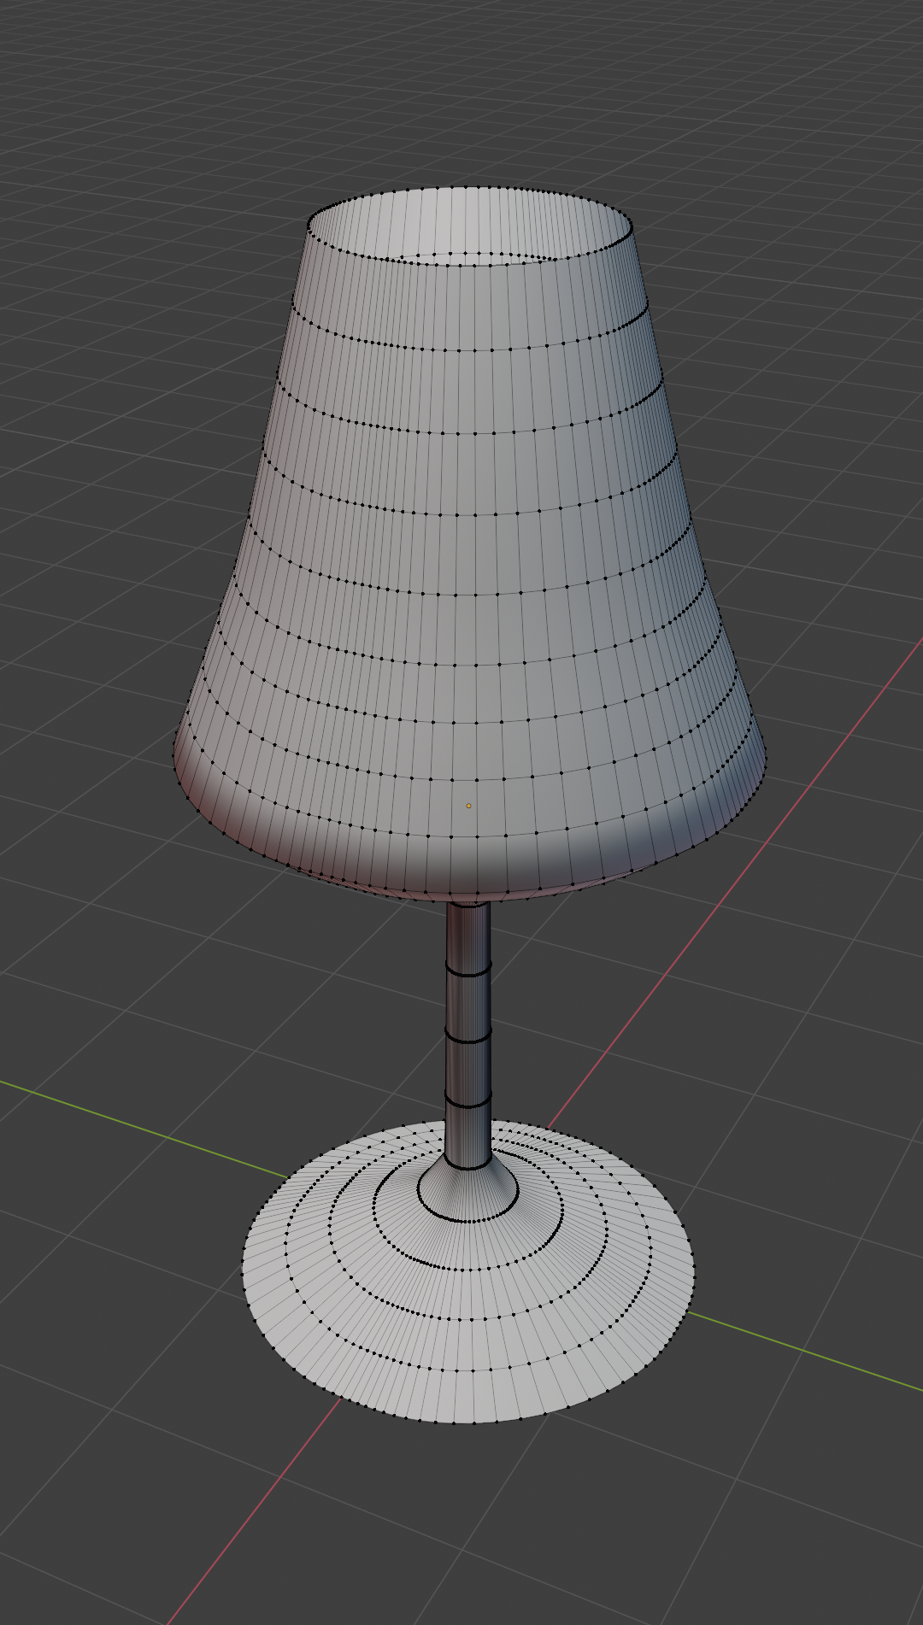
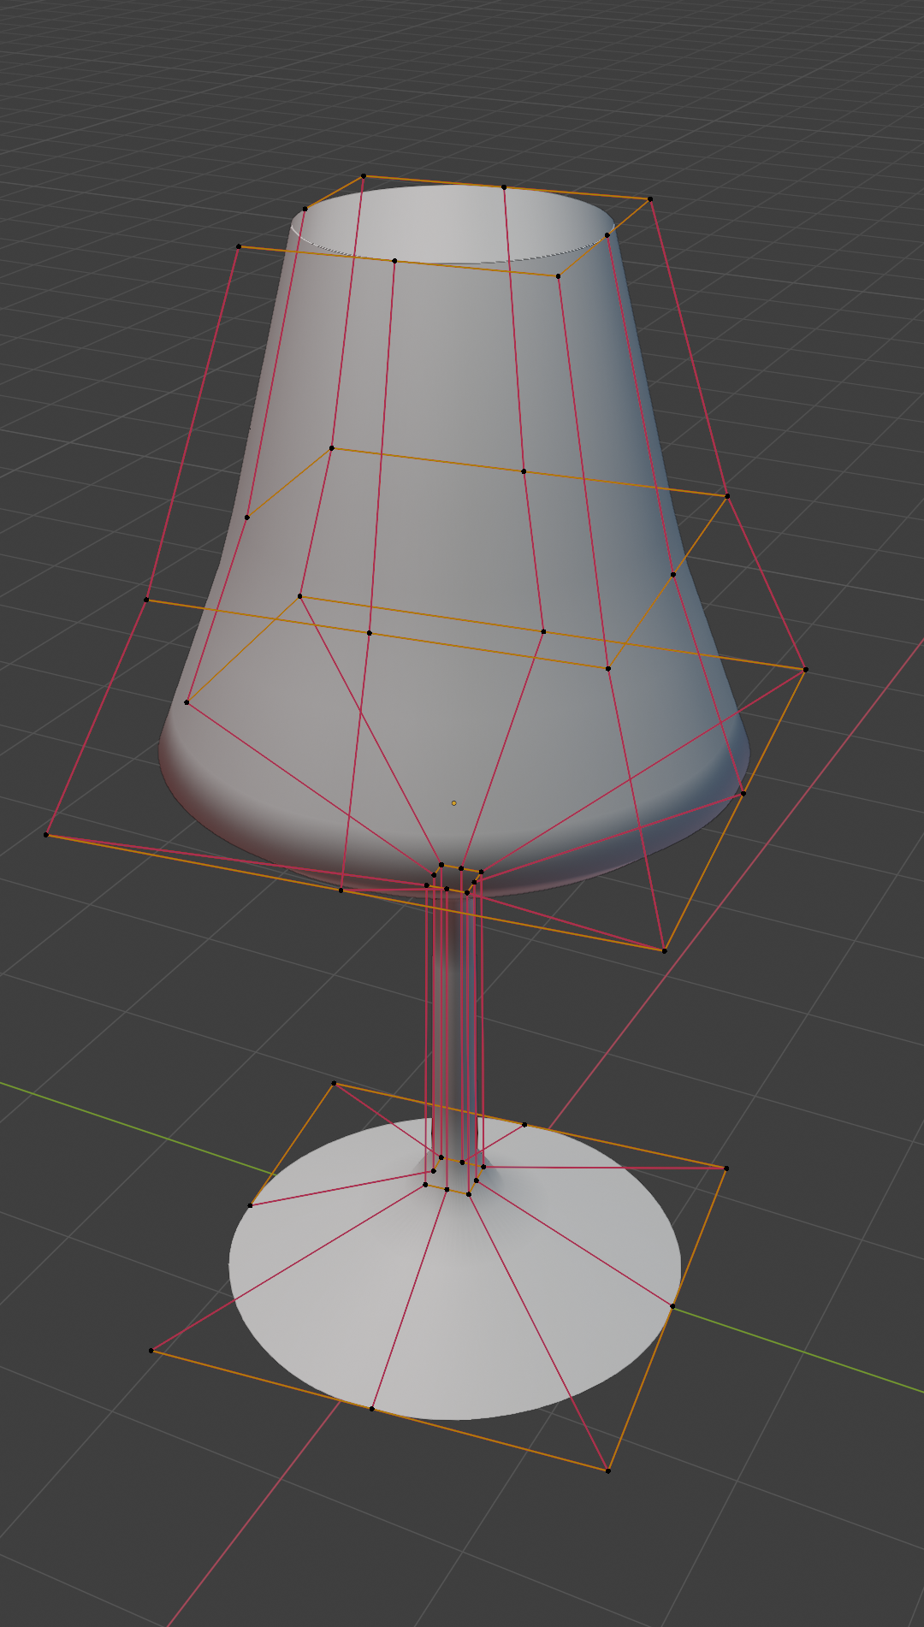
Foundations of 3D surface representation
Foundational surface shape representations found in geometrical modeling are*:
Polygon meshes
Parametric surfaces
*Note that these representations are used to describe surface of the shape (a manifold – 2D surface in 3D world). Later, we will discuss how to describe interior of object (its volume). Interior of object can be described purely with spatially varying material enclosed in described surface. Also, advanced shape representations (e.g., voxels) can be used to efficiently describe the mesh. Since the topic of volumetric representation requires more knowledge about material and/or advanced shape representations, it will be covered later.

Slide 4
Polygonal mesh

Slide 5
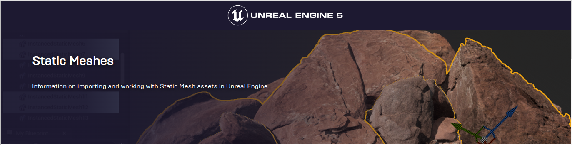
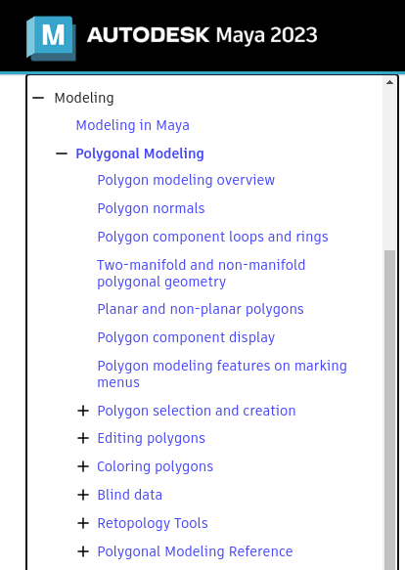
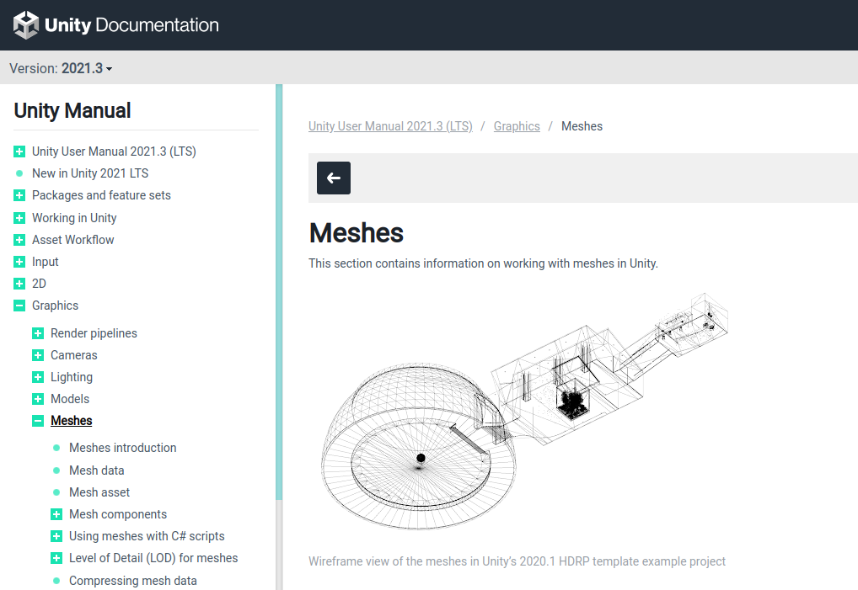
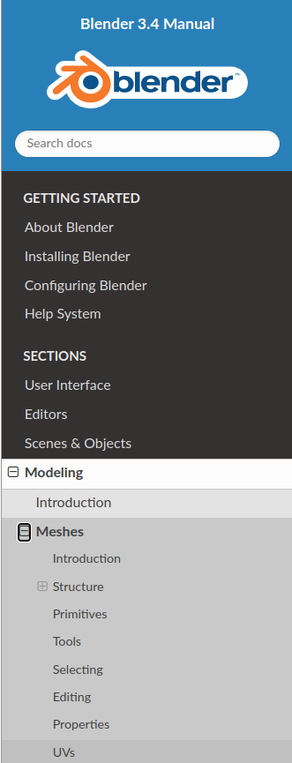
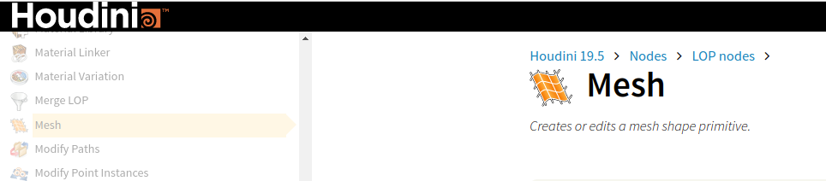
Polygon meshes
Polygon mesh (shortly mesh) representation is one of the most oldest, popular and widespread geometry representation used in computer graphics
  Very often, in professional DCC tools or game engines* we can find mesh representation that is used either for modeling or for rendering
Blender: https://docs.blender.org/manual/en/latest/modeling/meshes/index.html
Maya: https://help.autodesk.com/view/MAYAUL/2023/ENU/?guid=GUID-7941F97A-36E8-47FE-95D1-71412A3B3017
Houdini: https://www.sidefx.com/docs/houdini/nodes/lop/mesh.html
Unity: https://docs.unity3d.com/Manual/class-Mesh.html
Unreal: https://docs.unrealengine.com/4.26/en-US/WorkingWithContent/Types/StaticMeshes/
* Very often, mesh is commonly used for transporting models and scenes from DCC tools to game engines. DCC tools enable modeling using different shape representations, but in a lot of cases, all shapes are transformed to mesh representation and exported to other programs.

Slide 6
Mesh polygons: representation

Slide 7


Mesh building block: polygon
Polygon is planar shape which is defined by connecting array of points.
Individual points are called vertices (vertex, singular)
  In 2D they are defined using two coordinates,e.g., (x,y)
  In 3D they are defined using three coordinates, e.g., (x,y,z)
Lines connecting two vertices are called edges.
Once edges are presented and connect vertices we can define a face
  Order of connecting vertices matter and it can be clockwise or counterclockwise – winding direction
  Face orientation is defined by normal and normal depends on winding direction

Slide 8
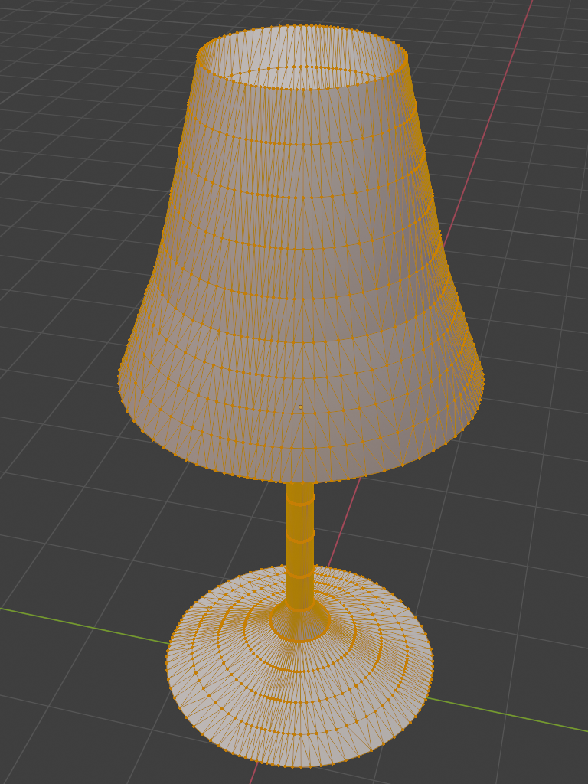

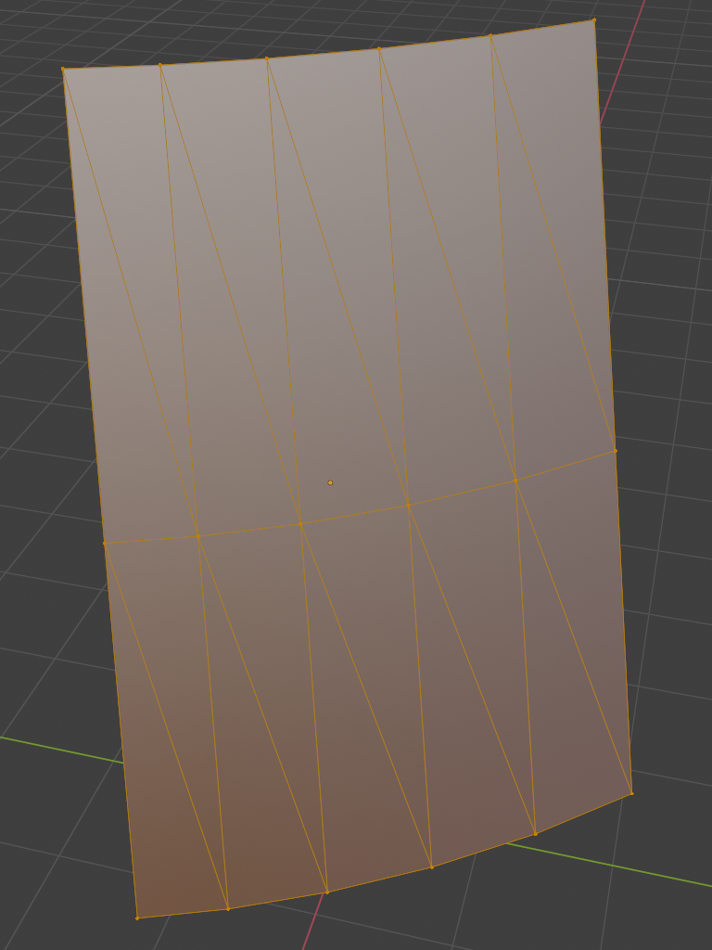
Types of polygons: triangle
Polygon with three vertices → triangle polygon.
  Very important type of polygon in computer graphics!

Slide 9
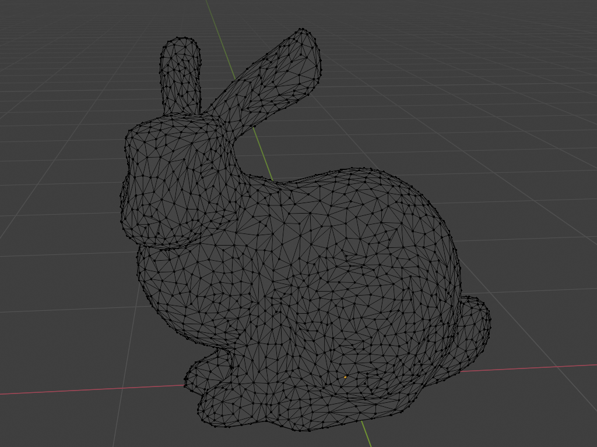
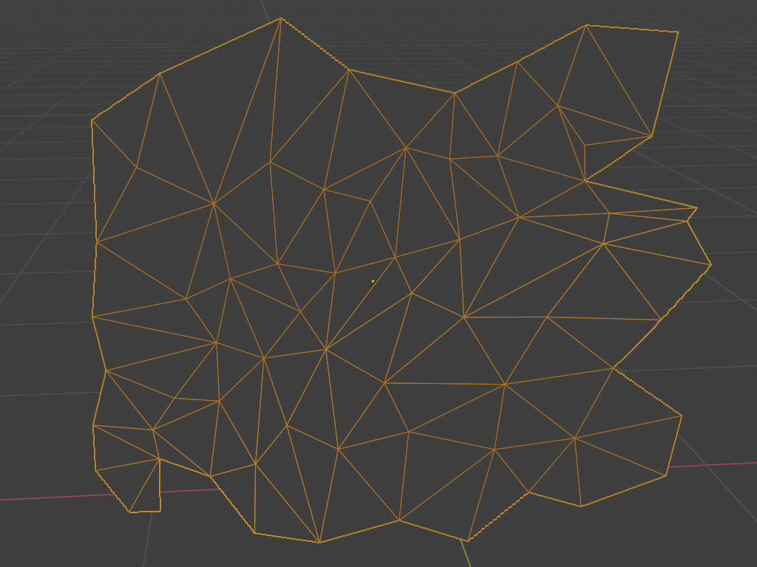
Types of polygons: triangle

Slide 10
Triangle mesh
Triangle mesh is foundational and most widely used data-structure for representation of a shape in graphics
Triangle mesh consists of many triangles joined along their edges to form a surface
Triangle is fundamental and simple primitive:
  All vertices lie in the same plane – always coplanar
  GPU graphics rendering pipeline is optimized for working with triangles
  Easy to define ray-triangle intersections needed for ray-tracing-based rendering
  Easy to subdivide in smaller triangles
  Texture coordinates are easily interpolated across triangle
Different shape representations used in modeling and acquisition can be transformed to triangle mesh
Triangle mesh has nice properties:
  Uniformity: simple operations
    Subdivision: single triangle is replaced with several smaller triangles. Used for smoothing
    Simplification: replacing the mesh with the simpler one which has the similar shape (topological or geometrical). Used for level of detail

Slide 11
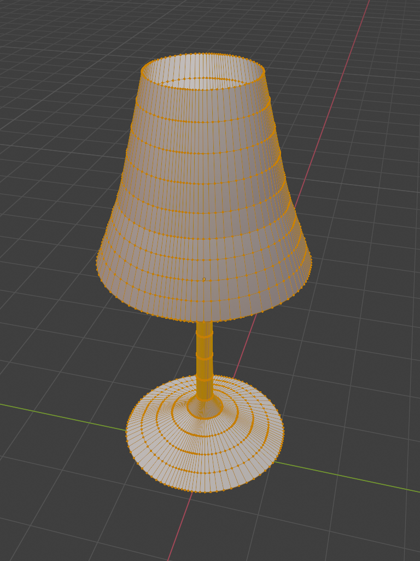

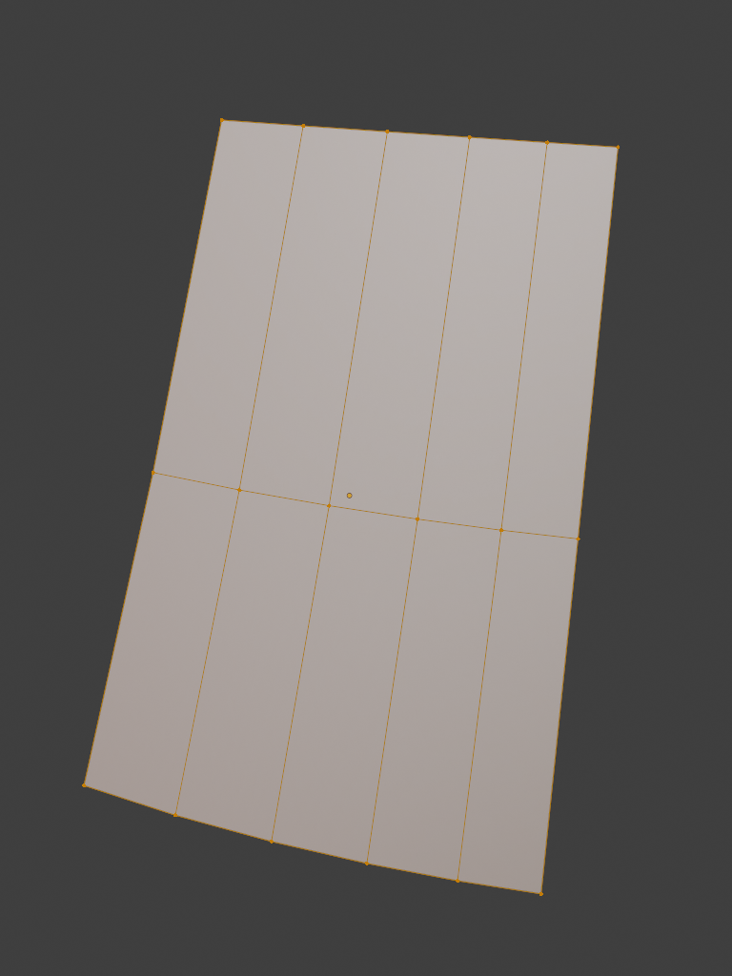
Types of polygons: quads
In case of four vertices, the polygon is called quad polygon (shortly quad).

Slide 12
Quad mesh
Often used as a modeling primitive
Complexity:
  Easy to create a quad where not all vertices lie on a plane
In graphics pipeline it is always transformed to triangle.
  Optionally, In ray-tracing-based rendering plane-ray intersection may be defined and then triangle representation is not needed*.
* As we will see, there is always a trade-off between which representation is good for modeling and which representation is good for rendering. Ray-tracing-based rendering can get very flexible with rendering wide representations of shapes but then there is a question if this is feasible to implement and maintain. Often, mapping between different shape representation is researched and used so that on higher level users are provided with intuitive authoring tools and on low level, rendering engine is given efficient representation for rendering process.

Slide 13
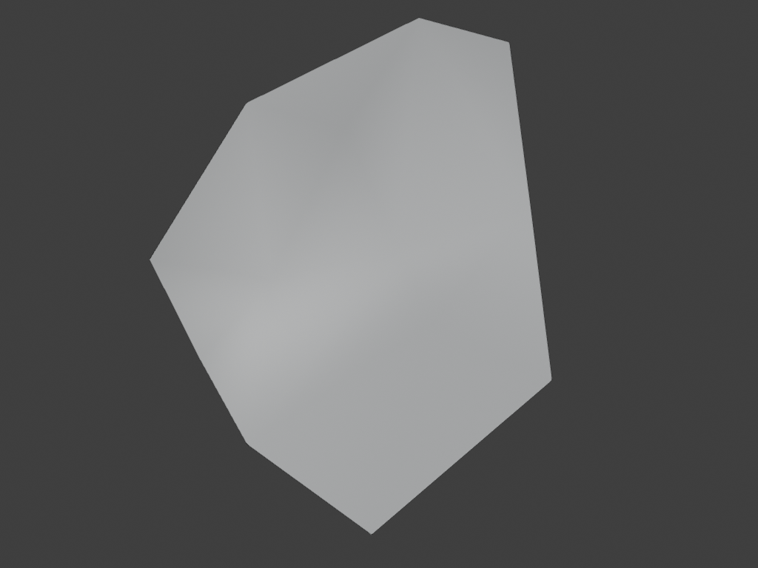
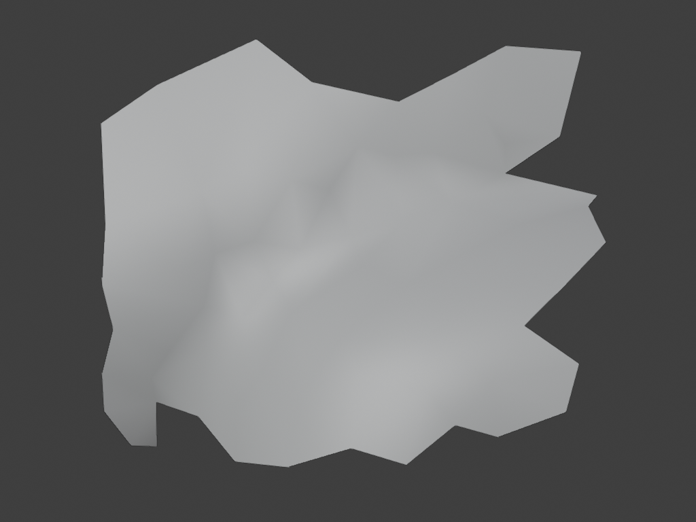
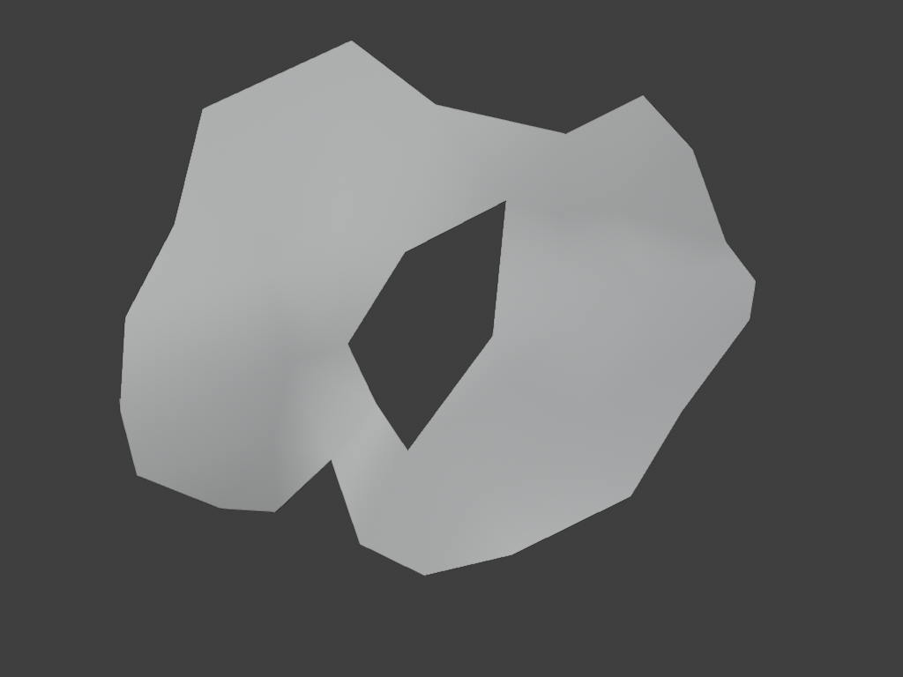
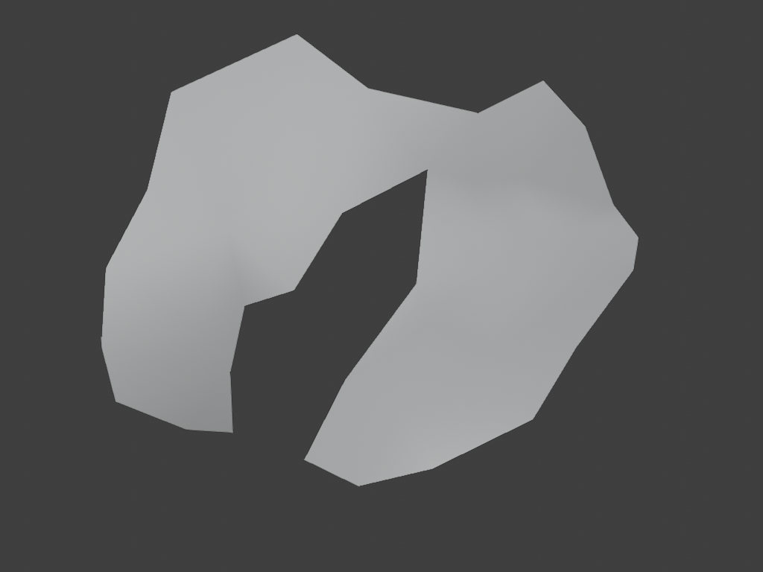
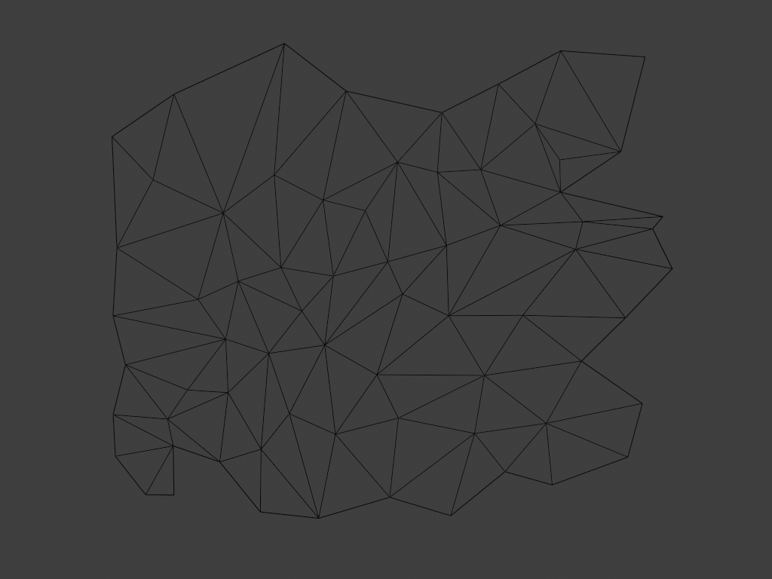
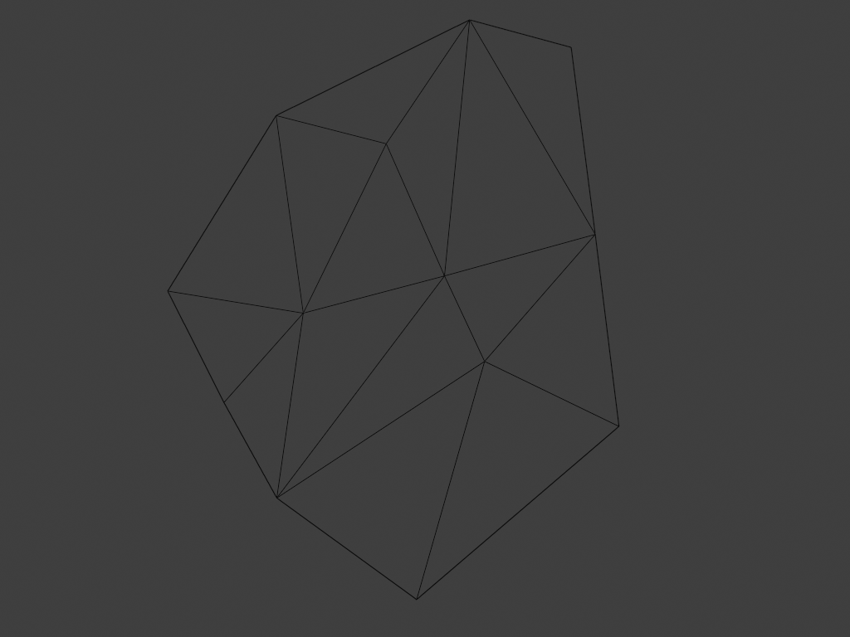
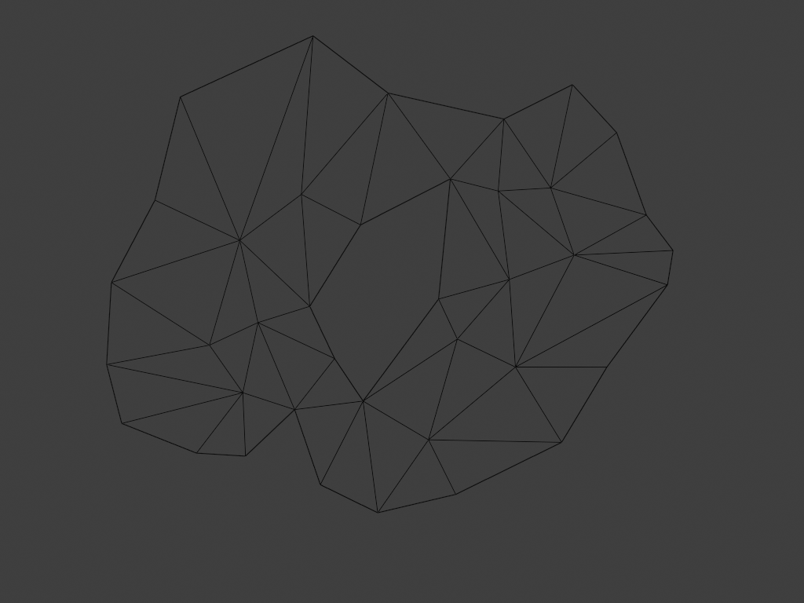
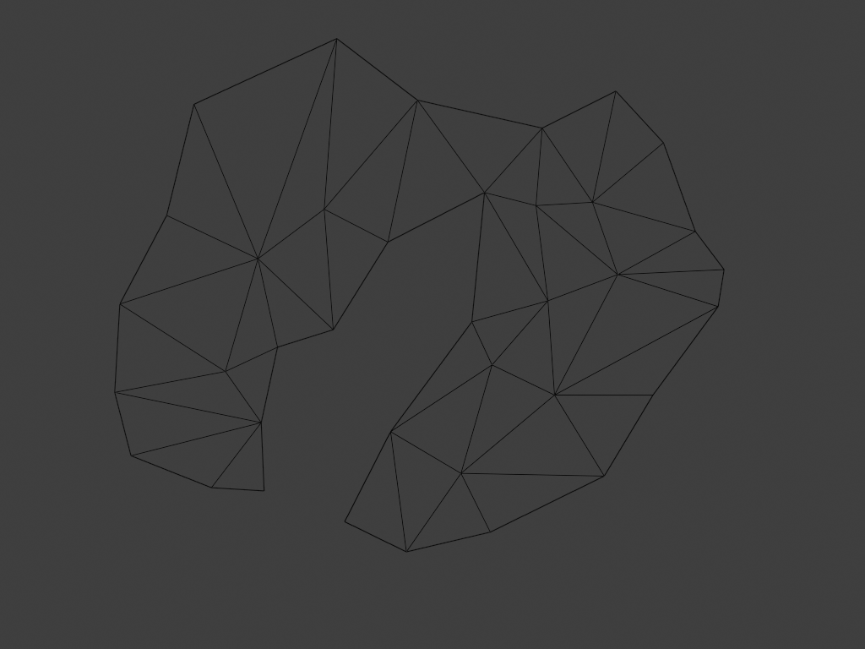
Types of polygons: general polygon
Polygon with more than four vertices is called general polygon.
  Polygons can be convex or concave, and more complex, they may also have holes.
Atomic element – face - of mesh can be any polygon. Common types are: triangle and quad.
It is a good practice to keep atomic elements as simple as possible (so that computation is easier) and combine those atomic elements into more complex shapes, e.g., convex or concave meshes or meshes with holes.

Slide 14
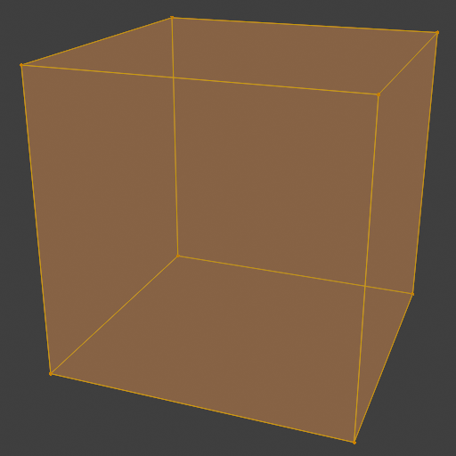
Connectivity
Complex polygons depend on vertex connectivity information.
Example: cube
  Define 8 vertices
  Define how are those vertices connected to form faces

Slide 15

Polygon mesh representation
Basic information needed for representing and storing polygonal mesh:
  Vertex positions → Geometry
  Vertex connectivity → topology
3D polygon mesh: 2D surface embedded in 3D space

Slide 16
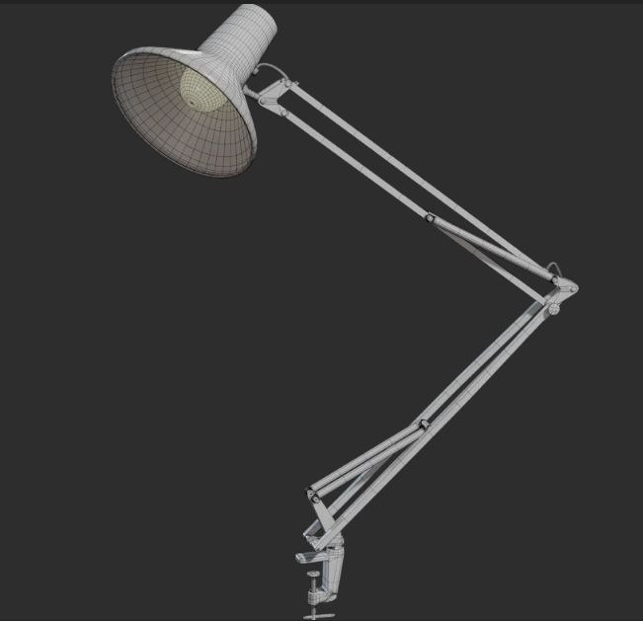
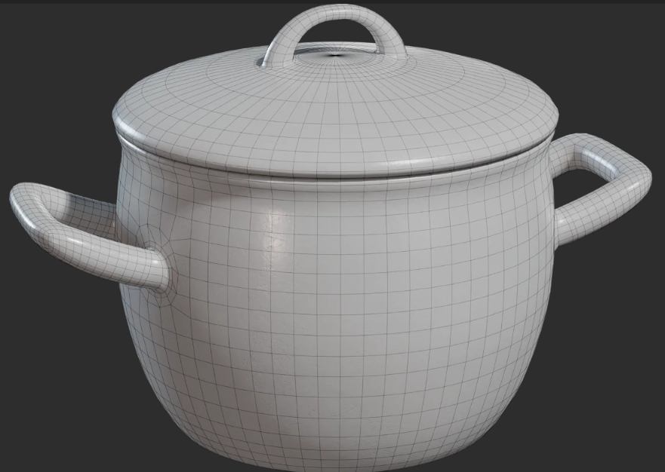
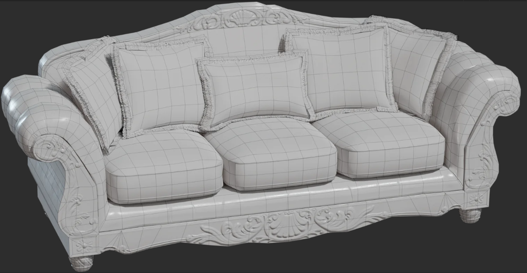
Examples of polygonal meshes
https://polyhaven.com/

Slide 17
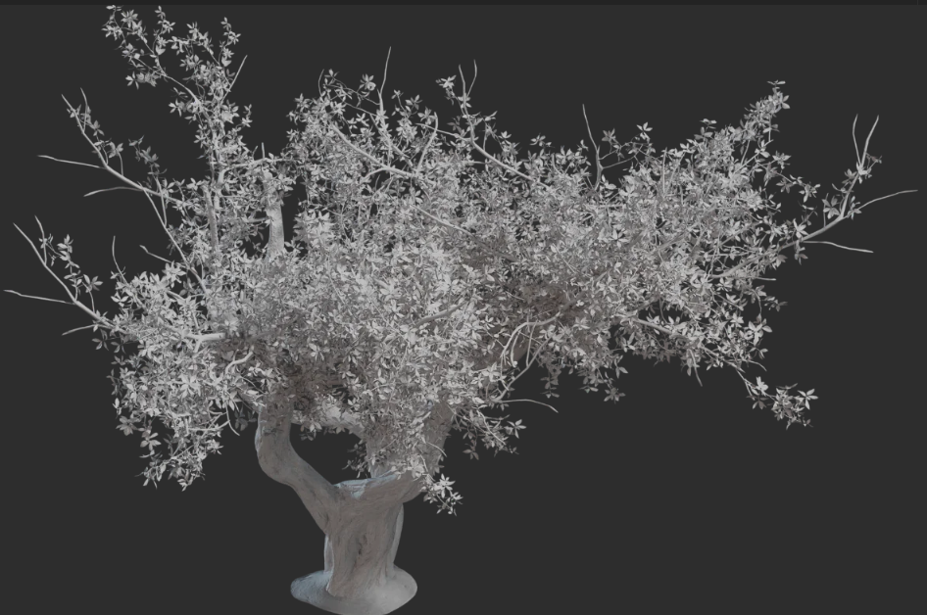
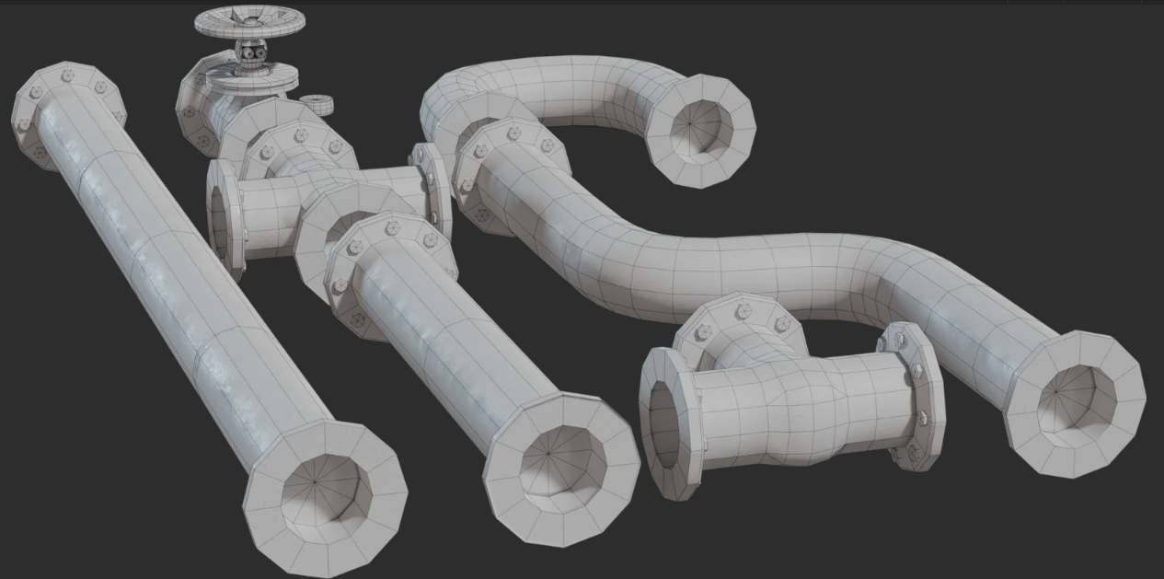
Examples of polygonal meshes
https://polyhaven.com/

Slide 18
Additional mesh information
Besides vertex positions and connectivity information, additional information can be used.
Those are values that user creates during modeling and which are used for rendering*:
  Normal*
  Texture coordinate*
  Color*
  Any kind of information that can be encoded and used for rendering: weights, temperature, etc.
Representation and storage of models is highly developed topic. For now we represented ideas on which any professional solutions build on.
* Those are in general called primitive variables. Primitive is generic term in computer graphics which describes object which is understandable by program.

Slide 19
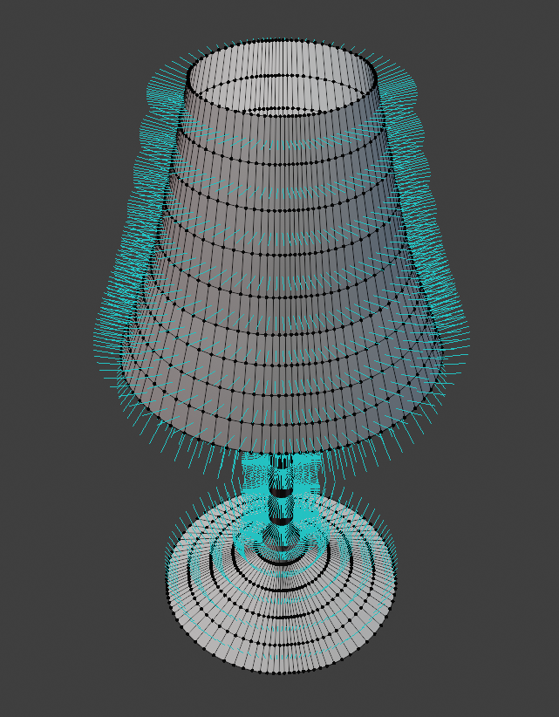
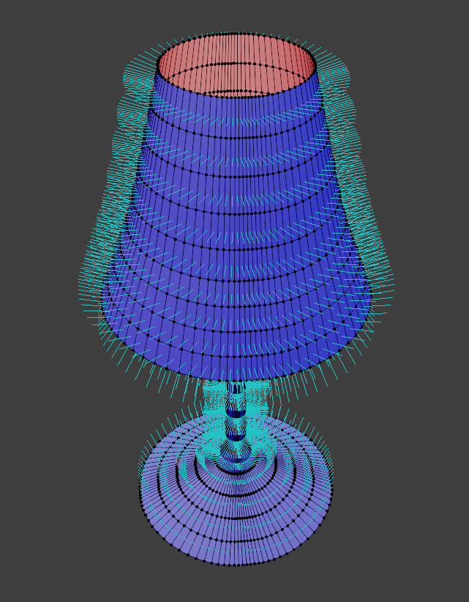
Additional mesh information: Normals
Orientation of surface in each point is determined by normal vector.
Normal vector is core information for rendering (shading) and modeling.
Mesh normal can be defined per:
  face
  per vertex

Slide 20
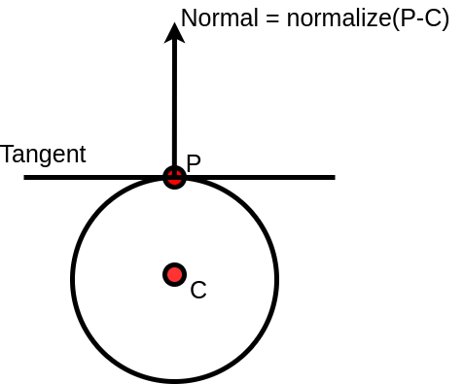
Computing normals
Normal in surface point is vector perpendicular to tangent in that surface point
Computation of normals depends on shape representation
  Sphere normal
  Mesh face normals can be calculated using triangle or quad polygon edges.

Slide 21
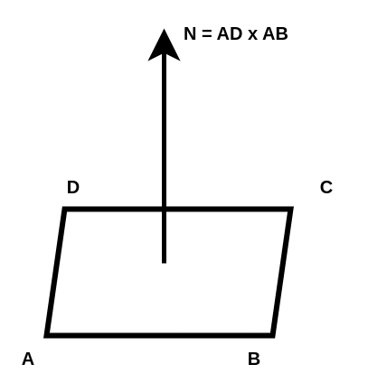
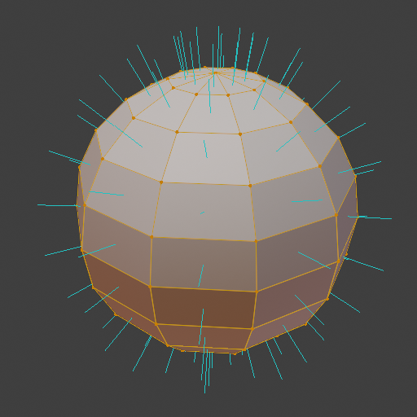
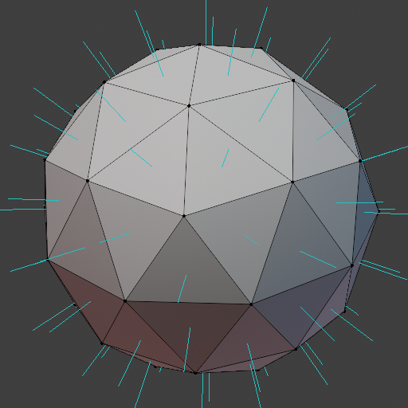
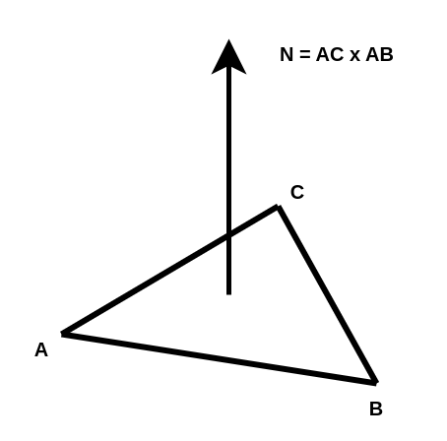
Normals: per face
Cross product between triangle or quad edges
Winding order of vertices defines orientation of normal
N = (B-A).crossProduct(C-A);

Slide 22
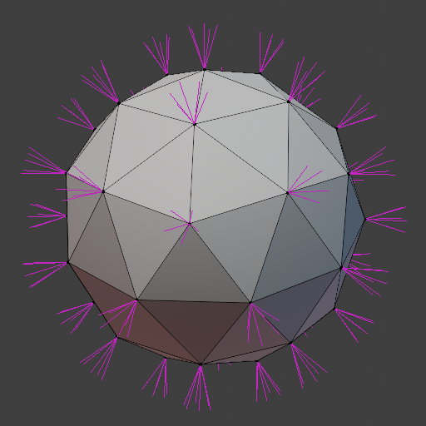
Normals: per vertex
If normals are defined per vertex, then multiple normals, one for each face, can be stored per vertex.

Slide 23
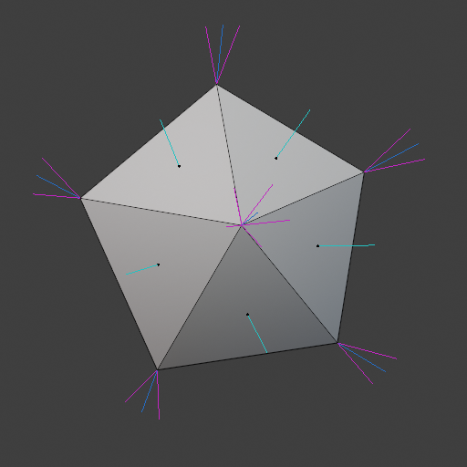
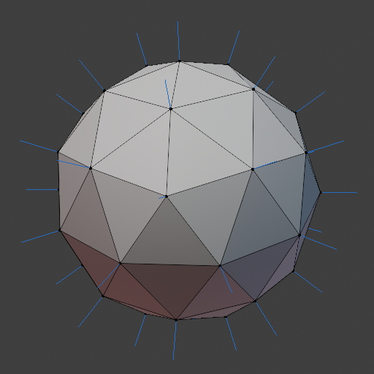
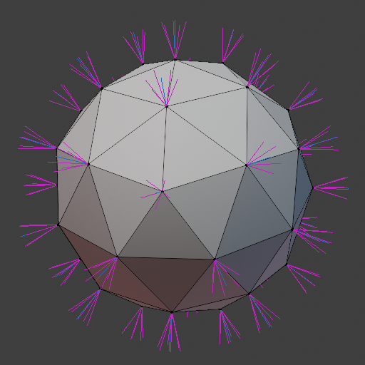
Normals: per vertex
One normal per vertex is calculated as:
  For each face:
    Calculate face normal
    Add normal to each connected vertex normal
  For each vertex normal:
    normalize

Slide 24
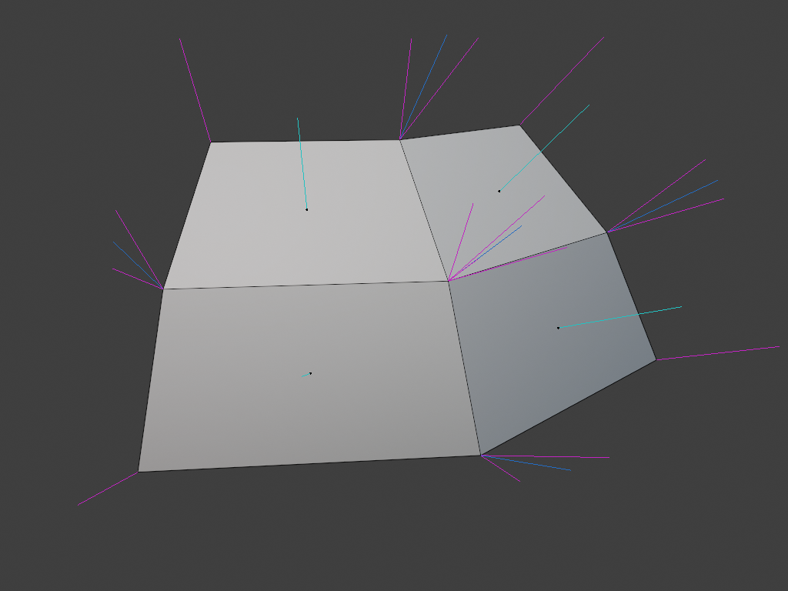
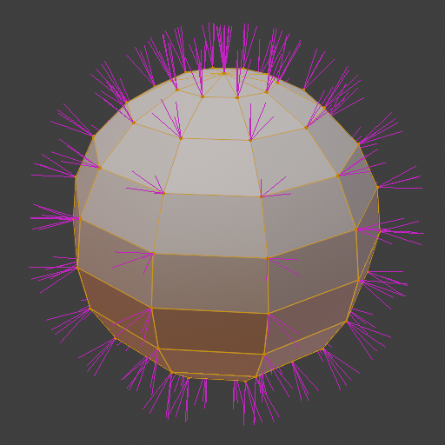
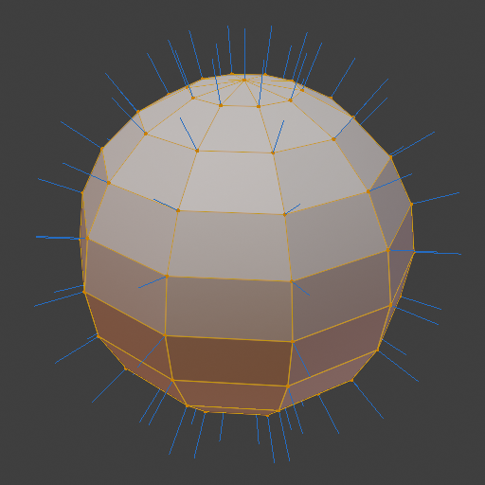

Normals: per vertex
One normal for each face per vertex
One normal per vertex

Slide 25
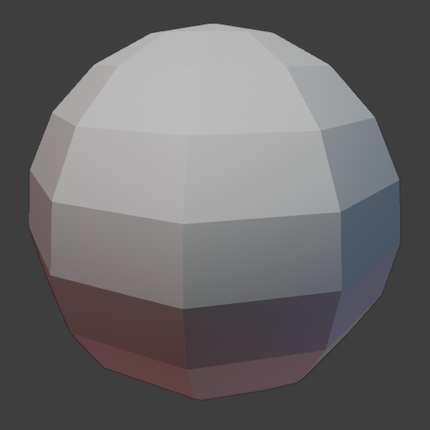
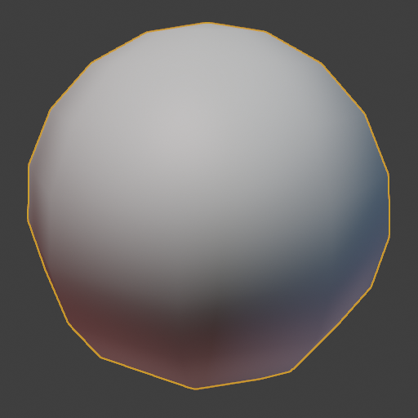
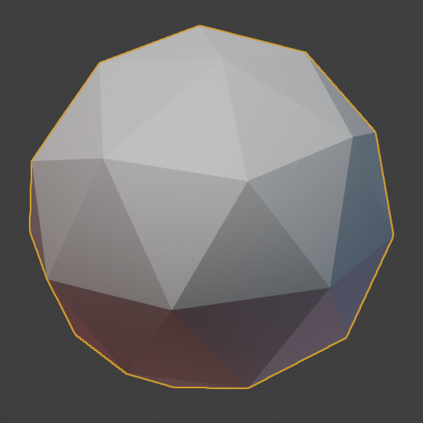
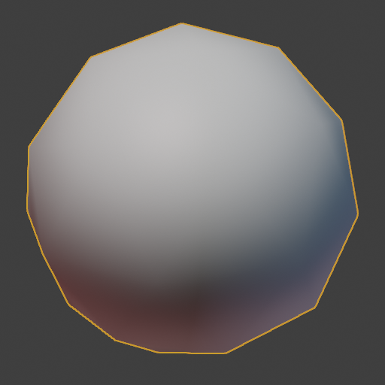
Using normals: shading
Appearance of object depends both on shape and material.
  Normal is main shape information used in shading; appearance calculation
Gouraud shading: normals defined per vertex are linearly interpolated over triangles (using barycentric coordinates).
  Geometry is not changed: note faceted silhouette
  Illusion of smooth surface is created during shading

Slide 26
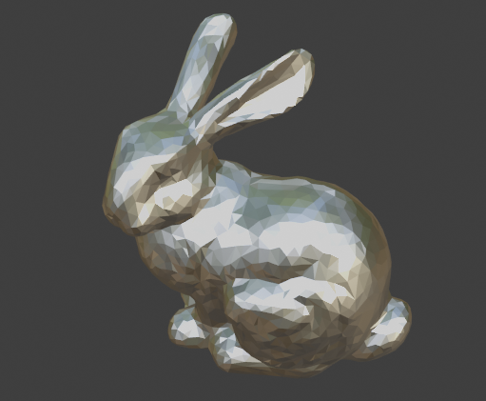
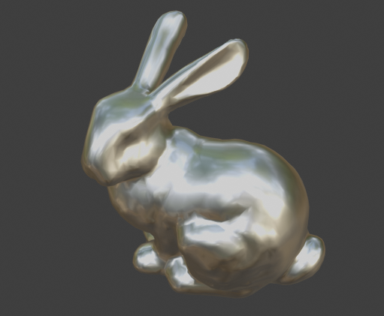
Smooth shading: example

Slide 27
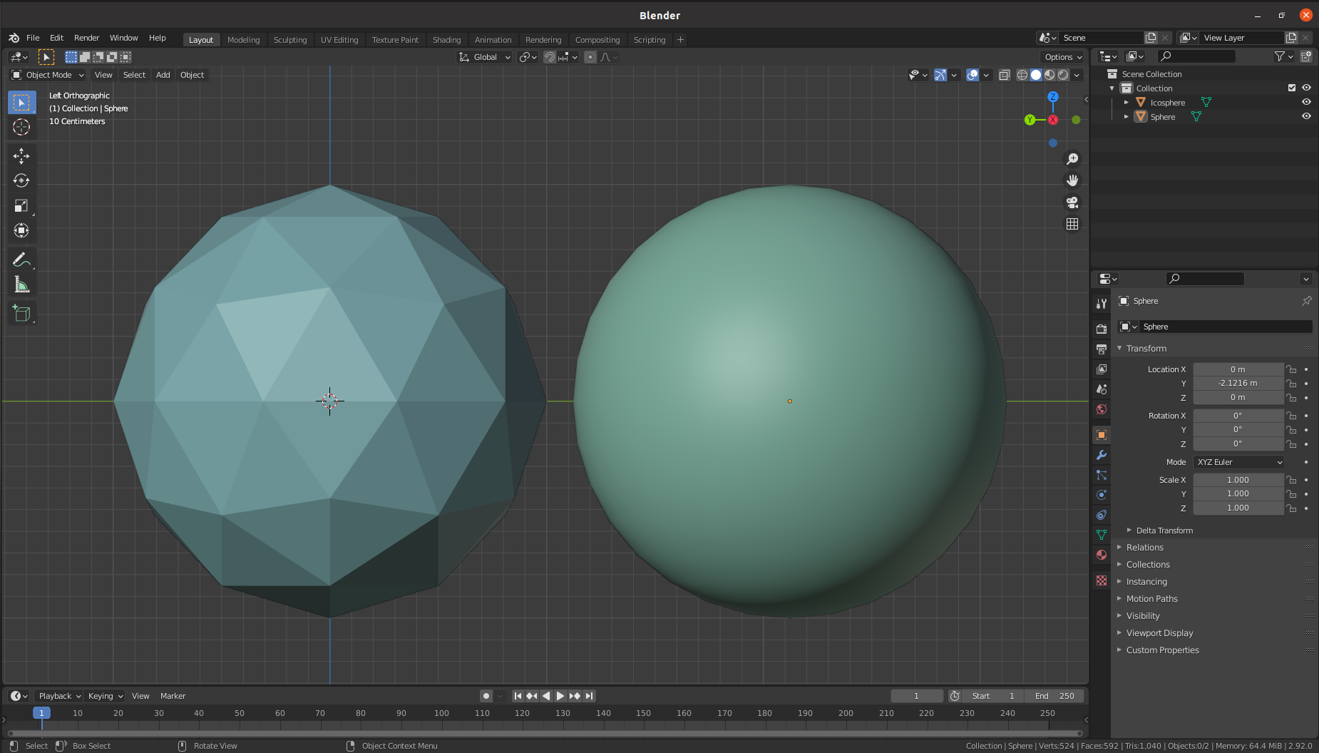
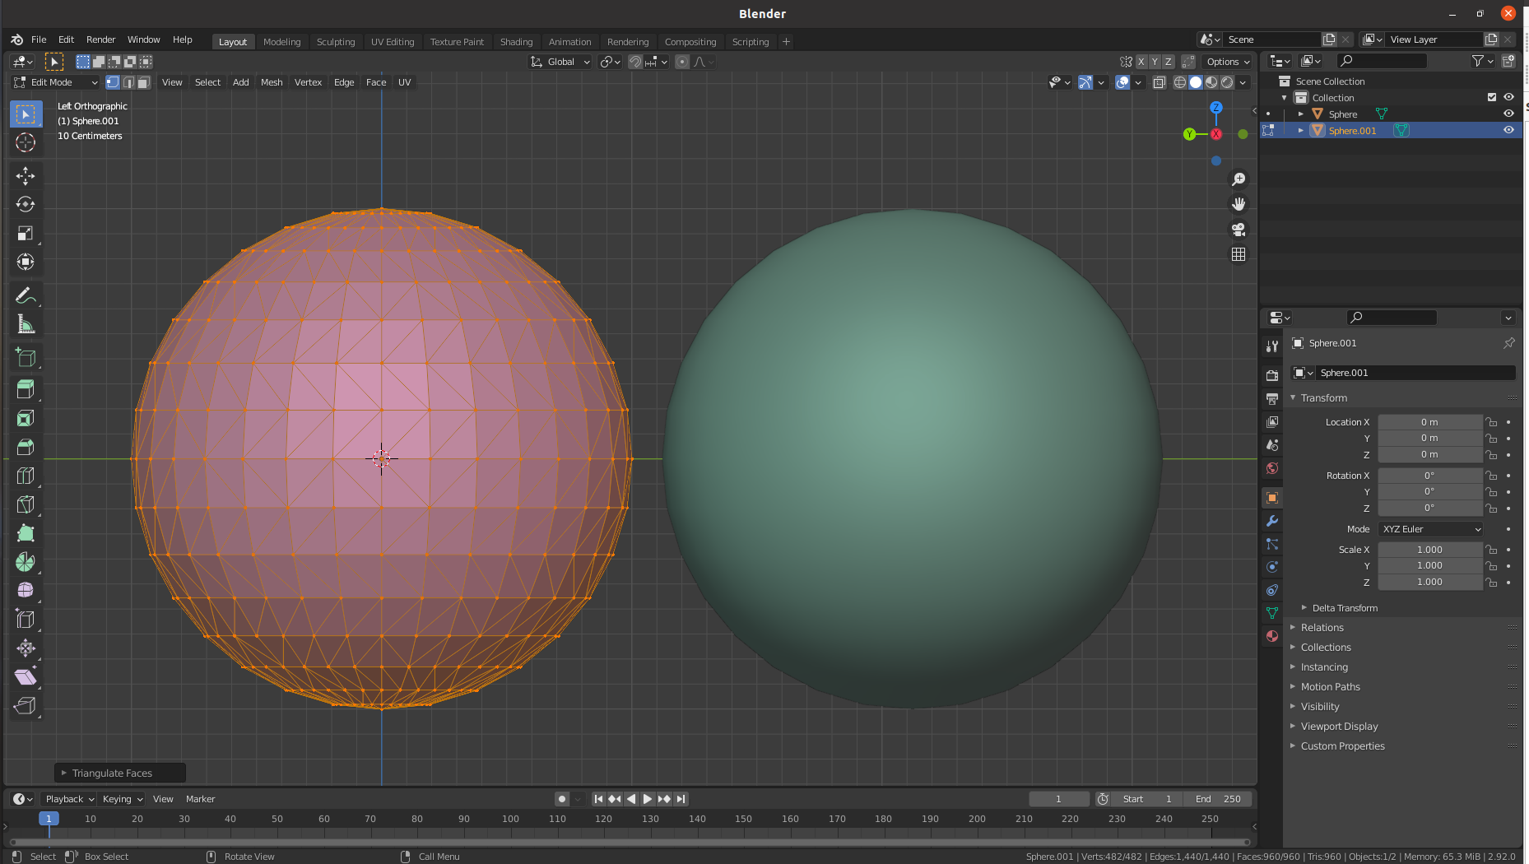
Note: approximating curved surfaces with polygons
Example: sphere vs icosahedron
  Each point on icosahedron is close to point of sphere
  Each normal vector of icosahedron is close to vector normal of the sphere in the same point. But, function that assigns normals to the sphere is continuous while for icosahedron is piecewise constant → this influences reflection of light!

Slide 28
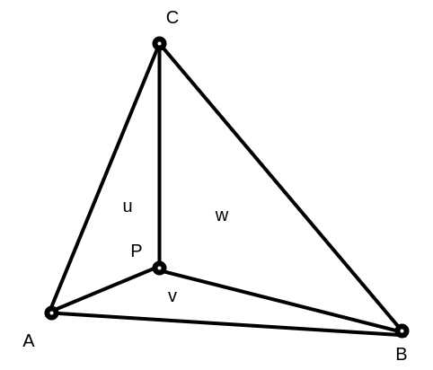
Triangle mesh: barycentric coordinates
Express position of any point located on triangle with three scalars.
  P = uA + vB + wC, where A,B,C are triangle vertices
  u,v,w, are barycentric coordinates, where u + v + w = 1 and
  0 <= u,v,w <=1, otherwise P is outside of triangle. If equal then P is on triangle edge.
aka areal coordinates: u,v,w are proportional to area of sub-triangles defined by P
  u = Area(Triangle(CAP)) / Area(Triangle(ABC))
  v = Area(Triangle(ABP)) / Area(Triangle(ABC))
  w = Area(Triangle(BCP)) / Area(Triangle(ABC))
  Area(Triangle(ABC)) = ||(B-A)x(C-A)||/2
Barycentric coordinates are very useful for interpolating vertex data across triangle surface, e.g., normals, colors, etc.
  We know P and A,B,C. Thus, calculate, u,v and w and use this factors for interpolating data

Slide 29





Using normals: shading
Amount of light incident on surface depends on cosine of the angle between light direction and surface normal
  Lambert’s Cosine law
  cos(θ) = dot(N, L)

Slide 30
Using normals: shading
Generally, normal vector is perpendicular to surface, but it can be perturbed so it is not perpendicular.
  This is trick which is used for shading TODO

Slide 31







Using normals: geometric manipulation
One of the basic modeling operations is extrusion
  This operation uses normal information for moving the face
Proceudural modeling utilizes normal direction for displacing mesh vertices
These are only some examples of normal vector usages. The point is to highlight its importance.

Slide 32




Additional mesh information: vertex colors
Similarly as normals are defined per vertex and interpolated over triangle for shading purposes, the same can be done with color
Simplest way to introduce variation over object surface – a form of texture
This method works fine for meshes with finer structure → more colors can be assigned to more vertices.
  When it is not possible to have fine mesh, then texture is used.
https://docs.blender.org/manual/en/latest/sculpt_paint/vertex_paint/index.html

Slide 33
Additional mesh information: vertex weights
TODO

Slide 34



Additional mesh information: texture coordinates
To add more details on object, often images and procedural patterns are used → textures.
The problem of applying texture image on 3D object is often quite complex than on flat plane.
  A a way of mapping a 2D image/pattern to 3D shape can be done by “unwrapping” mesh onto 2D plane.
https://polyhaven.com/a/wine_bottles_01

Slide 35






Mesh unwrapping: intuition
Mesh is unwrapped into 2D plane we can imagine it lies in 2D coordinate system.
Vertices of unwrapped mesh now have coordinates in this 2D coordinate system (u,v) → texture coordinates*
  (u,v) are in [0,1] range
  Unwrapped faces can be manipulated, but then texture might get deformed
  Whole unwrapped mesh can be translated or rotated or scaled to achieve different texture positioning
  Several faces can overlap

Slide 36



Texture coordinates: mesh unwrap
* Note: this is one way of calculating texture coordinates. Texture coordinates can also be calculated on the fly during rendering or other methods that we will discuss later.

Slide 37
Mesh polygons: storing

Slide 38
Important properties of mesh representation
Efficient topology traversal
Efficient use of memory
Efficient updates

Slide 39
Example: representing a cube in a computer
8 vertices: vertex array – geometry information
  vert_array = {{-1,1,1},{1,1,1},{1,1,-1},{-1,1,-1},{-1,-1,1},{1,-1,1},{1,-1,-1},{-1,-1,-1}}
6 quads for representing faces. Each quad requires 4 vertices: face index array – topology information.
  face_index_array = {4, 4, 4, 4, 4, 4}
  size(face_index_array) = number of polygons used for representing a shape
For each face, which indices of vertex array are used: vertex index array – topology information.
  vertex_index_array = {0, 1, 2, 3, 0, 4, 5, 1, 1, 5, 6, 2, 0, 3, 7, 4, 5, 4, 7, 6, 2, 6, 7, 3}
  size(vertex_index_array) = sum of all values in face index array
  Note: each face of the cube shares some vertices with other faces

Slide 40
Texture coordinates
Representing texture coordinates:
  Texture coordinate per vertex: list of (u,v) coordinates equal to the number of vertices. Example: texture_coordinates = {{0,0.5}, {1,0.5}, {0.5,1}, {0,0.5}, {0.5,0}, {1,0.5}}
  In UV space it is possible that multiple vertices have same texture coordinates thus connectivity information can be used to reduce number of texture coordinates to be written down

Slide 41
Recap: representing and storing mesh
To describe a mesh we need:
  Vertex array (vertex positions)
  Face index array (how many vertices each face is made of)
  Vertex index array (connectivity)
  Primitive variables:
    Vertex color
    Normals
    Texture coordinates
    Other optional application-specific values

Slide 42
Storing polygons: practical note
Even single polygon mesh in a 3D scene can can be quite large (10⁵-10⁶ vertices is not unusual)
Storing vertices and connectivity information must be performed efficiently
  All vertices must be stored
  Different techniques exist which try to minimize the amount of data needed for representing connectivity → yielding different standards, formats and API specifications for storing and transferring mesh data, e.g., OBJ or FBX*.
* Those are popular and widely used standards. We will discuss them more when we will be talking about triangle meshes. RenderMan, on the other hand, defines API specification for representing mesh data.

Slide 43
Storing and transferring mesh objects
Mesh data is often transferred between different modeling, rendering and interactive tools.
Interface between different tools and specification of how mesh should be stored is defined by standards*: https://renderman.pixar.com/resources/RenderMan_20/ribBinding.html
Different implementations of mesh storage formats exists, which are:
  Are more or less compact
  Are more or less human-readable
  Can contain additional object data which is described with the mesh (textures, materials, etc.)
  Can contain various metadata (e.g., physical behavior of object described with mesh)
  Store only mesh information
  Store whole scene and mesh is only one of elements
Popular formats:
  https://all3dp.com/2/most-common-3d-file-formats-model/
  https://www.sidefx.com/docs/houdini/io/formats/geometry_formats.html
3D scene is not necessary created, rendered and used in same software. Usually, whole pipeline of software is used, at least:
  DCC → game engines
Formats: OBJ, GLTF, USD
Interesting: https://www.scratchapixel.com/lessons/3d-basic-rendering/introduction-polygon-mesh/polygon-mesh-file-formats
* note that tendency is towards standardization of whole scene description. Which, besides mesh polygons, include materials, lights, cameras, different shape representations, etc.

Slide 44


Example: OBJ file format
OBJ file format. Each line starts with letter representing type of data:
v – vertices
vt – texture coordinates
vn – normals
F – faces (index of vertex, vertex texture coordinate, vertex normal

Slide 45
Practical note: using different formats
Professional file formats and representations are commonly used and are very efficient
Using modeling/interactive/rendering tools, user is often provided with “importer/exporter” – feature which enables importing and exporting different file formats
  Example: https://www.sidefx.com/docs/houdini/io/formats/index.html
The problem comes if one writes its own rendering program and parsing file formats for import can be not that easy. Luckily, different libraries can be used for this purposes:
  Example: https://github.com/assimp/assimp

Slide 46
Practical note: units
Note that until now we haven’t discussed units in which shape is stored.
Units are important for preserving consistent scale among different modeling/rendering tools in which object might be transferred.
Let’s discuss creation of two meshes in Blender. Mesh, that is, vertices are defined in a coordinate system. In this coordinate system we can have two same objects where one is larger and another is smaller. By relation/proportion we can distinguish the scale and we might not care about units.
  Since positions of vertices are relative to coordinate system, the axis of coordinate system must specify units.
But what happens if one of this objects in exported into another tool, for example Unity? Unity might use different coordinate system unit scale and object might be too big or too small in this coordinate system!
  Example: different scales with same coordinates.
Unit is defined by user who models the object and it must be taken care of during transfer.

Slide 47
Mesh polygons: acquisition and modeling

Slide 48

Manual/interactive modeling
DCC Tools provides basic shapes from which complex shapes are created.
1. Blender: https://docs.blender.org/manual/en/latest/modeling/meshes/primitives.html
2. Maya: https://knowledge.autodesk.com/support/maya/learn-explore/caas/CloudHelp/cloudhelp/2022/ENU/Maya-Basics/files/GUID-45D2EAD4-5BCF-42DA-A1AB-EC6EE09FE705-htm.html
3. 3DS Max: https://knowledge.autodesk.com/support/3ds-max/learn-explore/caas/CloudHelp/cloudhelp/2021/ENU/3DSMax-Modeling/files/GUID-66152BDE-BA64-423F-8472-C1F0EB409E16-htm.html
4. Houdini: https://www.sidefx.com/docs/houdini/model/create.html

Slide 49









Practical tip: complex shapes from base shapes
Anything can be decomposed in simple forms^{1,2}: box, sphere, cylinder, torus, cones, etc.
https://www.youtube.com/watch?v=Q0qKO2JYR3Y&ab_channel=BlenderSecrets
1. http://www.thedrawingwebsite.com/2015/02/18/practicing-your-draw-fu-forms-forms-are-like-sentences/
2. https://www.youtube.com/watch?v=6T_-DiAzYBc&list=RDCMUClM2LuQ1q5WEc23462tQzBg&start_radio=1&rv=6T_-DiAzYBc&t=1343&ab_channel=Proko

Slide 50





Practical tip: complex shapes from base shapes
Sculpting base shapes.
https://www.youtube.com/watch?v=p4Y1hVCMMXw&ab_channel=RealEnay

Slide 51




Practical tip: complex shapes from base shapes
Procedural modeling
https://www.youtube.com/watch?v=fxOxygaEOFk&ab_channel=SimonHoudini

Slide 52



Scanning and photogrammetry
Scan the world: https://www.myminifactory.com/scantheworld/
Sans Factory: https://www.scansfactory.com/
Mega Scans: https://quixel.com/megascans/home/
Art Station 3D scanning and photogrammetry: https://www.artstation.com/channels/photogrammetry_3d_scanning?sort_by=popular

Slide 53

Simulations
https://people.csail.mit.edu/kuiwu/gvdb_sim.html

Slide 54
Mesh polygons: concluding

Slide 55
Important properties of meshes
Goal: not to go deep into definitions but rather to verify properties using simpler methods
Mesh boundary: formal sum of vertices
Closed mesh: mesh boundary is zero. Required for defining what is “inside” and “outside” by winding number rule
Manifold mesh: each vertex has arriving and leaving edge
  Manifolds are desired since it is easy to work with them (both manually and algorithmically)
  Smooth vs not smooth manifolds (e.g., cube)
  Self-intersecting meshes are not manifolds
  In graphics we generally use polyhedral manifolds
Oriented vs unoriented meshes
  We use oriented meshes so that boundary can be defined
<IMAGES: DEPICT IMPORTANT PROPERTIES!>

Slide 56
Exploring meshes
Meshlab is open-source tool for mesh manipulation and processing
  Mesh smoothing and sharpening
  Re-meshing: subdivide, re-sample, simplify,
  Topological operations: fill holes, fix self-intersections
  Boolean operations
Libigl library for mesh processing
  Mesh curvature
Blender
  Modeling with meshes
  Procedural meshes with Python
Sources of mesh data:
  https://casual-effects.com/data/index.html
  https://polyhaven.com/models
  https://sketchfab.com/
  http://graphics.stanford.edu/data/3Dscanrep/
More informations:
  https://www.realtimerendering.com/#polytech

Slide 57
Deeper into topic
CGAL is advanced geometry processing library
Polygonal mesh is highly used and researched method in computer graphics. We have covered foundations. There are many other topics. Some of those will be discussed later, some are out of scope for this course:
  Tessellation and triangulation
  Consolidation, mesh reparation
  Representation
  Simplification, level of detail
  Compression

Slide 58
Mesh shape representation: verdict
Pros:
  Most common surface representation
  Simple for representing and intuitive for modeling and acquisition
  A lot of effort has been made to represent various shapes with meshes
  Lot of research has been done to convert other shape representations to mesh representation
  Graphics hardware is adapted and optimized to work with (triangle) meshes → fast rendering
Cons:
  Not Guaranteeing smoothness
  Triangle meshes are not efficient or intuitive for manual/interactive modeling
  Not every object is well suited to mesh representation:
    Shapes that have geometrical detail at every level (e.g., fractured marble)
    Some objects have structure which is unsuitable for mesh representation, e.g., hair which has more compact representations

Slide 59
Parametric curves and surfaces

Slide 60
Another shape representation
Representing surface using mesh is the most used and widespread option for both authoring and transfer.
  Triangle mesh and thus triangle is basic atomic rendering primitive for GPU graphics pipelines and most ray-tracers.
However, objects made in modeling systems can have many underlying geometric descriptions.
  Different geometric descriptions enable easier and efficient modeling and representation of shapes on the user side.
  On the rendering side, all higher-level geometrical descriptions are evaluated as set of triangles and then used.
<IMAGE: show THE CONCEPT OF USER AND RENDERING SIDE AND HOW OBJECTS CAN BE REPRESENTED>

Slide 61


Applications
Design: cars, ships, airplanes, etc.
architecture,
Engineering,
Nature,
Animation,
Vector graphics,
https://www.freecadweb.org/
https://www.autodesk.com/products/autocad/included-toolsets/autocad-architecture

Slide 62
Parametric surfaces vs Mesh
Parametric surfaces are one of alternative geometric representations that have certain advantages over meshes in certain scenarios.
Some advantages of curves and curved (subdivision) surfaces are:
  They are represented by equations and thus have more compact representation than meshes (less memory for storing and transfer) and less transformation operations are needed
  Since they are represented by equations they provide salable geometric primitives – geometry can be generated on the fly by evaluating the equations (Analogy: vector and raster images)
  They can represent smoother and more continuous primitives than lines and triangles, thus more convenient for representing object like hair, organic and curved objects
  Other scene modeling tasks can be performed more simpler and faster, e.g., animation and collision
<IMAGES: APPLICATION OF CURVES AND CURVED SURFACES>

Slide 63


Parametric curves and surfaces
To understand parametric surfaces, we will start with parametric curves

Slide 64
Parametric curves

Slide 65


Parametric curves
Wide context of usages:
  Animating object/camera/light over path: position and orientation
  Rendering hair
https://developer.nvidia.com/gpugems/gpugems2/part-iii-high-quality-rendering/chapter-23-hair-animation-and-rendering-nalu-demo

Slide 66


Parametric curves
Described with a formula as a function of parameter t: p(t), t in [a,b]
  Generated points are continuous
Example: line segment
  p(t) = (1-t) p₀ + t p₁
Example: circle
  x(t) = r cos(2 * PI * t), t in [0,1]
  y(t) = r sin(2 * PI * t), t in [0,1]

Slide 67
Arbitrary curves? Various implementations:
  Bezier curve
  Hermite curve
  Catmull-Rom spline
  B-Splines

Slide 68
Bezier curves: linear interpolation
Linear interpolation between two points – control points - p₀ and p₁ traces out straight line.
  p(t) = (1-t) p₀ + t p₁, short: lerp(p₀, p₁, t)
  For 0 < t < 1, generated points are on straight line between p₀ and p₁. Otherwise outside.
  p(0) = p₀ and p(1) = p₁

Slide 69

Bezier curves: linear interpolation
Linear interpolation is fine for two points. But interpolating between multiple points gives us straight segments with sudden (discontinuous) changes at joints between.

Slide 70



Bezier curves: repeated interpolation
https://acko.net/files/fullfrontal/fullfrontal/wdcode/online.html

Slide 71

Bezier curves: repeated interpolation
This problem can be solved by taking linear interpolation one step further and linearly interpolate repeatedly → Bezier curves*
  To repeat interpolation, control points are added: P₂
  Example: 3 control points: P₀ ,P₁, P₂
  Linearly interpolate P₀ and P₁ to obtain Q₀
  Linearly interpolate P₁ and P₂ to obtain Q₁
  Linearly interpolate Q₀ and Q₁ to obtain curve point B
  B(t) = lerp(lerp(P₀,P₁,t),lerp(P₁,P₂,t),t)
https://en.wikipedia.org/wiki/B%C3%A9zier_curve
* Independently discovered by Paul de Casteljau and Pierre Bezier for use in French car industry.

Slide 72

Bezier curves: degrees
Degree of curve is n, if n +1 control points are used.
  More control points → more degrees of freedom
  n = 1 → 1st degree, linear curve
  n = 2 → 2nd degree, quadratic curve
  n = 3 → 3rd degree, cubic curve

Slide 73


Bezier curves: repeated interpolation
Repeated or recursive linear interpolation is often referred as de Casteljau algorithm.
Linear Bezier:
Quadratic Bezier:
Cubic Bezier: …
Higher degree: recursive formula:
De Casteljau algorithm gives pyramid of coefficients

Slide 74

Bezier curve: another representation
Quadratic Bezier:
Quadratic Bezier re-arranged → algebraic description
Every Bezier curve can be described with algebraic fromula. Therefore, repeated interpolation is not needed.
Generalized algebraic description: Bernstein form:

Slide 75



Bezier curve: Bernstein form
Bernstein form:
Bernstein polynomials aka Bezier basis functions:
If n = 2 (quadratic)

Slide 76

Bernstein polynomials
When t increases, blending weight form P0 decreases and blending weight for p1 increases, and so on...
Bernstein polynomials aka blending functions
https://www.sciencedirect.com/science/article/abs/pii/S0997753817306381

Slide 77


Bernstein polynomials
Bernstein function contains Bezier basis function (Bernstein polynomials) that defines properties of the curve:
Polynomials are in [0,1] when t is given in [0,1]
Curve will stay close to the control points P_{i}.
  Furthermore, whole Bezier curve will be located in convex hull of control points – useful for computing bounding area or volume of curve.

Slide 78

Bezier curve: matrix representation
In practice, it is useful (faster calculation) to represent Bezier curve in matrix form.
In practice, cubic Bezier curves are often used.
https://blog.demofox.org/2016/03/05/matrix-form-of-bezier-curves/

Slide 79
Bezier curves: good properties
Intuitive theory, good for understanding curves: repeated interpolation
Compact form: Bernstein form and matrix representation, power form*
Derivative of curve is straightforward: derivation of polynomial → tangent vector of curve point
Useful: Arbitrary number of points can be generated on curve
  If rotation of those points is needed, then curve (few control points) are rotated and then points are generated.
More on topic: https://www.youtube.com/watch?v=aVwxzDHniEw&ab_channel=FreyaHolm%C3%A9r
* Real-time rendering book, ch 17.1.

Slide 80
Bezier curves: problems
Bezier curves do not pass through all control points (except endpoints)
Not many degrees of freedom:
  Only control points can be chosen freely
  Not every curve can be described with Bezier curve (e.g., simple circle can not be described with one or collection of Bezier curves)
  Alternative is rational Bezier curve*
Degree increases with number of control points
  Hard to control if higher degree curve is used, complex computation
  Bernstein polynomials do not interpolate well
  For this reason, lower degree curves (often cubic curves) are concatenated to form larger spline
* Hoschek, J. and Lasser, D. (1993) Fundamentals of Computer Aided Geometric Design. A K Peters.

Slide 81

Joining Bezier curves
Often, multiple Bezier curves of lower degree are joined together to form splines
  Lower degree curves lower the complexity of computation
  Resulting curves will go through set of of points
For this purpose, cubic degree is often used
  Cubic curves are lowest degree curves that can describe S-shaped curve called inflection
Cubic Bezier with inflection: https://blog.maximeheckel.com/posts/cubic-bezier-from-math-to-motion/

Slide 82

Joining cubic Bezier curves
L₀
L₁
Example: two cubic Bezier curves with 4 control points:
  L_{i}, i = 0, 1, 2, 3
  K_{i}, i = 0, 1, 2, 3
To join the curves we can set L₃ = K₀ → joint - point where curves are joined
Composite curve formed from several curve pieces is called piecewise Bezier curve, p(t)
  Now t is in [t1, t2]
  First curve is p(t’), where t’ in [0,1].
  Second curve is p(t’), where t’ = (t – t1) / (t2 - t1)
Two curves connected just using L₃ = K₀ will not be smooth at joint.
Improved smoothness is achieved using tangent constraint: (K₁ – K₀) = c (L₃ – L₂), c > 0*
L₂
L₃=K₀
K₁
K₂
K₃
* Curves and Surfaces in Computer Aided Geometric Design, Farin, Gerald
https://cs184.eecs.berkeley.edu/sp22/lecture/7-77/intro-to-geometry-splines-and-be

Slide 83



Joined curves continuity
This way, many cubic Bezier curves are chained into piecewise cubic Bezier line
Continuity of joined curves:
  C⁰ – positional continuity - segments should joint at the same point
  C¹ – velocity continuity - derivation of any point (including joints) must be continuous
  C² - acceleration continuity - first and second derivatives are continuous functions
C⁰
C^{2 –} “A Frame” construction
C¹
https://cs184.eecs.berkeley.edu/sp22/lecture/7/intro-to-geometry-splines-and-be

Slide 84

Joined curves continuity
Geometrical continuity for describing joined curve smoothness
  G⁰ – positional continuity: holds when the end points of two curves or surfaces coincide
  G¹ – tangent continuity - tangent vectors from curve segments that meet at joint should be parallel and have same direction – no sharp edges. Continuous edges make splines look natural – often sufficient measure
  G² – curvature continuity - tangent vectors from curve segments that meet at joint should be of same length and rate of length change – perfectly smooth surface – two joined surfaces appear as one

Slide 85

Cubic Hermite curve
Bezier curves are good for describing theory behind smooth curves but are not controllable for authoring.
Cuves with cubic Hermite interpolation are easier to control and require:
  2 points. Starting and ending control points: p₀ and p₁
  2 vectors. Starting and ending tangents: m₀ and m₁ (longer tangents influence the shape)
Cubic Hermite curve interpolates p₀ and p₁ with tangents m₀ and m₁ at these points.
p₁
m₀
m₁
p₀
http://15462.courses.cs.cmu.edu/fall2020/article/10

Slide 86


Joining cubic Hermite curve
Cubic Hermite curve (aka interpolant aka segment aka spline segment) p(t), t in [0,1]:
Similarly as discussed with Bezier: Bernstein form with Hermite basis function exist
When interpolating more than two points, several Hermite curves can be connected together (similarly as done with Bezier).
https://en.wikipedia.org/wiki/Cubic_Hermite_spline

Slide 87

Splines: assembly of curves
Connecting multiple points P₀...P_{n}
  n – 1 cubic Hermite curves must be used
  resultant is assembly of curves called spline
  elements of assembly are called segments (e.g., Hermite sements)
P₃
P₀
P₀
P₅
P₁
P₄

Slide 88
Catmull-Rom spline
Given points P₀...P_{n}, the goal is to calculate tangents for Hermite curves which would create spline: continuous differentiable curve passing through each point.
Solution:
  Catmull-Rom spline

Slide 89

Catmull-Rom spline
Kochanek-Bartels: method for computing tangents at joints
Assume that there is only one tangent per control point
  Tangent at Pi can be computed as combination of two chords: P_{i}-P_{i-1} and P_{i+1}-P_{i}:
  Tension parameter - a: length of tangent, higher values → sharper bends
  Bias parameter - b: direction of tangent
Kochanek-Bartels method can be extended with additional, continuity, parameter and which is incorporated with calculating 2nd tangent at joint*.
* Real-time rendering book, ch 17.1.

Slide 90


Catmull-Rom spline
Catmull-Rom spline is a special case of Kochanek-Bartels Spline where tension and bias parameters are set to 0. Tangents in P₀...P_{n} are calculated using:
Properties:
  Rapid finding points on Catmull-Rom spline is possible
  Interpolating curve: passing through all control points but doesn’t stay inside convex hull of points
https://cs184.eecs.berkeley.edu/sp22/lecture/7-50/intro-to-geometry-splines-and-be

Slide 91



B-spline
Two types:
  Uniform: uniformly space control points
  Non-Uniform
Similarly to Bezier curve, it is parameterized function of x
  Where: n-1 – degree, c(k) – control points, β_{n} - basis function
Cubic B-spline is most widely used. Uniform cubic B-spline basis function:
Uniform cubic B-spline basis function
https://www.researchgate.net/publication/220494113_Efficient_GPU-Based_Texture_Interpolation_using_Uniform_B-Splines

Slide 92

Uniform cubic B-spline
Cubic B-spline is non-interpolating
  it is passing near control points, not through them. No guarantee that it is interpolating the control points
Multiple uniform cubic B-splines curves can be joined together as a spline
  Cubic B-spline is C² continuous
  Curve composited of multiple B-splines will be C² continuous

Slide 93
B-spline generalizations
B-splines explained so far have limitations
One limitation is that representing circle is not possible
  Solution, a generalization is to introduce additional coordinate to B-spline
  Rational B-spline → traversal of circles and conic sections is now possible
Another limitation is requirement of uniformly spaced control points: animation when positions of object are known at t = 1, 2, 3 and 10.
  Futher generalization: Non-uniform rational B-splines (NURBS)
  Very often used in CAD tools

Slide 94
Parametric surfaces

Slide 95



Parametric surfaces
Natural extension of parametric curves are parametric surfaces
  Similarly as triangle or polygon is extension of a line segment
Very useful for modeling curved surfaces
As curves, parametric surfaces are defined with small number of control points

Slide 96

Parametric surfaces
Common types
  Bezier surfaces
  B-spline surfaces
Ed Catmull's "Gumbo" model, composed from Bezier patches

Slide 97

Bezier surface: bilinear interpolation
Bezier curve is extended so it has two parameters (u,v) which define surface.
Similarly as we started with Bezier curve by explaining linear interpolation, we explain Bezier patch by explaining bilinear interpolation*.
  R₁(u) = lerp(Q₁₁,Q₁₂,u)
  R₂(u) = lerp(Q₁₂,Q₂₂,u)
  P(u,v) = lerp(R₁(u), R₂(u), v)
* Bilinear interpolation is crucial for computations in computer graphics. It is extensively used and one example is texture mapping.

Slide 98

Bezier surface: patch
p(u,v) is simplest, non-planar parametric surface with (u,v) in [0,1]. It has rectangular domain and thus resulting surface is called a patch.
https://www.sciencedirect.com/topics/computer-science/bilinear-interpolation

Slide 99

Bezier surface
Similarly as we added more points to linear interpolation to obtain Bezier curve, we add more points to bilinear interpolation to obtain Bezier surface
Example: biquadratic Bezier surface:
  9 control points

Slide 100


Bezier surface: repeated bilinear interpolation
Repeated bilinear interpolation is extension of de Casteljau’s algorithm to patches.
Starting control points:
https://acko.net/files/fullfrontal/fullfrontal/wdcode/online.html

Slide 101

Bezier surface: repeated bilinear interpolation
Repeated linear interpolation:

Slide 102


Bezier surface: repeated bilinear interpolation
Repeated bilinear interpolation

Slide 103

Bezier surface: repeated bilinear interpolation
Final Bezier surface

Slide 104

Bezier surface
Repeated bilinear interpolation is extension of De Casteljau algorithm to patches patches
Point on Bezier Patch can be described in Bernstein form using Bernstein polynoms

Slide 105



Bezier surface: continuity
  C⁰ – positional continuity – joined at the same point
  C¹ – velocity continuity - derivation of any point (including joints) must be continuous
  C² - acceleration continuity - first and second derivatives are continuous functions
https://cs184.eecs.berkeley.edu/sp22/lecture/7-96/intro-to-geometry-splines-and-be

Slide 106

Bezier surface properties
Passes through only corner control points
Boundary of the patch is described with Bezier curve of degree n formed by the points on the boundary
Tangents at border points are described with Bezier curve at border points – each corner control point has two tangents: for u and v direction
Patch lies within convex hull of its control points.
Control points can be generated and then points on patch will be rotated when evaluated (faster than other way around)
Derivative is straightforward (derivation of polynomials)
More on the topic: rational Bezier patches

Slide 107

Other parametrized surfaces
Bezier triangles
  Control points are located in triangulated grid
  Based on repeated interpolation: de Casteljau, Bernstein triangles
  Constructing complex object requires stitching Bezier triangles so that composite surface contains desired properties and look: continuity
Real-time rendering book, ch 17.2.

Slide 108

Other parametrized surfaces
Point-Normal (PN) Triangles
  Given triangle mesh with normals at each vertex, the goal is to construct “better looking” surface using just triangles
  This data is enough to construct surface using Bezier triangles*
  PN methods tries to improve mesh shading and silhouettes by creating curve surface to replace each triangle
Properties:
  Creases in PN triangles are hard to control
  Continuity between Bezier triangles is C0 but looks acceptable for certain applications
* Game engines (e.g., unity and unreal) support those methods since triangle mesh is basic building primitive.
https://alex.vlachos.com/graphics/CurvedPNTriangles.pdf

Slide 109

Other parametrized surfaces
Phong tessellation
  Similar as PN triangles, given the triangle points with normals, construct “better-looking” surface
  Phong tessallation attempts to create geometric version of Phong shading normal using repeated interpolation resulting in Bezier triangles.
Mesh, Butterfly subidivision, PN Triangles, Phong Tessellation
https://perso.telecom-paristech.fr/boubek/papers/PhongTessellation/

Slide 110


B-Spline surfaces
B-Spline curves can be extended to B-Spline surfaces which are similar to Bezier Surface
Often bicubic B-Spline surface is used to form composite surface
  Essencial for Catmull-Clark subidivison surfaces (will be discussed later)
Non-uniform rational B-Spline surface (NURBS) is often used in 3D modeling software
https://www.youtube.com/watch?v=1zNfh_g8jXM&ab_channel=BlenderSecrets
https://forums.cgsociety.org/t/audi-r8-v10-2010-nurbs-model-with-rhino-3d/1761843/3

Slide 111



Rendering of curved surfaces
Model made with parametric surfaces is tessellated for efficient rendering process.
  Surface can be tessellated in any number of triangles making it perfect for tuning trade-off between quality and speed (more triangles → better shading and silhouettes)
  Another advantage is that animation can be done on control points and then surface is tessellated for rendering.
For rendering purposes (both rasterization- and raytracing-based) it is beneficial to transform curved surface into triangulated mesh – tessellation

Slide 112

Modeling and transferring parametric surfaces
Parametric surfaces are stored using:
  STEP file format
  IGES file format
CAD programs are used to create and edit parametric surfaces.
https://www.freecadweb.org/

Slide 113
Exploring parametric curves and surfaces
Blender NURBS surfaces: https://docs.blender.org/manual/en/latest/modeling/surfaces/introduction.html
Blender NURBS and Bezier curves: https://docs.blender.org/manual/en/latest/modeling/curves/index.html
Tutorial on curves in Blender: https://behreajj.medium.com/scripting-curves-in-blender-with-python-c487097efd13
Houdini: https://www.sidefx.com/docs/houdini/nodes/sop/curve.html
Library for creating and manipulating NURBS surfaces and curves: http://verbnurbs.com/
More examples: https://www.realtimerendering.com/#curves

Slide 114
Further into topic
Parametric curves and surfaces are highly used and researched method in computer graphics. Until now we have covered foundations. There are many other topics. Some of those will be discussed later, some are out of scope for this course:
  NURBS: https://www.gamedeveloper.com/programming/using-nurbs-surfaces-in-real-time-applications

Slide 115
Literature
https://github.com/lorentzo/IntroductionToComputerGraphics/wiki/Foundations-of-3D-scene-modeling

