Slide 1
News
15.2.2023.

Slide 2
Exam date
NEW date confirmed: 29.3.2023. at 16h, Raum 136.1B

Slide 3
Projects
Deadline: 8.4.2023, 23:59
Project points will be announces after 8.4.2023 for everyone.

Slide 4
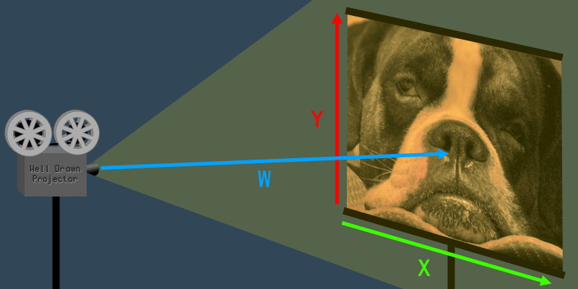
Homogeneous coordinates
Working in 3D often implies working with Euclidean geometry, coordinates in 3D space (x,y,z).
However, next to Euclidean geometry, there is also projective geometry which adds extra dimension: (x,y,z,w) – 4D:
  This four dimensional space is called projective space
  These coordinates are called homogeneous coordinates and are used for transformations
To explain homogeneous coordinates, let’s consider 2D coordinates to which homogeneous coordinate can also be added
  (x,y) coordinates define 2D image projected by 2D projector. In this case w coordinate determines scale of image; distance of projector to wall.
Same as in 2D space, w coordinate in 3D space determines scaling of (x,y,z) coordinate → perspective divide
Different projective spaces exist: https://en.wikipedia.org/wiki/Homogeneous_coordinates#Other_projective_spaces
More info:
  https://en.wikipedia.org/wiki/Projective_geometry
  https://yasenh.github.io/post/homogeneous-coordinates/
  https://www.tomdalling.com/blog/modern-opengl/explaining-homogenous-coordinates-and-projective-geometry/

Slide 5
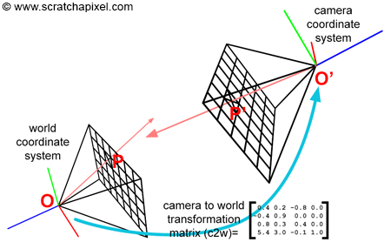
Look-at matrix and generating camera rays
Camera is placed in world origin O(0,0,0)
  Calculate point P(x,y,z) - world space pixel coordinate of virtual image plane through which ray passes
When camera is moved using look-at matrix, the look-at matrix defines camera-to-world matrix
  In this case, to generate ray, there are two options:
    Apply camera-to-world matrix to points O and P and calculate ray using transformed points O’ and P’
    Calculate ray using point O and P and then apply camera-to-world to this ray (origin and vector)
More info:
  https://www.scratchapixel.com/lessons/3d-basic-rendering/ray-tracing-generating-camera-rays/generating-camera-rays.html
  https://steveharveynz.wordpress.com/2012/12/20/ray-tracer-part-two-creating-the-camera/
  https://blenderartists.org/t/camera-from-location-target-and-up-vectors/576132

