Slide 1
Lecture 4: Transformations and Scene Organization
DHBW, Computer Graphics
Lovro Bosnar
1.2.2023.

Slide 2
Syllabus
3D scene
  Objects
  Lights
  Cameras
Rendering
Image and display
3D scene
  3D space
  Transforms
  Scene organization

Slide 3
3D space

Slide 4
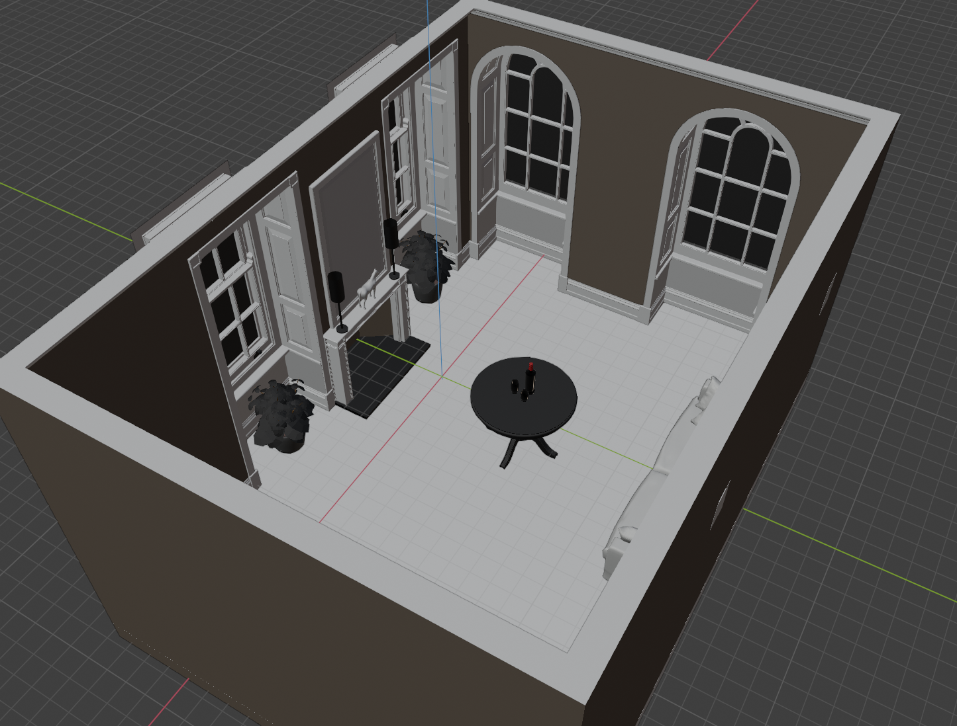
Introduction
Shape, positions and orientations of objects, lights and cameras in 3D scene are defined with points, vectors and coordinate systems.

Slide 5
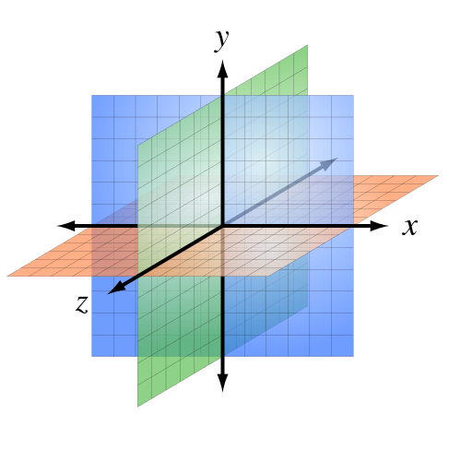
Coordinate system
Points and vectors are represented with three coordinates: (x,y,z)
These values are meaningless without a coordinate system:
  Origin (point) of the space
  Basis: three linearly independent vectors that define X, Y and Z axis of a space.
Origin and three vectors define a frame which defines coordinate system.
  Cartesian coordinate system: perpendicular axes
  Euclidean space
P
O

Slide 6
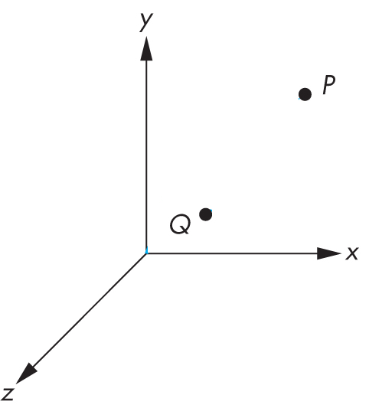
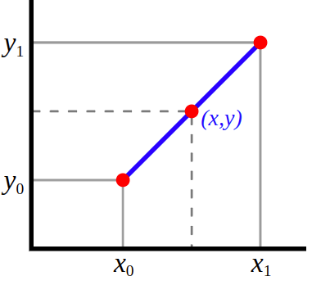
Points
Zero-dimensional location with respect to coordinate system:
  2D space (x,y)
  3D space: (x,y,z)
Interpolation between points: linear interpolation
  lerp(Q, P, t) = (1 - t) * Q + t * P;
P
t
Q

Slide 7

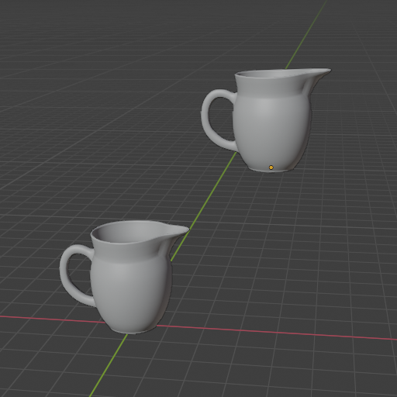
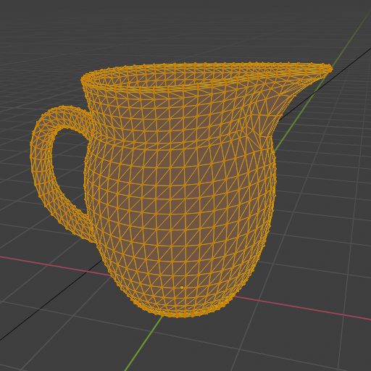

Points
Points are used to:
  Describe shape
  Define position of object in space

Slide 8
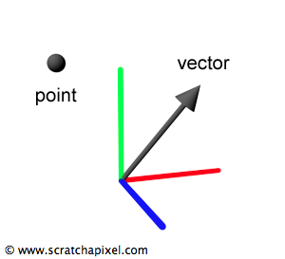
Vectors
Magnitude (norm/length) and direction in 2D or 3D space
  Two coordinates (x,y) – usually for texture space
  Three coordinates (x,y,z) – for any 3D elements

Slide 9
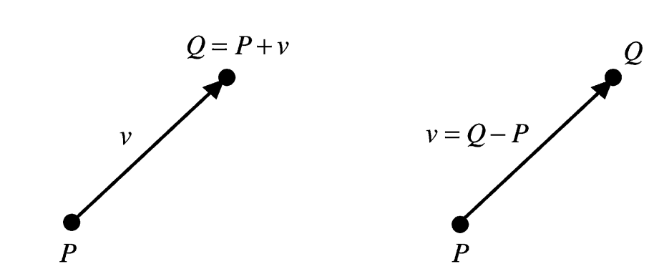
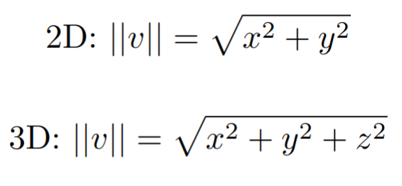
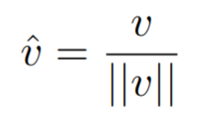
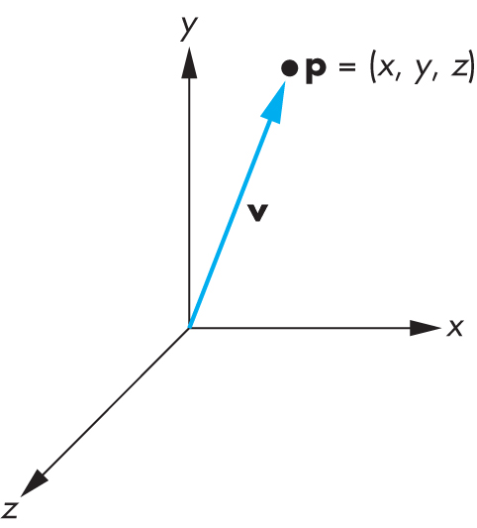
Points and vectors
Subtracting or adding point with vector results in new point
Distance between two points results in vector which contains length and direction.
Magnitude (length)
Direction obtained by normalization
Adding point to vector
Subtracting point from a point
https://www.researchgate.net/publication/220184055_On_the_algebraic_and_geometric_foundations_of_computer_graphics
http://www.c-jump.com/bcc/common/Talk3/Math/Vectors/W01_0090_dot_product.htm

Slide 10

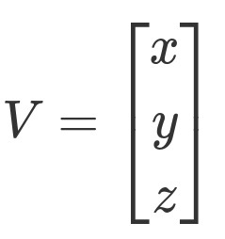
Row major and column major - notation
Points and vectors can be written as:
  [1x3] matrix → row major order (Direct X, Maya)
  [3x1] matrix → column major order (OpenGL, PBRT, Blender)

Slide 11
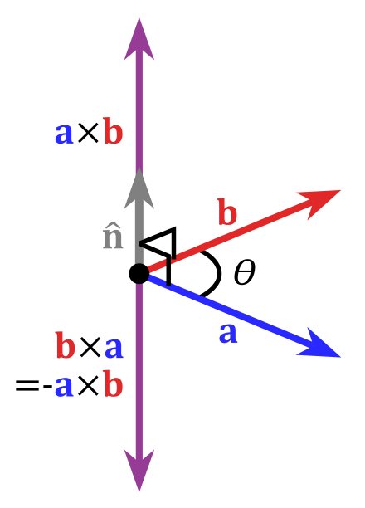
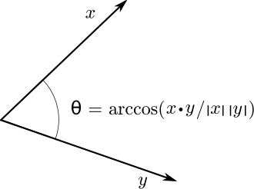
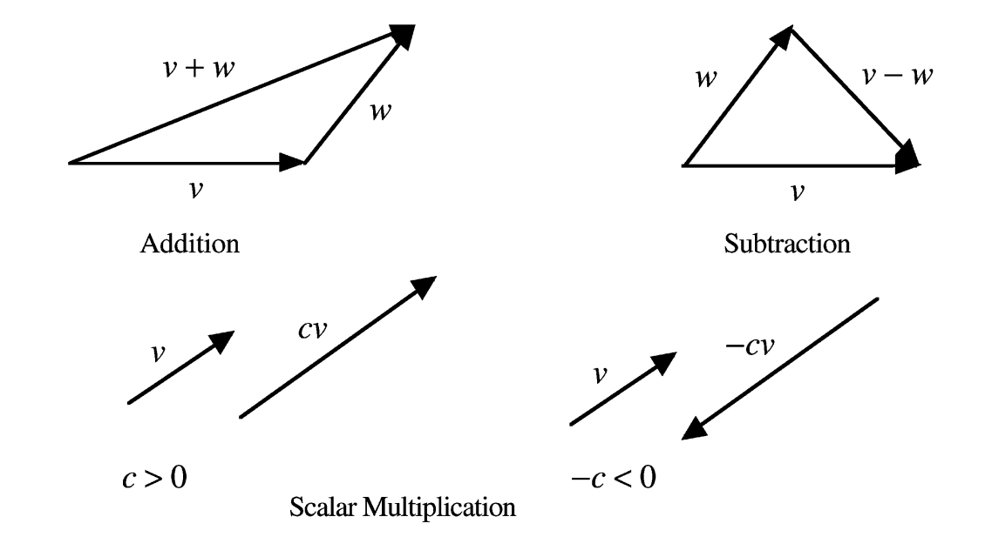
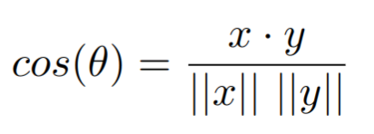
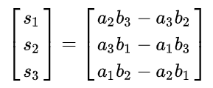
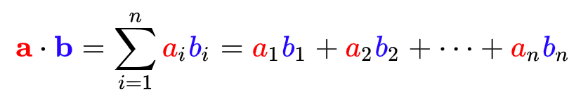
Common vector operations
Addition and subtraction
Addition, subtraction, multiplication with scalar, etc.
Dot (dotProduct(a,b)) and cross product (crossProduct(a,b)) operators
Normalization → length of vector = 1 (unit vector)
Dot product
https://en.wikipedia.org/wiki/Dot_product
Cross product
https://en.wikipedia.org/wiki/Cross_product

Slide 12
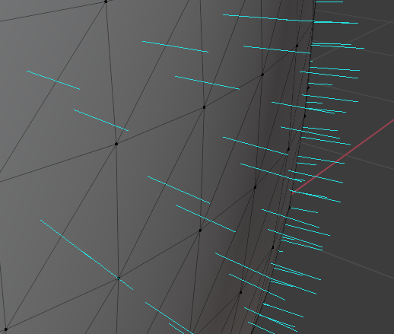
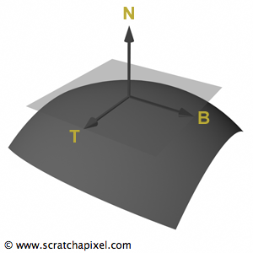
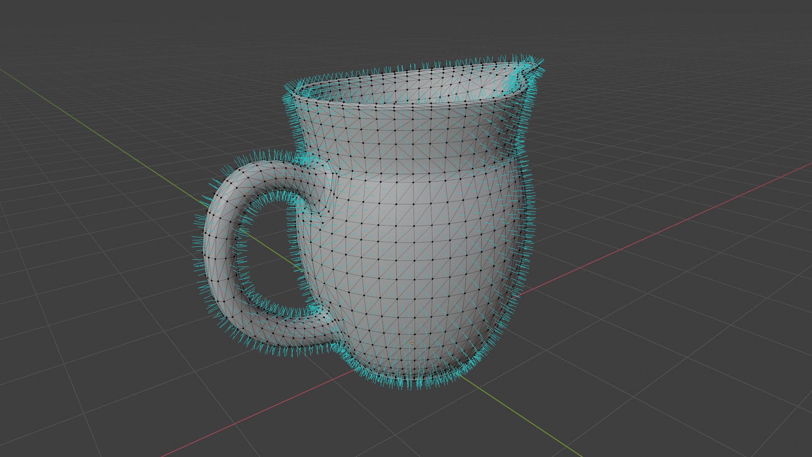
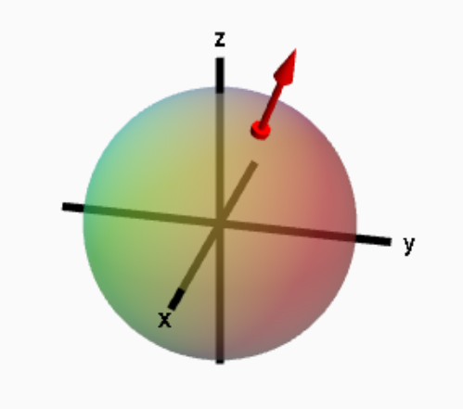
Normals
Normal (x,y,z)describes orientation of surface of a geometric object at a point
  Perpendicular to surface at a point
  Similar to vectors but they are defined in relationship to a particular surface: special care needed when applying transformations
It can be defined as cross product of any two non-parallel tangent vectors at that point.
https://www.scratchapixel.com/lessons/mathematics-physics-for-computer-graphics/geometry/points-vectors-and-normals.html
https://mathinsight.org/parametrized_surface_orient

Slide 13
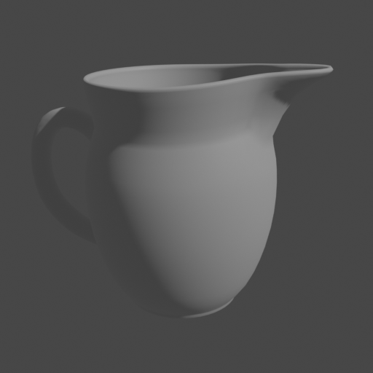

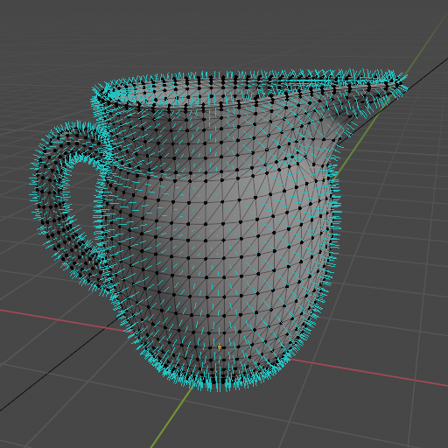
Normals
Crucial information for rendering and modeling
  Example: brightness of object – (clamped*) dot product of surface normal and light direction
* Convention is to define light and view vectors facing away from surface. If dot product is negative, clamping operation sets result to 0

Slide 14
Rays
Line specified by its origin (point) and direction (vector)
Often constructed by camera scene element
Ray is parametrically expressed as a function of scalar value t:
  r(t) = o + t * d, 0 < t < inf
Ray differential: camera rays offset by one sample in x and y direction from main ray on film plane
  Used for antialiasing of textures

Slide 15
Bounding boxes
Acceleration of rendering often relies on subdividing the image or 3D scene into smaller elements and computing those either in parallel or ignoring if not needed.
Examples of space subdivision:
  Axis aligned boxes
  Oriented bounding boxes
  Bounding volume hierarchy

Slide 16
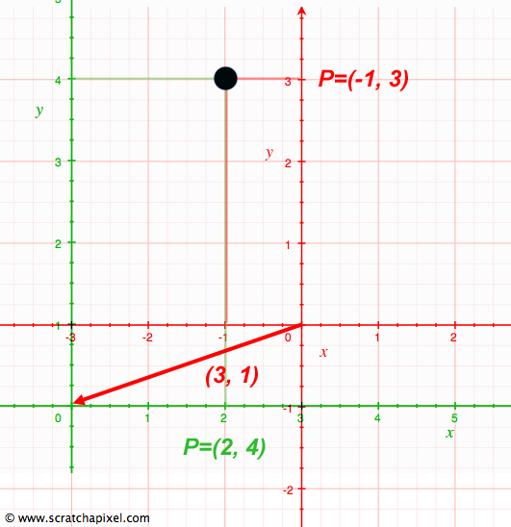
Coordinate system
Coordinate system is defined with origin (point) and basis (three unit vectors).
  But points and vectors depend on coordinate system!?
Infinite number of coordinate systems can be defined
  Referent coordinate system must be defined!
Point or vector in 3D space depend on its relationship to the frame – point can have same absolute position in space but its coordinates depend on frame.

Slide 17
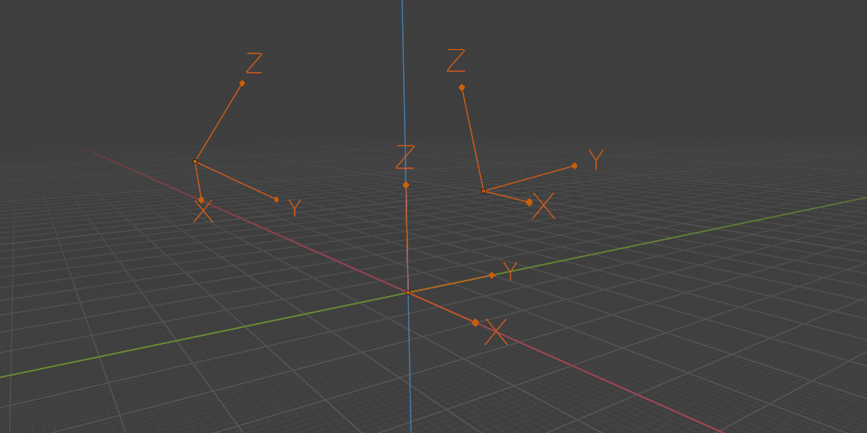
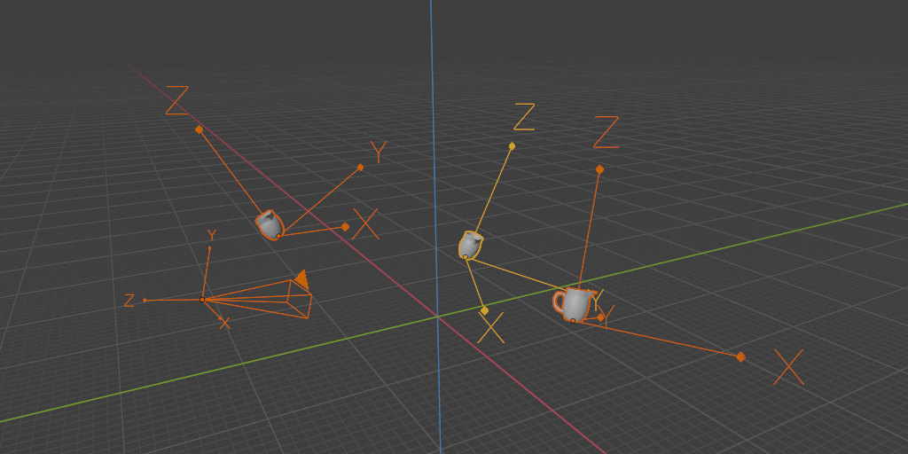
World coordinate system
World coordinate system – a standard frame (origin and basis)
All other – frames, local coordinate systems, are defined with respect to world coordinate system

Slide 18
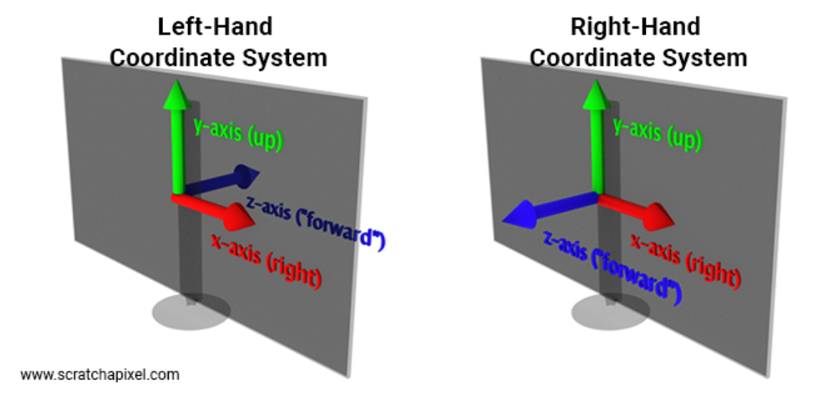
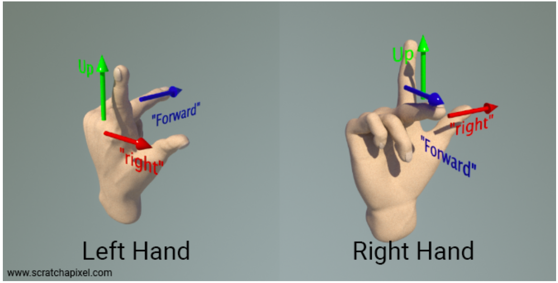
Coordinate system handedness - notation
Axis of X, Y and Z vectors defining coordinate system can face in one of two directions:
  Left-handed coordinate system
  Right-handed coordinate system
https://www.scratchapixel.com/lessons/mathematics-physics-for-computer-graphics/geometry/coordinate-systems.html

Slide 19
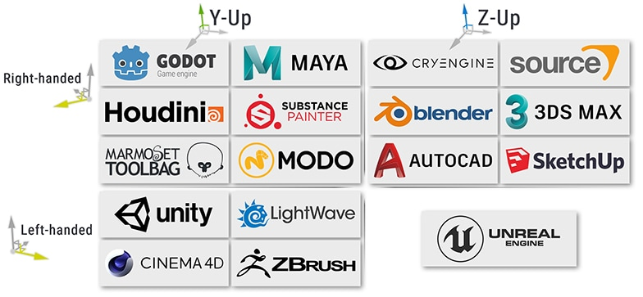
Coordinate system handedness and naming - notation
Handedness of coordinate system: orientation of left/right, up and forward vectors
Labeling axis (e.g., X, Y or Z) is matter of convention:
  Industry standard: right-handed coordinate system: x – right, y – up and z – outward
Exporting from one application to another requires special care of coordinate systems!
https://www.techarthub.com/a-guide-to-unitys-coordinate-system-with-practical-examples/

Slide 20
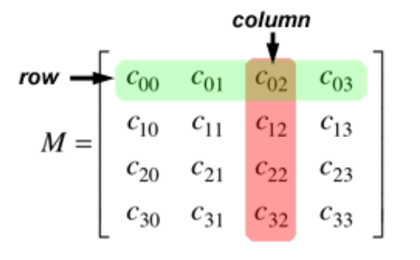
Matrices
Points and vectors are moved in space using linear transformations – multiplication with matrix
  Transformations: scaling, rotation and translation
  Multiplying point or vector with matrix returns transformed point or vector
Matrix (M): 2D array of numbers: m x n – number of rows (m) and columns (n)
  M_{ij} – matrix element at (i,j) position
For computer graphics square matrices 3x3 and 4x4 are most important since all transformations can be described with them

Slide 21
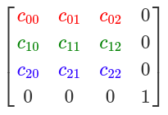
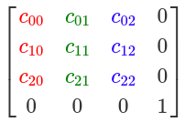
Row major and column major - notation
Matrices can be written as:
  Row major order (Direct X, Maya, PBRT)
  Column major order (OpenGL)

Slide 22
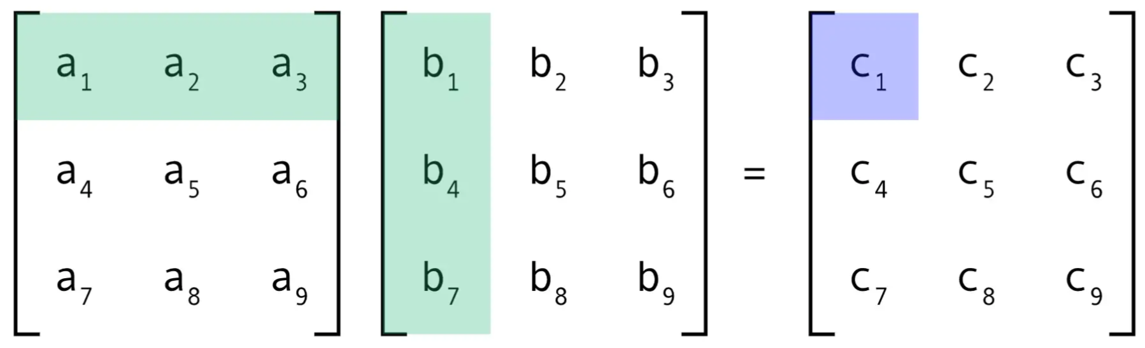
Matrix operations
Matrix-matrix multiplication gives matrix
  Useful for representing multiple transforms with one matrix
  Not commutative: order of multiplications, thus transforms is important!

Slide 23
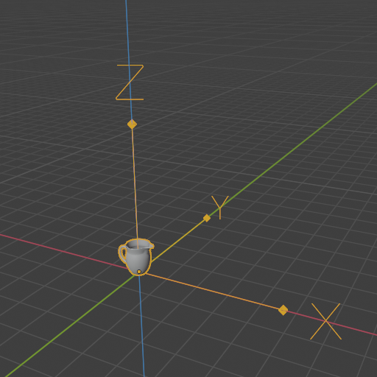
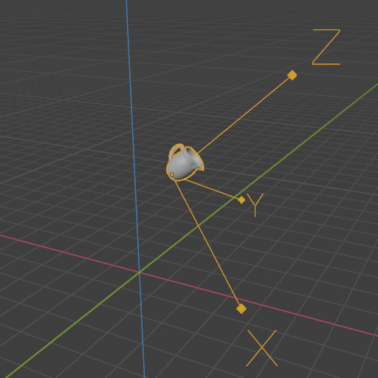
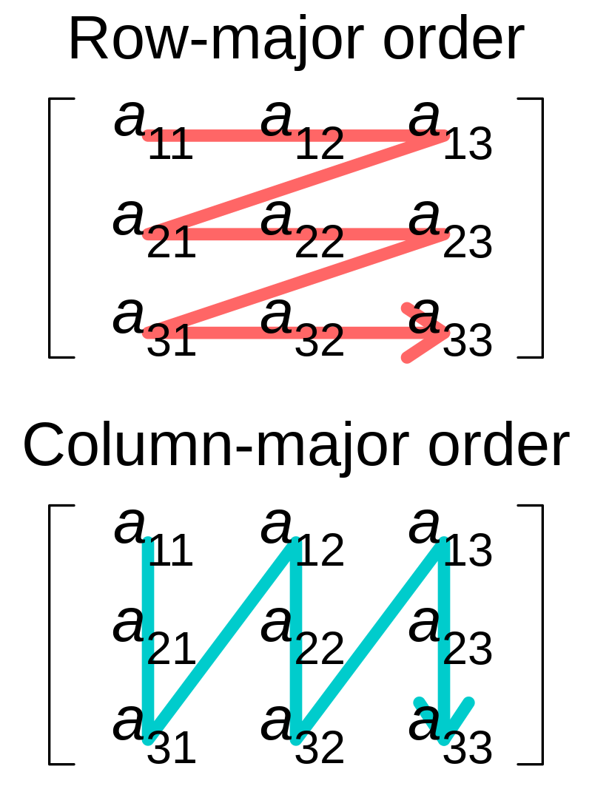

Matrix operations
M
Operators:
  Inverse: multiplying point A with matrix M given point B. Multiplying point B with inverse of matrix M gives point A.
    MM⁻¹ = I (identity matrix)
    Gauss-Jordan method*
  Transpose: switch row and column indices of a matrix. Row-mayor to column-mayor and vice versa
M⁻¹
Identity matrix (I)
*https://www.scratchapixel.com/lessons/mathematics-physics-for-computer-graphics/matrix-inverse/matrix-inverse.html

Slide 24
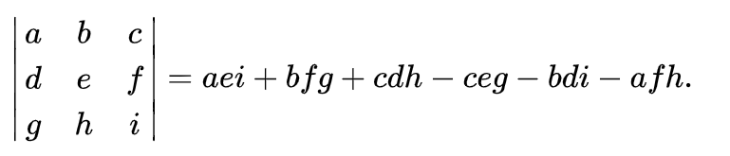
Matrix operations
Determinant:

Slide 25
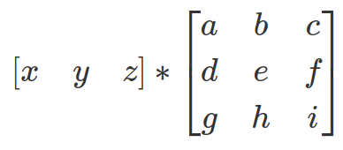

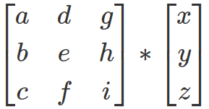


Matrix-point multiplication
Matrix-point/vector multiplication gives new point/vector → transformation
  Moving objects in space: multiply all points of object with matrix
  Row-major or column-major convention dictates matrix multiplication order
Row major order: point is on left side
Column major: point is on right side
Row-major points and vectors are written as [1x3] or [1x4] matrices and then multiplied with matrix which is [3x3] or [4x3]
https://www.scratchapixel.com/lessons/mathematics-physics-for-computer-graphics/geometry/row-major-vs-column-major-vector.html

Slide 26
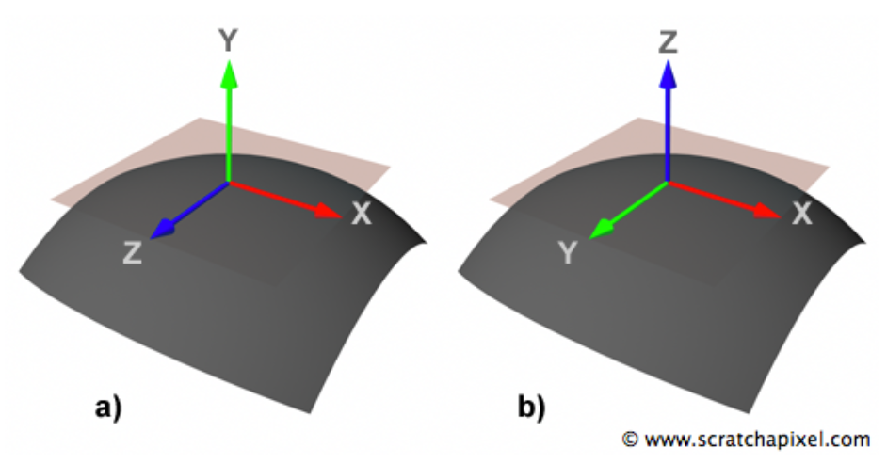
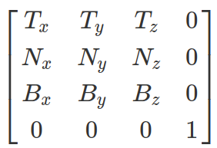
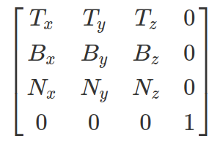
Matrix and local coordinate system
Often, local coordinate system using normal is constructed
  Normal is one axis of local coordinate system
  Tangent and bi-tangent are other to axes
  Example: Normal corresponds to up vector, tangent to right vector and bi-tangent to forward vector
Up is Y
Up is Z
Row-major notation
Row-major notation
* local coordinate system can be also constructed using single vector using cross product: https://graphics.pixar.com/library/OrthonormalB/paper.pdf

Slide 27
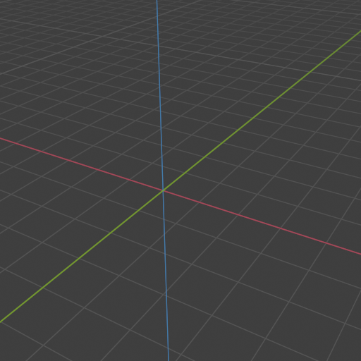
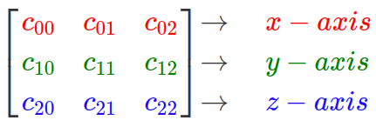
Matrix and coordinate system
Matrix can represent basis of a coordinate system → orientation matrix
  Each row of matrix represents an axis of coordinate system – orthogonal vectors → orthogonal matrix
  Inverse of orthogonal matrix is equal to its transpose
Row-major notation

Slide 28
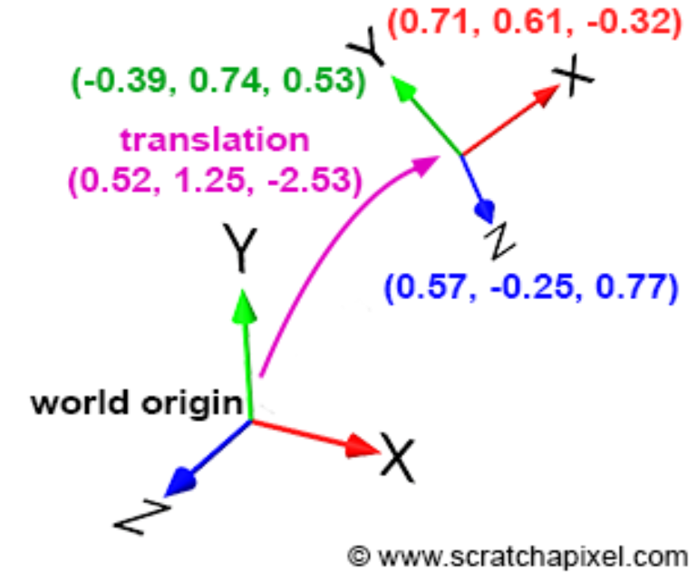
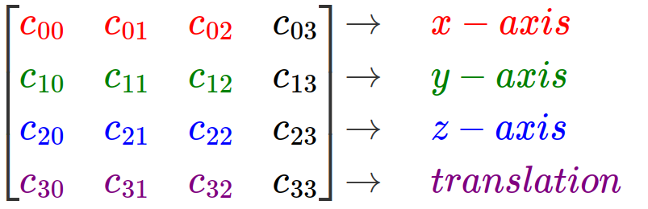
Transform, matrix and coordinate system
Transformation: take points, vectors and normals defined with respect to one coordinate frame and map their coordinate values to another frame.
Transformation of point from one coordinate system to another is done by matching their origins and basis.
Transformation from one to other coordinate system is performed with transformation matrix [4x4]
  By characterizing how the frame is transformed, we know how any point or vector specified in terms of that frame is transformed
  Points and vectors are expressed in terms of current coordinate system frame. Applying transformation matrix to points and vectors is equivalent to applying transformation matrix to current coordinate system frame
Row-major notation
Update 1.2.2023.
Adding row-major notation note
0
0
0
1
https://www.scratchapixel.com/lessons/3d-basic-rendering/computing-pixel-coordinates-of-3d-point/mathematics-computing-2d-coordinates-of-3d-points.html
https://www.pbr-book.org/3ed-2018/Geometry_and_Transformations/Transformations

Slide 29
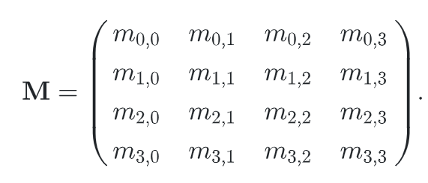
Transform, matrix and coordinate system
Transformation: take points, vectors and normals defined with respect to one coordinate frame and map their coordinate values to another frame.
Transformation from one to other coordinate system is performed with transformation matrix [4x4]
  Orientation (rotation), size (scale), and position (translation) of coordinate system represents the transformation that will be applied to the points when they are multiplied by this matrix
  Matrix M transforms points from one coordinate system to another
    Basis vector and origin of current coordinate system are transformed by matrix M
    Points and vectors are expressed in terms of current coordinate system frame. Applying transformation matrix to points and vectors is equivalent to applying transformation matrix to current coordinate system frame
TODO: image from “Virtualna okruzenja: interaktivna 3D grafika”
  Transformation matrix is 4x4 and it contains translation and rotation!
TODO

Slide 30
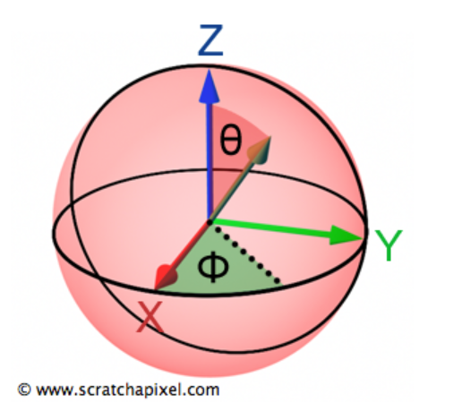
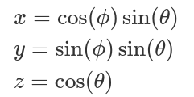
Spherical coordinate system
Spherical coordinates simplify computation needed for rendering
  Especially shading where calculations are performed on vectors
Representing vectors in spherical coordinate system
  Two angles: altitude (polar) angle ϴ [0, PI] and azimuth angle Φ in [0, 2PI]
Vector representation in spherical coordinate system using polar and azimuth angle.
Converting from spherical to Cartesian coordinate system

Slide 31
Transforms

Slide 32
Transforms
Basic tool for manipulating 3D scene elements; points and vectors:
  Position, orientate, reshape and animate objects, lights and cameras (3D scene modeling)
  Essential for rendering computations
Linear transforms: scaling, rotation
Affine transforms: translation, rotation, scaling, reflection, shearing
  Preserve parallelism of lines but not necessary lengths and angles
  Described with 4x4 matrix
  Require homogeneous point notation
Update 1.2.2023.
Adding 4x4 matrix note

Slide 33

Transforms in modeling
Essential modeling tool: https://www.youtube.com/watch?v=1qVbGr_ie30&t=1s&ab_channel=JoshGambrell

Slide 34

Transforms in animation
Crucial tool for animation: https://www.youtube.com/watch?v=CBJp82tlR3M

Slide 35


Transforms in rendering
All calculations must be preformed in the same coordinate system
  Example: light-surface interaction calculation (shading)
  Example: moving objects in camera space for easier calculations
Another example is projecting objects onto plane which is used for rasterization-based rendering.
https://www.scratchapixel.com/lessons/3d-basic-rendering/global-illumination-path-tracing/global-illumination-path-tracing-practical-implementation.html

Slide 36


Transforms in professional software
Godot: https://docs.godotengine.org/en/stable/classes/class_transform.html
Unity: https://docs.unity3d.com/ScriptReference/Transform.html
Unreal: https://docs.unrealengine.com/4.27/en-US/BlueprintAPI/Math/Transform/
Blender: https://docs.blender.org/manual/en/latest/scene_layout/object/properties/transforms.html
GLM: https://github.com/g-truc/glm

Slide 37
Basic transformations
Modeling elements, 3D scene and animations relies on transformations
  Translation
  Rotation
  Scale, reflection
  Shear

Slide 38

Identity transform
Identity transformation is default transformation
Represented by identity matrix (I)
  A * I = A, A – vector or point

Slide 39




Translation transform
Changes point from one location to another
  Translation transform translates coordinates of point P(x,y,z) by (Δx, Δy, Δz)
Represented by translation matrix T
To translate whole object, all points of object are multiplied with transformation matrix
T

Slide 40


Homogeneous coordinate
Point (x,y,z)can be written as [1x3] matrix
  Often, transformation matrices are [4x4]
To multiply point with transformation matrices, write points as homogeneous point/coordinate: (x,y,z,w), [1x4].
  If the resulting w coordinate is not 1, then x,y,z must be divided by w to obtain usable Cartesian point.
Column-major notation: matrix-point multiplication
https://www.pbr-book.org/3ed-2018/Geometry_and_Transformations/Applying_Transformations

Slide 41


Transforming points and vectors
Transformation matrices are [4x4] matrices.
Point (x,y,z)can be written as [1x3] matrix
Homogeneous notation is needed:
  Points: P(x,y,z,1)
  Vectors: V(x,y,z,0)
If the resulting w coordinate is not 1 or 0, then x,y,z must be divided by w to obtain usable Cartesian point.
Translation matrix on point.
Translation matrix on vector – no change!

Slide 42
Translation transform
Inverse: T⁻¹(t) = T(-t)
Rigid-body transform: preserves distances between points and headedness
T
T⁻¹

Slide 43


Translation transform and instancing
Different transformations can be assigned to same object in order to place copies of object in the scene - instancing

Slide 44





Scale transform
Enlarging or diminishing objects
  Multiply points P or vectors V components (x,y,z) by scale (s_{x}, s_{y}, s_{z})
  Represented by scaling matrix S
If all scaling factors are same: uniform (isotropic) scaling, else non-uniform (anisotropic).
To scale whole object, all points of object are multiplied with scaling matrix
Z
Z
Z
Z
Y
Y
Y
Y
X
X
X
X
Original
Uniform
Anisotropic (z)
Anisotropic (x,y)

Slide 45




Scale transform
X,Y,Z
Inverse
S(-x,1,1)
S
S(1,1,-z)
S⁻¹
Negative value of scaling factor gives reflection (mirror) matrix
Triangle with clockwise orientation will have counter-clockwise orientation after reflection
Original
Uniform

Slide 46

Scale transform and instancing
Application of different scale and translation matrices for instancing

Slide 47







Rotation transformation
X,Y,Z
Rotates objects around arbitrary axis from origin to any direction for a given angle
  Most common rotations: rotation around X, Y and Z coordinate axes by angle θ
  Represented by rotation matrices R_{x}(θ), R_{y}(θ), R_{z}(θ)
  Clockwise vs counter-clockwise rotation by angle θ
To rotate whole object, all points of object are multiplied with rotation matrix
left-handed coordinate system, the matrix for clockwise rotation

Slide 48


Rotation transformation
Rigid-body transform: preserve distance between points and headedness
Inverse
Rotation around arbitrary axis
  Rotation around arbitrary axis (x,y,z) is represented by rotation matrix R_{x,y,z}(θ) – a combination of R_{x}(θ), R_{y}(θ), R_{z}(θ)
  Matrix consist of unit vectors → orthogonal matrix
R_{x,y,z}(θ)
R⁻¹_{x,y,z}(θ)

Slide 49



Combining rotation matrices
R_{z}(80) * R_{y}(60)
R_{y}(60) * R_{z}(80)
X,Y,Z

Slide 50

Rotate transform and instancing
Application of different scale, translation and rotation matrices for instancing

Slide 51




Rotation and translation
If object is not in world origin, rotation origin can be local or world coordinate system
  Pivot point
For orienting object which is not in world origin
  object is first translated so that pivot point in the center and then rotation is performed after which object is again transformed so that pivot point is in the same position as before.
X,Y,Z
R_{z}(60)
R_{z}(60)

Slide 52
Rotation transformation
Orientation matrix
  Rotation matrix associated with camera view or object → local coordinate system
  Defines its orientation in space: directions for up and forward are needed to define this matrix

Slide 53

Shear transform
6 basic shearing matrices for 3D case: xy, xz, yx, yz, zx, zy
http://15462.courses.cs.cmu.edu/fall2019/lecture/transformations/slide_028

Slide 54







Concatenation of transforms
X,Y,Z
Matrix multiplication is non-commutative: order of multiplication matters
Example: objects in 3D scene must be scaled, rotated and translated
  Matrix is concatenated into one matrix which is used for multiplication of points P
  Such matrix must be composited as :
    C = TRS, C * P = TRS * P
    Scaling is applied first, then rotation and finally translation
Concatenation of only translation and rotation matrices results in rigid-body transform.
1. Translate
1. Scale
1. Translate
2. Rotate
2. Rotate
Original position
3. Scale
3. Translate

Slide 55

Special care: transformations of normals
Normal can not be transformed with the same matrix used for transforming points and vectors.
  It has to be multiplied with transpose of the inverse of that matrix: P’ = P * (M⁻¹)^{T}
Original
Wrong
Correct
https://paroj.github.io/gltut/Illumination/Tut09%20Normal%20Transformation.html

Slide 56
Special transforms
Euler transform
Rotation about an arbitrary axis
Quaternions
Othographic projection
Perspective projection
Look-at matrix transform

Slide 57


Euler transform
Represented by Euler matrix, a concatenation of R_{x}(θ), R_{y}(θ), R_{z}(θ) – rotation matrices around X, Y and Z axes
Establish default view, e.g., facing positive X with Z up.
Angles of rotation: yaw, pitch, roll
Problems:
  Gimbal lock: e.g., when pitch and roll become aligned, changes to roll and yaw result in same rotation
  Interpolation between two Euler angle sets is not as simple as interpolating each angle
Good: angles can be easily extracted from Euler matrix → matrix decomposition
https://www.researchgate.net/publication/335854843_Special_Orthogonal_Group_SO3_Euler_Angles_Angle-axis_Rodriguez_Vector_and_Unit-Quaternion_Overview_Mapping_and_Challenges
Gimbal lock: one degree of freedom (rotation angle) is lost.
https://en.wikipedia.org/wiki/Gimbal_lock

Slide 58

Rotation about arbitrary axis
Rotate point P by some angle θ around arbitrary rotation axis r defined with point P₁ and P₂:
Translate space so that rotation axis r passes through the origin
Rotate space about X axis so that rotation axis r lies in the XZ plane
Rotate space about Y axis so that rotation axis r lies along Z axis
Perform rotation around Z axis for angle θ
Return to original space using inverse of steps (3), (2), and (1)
https://www.eng.uc.edu/~beaucag/Classes/Properties/OptionalProjects/CoordinateTransformationCode/Rotate%20about%20an%20arbitrary%20axis%20(3%20dimensions).html
https://en.ppt-online.org/31501
https://ksuweb.kennesaw.edu/~plaval/math4490/rotgen.pdf

Slide 59

Quaternions
Practical use: describing rotation and orientation
Orientation is represented by a rotation around particular axis
  Quaternion: q = s + xi + yj + zk
    S – scalar
    i, j, z – three spatial axes (complex numbers)
    (x,y,z) represent axis
Unit quaternion can represents any 3D rotation
  Rotating point p using quaternion: q * p * q⁻¹
  Inverse of unit quaternion: q⁻¹ = s - xi - yj – zk
  Often, quaternion is transformed into matrix and then multiplied with point
Interpolation between two quarternions is stable and constant
  GLM: https://glm.g-truc.net/0.9.0/api/a00135.html
  Blender: https://docs.blender.org/api/current/mathutils.html#mathutils.Quaternion
  Unity: https://docs.unity3d.com/ScriptReference/Quaternion.html

Slide 60




Quaternions
Intuitive representation:
  q = cos(θ/2) + sin(θ/2) * (xi + yj + zk)
  Rotation around axis defined with (x,y,z) for angle θ
https://eater.net/quaternions/video/doublecover
https://danceswithcode.net/engineeringnotes/quaternions/quaternions.html
https://personal.utdallas.edu/~sxb027100/dock/quaternion.html
https://danceswithcode.net/engineeringnotes/quaternions/quaternions.html
https://paroj.github.io/gltut/Positioning/Tut08%20Quaternions.html

Slide 61



Orthographic projection
Projects points P(x,y,z) on plane z = 0
  Used for projecting one object onto another
  Used for simulating ortographic camera for rasteriation-based rendering.
    Additional parameters will be introduced: viewing frustum, focal length

Slide 62




Perspective projection
Projects points P(x,y,z) on plane z = 1
  Used for simulating perspective camera for rasteriation-based rendering.
    Additional parameters will be introduced: viewing frustum, focal length
  Perspective division: foreshortening effect – more distant objects are smaller
Homogeneous coordinate is equal to z
Cartesian coordinates are obtained by dividing with homogeneous coordinate - perspective division:
x/z and y/z

Slide 63



Look-at transform
Often used for transforming camera in 3D scene
Look-at methods gives look-at transform which defines transformation matrix
Row-major, right-handed coordinate system.
Forward = normalize(from – to)
Right = crossProduct(tmp, Forward), tmp = (0,1,0)
Up = crossProduct(Forward, Right)

Slide 64
Scene organization

Slide 65
Introduction
Elements of a 3D scene: lights, cameras and objects coupled with transformations
Production scenes are often complex, containing large amount of scene elements
To simplify scene organization, editing, rendering, storage and transfer scene graphs are used

Slide 66



Slide 67

Complex objects are represented in hierarchical fashion.

Slide 68

3D scene as scene-graph
3D scene representation has inherent tree-like structure
3D scene can be represented with scene-graph
  Defines structure and hierarchy of 3D scene
  Hierarchical data structure for organizing and structuring storing whole 3D scene, with all its elements
https://learnopengl.com/Guest-Articles/2021/Scene/Scene-Graph

Slide 69

Scene graph in Godot:https://github.com/godotengine/godot-demo-projects/tree/master/3d/rigidbody_character

Slide 70

Scene graph in Unreal:https://docs.unrealengine.com/4.27/en-US/AnimatingObjects/SkeletalMeshAnimation/Persona/VirtualBones/

Slide 71
Scene graph
Arrangement between user who builds 3D scene and renderer
User oriented data structure for modeling and organizing scene elements and their relationships in hierarchy
  Edited and created by user: artists and designers
Support for rendering
  Scene graph is traversed to render the scene

Slide 72
Scene graph
Scene graph:
  Root node – starting point for whole scene
    Data: type of coordinate system, scene units, etc.
  Internal nodes – organize scene into hierarchy.
    Often those are transformation information (where and how are objects positioned)
  Leaf nodes – contain elements of the scene: objects, camera, lights.
    As objects in the scene can repeat, these nodes can be duplicated

Slide 73
Leaf nodes
Contain elements of the scene:
  Object meshes
  Object materials
  Lights
  Cameras
  EXAMPLES
TODO

Slide 74
Internal nodes*
Often: transformation nodes defining positions of sub-trees: translations, rotations, scaling, etc.
Other types:
  Grouping – contain nodes without any other function
  Conditional – type of grouping node which enables activation only the particular children node
  Level of detail – contains children nodes where each has a copy of objects with varying level of detail and only one is active depending on camera distance
  Billboard – grouping node which orientates all children node towards camera
As materials and textures are often shared between different objects, they can be stored as internal node which is references by children nodes

Slide 75


Internal nodes: transformations
Internal nodes with transformation affects whole sub-tree

Slide 76
Scene graph and scene transfer
Different modeling, rendering and interaction software have different scene graph formats for description and storage
  Transfer requires standardized formats and importer/exporter functions
  Different formats exists which differ by scene elements support
Standardized scene description that can be shared between different rendering, modeling and interaction tools

Slide 77
Scene graph and scene transfer
Tendency towards standardized formats is required
Popular scene description formats:
  glTF: https://github.com/KhronosGroup/glTF
  USD: https://graphics.pixar.com/usd/release/index.html

Slide 78

Scene graph example: glTF
https://github.com/KhronosGroup/glTF-Tutorials/blob/master/gltfTutorial/gltfTutorial_002_BasicGltfStructure.md

Slide 79


Scene graph example: glTF

Slide 80

Example: scene graph
Scene graph can be stored in various formats:
  Example: appleseed XML https://github.com/appleseedhq/appleseed/wiki/Project-File-Format

Slide 81
Summary
Questions: https://github.com/lorentzo/IntroductionToComputerGraphics/tree/main/lectures/4_transforms

Slide 82
Literature
https://github.com/lorentzo/IntroductionToComputerGraphics

