Slide 1
Computer Graphics

Slide 2
Contents
Computer graphics: what and why
Many scenes, two rendering paradigms and one image
Course organization

Slide 3
Computer graphics: what and why

Slide 4
Motivation
“Inspired by nature, incorporate science and art with technology to create virtual environments that exist or never could have existed.”
“Computer graphics is science and art of communicating visually via computer display and its interaction devices”*
“A collaboration between art and technology”**
To visualize
To express
* Book: principles and practices
** Pixar

Slide 5

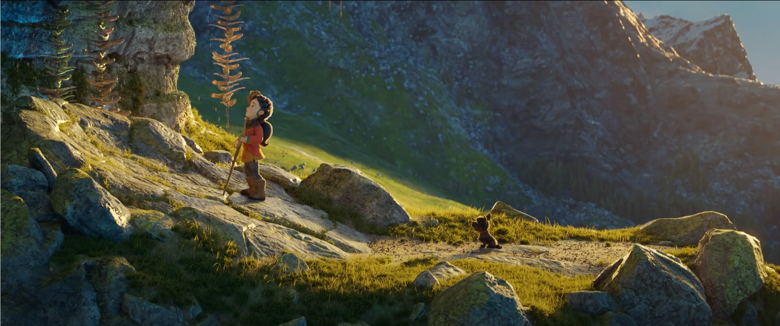

Computer graphics
“Generating images using computer”

Slide 6


Computer graphics
Generating images:
3D scene – what will be present in image
Rendering – how image is generated from 3D scene
Image display – how image is displayed

Slide 7

Graphics and computer games
https://www.rockstargames.com/reddeadredemption2/

Slide 8

Graphics and animated film
https://www.pixar.com/soul

Slide 9
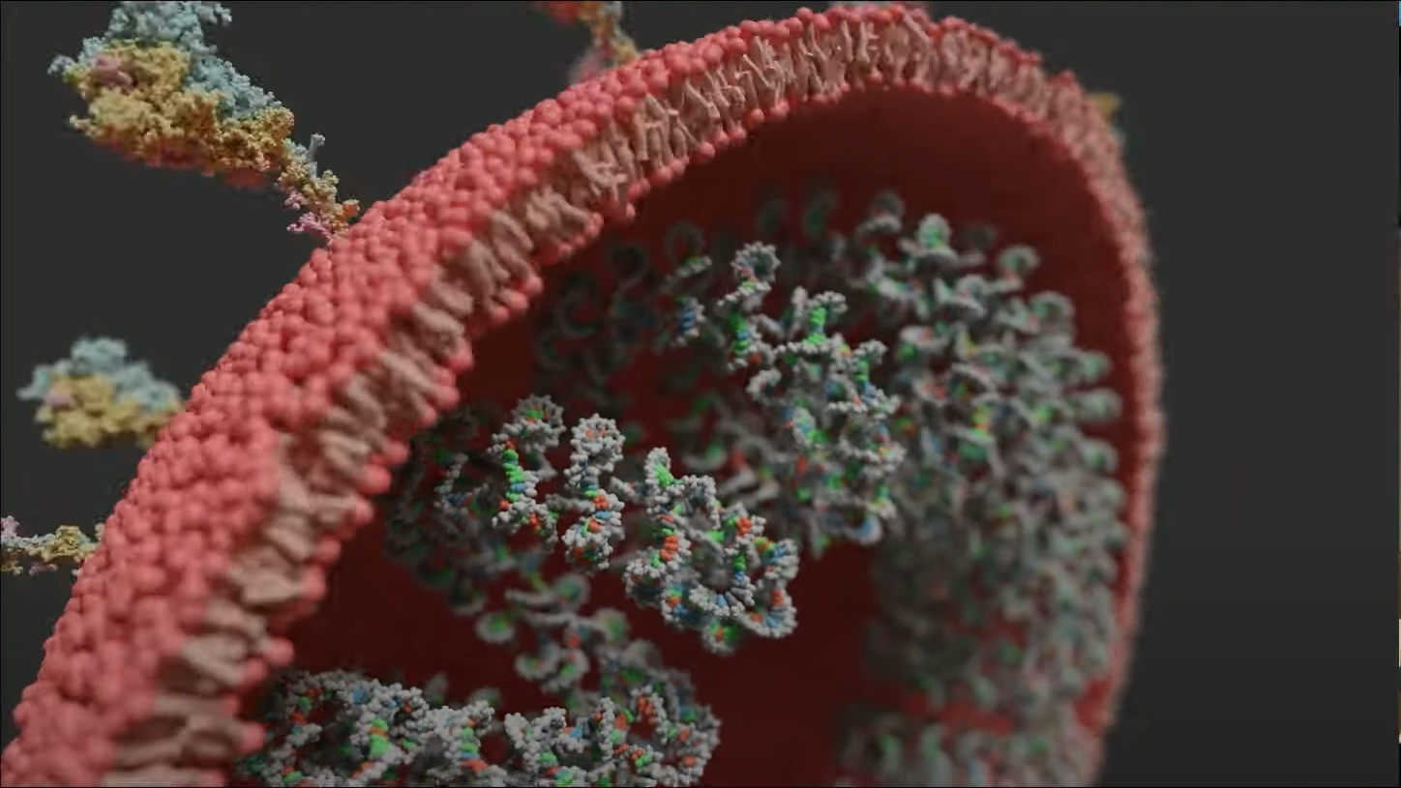
Graphics and scientific visualization
https://www.youtube.com/watch?v=adhTmwYwOiA&ab_channel=Blender

Slide 10
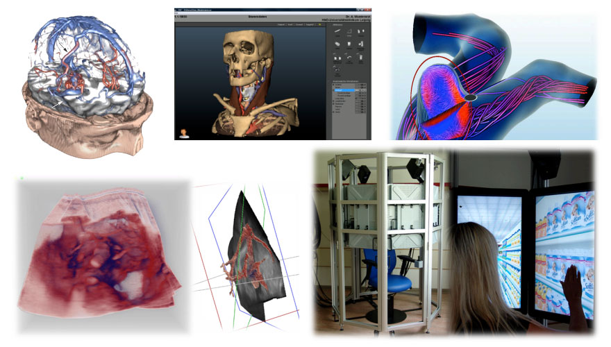
Graphics and medicine
https://www.siggraph.org/news/eurographics-celebrates-computer-graphics-in-medicine/

Slide 11
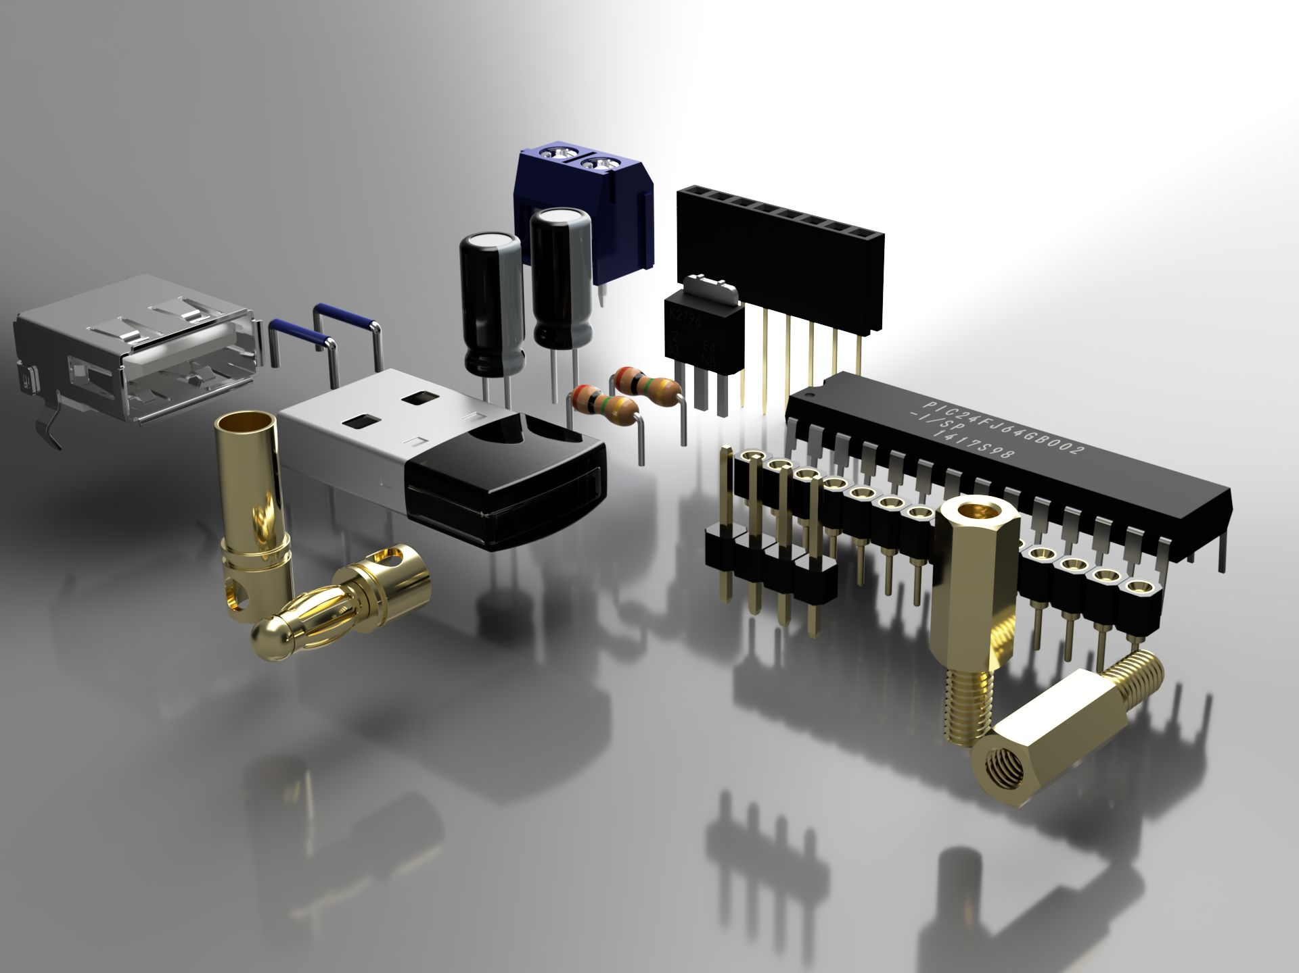
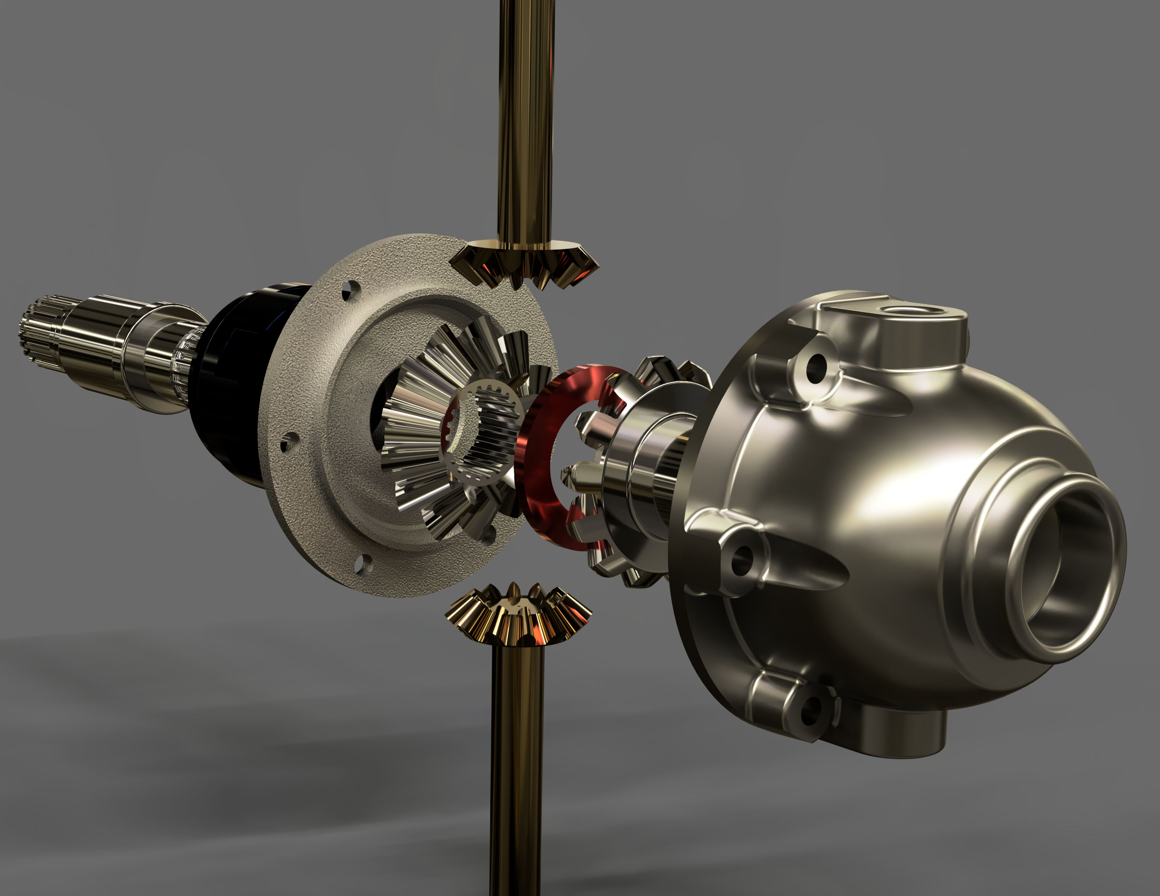
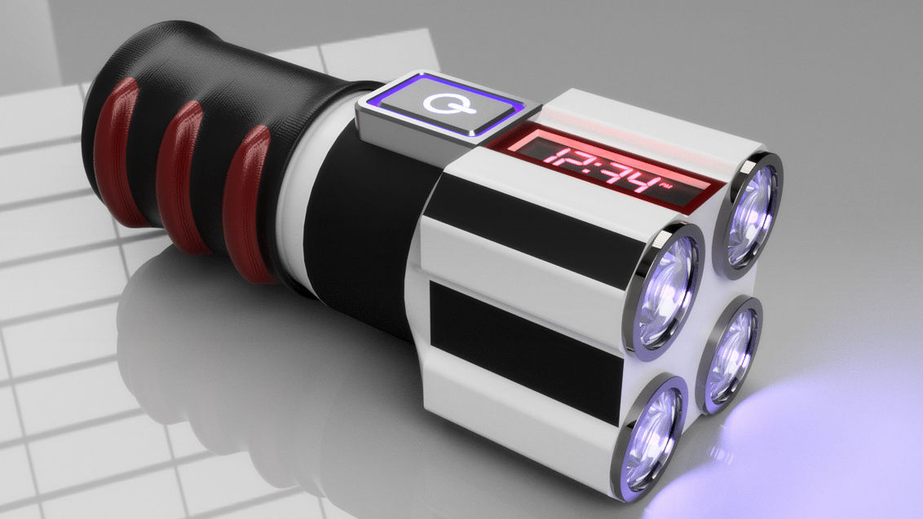
Graphics and CAD, manufacturing, engineering, product design
https://gallery.autodesk.com/projects/all#filters=%5B%5D&sort=popularity

Slide 12
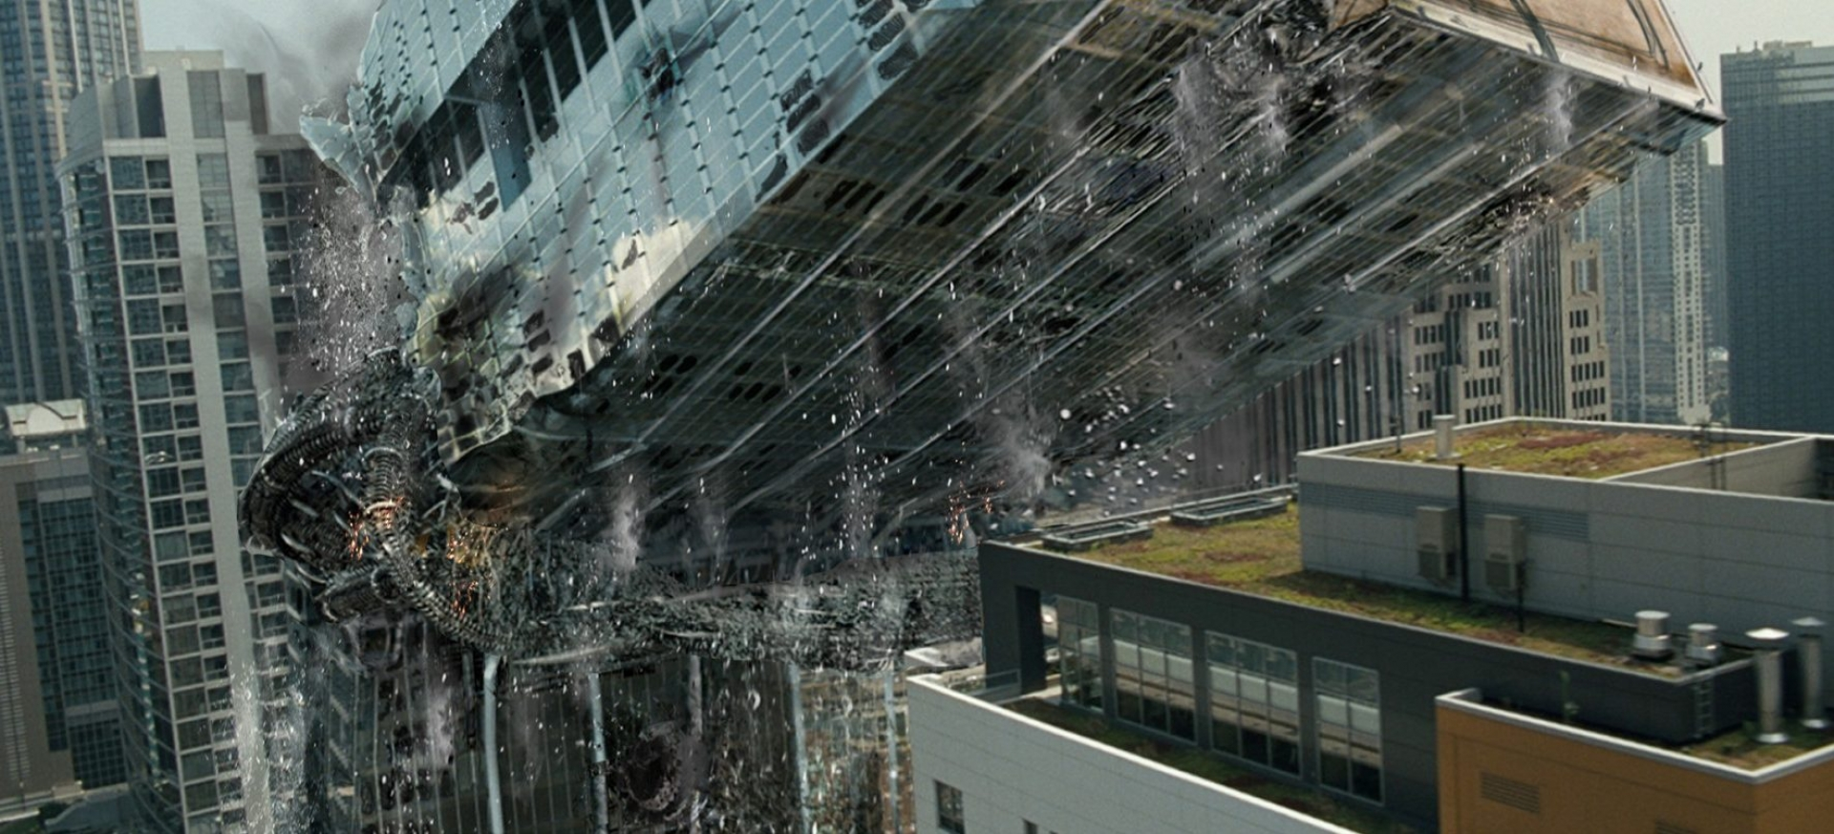
Graphics and VFX in film
https://www.ilm.com/art-department/vfx/

Slide 13
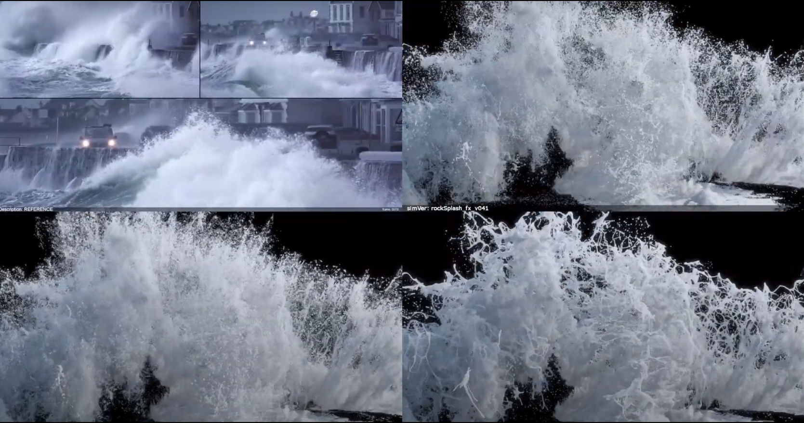
Graphics and simulation for VFX in film
https://www.youtube.com/watch?v=lS--1gRjfRk&ab_channel=Rebelway

Slide 14

Graphics and motion capture for VFX in film
https://www.fxguide.com/fxfeatured/weta-digitals-remarkable-face-pipeline-alita-battle-angel/

Slide 15
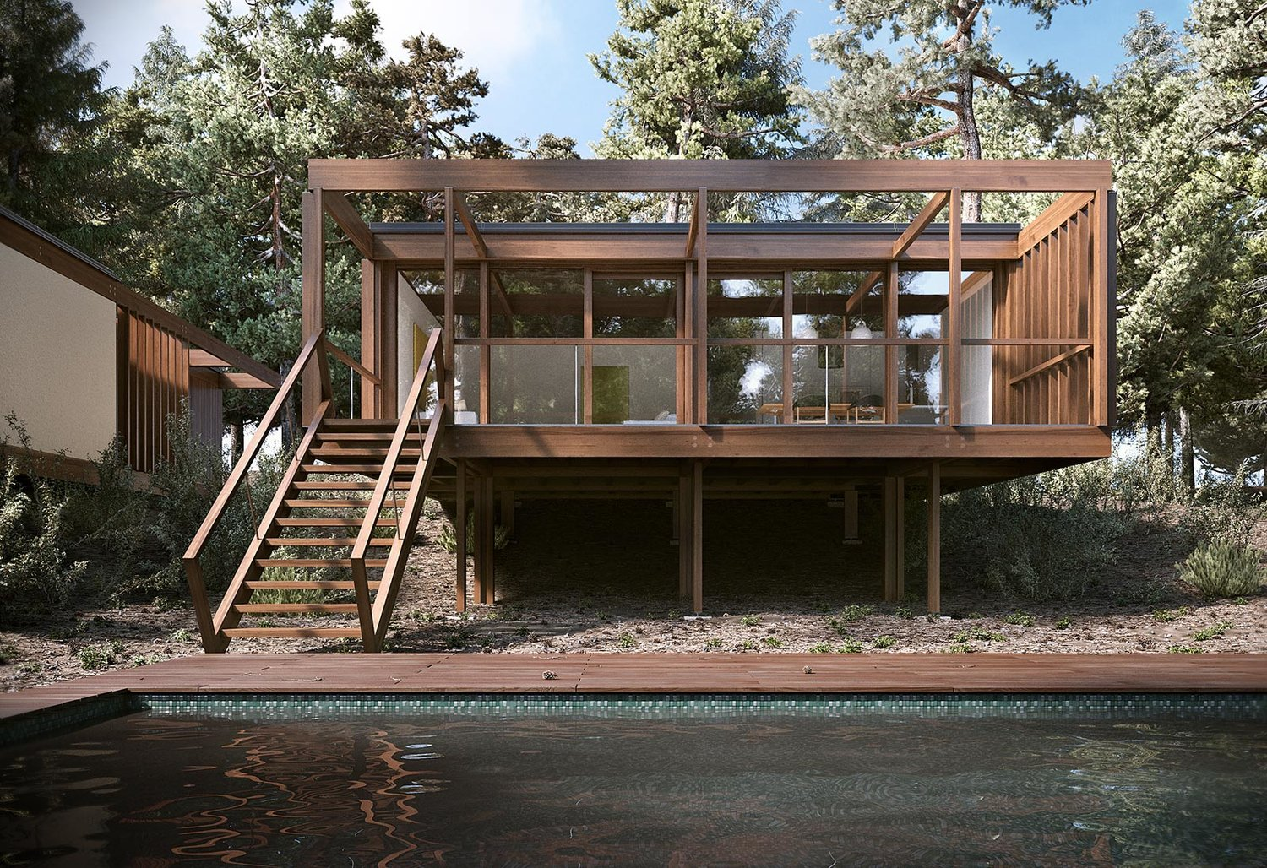
Graphics and arhitecture
https://www.blenderguru.com/articles/20-jaw-dropping-architectural-renders

Slide 16

Graphics and product design; product visualization
https://www.youtube.com/watch?v=-BscQpkhpJw&ab_channel=Houdini

Slide 17

Graphics and interior design; ergonomic design
https://www.blenderguru.com/articles/20-jaw-dropping-architectural-renders

Slide 18
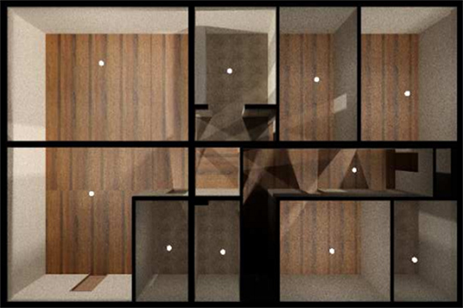
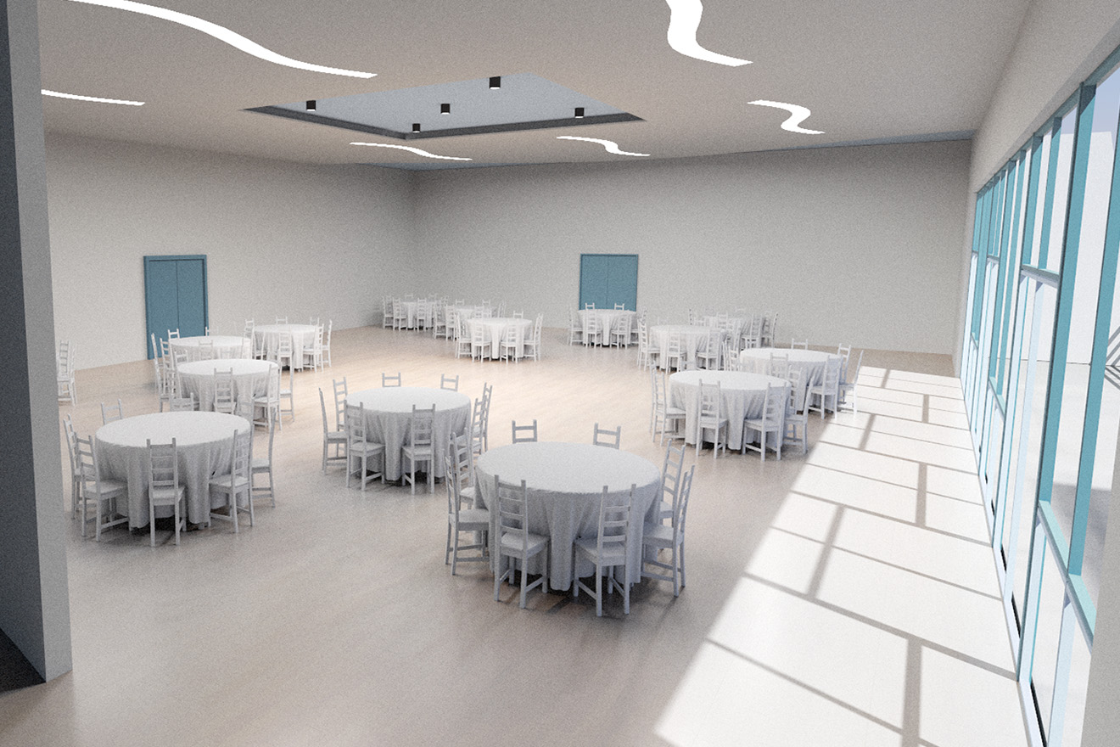
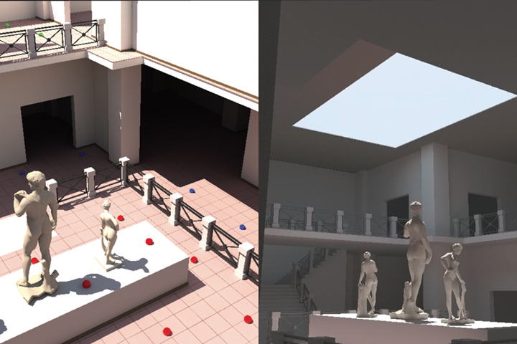
Graphics and illumination planning
http://graphics.cs.aueb.gr/graphics/research_lightingopt.html

Slide 19
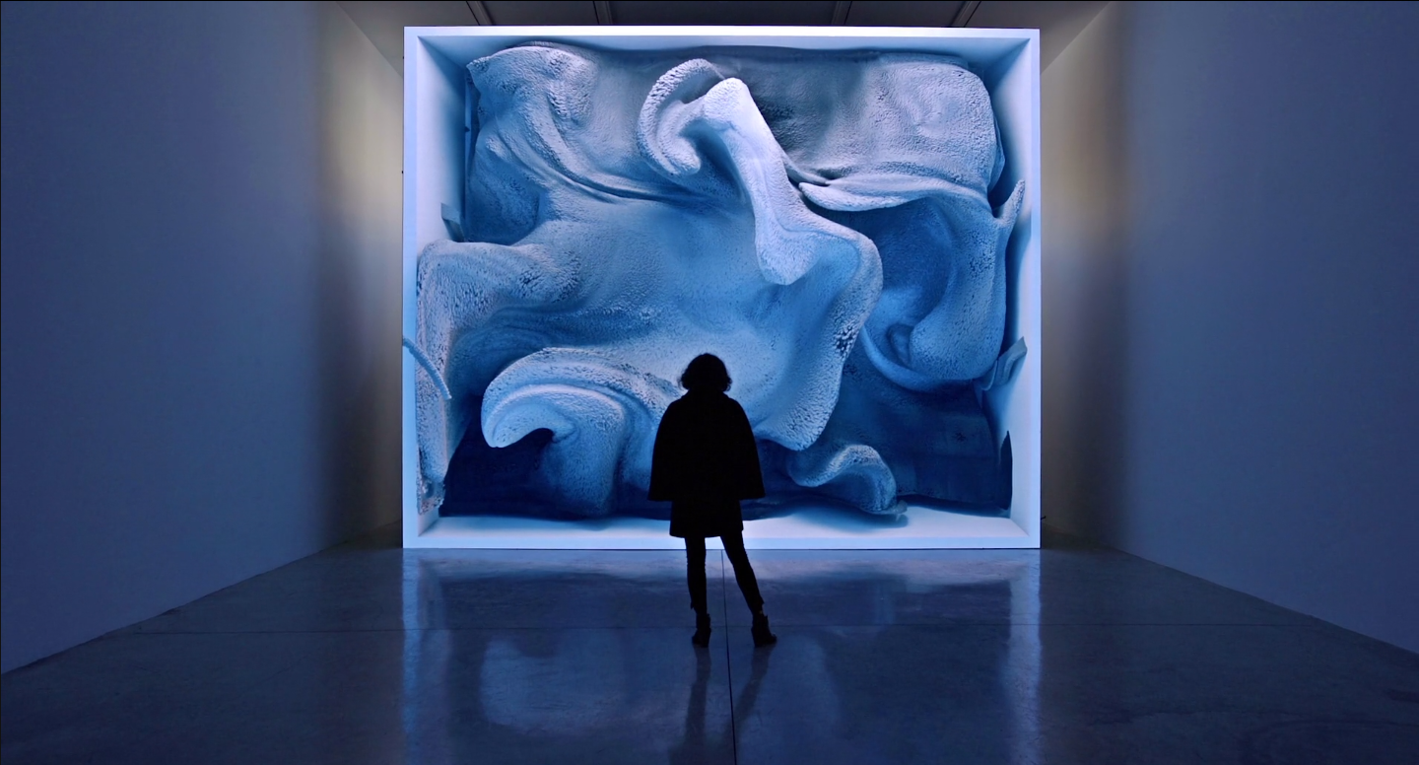
Graphics and new media art
https://refikanadol.com/

Slide 20
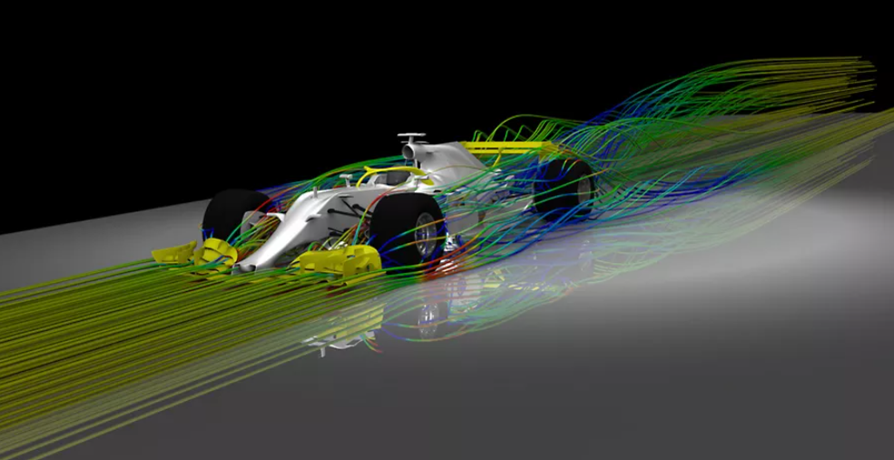
Graphics and predictive simulations
https://www.ansys.com/company-information/the-ansys-story

Slide 21
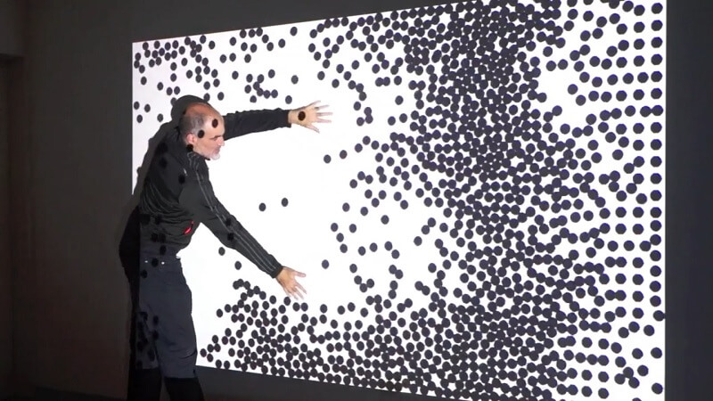
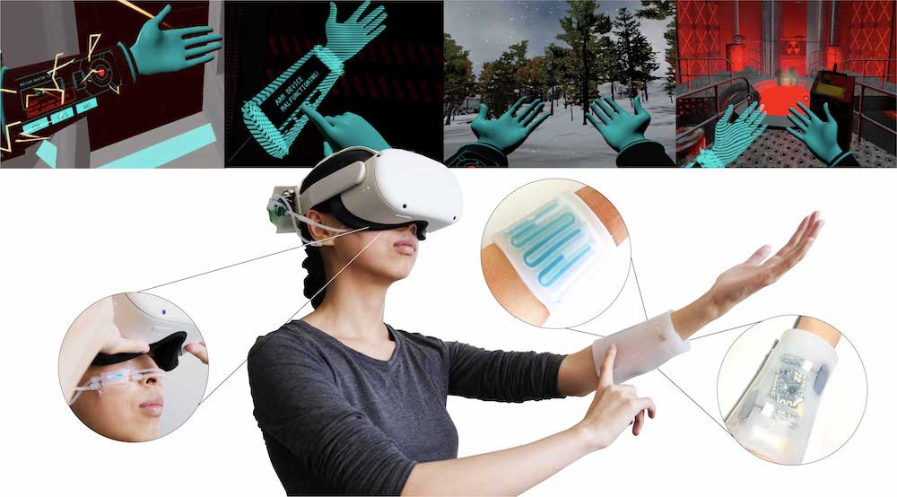
User interfaces
Graphics and user interfaces
https://parametrichouse.com/kinect/
http://plopes.org/

Slide 22
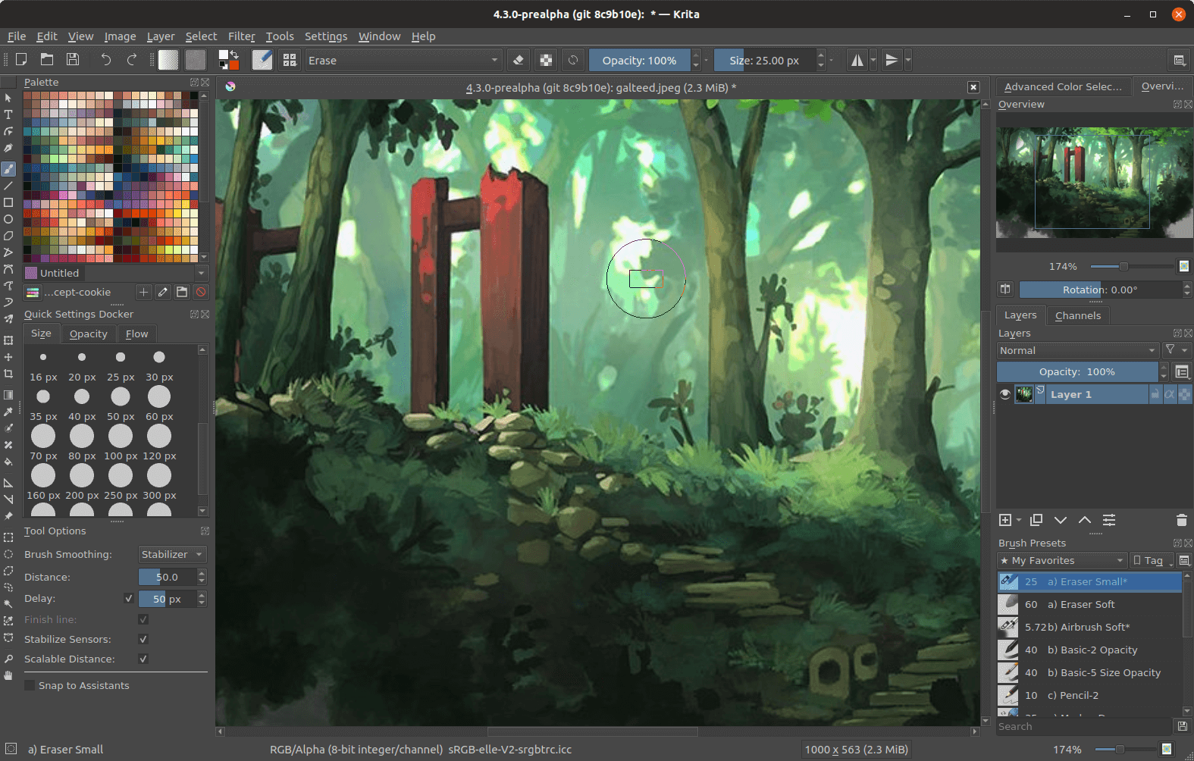
Image manipulation and digital drawing
https://krita.org/en/features/highlights/

Slide 23
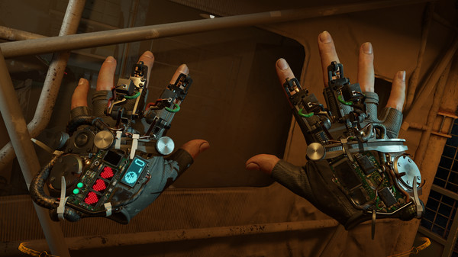
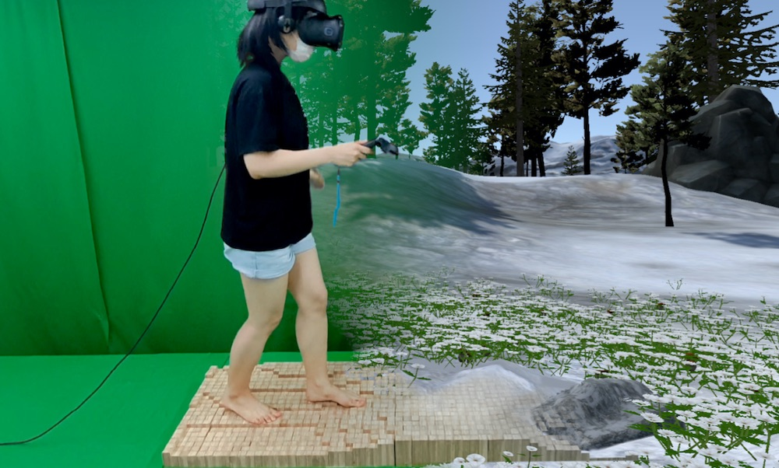
Graphics and VR
http://plopes.org/
https://store.steampowered.com/app/546560/HalfLife_Alyx/

Slide 24
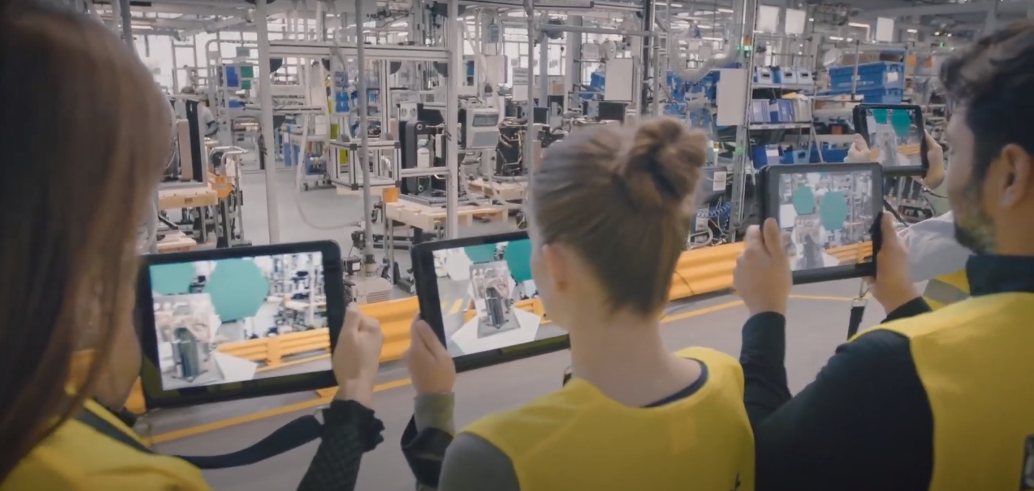
Computer graphics and AR
https://deltareality.com/portfolio/vaillant-ar-facility-tour/

Slide 25
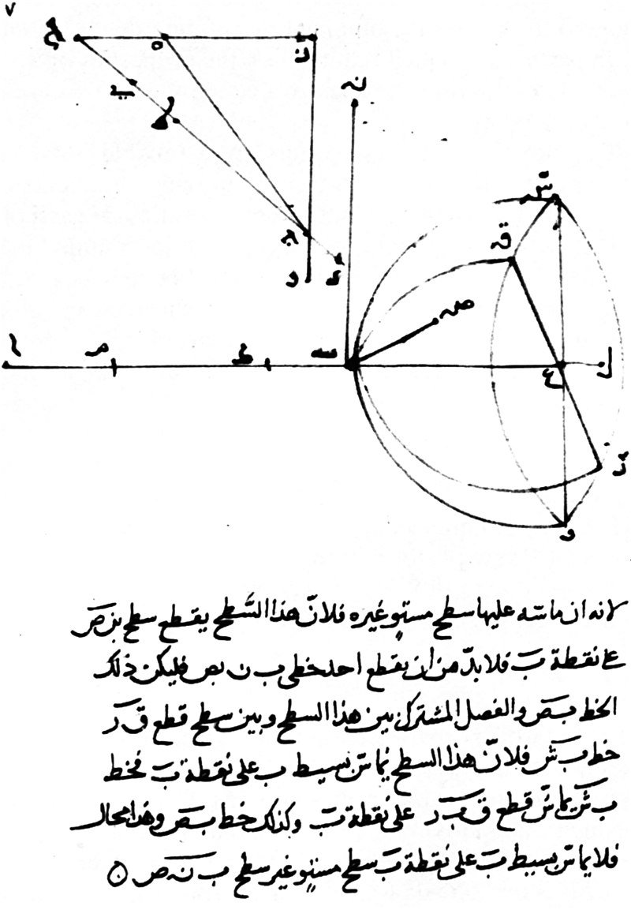
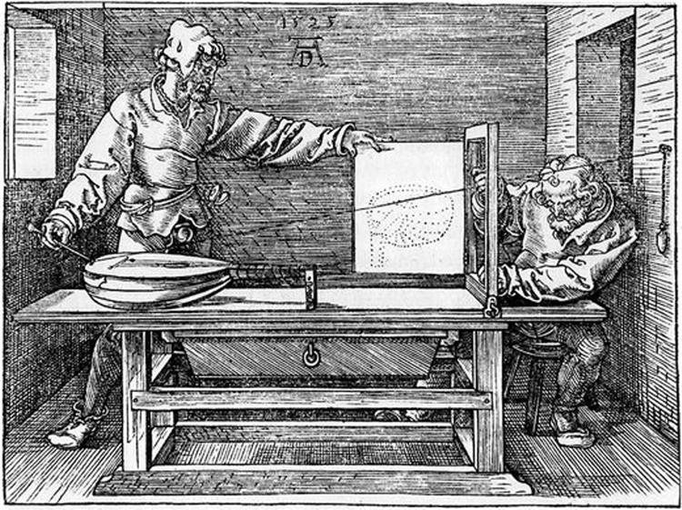
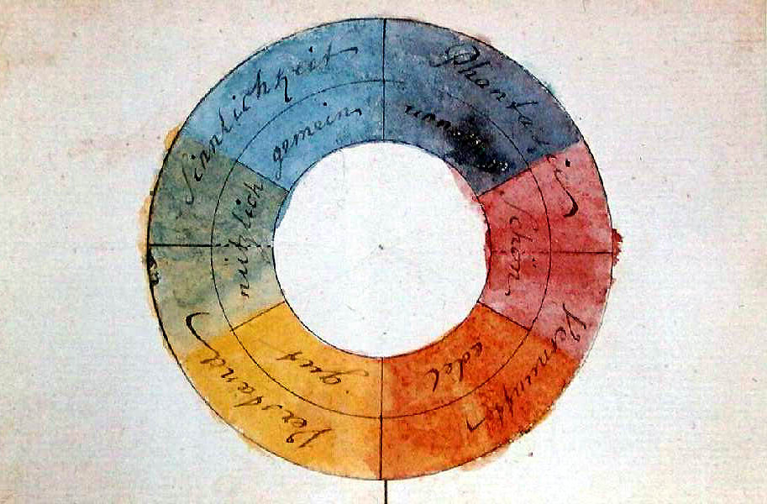
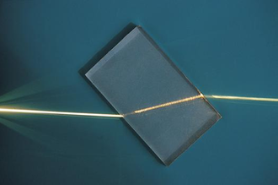
Bit of history
Geometric optics (Alhazen (Ibn al-Haytham), "the father of Optics", 1010)
Development of perspective projection in drawing: perspective machine (e.g., Albrecht Dürer, 1525)
Development in optics (Physics, e.g. Young, 1807)
Johann Wolfgang von Goethe and Theory of Colors, 1810
Geometry, linear algebra, statistics

Slide 26
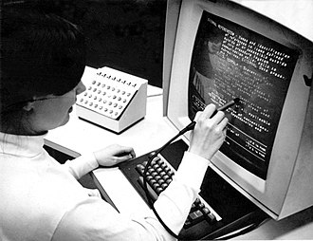

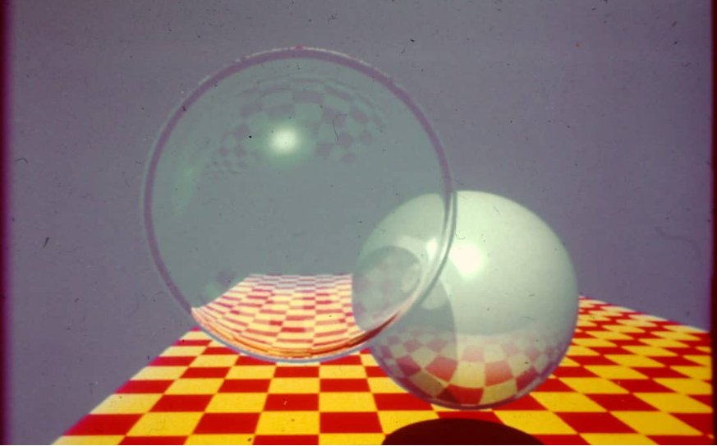
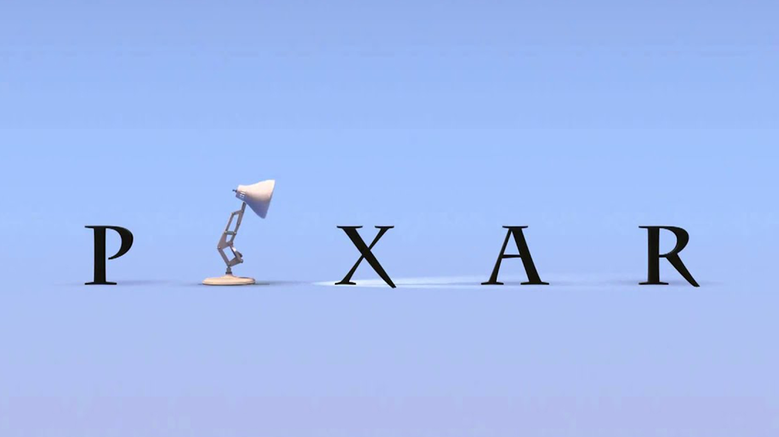
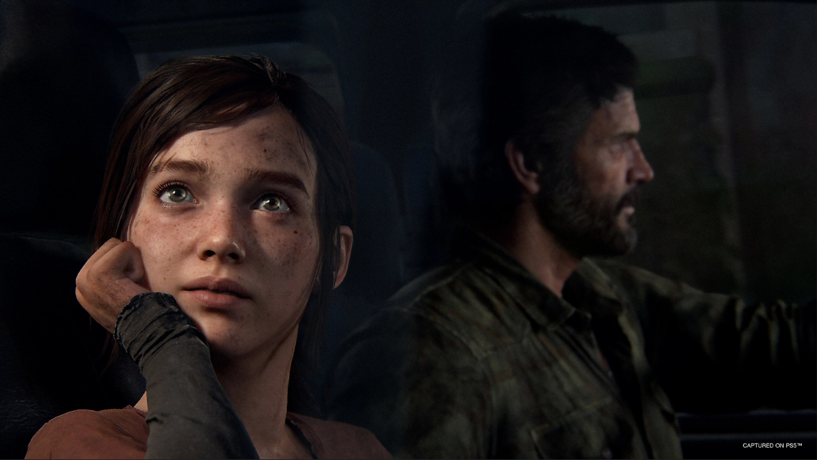
Bit of history
Computer science and hardware (IBM 2250, 1964)
VFX (ILM, 1975)
Ray-tracing (J. Turner Whitted, 1979)
Animated films (Pixar, 1986)
Games (Naughty dog, 2013)

Slide 27
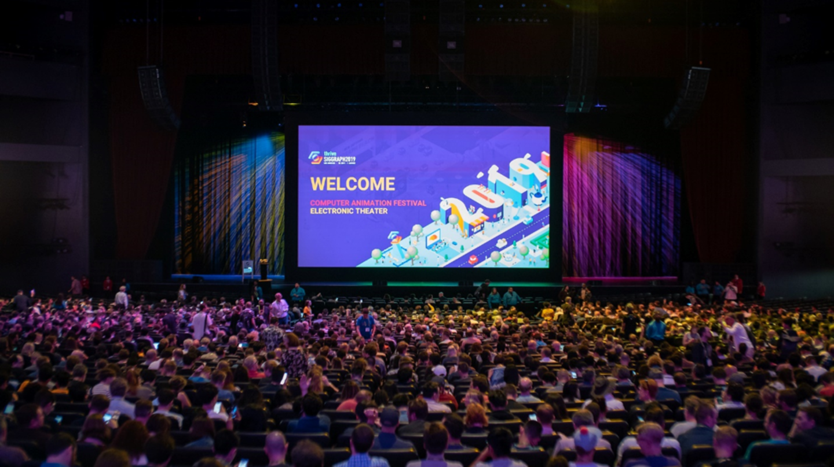
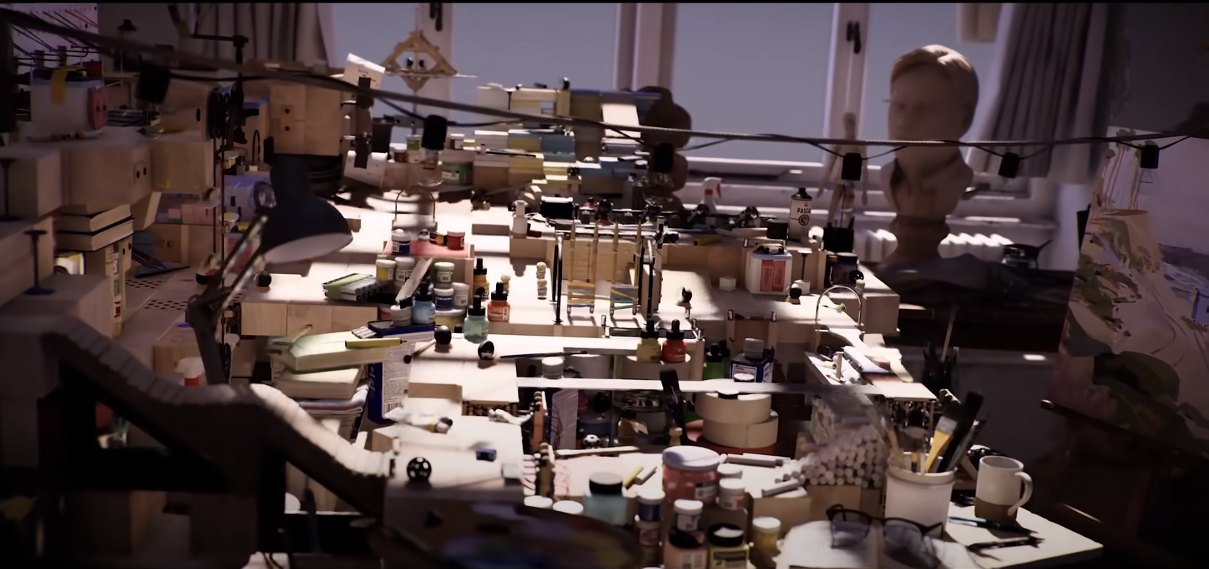
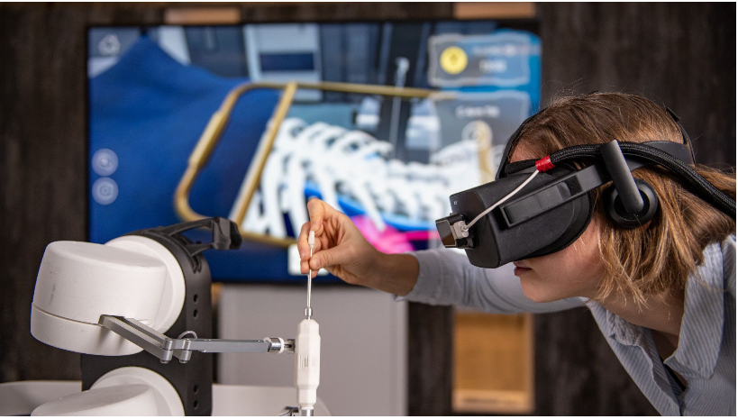
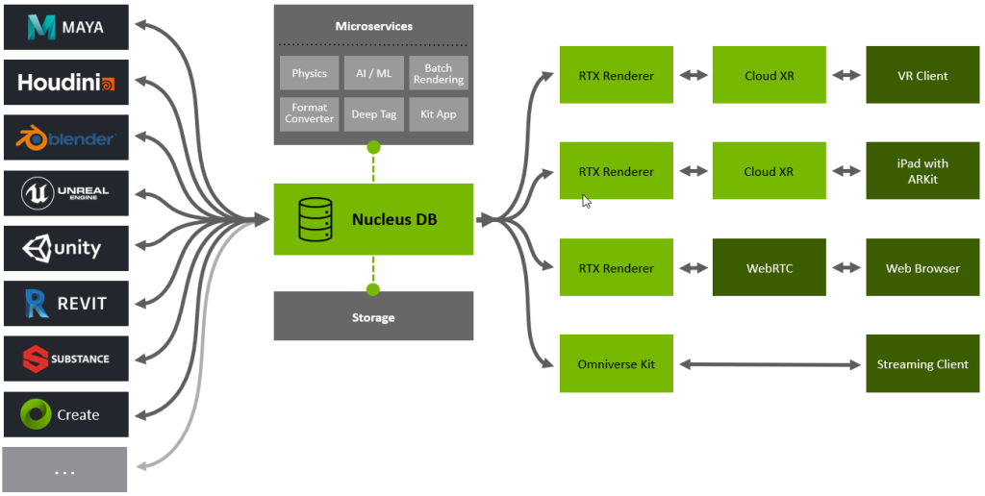
Computer graphics today
https://www.siggraph.org/
https://research.nvidia.com/research-area/real-time-rendering
https://www.research.autodesk.com/blog/inside-autodesk-research-exploring-our-research-teams/#industry-futures
https://www.nvidia.com/en-us/omniverse/

Slide 28
Computer graphics and you
You like physics and would like to see its practical applications in generating amazing imagery and effects.
You like mathematics: computer graphics is applied mathematics. Enough said.
You like programming: computer graphics is exciting application that employs complex architectures for modeling and rendering and in return gives very gratifying results.
You like art and design: Computer graphics is not only about tools which serve for simulating and rendering 3D scenes - it is also how we use those tools to create something that exists or never existed
You like animated films or VFX: yes there is a lot of computer graphics there combined with other disciplines to support stories to remember
You like computer vision or image processing: graphics is about creating and manipulating images
You like human-computer interaction: computer graphics enables visual interfaces and interaction
You like computer games: amazing application of computer graphics combined with different disciplines
You like visualization: biology? Chemistry? Geology? Astronomy? Computer graphics is there for you!

Slide 29
Many scenes, two renderers and one image

Slide 30

Glimpse into image generation
Analogy: taking a photograph
World surrounding photographer → 3D scene
Light interaction with world and image formation → rendering
Result: Image

Slide 31
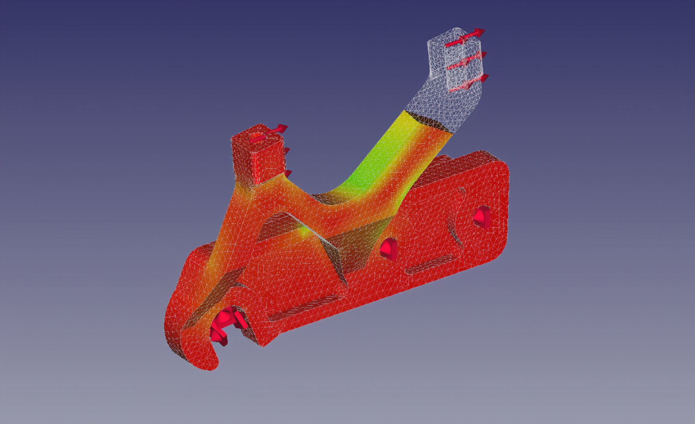
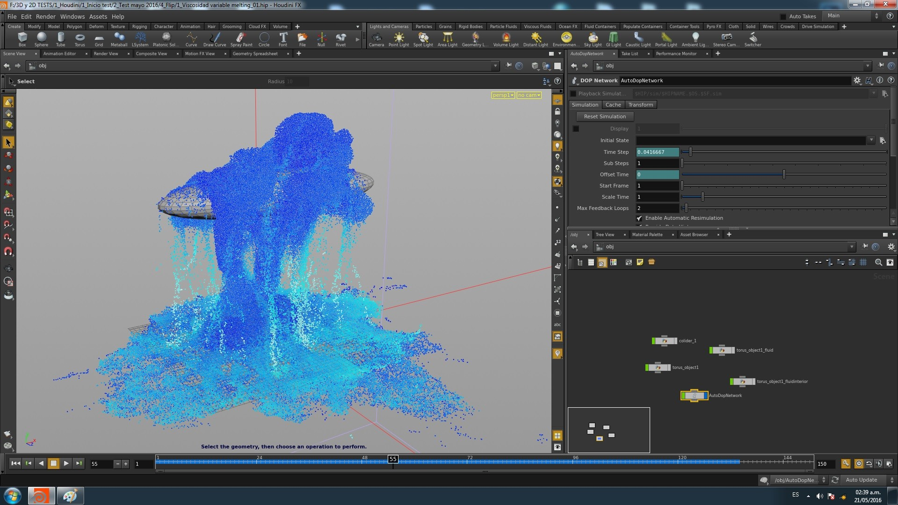
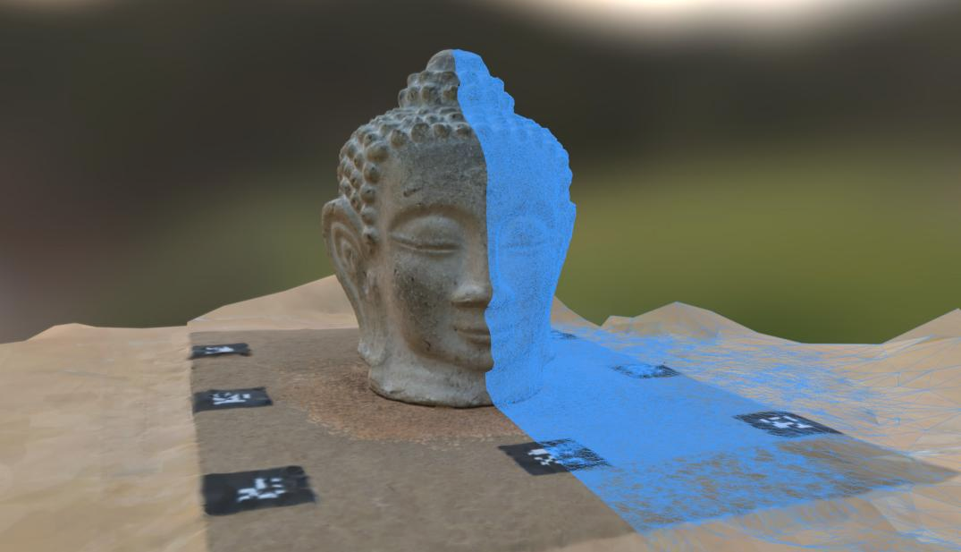
3D scene creation
Modeling: artists, engineers, designers, etc.
  CAD modeling, sculpting
  Animation
  Simulation
Acquisition from real world
  Scanning
https://www.freecadweb.org/
https://alicevision.org/
https://e7p.artstation.com/projects/XbPLD

Slide 32
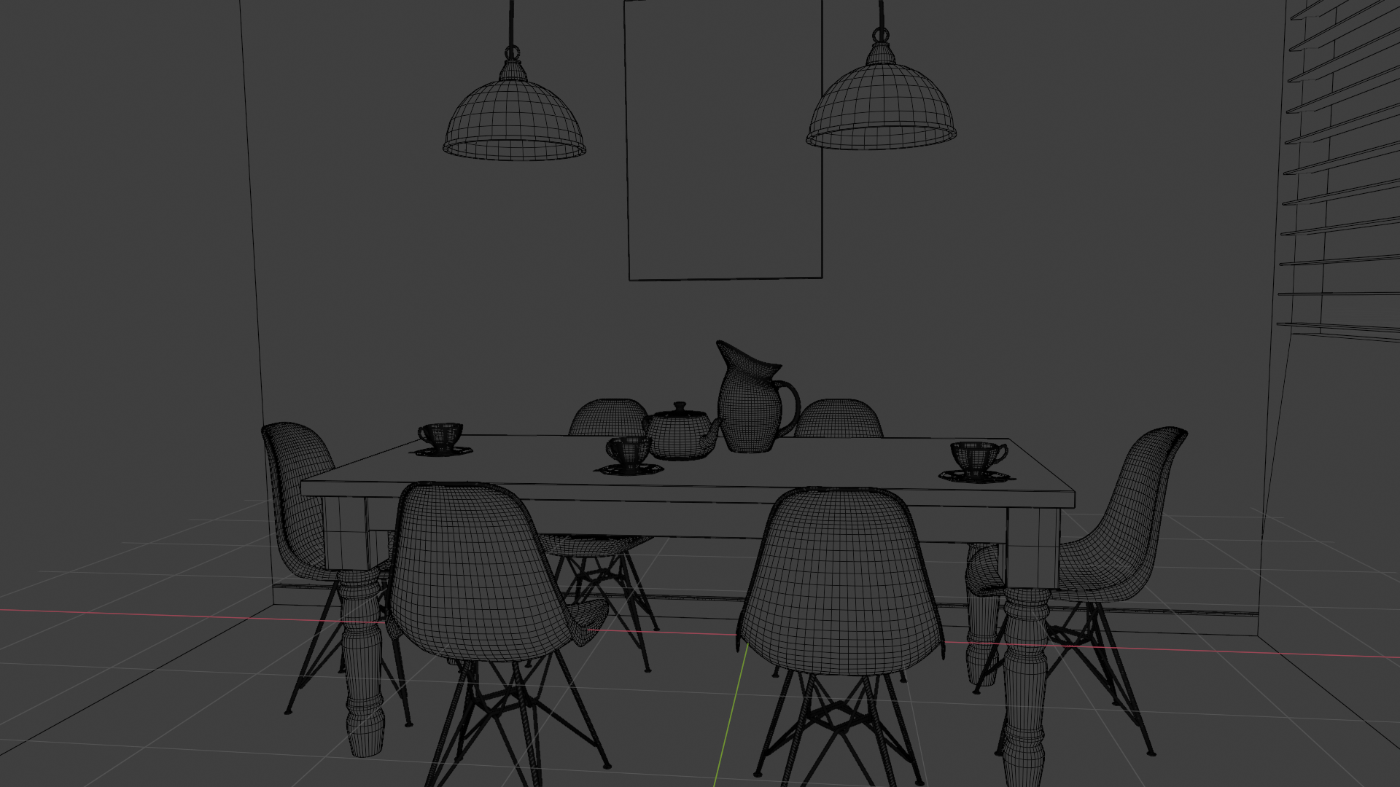
3D scene

Slide 33
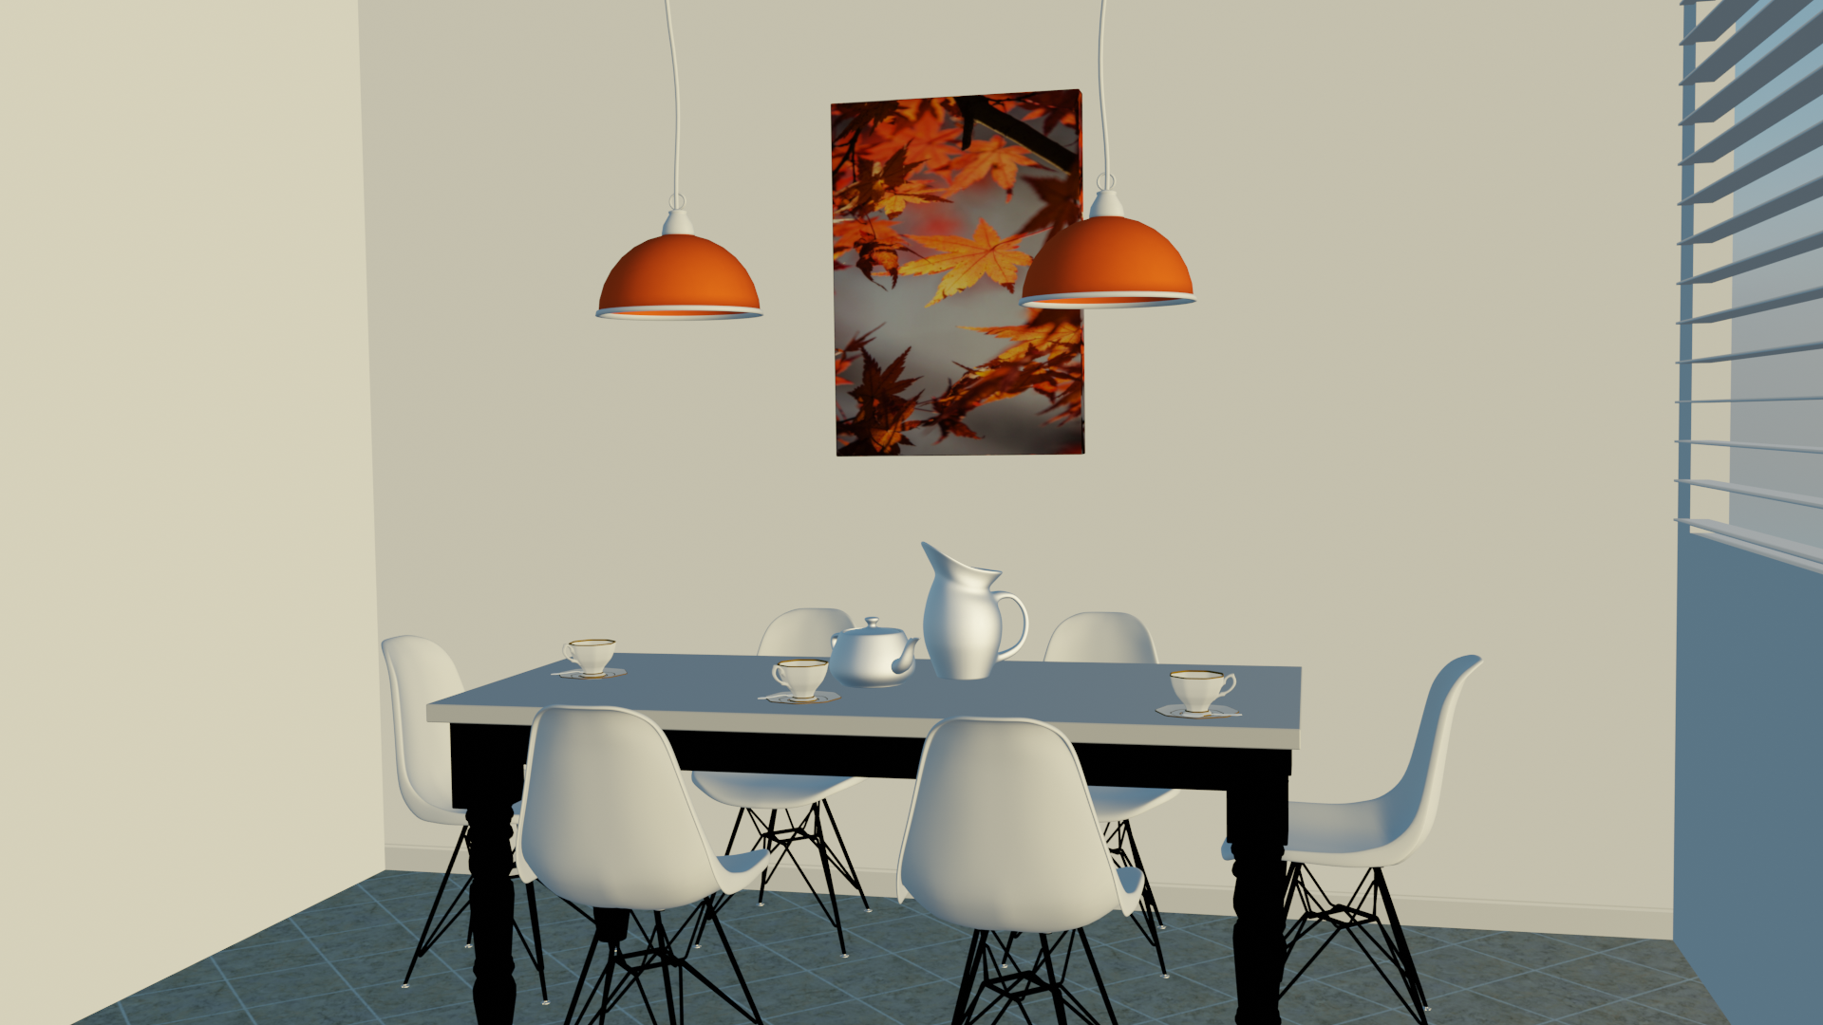

Slide 34
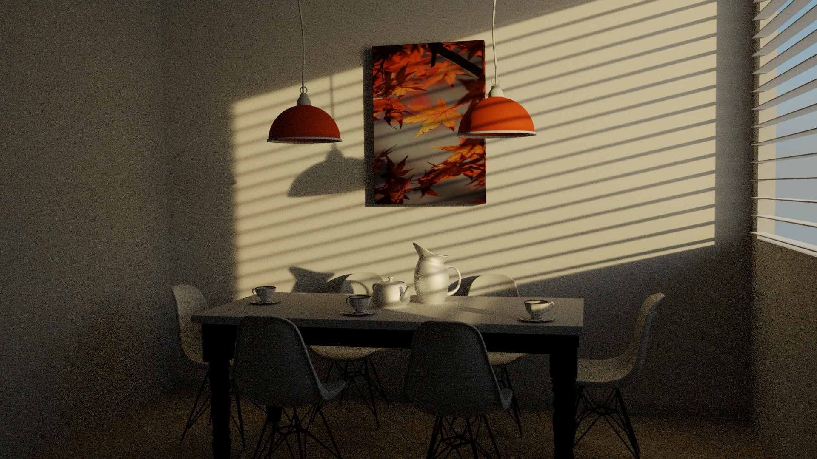

Slide 35
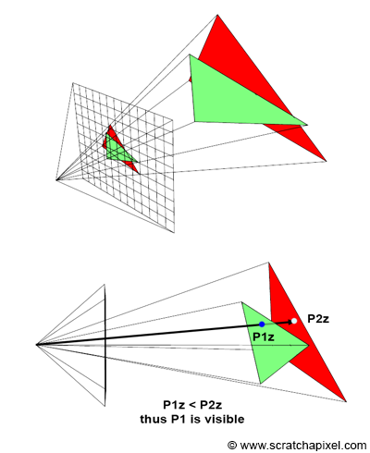
Rendering: rasterization-based rendering

Slide 36
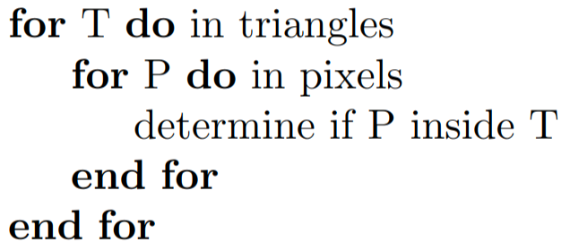

Rendering
Rasterization-based rendering
Ray-tracing based rendering

Slide 37
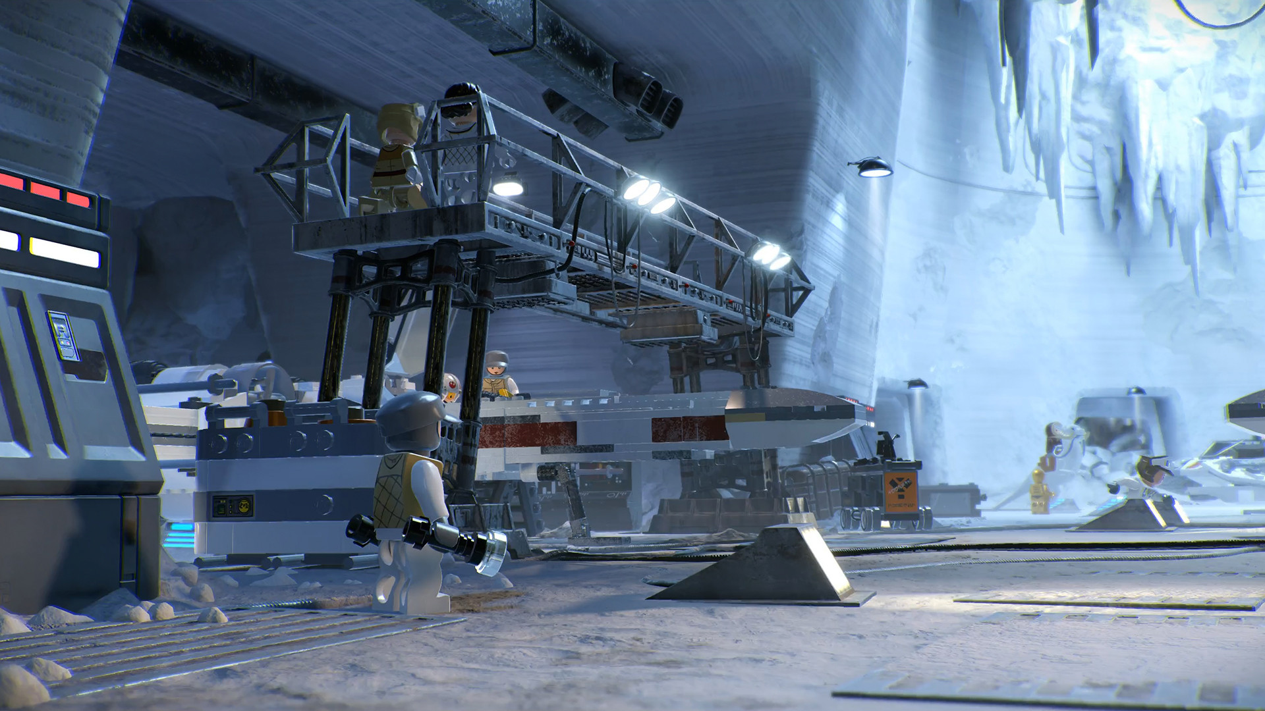
Rendering
Rasterization-based rendering: interactivity
Ray-tracing based rendering: fidelity
https://www.starwars.com/lego-star-wars-the-skywalker-saga

Slide 38
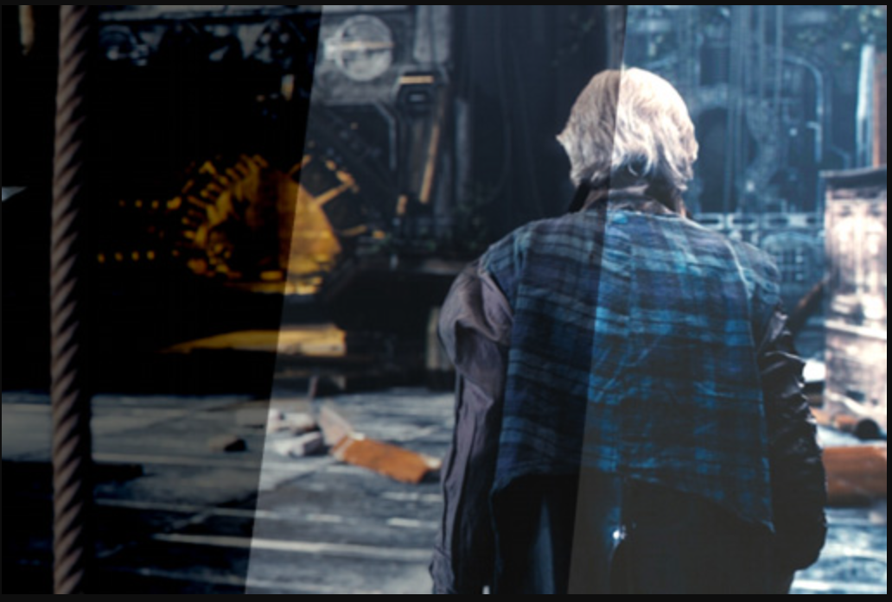
Image
Different exposures of the same render: https://docs.blender.org/manual/en/latest/render/color_management.html

Slide 39
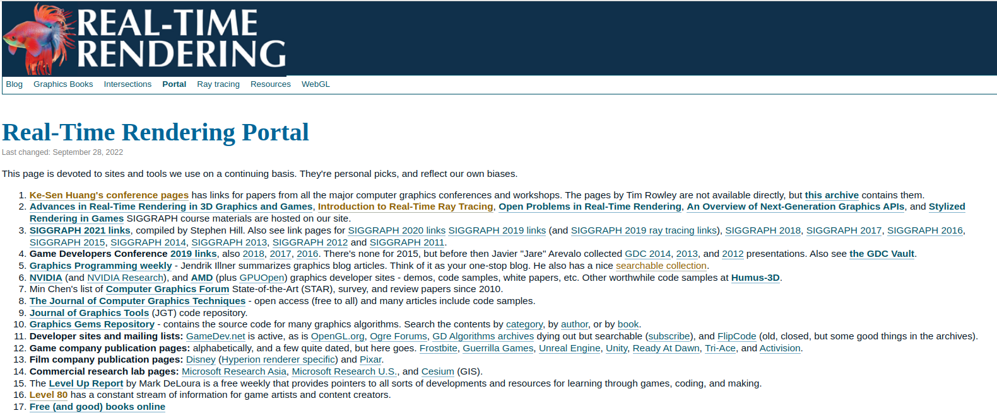
Landscape of computer graphics
https://www.realtimerendering.com/portal.html

Slide 40
Course organization

Slide 41
Computer graphics is a toolset
This course is not about art, design, game-development, film, visualization for engineering and science domains, etc.
This course gives fundamental tools for creating imagery for arbitrary discipline
Tool alone is not enough to create images
  Applying graphics to specific domain area (game, film, sci-vis, etc.) requires understanding domain as well.

Slide 42


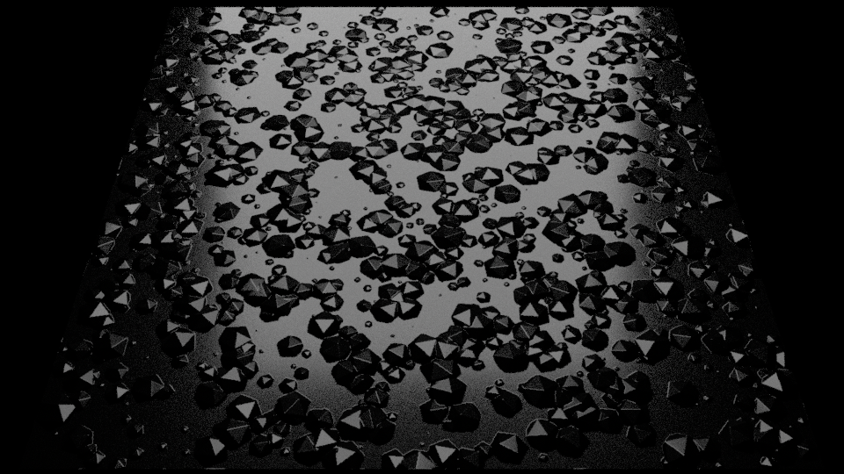
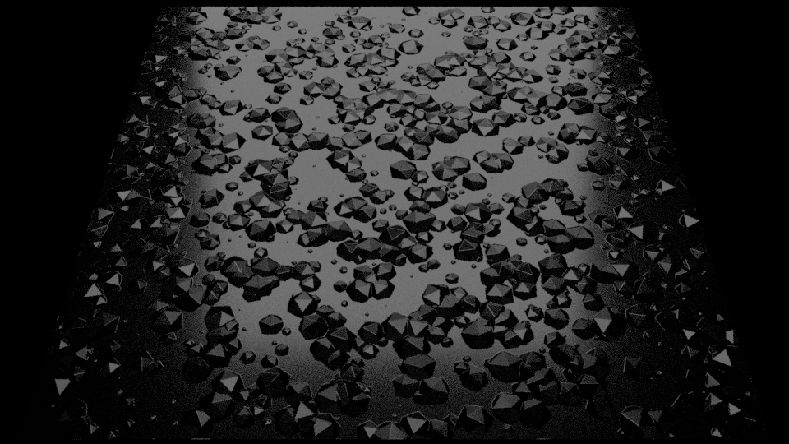
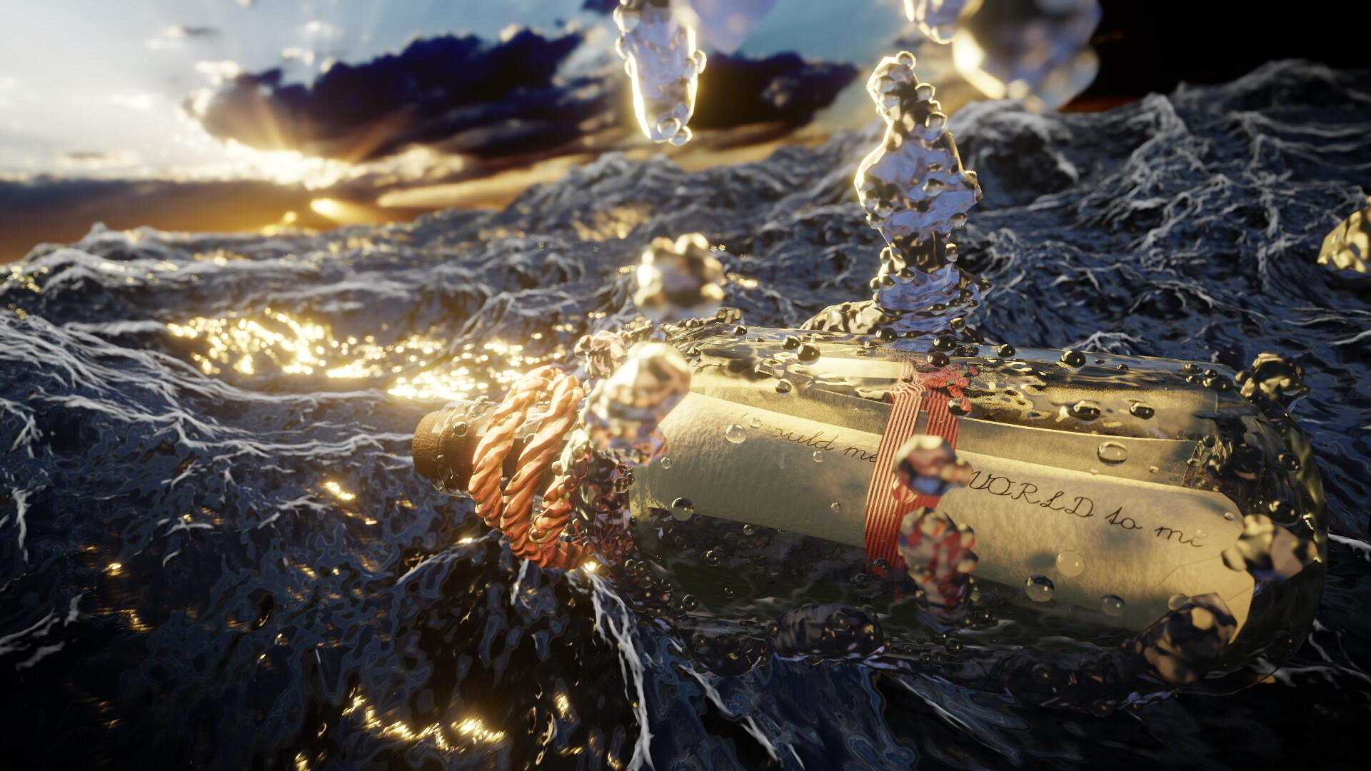
About lecturer
Computer science background, University of Zagreb (2014-2019)
  Computer graphics specialization
4th year PhD student, Technical University Kaiserslautern (2020-2023)
  Material and geometry modeling
Technical art
https://github.com/lorentzo/GSOC-2020-Report

Slide 43
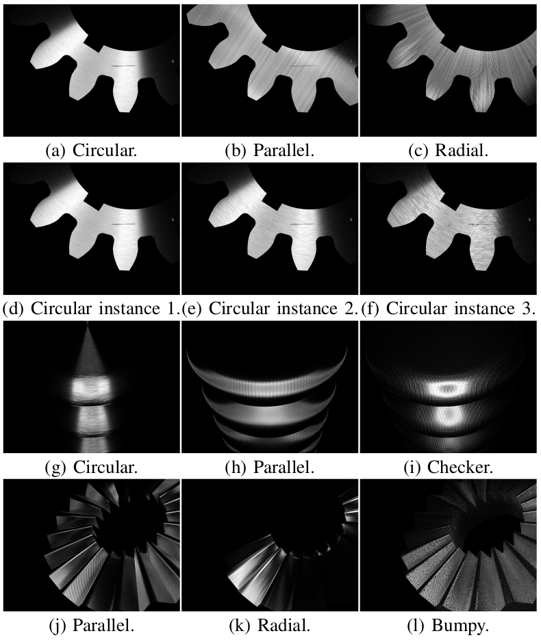
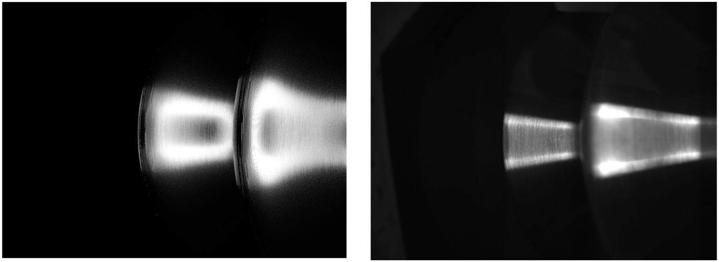
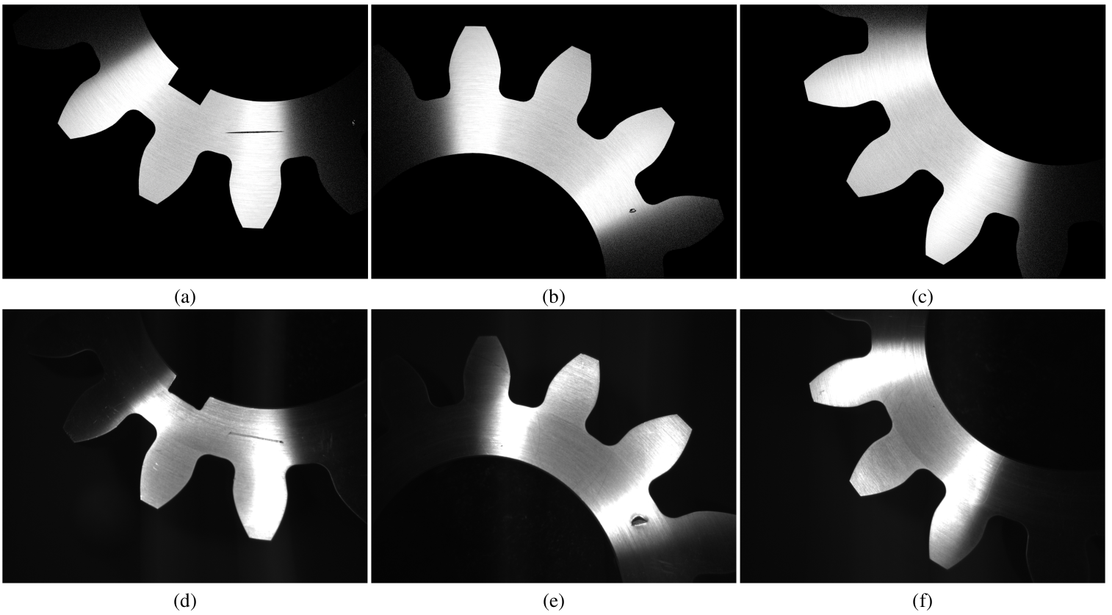

Slide 44

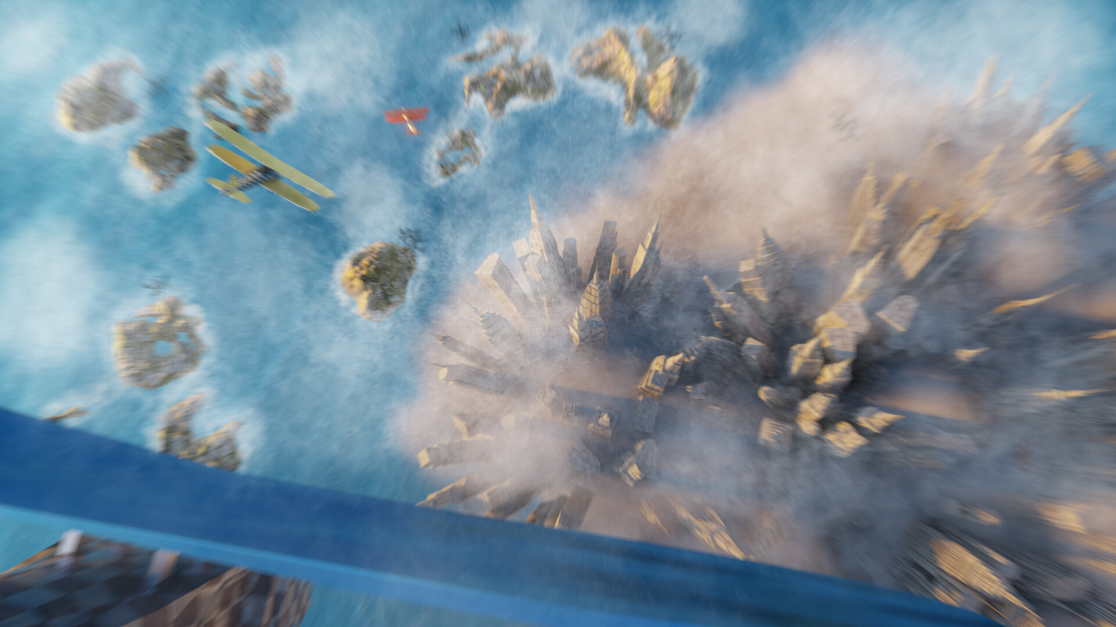



https://www.artstation.com/lovro

Slide 45
About you
What is computer graphics for you?

Slide 46
Course contents
Lectures
Project
Exam

Slide 47
Lectures plan
10 lectures; 3 x 45min
Lecture 1 (18.1.2023): introduction (this) and image synthesis overview
No lecture (25.1.2023)
Lecture 2 (1.2.2023): 3D scene overview, transforms and object shapes
Lecture 3 (8.2.2023): Materials: scattering model
Lecture 4 (15.2.2023): Materials: texture
Lecture 5 (22.2.2023): Lights and cameras
Lecture 6 (1.3.2023): Rendering overview
Lecture 7 (8.3.2023): Ray-tracing based rendering
Lecture 8 (15.3.2023): Rasteriztion-based rendering
Lecture 9 (22.3.2023): Display, images and post-processing
Lecture 10 (29.3.2023): Advanced topics and outlook

Slide 48
Lectures
The point of lectures is to give the structure and foundations
  They are starting point, a map, which is for you to explore.
During lectures write down important points and ask if anything is not clear
  Feel free to interrupt! If something is not clear for you it is a high possibility it is also not clear for someone else – it is good to repeat!

Slide 49

Map of computer graphics
Point of lectures is to give structure – a map and it is up to you to fill it.

Slide 50
Note for lectures
All information will be on slides
Take notes, some elements will be written on board
Note for slides
  Slides were intended for both lectures and as reading material. Therefore, some slides contain a lot of text which is intended for student to read at home. Those slides will have special icon.
  Important elements will be highlighted and noted that they should be written down by hand
  Your interaction is crucial for best learning experience
Write it
down
Questions
Reading
material

Slide 51
Lectures: what is important and preparing for exam
The point of lectures is to give overview with occasional deep dives
There might be a lot of content and faster pace of lecturing
Things that are important for you to take away and which will be on exam will be given as questions at the end of each lecture

Slide 52

Blender is our friend
https://www.blender.org/

Slide 53
Projects
During lectures we will cover wide range of methods and ideas conceptually
During project work, you will have time to dive deeper into technical aspects and implementations of what is the most interesting to you.
Projects: a time dedicated to experience real-life development (and research).
  Projects can be started even after this lecture: decide on topic and start investigating!.
  Projects should be time for you to research and work on your own - consultations are always possible!
  Projects are made to be fun and engaging: choose what you like!

Slide 54
Projects
One of following:
  Ray-tracing rendering engine from scratch
  Web-based interactive 3D engine: three.js
  Modeling and animation in Blender
Ideas for your own project?
  Game
  Animation
  Visualization

Slide 55


Projects: ray-tracing rendering engine from scratch
Complete rendering engine from scratch
Requirements: knowledge of one programming language (e.g., C++, Python, etc.)
Required and optional tasks.
Project guide: https://raytracing.github.io/

Slide 56


What after?
Good basis for building more complex renderer with advanced features:
  https://pbrt.org/
  https://github.com/mmp/pbrt-v3
  https://github.com/mitsuba-renderer/mitsuba2
Investigating and contributing to production rendering engines:
  https://github.com/appleseedhq/appleseed
  https://www.cycles-renderer.org/
  https://luxcorerender.org/
https://www.cycles-renderer.org/
https://github.com/mmp/pbrt-v3

Slide 57


Projects: web-based interactive 3D engine: three.js
Web-based 3D library and renderer based on WebGL
Requirements:
  Three.js setup
  Knowledge of javascript
  Learning about three.js API
Three.js library with documentation and examples for project: https://threejs.org/
https://henryheffernan.com/

Slide 58


What after?
Building advanced web-based 3D graphics:
  https://threejs.org/
Diving deeper into real-time, interactive rendering libraries such as WebGL or OpenGL:
  http://learnwebgl.brown37.net/
  https://learnopengl.com/
Game engines for advanced interactive graphics:
  https://www.unrealengine.com/en-US
  https://unity.com/
  https://godotengine.org/
https://jhugheswebdev.github.io/sound-equalizer-threejs/
https://godotengine.org/

Slide 59


Project: modeling and animation in Blender
Learning modeling, animation and rendering in open-source, production tool.
Prerequisites:
  Downloading blender: https://www.blender.org/
Blender: https://www.blender.org/
https://casual-effects.com/data/index.html

Slide 60


What after?
Advanced 3D modeling, sculpting, lighting, material modeling, rendering and compositing in Blender and other content creation tools:
  https://www.blender.org/features/
  https://www.maxon.net/en/zbrush
  https://www.adobe.com/products/substance3d-painter.html
  https://renderman.pixar.com/
Advanced procedural modeling in Houdini:
  https://www.sidefx.com/
https://www.adobe.com/products/substance3d-painter.html
https://www.thegnomonworkshop.com/tutorials/creating-procedural-environments-in-houdini

Slide 61
Projects: your own project?
Write a small project roadmap and deliverables.

Slide 62
Course outcomes
Understand fundamental concepts and theory behind.
Typically mathematics, algorithms and methods used in computer graphics
Understanding how foundations are supporting technology and which technology exists for you to create
Structure and map of the computer graphics

Slide 63
Special outcomes
“Seeing world with different eyes”
Foundations for visualization and expression

Slide 64
Course web-site and materials
Course web-site
  https://github.com/lorentzo/IntroductionToComputerGraphics
  All materials are available in advance with most recent updates
    TIP: read materials before lecture – it helps for following the lecture

Slide 65
Additional learning material
https://www.realtimerendering.com/
https://www.scratchapixel.com/
https://learnopengl.com/
https://raytracing.github.io/
https://pbrt.org/

Slide 66
Course grading
One project of choice
  Grading: amount of technical contribution and documentation
  Deadline: 5.4.2023
Exam
  Theory and concepts, multiple choices type of exam
  Concepts, not equations and learning by heart
  Preparation: questions after lectures
  Date: 5.4.2023, 14h (30 min)

