Slide 1
Computer image generation overview

Slide 2
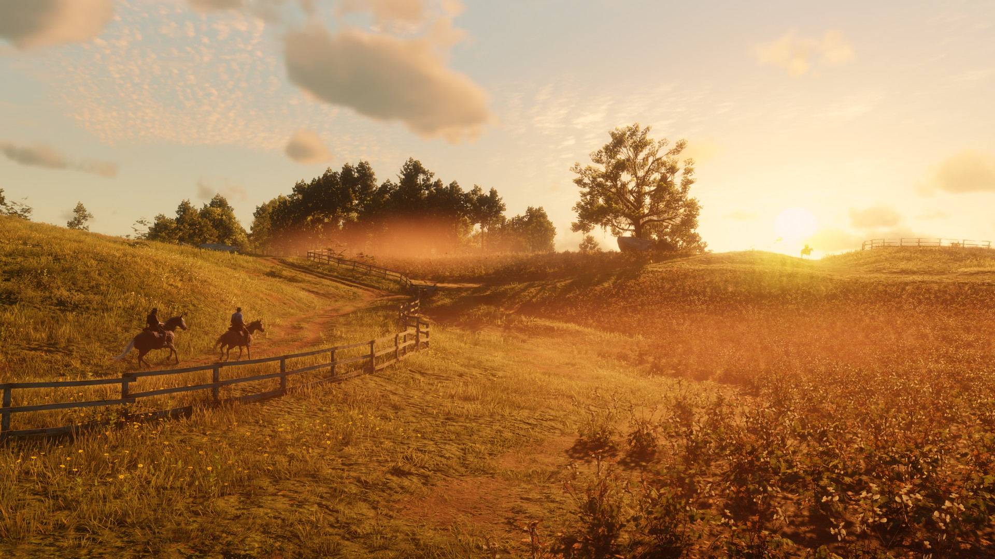
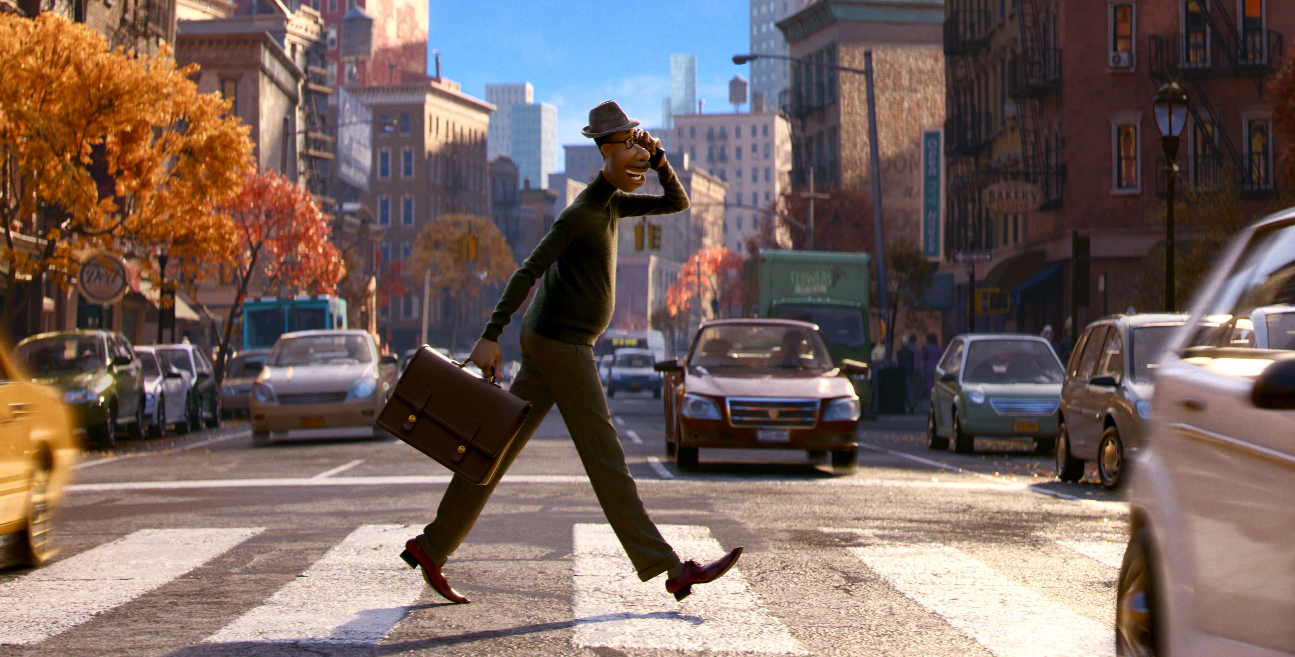
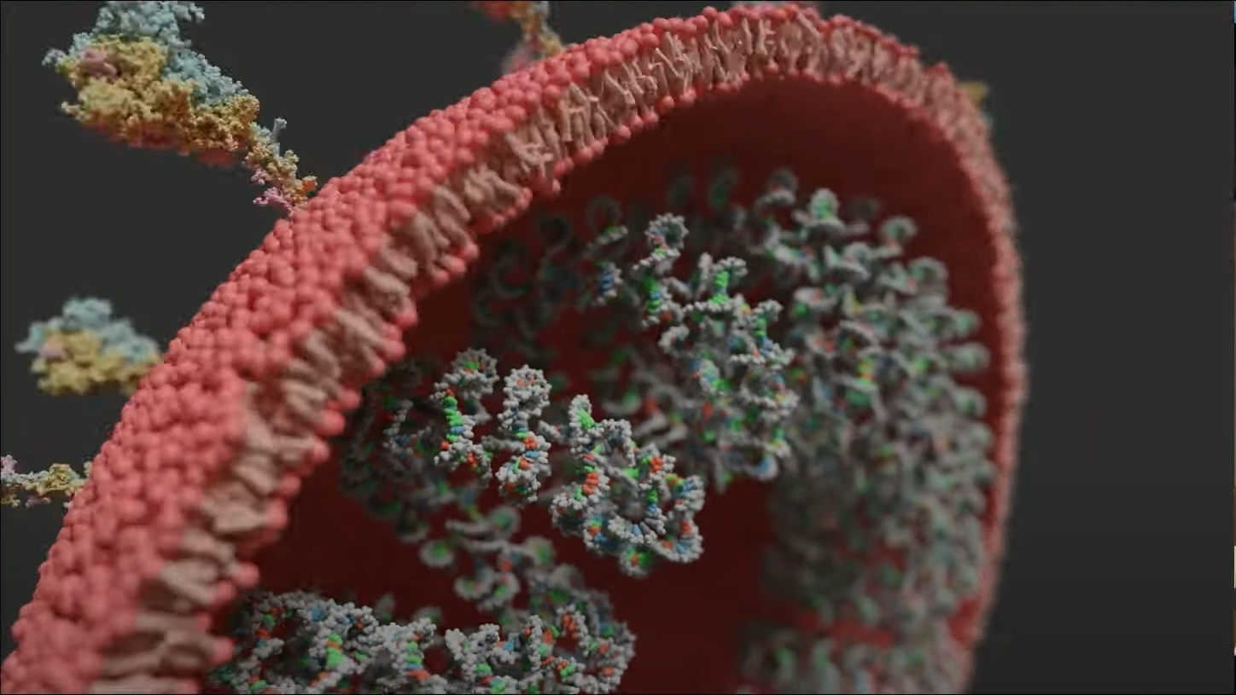
Goal of Computer graphics
Any interactive virtual environment, animation, application, development and research in computer graphics → synthesizing images
Graphics and animated film
https://www.pixar.com/soul
Graphics and scientific visualization
https://www.youtube.com/watch?v=adhTmwYwOiA&ab_channel=Blender
Graphics and computer games
https://www.rockstargames.com/reddeadredemption2/

Slide 3
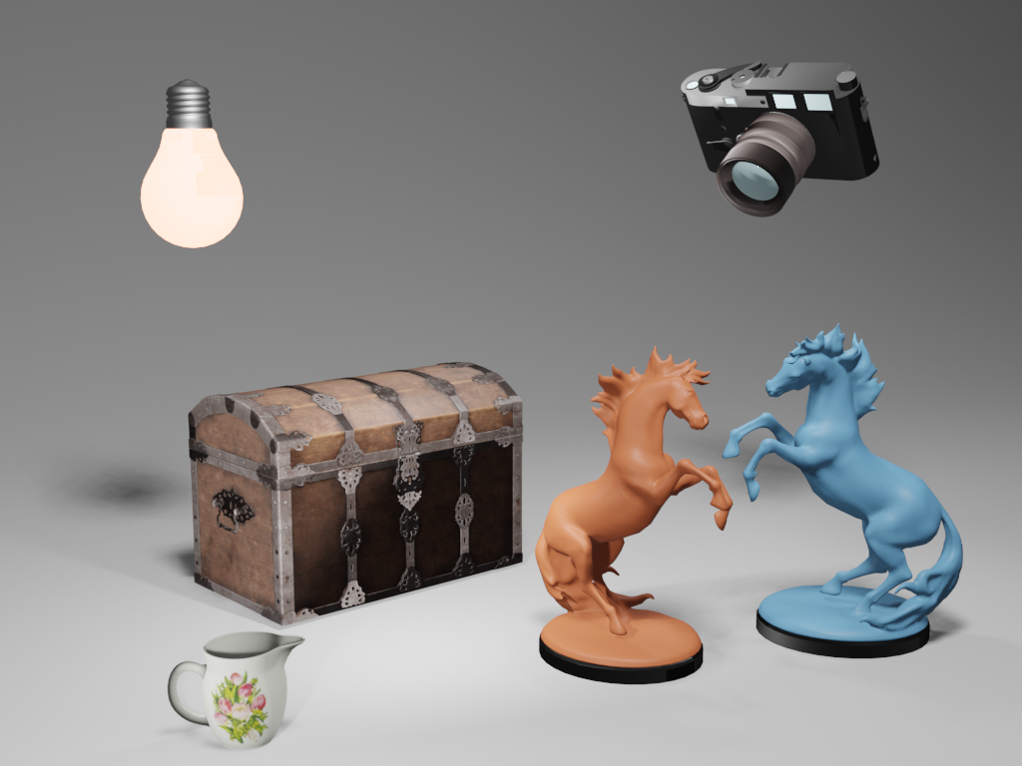

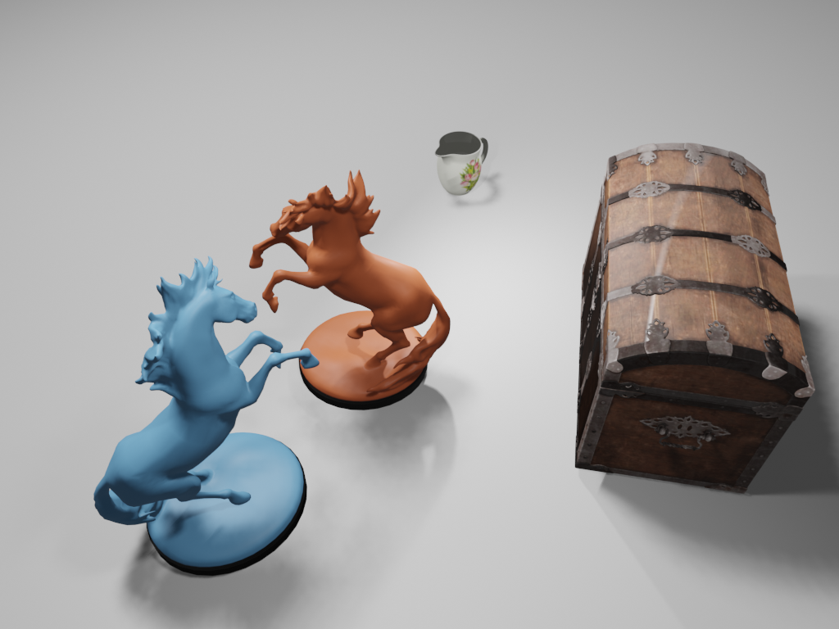
Image synthesis: intuition
Analogy with photography:
  Light source emits light
  Light travels through the space, interacts with objects
  Small amount of light reflects into camera → image
https://polyhaven.com/models

Slide 4
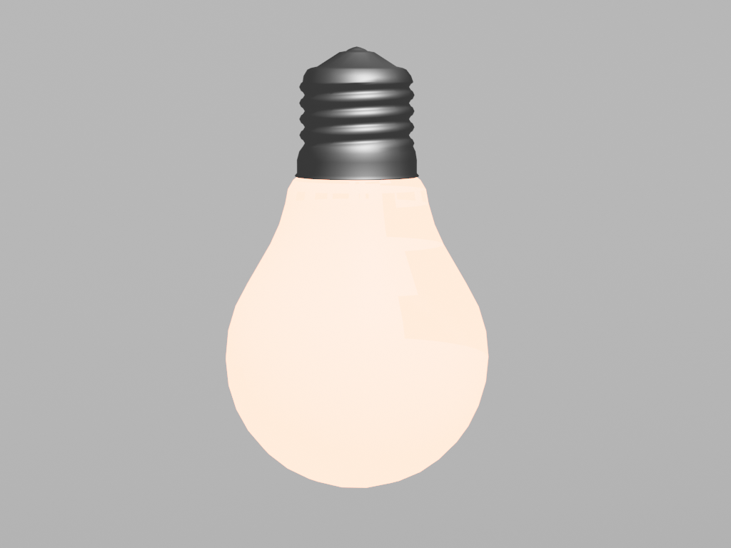
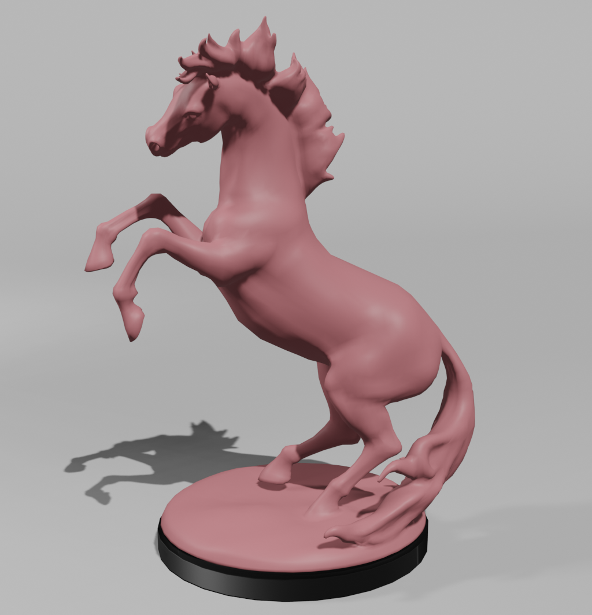
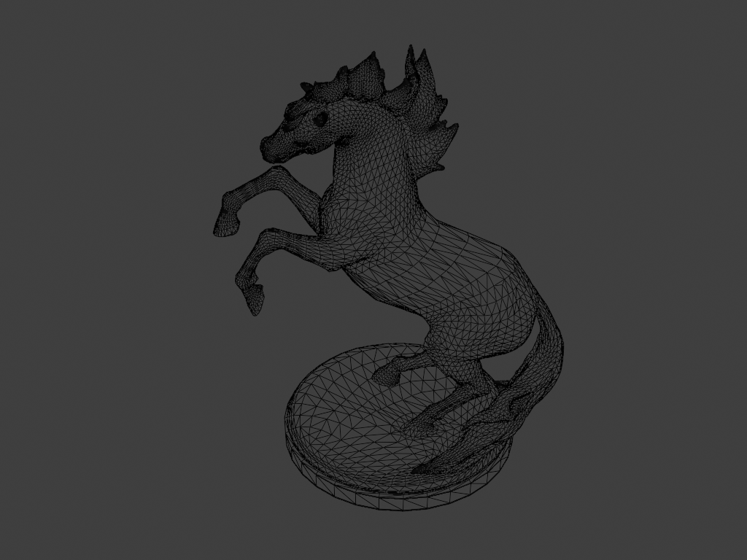
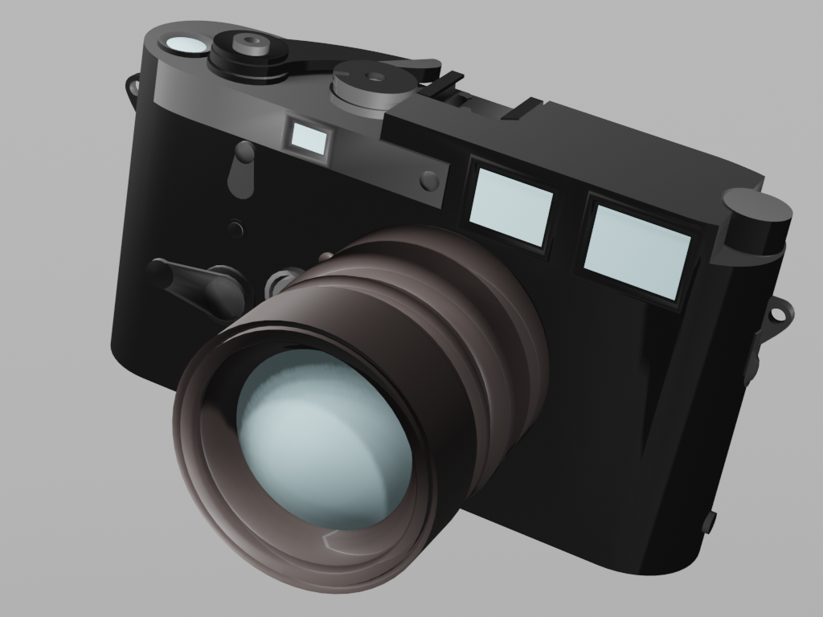
Fundamental image synthesis questions
How to represent real world objects, lights and cameras in a computer?
  3D scene modeling
How to generate image based on computer representation of those elements?
  Rendering and image

Slide 5
Enter computer graphics
Computer graphics is solving a problem of:
  Representing real-world in a computer using models
  Generating (synthesizing) images based on those models
Merge with prev slide

Slide 6
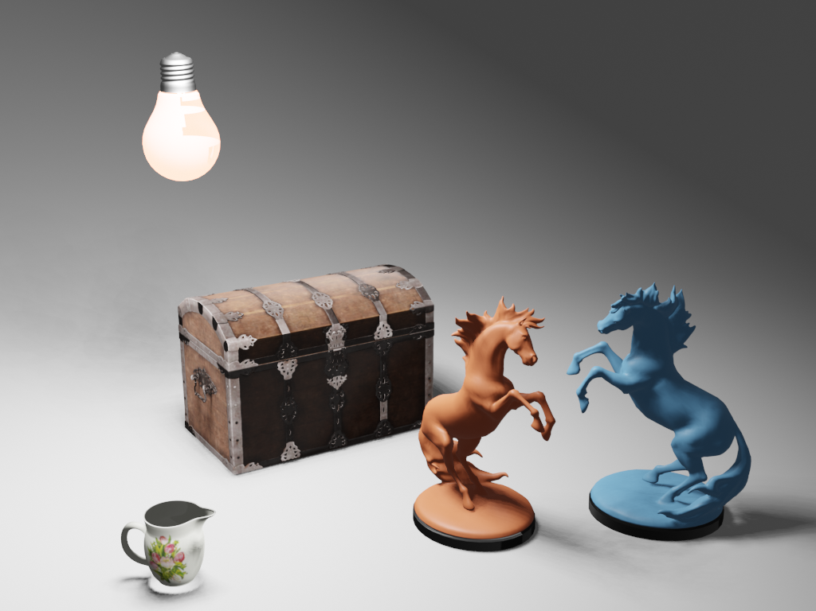
Art of computer graphics
Decompose real world objects and phenomena into separate models and processes which can be modeled and then again combined into a virtual world.
  All of those parts are deeply intertwined and one doesn’t makes sense without another.
  Example: without light we can’t see objects and without objects we can’t see light.
No objects
No light

Slide 7
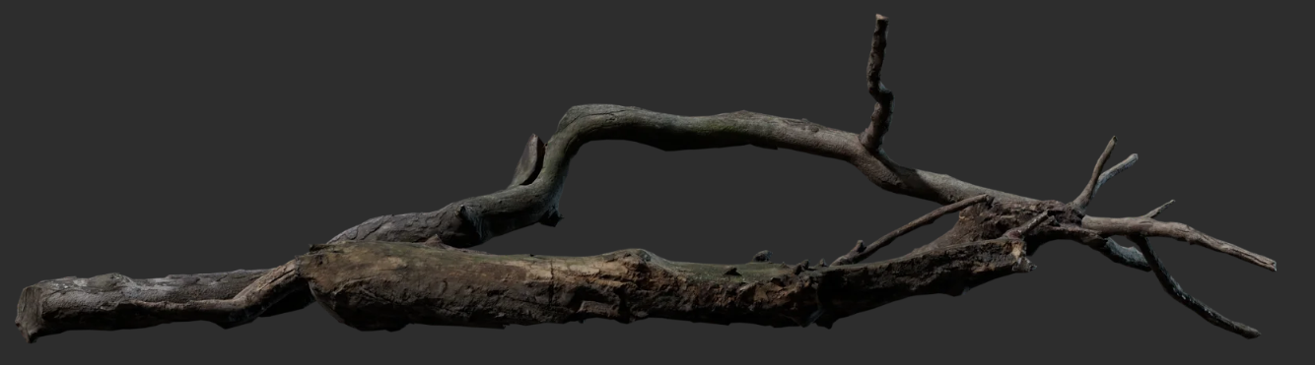
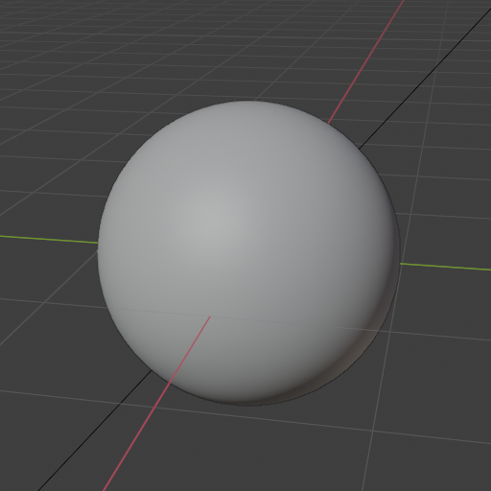
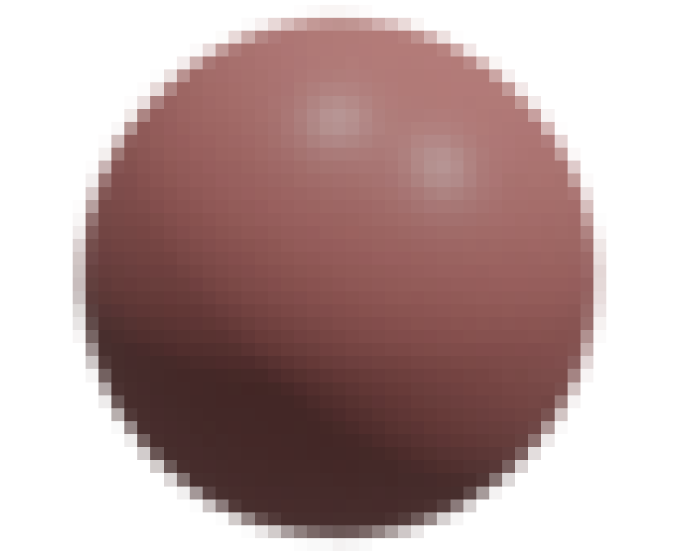
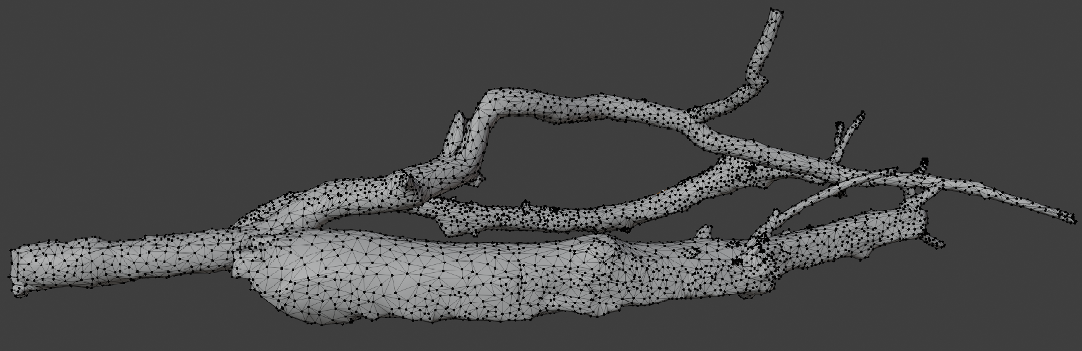
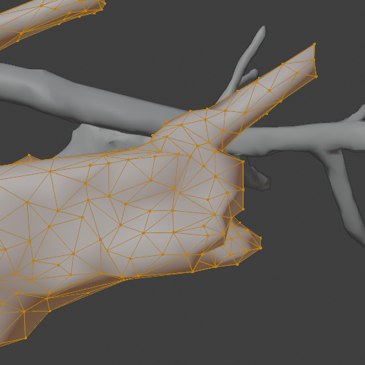
Simplification of a real world
Computer graphics problems are solved using simulation and approximation.
  The real world objects and phenomena is simulated and approximated to achieve desired outcomes for specific application.
Description of a real world in a 3D scene must be discretized for display
  Real world and 3D scene are continuous, synthesizing images means creating discrete image: array of pixels
3D scene
Image

Slide 8
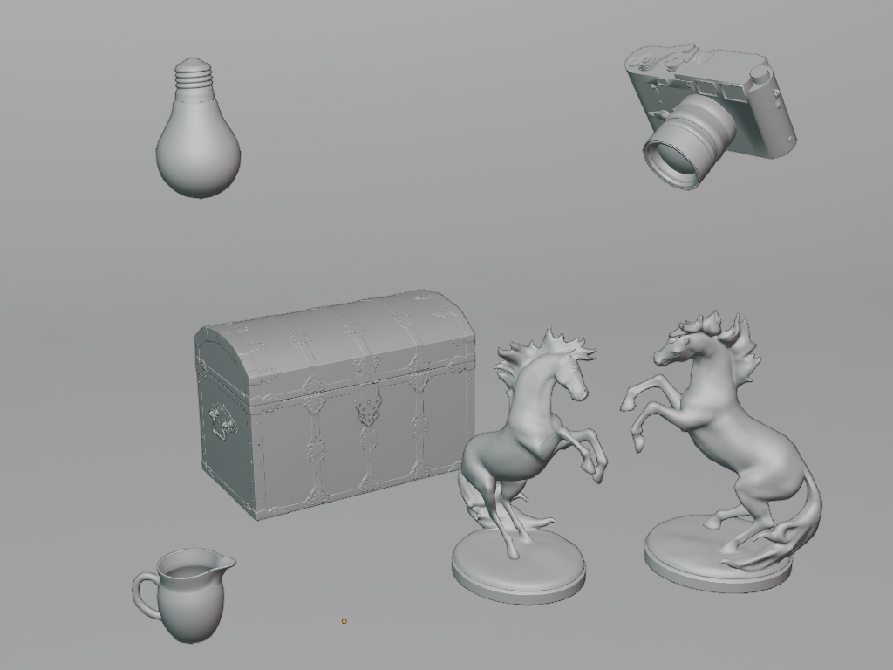
Pillars of computer graphics
To synthesize an image:
  We need a description of a 3D scene which contains objects, lights and cameras
  A way to transform a 3D scene into 2D array of pixels – rendering
  A way of storing 2D array of pixels for raster display – image
3D Scene
Image
Rendering

Slide 9
Modeling and rendering
Computer graphics is concerned with:
  Techniques and methods for modeling of 3D scene: what will be rendered
  Development of rendering algorithms for creating image out of a 3D scene
  Storing and displaying images

Slide 10
Image generation software can be thus split into:
  Modeling – process in which 3D scene is defined: what is rendered
  Rendering – process in which image of 3D scene is generated
Merge with prev
* As discussed, but to highlight again, 3D scene modeling and rendering in order to obtain an image is highly intertwined process. For learning purposes in production and as well as in research in development theses processes are separated. Depending on application and teaching the description of whole process can start from rendering as well.

Slide 11
Modeling and rendering are intertwined
Rendering process must “understand” how 3D scene is represented
Modeling of 3D scene relies on representations which are understood by rendering algorithm

Slide 12
3D Scene Modeling
A start of image generation journey: “what we render”

Slide 13
3D scene modeling
In order to generate an image we need something to render → a 3D scene:
  Objects: what we want to visualize
  Cameras: from where and how are we viewing the objects
  Light sources: enable us to see objects → light reflected to camera

Slide 14
The real world is made of wide range of objects.
  For 3D scene modeling, objects are described using: shape and material
The reason why we see objects around us is due to light reflecting in our eyes.
  For 3D scene modeling, we separate objects which generate light - light sources and those which only reflect light.
3D scene is simulated 3D world from which images can be taken - similarly as photographing a real world. Thus, we also need to simulate a device which is needed for taking images – a camera – which also defines from where image is taken.

Slide 15
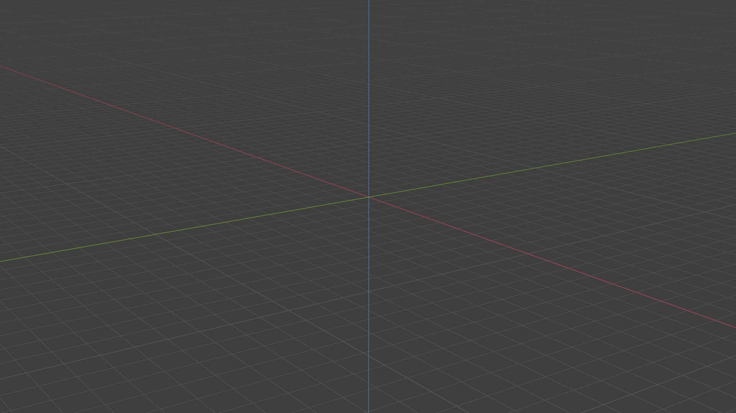
3D space
To define any object and in 3D scene we need to introduce a concept of 3D space.
  3D space is represented with 3 coordinate axis: Cartesian coordinate system
  This main coordinate system is called world.

Slide 16
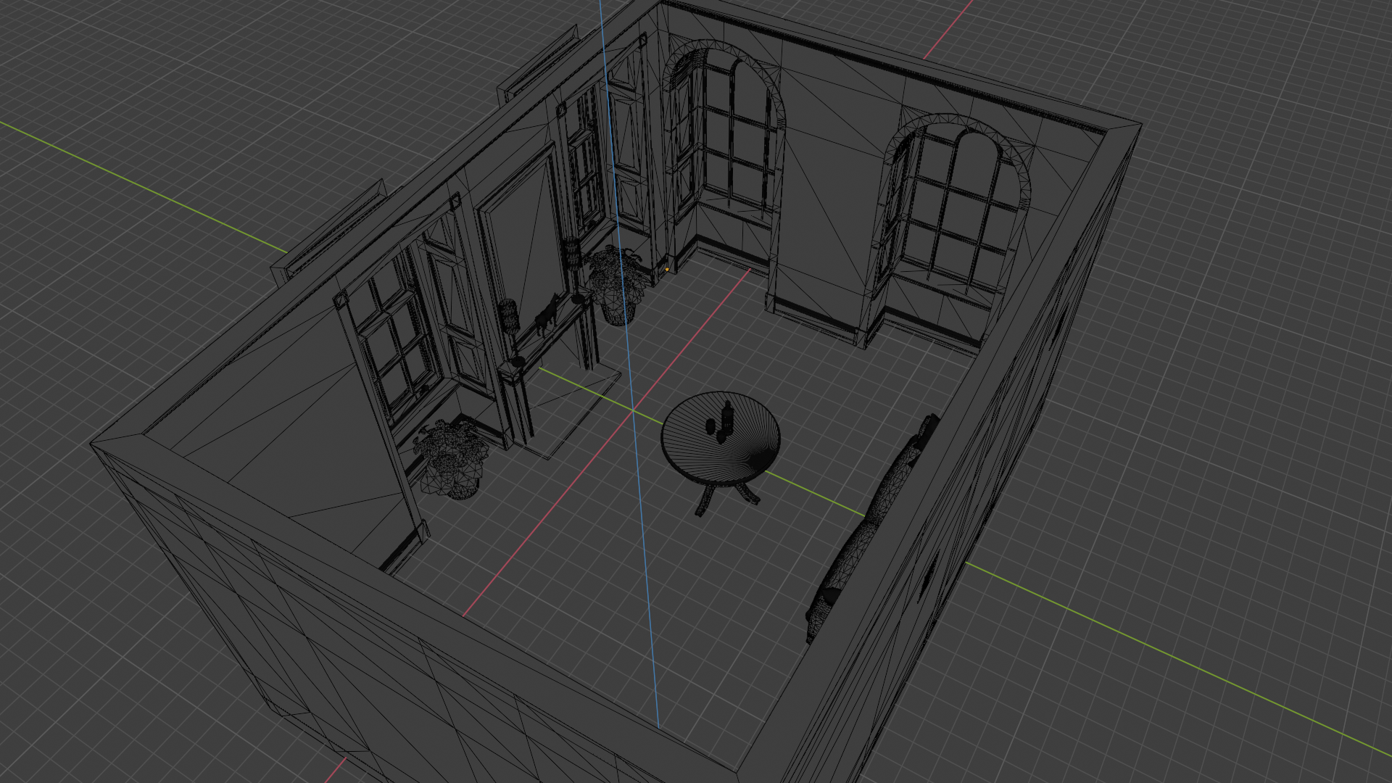
World coordinate system
All objects have unique transform in this world coordinate system:
  Position
  Rotation
  Scale

Slide 17
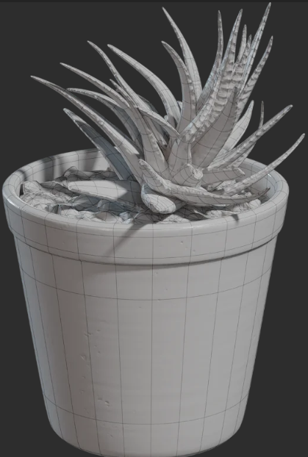
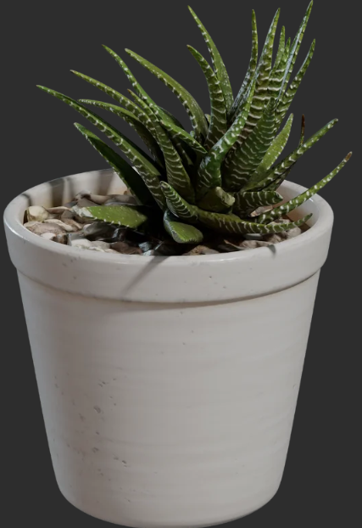
Objects in 3D scene
Modeling 3D scene object is separated into modeling:
  Object shape
  Object material
Shape
Shape and material

Slide 18
Representing objects is not only important for visualizing purposes, it is also important for modeling them. Therefore, even some objects for which we only care about the surface appearance (e.g., car rim) we would like to represent them as solids in certain modeling tools which would enable simulation of cutting and modling the surface). For example: https://www.autodesk.com/products/fusion-360/features#3d-modeling or https://pixologic.com/.
Converting all objects to same representation (triangulated mesh) is also convenient for applying various rendering effects. For example, techniques for adding more details during rendering time can be only developed to work with triangulated mesh.

Slide 19
Object shape
Object shape is needed for:
  Defining object form, size, etc.
  Placing object correctly in the scene with respect to other objects
  Determining which objects are occluded and areas into which shadow is cast by an object
  Determining visibility

Slide 20
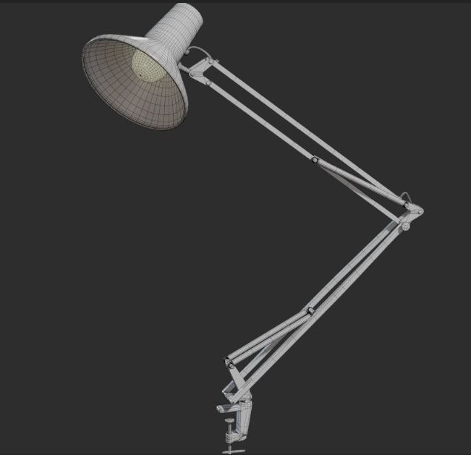



Shape representation
We start by defining points (x,y,z) in 3D space.
To define a surface, simplest way is to connect points to form a polygon.
  Most commonly used polygons are triangles.

Slide 21
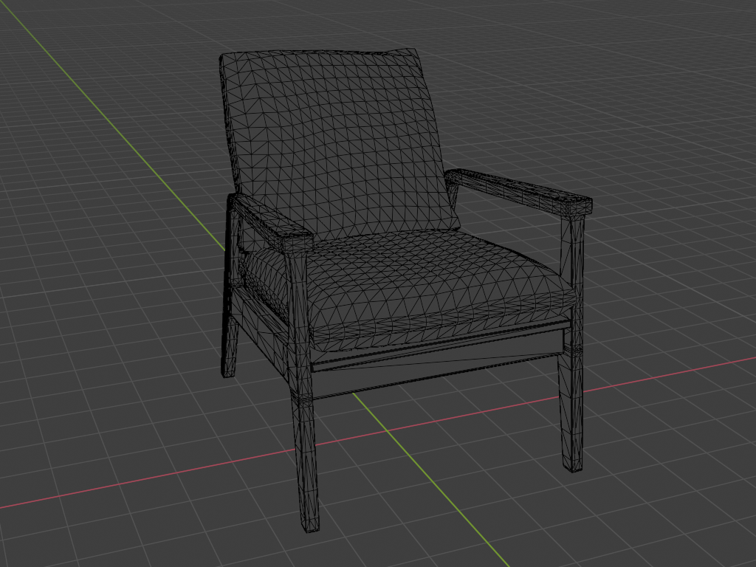
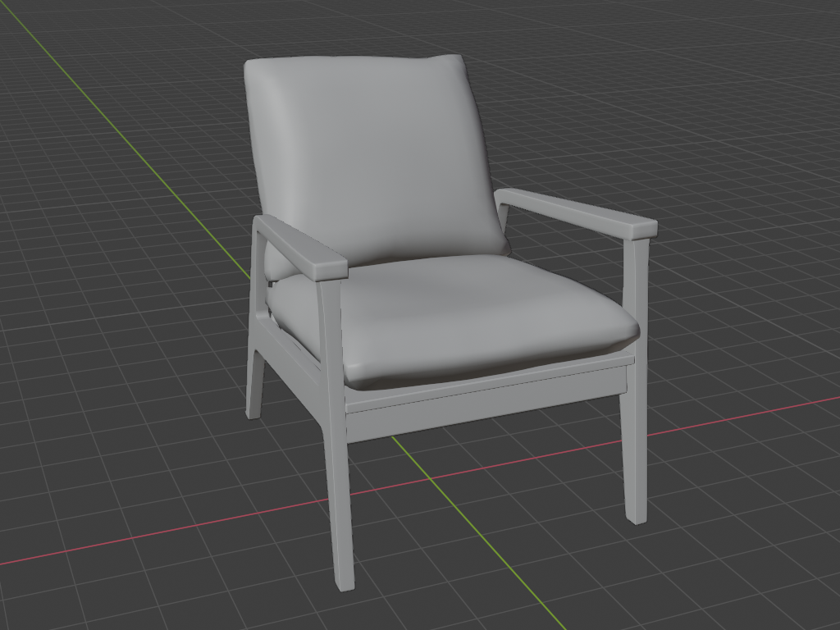
Triangle shape representation
https://polyhaven.com/a/modern_arm_chair_01

Slide 22
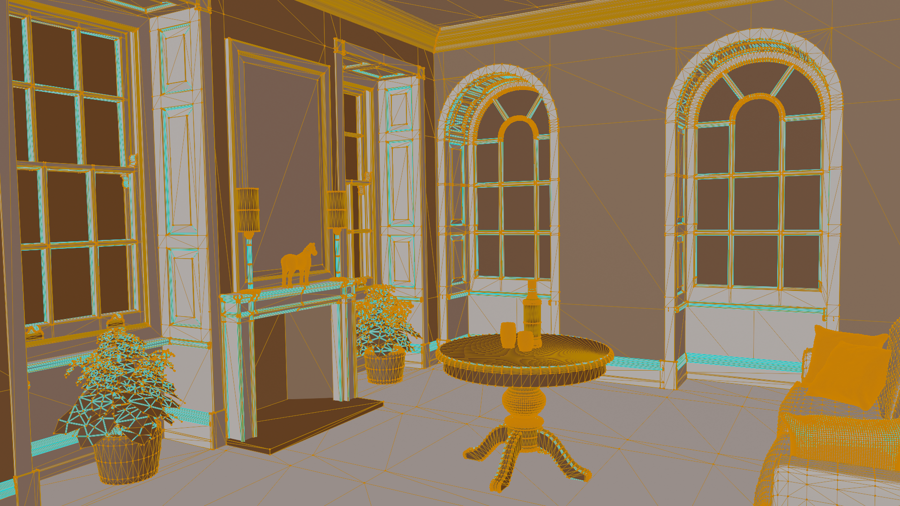

Slide 23
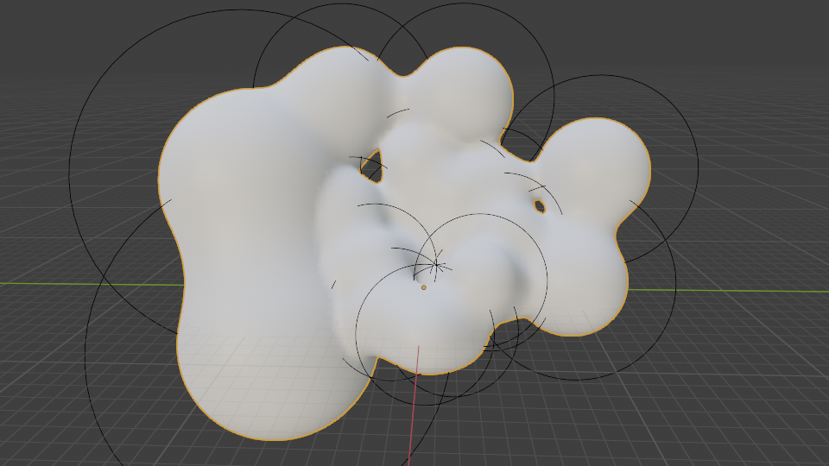
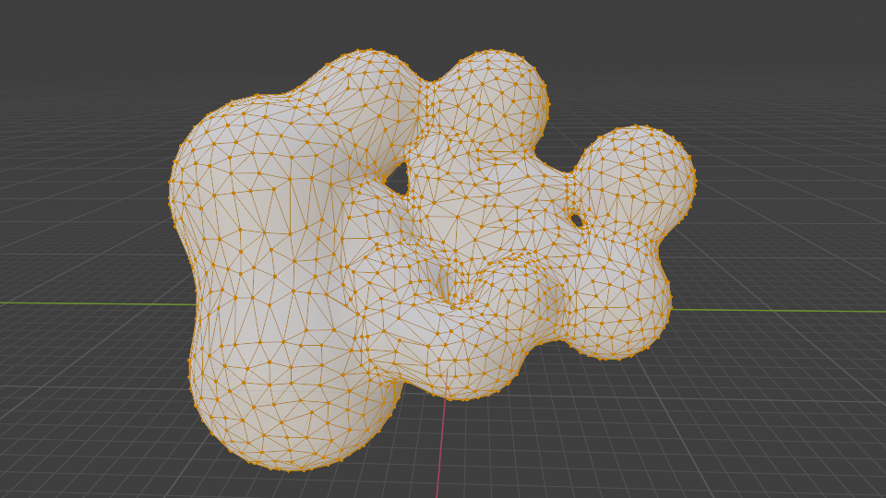
Why triangles?
Are objects that we have seen created using triangles?
  NO!
Modeling is often done using different shape representations
  It is very often that different shape representations are turned into triangles before/during rendering stage - using triangulation.
Triangle is most widely used primitive for surface shape representation
  Simple
  Efficient for storage and transfer
  Efficient for rendering
Metaballs: implicit representation
Triangulation

Slide 24
Other shape representations
Various representations for 3D models exists.
  Some are better for modeling
  Other are better for rendering (triangulated mesh).

Slide 25
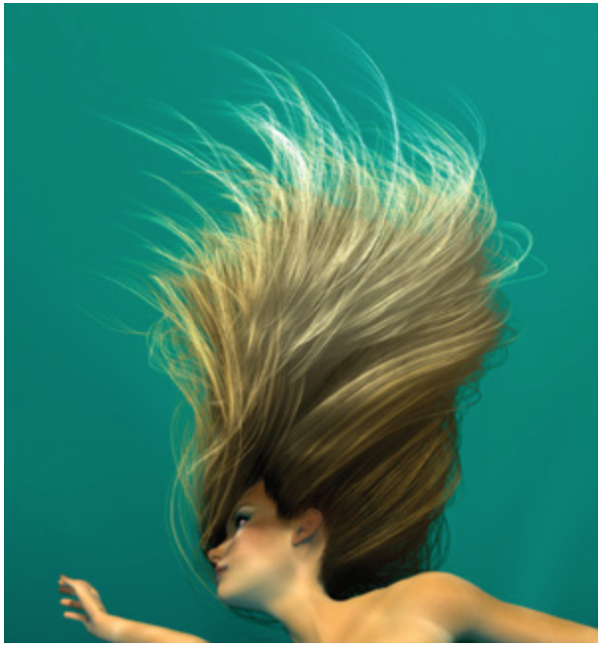

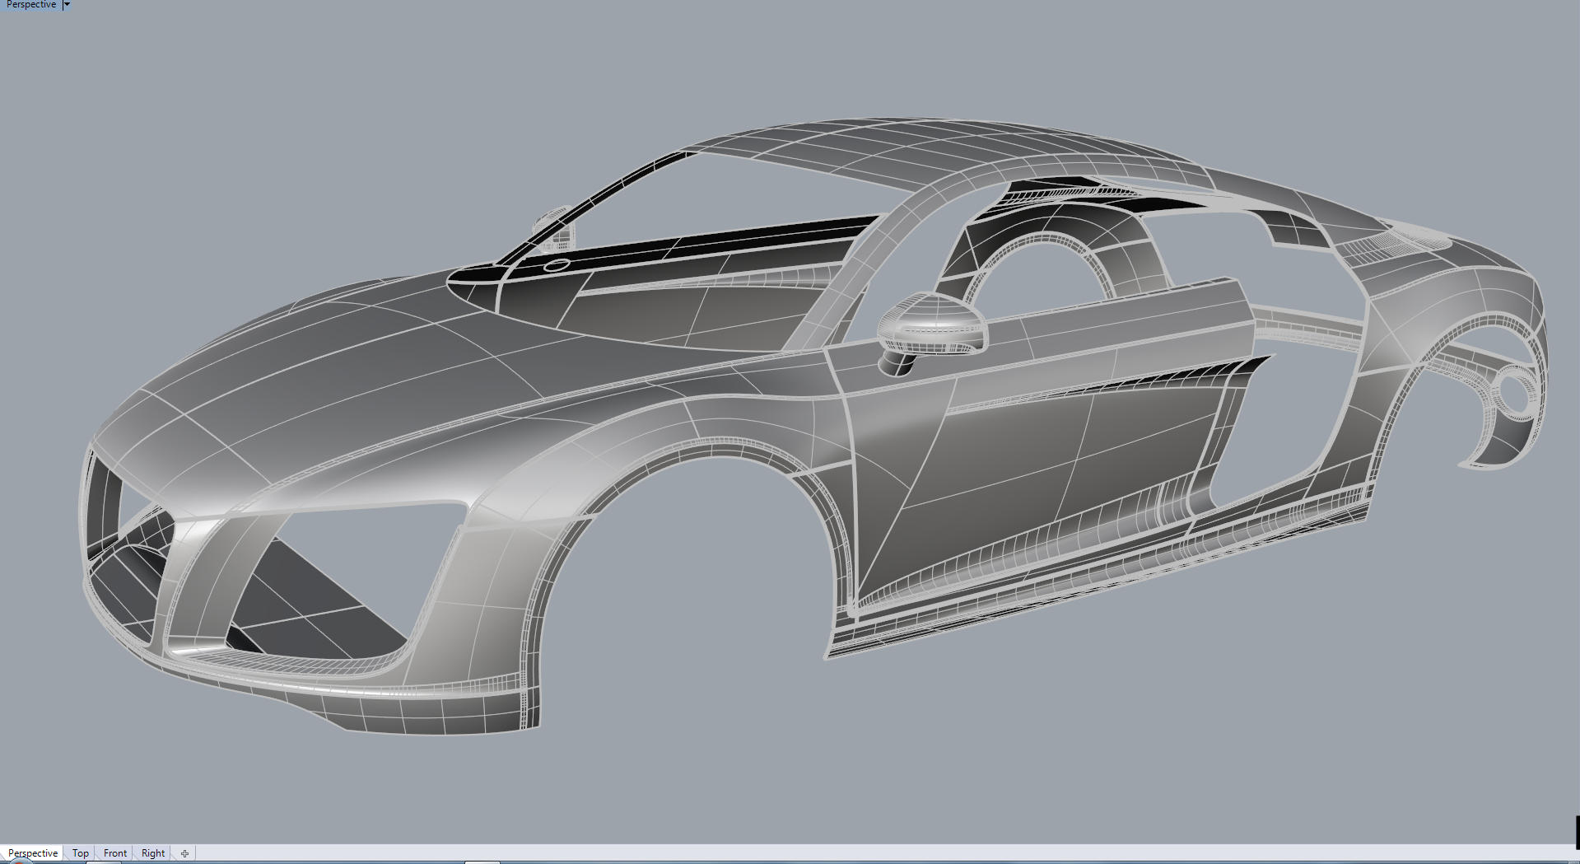
Shape representations for modeling
In professional software, various shape representations for efficient modeling exist.
Parametric surfaces: https://forums.cgsociety.org/t/audi-r8-v10-2010-nurbs-model-with-rhino-3d/1761843/3
Implicit surface representation: https://www.shadertoy.com/view/ld3Gz2
Hair modeling using parametric curves: https://developer.nvidia.com/gpugems/gpugems2/part-iii-high-quality-rendering/chapter-23-hair-animation-and-rendering-nalu-demo

Slide 26
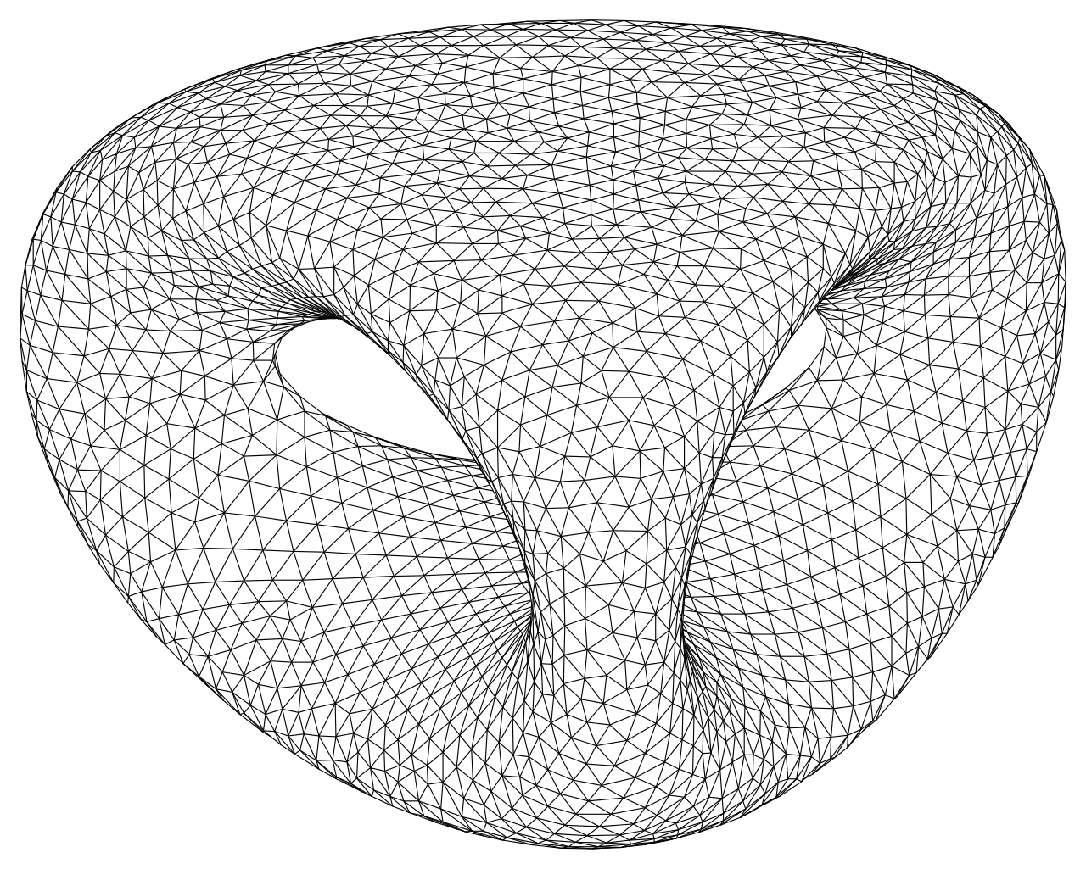
Shape representations for rendering
Almost always prior rendering, different shape representations are converted to triangulated mesh for efficient rendering.
  One representation for rendering makes rendering process highly efficient
  Graphics cards (graphics processing units, GPU) is highly efficient for processing triangles
  Lot of research and hardware development was focused onto efficient rendering of triangles*.
* It is easy to imagine that different rendering primitive is used. But due to historical events this turned out to be a triangle. What is important to note is that mapping of various representations to triangle mesh is possible and thus it is not important which is the rendering primitive as long as it supports various representations.

Slide 27
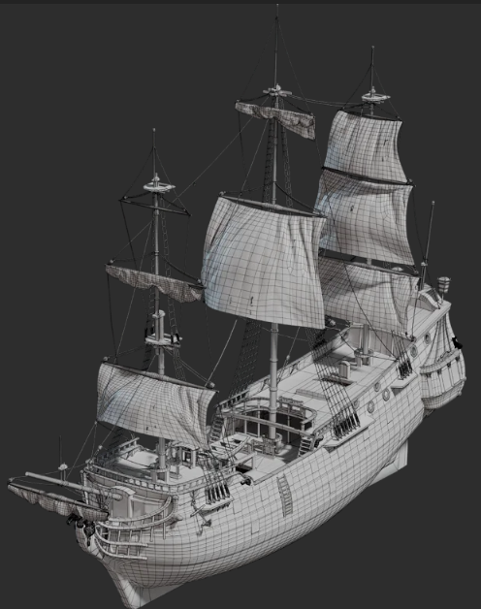
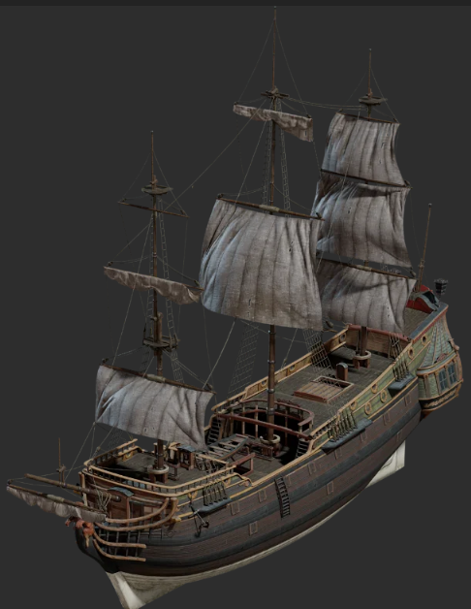
Object material
Shape defines what is visible, material defines how it looks.

Slide 29
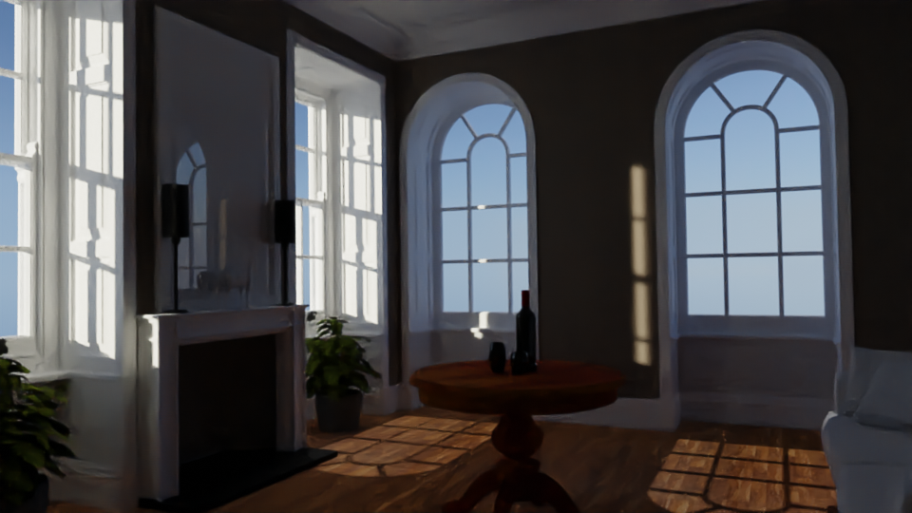

Slide 30

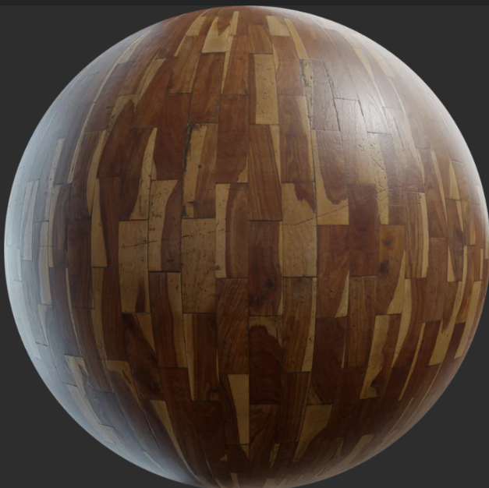
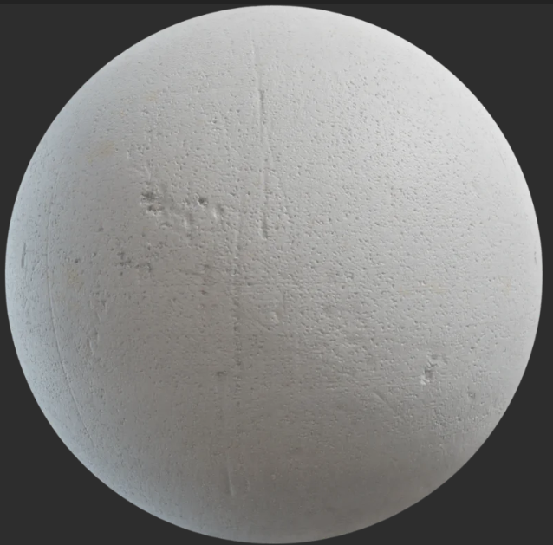
Material modeling

Slide 31
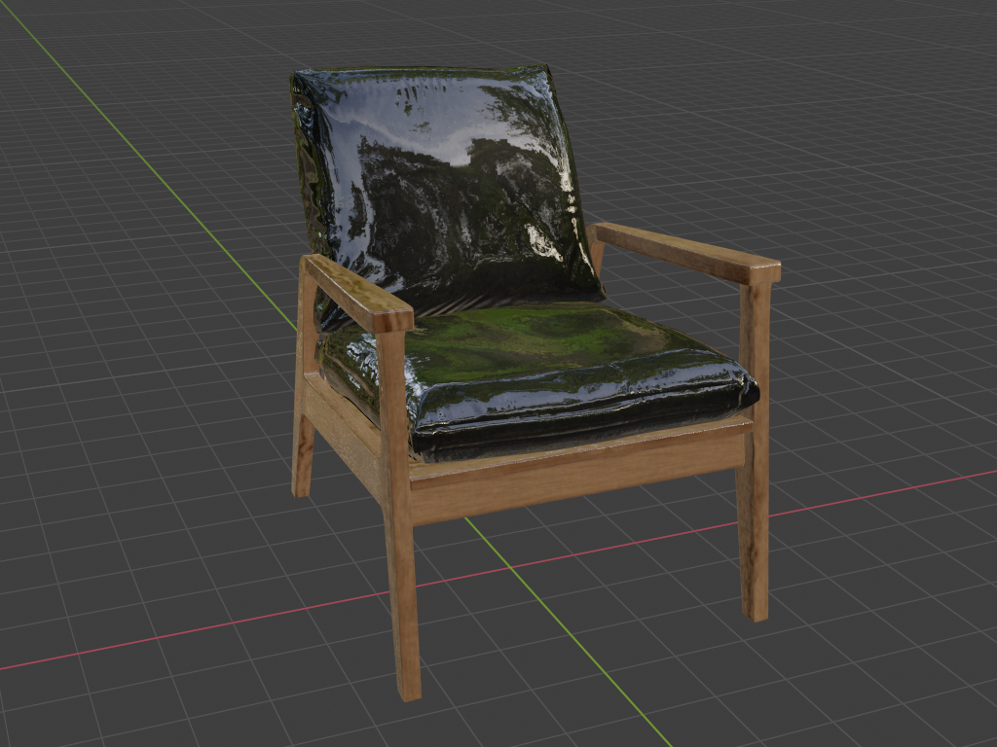
3D objects: appearance
Shape
Shape + Material: object appearance greatly depends on material.

Slide 32
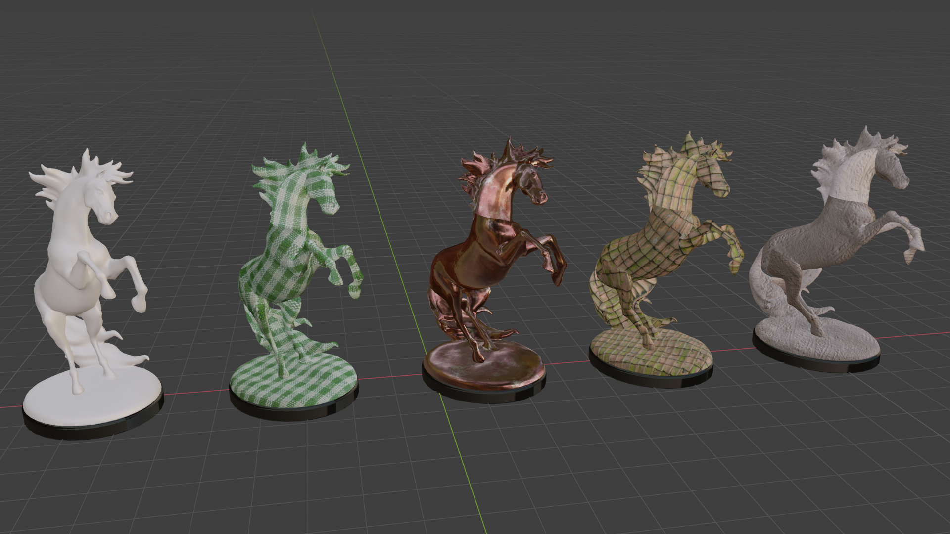
Material and shape
Material and shape can be modeled separately.

Slide 33
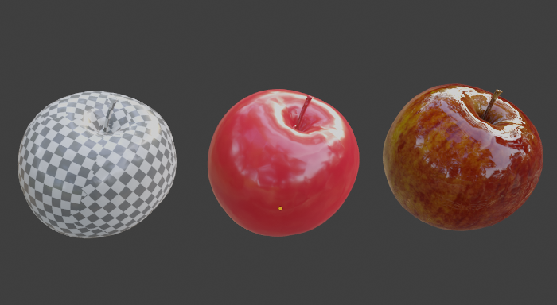
Material
Defines light-matter interaction → object appearance
Material modeling is decomposed into:
  How light scatters on surface → scattering model
  Variation of scattering function parameters and small scale geometry over surface → texture
Geometry
Scattering model
Texture

Slide 34
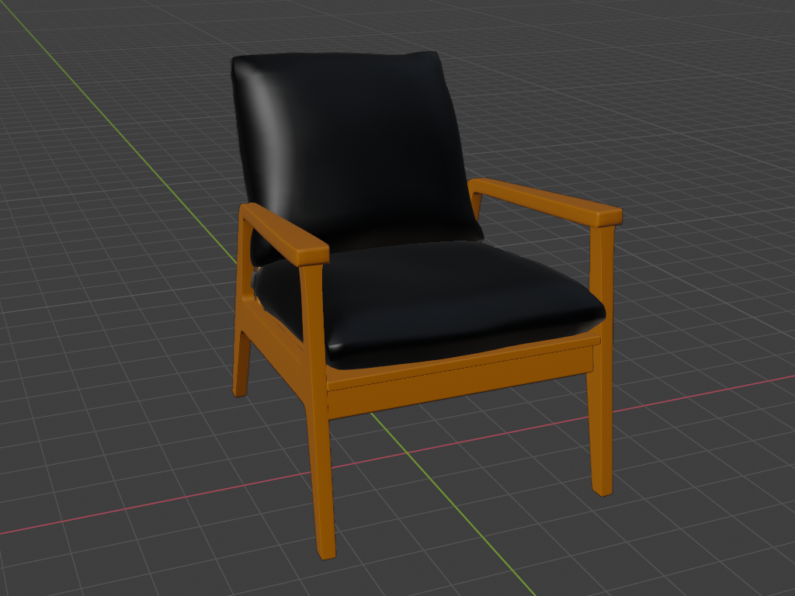
Material
Uniform material parameters
Material is defined using only scattering model*
Varying material parameters
Material is defined using scattering function and texture

Slide 35
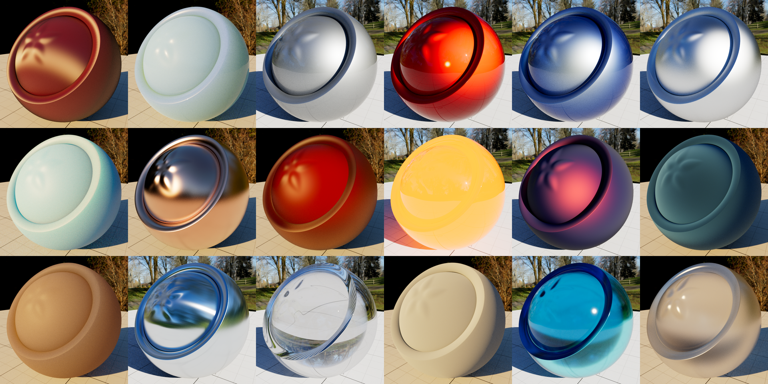
Material: scattering model
Defines if object appears like:
  Metal
  Plastic
  Glass
  Glossy
  Matte
  Reflective
  Transmissive
  Etc.
https://appleseedhq.net/gallery.html

Slide 36
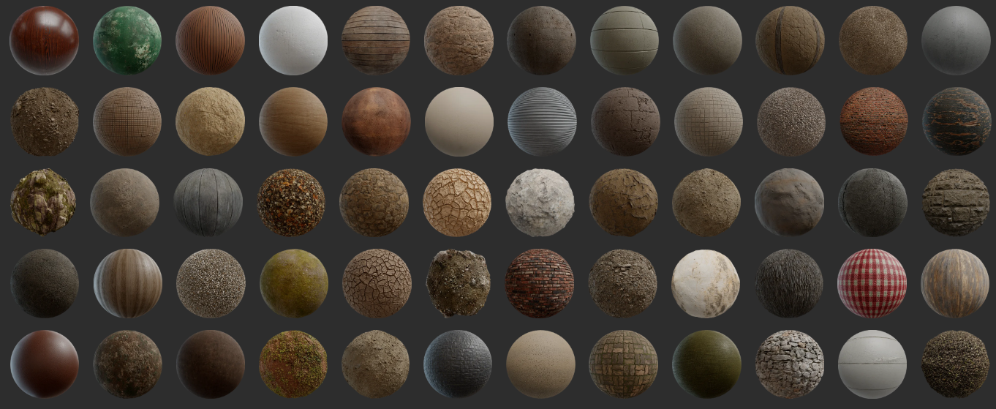
Material: texture
Gives look and feel to the object:
  Wood
  Dirt
  Cloth
  Fabric
  Rock
  Brick
  Plaster
  Finishing
  Imperfections
  Etc.
https://polyhaven.com/textures

Slide 37
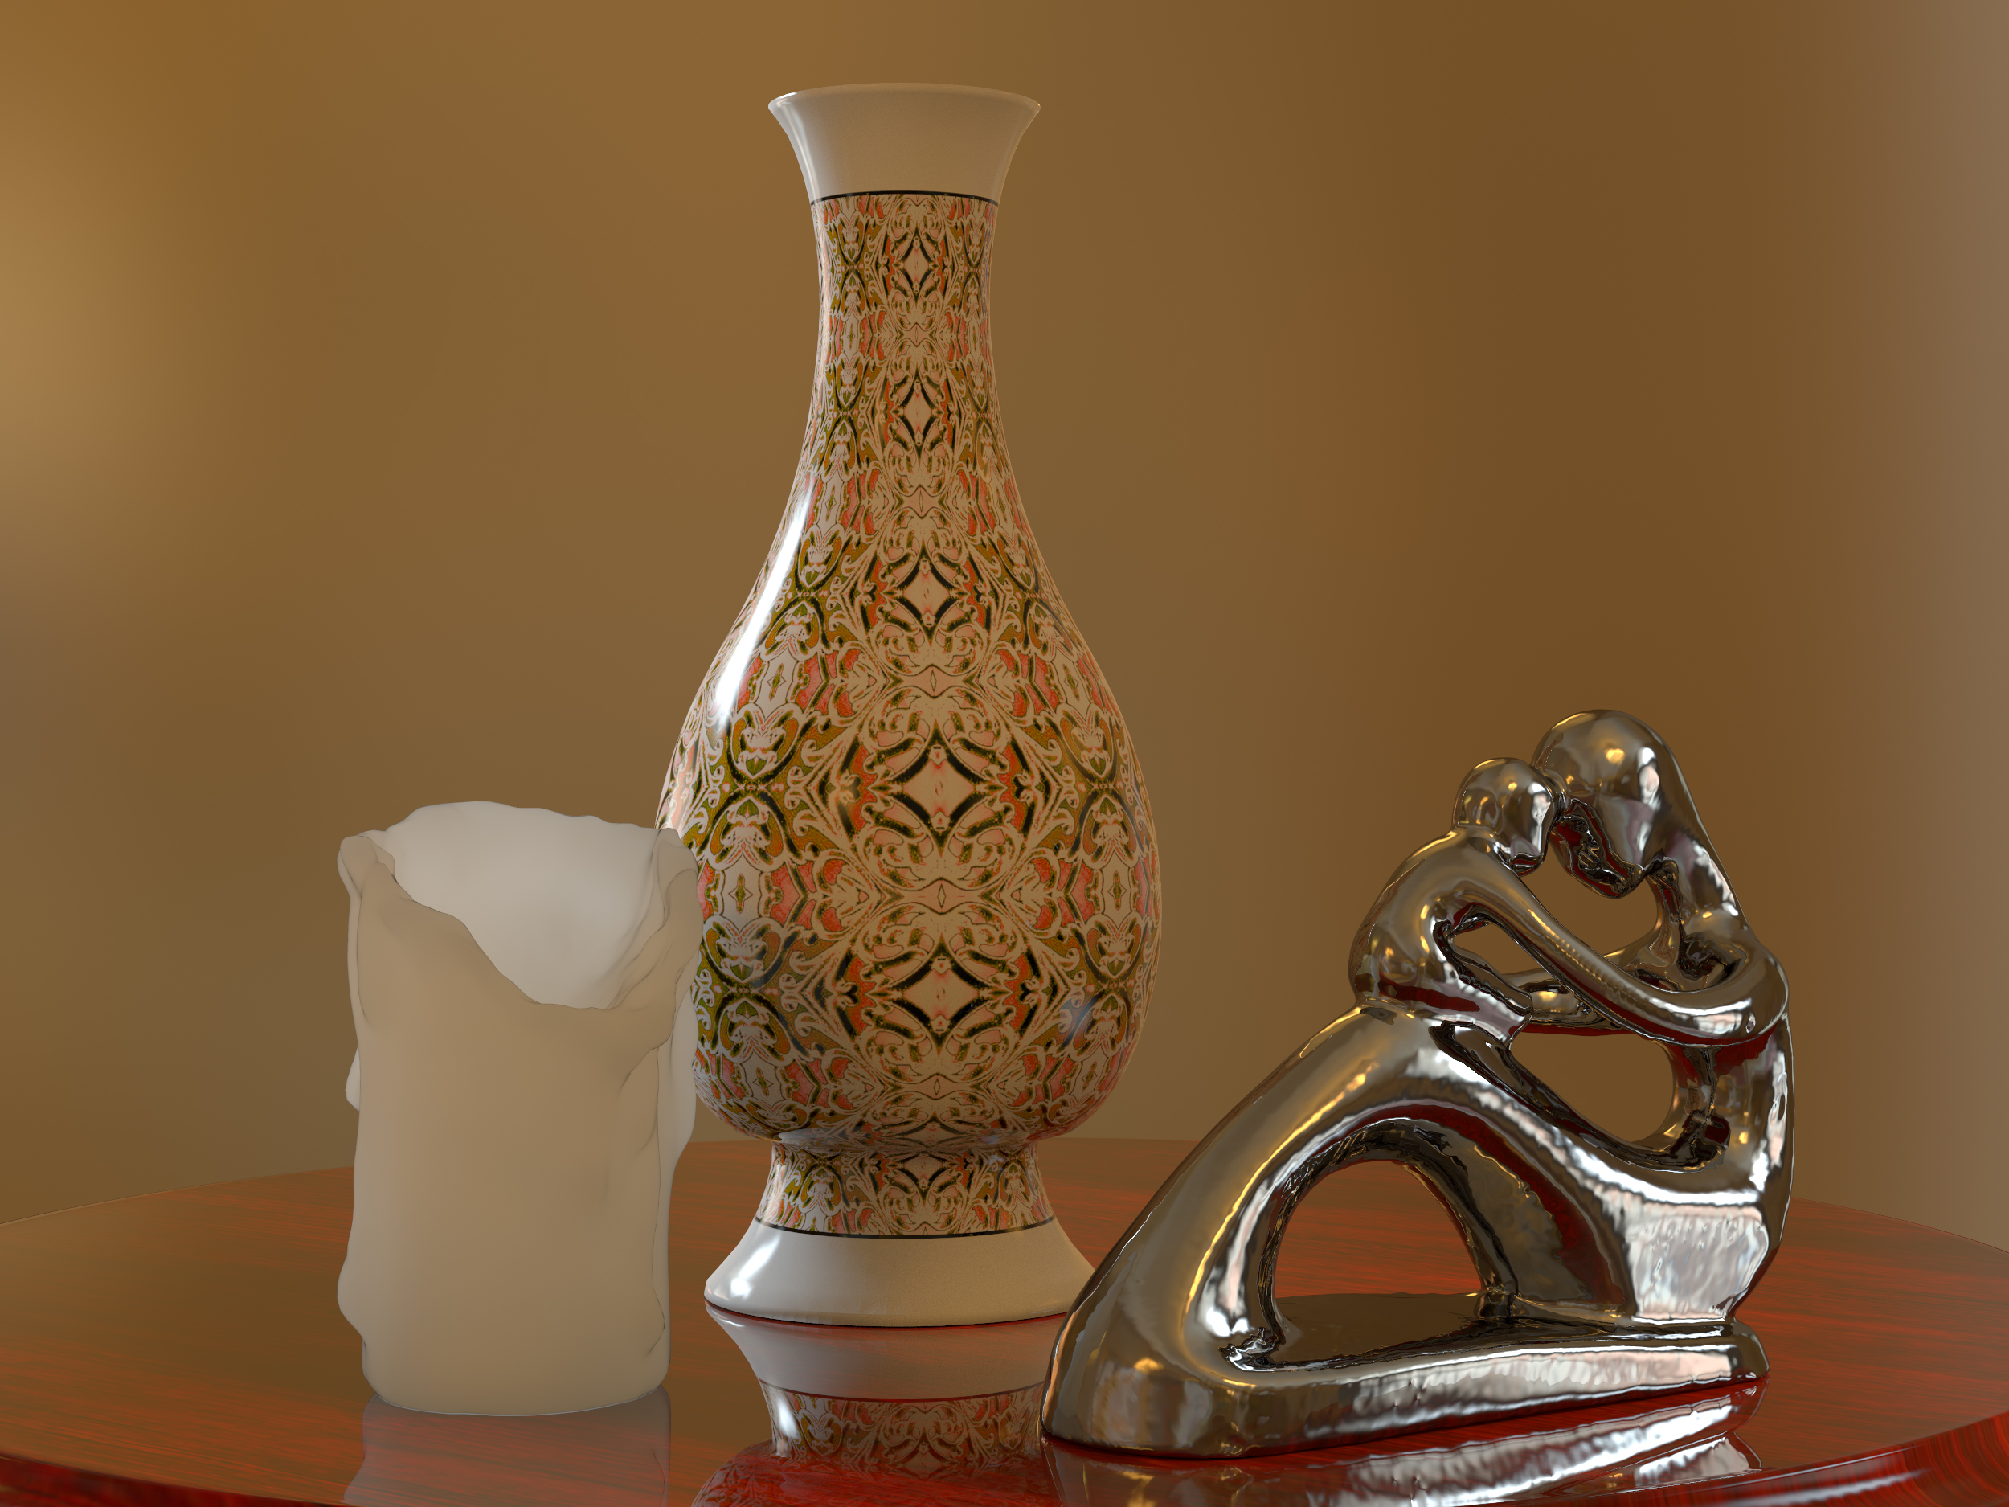
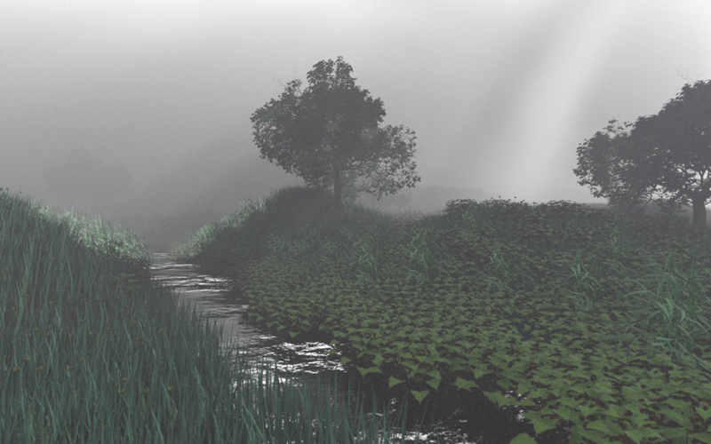
Material
Generally, material defines:
  How light travels between objects: participating media, e.g., fog
  How light interacts with surfaces: surface scattering, e.g., metals
  How light interacts sub-surface, e.g., wax, leafs

Slide 38
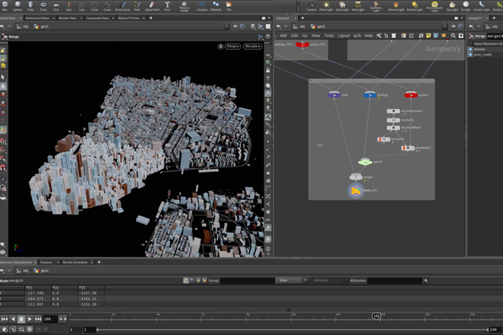

Creating 3D scene objects
Interactive modeling using digital content creation (DCC) tools:
  Blender and Houdini
https://www.sidefx.com/products/houdini/
Autodesk modeling tools: https://www.autodesk.com/
Cinema 4D: https://www.maxon.net/en/cinema-4d
https://www.blender.org/

Slide 39
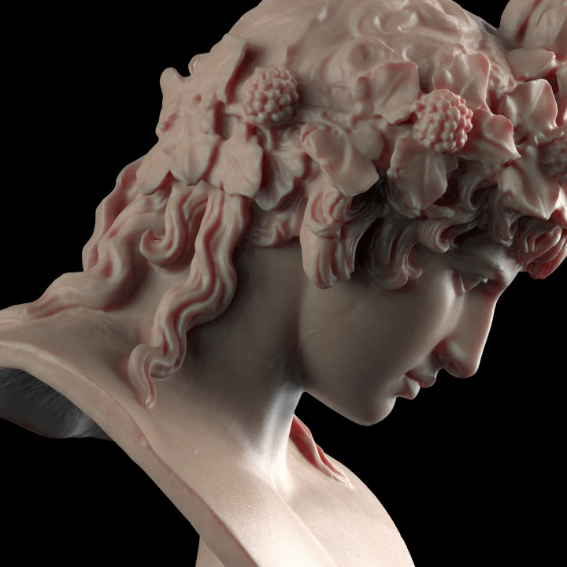
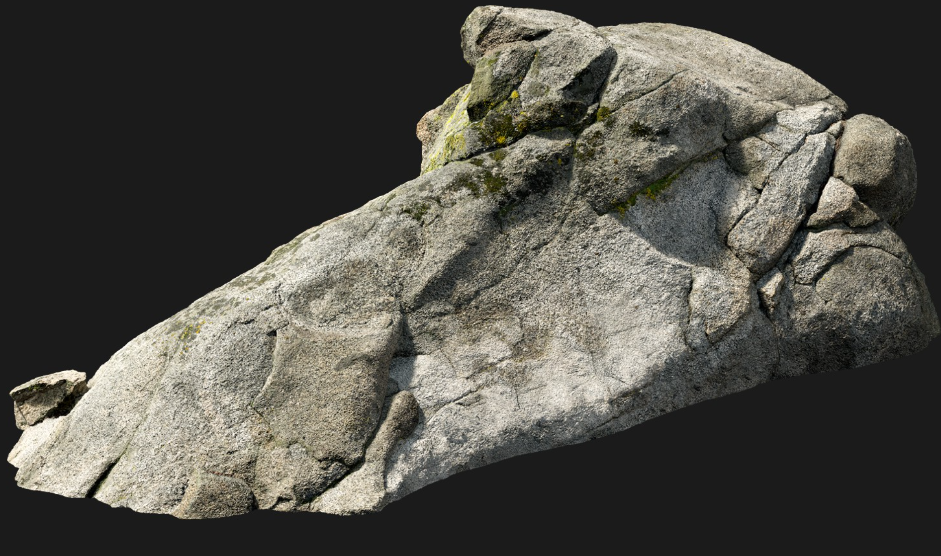
Creating 3D scene objects
3D scanning can be used to “import” real object into digital world.
https://www.myminifactory.com/object/3d-print-bust-of-antinous-as-dionysus-50345
https://quixel.com/megascans/home/

Slide 40
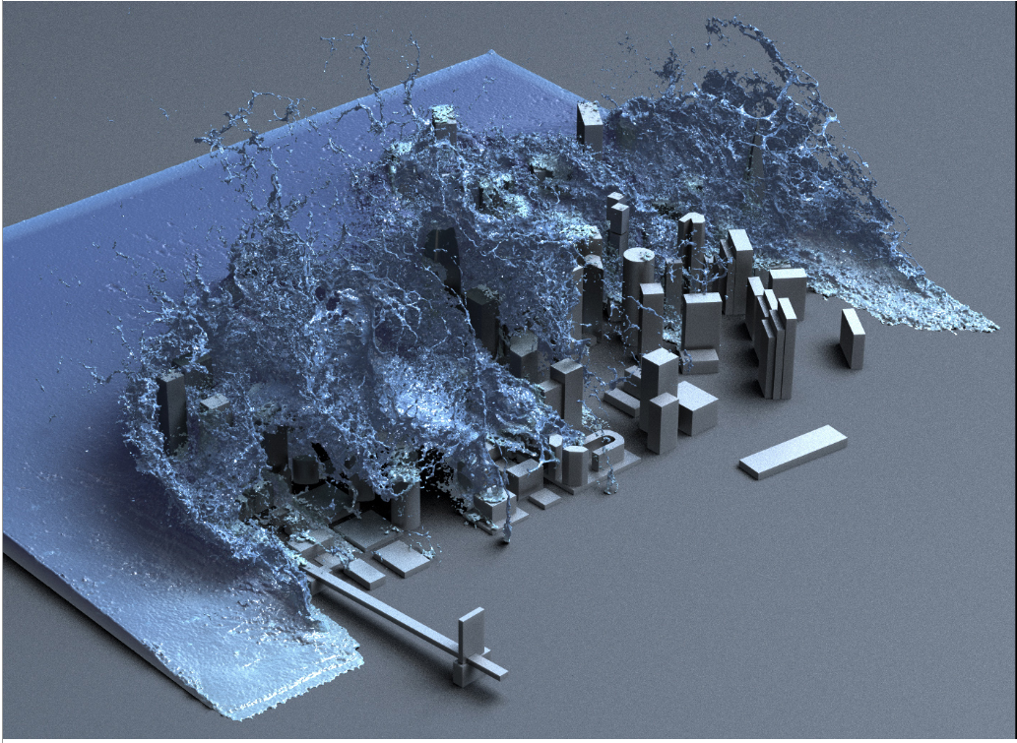
Creating 3D scene objects
Simulations
  Some objects are very hard to model by hand and capture from a real world.
  Procedural and physical simulations are employed to generate shape.
https://people.csail.mit.edu/kuiwu/gvdb_sim.html

Slide 41
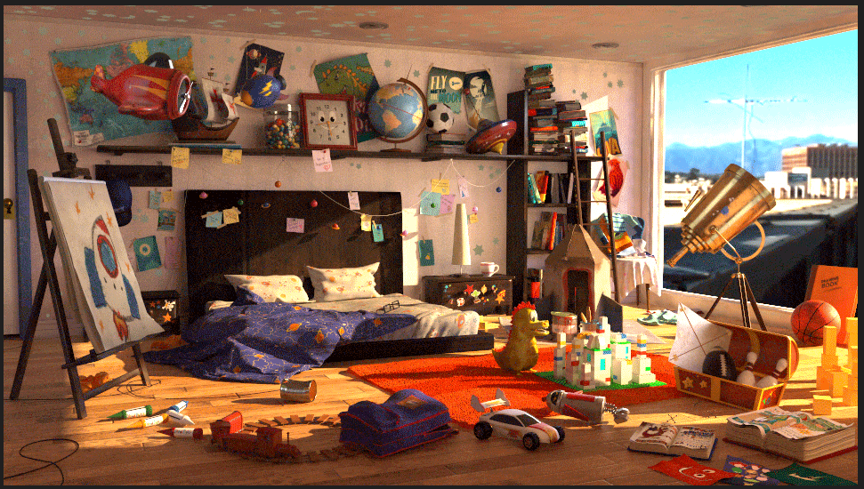
Light in 3D scene
https://discover.therookies.co/2018/06/24/learn-how-to-light-and-render-like-a-pixar-artist/

Slide 42
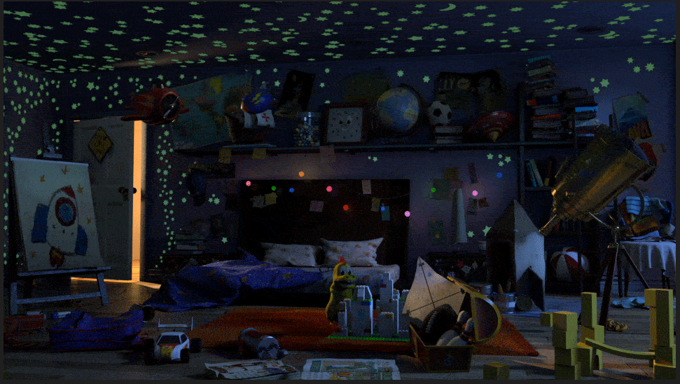

Slide 43
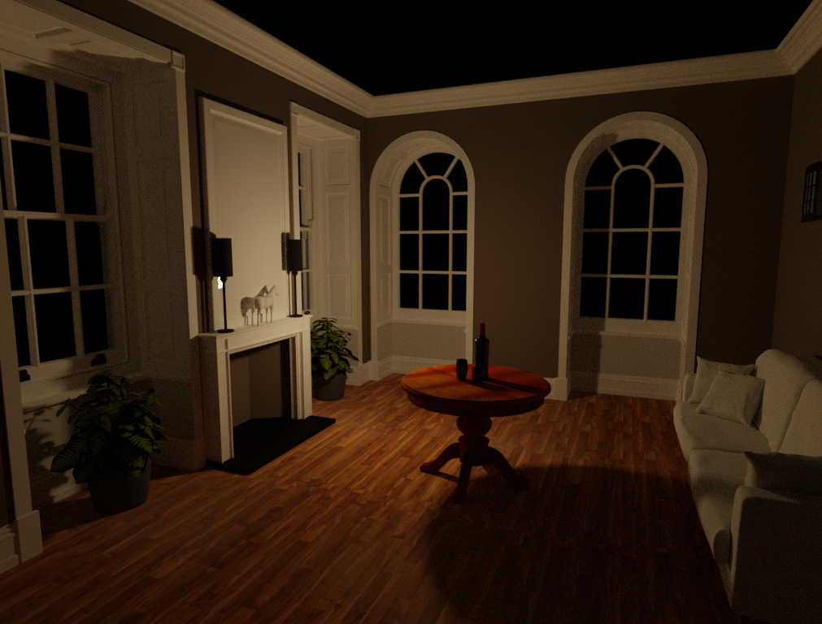
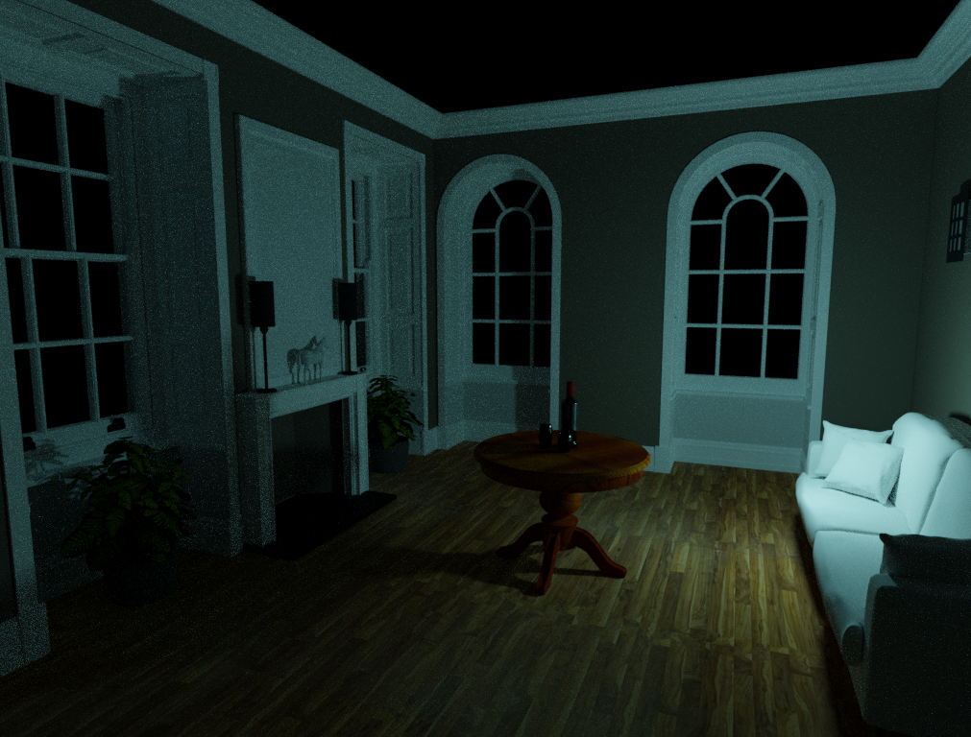
Lights
Light sources define:
  Position and direction
  Color and intensity

Slide 44


Lights
Light sources can further have:
  Size
  Shape
Physical lights have size and shape
Non-physical lights only determine position/direction and intensity

Slide 45




Non-physical Lights
Fundamental light sources are:
  Point lights
  Directional lights
Non-physical lights: no shape or size!
https://www.scratchapixel.com/lessons/3d-basic-rendering/introduction-to-shading/shading-lights

Slide 46
Camera
Camera defines point of view and it is used to simulate effects of real-world cameras.

Slide 47




Camera
Fundamental camera model in computer graphics: pinhole camera:
  Eye (aperture)
  Focal length
  Film size
  (Lens)
Pinhole camera simplification

Slide 48


Camera
Camera defines portion of visible scene → viewing frustum
Amount of visible scene depends on:
  Film size
  Focal length

Slide 49

Animated objects
So far we have discussed static objects → single image
To introduce movement – animation we need time component
Animation:
  Movement of objects or their parts: scaling, translating, rotating
Rendering image after each movement in 3D scene → sequence of images → animation
https://www.3dart.it/en/character-movement-animations-to-download/

Slide 50


Animation
Animation describes change of a shape, material, position, illumination, viewing over time, etc.
Animation can be created:
  Interactive modeling: rigging, skinning, keyframing, etc.
  Procedurally: e.g., physical simulation
Animation can be:
  Pregenerated
  Generated at render-time
https://www.fudgeanimation.com/experiments/top-5-rigging-tips/
https://dreamfarmstudios.com/blog/what-you-might-not-know-about-the-vfx-component-of-the-3d-animation-pipeline/

Slide 51


Material: animation vs appearance
In context of appearance modeling, material defines how light interacts with surface
In context of animation, especially physically-based animation, material defines shape deformation, e.g., viscosity for liquids or stiffness for deformable objects
Houdini liquid simulation: https://martinfatnes.artstation.com/projects/8eRzEx
Houdini liquid simulation: https://mathildeb.artstation.com/projects/rRZWz5

Slide 52

Material: animation vs appearance
Animation: deformation of object shape
Material can be modeled separately
https://www.youtube.com/watch?v=ESShqTMvZWU&t=2s&ab_channel=MKGraphics

Slide 53


Interaction with 3D scene
Use user input to modify 3D scene
  Game engines: Godot, Unity, Unreal
https://www.orithegame.com/
https://unity.com/solutions/digital-twins

Slide 54
3D scene: recap
3D scene
  3D objects
  Lights
  Cameras
Rendering takes 3D scene information for generating image.

Slide 55
Rendering
A process of generating image from a 3D scene

Slide 56


Rendering
Rendering: generating images from a 3D scene.
Scene from: https://casual-effects.com/data/index.html (Sponza Palace in Dubrovnik). Rendered in Blender, EEVEE.

Slide 57

Rendering: generating images from a 3D scene.
3. Image
1. Scene modeling
Material modeling

Slide 58

https://www.artstation.com/lovro

Slide 59

https://www.artstation.com/lovro

Slide 60

https://www.artstation.com/lovro

Slide 61

https://www.artstation.com/lovro

Slide 62


Rendering: photo-realistic images
Photo-realistic images – images that look like a photograph* of a real world.
  To make objects appear as they do in real world, we need to simulate laws of physics: optics – light-matter interaction
Juan Carlos Gutiérrez: https://appleseedhq.net/gallery.html
Juan Carlos Gutiérrez: https://appleseedhq.net/gallery.html
* Note that there is also distinction between images that look like a real photo and that are “correct” like a real photo. In graphics, almost always it enough to create images that look like a real photo but the way they are produced doesn’t necessary be correct in terms of how real world works. Again, this is trade-off between quality and speed and decision depends on application.

Slide 63


Rendering: non-photorealistic images
Non-photo-realistic (NPR) images* – images that contain wide range of expressive styles.
Enthymeme: https://appleseedhq.net/gallery.html
https://appleseedhq.net/gallery.html
* Specific look of NPR images often comes from exaggerating some characteristics of 3D scene or rendering algorithm. Therefore, it is better to start with photo-realistic rendering and then altering this method to obtain required style in NPR.

Slide 64
Rendering
In both cases, image is generated using certain rendering method.
Rendering process takes 3D scene information and creates 2D image.

Slide 65

Rendering: simulating visual system
Foreshortening effect: objects that are further appear smaller than those which are closer
Important for photo-realistic rendering since it simulates how our visual system works
  It defines shape and size with respect to the distance to the eye.
Foreshortening effect: trace rays from corners of objects to eye and intersecting them with imaginary canvas that lies in between → perspective projection.
Direct result of such method is called wireframe rendering.

Slide 66
Rendering: visibility problem
Camera placed at certain point of view covers only small portion of 3D scene
Visibility problem*: determine if two points in 3D scene are visible (not obstructed)
  Determine which objects are visible from camera
  Determine which surfaces are visible to each other in 3D scene
Solving the visibility relies in object shape information
Solution to visibility problem in computer graphics can be solved using two main methods:
  Rasterization**
  Ray-tracing
https://techpubs.jurassic.nl/manuals/nt/developer/Optimizer_PG/sgi_html/ch05.html
* Also known as: hidden surface elimination, hidden surface determination, hidden surface removal, occlusion culling and visible surface determination
** This is umbrella term and some popular methods are painter’s algorithm and z-buffer. Almost all GPUs use an algorithm from this category.

Slide 67


Rendering: visibility problem
Camera: what is visible?

Slide 68
Rendering: appearance
Once visibility problem is solve; which geometry is visible from certain viewpoint, appearance of object is calculated
  Appearance: The look of objects in terms of color, texture and brightness.
Object appearance depends on:
  Object shape and material
  Illumination
  Camera viewpoint
Appearance of object is simulated using shading

Slide 69
Rendering: shading
Shading defines interaction of light with object material
  Gathering light falling on surface → light transport
Implementation of mathematical model which simulates light interaction with surface is called a shader.
Real-world light-matter interaction is complex topic.
  In CG there is always trade-off between quality of image and rendering speed.

Slide 70


Rendering: shading
Absorption and reflection
Specular reflection
Light falling on an object can be: absorbed or reflected
Absorption gives objects their unique color. If white light (containing all colors) falls onto object which absorbs all colors except red – which is reflected, we perceive this object as red.
  Color of object is one foundational material information of an object.
Scattering. Light which is not absorbed is scattered. Direction of scattering depends on:
  Surface orientation → surface normal vector.
  Scattering model – a model which describes what happens with light as small scale. This model can have uniform parameters or varying parameters – giving textured look
Diffuse and specular reflection

Slide 71

Rendering: light transport
Crucial information for shading is amount of light falling on surface → light transport
Light is emitted from light sources, reflects from objects and eventually might fall into camera → forward tracing
  Extremely expensive to calculate complete light behavior in whole scene.
Backward tracing: starting from camera, find visible objects and incoming light from there

Slide 72

Forward tracing
https://www.youtube.com/watch?v=frLwRLS_ZR0&ab_channel=WaltDisneyAnimationStudios

Slide 73

Backward tracing

Slide 74

Forward tracing is expensive!

Slide 75
Forward tracing
Object surface which is visible from camera might receive light from any light source or surface which is facing.
Amount of light which falls into camera is extremely small. Thus rendering employs light transport only for visible surfaces starting from the camera and only for relevant light paths.

Slide 76


Local and global illumination
Taking in account only light from light sources → direct (local) illumination
Taking in account light reflected from other objects → indirect illumination
Simulating direct and indirect illumination → global illumination
  Often solved with ray-tracing based methods: path tracing
  Another approach: radiosity
https://en.wikipedia.org/wiki/Global_illumination

Slide 77

Rendering: recap
Rendering:
  Solving visibility problem: what is visible from camera point of view
    Perspective projection
    Object shape
  Shading: calculating appearance of visible objects
    Material and shape of object
    Viewing direction
    Light falling on the object: light-transport (again, visibility problem)

Slide 78
Practical rendering
In practice, rendering is implemented using
  Rasterization
  Ray-tracing
These two methods are essentially solving visibility problem
Shading is influenced by this choice since it depends on visibility problem

Slide 79



Rasterization
Visibility problem is solved by projecting object on surface of canvas from given point of view
  Project point P onto screen to compute P’
  Perspective projection matrix
Object-centric approach

Slide 80


Ray-tracing
Trace rays from camera for each pixel on canvas and intersect objects in the scene → closest objects are visible ones
  Perspective camera
Image-centric approach

Slide 81

Scene
Blender, WorkBench
Scene: Crytek Spinoza (Sponza Palace in Dubrovnik)
https://casual-effects.com/data/index.html

Slide 82

Rasterization-based render
Blender, EEVEE
Scene: Crytek Spinoza (Sponza Palace in Dubrovnik)
https://casual-effects.com/data/index.html

Slide 83

Ray-tracing-based render
Blender, Cycles
Scene: Crytek Spinoza (Sponza Palace in Dubrovnik)
https://casual-effects.com/data/index.html

Slide 84
Rasterization vs ray-tracing
Rasterization can quickly determine visibility but has limited shading capabilities when it comes to light transport
  Geometry (object shape) is projected onto canvas and large amount of information is lost
  Mainstream method for used by graphic cards and in real-time rendering
Ray-tracing has advanced shading possibilities when it comes to light-transport but it is slow
  Shadows, soft shadows, reflections, refractions, volumetric scattering, etc.
  Easier to create photo-realistic images
  Often requires acceleration-structure for solving visibility problem

Slide 85


Practical rendering
Blender EEVEE: rasterization-based rendering engine
Blender Cycles: ray-tracing based rendering engine

Slide 86


Practical rendering
Projects!
Programming your own rasterization-based rendered:
  https://learnopengl.com/
Programming your own ray-tracing based rendered:
  https://raytracing.github.io/

Slide 87
Image
A result of 3D scene rendering

Slide 88




Image and display
Rendered image is displayed on raster devices → raster images
  Raster: array of pixels → discretization
Raster images: collection of pixels with color values (R,G,B)
https://www.mathworks.com/help/images/image-types-in-the-toolbox.html

Slide 89



Image and display
Limitations of display device and raster discretization cause problems:
  Aliasing
  Display gamut
https://www.gamedesigning.org/gaming/anti-aliasing/

Slide 90


Image post-processing
Example: color-grading for achieving desired look on rendered image
https://advances.realtimerendering.com/other/2016/naughty_dog/NaughtyDog_TechArt_Final.pdf

Slide 91
Merging all together
3D scene, rendering and Image

Slide 92
Image synthesis: big picture
3D scene, rendering and resulting image are highly intertwined elements of image synthesis process
3D Scene
Image
Rendering

