Slide 1
Imaging pipeline and post-processing

Slide 2
Display and images

Slide 3
Digital imagery
Digital imagery appears in all forms of media. Most of these are:
  Digital photos or other types of 2D pictures scanned or loaded in computer
  Generated in 3D using modeling and rendering software
  <image: variety of digital images: real, rendered, video, photo>

Slide 4
Display device
Images are shown on a display device
  e.g., monitor, television screen, etc.
  <images: variety of display devices>
Display devices are adapted for showing raster images → raster display devices
Raster display device is made of arrays of pixels → discrete representation
  For example, each pixel of image created with digital camera (and thus rendering) stores red, green and blue value used to drive the red, green and blue values of screen pixel.
  <image: raster device and raster image>

Slide 5
Rendering speed
Number of rendered images for display per second is called frames per second (FPS):
  Real-time graphics > 60 fps
  Interactive graphics 1 < x < 20 fps. TODO
  Offline graphics < 1 fps

Slide 6
Raster image graphics
Raster images are rectangular array of values called pixels.
All values in such have same type, examples:
  Floating point numbers representing levels of gray
  Floating point triplets representing mixture of red, green and blue (RBG)
  Floating point numbers representing depth from camera
Such rectangular array of numbers can be interpreted in many ways
  This is powerful since we can store/encode any information in such array
  Numbers in array do not have particular significance until stored in certain standardized file format

Slide 7
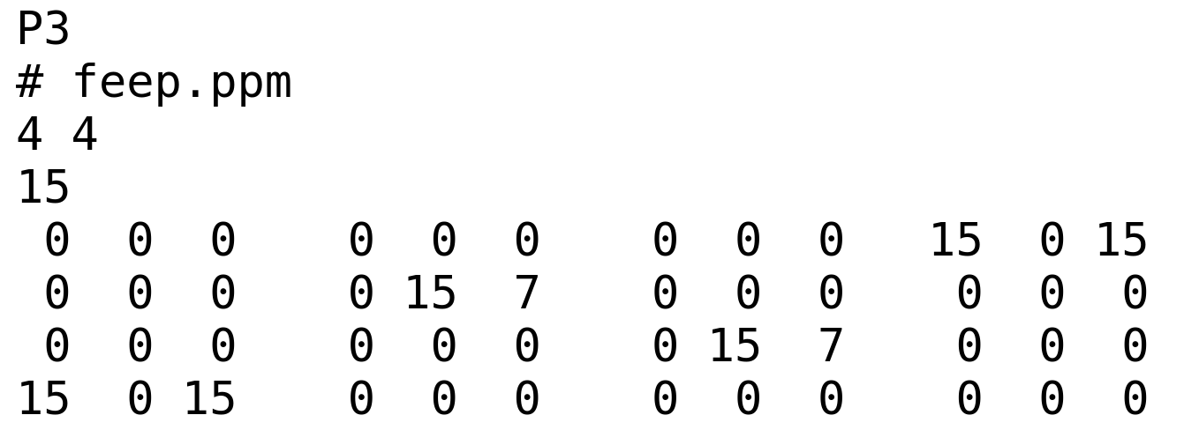
Naive image file format: PPM
Portable Pixel Map (PPM) text-based* version file format is useful for understanding how basics of image organization works
Header:
  Width (w) and height (h) of image is specified
  Maximum color value
Pixel values:
  3 * w * h color values representing red, green and blue components of pixel
  Pixel values ordering: left-to-right, top-to-bottom
  Separated by white-space
Notes:
  Easy to write and analyze
  Inefficient and highly redundant (compression is not present)
  Little information about image
* Text-based version carries code P3, binary version carries code P5. More information: https://netpbm.sourceforge.net/doc/ppm.html

Slide 8
Raster image file formats
Images are stored in many formats; typically the storage format closely related to the display format
File formats use different compression strategies:
  Lossless compression is one in which data occupies less space but from which original data can be reconstructred.
  Lossy compression is resulting in even less occupied space, but original data can not be restored. Nevertheless, existing data is enough for intended use
In some cases, content is described in terms of channels
  e.g., red values for all pixels represents red color channel
  e.g., depth values form depth channel
  e.g., transparency values from alpha channel
Some formats store metadata
  e.g., bit depth of color channed (e.g., 8 bit)
  e.g. information on when and with which program the image was produced

Slide 9
Tip: file formats in production
Blender: https://docs.blender.org/manual/en/latest/files/media/image_formats.html
Houdini: https://www.sidefx.com/docs/houdini/io/formats/image_formats.html

Slide 10
Raster image file formats
Examples of often used raster image file formats are:
  Tag Image File Format - JPEG
  Portable Network Graphics - PNG
  Tag Image File Format - TIFF/TIF
Examples of advanced image file formats:
  OpenEXR (https://github.com/AcademySoftwareFoundation/openexr)
  High Dynamic Range Image - HDRI
Library for handling different file formats for computer graphics applications: https://github.com/OpenImageIO/oiio

Slide 11
JPEG
Most digital cameras produce JPEG images
Thus they are de-facto standard for storing gray or RGB values
This format is lossy
  Problematic for comparing the image due to differences in compression algorithm

Slide 12
PNG
PNG file format is more compact than PPM and equally easy to use.
Lossless data compression
Developed as an improved replacement for Graphics Interchange Format (GIF)
Supports:
  RGB images with and without alpha channel
  Grayscale images with and without alpha channel

Slide 13
TIFF
TIFF images store multiple channels
  Each channel store description of contents
TIFF is ideal for representing intermediate or final results
  In image editing and compositing tools, multiple images are often blended or laid atop one another
Compression
  uncompressed
  Compressed with lossless scheme
  Compressed with lossy scheme

Slide 14
Note:vector graphics images
Alternative to raster graphics image is vector graphics image
  Images are created directly from geometric shapes defined on 2D Cartesian coordinate system.
  Information in such image is stored as points, lines, curves and polygons
Today, raster-based monitors and printers are typically used
  Nevertheless, vector data and software is used in applications where geometric precision is required: engineering, architecture, typography
  To display an image, rendering is performed to evaluate analytically defines shapes on raster display

Slide 15
Sampling and reconstruction
Clash between continuous and discrete representations

Slide 16
Continuous and discrete
Due to raster display devices, rendered images must be discrete array of pixels
3D scene color values, on the other hand, are continuously changing
Rendering process, in order to create a discrete image of 3D scene, samples the pixels on film plane and for each sample calculates color
Quality of final discrete 2D image is highly determined by:
  How is the sampling of pixel performed
  Methods which combine pixel samples in pixel color
<image: 3D scene which is cont and image which is discrete>

Slide 17
Image: show how discretization process can cause aliasing for motivation, aliasing will be then explained

Slide 18
Scene sampling and Image buffer
Process of rendering images is inherently a sampling task
Generation of image is the process of sampling a 3D scene in order to obtain colors for each pixel in the image
  In rendering process, camera description is used to generate samples on film plane for which color is calculated
  Color of each pixel for each sample is stored in image buffer – intermediate representation of image used by renderer
  Final image is reconstructed from pixel samples
3D scene is continuous description which must be discretized for display
  Doing so, the amount information is reduced → problems!

Slide 19
Aliasing
Sampling process might result in aliasing – an unwanted artifact in spatial or temporal domain (spatial vs temporal sampling)
  Aliasing happens if signal is sampled at too low frequency than the original and thus reconstruction can not be done correctly
  Sampling frequency must be twice the maximum frequency of signal which is sampled – sampling theorem – Nyquist rate/limit
  As maximum frequency must be present, signal must be band-limited
3D scenes are normally never band-limited when rendering with point samples
  Edges of triangles or shadow boundaries produce signal that changes discontinuously and produces frequencies which are infinite
  Any rapid change of color can cause aliasing problems: specular highlights
  Also, pixel footprint in the scene may contain lots of objects which are hard to sample even with dense number of samples per pixel
Point sampling is almost always used and entierly avoiding aliasing is not possible
At times, it is possible to know when the signal is band limited and then anti-aliasing is performed
  Example is texture usage: frequrency of texture sampling can be compared to sampling rate of pixel and if texture sampling is higher then algorithms for band limiting the texture are used.
Sampled signal must be reconstructed to recover original signal → filtering - final image is reconstructed from pixel samples

Slide 20
Examples of aliasing:
  Jagged edges of line or triangle edge, flickering highlights (firelfys)
  TODO: images

Slide 21
Antialiasing*
Different methods:
  Tradeoff between: quality, ability to capture sharp details or other phenomena, appearance, memory, speed and computing power
Screen-based antialiasing methods:
  Operate only on the output samples of the pipeline
RTR 5.4.
https://www.pbr-book.org/3ed-2018/Sampling_and_Reconstruction/Image_Reconstruction
* In terms of signal processing this can be seen as sampling, filtering and reconstruction.

Slide 22
Antialiasing: sampling rate
Often problem causing aliasing is low samping rate
Let’s see what happens with one sample per pixel:
  TODO RTR fig 5.24
Let’s see what happens with four samples per pixel:
  TODO RTR fig 5.24

Slide 23
Antialiasing: sampling rate
By using more samples per pixel and blending those in some fashion a better pixel color can be computed
Screen-based antialiasing schemes:
  Sampling pattern is used for the screen
  Samples are points samples
  Pixel color is sum of weighted pixel samples

Slide 24
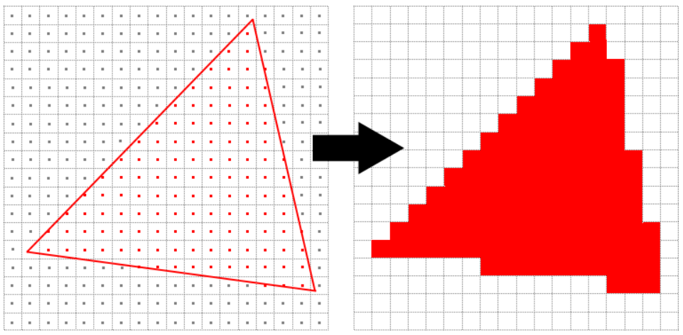
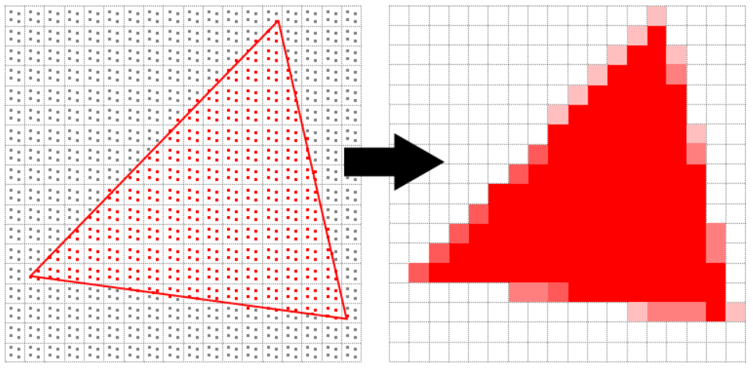
MSAA
Aliasing appears always when there are a lot of details under a pixel footprint in the scene
To solve this, multiple sample per pixels can be used to “catch” high frequency details.
  This method is called Multisample anti-aliasing (MSAA)
MSAAx4
https://vulkan-tutorial.com/Multisampling

Slide 25
Supersampling
Supersampling or oversampling Antialiasing algorithms take more than one sample per pixel
  Full-screen anti-aliasing (FSAA) or super sampling antialiasing (SSAA)

Slide 26
Limitations of display device

Slide 27
Limitation of display device
Display devices are limited in:
  Resolution (number of pixels)
  Brightness (intensity)
  Contrast
  Color (gamut)
Rendered images may contain values which can not be directly shown on display devices.

Slide 28
Display encoding
All input values (e.g., texture image) for rendering and all values during rendering must be in linear colorspace.
  Linear values are needed for correct addition and multiplication operations
On the other hand, display devices have nonlinear (power law) relationship between input voltage and display radiance
  Early display devices that were based on cathode-ray tube (CRT). As energy level applied to pixel is increased, the radiance emitted doesn’t grow linearly but according to power law. For example, pixel set to 50% will emit 0.5^2 amount of light.
  LCDs and other display devices mimic the CRT response, although have different intrinsic tone response curves.
  Relationship between digital values in image buffer and radiance levels emitted from the display is described with electrical-optical transfer function (EOTF)*
Problem 1: image which is rendered is in linear colorspace and will not display correctly if shown directly
  Linear values will appear to dim on the screen <image>
Problem 2: when working in modeling tools where we pick texture images or colors on screen, those colors are encoded for display device so we can see them properly
  They can not be used in rendering computation directly because they are in non-linear space: shading computations are correct for linear values <image>
When encoding linear color values for display, the goal is to cancel out the effect of display transfer function: inverse of display transfer function is applied to color values – gamma correction
  Standard transfer function for personal computer display is called sRGB
  <image: texture → decoding → shading → encoding → display (decoding)>
* also optical-electrical transfer function describe the other end of the process for image and video capture devices

Slide 29
Gamma correction
Gamma correction can be seen as last step in rendering and post-processing – when everything is computed and image is ready for display.
  To encode rendered image which is in linear colorspace (x) for sRGB display (y) the following formula is applied to all color values:
    y = x^{1 / gamma}, where gamma = 2.2
Everything we see on the screen (e.g., image textures or color-pickers in modeling tools) is display-encoded data and those values must be decoded to linear values for rendering.
  To decode sRGB display encoded values (y) to linear colorspace (x) the following formula is applied to all color values:
    x = y^{gamma}, where gamma = 2.2

Slide 30
High dynamic range display encoding
By now we have discussed standard dynamic range (SDR):
  SDR Monitors use sRGB display standard
  SDR Televisions use Rec. 709 and Rec. 1886 display standards
Both SDR monitors and televisions have same RGB gamut and white point (D65), also similar non-linear encoding curves and luminance levels
HDR displays use Rec. 2020 and Rec. 2100 standards
  Rec. 2020 has significantly wider color gamut and same white point (D65) as Rec. 709 and sRGB color spaces
  Rec. 2100 defines two non-linear display encodings: perceptual quantizer (PQ) and hybrid-log gamma (HLG)
<image comparing gamuts>
Therefore, different methods must be used for transferring rendered images in linear colorspace to HDR display:
  HDR10
  scRGB
  Dolby Vision

Slide 31
Tone mapping
Reminder: Rendering is process of calculating image color based on 3D scene description.
  The final results is – pixel values in display buffer – still needs to be determined.
Reminder: Display encoding is process in which linear color (radiance) values are converted to nonlinear values for display hardware.
  Inverse of display EOTF is applied so that linear values in image buffer match the linear radiance emitted by the display
Between rendering and display encoding there is tone mapping step.
But let’s see the big picture of imaging pipeline first.

Slide 32
Imaging pipeline
Tone mapping is step between image states*:
  Scene-referred
    Defined in reference to scene color (radiance) values.
    Physically-based rendering computations are correct for this state
  Display-referred
    Defined in reference to display color (radiance) values.
Scene-referred image state
Display-referred image state
Linear display
color
Non-linear
display
color
Linear
display
color
Rendering
Linear scene
color
Tone mapping
Display encoding
Display
Viewer
User
* Display limitations require non-linear transform between two states

Slide 33
Tone mapping
Tone mapping (end-to-end or scene-to-screen transfer) is about converting scene color values to display radiance values
  Goal 1: image reproduction - create display-referred image that reproduces, as closely as possible given display and viewing properties, perceptual impression that viewer would have if they were observing original scene.
  Goal 2: preferred image reproduction – create display-referred image that looks better (to some criteria) than original scene.

Slide 34
Tone mapping: image reproduction
Reproduce a similar perceptual impression as the original scene, problems:
  Original scene luminance exceeds display capabilities
  Saturation (purity) of original scene also exceeds display capabilities
Exposure is another term critical to image reproduction
  Exposure in photography refers to controlling the amount of light falling on film/sensor.
  In rendering, exposure is a linear scaling operation performed on scene-referred image before tone mapping is applied.

Slide 35
Tone mapping: image reproduction
<image: image with and without image reproduction tone mapping>

Slide 36
Tone mapping: image reproduction
Global tone mapping:
  Scaling by exposure
  Then applying tone repoducton
Local tone mapping:
  Different mapping pixel-to-pixel based on surrounding pixels and other factors

Slide 37
Global tone mapping
Tone reporduction
  TODO - RTR 8.2
Exposure
  TODO - RTR 8.2

Slide 38
Tone mapping: preferred image reproduction
Creative manipulation of image colors to obtain image desired artistic “look” - is called color grading.
Grading look up tables (LUT) contain desired color transformations which are applied on image
  e.g., baked color curves
Color grading is possible on:
  Scene-referred images: produce hi-fi results
  Display-referred images: easier to set-up

Slide 39
Color grading
<example of color graded images>

Slide 40
More into topic
https://developer.nvidia.com/sites/default/files/akamai/gameworks/hdr/UHDColorForGames.pdf
Color grading: http://filmicworlds.com/blog/minimal-color-grading-tools/
https://cinematiccolor.org/

