Slide 1
News
29.3.2023.

Slide 2
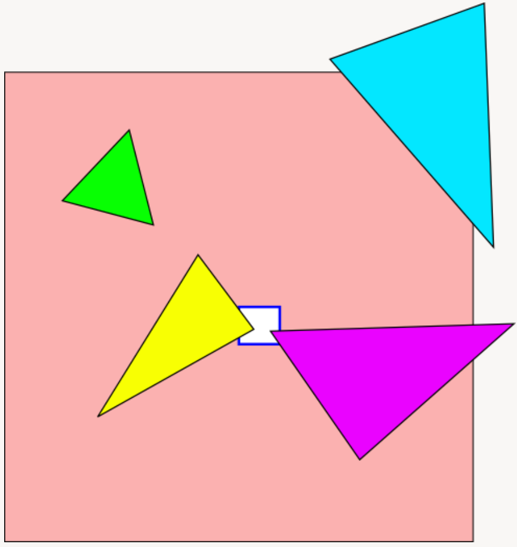
Rasterization: clipping
Can't we use whole triangle instead of clipping it if it is partially inside view volume?
“As long as our triangle coverage test is reliable, we don’t need to clip against the left, right, top and bottom planes at all!”
…
“That test is usually done in integer arithmetic with some fixed precision. And eventually, as you move say one triangle vertex further and further out, you’ll get integer overflows and wrong test results.”
“[Therefore,] clip triangles eventually, just as they’re about to go outside the safe range where the rasterizer calculations can’t overflow”
…
“clip against the guard-band clip planes which are chosen so that after the projection and viewport transforms, the resulting coordinates are in the safe range”
https://fgiesen.wordpress.com/2011/07/05/a-trip-through-the-graphics-pipeline-2011-part-5/
White: viewport
Orange: guard-band clipping – safe range for clipping

Slide 3
Rasterization: clipping and more
Clipping:
  Intuition: https://fgiesen.wordpress.com/2011/07/05/a-trip-through-the-graphics-pipeline-2011-part-5/
  Intuition: https://www.gamedeveloper.com/business/in-depth-software-rasterizer-and-triangle-clipping
  OpenGL clipping: https://www.khronos.org/opengl/wiki/Vertex_Post-Processing
  Line clipping: https://en.wikipedia.org/wiki/Cohen%E2%80%93Sutherland_algorithm
  Polygon clipping: https://en.wikipedia.org/wiki/Sutherland%E2%80%93Hodgman_algorithm
Rasterization pipeline:
  https://fgiesen.wordpress.com/2013/02/17/optimizing-sw-occlusion-culling-index/
  OpenGL: https://www.khronos.org/opengl/wiki/Rendering_Pipeline_Overview
  OpenGL: https://registry.khronos.org/OpenGL/specs/gl/glspec46.core.pdf#page=475&zoom=100,168,741

Slide 4
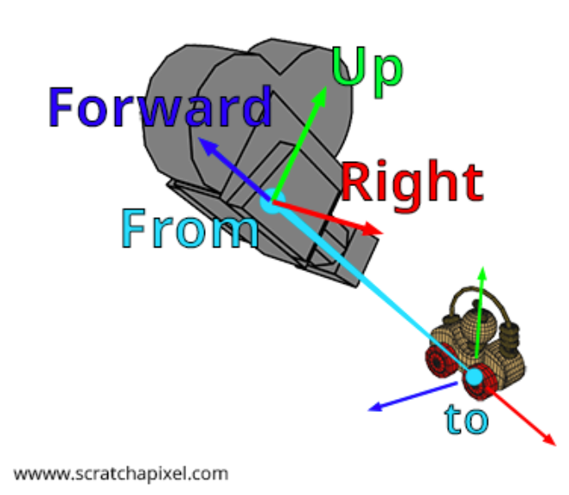
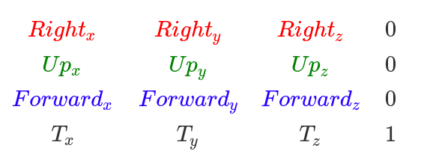
Camera: look at
What if rand_vector == forward?
Forward = normalize(From – To)
Right = crossProduct(randomVec, Forward)
RandomVec = (0,1,0) – not completely random!
Up = crossProduct(forward, right)
Solutions:
Make sure to add check rand_vector close to forward. If this is true, pick another vector by hand. Otherwise crossProduct() will fail.
Use quaternions → stable orientation description
Require additional up vector as input next to from and to
  https://registry.khronos.org/OpenGL-Refpages/gl2.1/xhtml/gluLookAt.xml
  https://glm.g-truc.net/0.9.5/api/a00176.html#ga454fdf3163c2779eeeeeb9d75907ce97
From_{x}
From_{y}
From_{z}

Slide 5

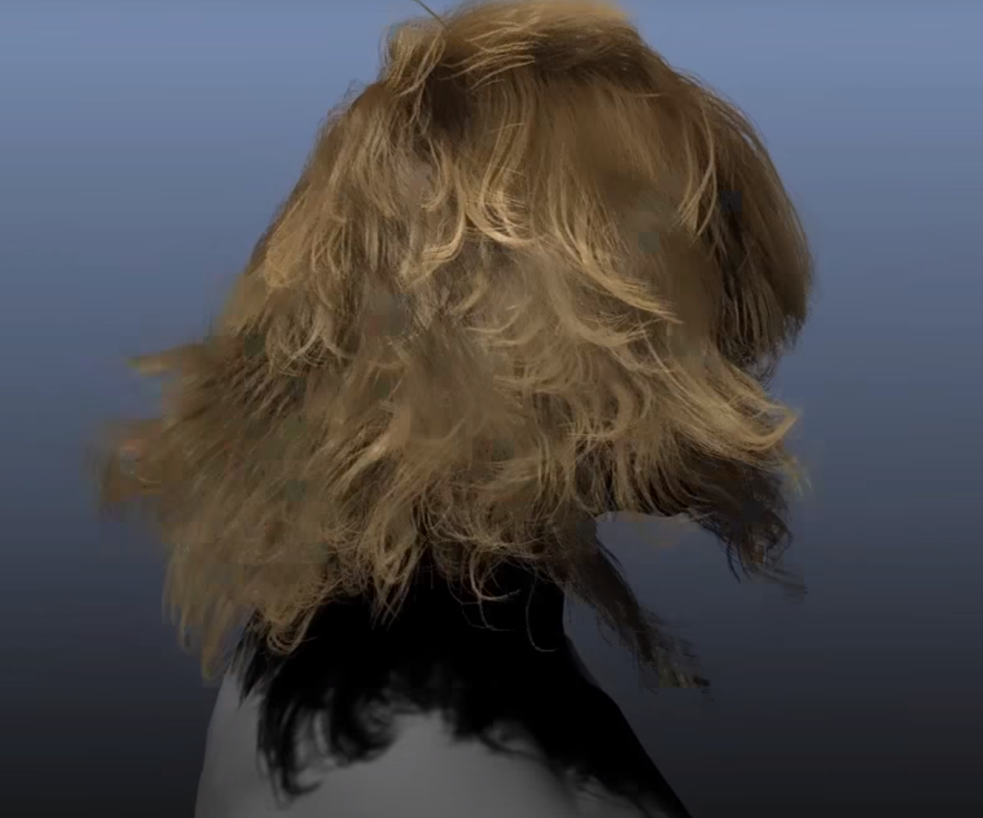
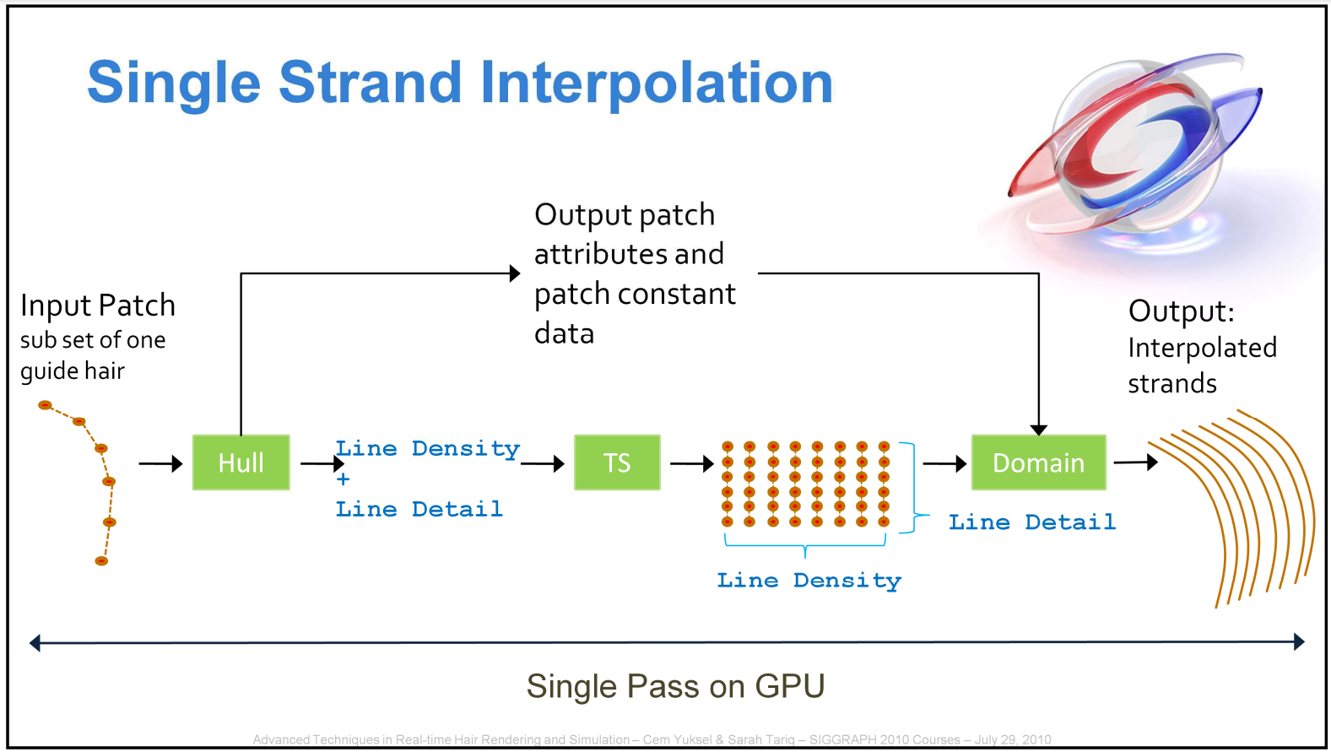
Hair modeling
Practical:
  NVIDIA: https://developer.nvidia.com/gpugems/gpugems2/part-iii-high-quality-rendering/chapter-23-hair-animation-and-rendering-nalu-demo
  NVIDIA: https://developer.nvidia.com/content/hairworks-11-release
  Cem Yuksel: http://www.cemyuksel.com/courses/conferences/siggraph2010-hair/
Research:
  https://web.engr.oregonstate.edu/~mjb/cs557/Projects/Papers/HairRendering.pdf
  https://gamma.cs.unc.edu/HAIRSURVEY/WBKMCL07.pdf
  http://www.cemyuksel.com/research/gihair/
  https://diglib.eg.org/bitstream/handle/10.2312/sr20191215/001-008.pdf
Key hair strands (guide hair) is generated on application stage. Then it is interpolated and generated on GPU and finally rendered.

Slide 6
Lecture evaluation
Personal lecture evaluation process
  Link: https://forms.gle/sf5U3qyWgh7h9dra7
  Deadline: 8.4.2023.
DHBW lecture evaluation process has started (link was sent by the system)
  Deadline: 8.4.2023.

Slide 7
Project
Deadline: 8.4.2023., 23:59h
Mail:
  lovro.bosnar@itwm.fraunhofer.de
  lovro.bosnar1@gmail.com
  If you don’t receive confirmation of your mail/submission under 24h please check mail address again and send again. I will at least confirm each mail/submission that I receive.
Questions?

