Slide 1
Lecture 6: Parametric curves and surfaces, implicit surfaces
DHBW, Computer Graphics
Lovro Bosnar
8.2.2023.

Slide 2


Slide 3
Syllabus
3D scene
  Objects
    Shape
    Material
  Lights
  Cameras
Rendering
Image and display
Parametric curves
Parametric surfaces
Implicit surfaces

Slide 4
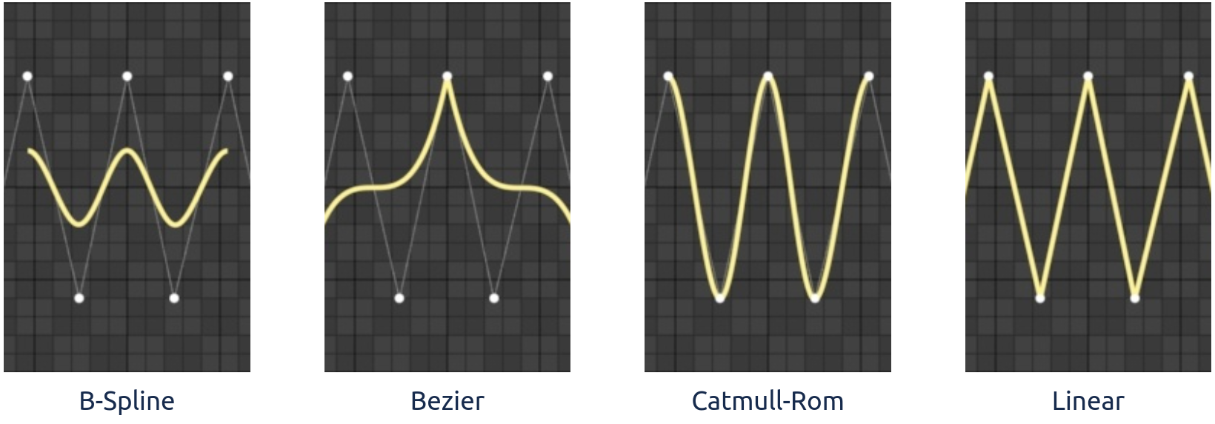
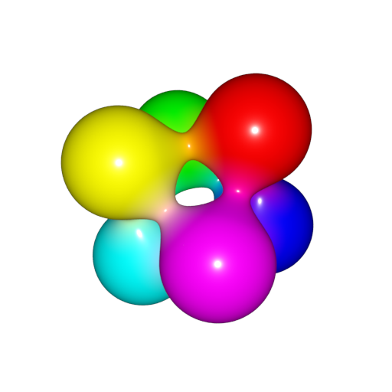
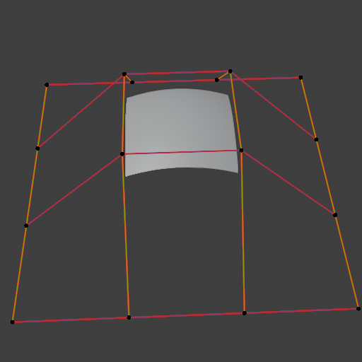
Recap: shape representations
Points
  Point clouds
  Particles and Particle systems
Lines
  Parametric curves
Surfaces:
  Polygonal mesh
  Subdivision surfaces
  Parametric surfaces
  Implicit surfaces
Volumetric objects/solids
  Voxels
  Space partitioning data-structures
Parametric curves
Parametric surfaces
Implicit surfaces

Slide 5
Recap: shape representations
Mesh surface representation:the most used and widespread
  Triangle: basic atomic rendering primitive for GPU graphics pipelines and most ray-tracers
Objects made in modeling systems can have many underlying geometric descriptions.
  Easier and efficient modeling of shapes for the user
  All higher-level geometrical descriptions are evaluated as set of triangles and then used

Slide 6
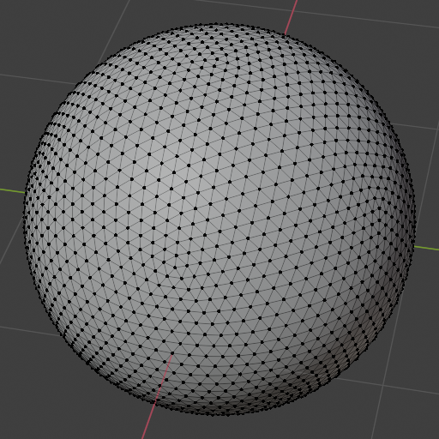

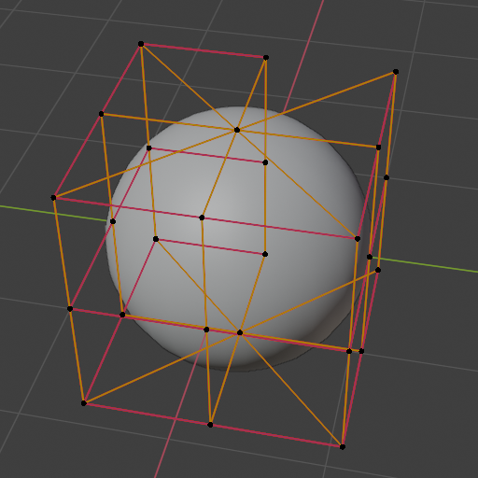
Parametric surfaces vs Mesh
Parametric surfaces have advantages over meshes in certain scenarios:
More compact representation than meshes:
  Described with small number of control points and parametric equation
  Less memory requirements
  Less transformation operations
Scalable geometric primitives
  Geometry can be generated on the fly by evaluating the equations
They can represent smoother and more continuous primitives than polygons
  Convenient for representing organic and curved objects
Certain modeling tasks can be efficiently performed
  Example: less operations are needed for animation and collision

Slide 7
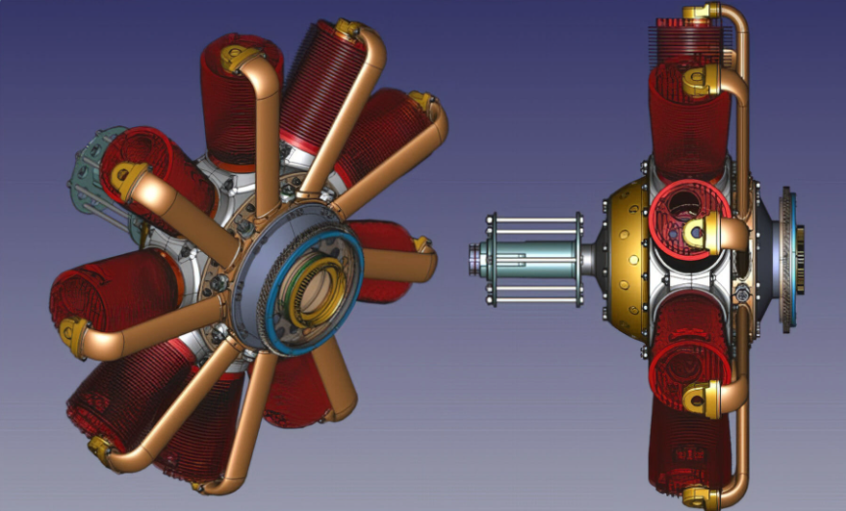
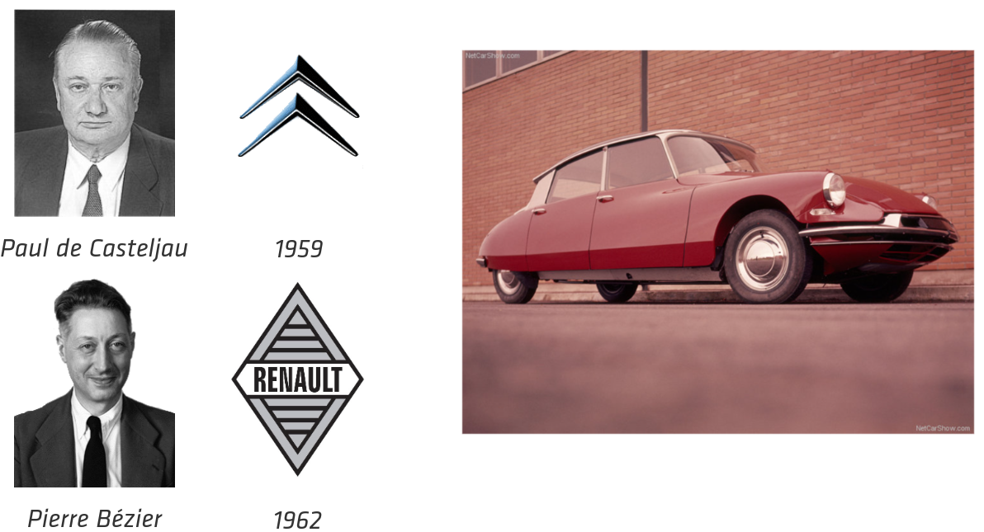
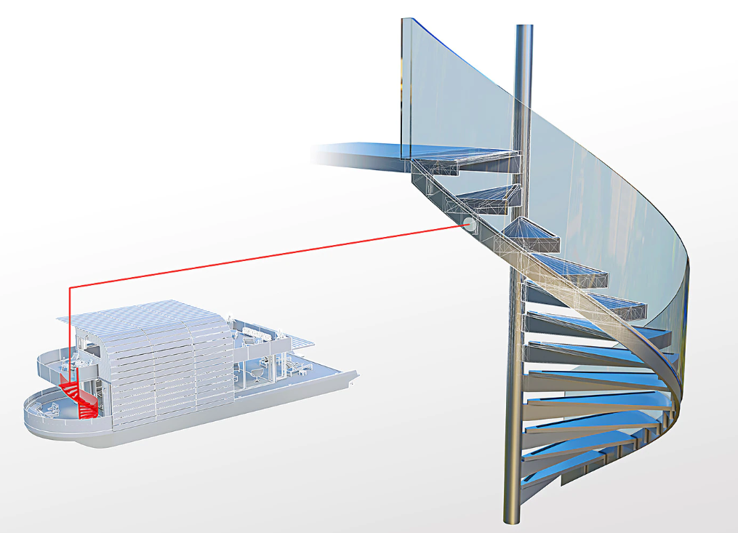
Applications
Manufacturing product design using parametric surfaces https://www.freecad.org/
https://en.wikipedia.org/wiki/Paul_de_Casteljau
https://en.wikipedia.org/wiki/Pierre_B%C3%A9zier
Architecture and parametric surfaces: https://www.autodesk.com/products/autocad/included-toolsets/autocad-architecture

Slide 8

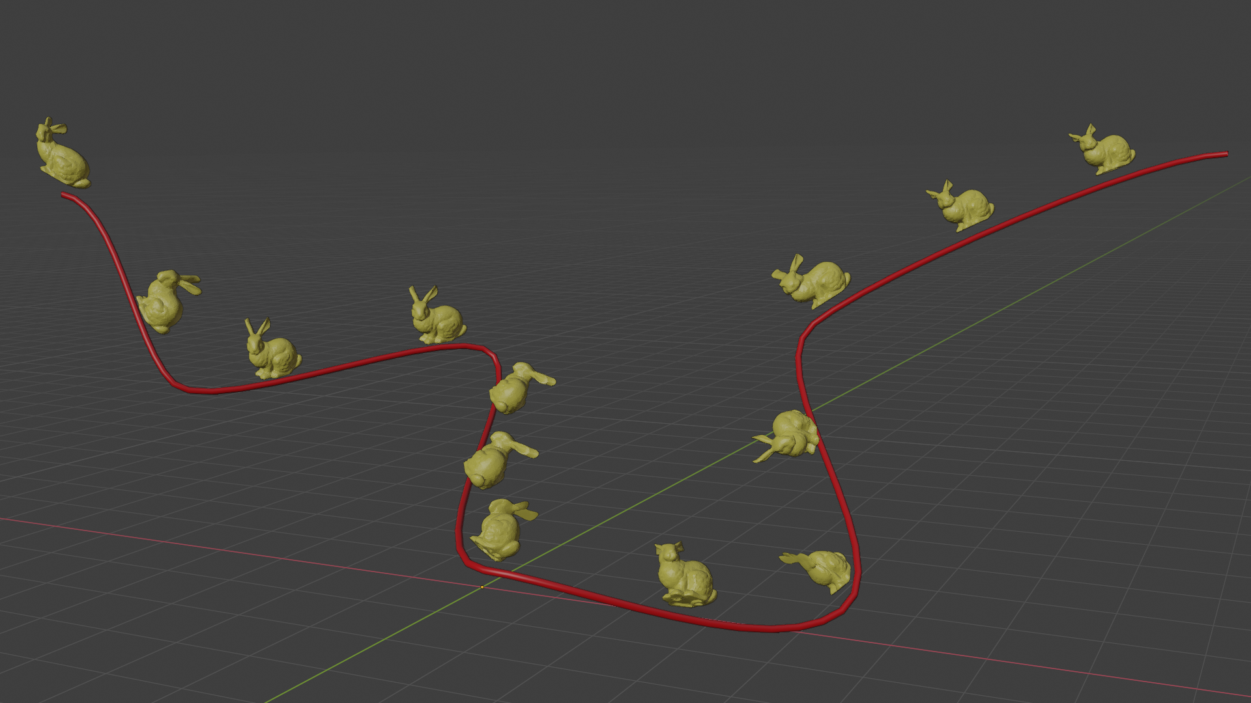
Animation paths using curves: https://docs.blender.org/manual/en/latest/animation/constraints/relationship/follow_path.html
Rendering hair using curves: https://developer.nvidia.com/gpugems/gpugems2/part-iii-high-quality-rendering/chapter-23-hair-animation-and-rendering-nalu-demo

Slide 9
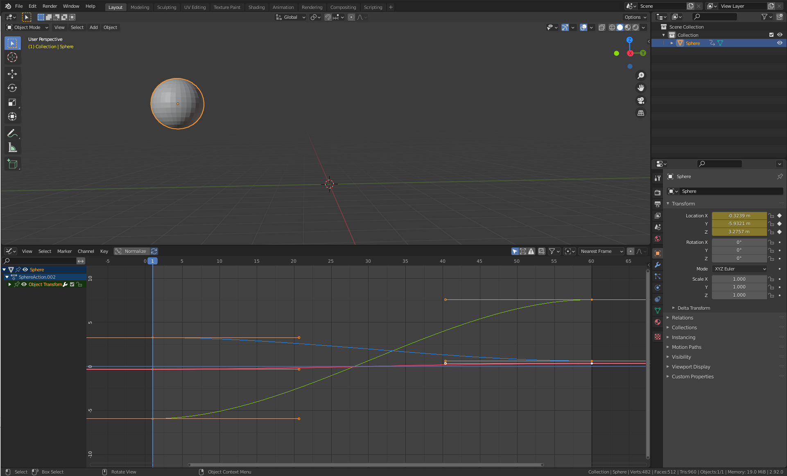

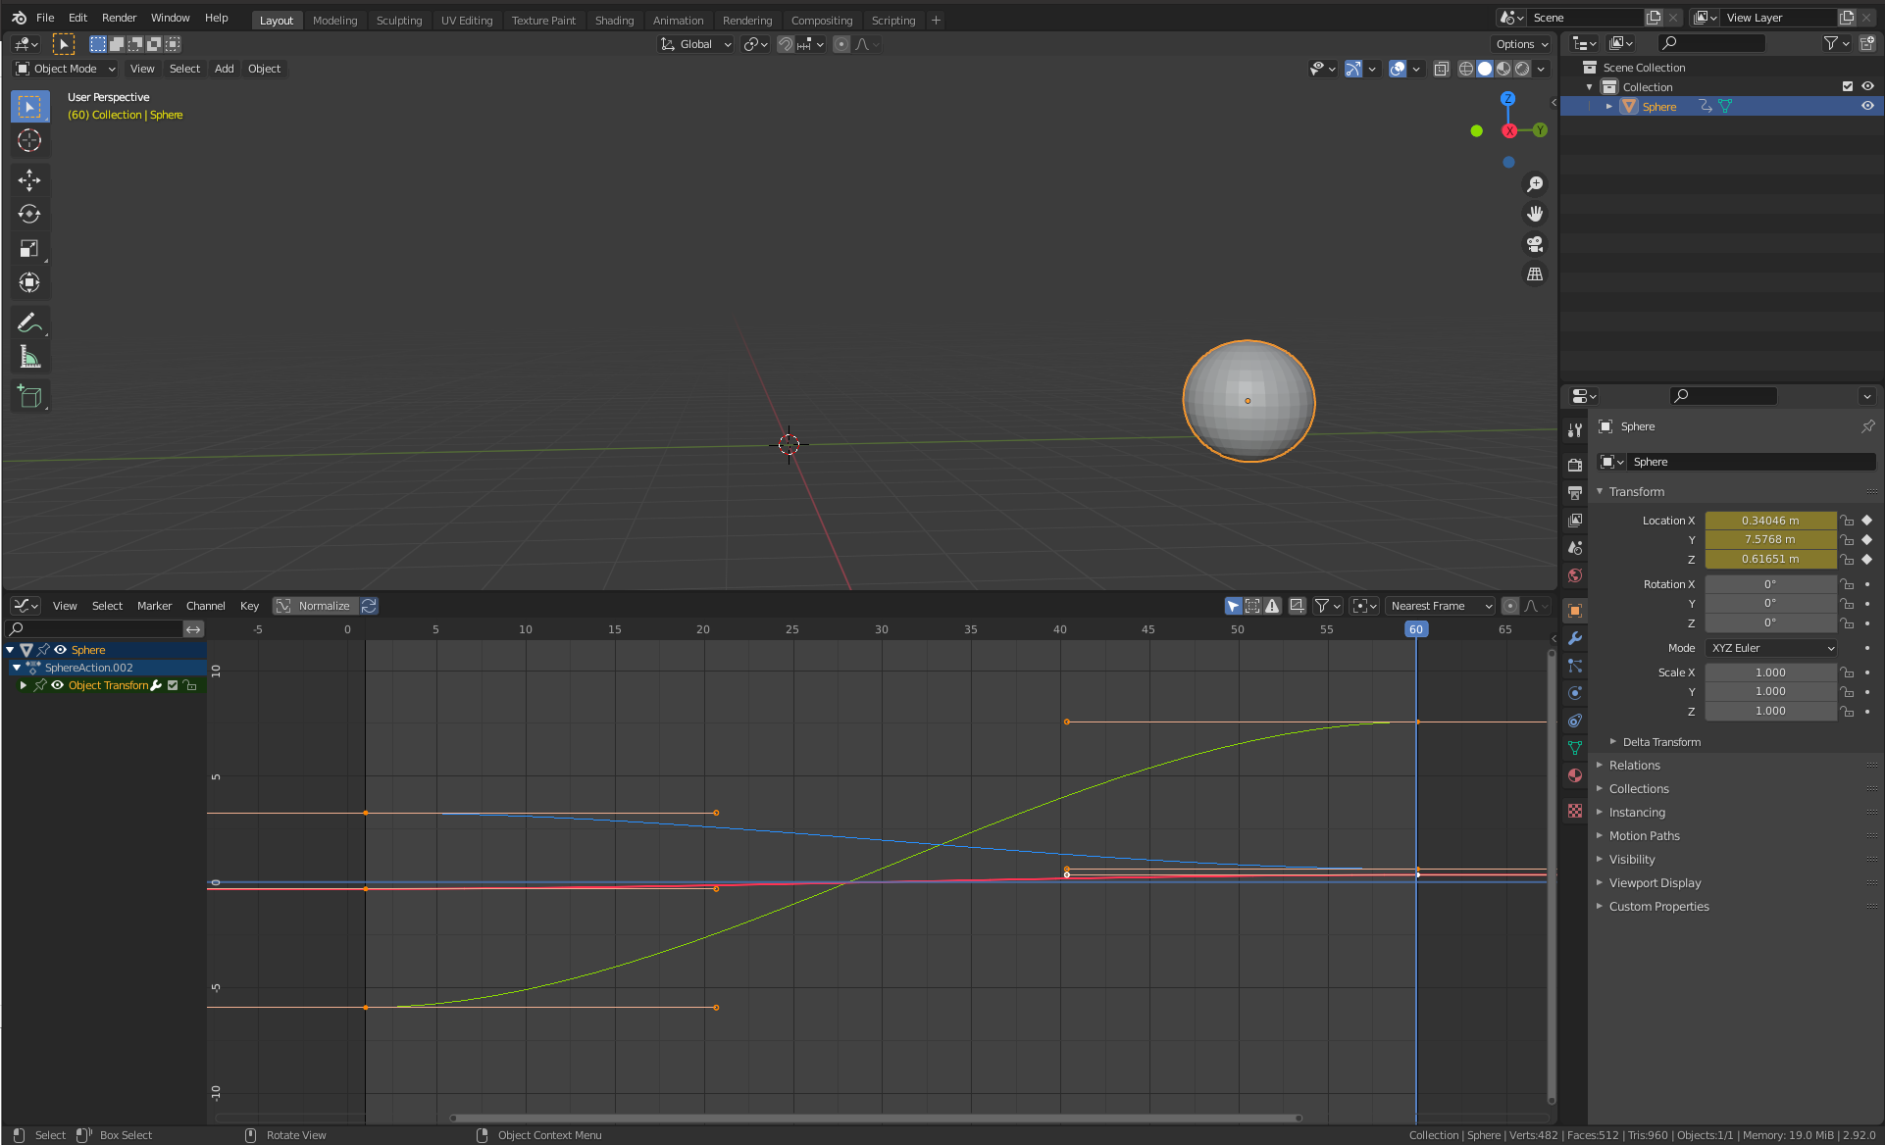
Interpolation between key-frames (transforms) using curves: https://docs.blender.org/manual/en/latest/editors/graph_editor/introduction.html

Slide 10
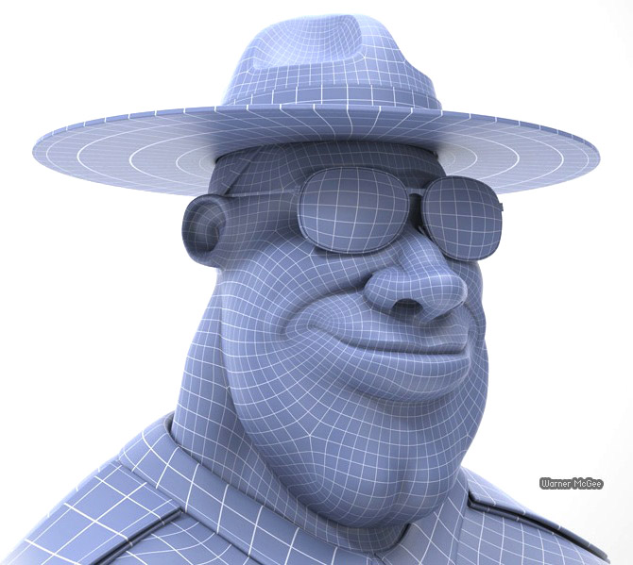
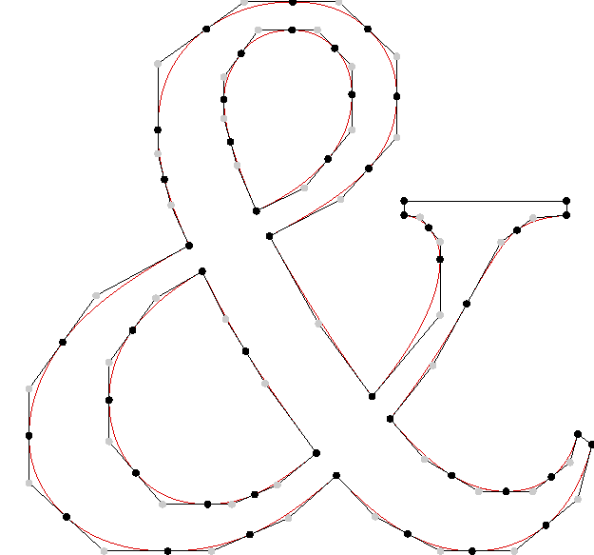
Font design (using Bezier curves): https://font-bakers.github.io/knead/user-guide/
Character modeling using Bezier patches

Slide 11
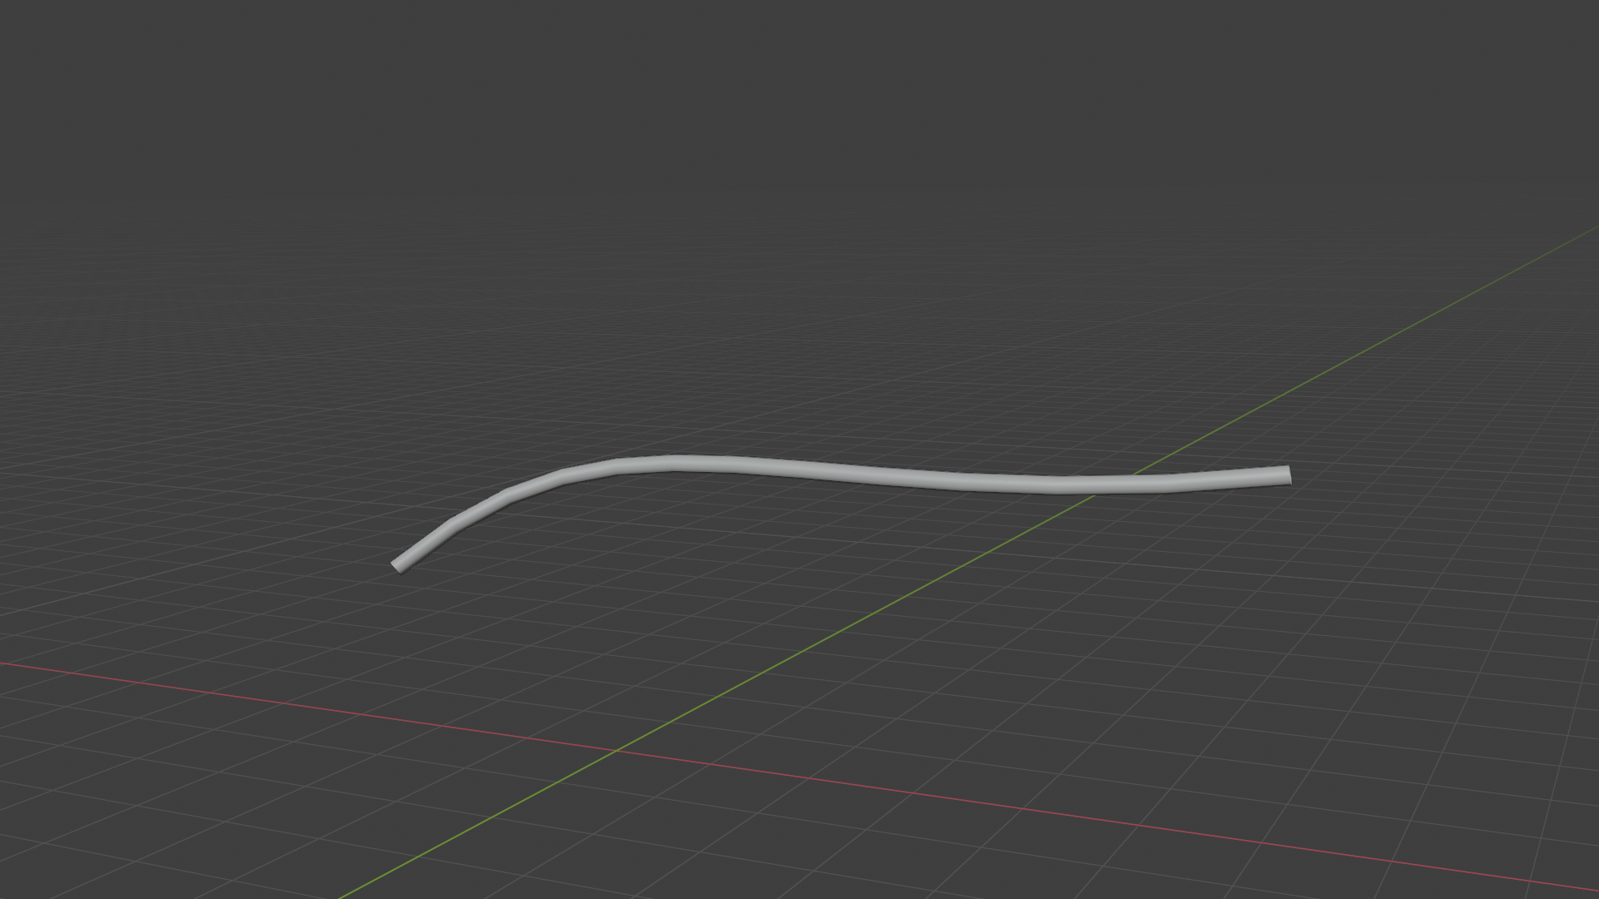
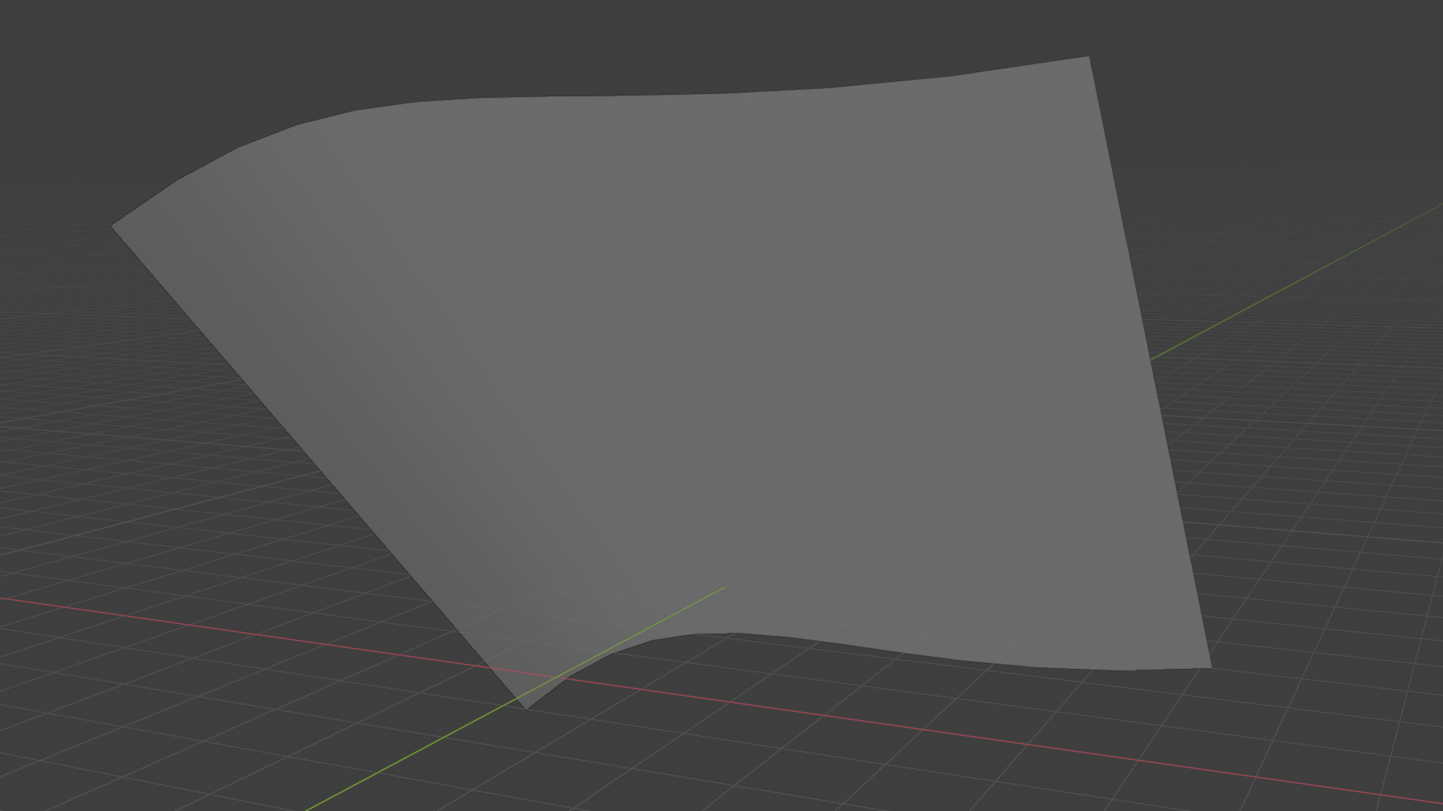
Parametric curves and surfaces
Parametric surfaces are extension of parametric curves

Slide 12
Parametric curves

Slide 13
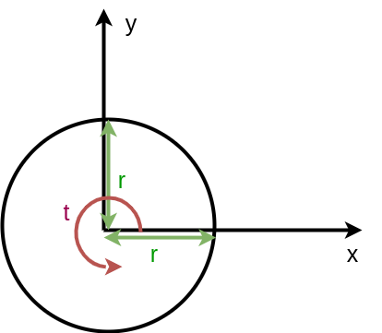
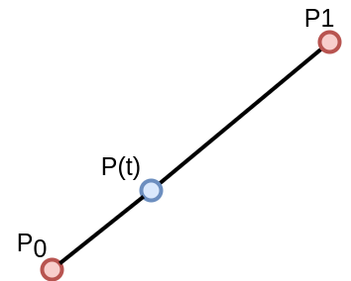
Parametric curves
Described with a formula as a function of parameter t: p(t), t in [a,b]
  Generated points are continuous
(x(t), y(t))
Example: line segment
P(t) = (1-t) P₀ + t P₁
Example: circle
x(t) = r cos(2 * PI * t), t in [0,1]
y(t) = r sin(2 * PI * t), t in [0,1]

Slide 14
Parametric curves
Bezier curve
Hermite curve
Catmull-Rom spline
B-Splines

Slide 15
Bezier curves: linear interpolation
Linear interpolation between two control points P₀ and P₁ traces out straight line.
  P(t) = (1-t) P₀ + t P₁
  Short: lerp(P₀, P₁, t)
  For 0 < t < 1, generated points are on straight line between P₀ and P₁. Otherwise outside.
  P(0) = P₀ and P(1) = P₁
P(x,y,z)
P(x,y)

Slide 16
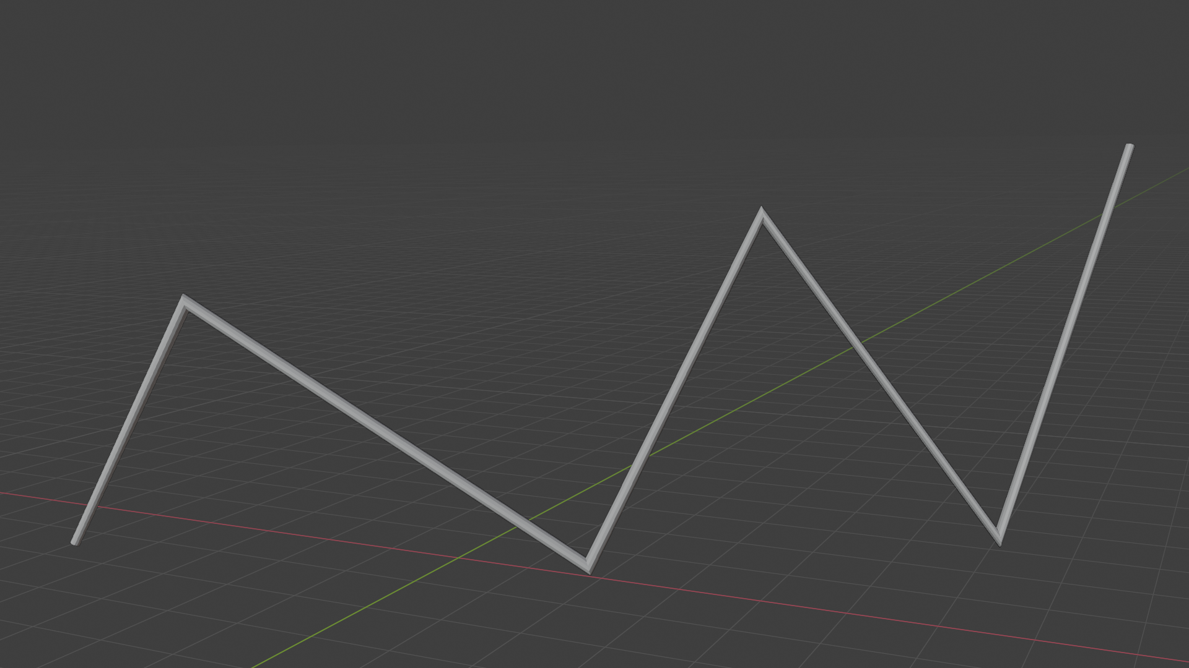
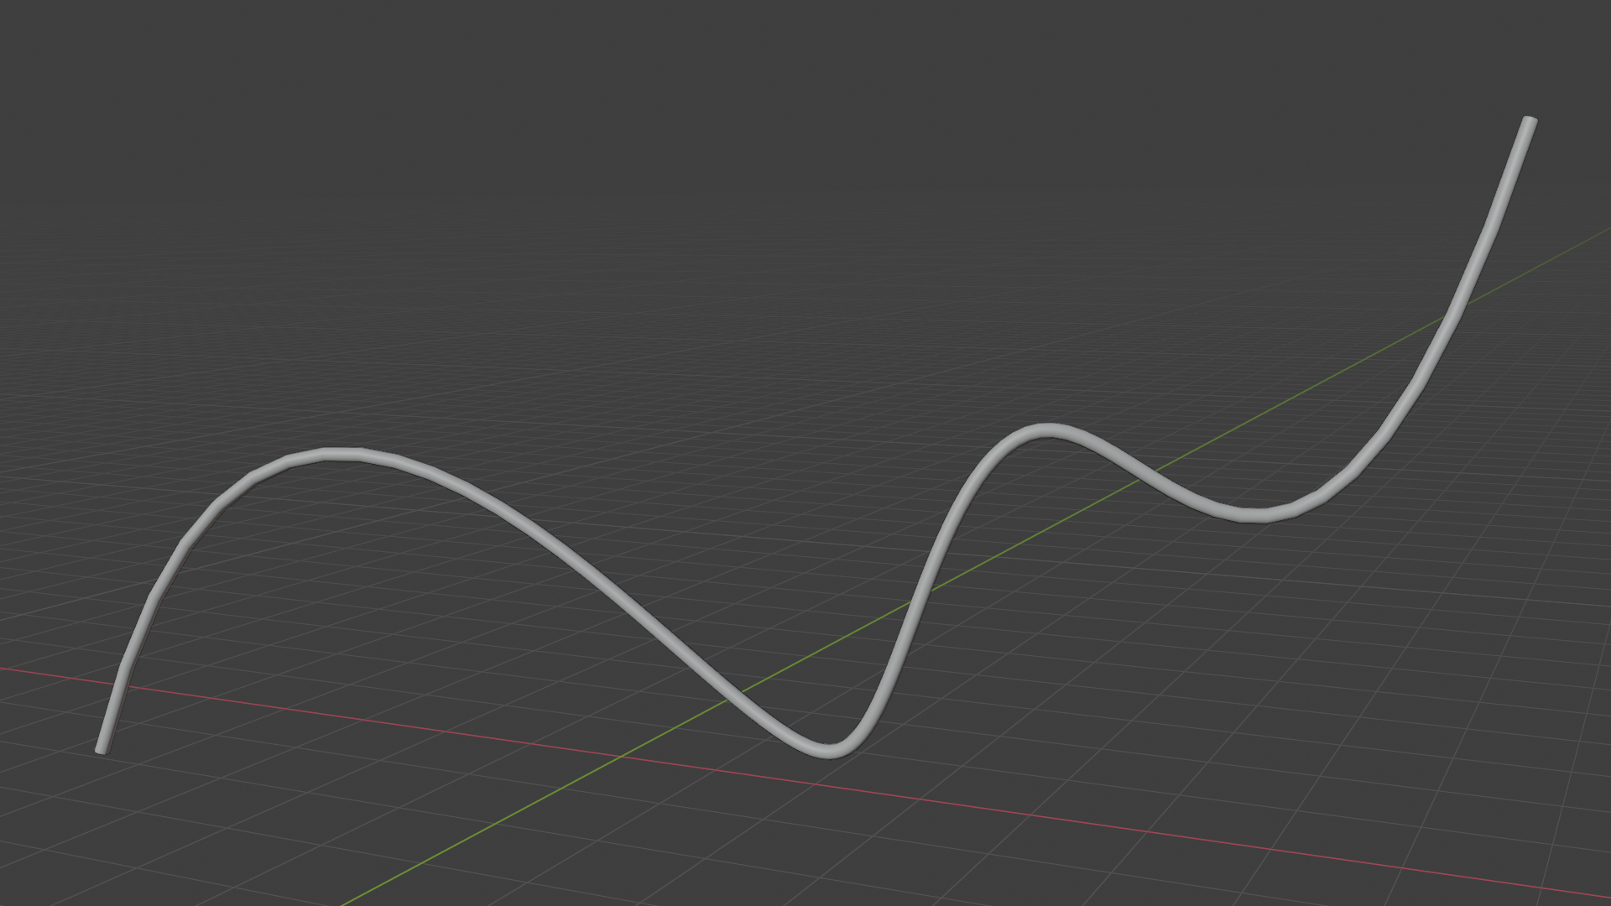
Bezier curves: linear interpolation
Linear interpolation
Linear interpolation between multiple points gives us straight segments with sudden (discontinuous) changes at points.
Smooth curve

Slide 17
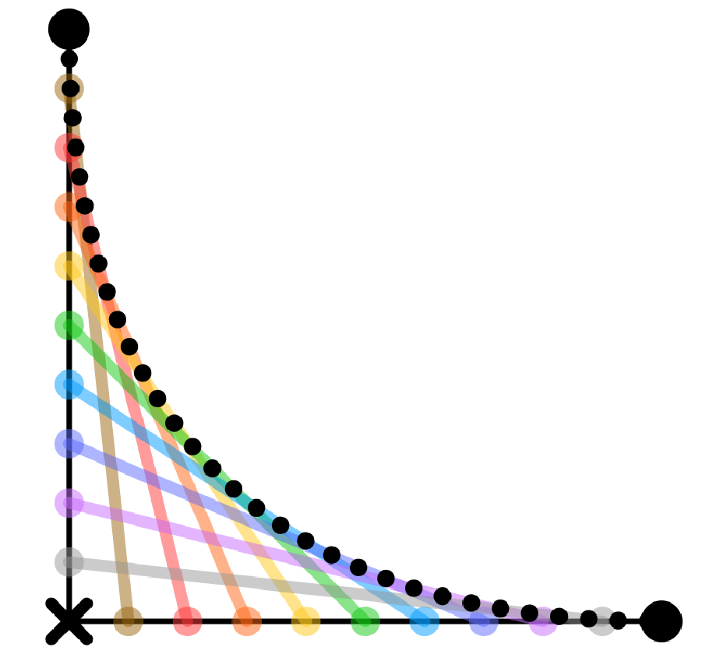
Bezier curves: repeated interpolation
Instead of linear interpolation between two points: P₀ and P₁ – end points, add another point C – control point and use it for repeated linear interpolation
P₀
P₁
C
* Independently discovered by Paul de Casteljau and Pierre Bezier for use in French car industry.

Slide 18
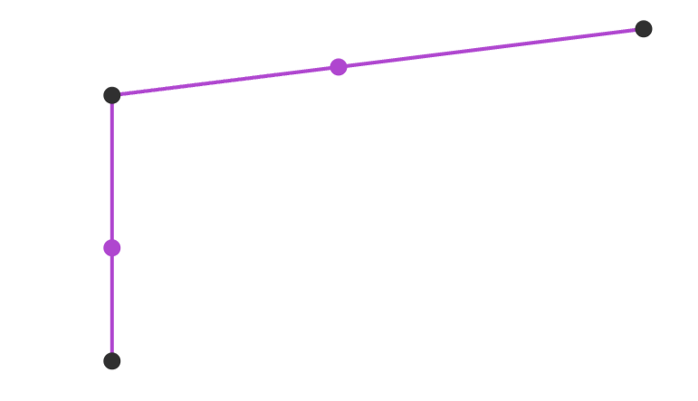

Bezier curves: repeated interpolation
Linear interpolation
P₂
B(t)
P₁
P₀
A(t)
P₁
A(t)
A(t) = lerp(P₀, P₁, t)
P₀
A(t) = lerp(P₀, P₁, t)
B(t) = lerp(P₁, P₂, t)

Slide 19
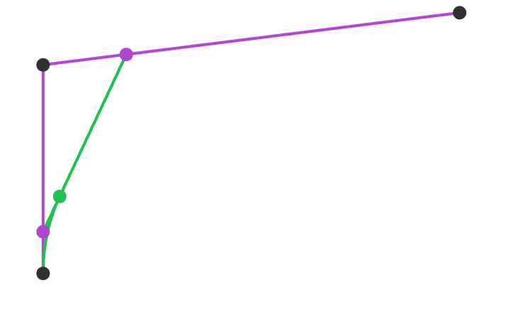
Quadratic Bezier curve
Repeated interpolation:
  A(t): linear interpolation between P₀ and P₁
  B(t): linear interpolation between P₀ and P₁
  C(t): linear interpolation between A(t) and B(t)
P₂
P₁
B(t)
C(t)
A(t)
P₀
A(t) = lerp(P₀, P₁, t)
B(t) = lerp(P₁, P₂, t)
C(t) = lerp(A(t), B(t), t)

Slide 20
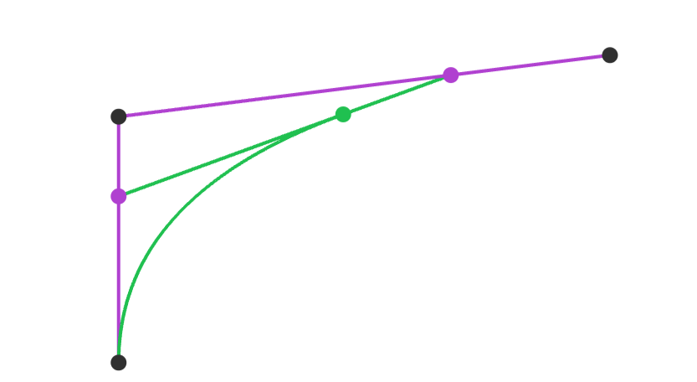
Quadratic Bezier curve
Repeated interpolation:
  A(t): linear interpolation between P₀ and P₁
  B(t): linear interpolation between P₀ and P₁
  C(t): linear interpolation between A(t) and B(t)
B(t)
P₂
P₁
C(t)
A(t)
P₀
A(t) = lerp(P₀, P₁, t)
B(t) = lerp(P₁, P₂, t)
C(t) = lerp(A(t), B(t), t)

Slide 21
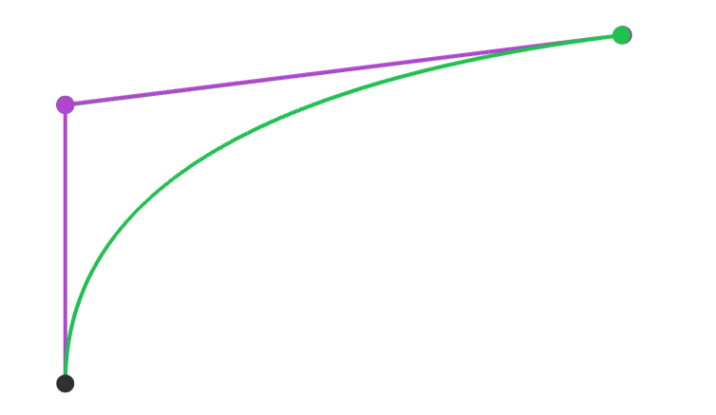
Quadratic Bezier curve
Repeated interpolation:
  A(t): linear interpolation between P₀ and P₁
  B(t): linear interpolation between P₀ and P₁
  C(t): linear interpolation between A(t) and B(t)
B(t)
P₂
P₁
C(t)
A(t)
P₀
A(t) = lerp(P₀, P₁, t)
B(t) = lerp(P₁, P₂, t)
C(t) = lerp(A(t), B(t), t)

Slide 22
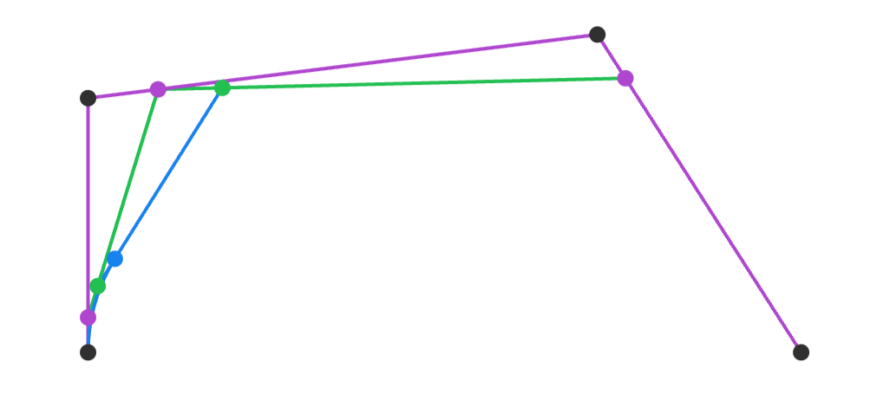
Cubic Bezier curve
P₂
B(t)
C(t)
P₁
E(t)
F(t)
A(t)
D(t)
P₃
P₀
A(t) = lerp(P₀, P₁, t)
B(t) = lerp(P₁, P₂, t)
C(t) = lerp(P₂, P₃, t)
D(t) = lerp(A(t), B(t), t)
E(t) = lerp(B(t), C(t), t)
F(t) = lerp(D(t), E(t), t)

Slide 23
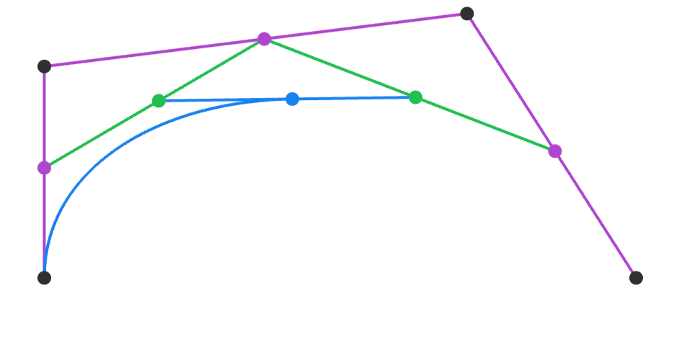
Cubic Bezier curve
P₂
B(t)
P₁
D(t)
E(t)
F(t)
C(t)
A(t)
P₃
P₀
A(t) = lerp(P₀, P₁, t)
B(t) = lerp(P₁, P₂, t)
C(t) = lerp(P₂, P₃, t)
D(t) = lerp(A(t), B(t), t)
E(t) = lerp(B(t), C(t), t)
F(t) = lerp(D(t), E(t), t)

Slide 24
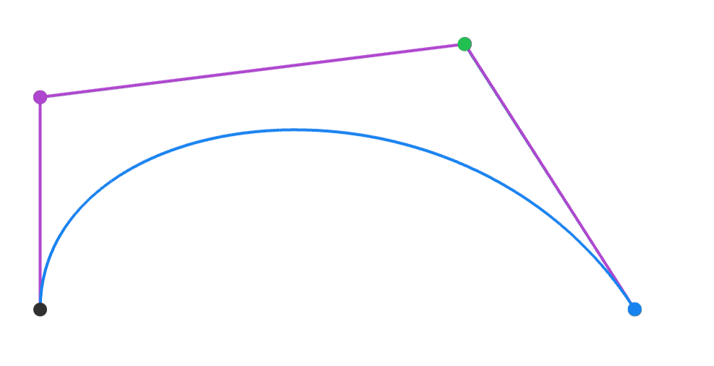
Cubic Bezier curve
E(t)
B(t)
P₂
P₁
A(t)
F(t)
D(t)
C(t)
P₃
P₀
A(t) = lerp(P₀, P₁, t)
B(t) = lerp(P₁, P₂, t)
C(t) = lerp(P₂, P₃, t)
D(t) = lerp(A(t), B(t), t)
E(t) = lerp(B(t), C(t), t)
F(t) = lerp(D(t), E(t), t)

Slide 25
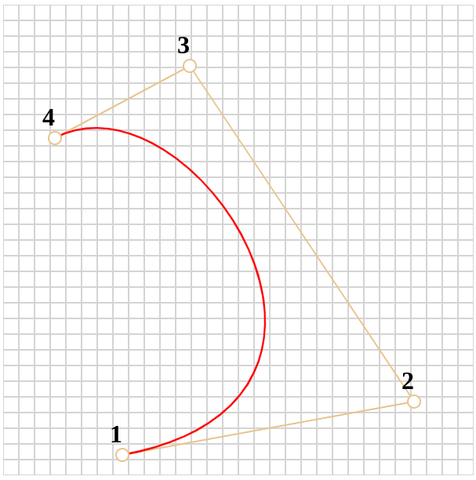
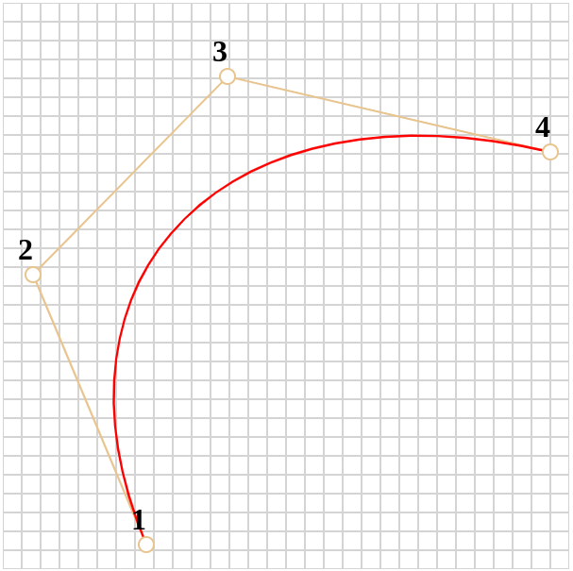
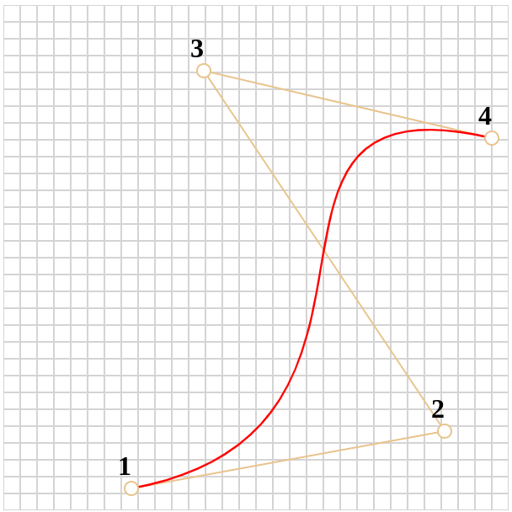
Control points are for the user
The point of curves in computer graphics is to interpolate between two or more points and that the shape of curve is modifiable via control points by the user to their liking.

Slide 26
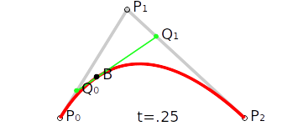
Bezier curves: repeated interpolation
This problem can be solved by taking linear interpolation one step further and linearly interpolate repeatedly → Bezier curves*
  To repeat interpolation, control points are added: P₁
  Example: 3 control points: P₀ ,P₁, P₂
  Linearly interpolate P₀ and P₁ to obtain Q₀
  Linearly interpolate P₁ and P₂ to obtain Q₁
  Linearly interpolate Q₀ and Q₁ to obtain curve point B
  B(t) = lerp(lerp(P₀,P₁,t),lerp(P₁,P₂,t),t)
https://en.wikipedia.org/wiki/B%C3%A9zier_curve
* Independently discovered by Paul de Casteljau and Pierre Bezier for use in French car industry.

Slide 27
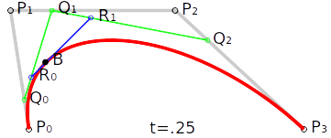
Bezier curves
Degree of curve is n, if n +1 control points are used.
  More control points → more degrees of freedom
Most often, cubic Bezier curve is used
  Higher degree Bezier curves are expensive to evaluate and harder to control
n = 1 → 1st degree, linear Bezier
n = 2 → 2nd degree, quadratic Bezier
n = 3 → 3rd degree, cubic Bezier
B
https://acko.net/files/fullfrontal/fullfrontal/wdcode/online.html
https://www.youtube.com/watch?v=jvPPXbo87ds&ab_channel=FreyaHolm%C3%A9r

Slide 28
Bezier curves: de Casteljau algorithm
Repeated or recursive linear interpolation is often referred as de Casteljau algorithm.
Linear Bezier:
B
Quadratic Bezier:
Cubic Bezier:

Slide 29
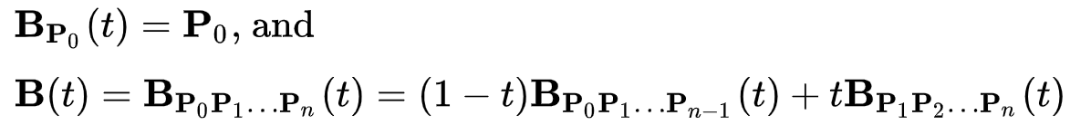
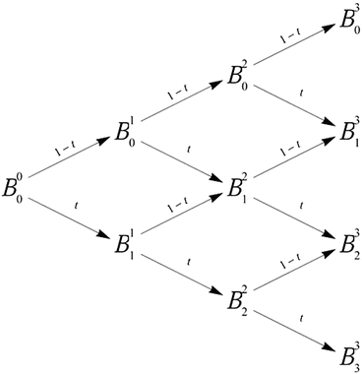
De Casteljau algorithm: recursive formula*
Recursive formula for arbitrary Bezier curve degree:
De Casteljau algorithm → pyramid of coefficients

Slide 30
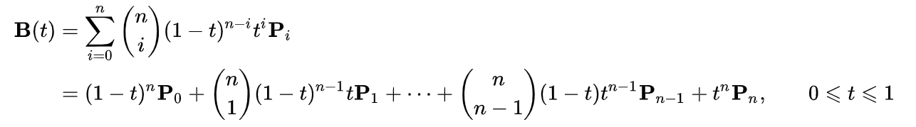
Bezier curve: Bernstein form
Quadratic Bezier:
Quadratic Bezier re-arranged → algebraic description
Every Bezier curve can be described with algebraic fromula
  repeated interpolation is not needed.
Generalized algebraic description: Bernstein form:

Slide 31
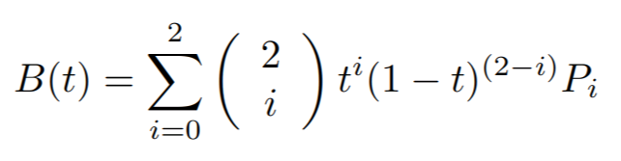
Bezier curve: Bernstein form
Example: n = 2 (quadratic)
Bernstein
form
“Repeated
interpolation”

Slide 32
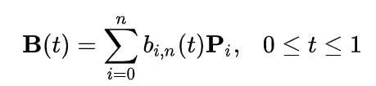

Bezier curve: Bernstein form
Bernstein form:
Basis function
Control points
Bernstein polynomials aka Bezier basis functions:

Slide 33
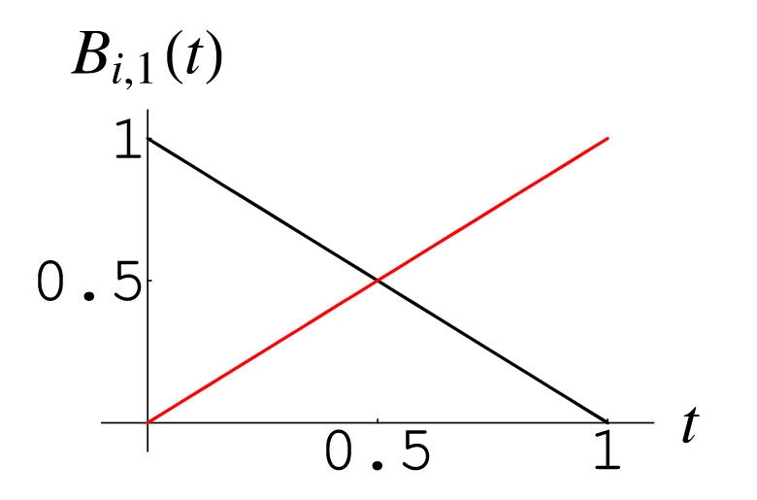
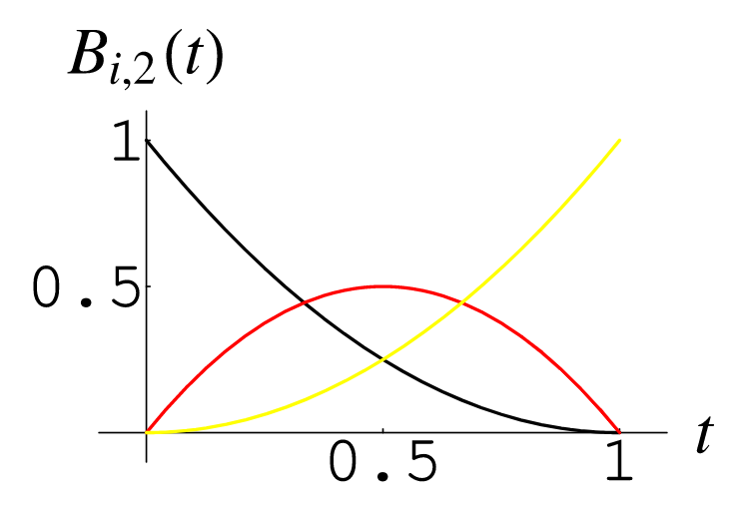
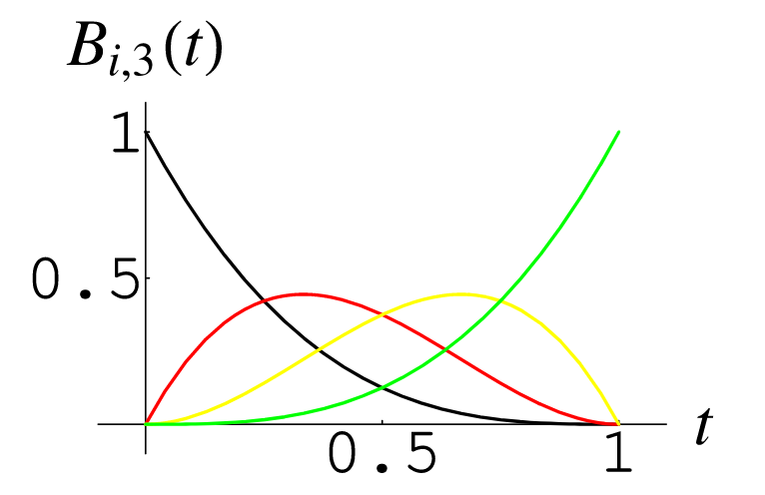
Basis functions
Defines influence (weighting) of each control point as parameter t changes.
  Example: when t increases, blending weight form P₀ decreases and blending weight for P₁ increases, etc.
b
b
b
Bernstein polynomials aka blending functions: linear, quadratic, cubic
https://mathworld.wolfram.com/BernsteinPolynomial.html

Slide 34
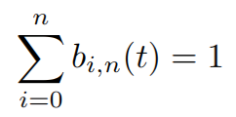

Bernstein polynomials
Bernstein polynomials (Bezier basis function) defines properties of a Bezier curve:
“Polynomials are in [0,1] when t in [0,1]”
“Curve will stay close to the control points P_{i}”
Whole Bezier curve will be located in convex hull of control points
  useful for computing bounding area or volume of curve.
b

Slide 35
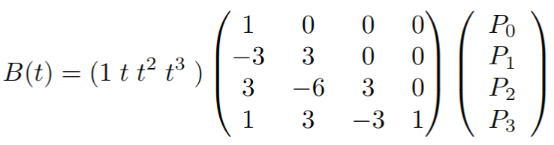
Bezier curve: matrix representation
In practice, for efficient calculation, Bezier curve is represented in a matrix form
Example: cubic Bezier curve
https://blog.demofox.org/2016/03/05/matrix-form-of-bezier-curves/

Slide 36
Bezier curves: good properties
Intuitive theory, good for understanding curves: repeated interpolation
Compact form: Bernstein form and matrix representation
Tangent vector at curve point can be calculated easily (derivation of polynomial)
Easy manipulation of large number of points
  Large number of points can be generated from parametric description
  If rotation of those points is needed, then curve (few control points) are rotated and then points are generated
Experiments and analysis: https://www.youtube.com/watch?v=aVwxzDHniEw&ab_channel=FreyaHolm%C3%A9r

Slide 37
Bezier curves: problems
Non-interpolating: do not pass through all control points (except endpoints)
Not many degrees of freedom:
  Only position of control points can be chosen freely
  Not every curve can be described with Bezier curve (e.g., simple circle can not be described with one or collection of Bezier curves)
  Alternative is rational Bezier curve*
Degree increases with number of control points
  Hard to control and complex computation
  Bernstein polynomials do not interpolate well
* Hoschek, J. and Lasser, D. (1993) Fundamentals of Computer Aided Geometric Design. A K Peters.

Slide 38
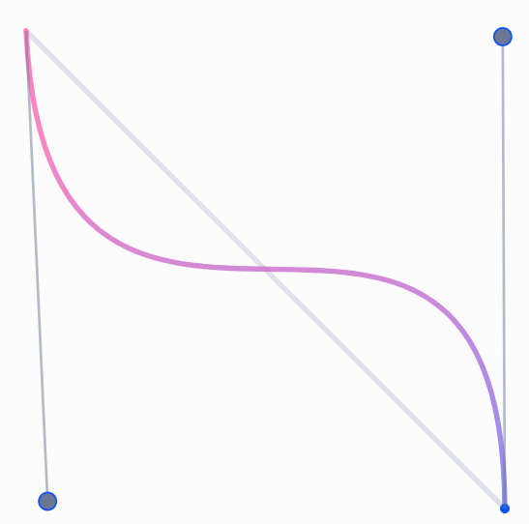
Joining cubic Bezier curves
In practice, cubic Bezier curves are concatenated to form larger spline
  Cubic curves are lowest degree curves that can describe complex form, e.g., S-shaped curve called inflection
  Lower computation complexity
  Easy to manipulate with
  Resulting composite curve will pass through the set of points
Cubic Bezier with inflection: https://blog.maximeheckel.com/posts/cubic-bezier-from-math-to-motion/

Slide 39
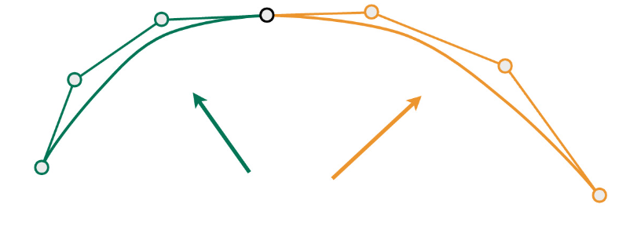
Joining cubic Bezier curves
L₀
L₁
Example: two cubic Bezier curves (4 control points):
  L_{i}, i = 0, 1, 2, 3
  K_{i}, i = 0, 1, 2, 3
To join the curves we can set L₃ = K₀
  Joint - point where curves are joined
This way, many cubic Bezier curves are chained into composite bezier curve
L₂
L₃=K₀
K₁
K₂
K₃
https://cs184.eecs.berkeley.edu/sp22/lecture/7-77/intro-to-geometry-splines-and-be

Slide 40
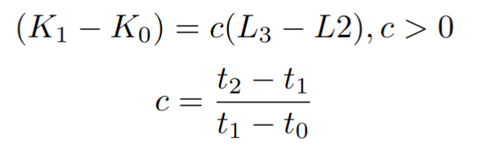
Joining cubic Bezier curves
L₀
L₁
Composite curve is called piecewise Bezier curve, p(t)
  First segment is p(t), where t in [0,1]
  Second segment is p(t’), where t’ = (t – t1) / (t2 – t1), t in [0,1]
Two curves connected just using L₃ = K₀ will not be smooth at joint.
  Improved smoothness can be achieved by joining tangentially: tangent of first and second curve at joint must be parallel*:
L₂
L₃=K₀
K₁
K₂
K₃
* Curves and Surfaces in Computer Aided Geometric Design. Farin, Gerald.

Slide 41
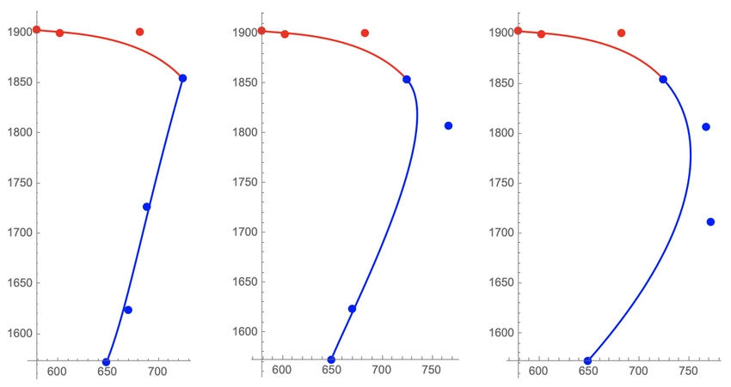
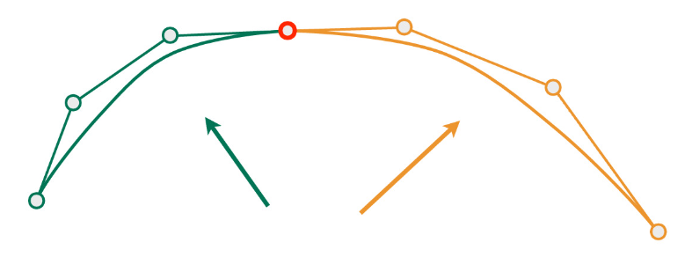
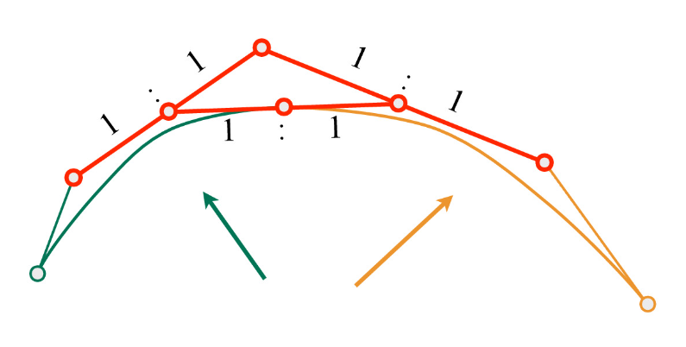
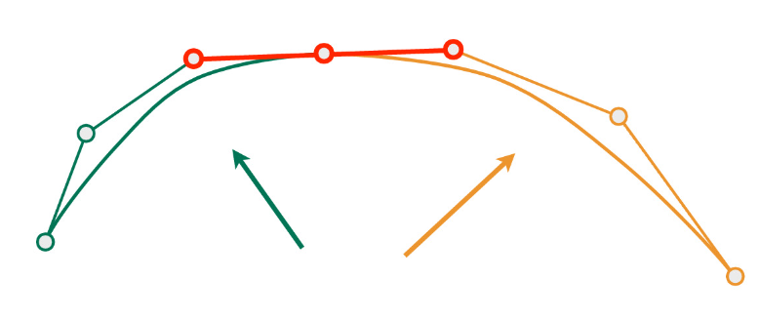
Joined curves continuity
Continuity of joined curves:
  C⁰ – positional continuity - segments should joint at the same point
  C¹ – velocity continuity - derivation of any point (also joints) must be continuous
  C² - acceleration continuity - first and second derivatives are continuous functions
C⁰
C¹
C²
C⁰
C^{2 –} “A Frame” construction
C¹
https://cs184.eecs.berkeley.edu/sp22/lecture/7/intro-to-geometry-splines-and-be

Slide 42
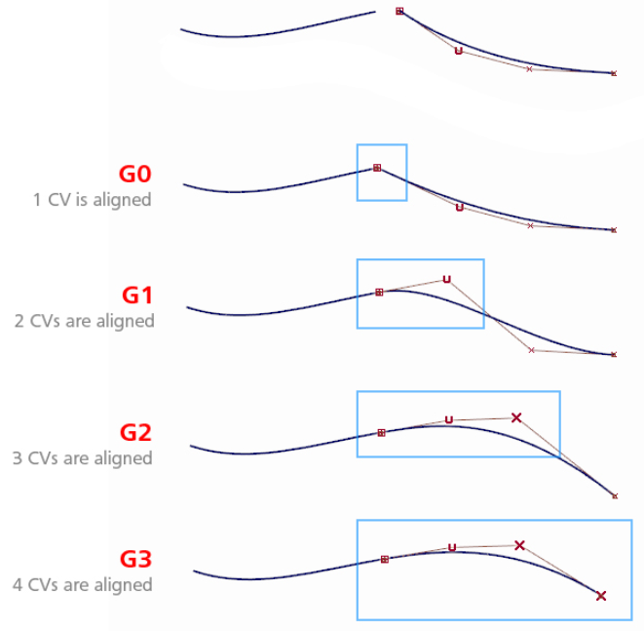
Joined curves continuity
Geometrical continuity:
  G⁰ – positional continuity: holds when the end points of two curves coincide
  G¹ – tangent continuity - tangent vectors from curve segments that meet at joint should be parallel and have same direction – no sharp edges
  G² – curvature continuity - tangent vectors from curve segments that meet at joint should be of same length and rate of length change
https://knowledge.autodesk.com/de/support/alias-products/getting-started/caas/CloudHelp/cloudhelp/2016/DEU/Alias-Tutorials-Legacy/files/GUID-E1BDFBD0-33CC-44C4-866D-5F367105A050-htm.html

Slide 43
Parametric curves
Bezier curve
  Intuitive theory: repeated interpolation de Casteljau algorithm
  Formalization: Bernsten and matrix form
  Concatenating cubic curves into composite curves
  Curve continuity
Hermite curve
  In practice, cubic Hermite curve is used for simpler authoring
Catmull-Rom spline
B-Splines

Slide 44

Cubic Hermite curve
Cubic Hermite interpolation curve:
  Interpolates points P₀ and P₁ – starting and ending control points
  Interpolation is controlled with tangent vectors: m₀ at P₀ and m₁ at P₁
    Tangent vector magnitude and direction influence the curve shape
C₁
C₀
P₁
m₁
P₁
m₀
P₀
P₀
http://15462.courses.cs.cmu.edu/fall2020/article/10

Slide 45


Cubic Hermite curve
Cubic Hermite curve p(t), t in [0,1]:
2t³ – 3t² +1
-2t³ + 3t²
Similarly as discussed with Bezier: Bernstein form with Hermite basis function exists
  Control points polynomial are in [0,1] for t in [0,1]. This is not the case for tangent polynomials
t³ – 2t² + t
t³ - t²
https://en.wikipedia.org/wiki/Cubic_Hermite_spline

Slide 46

Cubic Hermite curve
In practice, cubic Hermite interpolation curve is represented with matrix form for efficient computation.
https://www.cubic.org/docs/hermite.htm

Slide 47

Splines: assembly of curves
When interpolating more than two points, several Hermite curves can be connected together (similarly as done with Bezier).
Connecting multiple points P₀...P_{n}
  n – 1 cubic Hermite curves must be used
  Resultant is assembly of curves called spline
  Elements of assembly are called segments (e.g., Hermite sements)
P₃
P₀
P₀
P₅
How to calculate the tangent vectors in given points?
Solution: Catmull-Rom spline
P₁
P₄

Slide 48
Parametric curves
Bezier curve
Hermite curve
Catmull-Rom spline
  Use cubic Hermite curve to build a spline
B-Splines

Slide 49
Catmull-Rom spline
Cubic Hermite interpolation curve tangents can be hard to control
Therefore, tangents are calculated from control points P₀...P_{n} specified by the user
  Given points P₀...P_{n}, the goal is to calculate tangents needed for Hermite curves which would create spline: continuous differentiable curve passing through each point → Catmull-Rom spline
P₃
P₀
P₀
P₅
P₁
P₄

Slide 50


Kochanek-Bartels method
Method for computing tangents m_{i} at joints P_{i}
Assume that there is only one tangent per control point
  Tangent m_{i} at P_{i} can be computed as combination of two chords: P_{i}-P_{i-1} and P_{i+1}-P_{i}
m_{i}
P_{i}
Tension parameter - a: length of tangent. Higher values → sharper curve bending
Bias parameter - b: direction of tangent
P_{i-1}
P_{i+1}
Kochanek-Bartels method can be extended with additional, continuity, parameter. For this, additional tangent at control points is introduced: https://www.cubic.org/docs/hermite.htm

Slide 51


Catmull-Rom spline
Catmull-Rom spline is a special case where tension and bias parameters of Kochanek-Bartels method are set to 0.
Tangents m_{i} in P₀...P_{n} are calculated using:
https://cs184.eecs.berkeley.edu/sp22/lecture/7-50/intro-to-geometry-splines-and-be
Properties:
Finding points on Catmull-Rom spline is fast and efficient
Interpolating: passing through all control points but doesn’t stay inside convex hull of points

Slide 52
Parametric curves
Bezier curve
Hermite curve
Catmull-Rom spline
B-Splines
  Next to Catmull-Rom spline, B-splines are widely used

Slide 53



B-spline
Types:
  Uniform: uniformly space control points
  Non-Uniform
Parameterized function of x. (Similarly to Bezier curve)
c(1)
c(3)
c(0)
n-1 – degree, c(k) – control points, β_{n} - basis function
c(2)
Cubic B-spline is most widely used.
Basis function of uniform cubic B-spline:
Cubic B-spline: non-interpolating https://docs.bentley.com/LiveContent/web/ProStructures%20Help-v6/en/SECurvesPlaceBsplineCurve.html
https://www.researchgate.net/publication/220494113_Efficient_GPU-Based_Texture_Interpolation_using_Uniform_B-Splines

Slide 54

Uniform cubic B-spline
Multiple uniform cubic B-splines curves can be joined together
  Cubic B-spline is C² continuous
  Curve composited of multiple B-splines will be C² continuous
Cubic B-spline is non-interpolating
  Passing near control points, not through them.
  No guarantee that it is interpolating the control points
P₄
P₅
P₁
P₃
P₂
P₂

Slide 55
Limitations and generalizations
Representing circle is not possible
  Solution, a generalization is to introduce additional coordinate to B-spline → rational B-spline
Uniformly spaced control points:
  Example: animation when positions of object are known at t = 1, 2, 3 and 10.
  Futher generalization: Non-uniform rational B-splines (NURBS)
    Very often used in CAD tools
NURBS in Blender: https://docs.blender.org/manual/en/latest/modeling/curves/introduction.html

Slide 56
Parametric surfaces

Slide 57



Parametric surfaces
Natural extension of parametric curves are parametric surfaces
  Similarly as triangle or polygon is extension of a line segment
Very useful for modeling curved surfaces
Similarly as parametric curves, parametric surfaces are defined with small number of control points and parametric equation
NURBS surface
NURBS sphere
NURBS torus

Slide 58


Parametric surfaces
Common types
  Bezier surfaces
  B-spline surfaces
Ed Catmull’s "Gumbo" model, composed from Bezier patches
https://en.wikipedia.org/wiki/B%C3%A9zier_surface
NURBS Renderman: https://rmanwiki.pixar.com/display/REN24/NURBS

Slide 59

Bezier surface: bilinear interpolation
Bezier curve is extended so it has two parameters (u,v) which define surface
As linear Bezier curve is defined with linear interpolation, planar Bezier patch is defined with bilinear interpolation.
R₁(u) = lerp(Q₁₁,Q₁₂,u)
R₂(u) = lerp(Q₁₂,Q₂₂,u)
P(u,v) = lerp(R₁(u), R₂(u), v)
Bilinear interpolation

Slide 60

Bezier surface: patch
Planar Bezier patch p(u,v) is simplest, non-planar parametric surface
It has rectangular domain and thus resulting surface is called a patch
Bilinear interpolation defines planar Bezier patch p(u,v) where (u,v) are in [0,1]. https://www.sciencedirect.com/topics/computer-science/bilinear-interpolation

Slide 61

Bezier surface
Bezier surface is achieved by adding more points to bilinear interpolation (similarly as we added more points to linear interpolation to obtain Bezier curve)
Repeated bilinear interpolation is extension of de Casteljau’s algorithm to Bezier patches.
Example: biquadratic Bezier surface
  9 control points

Slide 62

Bezier surface: repeated bilinear interpolation
Starting control points
y
x
https://acko.net/files/fullfrontal/fullfrontal/wdcode/online.html

Slide 63

Bezier surface: repeated bilinear interpolation
Repeated linear interpolation
y
x

Slide 64

Bezier surface: repeated bilinear interpolation
Repeated linear interpolation
  Bezier cubic curves
z
y
x

Slide 65

Bezier surface: repeated bilinear interpolation
Repeated linear interpolation
z
y
x

Slide 66

Bezier surface: repeated bilinear interpolation
Repeated bilinear interpolation
z
y
x

Slide 67

Bezier surface: repeated bilinear interpolation
Repeated bilinear interpolation
z
y
x

Slide 68

Bezier surface: repeated bilinear interpolation
Repeated bilinear interpolation
z
y
x

Slide 69

Bezier surface: repeated bilinear interpolation
Bicubic Bezier surface
z
y
x

Slide 70

Bezier surface
Repeated bilinear interpolation is extension of De Casteljau algorithm to patches
Point on Bezier Patch can be described in Bernstein form using Bernstein polynoms
Bicubic Bezier surface defined with 16 control points
  Building block for more complex surfaces

Slide 71



Bezier surface: continuity
Surface continuity
C⁰ – positional continuity – joined at the same point
C¹ – velocity continuity - derivation of any point (including joints) must be continuous
C² - acceleration continuity - first and second derivatives are continuous functions
https://cs184.eecs.berkeley.edu/sp22/lecture/7-96/intro-to-geometry-splines-and-be

Slide 72

Bezier surface: continuity
https://knowledge.autodesk.com/de/support/alias-products/getting-started/caas/CloudHelp/cloudhelp/2016/DEU/Alias-Tutorials-Legacy/files/GUID-E1BDFBD0-33CC-44C4-866D-5F367105A050-htm.html

Slide 73

Bi-cubic Bezier surface properties
Non-interpolating: passes through only corner control points
Boundary of the patch: Bezier curve of degree n
Tangents at border points: described with Bezier curve at border points – two tangents: for u and v direction
  Derivative is straightforward (derivation of polynomials)
Patch lies within convex hull of its control points
Arbitrary number of points on patch can be generated
  Prior generation, transformation on patch can be done which is efficient than transformation on generated points
Extension: rational Bezier patches
  https://theses.hal.science/tel-01064604/document/

Slide 74
Parametrized surfaces based on Bezier surface
Bezier triangles
Point-Normal (PN) Triangles
Phong tessellation

Slide 75

Bezier triangles
Control points are located in triangulated grid
Based on repeated interpolation:
  de Casteljau algorithm
  Bernstein triangles
Constructing complex object requires stitching Bezier triangles so that composite surface contains desired properties and look, e.g., continuity
https://bezier.readthedocs.io/en/stable/python/reference/bezier.triangle.html
https://github.com/xtmacbook/notebook/blob/master/B%C3%A9zier/B%C3%A9zier%20triangle.md

Slide 76

Point-Normal (PN) Triangles
Given triangle mesh with normals at each vertex, the goal is to construct smoother surface using Bezier triangles
Properties:
  Improves mesh shading and silhouettes by creating curved surface to replace each triangle
  Creases in PN triangles are hard to control
  Continuity between Bezier triangles is C₀ but looks acceptable for certain applications
Comparison of original mesh and PN triangle counterpart
https://www.gamedeveloper.com/programming/b-zier-triangles-and-n-patches
https://alex.vlachos.com/graphics/CurvedPNTriangles.pdf
* Game engines (e.g., unity and unreal) support those methods since triangle mesh is basic building primitive.

Slide 77

Phong tessellation
Similar as PN triangles, given the triangle points with normals, construct smoother surface
Phong tessallation attempts to create geometric version of Phong shading normal using repeated interpolation resulting in Bezier triangles.
Mesh, Butterfly subidivision, PN Triangles, Phong Tessellation
https://perso.telecom-paristech.fr/boubek/papers/PhongTessellation/

Slide 78
Parametric surfaces
Common types
  Bezier surfaces
  B-spline surfaces
Ed Catmull’s "Gumbo" model, composed from Bezier patches
https://en.wikipedia.org/wiki/B%C3%A9zier_surface
NURBS Renderman: https://rmanwiki.pixar.com/display/REN24/NURBS

Slide 79


B-Spline surfaces
B-Spline curves can be extended to B-Spline surfaces which are similar to Bezier surface
Often bicubic B-Spline surface is used to form composite surface
  Basis for Catmull-Clark subidivison surfaces
Non-uniform rational B-Spline surface (NURBS) is often used in 3D modeling software
https://forums.cgsociety.org/t/audi-r8-v10-2010-nurbs-model-with-rhino-3d/1761843/3
https://www.youtube.com/watch?v=1zNfh_g8jXM&ab_channel=BlenderSecrets

Slide 80
Animation with parametric curves
Animation is done on control points
  Easier for user to handle large smooth surfaces
  Final surface is tessellated for rendering
Supporting image

Slide 81



Rendering of parametric surfaces
Ray-parametric-surface intersection can be defined
Model made with parametric surfaces is tessellated for efficient rendering process.
  Trade-off between quality and speed: more triangles → higher quality shading and silhouettes
NURBS torus
Tessellation 1
Tessellation 2
Tessellation 3

Slide 82

Modeling and transferring parametric surfaces
Parametric curves and surfaces are extensively used in CAD and modeling software:
  https://www.freecad.org/
  https://docs.blender.org/manual/en/latest/modeling/surfaces/index.html
  https://www.autodesk.com/collections/product-design-manufacturing/overview
Parametric surfaces are stored using:
  STEP file format: https://www.adobe.com/creativecloud/file-types/image/vector/step-file.html
  IGES file format: https://www.adobe.com/creativecloud/file-types/image/vector/iges-file.html

Slide 83
Exploring parametric curves and surfaces
Parametric curves and surfaces are highly used and researched method in computer graphics. We only covered foundations.
NURBS in real-time: https://www.gamedeveloper.com/programming/using-nurbs-surfaces-in-real-time-applications
Blender NURBS surfaces: https://docs.blender.org/manual/en/latest/modeling/surfaces/introduction.html
Blender NURBS and Bezier curves: https://docs.blender.org/manual/en/latest/modeling/curves/index.html
Tutorial on curves in Blender: https://behreajj.medium.com/scripting-curves-in-blender-with-python-c487097efd13
Houdini: https://www.sidefx.com/docs/houdini/nodes/sop/curve.html
Library for creating and manipulating NURBS surfaces and curves: http://verbnurbs.com/
More examples: https://www.realtimerendering.com/#curves

Slide 84
Implicit surfaces

Slide 85
Implicit surfaces
Described with a function. Instead of using parameters (u,v) surface is described with implicit function f(p):
  f(p) = 0, if p on surface
  f(p) < 0, if p inside surface
  f(p) > 0, if p outside surface
Surface can not be computed directly
  Distance is computed by evaluating point p(x,y,z) in space → signed distance function

Slide 86





https://iquilezles.org/articles/distfunctions/

Slide 87



Implicit surfaces: normal
Crucial information for shading is normal.
Normal vector N of implicit surface in point p
  Normalized gradient of function f in point p: ∇f(p)
  Intuition: Gradient points in direction of steepest ascent in the function near p and thus is orthogonal to surface
Analytical expression:
Function must be differentiable
Approximation:
Central difference using small number ε
https://iquilezles.org/articles/normalsSDF/

Slide 88




Implicit surfaces: modeling
Blending of implicit surfaces: blobby modeling, soft objects or metaballs
  Blender: https://docs.blender.org/manual/en/latest/modeling/metas/index.html
Example of blending: resulting distance d by blending between two distances d₁ and d₂ with a blend radius r_{b}
https://www.chaos.com/gallery/elmar-glaubauf-metaballs

Slide 89

Implicit surfaces: modeling
Constructive solid geometry: set of operations – Boolean operations:
  Intersection
  Union
  Difference
Well defined for closed objects (volumetric bodies)
Used to create complex shapes from simple, base shapes (e.g., cubes, spheres, etc.)

Slide 90


Implicit surfaces: rendering
Ray-marching
  At first point p on the ray, shortest distance d to the surface is evaluated (sphere around the point)
  Move in ray direction for distance d
  Repeat until surface is reached within some distance (small threshold) or max number of steps is reached (background hit)
Effects: shadows, reflections, ambient occlusion, etc.
https://iquilezles.org/articles/raymarchingdf/
https://nanzhaodocumentations.wordpress.com/2021/01/15/creative-computing-term-1-assessment-my-shader-world-in-raymarching-%F0%9F%91%BE/
https://iquilezles.org/articles/nvscene2008/rwwtt.pdf

Slide 91





Implicit surfaces: rendering
Turn surface into triangles (triangulation) and then render
Marching cubes algorithm: surface extraction, polygonization
  First, surface is partitioned into adjacent cells at whose corners the implicit surface is evaluated
  Negative values are considered outside surface, positive values inside surface
  Within each cell, the intersection of cell edges with the implicit surface are connected to form one or more polygons
3D case: creating cells, labeling cell corners, calculating cell edge points, connecting edge points to form polygon
3D case
https://people.eecs.berkeley.edu/~jrs/meshpapers/Bloomenthal.pdf
https://www.cs.carleton.edu/cs_comps/0405/shape/marching_cubes.html

Slide 92
Summary questions
https://github.com/lorentzo/IntroductionToComputerGraphics/tree/main/lectures/6_parametric_curves_surfaces

Slide 93
Reading material
https://github.com/lorentzo/IntroductionToComputerGraphics

