Slide 1
CORE FIGURE COMPARISON
Four figures, one evidence hierarchy
Compare only the objects that the February 2021 inputs actually identify
Primary: our old-input implementation versus the 2025 paper
Supporting: older Stata lineage and public-data robustness
11 August 2026
Notes:
[Sources]
- docs/project/tasks/figure1-replication.md
- docs/project/tasks/figure5-replication.md
- docs/project/tasks/figure6-replication.md
- docs/project/tasks/figure8-replication.md
- Presentation/1_replication_package_validation/replication_package_validation.pptx (visual source)

Slide 2
EVIDENCE ROLES
02
One label cannot mean the same thing across all four figures
2025 targets
Authors-old (2021)
Figures 1, 5, 6, and 8
Revised definitions through 2019
Exact for the older paper; precursor evidence only for revised exhibits.
Ours-public
Figure 1 only: a later public vintage tests broad trend robustness.
Naming rule
Call a result a reconstruction only when the supplied inputs identify the revised object. Otherwise retain the word proxy.
Ours-authors
Figures 1, 5, and 6: reconstructions. Figure 8: bounded proxy.
Notes:
[Sources]
- MSS_SGR_July242025.pdf, Figures 1, 5, 6, and 8
- docs/project/tasks/result-selection.md, completed feasibility classification
- Results_Proposal/major_results.md, R-001 to R-003
- docs/project/tasks/figure6-replication.md

Slide 3
METHOD CROSSWALK
03
Inputs, methods, and estimands change together
Version
Inputs
Role
Procedure / boundary
1 · 2025 paper
Revised to 2019
Benchmark
23 intermediaries × 34 instruments; matrix/Leontief method; exact code unavailable
2 · 2021 Stata
Feb. 2021 kit
Context
Old Figure 6 composition; staged round-by-round debt allocation
3 · Ours-public
2026 public
Robustness
21 intermediaries; public classifications/equity; 1963-2019
4 · Ours-authors
Feb. 2021 kit
Primary
Rebuild intermediary claims; 2025 Figure 1 definition; 1963-2016
PRIMARY TEST
#4 versus #1
Main result
Same target object; different vintage and incomplete old-kit denominator
SUPPORTING
#4 vs #2 / #3
Diagnostics
Method lineage and public-vintage robustness; never pool the series
Rule
Only #4 versus #1 answers the project's central replication question. #2 and #3 explain lineage and robustness; they do not replace the benchmark.
Notes:
[Sources]
- MSS_SGR_July242025.pdf, Sections 2.1-2.3 and Figure 1
- docs/project/tasks/figure1-replication.md
- docs/data/figure1-data.md, Two pipelines / version boundary
- MSS2021Febreplicationkit/code/build_fa_unveiling_data.do

Slide 4
EVIDENCE ROLES
02
One label cannot mean the same thing across all four figures
2025 targets
Authors-old (2021)
Figures 1, 5, 6, and 8
Revised definitions through 2019
Exact for the older paper; precursor evidence only for revised exhibits.
Ours-public
Figure 1 only: a later public vintage tests broad trend robustness.
Naming rule
Call a result a reconstruction only when the supplied inputs identify the revised object. Otherwise retain the word proxy.
Ours-authors
Figures 1, 5, and 6: reconstructions. Figure 8: bounded proxy.
Notes:
[Sources]
- MSS_SGR_July242025.pdf, Figures 1, 5, 6, and 8
- docs/project/tasks/result-selection.md, completed feasibility classification
- Results_Proposal/major_results.md, R-001 to R-003
- docs/project/tasks/figure6-replication.md

Slide 5
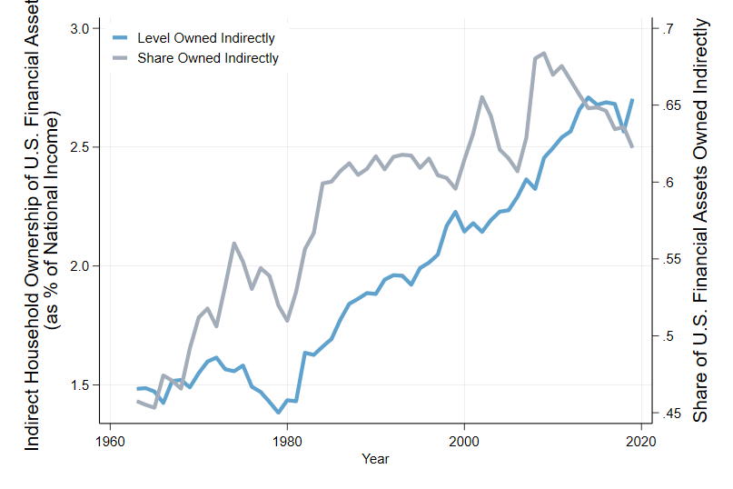
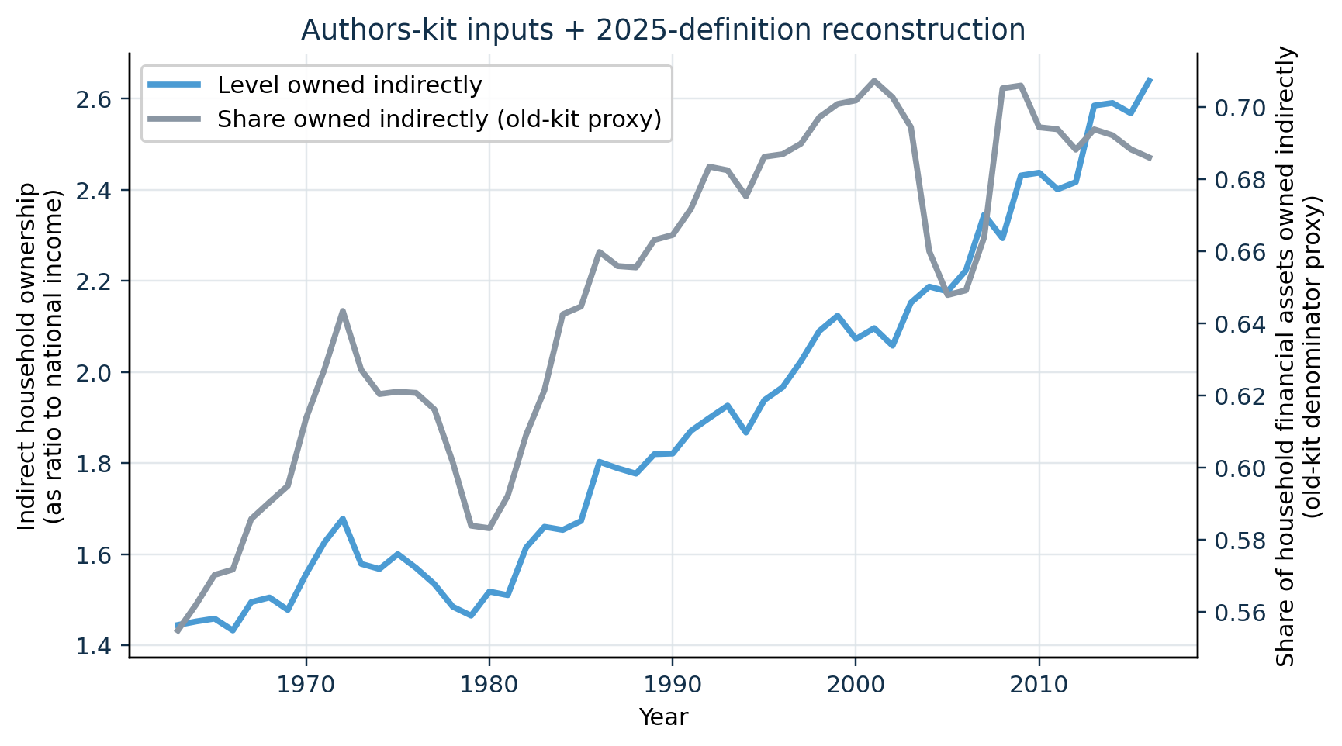
PRIMARY COMPARISON
04
Our old-input reconstruction tracks the 2025 Figure 1 pattern
2025 paper · Figure 1 · PDF p. 11
Our implementation · 2021 authors' inputs
CLOSE LEVEL MATCH
The national-income-normalized level has correlation 0.995 and MAE 5.3 pp against the digitized 2025 curve over 1963-2016.
The paper caption is removed from the image and restated here: the lines report the stock-to-income level and household-financial-asset share held indirectly.
Notes:
[Sources]
- MSS_SGR_July242025.pdf, Figure 1, physical PDF page 11; chart cropped without caption
- Results_Proposal/figures/figure1_authors_data_reconstruction.png
- Data/processed/figure1_authors_comparison.csv
- docs/project/tasks/figure1-replication.md, Evidence

Slide 6
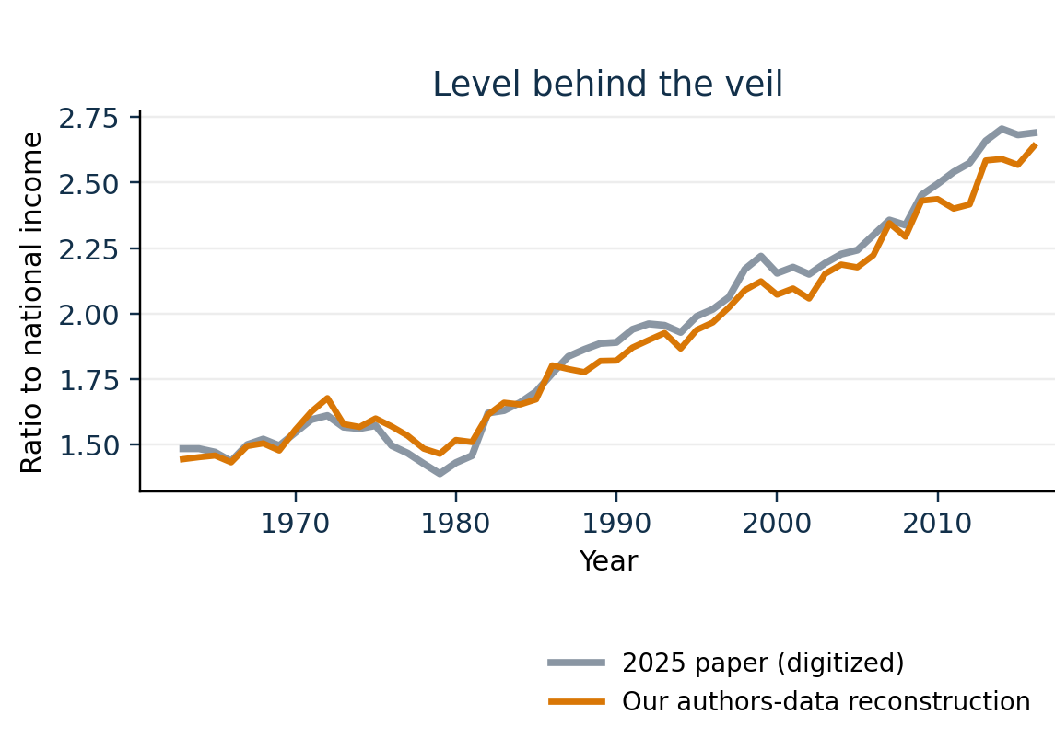
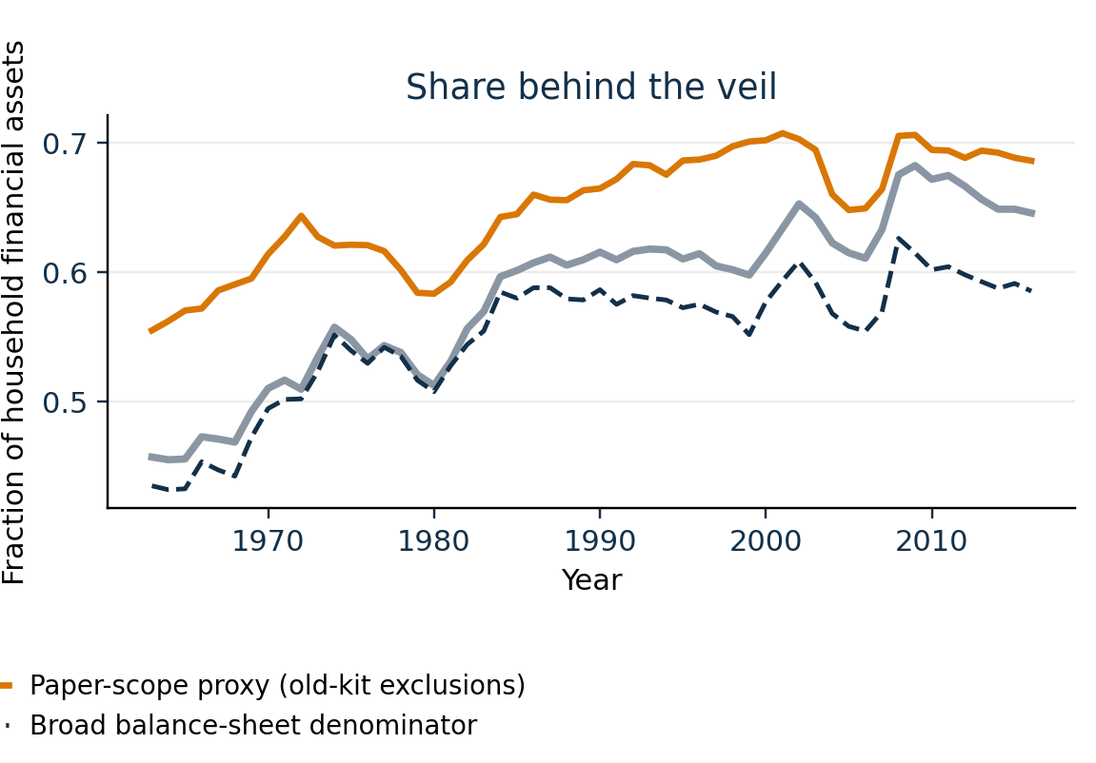
FIGURE 1 DIAGNOSTIC
05
The remaining Figure 1 gap is concentrated in the share
Level behind the veil · paper versus ours
Share behind the veil · denominator variants
WHAT MATCHES
Level: 144.4% versus 148.5% in 1963; 263.9% versus 269.0% in 2016.
Share MAE is 6.6 pp for the paper-scope proxy and 3.2 pp for the broad denominator; the latter's closer fit is not proof of conceptual equivalence.
Notes:
[Sources]
- Results_Proposal/figures/figure1_authors_data_comparison.png
- Data/processed/figure1_authors_comparison.csv
- Code/scripts/build_figure1_authors_data.py
- docs/project/tasks/figure1-replication.md, Evidence and limitations

Slide 7
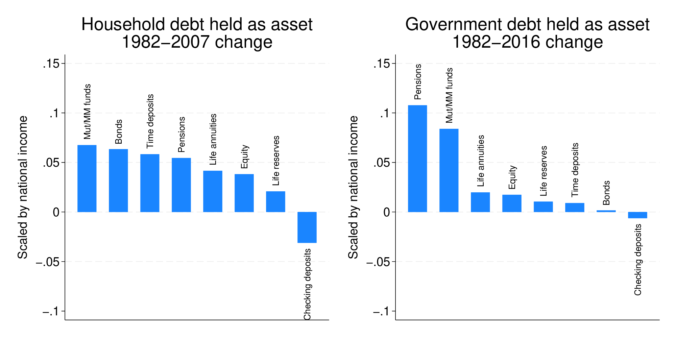
AUTHORS' OLD APPROACH
06
The 2021 Stata output is a precursor, not the same outcome
2021 package · old Figure 6 · Stata
Our Python · 2025-defined Figure 1 object
NOT A CONTROLLED TEST
Both use the same broad Financial Accounts lineage, but the Stata chart decomposes increases in debt holdings; ours totals all household claims on intermediaries.
Different estimands plus different algorithms mean the visual gap cannot be attributed purely to the 2021 round-by-round versus 2025 matrix methodology.
Notes:
[Sources]
- MSS2021Febreplicationkit/output/fig_owndet.eps
- MSS2021Febreplicationkit/code/mss_analysis.do, lines 587-678
- Results_Proposal/figures/figure1_authors_data_reconstruction.png
- Results_Proposal/major_results.md, R-001 authors' implementation boundary

Slide 8
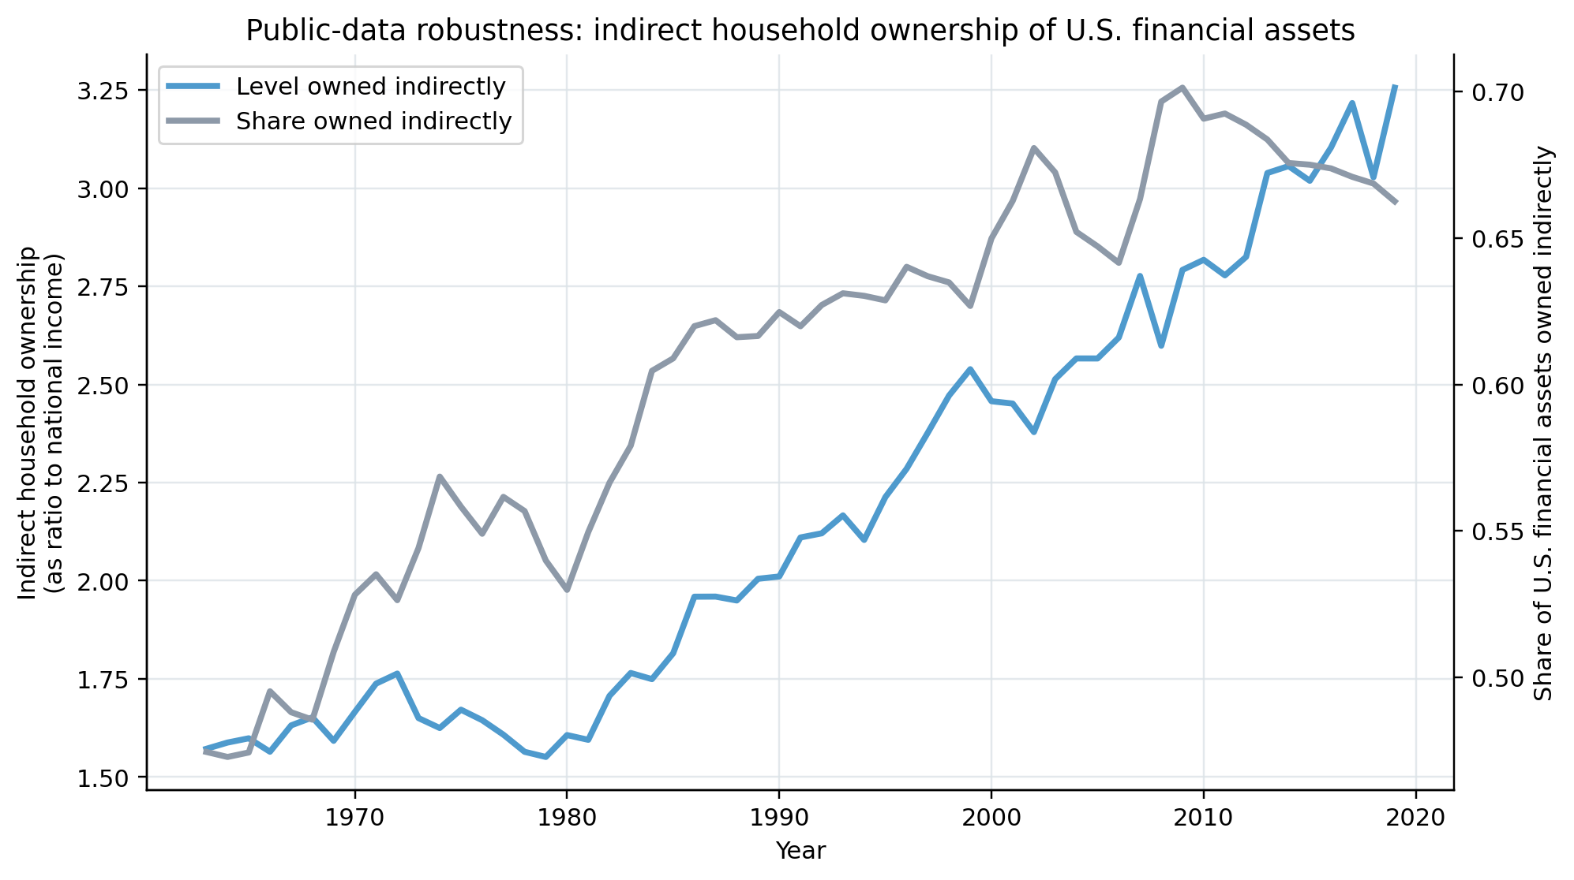
SECONDARY ROBUSTNESS
07
Public data recover the broad rise through 2019
Procedure
Our public-data Figure 1 · 1963-2019
Public-data construction
Input
Coverage
Treatment
FWTW
1963-2019
21 sectors
BEA/FRED
Annual
NI denominator
Equity
Later vintage
Public proxy
Output
Two ratios
Robustness
TREND ROBUST
Indirect share: 47.5% in 1963, a 70.1% peak in 2009, and 66.2% in 2019.
Later revisions, 21 rather than 23 intermediaries, and a different equity extension prevent an exact target comparison.
Notes:
[Sources]
- Results_Proposal/figures/figure1_indirect_household_ownership.png
- Code/scripts/build_figure1.py
- Data/raw/README.md (Federal Reserve FWTW and BEA/FRED provenance)
- docs/data/figure1-data.md, New-data robustness inputs

Slide 9
FIGURE 5 IDENTIFICATION
08
The 2021 wealth pipeline identifies revised saving
Target
1 · Allocate wealth
2025 Figure 5
Saving contribution by wealth group
B.101 totals × fine DINA shares for four groups and 29 balance-sheet categories.
2 · Remove valuations
Housing gains + debt write-downs; residual equity return closes to NIPA.
Classification
Reconstruction: wealth, valuation, fine-share, and NIPA inputs are supplied through 2016.
3 · Match display
Trailing 10-year mean of saving / national income, less its 1982 value.
Notes:
[Sources]
- MSS_SGR_July242025.pdf, Section 3.4 and Figure 5, physical PDF page 22
- MSS2021Febreplicationkit/code/build_wealth_saving_data.do
- docs/data/figure5-data.md
- Code/unveiling/figure5_authors.py

Slide 10
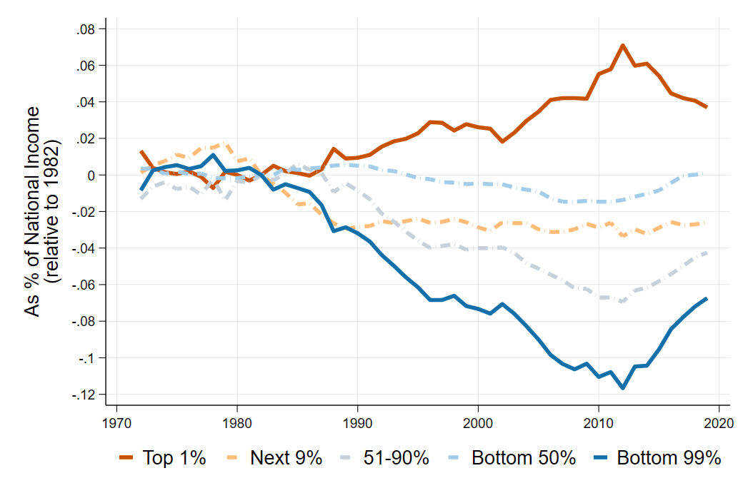
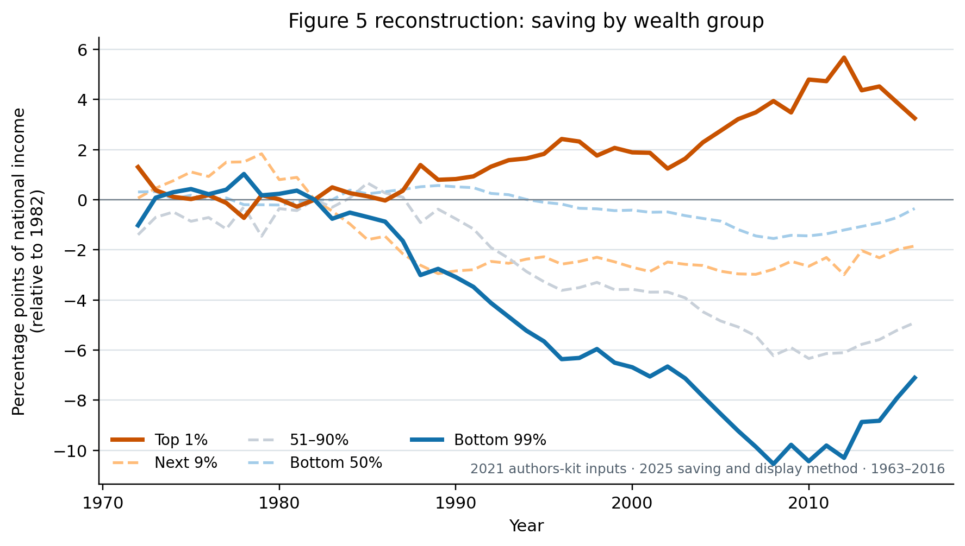
FIGURE 5 PRIMARY COMPARISON
09
The older inputs reproduce the saving divergence
2025 paper · ratio axis (0.10 = 10 pp)
Our reconstruction · percentage-point axis
HIGH-FIDELITY MATCH
Top 1% / bottom 99% correlations: 0.992 / 0.997; MAE: 0.40 / 0.42 pp.
2016 shifts: ours +3.25 / -7.11 pp; digitized paper +4.35 / -8.46 pp. Paper image excludes its printed caption.
Notes:
[Sources]
- MSS_SGR_July242025.pdf, Figure 5, physical PDF page 22; embedded chart extracted without caption
- Results_Proposal/figures/figure5_authors_data_reconstruction.png
- Data/processed/figure5_authors_comparison.csv
- docs/project/tasks/figure5-replication.md, Verification and result

Slide 11
FIGURE 6 IDENTIFICATION
10
The same saving rate supports rank and wealth-level views
Target
1 · Rebuild bins
2025 Figure 6
Net saving rate by wealth percentile
Raw DINA: bottom 40%, then one-percentile bins through the top 1%.
2 · Match income
Personal plus attributable corporate disposable income, allocated by income and equity shares.
Classification
Exact-method reconstruction through 2016; the paper's later window ends in 2019.
3 · Hold rate fixed
Active saving divided by disposable income; only the horizontal coordinate changes.
Notes:
[Sources]
- MSS_SGR_July242025.pdf, Section 3.4 and Figure 6, physical PDF page 24
- docs/data/figure6-data.md
- docs/project/tasks/figure6-replication.md
- Code/unveiling/figure6_authors.py

Slide 12
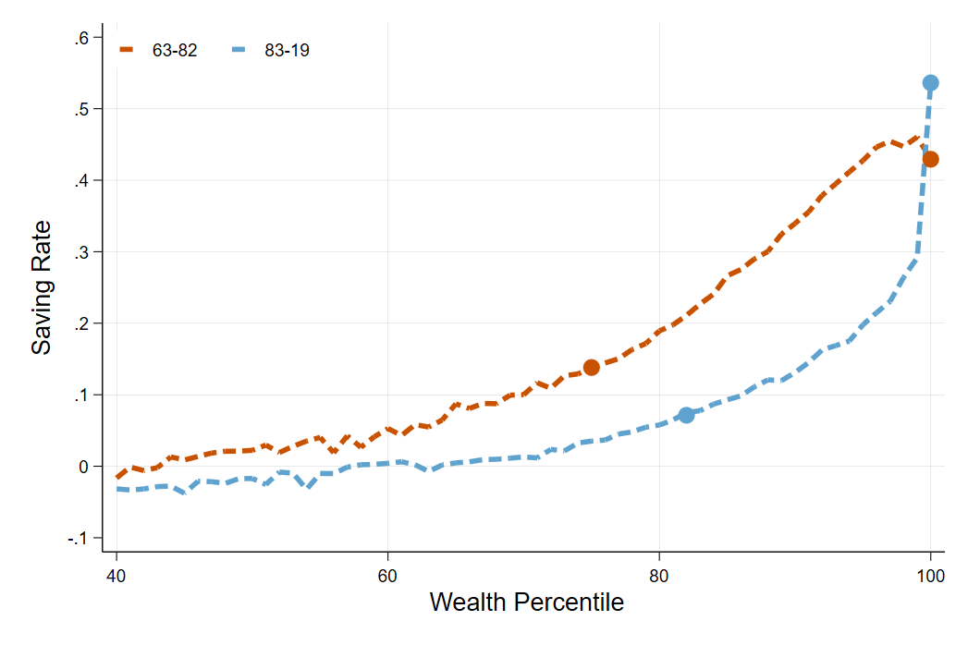
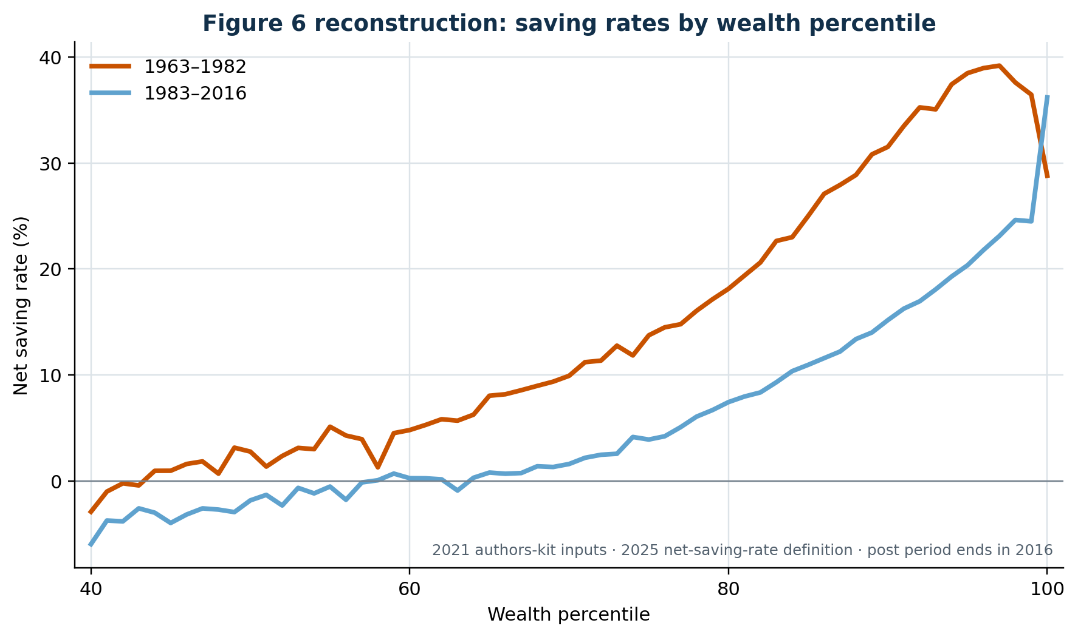
FIGURE 6 PRIMARY COMPARISON
11
The older inputs reproduce the cross-sectional saving pattern
2025 paper · 1963–82 and 1983–2019
Our reconstruction · second period ends in 2016
CLOSE SHAPE MATCH
Correlations: 0.991 / 0.969; MAE: 1.46 / 1.22 pp.
Top 1%: ours 28.8%→36.2%; paper ≈43%→54%. The old inputs end in 2016, not 2019.
Notes:
[Sources]
- MSS_SGR_July242025.pdf, Figure 6, physical PDF page 24; embedded chart extracted without caption
- Results_Proposal/figures/figure6_authors_data_percentiles.png
- Data/processed/figure6_authors_comparison.csv
- Data/processed/figure6_digitization_audit.csv
- docs/project/tasks/figure6-replication.md

Slide 13
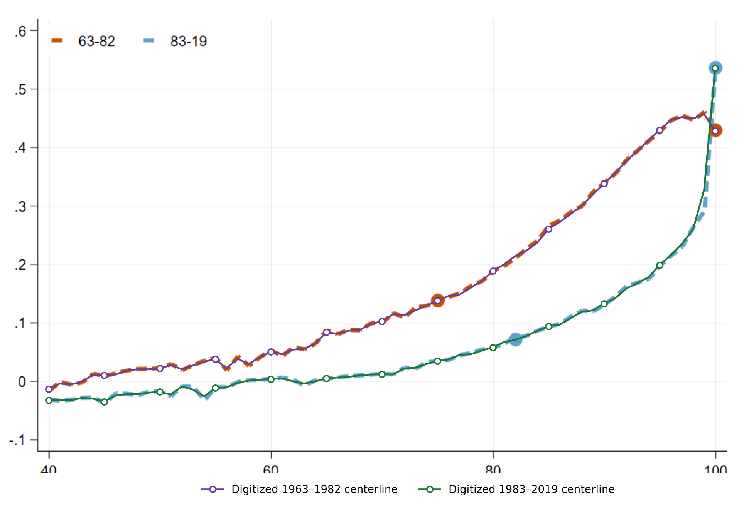
DIGITIZATION AUDIT
12
Recovered centerlines match the paper pixels
Calibration and trace
Original raster + recovered centerlines
No hand-clicking or screenshot interpolation
Object
Audit
Result
Source
1047×698
Embedded
Grid
61 × 2
122 samples
Matches
122 / 122
0 filled
Scale
1 pixel
0.129 pp
PIXEL TRACE PASSES
Solid recovered centerlines overlap the original dashed curves.
The overlay corrected the blue top-1 endpoint by ≈1.3 pp; post-period correlation / MAE are 0.969 / 1.22 pp.
Notes:
[Sources]
- MSS_SGR_July242025.pdf, Figure 6, physical PDF page 24; original embedded raster
- Results_Proposal/figures/figure6_digitization_overlay_slide.png
- Data/processed/figure6_digitization_audit.csv
- Code/unveiling/paper_benchmarks.py
- Code/scripts/build_figure6_authors_data.py
- docs/data/figure6-data.md, Paper-curve digitization

Slide 14
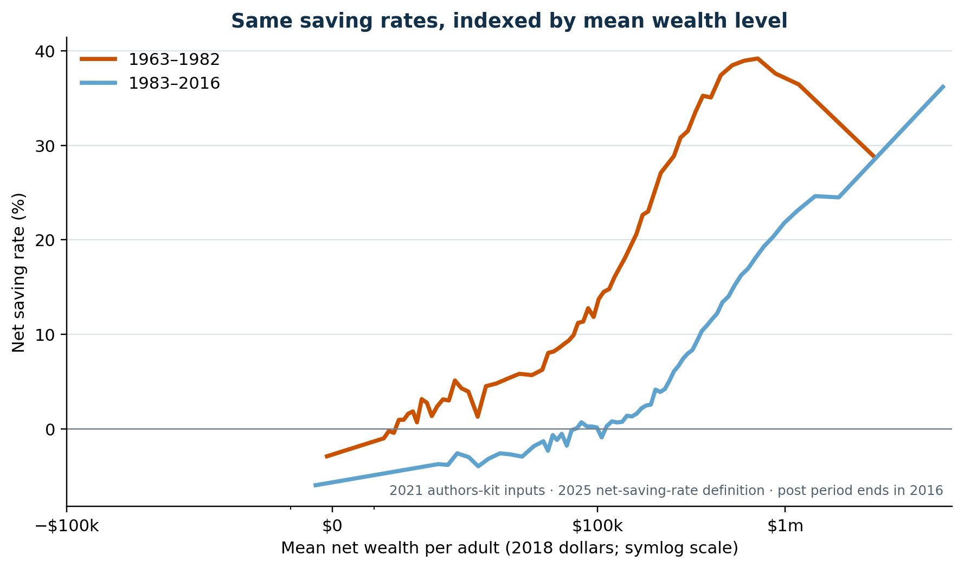
FIGURE 6 MECHANISM VIEW
13
Rising wealth alone does not explain the saving-rate shift
Same rates · wealth percentile
Same rates · mean real wealth per adult
NOT PURE COMPOSITION
At similar mean wealth, post-1982 cohorts often save less.
Near $300k mean wealth: pre p90 saves 31.5%; post p80 saves 7.4%. Cohort means are not fixed-dollar bins.
Notes:
[Sources]
- Results_Proposal/figures/figure6_authors_data_percentiles.png
- Results_Proposal/figures/figure6_authors_data_wealth_levels.png
- Data/processed/figure6_authors_data.csv
- docs/project/personal-considerations-saving-inequality.md
- docs/data/figure6-data.md

Slide 15
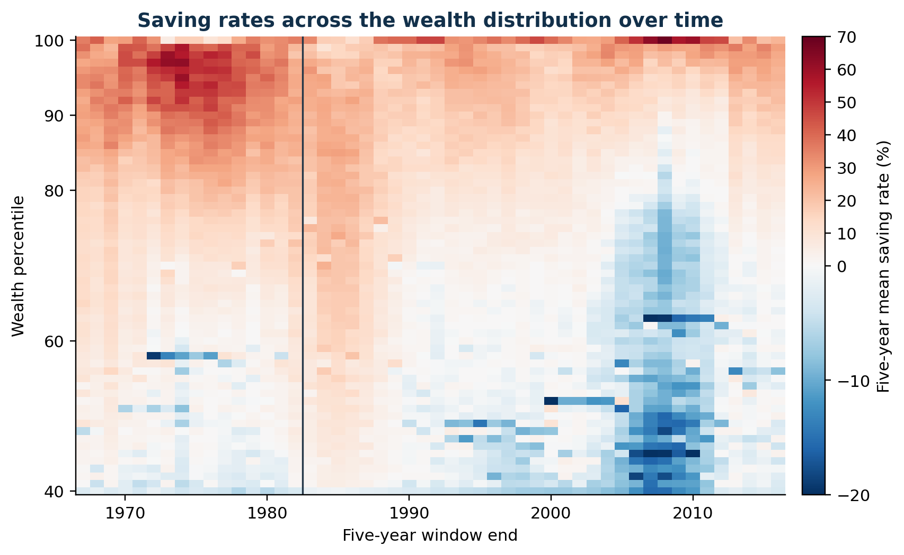
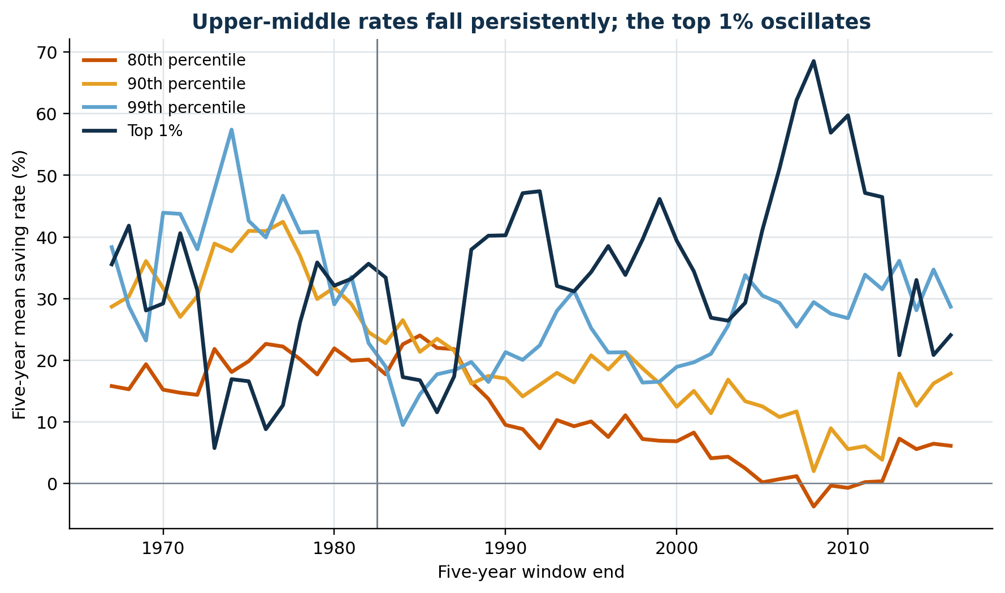
FIGURE 6 TIME EVOLUTION
14
Upper-middle rates trend down; the top 1% remains volatile
Full distribution · trailing five-year means
Selected upper-tail percentiles
NOT A SINGLE BREAK
The 80th–90th percentiles decline persistently after the late 1980s.
The top 1% oscillates sharply, including a 2008 five-year peak; this is not one smooth monotone trend.
Notes:
[Sources]
- Data/processed/figure6_authors_rolling5.csv
- Results_Proposal/figures/figure6_rolling5_heatmap.png
- Results_Proposal/figures/figure6_rolling5_selected_percentiles.png
- Code/scripts/build_figure6_authors_data.py
- docs/data/figure6-data.md

Slide 16
FIGURE 8 FEASIBILITY
15
Figure 8 stops one step before the revised matrix solve
Target
1 · Missing upstream
2025 Figure 8
Net household debt by wealth group
Completed 2025 instrument × sector matrices and augmented household columns.
2 · Old-kit output
Fine debt assets after seven rounds + fine liabilities.
Classification
Proxy: group, sign, scale, and base are revised; unveiled asset stocks still come from the older method.
3 · Applied faithfully
Net debt = debt assets − liabilities; divide by NI; subtract 1982.
Notes:
[Sources]
- MSS_SGR_July242025.pdf, Sections 4.1-4.2 and Figure 8, physical PDF page 29
- MSS2021Febreplicationkit/code/build_fa_unveiling_data.do
- docs/data/figure8-data.md
- Code/unveiling/figure8_authors.py

Slide 17
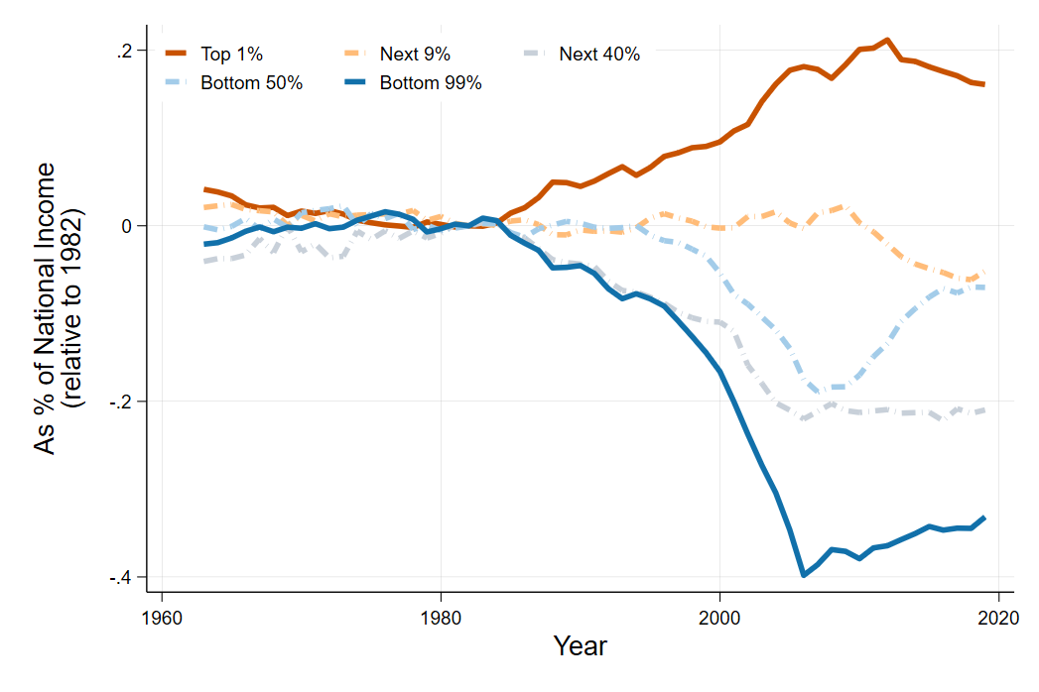
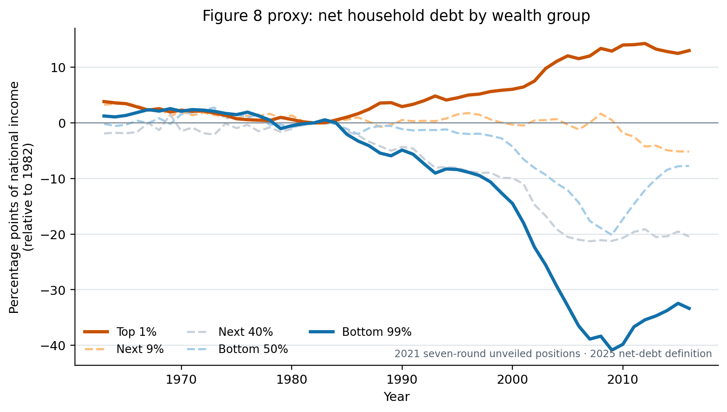
FIGURE 8 PRIMARY COMPARISON
16
The proxy reproduces borrowing, but understates top-1 lending
2025 paper · ratio axis (0.10 = 10 pp)
Our proxy · percentage-point axis
CLOSE PROXY
2007: bottom 99% -38.88 pp proxy vs -38.76 paper; top 1% +12.03 vs +18.02.
Correlations: 0.993 / 0.995 (top 1% / bottom 99%). Missing matrices prevent a code-only interpretation.
Notes:
[Sources]
- MSS_SGR_July242025.pdf, Figure 8, physical PDF page 29; embedded chart extracted without caption
- Results_Proposal/figures/figure8_authors_proxy.png
- Data/processed/figure8_authors_proxy_comparison.csv
- docs/project/tasks/figure8-replication.md, Verification and result

Slide 18
REPLICATION SYNTHESIS
17
Figures 1, 5, and 6 reconstruct; Figure 8 remains a proxy
Conclusion
Figure 1
What did the 2021 kit let us test?
Close stock reconstruction; share denominator remains version-specific.
Figures 5–6
High-fidelity saving-flow and saving-rate reconstructions through 2016.
Main lesson
The 2021 inputs reproduce the paper's core patterns and support a new Figure 6 mechanism diagnostic. Figure 8 alone remains method-bounded.
Figure 8
Direction and bottom-99 level match; revised matrices are unavailable.
Notes:
[Sources]
- Results_Proposal/major_results.md, R-001 to R-003
- docs/project/tasks/figure1-replication.md
- docs/project/tasks/figure5-replication.md
- docs/project/tasks/figure6-replication.md
- docs/project/tasks/figure8-replication.md

