Slide 1
CORE FIGURE COMPARISON
Four figures, one evidence hierarchy
Compare only the objects that the February 2021 inputs actually identify
Primary: our old-input implementation versus the 2025 paper
Supporting: older Stata lineage and public-data robustness
12 August 2026
Notes:
[Sources]
- docs/project/tasks/figure1-replication.md
- docs/project/tasks/figure5-replication.md
- docs/project/tasks/figure6-replication.md
- docs/project/tasks/figure8-replication.md
- Presentation/1_replication_package_validation/replication_package_validation.pptx (visual source)

Slide 2
EVIDENCE ROLES
02
One label cannot mean the same thing across all four figures
2025 targets
Authors-old (2021)
Figures 1, 5, 6, and 8
Revised definitions through 2019
Exact for the older paper; precursor evidence only for revised exhibits.
Ours-public
Figure 1 only: a later public vintage tests broad trend robustness.
Naming rule
Call a result a reconstruction only when the supplied inputs identify the revised object. Otherwise retain the word proxy.
Ours-authors
Figures 1, 5, and 6: reconstructions. Figure 8: current proxy; full-method rerun planned.
Notes:
[Sources]
- MSS_SGR_July242025.pdf, Figures 1, 5, 6, and 8
- docs/project/tasks/result-selection.md
- Results_Proposal/major_results.md, R-001 to R-003
- docs/project/tasks/figure8-replication.md

Slide 3
METHOD CROSSWALK
03
Inputs, methods, and estimands change together
Version
Inputs
Role
Procedure / boundary
1 · 2025 paper
Revised to 2019
Benchmark
34 instruments; 23 intermediaries + 4 owners; matrix/Leontief method; exact code unavailable
2 · 2021 Stata
Feb. 2021 kit
Context
Old Figure 6 composition; staged round-by-round debt allocation
3 · Ours-public
2026 public
Robustness
31 instruments; 25 substantive sectors; completed public FWTW; 1963–2019
4 · Ours-authors
Feb. 2021 kit
Primary
Rebuild intermediary claims; 2025 Figure 1 definition; 1963-2016
PRIMARY TEST
#4 versus #1
Main result
Same target object; different vintage and incomplete old-kit denominator
SUPPORTING
#4 vs #2 / #3
Diagnostics
Method lineage and public-vintage robustness; never pool the series
Rule
Only #4 versus #1 answers the project's central replication question. #2 and #3 explain lineage and robustness; they do not replace the benchmark.
Notes:
[Sources]
- MSS_SGR_July242025.pdf, Sections 2.2 and 4.1
- https://www.federalreserve.gov/releases/efa/fwtw.htm
- Data/raw/fwtw/fwtw_data_2026-06-18.csv
- docs/data/figure1-data.md

Slide 4
FIGURE 5 IDENTIFICATION
09
The 2021 wealth pipeline identifies revised saving
Target
1 · Allocate wealth
2025 Figure 5
Saving contribution by wealth group
B.101 totals × fine DINA shares for four groups and 29 balance-sheet categories.
2 · Remove valuations
Housing gains + debt write-downs; residual equity return closes to NIPA.
Classification
Reconstruction: wealth, valuation, fine-share, and NIPA inputs are supplied through 2016.
3 · Match display
Trailing 10-year mean of saving / national income, less its 1982 value.
Notes:
[Sources]
- MSS_SGR_July242025.pdf, Section 3.4 and Figure 5, physical PDF page 22
- MSS2021Febreplicationkit/code/build_wealth_saving_data.do
- docs/data/figure5-data.md
- Code/unveiling/figure5_authors.py

Slide 5
FIGURE 8 FEASIBILITY
16
The exact 2025 vintage is missing—not the method
Target
1 · Exact-vintage gap
2025 Figure 8
Net household debt by wealth group
Authors’ completed matrices, equity split, and exact crosswalk are not in the 2021 kit.
2 · Available now
Public completed FWTW plus 2021 DINA/NIPA support a full-Leontief mixed-vintage rerun.
Classification
Current plotted result: proxy. Planned public-FWTW rerun: method reconstruction with explicit vintage/taxonomy caveats.
3 · Current graph
Still uses seven-round debt assets with the 2025 group, sign, scale, and base.
Notes:
[Sources]
- MSS_SGR_July242025.pdf, Sections 4.1–4.2 and Figure 8
- https://www.federalreserve.gov/releases/efa/fwtw.htm
- docs/project/tasks/figure8-replication.md
- docs/data/figure8-data.md

Slide 6
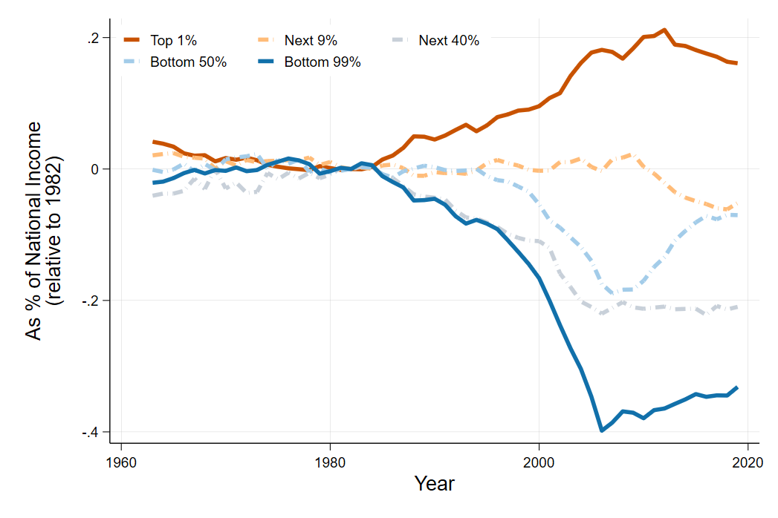
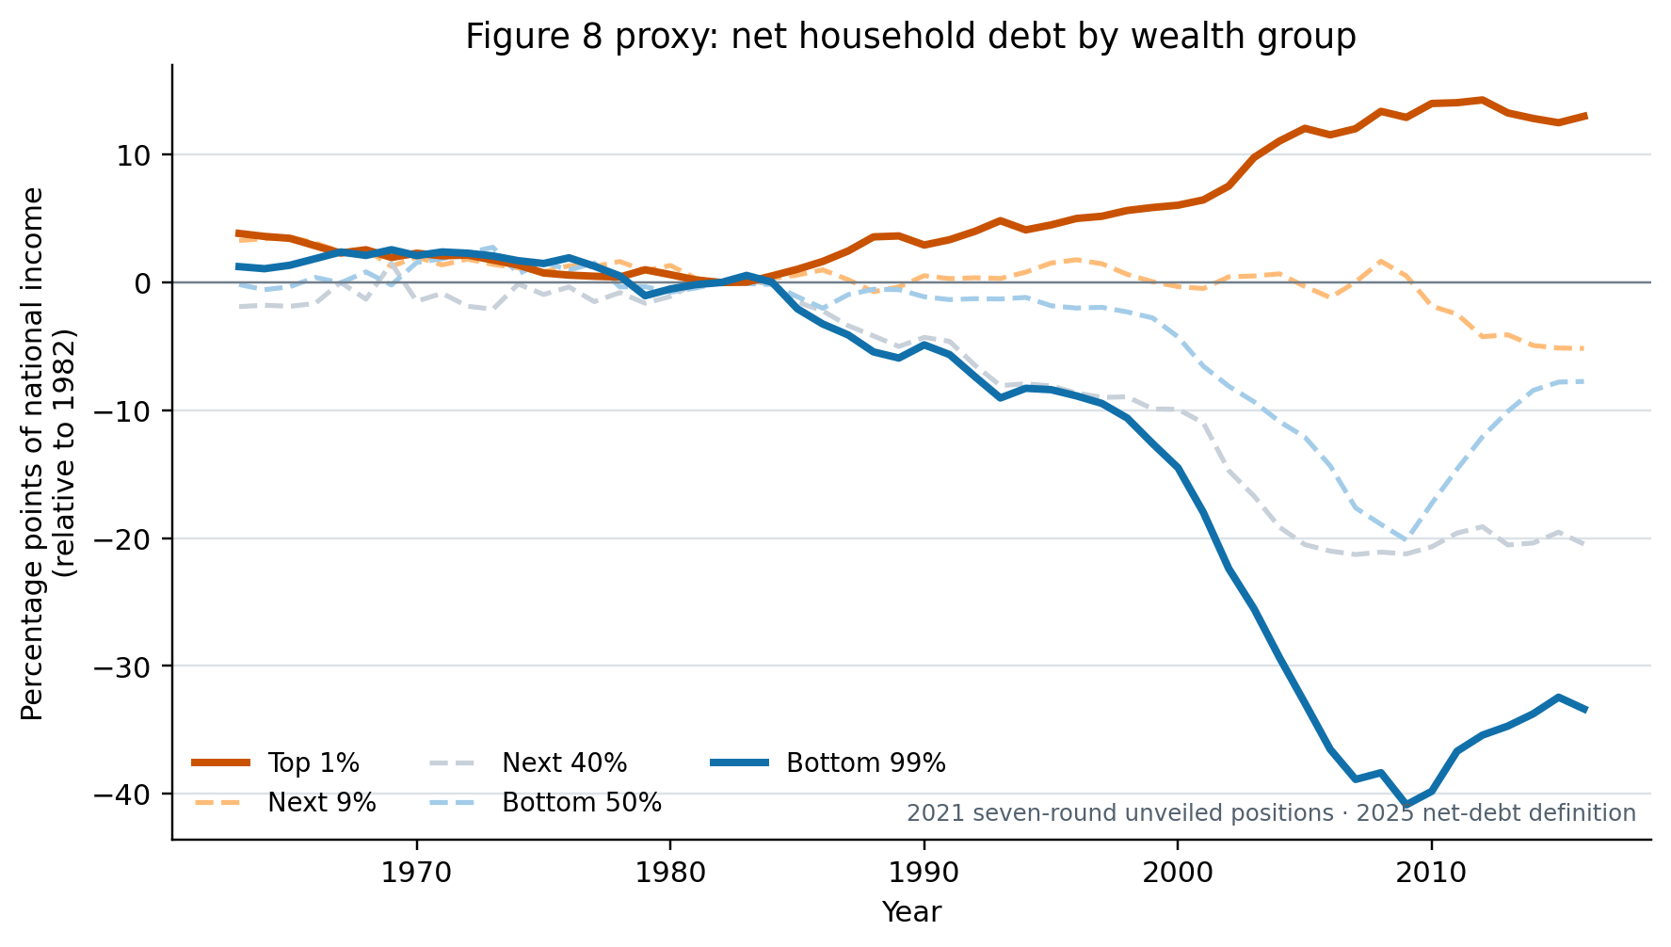
FIGURE 8 PRIMARY COMPARISON
17
The proxy reproduces borrowing, but understates top-1 lending
2025 paper · ratio axis (0.10 = 10 pp)
Our proxy · percentage-point axis
CLOSE PROXY
2007: bottom 99% -38.88 pp proxy vs -38.76 paper; top 1% +12.03 vs +18.02.
Correlations: 0.993 / 0.995 (top 1% / bottom 99%). Exact-vintage inputs are missing; public FWTW supports a separate method rerun.
Notes:
[Sources]
- MSS_SGR_July242025.pdf, Figure 8, physical PDF page 29; embedded chart extracted without caption
- Results_Proposal/figures/figure8_authors_proxy.png
- Data/processed/figure8_authors_proxy_comparison.csv
- docs/project/tasks/figure8-replication.md, Verification and result

Slide 7
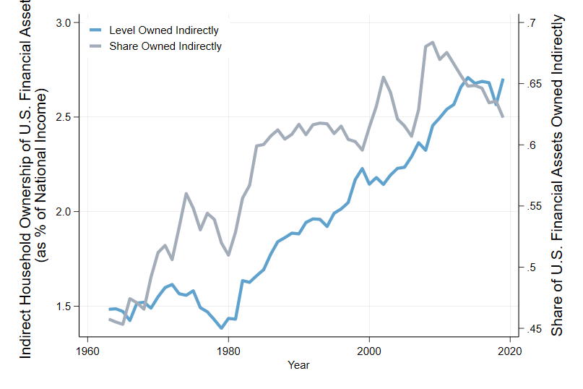
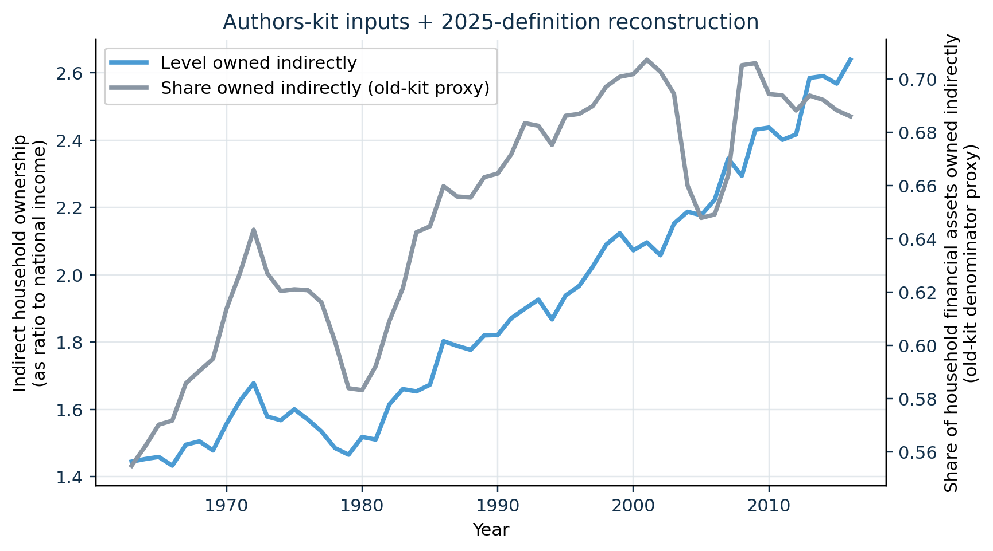
PRIMARY COMPARISON
05
Our old-input reconstruction tracks the 2025 Figure 1 pattern
2025 paper · Figure 1 · PDF p. 11
Our implementation · 2021 authors' inputs
CLOSE LEVEL MATCH
The national-income-normalized level has correlation 0.995 and MAE 5.3 pp against the digitized 2025 curve over 1963-2016.
The paper caption is removed from the image and restated here: the lines report the stock-to-income level and household-financial-asset share held indirectly.
Notes:
[Sources]
- MSS_SGR_July242025.pdf, Figure 1, physical PDF page 11; chart cropped without caption
- Results_Proposal/figures/figure1_authors_data_reconstruction.png
- Data/processed/figure1_authors_comparison.csv
- docs/project/tasks/figure1-replication.md, Evidence

Slide 8
REPLICATION SYNTHESIS
18
Figure 8 has a proxy today—and a full-method rerun path
Conclusion
Figure 1
What did the 2021 kit let us test?
Close stock reconstruction; share denominator remains version-specific.
Figures 5–6
High-fidelity saving-flow and saving-rate reconstructions through 2016.
Main lesson
The 2021 inputs establish old-vintage evidence. For Figure 8, current public FWTW can test the 2025 operator, but not reproduce the authors’ exact vintage.
Figure 8
Current proxy matches direction; public FWTW enables the next full-Leontief, mixed-vintage reconstruction.
Notes:
[Sources]
- Results_Proposal/major_results.md, R-001 to R-003
- docs/project/tasks/figure1-replication.md
- docs/project/tasks/figure5-replication.md
- docs/project/tasks/figure6-replication.md
- docs/project/tasks/figure8-replication.md
- https://www.federalreserve.gov/releases/efa/fwtw.htm

