Slide 1
REPLICATION PACKAGE · METHODOLOGY, DATA, RESULTS
Replicating the Saving Glut of the Rich
A transparent reconstruction of Mian, Straub, and Sufi (2025) from the February 2021 authors’ package
SUBMISSION QUESTION
Which claims can the available data reproduce—and which remain version-bound?
13 August 2026
Notes:
[Sources]
- MSS_SGR_July242025.pdf (target paper)
- MSS2021Febreplicationkit/readme.pdf (available authors’ package)
- NotebookLM-Present-Unveiling_the_Rich_Saving_Glut.pdf, pp. 1–6 (orientation and visual inspiration only)

Slide 2
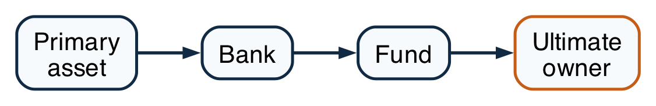
THE ECONOMIC PROBLEM
02
Intermediation hides the ultimate owner
OBSERVED BALANCE-SHEET CHAIN
ECONOMIC INCIDENCE
What accounts record
Primary asset → bank → fund → household
What incidence asks
Which terminal sector ultimately owns the primary claim?
WHY IT MATTERS
Unveiling follows every liability until the claim reaches a terminal owner.
Source: Mian, Straub, and Sufi (2025), Sections 2.1–2.2.
Notes:
Unveiling follows every liability until the claim reaches a terminal owner.
[Sources]
- /Users/lorenzogorini/Library/CloudStorage/OneDrive-UniversitàCommercialeLuigiBocconi/PhD/research-wiki/papers/inequality/mian-2025-saving-glut-rich/full.md, Sections 2.1–2.2.
[/Sources]

Slide 3
DIRECT OWNERSHIP
03
Rows issue liabilities; columns hold them
PAPER EQUATION (4)
ORIENTATION AND INVARIANT
row i = issuer / borrower
column j = holder / lender
Mₕ,ₜ: dollar matrix for instrument h.
Lₜ: liabilities issued by each sector.
⊙: elementwise row scaling.
WHY IT MATTERS
Build the direct network from instrument claims; Figure 1 counts household claims on intermediary issuers before the solve.
Source: Mian, Straub, and Sufi (2025), Section 2.1 and Equation (4).
Notes:
Aggregate instrument positions in dollars, then divide each issuer row by its own liabilities.
[Sources]
- /Users/lorenzogorini/Library/CloudStorage/OneDrive-UniversitàCommercialeLuigiBocconi/PhD/research-wiki/papers/inequality/mian-2025-saving-glut-rich/full.md, Section 2.1 and Equation (4).
[/Sources]

Slide 4
LEONTIEF INVERSE
04
One inverse sums every intermediary path
PAPER EQUATION (1)
EQUIVALENT ULTIMATE-OWNER BLOCK
M̄ₜ is the full unveiled ownership matrix.
Bₜ: direct exits from intermediaries to owners.
Qₜ: ownership that remains inside intermediaries.
WHY IT MATTERS
The block solve is the paper's full-matrix series restricted to claims that terminate at owners.
Source: Mian, Straub, and Sufi (2025), Section 2.2 and Equation (1).
Notes:
The block solve is the paper's full-matrix series restricted to claims that terminate at owners.
[Sources]
- /Users/lorenzogorini/Library/CloudStorage/OneDrive-UniversitàCommercialeLuigiBocconi/PhD/research-wiki/papers/inequality/mian-2025-saving-glut-rich/full.md, Section 2.2 and Equation (1).
[/Sources]

Slide 5
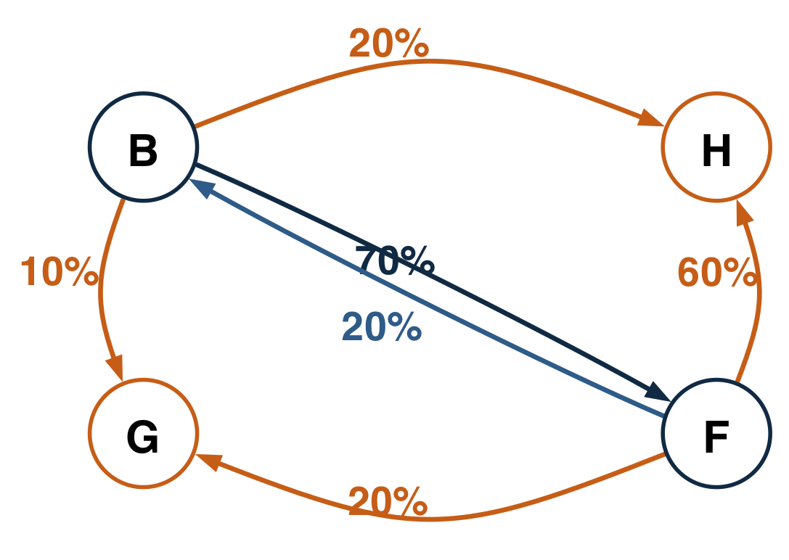
WORKED NETWORK
05
A four-sector network makes every path auditable
DIRECT-OWNERSHIP GRAPH
EDGE MEANING
Bank row: H 20%, G 10%, F 70%.
Fund row: H 60%, G 20%, B 20%.
Arrow i → j: j holds i's liability.
RECIPROCAL INTERMEDIATION: B ↔ F
WHY IT MATTERS
The reciprocal bank–fund link creates infinitely many paths, all with economically readable weights.
Source: project worked example; edge labels are direct liability shares.
Notes:
The reciprocal bank–fund link creates infinitely many paths, all with economically readable weights.
[Sources]
- /Users/lorenzogorini/Library/CloudStorage/OneDrive-UniversitàCommercialeLuigiBocconi/PhD/Courses/Macro 3 - Favero/Paper Replication/Code/examples/leontief_unveiling.py.
[/Sources]

Slide 6
WORKED RESULT
06
Direct 20% becomes ultimate household ownership of 72.093%
FIXED-POINT LOGIC
DIRECT + INDIRECT
Household share of bank liabilities
20.0%
direct
52.093% indirect
WHY IT MATTERS
The additional 52.093 percentage points are the bank's household claim carried through the fund and every reciprocal loop.
Source: project worked example; values are percentage shares of the bank's liabilities.
Notes:
The additional 52.093 percentage points are the bank's household claim carried through the fund and every reciprocal loop.
[Sources]
- /Users/lorenzogorini/Library/CloudStorage/OneDrive-UniversitàCommercialeLuigiBocconi/PhD/Courses/Macro 3 - Favero/Paper Replication/Code/examples/leontief_unveiling.py.
[/Sources]

Slide 7
REPLICATION CHOICE
07
The 2021 rounds are not a fixed-Q truncation
AUTHORS' 2021 STAGE-SPECIFIC PIPELINE
2025 METHOD AND OUR IMPLEMENTATION
Convergence: ρ(Qₜ) < 1.
Conservation: Ωₜ1ₘ = 1ₖ.
Implementation: solve the linear system directly.
Seven stages change instruments, adjustments, and residual rules.
WHY IT MATTERS
They share proportional allocation logic; equivalence requires the same fixed matrix in every round.
Source: 2021 replication kit; July 2025 paper; docs/methods/leontief-unveiling.md.
Notes:
They share proportional allocation logic; equivalence requires the same fixed matrix in every round.
[Sources]
- /Users/lorenzogorini/Library/CloudStorage/OneDrive-UniversitàCommercialeLuigiBocconi/PhD/Courses/Macro 3 - Favero/Paper Replication/MSS2021Febreplicationkit/code/build_fa_unveiling_data.do.
- /Users/lorenzogorini/Library/CloudStorage/OneDrive-UniversitàCommercialeLuigiBocconi/PhD/Courses/Macro 3 - Favero/Paper Replication/MSS_SGR_July242025.pdf, Section 2.2.
- /Users/lorenzogorini/Library/CloudStorage/OneDrive-UniversitàCommercialeLuigiBocconi/PhD/Courses/Macro 3 - Favero/Paper Replication/docs/methods/leontief-unveiling.md.
[/Sources]

Slide 8
IDENTIFICATION MAP
08
No dataset identifies the entire object
NETWORK STOCKS
GROUP ALLOCATION AND FLOWS
FA / FWTW
DINA
Sector-by-sector financial stocks and instrument-level bilateral positions.
Household assets and liabilities distributed across income or wealth groups.
NIPA
Who holds whose liability?
Aggregate income, saving, and national-account closure—not bilateral ownership.
WHY IT MATTERS
Stocks, counterparties, household groups, and flows are distinct dimensions that must be combined explicitly.
Source: paper data appendix; project author-kit data map.
Notes:
Stocks, counterparties, household groups, and flows are distinct dimensions that must be combined explicitly.
[Sources]
- /Users/lorenzogorini/Library/CloudStorage/OneDrive-UniversitàCommercialeLuigiBocconi/PhD/Courses/Macro 3 - Favero/Paper Replication/docs/data/author-kit-data-map.md.
- /Users/lorenzogorini/Library/CloudStorage/OneDrive-UniversitàCommercialeLuigiBocconi/PhD/research-wiki/papers/inequality/mian-2025-saving-glut-rich/full.md, data appendix.
[/Sources]

Slide 9
SAVING VS. VALUATION
09
Valuation data separate saving from capital gains
GROUP SAVING EQUATION
DATA ROLES
DINA × B101: wealth levels by group and asset.
JST / FA: market returns and balance-sheet values.
Write-down data: credit losses and defaults.
NIPA: aggregate saving/income closure.
Δ wealth: observed change in asset holdings.
πᵃ_tWᵃ_g,t−1: passive valuation gain.
Θ_g,t: active saving flow.
Figure 5 baseline: groups ranked by wealth
WHY IT MATTERS
A change in wealth is not saving unless capital gains, write-downs, and other valuation effects are removed.
Source: paper saving methodology and data appendix; Figure 5 baseline is wealth-ranked.
Notes:
A change in wealth is not saving unless capital gains, write-downs, and other valuation effects are removed.
[Sources]
- /Users/lorenzogorini/Library/CloudStorage/OneDrive-UniversitàCommercialeLuigiBocconi/PhD/research-wiki/papers/inequality/mian-2025-saving-glut-rich/full.md, saving methodology and Figure 5.
[/Sources]

Slide 10
FIGURE LINEAGE
10
Figures 1, 5, and 8 use different data branches
NETWORK AND SAVING
DEBT DISTRIBUTION
1
Figure 1 · indirect ownership
FA/FWTW matrices → normalize → unveil.
8
Figure 8 · net household debt
Augmented ownership matrix + DINA liabilities.
5
Figure 5 · saving glut
DINA × B101 + valuations + NIPA closure.
This branch needs both the financial-network allocation and group-specific balance-sheet liabilities.
WHY IT MATTERS
The figures share distributional inputs, but each one requires a different economic object and transformation chain.
Source: July 2025 paper methods and project figure-lineage records.
Notes:
The figures share distributional inputs, but each one requires a different economic object and transformation chain.
[Sources]
- /Users/lorenzogorini/Library/CloudStorage/OneDrive-UniversitàCommercialeLuigiBocconi/PhD/research-wiki/papers/inequality/mian-2025-saving-glut-rich/full.md, Figures 1, 5, and 8.
- /Users/lorenzogorini/Library/CloudStorage/OneDrive-UniversitàCommercialeLuigiBocconi/PhD/Courses/Macro 3 - Favero/Paper Replication/docs/project/tasks/result-selection.md.
[/Sources]

Slide 11
DATA-VINTAGE BOUNDARY
11
Three vintages expose different network objects
INPUT INVENTORY
WHAT WE CAN CLAIM
1
2021 package
METHOD REPLICATION
DINA/NIPA and old FA preparation to 2016; seven-stage routing; no Batty completion.
• Complete instrument-level dollar matrices.
• Row-normalize direct ownership.
• Add DINA wealth-group columns.
• Apply the full Leontief solve.
• Report taxonomy and end-year gaps.
2
2025 target
34 instruments; 23 intermediaries + 4 owners; authors’ Batty-based equity extension; to 2019.
3
Feasible public rerun
Current completed FWTW: 31 instruments and 25 substantive sectors; pair with 2021 DINA/NIPA.
WHY IT MATTERS
The feasible rerun is mixed-source: current public network plus 2021 distributional inputs. It tests the 2025 method, not the authors’ exact values.
Source: 2025 paper; Federal Reserve FWTW release and announcements; 2021-kit audit.
Notes:
[Sources]
- MSS_SGR_July242025.pdf, Sections 2.2 and 4.1
- https://www.federalreserve.gov/releases/efa/fwtw.htm
- https://www.federalreserve.gov/releases/efa/fwtw_announcements.htm
- Data/raw/fwtw/fwtw_data_2026-06-18.csv
- docs/data/figure1-data.md
- docs/project/tasks/figure8-replication.md

Slide 12
REPLICATION STRATEGY
12
Use the earliest source that identifies each object
THREE EVIDENCE LAYERS
STORAGE POLICY
1
Benchmark
RAW STAYS IMMUTABLE
Regenerate authors’ output for its own vintage.
Symlink the authors' raw-data location if needed.
Do not duplicate large raw sources.
Save only documented interim data that materially speeds reruns.
Always retain compact final matrices, figures, and diagnostics.
2
Reconstruction
Use the earliest input that identifies the target object.
3
Robustness
Change vintage or taxonomy only with an explicit label.
WHY IT MATTERS
Old-kit-only reconstruction is preferred when identified; the FWTW network requires a documented public-data supplement.
Source: project replication protocol; Figure 1 and Figure 8 data contracts.
Notes:
[Sources]
- AGENTS.md, independent-replication layers
- docs/data/data-guide.md
- docs/data/figure1-data.md
- docs/data/figure8-data.md

Slide 13
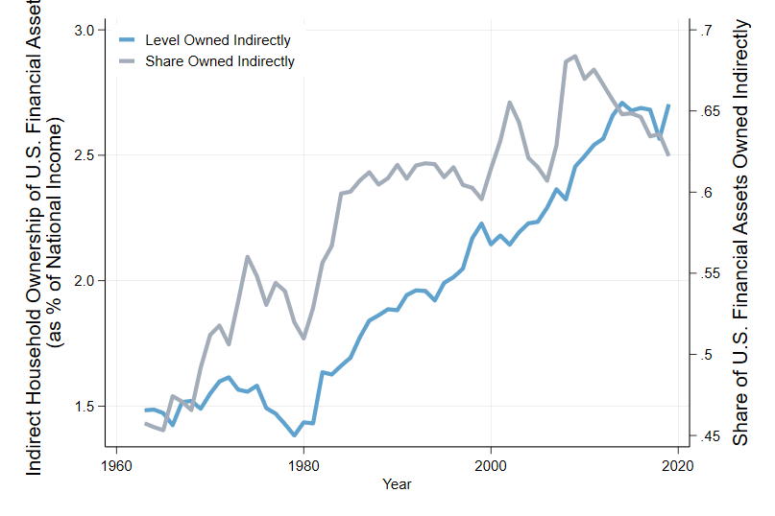
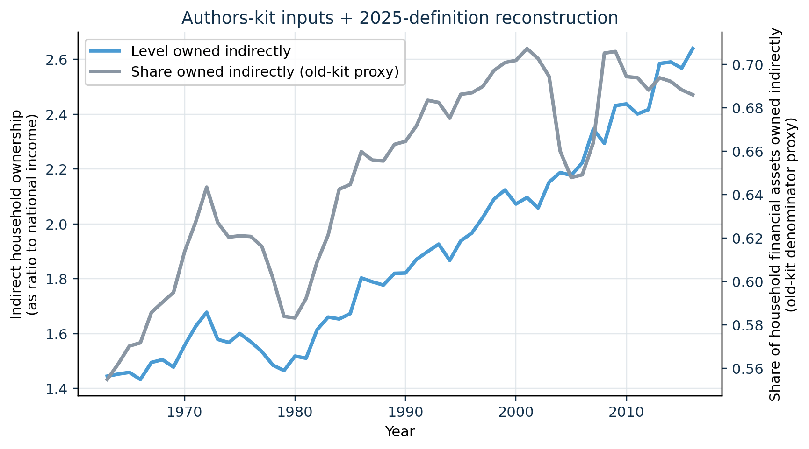
PRIMARY COMPARISON
13
Our old-input reconstruction tracks the 2025 Figure 1 pattern
2025 paper · Figure 1 · PDF p. 11
Our implementation · 2021 authors' inputs
CLOSE LEVEL MATCH
The national-income-normalized level has correlation 0.995 and MAE 5.3 pp against the digitized 2025 curve over 1963-2016.
The paper caption is removed from the image and restated here: the lines report the stock-to-income level and household-financial-asset share held indirectly.
Notes:
[Sources]
- MSS_SGR_July242025.pdf, Figure 1, physical PDF page 11; chart cropped without caption
- Results_Proposal/figures/figure1_authors_data_reconstruction.png
- Data/processed/figure1_authors_comparison.csv
- docs/project/tasks/figure1-replication.md, Evidence

Slide 14
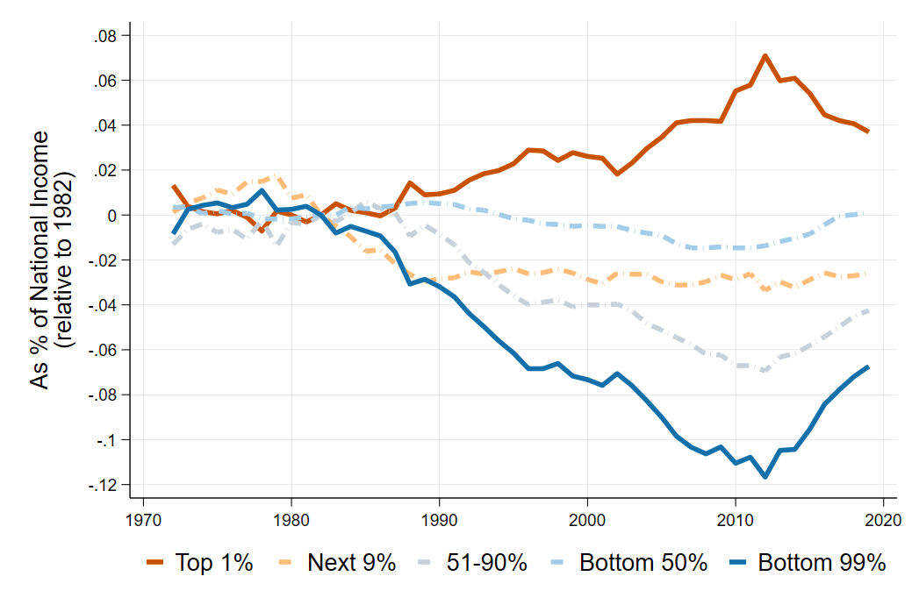
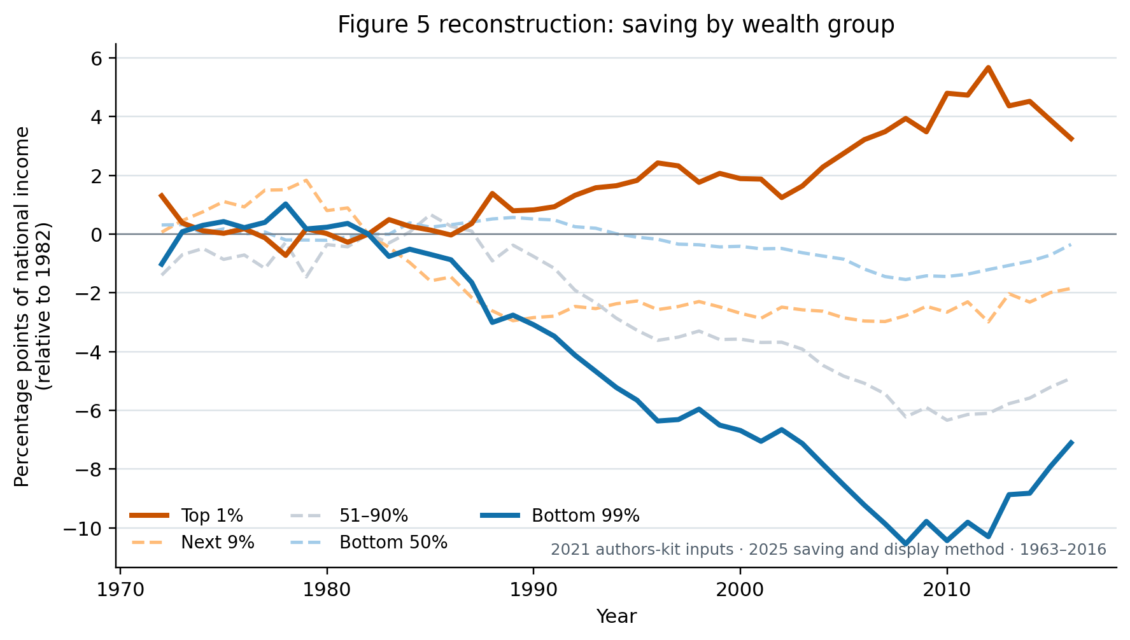
FIGURE 5 PRIMARY COMPARISON
14
The older inputs reproduce the saving divergence
2025 paper · ratio axis (0.10 = 10 pp)
Our reconstruction · percentage-point axis
HIGH-FIDELITY MATCH
Top 1% / bottom 99% correlations: 0.992 / 0.997; MAE: 0.40 / 0.42 pp.
2016 shifts: ours +3.25 / -7.11 pp; digitized paper +4.35 / -8.46 pp. Paper image excludes its printed caption.
Notes:
[Sources]
- MSS_SGR_July242025.pdf, Figure 5, physical PDF page 22; embedded chart extracted without caption
- Results_Proposal/figures/figure5_authors_data_reconstruction.png
- Data/processed/figure5_authors_comparison.csv
- docs/project/tasks/figure5-replication.md, Verification and result

Slide 15
FIGURE 8 FEASIBILITY
15
The exact 2025 vintage is missing—not the method
Target
1 · Exact-vintage gap
2025 Figure 8
Net household debt by wealth group
Authors’ completed matrices, equity split, and exact crosswalk are not in the 2021 kit.
2 · Available now
Public completed FWTW plus 2021 DINA/NIPA support a full-Leontief mixed-vintage rerun.
Classification
Current plotted result: proxy. Planned public-FWTW rerun: method reconstruction with explicit vintage/taxonomy caveats.
3 · Current graph
Still uses seven-round debt assets with the 2025 group, sign, scale, and base.
Notes:
[Sources]
- MSS_SGR_July242025.pdf, Sections 4.1–4.2 and Figure 8
- https://www.federalreserve.gov/releases/efa/fwtw.htm
- docs/project/tasks/figure8-replication.md
- docs/data/figure8-data.md

Slide 16
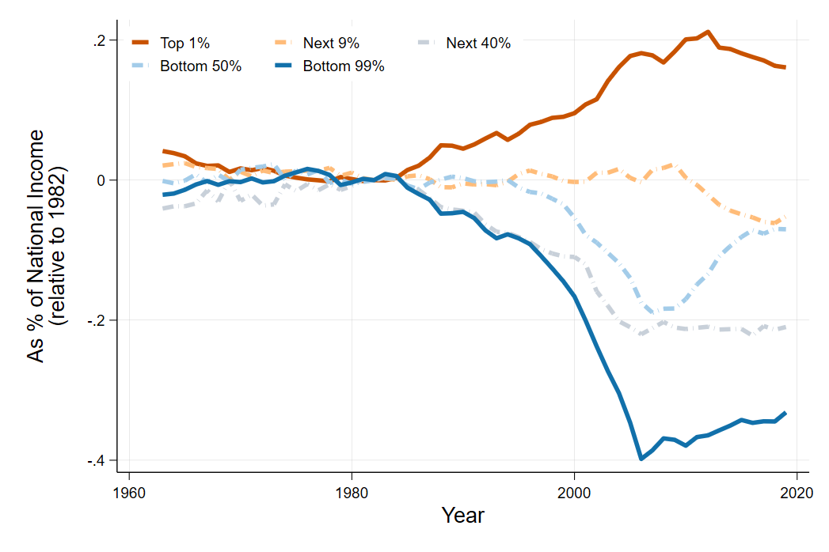
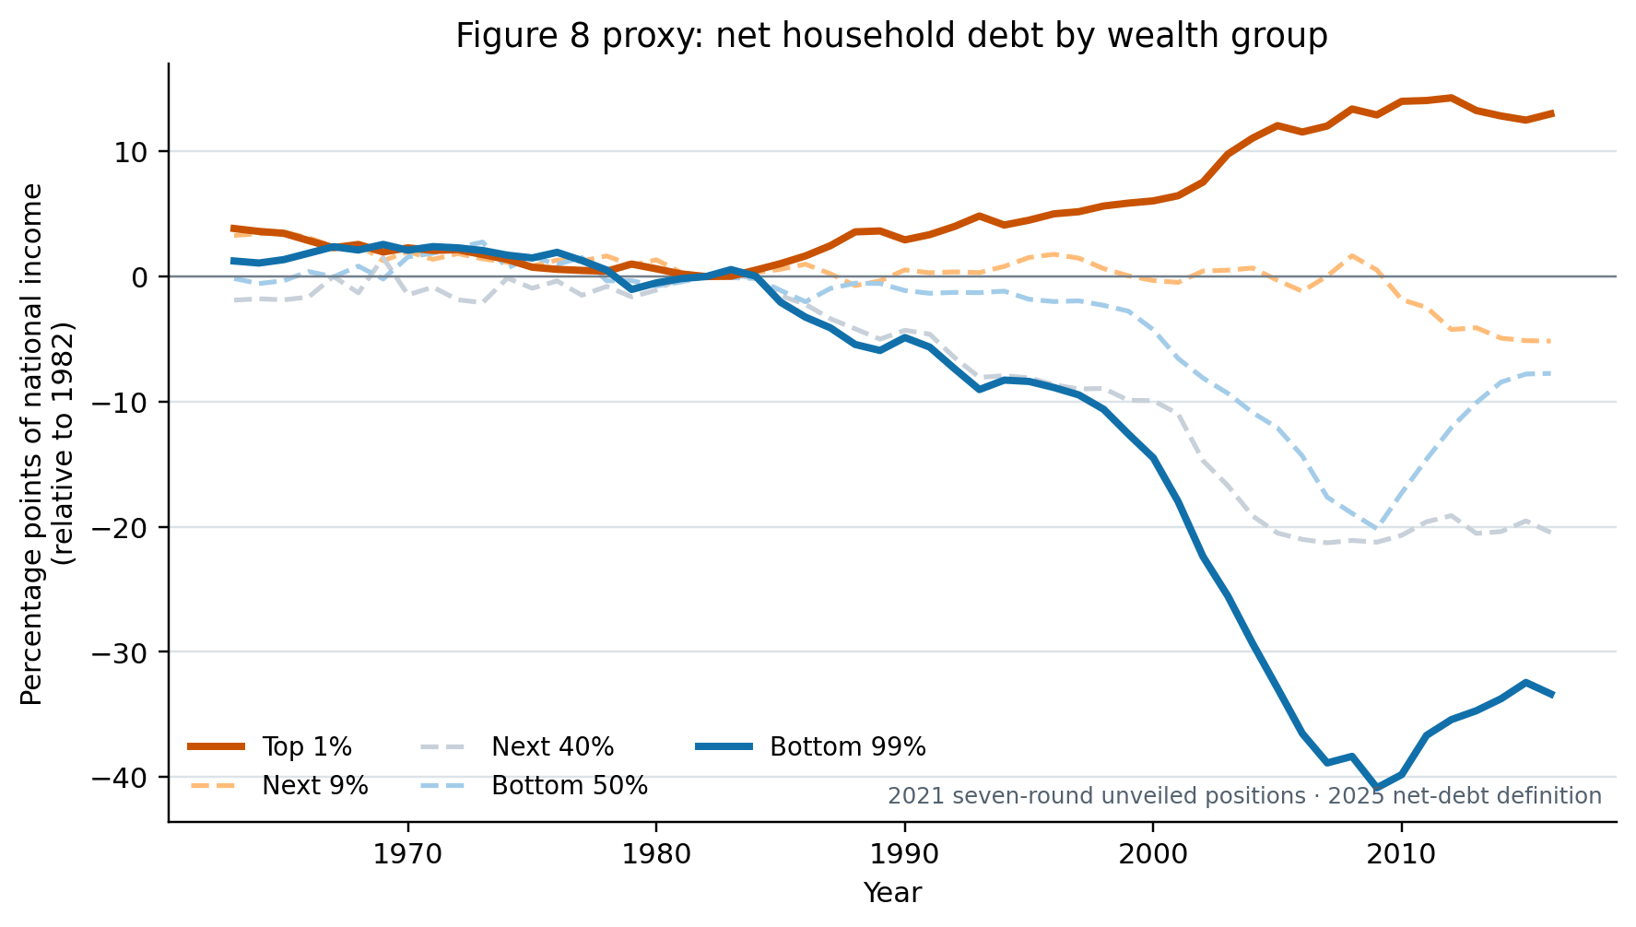
FIGURE 8 PRIMARY COMPARISON
16
The proxy reproduces borrowing, but understates top-1 lending
2025 paper · ratio axis (0.10 = 10 pp)
Our proxy · percentage-point axis
CLOSE PROXY
2007: bottom 99% -38.88 pp proxy vs -38.76 paper; top 1% +12.03 vs +18.02.
Correlations: 0.993 / 0.995 (top 1% / bottom 99%). Exact-vintage inputs are missing; public FWTW supports a separate method rerun.
Notes:
[Sources]
- MSS_SGR_July242025.pdf, Figure 8, physical PDF page 29; embedded chart extracted without caption
- Results_Proposal/figures/figure8_authors_proxy.png
- Data/processed/figure8_authors_proxy_comparison.csv
- docs/project/tasks/figure8-replication.md, Verification and result

Slide 17
REPLICATION SYNTHESIS
17
Two reconstructions and one bounded proxy
Conclusion
Figure 1
What did the available package let us test?
Close stock reconstruction; the indirect-share denominator remains version-specific.
Figure 5
High-fidelity saving-flow reconstruction through 2016.
Main lesson
The 2021 inputs identify the revised Figure 1 and Figure 5 objects far enough upstream for reconstruction. Figure 8 remains a seven-round proxy; public FWTW defines a future mixed-vintage method test, not an exact replication.
Figure 8
Current proxy matches the direction; exact revised matrices and vintage are unavailable.
Notes:
[Sources]
- Results_Proposal/major_results.md, R-001 to R-003
- docs/project/tasks/figure1-replication.md
- docs/project/tasks/figure5-replication.md
- docs/project/tasks/figure8-replication.md
- https://www.federalreserve.gov/releases/efa/fwtw.htm

