Slide 1
REPLICATION-PACKAGE VALIDATION
Does the 2021 package still validate the 2025 paper?
Side-by-side comparison of regenerated Stata outputs with the closest exhibits in the July 2025 paper
Regenerated February 2021 package output
Authoritative July 2025 paper exhibit
Revised 10 August 2026
Notes:
[Sources]
- MSS2021Febreplicationkit/mss_savingglut_master.do and regenerated output directory.
- Mian, Straub, and Sufi, Saving Glut of the Rich, July 25, 2025 draft (MSS_SGR_July242025.pdf).
[/Sources]

Slide 2
HOW TO READ THE DECK
02
The comparison tests lineage—not exact 2025 reproducibility
Question
Strong precursor
Do the regenerated 2021 outputs recover the economic patterns and accounting objects used in the revised 2025 paper?
Same core object and very similar graphical claim; exact values need not match.
Partial match
Same accounting lineage, but smoothing, groups, sample, or transformation changed.
Hard boundary
The old kit ends around 2016 and uses the earlier round-by-round unveiling and earlier distributional specifications. It cannot be labeled an exact replication of the 2019 endpoint or the revised matrix implementation.
Context only
Related motivation or input, but not the same 2025 outcome variable.
Notes:
[Sources]
- MSS2021Febreplicationkit/readme.pdf and mss_savingglut_master.do.
- MSS_SGR_July242025.pdf, especially Sections 2–4 and Figures 1, 5, 8–11.
[/Sources]

Slide 3
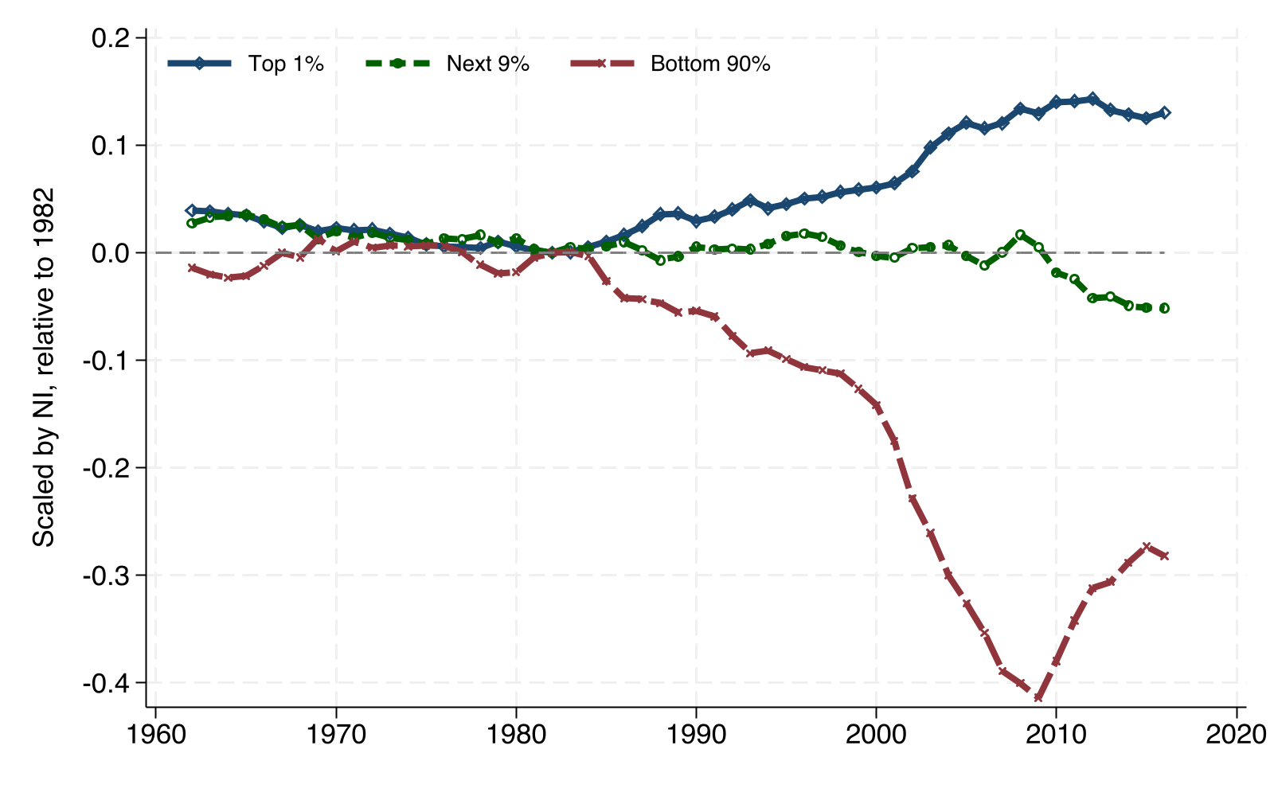
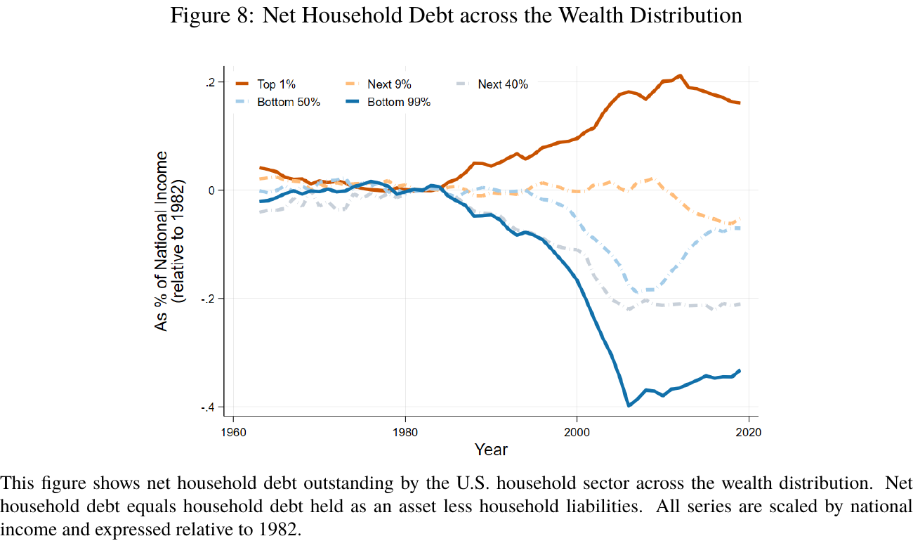
HOUSEHOLD DEBT STOCKS
03
Net household debt is the closest direct old-to-new match
2021 package · Figure 7
2025 paper · Figure 8 · PDF p. 29
CLOSEST MATCH
The same net-debt object produces the same divergence: the top 1% accumulates debt assets while less-wealthy households become net borrowers.
Version change: bottom 90% becomes bottom 99% with next 9%, next 40%, and bottom 50% detail; the revised series extends to 2019 and changes magnitudes.
Notes:
[Sources]
- Presentation reformat generated by Code/stata/format_2021_benchmark_figures.do from the authors' YinequalityFAanalysis.dta; statistical logic matches code/mss_analysis.do:774–800.
- MSS_SGR_July242025.pdf, Figure 8, PDF p. 29 (paper p. 28).
[/Sources]

Slide 4
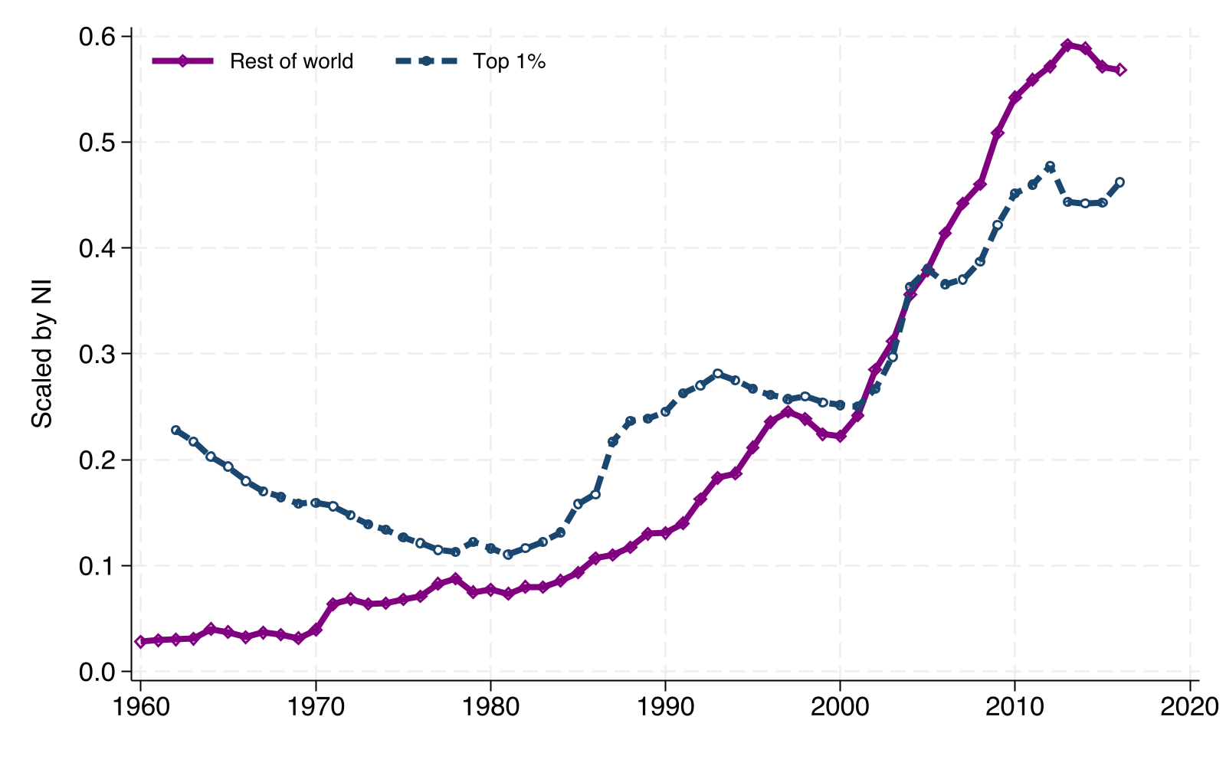
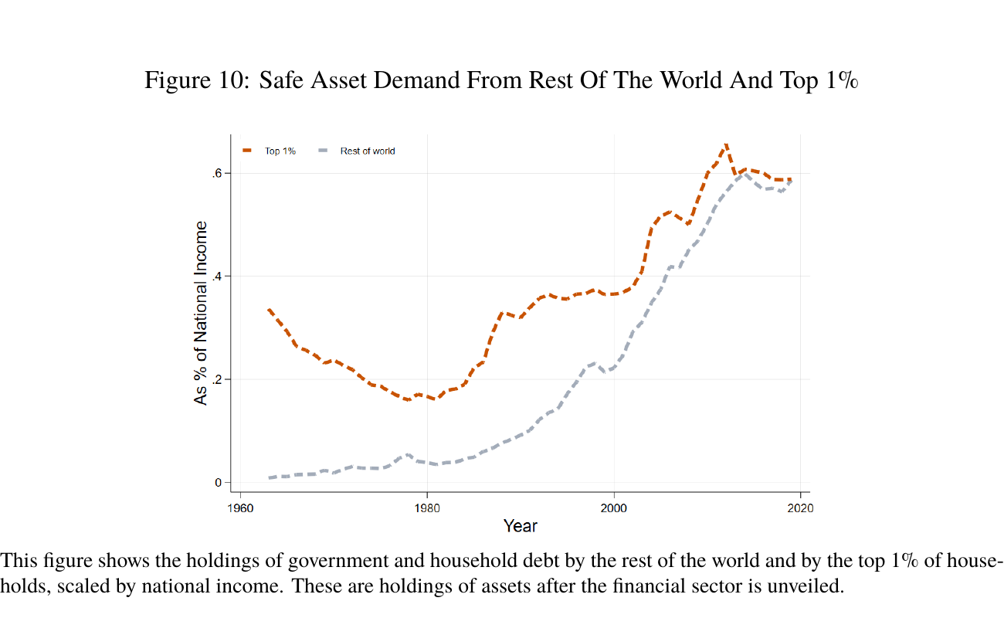
SAFE ASSETS
04
Safe-asset demand is a strong precursor to 2025 Figure 10
2021 package · Figure 9
2025 paper · Figure 10 · PDF p. 32
STRONG PRECURSOR
Both compare unveiled U.S. government and household debt held by the rest of the world with holdings by the top 1%, scaled by national income.
Version change: the revised matrix method and updated data shift levels and extend the endpoint to 2019; the 2025 paper emphasizes increases of 54.8 and 42.1 percentage points of national income.
Notes:
[Sources]
- Presentation reformat generated by Code/stata/format_2021_benchmark_figures.do from the authors' YinequalityFAanalysis.dta; statistical logic matches code/mss_analysis.do:865–896.
- MSS_SGR_July242025.pdf, Figure 10, PDF p. 32 (paper p. 31).
[/Sources]

Slide 5
05
REFERENCE MATERIAL
Appendix: weaker or non-direct comparisons
Retained for future use, but excluded from the current presentation sequence because the old and new exhibits do not map cleanly onto one another.
Notes:
[Sources]
- Deck-structure decision requested by the user on 2026-08-10: keep only the net-debt and safe-asset comparisons in the main sequence.
[/Sources]

Slide 6
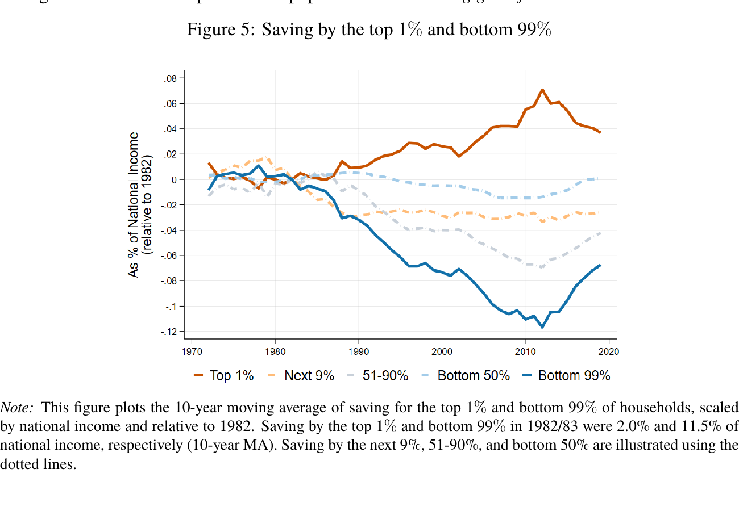
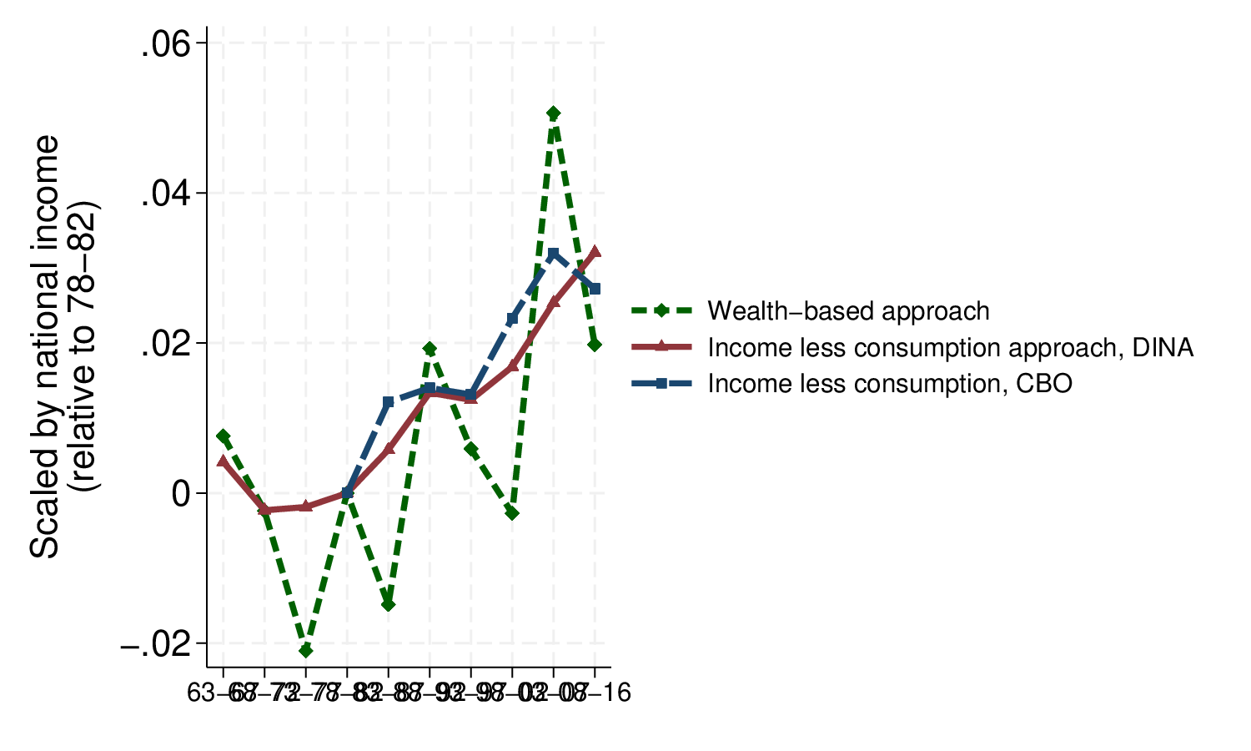
SAVING GLUT
06
Old top-1% saving is a strong precursor to 2025 Figure 5
2021 package · Figure 1 · fig_glut.eps
2025 paper · Figure 5 · PDF p. 22
STRONG PRECURSOR
Both show a post-1980s rise in saving by the top 1%. The 2025 exhibit additionally makes the offsetting fall in bottom-99% saving central.
Version change: five-year bins and three top-1% measures become 10-year moving averages, explicit bottom-99% subgroups, 1982 normalization, and data through 2019.
Notes:
[Sources]
- Regenerated MSS2021Febreplicationkit/output/fig_glut.eps; produced by code/mss_analysis.do:153–184.
- MSS_SGR_July242025.pdf, Figure 5, PDF p. 22 (paper p. 21).
[/Sources]

Slide 7
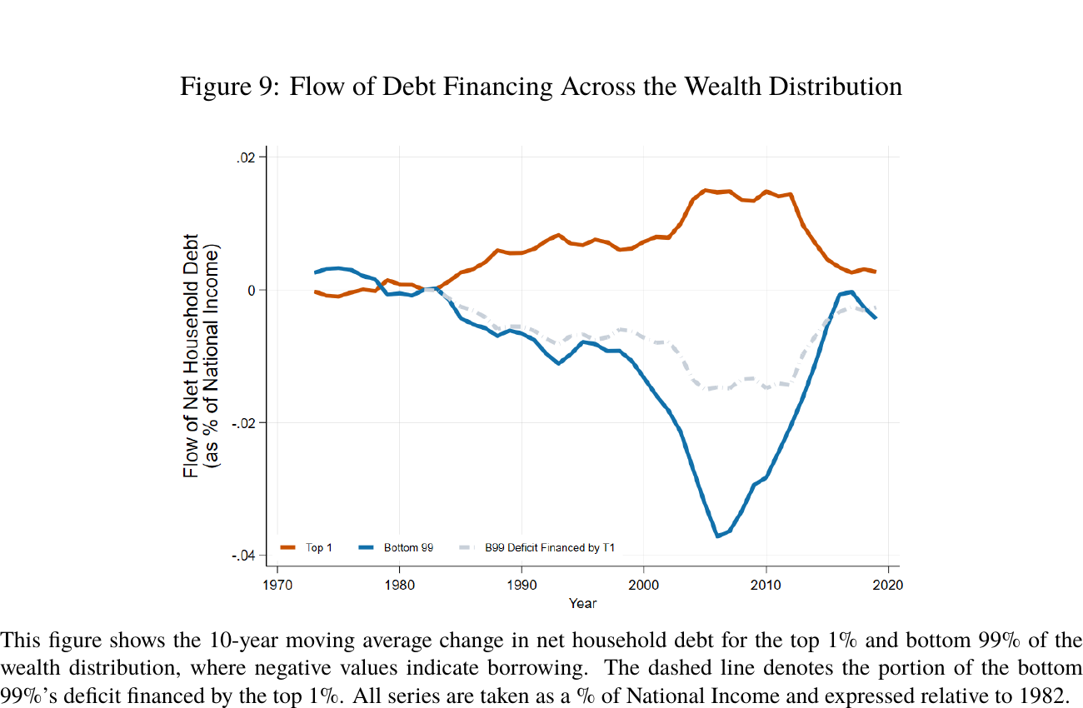
DEBT FINANCING FLOWS
07
Debt-financing lineage survives, but the transformation changes
2021 package · Table 7
2025 paper · Figure 9 · PDF p. 31
Average annual net household-debt accumulation
(% of national income)
Period
Bottom 90%
Top 1%
1963–82
−2.6
+0.3
1983–97
−3.1
+0.8
1998–07
−6.0
+1.3
2008–16
−2.2
+0.6
PARTIAL MATCH
Table 7 already contains the stock-to-flow accounting object. Figure 9 turns it into a continuous 10-year moving-average series and explicitly attributes bottom-99% deficit financing to the top 1%.
Version change: period averages and bottom-90% groups become annual moving-average flows and a bottom-99%-financed-by-top-1% counterfactual.
Notes:
[Sources]
- MSS2021Febreplicationkit/output/tab_nhhd_.tex; produced by code/mss_analysis.do:745–769. Displayed values are Theta^NHHD multiplied by 100.
- MSS_SGR_July242025.pdf, Figure 9, PDF p. 31 (paper p. 30).
[/Sources]

Slide 8
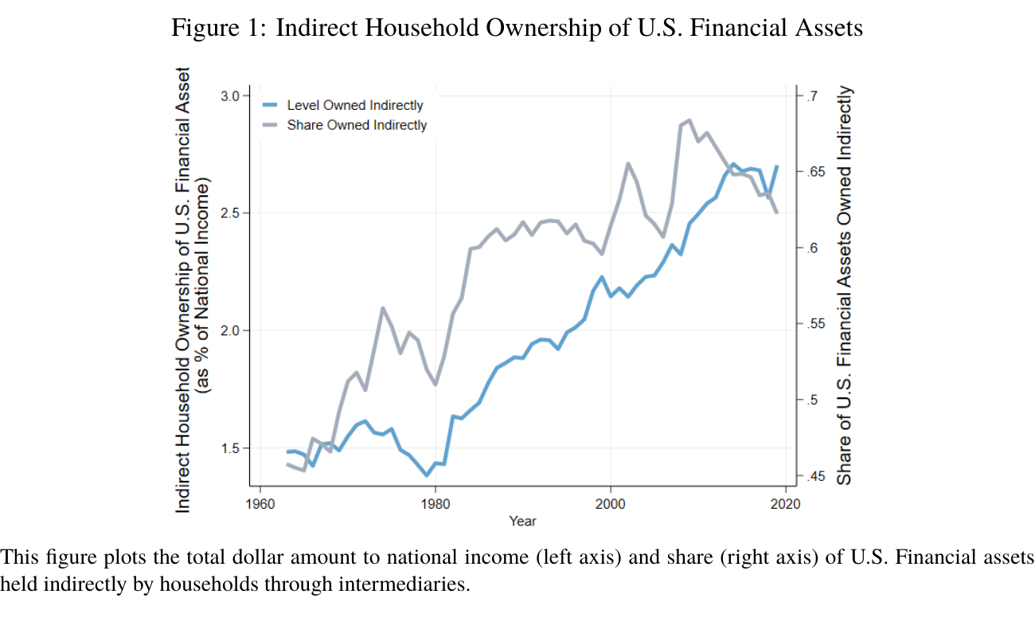
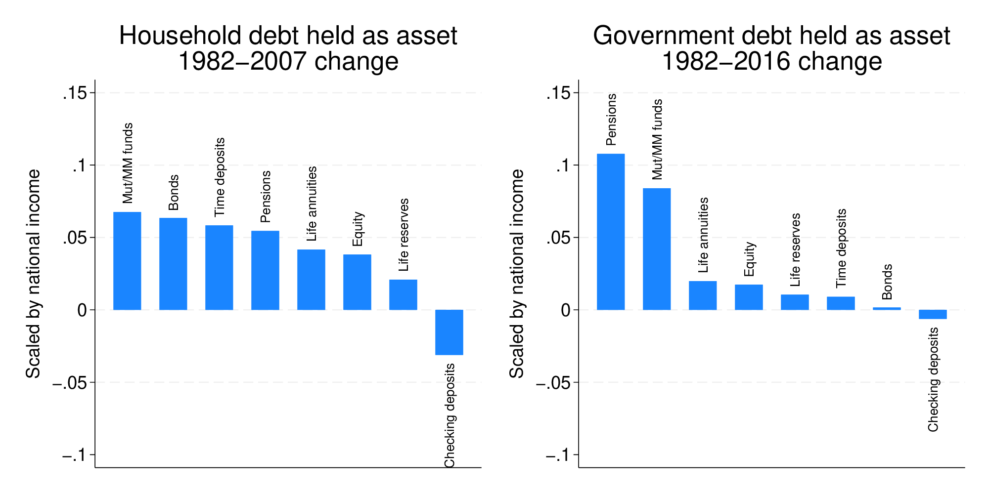
FINANCIAL INTERMEDIATION
08
The old ownership-detail chart does not reproduce 2025 Figure 1
2021 package · Figure 6 · fig_owndet.eps
2025 paper · Figure 1 · PDF p. 11
CONTEXT ONLY
The old output shows the intermediary vehicles holding household and government debt. Figure 1 instead measures aggregate indirect ownership of all U.S. financial assets.
Version change: asset-specific ownership detail is replaced by an economy-wide indirect-ownership measure generated by the revised matrix/Leontief-style unveiling framework.
Notes:
[Sources]
- Regenerated MSS2021Febreplicationkit/output/fig_owndet.eps; produced by code/mss_analysis.do:587–678.
- MSS_SGR_July242025.pdf, Figure 1, PDF p. 11 (paper p. 10).
[/Sources]

Slide 9
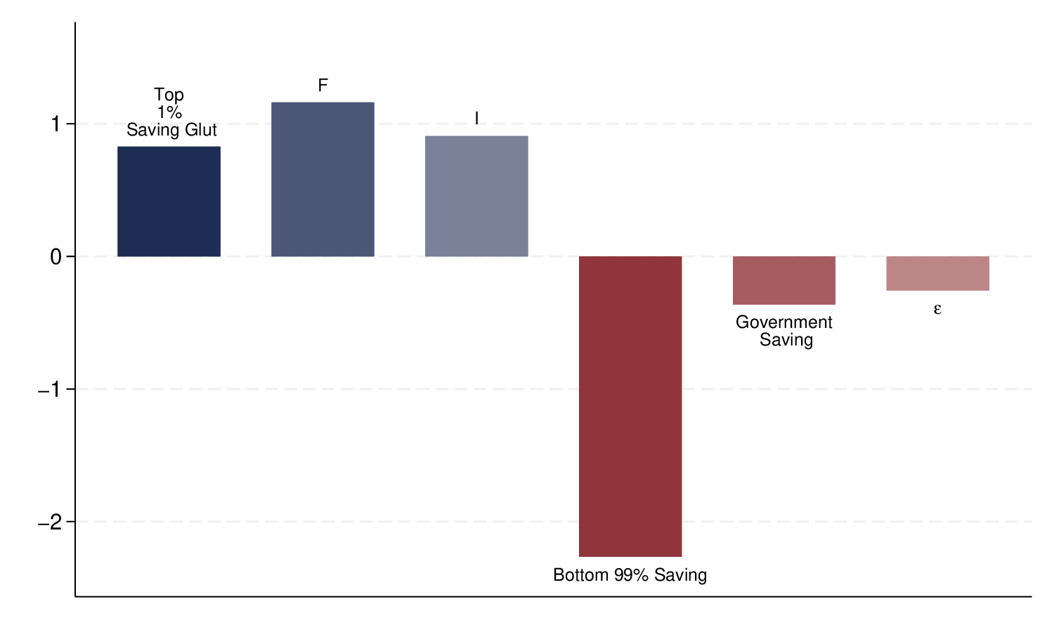
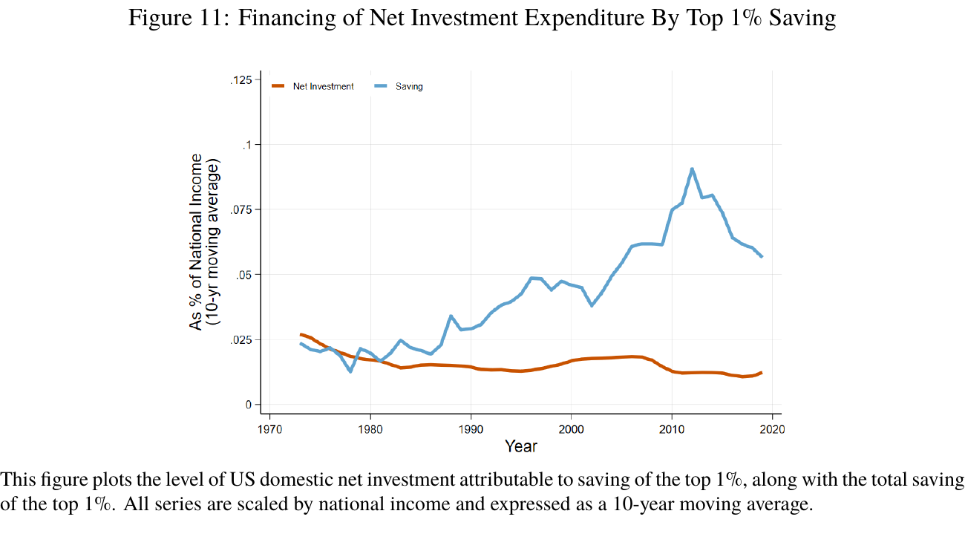
USES OF TOP-1% SAVING
09
The 2025 investment result revises the old absorption exercise
2021 package · Figure 4
2025 paper · Figure 11 · PDF p. 33
PARTIAL / CONTEXT
Both ask where additional top-1% saving goes. The old figure is cumulative; the 2025 figure attributes annual net-investment flows to the assets funded by top-1% saving.
Version change: cumulative bars with a zero-sum closure become 10-year moving-average saving and attributed investment series under a maintained marginal-equals-average cash-flow assumption.
Notes:
[Sources]
- Regenerated MSS2021Febreplicationkit/output/fig_bottomline.eps; produced by code/mss_analysis.do:400–438.
- MSS_SGR_July242025.pdf, Figure 11, PDF p. 33 (paper p. 32).
[/Sources]

Slide 10
OVERALL ASSESSMENT
10
Verdict: valid historical pipeline, not an exact 2025 replication
2025 exhibit
Closest 2021 output
Assessment
Reason
Figure 5 · Saving
Figure 1
Strong precursor
Same top-1% rise; groups and smoothing revised
Figure 8 · Net debt
Figure 7
Closest match
Same net-debt object, sign, and 1982 normalization
Figure 9 · Debt flow
Table 7
Partial match
Same stock-to-flow lineage; continuous attribution is new
Figure 10 · Safe assets
Figure 9
Strong precursor
Same holders, assets, and national-income scaling
Figure 1 · Indirect ownership
Figure 6
Context only
Different dependent variable and revised matrix method
Figure 11 · Investment
Figure 4
Partial/context
Same question; different attribution and time transformation
Bottom line
Use the 2021 kit to validate the historical qualitative claims and accounting lineage. Exact 2025 replication still requires the revised matrix construction, revised group definitions, revised transformations, and the 2017–2019 data extension.
Notes:
[Sources]
- docs/reference/author-output-crosswalk.md.
- MSS2021Febreplicationkit/output/ regenerated by the full Stata master run.
- MSS_SGR_July242025.pdf, Figures 1, 5, and 8–11.
[/Sources]

