Slide 1
THEORETICAL METHODOLOGY · CONDENSED
Unveiling the Financial Network
A seven-slide account of the paper's ownership matrix and Leontief inverse
CORE QUESTION
How do we recover ultimate owners from a network of direct financial claims?
Prepared 10 August 2026
Notes:
Condensed module for combining the methodology with the data and empirical results decks.
[Sources]
- /Users/lorenzogorini/Library/CloudStorage/OneDrive-UniversitàCommercialeLuigiBocconi/PhD/research-wiki/papers/inequality/mian-2025-saving-glut-rich/full.md, Sections 2.1–2.2.
[/Sources]

Slide 2
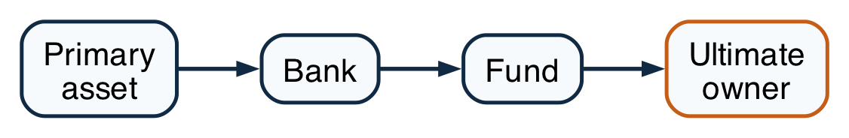
THE ECONOMIC PROBLEM
02
Intermediation hides the ultimate owner
OBSERVED BALANCE-SHEET CHAIN
ECONOMIC INCIDENCE
What accounts record
Primary asset → bank → fund → household
What incidence asks
Which terminal sector ultimately owns the primary claim?
WHY IT MATTERS
Unveiling follows every liability until the claim reaches a terminal owner.
Source: Mian, Straub, and Sufi (2025), Sections 2.1–2.2.
Notes:
Unveiling follows every liability until the claim reaches a terminal owner.
[Sources]
- /Users/lorenzogorini/Library/CloudStorage/OneDrive-UniversitàCommercialeLuigiBocconi/PhD/research-wiki/papers/inequality/mian-2025-saving-glut-rich/full.md, Sections 2.1–2.2.
[/Sources]

Slide 3
DIRECT OWNERSHIP
03
Rows issue liabilities; columns hold them
PAPER EQUATION (4)
ORIENTATION AND INVARIANT
row i = issuer / borrower
column j = holder / lender
Mₕ,ₜ: dollar matrix for instrument h.
Lₜ: liabilities issued by each sector.
⊙: elementwise row scaling.
WHY IT MATTERS
Build the direct network from instrument claims; Figure 1 counts household claims on intermediary issuers before the solve.
Source: Mian, Straub, and Sufi (2025), Section 2.1 and Equation (4).
Notes:
Aggregate instrument positions in dollars, then divide each issuer row by its own liabilities.
[Sources]
- /Users/lorenzogorini/Library/CloudStorage/OneDrive-UniversitàCommercialeLuigiBocconi/PhD/research-wiki/papers/inequality/mian-2025-saving-glut-rich/full.md, Section 2.1 and Equation (4).
[/Sources]

Slide 4
LEONTIEF INVERSE
04
One inverse sums every intermediary path
PAPER EQUATION (1)
EQUIVALENT ULTIMATE-OWNER BLOCK
M̄ₜ is the full unveiled ownership matrix.
Bₜ: direct exits from intermediaries to owners.
Qₜ: ownership that remains inside intermediaries.
WHY IT MATTERS
The block solve is the paper's full-matrix series restricted to claims that terminate at owners.
Source: Mian, Straub, and Sufi (2025), Section 2.2 and Equation (1).
Notes:
The block solve is the paper's full-matrix series restricted to claims that terminate at owners.
[Sources]
- /Users/lorenzogorini/Library/CloudStorage/OneDrive-UniversitàCommercialeLuigiBocconi/PhD/research-wiki/papers/inequality/mian-2025-saving-glut-rich/full.md, Section 2.2 and Equation (1).
[/Sources]

Slide 5
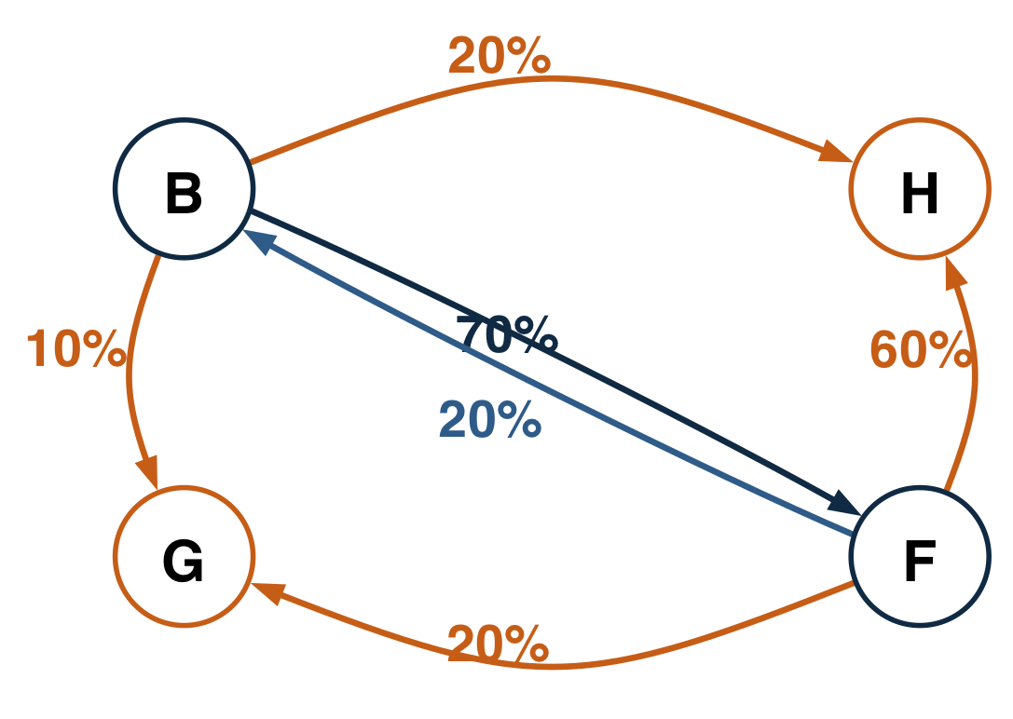
WORKED NETWORK
05
A four-sector network makes every path auditable
DIRECT-OWNERSHIP GRAPH
EDGE MEANING
Bank row: H 20%, G 10%, F 70%.
Fund row: H 60%, G 20%, B 20%.
Arrow i → j: j holds i's liability.
RECIPROCAL INTERMEDIATION: B ↔ F
WHY IT MATTERS
The reciprocal bank–fund link creates infinitely many paths, all with economically readable weights.
Source: project worked example; edge labels are direct liability shares.
Notes:
The reciprocal bank–fund link creates infinitely many paths, all with economically readable weights.
[Sources]
- /Users/lorenzogorini/Library/CloudStorage/OneDrive-UniversitàCommercialeLuigiBocconi/PhD/Courses/Macro 3 - Favero/Paper Replication/Code/examples/leontief_unveiling.py.
[/Sources]

Slide 6
WORKED RESULT
06
Direct 20% becomes ultimate household ownership of 72.093%
FIXED-POINT LOGIC
DIRECT + INDIRECT
Household share of bank liabilities
20.0%
direct
52.093% indirect
WHY IT MATTERS
The additional 52.093 percentage points are the bank's household claim carried through the fund and every reciprocal loop.
Source: project worked example; values are percentage shares of the bank's liabilities.
Notes:
The additional 52.093 percentage points are the bank's household claim carried through the fund and every reciprocal loop.
[Sources]
- /Users/lorenzogorini/Library/CloudStorage/OneDrive-UniversitàCommercialeLuigiBocconi/PhD/Courses/Macro 3 - Favero/Paper Replication/Code/examples/leontief_unveiling.py.
[/Sources]

Slide 7
REPLICATION CHOICE
07
The 2021 rounds are not a fixed-Q truncation
AUTHORS' 2021 STAGE-SPECIFIC PIPELINE
2025 METHOD AND OUR IMPLEMENTATION
Convergence: ρ(Qₜ) < 1.
Conservation: Ωₜ1ₘ = 1ₖ.
Implementation: solve the linear system directly.
Seven stages change instruments, adjustments, and residual rules.
WHY IT MATTERS
They share proportional allocation logic; equivalence requires the same fixed matrix in every round.
Source: 2021 replication kit; July 2025 paper; docs/methods/leontief-unveiling.md.
Notes:
They share proportional allocation logic; equivalence requires the same fixed matrix in every round.
[Sources]
- /Users/lorenzogorini/Library/CloudStorage/OneDrive-UniversitàCommercialeLuigiBocconi/PhD/Courses/Macro 3 - Favero/Paper Replication/MSS2021Febreplicationkit/code/build_fa_unveiling_data.do.
- /Users/lorenzogorini/Library/CloudStorage/OneDrive-UniversitàCommercialeLuigiBocconi/PhD/Courses/Macro 3 - Favero/Paper Replication/MSS_SGR_July242025.pdf, Section 2.2.
- /Users/lorenzogorini/Library/CloudStorage/OneDrive-UniversitàCommercialeLuigiBocconi/PhD/Courses/Macro 3 - Favero/Paper Replication/docs/methods/leontief-unveiling.md.
[/Sources]

