Slide 1
FIGURE 8 METHOD COMPARISON
Three routes to unveiled net household debt
Separate the data vintage from the network operator
Full inverse: B · 2021 direct cells C · public FWTW
Seven rounds: A · 2021 final-file benchmark
14 August 2026
Notes:
[Sources]
- docs/project/tasks/figure8-replication.md
- docs/data/figure8-2021-direct-data.md
- docs/data/figure8-public-fwtw-data.md
- Presentation/4_figure_comparison/presentation.pptx (visual source)

Slide 2
COMMON TARGET
02
One estimand, three deliberately separate routes
2025 Figure 8
A · Old benchmark
ND(g,t) = household-debt assets − debt owed
Scale by national income; subtract 1982
2021 final debt positions after the authors’ seven-round unveiling; revised display rule only.
B · Primary test
2021 direct/pre-unveiling cells, reconstructed network, and the 2025 full Leontief operator.
Why three?
A→B changes the operator while holding the old vintage as close as saved inputs permit; C tests the method on an independent public network.
C · Public robustness
Current public FWTW bilateral levels plus 2021 DINA/NIPA and the same full operator.
Notes:
[Sources]
- MSS_SGR_July242025.pdf, Sections 4.1–4.2 and Figure 8
- Code/unveiling/figure8_authors.py
- Code/unveiling/figure8_2021_direct.py
- Code/unveiling/figure8_public_fwtw.py

Slide 3
METHOD CROSSWALK
03
Data and operator choices are now visible separately
Object
Input
Operator
Interpretation / boundary
2025 target
Authors’ 2019 vintage
Full inverse
34 instruments; 23 intermediaries + 4 owners; custom equity extension
A · Old benchmark
2021 final file
Seven rounds
Starts after old unveiling; validates the older supplied pipeline
B · Primary test
2021 direct cells
Full inverse
351 saved direct fields; eight coarsened intermediary rows; no round fields read
C · Robustness
Public 2026 FWTW
Full inverse
31 instruments; 25 substantive sectors; independent current taxonomy
Common layer
2021 DINA/NIPA
Through 2016
Same groups, net-debt sign, national-income scale, and 1982 base
Identification
A versus B
Closest operator test
Not exact: the kit does not save the full 34×27 annual direct cube
Hierarchy
Lead with B; use A as the older-code benchmark and C as a public-data robustness check.
Notes:
[Sources]
- MSS_SGR_July242025.pdf, Sections 2.2 and 4.1; Table A1
- docs/data/figure8-data.md
- docs/data/figure8-2021-direct-data.md
- docs/data/figure8-public-fwtw-data.md

Slide 4
PRIMARY IMPLEMENTATION
04
Restart upstream, then replace seven rounds with the full inverse
Question
1 · Recover cells
Can the 2021 direct vintage support the 2025 operator without using any seven-round outputs?
Read 351 pre-unveiling fields; rebuild mutual-fund allocation and eight intermediary rows.
2 · Complete network
Clip signed artifacts, balance to kit margins, split households by DINA, solve Ω = (I − Q)⁻¹B.
Verified boundary
Zero seven-round variables read; source debt margins close within $2 million and unveiled ownership rows within 4.5×10⁻¹⁶.
3 · Net debt
Trace household-debt assets to ultimate owners; subtract group mortgage and nonmortgage debt.
Notes:
[Sources]
- MSS_SGR_July242025.pdf, equations (1), (3), and (4); Sections 4.1–4.2
- Code/unveiling/figure8_2021_direct.py
- Data/interim/figure8_2021_direct_network_diagnostics.csv
- Data/interim/figure8_2021_direct_component_diagnostics.csv

Slide 5
PUBLIC-DATA ROBUSTNESS
05
Public FWTW tests portability—not a same-vintage effect
Classification
1 · Public FWTW
Same full operator
Different completed direct matrix
June 2026 release: 31 instruments and 25 substantive sectors, already completed by the Fed.
2 · Common layer
Reuse 2021 DINA group shares and authors-kit national income; stop in 2016.
Interpretation
Useful robustness, but operator, vintage, taxonomy, completion algorithm, and corporate-equity coverage differ from the paper.
3 · Full solve
Split household holders, reorient negative positions, and apply the same Leontief operator.
Notes:
[Sources]
- MSS_SGR_July242025.pdf, Section 2.2
- https://www.federalreserve.gov/releases/efa/fwtw.htm
- https://www.federalreserve.gov/releases/efa/fwtw_announcements.htm
- Data/raw/README.md
- docs/data/figure8-public-fwtw-data.md

Slide 6
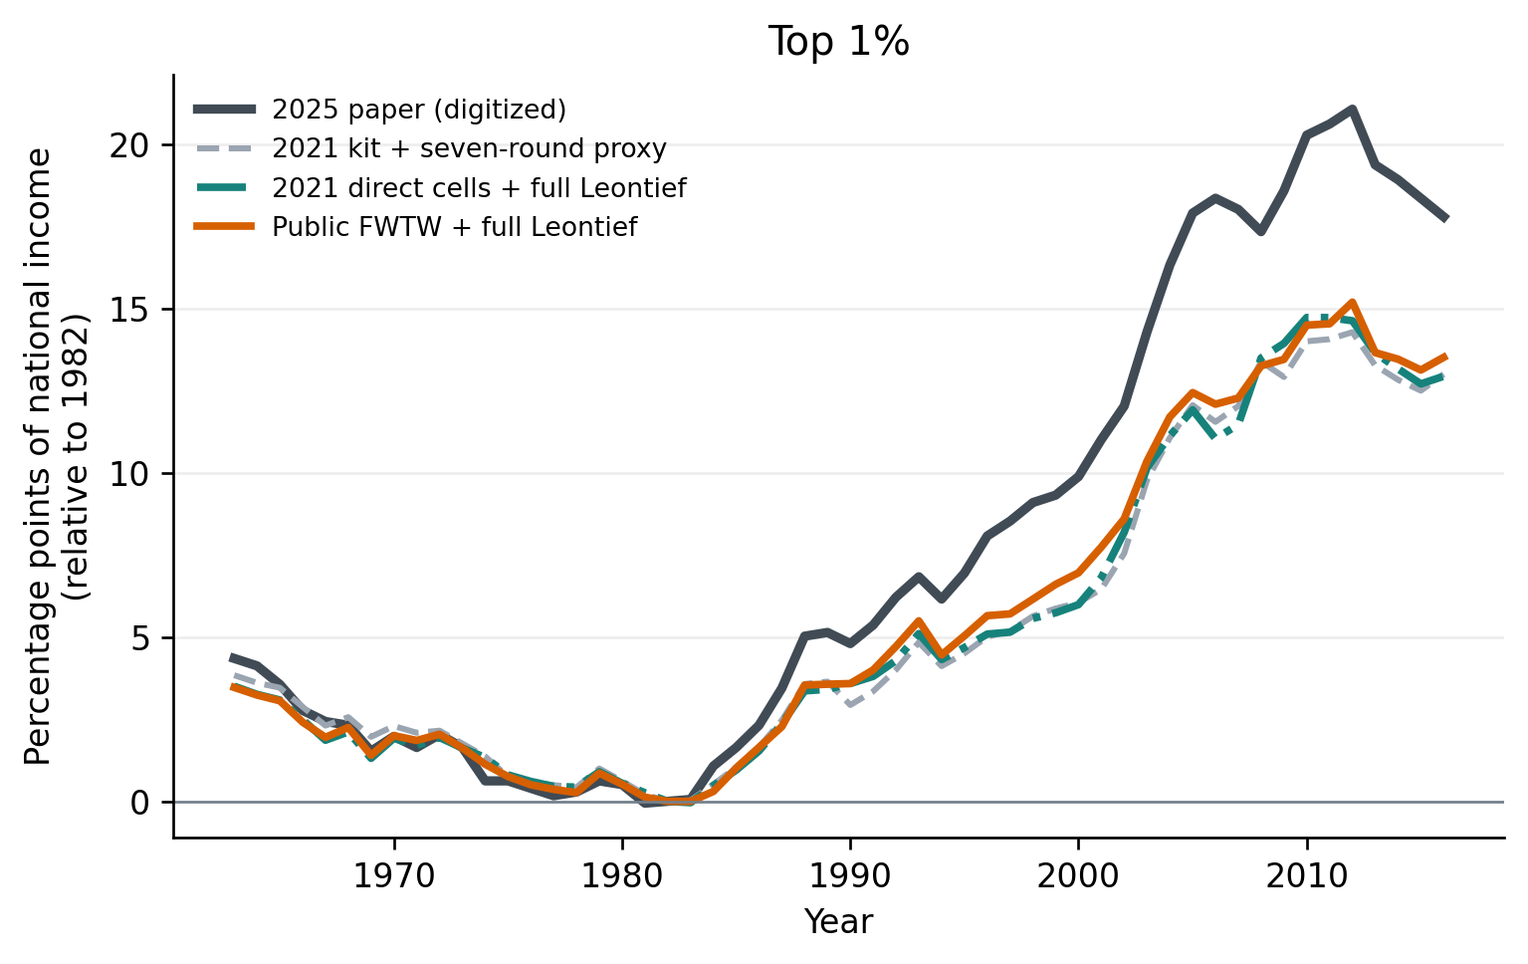
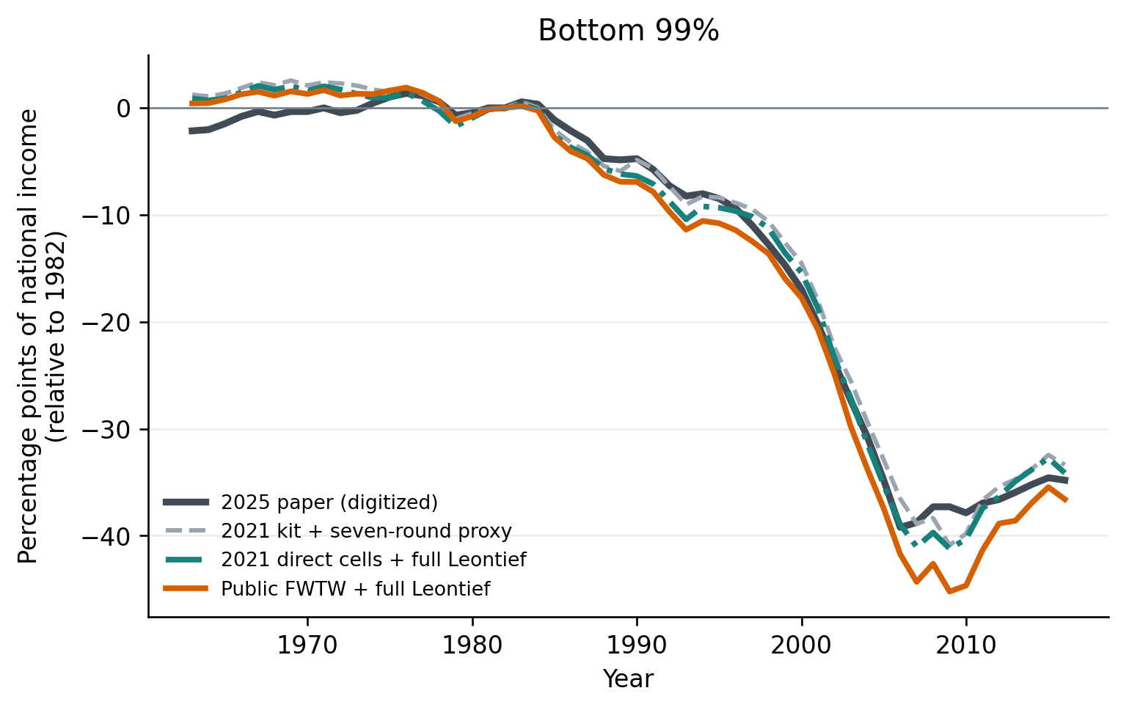
FIGURE 8 METHOD COMPARISON
06
All routes recover the split; level gaps remain
Top 1% · paper plus three routes
Bottom 99% · paper plus three routes
TREND ROBUST
Top-1 MAE: 2.33 pp for 2021-direct/full vs 2.41 proxy; public/full is 2.12 pp.
Bottom-99 MAE: 1.31 pp for 2021-direct/full vs 1.38 proxy; public/full is 1.98 pp.
Notes:
[Sources]
- MSS_SGR_July242025.pdf, Figure 8, physical page 29; digitized benchmark
- Results_Proposal/figures/figure8_method_comparison_top1.png
- Results_Proposal/figures/figure8_method_comparison_bottom99.png
- Data/processed/figure8_method_comparison_metrics.csv

Slide 7
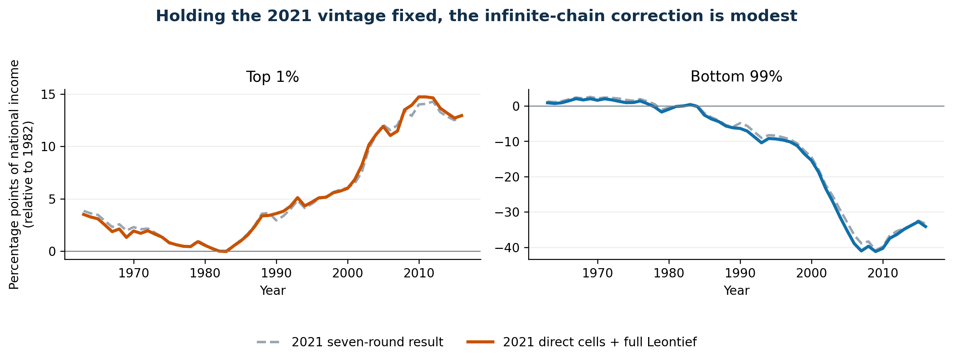
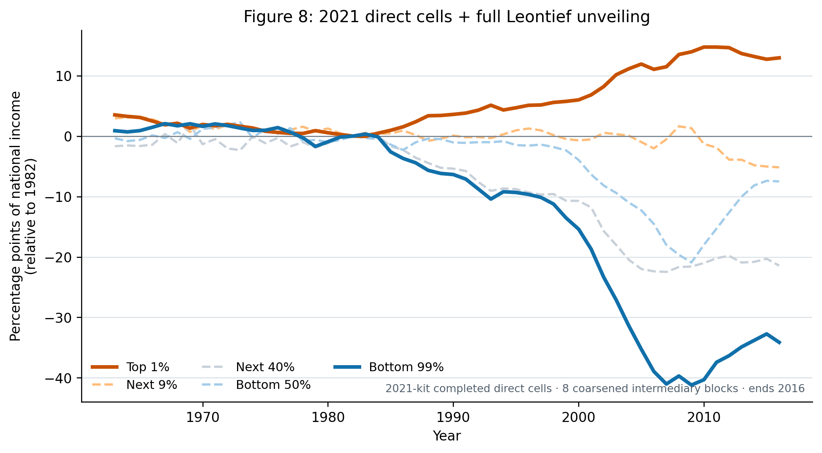
SAME-VINTAGE OPERATOR TEST
07
The full inverse changes the old network only modestly
B minus A · full inverse minus seven rounds
B · 2021 direct cells + full inverse
TRUNCATION IS NOT THE MAIN GAP
Mean |B−A|: 0.26 pp top 1% and 0.75 pp bottom 99%; 2007 differences are −0.56 and −2.15 pp.
Caveat: signed-cell clipping absorbs 8.5–37.8% of gross debt-cell mass; 3.2–10.0% remains unassigned after coarsening.
Notes:
[Sources]
- Results_Proposal/figures/figure8_2021_operator_comparison.png
- Results_Proposal/figures/figure8_2021_direct_full_leontief.png
- Data/processed/figure8_2021_operator_comparison_metrics.csv
- Data/interim/figure8_2021_direct_network_diagnostics.csv

Slide 8
REPLICATION SYNTHESIS
08
Lead with the same-vintage test; keep both comparators
Submission choice
Main result
Primary: 2021 direct cells + full inverse.
Benchmarks: old final file and public FWTW.
Route B restarts before unveiling and applies the 2025 operator to the old data vintage through 2016.
Two distinct checks
Route A validates the supplied older pipeline; Route C tests the method on current public bilateral data.
Report explicitly
The small A→B gap suggests seven-round truncation is not the main paper discrepancy; matrix coverage, completion, taxonomy, and wealth mapping remain.
Economic conclusion
All three show rising top-1 net lending and increasingly negative bottom-99 net debt after 1982.
Notes:
[Sources]
- docs/project/tasks/figure8-replication.md
- docs/data/figure8-2021-direct-data.md
- docs/data/figure8-public-fwtw-data.md
- Data/processed/figure8_method_comparison_metrics.csv
- MSS_SGR_July242025.pdf, Figure 8

