Slide 1
CORE FIGURE COMPARISON
Paper figures versus our implementations
2025 target on the left; our common-sample reconstruction on the right
Figures 1, 5, and 6: 2025 definitions with 2021 authors-kit inputs
Figure 8: 2021 direct cells with the full Leontief inverse
16 August 2026
Notes:
[Sources]
- MSS_SGR_July242025.pdf, Figures 1, 5, 6, and 8
- docs/project/tasks/figure1-replication.md
- docs/project/tasks/figure5-replication.md
- docs/project/tasks/figure6-replication.md
- docs/project/tasks/figure8-replication.md

Slide 2
COMPARISON CONTRACT
02
Each slide compares the paper directly with our implementation
2025 targets
Figures 1, 5, and 6
Figures 1, 5, 6, and 8
Revised definitions through 2019
Recompute the 2025 objects with February 2021 authors-kit inputs; the available series end in 2016.
Figure 8
Restart from saved direct cells and replace seven rounds with the full Leontief inverse.
Reading rule
The left panel is the paper target and the right panel is our implementation. Supporting diagnostics live in their method or extension decks.
Common comparison
Same target definition, common-period fit metrics, and an explicit vintage or matrix boundary.
Notes:
[Sources]
- MSS_SGR_July242025.pdf, Figures 1, 5, 6, and 8
- docs/project/tasks/result-selection.md
- docs/project/tasks/figure8-replication.md

Slide 3
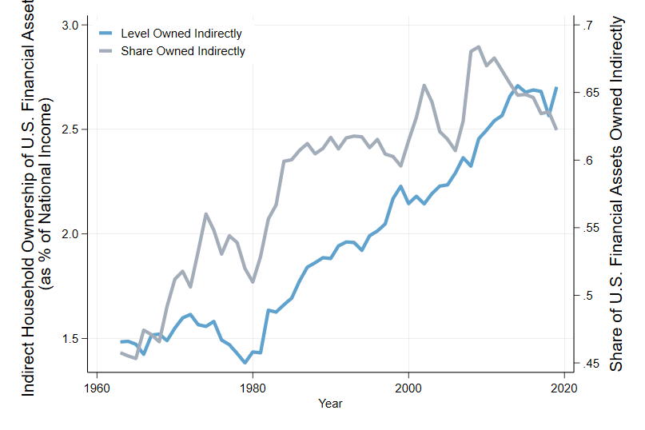
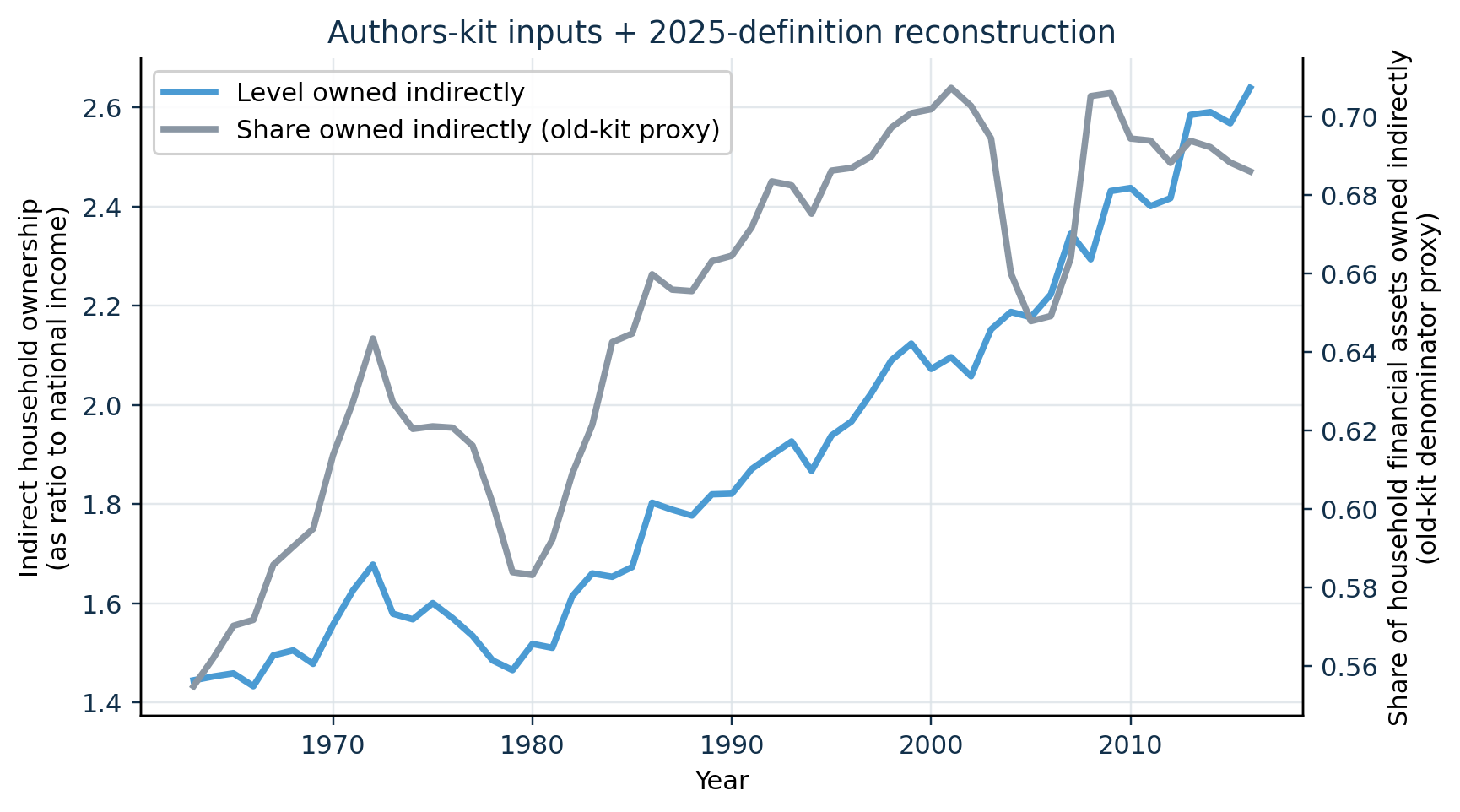
PRIMARY COMPARISON
03
Our old-input reconstruction tracks the 2025 Figure 1 pattern
2025 paper · Figure 1 · PDF p. 11
Our implementation · 2021 authors' inputs
CLOSE LEVEL MATCH
The national-income-normalized level has correlation 0.995 and MAE 5.3 pp against the digitized 2025 curve over 1963-2016.
The paper caption is removed from the image and restated here: the lines report the stock-to-income level and household-financial-asset share held indirectly.
Notes:
[Sources]
- MSS_SGR_July242025.pdf, Figure 1, physical PDF page 11; chart cropped without caption
- Results_Proposal/figures/figure1_authors_data_reconstruction.png
- Data/processed/figure1_authors_comparison.csv
- docs/project/tasks/figure1-replication.md, Evidence

Slide 4
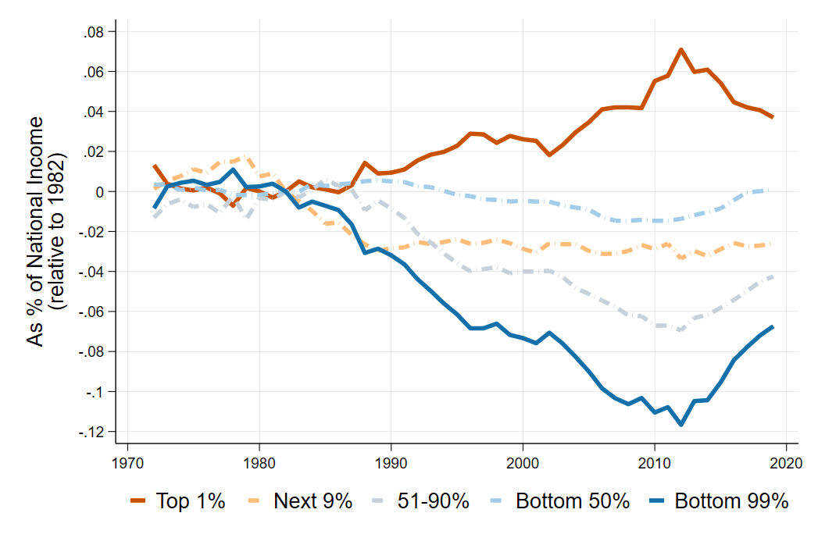
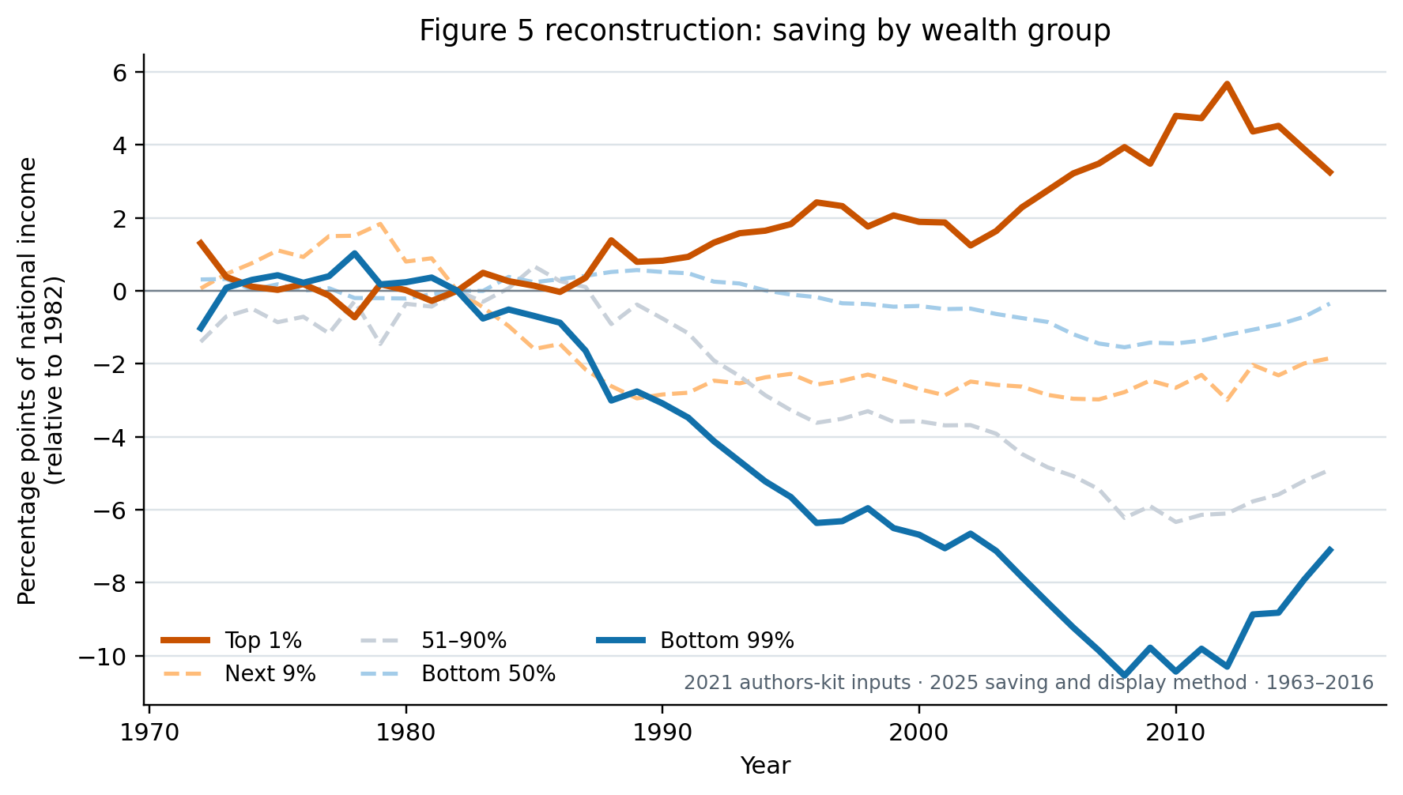
FIGURE 5 PRIMARY COMPARISON
04
The older inputs reproduce the saving divergence
2025 paper · ratio axis (0.10 = 10 pp)
Our reconstruction · percentage-point axis
HIGH-FIDELITY MATCH
Top 1% / bottom 99% correlations: 0.992 / 0.997; MAE: 0.40 / 0.42 pp.
2016 shifts: ours +3.25 / -7.11 pp; digitized paper +4.35 / -8.46 pp. Paper image excludes its printed caption.
Notes:
[Sources]
- MSS_SGR_July242025.pdf, Figure 5, physical PDF page 22; embedded chart extracted without caption
- Results_Proposal/figures/figure5_authors_data_reconstruction.png
- Data/processed/figure5_authors_comparison.csv
- docs/project/tasks/figure5-replication.md, Verification and result

Slide 5
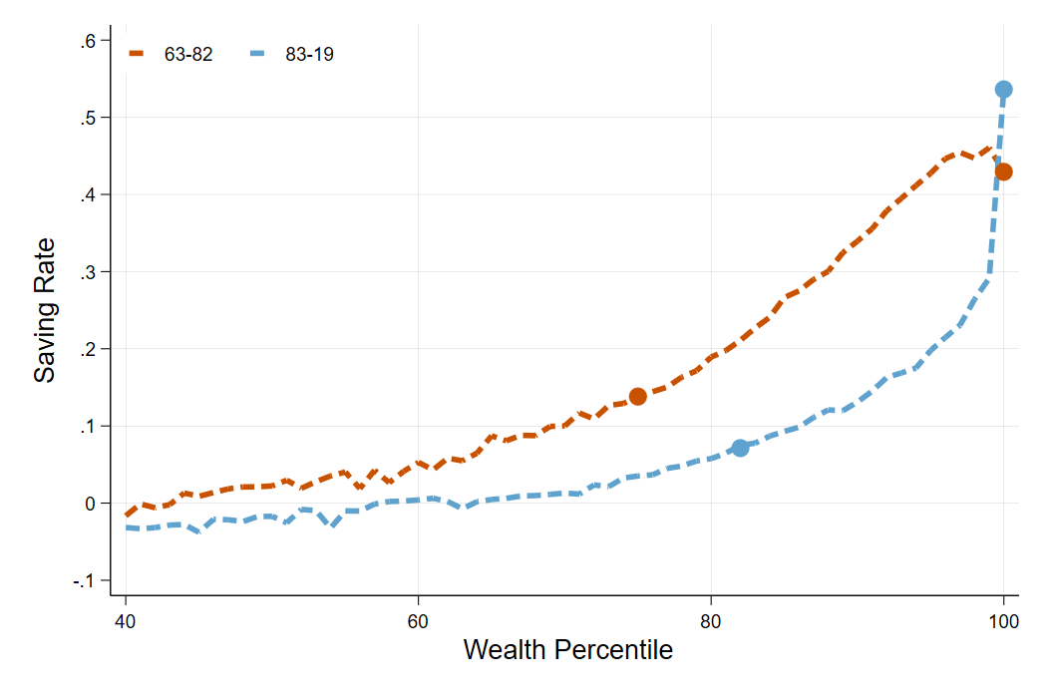
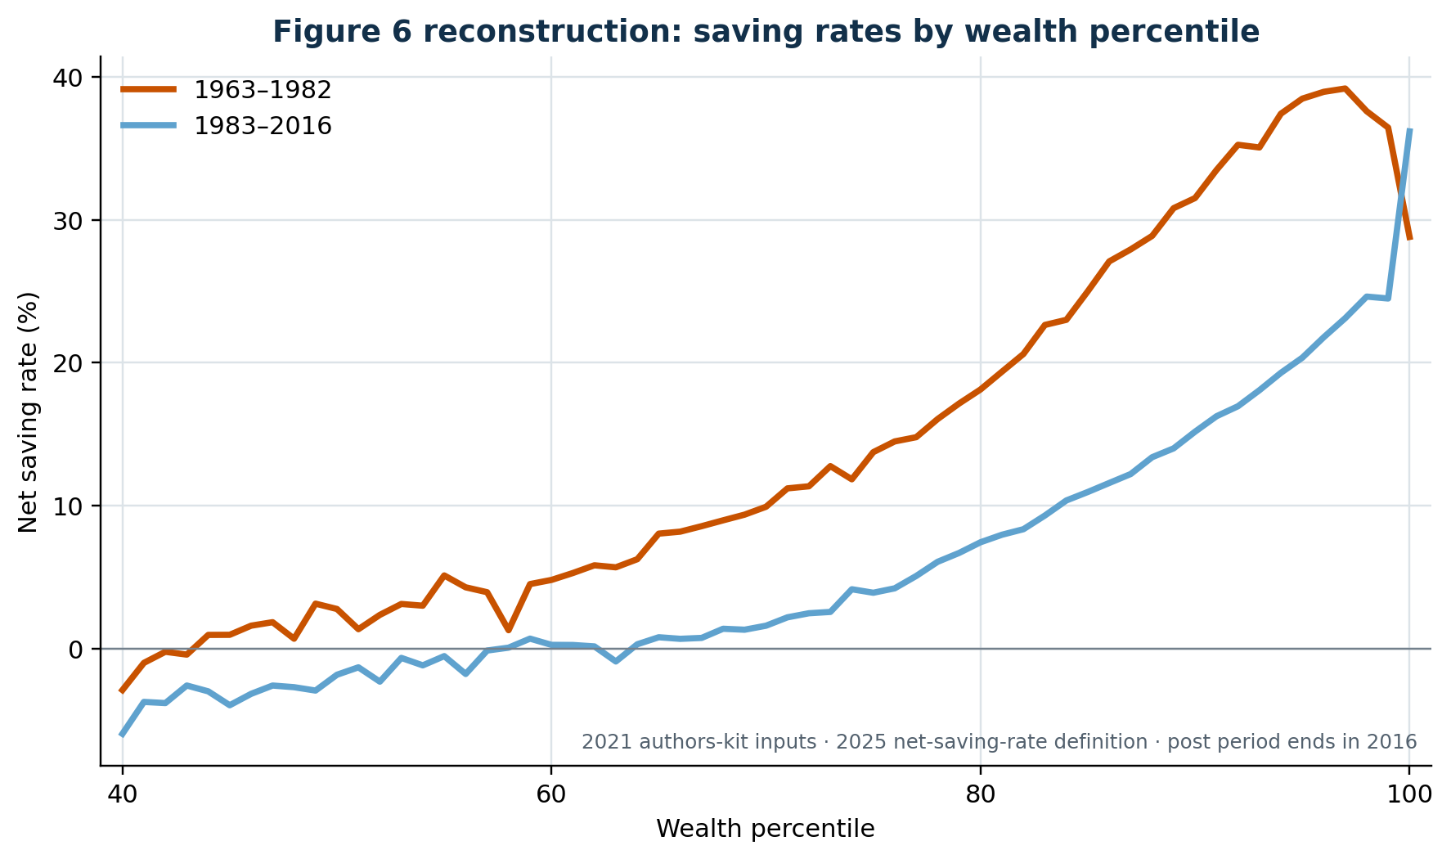
FIGURE 6 PRIMARY COMPARISON
05
The older inputs reproduce the cross-sectional saving pattern
2025 paper · 1963–82 and 1983–2019
Our reconstruction · second period ends in 2016
CLOSE SHAPE MATCH
Correlations: 0.991 / 0.969; MAE: 1.46 / 1.22 pp.
Top 1%: ours 28.8%→36.2%; paper ≈43%→54%. The old inputs end in 2016, not 2019.
Notes:
[Sources]
- MSS_SGR_July242025.pdf, Figure 6, physical PDF page 24; embedded chart extracted without caption
- Results_Proposal/figures/figure6_authors_data_percentiles.png
- Data/processed/figure6_authors_comparison.csv
- Data/processed/figure6_digitization_audit.csv
- docs/project/tasks/figure6-replication.md

Slide 6
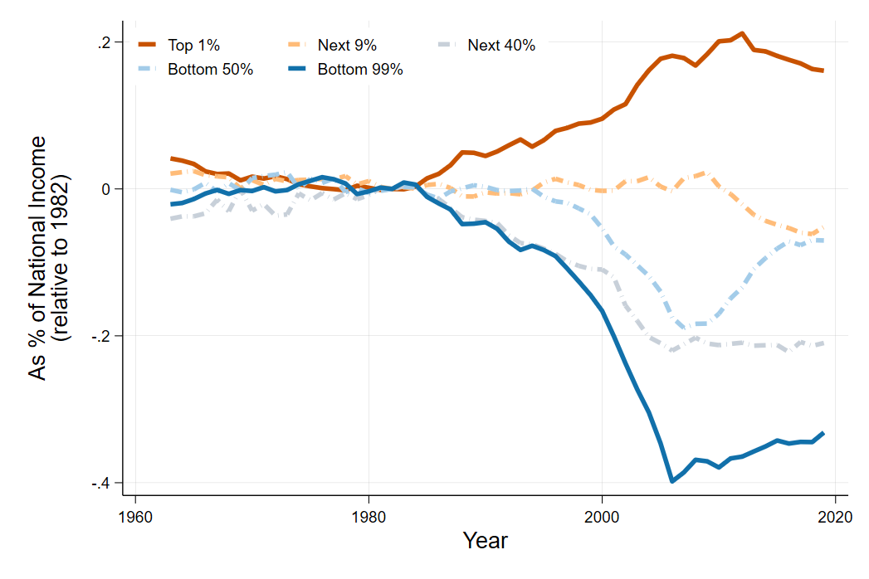
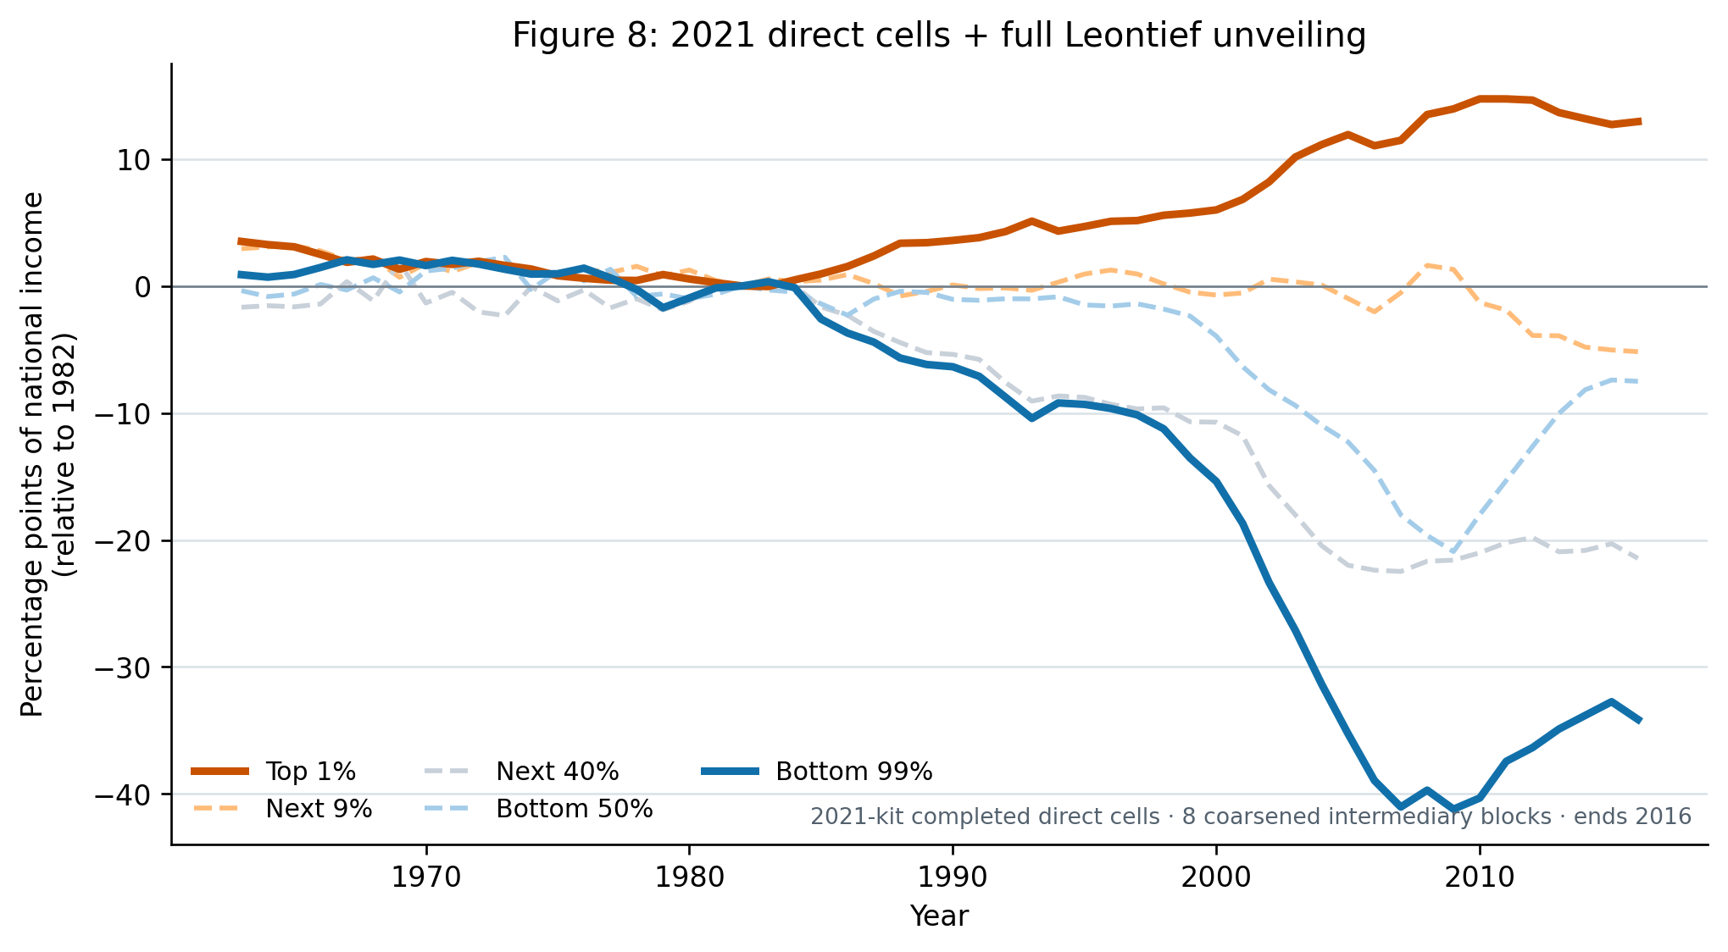
FIGURE 8 PRIMARY COMPARISON
06
The full inverse recovers the lender–borrower split
2025 paper · ratio axis (0.10 = 10 pp)
Our implementation · 2021 direct cells + full Leontief
FULL-INVERSE MATCH
Correlations: 0.994 / 0.995 (top 1% / bottom 99%); MAE: 2.33 / 1.31 pp.
2007: top 1% +11.47 pp versus +18.02 paper; bottom 99% −41.03 pp versus −38.76 paper. Eight coarsened intermediary blocks; ends 2016.
Notes:
[Sources]
- MSS_SGR_July242025.pdf, Figure 8, physical PDF page 29
- Results_Proposal/figures/figure8_2021_direct_full_leontief.png
- Data/processed/figure8_method_comparison.csv
- Data/processed/figure8_method_comparison_metrics.csv
- docs/project/tasks/figure8-replication.md
- Code/scripts/build_figure8_2021_direct.py
- Code/scripts/build_figure8_method_comparison.py

Slide 7
REPLICATION SYNTHESIS
07
All four comparisons recover the paper’s central patterns
Conclusion
Figure 1
What survives independent implementation?
Indirect household ownership rises strongly; the reconstructed level tracks the target through 2016.
Figures 5–6
Saving-flow divergence and the cross-sectional saving-rate profile reproduce closely.
Main lesson
The 2021 inputs support high-fidelity reconstructions of the paper’s mechanisms. Remaining gaps concentrate in data vintage and financial-network detail.
Figure 8
The full-inverse result recovers the lender–borrower split; the top-1 level remains understated.
Notes:
[Sources]
- Results_Proposal/major_results.md, R-001 to R-003
- docs/project/tasks/figure1-replication.md
- docs/project/tasks/figure5-replication.md
- docs/project/tasks/figure6-replication.md
- docs/project/tasks/figure8-replication.md

