Slide 1
PROPOSED EXTENSION · PRELIMINARY ACCOUNTING EVIDENCE
Mortgages link rich saving
to middle-wealth borrowing
A category-specific extension of Mian, Straub, and Sufi
1963–2016 authors-kit inputs · full Leontief unveiling · descriptive, not causal
Research-extension evidence for the course submission
Notes:
[Sources]
- MSS_SGR_July242025.pdf, Sections 3.1, 3.5, and 4.1–4.2.
- research_extension_idea_2.md, Stage 1 research design.
- Data/processed/debt_composition_presentation_metrics.csv, generated 2026-08-14.
[/Sources]

Slide 2
RESEARCH EXTENSION · PRELIMINARY EVIDENCE
02
Mortgage debt dominated below the top 10%
Largest mortgage build-up
+23.6 pp
Next 40% mortgage liabilities
Top 1%: +4.5 pp
The housing channel is quantitatively much larger than consumer credit for the middle 40% and bottom half.
Source: 2021 authors-kit Financial Accounts and DINA shares; positive liabilities owed; 1982–2007 change.
Notes:
[Sources]
- Data/processed/debt_composition_2021_direct.csv, debt_liabilities_relative_to_1982.
- MSS2021Febreplicationkit/data/finalfiles/Yunveilhhd.dta, d_hh_hmort and d_hh_ccred.
- MSS2021Febreplicationkit/data/PSZusdina/Yszshares_fine.dta, owner-mortgage and nonmortgage wealth shares.
- Code/scripts/build_debt_composition_extension.py.
[/Sources]

Slide 3
RESEARCH EXTENSION · PRELIMINARY EVIDENCE
03
Mortgages drove the housing-boom saving drag
1998–2007
−3.09 pp/yr
Next 40% mortgage contribution to active saving
Top 1%: −0.43 pp/yr
Write-down-adjusted mortgage borrowing explains most of the selected debt-related saving reduction in the boom.
Source: Figure 5 balance sheets and debt write-down factors; negative values mean active borrowing reduced saving.
Notes:
[Sources]
- Data/processed/debt_composition_period_summary.csv, 1998–2007 period averages.
- MSS2021Febreplicationkit/data/finalfiles/YwealthFOF.dta, group debt levels after DINA allocation.
- MSS2021Febreplicationkit/data/finalfiles/Ywealthreturns.dta, mortgage and consumer-debt write-down factors.
- Code/unveiling/debt_composition_extension.py, S[g,k,t] = W[g,k,t] - (1 + pi[g,k,t]) W[g,k,t-1].
[/Sources]

Slide 4
RESEARCH EXTENSION · PRELIMINARY EVIDENCE
04
Unveiling separates mortgage lenders from borrowers
Mortgage net positions
+8.69 pp
Top 1%
−19.02 pp
Next 40%
The same mortgage expansion creates a widening lender–borrower split once banks, funds, insurers, and GSE chains are unveiled.
Source: 2021 direct cells + full Leontief solve; positive net position means ultimate assets exceed debt owed.
Notes:
[Sources]
- Data/processed/debt_composition_2021_direct.csv, net_debt_relative_to_1982.
- Code/unveiling/figure8_2021_direct.py, category-specific Omega = (I - Q)^(-1) B allocation.
- Data/interim/debt_composition_accounting_diagnostics.csv; category additivity error at most 9.31e-10 million dollars and spectral radius at most 0.180.
- MSS_SGR_July242025.pdf, Sections 2.1–2.2 and 4.1–4.2.
[/Sources]

Slide 5
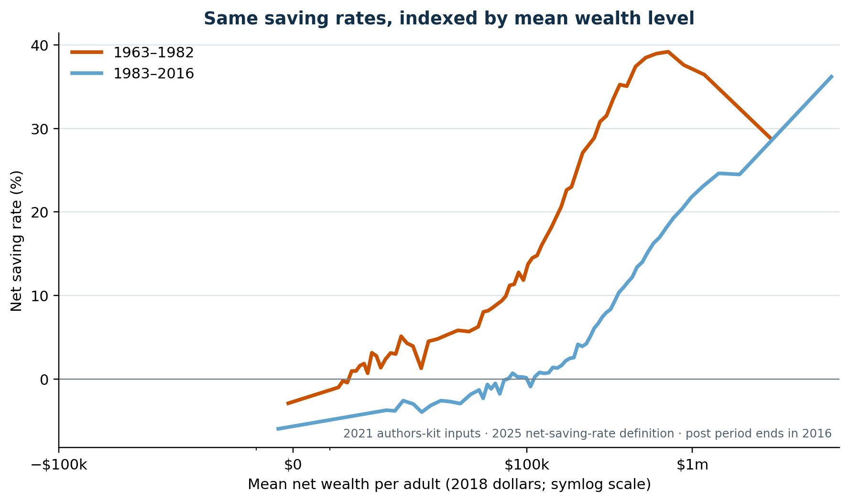
RESEARCH EXTENSION · PRELIMINARY EVIDENCE
05
Similar wealth carries much lower saving after 1982
Comparable mean wealth
$303k · 31.5%
Pre: 90th pct.
$286k · 7.4%
Post: 80th pct.
The saving-rate decline is not only a change in percentile labels: similarly wealthy cohorts save much less in the later period.
Source: Figure 6 exact-method reconstruction; cohort means in 2018 dollars, not fixed-dollar bins.
Notes:
[Sources]
- Results_Proposal/figures/figure6_authors_data_wealth_levels.png.
- Data/processed/figure6_authors_data.csv, pre-1982 90th-percentile and post-1982 80th-percentile rows.
- Code/scripts/build_figure6_authors_data.py.
- docs/project/tasks/figure6-replication.md, matched wealth-level interpretation and repeated-cross-section boundary.
[/Sources]

Slide 6
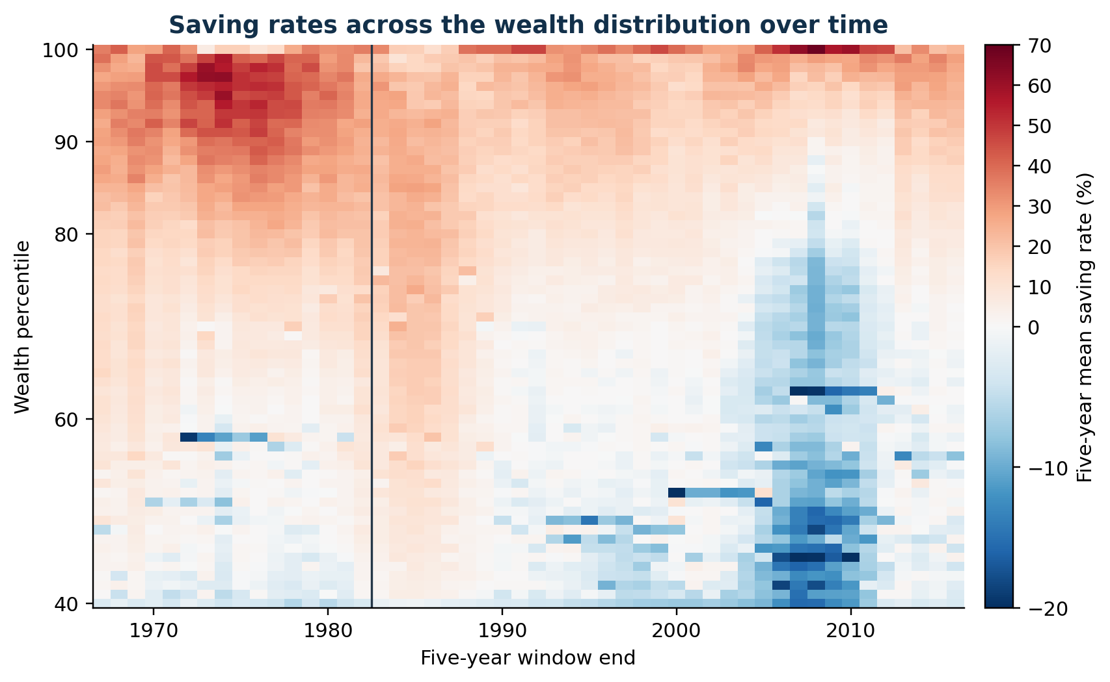
RESEARCH EXTENSION · PRELIMINARY EVIDENCE
06
Upper-middle saving falls; the top 1% stays volatile
Five-year rates
20.1% → 6.1%
80th pct.: 1982 → 2016
68.5% peak
Top 1% · 2008 window
The paper’s two periods compress heterogeneous dynamics: upper-middle rates trend down while the top 1% remains highly volatile.
Source: trailing five-year means of the same annual Figure 6 net saving rate; vertical line marks 1982.
Notes:
[Sources]
- Results_Proposal/figures/figure6_rolling5_heatmap.png.
- Data/processed/figure6_authors_rolling5.csv.
- Code/scripts/build_figure6_authors_data.py.
- docs/project/tasks/figure6-replication.md, time-evolution interpretation and nonmonotonicity boundary.
[/Sources]

Slide 7
RESEARCH EXTENSION · PRELIMINARY EVIDENCE
07
The next step is a causal mortgage-credit test
01
Established here
02
Not identified
03
Proposed test
Mortgages dominate the pre-2008 debt build-up and saving drag for the next 40% and bottom 50%; the top 1% becomes a net ultimate lender.
These accounts do not establish that credit supply caused house-price growth or lower saving. Age, homeownership, income, and housing supply remain confounders.
Combine SCF or DFA borrower detail with ultimate owners; then exploit mortgage-policy or credit-supply shocks.
Research question: did expanded mortgage credit transmit top-wealth saving into house prices and lower measured saving below the top?
Next data: SCF/DFA borrower composition; causal design must separate credit supply from demand and wealth-rank mechanics.
Notes:
[Sources]
- research_extension_idea_2.md, Stages 2–4 and measurement safeguards.
- Federal Reserve Survey of Consumer Finances: https://www.federalreserve.gov/econres/scfindex.htm
- Federal Reserve Distributional Financial Accounts: https://www.federalreserve.gov/releases/z1/dataviz/dfa/index.html
- CBO, Trends in the Distribution of Family Wealth, 1989 to 2022: https://www.cbo.gov/publication/60807
- Bartscher, Kuhn, Schularick, and Steins (2025): https://doi.org/10.1016/j.red.2025.101288
[/Sources]

