Slide 1
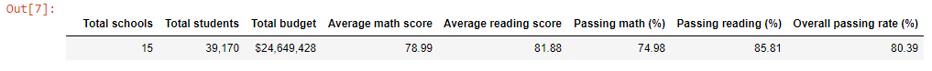
1. District Summary

Slide 2
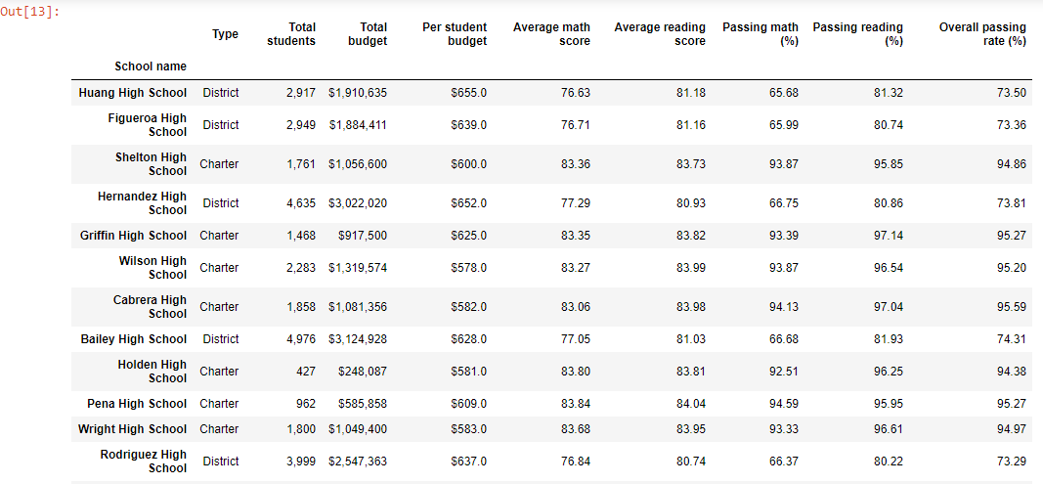
2. School Summary

Slide 3
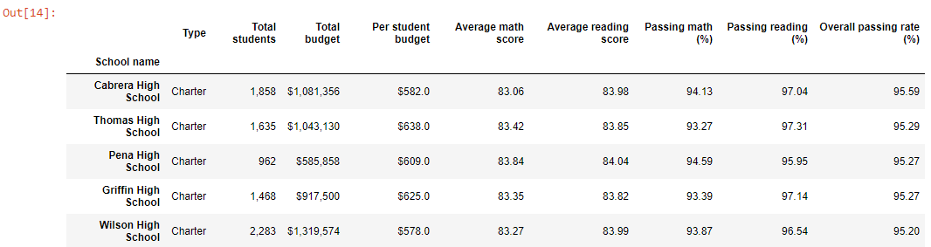
3. Top Performing Schools

Slide 4
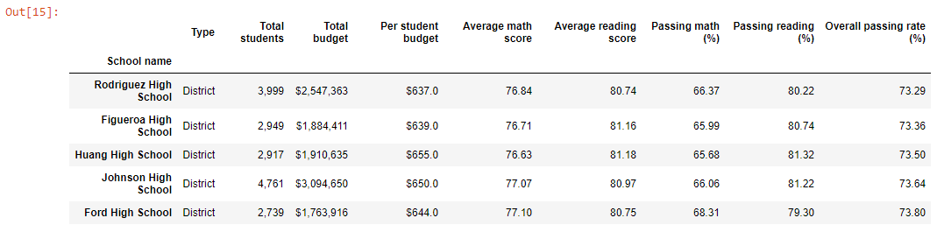
4. Bottom Performing Schools

Slide 5
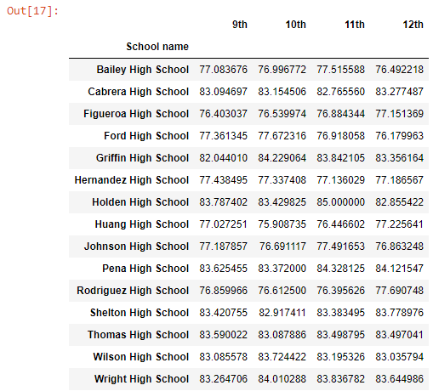
5. Math Scores by Grade

Slide 6
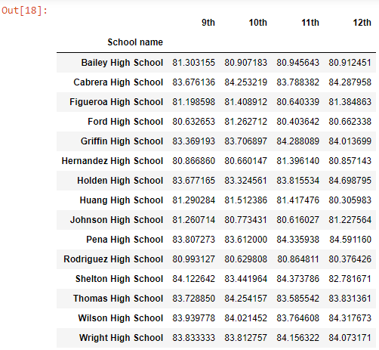
6. Reading Scores by Grade

Slide 7
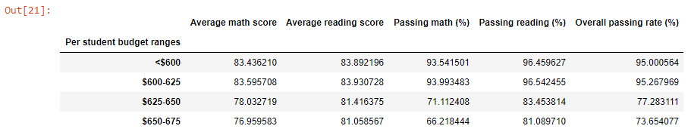
7. Scores by School Spending

Slide 8
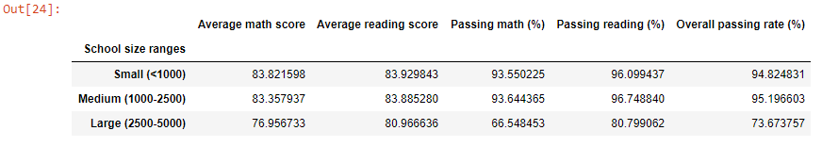
8. Scores by School Size

Slide 9
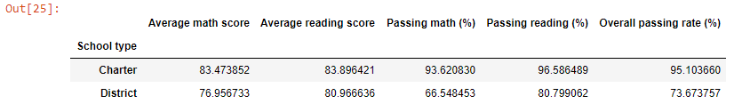
9. Scores by School Type

