Slide 1


Topic of the talk: details of the talk
Francesco Lorenzi
Luca Salasnich
Where,
when
Dipartimento di Fisica
e Astronomia
“Galileo Galilei”

Slide 2
Topics of this talk
LIST OF TOPICS
Low-energy scattering theory
- Universal and nonuniversal behaviour
- On-shell approximation (submitted to PRA)
3) Solitons in Bose-Einstein condensates
- Collision with narrow barrier
- Application: matter-wave interferometer

Slide 3
1) First topic

Slide 4
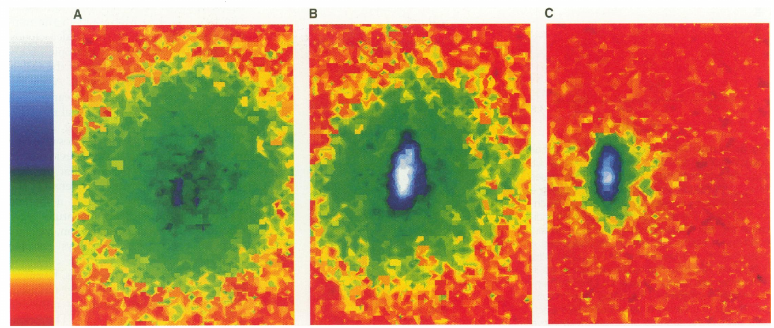
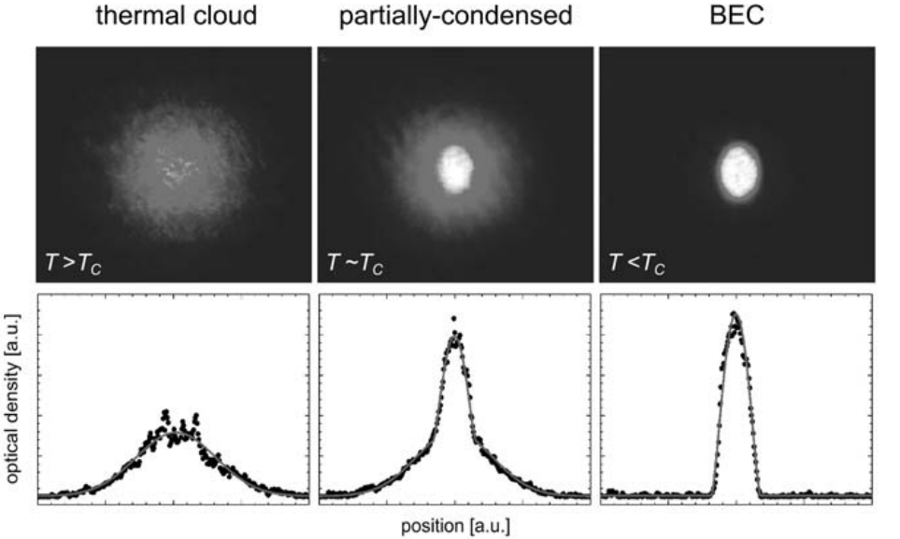
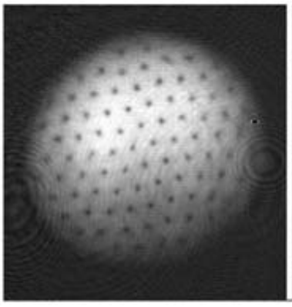
Images and words + citation
Bose-Einstein condensation in trapped alkali atoms (for example ⁸⁷Rb, ⁷Li,²³Na) have been achieved in 1995.
This is about 70 years later than the theoretical prediction by Bose and Einstein, around 1924.
Used techniques were Magneto Optical Traps (MOTs) and laser cooling.
Since then many condensate and superfluid have been measured in these systems, such as bright and dark solitons, quantized vortices, droplets.
Top: [Anderson et al. Observation of Bose-Einstein Condensation in a Dilute Atomic Vapor. Science 269, 198–201 (1995).]
Bottom: [Inguscio, M. & Fallani, L. Atomic Physics: Precise Measurements and Ultracold Matter. (OUP Oxford, 2013).]

Slide 5
Words and equations
Let us consider the relative component of a two-body problem
With
A standard result from scattering theory is the so-called Lippman-Schwinger (LS) equation for scattering at energy E
with
Introducing the transition (T-) matrix,
the LS equation becomes an operator equation
All of this is valid in all spatial dimensions D=1, 2, 3.

Slide 6
Thank you for the attention!

