Slide 1


Reinforcement Learning Project 2023/2024 Lorenzo Di Luccio 1797569 Renato Giamba 1816155
«Learning model-based planning from scratch»

Slide 2
Introduction (1)
Model-based planning:
proposal of a sequence of actions
evaluation of such actions with a model of the environment
final refinement to optimize expected rewards.
Main advantages of model-based vs model-free methods:
generalization for never encountered states
better linking between present actions and future rewards
resolution of states with the same values or Q values.

Slide 3
Introduction (2)
Planning is challenging: a model can evaluate a plan and execute it, but it doesn’t know how to construct one.
Imagination-based Planner (IBP): model-based agent which can perform the three stages of planning.
IBP is flexible: it can deal with discrete or continuous environments.

Slide 4
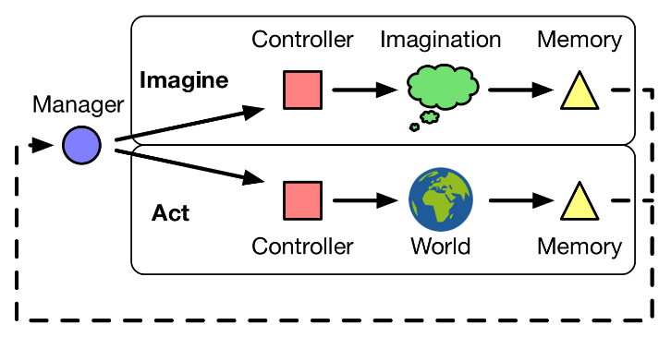
IBP (1) – Architecture
The whole IBP can be seen as a recurrent policy, that acts on an environment (world) and is able to plan using four components:
manager
controller
imaginator
memory

Slide 5
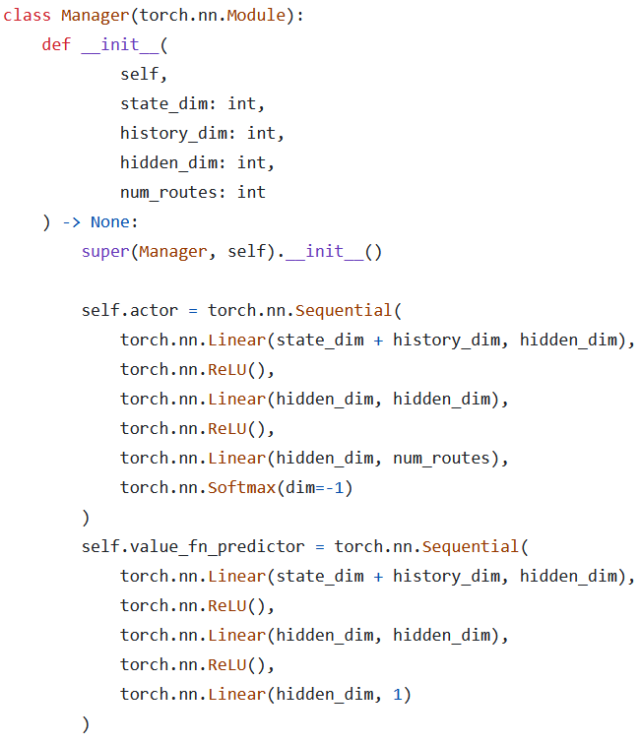

IBP (2) – Manager
The manager is a discrete policy $π_{M}:𝒮×ℋ→𝒰$ that maps a state $s∈𝒮$ and the history $h∈ℋ$ into a route $u∈𝒰=\left\{act,img1,img2\right\}$.
It is trained with the REINFORCE + baseline algorithm.

Slide 6
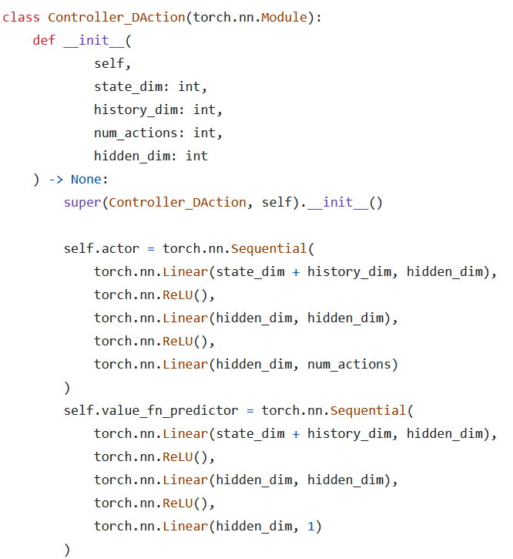

IBP (3) – Controller
The controller is a policy $π_{C}:𝒮×ℋ→𝒜$ that maps a state $s∈𝒮$ and the history $h∈ℋ$ into an action $a∈𝒜$.
It is trained with the REINFORCE + baseline algorithm.

Slide 7
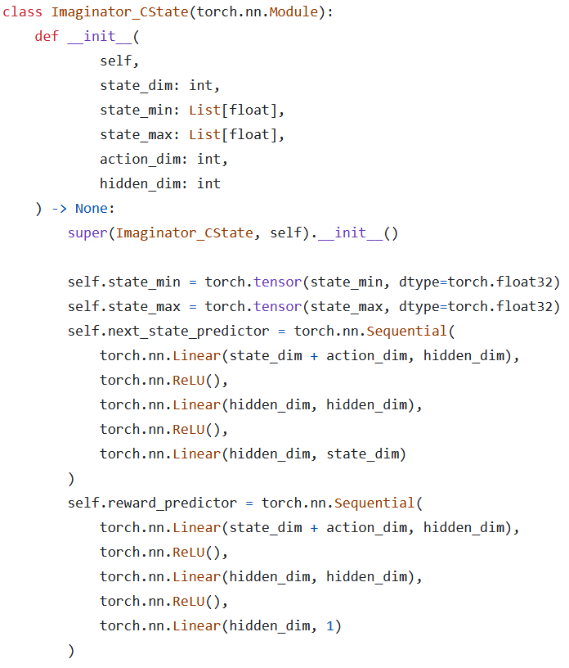
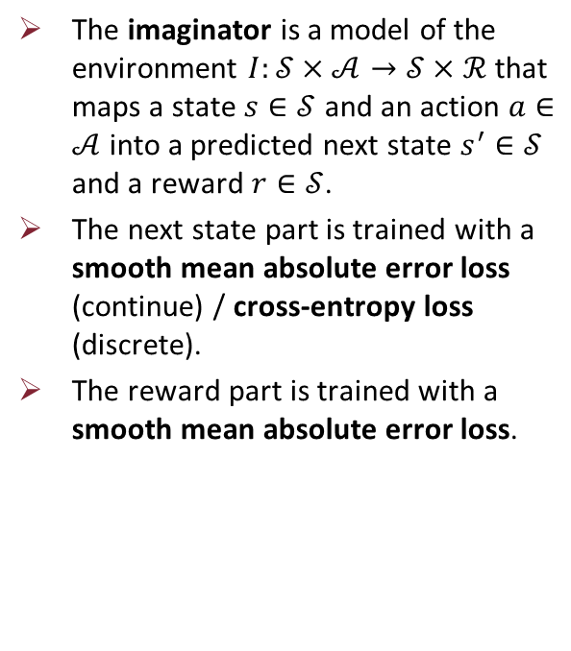
IBP (4) – Imaginator
The imaginator is a model of the environment $I:𝒮×𝒜→𝒮×ℛ$ that maps a state $s∈𝒮$ and an action $a∈𝒜$ into a predicted next state $s^{′}∈𝒮$ and a reward $r∈𝒮$.
The next state part is trained with a smooth mean absolute error loss (continue) / cross-entropy loss (discrete).
The reward part is trained with a smooth mean absolute error loss.

Slide 8
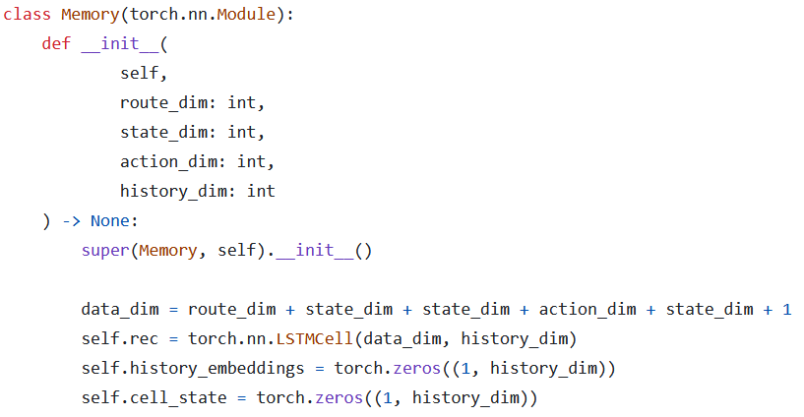

IBP (5) – Memory
The memory is a function $μ:𝒟×ℋ→ℋ$ that maps the data $d∈𝒟$ from an iteration and an old history $h∈ℋ$ into a newly aggregated history $h^{′}∈ℋ$.
It is trained jointly with the controller using backpropagation through time (BTT).

Slide 9
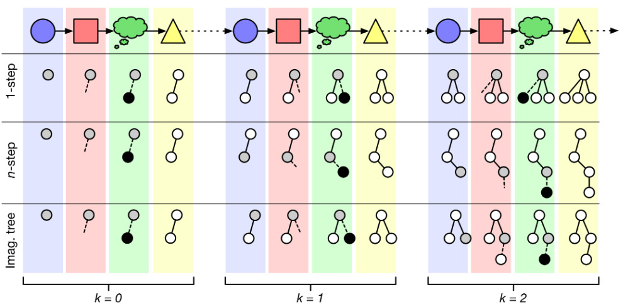
IBP (6) – Imagination strategies
IBP must have an imagination strategy to construct its plans.
The three easiest imagination strategies are:
1-step imagination
n-step imagination
imagination tree
Imagination strategy used: simpler version of the imagination tree.

Slide 10
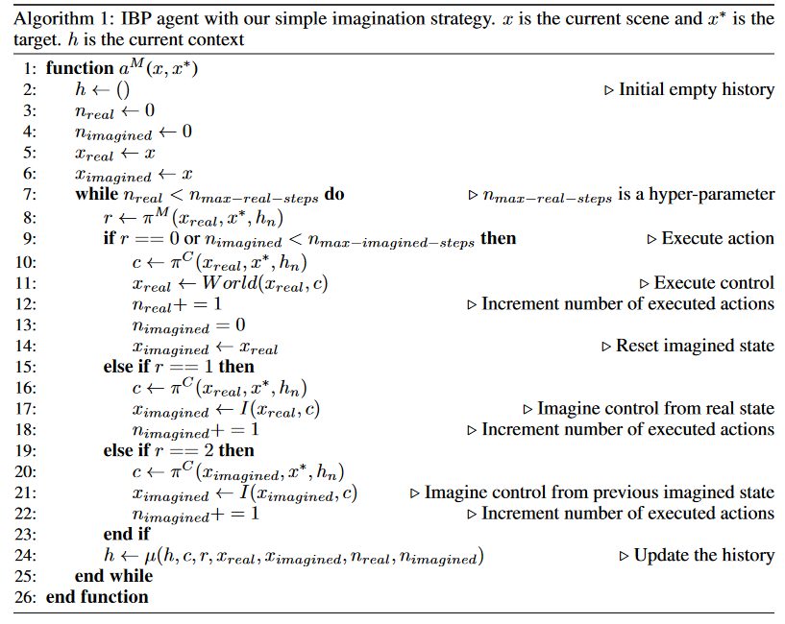
IBP (7) – Training algorithm
$$≥$$
$$≥$$

Slide 11
IBP (8) – Training algorithm: gradients
The paper doesn’t clearly specify how to build a backward computation graph for gradients computation.
The one in the code is an implementation based on our understanding of how things should be.

Slide 12
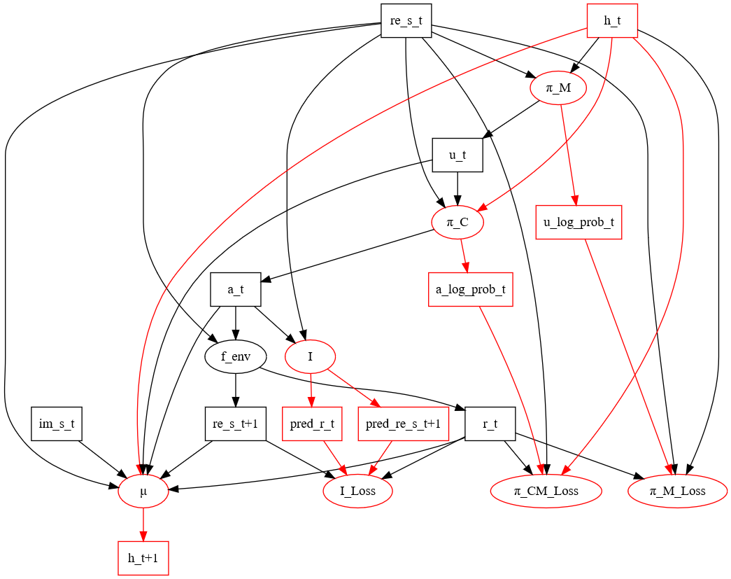
IBP (9) – Gradients for «Act»

Slide 13
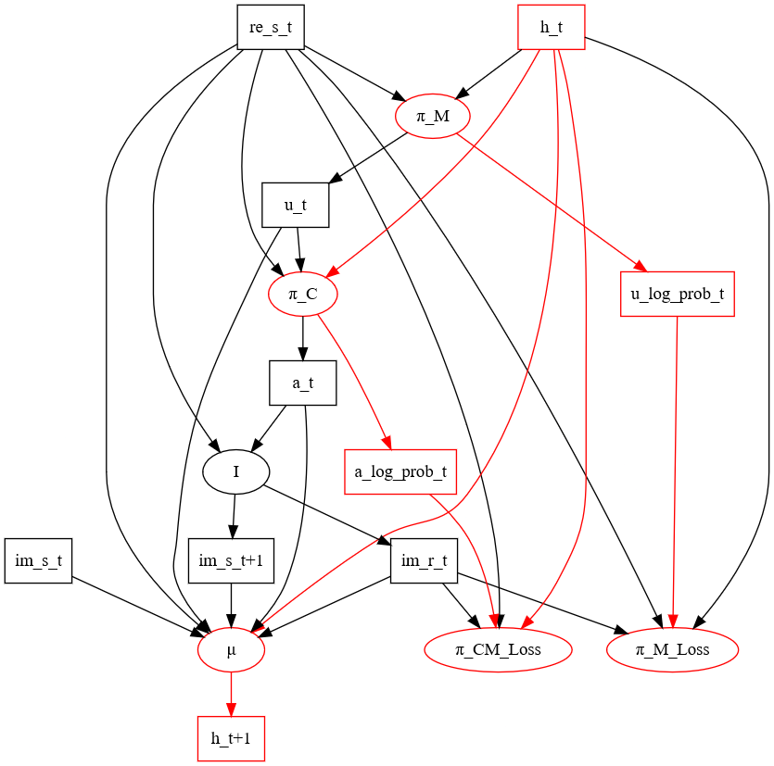
IBP (10) – Gradients for «Imag1»

Slide 14
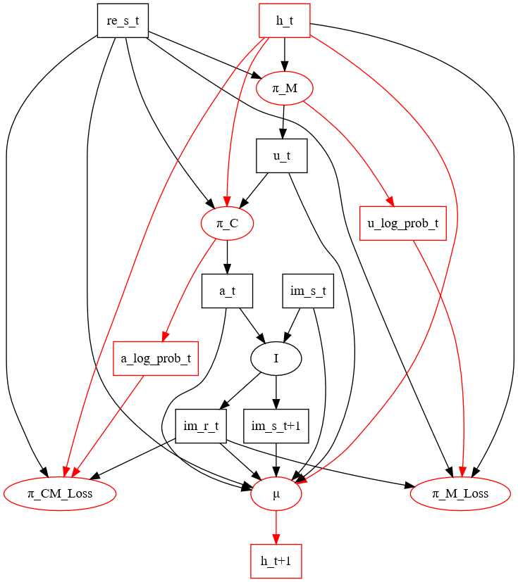
IBP (11) – Gradients for «Imag2»

Slide 15
Experimental settings and hyperparameters
Optimizers: 3 ADAM optimizer for manager, imaginator and controller + memory (trained jointly).
Learning rates: 0.001 for each optimizer to start then decrease when performances don’t improve.
Gamma factor: 0.99
Run: 1,000 episodes for each run.
Episode: variable number of steps. It stops if the environment terminates or truncates.
Imagination budgets: 0, 1 or 2. The models with 1 or 2 are pretrained on the model with 0.

Slide 16
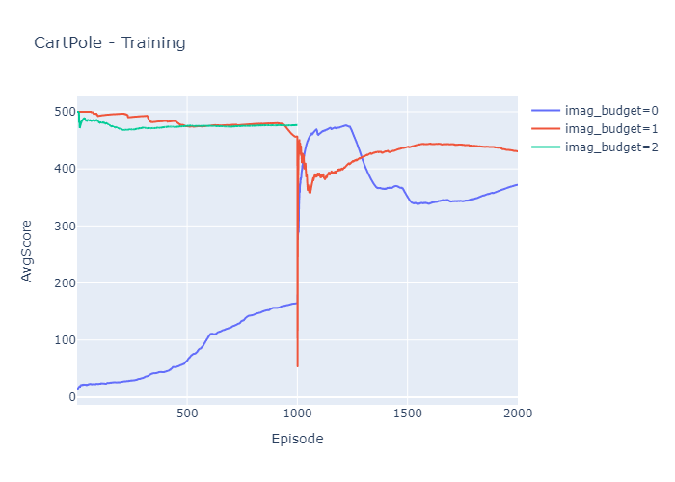
Experiment 1: CartPole (1) – Training

Slide 17
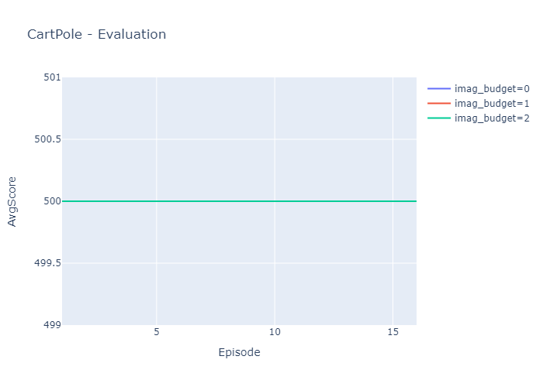
Experiment 1: CartPole (2) – Evaluation

Slide 18
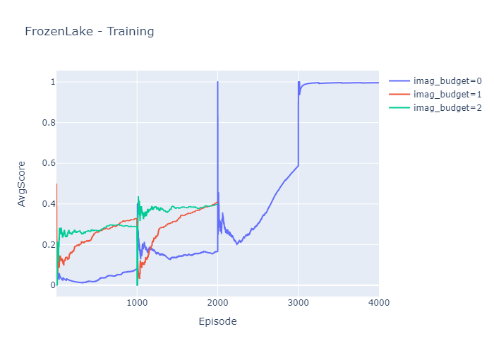
Experiment 2: FrozenLake (1) – Training

Slide 19

Experiment 2: FrozenLake (2) – Evaluation

Slide 20
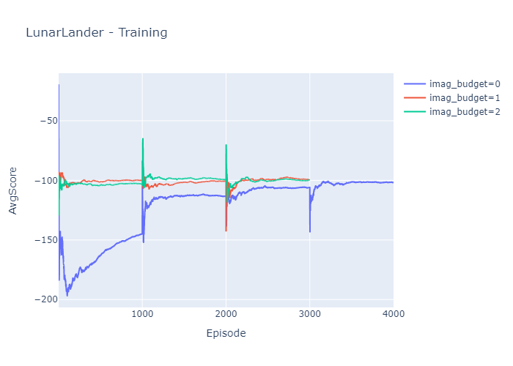
Experiment 3: LunarLander (1) – Training

Slide 21
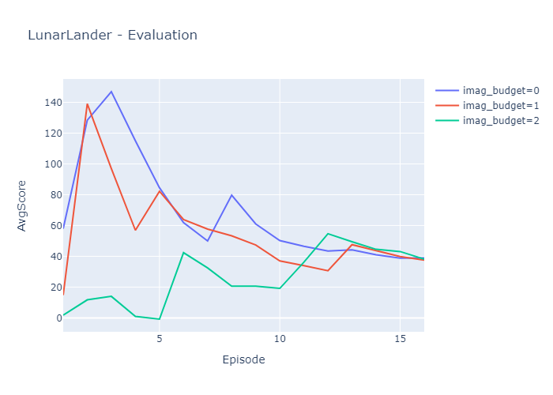
Experiment 3: LunarLander (2) – Evaluation

Slide 22

Final considerations (1)
The paper sounds vague and unclear in some parts:
use of an unspecified target state $x^{∗}$ in the training algorithm
lack of detailed instructions on gradients
some graphs are difficult to understand
almost no graphs of results with metrics and statistics

Slide 23
Final considerations (2)
The agent is generally unstable for various reasons:
use of four different neural networks
the REINFORCE algorithm generates gradients with high variance
training with other RL algorithms could be harder and costly

Slide 24
Final considerations (3)
The learning algorithm seems tuned for something very specific:
good (?) performances on environment created ad-hoc (spaceship task)
poor performances on simpler ones
it may not fail on generalization if the components are implemented with more powerful and complex neural networks (GNNs)
advanced neural networks could slow down the agent

Slide 25
Thanks for your attention!

