Slide 1


Reinforcement Learning Project 2023/2024 Lorenzo Di Luccio 1797569 Renato Giamba 1816155
«Learning model-based planning from scratch»

Slide 2
Introduction (1)
Model-based planning:
proposal of a sequence of actions
evaluation of such actions with a model of the environment
final refinement to optimize expected rewards.
Main advantages of model-based vs model-free methods:
generalization for never encountered states
better linking between present actions and future rewards
resolution of states with the same values or Q values.

Slide 3
Introduction (2)
Planning is challenging: a model can evaluate a plan and execute it, but it doesn’t know how to construct one.
Imagination-based Planner (IBP): model-based agent which can perform the three stages of planning.
IBP is flexible: it can deal with discrete or continuous environments.

Slide 4
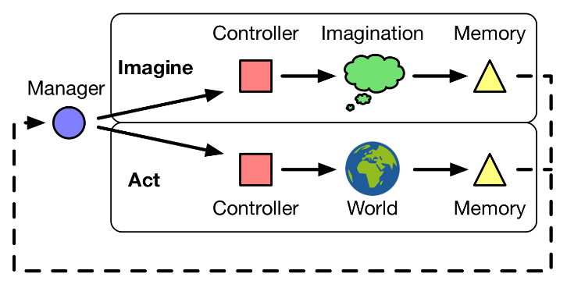
IBP (1) – Architecture
The whole IBP can be seen as a recurrent policy, that acts on an environment (world) and is able to plan using four components:
manager
controller
imaginator
memory

Slide 5

IBP (2) – Manager
The manager is a discrete policy $π_{M}:𝒮×ℋ→𝒰$ that maps a state $s∈𝒮$ and the history $h∈ℋ$ into a route $u∈𝒰=\left\{act,img1,img2\right\}$.
It is trained with the REINFORCE + baseline algorithm.

Slide 6

IBP (3) – Controller
The controller is a policy $π_{C}:𝒮×ℋ→𝒜$ that maps a state $s∈𝒮$ and the history $h∈ℋ$ into an action $a∈𝒜$.
It is trained with the REINFORCE + baseline algorithm.

Slide 7
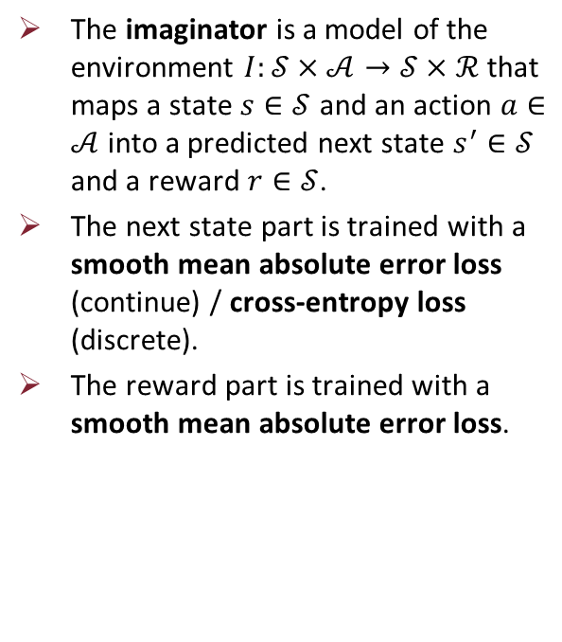
IBP (4) – Imaginator
The imaginator is a model of the environment $I:𝒮×𝒜→𝒮×ℛ$ that maps a state $s∈𝒮$ and an action $a∈𝒜$ into a predicted next state $s^{′}∈𝒮$ and a reward $r∈𝒮$.
The next state part is trained with a smooth mean absolute error loss (continue) / cross-entropy loss (discrete).
The reward part is trained with a smooth mean absolute error loss.

Slide 8

IBP (5) – Memory
The memory is a function $μ:𝒟×ℋ→ℋ$ that maps the data $d∈𝒟$ from an iteration and an old history $h∈ℋ$ into a newly aggregated history $h^{′}∈ℋ$.
It is trained jointly with the controller using backpropagation through time (BTT).

Slide 9
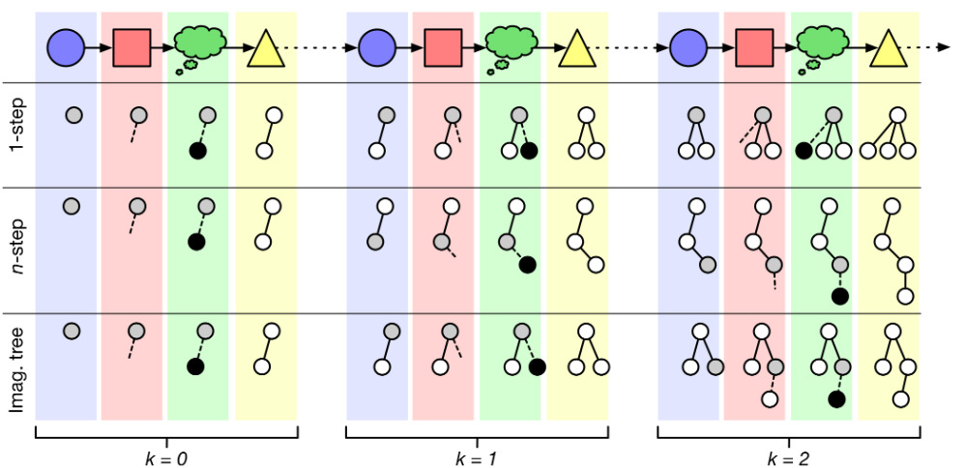
IBP (6) – Imagination strategies
IBP must have an imagination strategy to construct its plans.
The three easiest imagination strategies are:
1-step imagination
n-step imagination
imagination tree
Imagination strategy used: simpler version of the imagination tree.

Slide 10
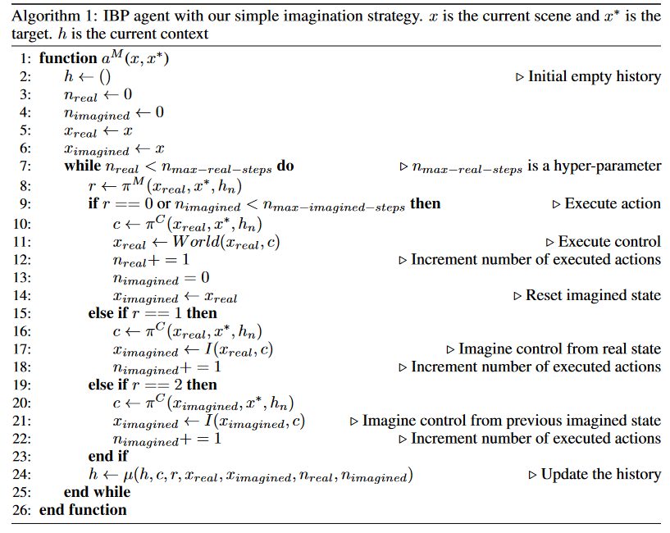
IBP (7) – Training algorithm
$$≥$$
$$≥$$

Slide 11
Thanks for your attention!

Slide 12
Introduction (1)
Objective: studying optimal gestures for interfacing experienced firefighters with a drone.
Why?
Drones are getting more popular and are used for many tasks.
Challenging, because drones have very simple and basic interfaces (joystick, …).
In more complex task-oriented scenarios, drones have to make decisions based on human input.

Slide 13
Introduction (2) – Drones making decisions
For interfacing with a drone in task-oriented scenarios, we need to control the drone, know its location and an interactive communication channel with it. But:
Little external controlling devices could go out of battery or not operate well when lots of people are present.
CLI are slow because a human has to interrupt an activity and type commands in the middle of the task, while he could be useful elsewhere.
Often, there’s no time or resources for relying on better devices.

Slide 14
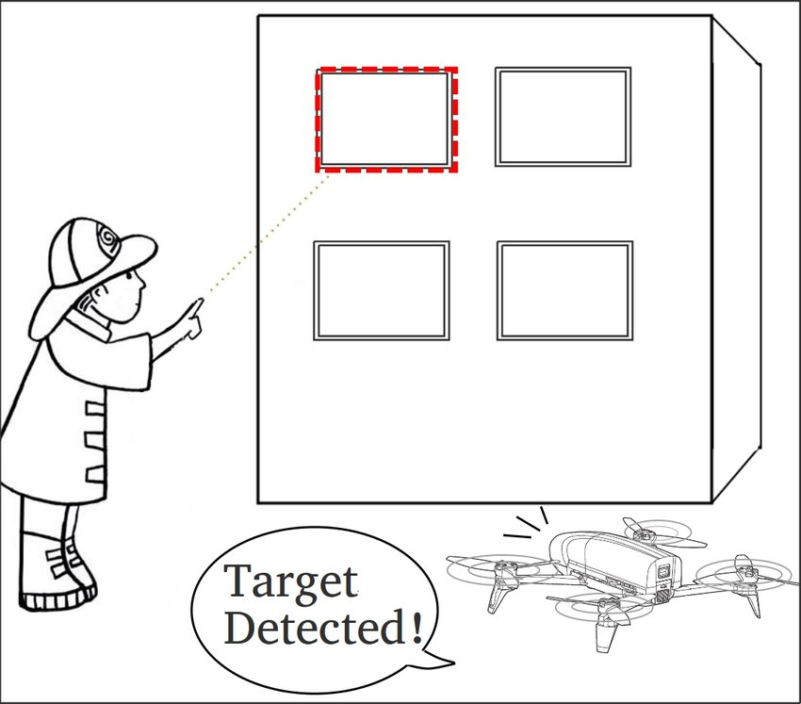
Introduction (3) – Gestures
Gesture inputs could be a solution for these issues.
They’re a natural, fast and visual form of communication.
They can cooperate with GPS for more robust system.
They can substitute GPS in indoor environments.
They can be used in low-resources environments (only a drone with its camera is needed, no external devices or GPS or other cameras).

Slide 15
User Study (1)
Where? Fire brigate in Kobe, Japan.
Who? Seven firefighters with different positions from officer to chief.
Main question: how to interact with a drone, i.e. how to indicate a window to enter in and perform its tasks?
Main hypothesis: use pointing gestures to indicate the window.
Side questions: what are your opinions on using drones to help firefighters? Are they useful?

Slide 16
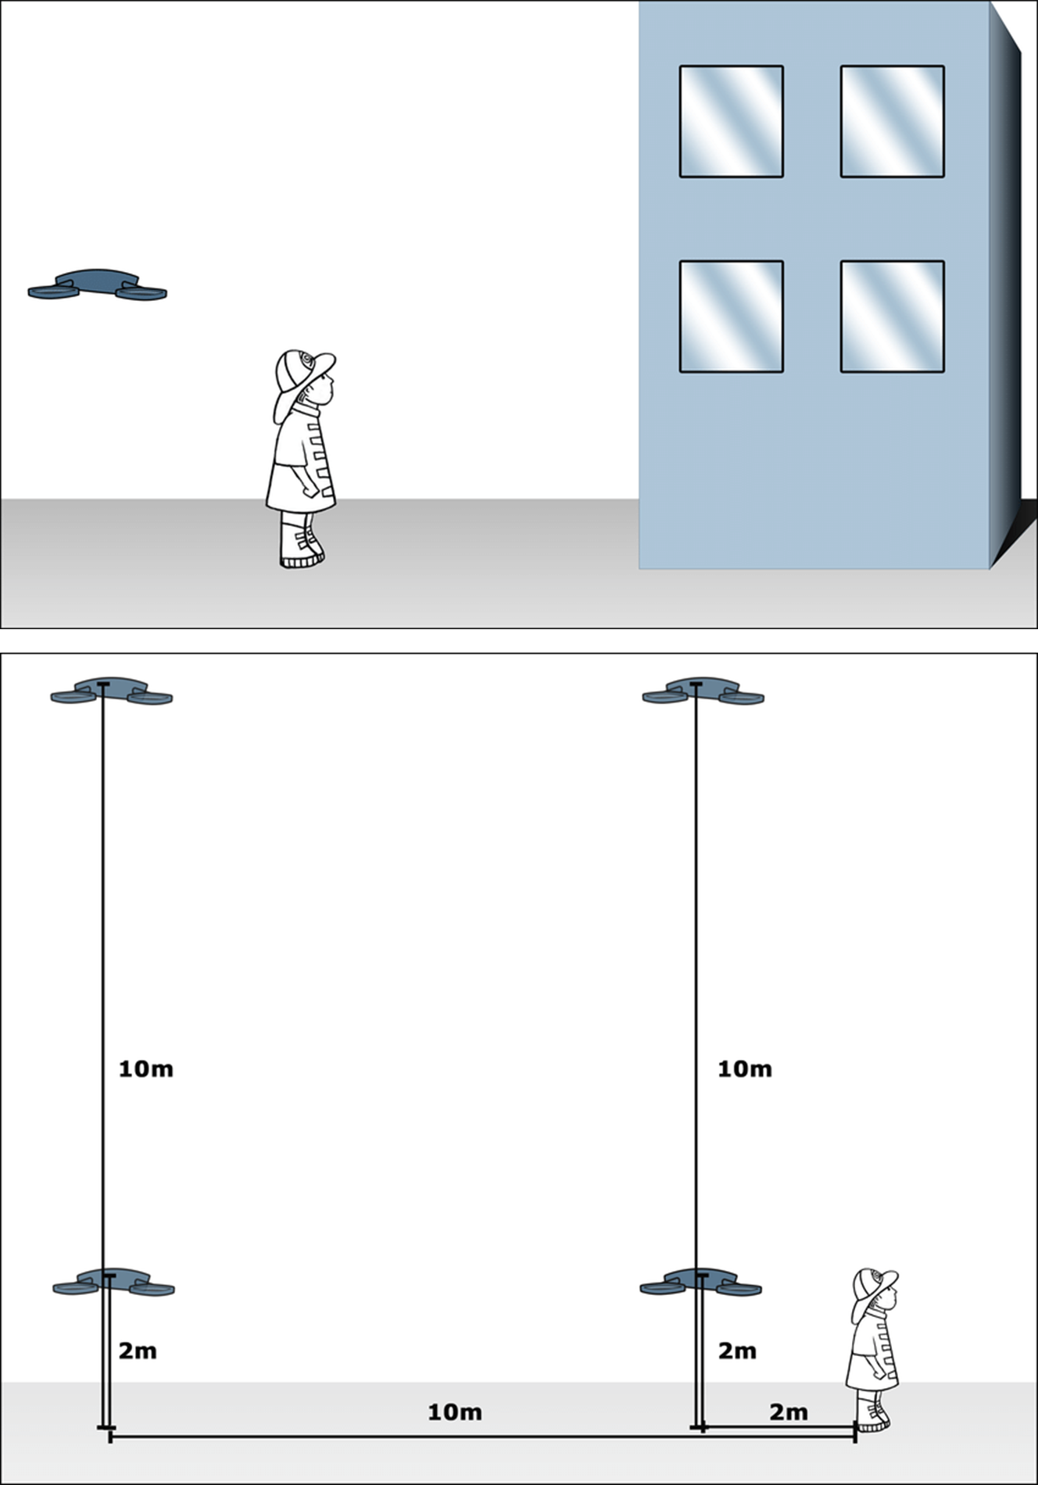
User Study (2) – Environment
Firefighting scenario with a drone hovering near the building.
Each firefighter is asked to indicate a window to the drone in whichever way the prefer.
Tested 4 setups, where the firefighter is always 40 m from the building.

Slide 17
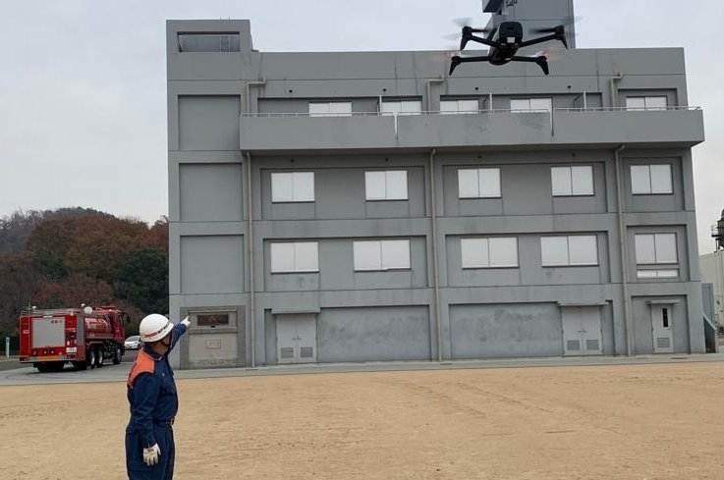
User Study (3) – Results
Firefighters always wanted feedback from the drone on how its task was evolving.
To indicate a particular window, pointing gestures and verbal commands were always used, with no hint from the paper authors.

Slide 18
Methodology (1) – System architecture
User: human interacting with the Camera pointing towards Targets.
Camera: main sensor on the Drone that sends RGB images to the Processing Unit.
Targets: visual objects that a Processing Unit on the Drone was trained on to detect.
Processing Unit: simple and fast computational system that processes images from the Camera, perform gesture and target detection and sends controls to the Drone.

Slide 19
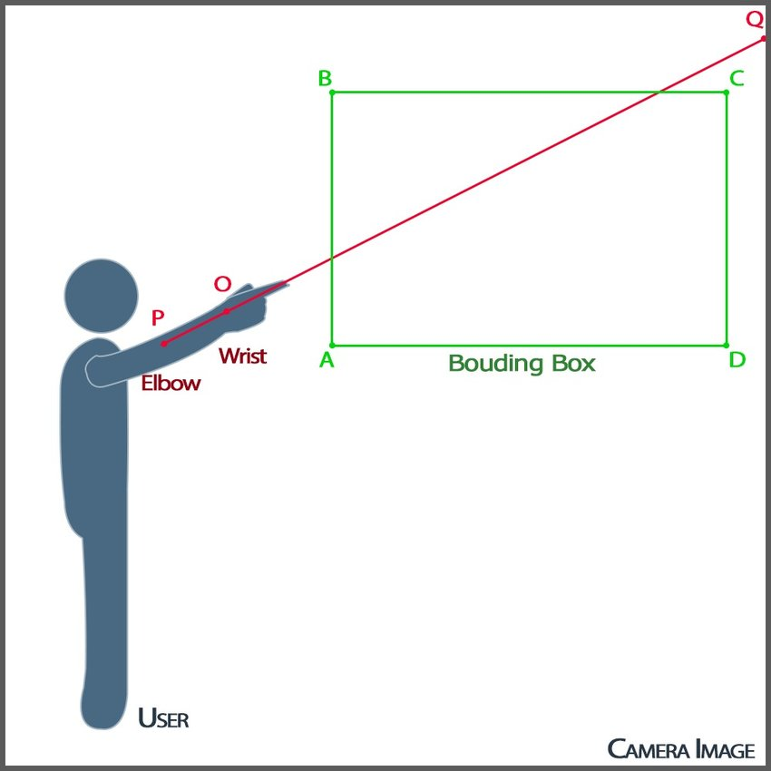
Methodology (2) – System architecture details
Gesture detection: made with Openpose. Find two points (wirst and elbow) on the User’s arm and use them to compute the extended point segment (PQ).
Target detection: made with YOLO. Using the outputs from Openpose, find the bounding box (ABCD) of a Target. If the bounding box and the extended point segments overlap, the Target is selected and the Drone interacts with it.

Slide 20
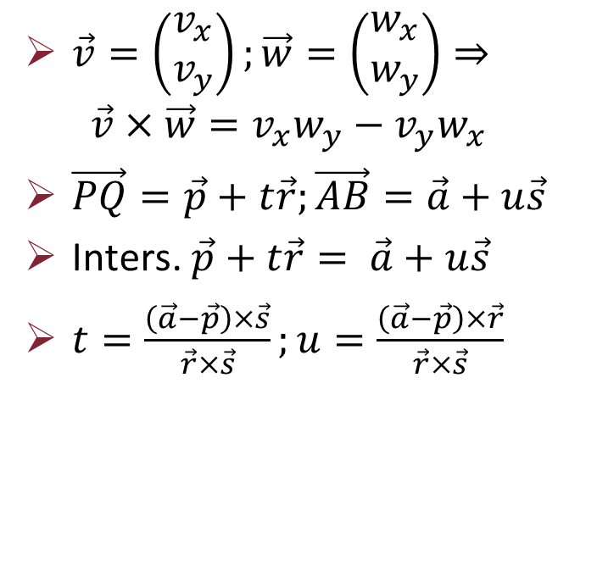
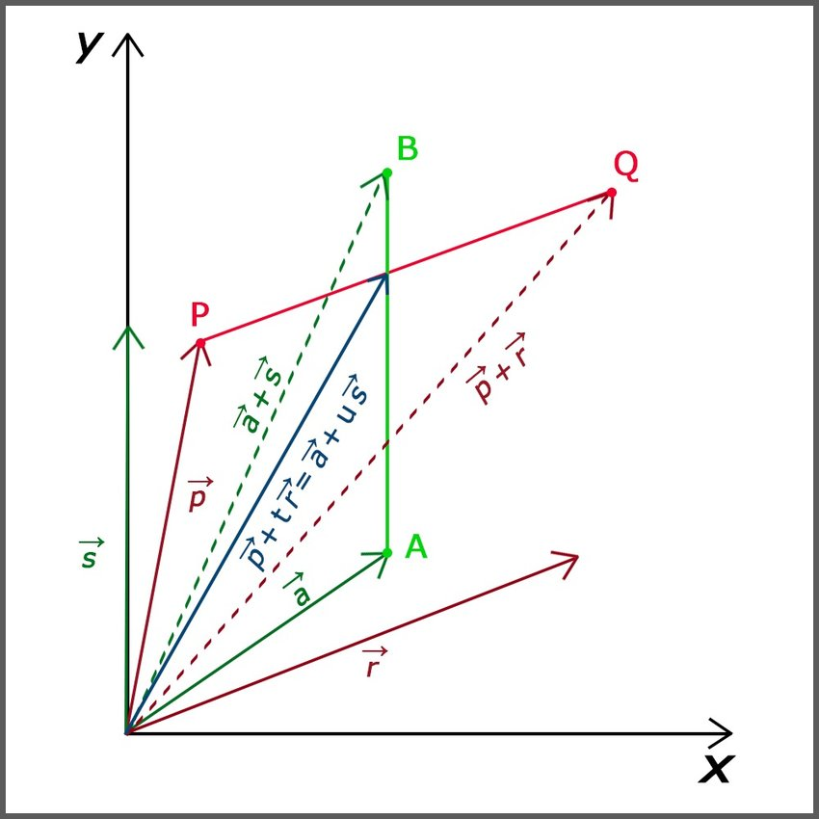
Methodology (3) – 2D math

Slide 21
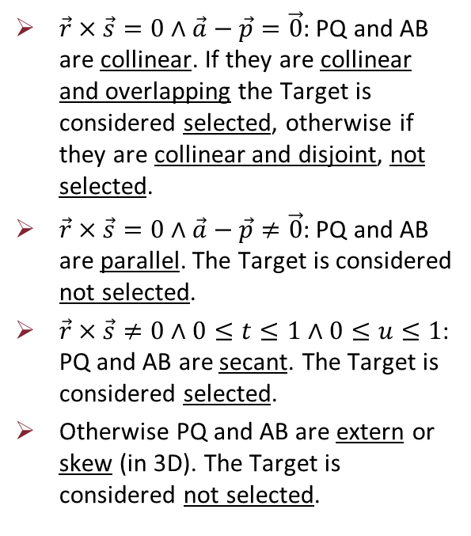
Methodology (4) – 2D math: cases

Slide 22
Methodology (5) - Resources
Parrot Bebop 2 drone quadricopter with 1080p full HD camera (actual image size is 856x480 for performance) and an embedded PID controller.
The ROS Parrot Bebop 2 SDK (bebop_autonomy).
Alienware 13 R3 laptop with Nvidia GTX 1060 GPU, Intel i7-7700hp CPU, 8 GB RAM.
Wi-fi interface between drone and laptop using ROS.

Slide 23
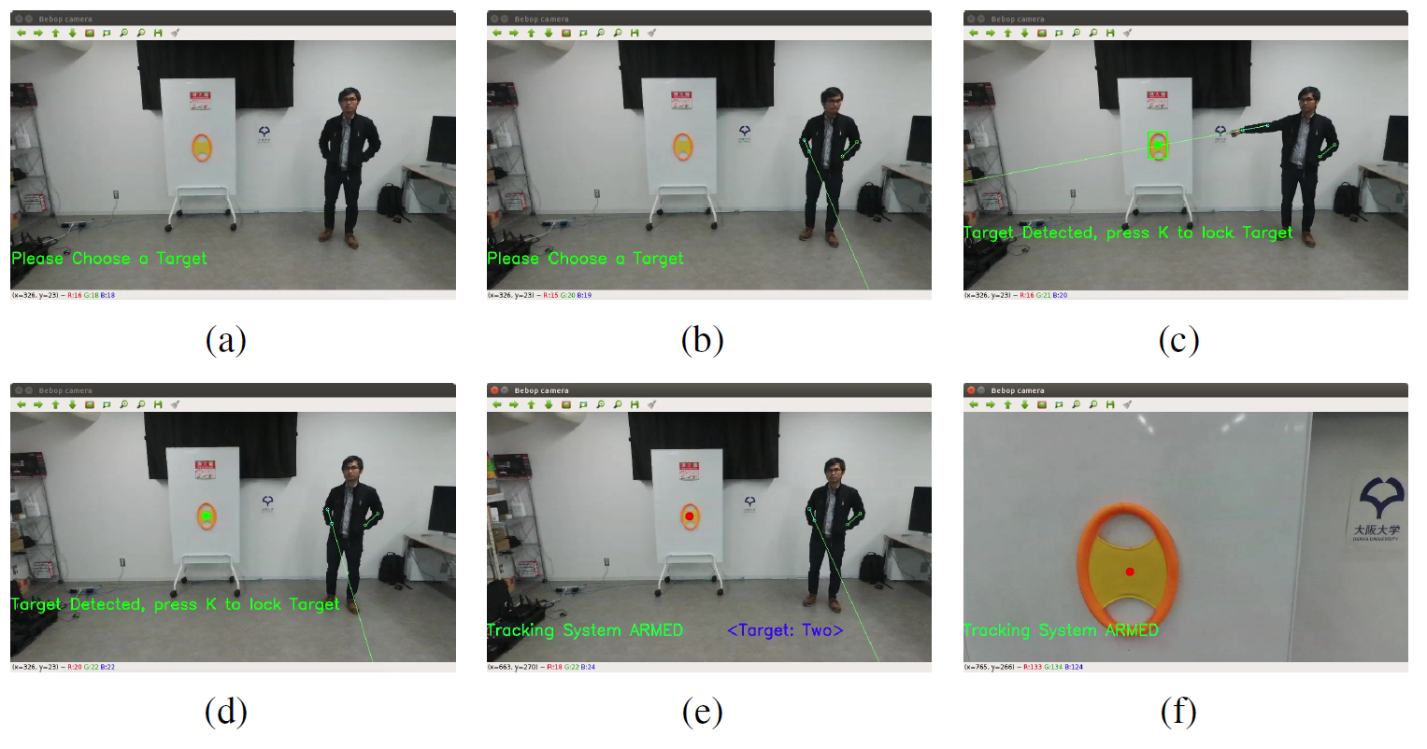
Methodology (6) – Full app
Flowchart
Simple demo

Slide 24
Final Thoughts and Considerations (1)
No numerical results on HRI metrics, because the paper is more investigational.
On the other side it provides a good baseline to start with Human-Drone Interaction and more related tasks relying on very few resources.
Point gestures were demonstrated to be a good way to indicate targets, because other gestures could be misunderstood based on sensibility, culture differences and other backgrounds between people.
Probable project idea: find optimal gestures also for Humanoid Robots for a different task.

Slide 25
Final Thoughts and Considerations (2)
The procedure only words in 2D, which could cause depth issues during the drone path planning. It should be extended to 3D or integrate SLAM.
The drone relying only on its camera could be problematic in scenarios with limited visibility like fires one. Some other sensors could be added like microphones or lasers.
Training YOLO with only 400 images of windows is very limiting. A more robust training should be performed with more images of windows in different status (open, closed, intact, broken, …) and in different lighting (day, night, with fire, with smoke, …).
Even if it’s more difficult to synchronize, a little swarm of drones could be used for speed, instead of a single one.

Slide 26
Thanks for your attention!

