Slide 1


Reinforcement Learning Project 2023/2024 Lorenzo Di Luccio 1797569 Renato Giamba 1816155
«Learning model-based planning from scratch»

Slide 2
Introduction (1)
Model-based planning:
proposal of a sequence of actions
evaluation of such actions with a model of the environment
final refinement to optimize expected rewards.
Main advantages of model-based vs model-free methods:
generalization for never encountered states
better linking between present actions and future rewards
resolution of states with the same values or Q values.

Slide 3
Introduction (2)
Planning is challenging: a model can evaluate a plan and execute it, but it doesn’t know how to construct one.
Imagination-based Planner (IBP): model-based agent which can perform the three stages of planning.
IBP is flexible: it can deal with discrete or continuous environments.

Slide 4
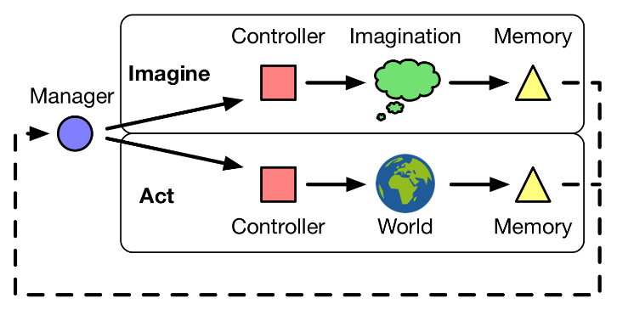
IBP (1) – Architecture
The whole IBP can be seen as a recurrent policy, that acts on an environment (world) and is able to plan using four components:
manager
controller
imaginator
memory

Slide 5
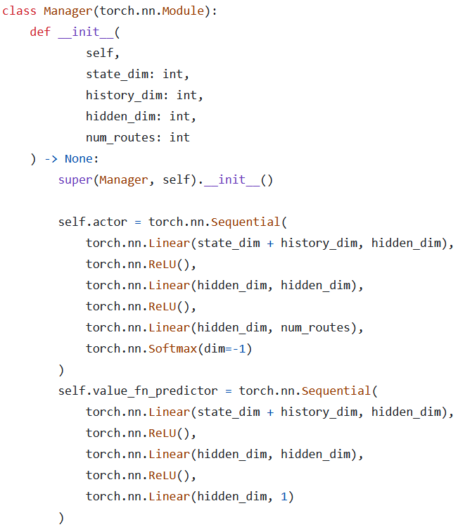

IBP (2) – Manager
The manager is a discrete policy $π_{M}:𝒮×ℋ→𝒰$ that maps a state $s∈𝒮$ and the history $h∈ℋ$ into a route $u∈𝒰=\left\{act,img1,img2\right\}$.
It is trained with the REINFORCE + baseline algorithm.

Slide 6
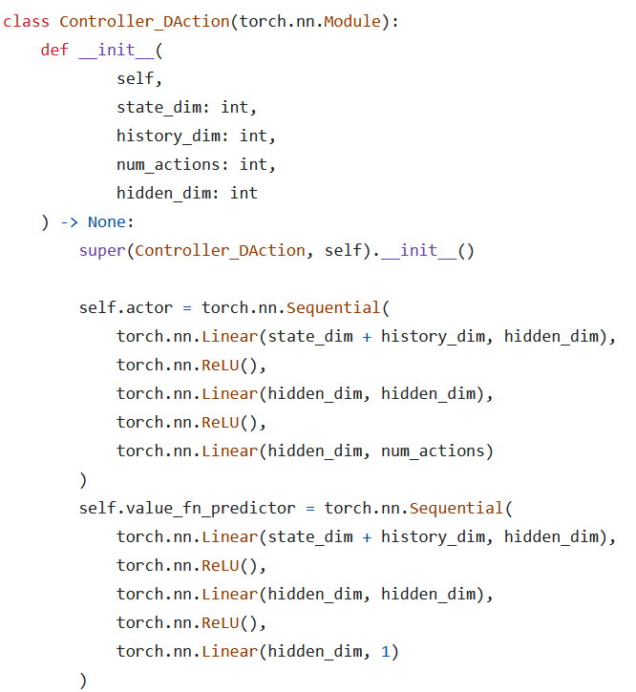

IBP (3) – Controller
The controller is a policy $π_{C}:𝒮×ℋ→𝒜$ that maps a state $s∈𝒮$ and the history $h∈ℋ$ into an action $a∈𝒜$.
It is trained with the REINFORCE + baseline algorithm.

Slide 7
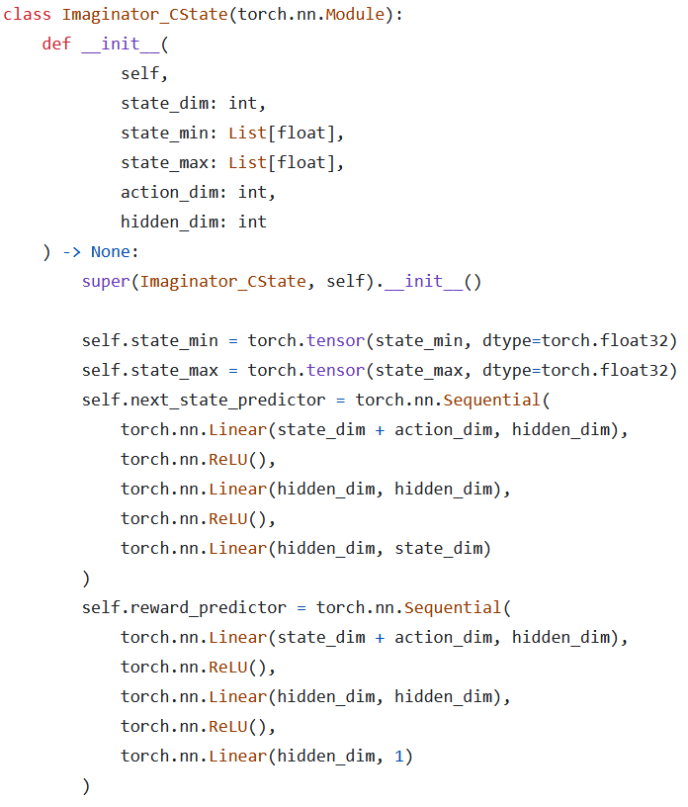
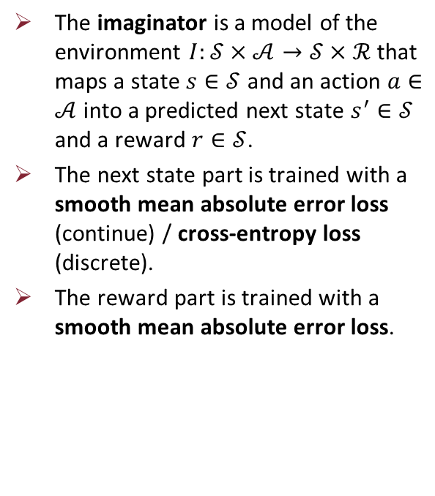
IBP (4) – Imaginator
The imaginator is a model of the environment $I:𝒮×𝒜→𝒮×ℛ$ that maps a state $s∈𝒮$ and an action $a∈𝒜$ into a predicted next state $s^{′}∈𝒮$ and a reward $r∈𝒮$.
The next state part is trained with a smooth mean absolute error loss (continue) / cross-entropy loss (discrete).
The reward part is trained with a smooth mean absolute error loss.

Slide 8
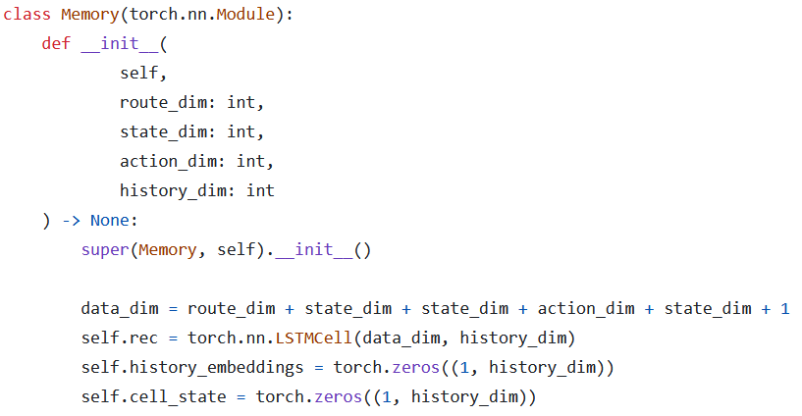

IBP (5) – Memory
The memory is a function $μ:𝒟×ℋ→ℋ$ that maps the data $d∈𝒟$ from an iteration and an old history $h∈ℋ$ into a newly aggregated history $h^{′}∈ℋ$.
It is trained jointly with the controller using backpropagation through time (BTT).

Slide 9
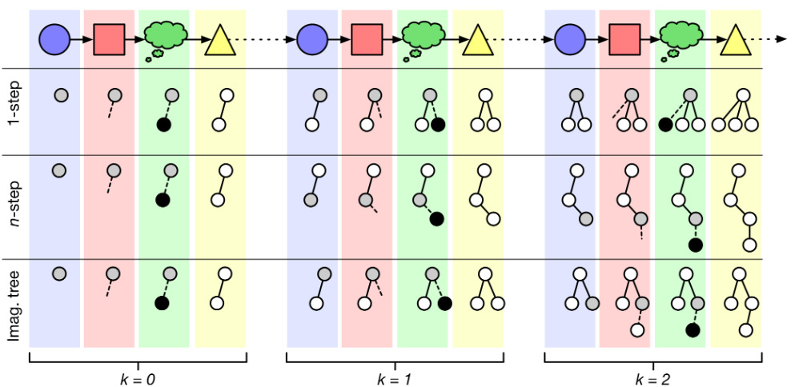
IBP (6) – Imagination strategies
IBP must have an imagination strategy to construct its plans.
The three easiest imagination strategies are:
1-step imagination
n-step imagination
imagination tree
Imagination strategy used: simpler version of the imagination tree.

Slide 10
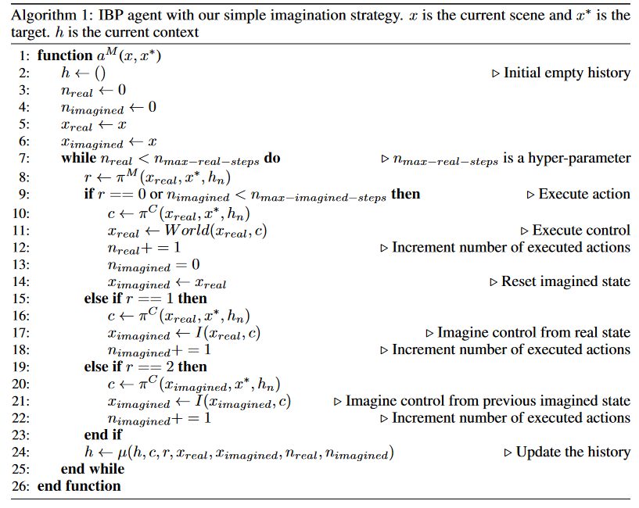
IBP (7) – Training algorithm
$$≥$$
$$≥$$

Slide 11
IBP (8) – Training algorithm: gradients
The paper doesn’t clearly specify how to build a backward computation graph for gradients computation.
The one in the code is an implementation based on our understanding of how things should be.

Slide 12
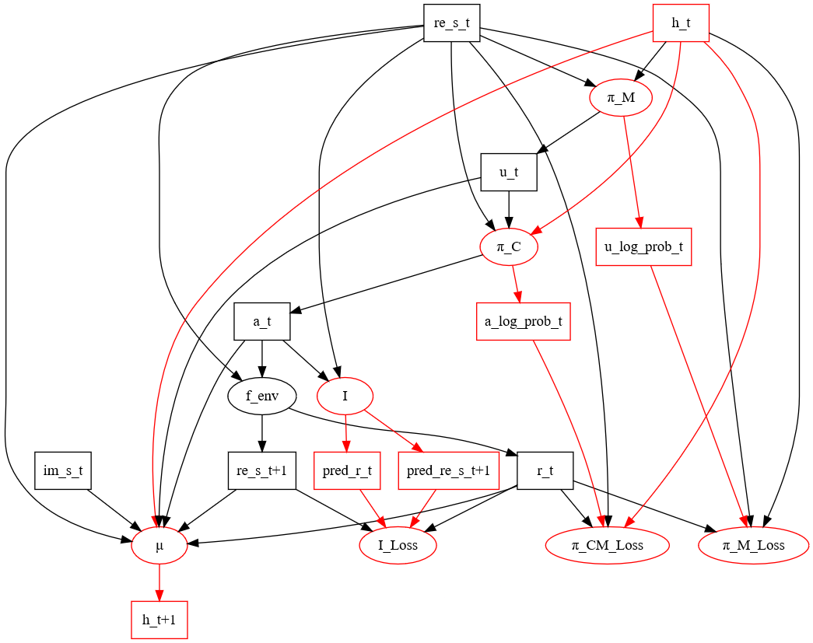
IBP (9) – Gradients for «Act»

Slide 13
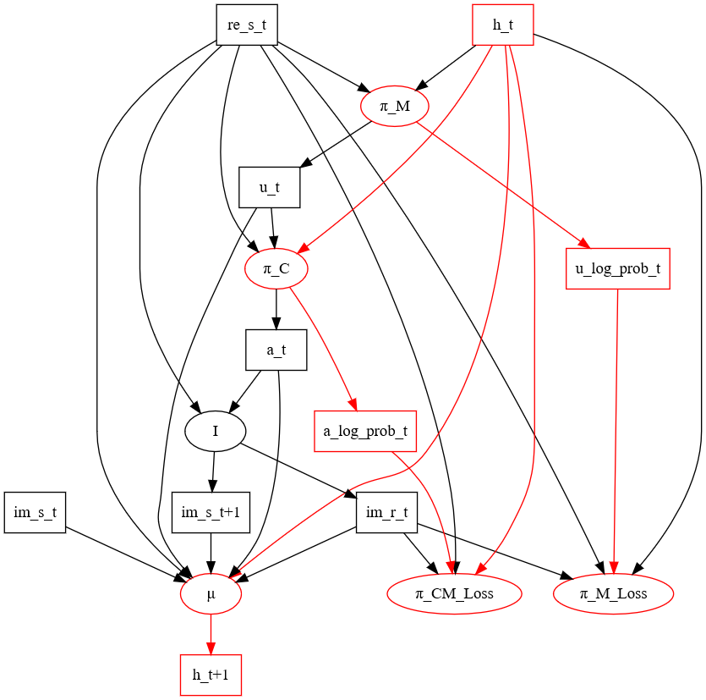
IBP (10) – Gradients for «Imag1»

Slide 14
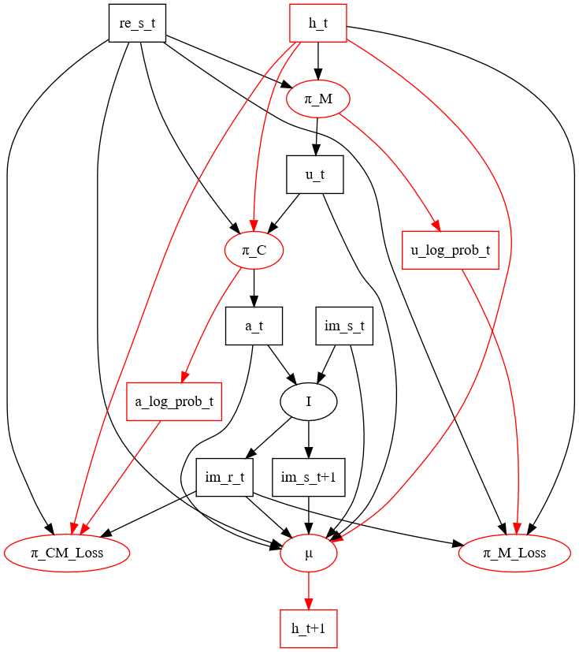
IBP (11) – Gradients for «Imag2»

Slide 15
Experimental settings and hyperparameters
Optimizers: 3 ADAM optimizer for manager, imaginator and controller + memory (trained jointly).
Learning rates: 0.001 for each optimizer to start then decrease when performances don’t improve.
Gamma factor: 0.99
Run: 1,000 episodes for each run.
Episode: variable number of steps. It stops if the environment terminates or truncates.
Imagination budgets: 0, 1 or 2. The models with 1 or 2 are pretrained on the model with 0.

Slide 16
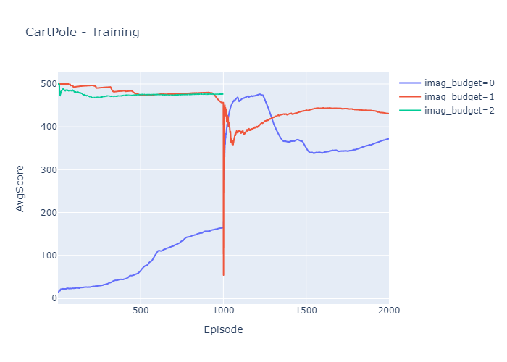
Experiment 1: CartPole (1) – Training

Slide 17
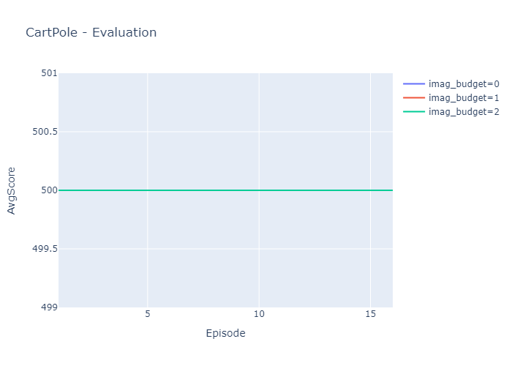
Experiment 1: CartPole (2) – Evaluation

Slide 18
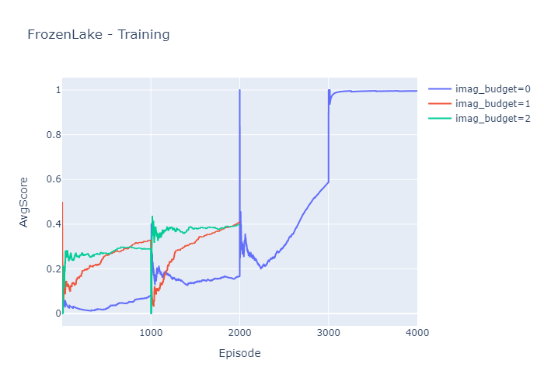
Experiment 2: FrozenLake (1) – Training

Slide 19

Experiment 2: FrozenLake (2) – Evaluation

Slide 20
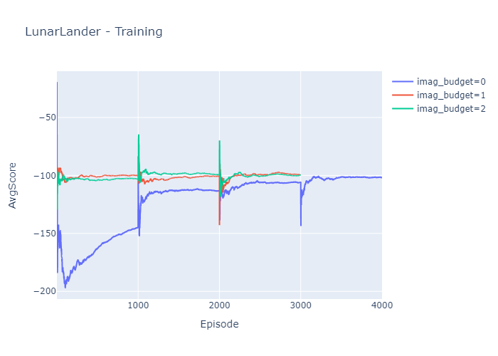
Experiment 3: LunarLander (1) – Training

Slide 21
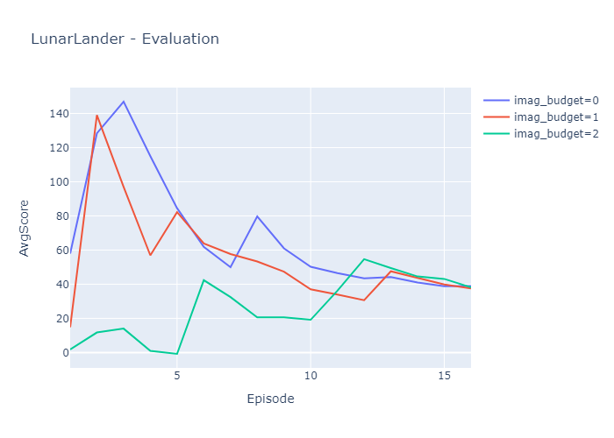
Experiment 2: LunarLander (2) – Evaluation

Slide 22
Final considerations
?

Slide 23
Thanks for your attention!

