Slide 1
Pricing Illiquidity in Strategic Asset Allocation: A Calibration Framework for Practitioners
Replacing subjective judgement with a simulation-based calibration methodology
Amundi Quant Solutions | V. Gisimundo, N. Zanetti, L. Meloncelli
OCTOBER 2026
• Document for professional investors only
Notes:
[Commercial + Technical]
Cover. Always shown.

Slide 2
Executive Summary
Replacing subjective judgement with a simulation-based calibration methodology
01
The challenge
Standard mean-variance optimization treats liquid and illiquid assets symmetrically, ignoring the return drag that locking up capital imposes. These costs grow non-linearly with portfolio illiquidity and are investor-specific, yet no systematic tool exists to quantify them.
02
Our contribution
A Monte Carlo simulation measures the return drag across illiquidity levels and fits a parametric penalty curve: subjective judgement is replaced by a transparent, replicable process grounded in portfolio dynamics.
03
The output
Investor-specific penalty curves calibrated on Amundi's Capital Market Assumptions for three institutional archetypes, feeding directly into a penalized mean-variance optimization.
Notes:
[Commercial]
The whole paper in one page: problem, contribution, output. Close on the bottom line (>150 bp net-return gap for the pension fund at ~12% volatility, Section 7.1).

Slide 3
Contents
Why illiquidity needs a price
The penalized optimization framework
Calibrating the penalty curve by simulation
Implications for portfolio construction
From research to practice
Notes:
[Commercial + Technical]
Agenda. Hide the chapters you do not need for a given audience.

Slide 4
Why illiquidity needs a price
01
The costs of locking up capital that mean-variance optimization does not see
Notes:
[Commercial + Technical]
Chapter divider.

Slide 5
Why Illiquidity Needs a Price
01 02 03 04 05 Why illiquidity needs a price
The hidden costs that mean-variance optimization ignores
01
02
Why it matters now
Private markets are now a central component of institutional portfolios: endowments hold the largest share of alternatives of any investor segment, and private pensions increased their allocations between 2020 and 2024 (Preqin, 2025).
These costs are not captured by the illiquidity premium, grow non-linearly with portfolio illiquidity, and depend on each investor's liabilities.
Rebalancing gap
Lock-up periods prevent the portfolio from returning to its target weights, creating a persistent return drag.
Forced sales at a discount
When liquid assets fall below the minimum buffer, illiquid positions must be sold on the secondary market at a haircut.
03
04
Payout pressure
Distributions must be met even when assets are locked, and payouts tend to spike precisely when markets fall.
Lost flexibility
Locked capital cannot be redeployed when new investment opportunities arise.
Notes:
[Commercial]
Frame the problem: MVO prices risk and return, but not the constraints of locked capital. The first three costs are exactly what the simulation measures.

Slide 6
Existing Approaches and Their Limits
01 02 03 04 05 Why illiquidity needs a price
Why the Hayes, Primbs & Chiquoine (2015) framework is the right starting point
Multi-period stochastic programming
Mulvey, Pauling & Madey (2003)
Mean-variance-liquidity frontier
Lo, Petrov & Wierzbicki (2003)
Shadow assets & liabilities
Kinlaw, Kritzman & Turkington (2013)
Penalty cost approach
Hayes, Primbs & Chiquoine (2015)
Strength
Detailed cash-flow modelling of illiquid assets and liabilities
Strength
Tractable extension of the MVO objective
Strength
Captures rebalancing, market timing and capital calls
Strength
Convex, portfolio-level and investor-specific; return-based language
Limitation
Computationally heavy and opaque for investment committees
Limitation
Marginal cost of illiquidity treated as constant
Limitation
Constant marginal cost, not investor-specific
Limitation
Penalty curve left to subjective judgement: the gap this paper fills
Notes:
[Technical]
Literature positioning (Sections 1.2-1.3).

Slide 7
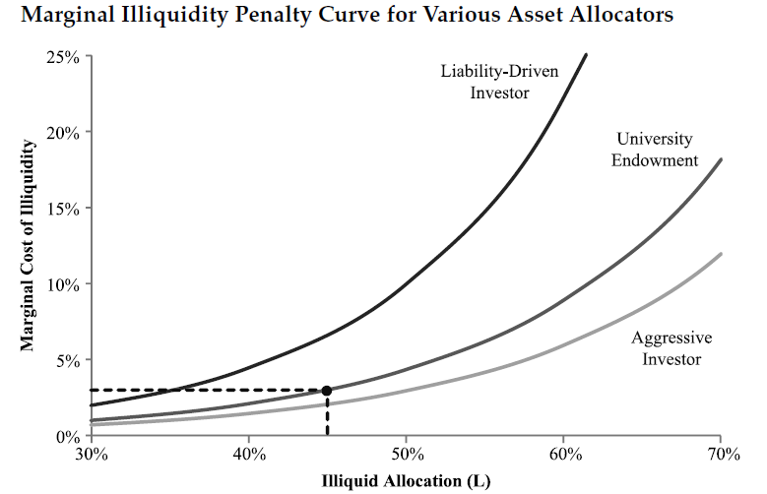
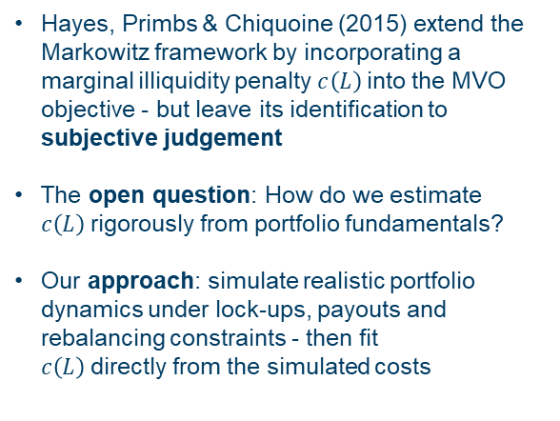
The Penalty Cost Approach
01 02 03 04 05 Why illiquidity needs a price
Hayes, Primbs & Chiquoine (2015): a marginal penalty curve inside the MVO
01
The framework
The MVO objective is reduced by an accumulated illiquidity penalty T(L), the area under a marginal penalty curve c(L) that rises with the portfolio's illiquidity level.
Marginal illiquidity penalty curves for different investor types
02
The open question
The original paper leaves the identification of c(L) to subjective judgement: how can it be estimated from portfolio fundamentals?
03
Our approach
Simulate realistic portfolio dynamics under lock-ups, payouts and rebalancing constraints, then fit c(L) directly from the simulated costs.
Source: Hayes, Primbs & Chiquoine (2015). At L = 45% the endowment's marginal penalty is about 3%.
Notes:
[Commercial + Technical]
Positioning: HPC (2015) gives the framework, we provide the calibration.

Slide 8
The penalized optimization framework
02
Extending Markowitz with a portfolio-level illiquidity penalty
Notes:
[Commercial + Technical]
Chapter divider.

Slide 9
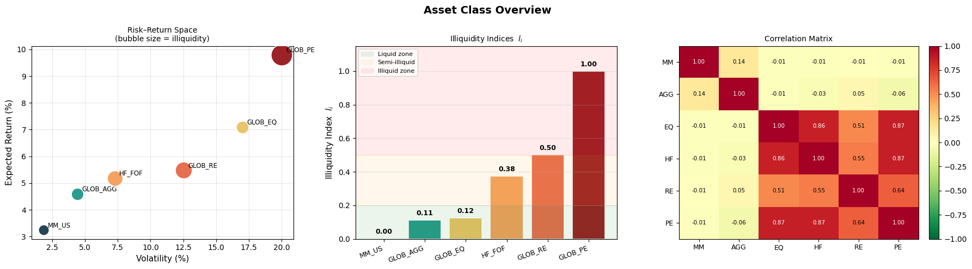
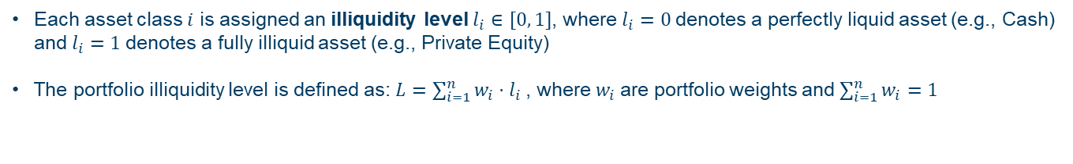
Asset Classes & Illiquidity Levels
01 02 03 04 05 The penalized optimization framework
Six asset classes spanning the full liquidity spectrum
Risk-return space · Illiquidity indices lᵢ · Correlation matrix
01
Illiquidity index lᵢ ∈ [0, 1]
Raw liquidity scores normalised to the unit interval: 0 for money market, 1 for private equity.
02
Portfolio illiquidity level L = Σ wᵢ · lᵢ
A continuous, portfolio-level measure: the share of the portfolio that is illiquid.
Key takeaway GLOB_EQ, HF_FOF and GLOB_PE are near-perfect substitutes (ρ ≈ 0.86–0.87): without a penalty, private equity (9.80%) captures the equity allocation.
Notes:
[Technical]

Slide 10
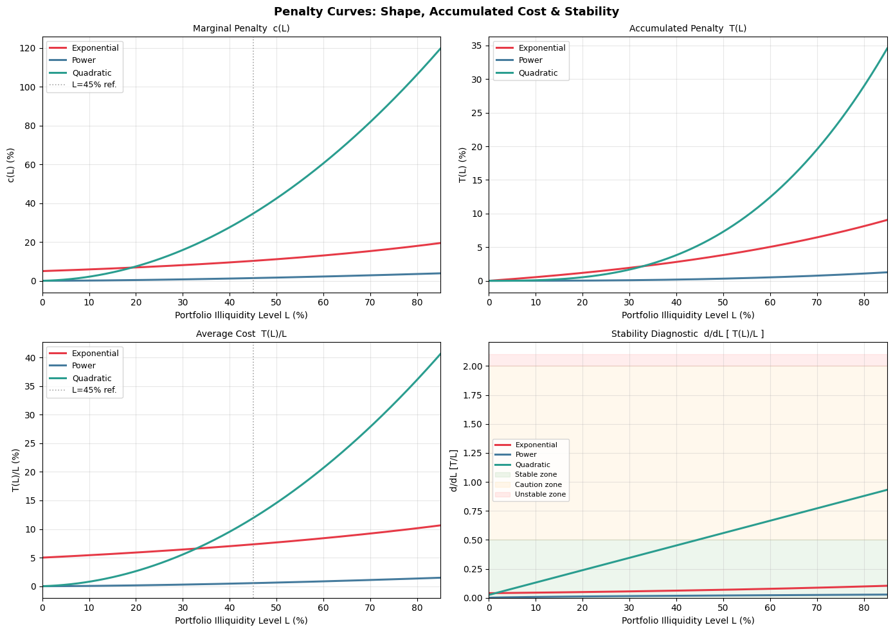
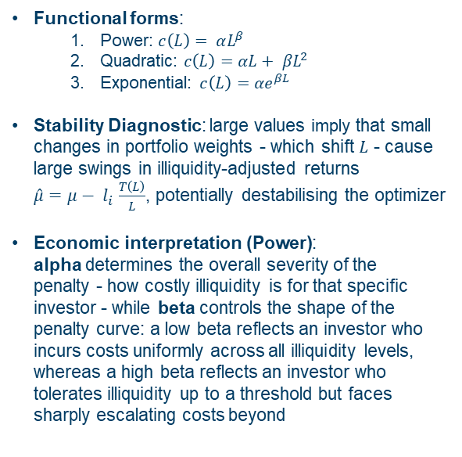
The Marginal Penalty Function
01 02 03 04 05 The penalized optimization framework
Three functional forms compared with identical parameters (α = 0.05, β = 1.6)
01
Three candidate forms
Power c(L) = α·L^β; quadratic c(L) = α·L + β·L²; exponential c(L) = α·e^(βL).
Marginal penalty, accumulated penalty, average cost and stability diagnostic
02
Desirable properties
Zero cost for a fully liquid portfolio, increasing and convex in L. The exponential fails c(0) = 0.
03
Reading the power form
α sets the level of the penalty (secondary-market costs); β its curvature (the liability side).
Notes:
[Technical]

Slide 11
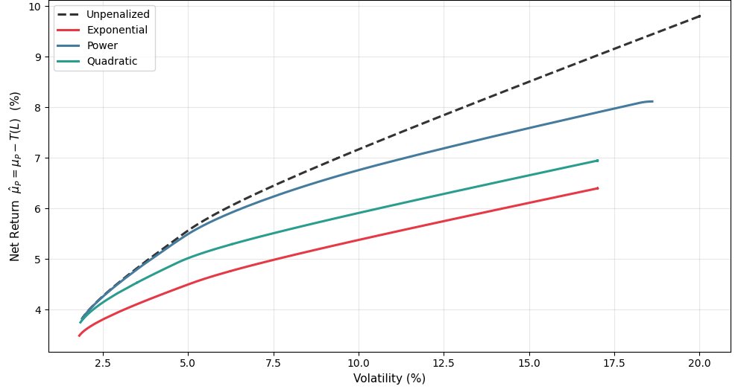
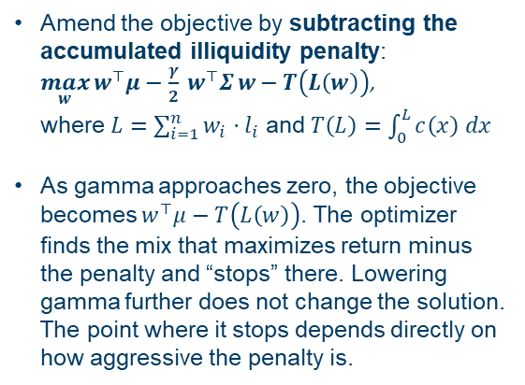
Portfolio Optimization with Illiquidity
01 02 03 04 05 The penalized optimization framework
Net efficient frontiers under the three penalties (α = 0.05, β = 1.6)
max w′μ − (γ/2)·w′Σw − T(L(w))
Net return μ − T(L) along the efficient frontier
L(w) = Σ wᵢ lᵢ , T(L) = ∫₀ᴸ c(x) dx
01
A third trade-off
Return, variance and illiquidity cost: the penalty discourages illiquid concentration without hard constraints.
02
The γ → 0 limit
The optimizer maximises return net of the penalty and stops there: the more aggressive the penalty, the earlier it stops.
Notes:
[Technical]

Slide 12
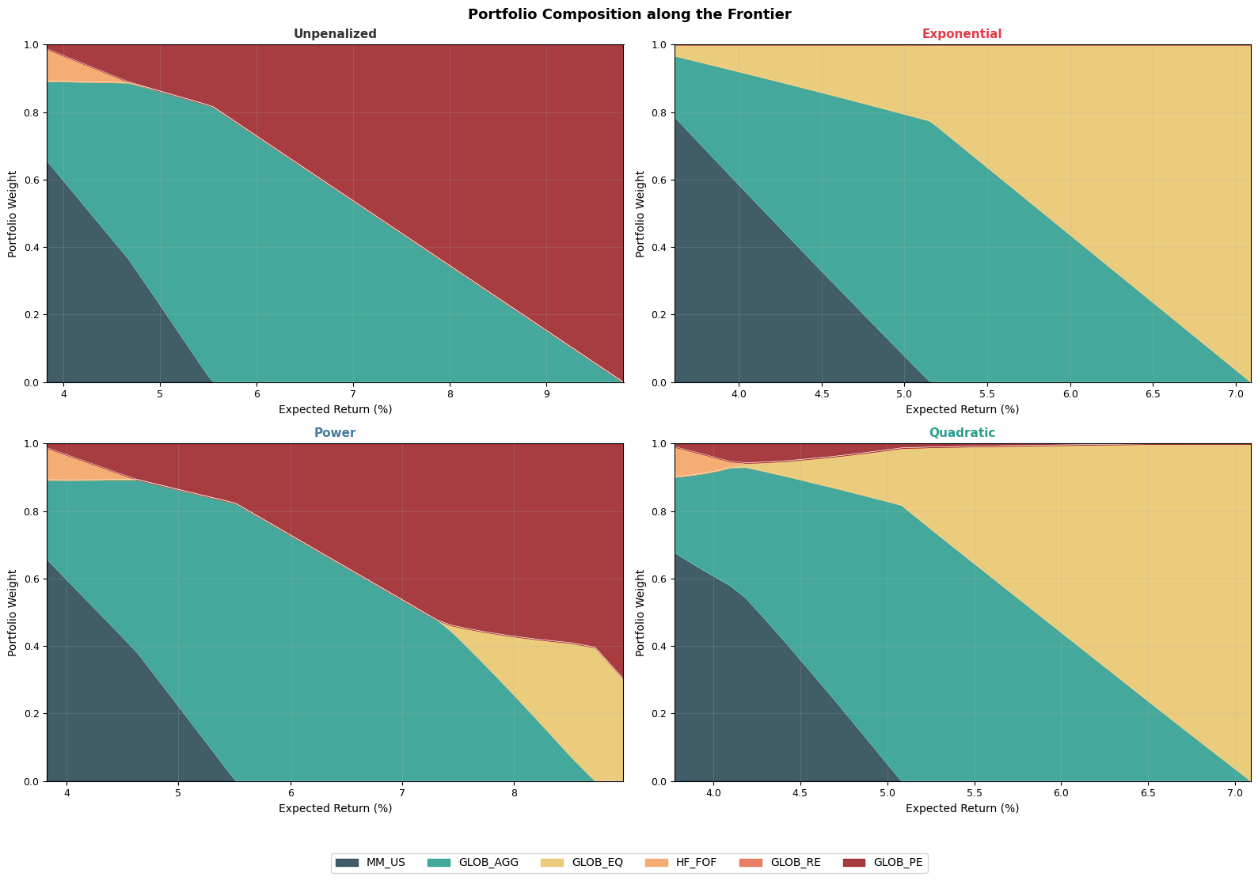
Efficient Frontiers & Portfolio Composition
01 02 03 04 05 The penalized optimization framework
Portfolio composition along the frontier (α = 0.05, β = 1.6)
Unpenalized · Exponential · Power · Quadratic
01
The penalty reshapes the allocation
PE is reduced and the return range compressed; GLOB_EQ becomes the liquid substitute (ρ = 0.87 with PE).
02
Only the power form is stable
The exponential collapses the frontier to a narrow range; the quadratic shows erratic composition spikes.
Notes:
[Technical]

Slide 13
Illiquidity-Adjusted Expected Returns
01 02 03 04 05 The penalized optimization framework
Speaking the language of investment committees
μ̂ᵢ = μᵢ − [ T(L) / L ] · lᵢ
Who bears the penalty: each asset pays lᵢ × T(L)/L
Asset class | Expected return μᵢ | Illiquidity index lᵢ | Share of T(L)/L borne
MM_US | 3.24% | 0.00 | none
GLOB_AGG | 4.59% | 0.11 | 11%
GLOB_EQ | 7.09% | 0.13 | 13%
HF_FOF | 5.18% | 0.38 | 38%
GLOB_RE | 5.48% | 0.50 | 50%
GLOB_PE | 9.80% | 1.00 | 100%
T(L) / L : average accumulated penalty per unit of portfolio illiquidity
01
A return hurdle
Each asset's expected return is reduced in proportion to its illiquidity index.
02
Same MVO, adjusted inputs
The penalized problem is a standard MVO on adjusted returns: no new risk concept to explain.
Source: Amundi Investment Institute, CMA 2026 (Table 1 of the thesis).
Notes:
[Commercial]
Equations (6)-(8) of the thesis. A liquid asset is untouched; private equity bears the full average penalty.

Slide 14
Calibrating the penalty curve by simulation
03
From subjective judgement to a curve grounded in portfolio dynamics
Notes:
[Commercial + Technical]
Chapter divider.

Slide 15
How the Calibration Works
01 02 03 04 05 Calibrating the penalty curve by simulation
A constrained real portfolio versus a frictionless liquid benchmark
Two portfolios, same world
Three sources of return drag
One calibrated curve
Real portfolio
Asset-specific lock-ups: tranches cannot be sold before expiry, or only at a secondary-market haircut.
01
Rebalancing gap
Lock-ups stop the portfolio from returning to target.
Calibrated penalty curve
The average drag, measured at L = 10%…70%, is fitted with a power function:
T(L) = A · L^B
c(L) = α · L^β
Ready to plug into the penalized mean-variance optimization.
02
Buffer restoration haircuts
Illiquid assets sold at a discount to restore the minimum buffer.
Liquid benchmark
Frictionless: rebalances freely to target weights every year and meets payouts at fair value.
03
Payout haircuts
Locked positions liquidated to pay distributions, often in downturns.
1,000 scenarios × 20 years per illiquidity level, parametrised on Amundi's Capital Market Assumptions.
Notes:
[Commercial]
Section 6 without equations. Two portfolios see the same world; the only difference is the lock-up.

Slide 16
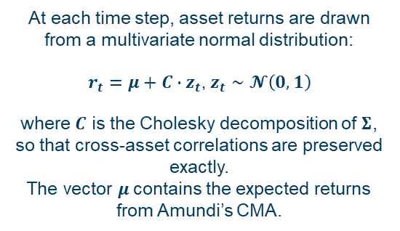
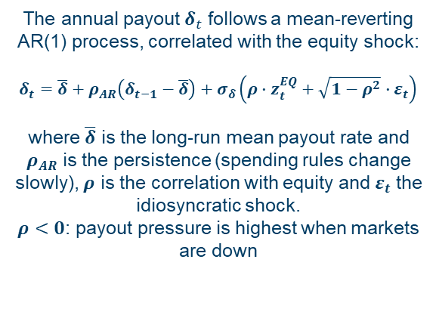
Simulation Design: Stochastic Dynamics
01 02 03 04 05 Calibrating the penalty curve by simulation
Correlated asset returns and a countercyclical payout process
For each target illiquidity level L we run N = 1,000 Monte Carlo scenarios over a 20-year horizon and measure the average annual return foregone by operating under lock-up constraints, relative to an unconstrained benchmark.
01
Asset returns
Multivariate normal on Amundi's CMA
02
Annual payout
Mean-reverting AR(1), correlated with equity
r_{t} = μ + C · z_{t} , z_{t} ~ N(0, I)
δ_{t} = δ_{LR} + ρ_{AR}(δ_{t−1} − δ_{LR}) + σ_{δ}(ρ·z_{t}^{EQ} + √(1−ρ²)·ε_{t})
C is the Cholesky factor of Σ: cross-asset correlations are preserved exactly.
μ contains the expected returns from Amundi's Capital Market Assumptions.
Benchmark and real portfolio share the same draw: any return gap is due to illiquidity alone.
δ_{LR} is the long-run mean payout rate, ρ_{AR} its persistence: spending rules adjust slowly.
ρ is the correlation with the equity shock; ε is an idiosyncratic shock.
ρ < 0: payout pressure is highest precisely when markets fall.
Notes:
[Technical]

Slide 17
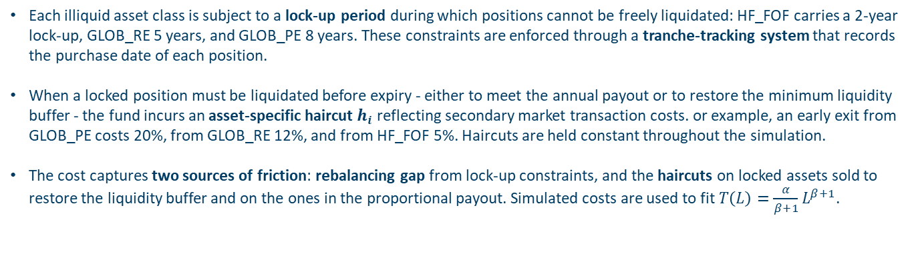
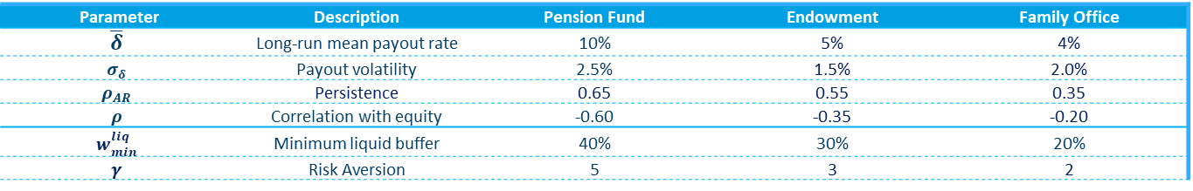
Simulation Design: Lock-ups, Haircuts & Costs
01 02 03 04 05 Calibrating the penalty curve by simulation
Tranche tracking and secondary-market frictions
01
02
03
Lock-up periods
HF_FOF is locked for 2 years, GLOB_RE for 5 and GLOB_PE for 8. A tranche-tracking system records the purchase date of each position.
Haircuts on early exit
A locked position sold before expiry, to pay the payout or restore the minimum buffer, incurs an asset-specific haircut hᵢ, held constant over the simulation.
Three sources of friction
The rebalancing gap from lock-ups, plus the haircuts paid on buffer restoration and on the proportional payout. The resulting costs are used to fit T(L).
Asset class | Illiquidity index lᵢ | Lock-up (years) | Haircut hᵢ | Calibration rationale
MM_US | 0.00 | 0 | 0.05% | Institutional transaction costs
GLOB_AGG | 0.11 | 0 | 0.10% | Institutional transaction costs
GLOB_EQ | 0.13 | 0 | 0.50% | Institutional transaction costs
HF_FOF | 0.38 | 2 | 5.0% | Redemption gates and notice periods
GLOB_RE | 0.50 | 5 | 12.0% | RE fund secondaries, lower end of range
GLOB_PE | 1.00 | 8 | 20.0% | Avg. discount 13.8%, higher in stress (Nadauld et al.)
Source: Table 3 of the thesis.
Notes:
[Technical]

Slide 18
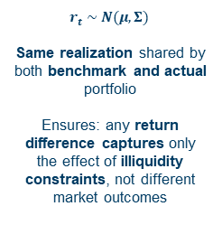
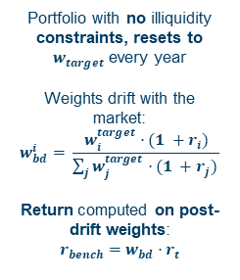
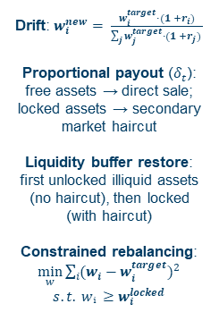
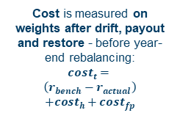
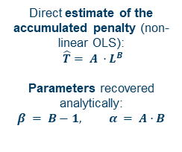
The Annual Simulation Cycle
01 02 03 04 05 Calibrating the penalty curve by simulation
Five steps from market returns to the fitted penalty
A Market returns
B Benchmark
C Real portfolio
D Annual cost
E Fitting
r_{t} ~ N(μ, Σ)
r_{bench} = w_{bd} · r_{t}
drift → payout → buffer
→ rebalance
cost_{t} = (r_{bench} − r_{real})
+ cost_{h} + cost_{fp}
T̂(L) = A · L^{B}
Same realization shared by the benchmark and the real portfolio.
Any return difference captures only the illiquidity constraints, not different market outcomes.
No illiquidity constraints: resets to w^{target} every year.
Weights drift with the market: w_{bd,i} = w_{i}^{target}(1+r_{i}) / Σ_{j} w_{j}^{target}(1+r_{j}).
Return computed on the post-drift weights.
Payout δ_{t}: free assets sold directly, locked assets at a secondary-market haircut.
Buffer restore: unlocked illiquid assets first (no haircut), then locked ones (with haircut).
Rebalancing: min Σ(w_{i} − w_{i}^{target})² s.t. w_{i} ≥ w_{i}^{locked}.
Measured on weights after drift, payout and restore, before year-end rebalancing.
cost_{h}: haircuts to restore the buffer; cost_{fp}: haircuts on payout sales.
Average annual cost at each illiquidity level L, across years and scenarios.
Non-linear OLS fit of the accumulated penalty.
Recovered analytically: β = B − 1, α = A · B.
Once the loop is complete: one point per L, one curve per archetype
Next year t + 1 · loop over T = 20 years × N = 1,000 scenarios, at every L
Notes:
[Technical]
[Technical]
Section 6.5 of the thesis. Steps A-D form the annual loop; step E runs once on the averaged costs.

Slide 19
Three Institutional Archetypes
01 02 03 04 05 Calibrating the penalty curve by simulation
Different liability structures, different liquidity needs
01
02
03
Pension Fund
University Endowment
Family Office
Most constrained
Intermediate
Least constrained
Mandatory distributions, early withdrawals in market stress, regulatory liquidity reserve.
Stable spending rule that smooths payouts; regular donations; long-duration liabilities.
No contractual obligations; discretionary, idiosyncratic beneficiary needs.
Mean payout rate
10%
Mean payout rate
5%
Mean payout rate
4%
Payout volatility
2.5%
Payout volatility
1.5%
Payout volatility
2.0%
Payout persistence
0.65
Payout persistence
0.55
Payout persistence
0.35
Correlation with equity
−0.60
Correlation with equity
−0.35
Correlation with equity
−0.20
Minimum liquid buffer
40%
Minimum liquid buffer
30%
Minimum liquid buffer
20%
Risk aversion γ
5
Risk aversion γ
3
Risk aversion γ
2
Payout: AR(1) process correlated with equity shocks. Sources: COVIP (2022), NACUBO-TIAA (2023), Ang, Papanikolaou & Westerfield (2014).
Notes:
[Commercial + Technical]
Tables 4 and 5 of the thesis. Negative correlation: payouts rise when equity falls.

Slide 20
Calibration Results
01 02 03 04 05 Calibrating the penalty curve by simulation
The simulation assigns a more convex cost profile than judgement alone
Fitted T(L) = A·L^B and recovered marginal curve c(L) = α·L^β (α = A·B, β = B − 1)
Archetype | A | B | α | β | R² | Subjective α | Subjective β
Pension Fund | 0.0359 | 3.6388 | 0.1305 | 2.6388 | 0.996 | 0.25 | 1.2
Endowment | 0.0288 | 5.1577 | 0.1484 | 4.1577 | 0.987 | 0.12 | 2.0
Family Office | 0.0055 | 2.7313 | 0.0150 | 1.7313 | 0.997 | 0.06 | 2.8
Pension Fund: β 2.64 vs 1.2
Highest cost at any illiquidity level, but concentrated at the high end: forced selling and payout shocks compound once illiquidity is large.
Endowment: β 4.16 vs 2.0
The most convex profile: costs are negligible below a threshold and then accelerate sharply.
Family Office: α 0.015 vs 0.06
Mild, gradually accumulating cost, consistent with the absence of binding payout obligations.
Notes:
[Commercial + Technical]
Table 6 (simulated) and Section 5.3 (subjective). R² between 0.987 and 0.997. Message: judgement overstates the cost of moderate illiquidity; the data concentrate it where forced selling becomes frequent.

Slide 21
Implications for portfolio construction
04
What changes in efficient frontiers and allocations
Notes:
[Commercial + Technical]
Chapter divider.

Slide 22
Key Results
01 02 03 04 05 Implications for portfolio construction
What pricing illiquidity changes in practice
>150 bp
≈ 8.5%
1.7 – 4.2
R² ≥ 0.987
Net-return advantage of the penalized portfolio for the pension fund at around 12% volatility
Maximum gross return of the penalized pension fund frontier: PE stops being added where its cost exceeds its benefit
Range of the calibrated curvature β across archetypes: the cost of illiquidity is investor-specific
Fit quality of the power penalty function across all three archetypes
Net-return dominance on a gross basis the penalized frontier sits below the unpenalized one; net of the accumulated penalty it dominates in all archetypes. Targeting a high gross return by concentrating in illiquid assets leads to a lower net return than pricing illiquidity, at the same level of risk.
Notes:
[Commercial]
Sections 6.8 and 7.1-7.2. For the family office the two frontiers are almost identical.

Slide 23
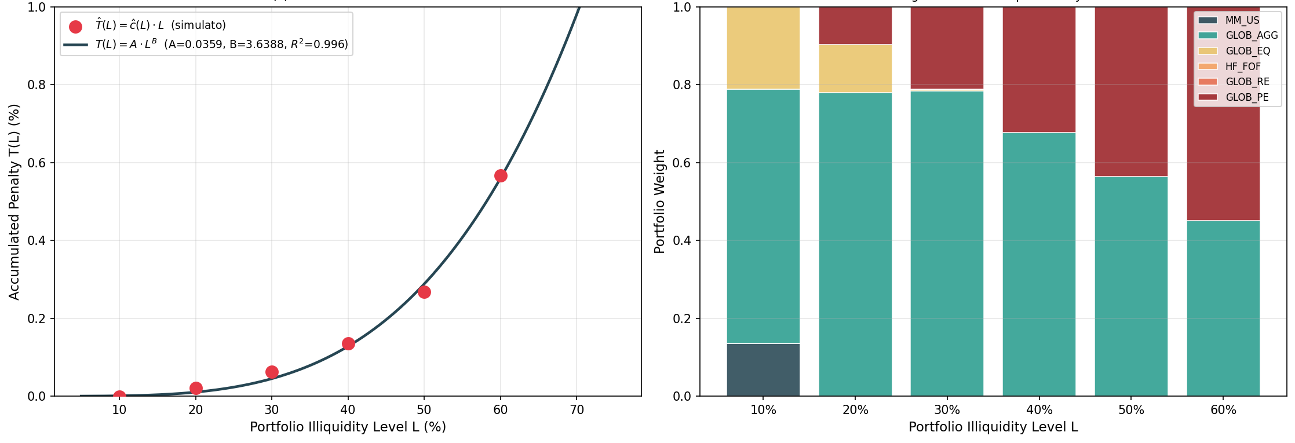
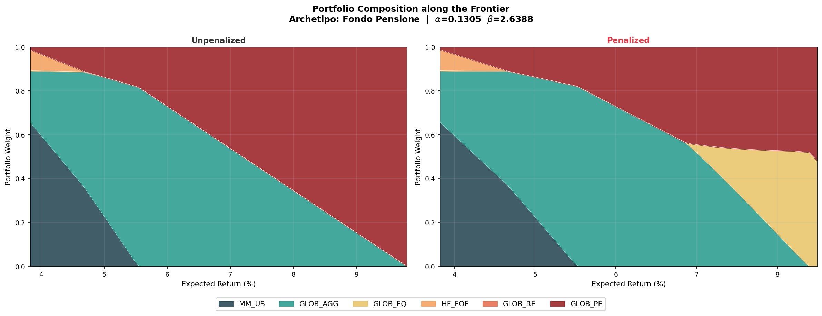
Pension Fund: Calibrated Curve and Allocation
01 02 03 04 05 Implications for portfolio construction
The most liquidity-constrained archetype
α = 0.13
Simulated cost and fitted curve · Target portfolios by illiquidity level
Level of the marginal penalty
β = 2.64
Curvature of the marginal penalty
R² = 0.996
Fit quality
Portfolio composition along the frontier: unpenalized vs penalized
Highest cost at any illiquidity level.
PE is reduced, with GLOB_EQ absorbing part of the equity exposure at high return levels.
Maximum attainable return capped at about 8.5%.
Notes:
[Technical]
Figure 8 and Figure 14 of the thesis.

Slide 24
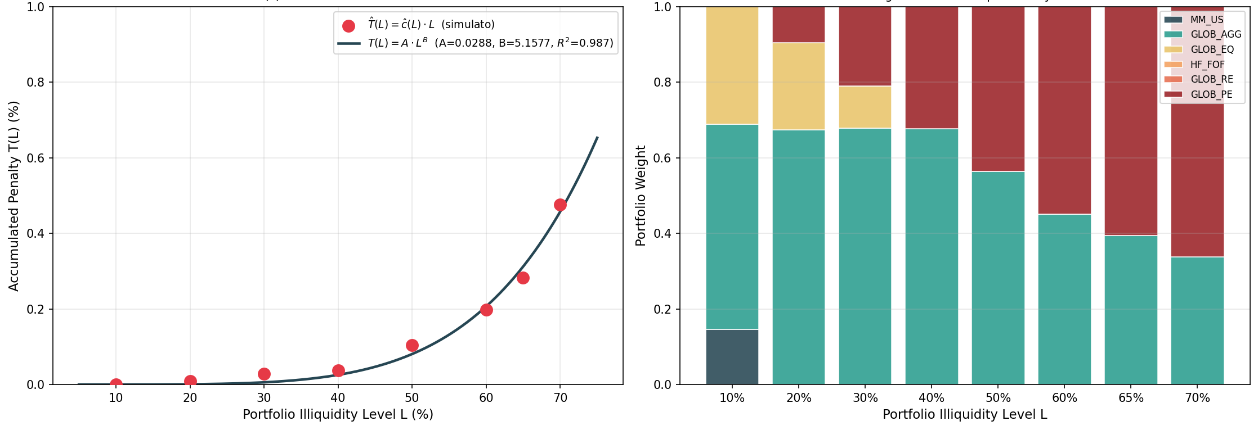
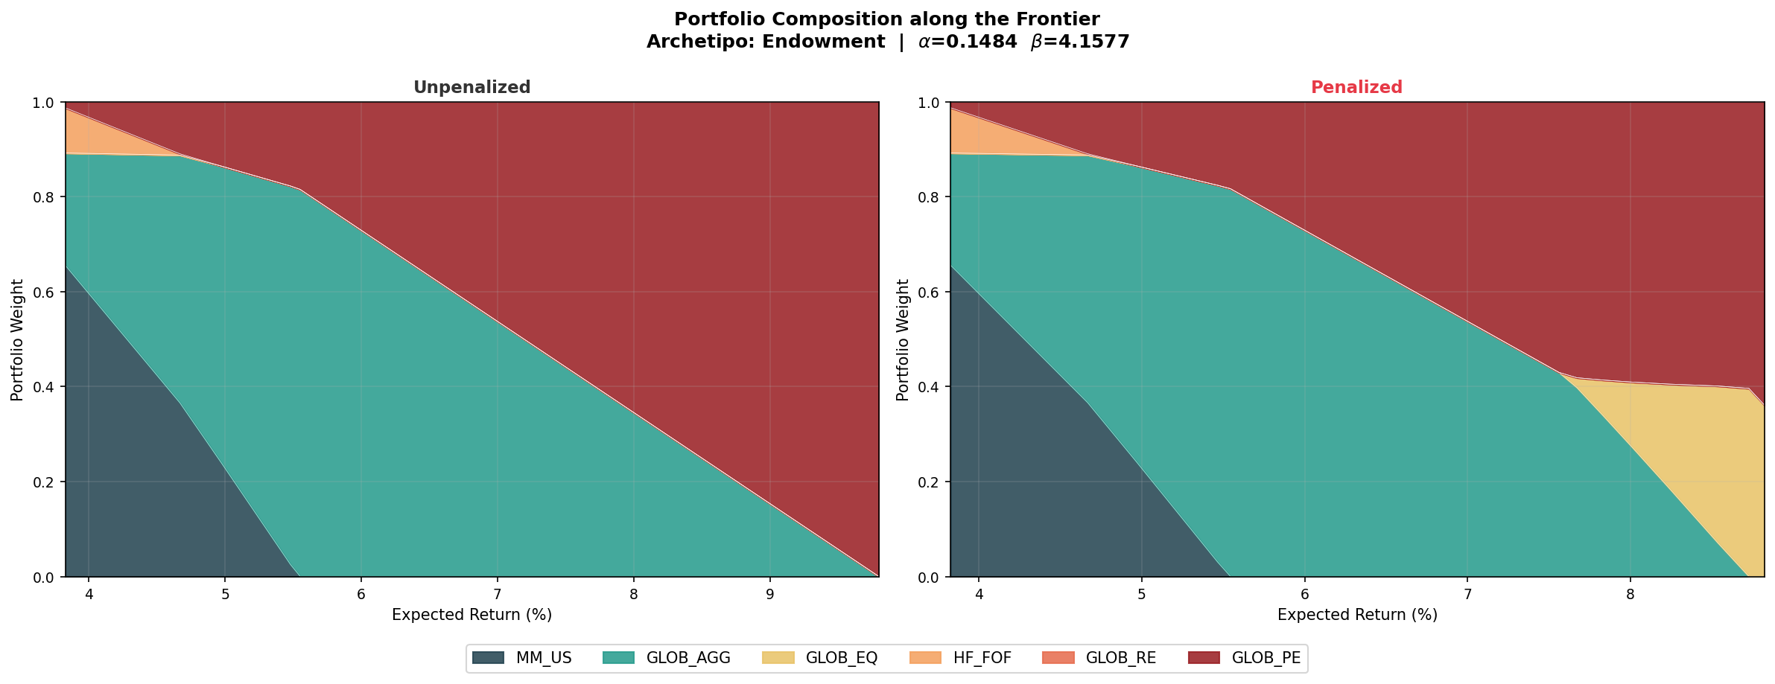
Endowment: Calibrated Curve and Allocation
01 02 03 04 05 Implications for portfolio construction
Intermediate profile with the most convex cost curve
α = 0.15
Simulated cost and fitted curve · Target portfolios by illiquidity level
Level of the marginal penalty
β = 4.16
Curvature of the marginal penalty
R² = 0.987
Fit quality
Portfolio composition along the frontier: unpenalized vs penalized
Costs negligible at low illiquidity, then accelerating sharply above a threshold.
Below the threshold, penalized and unpenalized allocations are nearly identical.
Above it, GLOB_EQ appears abruptly and displaces GLOB_PE.
Notes:
[Technical]
Figure 9 and Figure 15 of the thesis.

Slide 25
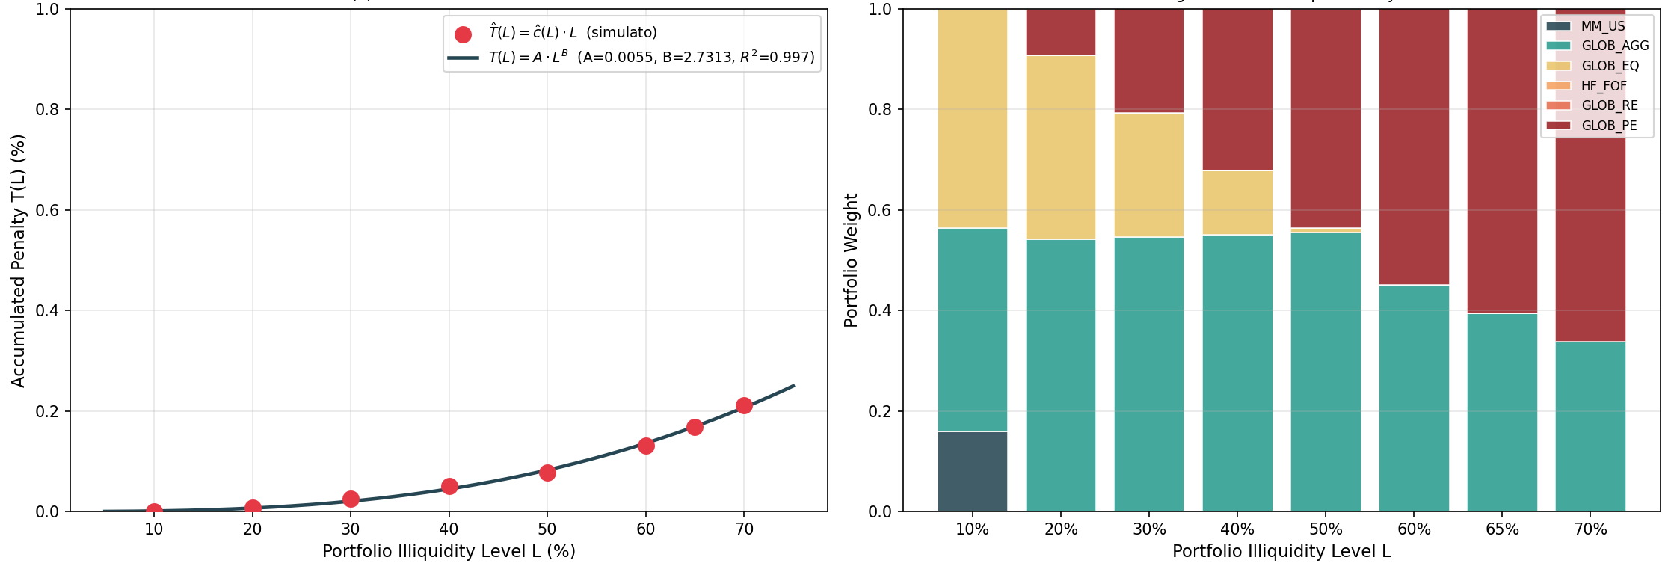
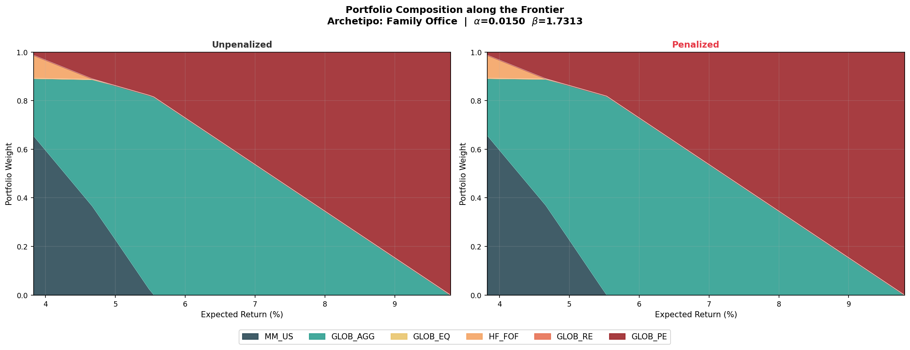
Family Office: Calibrated Curve and Allocation
01 02 03 04 05 Implications for portfolio construction
The least constrained archetype
α = 0.015
Simulated cost and fitted curve · Target portfolios by illiquidity level
Level of the marginal penalty
β = 1.73
Curvature of the marginal penalty
R² = 0.997
Fit quality
Portfolio composition along the frontier: unpenalized vs penalized
Mildest and most gradually accumulating penalty.
GLOB_PE dominates at high return levels in both cases.
For this investor the unpenalized MVO is a close approximation.
Notes:
[Technical]
Figure 10 and Figure 16 of the thesis.

Slide 26
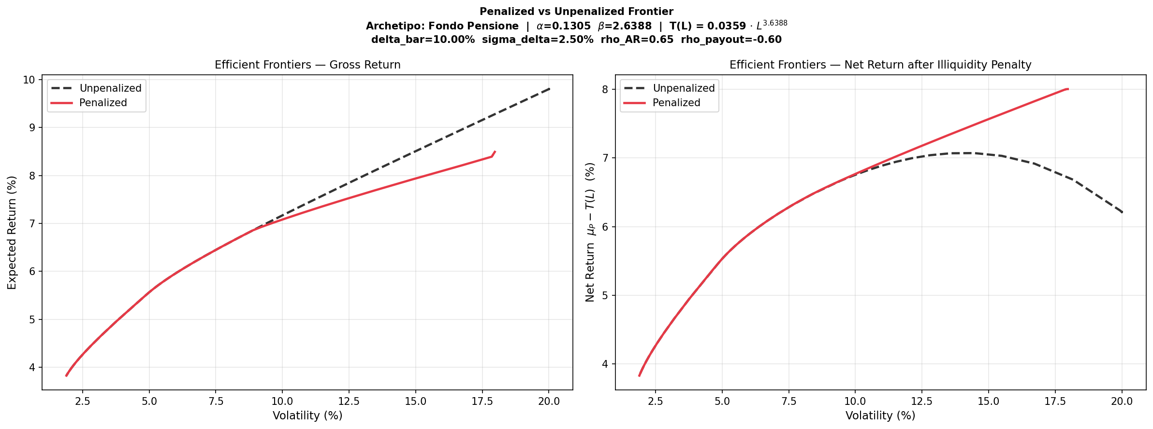
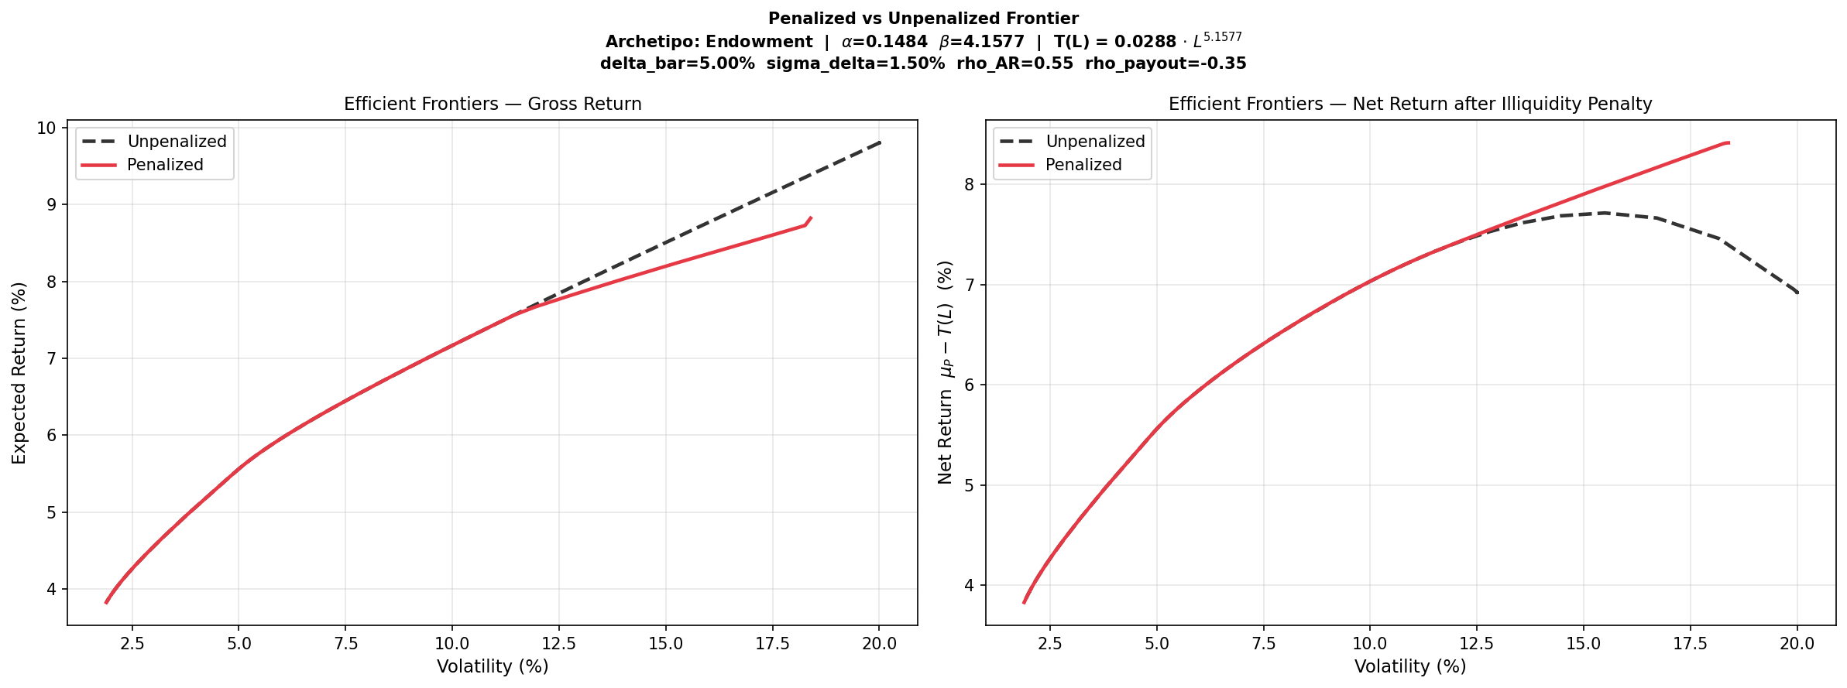
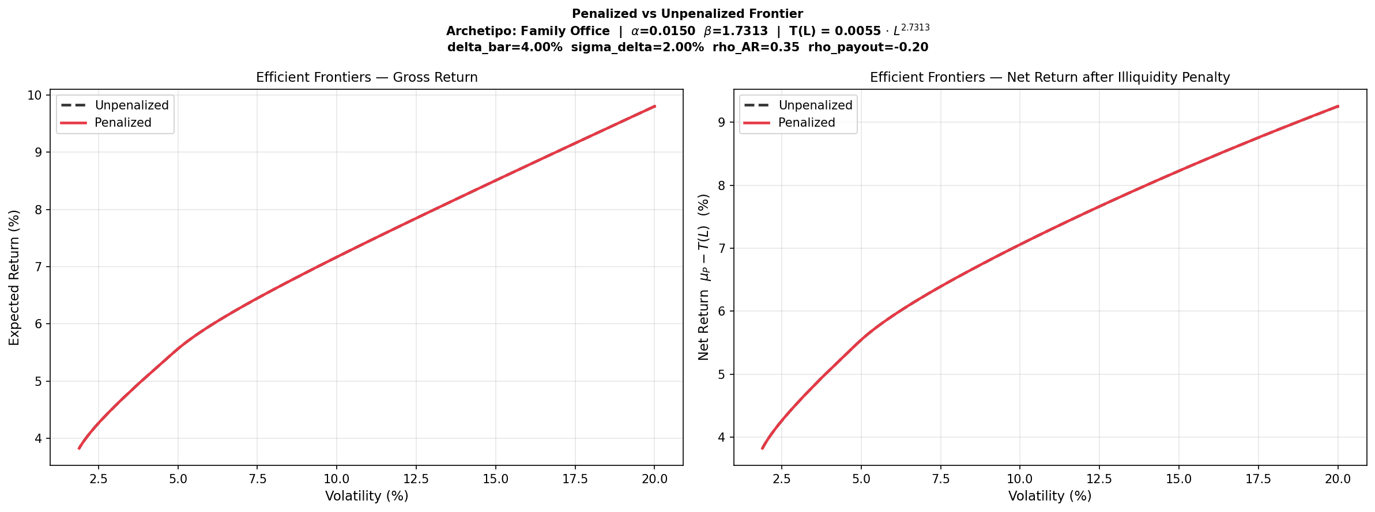

Gross vs Net Frontiers Across Archetypes
01 02 03 04 05 Implications for portfolio construction
Penalized (red) versus unpenalized (dashed) efficient frontier with the calibrated curves
Pension Fund α = 0.13, β = 2.64
Endowment α = 0.15, β = 4.16
Family Office α = 0.015, β = 1.73
Gross
expected return
Net
return μ − T(L)
Key takeaway net of the penalty the penalized frontier dominates: >150 bp for the pension fund, a high-volatility gap for the endowment, virtually none for the family office.
Notes:
[Commercial + Technical]
Figures 11-13 of the thesis (Section 7.1). Read the bottom row: the unpenalized net return turns hump-shaped for the pension fund and the endowment, while the family office frontiers coincide.

Slide 27
From research to practice
05
Using the framework in Amundi's SAA work, and extending it
Notes:
[Commercial + Technical]
Chapter divider.

Slide 28
Putting the Framework to Work at Amundi
01 02 03 04 05 From research to practice
From a research framework to a tool for institutional SAA mandates
01
Built on Amundi's own assumptions
Parametrised entirely on Amundi's CMAs: consistent with our forward-looking views and directly usable in client-facing SAA mandates.
02
Investor-specific
Different penalty curves across archetypes, reflecting payout dynamics and liability structure: one tool for the whole institutional client base.
03
Replicable and updatable
Transparent and auditable calibration, refreshable at every CMA update and ready for integration into the SAA pipeline.
04
A language committees understand
Illiquidity costs expressed as return premiums: accessible to non-quantitative stakeholders without losing analytical rigour.
Notes:
[Commercial]
From the ARA editorial committee note.

Slide 29
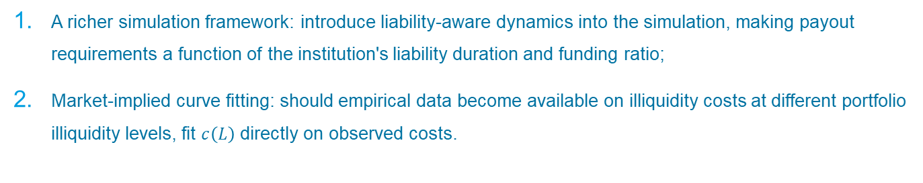
What’s next?
01 02 03 04 05 From research to practice
Towards a More Realistic and Investor-Specific Calibration Framework
01
02
03
Richer return dynamics
Replace the multivariate normal with regime-switching or stochastic-volatility models, to capture fat tails and the stress scenarios where forced selling is most costly.
Liability-aware calibration
Model the asset-liability structure explicitly: payouts driven by liability duration and funding ratio, so the curve depends on the investor's balance sheet.
Market-implied curve fitting
As data on illiquidity costs become available, estimate c(L) directly from observed costs and secondary-market records, validating the simulation.
Towards production integrate the calibration into the SAA pipeline, refresh the curves at each CMA update, and calibrate client-specific parameters for institutional mandates.
Notes:
[Commercial + Technical]
Section 8.2 limitations and future work.

Slide 30
DISCLAIMER
This document is for professional investors only. It presents research developed in collaboration with Amundi Quant Solutions and does not constitute investment advice or a recommendation. Results are illustrative and based on simulated scenarios.
Amundi Asset Management, French “Société par Actions Simplifiée” - SAS with a share capital of €1 143 615 555.
Portfolio management company approved by the French Financial Markets Authority (Autorité des Marchés Financiers) under no. GP 04000036 - Registered office: 91-93, boulevard Pasteur, 75015 Paris - France - 437 574 452 RCS Paris.
Notes:
[Commercial + Technical]
Disclaimer text to be validated by Compliance before external use.

