Slide 1
Pricing illiquidity in Strategic Asset Allocation: a calibration framework for asset allocation practitioners
Draft
JUNE 2026
• Document for professional investors only

Slide 2
Agenda
Overview
Asset Classes & Illiquidity Levels
The Marginal Penalty Function
Portfolio Optimization with Illiquidity
Efficient Frontiers & Portfolio Composition
Simulation, Aggregation & Fitting
Back to Portfolio Optimization
A different Institutional Profile
What’s next?

Slide 3
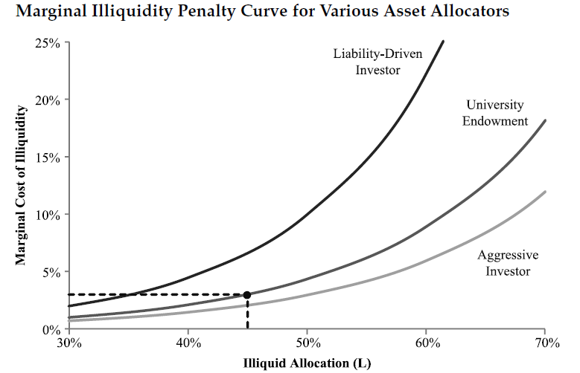
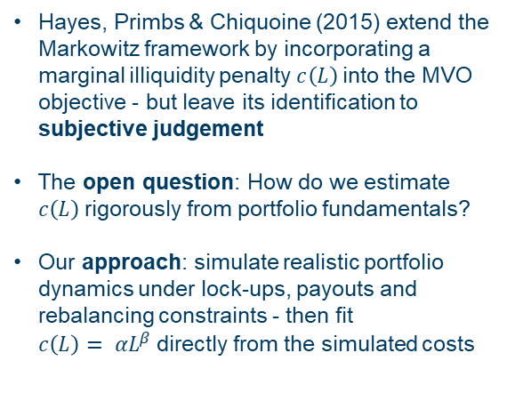
Overview
Bridging the Gap Between Theory and Calibration
Hayes, Primbs & Chiquoine (2015) extend the Markowitz framework by incorporating a marginal illiquidity penalty $c\left(L\right)$into the MVO objective - but leave its identification to subjective judgement
The open question: How do we estimate $c\left(L\right)$rigorously from portfolio fundamentals?
Our approach: simulate realistic portfolio dynamics under lock-ups, payouts and rebalancing constraints - then fit $c\left(L\right)= αL^{β}$directly from the simulated costs

Slide 4
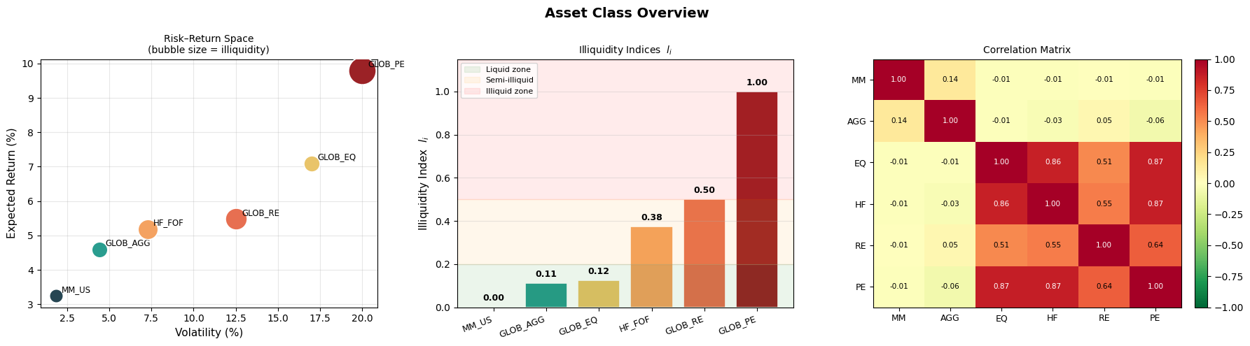
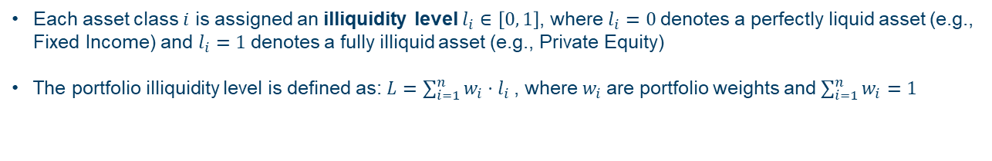
Asset Classes & Illiquidity Levels
Defining the Investment Universe
Each asset class $i$ is assigned an illiquidity level $l_{i}$ $∈\left[0, 1\right]$, where $l_{i}=0$denotes a perfectly liquid asset (e.g., Fixed Income) and $l_{i}=1$denotes a fully illiquid asset (e.g., Private Equity)
The portfolio illiquidity level is defined as: $L=\sum_{i=1}^{n}{w_{i}}⋅l_{i}$ , where $w_{i}$are portfolio weights and $\sum_{i=1}^{n}{w_{i}}=1$

Slide 5
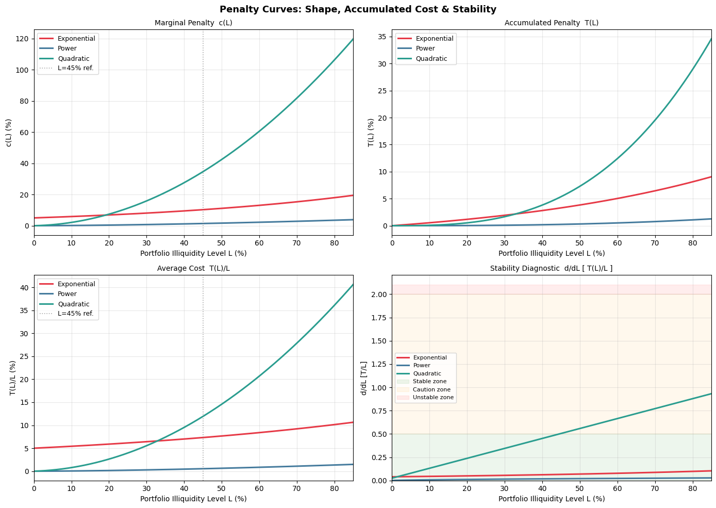
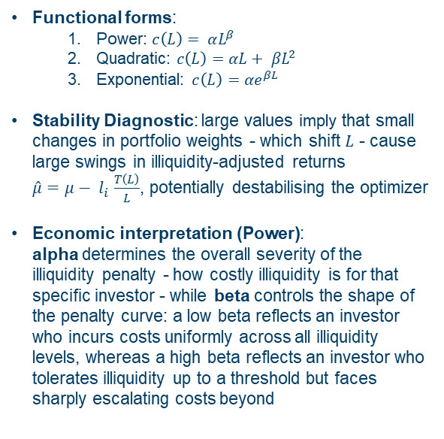
The Marginal Penalty Function
How different marginal curves behave with identical parameters ($α=0.05, β=1.6)$
Functional forms:
Power: $c\left(L\right)= αL^{β}$
Quadratic: $c\left(L\right)={αL+ βL}^{2}$
Exponential: $c\left(L\right)={αe}^{βL}$
Stability Diagnostic: large values imply that small changes in portfolio weights - which shift $L$ - cause large swings in illiquidity-adjusted returns $\hat{μ}$ $=μ− l_{i}$ $\frac{T\left(L\right)}{L}$, potentially destabilising the optimizer
Economic interpretation (Power): alpha determines the overall severity of the illiquidity penalty - how costly illiquidity is for that specific investor - while beta controls the shape of the penalty curve: a low beta reflects an investor who incurs costs uniformly across all illiquidity levels, whereas a high beta reflects an investor who tolerates illiquidity up to a threshold but faces sharply escalating costs beyond

Slide 6
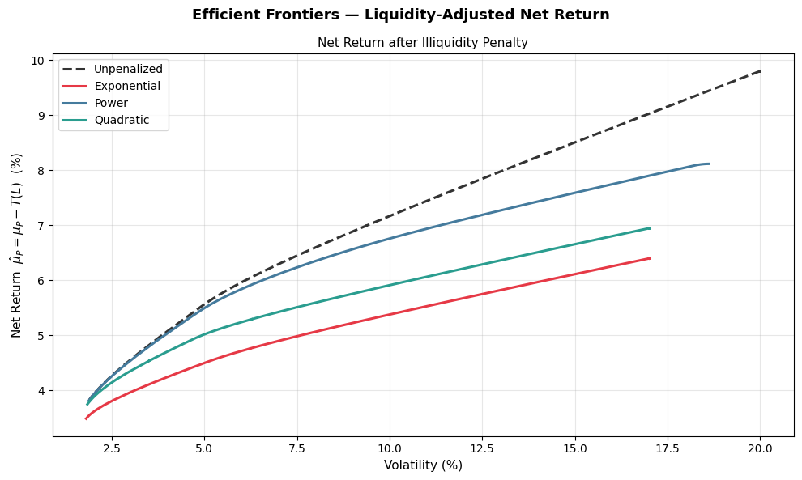
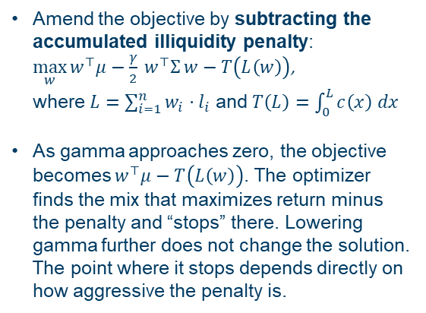
Portfolio Optimization with Illiquidity
Net Efficient Frontiers ($α=0.05, β=1.6)$
Amend the objective by subtracting the accumulated illiquidity penalty: $\max_{w}{w^{⊤}μ−\frac{γ}{2} w^{⊤}Σ w−T\left(L\left(w\right)\right)}$, where $L=\sum_{i=1}^{n}{w_{i}}⋅l_{i}$ and $T\left(L\right)=\int_{0}^{L}{c\left(x\right) dx}$
As gamma approaches zero, the objective becomes $w^{⊤}μ−T\left(L\left(w\right)\right)$. The optimizer finds the mix that maximizes return minus the penalty and “stops” there. Lowering gamma further does not change the solution. The point where it stops depends directly on how aggressive the penalty is.

Slide 7
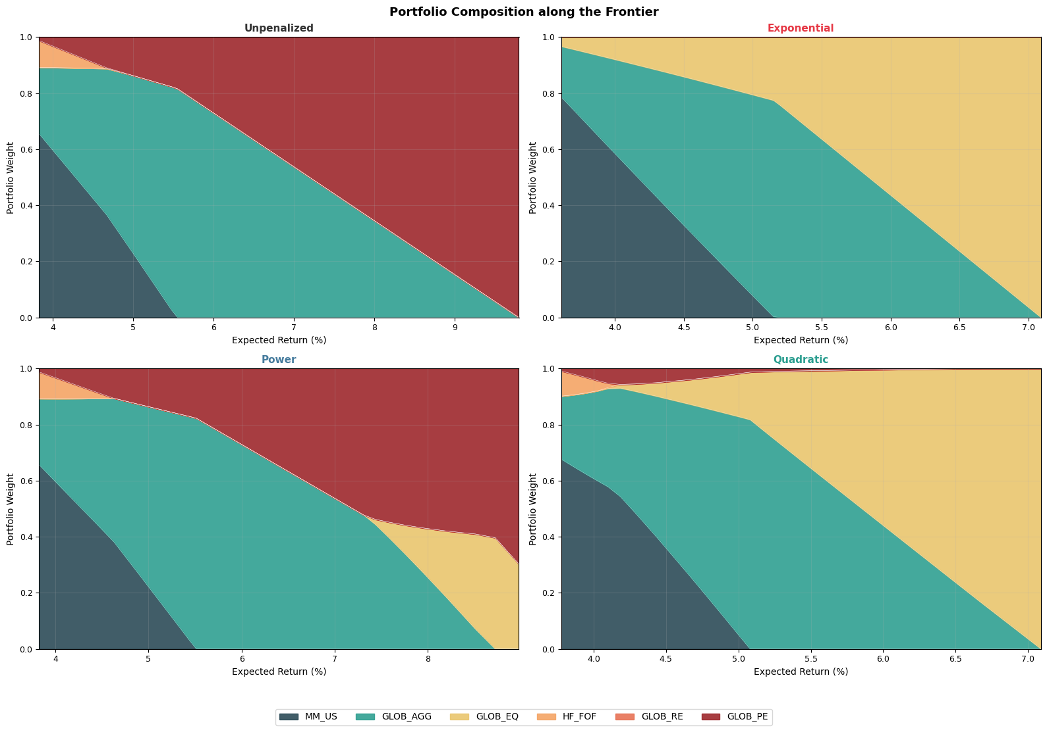
Efficient Frontiers & Portfolio Composition
Portfolio Composition by $L \text{(}α=0.05, β=1.6)$
The penalty reduces PE allocation and compresses the achievable return range, with GLOB_EQ emerging as the preferred liquid substitute given its high correlation with PE (ρ = 0.87) at a fraction of the illiquidity cost.
Only the Power penalty delivers stable, economically consistent allocations - Exponential collapses the frontier to an implausibly narrow return range, while Quadratic shows erratic composition spikes - confirming Power as the appropriate functional form.

Slide 8


Simulation, Aggregation & Fitting
Simulation Design (1/2): Stochastic Dynamics
We estimate $c\left(L\right)$empirically by simulating realistic portfolio dynamics. For each target illiquidity level $L$, we run $N=1000$ Monte Carlo scenarios over a 20-year horizon and measure the average annual return foregone by operating under lock-up constraints relative to an unconstrained benchmark.
Asset returns
Annual Payout
The annual payout $δ_{t}$ follows a mean-reverting AR(1) process, correlated with the equity shock:
$$δ_{t}=\overline{δ}+ρ_{AR}\left(δ_{t−1}−\overline{δ}\right)+σ_{δ}\left(ρ∙z_{t}^{EQ}+\sqrt{1−ρ^{2}}∙ε_{t}\right)$$
where $\overline{δ}$ is the long-run mean payout rate and $ρ_{AR}$ is the persistence (spending rules change slowly), $ρ$ is the correlation with equity and $ε_{t}$ the idiosyncratic shock.
$ρ<0$: payout pressure is highest when markets are down
At each time step, asset returns are drawn from a multivariate normal distribution:
$r_{t}=μ+C∙z_{t}$, $z_{t}∼𝓝\left(0, 1\right)$
where $C$ is the Cholesky decomposition of $Σ$, so that cross-asset correlations are preserved exactly.
The vector $μ$contains the expected real returns from Amundi’s CMA.

Slide 9
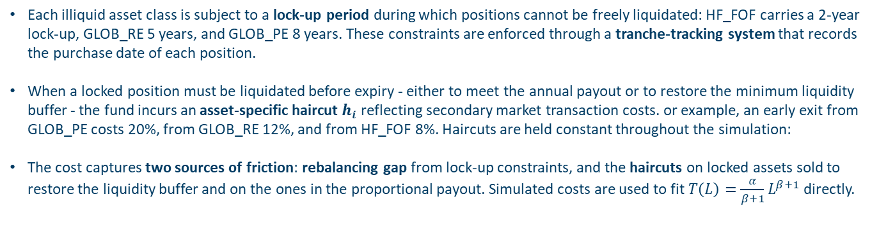
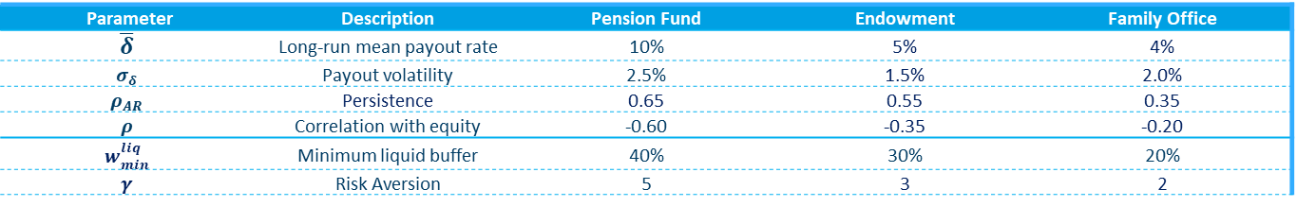
Simulation, Aggregation & Fitting
Simulation Design (1/2): Tranches, Lock-ups & Costs
Each illiquid asset class is subject to a lock-up period during which positions cannot be freely liquidated: HF_FOF carries a 2-year lock-up, GLOB_RE 5 years, and GLOB_PE 8 years. These constraints are enforced through a tranche-tracking system that records the purchase date of each position.
When a locked position must be liquidated before expiry - either to meet the annual payout or to restore the minimum liquidity buffer - the fund incurs an asset-specific haircut $h_{i}$ reflecting secondary market transaction costs. or example, an early exit from GLOB_PE costs 20%, from GLOB_RE 12%, and from HF_FOF 8%. Haircuts are held constant throughout the simulation:
The cost captures two sources of friction: rebalancing gap from lock-up constraints, and the haircuts on locked assets sold to restore the liquidity buffer and on the ones in the proportional payout. Simulated costs are used to fit $T\left(L\right)=\frac{α}{β+1}L^{β+1}$directly.
Parameter | Description | Pension Fund | Endowment | Family Office
$$\overline{δ}$$ | Long-run mean payout rate | 10% | 5% | 4%
$$σ_{δ}$$ | Payout volatility | 2.5% | 1.5% | 2.0%
$$ρ_{AR}$$ | Persistence | 0.65 | 0.55 | 0.35
$$ρ$$ | Correlation with equity | -0.60 | -0.35 | -0.20
$$w_{min}^{liq}$$ | Minimum liquid buffer | 40% | 30% | 20%
$$γ$$ | Risk Aversion | 5 | 3 | 2

Slide 10



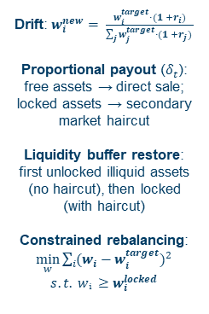

Simulation, Aggregation & Fitting
The Annual Simulation Cycle
Step A – Market Returns
Step B – Benchmark
Step C – Actual
Step D – Annual Cost
Step E – Fitting
$r_{t} \sim N(μ, Σ)$
Same realization shared by both benchmark and actual portfolio
Ensures: any return difference captures only the effect of illiquidity constraints, not different market outcomes
Portfolio with no illiquidity constraints, resets to $w_{target}$every year
Weights drift with the market:
$$w_{bd}^{i}= \frac{w_{i}^{target}·(1 +r_{i})}{\sum_{j}{w_{j}^{target}·(1 +r_{j})} }$$
Return computed on post-drift weights:
$$r_{bench}=w_{bd}·r_{t}$$
Drift: $w_{i}^{new}= \frac{w_{i}^{target}·(1 +r_{i})}{\sum_{j}{w_{j}^{target}·(1 +r_{j})} }$
Proportional payout ($δ_{t}$): free assets → direct sale; locked assets → secondary market haircut
Liquidity buffer restore: first unlocked illiquid assets (no haircut), then locked (with haircut)
Constrained rebalancing: $\min_{w}{\sum_{i}{{(w_{i}−w_{i}^{target})}^{2}}}$
$$s.t. wᵢ ≥w_{i}^{locked}$$
Cost is measured on weights after drift, payout and restore - before year-end rebalancing:
$$cost_{t}=$$
$$\left(r_{bench}−r_{actual}\right)$$
$$+cost_{h}+cost_{fp}$$
Direct estimate of the accumulated penalty (non-linear OLS):
$\hat{T}= A ·L^{B}$
Parameters recovered analytically:
$$β = B−1, α = A·B$$
Steps A through D are repeated for each of the T years, across all N scenarios

Slide 11
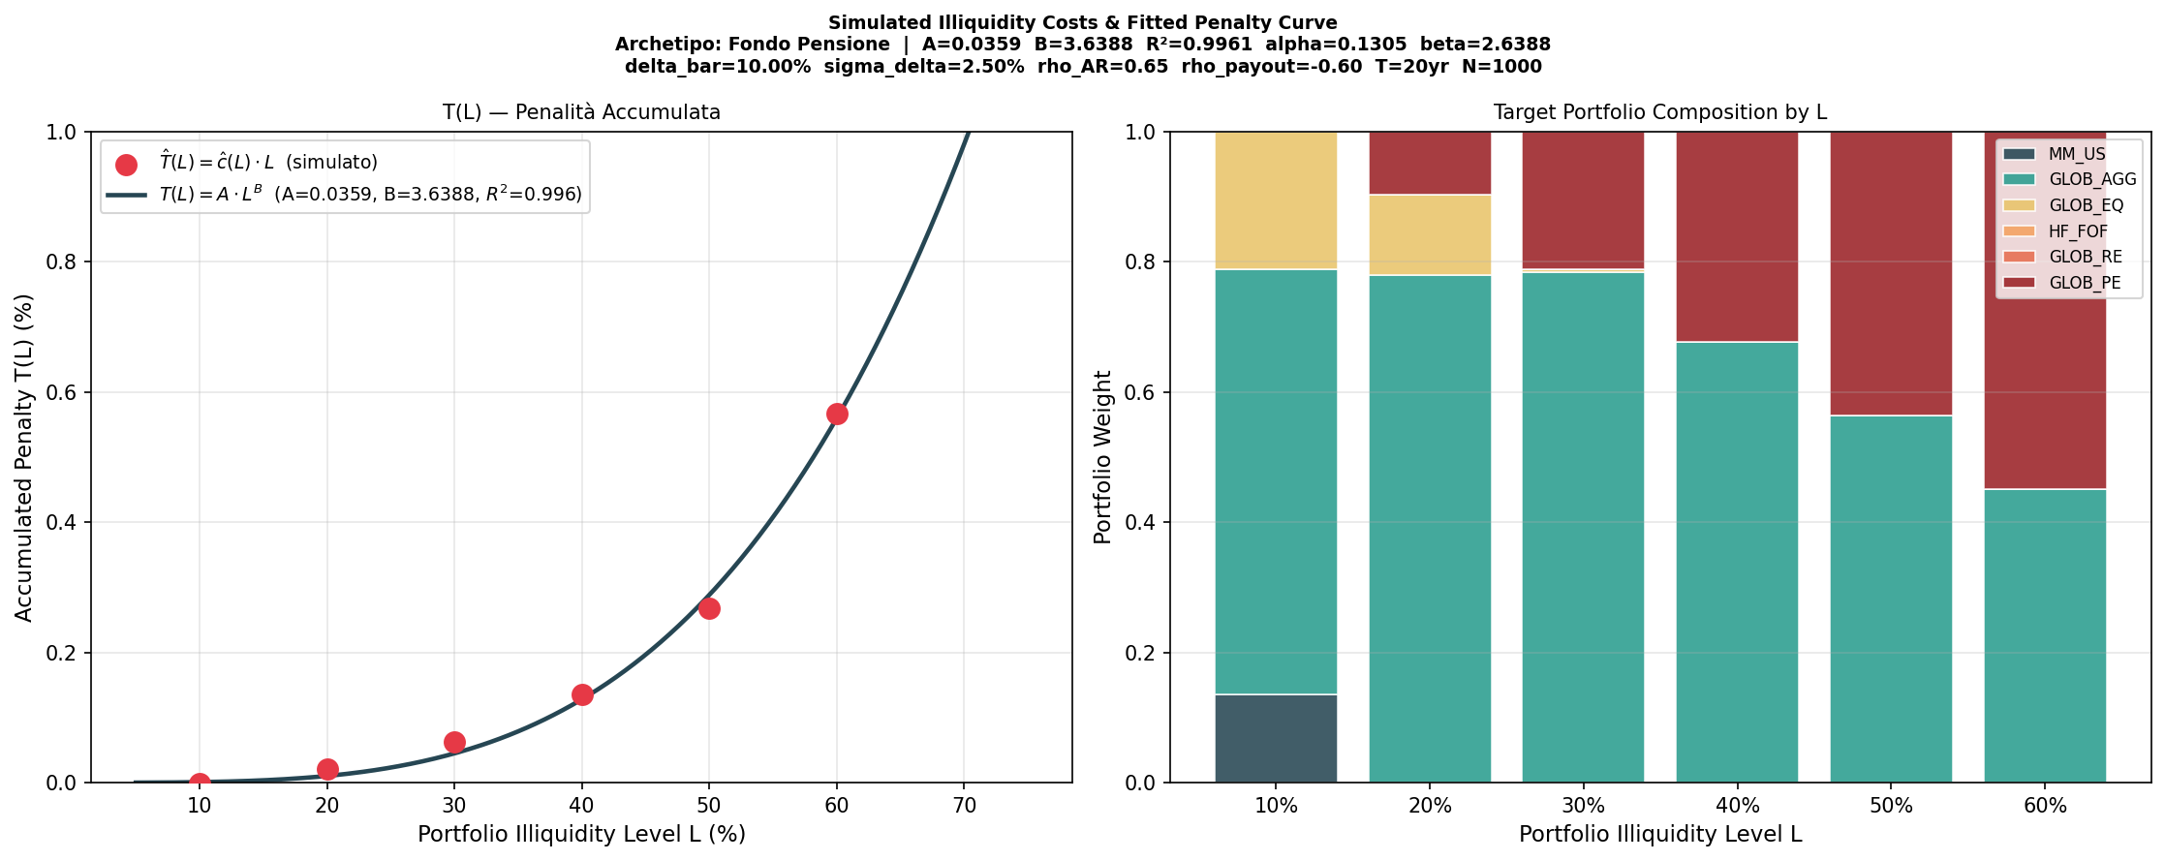
Simulation, Aggregation & Fitting
Fitting the parameters: pension fund ($α=0.12, β=2.49)$
The fitted parameters $α$and $β$provide a structured, simulation-based foundation for the accumulated penalty entering the penalized MVO: $T\left(L\right)=\frac{\hat{α}}{\hat{β}+1}L^{\hat{β}+1}$

Slide 12
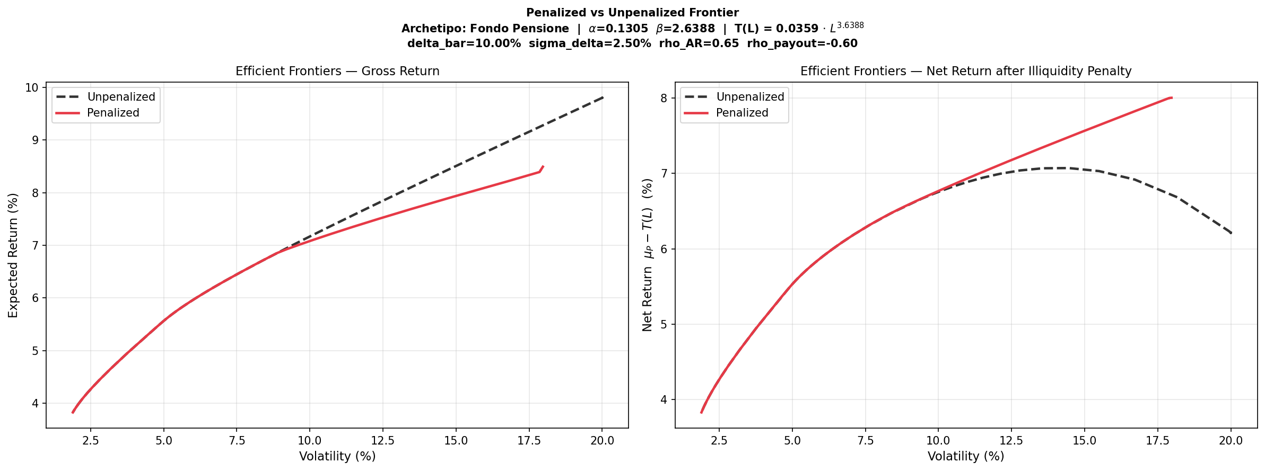
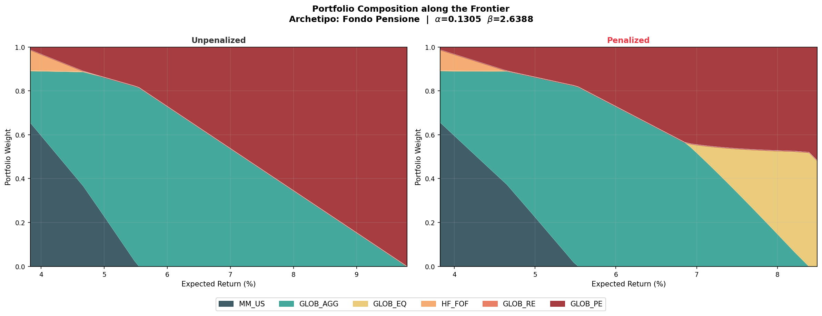
Back to Portfolio Optimization
Using estimated $α$ and $β$ in the Penalized MVO
The penalized frontier lies below the unpenalized on a gross return basis but consistently dominates on a net return basis, confirming that the unpenalized portfolio's apparent return advantage is entirely offset by its higher illiquidity cost;
The penalty reshapes portfolio composition by systematically substituting PE with GLOB_EQ, reflecting the optimizer's preference for assets that balance return potential against illiquidity cost rather than maximizing gross return through unconstrained PE exposure.

Slide 13
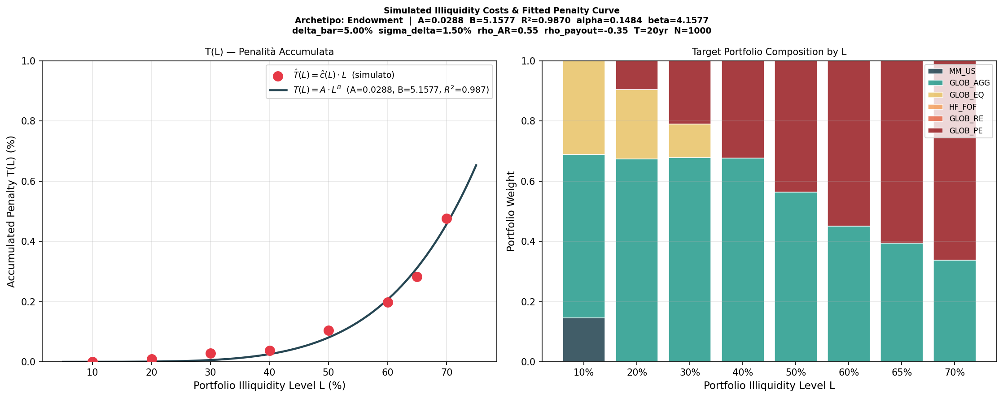
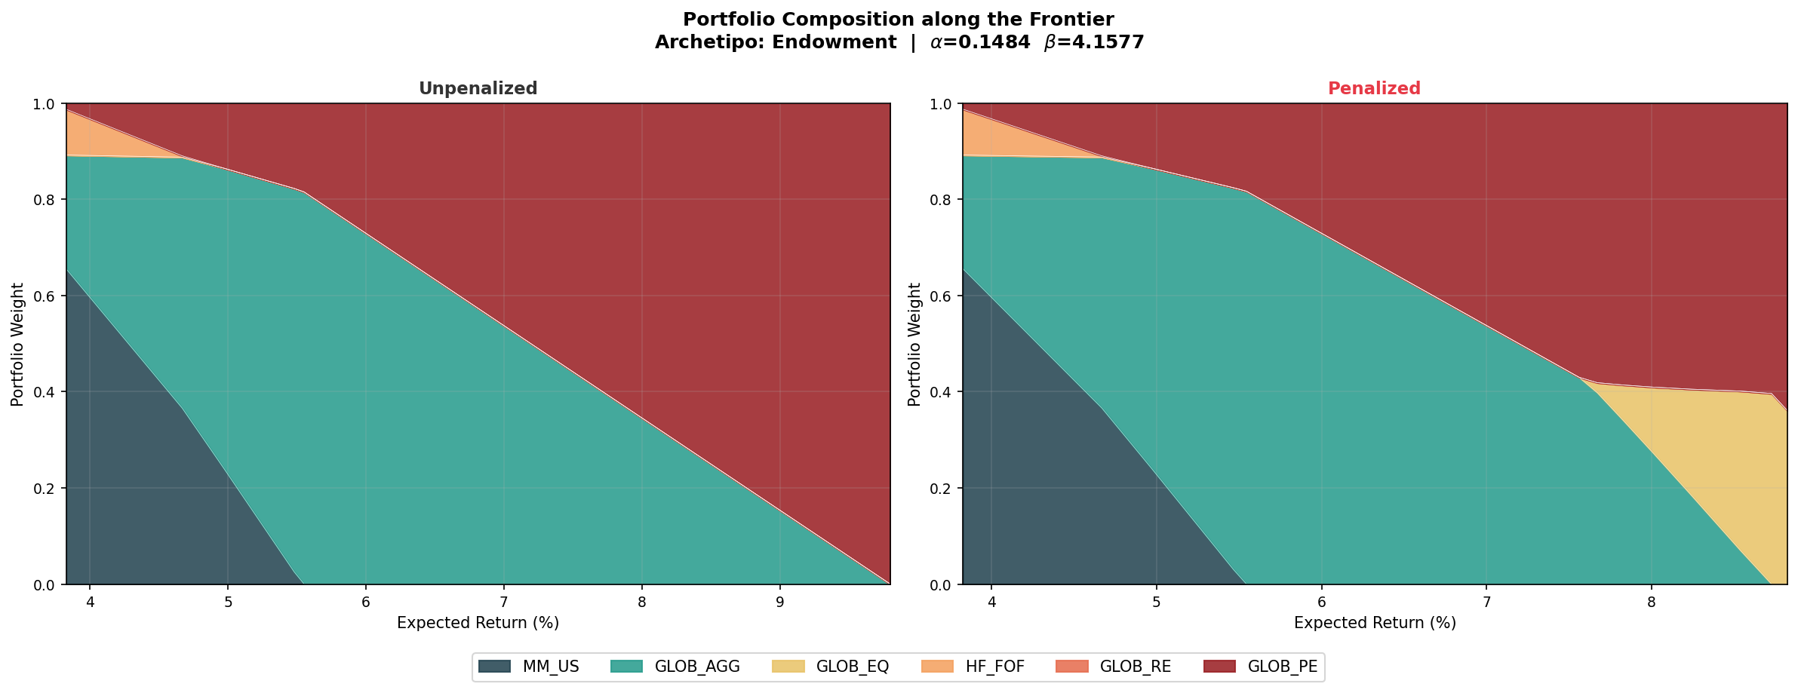
A different Institutional Profile
Fitting and Portfolio Composition of an Endowment ($α=0.16, β=4.28)$

Slide 14
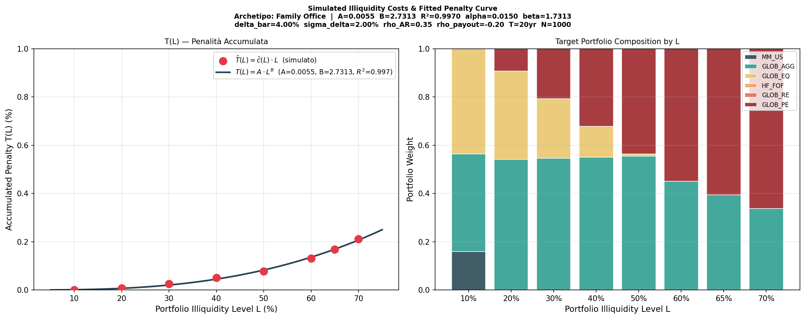
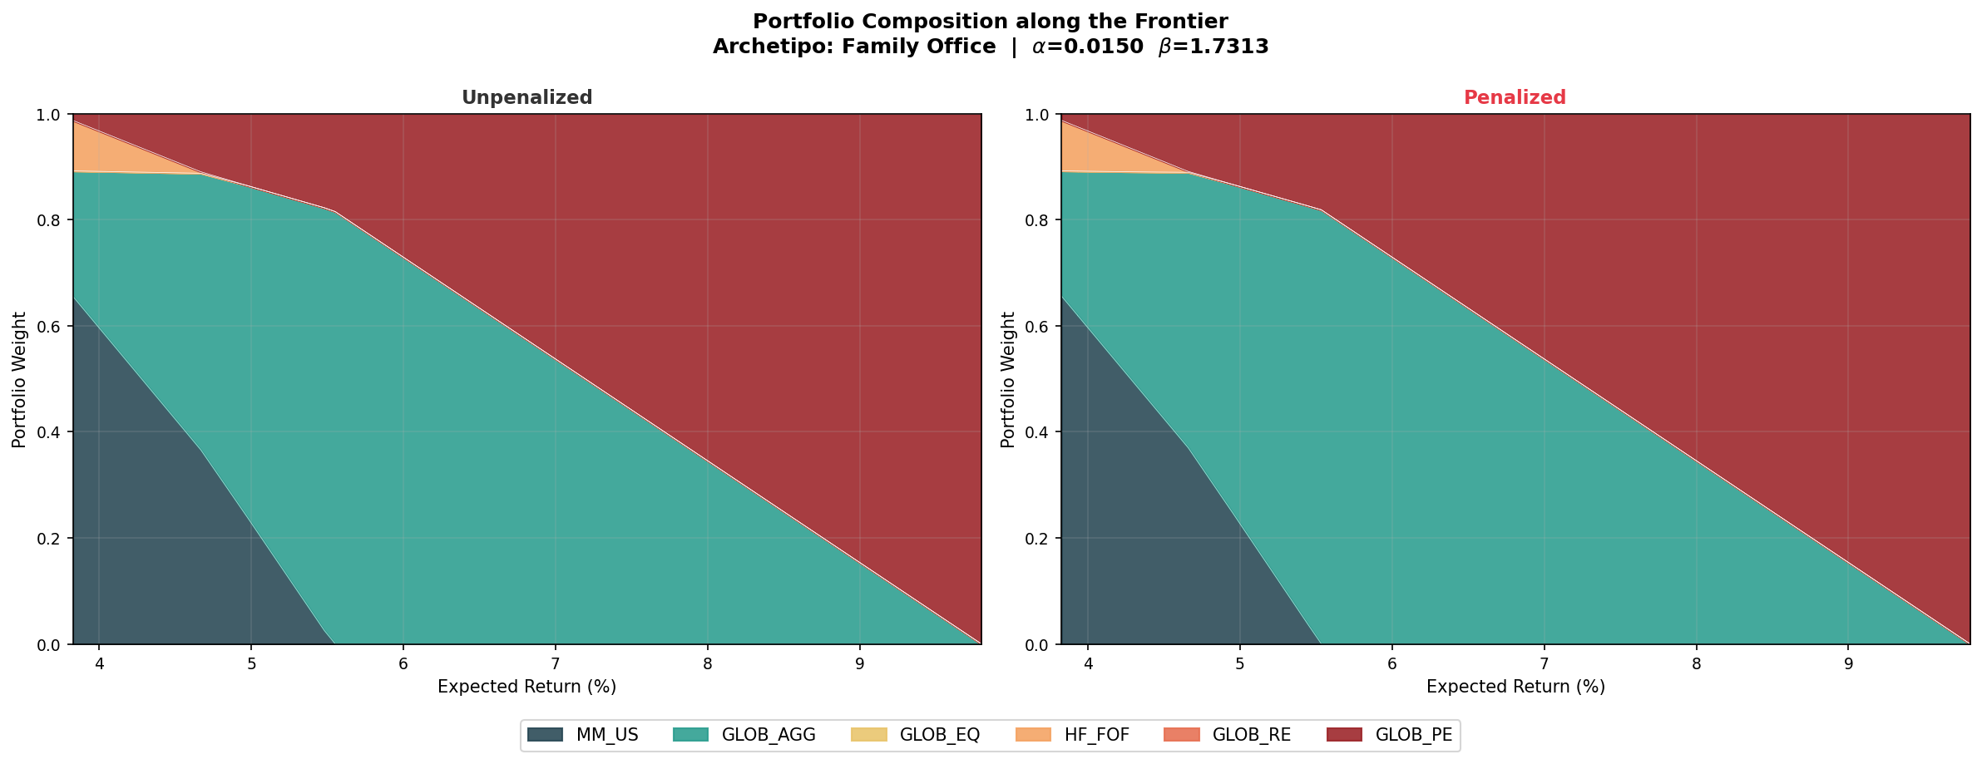
A different Institutional Profile
Fitting and Portfolio Composition of a Family Office ($α=0.16, β=4.28)$

Slide 15
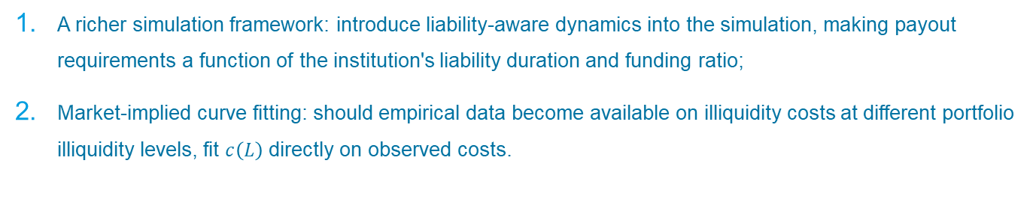
What’s next?
Towards a More Realistic and Investor-Specific Calibration Framework
A richer simulation framework: introduce liability-aware dynamics into the simulation, making payout requirements a function of the institution's liability duration and funding ratio;
Market-implied curve fitting: should empirical data become available on illiquidity costs at different portfolio illiquidity levels, fit $c\left(L\right)$ directly on observed costs.

